Slide 1
An updated preliminary study of the target and capture channel for the Muon Collider
A. Portone, J. Lorenzo, P. Testoni (F4E Barcelona)
L. Bottura, A. Kohlemainen (CERN)
02/02/2023

Slide 2
SUMMARY
We develop an (updated) alternative solution to the hybrid US-MAP [1-3] (5 resistive coils and 19 SC coils, 2.4 m bore) made of HTS (20 SC coils, 1.2 m bore)
Design highlights:
  Field on axis within 2-3% accuracy Sayed-Berg formula over 16 m channel length
  VIPER-like cable (HTS tapes, central cooling hole, steel jacket) with I_{max}≈60 kA
  Set of 20 coils (solenoid) whose axial length and turn numbers is minimized:
    Peak field on coil ≈20 T
    Magnetic energy ≈ 1 GJ
    Cable length ≈ 8 km
    Winding mass ≈ 100 t
  Stresses are within 316 LN structural limits (σ_{Y} ≈1000 MPa, σ_{M} <2/3 σ_{Y} , …)
  Whole winding split in 2 sections with 30 cm gap in between

Slide 3
REFERENCES
R.J. Weggel, N. Souchlas, H.G. Kirk, V.B. Graves, K.T. McDonald, A TARGET MAGNET SYSTEM FOR A MUON COLLIDER AND NEUTRINO FACTORY, TUPS053 Proceedings of IPAC2011, San Sebastián, Spain
R.J. Weggel, N. Souchlas, H.K. Sayed, J.S. Berg, H.G. Kirk, X. Ding, V.B. Graves, K.T. McDonald, DESIGN OF MAGNETS FOR THE TARGET AND DECAY REGION OF A MUON COLLIDER/NEUTRINO FACTORY TARGET TUPFI073 Proceedings of IPAC2013, Shanghai, China
C. Rogers, Overview of target, capture and cooling complex, https://indico.cern.ch/event/1147941/
H.K. Sayed and J. S. Berg, Optimized capture section for a muon accelerator front end, PHYSICAL REVIEW SPECIAL TOPICS - ACCELERATORS AND BEAMS 17, 070102 (2014)

Slide 4
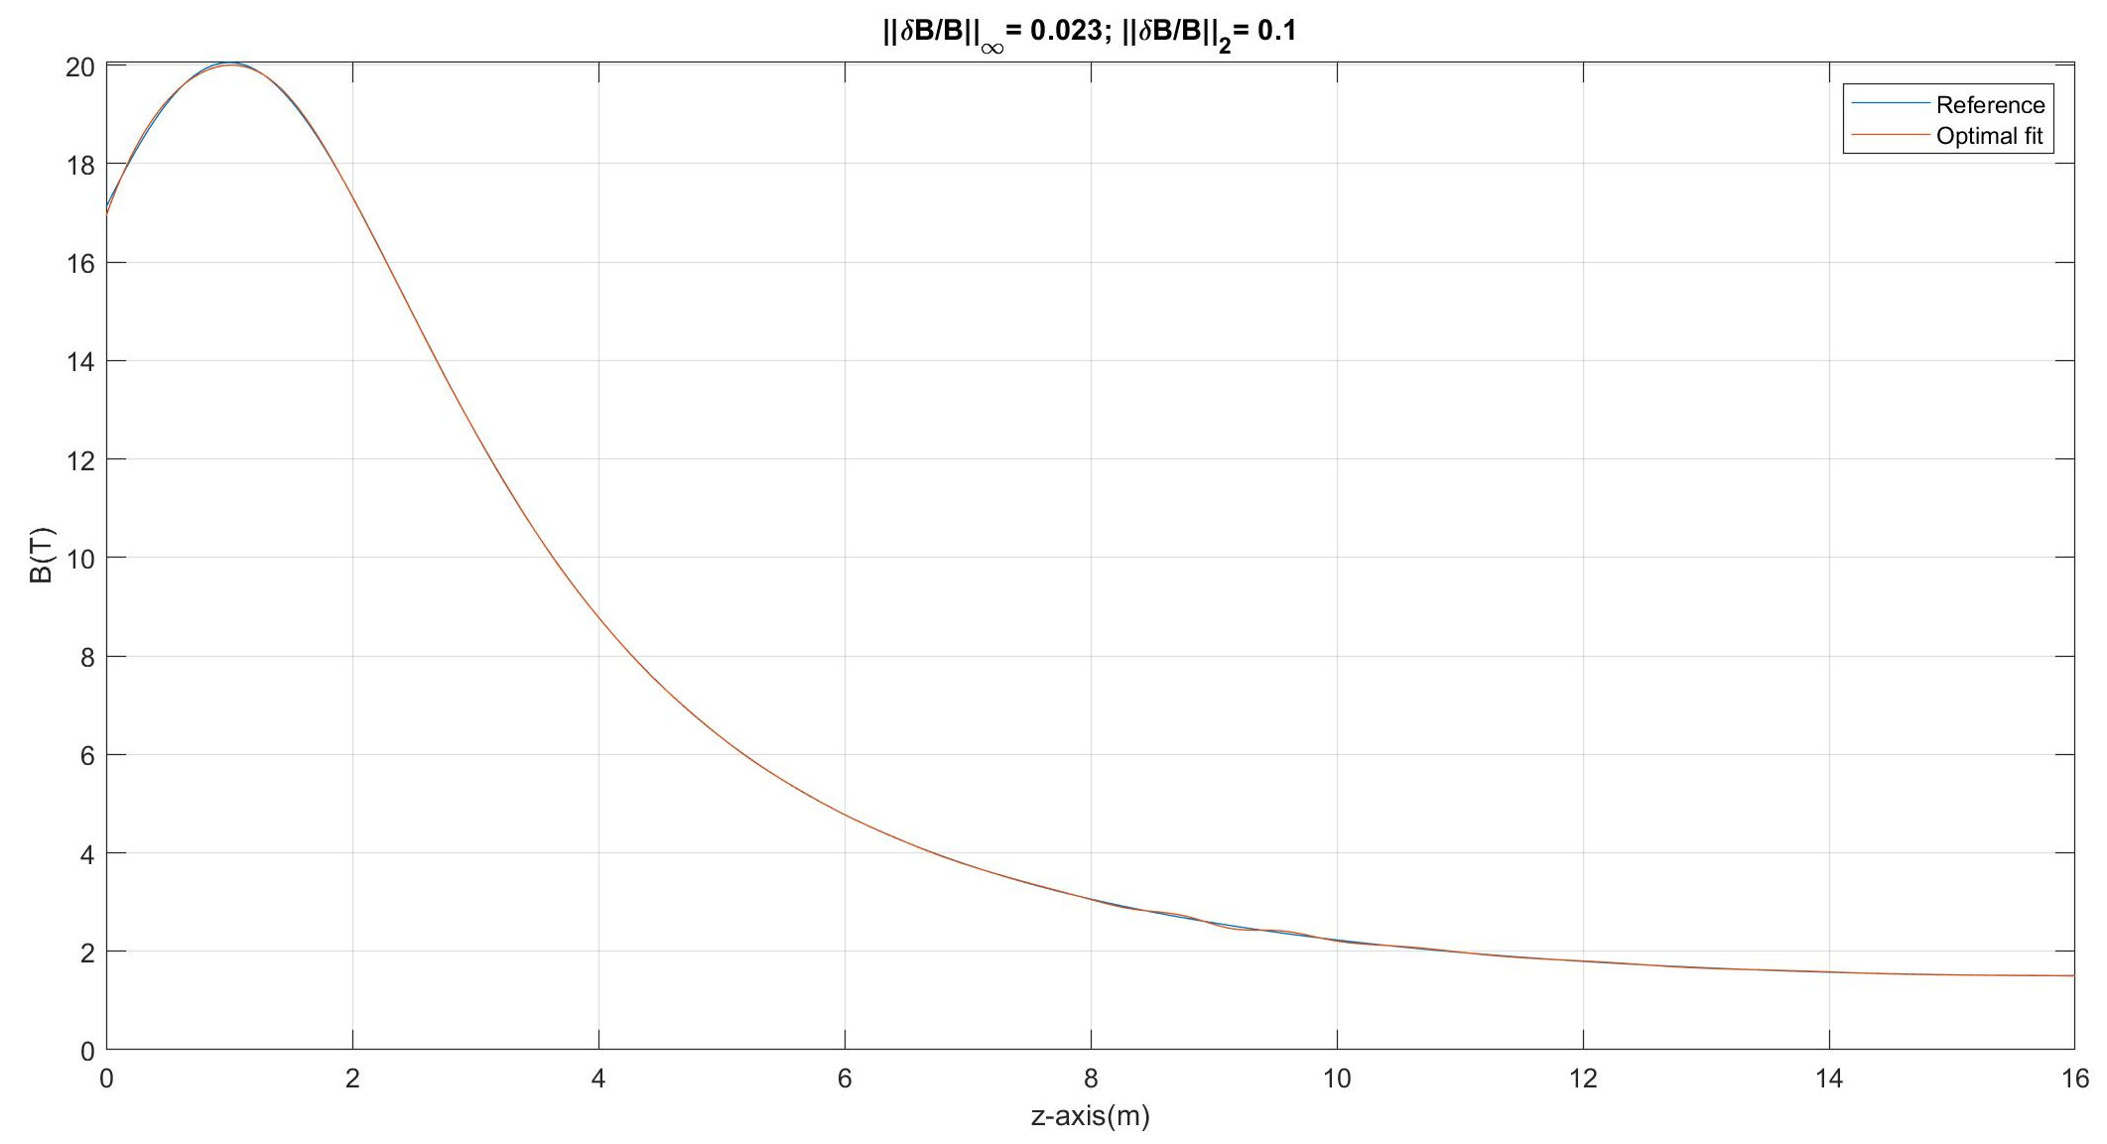
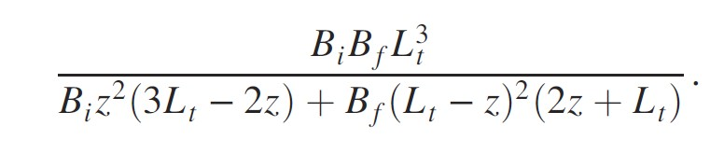
OPTIMAL FIT OF FIELD ON AXIS
Reference field formula (Sayed-Berg [4])
With B_{i}=20 T, B_{f}=1.5 T, L_{t}=15 m
-1<z(m)<15

Slide 5
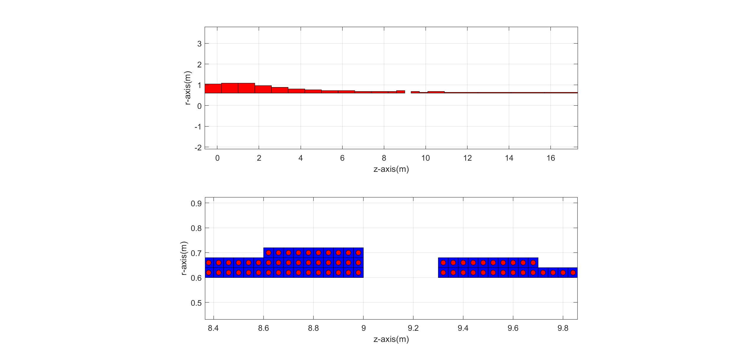
WINDING
Overall coils length L = 17.6 m (excluding 0.3 m gap)

Slide 6
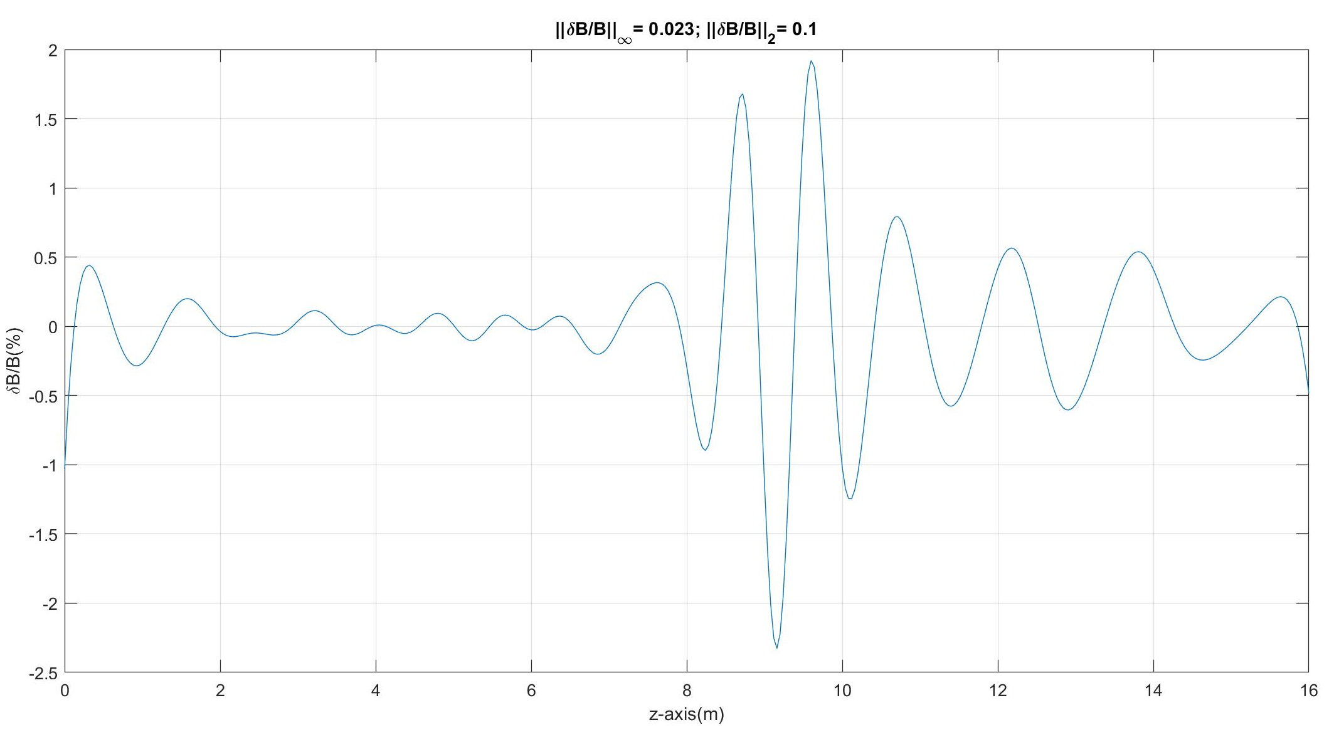
OPTIMAL FIT OF FIELD ON AXIS
Reference field formula (Sayed-Berg [4])
With B_{i}=20 T, B_{f}=1.5 T, L_{t}=15 m
-1<z(m)<15

Slide 7
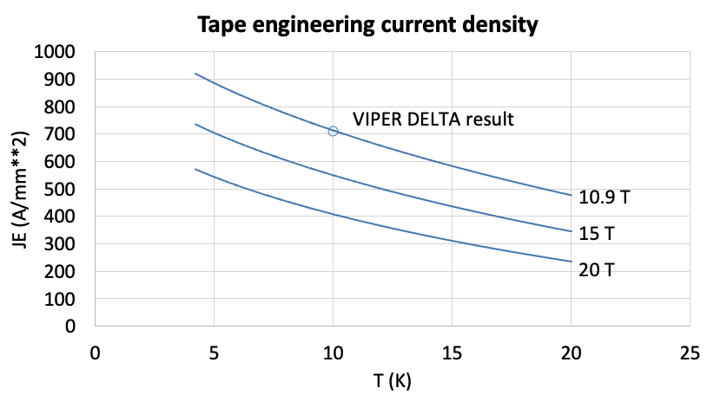
MUCOL TARGET SOLENOID CABLE
Copper diameter | 20 | (mm)
Hole diameter | 6 | (mm)
Jacket outer dimension | 38 | (mm)
HTS stack width | 6 | (mm)
HTS stack thickness | 6 | (mm)
number of stacks | 4 | (-)
Insulation thickness | 1 | (mm)
A non-Cu | 144 | (mm²)
A hole | 28 | (mm²)
A Cu | 142 | (mm²)
A Jacket | 1130 | (mm²)
A cable | 1225 | (mm²)
A insulation | 160 | (mm²)
JE non-Cu (20 K 20 T) | 400 | (A/mm¹)
JE cable (20 K, 20 T) | 47 | (A/mm¹)
JE Cu (20 K, 20 T) | 406 | (A/mm¹)
STAINLESS STEEL JACKET
COPPER SLEEVE
COPPER FORMER
SOLDERED HTS STACK
COOLING CHANNEL
Operating current: 60 kA
Operating field: 20 T
Operating temperature: 20 K
Jacket fraction: 74 %
20
38
40

Slide 8
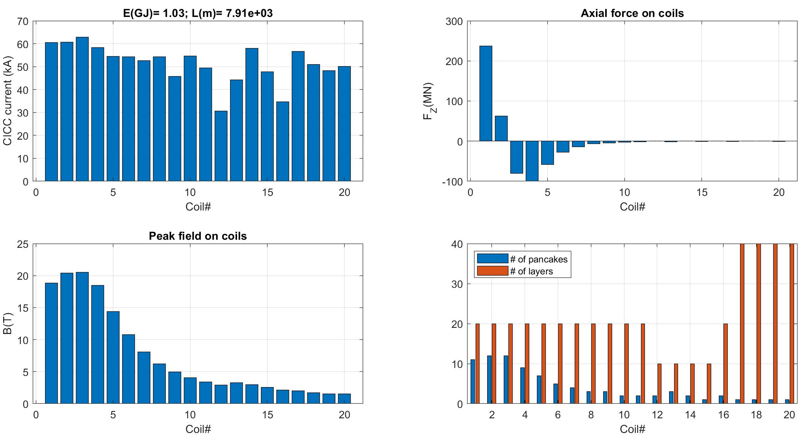
CURRENTS, FIELD AND AXIAL FORCES

Slide 9
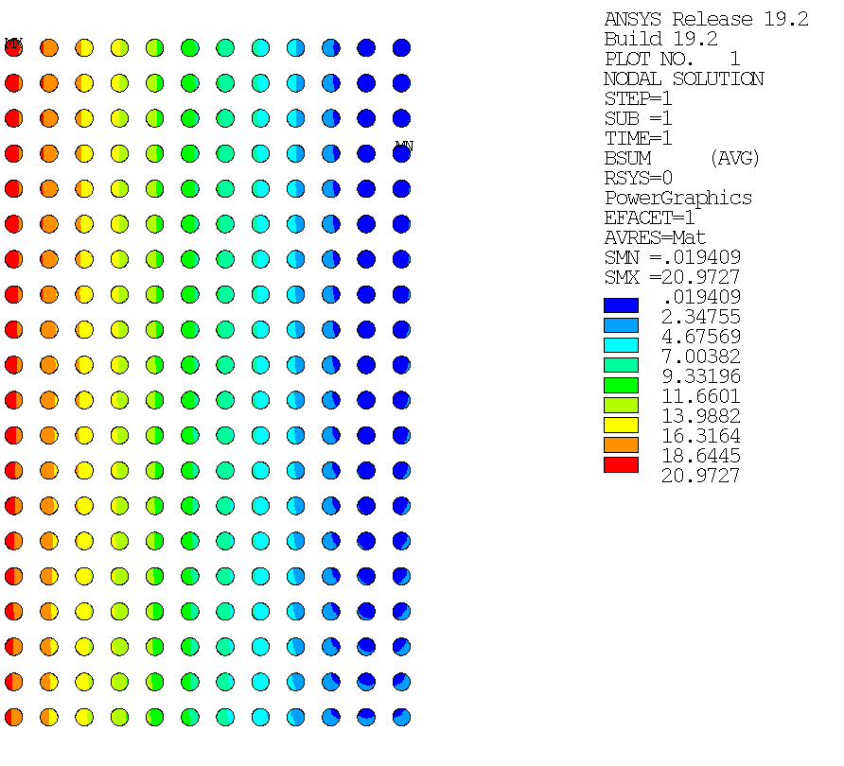
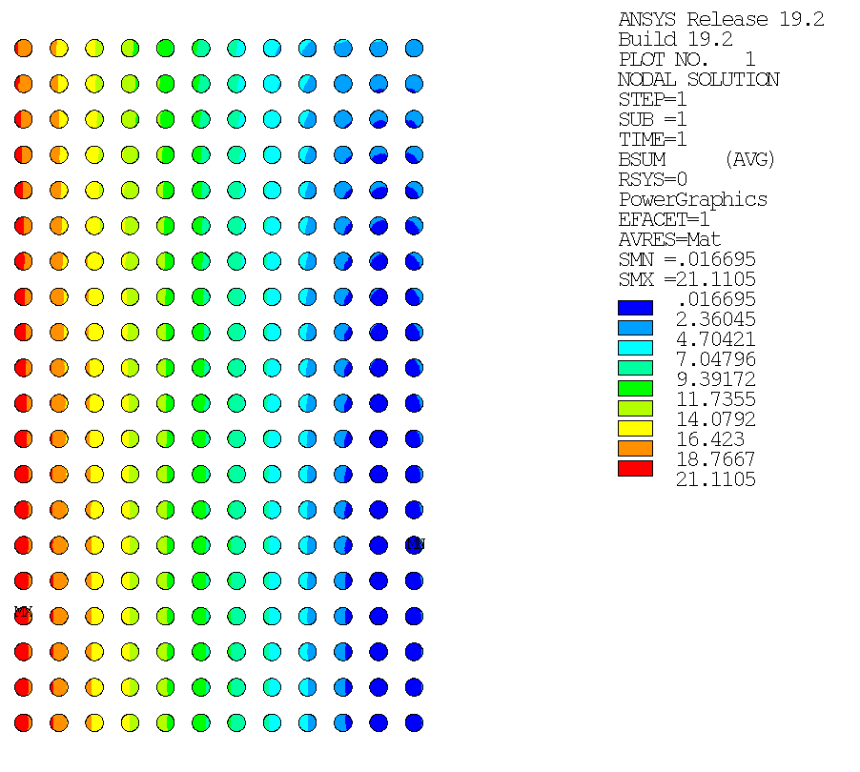
TOTAL MAGNETIC FIELD
Coil#2
Coil#3

Slide 10
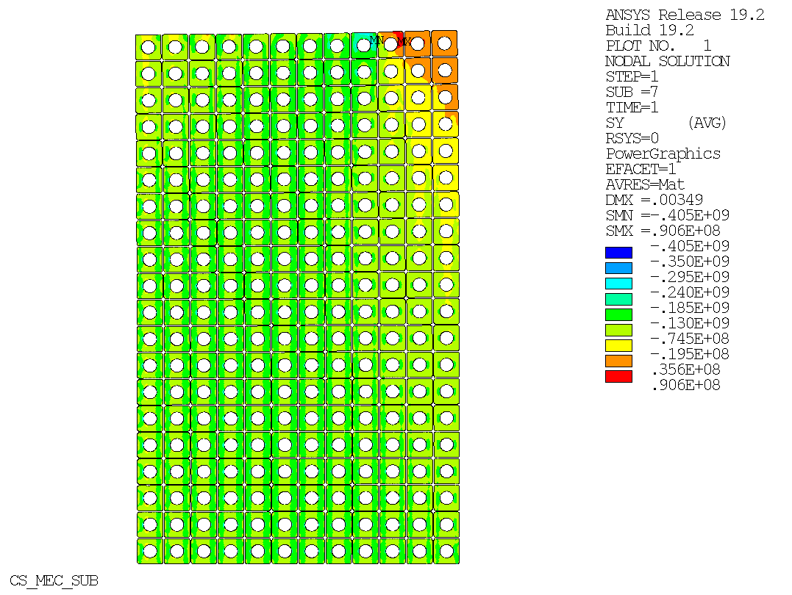
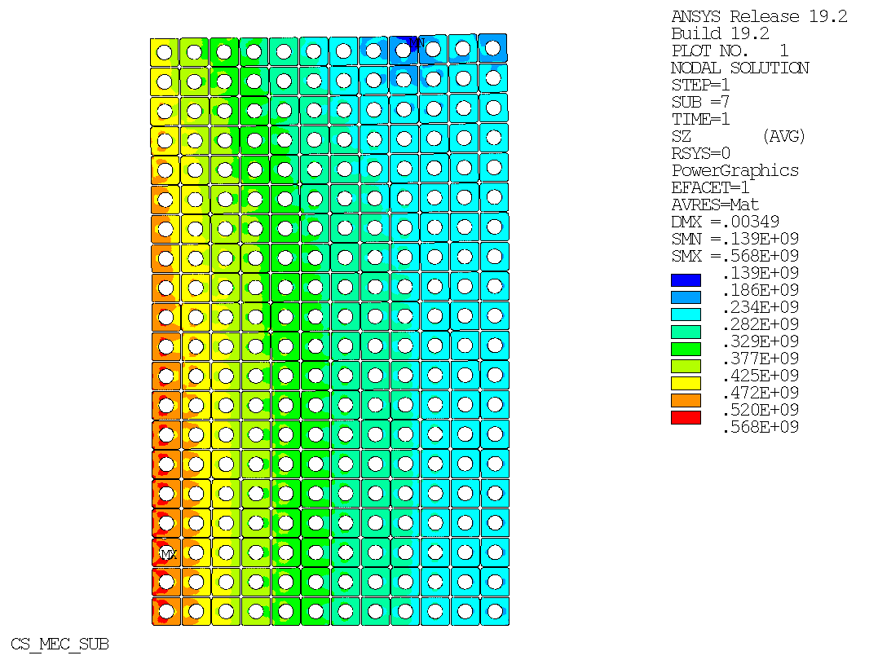
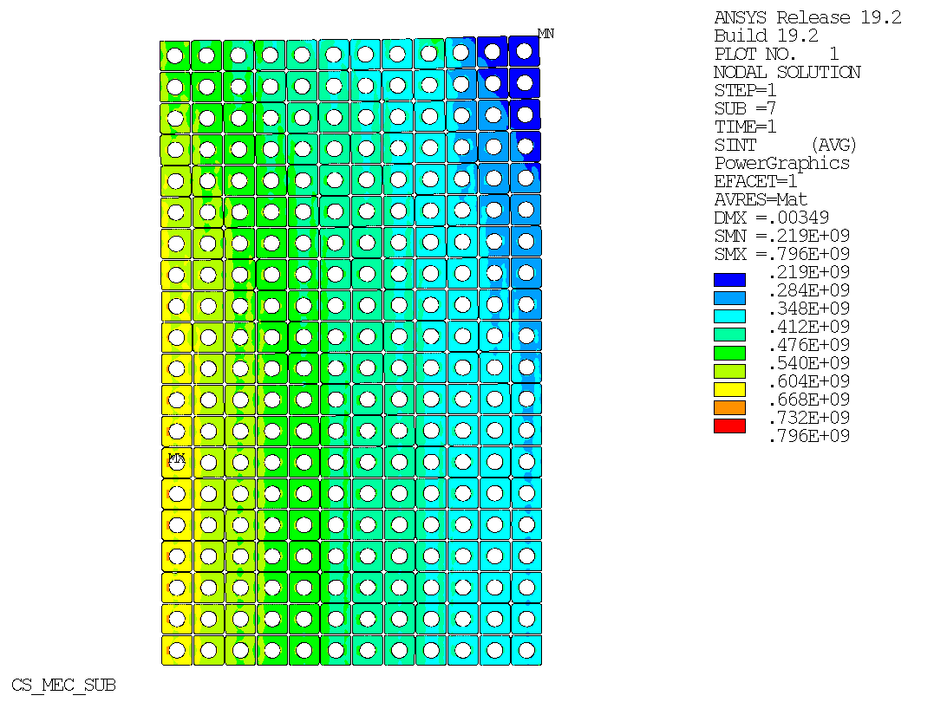
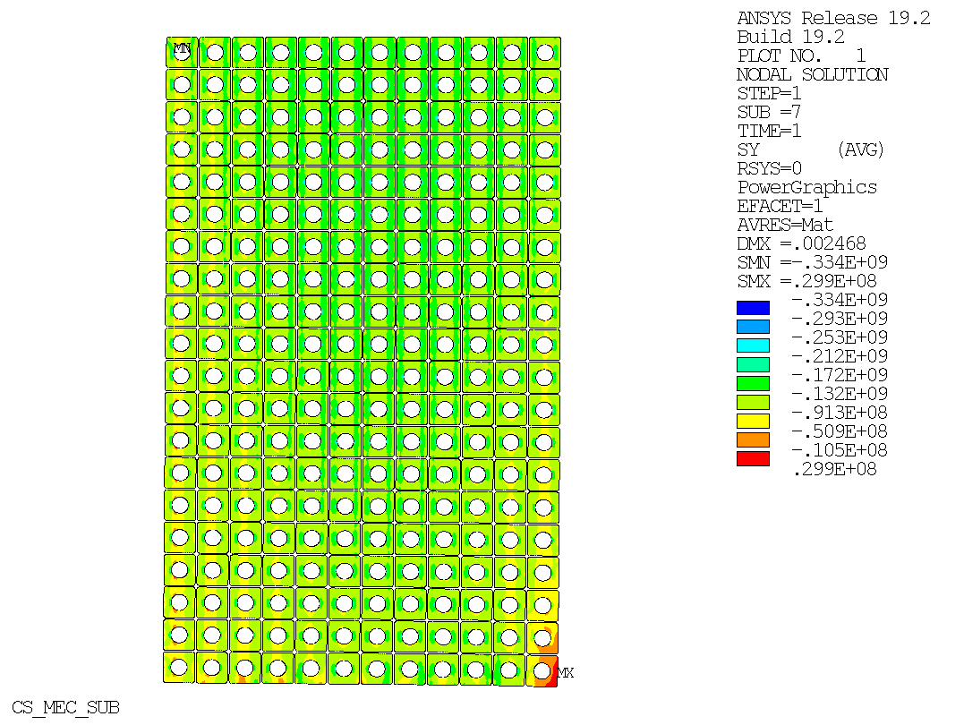
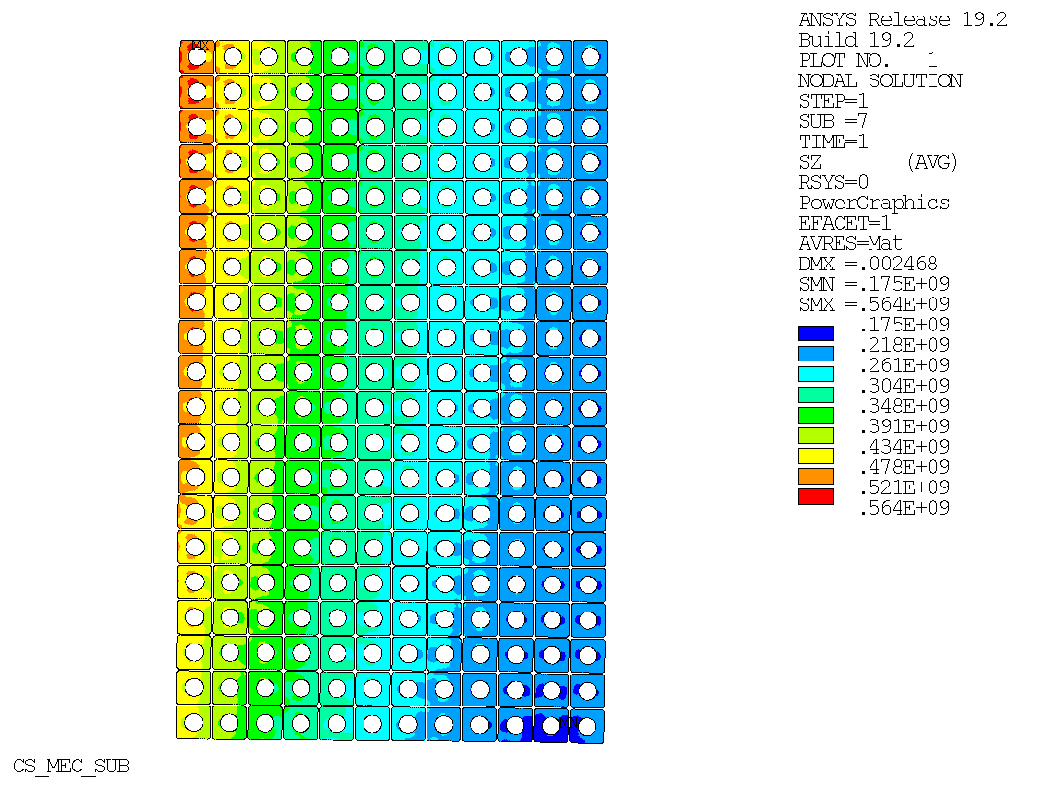
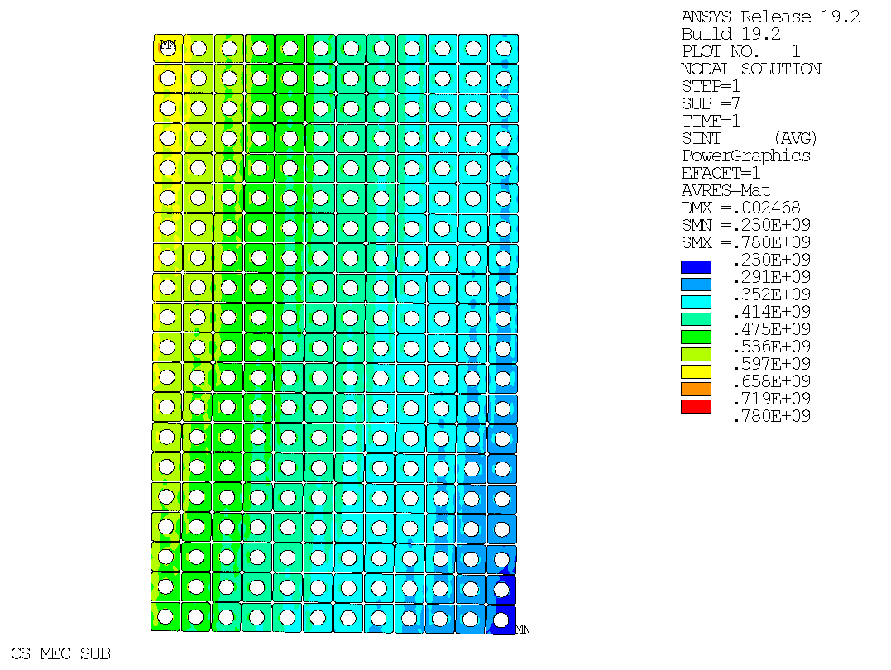
COILS STRESSES
Coil#3
Coil#3
Coil#3
Axial stress
Hoop stress
Tresca stress
Coil#2
Coil#2
Coil#2

Slide 11
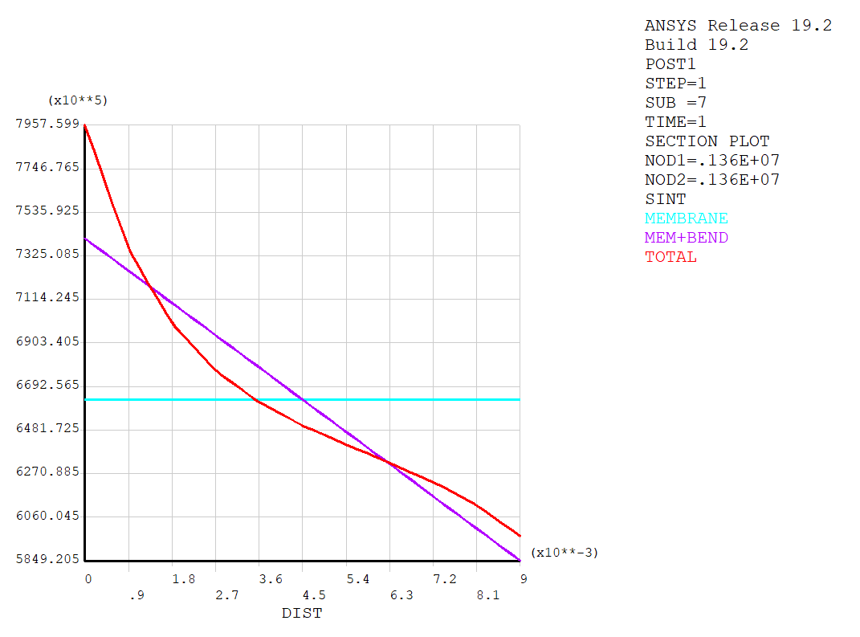
TRESCA MEMBRANE, BENDING, PEAKS STRESS

Slide 12
COILS WINDING
Coil # | Rc(m) | Zc(m) | DR(m) | DZ(m) | NR | NZ | I(A)
1 | 0.820 | -0.200 | 0.440 | 0.800 | 11 | 20 | 60563
2 | 0.840 | 0.600 | 0.480 | 0.800 | 12 | 20 | 60706
3 | 0.840 | 1.400 | 0.480 | 0.800 | 12 | 20 | 62848
4 | 0.780 | 2.200 | 0.360 | 0.800 | 9 | 20 | 58407
5 | 0.740 | 3.000 | 0.280 | 0.800 | 7 | 20 | 54433
6 | 0.700 | 3.800 | 0.200 | 0.800 | 5 | 20 | 54360
7 | 0.680 | 4.600 | 0.160 | 0.800 | 4 | 20 | 52688
8 | 0.660 | 5.400 | 0.120 | 0.800 | 3 | 20 | 54305
9 | 0.660 | 6.200 | 0.120 | 0.800 | 3 | 20 | 45720
10 | 0.640 | 7.000 | 0.080 | 0.800 | 2 | 20 | 54713
11 | 0.640 | 7.800 | 0.080 | 0.800 | 2 | 20 | 49427
12 | 0.640 | 8.400 | 0.080 | 0.400 | 2 | 10 | 30671
13 | 0.660 | 8.800 | 0.120 | 0.400 | 3 | 10 | 44273
14 | 0.640 | 9.500 | 0.080 | 0.400 | 2 | 10 | 57945
15 | 0.620 | 9.900 | 0.040 | 0.400 | 1 | 10 | 47690
16 | 0.640 | 10.500 | 0.080 | 0.800 | 2 | 20 | 34741
17 | 0.620 | 11.700 | 0.040 | 1.600 | 1 | 40 | 56598
18 | 0.620 | 13.300 | 0.040 | 1.600 | 1 | 40 | 50989
19 | 0.620 | 14.900 | 0.040 | 1.600 | 1 | 40 | 48182
20 | 0.620 | 16.500 | 0.040 | 1.600 | 1 | 40 | 50161
Coils total mass
95.6 t

Slide 13
Conclusions
Different magnetic configurations can provide a suitable B_{z} profile in the target and capture section
We explored one choice by optimally fitting Sayed-Berg profile[4] with:
  Constant bore aperture (1.2 m diameter clear bore)
  VIPER-type cable (with steel jacket)
  HTS to provide desired field, no resistive insert, and operating at T>4.2 K
This updated magnetic configuration features:
  20 solenoids whose total length L=17.6 m, divided in 2 sections (≈ 10 m and ≈ 8 m respectively)
  Peak field ≈ 20.5 T, cable current ≈60 kA
  Reduced turns number to homogenized cable current in each coil (< ≈ 60 kA)
  Reduced conductor length/weight/cost (L=7.9 km, M_{cable}=20.4 t)
Further improvements can be obtained by optimizing:
  Number of sections (here 2 are considered) vs size/weights/access to coils
  Inter-section gaps location and sizes for structural supports
  Actual field requirements (how much/where can we deviate from analytical profile?)

Slide 14
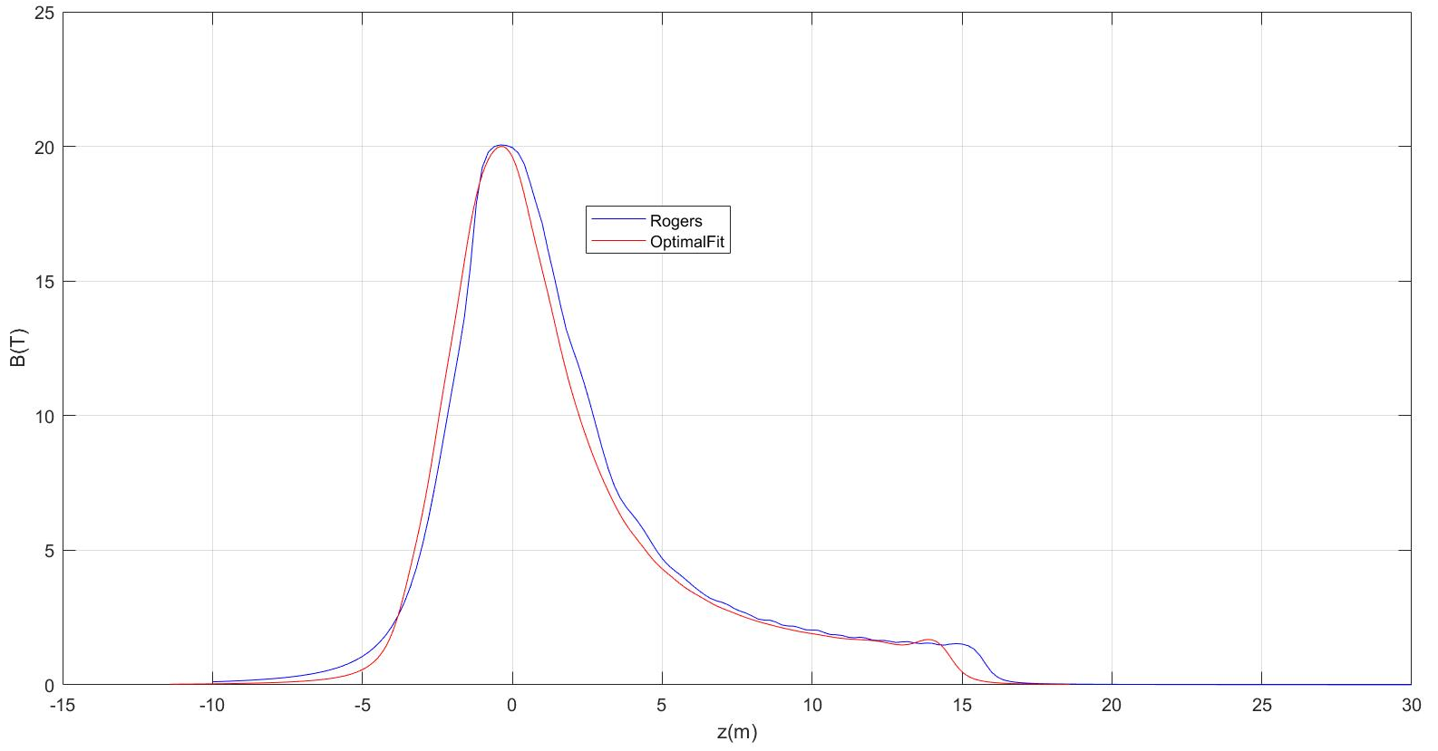
COMPARE FIELD ON AXIS
Blue = US-MAP
Red = OPT. FIT

