Slide 1
MUON Collider target and capture lay-out considerations
Antti Kolehmainen
2023-2-2 Muon Magnets Working Group

Slide 2
INTRODUCTION
First concept lay-out study
Inspiration:
  US MAP
  ITER main solenoid
  Many related presentations!
  Discussions with CERN colleagues
  Many magnet and cryostat designs
Support concept
Cryostat
Tungsten shield & target
And more

Slide 3
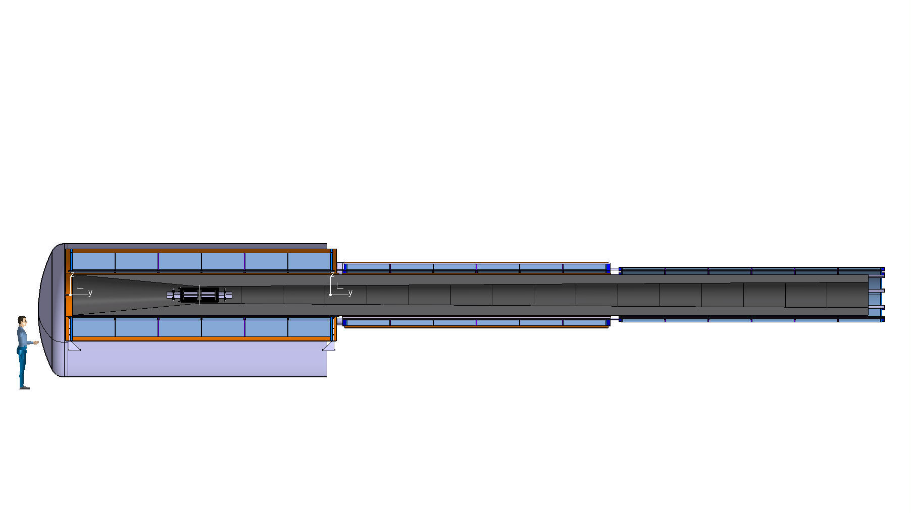
OVERVIEW
Coldmass = 100000 kg
Tungsten shield = 54000 kg(as solid)
Vacuum vessel + support structure = 20000 kg
Total assembly = 174 T
Coldmass = 30000 kg
Tungsten shiels = 54000 kg(as solid)
Vacuum vessel + supports = 10000 kg
Total assembly = 95 T
Coldmass = 12000 kg
Tungsten shield = 54000 kg(as solid)
Vacuum vessel + supports = 10000 kg
Total assembly = 76 T
Ø3.2 m
Length ≈ 20 m
-> SPLIT INTO THREE SUBASSEMBLIES!

Slide 4
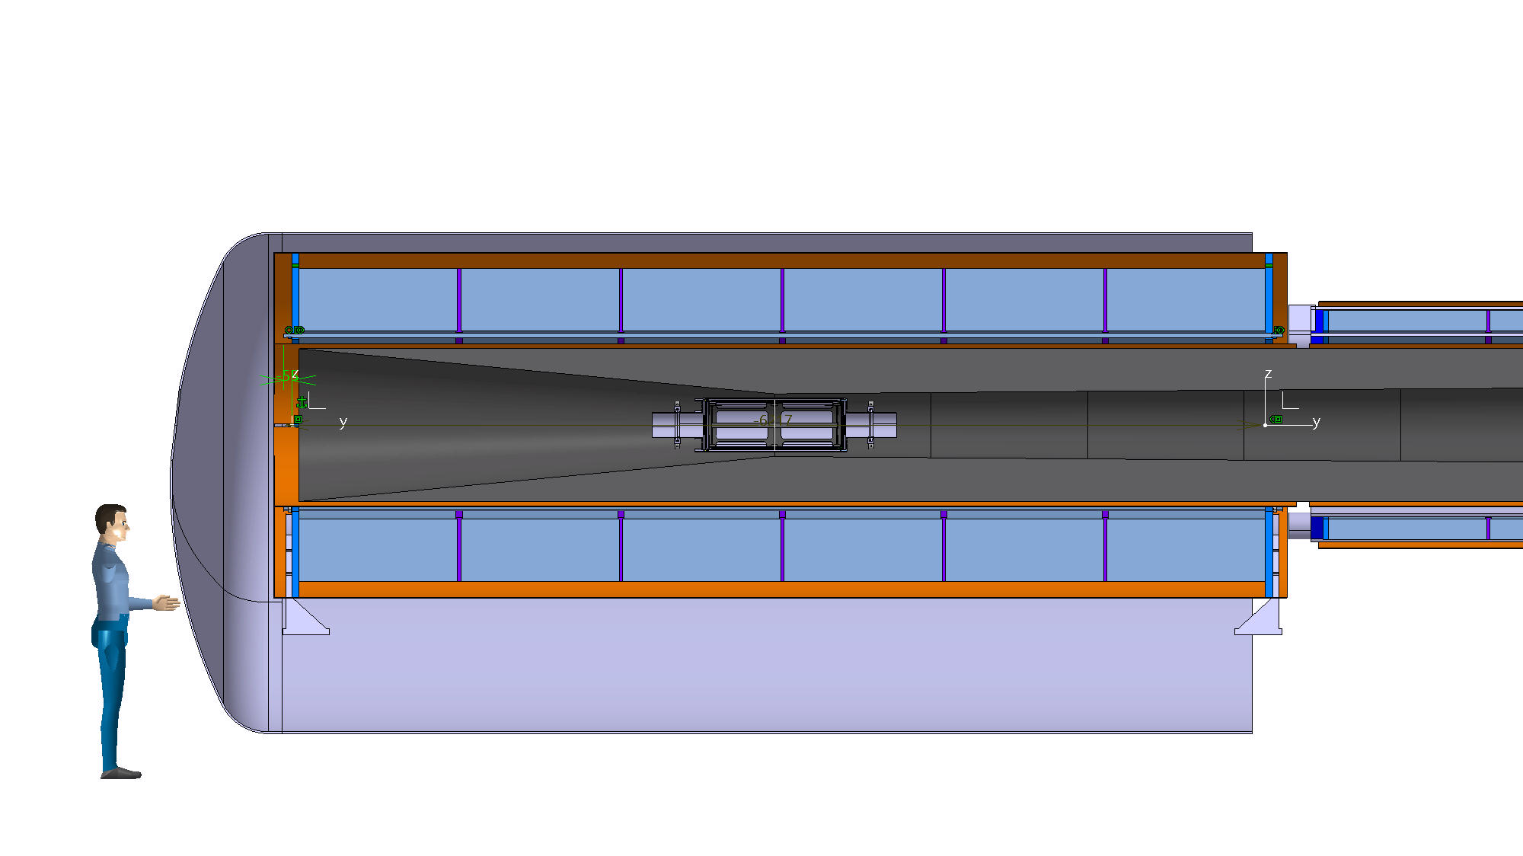
SUPPORT CONCEPT 1
Compression bars for electromagnetic force between the coils
Support tungsten shield trough vacuum vessel
Sliding support may be required due to thermal expansion
Fix point for all 18 coils
Cold support structure
Charge = 100 T
Fixed and sliding cold supports – may be swopped
Charge = 174 T
Sliding support required if He leak can create ∆T on the vessel
Warm backbone in the vacuum vessel

Slide 5
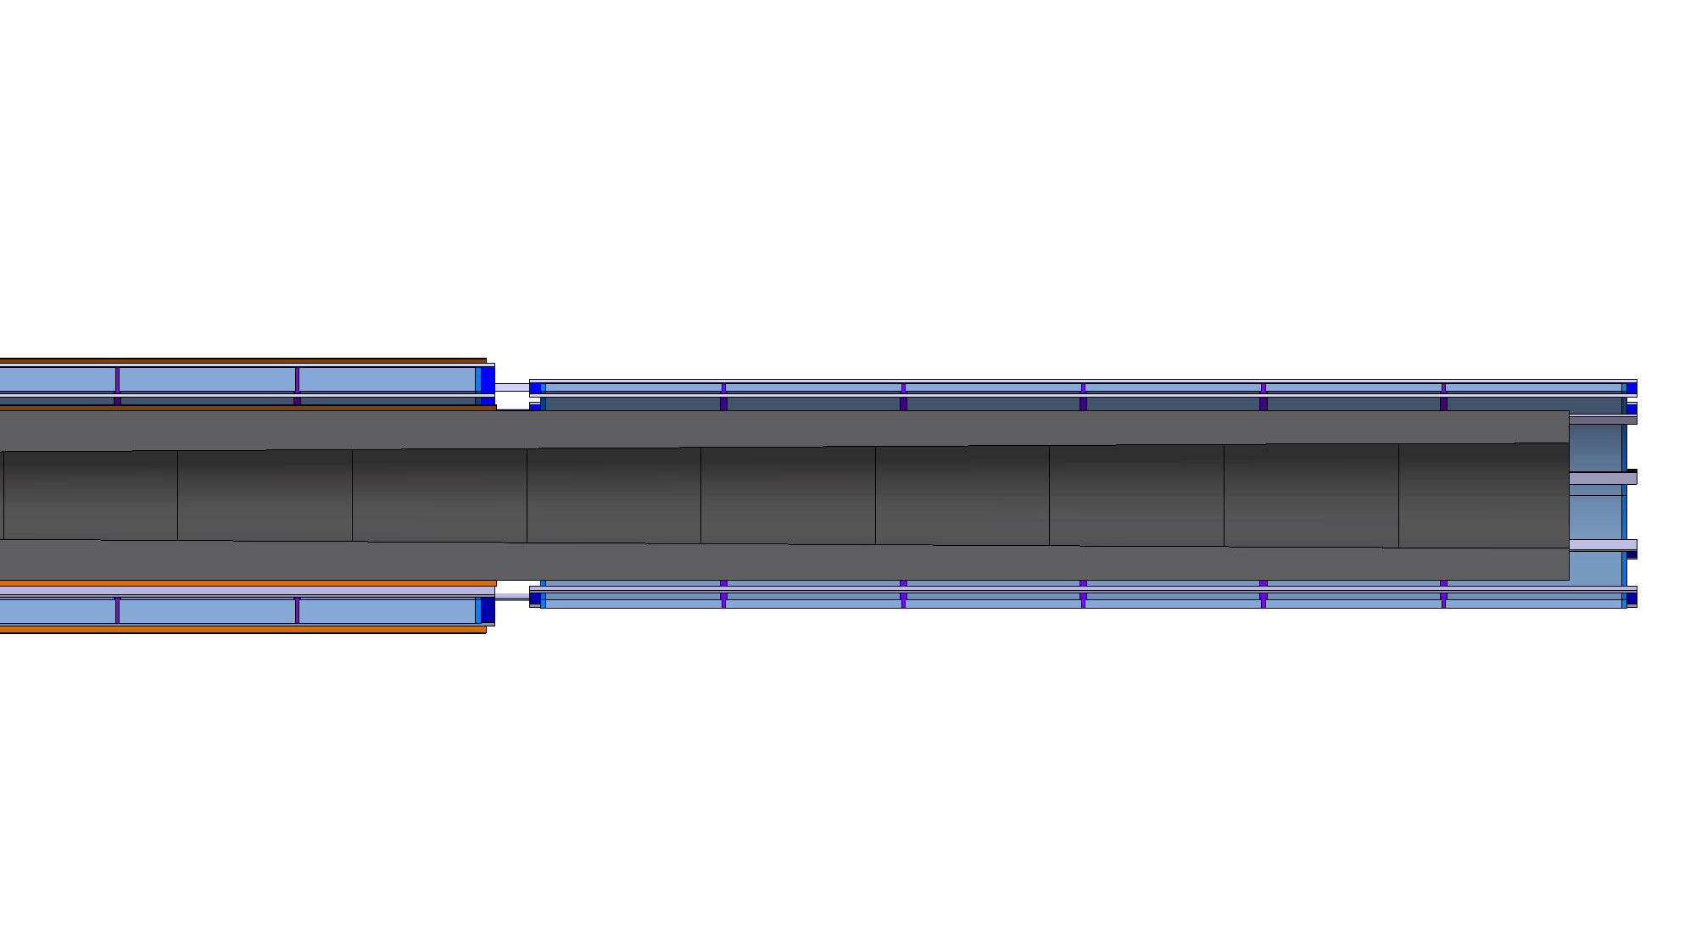
SUPPORT CONCEPT 2
Thermal contraction:
35 – 50 mm depending on the fix point for the large coils
Compression bars
Warm supports for the tungsten shield
MECHANICAL LAY-OUT IN DEVELOPMENT
Cold supports charge 30 T
Cold supports charge 12 T
Vacuum vessel
Vacuum vessel
Charge 95 T
(On two supports)
Charge 76 T

Slide 6
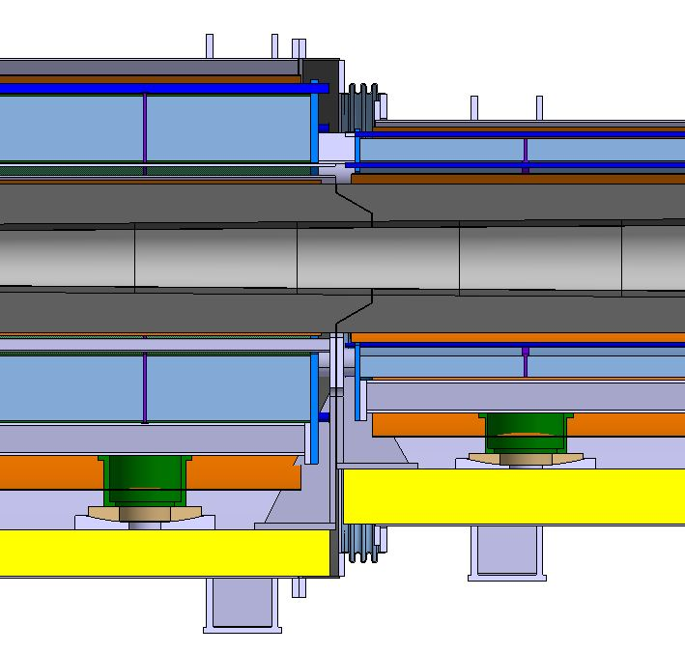
COIL GAP
300 mm coil to coil
9x Ø168 bars for coil attraction force 40 MN(w/ zero gap) max
Thermal shielding required
Must be attached to the coil assemblies for thermal contraction w/o electromagnetic force – may lead into hyperstatic supporting!

Slide 7
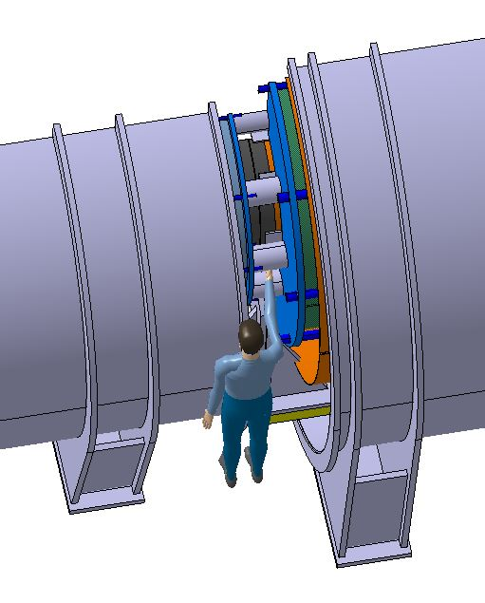
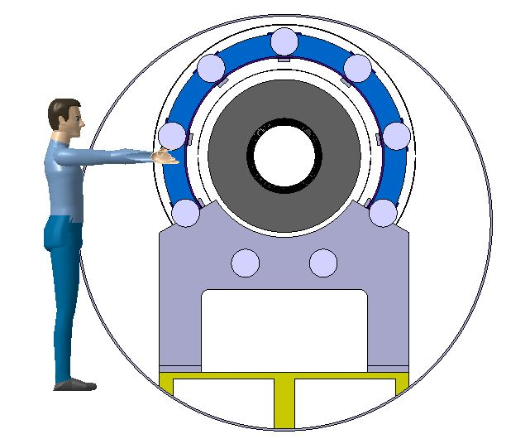
COIL GAP ACCESS
The tungsten shielding and anything within it remains out of reach in the first opening
Gap = 480 mm, cannot be extended as the coldmass and tungsten shield are supported at vacuum vessel extremities

Slide 8
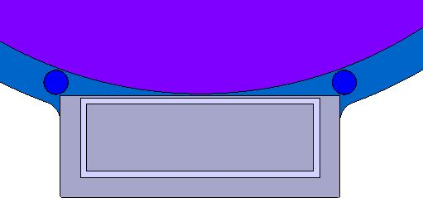
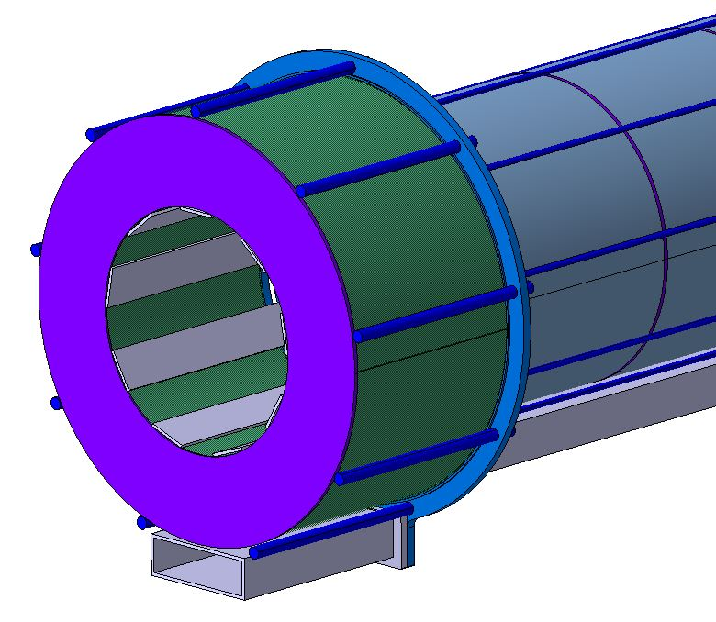
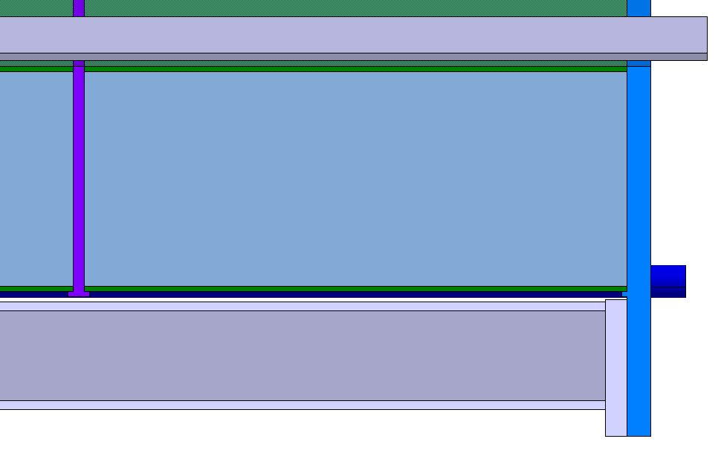
COIL ASSEMBLY
Beam for support interface
MANY MECHANICAL CALCULATIONS REQUIRED!
Coil shims and end plates with shoulders on external diameter for coil-to-coil centring
2x/9x Ø60 rods/flat bars for clamp load to keep coils together until electromagnetic forces are created
Supports might need active cooling or another solution to guarantee the clamp load at all times
End plates and rod tensioning probably needs more space

Slide 9
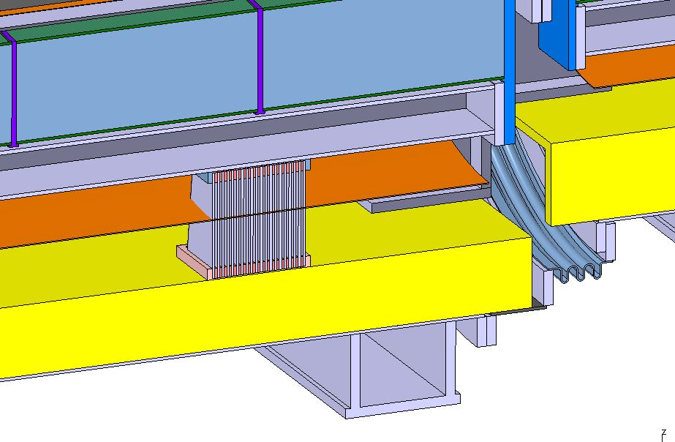
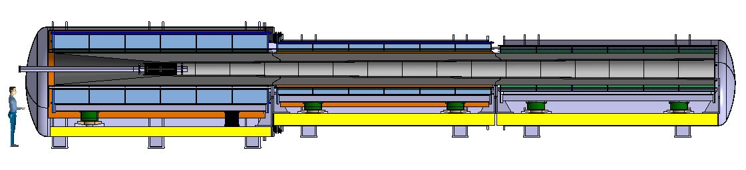
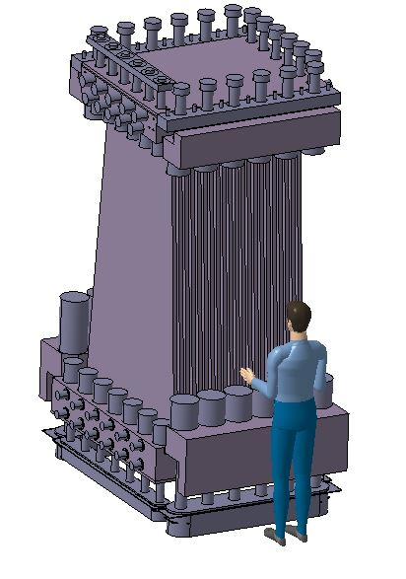
COIL ASSEMBLY SUPPORTING
Support structure to transfer cold mass and tungsten shield load to cryostat supporting
Fixed support
Flexible support
Sliding supports
ITER inspired flexible support = several plates together
Charge 50 T
Charge 50 T
Charge 15 – 6 T
May be swopped
DEVELOPMENT OF DIFFERENT CONCEPTS!
Sliding supports = GFRE supports on spherical bearing, shim the height = LHC dipole concept(similar mass)
Courtesy of Jose Lorenzo

Slide 10
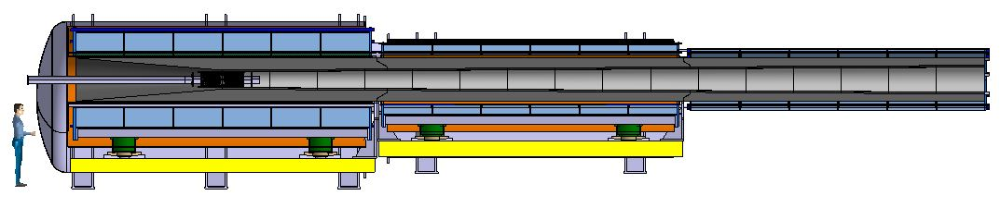
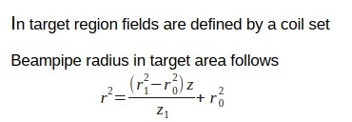
TUNGSTEN SHIELD
Inner radius defined by formula by Chris Rogers
If this is indeed for beam envelope, the shield must be updated if a beam pipe is required
Outer radius estimated from the surrounding coils assembly with thermal shielding
Resulting shield thickness to be studied(currently 258 mm – 158 mm)
Simplified model weights 160 T
Initial plan to use beads – filling ratio ≈ 63-74%
Tungsten price > 100 CHF/kg
Cool beads with water or He gas?

Slide 11
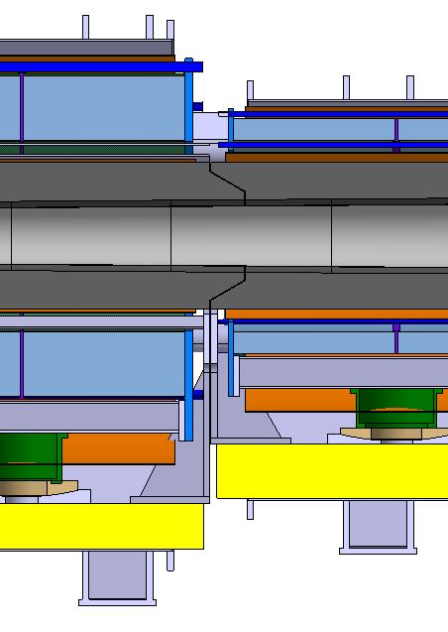
TUNGSTEN SHIELD
Split into three sections of 50 T supported through the warm structure at the bottom of the vacuum vessel
Conical interface to avoid gaps for radiation
  Align w.r.t. the magnets to guarantee fit during the final assembly of the target magnets
  Cooling of cone ends?
The temperature in operation?
  If increased, the supports system must cope with it = complication
Which material for the bead envelope?
  Cost and manufacturability
  Mechanical behaviour = deformation
Split all three main sections into several longitudinal sections for easier manipulation
Should target for service free life – can this be achieved?

Slide 12
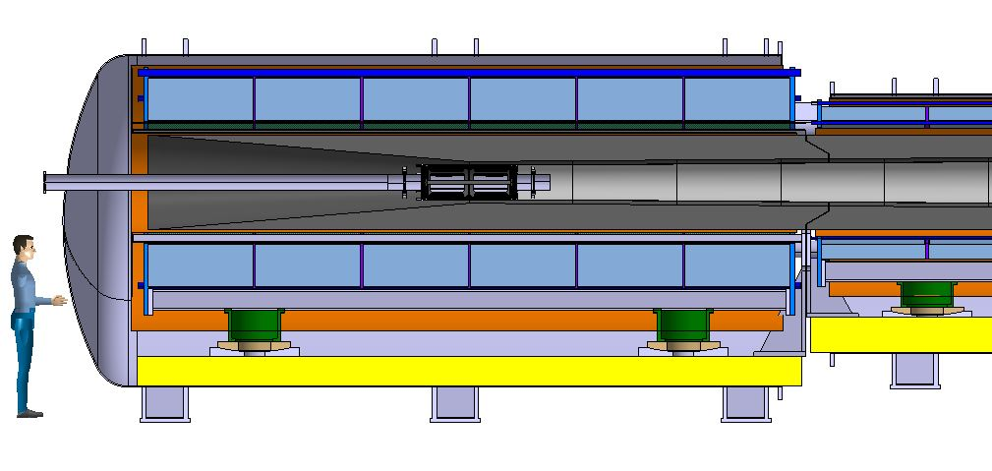
TARGET AND BEAM VACUUM
One conical chamber downstream from the target – IF dedicated beam vacuum
Insert from downstream side, 15 m clearance required downstream from magnets
  Installation order & minimized service
Move assembly upstream to allow target service
  Must be with robot due to radiation?
  Upstream equipment might have to removed for service. Septa style supports?
  Enough clearance between vacuum chamber and tungsten shield required
  Support system must allow this
Beam instrumentation?
Vacuum system bake-out required?
Conical chamber downstream from the target

Slide 13
MAGNETIC SHIELDING
Is a magnetic shield required?
If yes:
  What would be the size if made from iron?
  Coils for magnetic shielding – size and place?
Instrumentation in the magnetic field?
Vacuum pumps and other equipment, if any, in the magnetic field?
  ITER solutions?

Slide 14
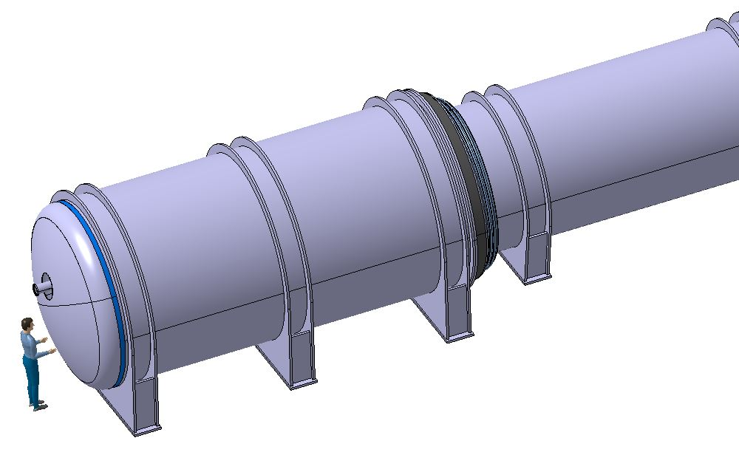
CRYOSTAT ASSEMBLY
Maximum diameter as shown 3.2 m
  Still very preliminary!
Study buckling support structure
Study supporting interfaces
Add current leads, operating current 60 kA for the first section, scale mid and small sections per current requirement
Add vacuum pumps, instrumentation and safety
If bellows for section connections, the large bellow(r = 1500 mm) would mean a vacuum force of appr. 707 kN
Opening L = 480 mm, limited space to assemble thermal shielding and intercoil supports – see slide 6

Slide 15
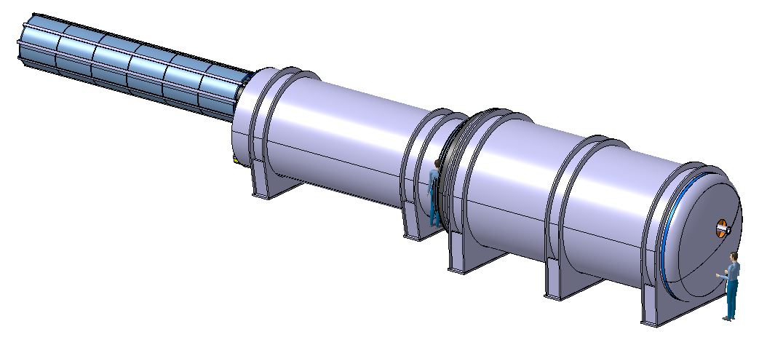
HANDLING
Full assembly: L ≈ 20 m, m ≈ 350 – 400 T
Divide into three subassemblies per set of physically similar coils
  L ≈ 7 m, m ≈ 200 T max
Transport as three subassemblies
Install front section on supports first
  Either on rails or movable platform or a 200 T overhead crane is required
Second and third section to be on rails or movable assembly platform for installation
Service during lifetime, if activated? Only with robot?
Disposal at the end of the lifetime due to radiation?

Slide 16
SUMMARY
Muon collider target and capture assembly is 20 m long and 350-400 T cryostat which could be divided into three sections, max 200 T, for handling and installation
Cold masses up to 100 T requiring robust cold supports allowing also thermal contraction
Coils are protected by a > 100 T tungsten shield requiring active cooling and room temperature supports inside the cryostat
Beam vacuum system may include a 15 m chamber requiring large space for assembly, target service would also need a significant space
Very high magnetic field may lead into issues with cryostat instrumentation and equipment
What is the radiation level? How to service sub-systems during the lifetime? Disposal at the end of the life?

Slide 17
Thank you for your attention!
Your questions please?
! / ?

