Slide 1

Initial Evaluations of the Cooling Solenoids for the Rectilinear 6D Cooling Channel
Jonathan Pavan, Siara Fabbri

Slide 2
DISCLAIMER:
These are tentative results based on the geometries and parameters from the US MAP original design [1]
[1] Stratakis, Diktys, and Robert B. Palmer. "Rectilinear six-dimensional ionization cooling channel for a muon collider: A theoretical and numerical study." Physical Review Special Topics-Accelerators and Beams 18.3 (2015): 031003.

Slide 3
Outline
Goal: simulate and characterize the cooling solenoid magnets based on geometries and initial parameters from the US MAP study.
Overview
Simulation study
  Approach and validation
  COMSOL setup
  Analytic formulas
Results
  Characterization of all coil types
  Case Study: Stage A1
  Characterization of all stages
Summary

Slide 4
Outline
Goal: simulate and characterize the cooling solenoid magnets based on geometries and initial parameters from the US MAP study.
Overview
Simulation study
  Approach and Validation
  COMSOL Setup
  Analytic formulas
Results
  Characterization of all coil types
  Case Study: Stage A1
  Characterization of all stages
Summary

Slide 5
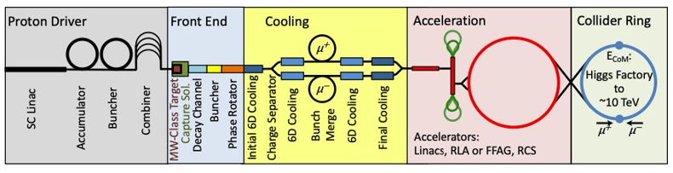
Overview: Cooling for a Muon Collider 1/2
Rectilinear 6D cooling scheme to reduce emittance of muon beam by several orders of magnitude
12 unique stages:
  4 cooling stages before bunch recombination (A1-A4)
  8 cooling stages after bunch recombination (B1-B8)
Each stage has a repeating series of a cell type
Figure from MAP study, ref [1]

Slide 6
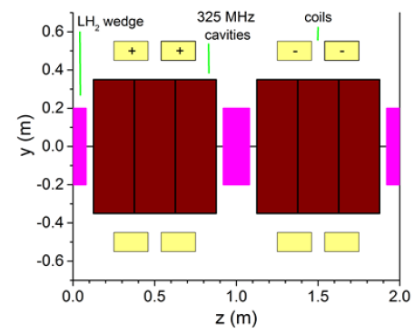
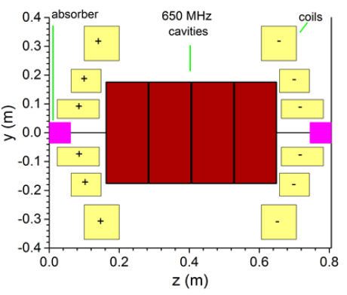
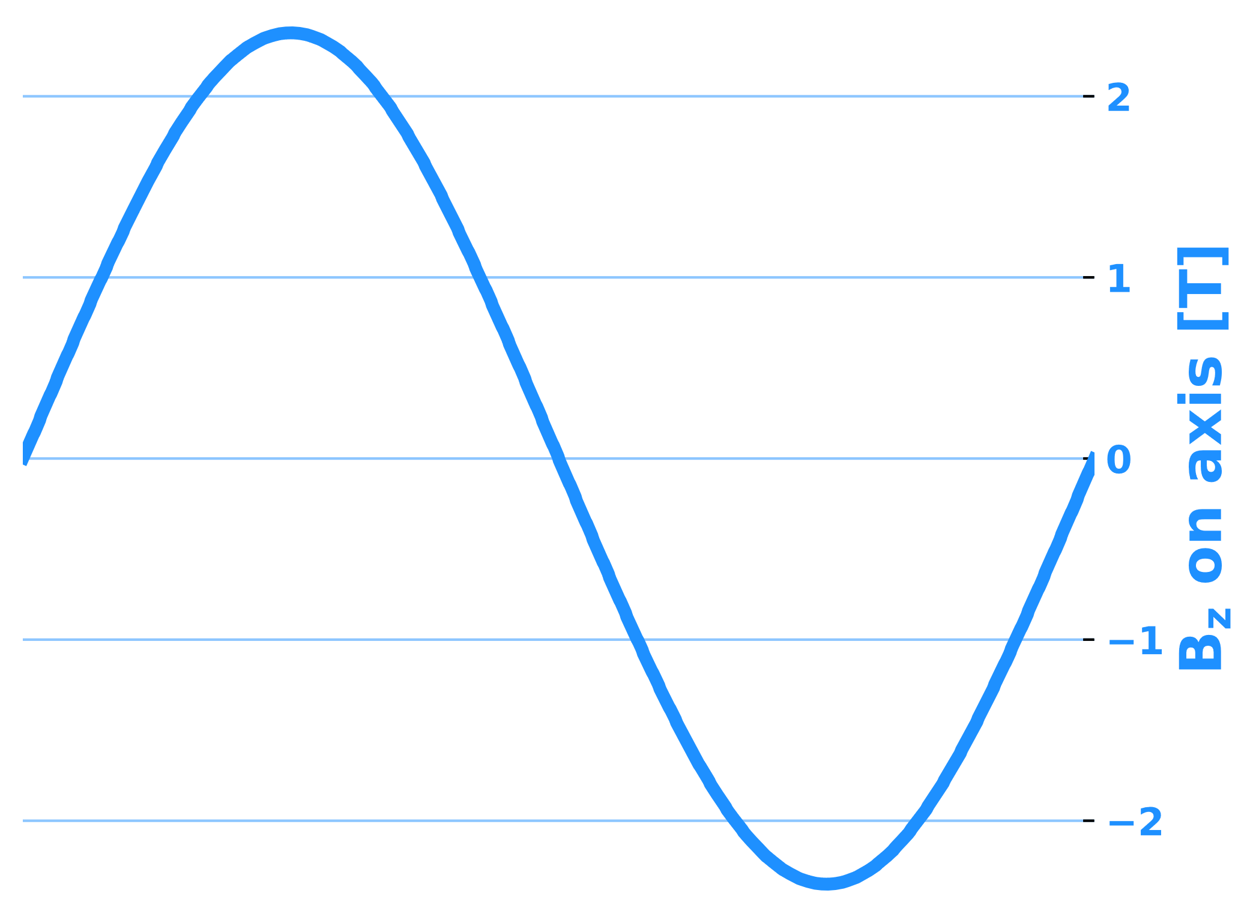
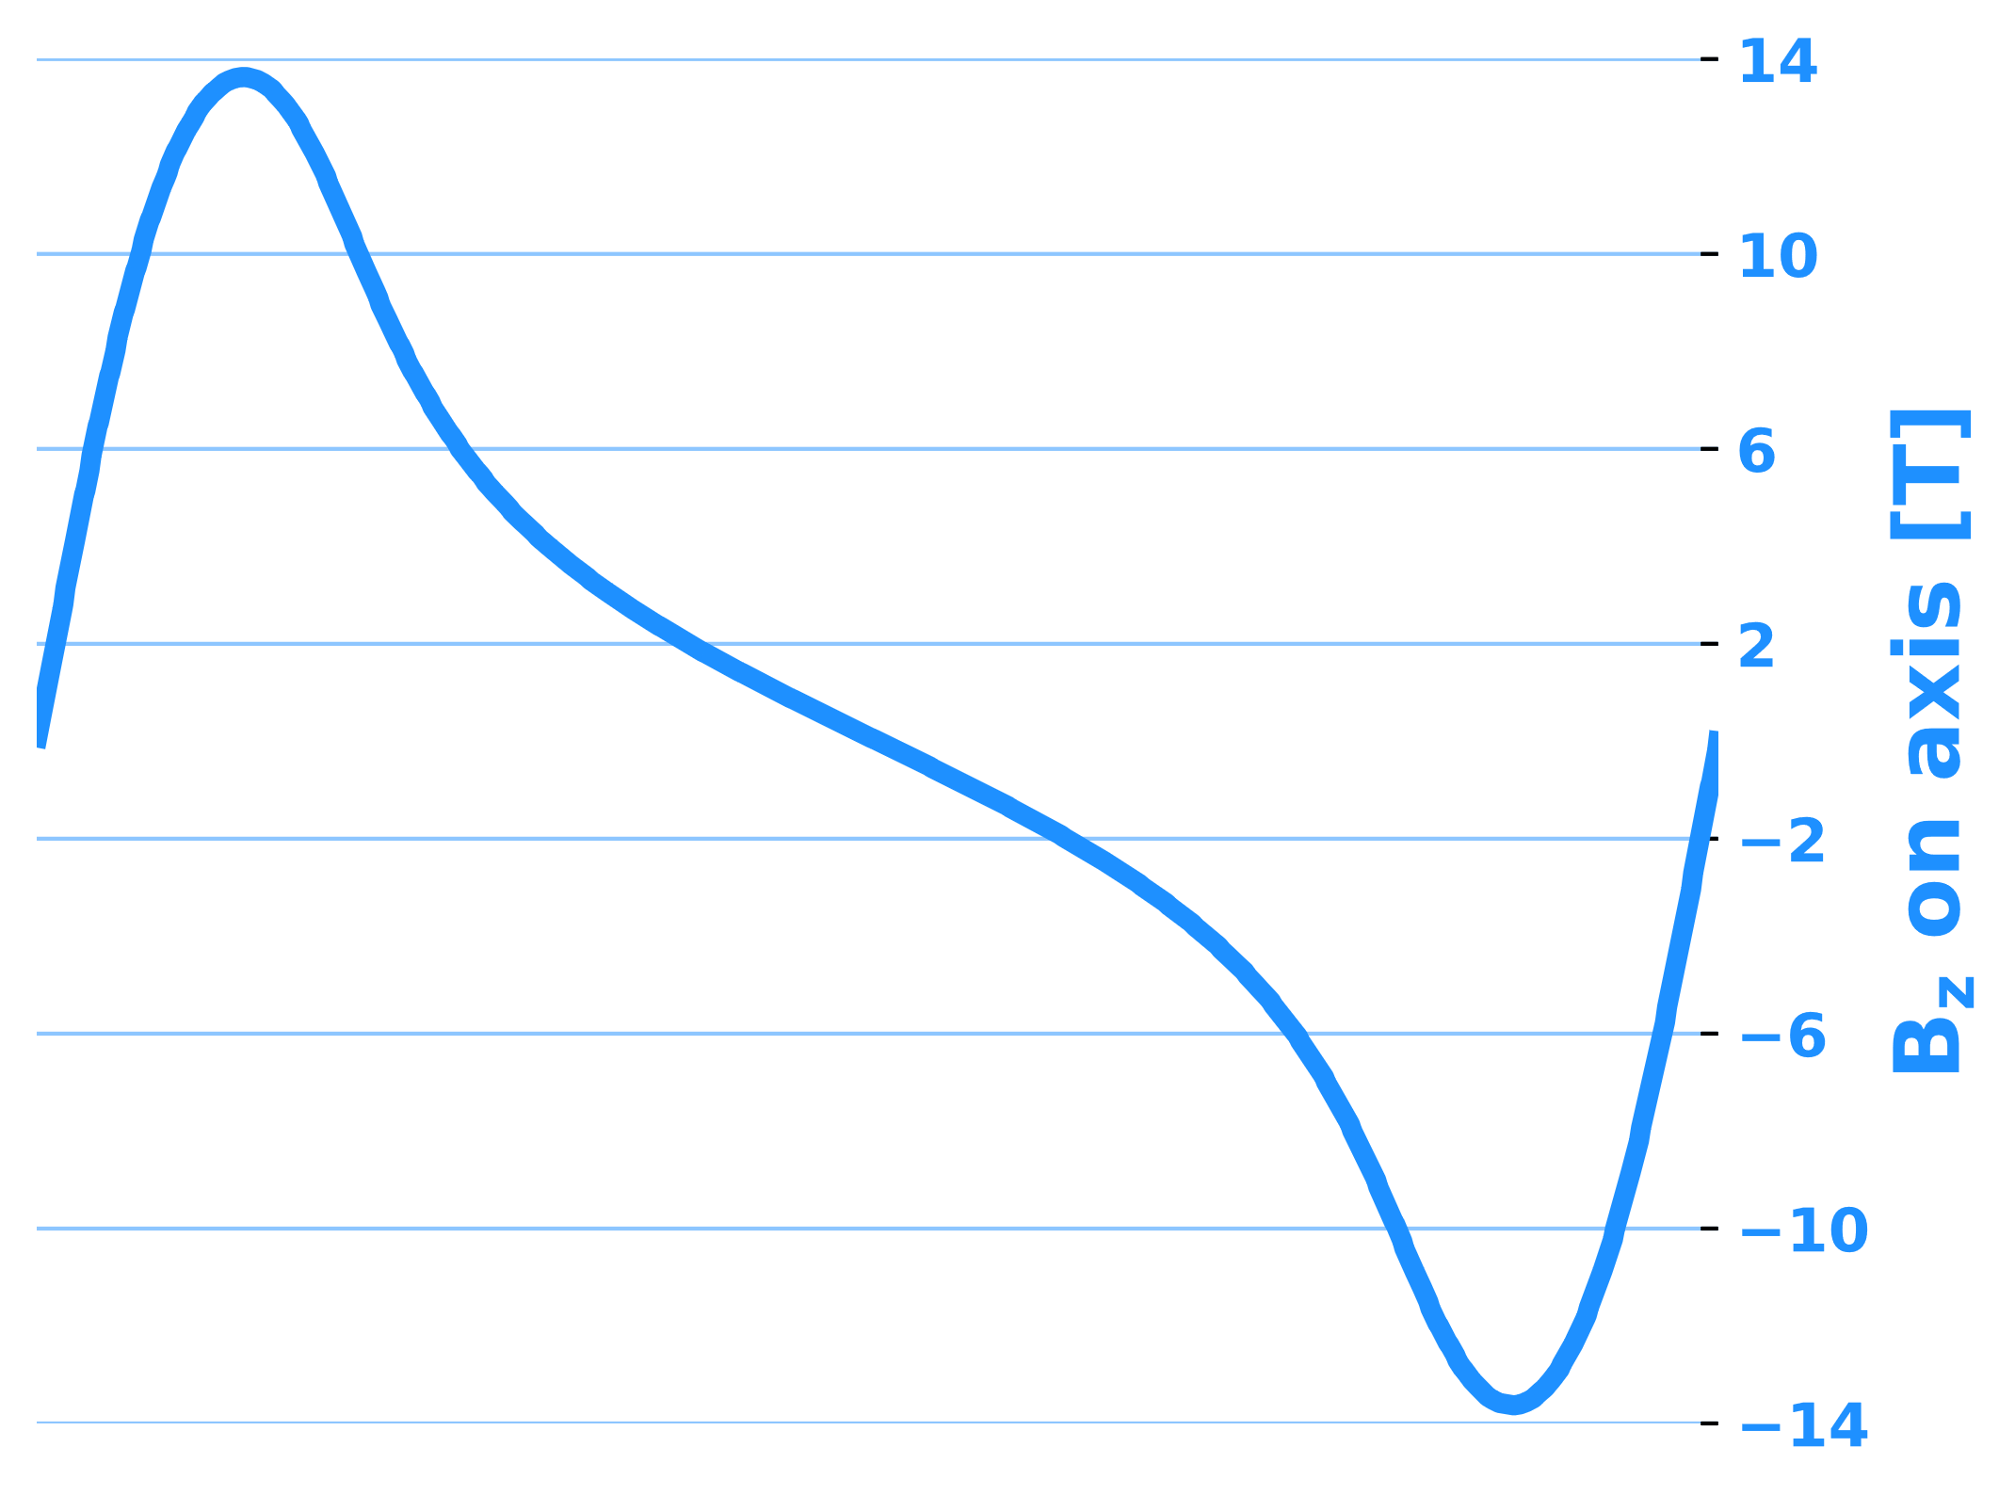
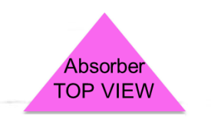
Overview: Cooling for a Muon Collider 2/2
High field, very compact solenoids
Each cell has symmetric solenoids of opposite polarity
Dipole component separated out!
Demonstrator – cell B7
Some stats:
Fields on axis: 2 to 14 T
Cell Lengths: 0.8 to 2.7 m
Total length of all Stages: ~ 1 km
Total number of solenoids: 2432
Cell in Stage A1
Cell in Stage B8
…
Images taken from ref [1] Stratakis, Diktys and corresponding presentations

Slide 7
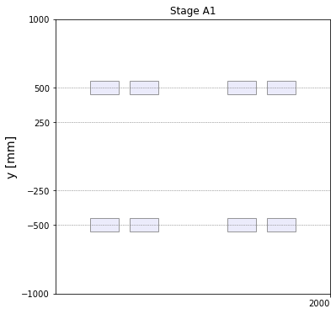
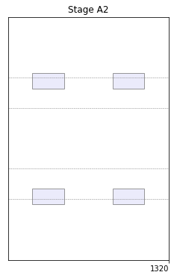
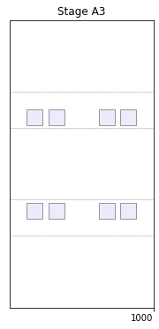
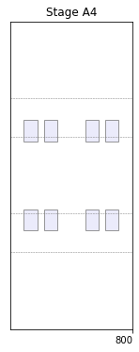
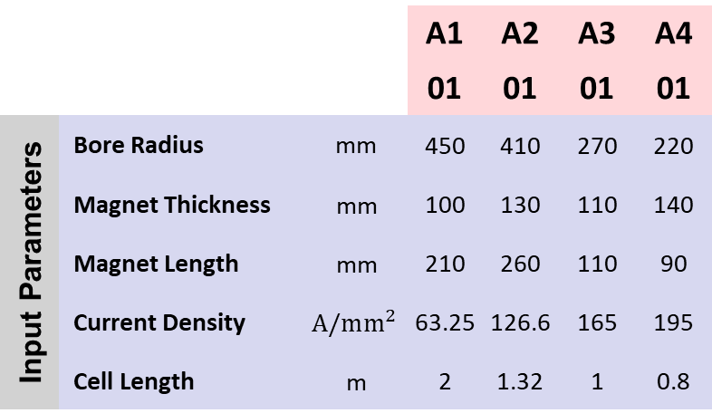
Overview: Input Parameters and Geometry 1/2
Changing Polarity!
 |  |  | A1 | A2 | A3 | A4
 |  |  | 01 | 01 | 01 | 01
Input Parameters | Bore Radius | mm | 450 | 410 | 270 | 220
 | Magnet Thickness | mm | 100 | 130 | 110 | 140
Geometry | Magnet Length | mm | 210 | 260 | 110 | 90
 | Current Density | $$A/mm^{2}$$ | 63.25 | 126.6 | 165 | 195
 | Cell Length | m | 2 | 1.32 | 1 | 0.8

Slide 8
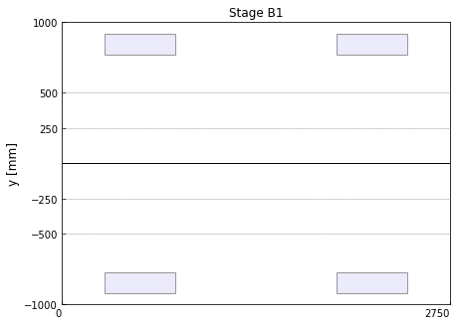
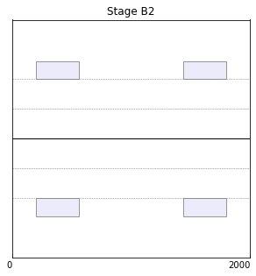
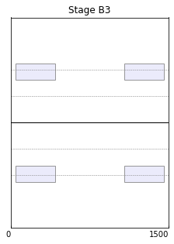
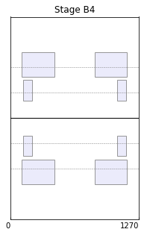
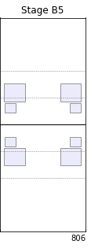
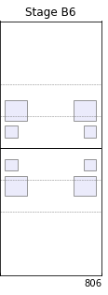
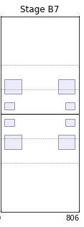
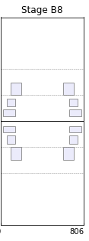
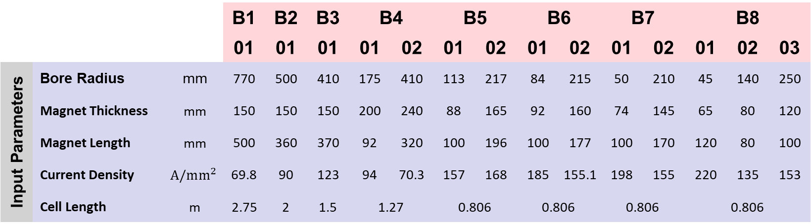
Overview: Input Parameters and Geometry 2/2
B4 to B8 tight packed coils at different radii!
Large bore!
 |  |  | B1 | B2 | B3 | B4 |  | B5 |  | B6 |  | B7 |  | B8
 |  |  | 01 | 01 | 01 | 01 | 02 | 01 | 02 | 01 | 02 | 01 | 02 | 01 | 02 | 03
Input Parameters | Bore Radius | mm | 770 | 500 | 410 | 175 | 410 | 113 | 217 | 84 | 215 | 50 | 210 | 45 | 140 | 250
 | Magnet Thickness | mm | 150 | 150 | 150 | 200 | 240 | 88 | 165 | 92 | 160 | 74 | 145 | 65 | 80 | 120
Geometry | Magnet Length | mm | 500 | 360 | 370 | 92 | 320 | 100 | 196 | 100 | 177 | 100 | 170 | 120 | 80 | 100
 | Current Density | $$A/mm^{2}$$ | 69.8 | 90 | 123 | 94 | 70.3 | 157 | 168 | 185 | 155.1 | 198 | 155 | 220 | 135 | 153
 | Cell Length | m | 2.75 | 2 | 1.5 | 1.27 |  | 0.806 |  | 0.806 |  | 0.806 |  | 0.806

Slide 9
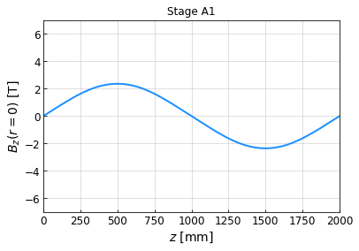
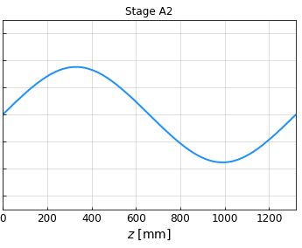
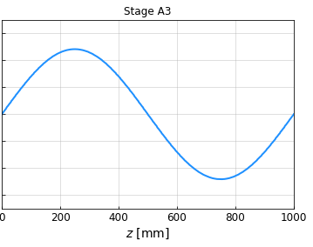
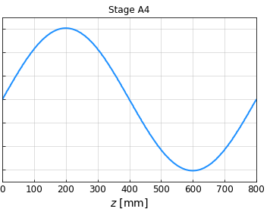
Overview: On-Axis Magnetic Field ($B_{z}$) in A1 to A4

Slide 10
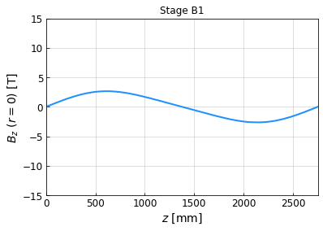
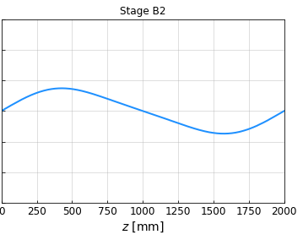
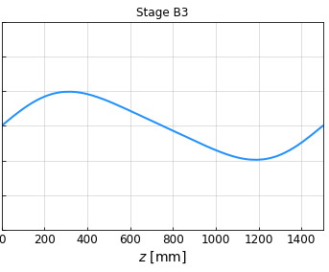
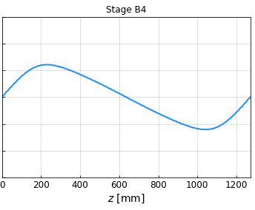
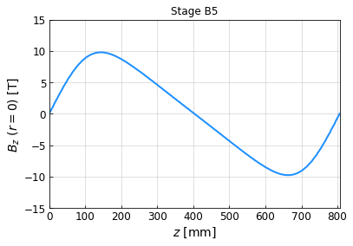
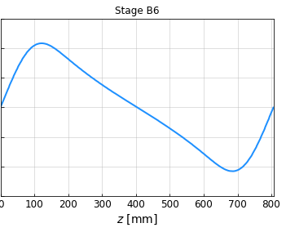
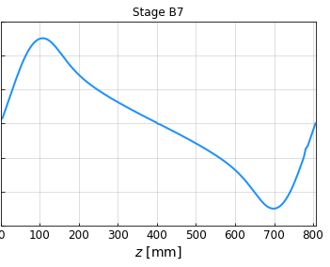
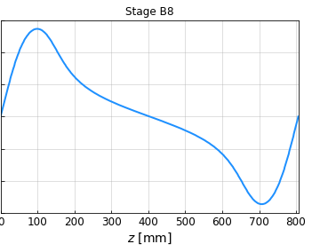
Overview: On-Axis Magnetic Field ($B_{z}$) in B1 to B8

Slide 11
Outline
Goal: simulate and characterize the cooling solenoid magnets based on geometries and initial parameters from the US MAP study.
Overview
Simulation study
  Approach and Validation
  COMSOL Setup
  Analytic formulas
Results
  Characterization of all coil types
  Case Study: Stage A1
  Characterization of all stages
Summary

Slide 12
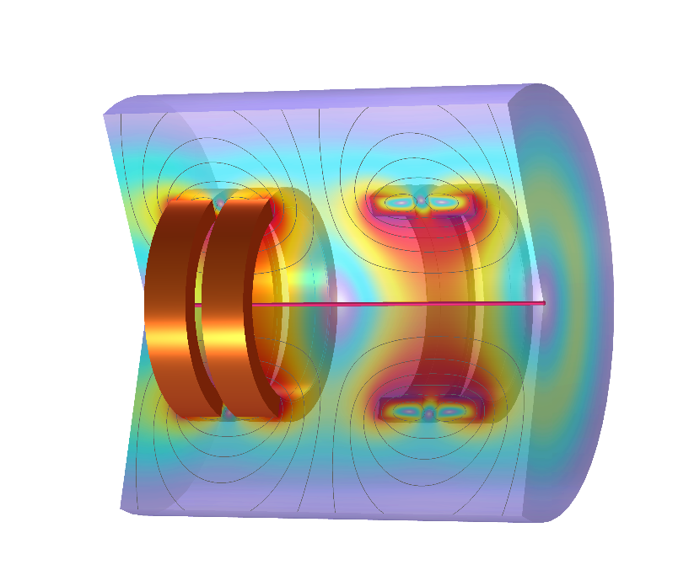
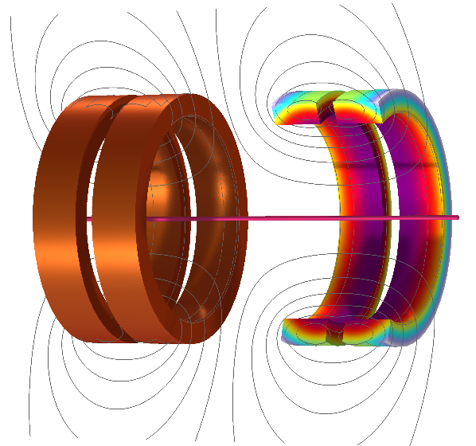


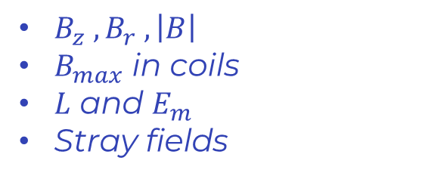
Simulation Study: Our Focus
Magnetic Properties
Mechanical Properties
$B_{z} , B_{r} , \left|B\right|$
$B_{max}$ in coils
$L$ and $E_{m}$
Stray fields
Stresses
Peak stress
Force densities
Coil parameters
We present results for:
  All coil types
  A detailed case study (A1)
  All stages (primarily a cell in a lattice, with some comparisons to the single cell)
$$r$$
$$z$$

Slide 13

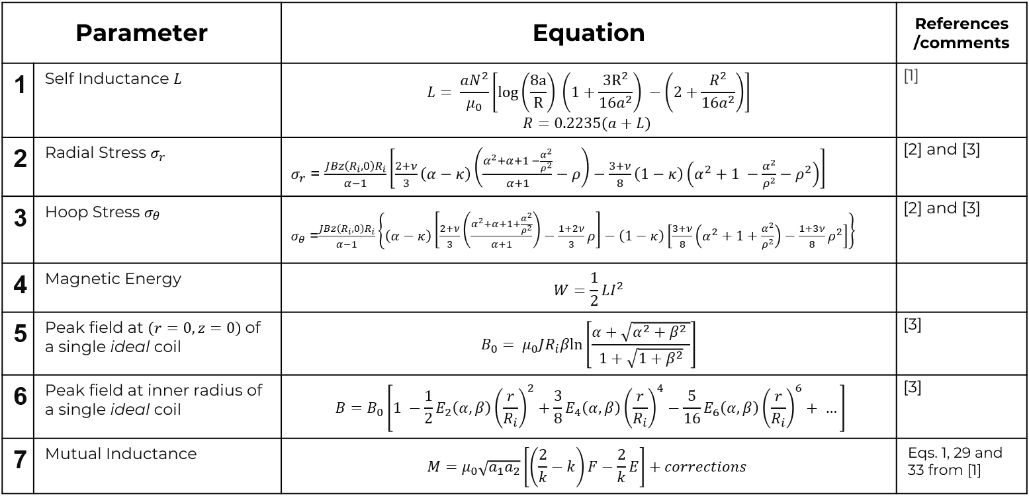
Simulation Study: Approach
Simulations done in COMSOL but continuously validated against analytical formulas and supplied G4beamline fieldmaps.
COMSOL
Analytic Formulas

Slide 14
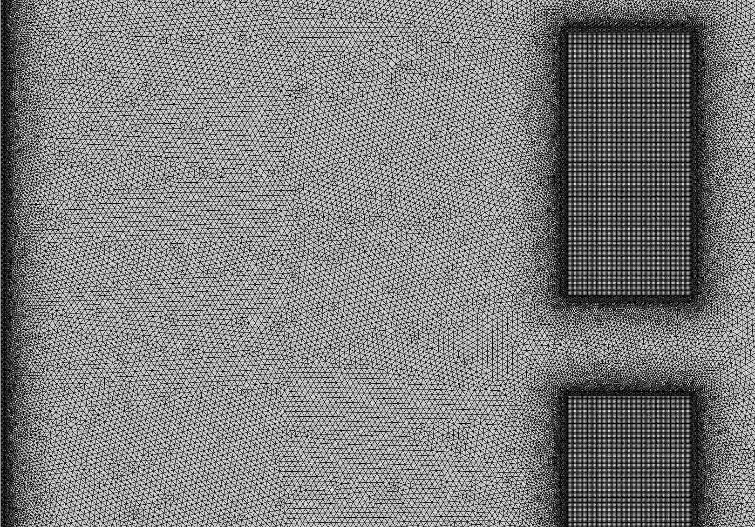

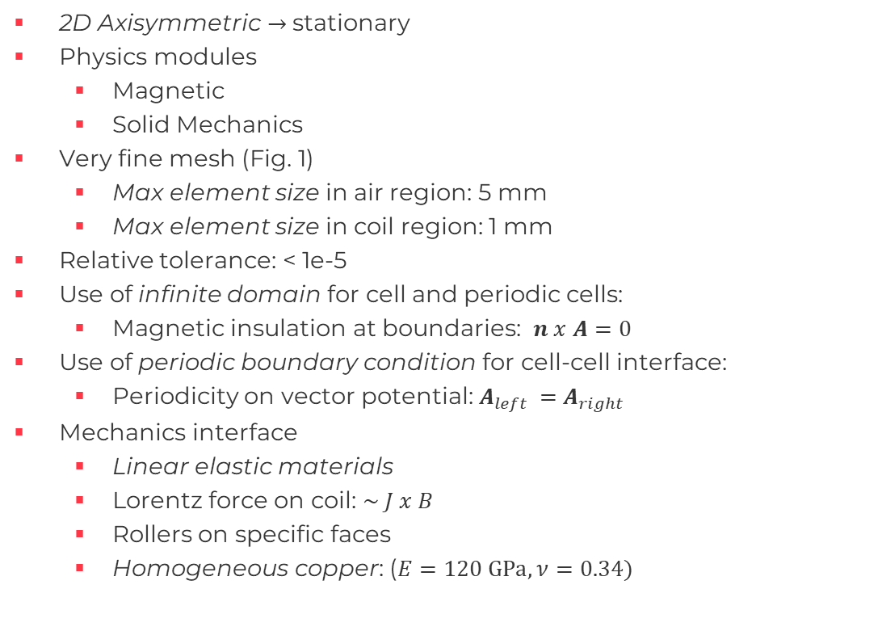


Simulation Study: COMSOL Setup
2D Axisymmetric $→$stationary
Physics modules
  Magnetic
  Solid Mechanics
Very fine mesh (Fig. 1)
  Max element size in air region: 5 mm
  Max element size in coil region: 1 mm
Relative tolerance: < 1e-5
Use of infinite domain for cell and periodic cells:
  Magnetic insulation at boundaries: $n x A=0$
Use of periodic boundary condition for cell-cell interface:
  Periodicity on vector potential: $A_{left }=A_{right}$
Mechanics interface
  Linear elastic materials
  Lorentz force on coil: $\sim J x B$
  Rollers on specific faces
  Homogeneous copper: ($E=120 GPa, ν=0.34)$
Fig. 1
$$210 mm$$
axis
$$r$$
$$z$$

Slide 15
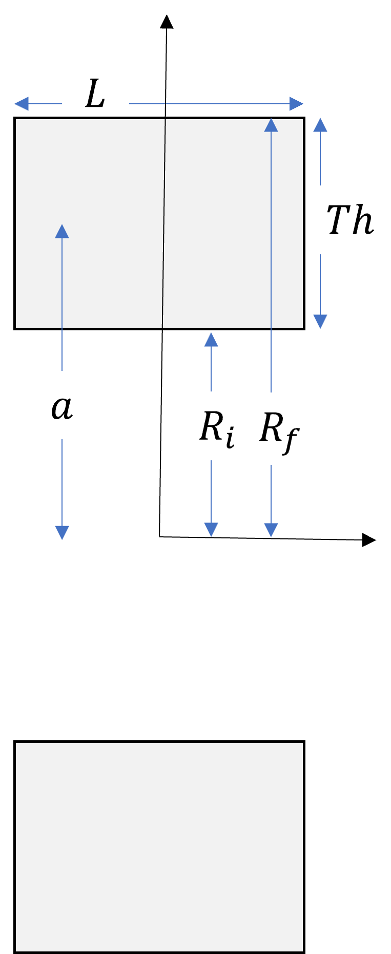
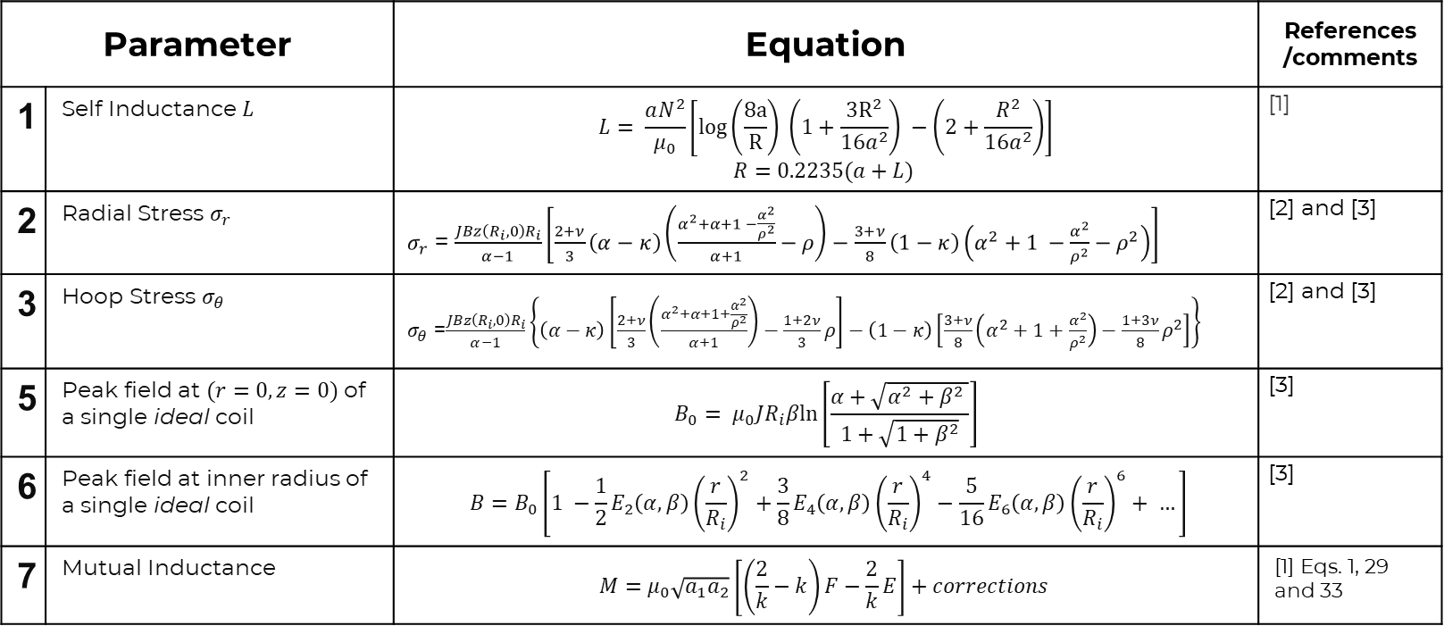

Simulation Study: Analytic Formulas for a Single Coil
Parameter | Parameter | Equation | References /comments
1 | Self Inductance $L$ | $$L= \frac{aN^{2}}{μ_{0}}\left[log\left(\frac{8a}{R}\right) \left(1+\frac{3R^{2}}{16a^{2}}\right) −\left(2+\frac{R^{2}}{{16a}^{2}}\right)\right]$$ $$R=0.2235(a+L)$$ | [1]
2 | Radial Stress $σ_{r}$ | $σ_{r}$ = $\frac{JBz\left(R_{i},0\right)R_{i}}{α−1}\left[\frac{2+ν}{3}\left(α−κ\right)\left(\frac{α^{2}+α+1 −\frac{α^{2}}{ρ^{2}}}{α+1}−ρ\right)−\frac{3+ν}{8}\left(1−κ\right)\left(α^{2}+1 −\frac{α^{2}}{ρ^{2}}−ρ^{2}\right)\right]$ | [2] and [3]
3 | $$\text{Hoop} \text{Stress} σ_{θ}$$ | $σ_{θ}$ =$\frac{JBz\left(R_{i},0\right)R_{i}}{α−1}\left\{\left(α−κ\right)\left[\frac{2+ν}{3}\left(\frac{α^{2}+α+1+\frac{α^{2}}{ρ^{2}}}{α+1}\right)−\frac{1+2ν}{3}ρ\right]−\left(1−κ\right)\left[\frac{3+ν}{8}\left(α^{2}+1+\frac{α^{2}}{ρ^{2}}\right)−{\frac{1+3ν}{8}ρ}^{2}\right]\right\}$ | [2] and [3]
5 | Peak field at $(r=0, z=0)$of a single ideal coil | $$B_{0}= μ_{0}JR_{i}βln\left[\frac{α+\sqrt{α^{2}+β^{2} }}{1+\sqrt{1+β^{2}}}\right]$$ | [3]
6 | Peak field at inner radius of a single ideal coil | $$B=B_{0}\left[1 −\frac{1}{2}E_{2}\left(α, β\right){\left(\frac{r}{R_{i}}\right)}^{2}+\frac{3}{8}E_{4}\left(α, β\right){\left(\frac{r}{R_{i}}\right)}^{4}−\frac{5}{16}E_{6}\left(α, β\right){\left(\frac{r}{R_{i}}\right)}^{6}+ …\right]$$ | [3]
7 | Mutual Inductance | $$M=μ_{0}\sqrt{a_{1}a_{2}}\left[\left(\frac{2}{k}−k\right)F−\frac{2}{k}E\right]+corrections$$ | [1] Eqs. 1, 29 and 33
$$α=\frac{R_{f}}{R_{i}}, β=\frac{L}{2R_{i}}$$
[1] Rosa, Edward Bennett, and Frederick Warren Grover. Formulas and tables for the calculation of mutual and self-inductance. No. 169. US Government Printing Office, 1948.
[2] Wilson, Martin N. "Superconducting magnets." (1983).
[3] Iwasa, Yukikazu. Case studies in superconducting magnets: design and operational issues. Springer science & business media, 2009.

Slide 16
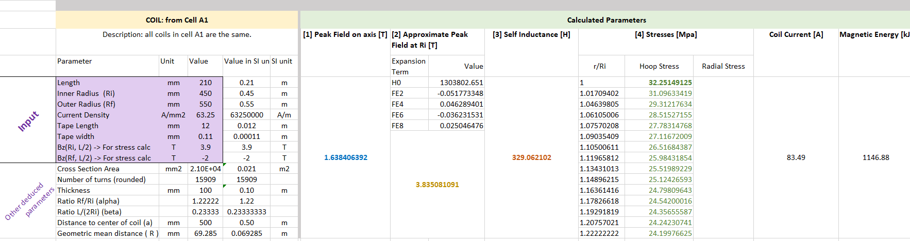
Simulation Study: Analytic Formulas $→$Coil Calculator
Calculates basics parameters for a given single coil geometry, current density, and tape size.

Slide 17
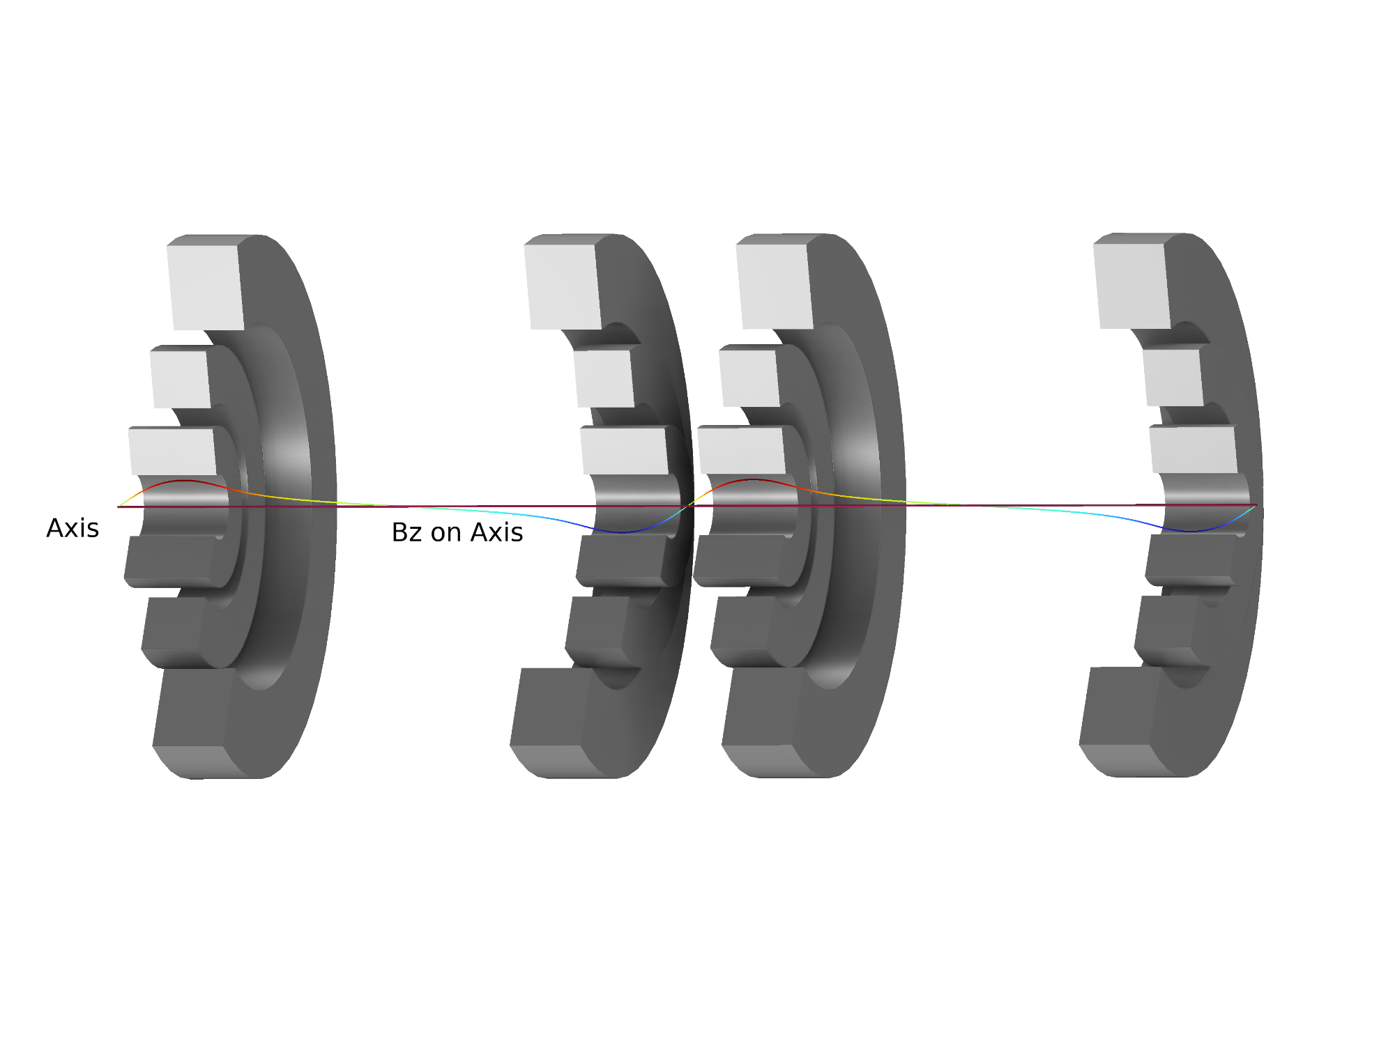
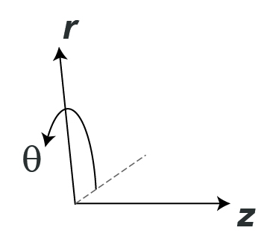
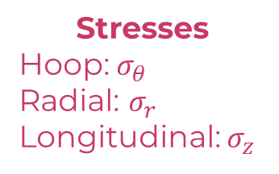
Simulation Study: Geometry and Definitions
Cell B8
Stresses
Hoop: $σ_{θ}$
Radial: $σ_{r}$
Longitudinal: $σ_{z}$
Repeating cells…

Slide 18
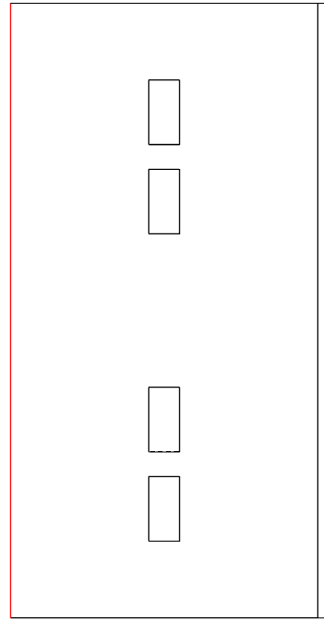
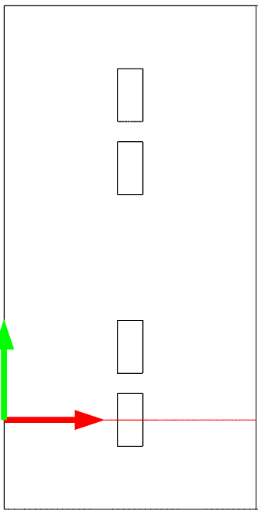
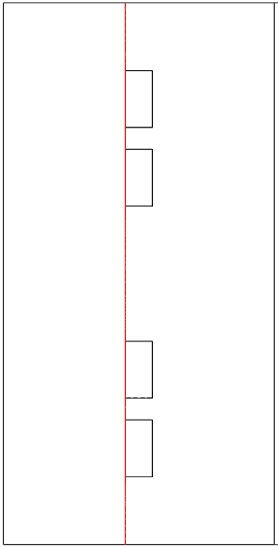
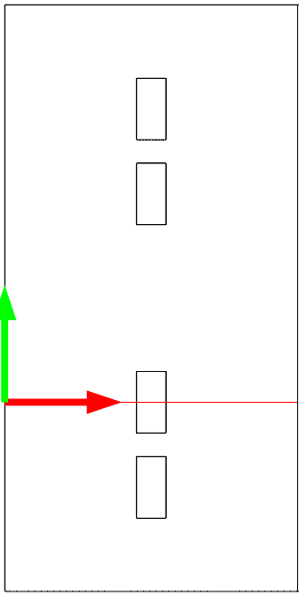


Simulation Study: Example of Evaluation Locations of Magnetic Fields
Field on axis
Field radially in Coil 1 midplane
$$r$$
$$z$$
Field on conductors
Field radially in Coil 2 midplane

Slide 19
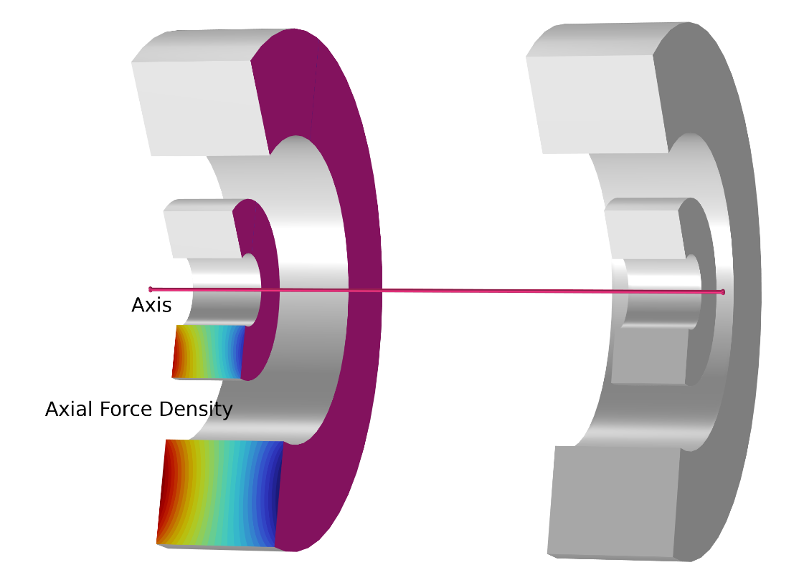
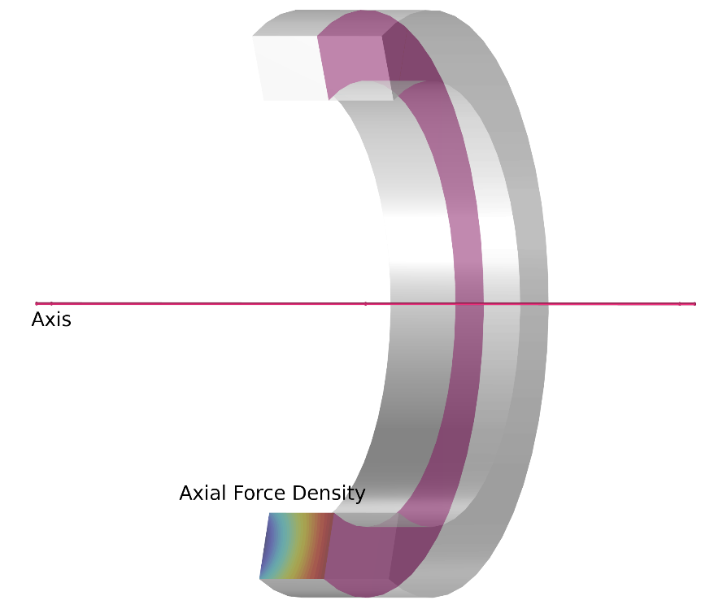

Simulation Study: Mechanics Calculations
1. Single Coil
2. Single Cell / Periodic Lattice
A single coil is split exploiting the symmetry of the system. In the middle of the coil a roller boundary (shown in purple) is placed.
The stresses are evaluated on just 2 of the 4 coils in the shown cell, exploiting symmetry. Rollers are placed such that they oppose the net axial force on a coil.

Slide 20
Outline
Goal: simulate and characterize the cooling solenoid magnets based on geometries and initial parameters from the US MAP study.
Overview
Simulation study
  Approach and Validation
  COMSOL Setup
  Analytic formulas
Results
  Characterization of all coil types
  Case Study: Stage A1
  Characterization of all stages
Summary

Slide 21




Results Part 1: Characterization of all Coil Types 1/4
Coil Properties
18 unique coil types
2 to 6 coils per cell
Inner bore diameter from 90 mm to 1540 mm
Lengths from 80 mm to 210 mm
Current densities from 63 to 220 $A/mm^{2}$

Slide 22



Results Part 1: Characterization of all Coil Types 2/4
Magnetic Properties

Slide 23



Results Part 1: Characterization of all Coil Types 3/4
Mechanical Properties
(+) Tension
(-) Compression
(-) Compression

Slide 24




Results Part 1: Characterization of all Coil Types 4/4
Stray Fields
Example
200 mT
100 mT
1 mT
$$r$$
*Turbopumps can operate at 5 to 10 mT
$$z$$

Slide 25
Outline
Goal: simulate and characterize the cooling solenoid magnets based on geometries and initial parameters from the US MAP study.
Overview
Simulation Study
  Approach and Validation
  COMSOL Setup
  Analytic formulas
Results
  Characterization of all coil types
  Case Study: Stage A1
  Characterization of all stages
Summary

Slide 26


Results Part 2: Case Study - Stage A1
1. Single Cell
2. Periodic Lattice
$$r$$
$$z$$

Slide 27



Results Part 2: Case Study - Stage A1
$B_{z}$ $in axial direction$

Slide 28



Results Part 2: Case Study - Stage A1
$$B_{z} in midplane of Coils 1 and 2$$

Slide 29













Results Part 2: Case Study - Stage A1
$$Force Densities and Integrals$$
1. Single Cell
2. Periodic Lattice
$$\frac{MN}{m^{3}}$$
$$\frac{MN}{m^{3}}$$
$$r$$
Coil 2 | [MN]
$$F_{z}$$ | -4.23
Coil 1 | [MN]
$$F_{z}$$ | 2.91
$$z$$
Coil 2 | [MN]
$$F_{z}$$ | -3.80
Coil 1 | [MN]
$$F_{z}$$ | 3.80

Slide 30






Results Part 2: Case Study - Stage A1
$$2D Hoop Stress$$
1. Single Cell
2. Periodic Lattice
axis
axis

Slide 31




Results Part 2: Case Study - Stage A1
$$2D Radial Stress$$
1. Single Cell
2. Periodic Lattice
axis
axis

Slide 32




Results Part 2: Case Study - Stage A1
$$2D Longitudinal Stress$$
1. Single Cell
2. Periodic Lattice
axis
axis

Slide 33












Results Part 2: Comparison to B7 – Demonstrator
$$2D Stresses in B7 Lattice$$
$σ_{θ}(MPa)$
$$r$$
$$z$$
$σ_{z}(MPa)$
$σ_{r}(MPa)$

Slide 34
Outline
Goal: simulate and characterize the cooling solenoid magnets based on geometries and initial parameters from the US MAP study.
Overview
Simulation study
  Approach and Validation
  COMSOL Setup
  Analytic formulas
Results
  Characterization of all coil types
  Case Study: Stage A1
  Characterization of all stages
Summary

Slide 35




Results Part 3: Characterization of all Stages, 1/4
Magnetic Properties – Cells and Lattices
For comparison purposes an LHC dipole stores ~7 MJ
Above 17 T (B5 to B8), highest performance required & difficult for ${Nb}_{3}Sn$

Slide 36

Results Part 3: Characterization of all Stages, 2/4
Mechanical Calculations in Lattices
Maximum and minimum values of hoop stress $σ_{θ}$
Coils with >150MPa will probably require reinforcement
Multi-radius-coil cells (B4-1, B5-1, B6-1, B7-1, B8-1, B8-2): the hoop stress decreases monotonically radially
For all other coils (A1 to B3, B4-2, B5-2, B6-2, B7-2, B8-3): there is a local minimum in hoop stress

Slide 37


Results Part 3: Characterization of all Stages, 2/4
Mechanical Calculations in Lattices
Maximum and minimum values of radial stress $σ_{r}$
Multi-radius-coil cells (B4-1, B5-1, B6-1, B7-1, B8-1, B8-2): tensile saddle-like profile on inner coil. To go towards a compressive stress profile $→$these coils would need to be wound in independent layers!
For all other coils (A1 to B3, B4-2, B5-2, B6-2, B7-2, B8-3): compressive ‘parabolic-like’ profile, with a minimum stress in the center

Slide 38

Results Part 3: Characterization of all Stages, 2/4
Mechanical Calculations in Lattices – Longitudinal Stress
Maximum and minimum values of longitudinal stress $σ_{z}$
As expected, the stresses are all compressive based on the roller positioning

Slide 39

Results Part 3: Characterization of all Stages, 2/4
Mechanical Calculations in Lattices - Forces
A support structure for a 37 MN axial force (3700 tons) will be a design challenge

Slide 40



Results Part 3: Characterization of all Stages 4/4
Stray Fields
Lattice
200 mT
1 mT
Cell
100 mT
*Turbopumps can operate at 5 to 10 mT

Slide 41
Outline
Goal: simulate and characterize the cooling solenoid magnets based on geometries and initial parameters from the US MAP study.
Overview
Simulation study
  Approach and Validation
  COMSOL Setup
  Analytic formulas
Results
  Characterization of all coil types
  Case Study: Stage A1
  Characterization of all stages
Summary

Slide 42

Summary
This study has presented a first look at the cooling stages and their solenoids based on input parameters from the US MAP study. From these results, it is obvious that the magnet parameters will need to be optimised from an energy/cost and engineering perspective.
Some key notes:
  Potentially large self inductance and large stored magnetic energy
  Hoop stresses > 150 MPa
  Tensile radial stresses
  Longitudinal forces ($F_{Z}$) on coils up to 37 MN
  Large stray fields
Questions going forward / some next steps:
  Beam dynamics vs. field quality and magnet alignment (as the magnet configurations are iterated on)
  Options to change towards optimized magnet configurations: higher current density (practical limits), number of magnets, magnet size (radius), etc.
What this study did not include:
  A more complete mechanical structure
  Matching sections between stages
  Deeper engineering considerations
      Iron
      Realistic space requirements (e.g. B8 is super tight)
      …
  Dipole magnets

Slide 43

Thank you for listening!
Questions?

Slide 44
Additional Slides

Slide 45





Results Part 1: Characterization of all Coil Types 1/4
Tape Properties
Assuming ReBCO 12 mm $×0.11$mm!
18 unique coil types
2 to 6 coils per cell
Inner bore diameter from 90 mm to 1540 mm
Lengths from 80 mm to 210 mm
Current densities from 63 to 220 $A/mm^{2}$

Slide 46




Results Part 1: Characterization of all Coil Types 2/4
Magnetic Properties
Assuming ReBCO 12 mm $×0.11$mm!

Slide 47



Results Part 2: Case Study - Stage A1
$$B_{r} in axial direction$$

Slide 48



Results Part 2: Case Study - Stage A1
$$B_{r} in midplane of Coils 1 and 2$$

