Slide 1
Analytical estimation of LTS accelerator magnet limits from quench protection
(proposal of a method, and application to Nb₃Sn dipoles )
Tiina Salmi, with Samuele Mariotto, Barbara Caiffi, Daniel Novelli, Stefania Farinon, Luca Bottura
Muon magnets WG meeting 27.4.2023

Slide 2
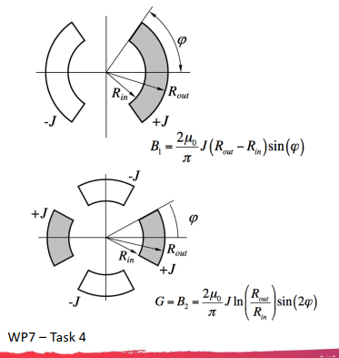
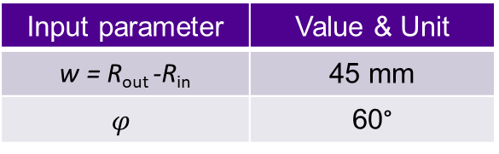
Calculation process and input parameters
Step 1
Step 2
Energy density limit from quench protection
Step 3
Dipole field
Current density
Aperture
Input parameter | Value & Unit
w = R_{out} -R_{in} | 45 mm
$$φ$$ | 60°
Input parameter | Value & Unit
Tmax | 350 K
t_{protdelay} | 40 ms
f_{Cu} | 0.4
f_{SC} | 0.3
f_{Ins} | 0.3
copper RRR | 150
Tcs | 10 K
Bave | Bpeak / 2
Result plot:

Slide 3
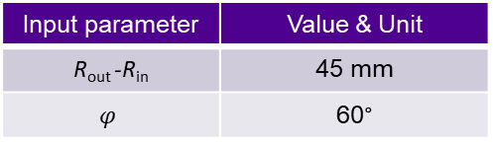
Equations for step 1
Equations from Barbara & Samuele presentation, citing E. Todesco Masterclass:
Result of step 1
Input parameter | Value & Unit
R_{out} -R_{in} | 45 mm
$$φ$$ | 60°

Slide 4
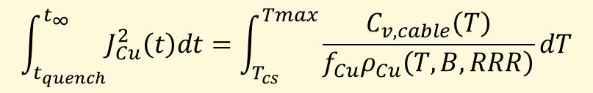
Equations for step 2
Quench
Plateau (t < protection delay): Constant current during quench detection and protection activation
Adiabatic heating at the quenched cable cross-section:
$$J_{Cu}^{2}ρ_{Cu}\left(T,B,RRR\right)f_{Cu}∆t=C_{v,cable}\left(T\right)∆T$$
Magnet current
Decay (t ≥protection delay): Current decay after switchin off the power supply, and bringing all coils resistive
Coil absorbs stored energy
After re-arranging and integrating we get the commonly used quench load equation for hotspot temperature:
Plateau
Decay
$$\int_{t_{quench}}^{t_{∞}}{J_{Cu}^{2}\left(t\right)dt}=\int_{T_{cs}}^{Tmax}{\frac{C_{v,cable}\left(T\right)}{f_{Cu}ρ_{Cu}\left(T,B,RRR\right)}dT}$$
0 t_{det} t_{prot. delay}
Time after spontaneous quench
J_{Cu}: Copper current density (A/m² ), ρ_{Cu}: Copper electrical resistivity of copper (Ωm), which is a function of temperature, T, magnetic field, B, and its residual resistivity ratio, RRR, f_{Cu}: Fraction of copper area in cable cross-section, C_{v,cable}: Volumetric heat capacity of the cable (J/m^{3.}), which is computed based on its material fractions f of copper, Nb3Sn and G10: $C_{v,cable}\left(T\right)=f_{Cu}γ_{Cu}c_{p,cu}\left(T\right)+ f_{Nb_{3}Sn}γ_{Nb_{3}Sn}c_{p,Nb_{3}Sn}\left(T\right)+f_{G10}γ_{G10}c_{p,G10}\left(T\right),$ with the γ_{Cu}, γ_{Nb3Sn} , γ_{G10} are the material-specific mass densities in m³/kg and c_{p}’s the specific heat capacity in J/K/kg.

Slide 5
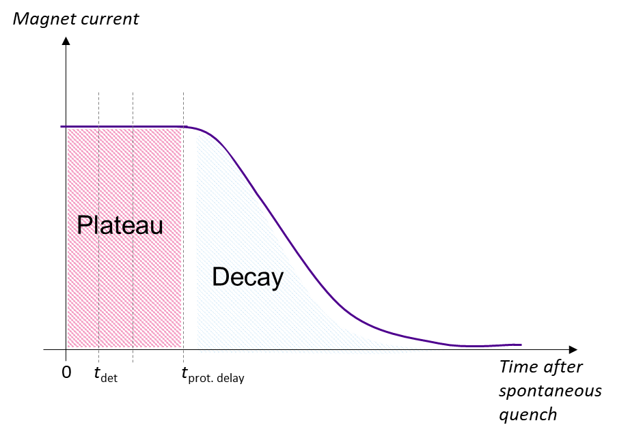
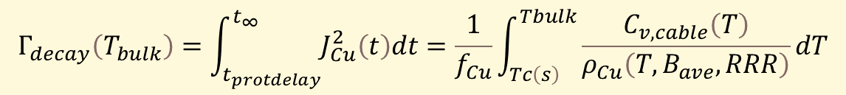
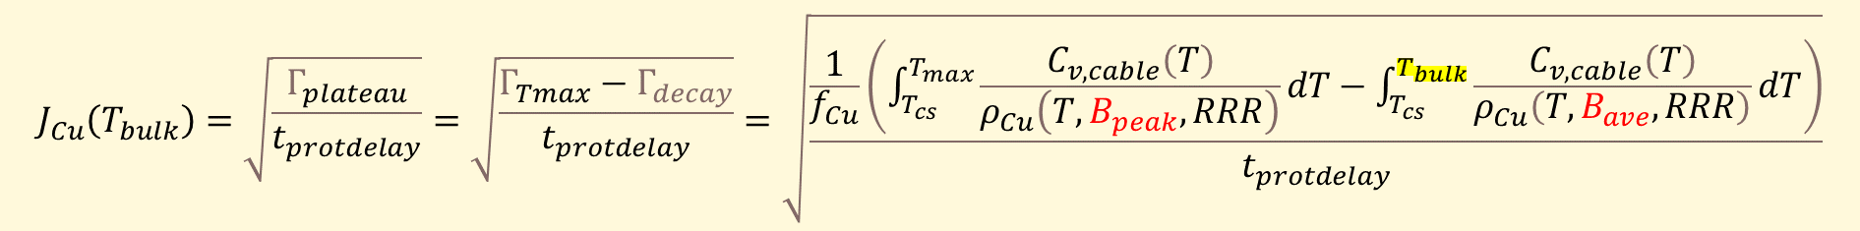

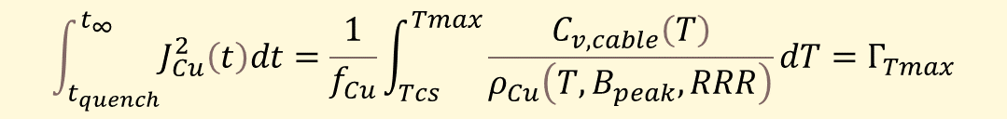


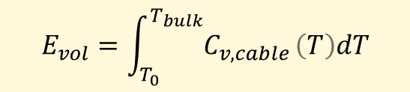
… Equations for step 2
If we fix the maximum allowed hotspot temperature, we can compute the allowed “quench load” $Γ_{Tmax}$:
It can be divided to two parts, reflecting the current decay profile:
If we fix the protection delay, $Γ_{plateau}$becomes trivial:
$Γ_{decay}$is related to average temperature rise in coil that was not heated during plateau:
The average temperature can be obtained from the stored energy density (J/m^3):
We can solve for Jcu:
$$\int_{t_{quench}}^{t_{∞}}{J_{Cu}^{2}\left(t\right)dt}=\frac{1}{f_{Cu}}\int_{Tcs}^{Tmax}{\frac{C_{v,cable}\left(T\right)}{ρ_{Cu}\left(T,B_{peak}, RRR\right)}dT}=Γ_{Tmax}$$
Only hotspot heats up (original quench location)
All coil starts to heat up
$$Γ_{Tmax}=Γ_{plateau}+Γ_{decay}$$
$$Γ_{plateau}=t_{protdelay}J_{Cu}^{2}$$
$$Γ_{decay}\left(T_{bulk}\right)=\int_{t_{protdelay}}^{t_{∞}}{J_{Cu}^{2}\left(t\right)dt}=\frac{1}{f_{Cu}}\int_{Tc\left(s\right)}^{Tbulk}{\frac{C_{v,cable}\left(T\right)}{ρ_{Cu}\left(T,B_{ave},RRR\right)}dT}$$
$$E_{vol}=\int_{T_{0}}^{T_{bulk}}{C_{v,cable }\left(T\right)dT}$$
$$J_{Cu}\left(T_{bulk}\right)=\sqrt{\begin{aligned}&\frac{Γ_{plateau}}{t_{protdelay}} \\ & \end{aligned}}=\sqrt{\begin{aligned}&\frac{Γ_{Tmax}−Γ_{decay}}{t_{protdelay}} \\ & \end{aligned}}=\sqrt{\begin{aligned}&\frac{\frac{1}{f_{Cu}}\left(\int_{T_{cs}}^{T_{max}}{\frac{C_{v,cable}\left(T\right)}{ρ_{Cu}\left(T,B_{peak},RRR\right)}dT}−\int_{T_{cs}}^{T_{bulk}}{\frac{C_{v,cable}\left(T\right)}{ρ_{Cu}\left(T,B_{ave},RRR\right)}dT}\right)}{t_{protdelay}} \\ & \end{aligned}}$$
L. Bottura, Contribution to: WAMSDO 2013, 1-9, e-Print: 1401.3927 [physics.acc-ph],
T. Salmi and D. Schoerling, IEEE TAS 29(4), 2019, doi: 10.1109/TASC.2018.2880340

Slide 6
Result of step 2
Input parameter | Value & Unit | Justification / reference
f_{Cu} | 0.4 | Cable material fractions based on average values of some recent cables designed for Nb3Sn accelerator magnets
f_{SC} | 0.3
f_{Ins} | 0.3
copper RRR | 150
Tmax | 350 K | Ambrosio, WAMSDO 2013
t_{protdelay} | 40 ms | Salmi et al. 2017
Tcs | 10 K
Bave | Bpeak / 2
Copper current density vs. dipole field from step 1
Max volumetric energy density vs. copper current density (Tmax = 350 K)
Max volumetric energy density vs. dipole field (Tmax = 350 K)
ACu = 0.4 * Acoil

Slide 7
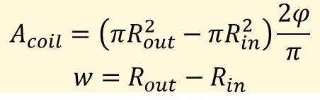
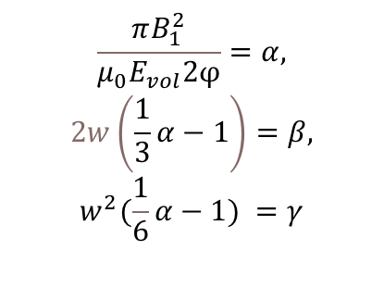
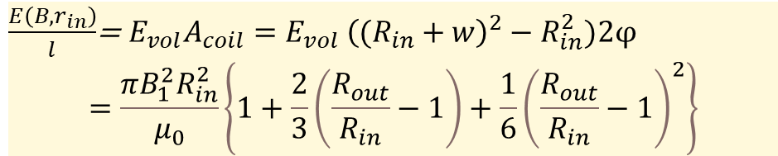
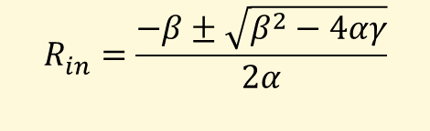
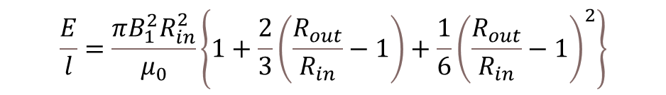
Equations for step 3
Stored energy per unit length, equation from Luca Bottura:
$$\frac{E}{l}=\frac{πB_{1}^{2}R_{in}^{2}}{μ_{0}}\left\{1+\frac{2}{3}\left(\frac{R_{out}}{R_{in}}−1\right)+\frac{1}{6}{\left(\frac{R_{out}}{R_{in}}−1\right)}^{2}\right\}$$
$$A_{coil}=\left({πR}_{out}^{2}−{πR}_{in}^{2}\right)\frac{2φ}{π}$$
$$w=R_{out}^{ }−R_{in}^{ }$$
Stored energy (E) has to match the volumetric energy density (Evol) given by quench protection requirement:
$\frac{E\left(B,r_{in}\right)}{l}$= $E_{vol}A_{coil}={{E_{vol}}_{ }\left((R_{in}+w\right)}^{2}−R_{in}^{2})\text{2}φ$
$$=\frac{πB_{1}^{2}R_{in}^{2}}{μ_{0}}\left\{1+\frac{2}{3}\left(\frac{R_{out}}{R_{in}}−1\right)+\frac{1}{6}{\left(\frac{R_{out}}{R_{in}}−1\right)}^{2}\right\}$$
$$\frac{πB_{1}^{2}}{μ_{0}E_{vol}\text{2}φ}=α,$$
$$2w\left(\frac{1}{3}α−1\right)=β,$$
$$w^{2}({\frac{1}{6}α−1)}^{ }=γ$$
…
$$R_{in}^{ }=\frac{−β±\sqrt{β^{2}−4αγ}}{2α}$$

Slide 8
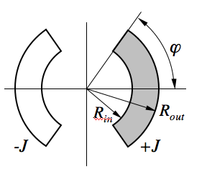
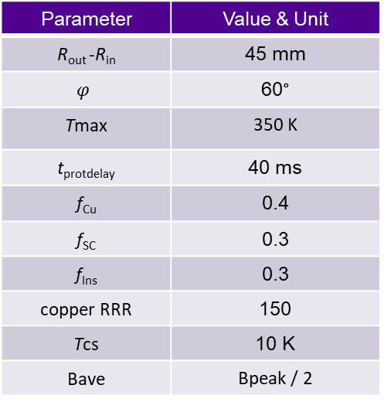
Result of step 3: Aperture vs. dipole field
Aperture = 2*Rin
Reminder of used input parameters:
Parameter | Value & Unit
R_{out} -R_{in} | 45 mm
$$φ$$ | 60°
Tmax | 350 K
t_{protdelay} | 40 ms
f_{Cu} | 0.4
f_{SC} | 0.3
f_{Ins} | 0.3
copper RRR | 150
Tcs | 10 K
Bave | Bpeak / 2

Slide 9
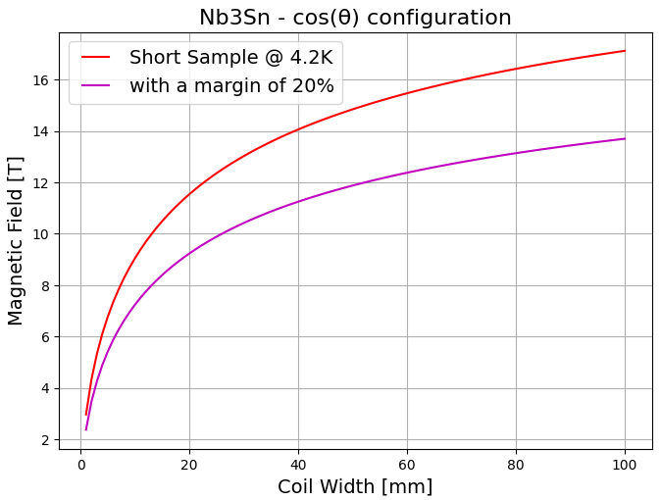
Impact of coil width
Inserting QP induced limit to the picture from Daniel Novelli :
Max aperture vs field for w = 30, 45, and 60 mm
Limit from QP for aperture = 150 mm
w = 30 mm → B1 = 10 T
w = 45 mm
→ B1 = 13.5 T
w = 60 mm
→ B1 = 16 T
R_{in} = 75 mm
w = 30 mm
Quench protection seems to be a limiting factor for coils with w < 30 mm, for thicker coils the limit comes from critical current density
→ When designing compact high current density/high energy density magnets, estimating the limits from QP very important

Slide 10
Strong increase of current density and stored energy density for coil w < 30 mm
J ∞ 1/w

Slide 11
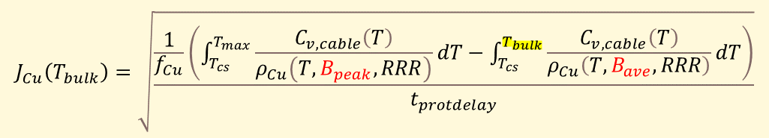
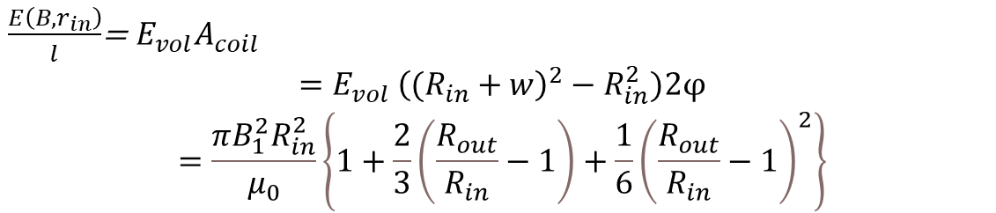
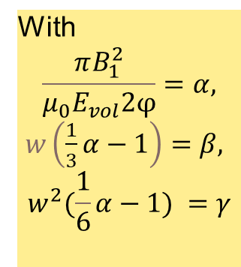


Summary of equations…
Step 3. Aperture vs stored energy density:
$\frac{E\left(B,r_{in}\right)}{l}$= $E_{vol}A_{coil}$
$$={{E_{vol}}_{ }\left((R_{in}+w\right)}^{2}−R_{in}^{2})\text{2}φ$$
$$=\frac{πB_{1}^{2}R_{in}^{2}}{μ_{0}}\left\{1+\frac{2}{3}\left(\frac{R_{out}}{R_{in}}−1\right)+\frac{1}{6}{\left(\frac{R_{out}}{R_{in}}−1\right)}^{2}\right\}$$
Step 1: Current density vs. dipole field:
With
$$\frac{πB_{1}^{2}}{μ_{0}E_{vol}\text{2}φ}=α,$$
$w\left(\frac{1}{3}α−1\right)=β,$
$$w^{2}({\frac{1}{6}α−1)}^{ }=γ$$
$$R_{in}^{ }=\frac{−β±\sqrt{β^{2}−4αγ}}{2α}$$
Step 2. Maximum energy density vs. current density:
$$J_{Cu}\left(T_{bulk}\right)=\sqrt{\begin{aligned}&\frac{\frac{1}{f_{Cu}}\left(\int_{T_{cs}}^{T_{max}}{\frac{C_{v,cable}\left(T\right)}{ρ_{Cu}\left(T,B_{peak},RRR\right)}dT}−\int_{T_{cs}}^{T_{bulk}}{\frac{C_{v,cable}\left(T\right)}{ρ_{Cu}\left(T,B_{ave},RRR\right)}dT}\right)}{t_{protdelay}} \\ & \end{aligned}}$$
$$E_{vol}=\int_{T_{0}}^{T_{bulk}}{C_{v,cable }\left(T\right)dT}$$
Aperture vs. dipole field!
with

Slide 12
Next steps
Nb₃Sn quadrupole
NbTi dipole and quadrupole
HTS magnets, insulated
HTS magnets, non-insulated…

Slide 13
Some more analysis

Slide 14
Examples of Jcu vs Estored in other magnets
Input parameter | Value & Unit | Justification / reference
f_{Cu} | 0.4 | Cable material fractions based on average values of some recent cables designed for Nb3Sn accelerator magnets
f_{SC} | 0.3
f_{Ins} | 0.3
copper RRR | 150
Tmax | 350 K | Ambrosio, WAMSDO 2013
t_{protdelay} | 40 ms | Salmi et al. 2017
Tcs | 10 K
Bave | Bpeak / 2

Slide 15
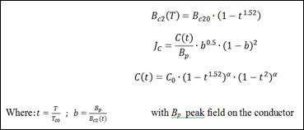
Additional analyses
Taking into account Nb3Sn critical current
Limit at 16 T for non-graded coil if SC fraction of cable is 0.3 and w = 45 mm
Jc fit by Bernardo Bordini, CERN
"Agressive parameters", based on Davide's email Oct 29, 2015
Tc0 (K) | 16
Bc20 (T) | 29.38
alpha | 0.96
C0 (A/mm^2T) | 267845

Slide 16
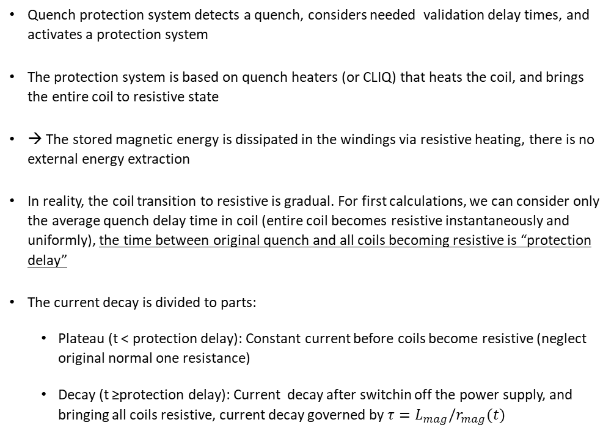
Assumed current decay profile after quench
Quench protection system detects a quench, considers needed validation delay times, and activates a protection system
The protection system is based on quench heaters (or CLIQ) that heats the coil, and brings the entire coil to resistive state
→ The stored magnetic energy is dissipated in the windings via resistive heating, there is no external energy extraction
In reality, the coil transition to resistive is gradual. For first calculations, we can consider only the average quench delay time in coil (entire coil becomes resistive instantaneously and uniformly), the time between original quench and all coils becoming resistive is “protection delay”
The current decay is divided to parts:
  Plateau (t < protection delay): Constant current before coils become resistive (neglect original normal one resistance)
  Decay (t ≥protection delay): Current decay after switchin off the power supply, and bringing all coils resistive, current decay governed by $τ=L_{mag}/r_{mag}(t)$
Magnet current
Plateau
Decay
0 t_{det} t_{prot. delay}
Time after spontaneous quench

