Slide 1
Benchmark on MUC magnetic field calculation
Update
27/04/2023
Daniele Calzolari, Jose Lorenzo and Pietro Testoni

Slide 2
Outline
On 16th of March we made a first presentation on:
Geometry of the tapering and chicane coils implemented
Spatial components of the magnetic field computed along three paths of points (one path along the coils axis and two oblique off axis paths)
Three different numerical codes (ANSYS, Current-loop approximation, Daniele C++ code) used to run the simulations
Four sets of data computed among the three codes and compared
Today we update (from slide 14) the presentation with:
Comparison of magnetic field computed along the perimeter of coil # 2
Conclusions

Slide 3
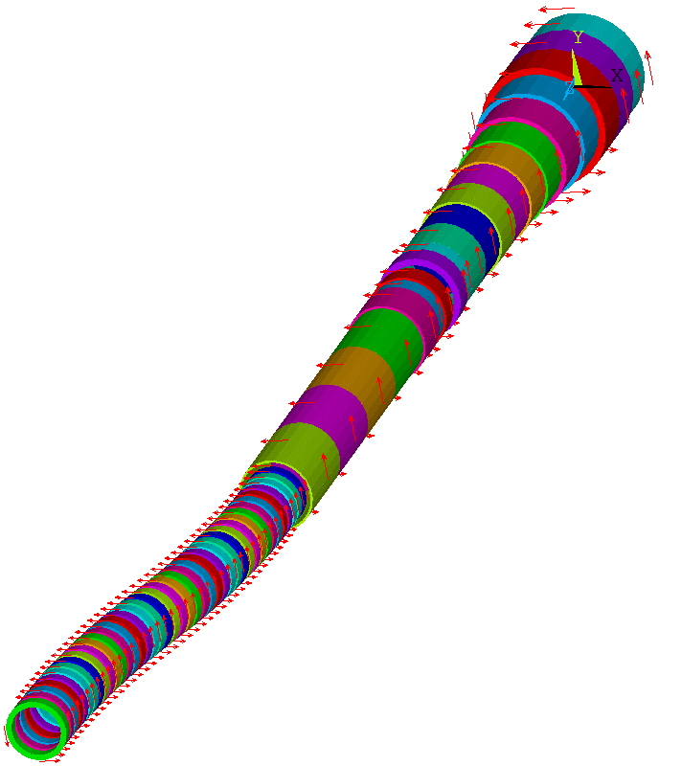
Geometry
Tapering Coil # | Rc(m) | Zc(m) | DR(m) | DZ(m) | NR | NZ | I(A)
1 | 0.820 | -0.200 | 0.440 | 0.800 | 11 | 20 | 60563
2 | 0.840 | 0.600 | 0.480 | 0.800 | 12 | 20 | 60706
3 | 0.840 | 1.400 | 0.480 | 0.800 | 12 | 20 | 62848
4 | 0.780 | 2.200 | 0.360 | 0.800 | 9 | 20 | 58407
5 | 0.740 | 3.000 | 0.280 | 0.800 | 7 | 20 | 54433
6 | 0.700 | 3.800 | 0.200 | 0.800 | 5 | 20 | 54360
7 | 0.680 | 4.600 | 0.160 | 0.800 | 4 | 20 | 52688
8 | 0.660 | 5.400 | 0.120 | 0.800 | 3 | 20 | 54305
9 | 0.660 | 6.200 | 0.120 | 0.800 | 3 | 20 | 45720
10 | 0.640 | 7.000 | 0.080 | 0.800 | 2 | 20 | 54713
11 | 0.640 | 7.800 | 0.080 | 0.800 | 2 | 20 | 49427
12 | 0.640 | 8.400 | 0.080 | 0.400 | 2 | 10 | 30671
13 | 0.660 | 8.800 | 0.120 | 0.400 | 3 | 10 | 44273
14 | 0.640 | 9.500 | 0.080 | 0.400 | 2 | 10 | 57945
15 | 0.620 | 9.900 | 0.040 | 0.400 | 1 | 10 | 47690
16 | 0.640 | 10.500 | 0.080 | 0.800 | 2 | 20 | 34741
17 | 0.620 | 11.700 | 0.040 | 1.600 | 1 | 40 | 56598
18 | 0.620 | 13.300 | 0.040 | 1.600 | 1 | 40 | 50989
19 | 0.620 | 14.900 | 0.040 | 1.600 | 1 | 40 | 48182
20 | 0.620 | 16.500 | 0.040 | 1.600 | 1 | 40 | 50161
41 Chicane coils:
Inner radius: 430 mm
Outer radius: 530 mm
Length: 180 mm
Current Density: 16.57 A/mm2
Placed at 0.625 deg intervals (250 mm in s)
Parameters assumed in C. Rogers past simulations

Slide 4
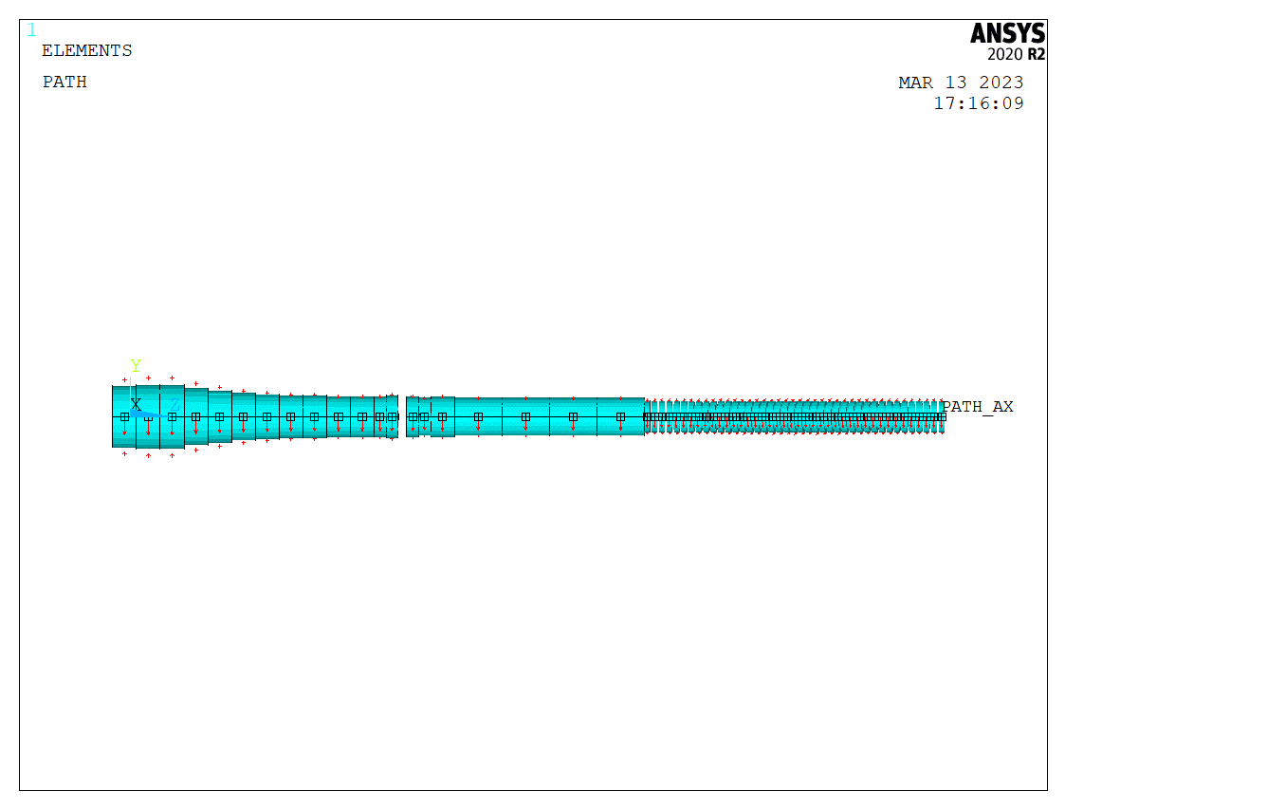
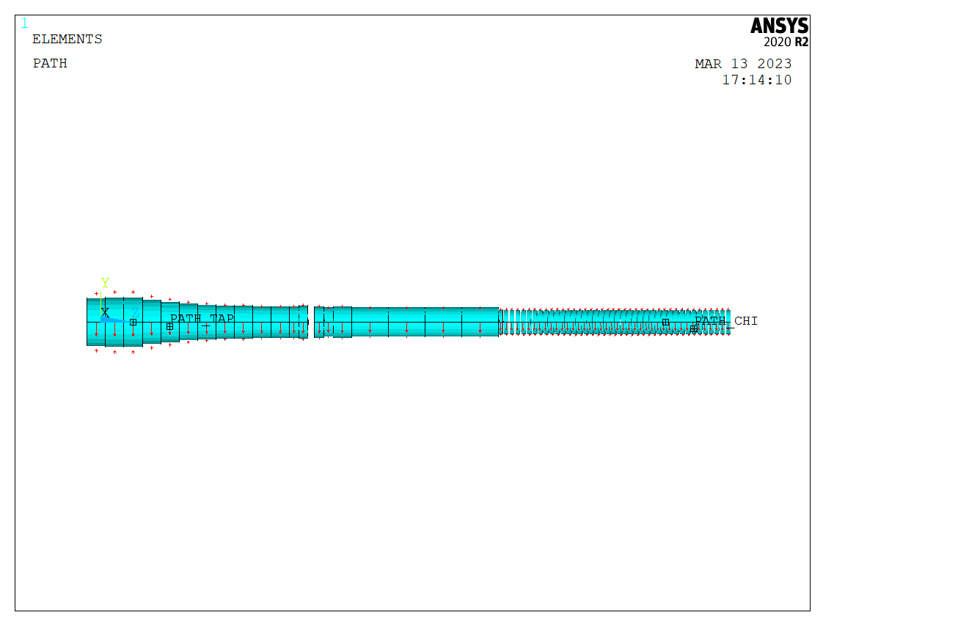
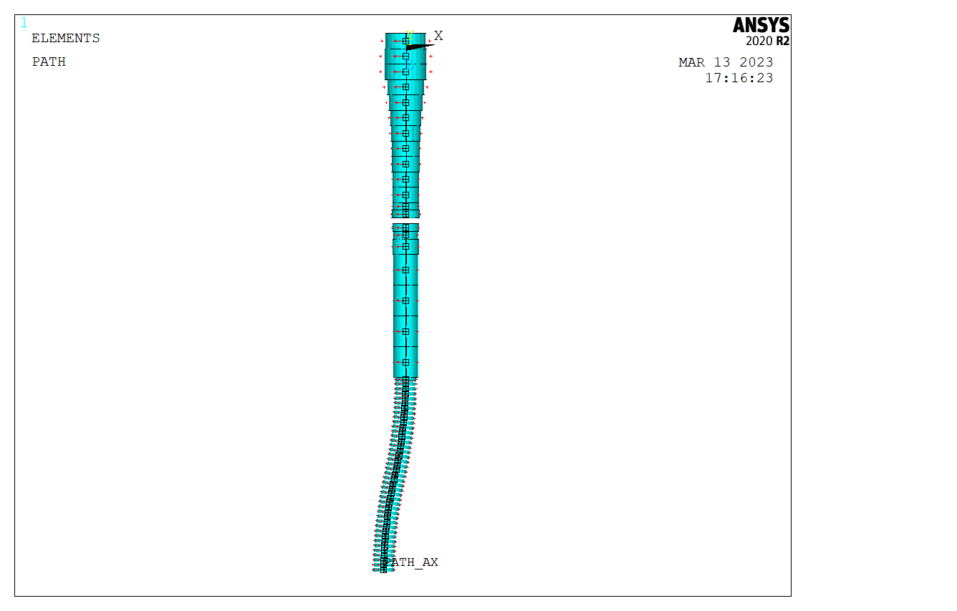
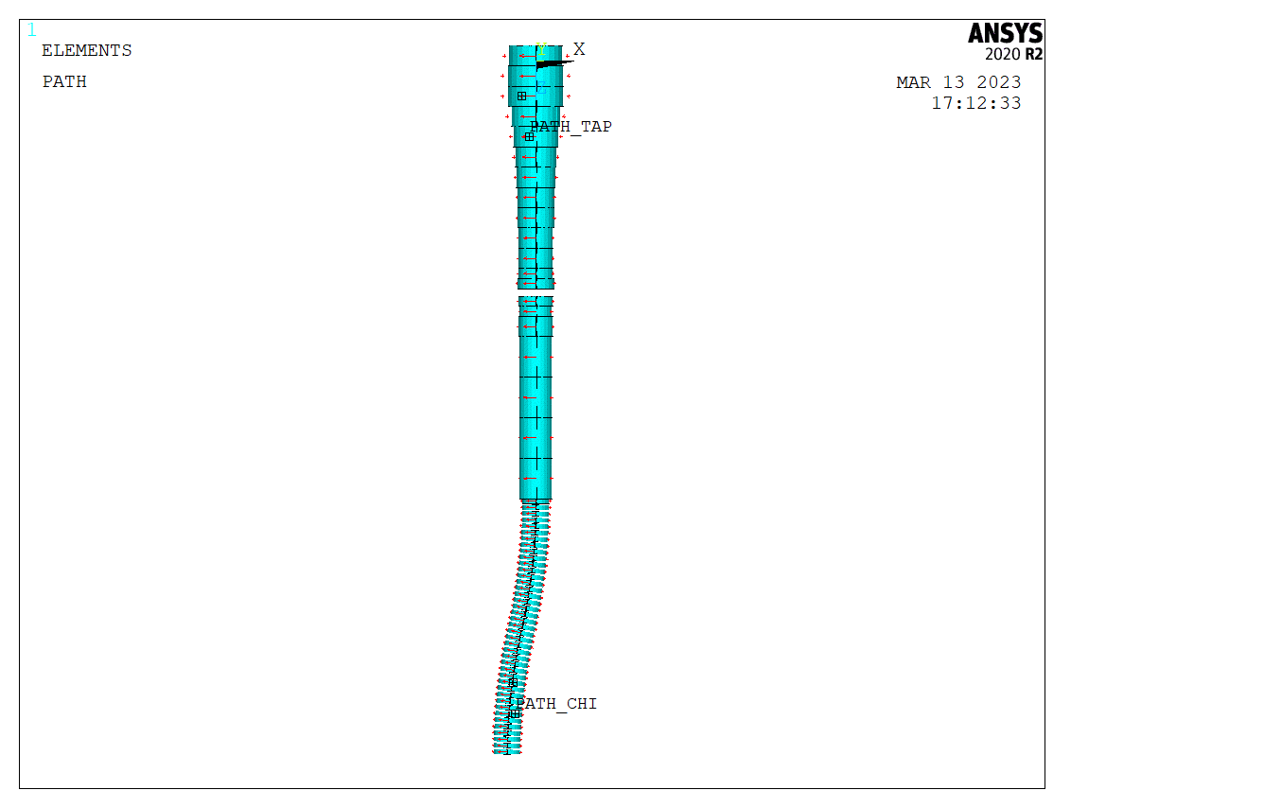
Paths of points to compute the magnetic field
In axis path
Two off axis paths
Y
Y
Z
Z
X
X
Z
Z

Slide 5
Numerical codes: ANSYS
ANSYS in the case of magnetostatic and linear problems implements a formulation based on the integration of the Biot Savart law *
It uses a primitive (meshless) current carrying elements (SOURC36)
Magnetic field can be computed either directly at specific locations or by a finite element mesh made of SOLID96 elements
*Biot-Savart Integration for Bars and Arcs, Miklos Gyimesi et al. IEEE TRANSACTIONS ON MAGNETICS,V OL. 29. NO. 6. NOVEMBER 1993

Slide 6
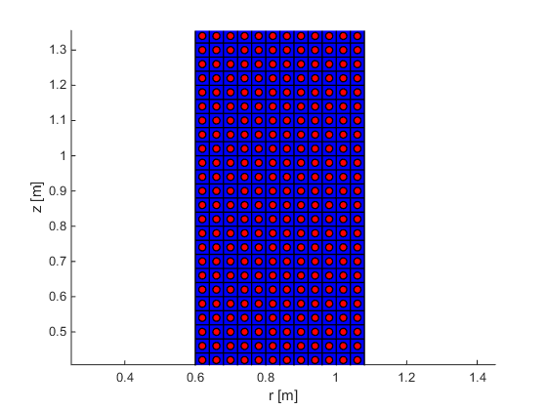
Numerical codes: Current-loop approximation
Based on the well-known analytical solution of the magnetic field produced by a current-carrying ring with infinitely small cross section.
The solution diverges at the source points (fine as long as we are not interested in the field inside the coil).
Each coil is sub-divided in several loops in radial and vertical directions.
Each loop is characterized by its radius, center position, direction cosines of axis, and current.
Straightforward computation of net vertical forces if concentric non-tilted coils.

Slide 7
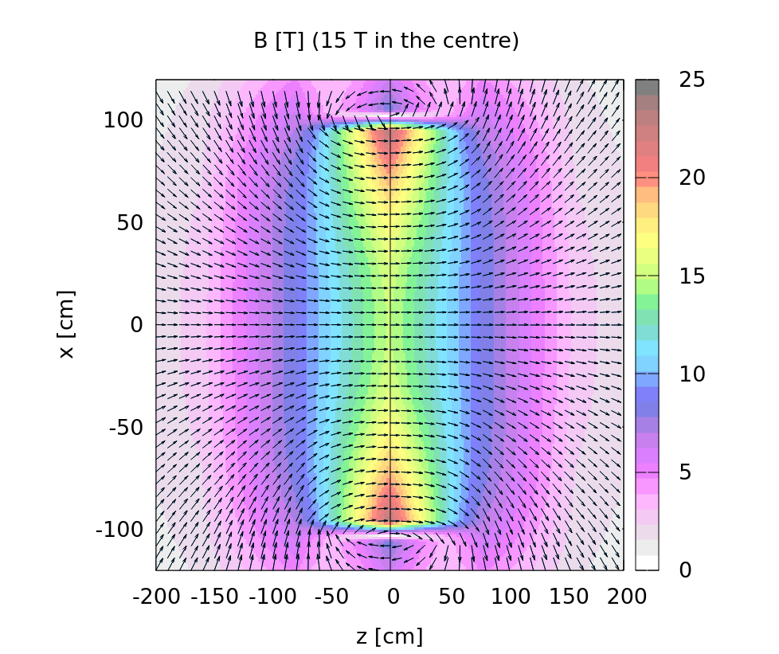
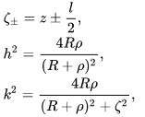
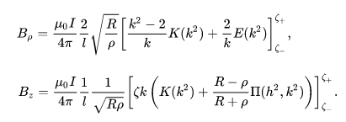
Numerical codes: Daniele
The C++ code provides a numerical integration of the Biot Savart law.
The code has been written ~1 year ago. It was a quick attempt to have a realistic magnetic field to set up simulation.
Magnetic field can be computed either directly at specific locations or on a cartesian mesh.
Evaluation of the magnetic field of a single coil
Requires the evaluation of elliptic integrals

Slide 8
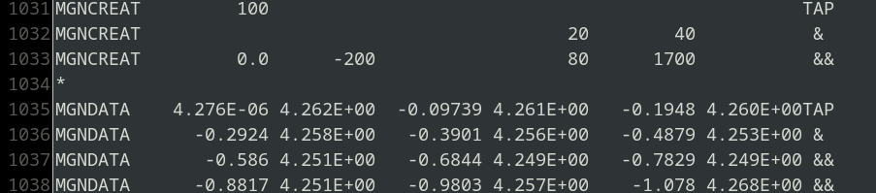
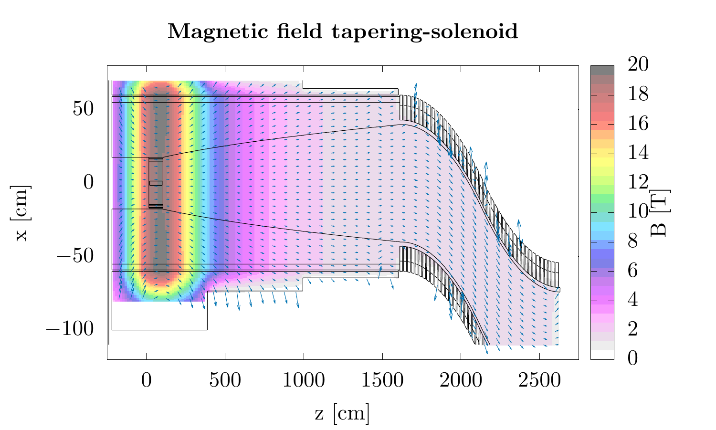
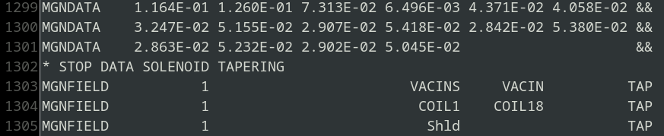
Results to FLUKA
Magnetic fields can be implemented in FLUKA via dedicated user routines or magnetic cards.
Using the magnetic cards is less error prone and (in general) the preferred approach.
It is possible to have 3D cartesian meshes or 2D when dealing with cylindrical symmetry.
Actual snapshot from the FLUKA inputfile.
…
Magnetic field as read by FLUKA

Slide 9
Sets of data
  in axis points with tapering and chicane coils ON
  in axis points with only chicane coils ON
  off axis points in the tapering region with tapering and chicane coils ON
  off axis points in the chicane region with tapering and chicane coils ON

Slide 10
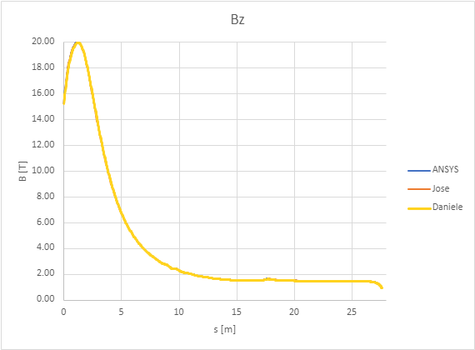
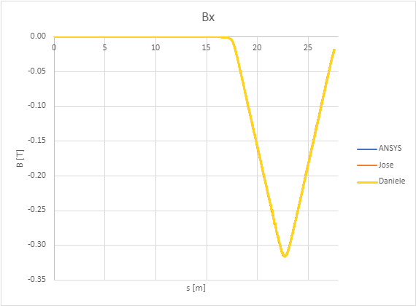
Results: in axis point with tapering and chicane coils ON

Slide 11
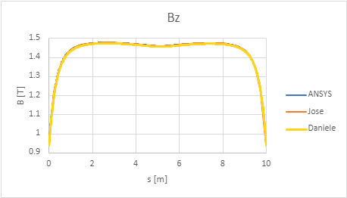
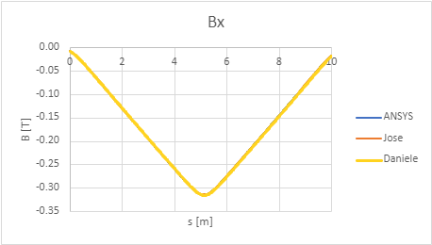
Results: in axis point with only chicane coils ON

Slide 12
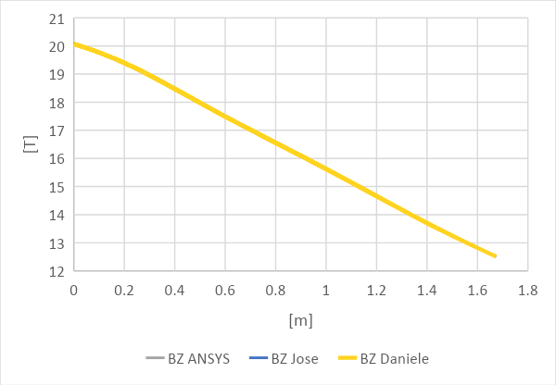
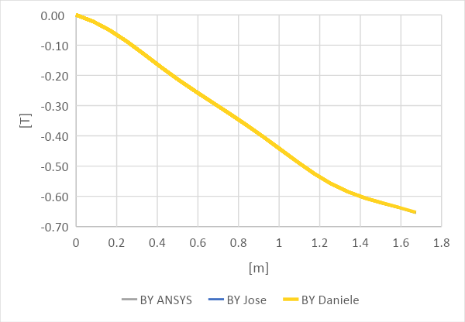
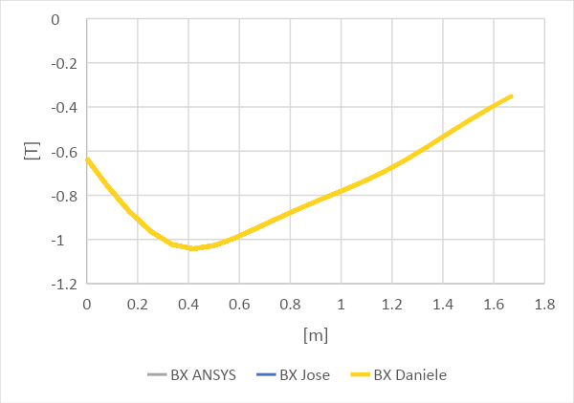
Results: off axis point in the tapering region

Slide 13
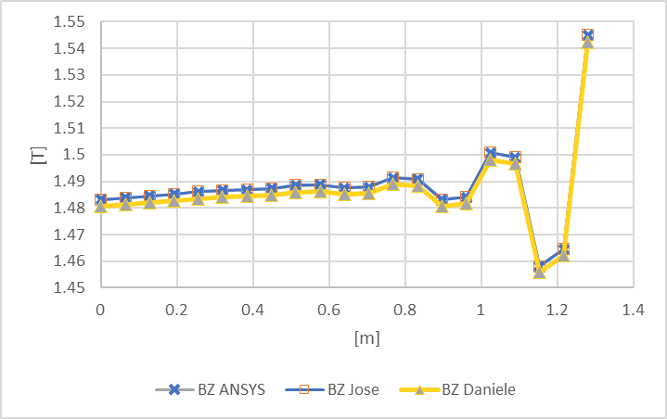
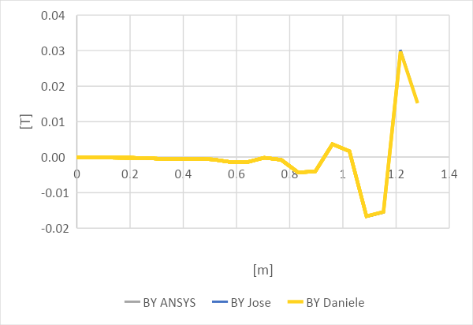
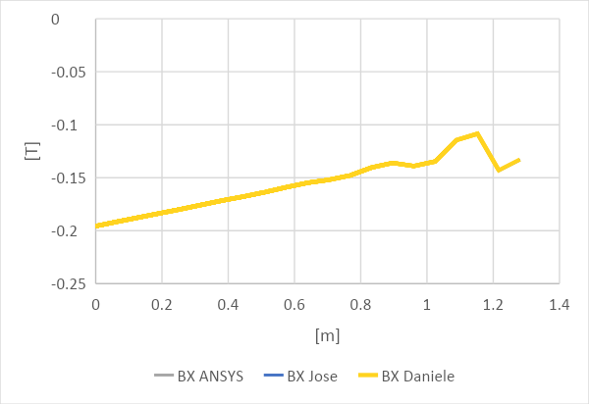
Results: off axis point in the chicane region

Slide 14
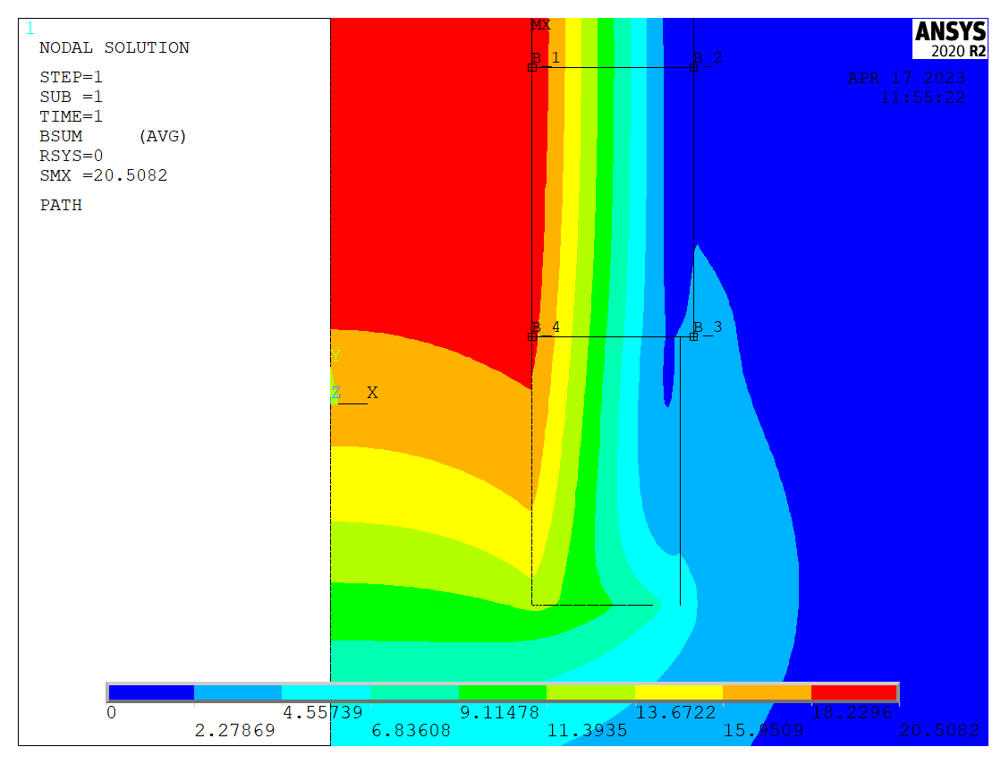
Geometry
Tapering Coil # | Rc(m) | Zc(m) | DR(m) | DZ(m) | NR | NZ | I(A)
1 | 0.820 | -0.200 | 0.440 | 0.800 | 11 | 20 | 60563
2 | 0.840 | 0.600 | 0.480 | 0.800 | 12 | 20 | 60706
3 | 0.840 | 1.400 | 0.480 | 0.800 | 12 | 20 | 62848
4 | 0.780 | 2.200 | 0.360 | 0.800 | 9 | 20 | 58407
5 | 0.740 | 3.000 | 0.280 | 0.800 | 7 | 20 | 54433
6 | 0.700 | 3.800 | 0.200 | 0.800 | 5 | 20 | 54360
7 | 0.680 | 4.600 | 0.160 | 0.800 | 4 | 20 | 52688
8 | 0.660 | 5.400 | 0.120 | 0.800 | 3 | 20 | 54305
9 | 0.660 | 6.200 | 0.120 | 0.800 | 3 | 20 | 45720
10 | 0.640 | 7.000 | 0.080 | 0.800 | 2 | 20 | 54713
11 | 0.640 | 7.800 | 0.080 | 0.800 | 2 | 20 | 49427
12 | 0.640 | 8.400 | 0.080 | 0.400 | 2 | 10 | 30671
13 | 0.660 | 8.800 | 0.120 | 0.400 | 3 | 10 | 44273
14 | 0.640 | 9.500 | 0.080 | 0.400 | 2 | 10 | 57945
15 | 0.620 | 9.900 | 0.040 | 0.400 | 1 | 10 | 47690
16 | 0.640 | 10.500 | 0.080 | 0.800 | 2 | 20 | 34741
17 | 0.620 | 11.700 | 0.040 | 1.600 | 1 | 40 | 56598
18 | 0.620 | 13.300 | 0.040 | 1.600 | 1 | 40 | 50989
19 | 0.620 | 14.900 | 0.040 | 1.600 | 1 | 40 | 48182
20 | 0.620 | 16.500 | 0.040 | 1.600 | 1 | 40 | 50161
path2
path1
path3
path4
  We have computed the two components of the magnetic field along the perimeter of coil #2 which is divided in four paths. In these simulations the chicane coils are not considered.
  Each path has 20 subdivisions, therefore the field is computed in 80 points in total

Slide 15
Numerical codes
Three different numerical codes (ANSYS, Current-loop approximation, Daniele C++ code) used to run the simulations
On top of that also the 2D ANSYS magnetic vector potential formulation implemented by the PLANE 13 element has been used
The current loop approximation has been run with two different settings:
  NR*NZ turns in each coil.
  (4*NR)*(4*NZ) turns in each coil.
  Singularity at source point is overcome by skipping the contribution of that source point
Daniele C++ code has been run with
  600 layers per magnet
  Singularity is overcome by zero contribution from the radial element located in the point (i.e. the magnetic field inside the infinitesimal element is given by all the others).

Slide 16
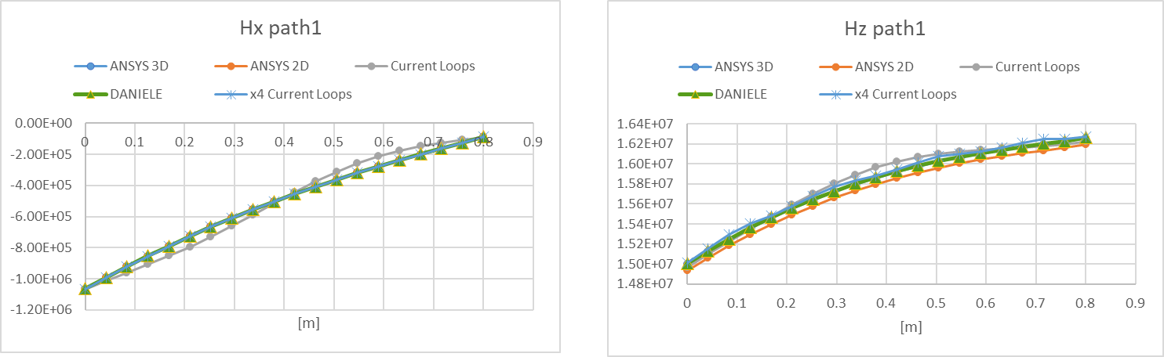
Results comparison along path 1
path1

Slide 17
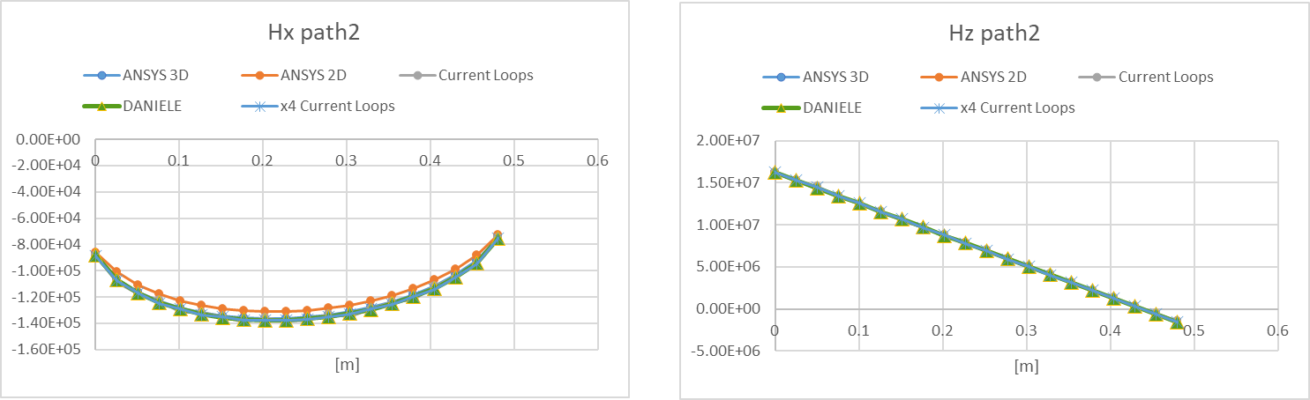
Results comparison along path 2
path2

Slide 18
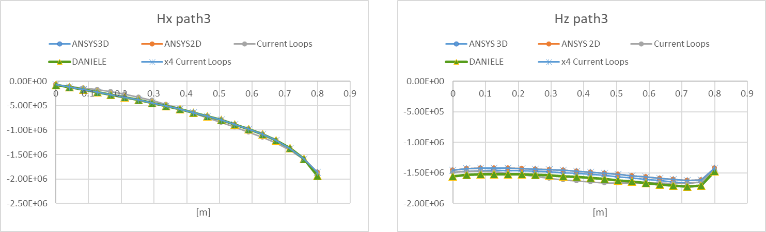
Results comparison along path 3
path3

Slide 19
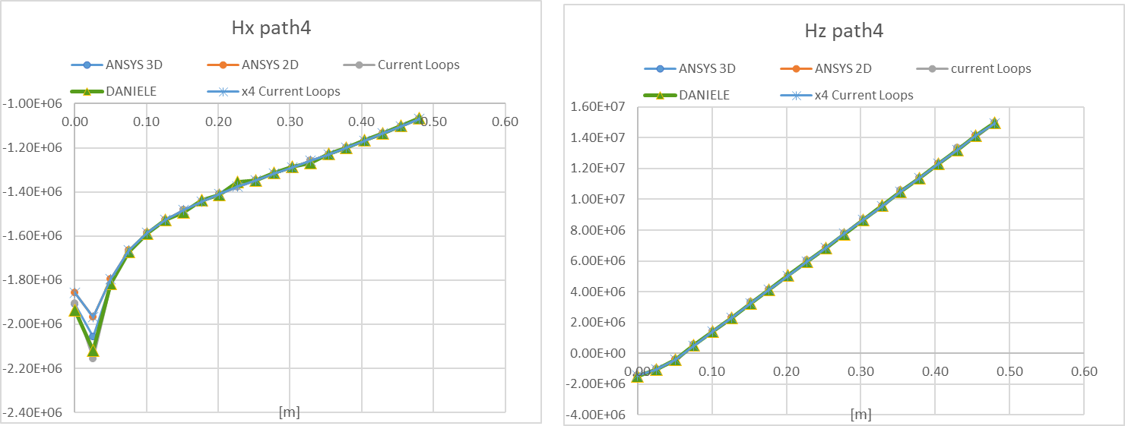
Results comparison along path 4
path4

Slide 20
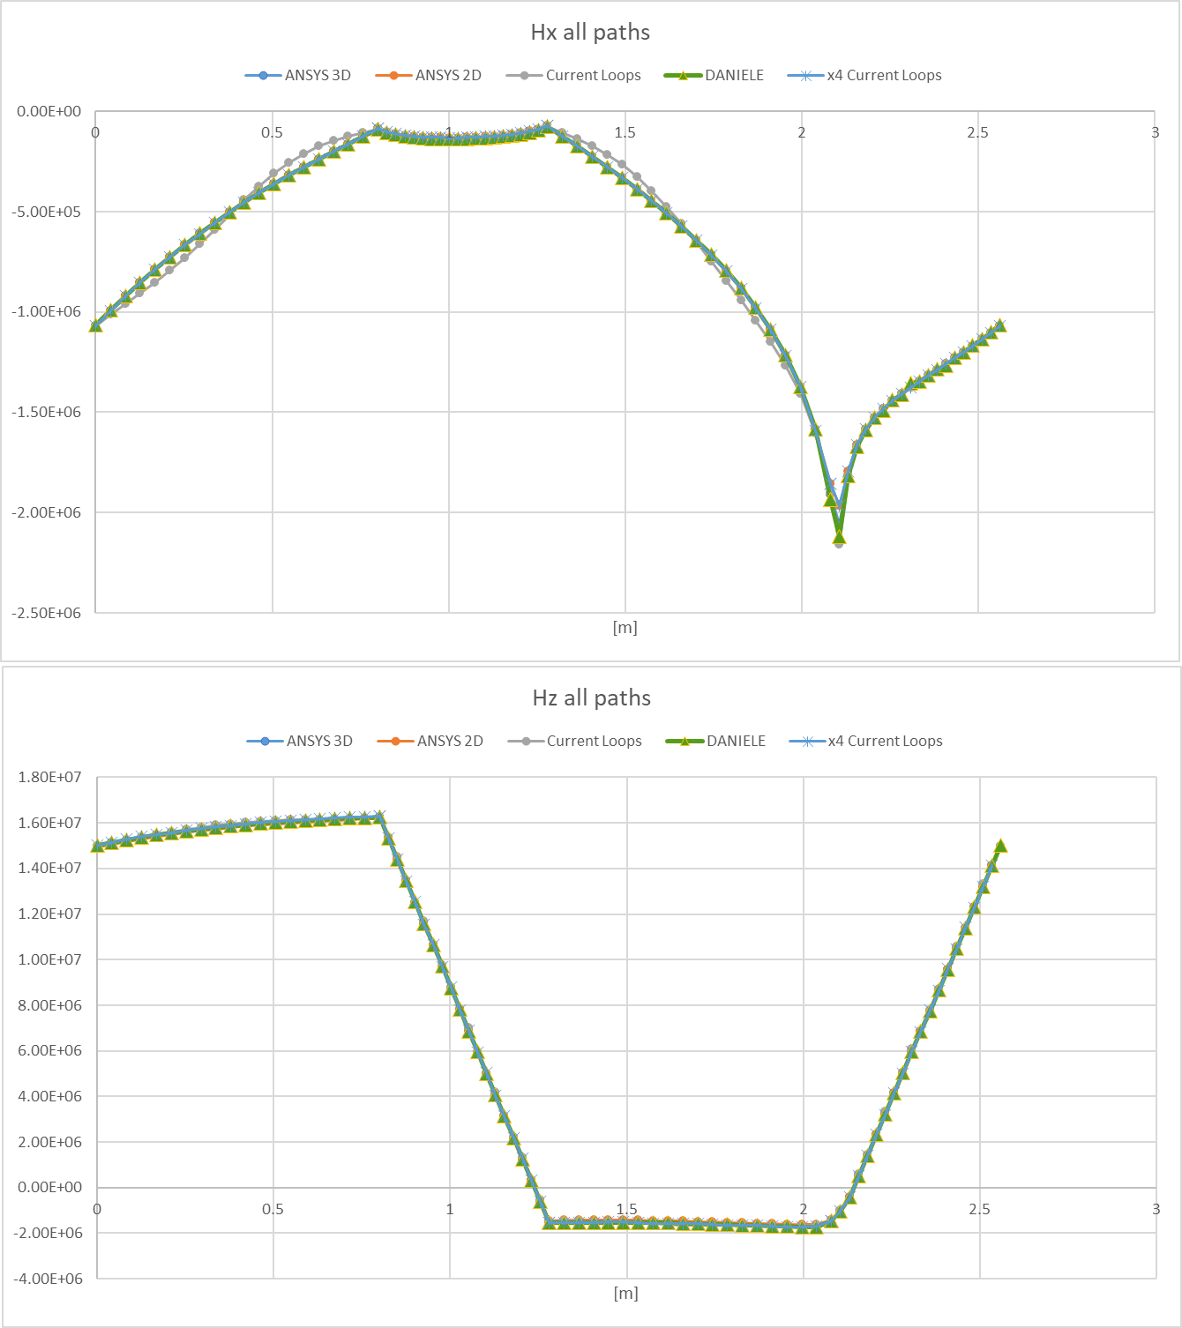
Results comparison along all paths

Slide 21
Conclusions
A benchmark exercise has been implemented to validate three different numerical codes used for the design of the MUC
The three components of the magnetic field have been compared along four different paths
The benchmark outcome shows that the three codes provide results in a good agreement
Final remark: the current assumption of the tapering field follows the inverse cubic field from past MAP studies. Deviation from this function are fine as long as the magnetic field decrease is adiabatic.
A further benchmark exercise has been studied, comparing the magnetic field along the perimeter of coil #2. Also in this case we can state that the codes used show a good agreement with the computed results

