Slide 1
Mechanical Analysis of HTS Forced-Flow Cooled Cable for the Target Solenoid
J. Lorenzo, A. Portone, P. Testoni (F4E Barcelona)
In collaboration with C. Accettura, L. Bottura, A. Kolehmainen (CERN)
01/06/2023

Slide 2
Outline
Introduction
Analysis Strategy
Stresses in HTS Tapes
Conclusions
Structural Design Criteria & Assessment (backup)

Slide 3
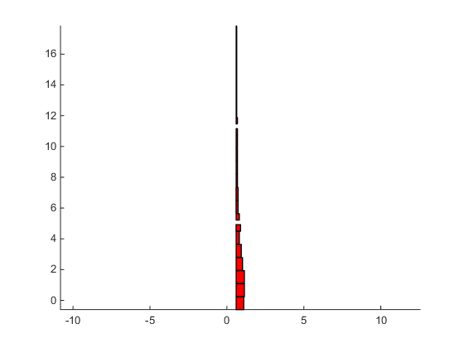
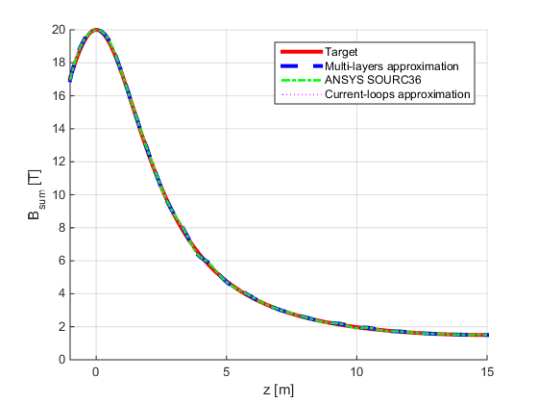

Introduction: HTS-based Target Solenoid
Scope
Mechanical assessment of the proposed HTS design for the Target Solenoid following the Structural Design Criteria for ITER Magnets (ITER MSDC).
Reference field (H. K. Sayed and J. S. Berg, 2014):
Coil | Rc [m] | Zc [m] | DR [m] | DZ [m] | NR | NZ | I [A] | It [MAt]
1 | 0.849 | -0.185 | 0.498 | 0.830 | 12 | 20 | 58905 | 14.137
2 | 0.870 | 0.665 | 0.540 | 0.830 | 13 | 20 | 60710 | 15.785
3 | 0.870 | 1.515 | 0.540 | 0.830 | 13 | 20 | 60392 | 15.702
4 | 0.808 | 2.365 | 0.415 | 0.830 | 10 | 20 | 51654 | 10.331
5 | 0.766 | 3.215 | 0.332 | 0.830 | 8 | 20 | 47469 | 7.595
6 | 0.704 | 4.065 | 0.208 | 0.830 | 5 | 20 | 46504 | 4.650
7 | 0.745 | 4.708 | 0.291 | 0.415 | 7 | 10 | 46293 | 3.240
8 | 0.704 | 5.423 | 0.208 | 0.415 | 5 | 10 | 53168 | 2.658
9 | 0.662 | 6.065 | 0.125 | 0.830 | 3 | 20 | 43280 | 2.597
10 | 0.662 | 6.915 | 0.125 | 0.830 | 3 | 20 | 42146 | 2.529
11 | 0.642 | 7.765 | 0.083 | 0.830 | 2 | 20 | 49452 | 1.978
12 | 0.642 | 8.615 | 0.083 | 0.830 | 2 | 20 | 44183 | 1.767
13 | 0.642 | 9.465 | 0.083 | 0.830 | 2 | 20 | 39567 | 1.583
14 | 0.642 | 10.315 | 0.083 | 0.830 | 2 | 20 | 32713 | 1.309
15 | 0.642 | 10.958 | 0.083 | 0.415 | 2 | 10 | 46717 | 0.934
16 | 0.642 | 11.673 | 0.083 | 0.415 | 2 | 10 | 45905 | 0.918
17 | 0.621 | 12.315 | 0.042 | 0.830 | 1 | 20 | 52310 | 1.046
18 | 0.621 | 13.165 | 0.042 | 0.830 | 1 | 20 | 56056 | 1.121
19 | 0.621 | 14.015 | 0.042 | 0.830 | 1 | 20 | 51602 | 1.032
20 | 0.621 | 14.865 | 0.042 | 0.830 | 1 | 20 | 51376 | 1.028
21 | 0.621 | 15.715 | 0.042 | 0.830 | 1 | 20 | 50471 | 1.009
22 | 0.621 | 16.565 | 0.042 | 0.830 | 1 | 20 | 52861 | 1.057
23 | 0.621 | 17.415 | 0.042 | 0.830 | 1 | 20 | 57438 | 1.149
$$B_{z}=\frac{B_{i}B_{f}L_{t}^{3}}{B_{i}z^{2}\left(2L_{t}−2z\right)+B_{f}{\left(L_{t}−z\right)}^{2}\left(2z+L_{t}\right)}$$
B_{i} = 20 T, B_{f} = 1.5 T, L_{t} = 15 m, -1 m < z < 15 m
Coil 23
Coil 1

Slide 4
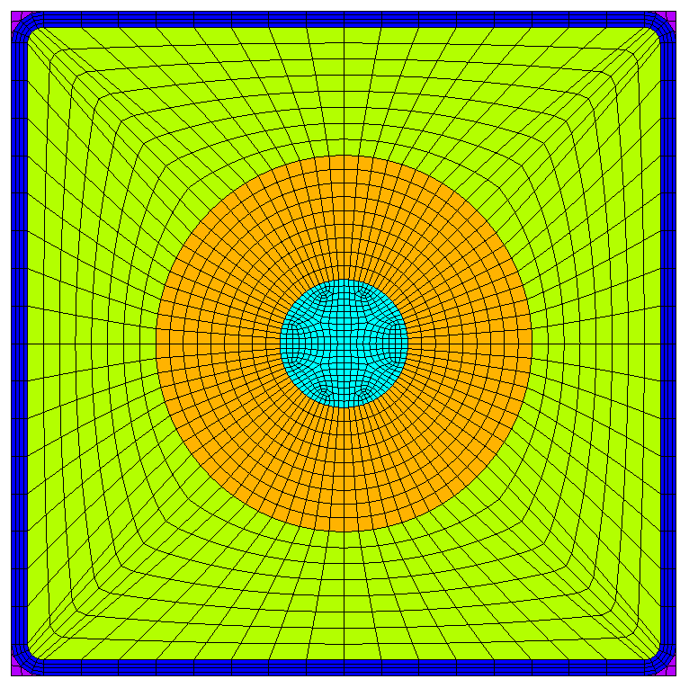
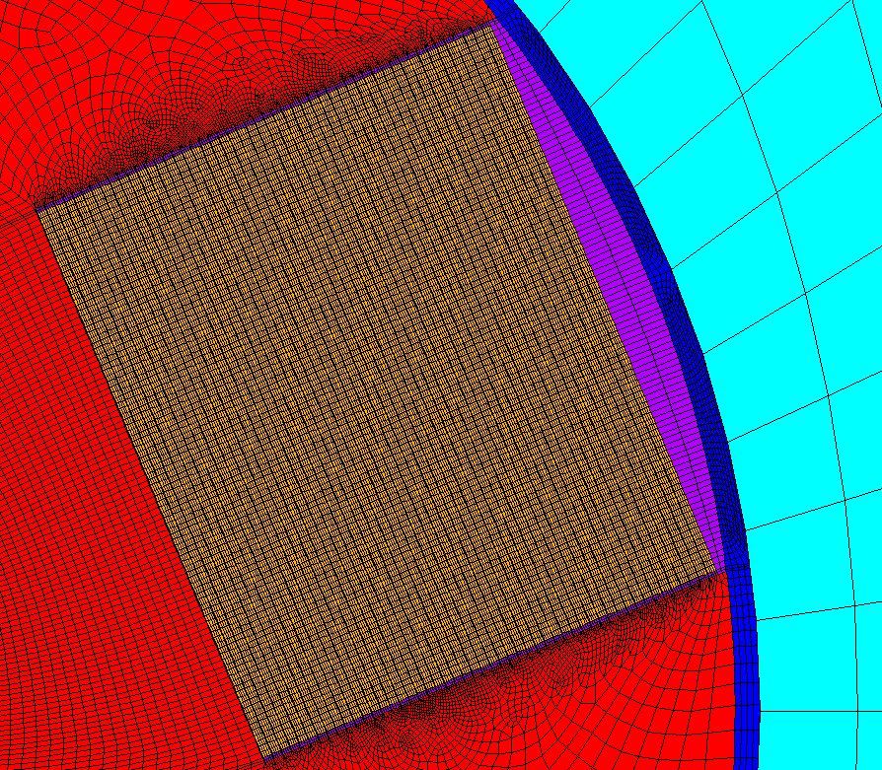
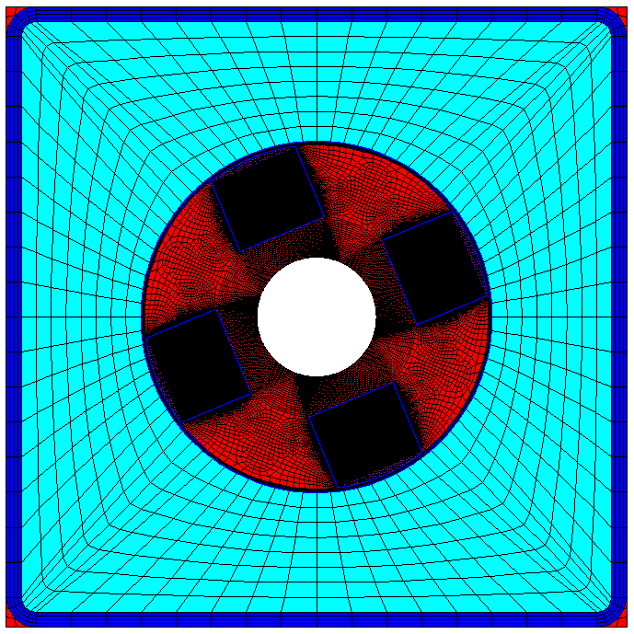
Introduction: Conductor
Conductor features
  Diameter of central cooling channel = 8 mm.
  Cable diameter = 23.5 mm.
  Square steel jacket 39.5 mm x 39.5 mm (minimum thickness of 8 mm).
  1 mm thick turn insulation.
Cable features (parametric studies, 50 tapes/stack)
  Bonded/frictional stack-former contact.
  3/4/6/8 stacks of HTS tapes.
  3/4/6 mm wide HTS tapes.
HTS tape features (90 um thickness)
  44 um thick Hastelloy.
  20 um thick copper layers (x2).
  2 um thick silver layers (x2).
  1.6 um REBCO layer.
  0.4 um buffer layer.
Cooling Channel
Cable
Jacket
Void Filler
Turn Insulation
Steel Wrap
Copper Former
Solder
HTS Stack

Slide 5
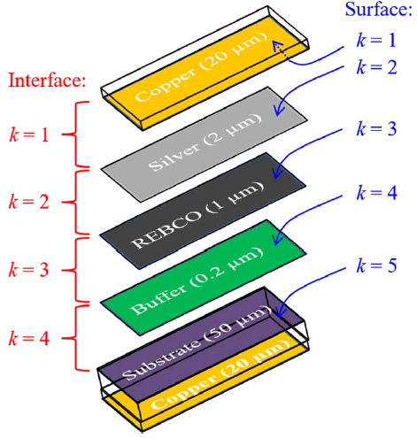
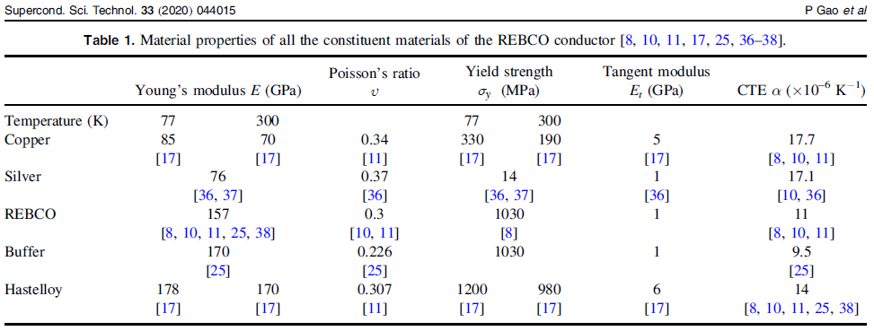
Introduction: Material Properties
 | Steel | Copper | Insulation | Filler | WP (smeared) | Solder | HTS Tape (smeared)
E_{x} [GPa] | 205 | 110 | 12 | 7 | 112 | 10 | 100
E_{y} [GPa] | 205 | 110 | 20 | 7 | 112 | 10 | 121
E_{z} [GPa] | 205 | 110 | 20 | 7 | 160 | 10 | 132
ν_{xy} [] | 0.29 | 0.33 | 0.33 | 0.3 | 0.25 | 0.33 | 0.25
ν_{xz} [] | 0.29 | 0.33 | 0.33 | 0.3 | 0.21 | 0.33 | 0.24
ν_{yz} [] | 0.29 | 0.33 | 0.17 | 0.3 | 0.21 | 0.33 | 0.30
G_{xy} [GPa] | 79 | 41 | 6 | 3 | 31 | 4 | 37
G_{xz} [GPa] | 79 | 41 | 6 | 3 | 42 | 4 | 46
G_{yz} [GPa] | 79 | 41 | 6 | 3 | 42 | 4 | 43
Properties of HTS tape obtained from smearing of isotropic properties of individual components at 77 K.
P. GAO, et al. Superconductor Science and Technology, 2020, vol. 33, no 4, p. 044015.

Slide 6
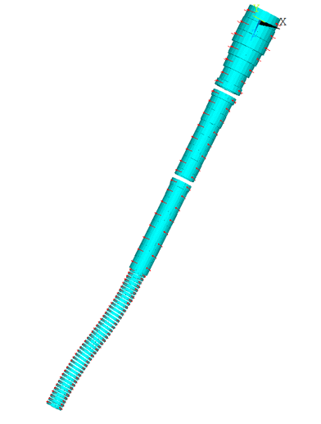
Introduction: Loads
Net Vertical Forces
(without chicane coils)
Net Vertical Forces
(with chicane coils)
Coil | Rc [m] | Zc [m] | DR [m] | DZ [m] | NR | NZ | I [A] | It [MAt] | Fz [MN] | Fz [MN]
1 | 0.849 | -0.185 | 0.498 | 0.830 | 12 | 20 | 58905 | 14.137 | 251.2 | 251.2
2 | 0.870 | 0.665 | 0.540 | 0.830 | 13 | 20 | 60710 | 15.785 | 59.50 | 59.51
3 | 0.870 | 1.515 | 0.540 | 0.830 | 13 | 20 | 60392 | 15.702 | -101.0 | -101.0
4 | 0.808 | 2.365 | 0.415 | 0.830 | 10 | 20 | 51654 | 10.331 | -101.4 | -101.4
5 | 0.766 | 3.215 | 0.332 | 0.830 | 8 | 20 | 47469 | 7.595 | -58.48 | -58.48
6 | 0.704 | 4.065 | 0.208 | 0.830 | 5 | 20 | 46504 | 4.650 | -17.10 | -17.10
7 | 0.745 | 4.708 | 0.291 | 0.415 | 7 | 10 | 46293 | 3.240 | -16.60 | -16.60
8 | 0.704 | 5.423 | 0.208 | 0.415 | 5 | 10 | 53168 | 2.658 | -2.179 | -2.177
9 | 0.662 | 6.065 | 0.125 | 0.830 | 3 | 20 | 43280 | 2.597 | -5.691 | -5.69
10 | 0.662 | 6.915 | 0.125 | 0.830 | 3 | 20 | 42146 | 2.529 | -2.609 | -2.608
11 | 0.642 | 7.765 | 0.083 | 0.830 | 2 | 20 | 49452 | 1.978 | -1.687 | -1.686
12 | 0.642 | 8.615 | 0.083 | 0.830 | 2 | 20 | 44183 | 1.767 | -0.9150 | -0.9147
13 | 0.642 | 9.465 | 0.083 | 0.830 | 2 | 20 | 39567 | 1.583 | -0.7432 | -0.7428
14 | 0.642 | 10.315 | 0.083 | 0.830 | 2 | 20 | 32713 | 1.309 | -0.1610 | -0.1603
15 | 0.642 | 10.958 | 0.083 | 0.415 | 2 | 10 | 46717 | 0.934 | -0.8960 | -0.8958
16 | 0.642 | 11.673 | 0.083 | 0.415 | 2 | 10 | 45905 | 0.918 | 0.3742 | 0.3754
17 | 0.621 | 12.315 | 0.042 | 0.830 | 1 | 20 | 52310 | 1.046 | -0.3951 | -0.3941
18 | 0.621 | 13.165 | 0.042 | 0.830 | 1 | 20 | 56056 | 1.121 | -0.0839 | -0.08169
19 | 0.621 | 14.015 | 0.042 | 0.830 | 1 | 20 | 51602 | 1.032 | -0.0973 | -0.09354
20 | 0.621 | 14.865 | 0.042 | 0.830 | 1 | 20 | 51376 | 1.028 | -0.0427 | -0.03481
21 | 0.621 | 15.715 | 0.042 | 0.830 | 1 | 20 | 50471 | 1.009 | -0.0091 | 0.01137
22 | 0.621 | 16.565 | 0.042 | 0.830 | 1 | 20 | 52861 | 1.057 | -0.0188 | 0.06418
23 | 0.621 | 17.415 | 0.042 | 0.830 | 1 | 20 | 57438 | 1.149 | -0.9872 | -0.3138
No pre-compression needed to keep the coils together.
Gravity load is not considered.
Cool-down is not considered.
Only Lorentz forces applied.
No cyclic loading considered (fatigue).

Slide 7
Outline
Introduction
Analysis Strategy
Stresses in HTS Tapes
Conclusions
Structural Design Criteria & Assessment (backup)

Slide 8
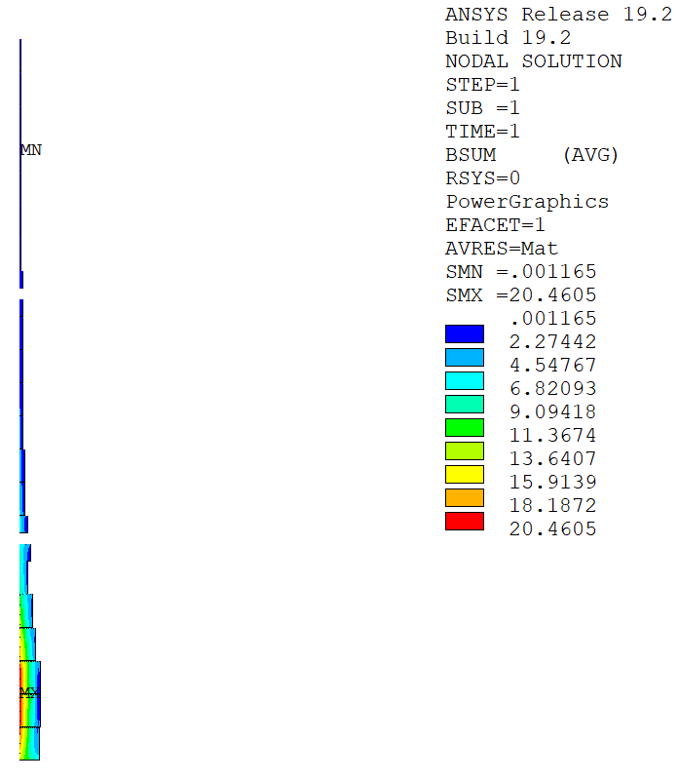
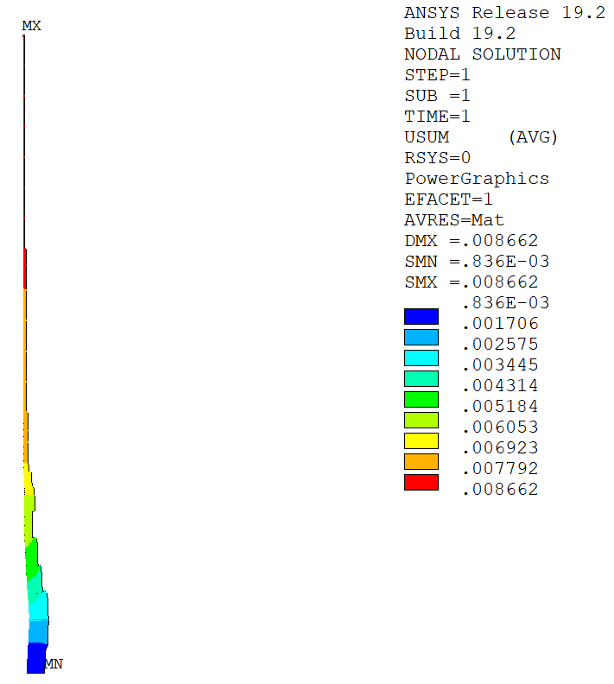
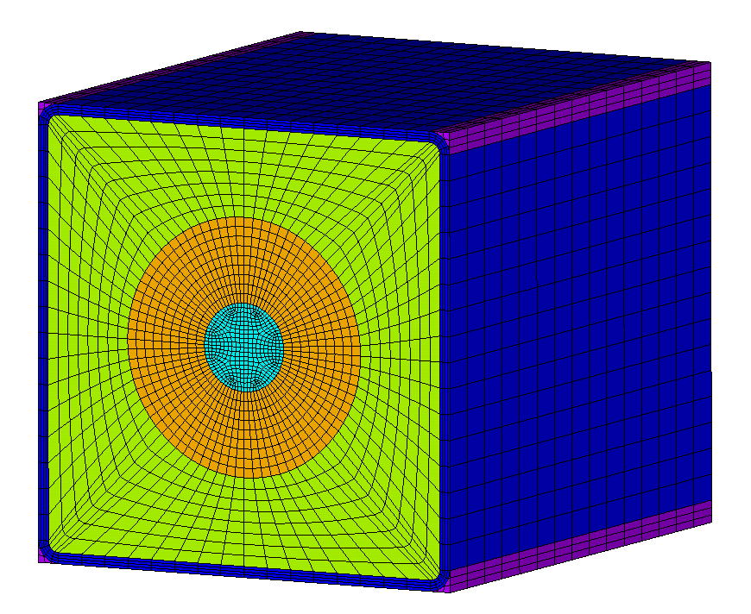
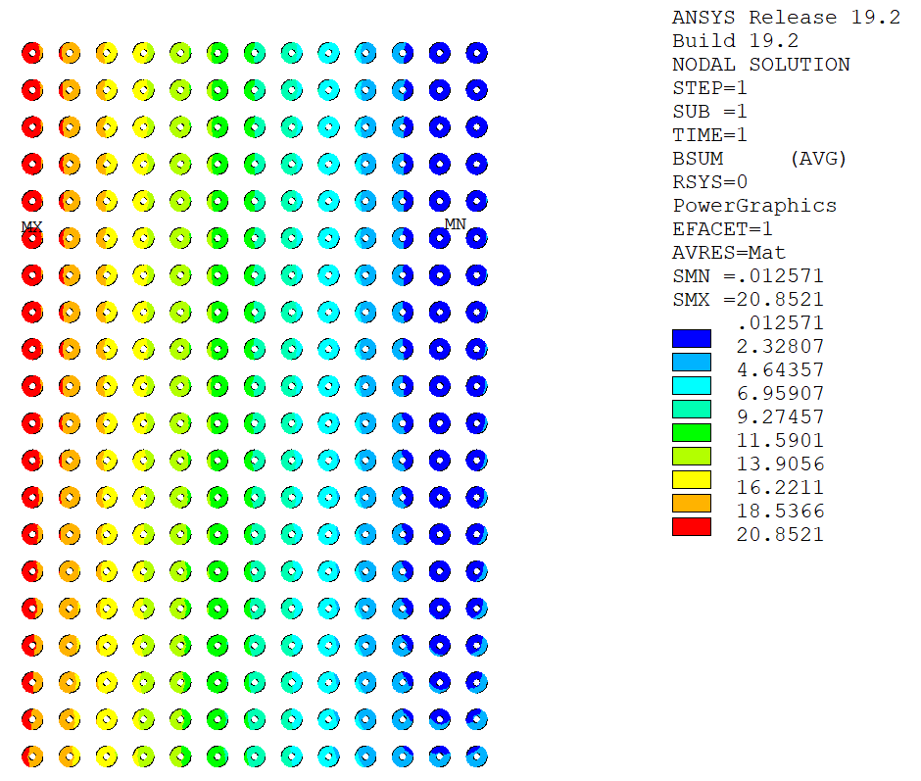
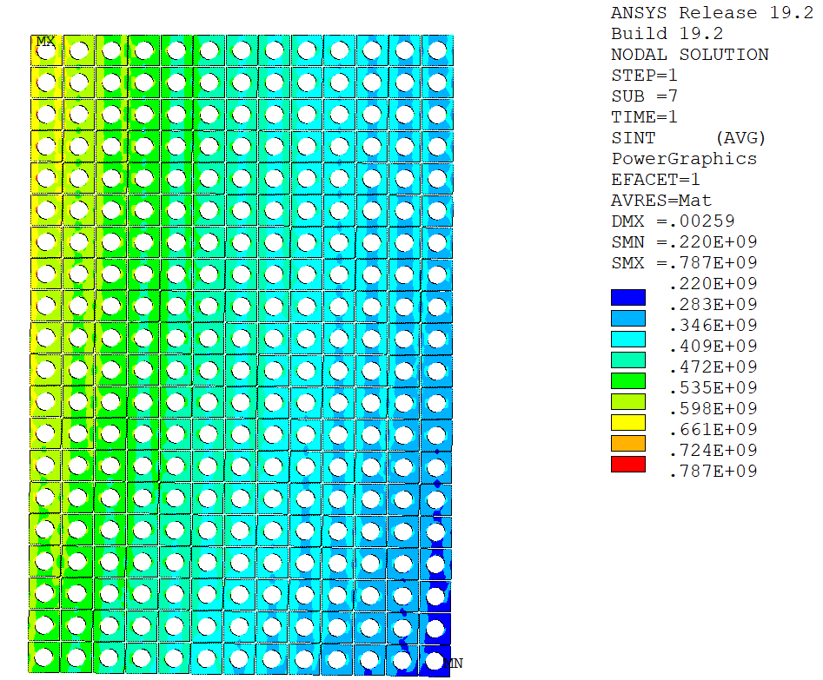
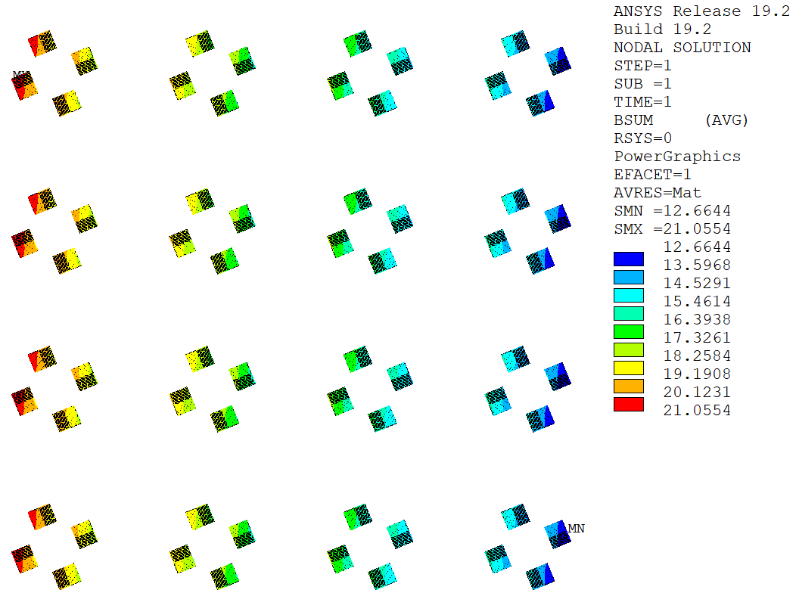
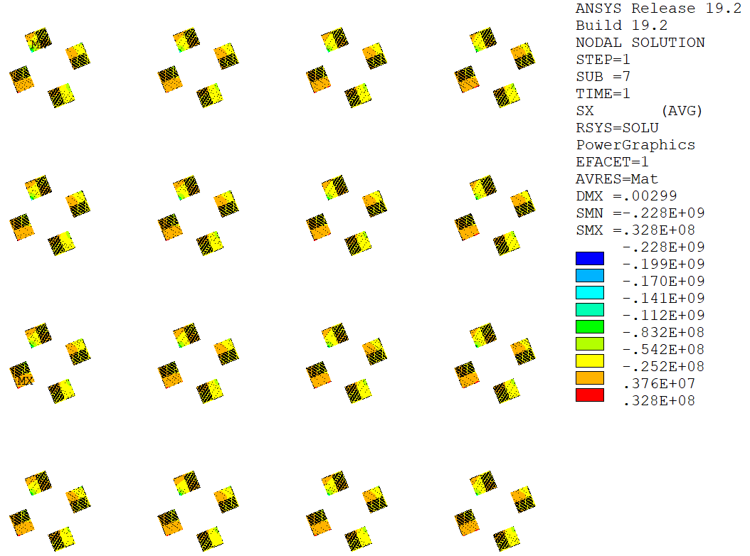
Analysis Strategy: Overview
Magnetic Models
Mechanical Models
2-D Axis. Global Electromagnetic Model
2-D Axis. Global Mechanical Model
3-D Homogenization Model
Nodal EM forces
WP mechanical properties
(E_{x}, E_{y}, E_{z}, ν_{xy}, ν_{xz}, ν_{yz}, G_{xy}, G_{xz}, G_{yz})
Boundary conditions (A_{z})
Boundary conditions (u_{r}, u_{z})
2-D Axis. Local Electromagnetic Model I
2-D Axis. Local Mechanical Model I
Assessment Jacket and Turn Insulation
(ITER Magnet Structural Design Criteria)
Nodal EM forces
Boundary conditions (A_{z})
Boundary conditions (u_{r}, u_{z})
2-D Axis. Local Electromagnetic Model II
2-D Axis. Local Mechanical Model II
Assessment HTS Tapes
(Tensile and shear stresses)
Nodal EM forces
Tape mechanical properties
(E_{x}, E_{y}, E_{z}, ν_{xy}, ν_{xz}, ν_{yz}, G_{xy}, G_{xz}, G_{yz})
Fully parametric model automatized with ANSYS Parametric Design Language (APDL).
3-D Homogenization Model

Slide 9
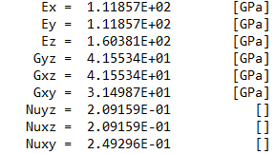
Analysis Strategy: Global Models
Magnetic Field [T]
Displacement [m]
Smeared Properties
The global stiffness of the WP is modelled by means of a homogenized orthotropic material.
Peak field in coils 2/3.
Homogenized WP.
Frictional contact between coils.
No pre-compression force applied.
Boundary Condition: u_{y} = 0
Nodal EM forces
Most loaded coil for detailed analysis
Global displacements

Slide 10
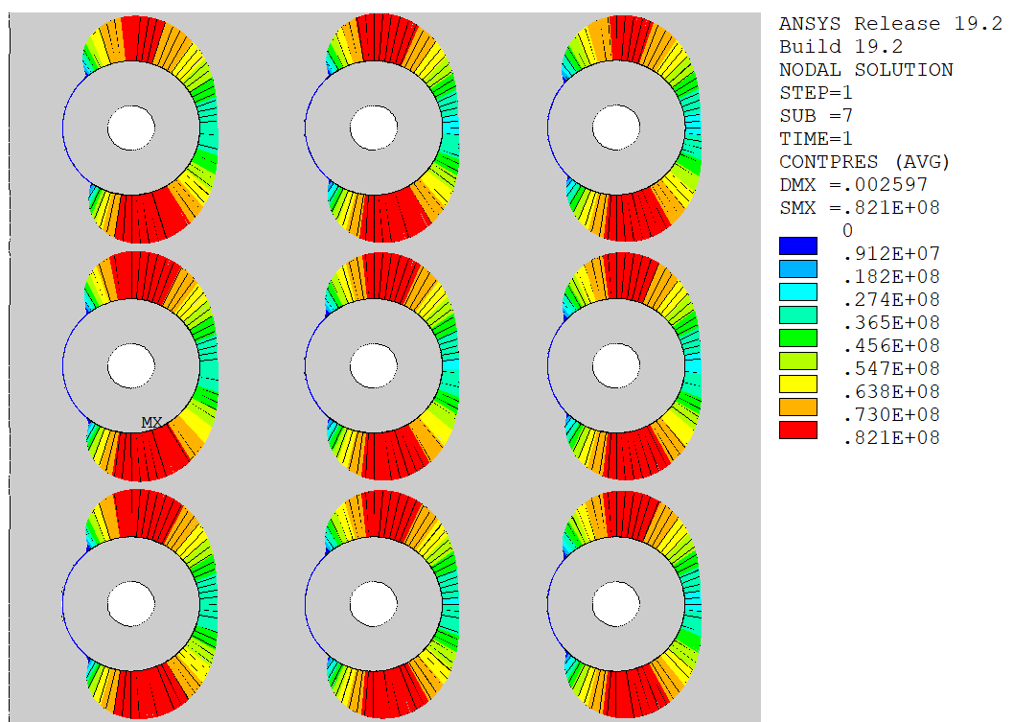
Analysis Strategy: Local Models I
Magnetic Field [T] in Coil 2 cables
Tresca Stress [Pa] in Coil 2 jackets
Frictional contact between cable and jacket
Nodal EM forces
Fine distribution of magnetic field
Stresses in jackets and insulation

Slide 11
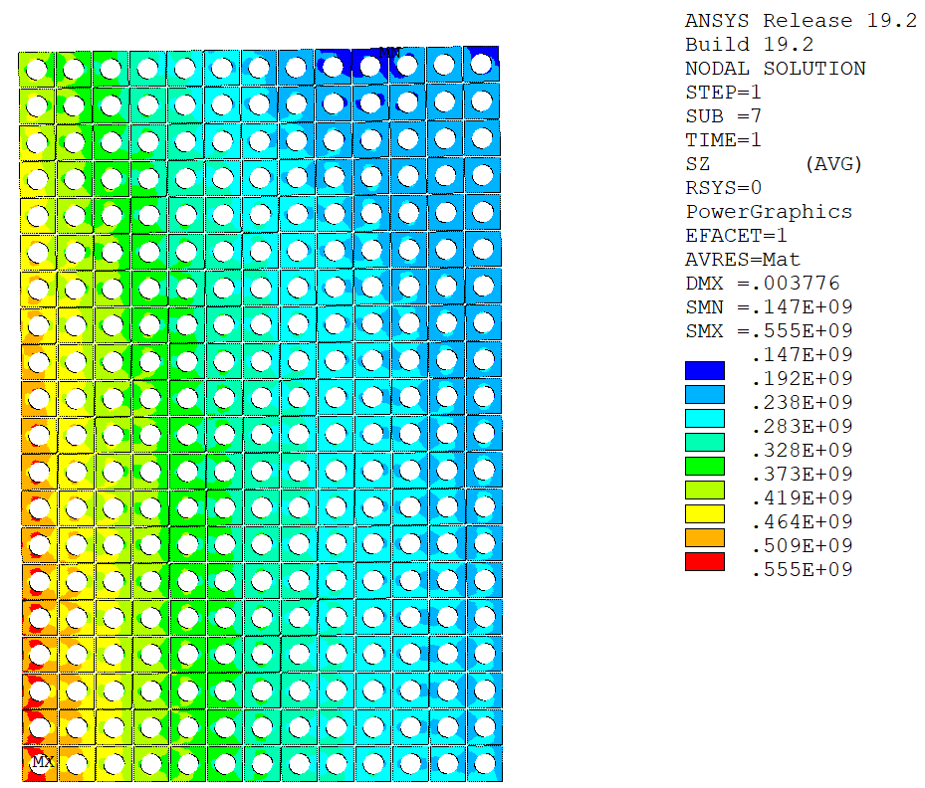
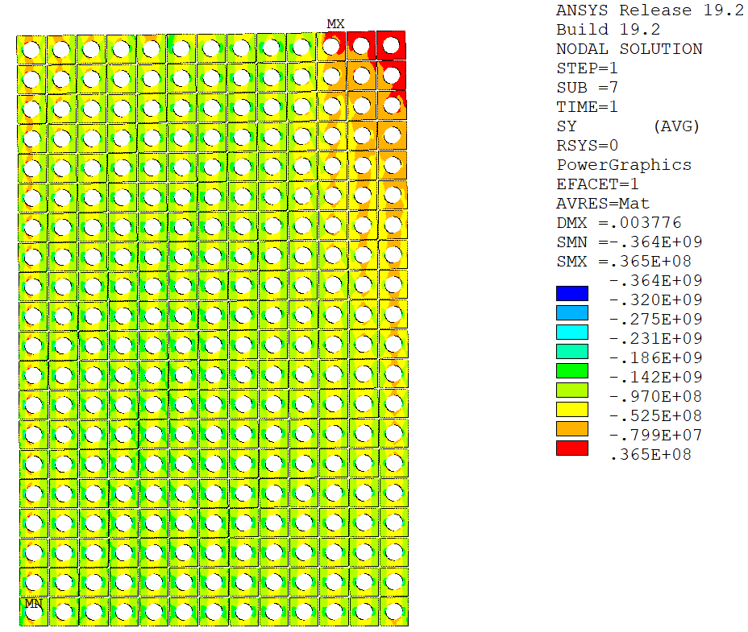
Analysis Strategy: Local Models I
a) Hoop Stress
b) Axial Stress [Pa]

Slide 12
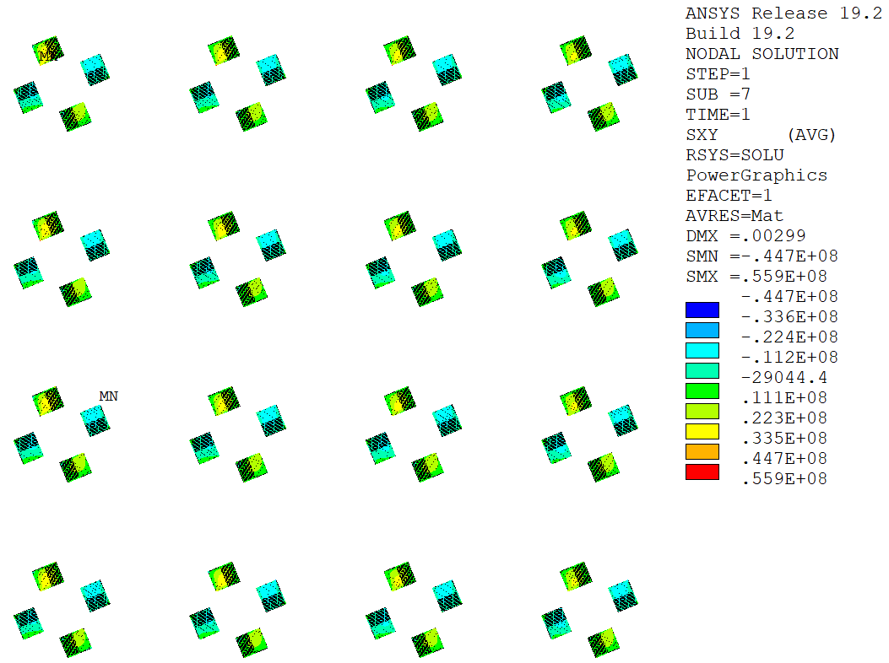
Analysis Strategy: Local Models II
Compressive/Tensile Stress [Pa] in tapes
Magnetic Field [T] in tapes
Shear Stress [Pa] in tapes
Nodal EM forces

Slide 13
Outline
Introduction
Analysis Strategy
Stresses in HTS Tapes
Conclusions
Structural Design Criteria & Assessment (backup)

Slide 14
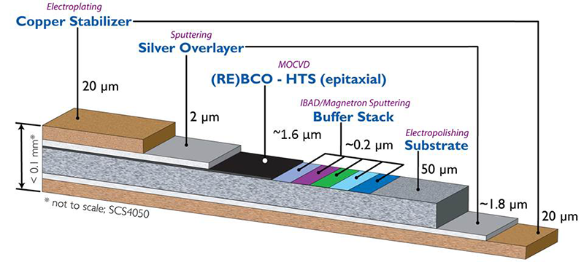
Stresses in HTS Tapes
Stress components of interest in the HTS tapes (de-bonding, degradation):
  Tensile stress across HTS tapes.
  Shear stress in HTS tapes.
The tapes are modelled as relatively stiff components (~100 GPa) due to the large amount of hastelloy and copper.
The surrounding solder is modelled as a rather soft material (~10 GPa) due to the mix of Sn and Pb.
Parametric Analyses:
  Bonded/frictional stack.
  Number of stacks (3, 4, 6, 8).
  Width of stacks (3 mm, 4 mm, 6 mm).
SuperPower

Slide 15
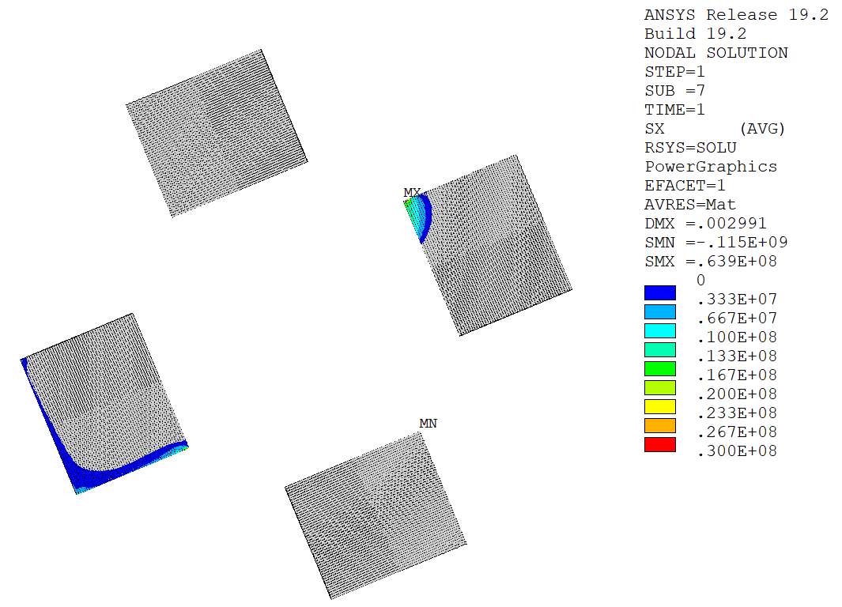
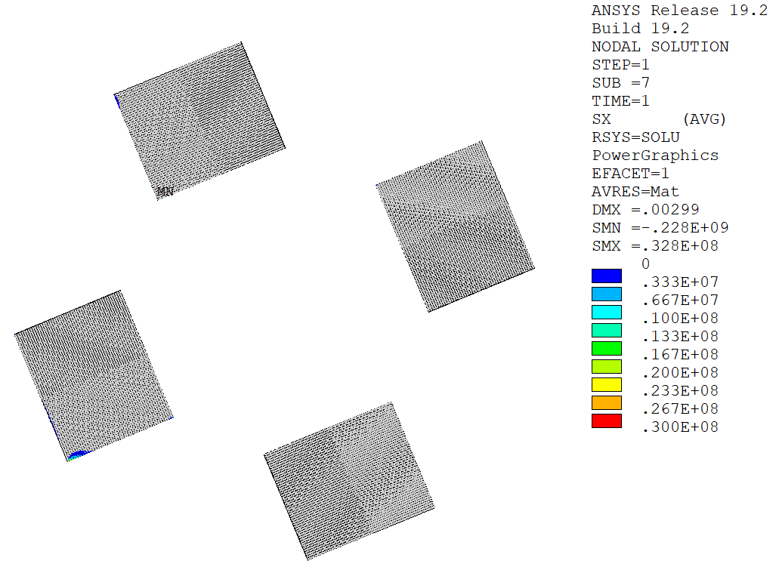
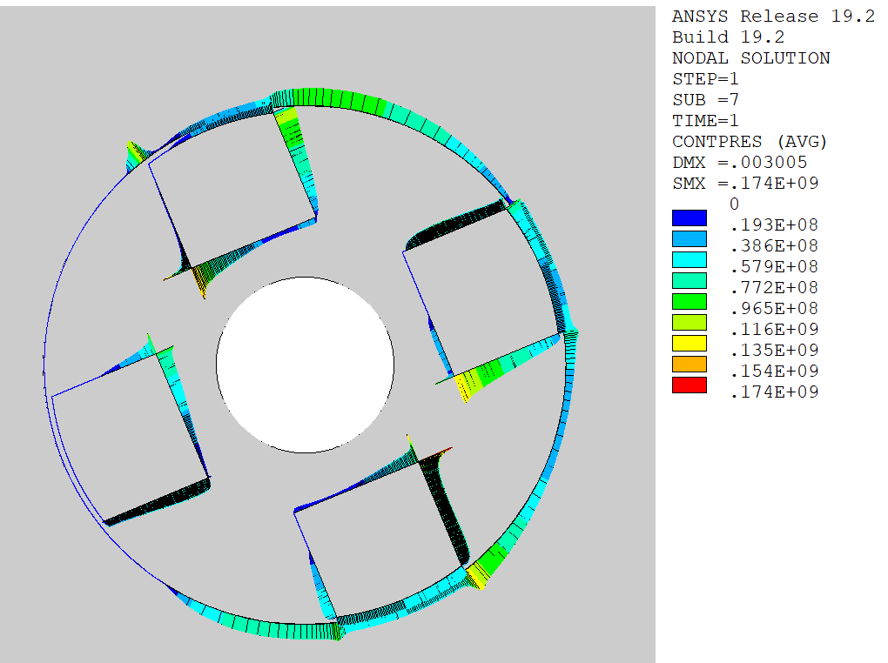
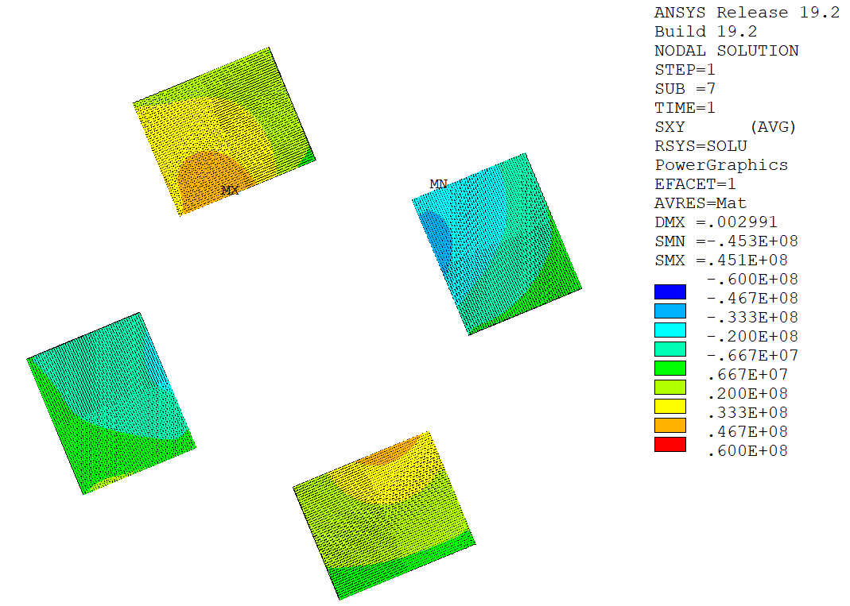
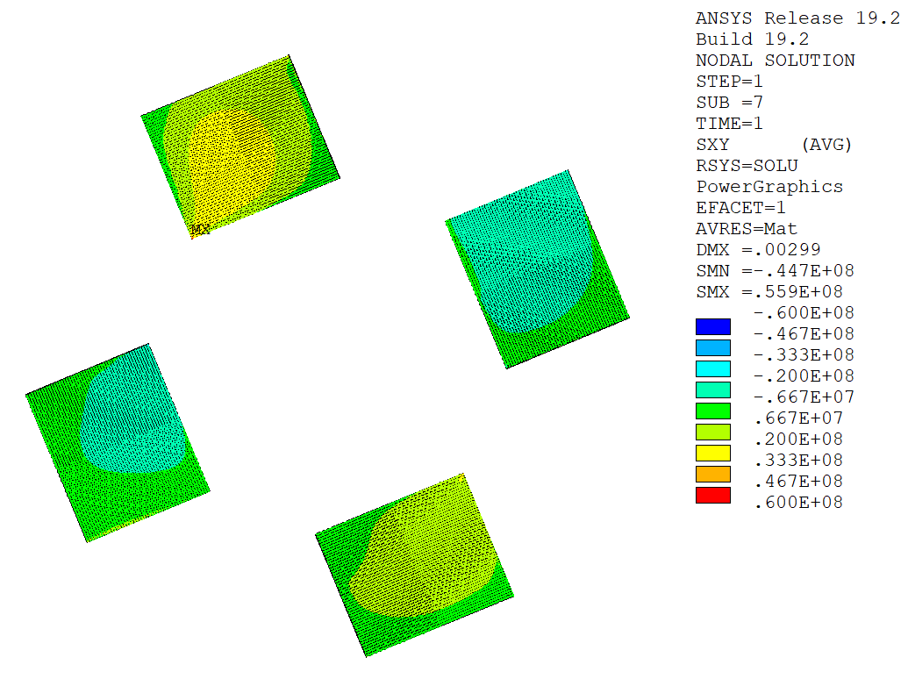
Bonded/Frictional Stack
Tensile Stress [Pa]
Tensile Stress [Pa]
Stack bonded to copper former.
Stack allowed to separate and slide in the copper former (μ = 0.2).
bonded stack
frictional contact
Contact Pressure [Pa]
Smaller tensile stress area with lower peak.
Lower shear stress in general.
Shear Stress [Pa]
Shear Stress [Pa]
bonded stack
frictional contact
~40 MPa
~30 MPa

Slide 16
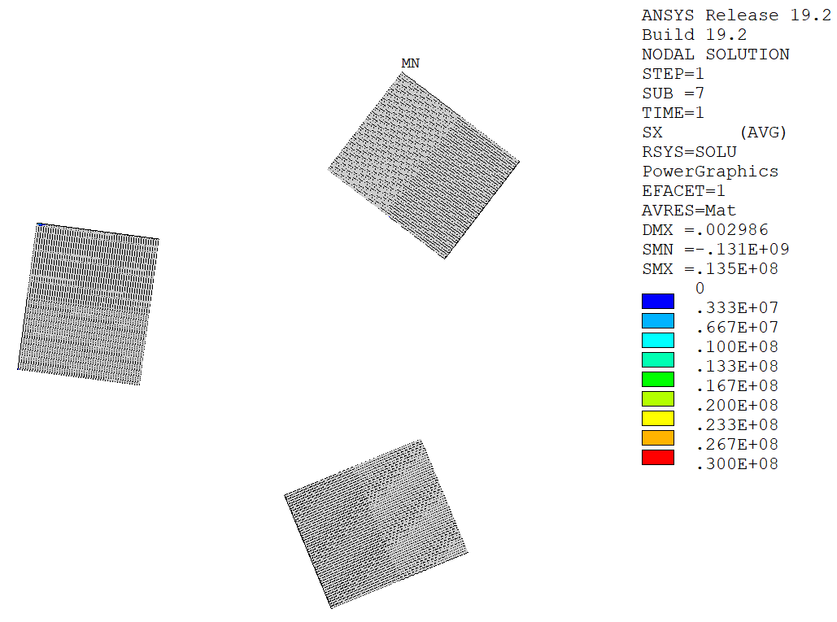
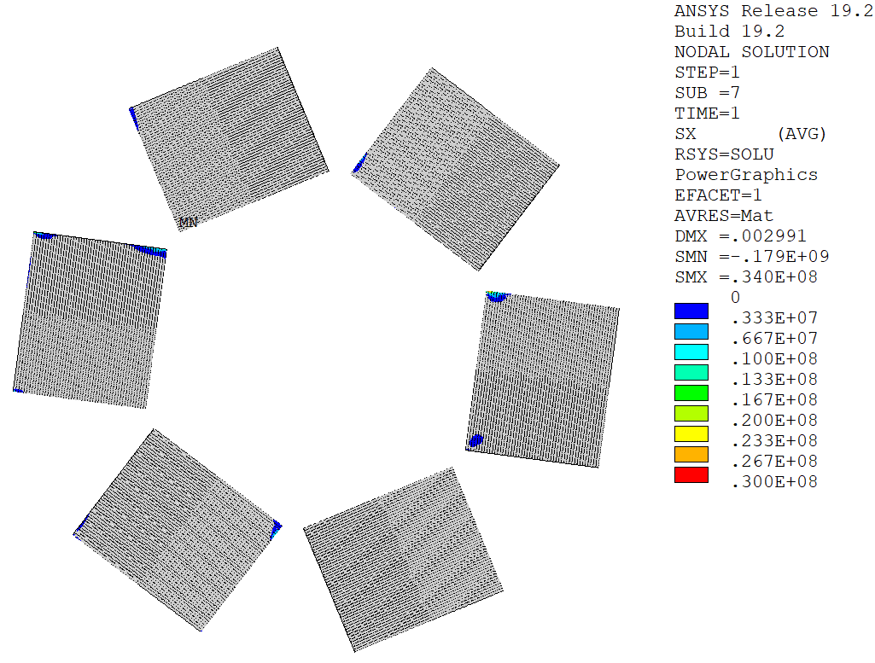
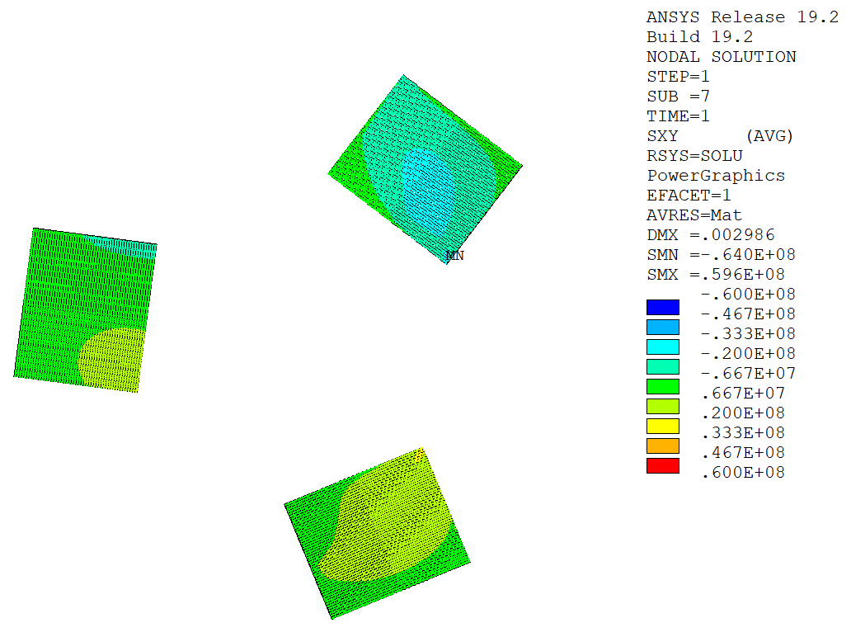
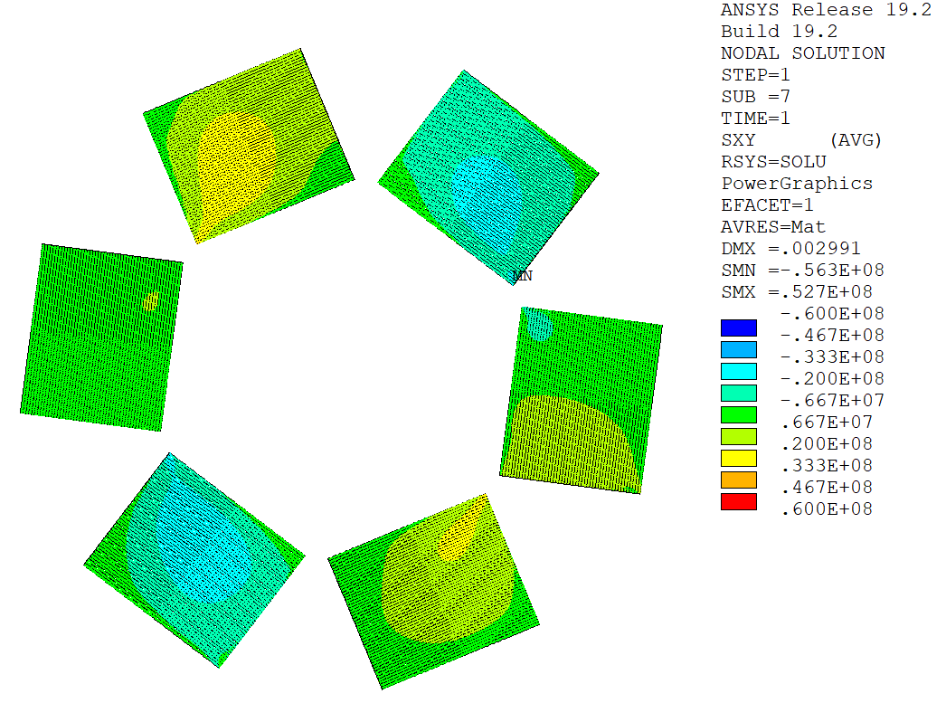
Stack Number (6 mm wide tape, frictional contact)
Tensile Stress [Pa]
Tensile Stress [Pa]
Tensile Stress [Pa]
81 mm²
108 mm²
162 mm²
Larger tensile stress area.
Shear Stress [Pa]
Shear Stress [Pa]
Shear Stress [Pa]
~30 MPa
~30 MPa
~30 MPa

Slide 17
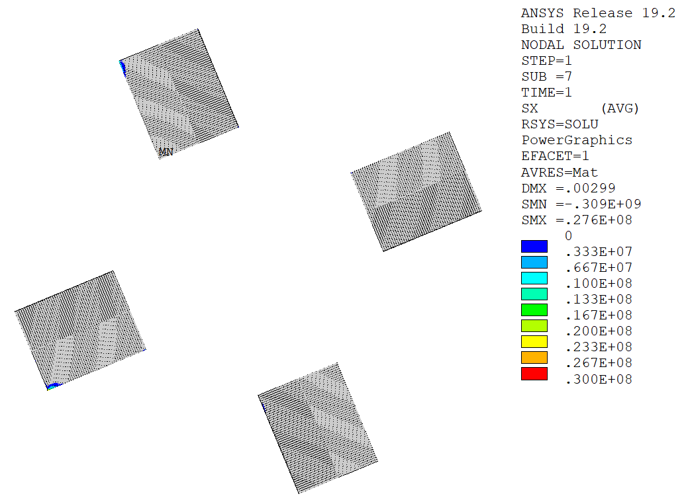
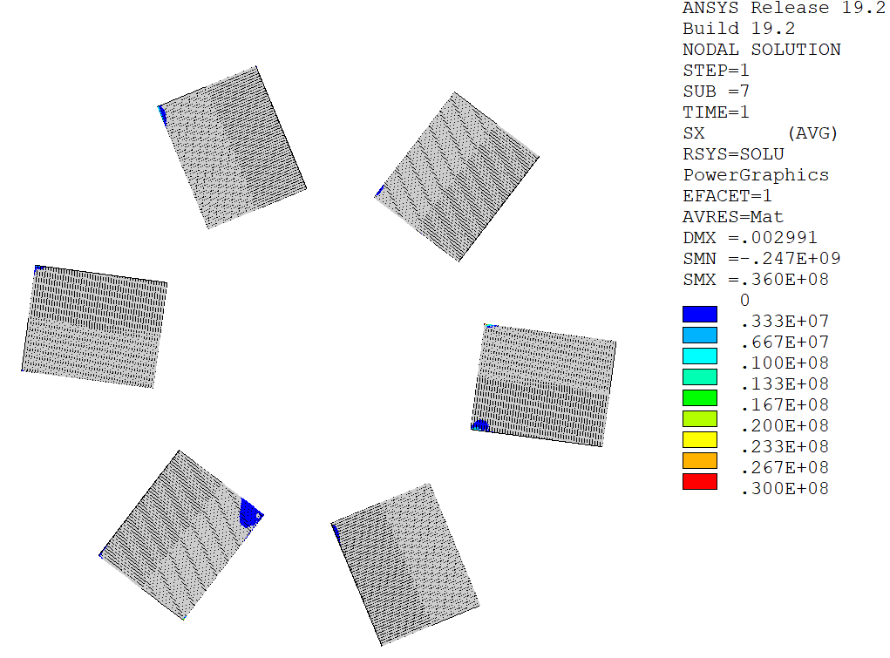
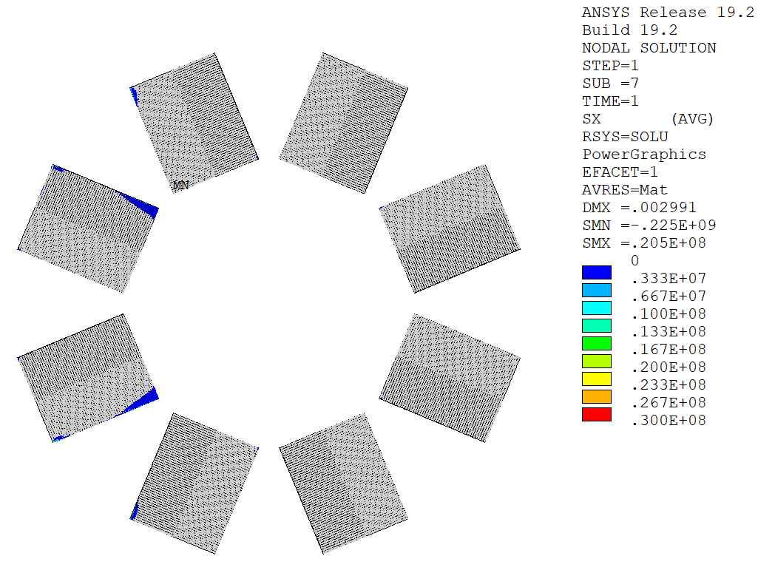
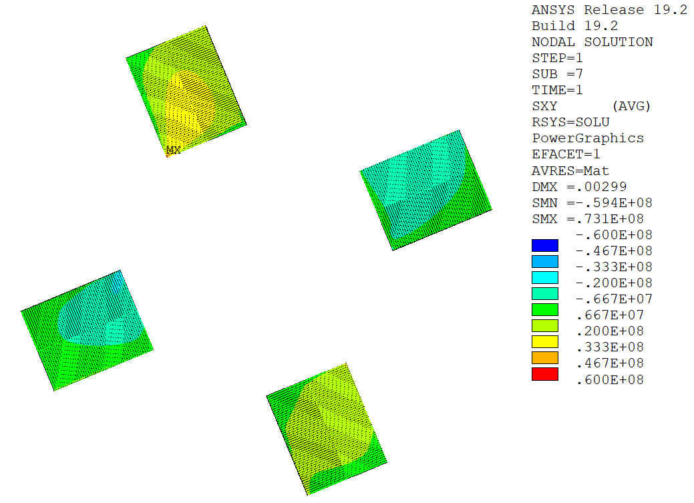
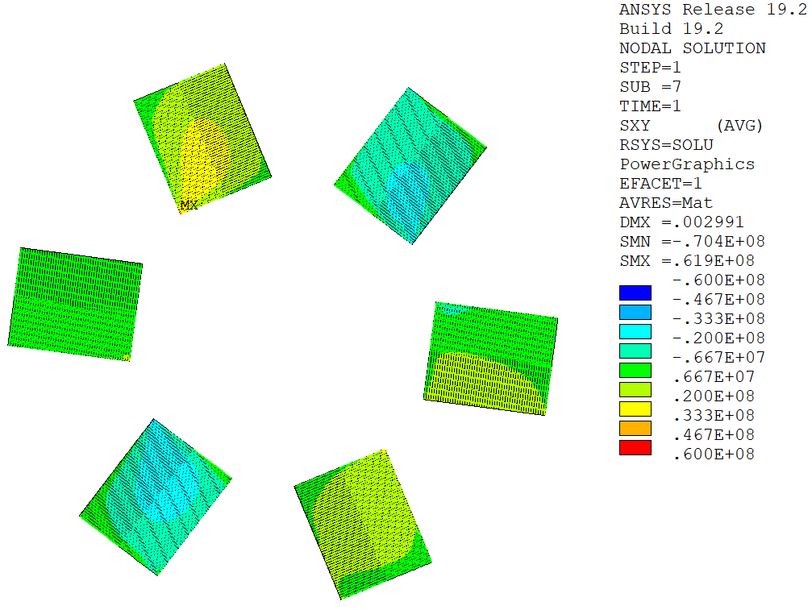
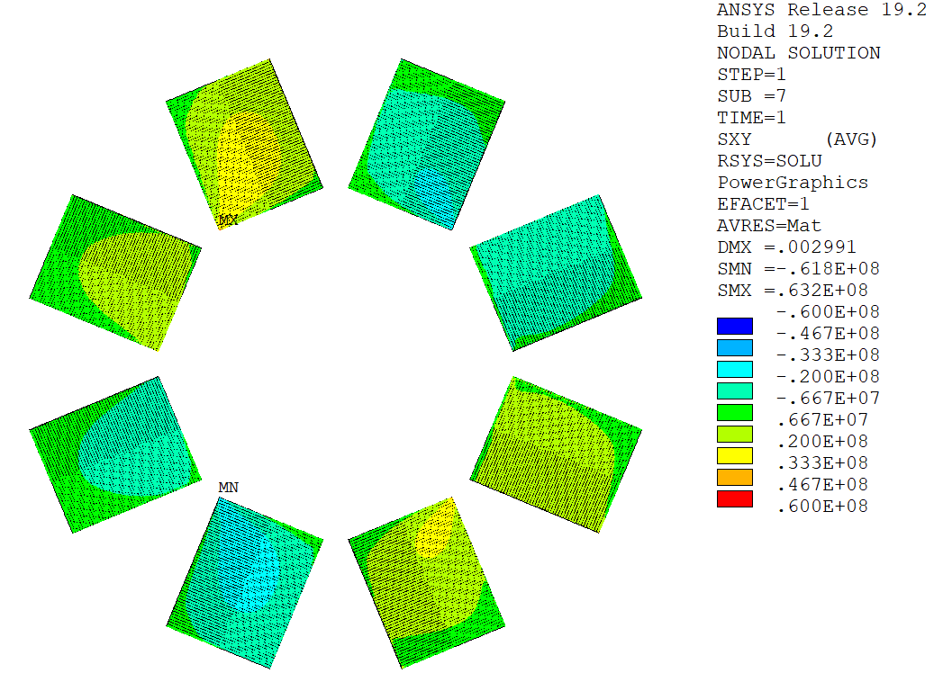
Stack Number (4 mm wide tape, frictional contact)
Tensile Stress [Pa]
Tensile Stress [Pa]
Tensile Stress [Pa]
72 mm²
108 mm²
144 mm²
Larger tensile stress area.
Shear Stress [Pa]
Shear Stress [Pa]
Shear Stress [Pa]
~30 MPa
~30 MPa
~30 MPa

Slide 18
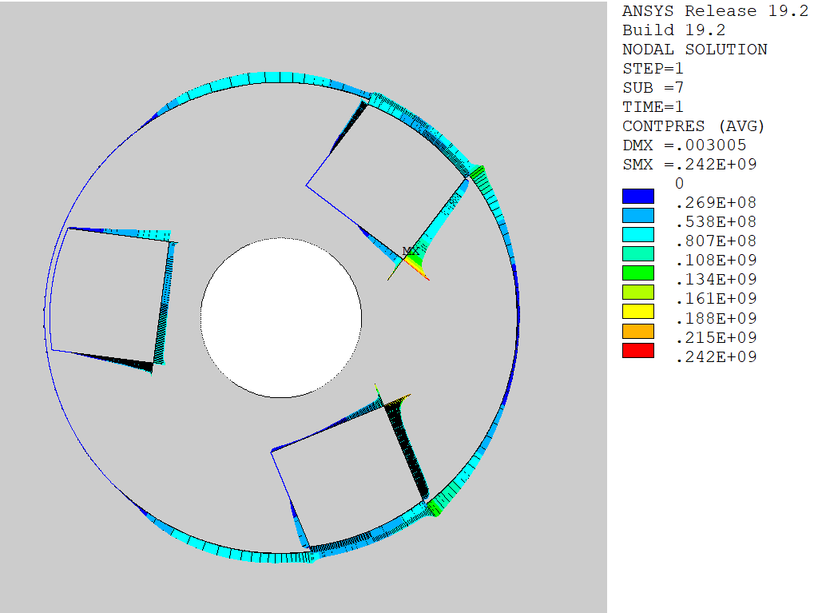
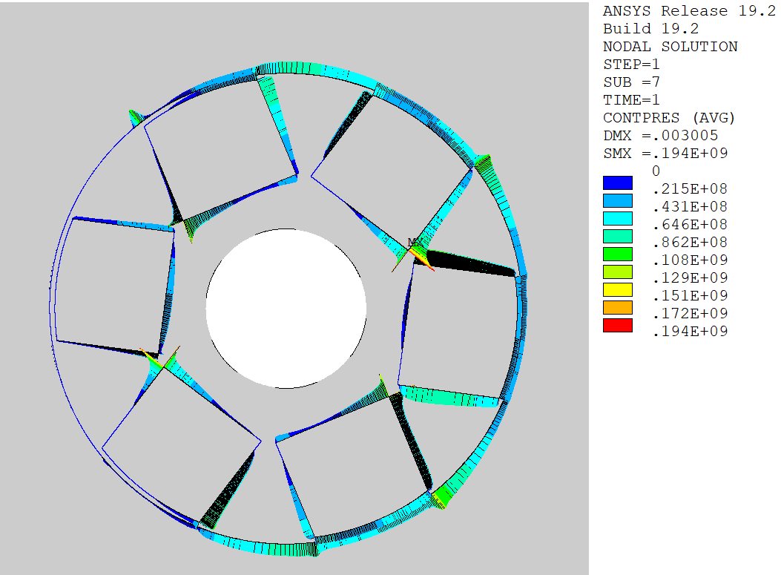
Stack Number (6 mm wide tape, frictional contact)
Shear Stress [Pa]
Shear Stress [Pa]
Shear Stress [Pa]
Contact Pressure [Pa]
Contact Pressure[Pa]
Contact Pressure [Pa]

Slide 19
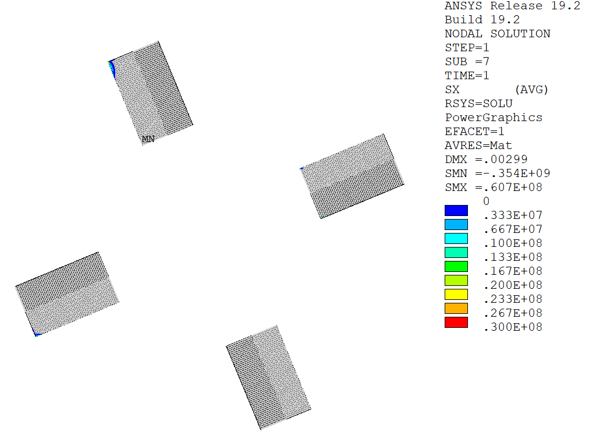
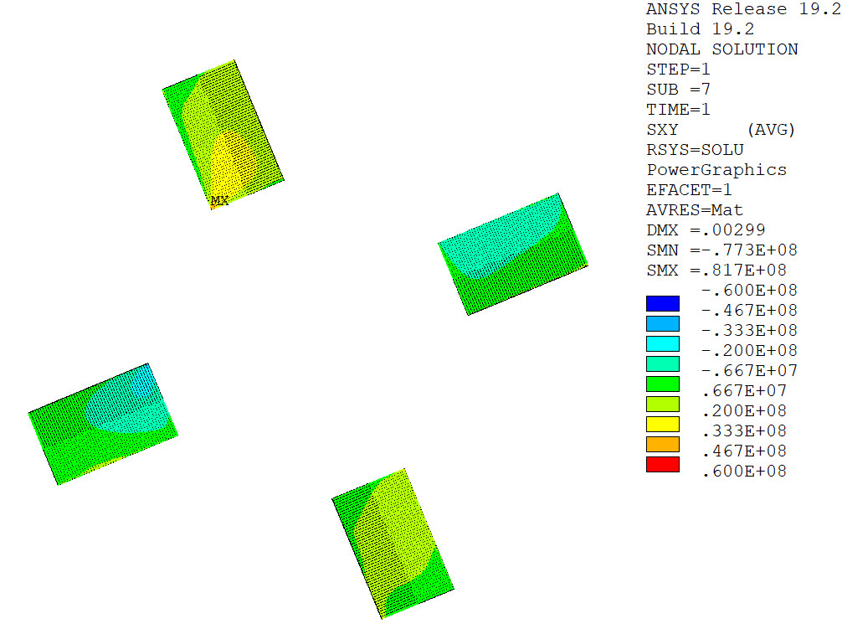
Stack Width (4 stacks, frictional contact)
Tensile Stress [Pa]
Tensile Stress [Pa]
Tensile Stress [Pa]
108 mm²
72 mm²
54 mm²
Increased peak compressive stress.
Increased peak shear stress.
Shear Stress [Pa]
Shear Stress [Pa]
Shear Stress [Pa]

Slide 20
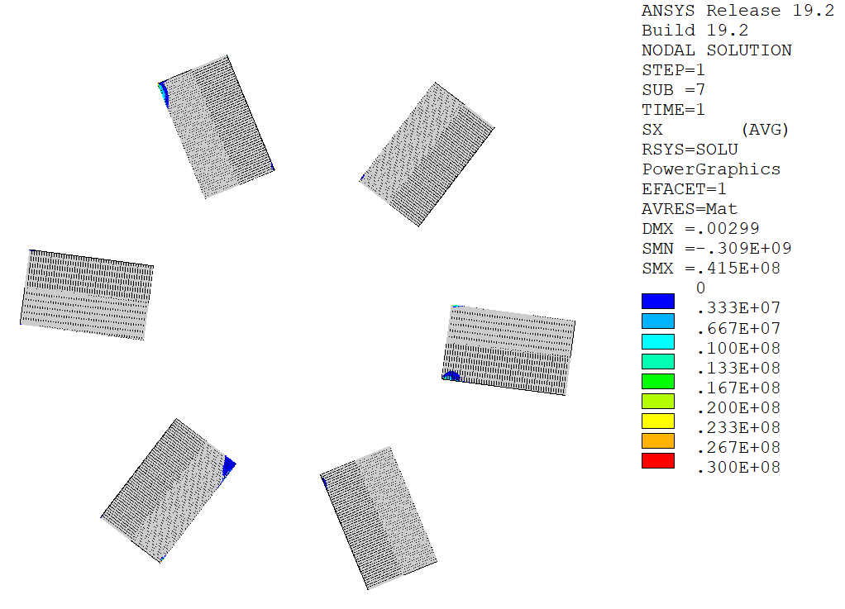
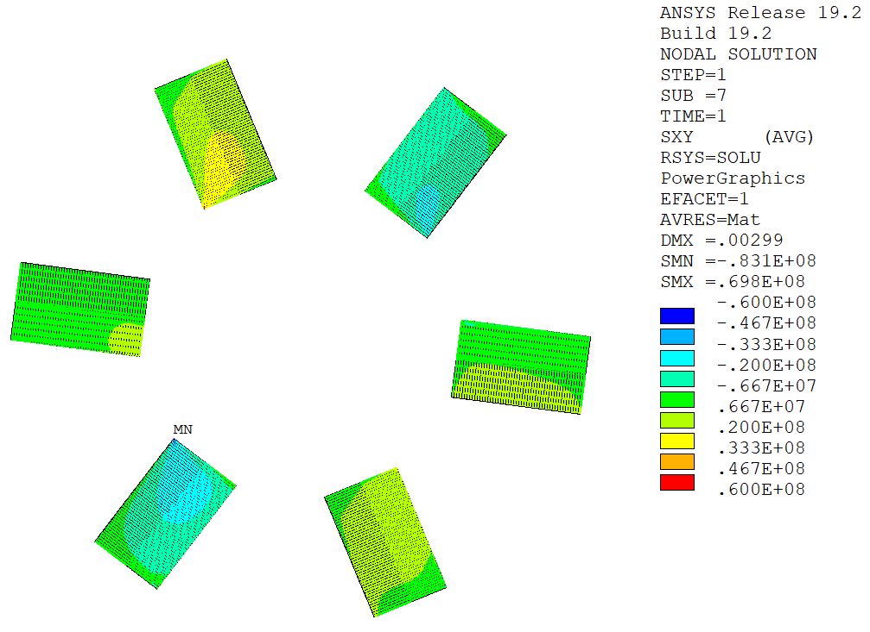
Stack Width (6 stacks, frictional contact)
Tensile Stress [Pa]
Tensile Stress [Pa]
Tensile Stress [Pa]
162 mm²
108 mm²
81 mm²
Increased peak compressive stress.
Increased peak shear stress.
Shear Stress [Pa]
Shear Stress [Pa]
Shear Stress [Pa]

Slide 21
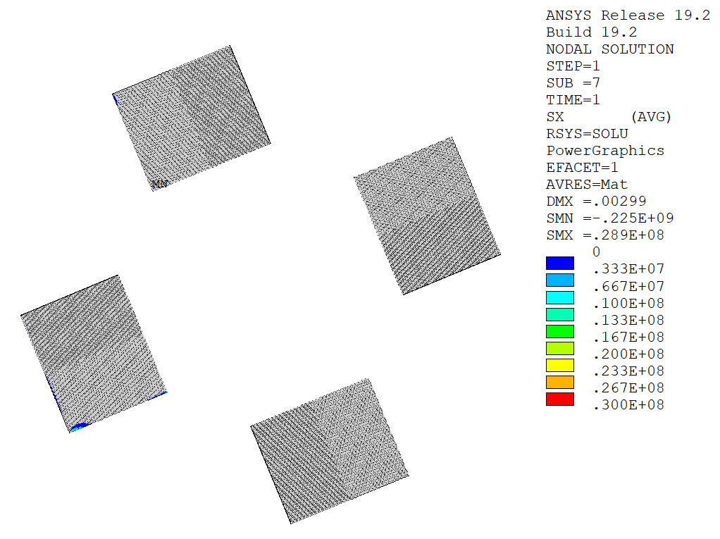
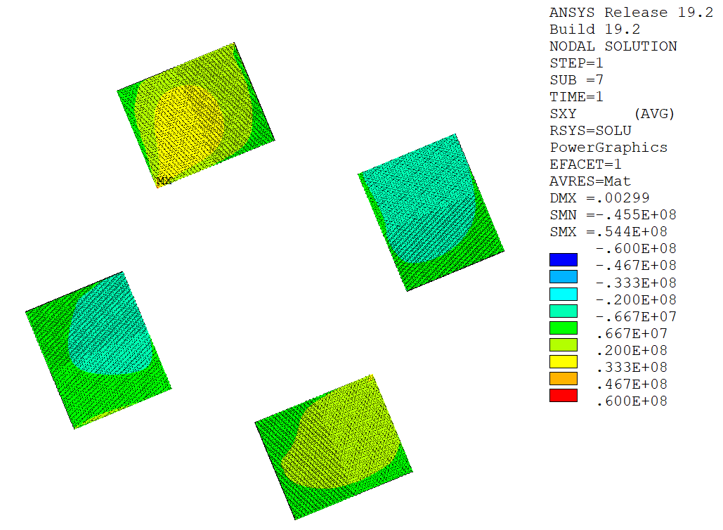
Tape Thickness (4 stacks, frictional contact)
Tensile Stress [Pa]
Tensile Stress [Pa]
108 mm²
108 mm²
50 tapes
thickness = 90 um
75 tapes
thickness = 60 um
Shear Stress [Pa]
Shear Stress [Pa]

Slide 22
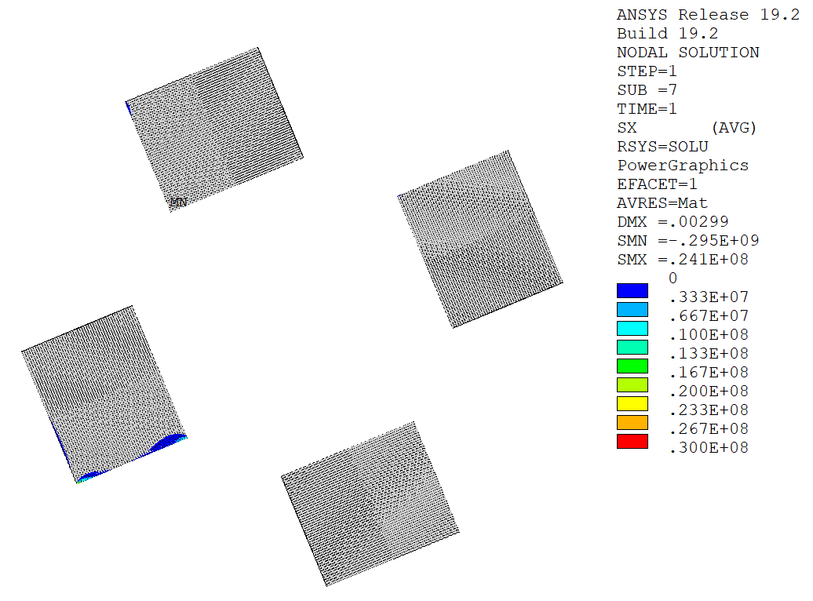
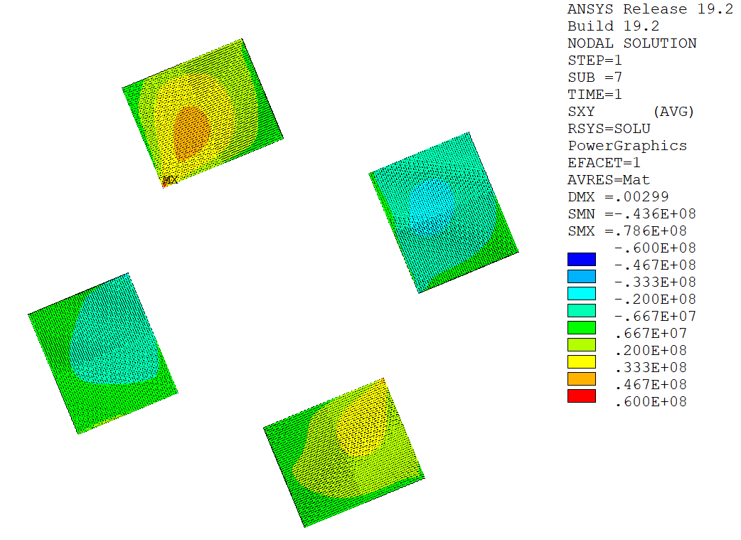
Solder Stiffness (4 stacks, frictional contact)
Tensile Stress [Pa]
Tensile Stress [Pa]
108 mm²
108 mm²
Larger tensile stress area.
Increased shear stress.
E_{solder} = 10 GPa
E_{solder} = 20 GPa
Shear Stress [Pa]
Shear Stress [Pa]
~30 MPa
~40 MPa

Slide 23
Outline
Introduction
Analysis Strategy
Stresses in HTS Tapes
Conclusions
Structural Design Criteria & Assessment (backup)

Slide 24
Conclusions
A magneto-structural analysis of the Target Solenoid is presented, involving several nested global and local axisymmetric models with different level of detail. The analysis is fully parametric and automatized in APDL.
On the one hand, the conductor jacket and turn insulation are assessed according to the ITER Magnet Structural Design Criteria (backup slides).
On the other hand, the tensile and shear stress distributions in the stacks of tapes are analyzed. Parametric studies are carried out to understand the impact of bonded/frictional stacks, number of stacks, width of stacks, etc.
Stack allowed to slide and separate in the former grooves results in lower tensile and shear stresses. Tensile stresses in the tapes are generally below 10 MPa, shear stresses around 30 MPa.
If the stack is bonded to the groove shear stress regions up to 45 MPa. Softer solder yields lower shear stress.
Fewer stacks reduce the regions with tensile stresses.
Wider stacks result in lower peak compressive and shear stresses.
Fewer and wider stacks approach is deemed preferable from the parametric analyses.

Slide 25
THANK YOU

Slide 26
Outline
Introduction
Analysis Strategy
Stresses in HTS Tapes
Conclusions
Structural Design Criteria & Assessment (backup)

Slide 27
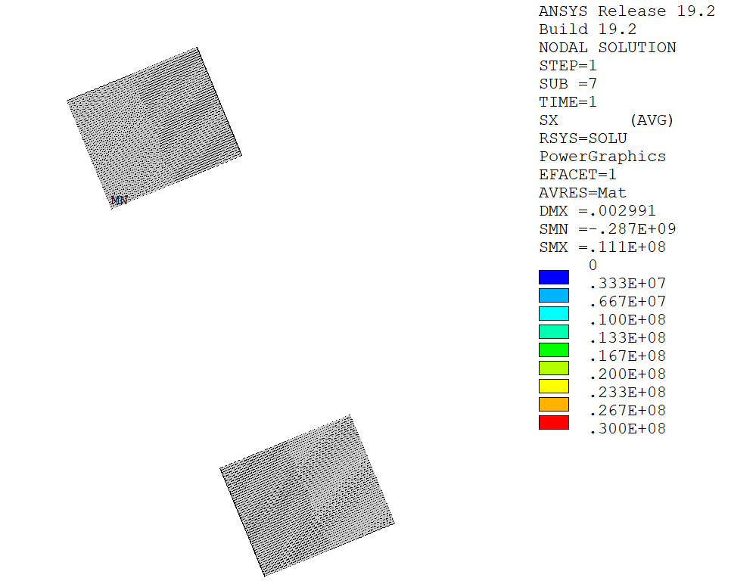
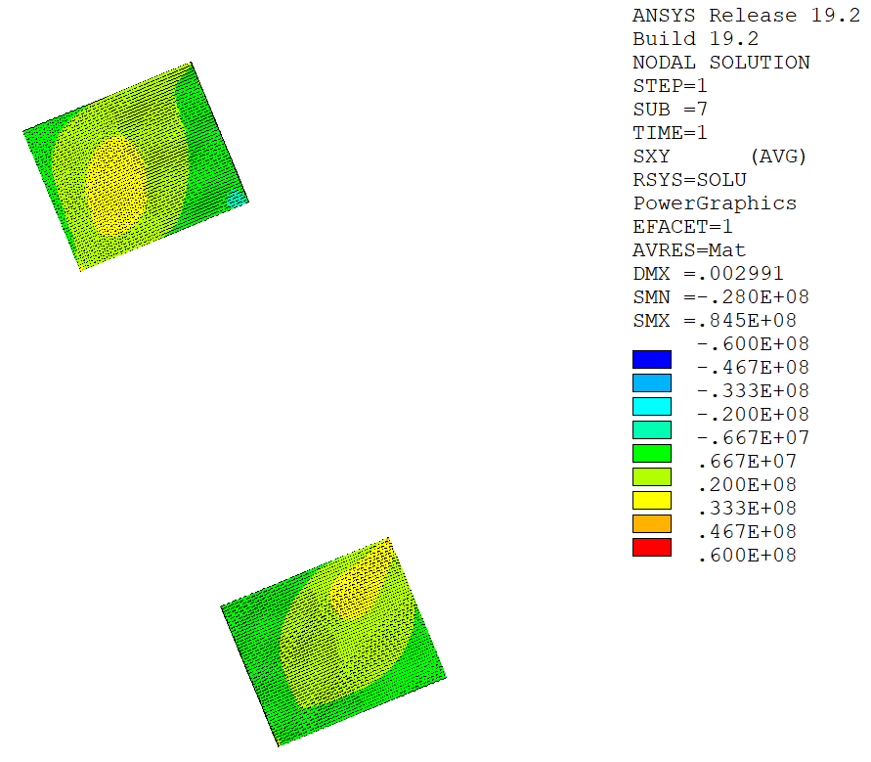
Stack Number (6 mm wide tape, frictional contact)
Tensile Stress [Pa]
Tensile Stress [Pa]
Shear Stress [Pa]
Shear Stress [Pa]

Slide 28
Outline
Introduction
Analysis Strategy
Stresses in HTS Tapes
Conclusions
Structural Design Criteria & Assessment (backup)

Slide 29
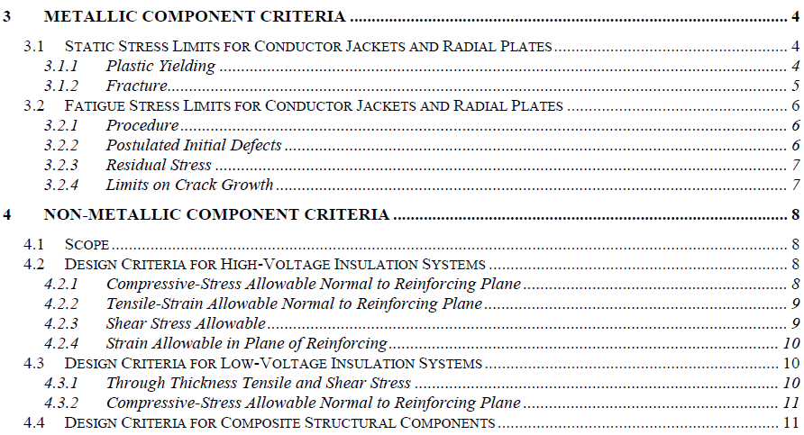
Structural Design Criteria & Assessment
ITER Magnet Structural Design Criteria:
  Part 1: Main Structural Components and Welds.
  Part 2: Magnet Windings (Radial Plates and Conductors) with High and Low Voltage Insulation and Epoxy Filler.
  Part 3: Bolts, Keys, Supports and Special Components.
  Part 4: Cryogenic Piping.
Jackets
Only static stress limits are considered.
Relevance of fatigue stress to be discussed (cyclic loading?).
Turn insulation

Slide 30
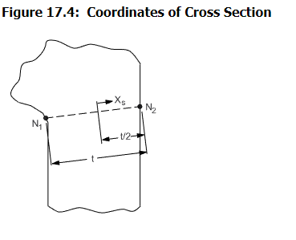






Structural Design Criteria & Assessment: Stress Linearization
$$σ_{ij}\left(x\right)≈σ_{m,ij}+σ_{b,ij}\frac{2x}{t}, −\frac{t}{2}≤x≤\frac{t}{2}$$
$σ_{m,ij}$ = membrane stress tensor (constant part).
$σ_{b,ij}$ = bending stress tensor (linear part).
$$\min_{σ_{m,ij},σ_{b,ij}}{\frac{1}{t}\int_{−\frac{t}{2}}^{\frac{t}{2}}{{\left[σ_{ij}\left(x\right)−σ_{m,ij}−σ_{b,ij}\frac{2x}{t}\right]}^{2}}dx}$$
Source: ANSYS Theory Reference
$$σ_{m,ij}=\frac{1}{t}\int_{−\frac{t}{2}}^{\frac{t}{2}}{σ_{ij}\left(x\right)}dx$$
$$σ_{b,ij}=−\frac{6}{t^{2}}\int_{−\frac{t}{2}}^{\frac{t}{2}}{xσ_{ij}\left(x\right)}dx$$
Once membrane and bending stress tensors are known, von Mises/Tresca stresses can be computed as usual.
Von Mises/Tresca stresses do not vary linearly along the defined paths.

Slide 31




Structural Design Criteria & Assessment: Stress Classification
Primary Stress, P
  Stress developed by imposed loading.
  Necessary to satisfy laws of equilibrium.
  Not self-limiting.
  Result in failure/gross distortion if considerably exceeds yield strength.
  Thermal stress is not primary.
Secondary Stress, Q
  Stress developed by constrain of adjacent material or by self-constraint of the structure.
  Self-limiting.
  Thermal stress.
$$ε_{ij}=C_{ijkl}\left(σ_{kl}\right)$$
$$ε_{ij}=\frac{1}{2}\left(u_{i,j}+u_{j,i}\right)$$
$$σ_{ij,j}+X_{i}=0$$
$$u_{i}=0 on ∂Ω_{D}$$
$$σ_{ij}n_{j}=0 on ∂Ω_{N}$$
$$ε_{ij}=C_{ijkl}\left(σ_{kl}\right)$$
$$ε_{ij}=\frac{1}{2}\left(u_{i,j}+u_{j,i}\right)$$
$$σ_{ij,j}=0$$
$$u_{i}=0 on ∂Ω_{D}$$
$$σ_{ij}n_{j}={\overline{t}}_{i} on ∂Ω_{N}$$
$$ε_{ij}=C_{ijkl}\left(σ_{kl}−α_{kl}ΔT\right)$$
$$ε_{ij}=\frac{1}{2}\left(u_{i,j}+u_{j,i}\right)$$
$$σ_{ij,j}=0$$
$$u_{i}=0 on ∂Ω_{D}$$
$$σ_{ij}n_{j}=0 on ∂Ω_{N}$$
$$ε_{ij}=C_{ijkl}\left(σ_{kl}\right)$$
$$ε_{ij}=\frac{1}{2}\left(u_{i,j}+u_{j,i}\right)$$
$$σ_{ij,j}=0$$
$$u_{i}={\overline{u}}_{i} on ∂Ω_{D}$$
$$σ_{ij}n_{j}=0 on ∂Ω_{N}$$
Rule of thumb:
  Thermal stresses are classified as secondary.
  Stresses induced by EM loads, inertial/gravity loads, pressure loads, etc., are classified as primary.

Slide 32


Structural Design Criteria & Assessment: Metallic Components
ITER MSDC Part 2 for Metallic Components:
  Allowable stress: $S_{m}=\frac{2}{3}S_{y}$
  Primary membrane stress: $P_{m}≤1.0 K_{m} S_{m}$
  Primary membrane + bending stress: $P_{m}+P_{b}≤1.3 K_{m} S_{m}$
  Primary + secondary stress $P+Q≤1.5 K_{m} S_{m}$
$K_{m}$ depends on type of service conditions:

Slide 33






Structural Design Criteria & Assessment: Metallic Components
ITER MSDC Part 2:
  $K_{m}=1.0$
  $S_{y}=1000 MPa$
  Allowable stress: $S_{m}=\frac{2}{3}S_{y}=667 MPa$
  Primary membrane stress: $P_{m}≤1.0 K_{m} S_{m}=667 MPa$
  Primary membrane + bending stress: $P_{m}+P_{b}≤1.3 K_{m} S_{m}=867 MPa$
  Primary + secondary stress (not considered, no thermal load applied).
$$P_{m}+P_{b}=749 MPa≤867 MPa$$
$$P_{m}=664 MPa≤667 MPa$$
PATH

Slide 34





Structural Design Criteria & Assessment: Metallic Components
Copper former is not intended to be a structural component in the cable but it reacts the magnetic load due to its relatively high stiffness (110 GPa vs. 205 GPa of steel).
The yield strength of copper is rather low compared to that of steel (factor ~3)), at least at room temperature (strength at cryogenic temperature needs to be investigated).
Frictional stacks
Frictional stacks
Bonded stacks

Slide 35



Structural Design Criteria & Assessment: Non-Metallic Components
ITER MSDC Part 2 for High-Voltage Insulation:
  Allowable compressive stress normal to the reinforcing plane. The compressive static stress in the through-thickness direction of the insulating material is limited to 50% of the minimum ultimate compressive strength:
  $$S_{c}=0.5σ_{cs}$$
  Allowable tensile strain normal to reinforcing plane. No primary tensile strain is allowed in the direction normal to the adhesive bonds between metal and composite.
  Allowable shear stress. The allowable shear strength of an insulator depends on the applied compressive stress.
  Allowable strain in plane of reinforcing. The allowed tensile or compressive strain in the plane of the insulation material is in the range [-0.5%, 0.5%].

Slide 36


Structural Design Criteria & Assessment: Non-Metallic Components
  Allowable compressive stress normal to the reinforcing plane.
  $$S_{c}=0.5σ_{cs}=600 MPa$$
$$192 MPa<600 MPa$$

Slide 37


Structural Design Criteria & Assessment: Non-Metallic Components
  Allowable tensile strain normal to reinforcing plane.
Small spots in the corner regions show normal tensile strain likely due to the fact that bonded insulation layers are assumed, and no separation is allowed.

Slide 38


Structural Design Criteria & Assessment: Non-Metallic Components
  Allowable shear stress.
A usage factor is defined as the ratio between element shear stress and allowable shear stress, which must be less than 1. Negative values correspond to tensile stresses that should be avoided, but these are likely due to the modelling of contact between adjacent insulating layers.

Slide 39




Structural Design Criteria & Assessment: Non-Metallic Components
  Allowable strain in plane of reinforcing.
$$\left[−0.41\%, +0.21\%\right]$$
$$\left[−0.09\%, +0.27\%\right]$$

