Slide 1


Mechanical Concepts for Final Cooling Solenoid
A. Bertarelli, C. Accettura, B. Bordini, A. Kolehmainen, F. Sanda
CERN

Slide 2
Outline
Introduction
Analytical Calculations
Finite Element Simulations for several Mechanical Concepts
  Concept 1 – Shrink-fitted cylindrical shell
  Concept 2 – Conical shrink disk
  Concept 3 – Hybrid configuration
Mechanical Concepts Pros and Cons
What’s Next?

Slide 3
Main Specs & Design Principles
Introduction
Main Specs: 1) Bore field > 40 T 2) Aperture 50 mm;
3) magnetic field homogeneity 1 % over 0.5 m
Principles guiding this conceptual design study (based on a
stationary analysis - dynamic studies to be performed at a later time)
  Non-insulated coils (protection, mechanical robustness)
  Avoid tensile radial stresses (minimize the risk of critical current degradation)
  Modular single layer pancakes (design as simple and flexible as possible)
  Use as wide as possible tapes (12 mm, to limit the number of pancakes)
  Intercept axial Lorentz forces between pancakes via support plates (minimize the
  pancakes mechanical interactions)
  In the ‘modular’ coils, maintain, as much as possible, the magnetic field lines parallel to the tapes (minimize axial Lorentz forces and maximize the conductor critical current) . Current per tape < 1000 A < estimated I_{c} (4.2 K, B⫽ 50 T)
  Radially support each coil via an outer ring that could eventually apply a precompression on the coil (limit the hoop stress and to avoid tensile radial stresses)
Ref. B. Bordini, 1st MuC Collaboration Meeting – Oct. 2022

Slide 4
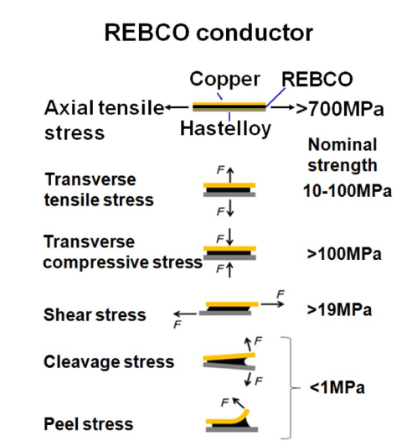
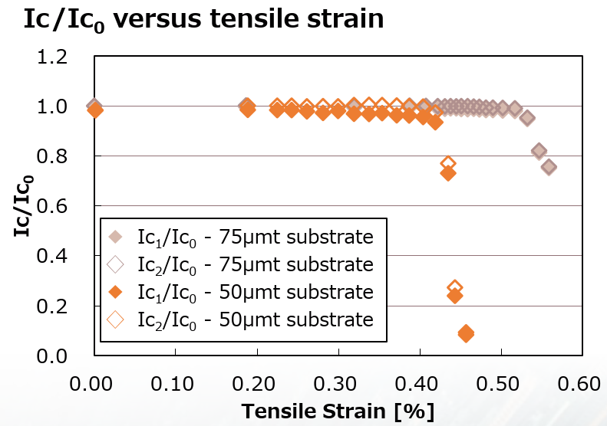
Basic Assumptions
Introduction
A high radial compression is necessary to reduce hoop stresses and prevent tensile radial stresses on the HTS coil
Mechanical concept is based on encapsulating HTS pancake coils in an external structure, generating high radial compressive stresses
Anistropic nature of HTS tape complicates stress analysis and assessment
Based on (incomplete) literature review, main assumptions for HTS tape are:
  In-plane tension limit is high ( > 700 MPa)
  Hoop tensile strain limit is ~ 0.4%
  In-plane compression limit is not known but should be higher than 100 MPa
  Radial tensile stress components to be avoided
  (what about 10-100 MPa limit?)
  Shear stress limit is low though not zero (> 19 MPa?)
  Given limited/unknown reliability of many of
  these assumptions, convenient safety margins
  should be adopted, particularly for shear and
  out-of-plane stresses
Hideaki Maeda and Yoshinori Yanagisawa IEEE TAS, VOL. 24, NO. 3, JUNE 2014

Slide 5
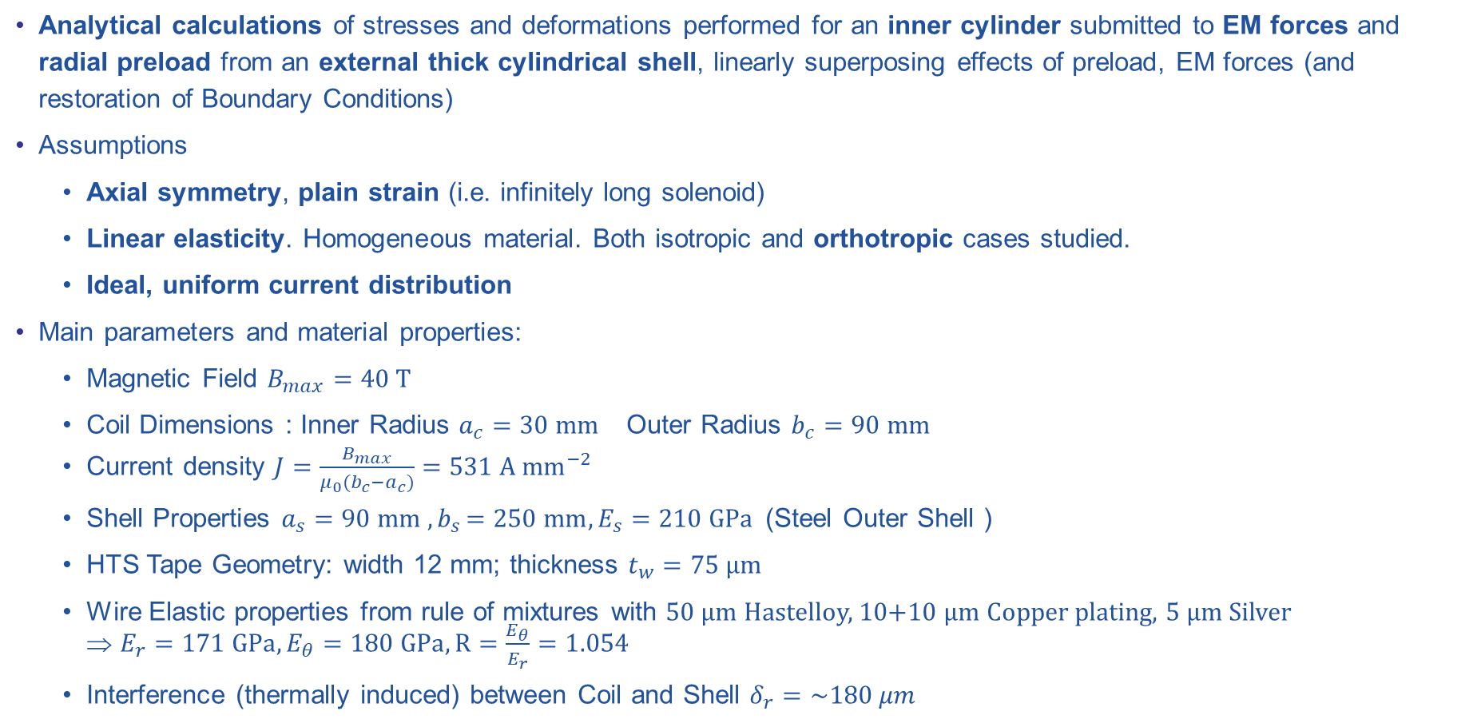
Hypotheses for Analytical Calculations
Analytical Calculations
Analytical calculations of stresses and deformations performed for an inner cylinder submitted to EM forces and radial preload from an external thick cylindrical shell, linearly superposing effects of preload, EM forces (and restoration of Boundary Conditions)
Assumptions
  Axial symmetry, plain strain (i.e. infinitely long solenoid)
  Linear elasticity. Homogeneous material. Both isotropic and orthotropic cases studied.
  Ideal, uniform current distribution
Main parameters and material properties:
  Magnetic Field $B_{max}=40 T$
  Coil Dimensions : Inner Radius $a_{c}=30 mm$ Outer Radius $b_{c}=90 mm$
  Current density $J=\frac{B_{max}}{μ_{0}(b_{c}−a_{c})}=531 A {mm}^{−2}$
  Shell Properties $a_{s}=90 mm {, b}_{s}=250 mm, E_{s}=210 GPa$(Steel Outer Shell )
  HTS Tape Geometry: width 12 mm; thickness $t_{w}=75 μm$
  Wire Elastic properties from rule of mixtures with 50 µm Hastelloy, 10+10 µm Copper plating, 5 µm Silver
  ⇒ $E_{r}=171 GPa, E_{θ}=180 GPa, R=\frac{E_{θ}}{E_{r}}=1.054$
  Interference (thermally induced) between Coil and Shell $δ_{r}=\sim 180 μm$

Slide 6
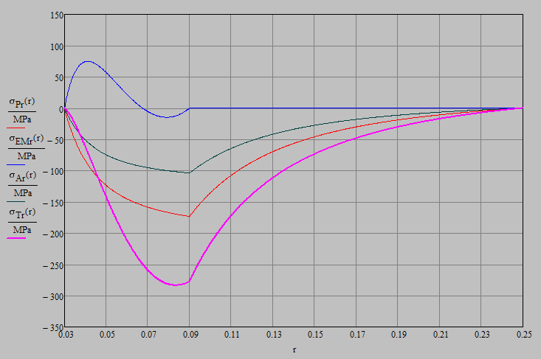
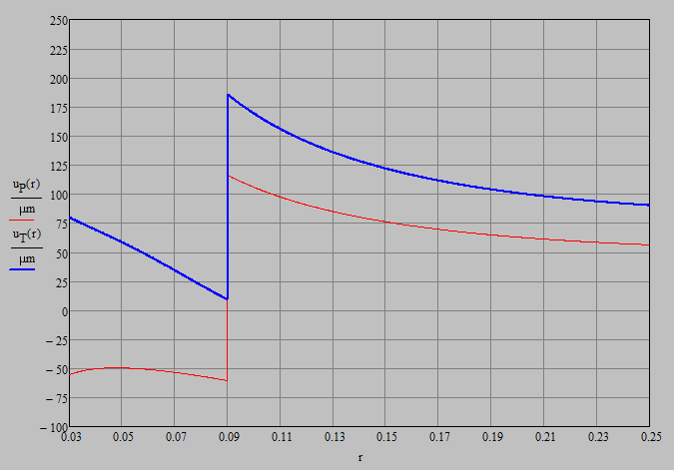

Results of Analytical Calculations
Results
Radial effects
  Shrink Fitting Pressure (at cold) $p_{δ}=170 MPa$
  Coil Radial stresses are always compressive, both for shrink-fitting and energization
  Min coil radial stress at energization $σ_{Trc}=−284 MPa$ in the vicinity of Coil OD. Final pressure $p_{T}=278 MPa$
  Coil Radial Displacement is always negative after shrink-fitting and becomes positive after energization

Slide 7
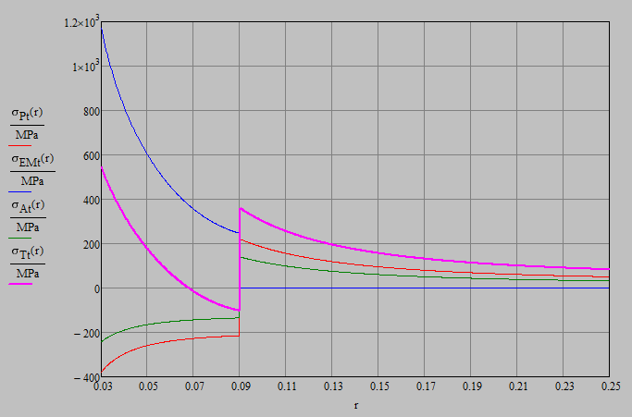
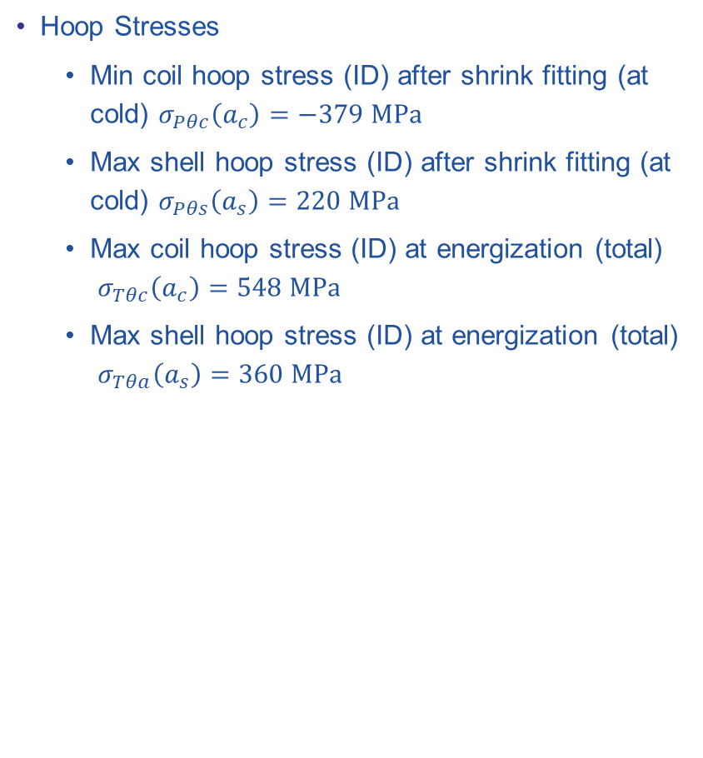
Results of Analytical Calculations
Analytical Calculations
Hoop Stresses
  Min coil hoop stress (ID) after shrink fitting (at cold) $σ_{Pθc}\left(a_{c}\right)=−379 MPa$
  Max shell hoop stress (ID) after shrink fitting (at cold) $σ_{Pθs}\left(a_{s}\right)=220 MPa$
  Max coil hoop stress (ID) at energization (total)
  $σ_{Tθc}\left(a_{c}\right)=548 MPa$
  Max shell hoop stress (ID) at energization (total)
  $σ_{Tθa}\left(a_{s}\right)=360 MPa$

Slide 8
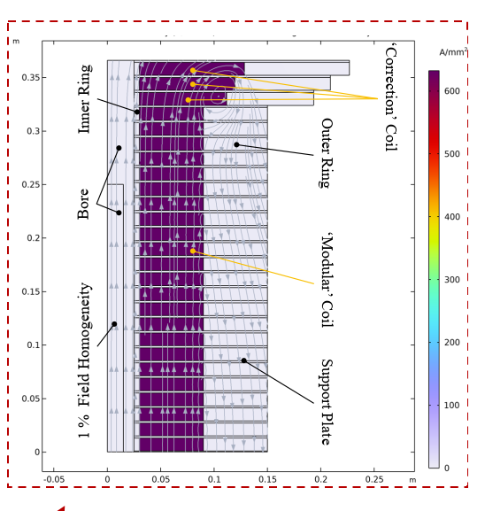
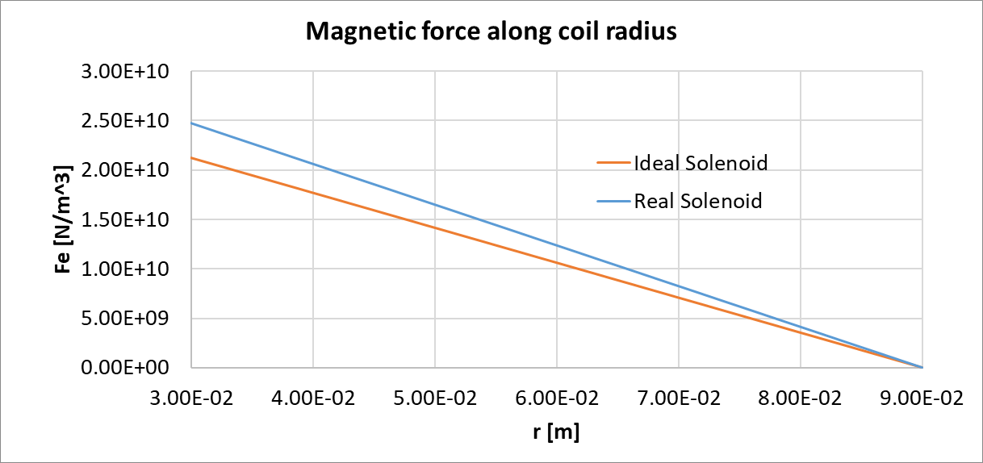

Concept 1 – Shrink-fitted Thick Cylindrical Shell
Finite Element Calculations
The baseline concept is based on encapsulating HTS pancake coils in a thick cylindrical shell, relying on thermally-induced shrink fitting
Linear Elastic Materials; orthotropic, homogenized HTS properties
Thermal condition
    ∆T_{shell} = 200 °C
Electromagnetic Forces
    Ideal Solenoid (${\text{J}}_{\text{ideal}}=\frac{B_{MAX}}{μ_{0}(r_{co}−r_{ci})}$ = 531 A/mm²)
    Real Solenoid (${\text{J}}_{\text{rea}\text{l}}={\text{J}}_{\text{ideal}}\frac{t_{coil}+t_{supportplate}}{t_{coil}}$ = 620 A/mm²)

Slide 9
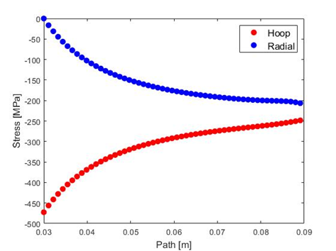
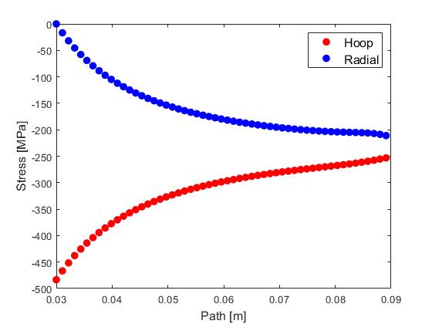
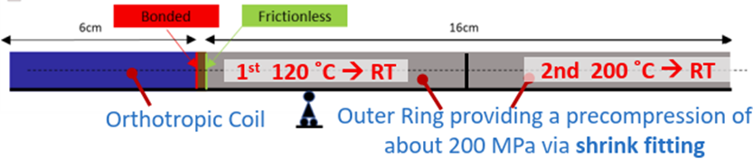
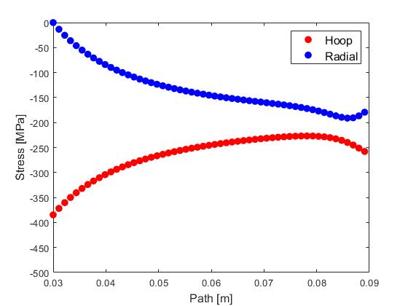
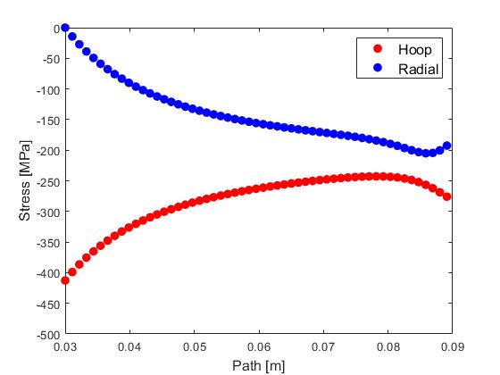
Concept 1 – Hoop and Radial Stresses: Preload and Cooldown
Finite Element Calculations
Achievable pre-compression, due to differential heat contraction and shell pre-heating
Single and double shrink-fit shells studies (to limit high temperature on HTS)
40 μm of Cu (600 turns)
20 μm of Cu (750 turns)
Step 1: Hot cerclage (∆T=200°C)→ similar results with double layer shellwith double layer shell
Step 2: Cool-down

Slide 10
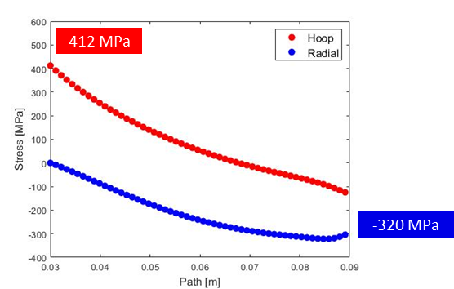
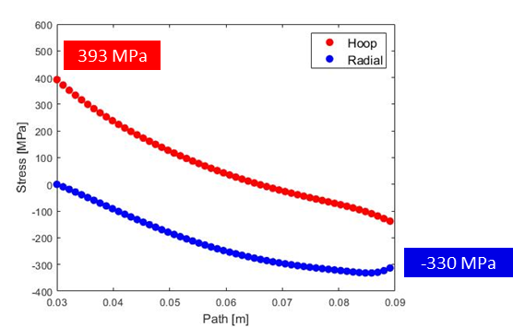
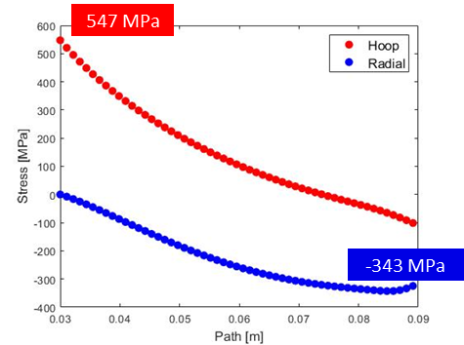
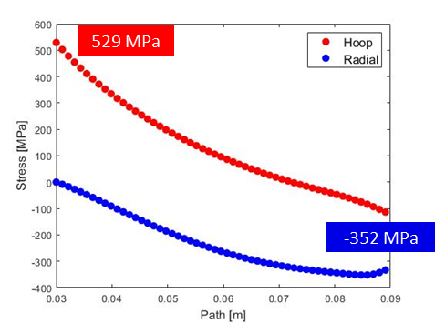
Concept 1 – Hoop and Radial Stresses: Energization
Finite Element Calculations
Final stresses due to energization:
40 μm of Cu (600 turns)
20 μm of Cu (750 turns)
Ideal Solenoid (no support plate)
Real Solenoid→ maximum strain 0.33%

Slide 11
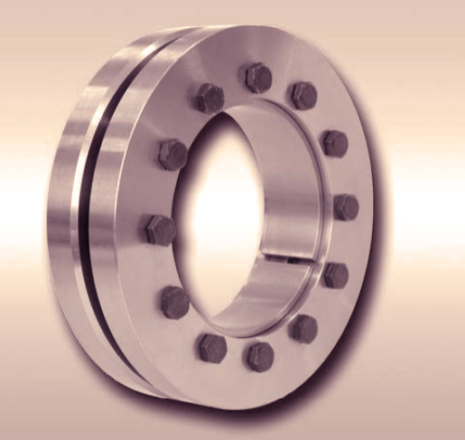
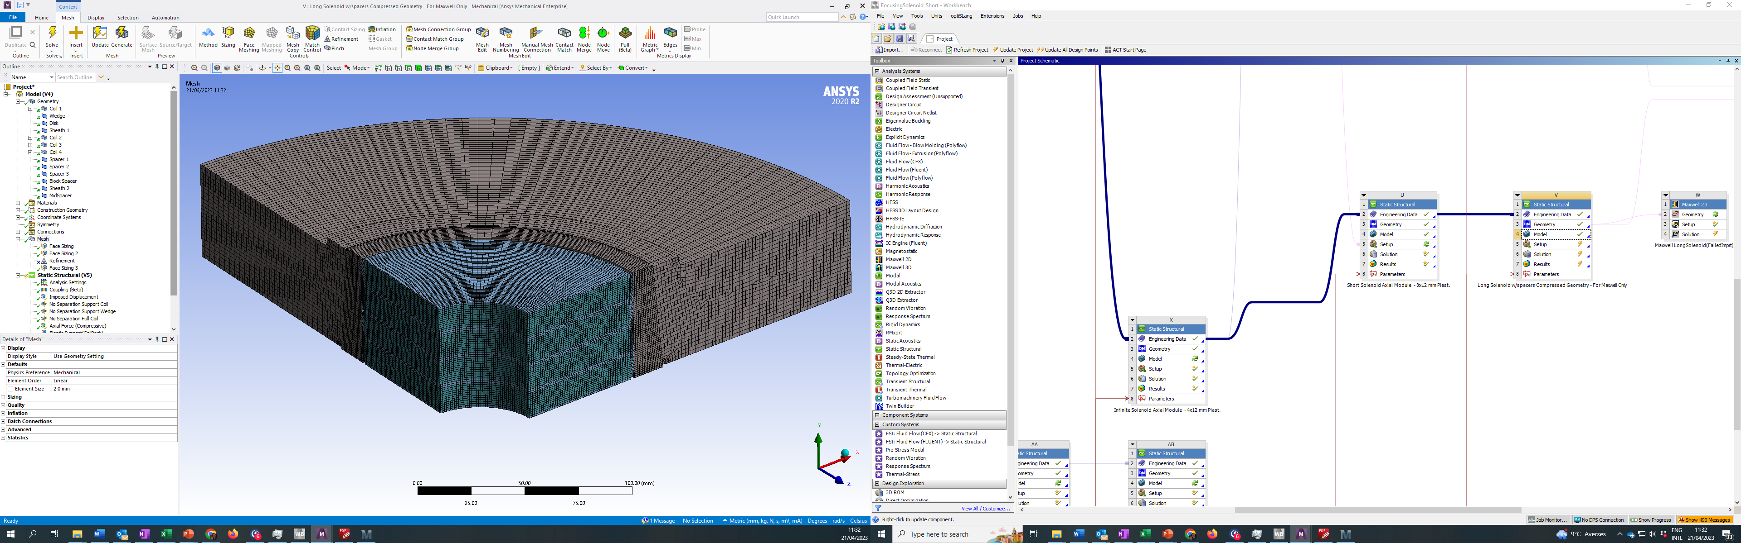
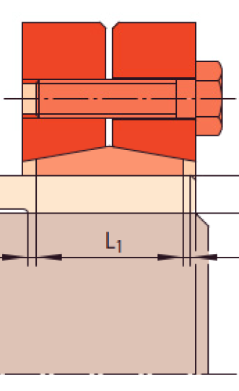
Concept 2 – Conical shrink disk
Finite Element Calculations
Alternative concept is based on a pair of adjustable shrink-discs with conical surfaces
Thicker coils packs can be assembled (up to 8 x 12 mm coils)
16 x M16x1.5 High Strength Bolts (not shown)
High Strength Inconel 718 Disk and Wedge
Stainless Steel Spacers
(2 mm)
OFS Copper Sheath (2 mm)
(elastic-plastic behaviour)
Symmetry Plane (XZ)
2 x 4 HTS Coils
(12 mm tape)

Slide 12
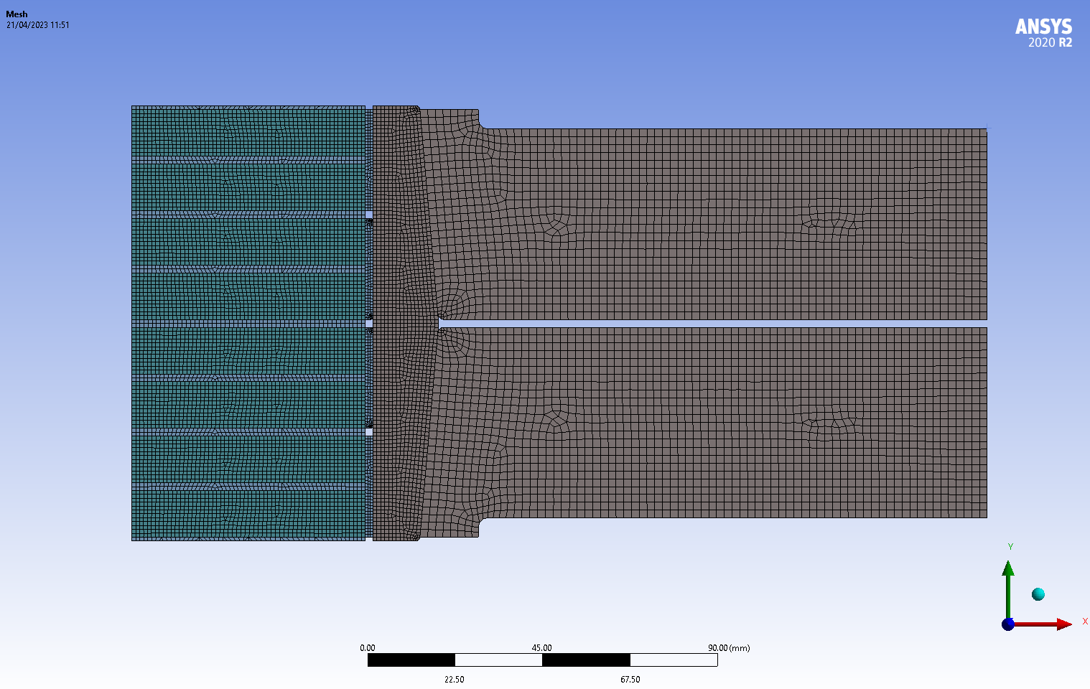
Concept 2 – Conical shrink disk: Geometry
Finite Element Calculations
Main Dimensions
Coil ID 60 mm
Coil OD 180 mm
Disc OD 500 mm
Coil Pack Height 112 mm

Slide 13
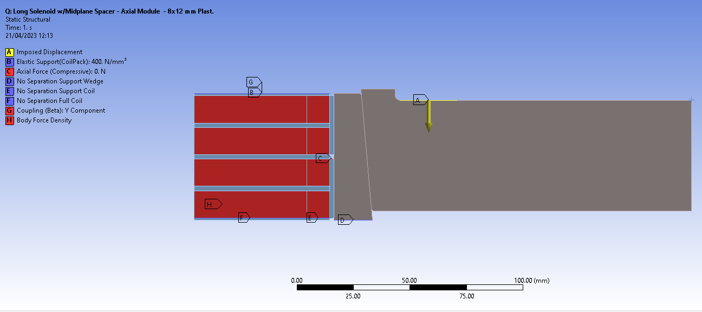
Concept 2 – Conical shrink disk: Boundary Conditions
Results
Imposed Displacement: 5 mm
615 A/mm² Uniform Current Density
(24.1 N/mm³ Peak Force)

Slide 14
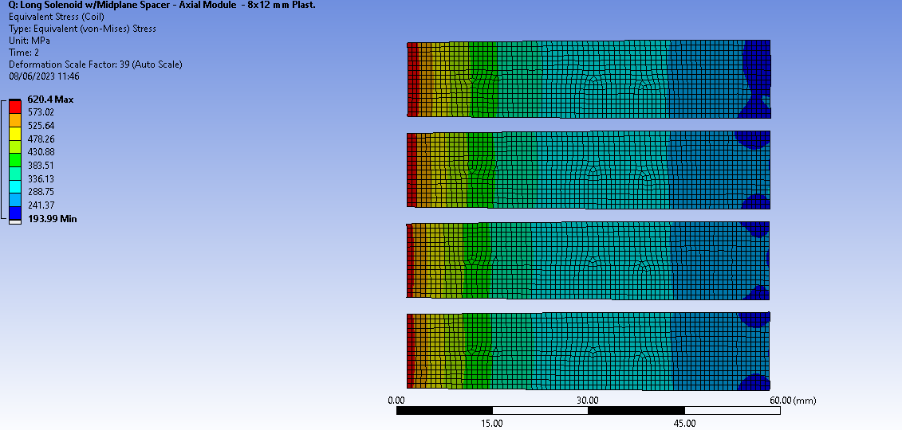
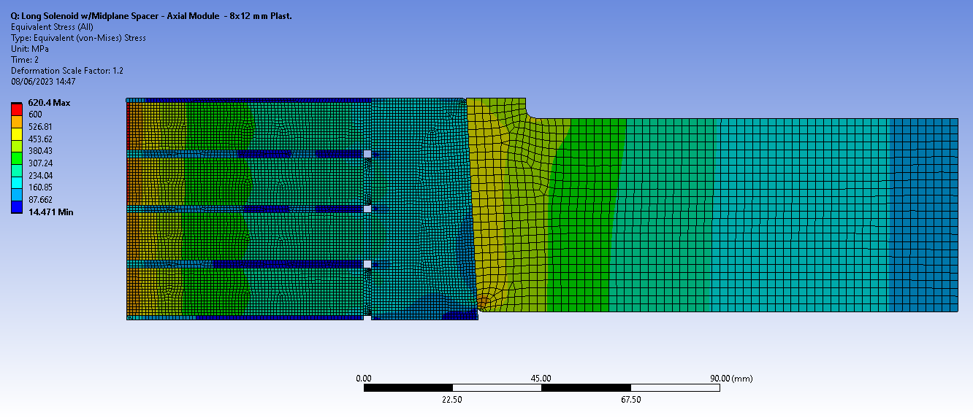
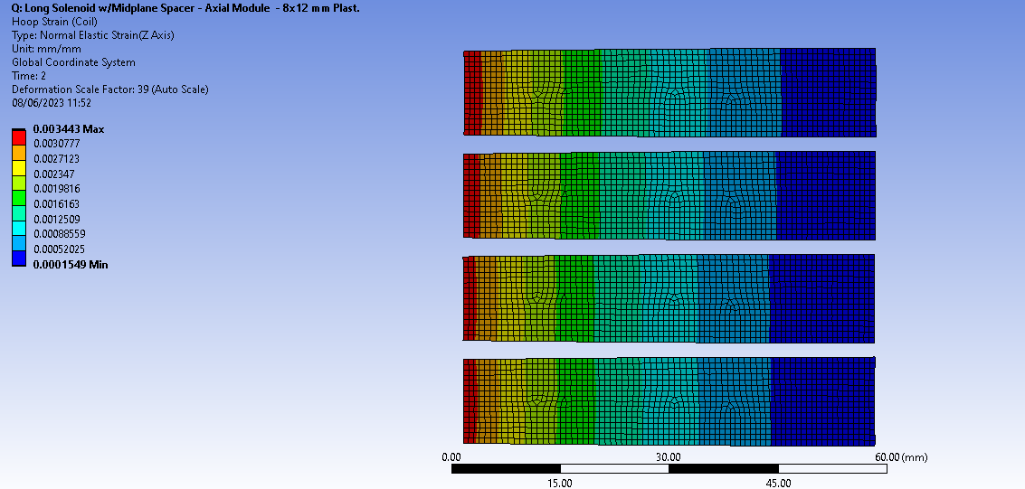
Concept 2 – Conical shrink disk: Hoop Stresses and Strains
Finite Element Calculations
2 Load Steps:
  Shrink Disk displacement (5 mm)
  Energization
Max. Hoop Stress (after energization): 620.4 MPa
Max. Hoop Strain (after energization): 0.344 %

Slide 15
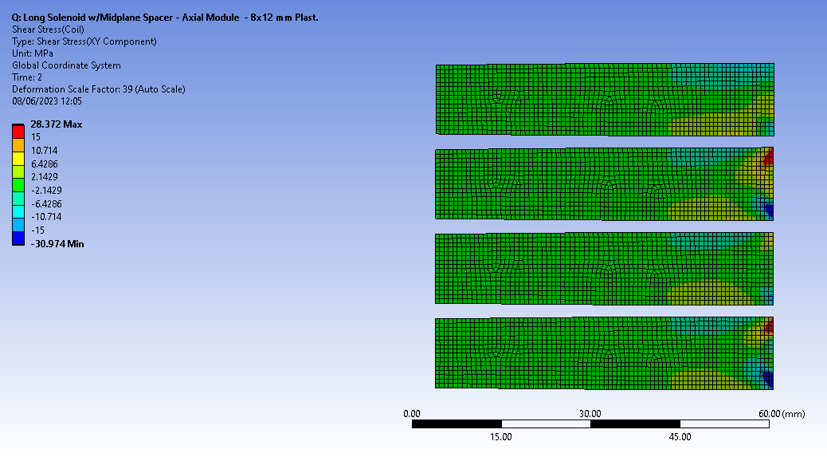

Concept 2 – Conical shrink disk: Shear Stresses
Finite Element Calculations
Shear Stresses globally lower than 15 MPa
However, locally they can reach after energization ~ $\left|30\right|$ MPa

Slide 16
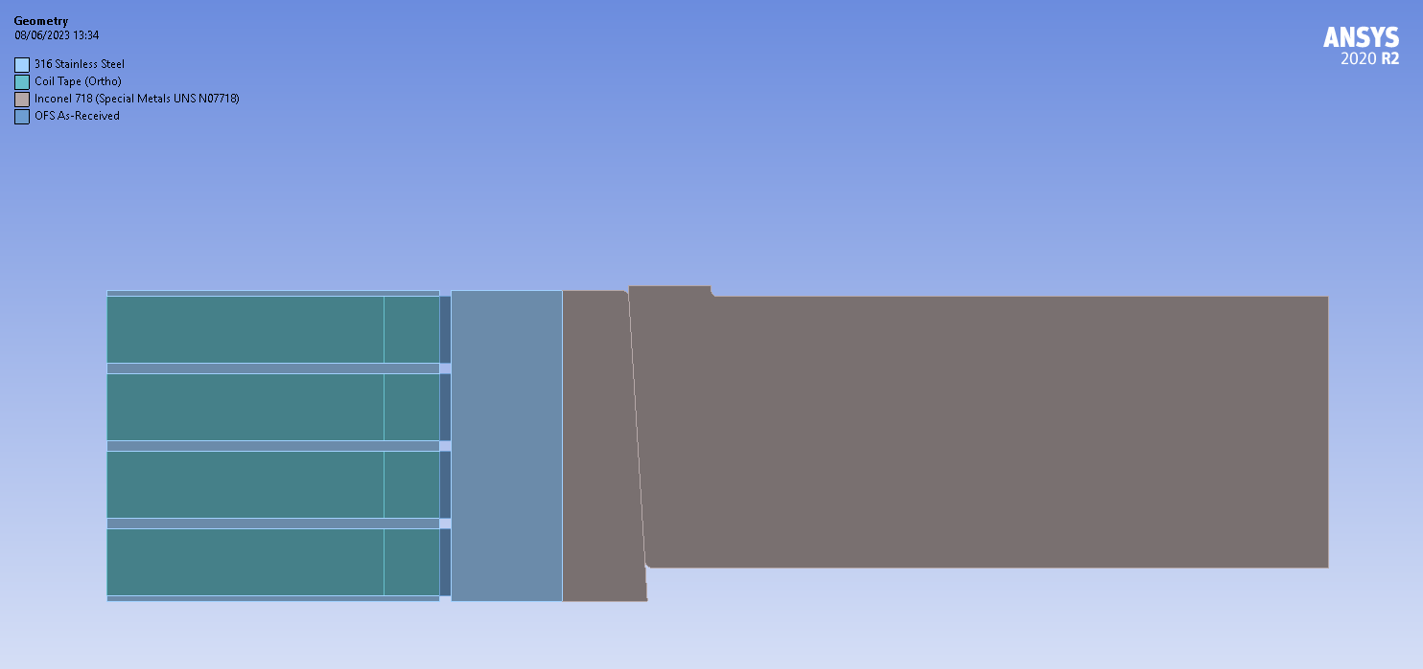
Concept 3 – Hybrid Solution (Shell and Shrink Disk)
Finite Element Calculations
To limit shear stresses, an intermediate steel shell is added (ID 184 mm; OD 224 mm)
~ 150 µm interference with coil pack created by differential heating
3 Load Steps: 1. Shell/Coil Interference; 2. Shrink Disk Displacement (2.2 mm); 3. Energization
Stainless Steel Intermediate Shell
(2 mm)

Slide 17
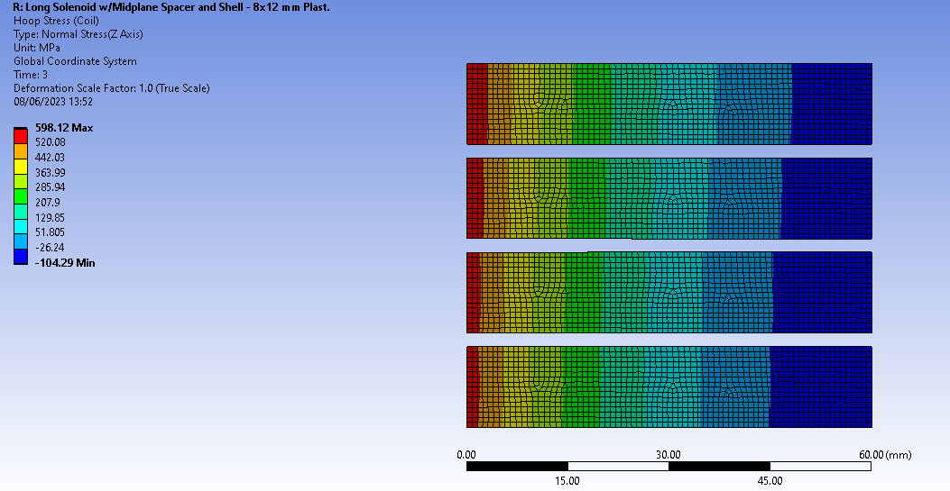
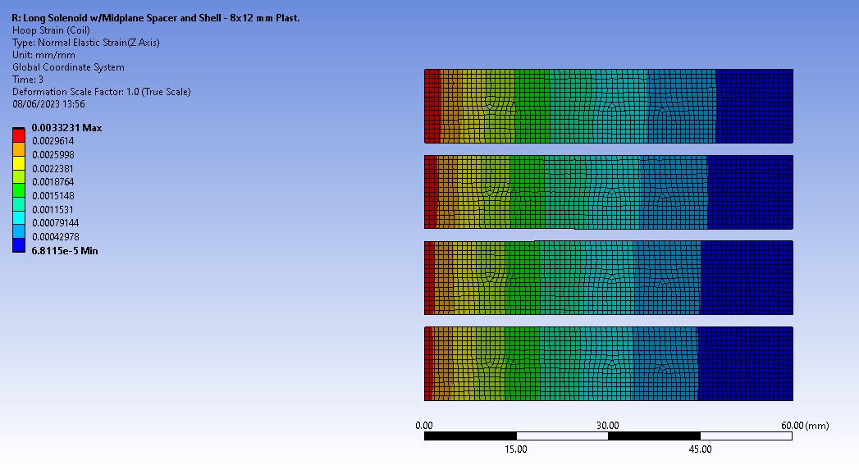
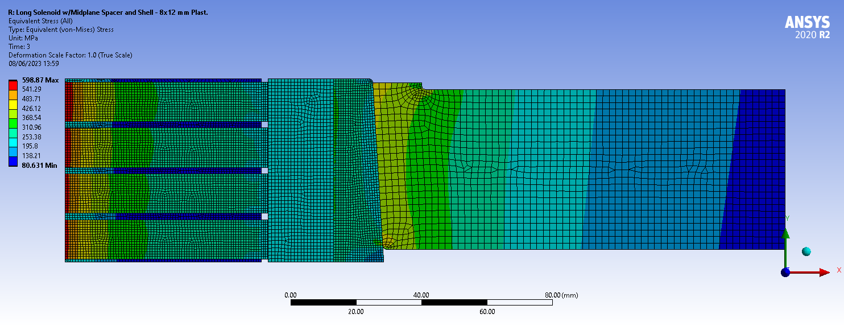
Concept 3 – Hybrid Solution: Hoop Stresses and Strains
Finite Element Calculations
Min. Hoop Stress after shrinking: -426 MPa
Max. Hoop Stress after energization: 598 MPa
Max. Hoop Strain after energization: 0.332 %

Slide 18
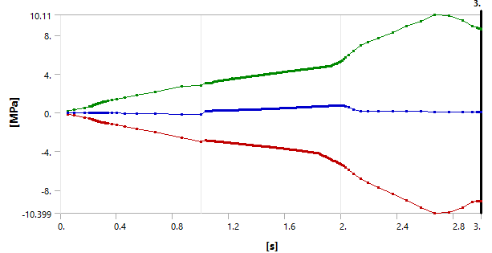
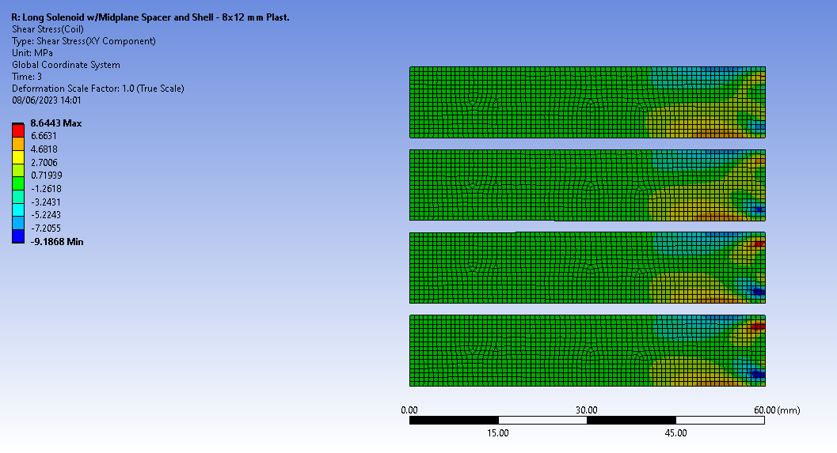

Concept 2 – Conical shrink disk: Shear Stresses
Finite Element Calculations
Local peak shear stress ~ 10 MPa
Max Shear after energization $\left|9.2\right|$ MPa

Slide 19
Mechanical Concepts Pros and Cons
Proposal
Concept 1 - Pros
  Simple
  Limit shear stresses
Concept 1 - Cons
  Requires tight tolerances (~ 2 MPa/µm)
  Cannot be adjusted
  Several coaxial shells necessary to limit Tmax on Coil (if overheating is applied)
Concept 2 – Pros
  Easily adjustable
  Tolerances less critical
  Thicker coil packs can be assembled (up to 8 × 12 mm coils)
Concept 2 – Cons
  High shear stresses locally induced
  Requires control of friction coefficient between conical surfaces ⇒ if lubrication not admissible, hard coatings likely required
Concept 3 – Pros
  As concept 2 with limited shear stresses
Concept 3 – Cons
  Somehow similar to concept one, though lower temperatures and less tight tolerances are required (thanks to adjustment)

Slide 20
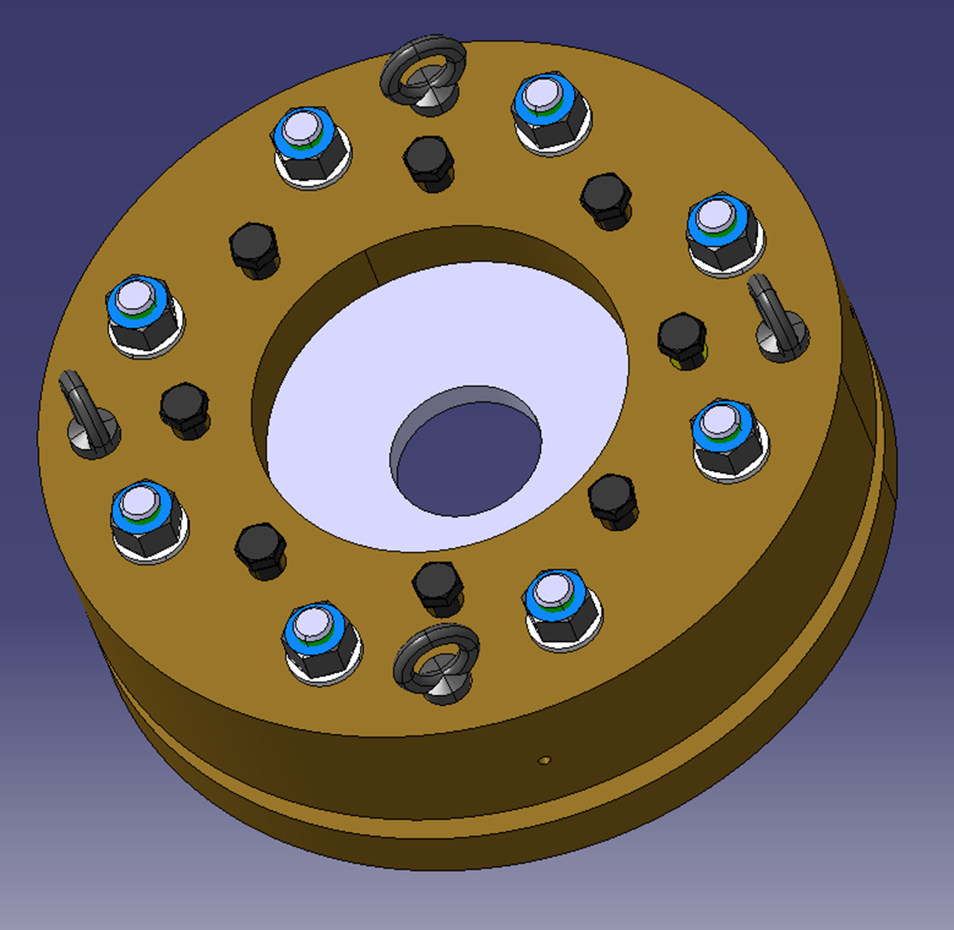
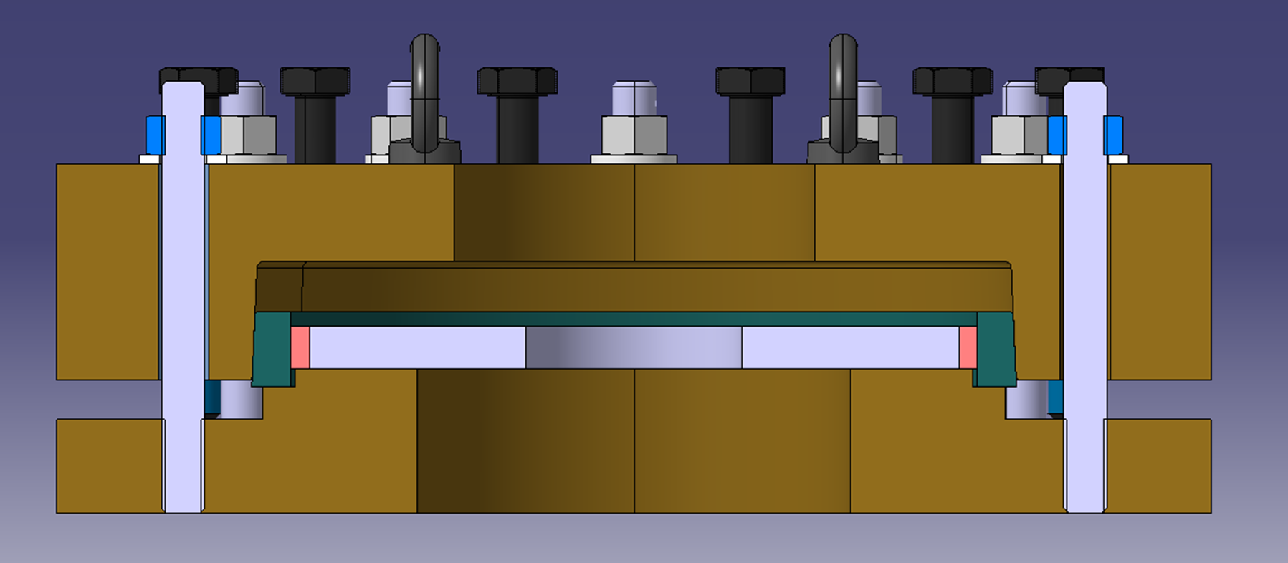
What’s next?
Proposal
Further design optimization necessary, particularly to limit shear stresses
For concepts 2 and 3, key to limit friction coefficient on sliding surfaces (0.1 assumed): R&D on hard coatings to be launched
Reliability/applicability of admissible limits found in literature to be confirmed
Necessary to characterize mechanical properties of representative coil samples to validate this concept ⇒ a compressive jig with controlled compressive force is proposed to test pancake coil (customized design based on Shrink Disc concept) at EN-MME Mechanical Measurement Lab

Slide 21
Thanks for your attention

Slide 22
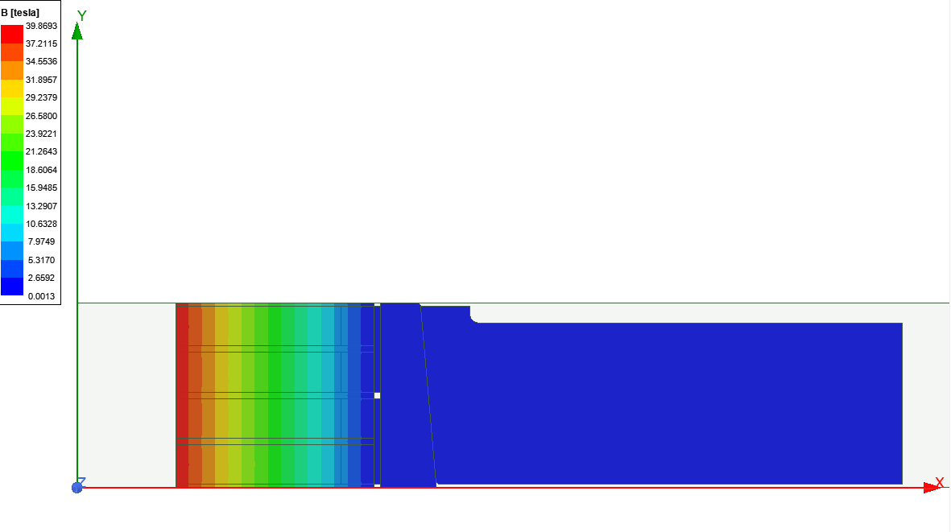
Magnetic Field with Double Symmetry BC (Long Solenoid)
Finite Element Calculations

