Slide 1
A Taste of Nuclear Structure from an Experimental Point of View
(in two lectures)
😳
Sean J Freeman EP Department, CERN and Department of Physics and Astronomy, the University of Manchester
n_TOF Winter School 2023

Slide 2
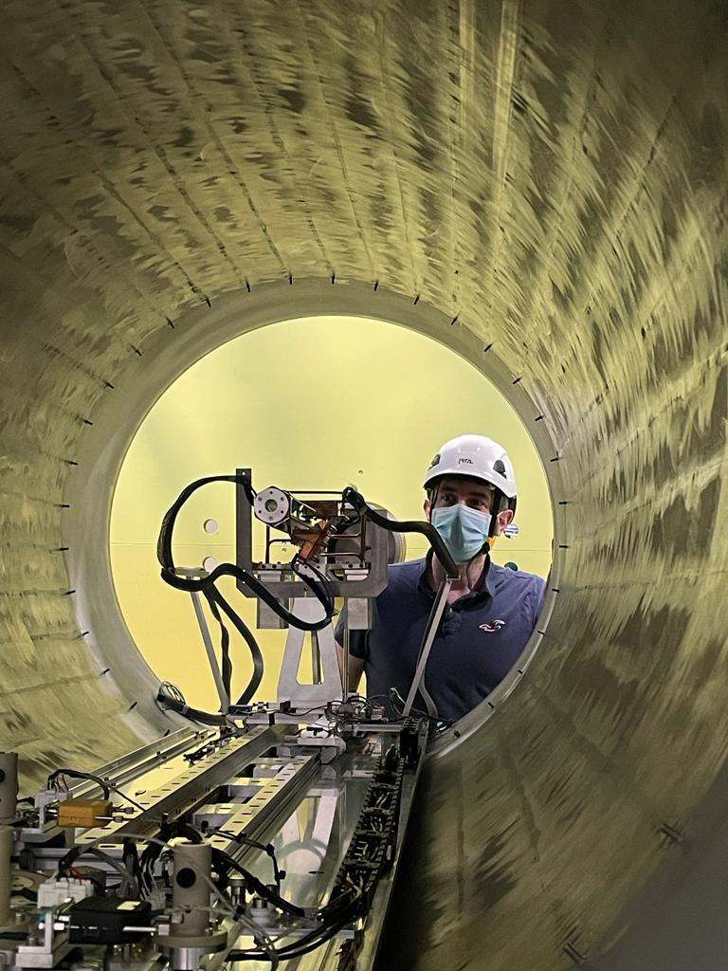
Plan of Action
Keep it simple and give a flavour of WHY/WHAT/HOW of nuclear structure.
Back to basics: what is a nucleus?
nucleus as a quantum system, single-particle and collective structure, exotic nuclei – not comprehensive, just a flavour!
What characterises a nucleus and how do we study them?
nuclear properties, nuclear reactions, historical context, stable and exotic ion beams.
Case study: some recent example measurements from ISOLDE@CERN – will push the boundaries of nuclear structure into other areas
Perspectives.
PHYSICS
EXPERIMENTS
⚠️ - taking an experimental, intuitive, pedagogical, heuristic approach – with lots of “cartoon” explanations!

Slide 3
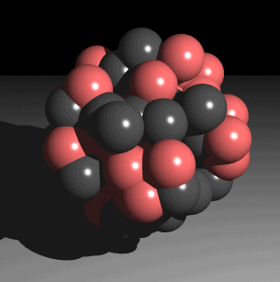
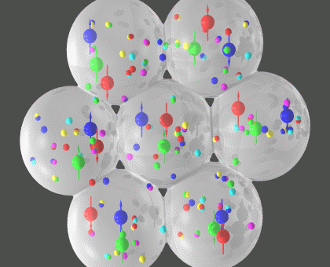
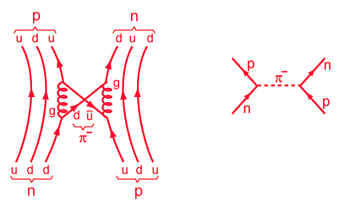
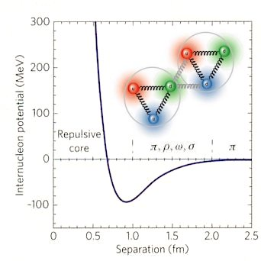
What is a nucleus?
Protons (charged) and neutrons; nucleons.
Electrostatic repulsion vs strong attraction.
Nucleon incompressibility, r=1.2A^{1/3} fm.
Looks static, dull and uninteresting.
Quantum mechanics makes it much more dynamic – see next.
N-N binding force that depends on separation, spin orientation, and relative momentum with tensor, non-central and exchange contributions.
In-medium effects make things even more complex with three-body forces and higher order contributions.
π
Δ
π
N₁
N₂
N₃

Slide 4
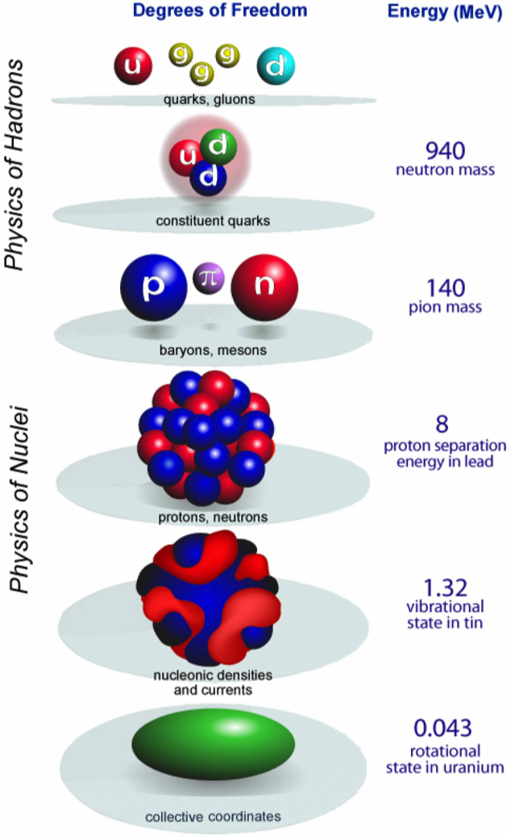
Challenges in nuclear structure
Describe a many-body system using quantum mechanics where particles interact via a complicated force.
In principle, could operate like solving hydrogen atom.
Ab-initio Models: write down the Schrödinger equation for each nucleon including interactions with all other nucleons using nucleon-nucleon interaction – complex coupled equations.
Calculations beyond A=12 become difficult; with a good form of the N-N force:
⁴He takes ~1 cpu-hour
⁸Be takes ~300 cpu-hour
¹²C takes ~70,000 cpu-hour (8 years!)
In principle, could operate like solid-state physics and use statistical mechanics, but not enough 300 particles rather than 10²³!
Some analogy with a liquid droplet, can approach macroscopically.

Slide 5
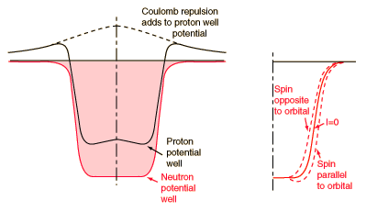
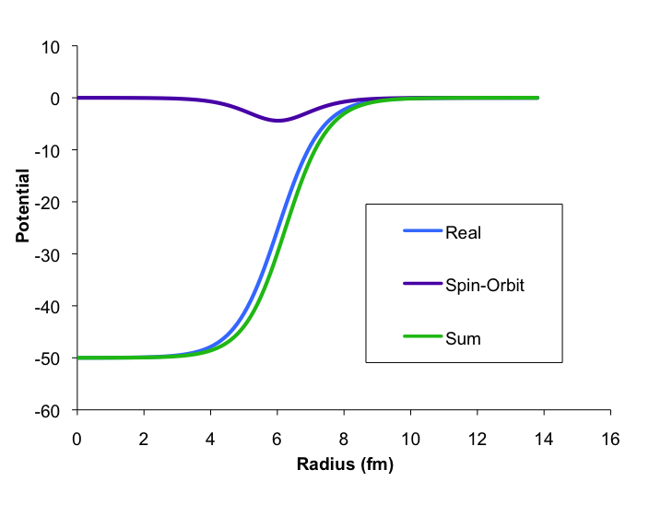


Mean-field approaches to single-particle structure
Example of potentials for a neutron bound to a ¹¹²Sn nucleus
Mean-field potential: assume that all the interactions with all the other nucleons averages out to some potential that only depends on the coordinates of the nucleon in question. Schrödinger equation separates into single nucleon equations.
Hartree-Foch is one theoretical tool – but you can guess the general form!
The nuclear shell-model uses a simple approach with a harmonic oscillator potential with a spin-orbit interaction – could use anything that is a complete basis set!
Spin-orbit interaction is a famous addition from 75 years ago that “fixes” the magic numbers.
Run the now easy quantum mechanics and get levels in the well…

Slide 6
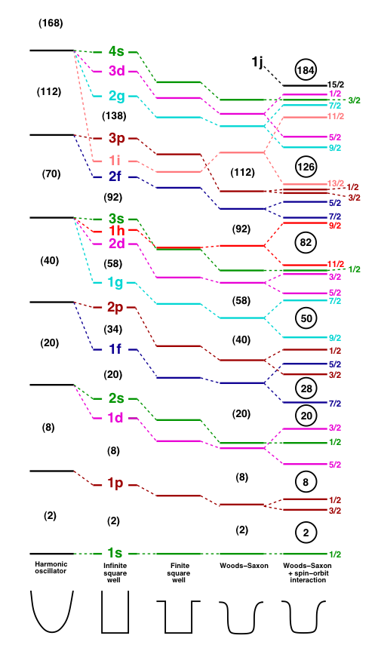
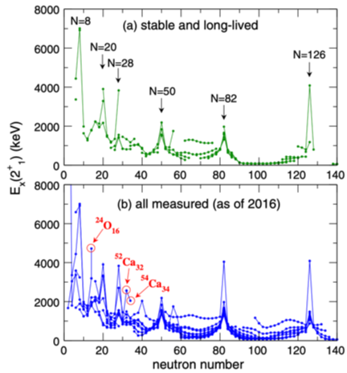
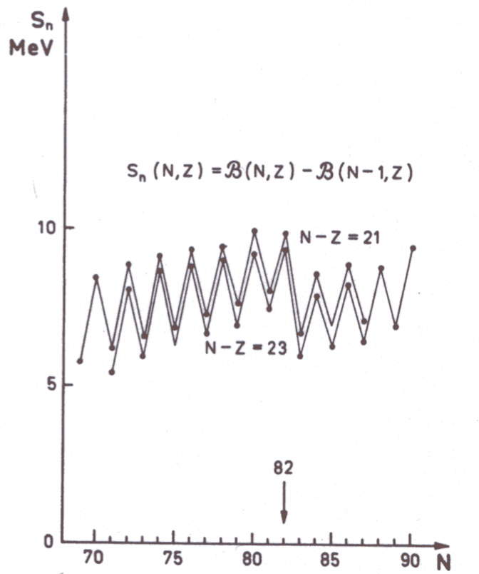
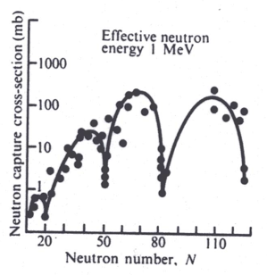
Magic numbers
Nucleons as fermions fill single-particle levels…clumping of levels causes jumps in nuclear properties.
from Rev. Mod. Phys. 92, 015002 (2020)
(STABLE) Magic numbers 2, 8, 20, 28, 50, 82 and 126
But starting to these disappear and new ones appear away from stability.

Slide 7
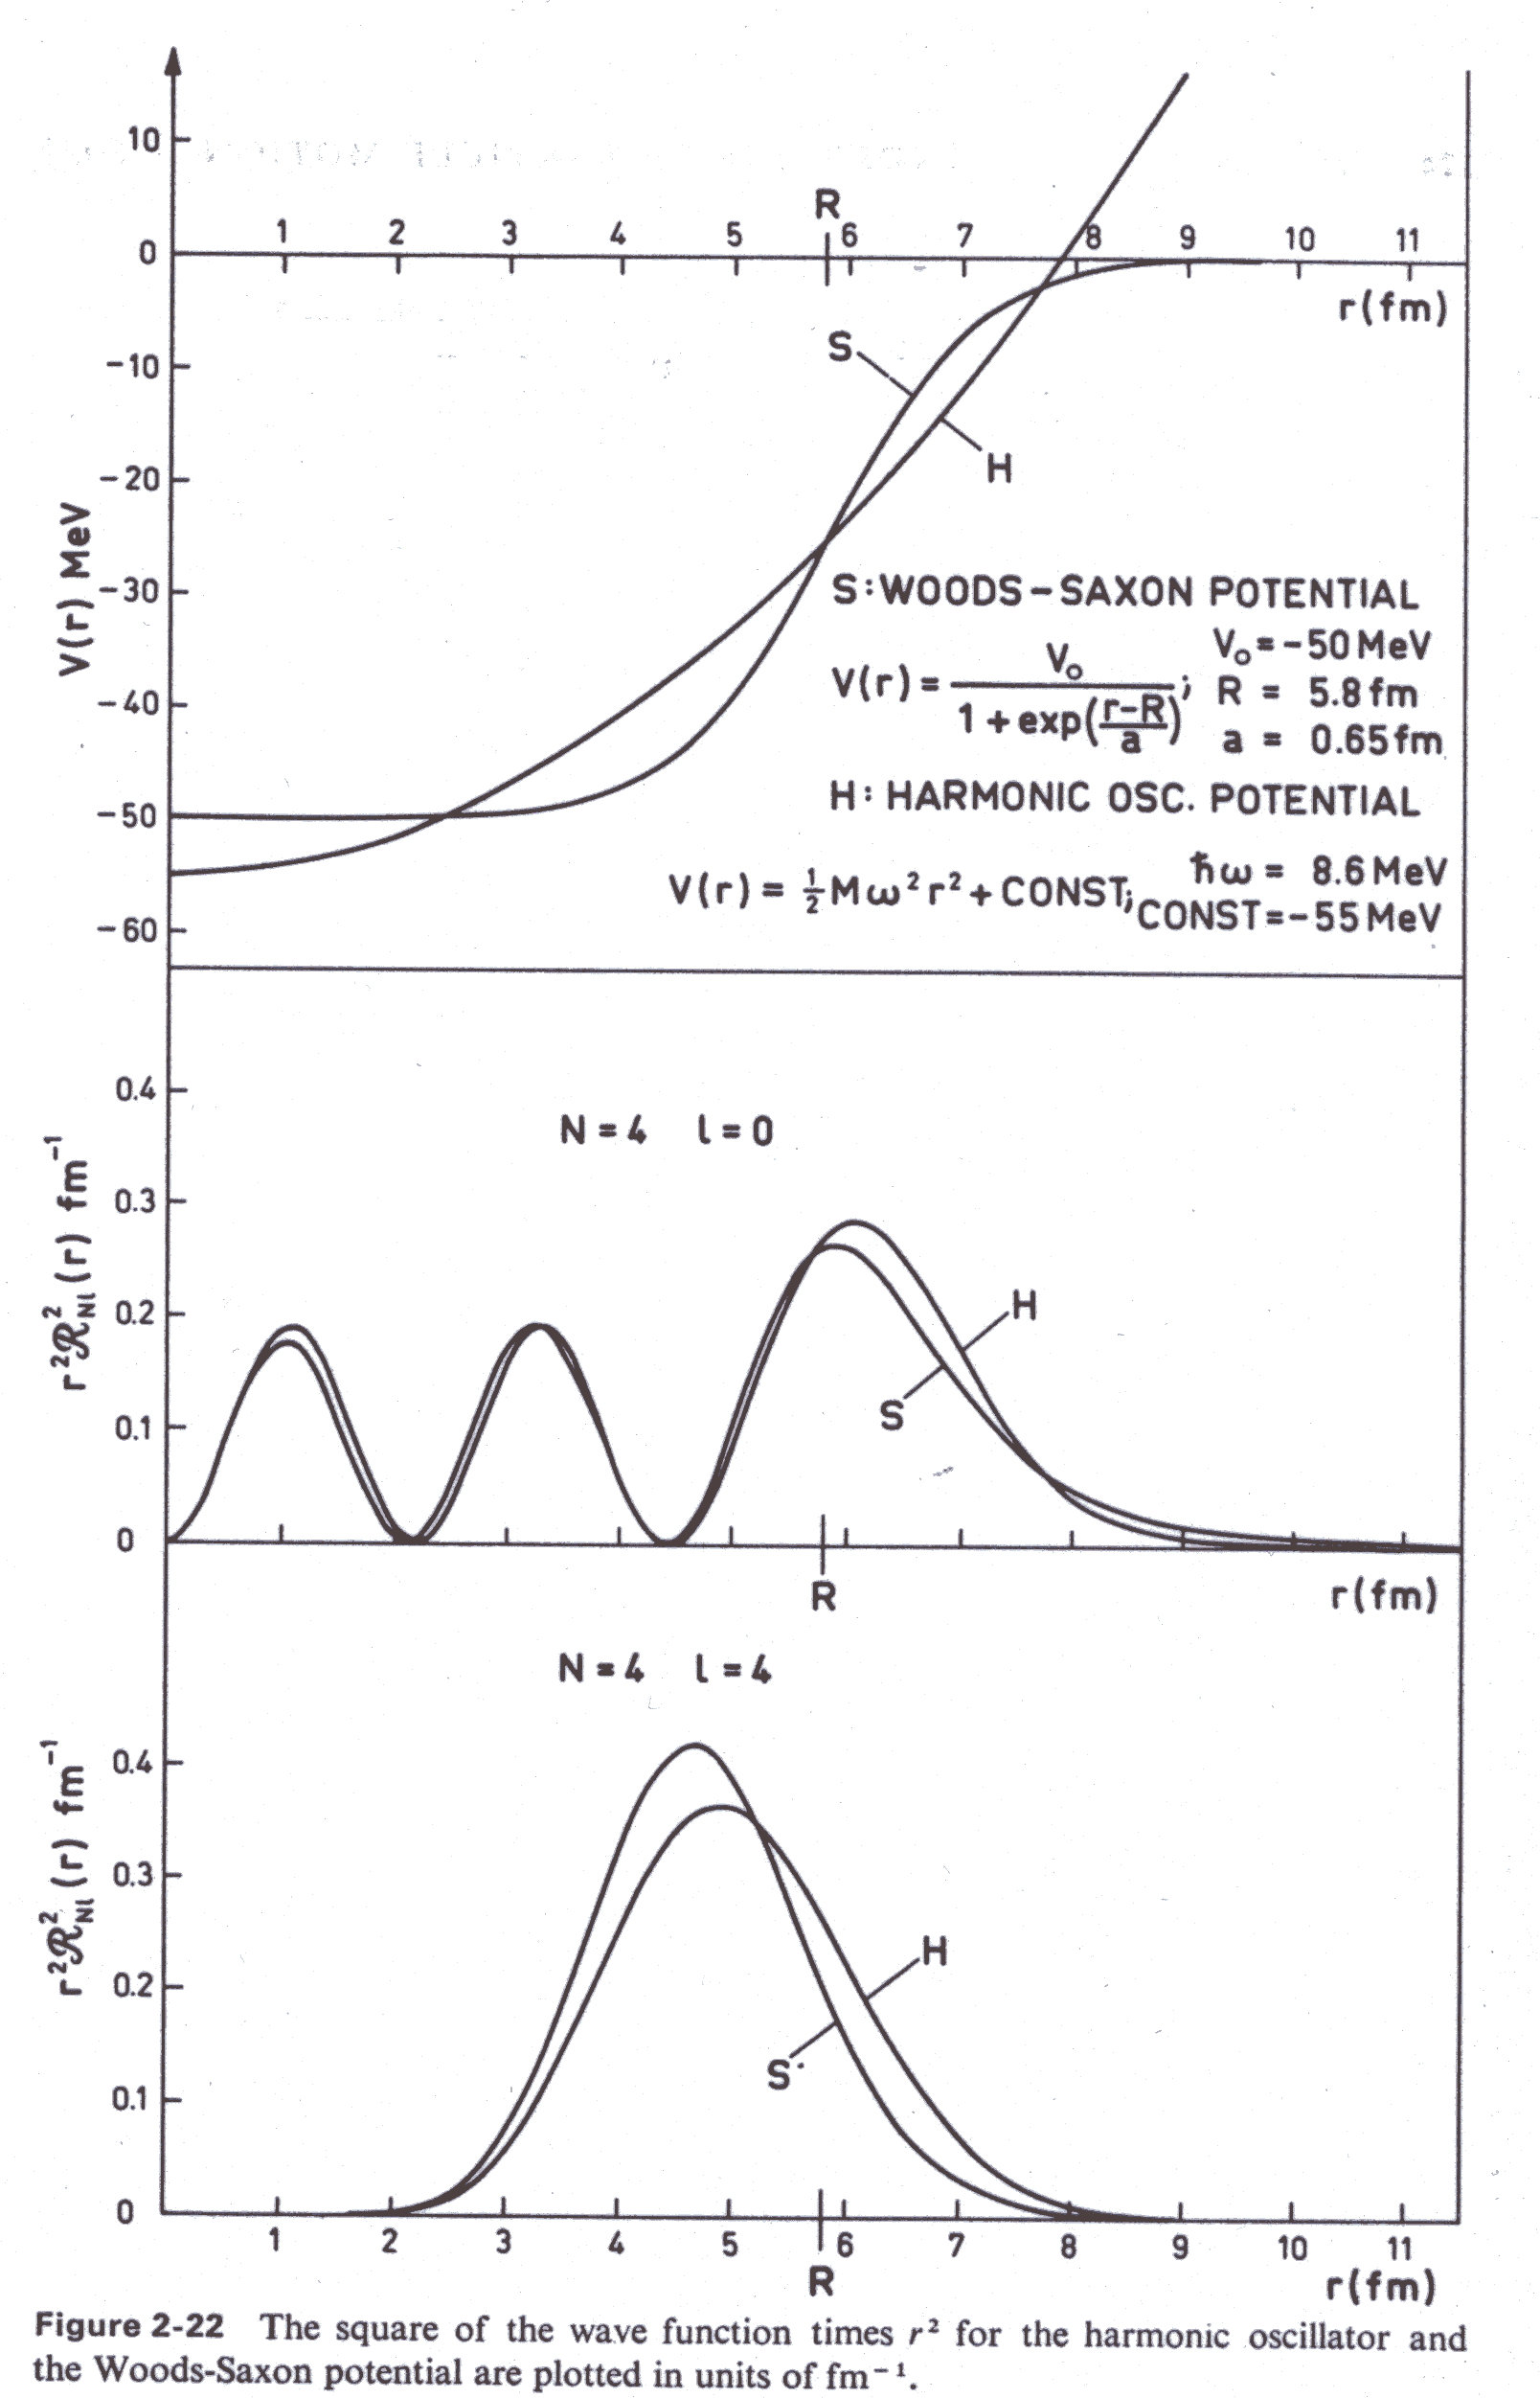
Independent-particle model:
Single-nucleon wavefunctions characterised by:
n, l, and j quantum numbers.
Nuclear wavefunction constructed using products of single-nucleon wavefunctions coupled to give the right spin and appropriately anti-symmetrised.
BUT – extremely limited success in describing experimental data.
Essentially just spin-parities of a few nuclei around closed shells along the line of stability.

Slide 8

Beware the residual interaction:
The nucleus is made up of A nucleons:
Depends only on
coordinates of one nucleon, i
one-body operator
Limit to
two-body interaction – ignoring 3-body forces already!
Invent an AVERAGE or MEAN-FIELD POTENTIAL:
Depends on the motion of nucleons i and j, i.e. the associated single-particle quantum numbers, and builds “correlations” between nucleons.
Scatters from below Fermi surface to above (later!).
KE plus mean-field potential are
one-body operators
generates IPM configurations as a basis set
the residual interaction, contains the two-body terms that mixes the basis sets.
You cannot ignore the residual interaction – nuclear shell model uses phenomenological residual interactions and matrix diagonalization to solve the problem – results are admixtures of independent-particle configurations.

Slide 9
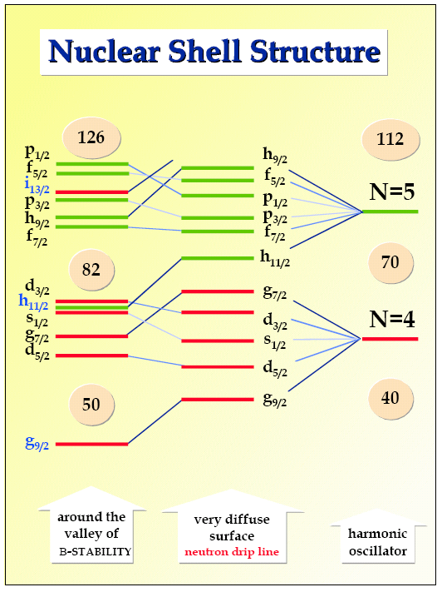
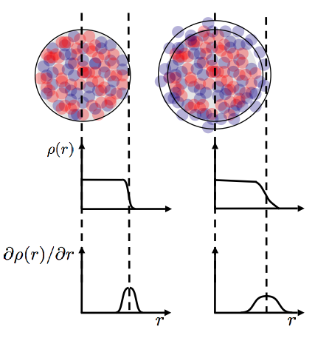
Expectations in very exotic nuclei:
When adding nucleons can expect the system to become less well bound; final nucleons can wander more: surface becomes more diffuse.
Changes in diffuseness of mean-field potential near neutron drip line may influence spin-orbit interaction:
Nuclei with neutron haloes have been observed!
J.Dobaczewski et al. Prog.Part.Nucl.Phys. 59 432 (2007)

Slide 10
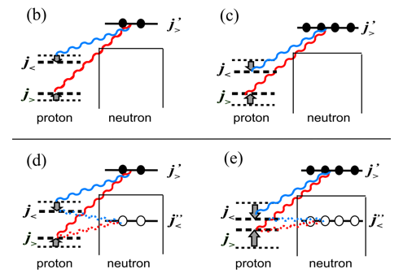
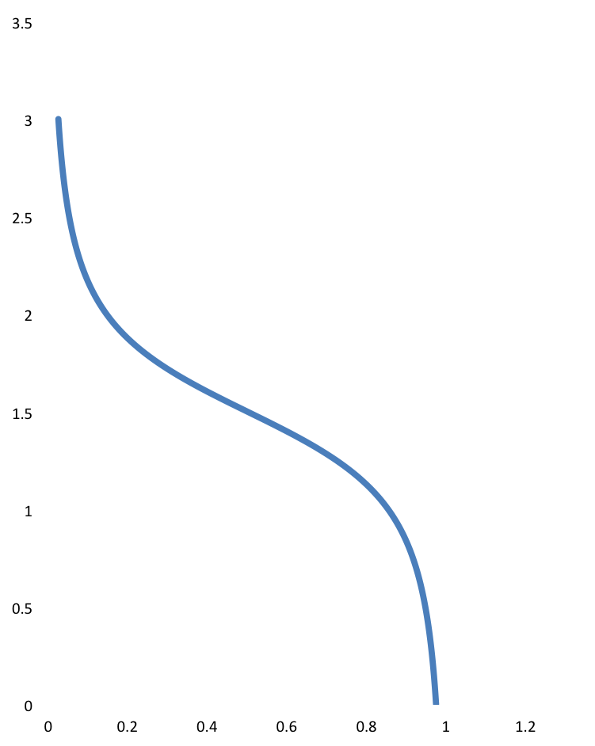
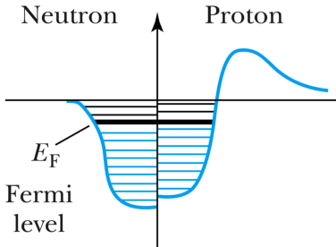
Shell evolution
Different isotopes have different N/Z
Fermi surfaces sample different single-particle orbitals.
Correlations between nucleons depend on their orbitals, expect to different nuclear structure in different nuclei.
In IPM, protons and neutrons fill the levels according to Pauli, e.g. stable mid-shell nucleus with N>Z.
ε
λ
V²
Potentials around 50 MeV deep (nucleon scattering).
Energy in N-N residual interactions
<< 7 MeV (binding energy per nucleon).
Residual interactions scatter nucleons from orbitals around the Fermi level.
from Rev. Mod. Phys. 92, 015002 (2020)
Expect changes in shell structure of protons/neutrons as you move along a chain of isotones/isotopes – sometimes enough to create or destroy magic numbers
Expect differences in the overall effect of residual interactions when you excite nucleons within a nucleus.

Slide 11
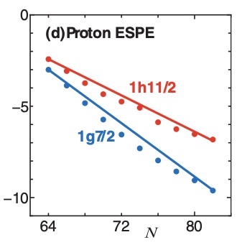
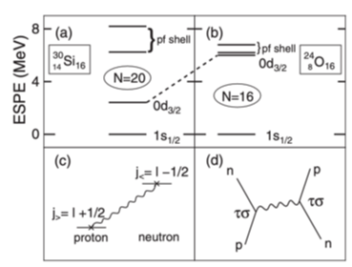
Shell evolution
^{16,18}O are stable!
As chains of isotopes and exotic nuclei are probed, beginning to see examples of phenomena.
Proton states in Sb isotopes probed by gently adding a proton to Sn targets in a transfer reaction.
²⁵O produced in single-neutron knockout reaction from ²⁶O. Ground-state mass reconstructed from the reaction products; difference with ²⁴O tells you the d_{3/2} energy.
h_{9/2}
h
h_{11/2}
g_{7/2}
g
g_{9/2}
Neutrons filling h_{11/2} tensor interactions with proton orbitals.
from PRL 92 (2004) 162501
Other examples of new magic numbers starting to emerge e.g. N=32 and N=34 in calcium isotopes.
from Rev. Mod. Phys. 92, 015002 (2020)
Prompted discussions of what makes a magic number and what quantities characterise them?

Slide 12
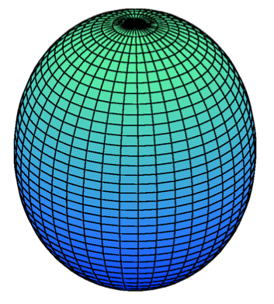
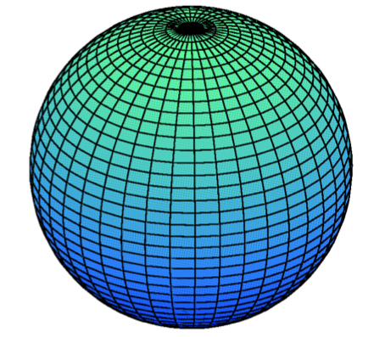
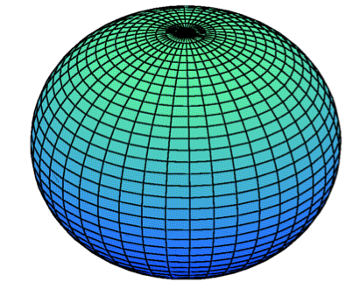
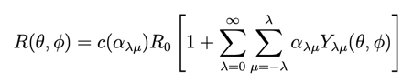


Collectivity and nuclear shape
Example: quadrupole shapes
For a nucleus corresponding to a shell closure, large jump from Fermi level to the next empty orbital – effect of residual interactions low and IPM works (a little) better.
Going away from a closed shell, with increasing numbers of (valence) nucleons outside the shell, the correlations between them increase and can have macroscopic effects on the nuclear structure, distorting the surface.
Distortions of the nuclear surface described by a spherical harmonic expansion – good angular momentum:
Excitations can arise if the shape changes with time – NUCLEAR VIBRATIONS.
Spherical
Oblate
Prolate
Permanent distortions lead to NUCLEAR SHAPE and excitations can arise from ROTATIONS of that shape.
Given the nucleus has a charge – distortion results in electromagnetic moments, which can be probed experimentally in some nuclear reactions or by their effect on electron levels in the associated atom/ion (see later!).
Coherence in the admixtures of single-particle configurations can greatly increase some observables – e.g. electrostatic moments, e/m transition rates...

Slide 13
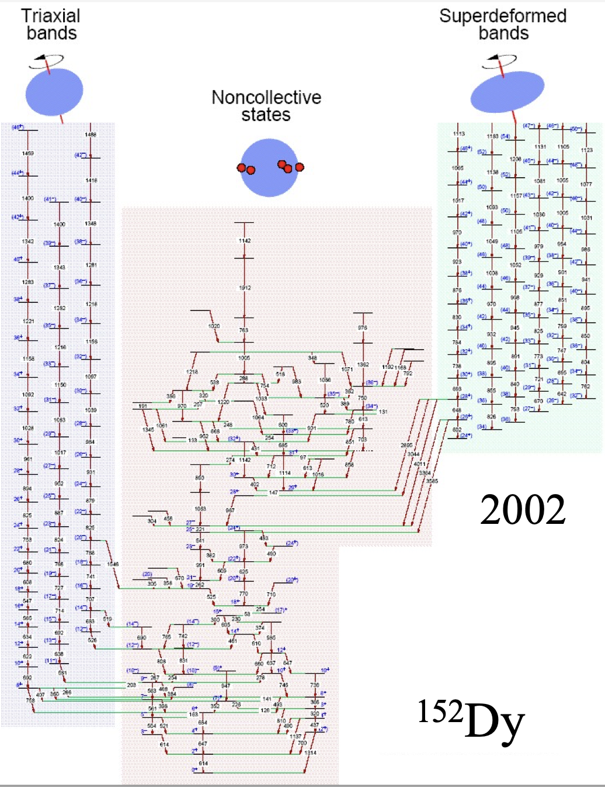
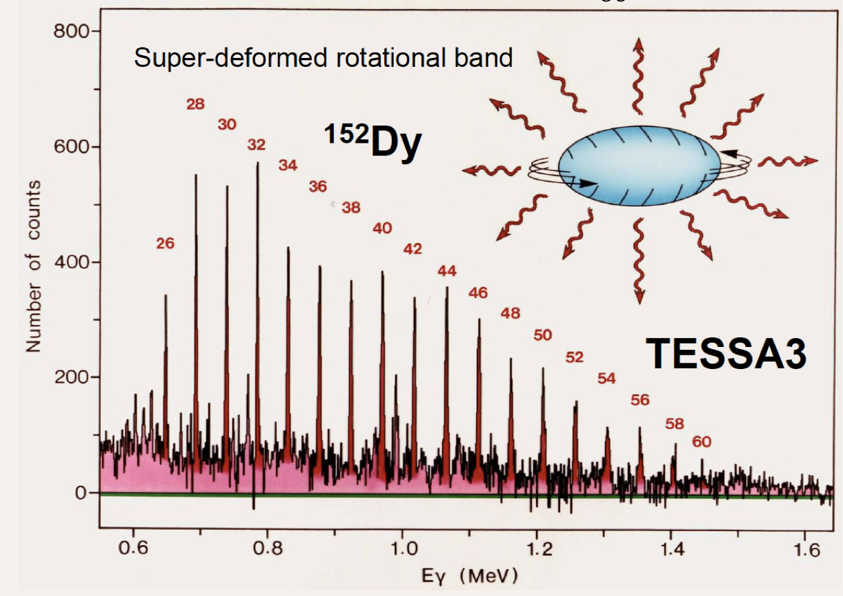
Vibrations and rotations
Harmonic vibrators give equally spaced energy levels.
Rotational levels proportional to I(I+1) – gaps between them as I.
e/m transition strengths between levels (deduced by measuring the lifetime of the excited state) are also characteristic.

Slide 14
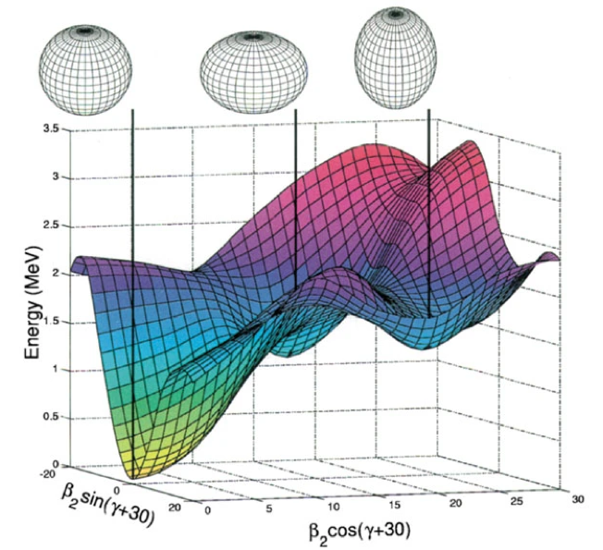
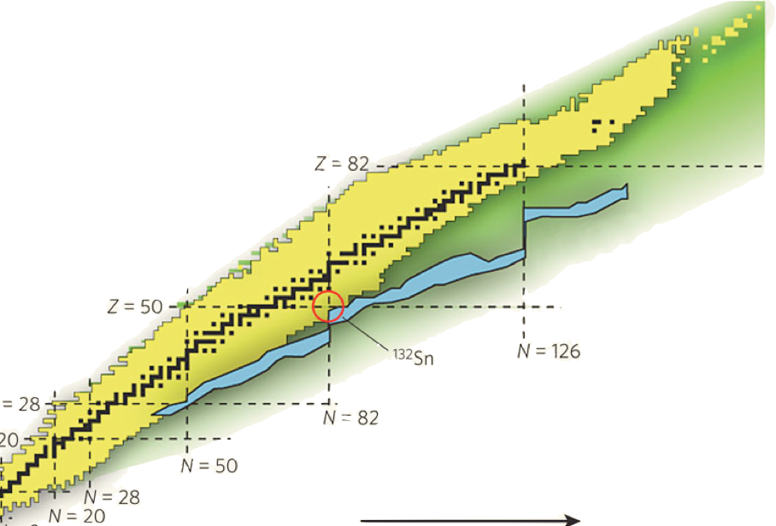
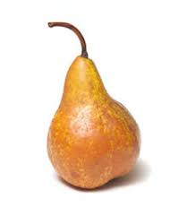
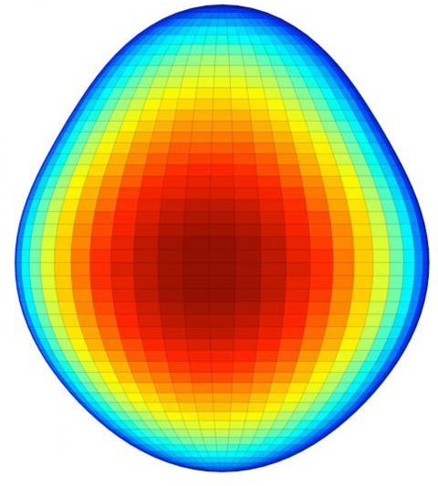
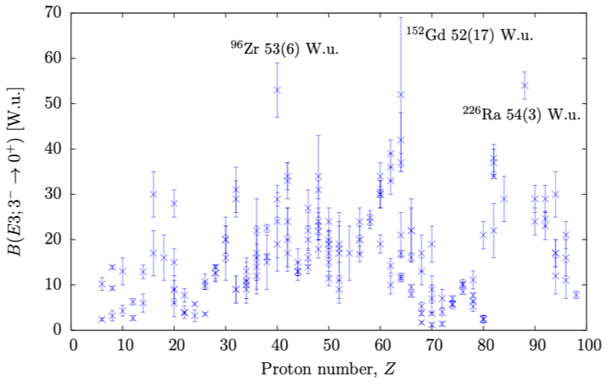
Shape evolution and coexistence
We saw that the effect of residual interactions changes along chains of isotopes/isotones and within excited states in the same nucleus – these also drive evolution in nuclear shape.
You need to access particular (N,Z) to study certain shapes.
EXAMPLE: octupole or pear-shaped deformation related to correlations induced by a Y₃ operator, strong between orbitals of opposite parity and ∆J, ∆L = 3 close to the Fermi level.
.
184
N/Z
134
Z = 88
126
88
Z = 56
82
N = 134
Z = 34
56
N = 88
50
N = 56
EXAMPLE: spherical, oblate and prolate shapes exist as different excited states in the same nucleus¹⁸⁶Pb.
N = 34
34
28
20
Figures curtesy of Liam Gaffney, Liverpool
A.Andreyev et al., Nature 405, 430 (2000)

Slide 15
Pause for thought:
How can we understand the forces binding nuclei?
How do these forces lead to the microscopic structure of nuclei?
How do macroscopic structures arise in nuclei?
What are the limiting conditions for the nuclear binding and what phenomena emerge at the limits?
What impact does nuclear structure have on other areas such as the origin of the chemical elements and fundamental physics?
nuclei = a complex, many-body problem bound with complicated strong force.
relatively simple structures emerge from this complexity.
correlations between nucleons are very important.
nuclear structure has microscopic (single-particle) and macroscopic (collective) features.
the only bound system of two different fermions – the proton/neutron Fermi surfaces sample different single-particle orbitals and the resulting correlations support different structures.
leads to an evolution of shell structure, nuclear shape and shape coexistence.
expectation of strange effects in the most exotic, least bound systems near the proton and neutron driplines.
Nuclei far from the line of stability hold the keys to answering these questions.
How do we access and study exotic nuclei?.

Slide 16
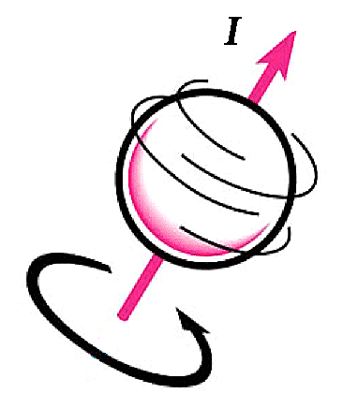
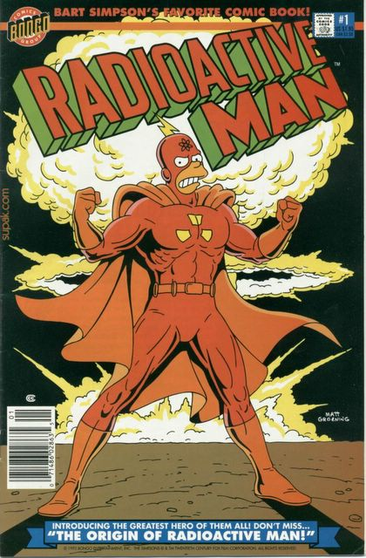
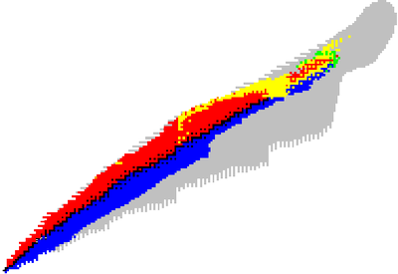
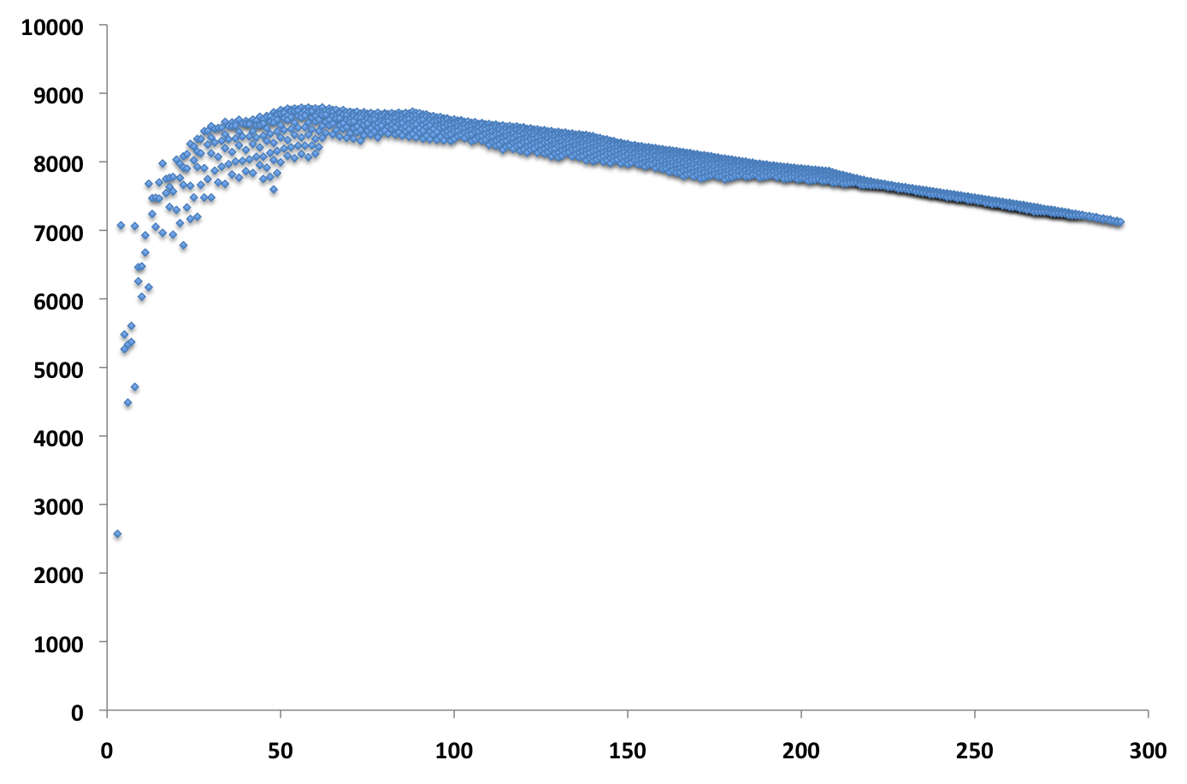
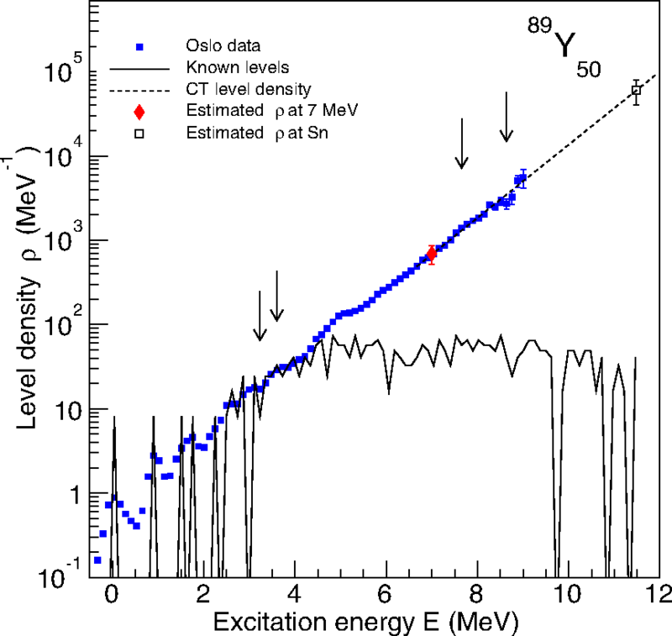
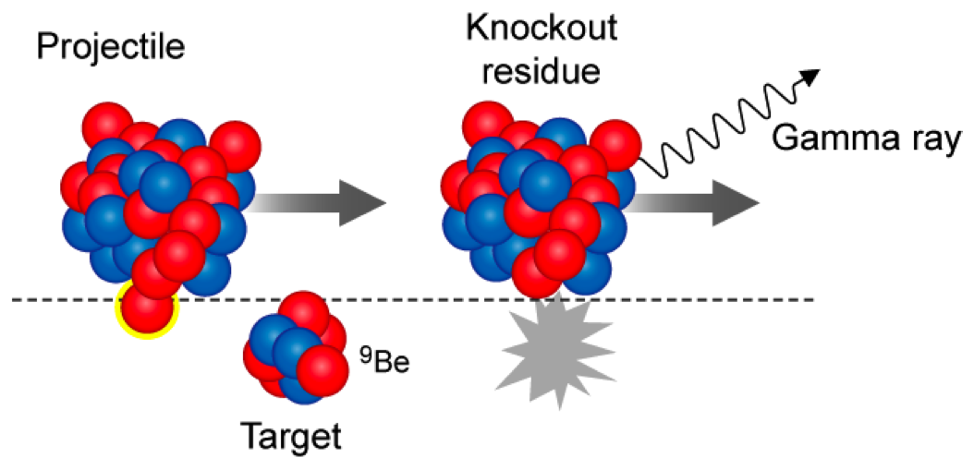
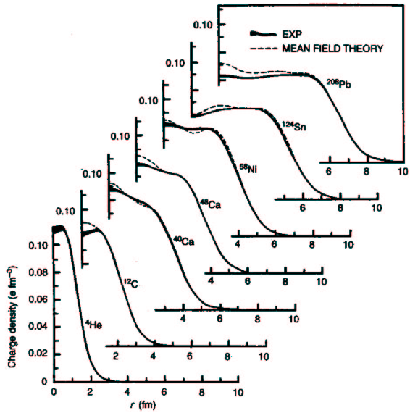
decay properties:
mode, lifetime, BR..
What characterizes a nucleus?
Some examples of relevant quantities….
radii, charge and matter distributions
numbers of nucleons
spin-parity
and e/m moments
mass/binding energy
….in principle, for the ground state and excited states.
Nuclear reactions are important tools:
produce nuclides.
select states.
reaction properties such as cross sections.
Deduce, mostly model-dependently:
transition rates
orbital occupancy
single-particle nature
pairing and clustering
etc.
M. Guttormsen et al., PRC 90, 044309 (2014)

Slide 17
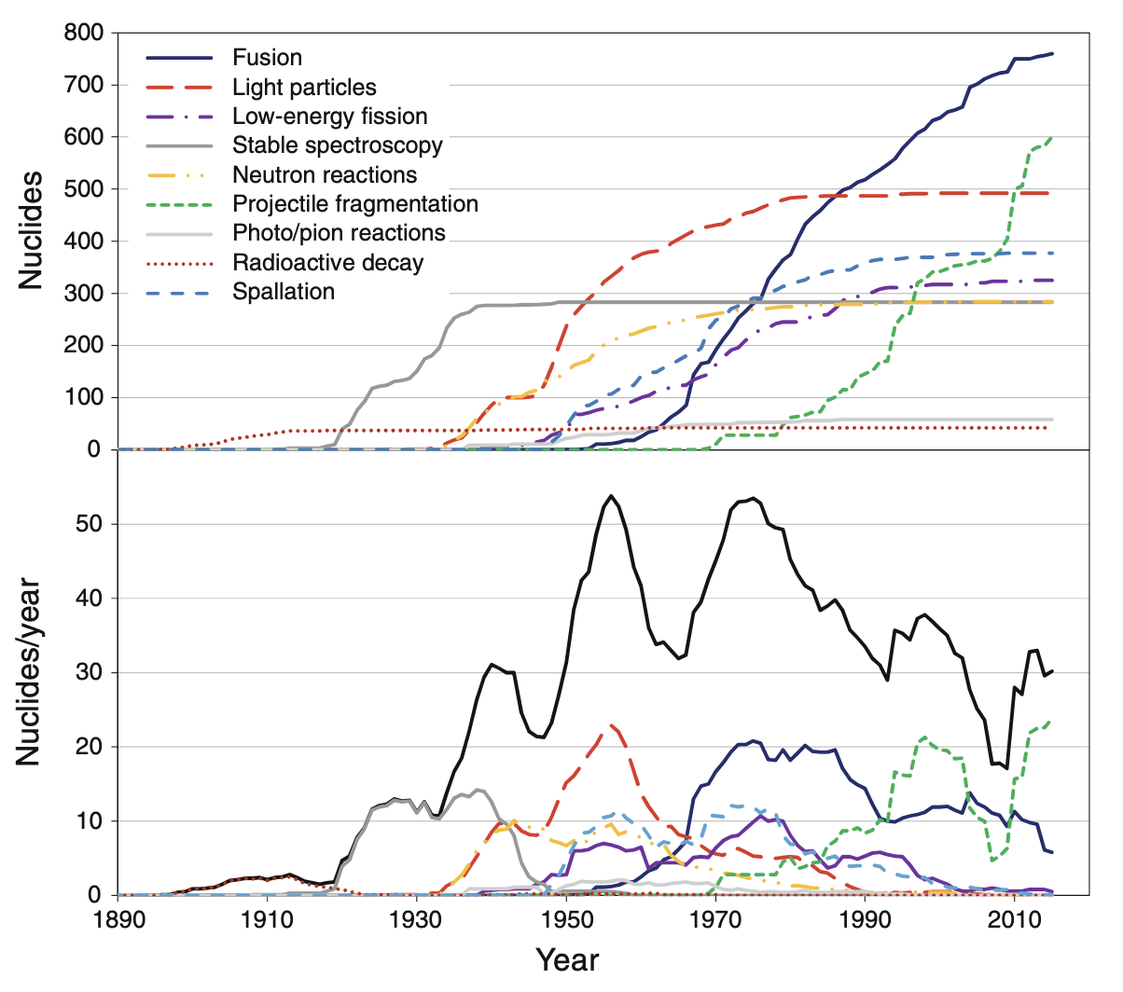
Historical perspective
from “The Discovery of Isotopes” Michael Thoennessen
(i) Early Years: discoveries of radioactivity, nucleus, nuclear reactions, protons and neutrons, isotopes – using mainly decay.
(ii) Neutrons: from reactions initiated by radioactivity, then fission, then accelerators.
(iii) Light-ion accelerators: explosion of small machines for protons, deuterons and alphas for elastic/inelastic scattering, compound nucleus, transfer, with increasing energy allows spallation etc.
(iv) Heavy-ion accelerators: Coulomb excitation, fusion evaporation, with increasing energy projectile fragmentation
(i)
(ii)
(v) Radioactive ion beam facilities: early work on spallation and fragmentation harnessed for production of beams of exotic nuclei used to induce secondary nuclear reactions.
(iv)
(iii)
(v)

Slide 18
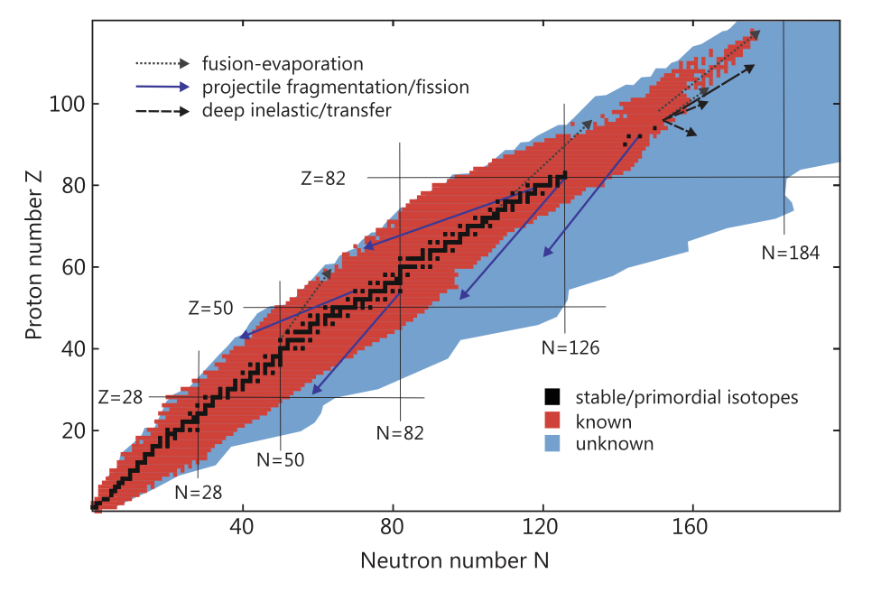
Radioactive Ion Beam Facilities
Most isotopes predicted to exist are not known.
Many known exotic isotopes have only rudimentary studies.
The proton drip line has been reached in many cases; the neutron drip line is largely unknown.
Requires:
high-intensity exotic nuclei for direct study.
high-energy exotic beams to initiate secondary reactions
Two main types of facility have emerged.
from “The Discovery of Isotopes” Michael Thoennessen

Slide 19
ISOL
Driver
Accelerator
protons ten MeV to GeV
heavy-ions 100s MeV
IN-FLIGHT
usually heavy-ions 100s MeV/A
Driver
Accelerator
surface, plasma, lasers
uranium carbide, Ta metal, molten metals and salts
fusion, fission, spallation, fragmentation
Hot thick target
Ion Source
thin light target: Be, Li..
projectile fragmentation
Fragment separator
relatively small
magnetic system
Isotope separator
extensive
magnetic system
excellent beam properties
chemical sensitivity
half-lives > 1ms
chemical insensitivity
half-lives < 1ms
beam properties fixed
DISCOVERY POTENTIAL:
precision studies of exotic nuclei
∼10s keV
DISCOVERY POTENTIAL:
loosely-bound isotopes at the very edge of stability
∼0.1 to few GeV
Post accelerator
Examples:
ISOLDE 1.4 GeV protons
TRIUMF-ISAC 600 MeV protons
INFN-SPES and RAON-Korea
70 MeV protons
SPIRAL/DESIR–GANIL heavy-ions 25 MeV/A (fusion etc.)
Examples:
RIBF-RIKEN 350 MeV/A heavy ions
FRIB-USA 200-250 MeV/A heavy ions
FAIR-GERMANY 2 GeV/A heavy ions
GANIL 95 MeV/A
∼10 MeV/u

Slide 20
Light-ion driver
accelerator
Heavy-ion driver
accelerator
ISOL - TRICKS
IN-FLIGHT -TRICKS
play with chemistry e.g. make and extract molecules for refractory species
Thick target
Ion source
Fragment separator
Isotope separator
FRIB – subject to efficiencies
Stopper catcher
∼10s keV
>1 ms is fundamental limit, but has the advantage of easy to switch between isotopes with systematics under control
∼0.1s to few GeV
Post accelerator
∼10s keV
Post accelerator
∼10 MeV/u
RAON plan – very ambitious!
∼10 MeV/u

Slide 21

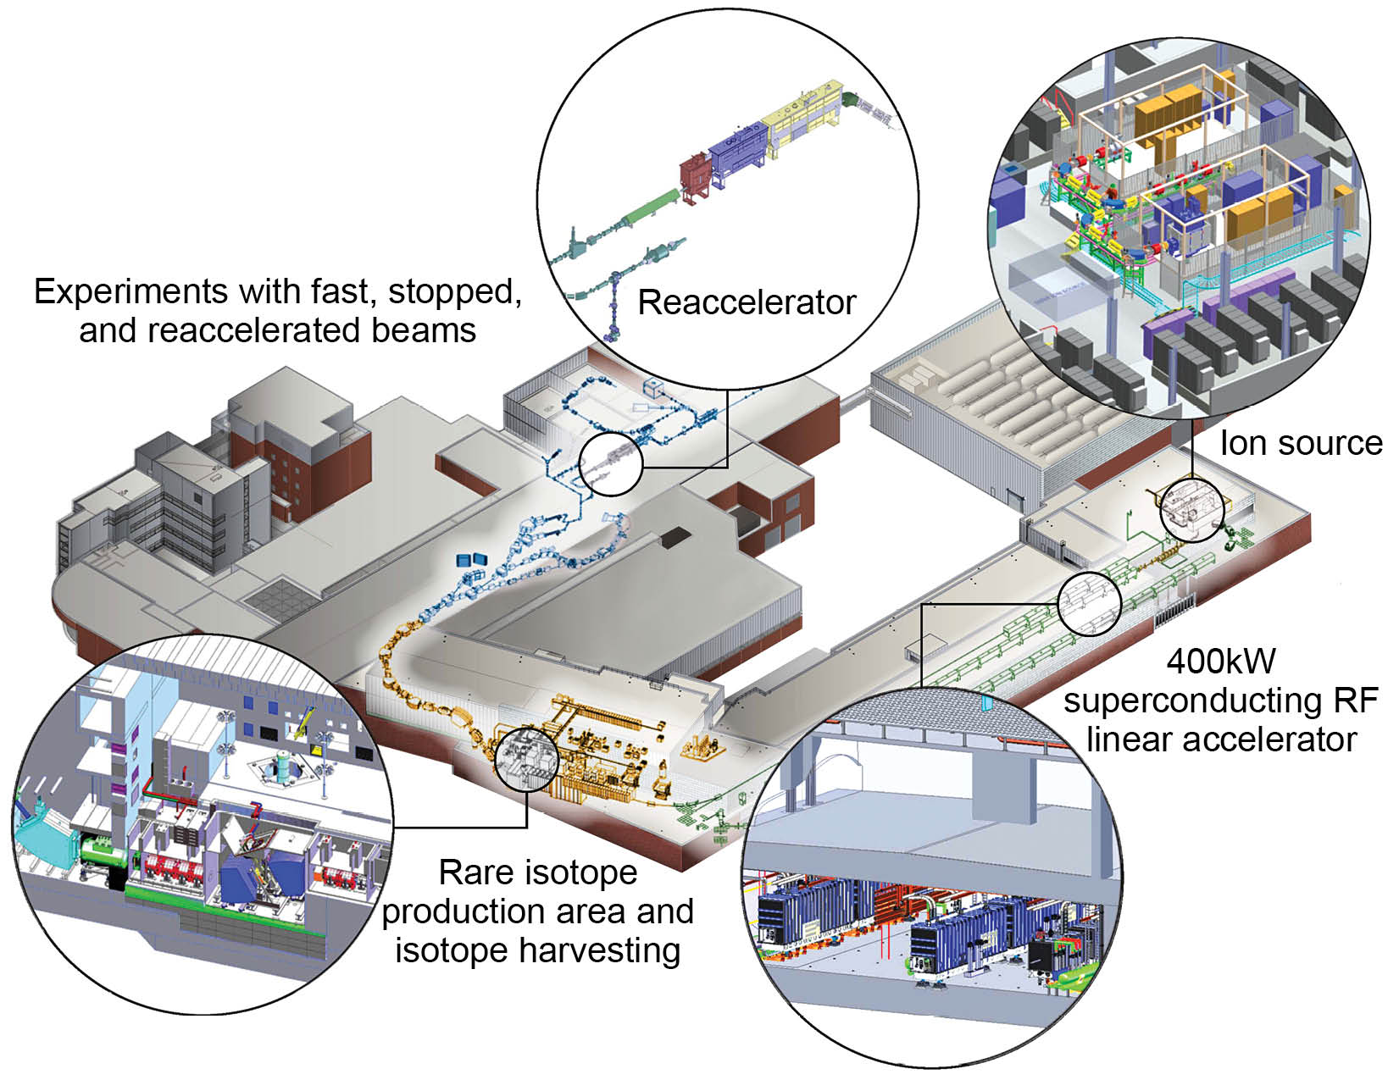

Facility for Rare Isotope Beams
at Michigan State University

Slide 22
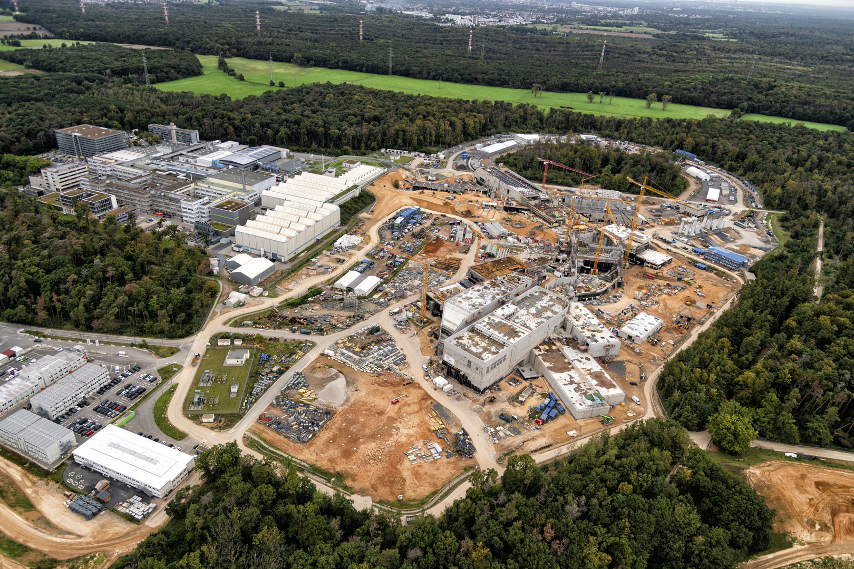


Slide 23
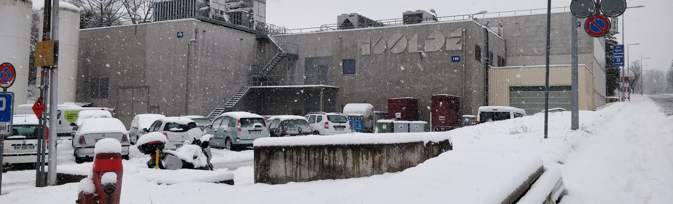


As an example of an ISOL facility and a slightly deeper dive into the experiments in nuclear structure and the physics that can be addressed….will stray into other scientific areas in the process!
Still high-level view – presenting work of a vast array of scientific, engineering and technical experts.

Slide 24
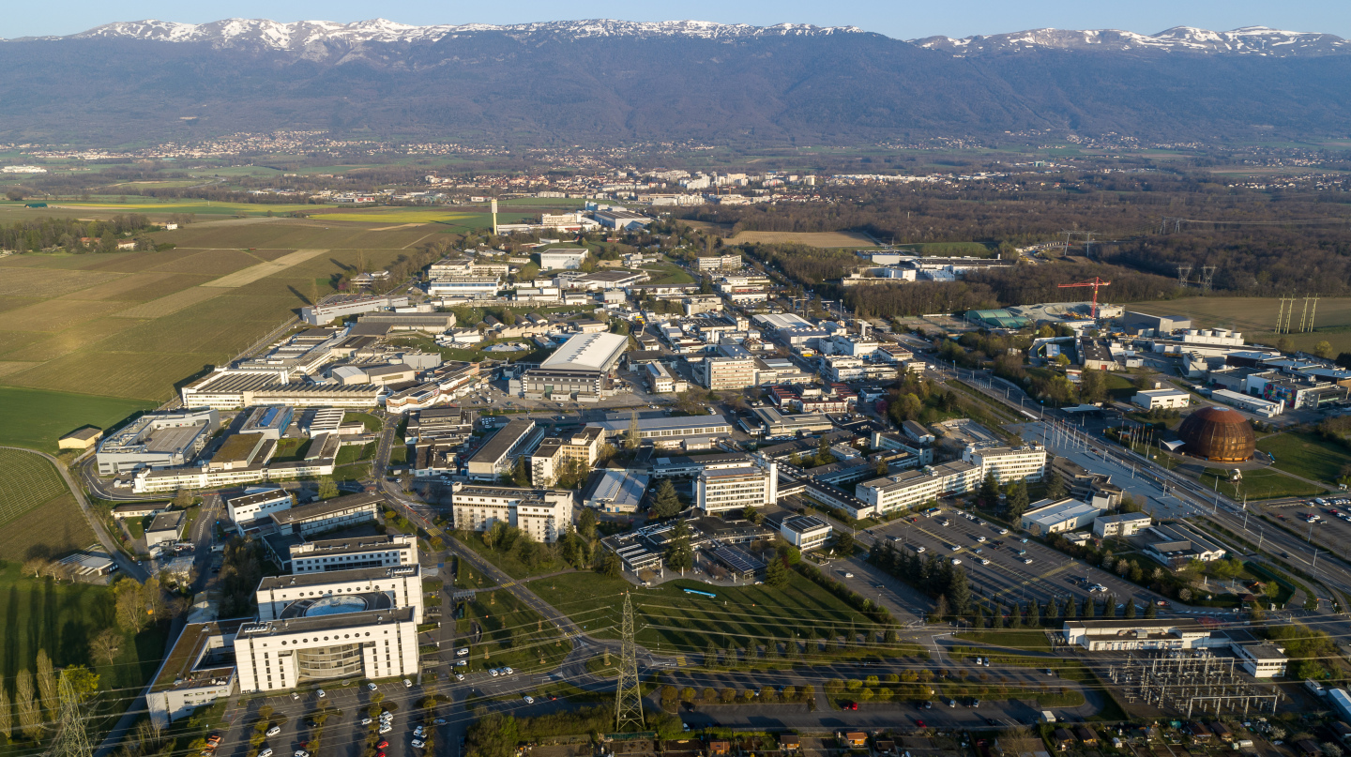


Slide 25
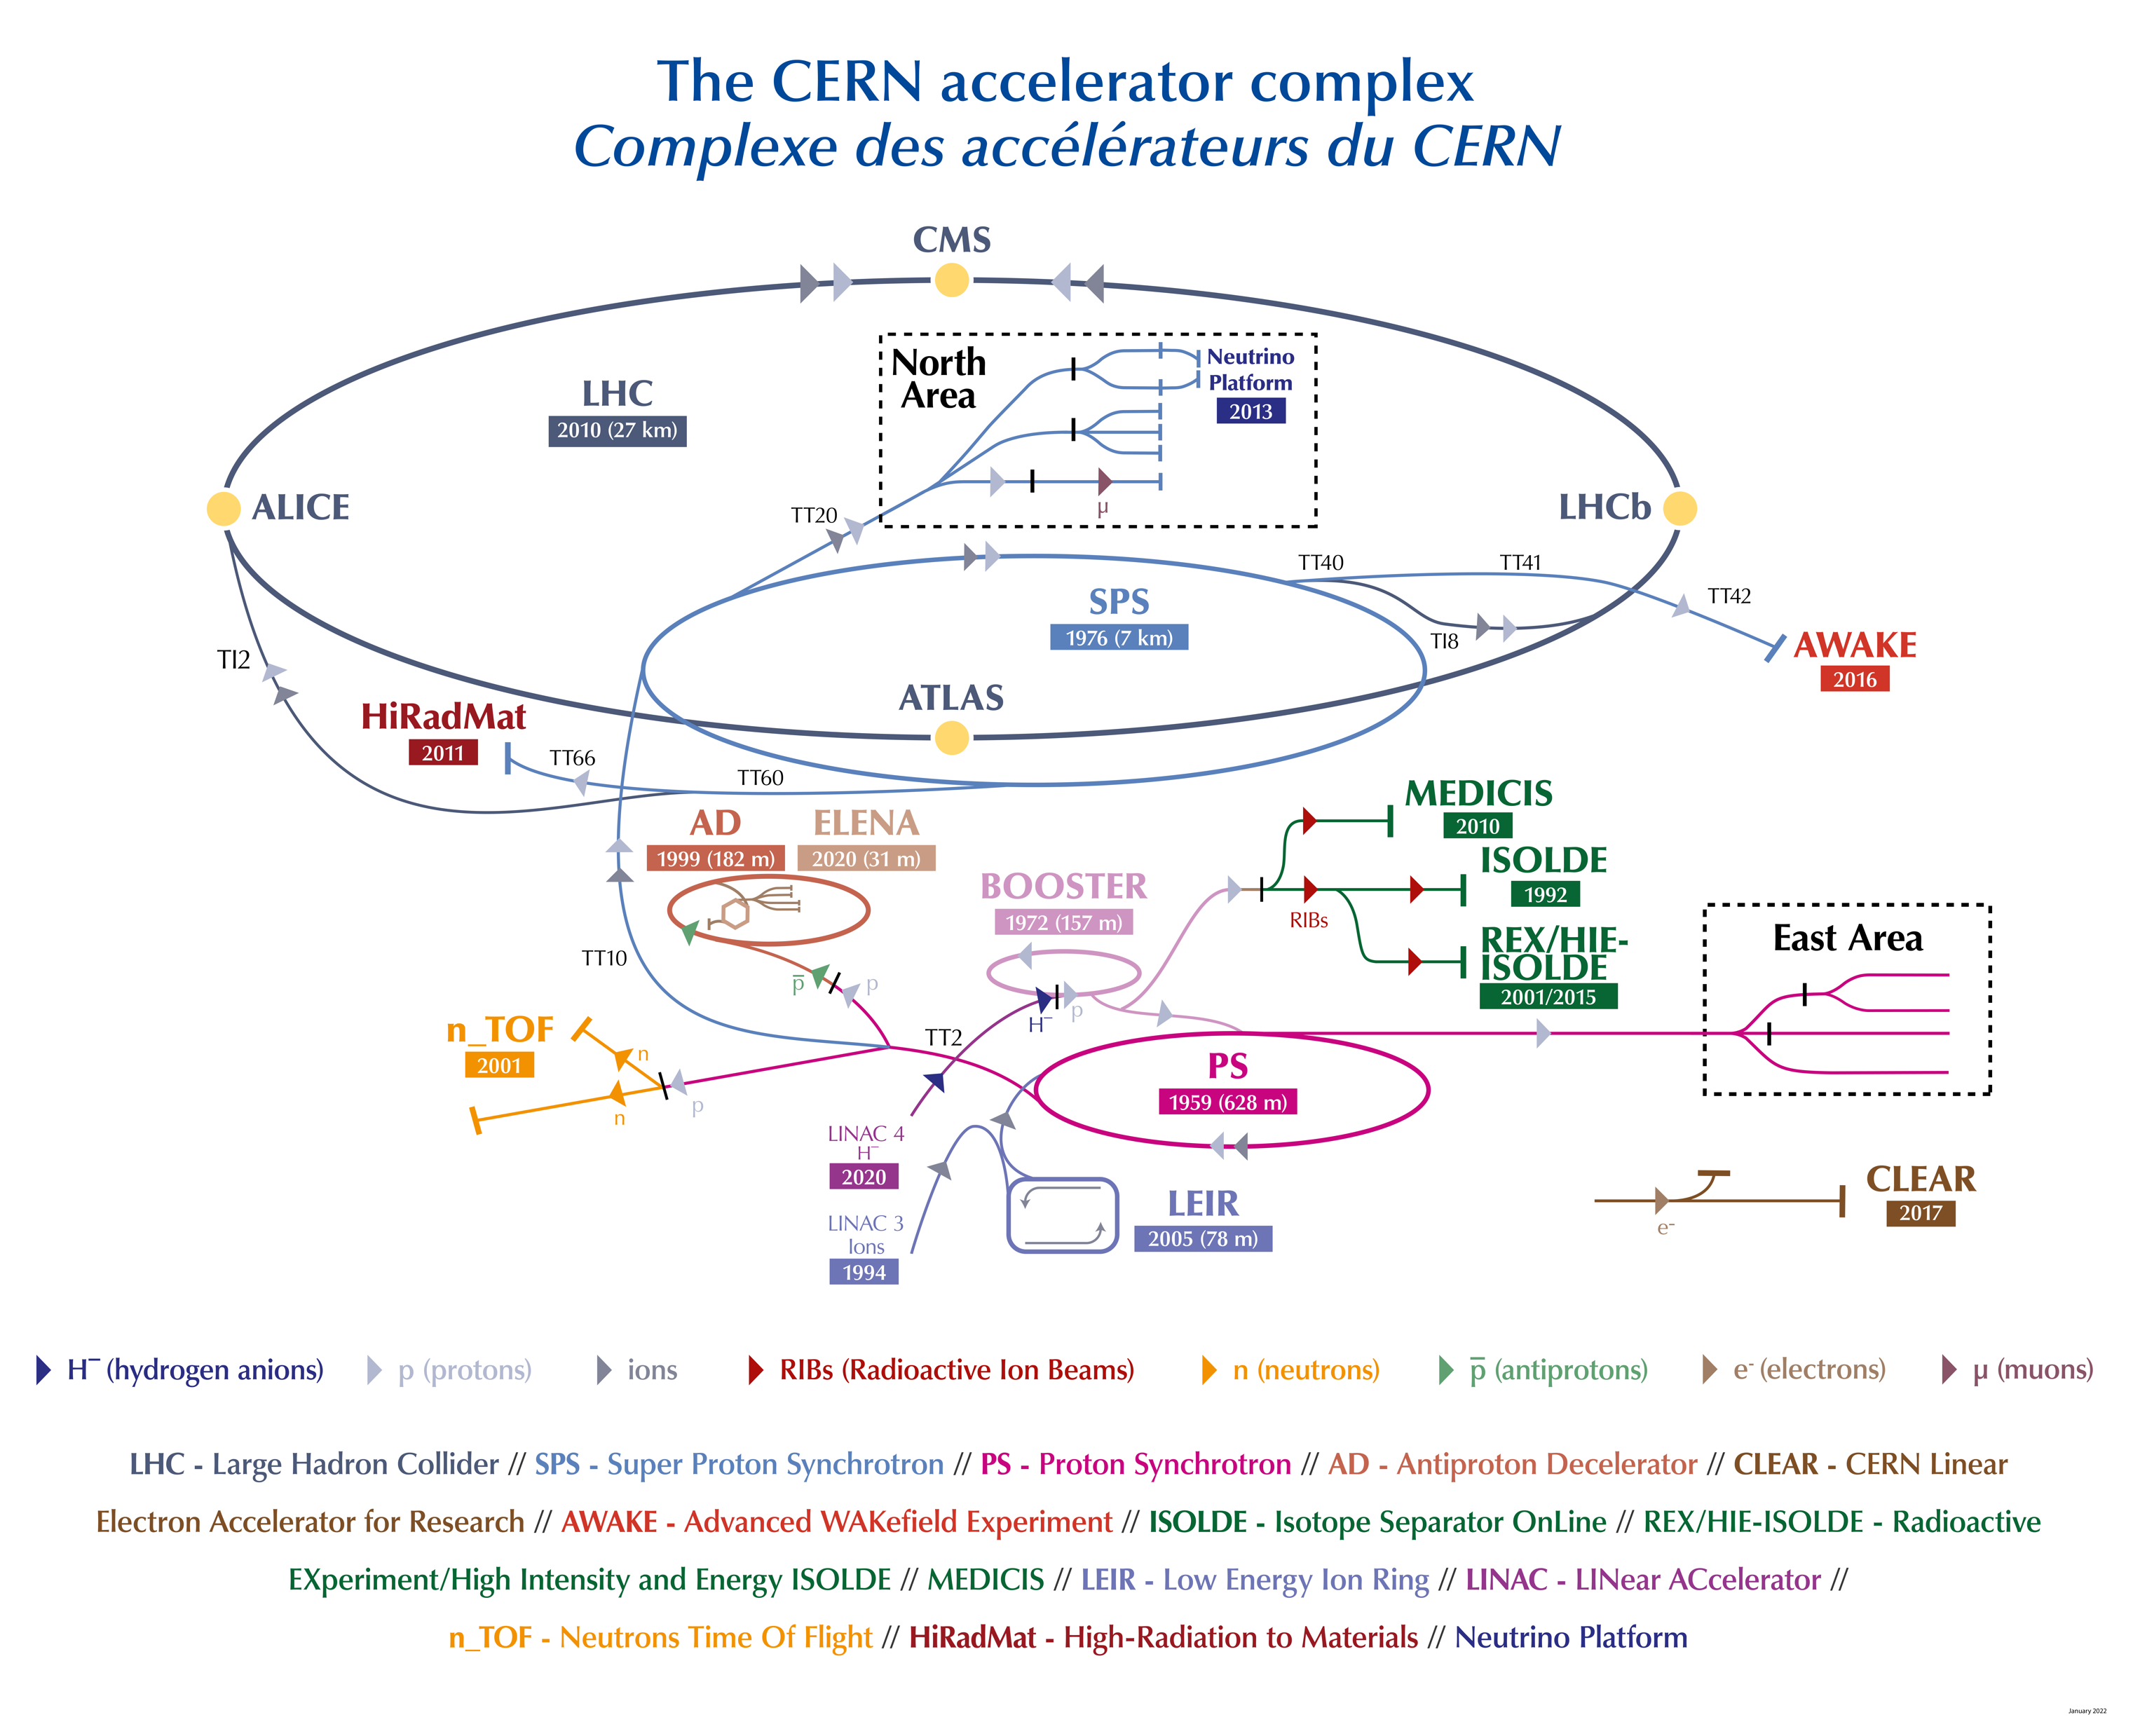

Slide 26
ISOL with GeV Protons
High-energy protons are impacted onto a thick target, e.g. ²³⁸U.
With GeV protons, reactions produce a wide variety of nuclei simultaneously.
²³⁸U
Spallation
Fission
Fragmentation
Double-edged sword – many isotopes, but an experiment will just want one!

Slide 27
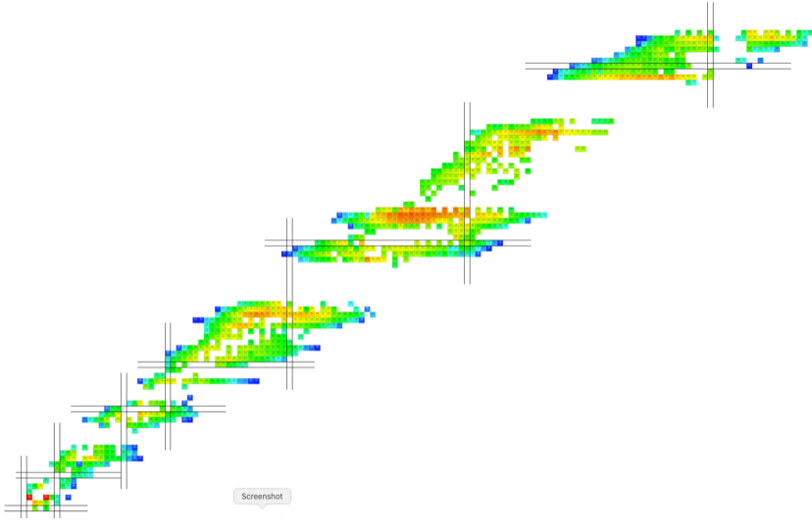
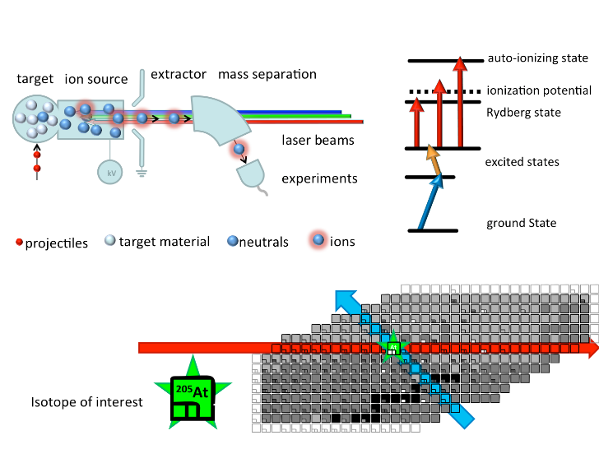
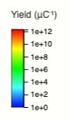
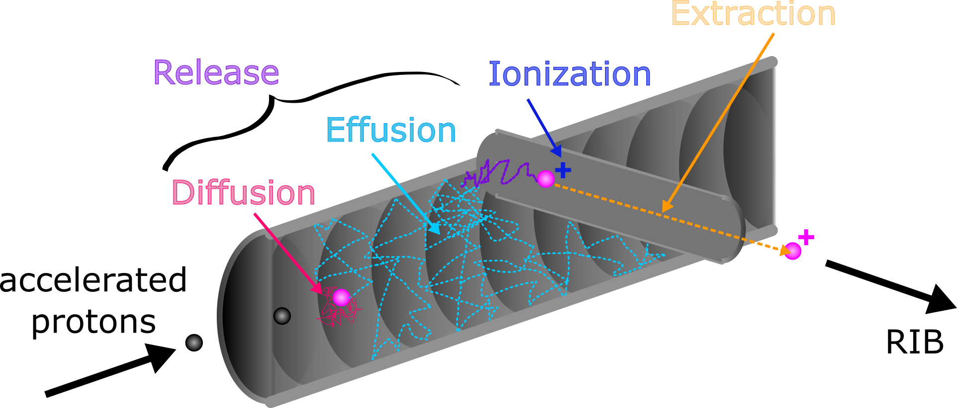

Isotope Production with GeV protons and over 50 years of experience
Over 20 target materials − carbides, oxides, solid metals, molten metals and molten salts − operated at high temperature.
Three broad types of ion sources: surface, plasma, laser.
> 1300 isotopes of 75 chemical
elements.
Variety of beams ⬄ breadth of science

Slide 28
Research with radioactive beams at ISOLDE
Physics beyond the Standard model
Nuclear astrophysics
Condensed-matter physics and material science
Nuclear physics: reactions and structure
Radioisotopes for medical applications
Atomic and molecular physics
Life sciences and biophysics

Slide 29
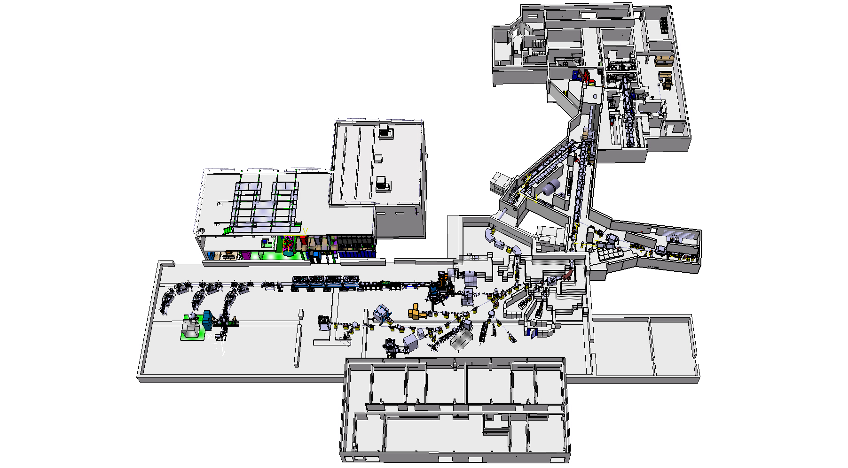
Low-energy installations
MEDICIS
Medical isotopes research
nuclear physics, condensed matter, fundamental interactions, chemistry, biology, medicine…
WISArD
Scalar and tensor currents in weak interactions: βν(θ)
Condensed-matter physics
GPS
VITO
HRS
Emission channeling, perturbed angular correlations, Mössbauer, isotope collections….
.
Laser-polarised beams for nuclear physics, chemistry and biology using β-NMR etc.
HRS
Protons
Protons
TAS
GPS
Total absorption spectrometer for β-decay feeding
Travelling setups
High-energy area: see next slide!
MIRACLS
MR-TOF
ISOLTRAP
COLLAPS
PUMA
CRIS
IDS
Laser spectroscopy:
nuclear charge radii and
moments.
Coming soon! Interaction of RIB & antiprotons
Precision nuclear
masses
Decay station for α, β, γ, p & n.

Slide 30


HIE-ISOLDE completed 2018
REX TRAP + EBIS
1+ to N+
40-60 keV 1+ ions
Four cryomodules each with five rf cavities
REX normal conducting linac <3.1 MeV/u
(2001-12)
HIE super conducting linac <9.2 MeV/u
(2014-18)
MINIBALL
(array of 24 segmented Ge crystals)
nuclear structure, reactions and astrophysics
Scattering
Expts Chamber (SEC)
ISOLDE Solenoidal Spectrometer (ISS)

Slide 31
Some recent science highlights from ISOLDE:
a quick stroll through fundamental science, nuclear physics to condensed matter…
Difficult to be representative of the overall science programme
– spoilt for choice!

Slide 32

Electric dipole moment searches
Searching for effects of EDM in atomic
energy levels provides a precision method to test fundamental physics..
atoms
molecules
Polarisation of molecules of heavy elements amplifies the interaction with external electric fields by factors of up to 10⁶ and are less sensitive to problematic systematic effects.
Goal: Reduce limits using heavy molecules with octupole nucleus.
Static nuclear octupole deformation of the
heavy element can add an additional enhancement via the atomic Schiff moment.
Invariably involves a short-lived radioactive isotope
Where do octupole nuclei lie away from stability and what signatures?
Molecular spectroscopy of heavy molecules?

Slide 33





Stable octupole shape versus octupole vibration?
Circumstantial evidence existed for some time that certain nuclei show octupole distortion…but observables (interleaved parity bands in even-even; parity doublets in odd-A; enhanced E1) are indirect
ISOLDE Coulomb excitation establish direct evidence for stable octupole deformation in ²²⁴Ra via measurements of transition matrix elements – neighboring odd isotopes would have enhanced EDM’s.
²²⁰Rn appears to how dynamic octupole vibration – ^{219,221}Rn unlikely to have enhancement.
Radioactive
Nature 497, 199 (2013)
REX-ISOLDE 2.8 MeV/u
Sparse data on stable pear shapes extended to show the boundaries of this region:
²²²Ra has patterns of transitions and matrix elements consistent with stable octupole shape.
²²⁸Ra is exhibits octupole vibration.
PRL 124, 042503 (2020)
HIE-ISOLDE 4.3 MeV/u

Slide 34





Spectroscopy of Radioactive RaF
Multiple laser beams stepwise excite a neutral radioactive atom/molecule to ionization continuum.
Tuning the frequency of one laser as the ion yield is monitored enables the molecular levels to be mapped out.
Nature 581, 396 (2020)
ISOLDE experiments established low-lying electronic structures of RaF with nuclear octupole deformation giving evidence for their suitability for laser cooling, a pivotal step to precision measurements for EDM searches.
Recently followed up by AcF measurements during “winter physics” in 2022.

Slide 35

ISOLDE Solenoidal Spectrometer
Direct reactions: e.g. addition of neutron to a nucleus (d,p) without excitation of other degrees of freedom probe single-particle strength distributions.
Stable species: deuteron beam on target – CM with small velocity.
Unstable species: heavy beam on deuterated target - CM with large velocity, creating kinematic issues for measuring outgoing proton.
Helical orbit spectrometer principle
Target on the field axis + array of Si detectors.
MEASURE: position z, cyclotron period T_{cyc} and energy E_{p} of emitted protons from transfer reaction
4T superconducting (former MRI) solenoid from UQ hospital, Brisbane to ISOLDE in 2017
Linear transformation between E_{cm} and E_{lab}
CM Energy:
No kinematic compression of the Q-value spectrum –
excellent resolution without need for γ rays.

Slide 36




First ISS Physics (CERN Run 2) 2018 – with HELIOS Si array.
(i) Terra incognita Z<82 N>126
(ii) Single-particle evolution driving shape changes
Study excited states in ²⁰⁷Hg for the first time using transfer reactions, ²⁰⁶Hg(d,p)@7.4 MeV/A, 5x10⁵ pps,
165 μg/cm²,140-keV FWHM.
Map single-particle trends close to abrupt shape change in ³⁰Mg: ²⁸Mg(d,p)@9.47 MeV/A, 10⁶ pps,
80 and 120 μg/cm², 150-keV FHWM.
on-axis singles
²⁰⁸Pb
Si recoil detector
A first step in improving the understanding of sp structure of nuclei in a key part of the r process
²⁰⁷Hg
(5/2⁺)
(3/2⁺)
(1/2⁺)
Tests of shell models tuned for the Island of Inversion and highlights the role of geometry of the binding potential on behaviour of orbitals close to threshold.
9/2⁺
(7/2⁺)
Tang et al.
PRL 124, 062502 (2020)
MacGregor et al.
PRC Letts 104, L051301 (2021)

Slide 37





Transfer-induced fission:
Proof of principle experiment using the HELIOS@ANL
²³⁸U(d,pf) 8.6 MeV/u
Accepted PRL 2023
ISOLDE: MWPC coupled to solar-cell array being developed to study transfer-induced fission
ISOLDE – LISA initiative to develop actinide beams for study

Slide 38




Indium – from one extreme to the other - two back-to-back ISOLDE PRL’s in July
Part of nuclear chart with corner stones of doubly-magic Sn isotopes : ¹⁰⁰Sn and ¹³²Sn (★)
N=82
Tellurium - Te
N=50
Antinomy - Sb
Tin - Sn
★
★
Z=50
Indium - In
Cadium - Cd
⁹⁹In
¹³³In
Precision measurement of ground and isomeric state using ISOLTRAP.
Excitation of isomer extremely constant across In
In contrast to measurements of magnetic moment, which increases near N=50 - also ISOLDE experiment from 2022!
Very difficult to reproduce with modern calculations and may point to missing physics.
Measured β decays from ground and isomeric levels using ISOLDE DECAY STATION.
Decays populate just a few unbound levels in ¹³³Sn.
Measured resonance properties that are critical for benchmarking models of the astrophysical r process that manufactures many of the heavy chemical elements.
Good example of versatility of ISOLDE – precision studies of both neutron-rich and neutron-deficient exotic isotopes separated by 34 neutrons!

Slide 39

Towards a nuclear clock...
For 60 years, atomic clocks have been used with a precision of 1s in 300 million years.
Based on the frequency of a transition between two atomic levels in cold ¹³³Cs atoms.
If you can find two nuclear levels with separation corresponding to optical photons, the nuclear clock would be much more precise as less sensitive to external perturbations.
²²⁹Th isomer is currently the best candidate for a nuclear clock, with a first excited state at only around 8 eV from the ground state and a long half life
Experiment at ISOLDE: ^{229m}Th ions produced using β-decay of a ²²⁹Fr - ²²⁹Ra beam implanted into CaF₂ and MgF₂ crystals. Radiative decays of ²²⁹Th observed for the first time giving precise measurement of transition energy (essential for laser excitation of the clock) and confirmed “long” lifetime of ^{229m}Th state

Slide 40



Vacancy centres in diamond as potential qubits
Diamond has excellent optical/mechanical properties for integrating into photonic circuits and quantum info tech – refractive index, transmission window, band gap, high Young’s modulus etc.
Optically active crystal defects “color centres” can exhibit stable single-photon fluorescence, combined with nanophotonic circuits, could act as qubits - those created by nitrogen are well studied.
Implantation of radioactive ¹²¹Sn into diamond at ISOLDE allows β “emission channeling” to study the lattice site location – measure intensity of β as a function of angle to lattice direction and model the results.
Experiments revealed that Sn vacancy centres are very promising candidates for single-photon emission due to their excellent optical properties and a very simple structural formation mechanism.
PRL 125, 045301 (2020)
PRL 125, 045301 (2020)

Slide 41

Perspectives
The study of the nuclear many-body problem, effectively “nuclear structure”, is a tricky and difficult problem.
It is (endlessly!) fascinating how the nucleus can exhibit such different behaviour and how simplicity emerges from such a complex system.
The study of exotic nuclei is giving new impetus to these challenges and the start of several new facilities – FRIB (USA), FAIR (Germany), RAON (Korea), SPES (Italy)… and improvements to others GANIL (France), ISOLDE (CERN), RIKEN (Japan) – make it an exciting time for nuclear structure.
More and more nuclear structure and the techniques used to study the nucleus are becoming important for other areas of study from fundamental forces through to condensed matter physics.

Slide 43


Large Shape Staggering in Neutron-Deficient Bi Isotopes
In-source laser spectroscopy – wavelengths of ionising lasers scanned as yields deduced by measurements of α decay, mapping out the atomic hyperfine structure.
Deduce changes in mean-square charge radii via the isotope shifts.
Spectacular changes in radius in Bi isotopes due to rapidly changing gs shapes.
Only second example of such dramatic changes – Hg isotopes studied at ISOLDE 50 years ago.
PRL 127, 192501 (2021)

Slide 44


ISS Science Programme: (d,p) studies
²¹³Rn
Z=82
²⁰⁷Hg
Early implementation 2018
CERN Long Shutdown 2019-20 😩
Fully commissioned 2021
Z=50
¹¹¹Sn
Fully commissioned 2022
⁹⁵Kr
For the future:
(t,p) and (t,α)
forward-going reactions (d,d’)
⁶²Zn
Z=28
⁶⁹Ni
N=50
N=40
N=126
²⁹Mg
³¹Mg
N=82
¹²Be
²⁸Na
N=20
N=28

Slide 45






Third ISS Physics (CERN Run 2) 2022 – with ISS Si array.
⁶⁸Ni(d,p)
• ⁶⁸Ni ~2 x 10⁴ pps @ 6.0 MeV/u
• N = 50 shell gap approaching ⁷⁸Ni
• Intruder configurations leading to shape coexistence
Ex = 2.5 MeV
L = 2
Ex = 2.8 MeV
L = 4
GANIL experiment
(2010, unpublished, M. Moukkamad et al.)
E_{beam} = 25.14 MeV/u; CD₂ Target : 2.6 mg/cm²

