Slide 1
Stars
From stellar models to nucleosynthesis
Oscar Straniero
Italian National Institute of Astrophysics
The n_TOF nuclear physics winter school, gen 21-24, 2024

Slide 2
OVERVIEW:
Stellar models and nucleosyntesis, a brief introduction.
Nuclear reactions in stars
Evolution of low-mass stars.
The Asymptotic Giant Branch.
Synthesis of elements beyond the iron peak in AGB stars .
The origin of the main s-process component.

Slide 3
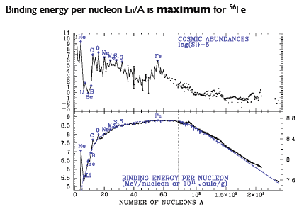

Slide 4
S(E) of the ¹²C+¹²C reaction. High energy data show a series of narrows resonances, representing a clustered structure (α clusters) of the compound nucleus of ²⁴Mg*.

Slide 5
A stellar model may be as complex as you want: rotation, magnetic fields, dynamical and secular instabilities of various nature, ……..
However, most of our knowledge concerning stellar evolution is based on relatively simple models: Self-gravitating, spherical symmetric stars in thermal and hydrostatic equilibrium.

Slide 6
STELLAR STRUCTURE EQUATIONS:
The overall problem: 4+N differential equations, in 4+N dependent variables:
r (radius),
L_{r} (luminosity),
P (pressure),
T (temperature),
Y_{i} (chemical composition: abundances)
all depending on the lagrangian mass coordinate:
$m_{r}=\int_{0}^{r}{4πρr^{2}dr}$
and the time: t
*Appropriate boundary conditions needed
Hydrostatic equilibrium
Mass conservation
Energy conservation
Energy transport
Nuclear reactions + turbulent convection
Spatial & temporal resolution:
1 stellar model contains about 1000 mesh points: m_{r}.=0 to M
1 evolutionary track contains up to 10⁶ stellar models: from t = 0 to 13 Gyr or collapse

Slide 7
Stellar structure equations
INPUT PHYSICS
Astronomical Observations
Theoretical Predictions
Stars as laboratory of fundamental physics

Slide 8
a STAR evolves because:
Energy los, as due to photons and neutrinos emission.
Chemical composition changes, as due to the concurrent action of nuclear burning and mixing.

Slide 9
Energy leaks….
……Energy sources

Slide 10
From energy conservation
T_{eff} = effective temperature
surface temperature if stars were perfect black bodies
Roughly speaking, it corresponds to the temperature at the base of the photosphere

Slide 11
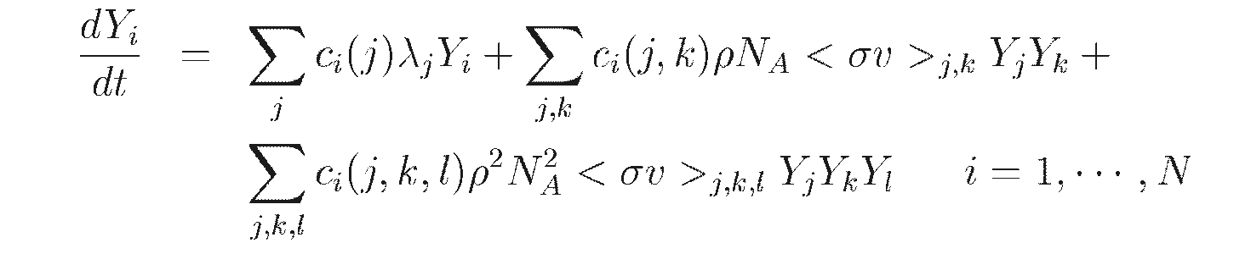
composition changes
Y_{i}=X_{i}/A_{i}
nuclear
Mixing: dynamical or secular instabilities

Slide 12
Nuclear reactions in an astrophysical PLASMA
In stellar interiors, nuclei are in thermal equilibrium with electrons and photons.
At variance with the electrons, their thermal energy spectrum is always well described by the classical Maxwell-Boltzmann distribution (with rare exceptions, such as in the case of a neutron stars). Nuclear masses are much larger that the electron mass, indeed!!!

Slide 13
Nuclear reaction: fusion of 2 nuclei
b
j
k
a
Center of mass energy
density of pair with CM energy E
A factor ½ is needed in case of identical nuclei

Slide 14
Reaction Rate
σ is the cross section
f(v) is the velocity distribution function
the rate of reactions among particles pairs with relative velocity between v and v+dv:
vt
σ
Equation 1

Slide 15

since d³v=4πv²dv and E= ½ μv², and using the MB energy distribution:
Substituting into equation 1:
This is the n. of reaction among pairs with energy E e E+dE. Note that it depends on T, on the density of the interacting nuclei and on the energy.
To get the total reaction rate, we must integrate over the whole energy spectrum

Slide 16
Total rate: Integral over the energy spectrum:
Equation 2
Equation 3
Reaction Rate = Number of reaction/time/volume

Slide 17
What about the cross section?

Slide 18
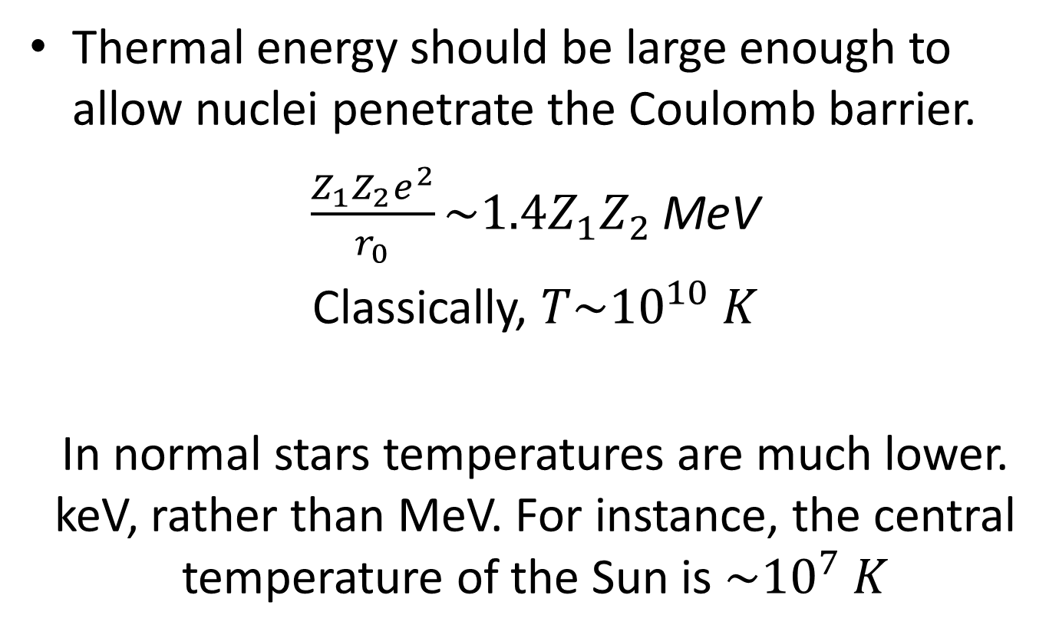
Nuclear reactions among charge nuclei
Thermal energy should be large enough to allow nuclei penetrate the Coulomb barrier.
$\frac{Z_{1}Z_{2}e^{2}}{r_{0}}\sim 1.4Z_{1}Z_{2}$ MeV
Classically, $T\sim {10}^{10} K$
In normal stars temperatures are much lower. keV, rather than MeV. For instance, the central temperature of the Sun is $\sim {10}^{7} K$

Slide 19
Nuclear fusion: cross section
The cross section σ(E) represents the probability that a reaction occurs among particle pairs with center-of-mass energy = E. It is the product of 2 independent probabilities representing:
The penetration of Coulomb barrier (Coulomb probability)
The formation of a specific the compound nucleus (nuclear probability)

Slide 20
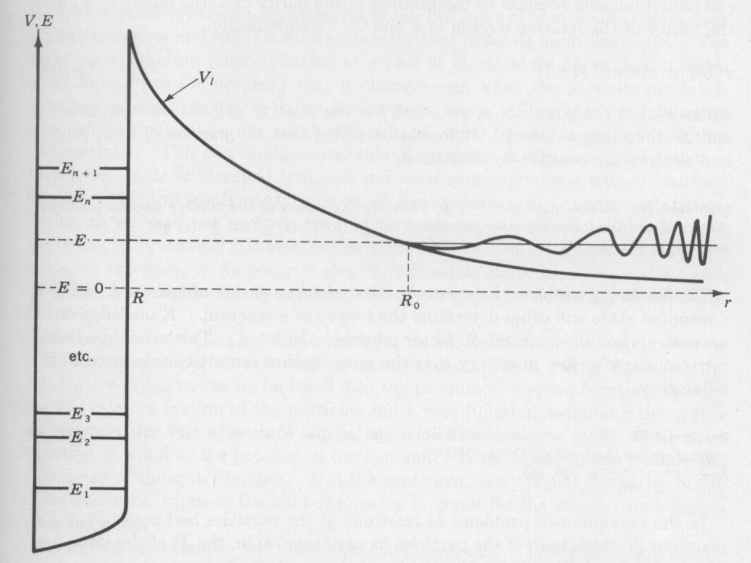

Slide 21
The penetrability of the Coulomb barrier:
The Coulomb barrier is too high, but quantum mechanics allows its penetrability.
The tunnel probability is (Gamow 1934):

Slide 22
For non-resonant reactions, P_{nuc}(E) is a slowly decreasing function of E:
So, introducing the astrophysical factor S(E)
The cross section is the product of the tunnel probability and a nuclear probability:
For non-resonant reactions, S(E) is a slowly varying function of E.

Slide 23

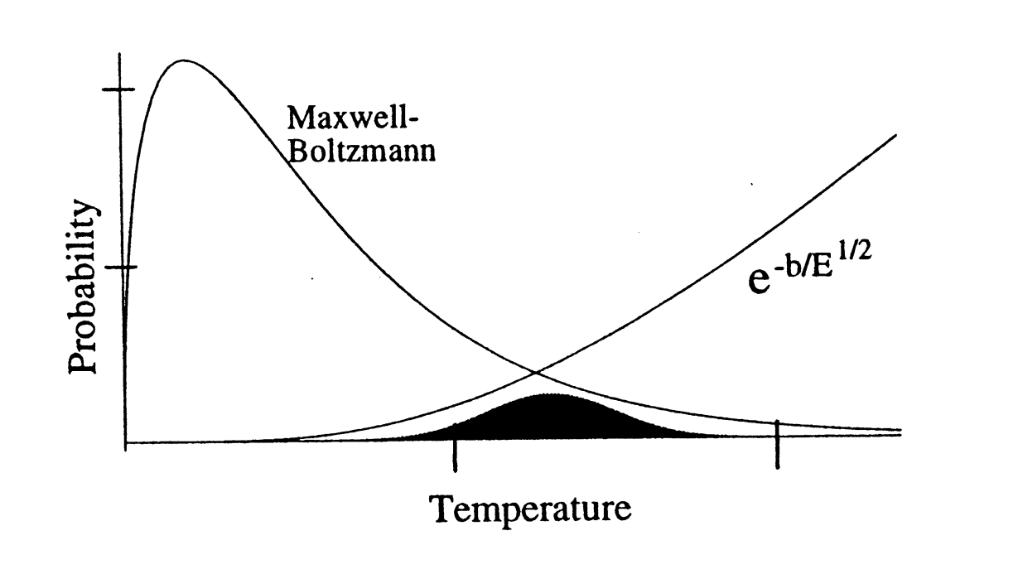
The Gamow’s peak
After substitutions:
Energy

Slide 24
The maximum occurs at:
GAMOW’s Peak

Slide 25
Gamow’s peak energy in different astrophysical environments:
T = 16 MK (Sun)
p+p 5 KeV
3He+3He 20 KeV
3He+4He 21 KeV
14N+p 25 KeV
T = 70 MK (RGB stars)
14N+p 65 KeV
T = 200 MK (He-burning)
12C+α 300 KeV
T = 600 MK (C-burning)
12C+12C 1.5 MeV
T = 1 GK (Universe, 3 m after BB)
p+d 100 KeV

Slide 26
Resonances
Stretching due to the Coulomb force
Resonanceces above the threshold.

Slide 27
slide by C. Iliadis

Slide 29
And in case of neutrons?

Slide 30
Rate x unit mass
Rate of energy production

Slide 31
Fraction by number:
Two bodies reactions:
Three bodies (triple-α):
Radioactive decays:
τ_{i} = e-folding time

Slide 32
Chemical changes. General problem!
i=1…….n
Notes:
1) n_{i} is the number of i involved in the reaction.
2) (-) in case i=k or j or l

Slide 33
Libraries of reaction rates (Na<σv>)
For reactions among charge nuclei
REACLIB: https://reaclib.jinaweb.org/
For neutron captures:
KADONIS: http://www.kadonis.org/

Slide 34
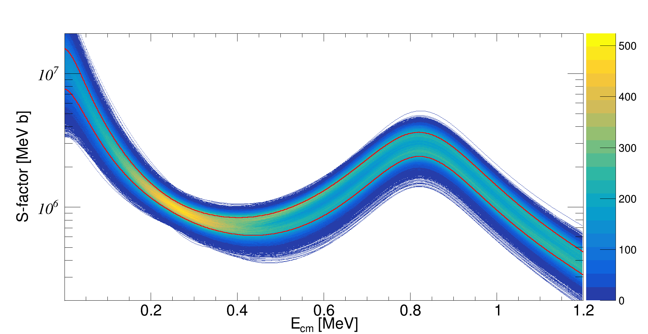
13C(α,n)16O

Slide 35
Chart of nuclides (or isotopes)

Slide 36
The nuclear network of a stellar model
In principle, the network should include all the isotopes that can be produced/consumed.
For instance, if neutrons are released, as in AGB stars, all the stable isotopes with 1≤A≤208 and those ustable, but closer to the stability valley in the n-rich side, should be considered: that is about 600-700 isotopes……or 600-700 (+4) differential equations.
In many extant stellar models (but not all), the network is limited to the isotopes involved in nuclear reactions that account for most of the energy generation. Then, a detailed nucleosynthesis is calculated by means of a post-process code.
However, the selection of the minimal network to be used in stellar model calc is not an obvious task, in particulare, when mixing by convection and nuclear burning occur on timescales comparable to the timescale of the physical structure variations. This is a common feature of the advanced phases of stellar evolution.

Slide 37
Energy transport by radiation and convective instabilities

Slide 38
Energy transport
opacity

Slide 39
Convective inStability
Schwarzschild/Ledoux criteria for convective instability
Convection on
convective
semiconvective

Slide 40
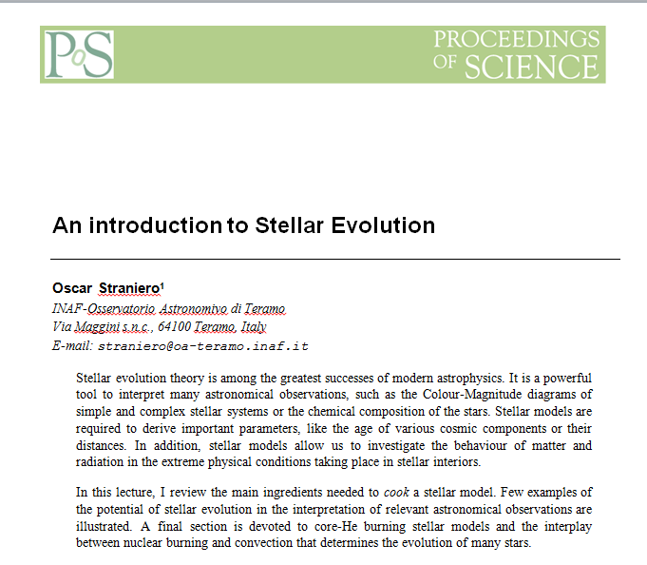

http://pos.sissa.it/cgi-bin/reader/conf.cgi?confid=148
https://link.springer.com/article/10.1140/epjp/i2018-12237-1

Slide 41
Application to stars

Slide 42
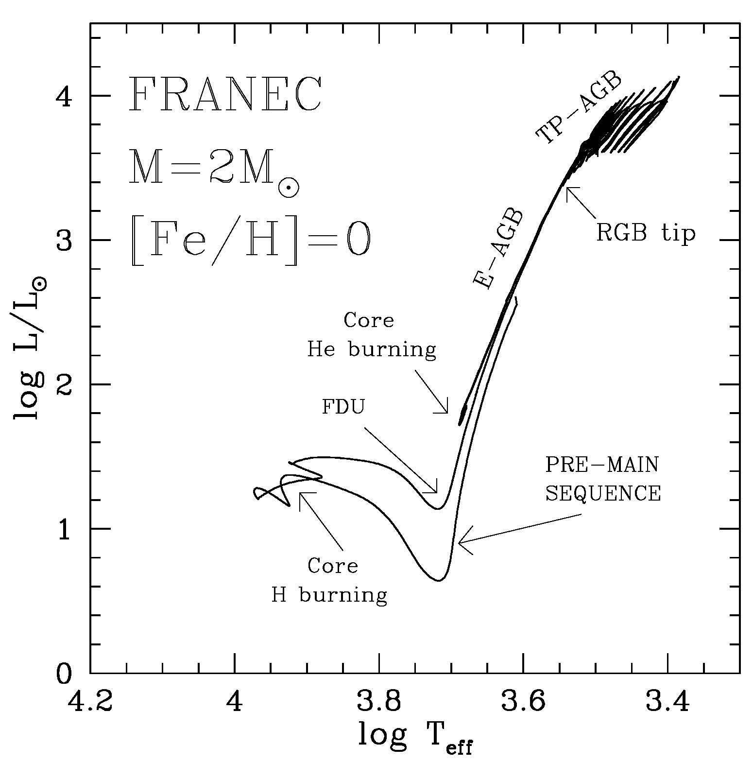
The Hertzsprung-Russell diagram
Pre-MS → fully convective star (because of large opacity.
MS → convective core (powered by H burning through the CNO cycle)
FDU (first dredge up) → the envelope cool down and a deep convective envelope develops (due to shell-H burning + large opacity)
RGB → degenerate core and deep convective envelope.
RGB tip → activation of the triple-α (He-flash)
Core-He burning → triple-α followed by 12C+α, fully convective core surrounded by a semiconvective layer (where partial mixing of He,C and O allows neutrality).
Early-AGB → two burning shell (H and He) → deep convective envelope (large opacity).
Thermal Pulse AGB → Alternate shell burnings, deep convective envelope periodically penetrating the H-exhausted core – when H burning off (third dredge up or TDU)
Post-AGB
RGB
start

Slide 43
Asymptotic Giant Branch stars

Slide 44
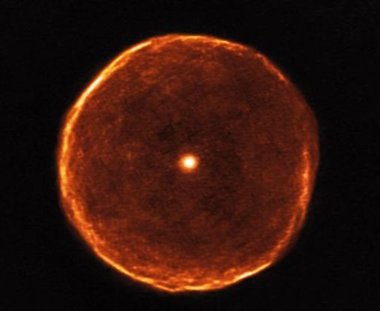
U Antliae in the Pneumatic Machine

Slide 45
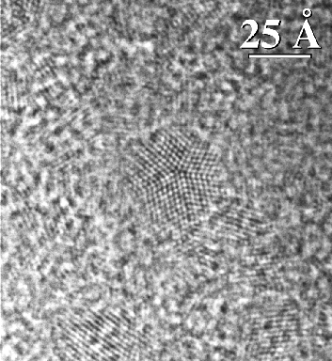
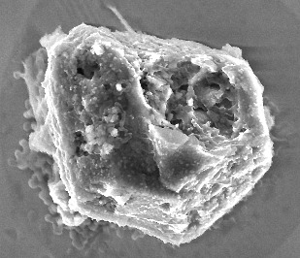
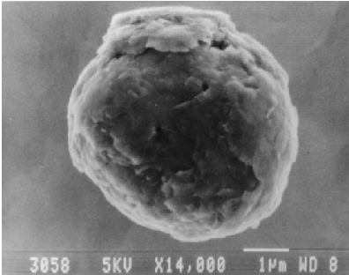
STURDUST
Diamonds
SiCs
Graphites

Slide 46
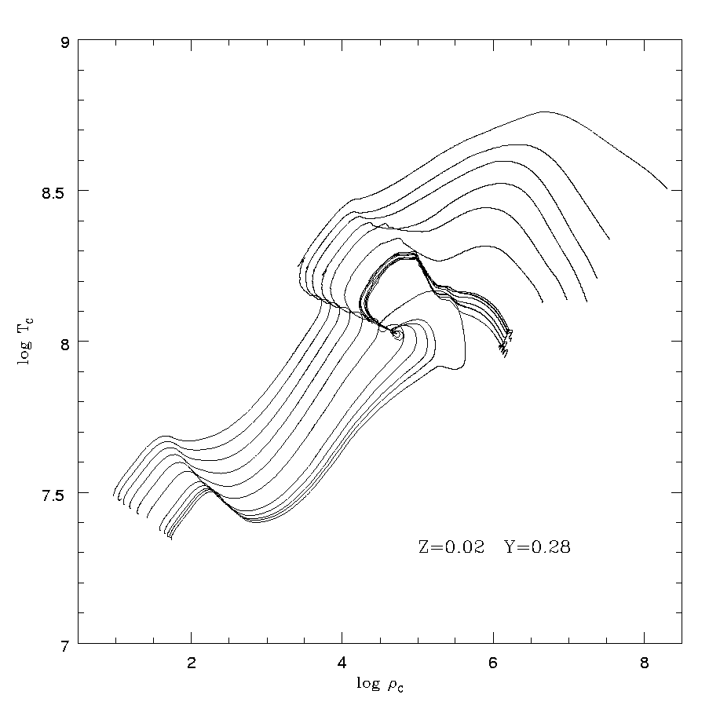
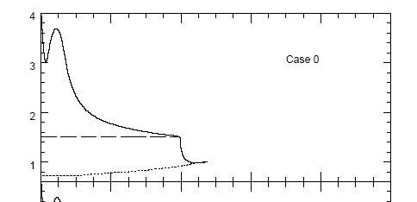

Beyond the core He burning: the early-AGB
Central temperature vs central density for 1-9 Mꙩ evolutionary tracks
E-AGB
ν-cooling
RGB
He burning
H-rich
H burning
1-9 Mꙩ
He
CO
Conv. Env.
Second dredge up
H burning
He burning

Slide 47
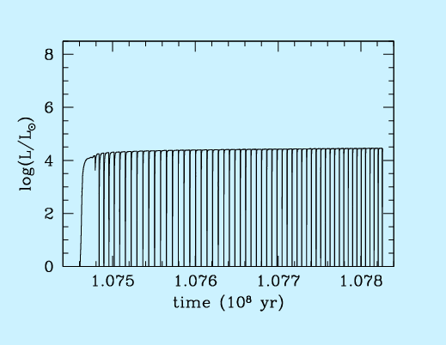
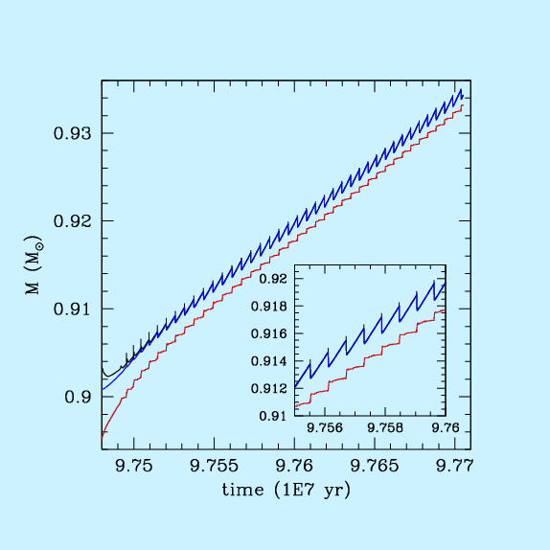
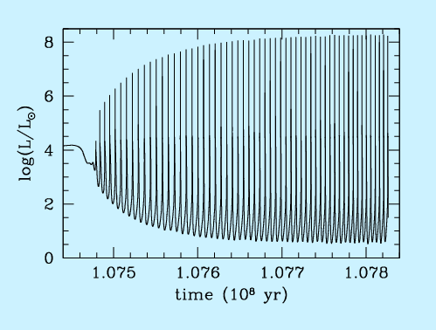
Thermal pulses and TDU in AGB stars
H-rich (30% He)
For most of the time, the H-burning (upper panel) provides the energy to sustain the star shine.
When enough helium has been accreted on top of the H-exhausted core, a He flash occurs (lower panel), eventually followed by a third dredge up (TDU).
CNO
C/O
3α
He-rich (20% C )

Slide 48
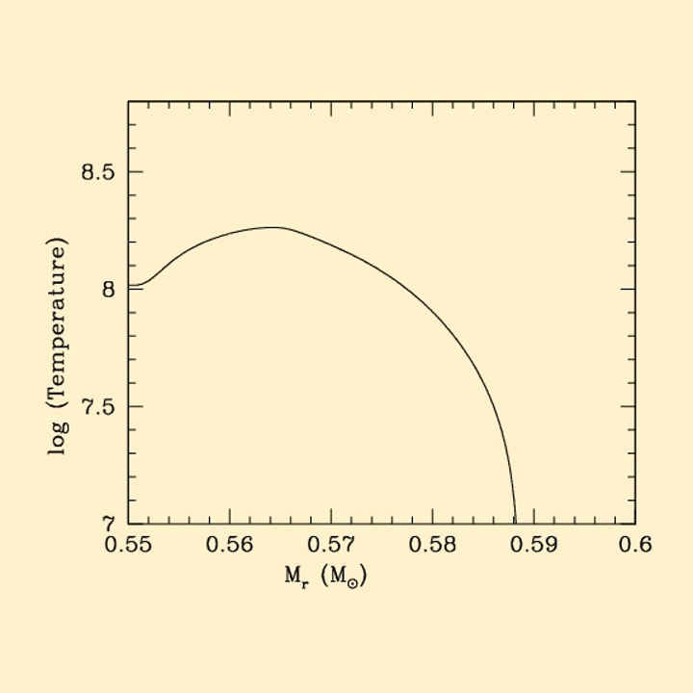
The movie shows the evolution of the temperature profile in the intershell zone before and during a thermal pulse

Slide 49
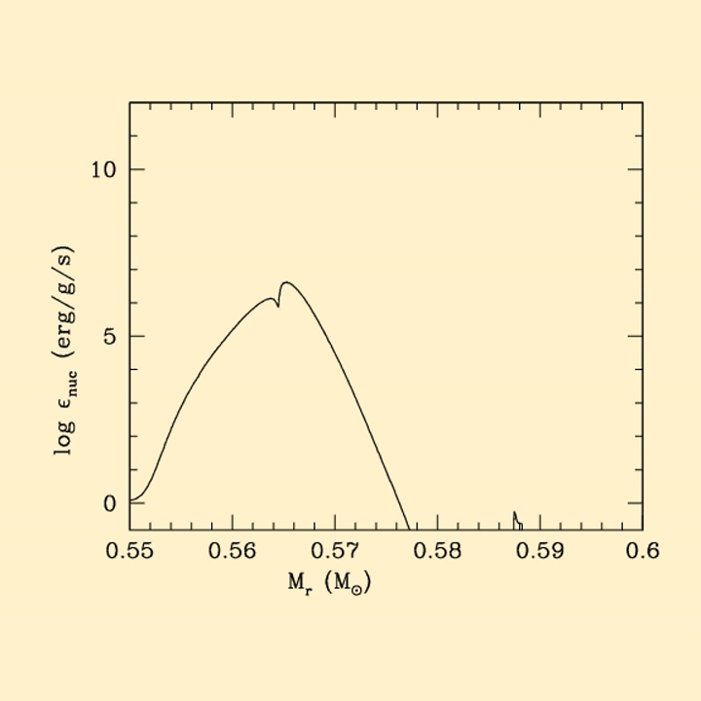
The movie shows the evolution of the ε_{nucl} profile in the intershell zone before and during a thermal pulse

Slide 50
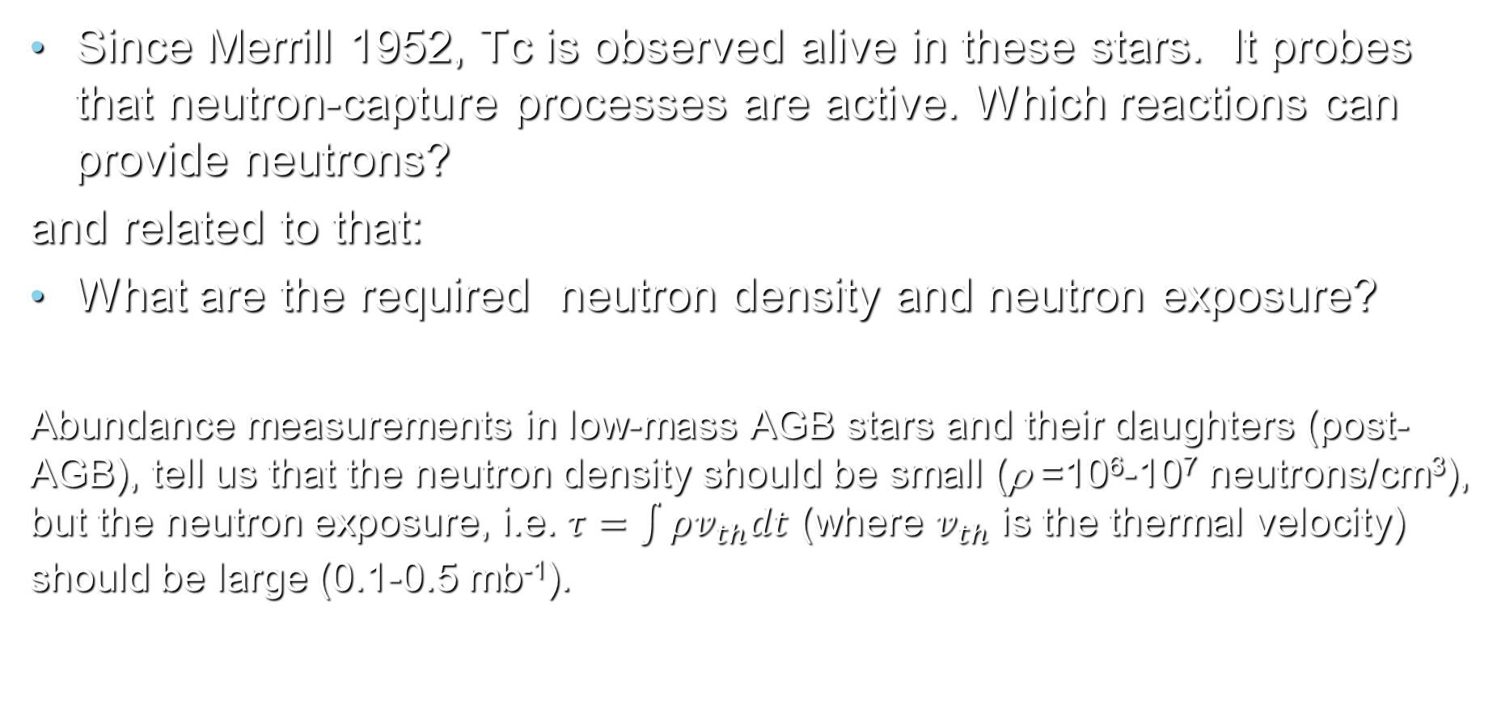
Questions about neutron-capture nucleosynthesis in AGB stars
Since Merrill 1952, Tc is observed alive in these stars. It probes that neutron-capture processes are active. Which reactions can provide neutrons?
and related to that:
What are the required neutron density and neutron exposure?
Abundance measurements in low-mass AGB stars and their daughters (post-AGB), tell us that the neutron density should be small (ρ =10⁶-10⁷ neutrons/cm³), but the neutron exposure, i.e. $τ=\int{ρv_{th}dt}$ (where $v_{th}$ is the thermal velocity) should be large (0.1-0.5 mb⁻¹).

Slide 51
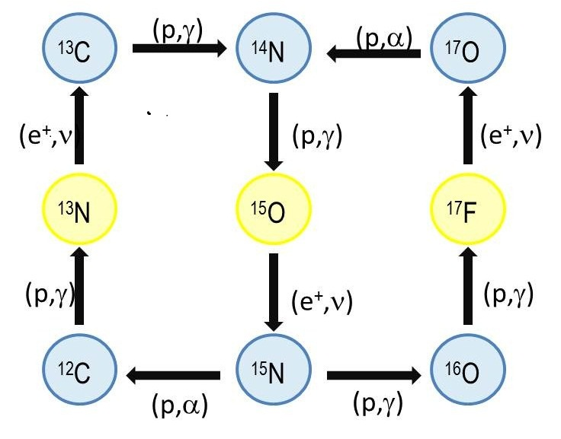
The two burning shells
H burning shell → CNO cycle → α and 14N
……. also traces of 13C
He burning shell →3α and 12C+α →12C and 16O
  …….. also 14N(α,γ)18F →18O(α,γ)22Ne

Slide 52
Possible neutron sources 22Ne(α,n)25Mg and 13C(α,n)16O.
Before the 1995, all the proposed scenarios for AGB s process nucleosynthesis supposed that the neutron source was active during the thermal pulse (see, e.g., Iben and Renzini 1984).
It implies high temperature (300 MK or 30 keV), high neutron density (10¹¹-10¹³ cm⁻³), but short timescale (months), so that the neutron exposure is quite (too) low.
All these fetures are in contrast with the observed nucleosynthesis yields.

Slide 53

s-Proess paradigm for low-mass AGB (1.2-3 M⊙)
Straniero et al. 1995 – Gallino et al. 1998
Bagnasciuga (wet&dry)
A ¹³C pocket shall form in the transition strip between the sea (convective env.) and the shore (core)

Slide 54
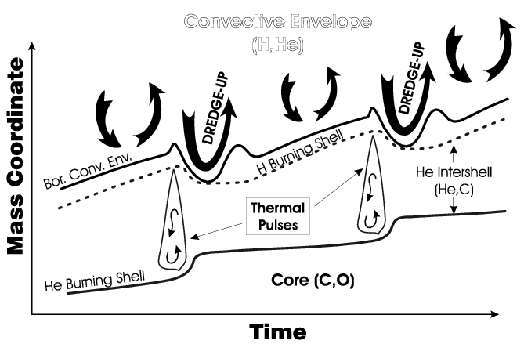
s-Proess paradigm for low-mass AGB (1.2-3 M⊙)
Straniero et al. 1995 – Gallino et al. 1998
Convective Envelope (H rich)

Slide 55
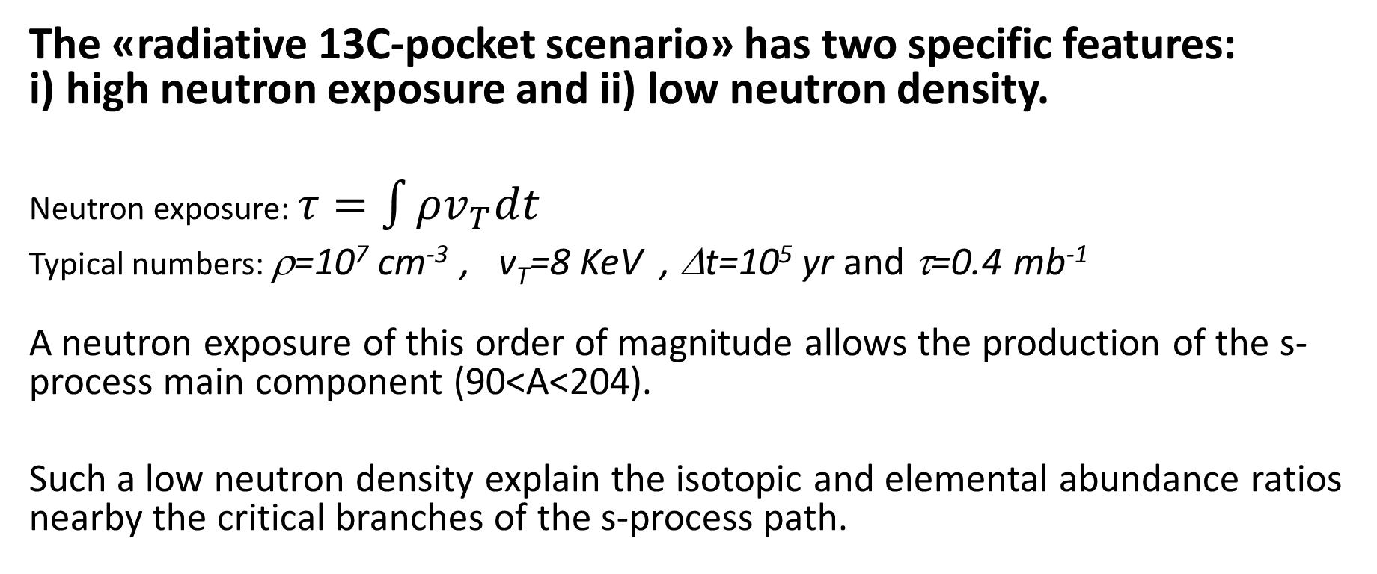
The «radiative 13C-pocket scenario» has two specific features: i) high neutron exposure and ii) low neutron density.
Neutron exposure: $τ=\int{ρv_{T}dt}$
Typical numbers: ρ=10⁷ cm⁻³ , v_{T}=8 KeV , Δt=10⁵ yr and τ=0.4 mb⁻¹
A neutron exposure of this order of magnitude allows the production of the s-process main component (90<A<204).
Such a low neutron density explain the isotopic and elemental abundance ratios nearby the critical branches of the s-process path.
* 1 barn=10⁻²⁴ cm²

Slide 56
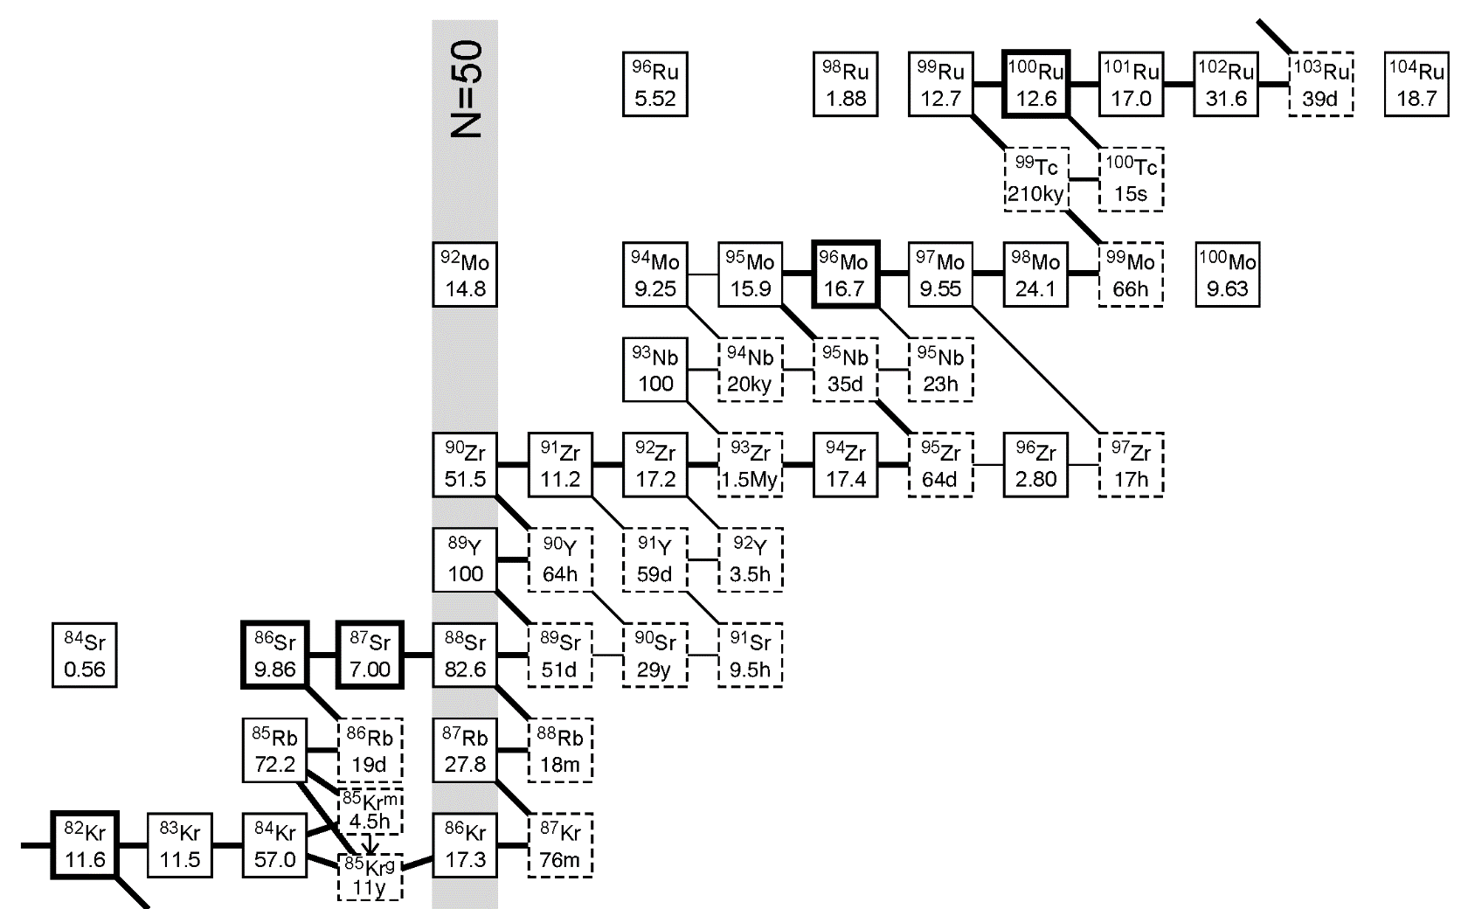
Many observational confirmations of the low-mass AGB scenario:
Low Rb/Sr in S and C stars (Lambert 1995, Abia 2001)
Low ⁹⁶Zr in S stars and SiC grains (Zinner 1995, Lugaro 2003)
Branches discriminate between different scenarios

Slide 58
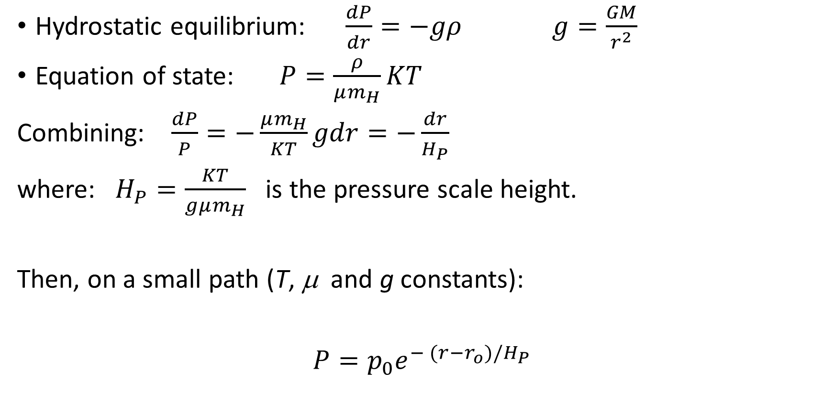
Pressure scale height
Hydrostatic equilibrium: $\frac{dP}{dr}=−gρ$ $g=\frac{GM}{r^{2}}$
Equation of state: $P=\frac{ρ}{μm_{H}}KT$
Combining: $\frac{dP}{P}=−\frac{μm_{H}}{KT}gdr=−\frac{dr}{H_{P}}$
where: $H_{P}=\frac{KT}{gμm_{H}}$ is the pressure scale height.
Then, on a small path (T, μ and g constants):
$P=p_{0}e^{− (r−r_{o})/H_{P}}$

Slide 59
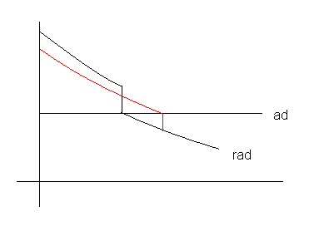

Case b: dredge up
In case of dredge up, the H-rich envelope penetrates the He-rich mantel. The sharp variation of the chemical composition at the conv. border, causes a drop of the radiative opacity and, in turn, a sharp decrease of the radiative gradient. Then, the convective border becomes unstable and convection can easily penetrate inward. In this case, the overshoot induced by the chemical discontinuity is much larger
Convective layer
Transition layer
stable radiative layer
overshoot
convective
radiative
Hydrodynamical models of overshoot:
1) the penetration increases as the stability of the radiative layer below the convective zone decreases , e.g. Singh 1995
The velocity decays exponentially,
e.g. Freytag 1996
T gradients ($∇_{T}$)
H
He

Slide 60
Why an exponential decay of V?
Viscous dissipation of kinetic energy ->
V[r(t)]=average velocity of a penetrating convective cell;
Vo= V at the convective border (r=r_{o} at time t=0)

Slide 61
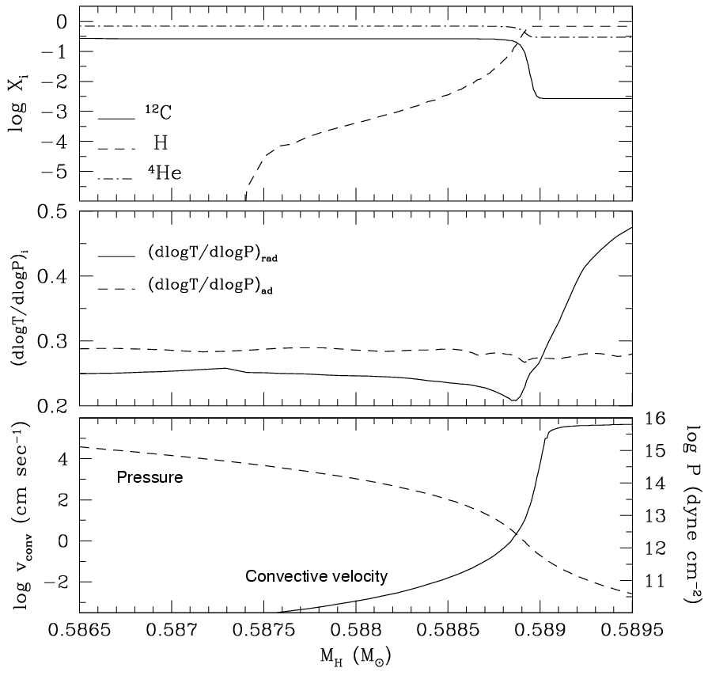
Convective envelope attains the maximum penetration into the He core
Chemical stratification
proton tail
Temperature gradient
He
H
Radiative core | Transition zone | Convective envelope
*note: below the convective envelope, r<r₀ or δr<0

Slide 62
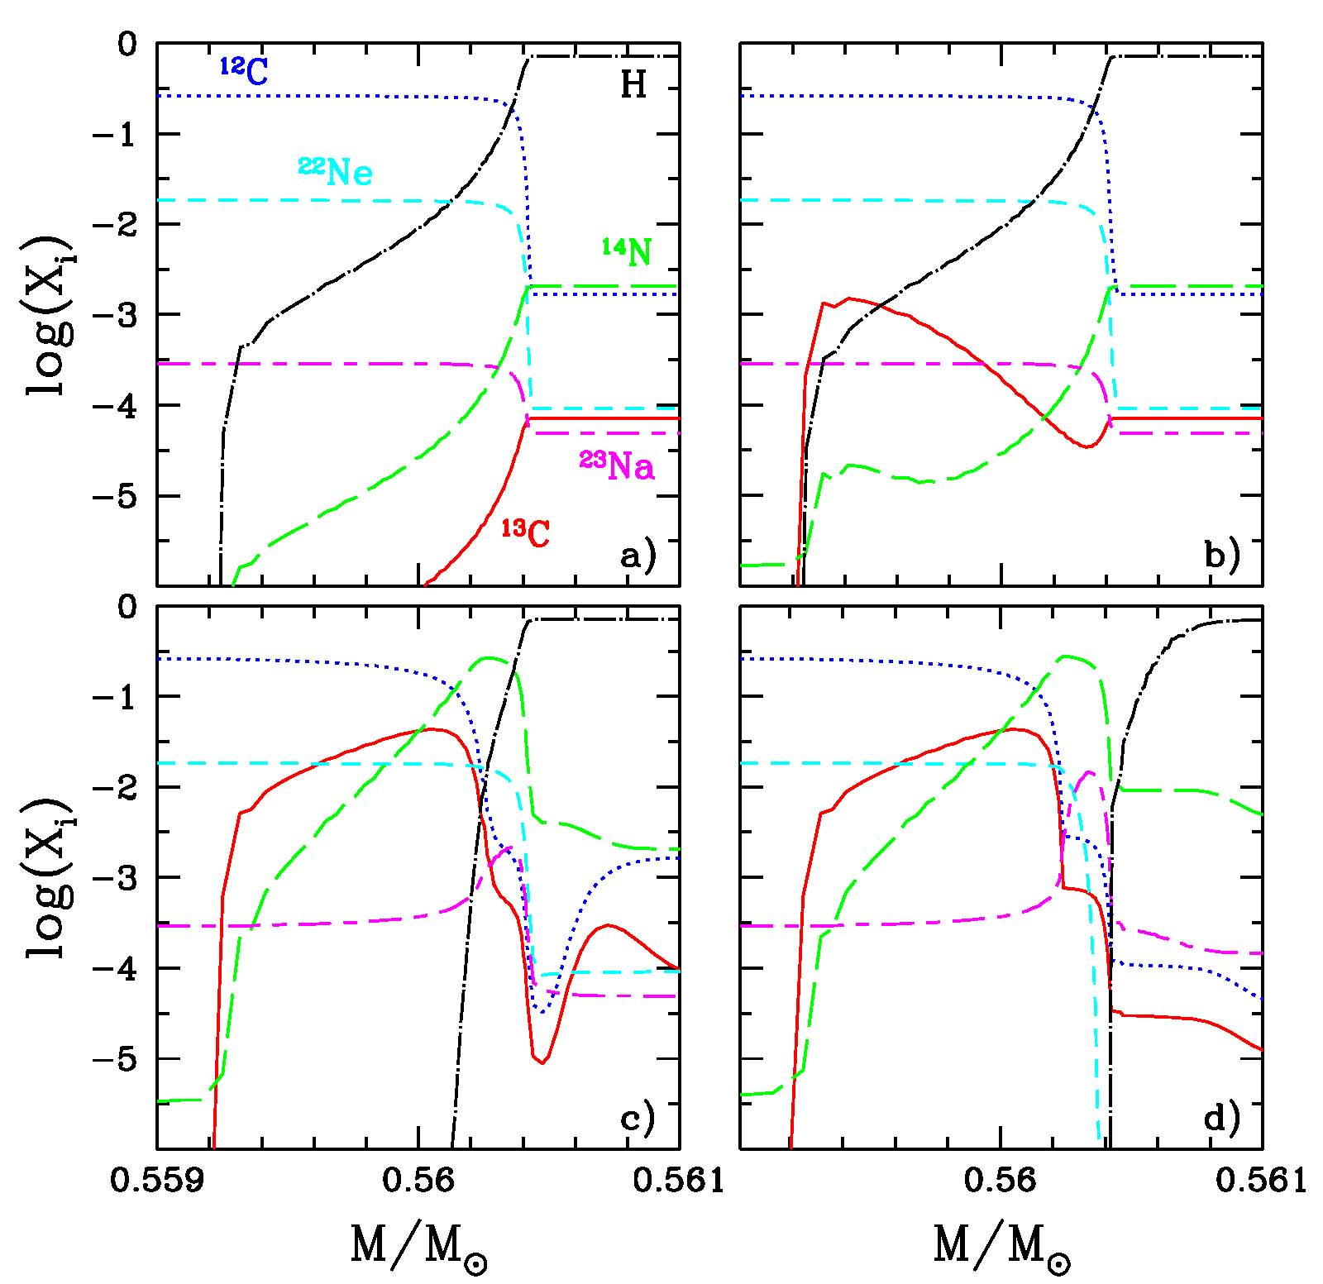
The formation of the ¹³C pocket.
a)
Maximum envelope
penetration (TDU);
b) & c)
¹²C(p,γ)¹³N(β⁻)¹³C followed by ¹³C(p,γ)¹⁴N;
d)
²²Ne(p,γ)²³Na;
M=2M
Z=Z

Slide 63
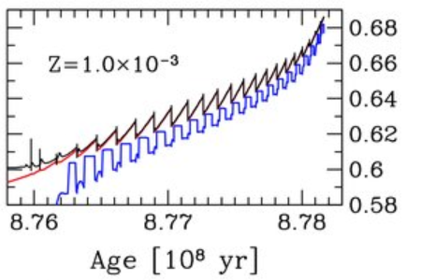
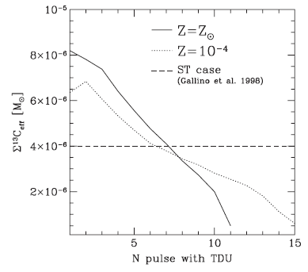
Nucleosynthesis in the He-rich mantel of AGB stars
Multiple neutron exposures. After each TDU, a new ¹³C pocket forms. Due to the overlap of the convective shells powered by the TPs, the final s-process yield is the cumulative contribution of all these pockets

Slide 64
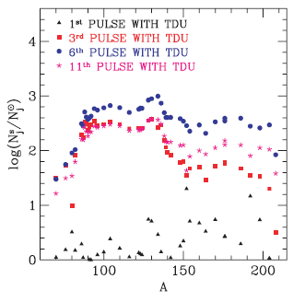
Multiple neutron exposures in AGB stars
After each TDU, the ashes of the s-process are mixed and diluted with the envelope material. Heavy elements appear at the surface.

Slide 65
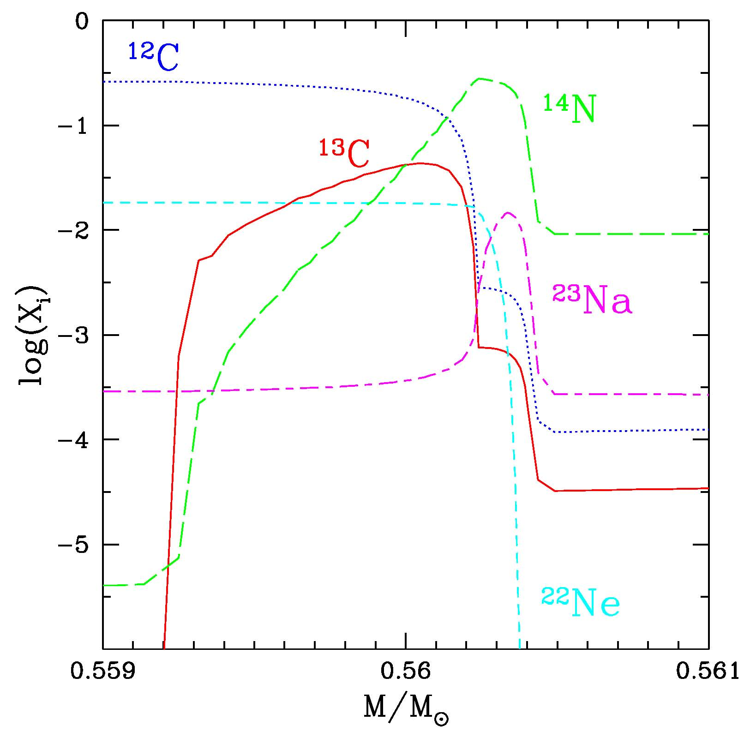
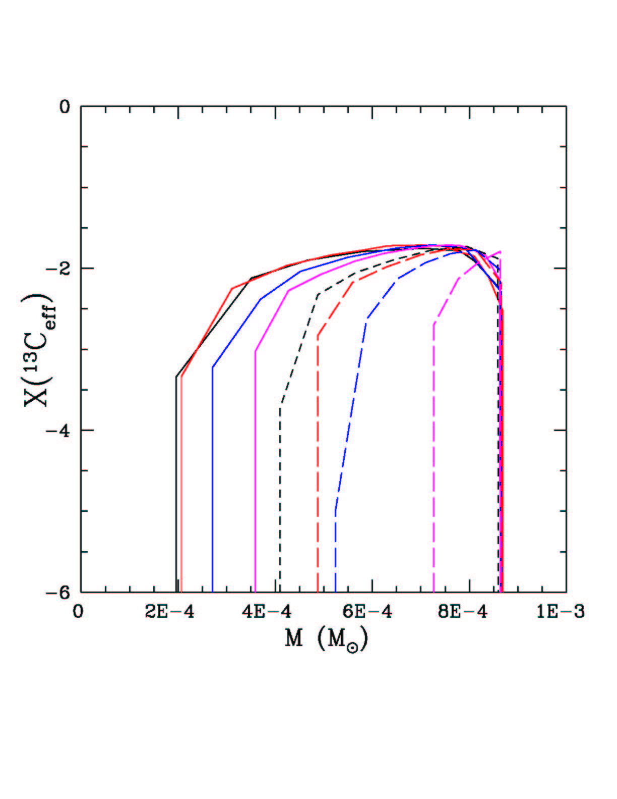
The resulting ¹³C pockets
X(¹³C_{eff})=X(¹³C)-X(¹⁴N)*13/14
1st
ΔM~10⁻³ M
11th
¹⁴N strong neutron poison via
¹⁴N(n,p)¹⁴C reaction

Slide 66
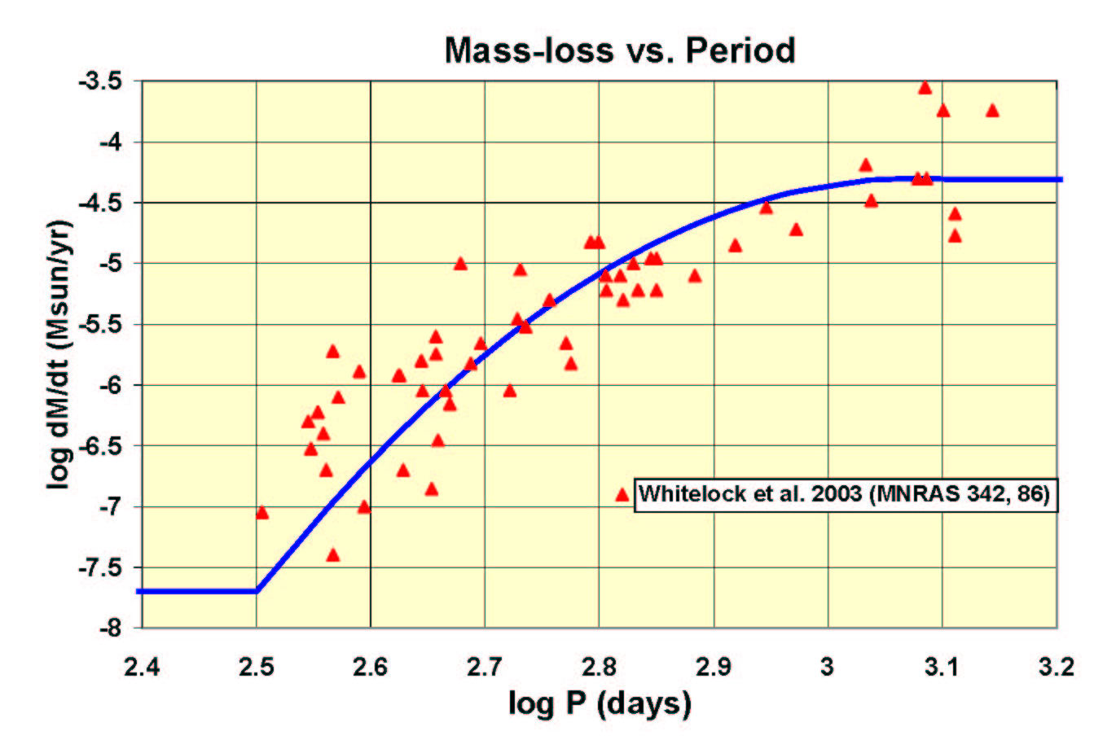
AGB MASS LOSS is driven by pulsation.
Stellar wind determines the duration of the AGB and the pollution of the interstellar gas.
REIMER’S MASS-LOSS
(η=0.2-0.4)
UP TO EARLY-AGB PHASE

Slide 67
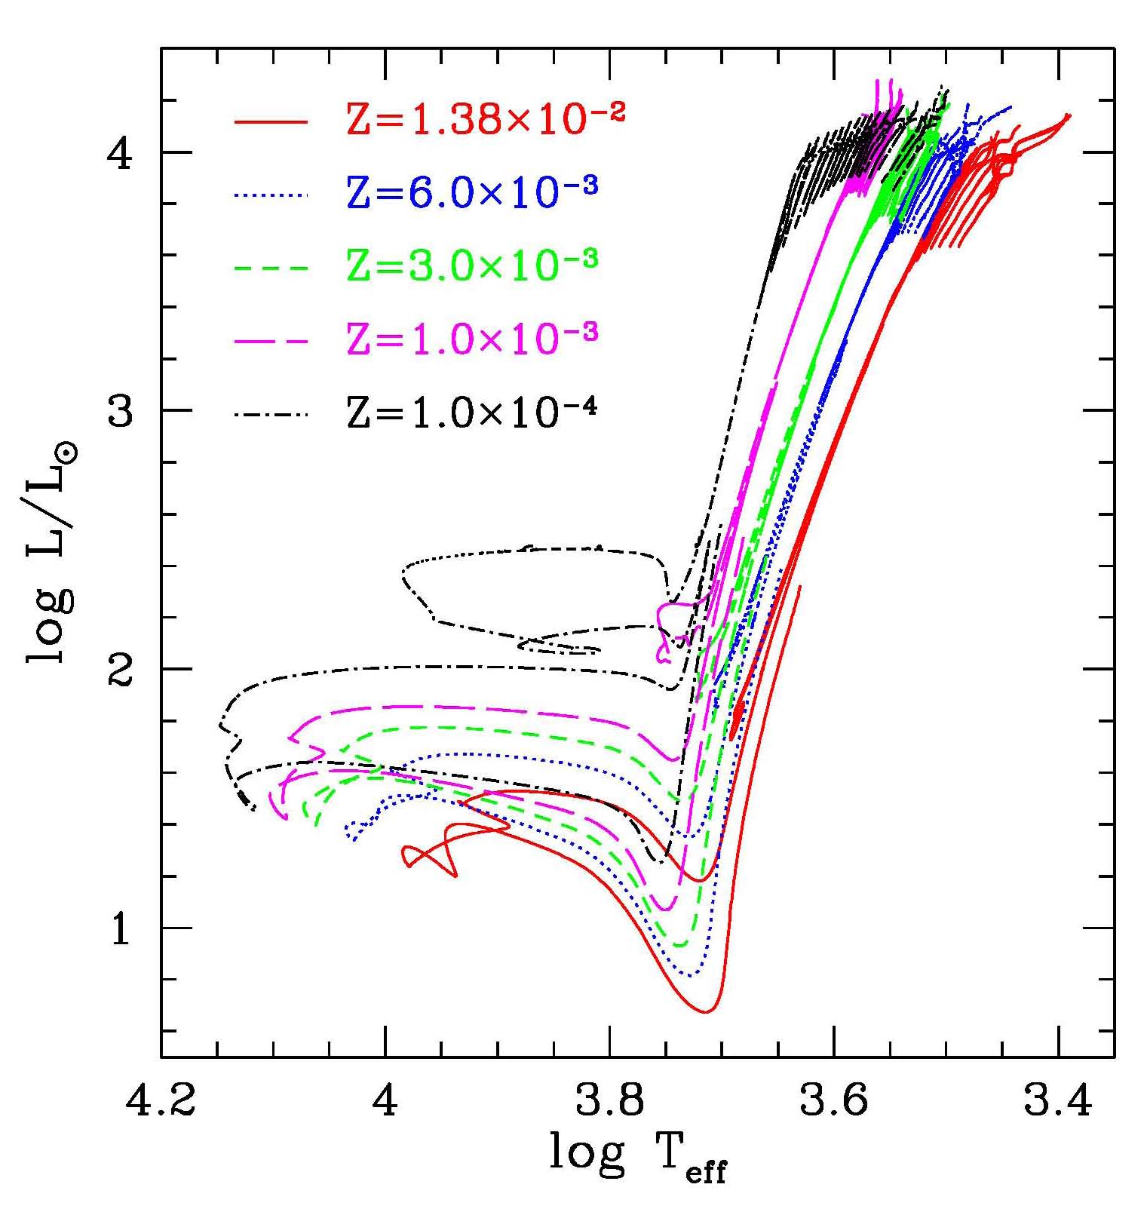
Results
The C-rich opacities
make the stars redder in the AGB phase.
When C/O>1, new molecular species form, such as CN, CH or C2.
Affects integrated colors

Slide 68
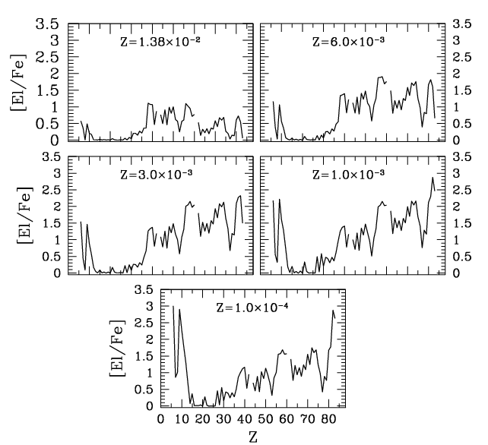
Final AGB composition for 0.0001<Z<Z
Pb, Bi
hs=Ba,La,Cs,Nd,Sm
ls=Y,Sr,Zr

Slide 69

A 3 player game
poisons
seeds
neutrons
(neutrons-poisons)
$$\left[\frac{hs}{ls}\right]$$
seeds

Slide 70
Y_{n} decrees when the metallicity increases: more seeds (⁵⁶Fe) and more poisons (¹⁴N), while the ¹³C is more or less the same

Slide 71
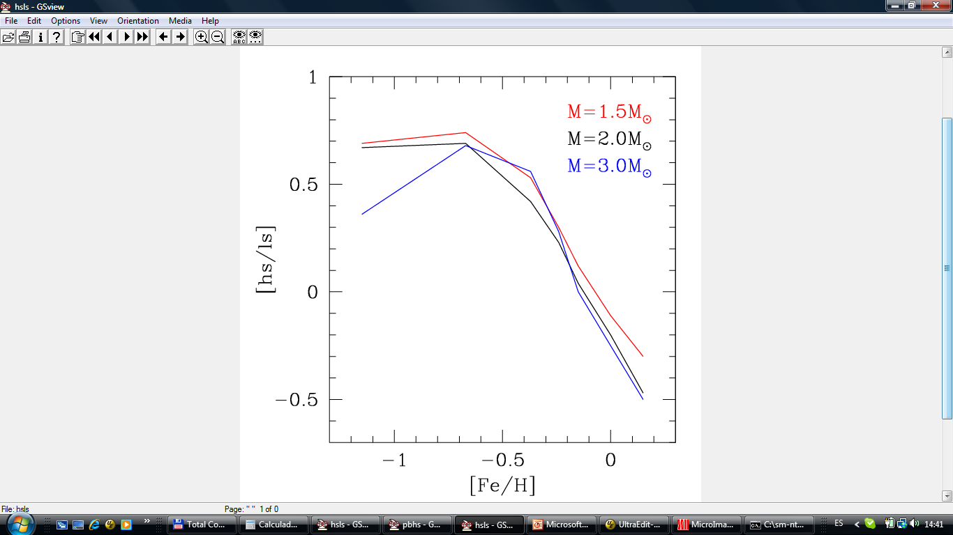
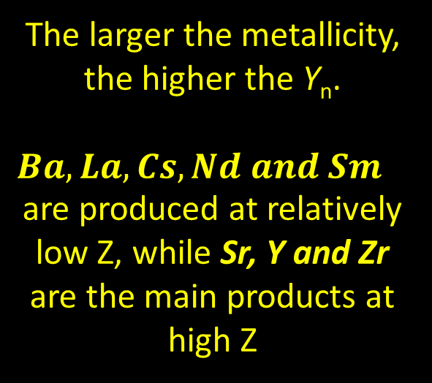
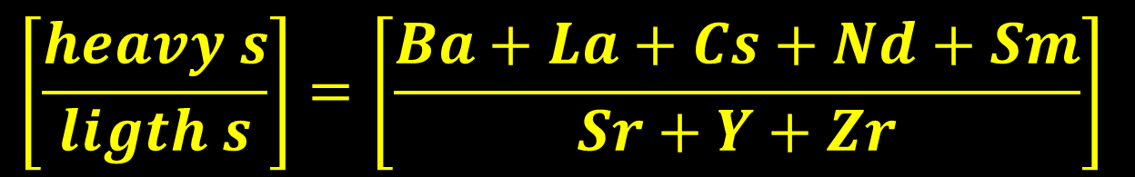
$$\left[\frac{heavy s}{ligth s}\right]=\left[\frac{Ba+La+Cs+Nd+Sm}{Sr+Y+Zr}\right]$$
The larger the metallicity, the higher the Y_{n}.
$Ba, La, Cs, Nd and Sm$are produced at relatively low Z, while Sr, Y and Zr are the main products at high Z

Slide 72
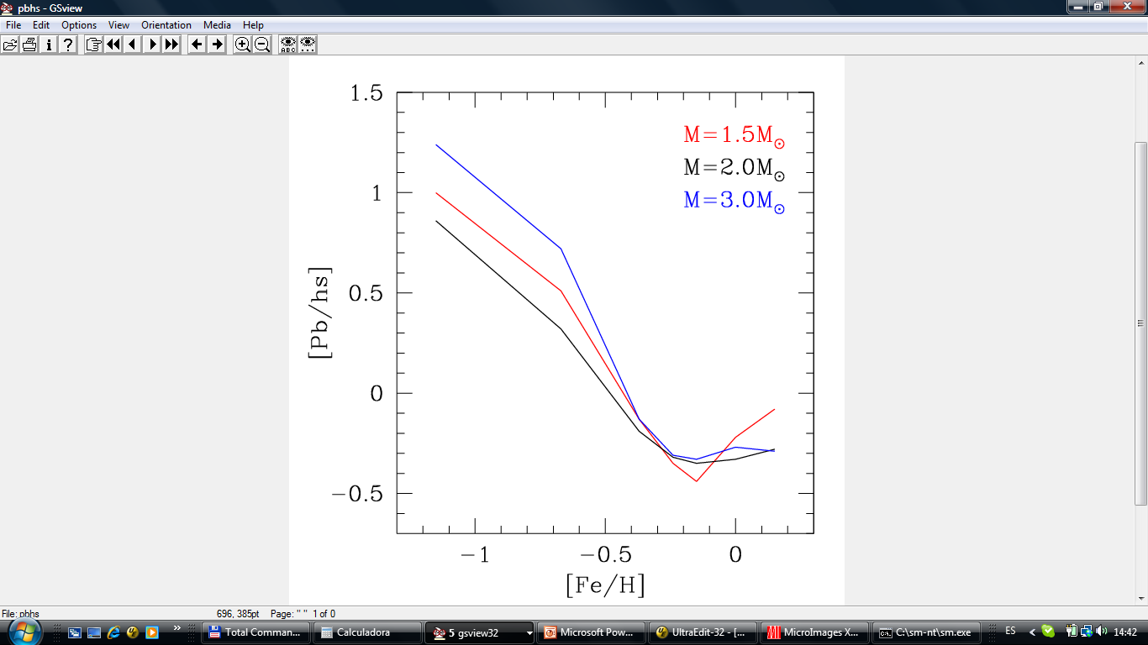
[Pb/hs]
Lead is produced by low-metallicity low-mass stars.
In these stars the neutron exposure may be larger than a few mb⁻¹ .

Slide 73
Varying the metallicity: theory versus observations
AGB stars undergoing TPs and III TDU in the Galactic Disk or in nearby Galaxies (either O- and C-rich), like C(N type) stars. Tc detected (or low Nb).
Post-AGB stars showing s-process enhancements.
s-rich stars, dwarfs or giants (no Tc), like Ba stars or CEMPs.
AGB imprints in pre-solar grains (SIC or O-rich).
AGB imprints in the Galactic Chemical Evolution.

Slide 74
Model Constraints
hs/ls: is a measure of the neutrons/seeds ratio. It depends on the amount of neutrons (¹³C), poisons (¹⁴N) and seeds (Fe). Better than X/Fe, which is affected by several uncertain quantities, such as mass-loss rate, dredge-up ……
Branching: Rb/Sr or ⁹⁶Zr/⁹⁰Zr. They depends on the neutron density and, in turn, on the temperature of the stellar site where they are syntesized….
AGB Luminosity Functions: constraints for mass loss and dredge up efficiency.

Slide 75
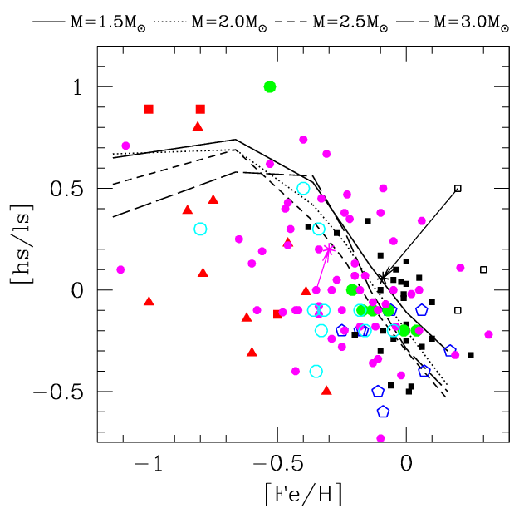
Combining hs and ls
According to the standard paradigm, the [hs/ls] attains an asymptotic value after very few TPs (3 or 4). This index is independent on the evolutionary status of the observed star Cristallo et al 2009).
RR Erc
HR107

Slide 76
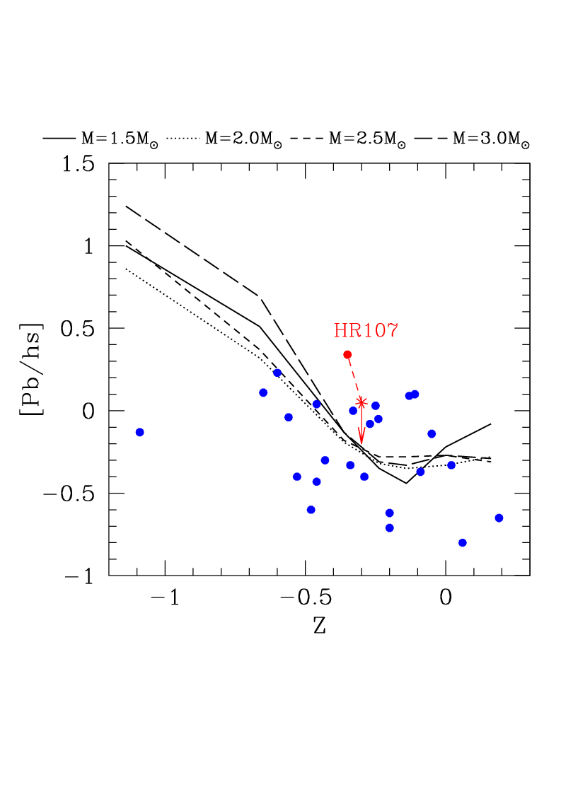
Lead and hs
[Fe/H]

Slide 77
AGB nucleosynthesis is a complex interplay of several phenomena, among which convection and nuclear burning are the most important, but other physical processes may be in action.
Interferences may be constructive or destructive, so that the resulting nucleosynthesis may be enhanced or suppressed.

Slide 78
Evidences for a more complex world:
Spread of hs/ls at different metallicity
s-exceptions: CEMPs and Ba-stars
They are binary stars; in this case we see the secondary component of the binary, polluted with the material lost by the primary when it was on the AGB (see Bisterzo et al. 2011-2012). Todays the primary is a faint white dwarfs

Slide 79
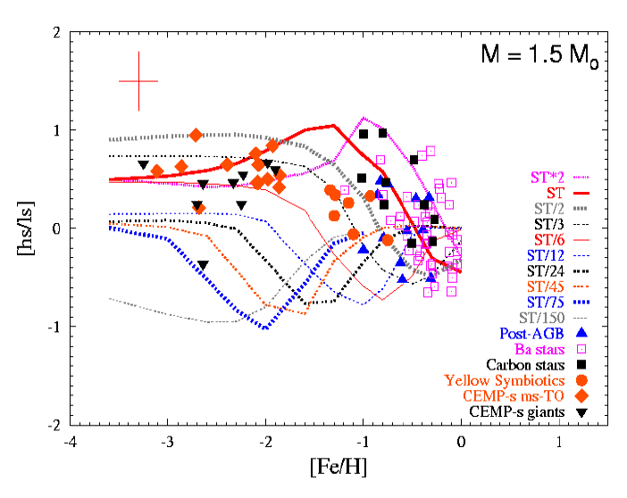
The Roberto Gallino recipe to explain the spread: star-to-star variation of the ¹³C amount
The formation of the 13C pocket is a stochastic process. In this case, a spread of the pocket size is naturally expected, so that stars with similar characteristics (mass, metallicity) may show different s-process enhancements.

Slide 80
Alternative n. 2: Poisons variation
The same effect on (n-p)/seed may be obtained by varying the amount of poisons (like ¹⁴N), instead of the ¹³C.
It is equivalent to reduce the effective ¹³C
¹³C_{eff}=¹³C-¹⁴N
An interesting case is obtained by considering mixings induced by stellar rotations.
Rotation may induce several types of dynamical and secular instabilities.
In the He-rich zone of an AGB stars, in particular, Eddington-Sweet and shear instabilities are at work.

Slide 81
Additional processes….
Instabilities induced by Rotation may modify the H profile left by the third dredge up and, later on, the ¹³C and the ¹⁴N profile into the pocket (Piersanti et al. 2013).
The bulk motion in the convective envelope generates gravity waves propagating inward . Turbulence may be generated by non-linear effects (Denussenkov 2003) or by interaction with rotation (Talon 2007). The consequent mixing may affect nucleosynthesis and angular momentum transport
Magnetic field dissipates angular momentum (magnetic breaking, Sujis 2008), but may also induce magnetic buoyancy, possibly operating in the He-rich intershell (see Vescovi et al. 2021).

Slide 82
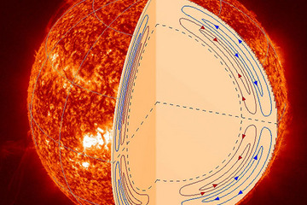
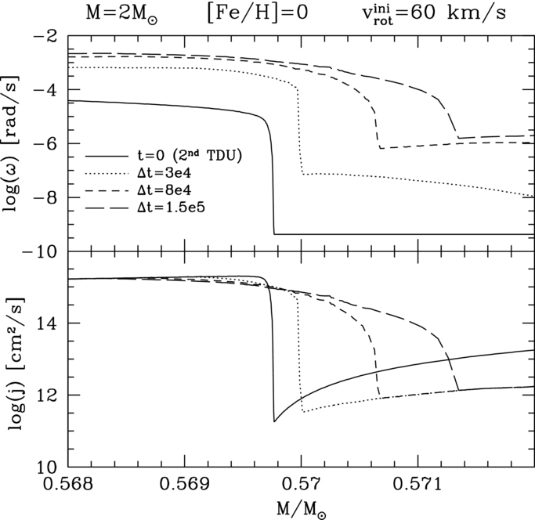
Differential Rotation: ES + GSF instabilities during the interpulse
Sharp variations of ω and j
left by the TDU drives GSF
Meridional Circulation is always
active in rotating stars, because of
the von Zeipel effect, but it is
inhibited by a μ gradient.
See, e.g. Langer et al. 1999, Siess et al. 2004, Herwig et al. 2003, Piersanti et al. 2013

Slide 83
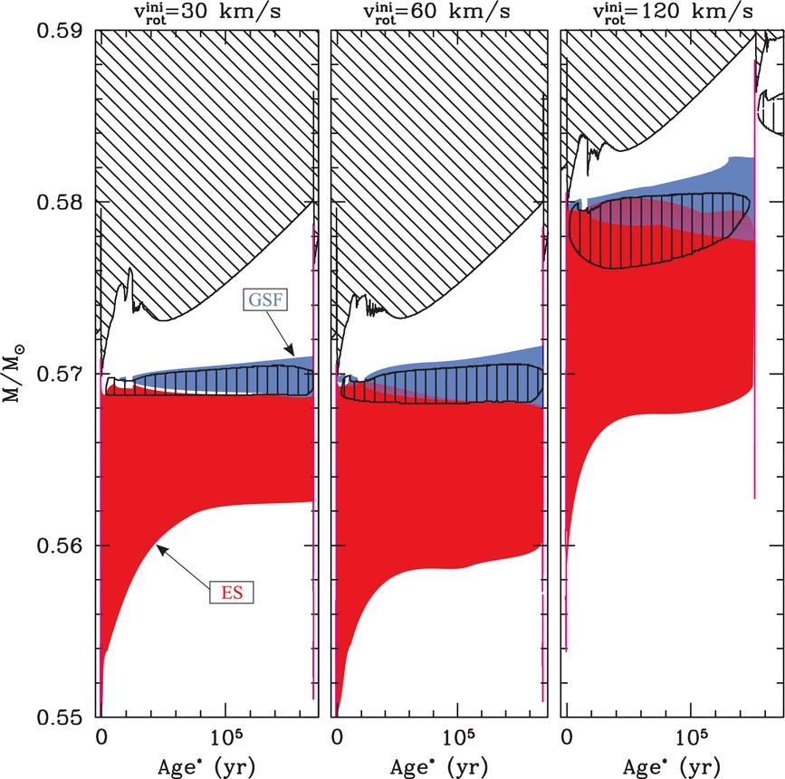
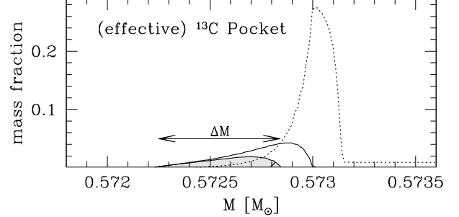
Development of rotation-induced instabilities between
the 2nd and the 3rd TDU (M=2 M_{ʘ} [Fe/H]=0)
\\\ convection
||| X(¹³C)>10⁻³
ES
GSF

Slide 84
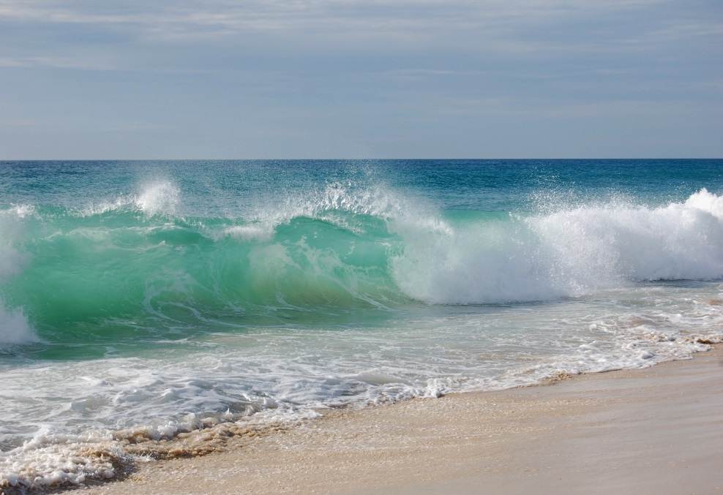

The rotation paradigm
+
Turbulent convection at TDU:
a proton profile forms at the top
of the He-rich zone
Rotation induced instabilities
during the interpulse: redistribution of
protons and, later on, of ¹³C -¹⁴N
on a larger area. Same neutrons, more seeds and more poisons
AS a result: lower

Slide 85
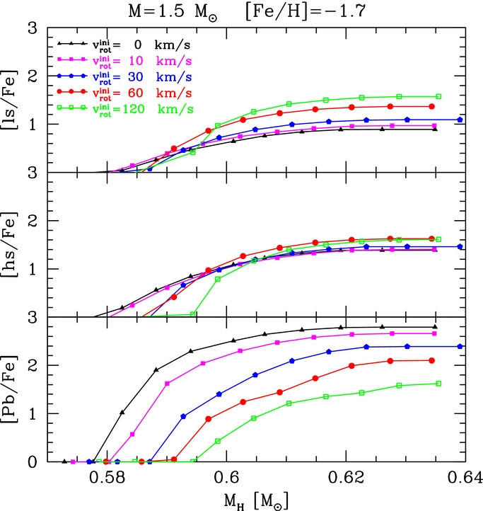
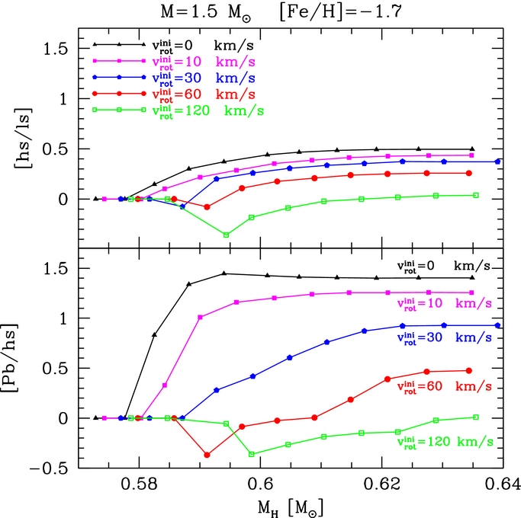

Consequences of rotational induced mixing
From Piersanti et al. 2013

Slide 86
Summary of the rotation effects (Piersanti et al. 2013)
Mixing induced by rotation may produce a partial or total overlap of the ¹⁴N and ¹³C pockets, so that the effective ¹³C is reduced.
Such an effect is expected to increases with the mass of the stars and with the initial V_{rot}.
It may naturally imply a spread in the neutron/seed ratio and, in turn, in [hs/ls] and [Pb/hs].
However, recent asteroseismic observations (KEPLER, TESS) show that rotation is probably suppressed in most of the giants.

Slide 87
A (theoretical) classification
 | Type I | Type II | Type III | Type IV | Type V | Type VI super-AGB
Mass range: Disk Halo | <1.2 <1.0 | 1.2-1.8 | 1.8-3.5 1.0-2.5 | 3.5-5 2.5-3 | 5-8 3-6.5 | 8-10 6.5-9
TDU | NO | YES | YES | ? | ? | ?
HBB | NO | NO | NO | marginal | YES | YES
s-process: ²²Ne(α,n) ²⁵Mg ¹³C(α,n)¹⁶O | NO NO | NO YES | marginal YES | YES YES | YES marginal | YES NO
Final core mass | 0.5-0.6 | ~ 0.6 | ~ 0.7 | 0.7-0.9 | 0.9-1.1 | 1.1-1.3
C/O | 0.35 | 0.5-0.9 | 0.5 -2 0.5-1000 | 0.5 to >1 | <1 >1 | <1
spectral type | M | M, MS, S | M,MS,S & C | M,MS, S &C | M,MS, S &C | M

