Slide 1
Theory Aspects of Nuclear Reactions in Astrophysics
n_TOF Winter School
2024
Thomas Rauscher
University of Basel
Switzerland

Slide 2
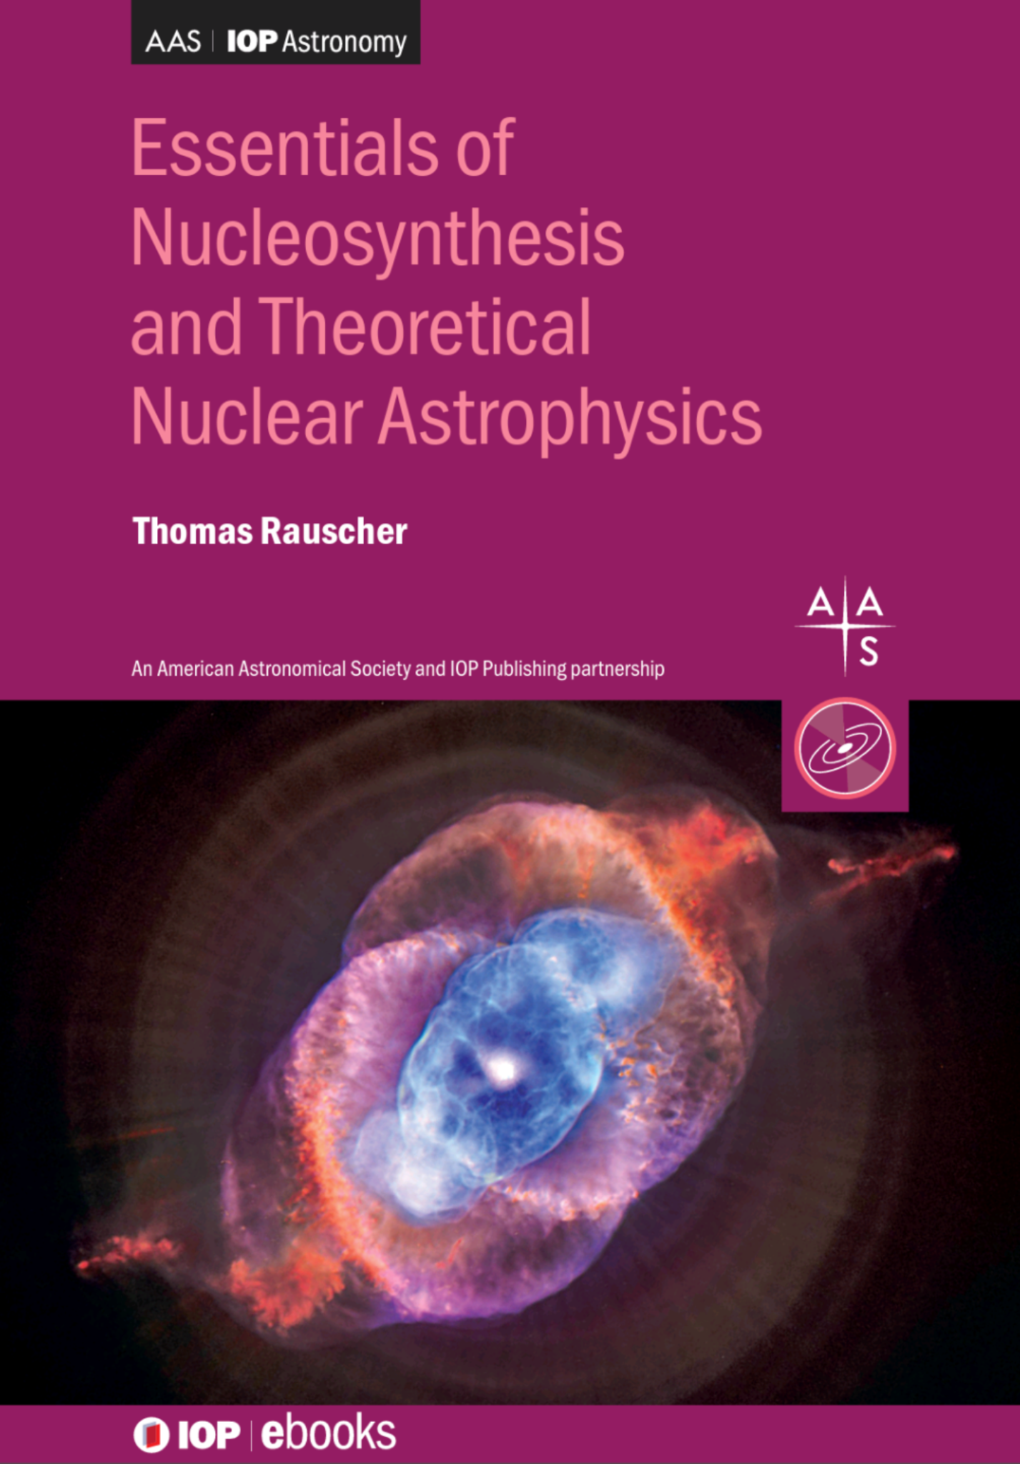
AAS-IOP ebook series
IOP Publishing, July 2020
ISBN: 978-0-7503-1149-6 (e-book)
ISBN: 978-0-7503-1150-2 (print)
Contents (summary), 2 parts in 1 volume:
Part 1: Essentials
  Basic definitions, equations of state, stellar structure, nuclear physics and reactions, stellar effects on cross sections, astrophysical reaction rates, reaction networks and reaction equilibria
Part 2: Nucleosynthesis
  Stellar evolution, hydrostatic and explosive burning, origin of the elements beyond Fe, Big Bang nucleosynthesis, Galactic Chemical Evolution
Mainly this talk (+Gunsing);
Stellar physics talk (Straniero)
The astrophysics talks
(Straniero, Pignatari)
https://iopscience.iop.org/book/978-0-7503-1149-6
https://store.ioppublishing.org/page/detail/Essentials-of-Nucleosynthesis-and-Theoretical-Nuclear-Astrophysics/?K=9780750311496

Slide 3
Outline
Nuclear reactions
  Optical model
  Direct reactions
  Compound reactions
    Resonant, statistical (Hauser-Feshbach)
Astrophysical reaction rates
  Reaction network
  Definition of reaction rates
  Relevant energy window (Gamow window)
  Stellar Modification of reaction cross sections
    contribution of excited target states to the stellar rate
  Reciprocity of stellar rates
Considerations regarding rate determinations for light and heavy nuclides

Slide 4
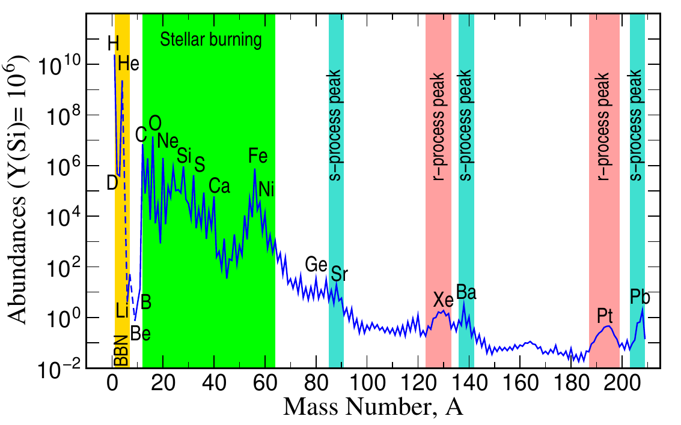
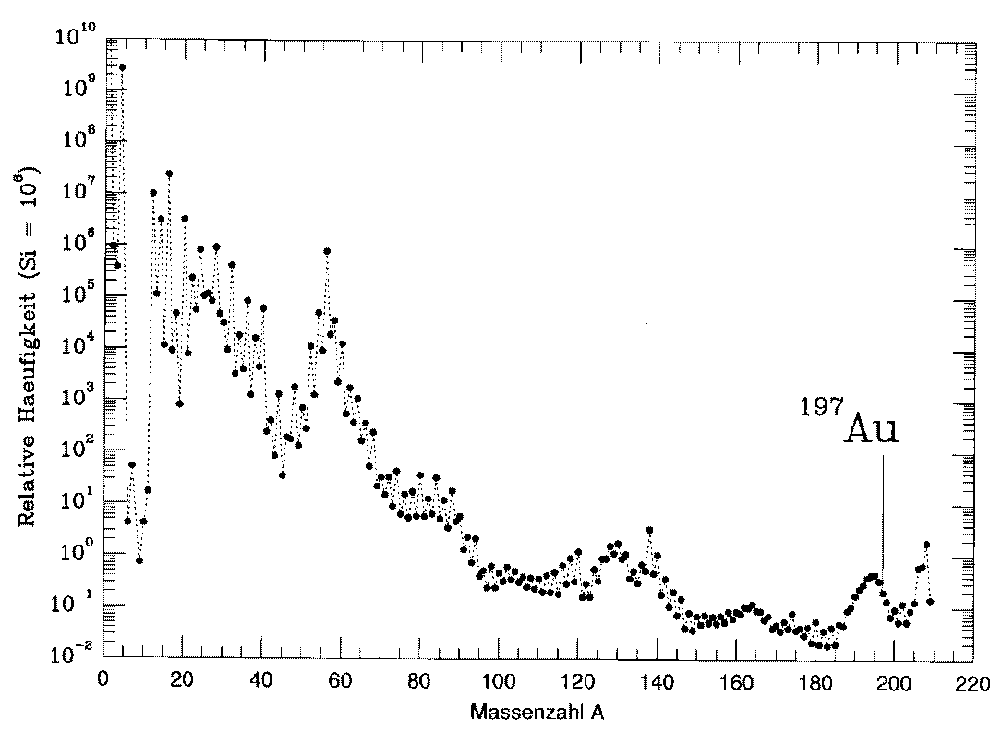
Solar Abundances
From:
Astronomy
Meteorites
Geology
Cowan+ 2022

Slide 5
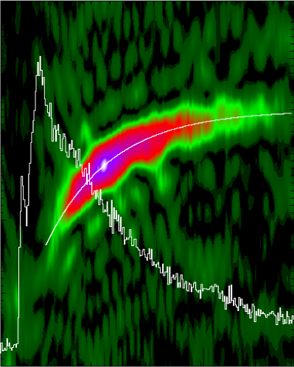
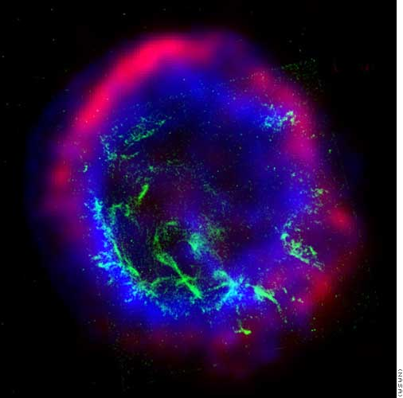
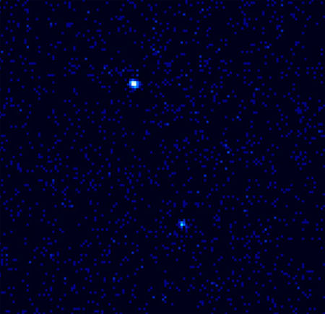
X-ray burst (RXTE)
Mass known
Supernova (Chandra,HST,..)
4U1728-34
Half-life known
331
nothing known
Fission
cycling?
330
Frequency (Hz)
329
p process
328
s-process
E0102-72.3
327
10
15
20
Time (s)
r process
Nova (Chandra)
νp-process
Ne
V382 Vel
EC
Metal poor halo star (Keck, HST)
rp process
CS22892-052
solar r abundance
observed
10
20
30
abundance
Wavelength (Α)
n-Star (Chandra)
stellar burning
KS 1731-260
Z
protons
Crust
processes
and finally:
Big Bang
neutrons
ν-process
Cosmic Rays
(from H. Schatz)
Notes:
Update slightly with EC

Slide 6
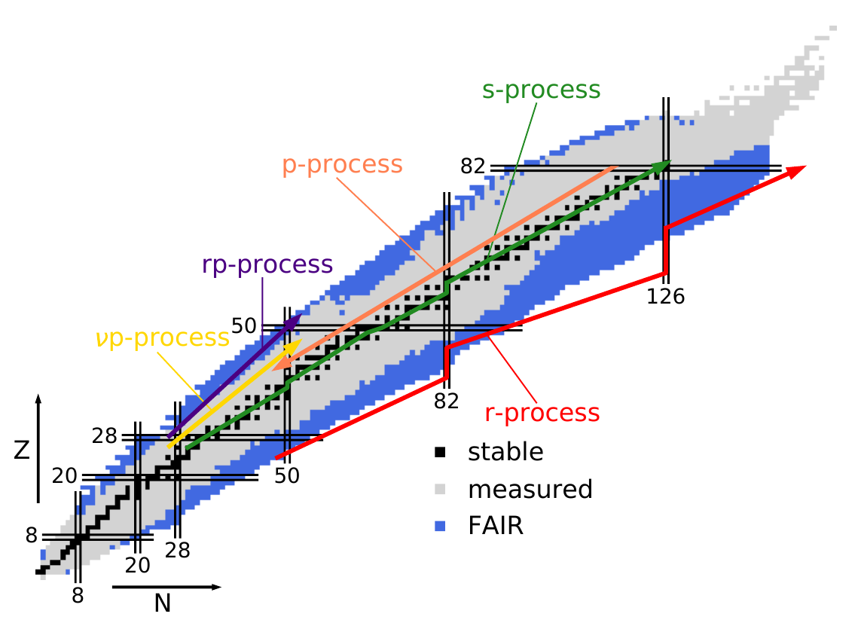
Nucleosynthesis Processes
Arcones, Thielemann 2023

Slide 7
Typical plasma temperatures and nuclear energies
Hydrostatic burning:
  H-, He- (s-process), C-burning: 0.01 – 0.3 GK, neutrons 1 – 90 keV, protons few 100 keV, alphas few MeV
  Late burning stage (Ne-, O-, Si-): up to few GK
Explosive:
  p/γ-process: 2 – 4 GK, neutrons 200 – 400 keV, protons < 6 MeV, alphas < 14 MeV
  rp-, νp-process: 1 – 2 GK, protons < 4 MeV, alphas < 10 MeV
  r-process: 1 GK, neutrons 100 keV
  Others see talk by Pignatari
Note: r-process, rp- , and νp-process involve reaction equilibria, individual cross sections are not important! (see later)

Slide 8
Have to consider:
What are the astrophysically relevant interaction energies (given plasma temperature)?
What type of reaction mechanism dominates for given nucleus at energies corresponding to the stellar plasma temperature?
Astrophysical modifications of the usual (nuclear physics) cross section?

Slide 9
Nuclear Reaction Basics

Slide 10
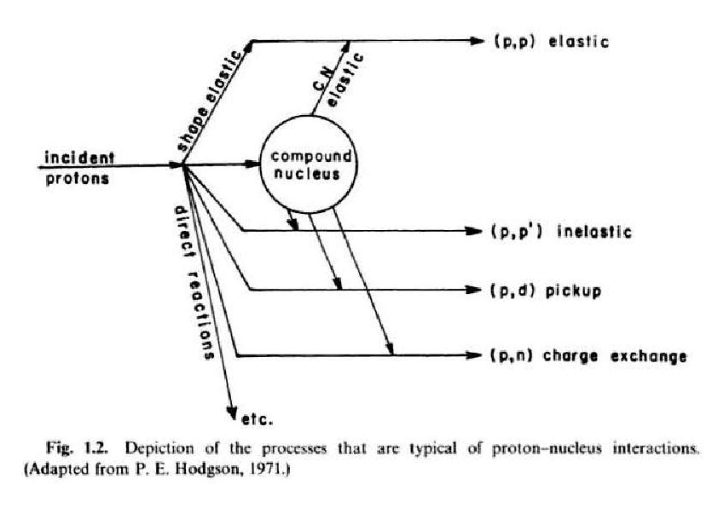
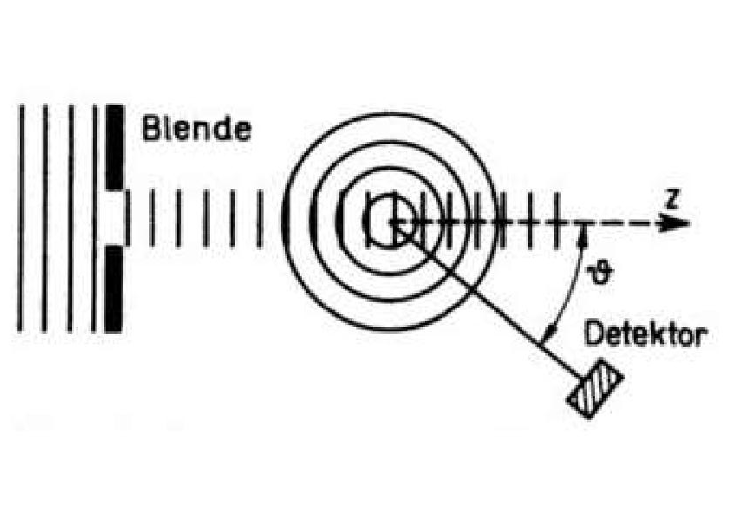
Instead of protons you may
use neutrons or alphas
in this figure!

Slide 11
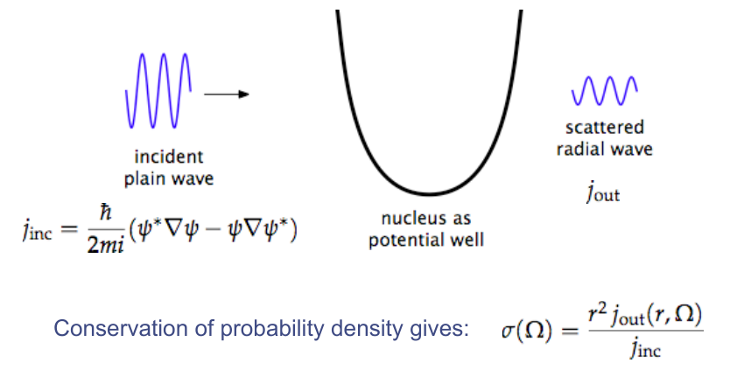
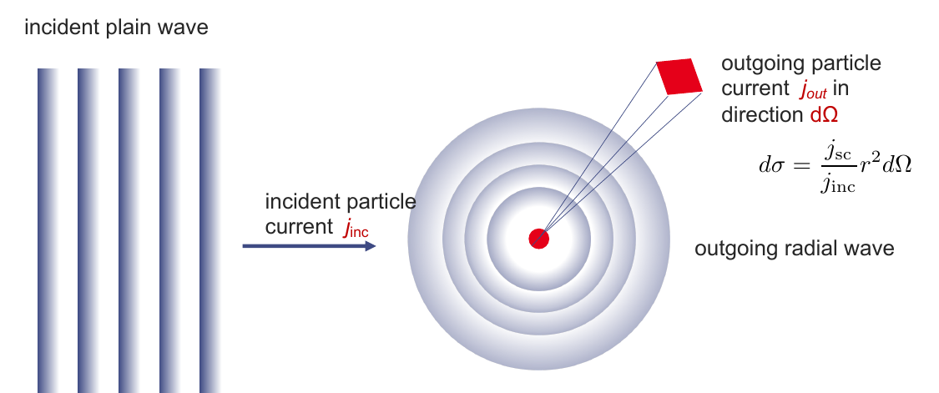
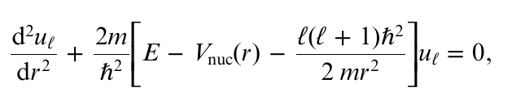
Optical model potential
(talk by F. Gunsing)
Radial time-independent Schrödinger equation for partial wave
Effective interaction potential for scattering with real and imaginary part (optical potential)
V_{nuc}(r)=V_{coul}(r)+Vf_{Re}(r)+Wf_{Imag}(r)
Interaction potential can be identified with a refraction index.
With real potential: flux conservation in elastic scattering; with imaginary potential: flux is lost from elastic scattering channel (absorption factor e^{-k}₂^{r} in solution).
This is comparable to loss when shining light on opaque “crystal ball”, therefore “optical model”

Slide 12
Decomposition of cross sections
compound-reaction
compound-elastic
theo
direct
compound-formation
(exp)
absorption
shape-elastic
theo
reaction
elastic
(exp)
total
exp
Not all of these can be directly measured.
Absorption by imaginary potential (optical model) gives split between reaction and elastic (scattering) c.s.; scattering is used to determine optical potential, but:
  also “elastic” may include “compound-elastic”
  does not necessarily define reaction mechanism
Direct and compound reactions can be distinguished experimentally by angular distribution of reaction products.
  Compound can be isolated resonances or many unresolved, “statistical” res.
Depending on projectile energy one reaction mechanism may dominate.

Slide 13
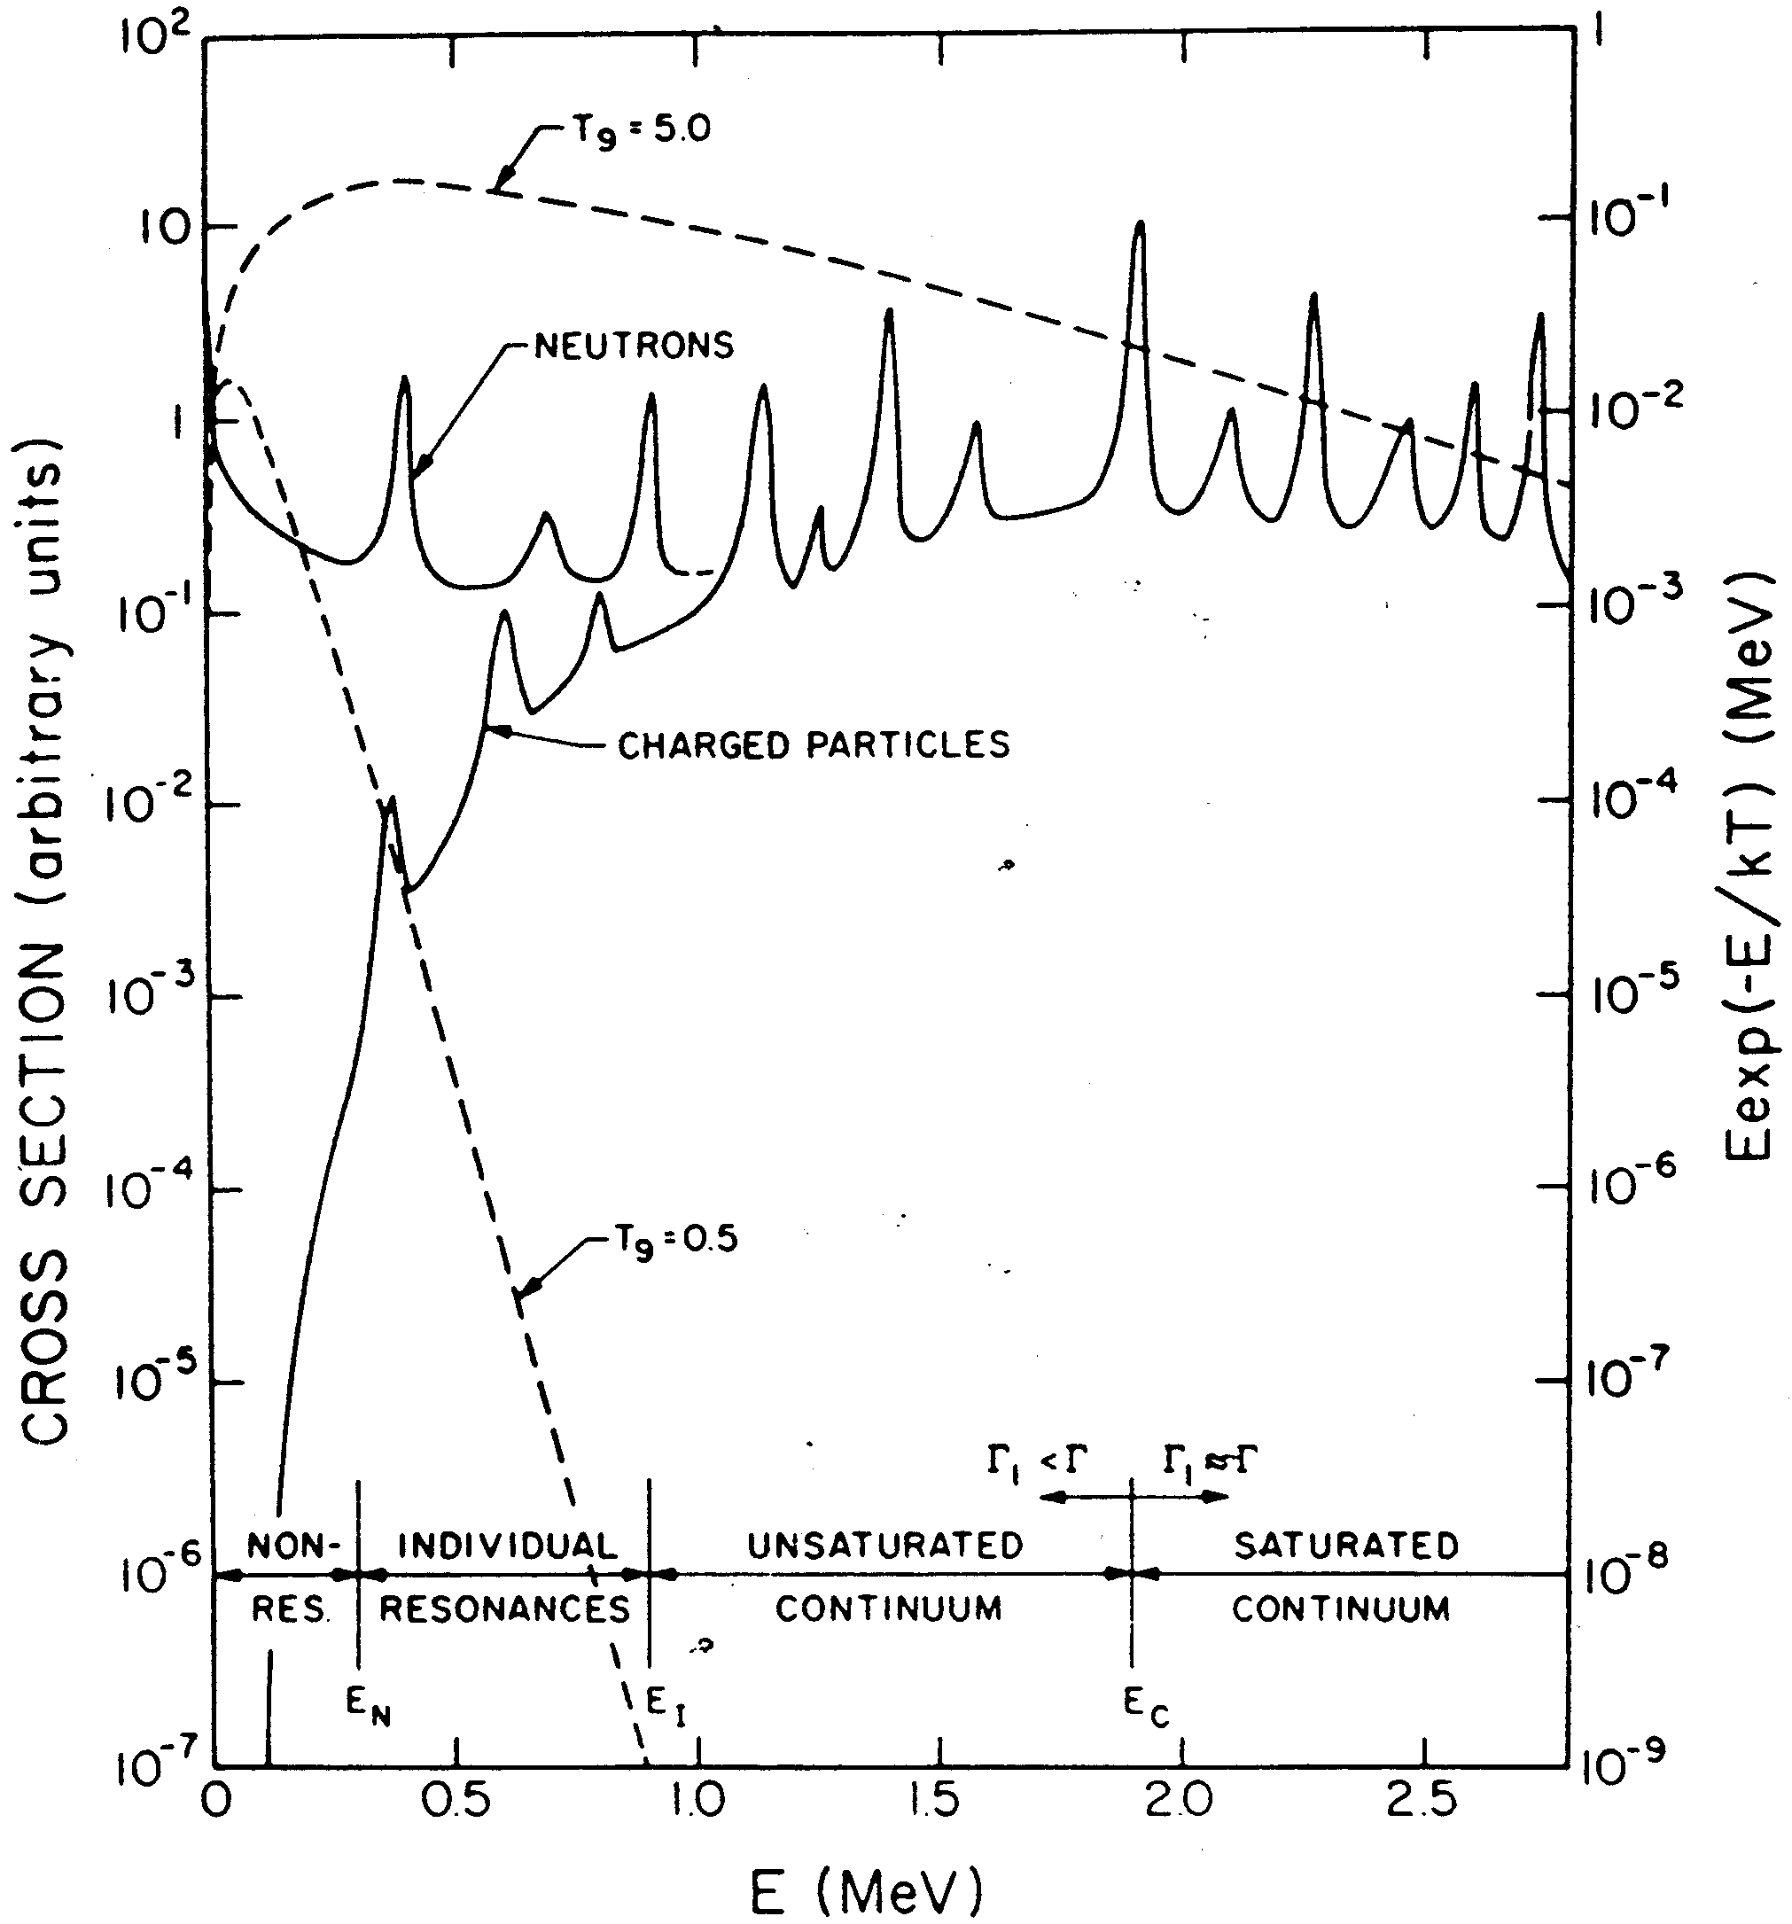
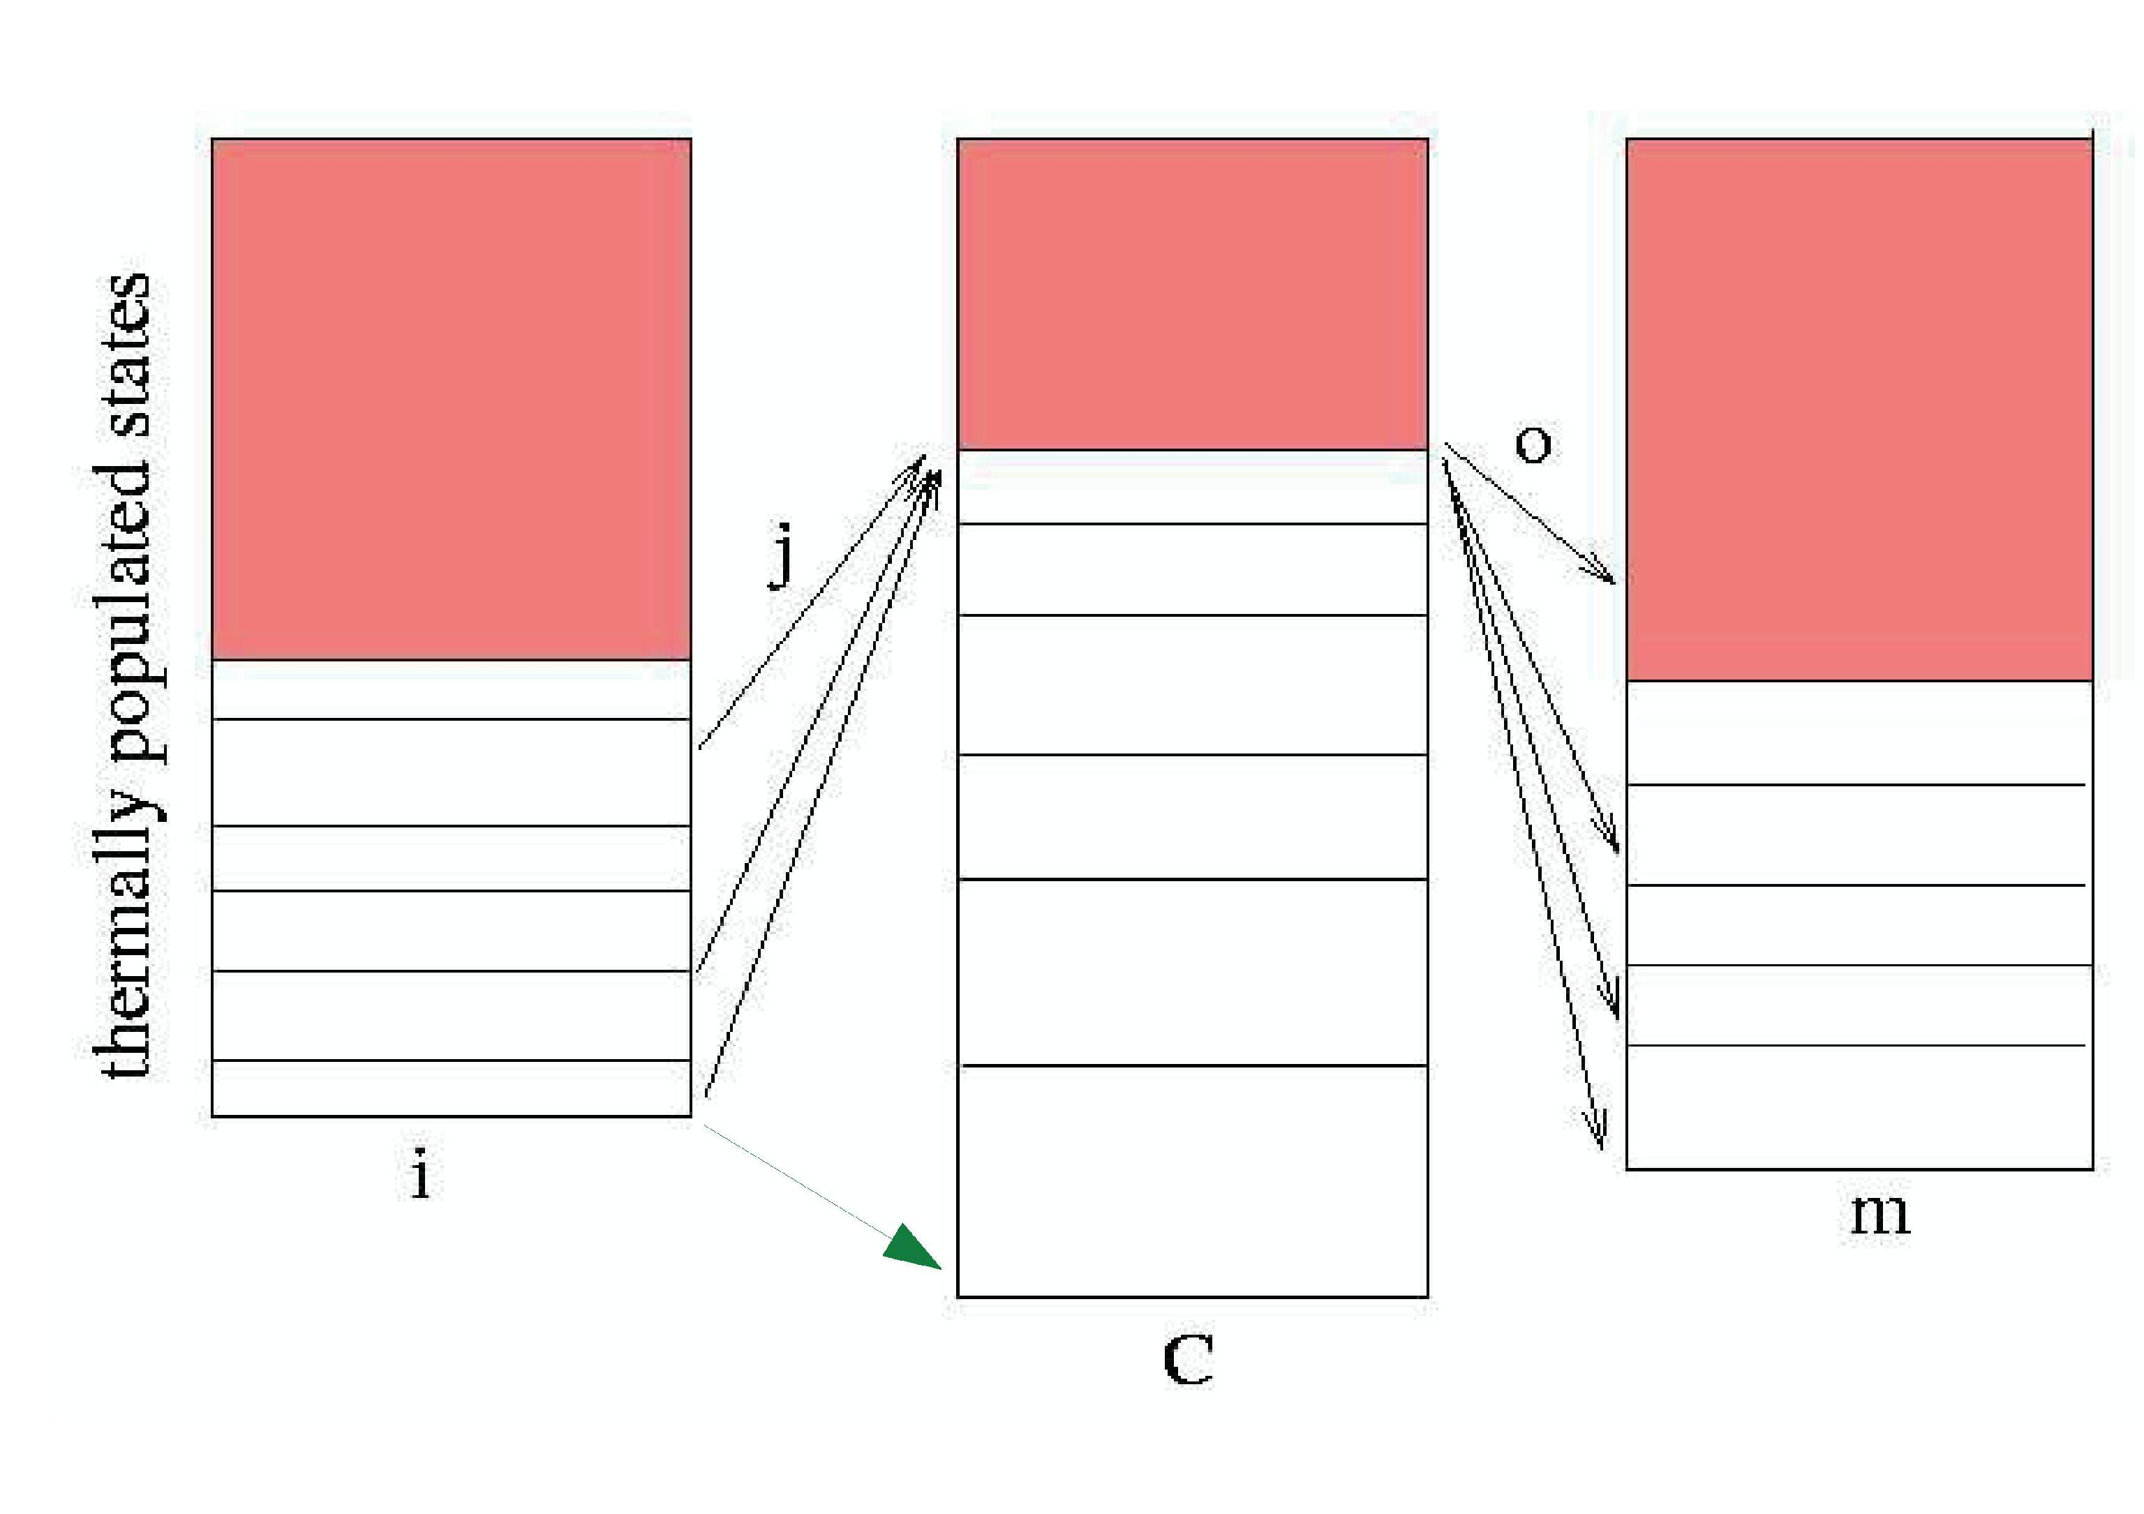
Reaction Mechanisms
Regimes:
Overlapping resonances: statistical model (Hauser-Feshbach)
Single resonances: Breit-Wigner, R-matrix (RGM, GCM in light nuclides)
Without or in between resonances or at high energy: Direct reactions (DWBA, potential model)
Determined by nucl. level density
Wagoner 1959

Slide 14
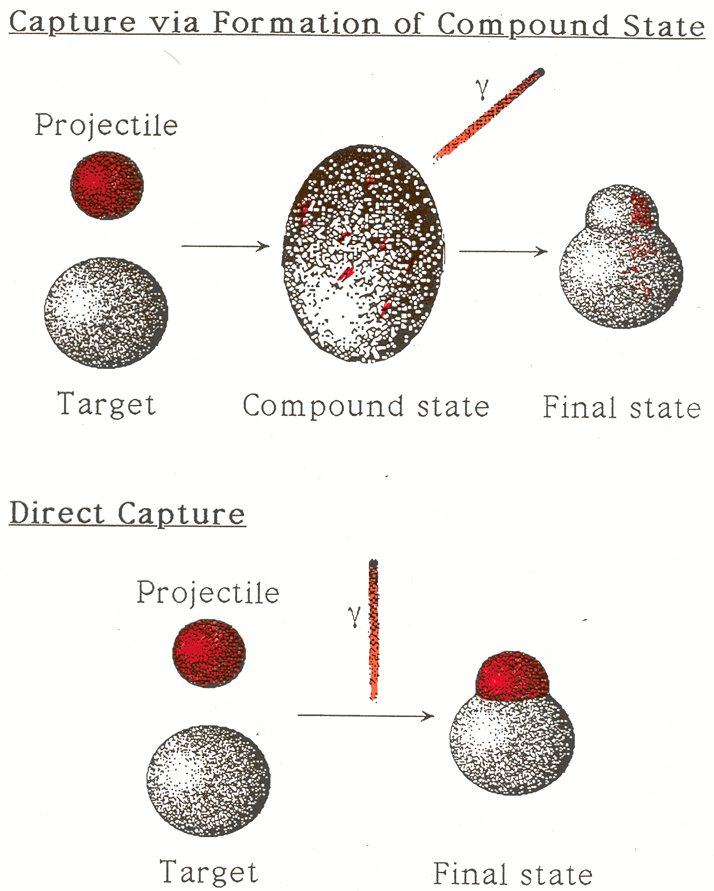
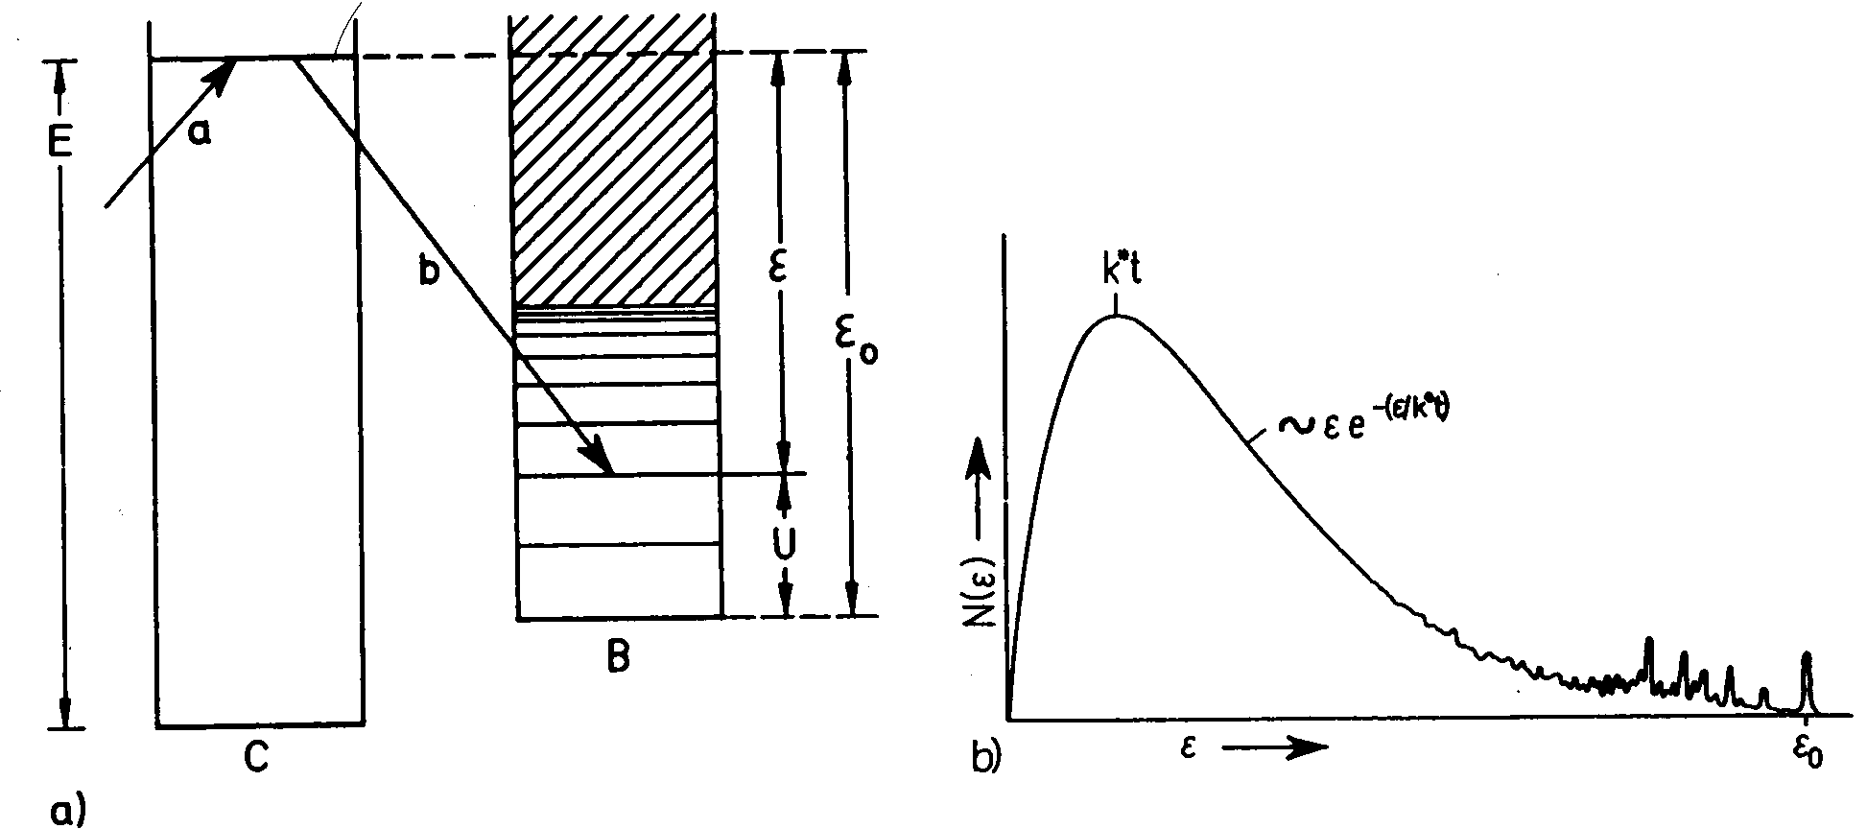
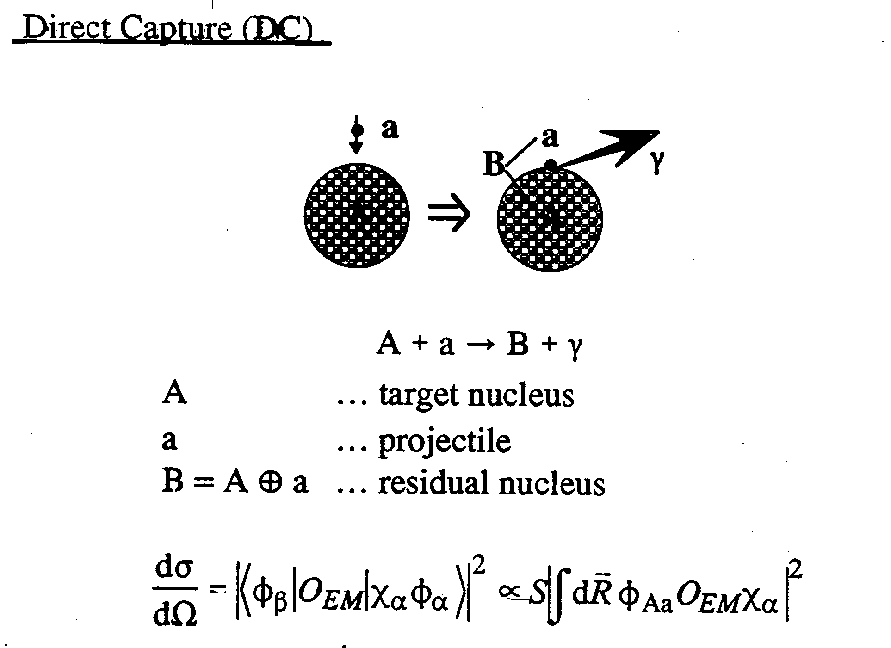
Reaction Mechanisms II
Statistical Model (Hauser-Feshbach):
Compound Reaction
Direct Reaction

Slide 15
Basic reaction mechanisms involving strong or electromagnetic interaction:
Example: neutron capture A + n -> B + γ
I. Direct reactions (for example, direct capture)
direct transition into bound states
E_{n}
γ
S_{n}
A+n
B
II. Resonant reactions (for example, resonant capture)
Step 1: Compound nucleus formation
(in an unbound state)
Step 2: Compound nucleus decay
E_{n}
Γ
Γ
S_{n}
γ
A+n
B
B

Slide 16
For example, a resonant A(n,α)B reaction:
Step 1: Compound nucleus formation
(in an unbound state)
Step 2: Compound nucleus decay
E_{n}
Γ
α
S_{n}
A+n
C
B+α
S_{α}
C
B
For resonant reactions, E_{n} has to “match” an excited state (but all excited states
have a width and there is always some cross section through tails)
But enhanced cross section for E_{n} ~ E_{x}- S_{n}

Slide 17
Direct reactions - for example direct capture:
a + A -> B + γ
Direct transition from initial state |a+A> to final state <f| (some state in B)
geometrical factor
(deBroglie wave length
of projectile - “size” of
projectile)
Interaction matrix
element (nuclear structure, overlap between initial and final state, independent of E)
Penetrability: probability
for projectile to reach
the target nucleus for
interaction.
Depends on projectile
Angular momentum l
and Energy E

Slide 18
Penetrability:
2 effects that can strongly reduce penetrability:
1. Coulomb barrier
V
Coulomb Barrier V_{c}
for a projectile with Z₂ and
a nucleus with Z₁
Potential
R
r
or
Example: ¹²C(p,γ) V_{C}= 3 MeV
Typical particle energies for light nuclei in astrophysics are kT=1-100 keV !
Therefore, all charged particle reaction rates in nuclear astrophysics
occur way below the Coulomb barrier – fusion is only possible
through tunneling

Slide 19
2. Angular momentum barrier
Incident particles can have orbital angular momentum L
Classical:
p
Momentum p
Impact parameter d
d
Z=0
In quantum mechanics the angular momentum of an incident particle can have
discrete values:
With
l = 0
s-wave
And parity of the
wave function: (-1)^{l}
l = 1
p-wave
l = 2
d-wave
…
For radial motion (with respect to the center of the nucleus), angular momentum
conservation (central potential !) leads to an energy barrier for non zero angular
momentum.
Classically, one needs the radial kinetic energy to overcome the central potential,
but if d != 0 then there is an increasing amount of “non radial kinetic energy”,
which one needs to supply as well (at z=0 for example, K_r=0, but of course K != 0)

Slide 20

Energy E of a particle with angular momentum L (still classical)
$$E=\frac{L^{2}}{2mr^{2}}$$
Similar here in quantum mechanics:
μ : reduced mass of projectile-target system
Peaks again at nuclear radius (like Coulomb barrier)
when combined with nuclear potential
Or in MeV using the nuclear radius and mass numbers of projectile A₁ and
target A₂:

Slide 21
Direct reactions – the simplest case: s-wave neutron capture
No Coulomb or angular momentum barriers:
V_{l}=0
V_{C}=0
s-wave capture therefore always dominates at low energies
But, change in potential still causes reflection – even without a barrier
Recall basic quantum mechanics:
Incoming wave
transmitted wave
Reflected wave
Potential
Transmission proportional to

Slide 22
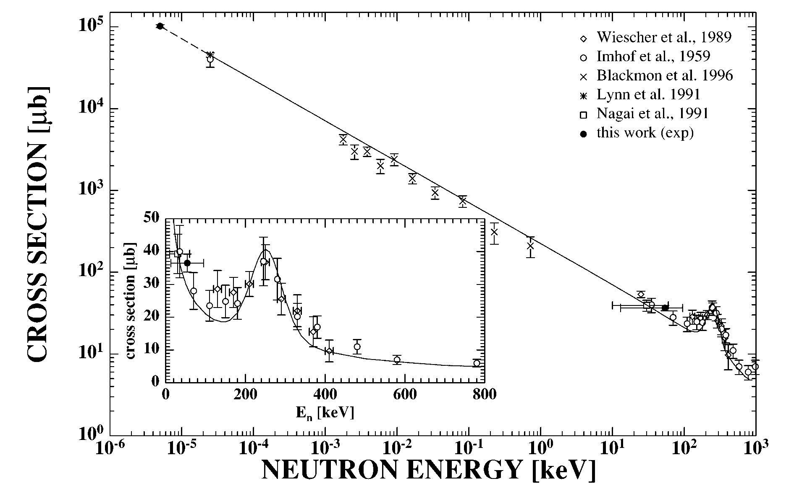
Therefore, for direct s-wave neutron capture:
Penetrability
Cross section:
Or
Example: ⁷Li(n,γ)
~1/v
Deviation
from 1/v
due to
resonant
contribution

Slide 23
Direct reactions – neutron captures with higher orbital angular momentum
For neutron capture, the only barrier is the angular momentum barrier
The penetrability scales with
and therefore the cross section is
for l>0 cross section decreases with decreasing energy (as there is a barrier present)
Therefore, s-wave capture in general dominates at low energies, in particular at
thermal energies. Higher l-capture usually plays only a role at higher energies.
What “higher” energies means depends on case to case - sometimes s-wave is
strongly suppressed because of angular momentum selection rules (as it would
then require higher gamma-ray multipolarities)

Slide 24
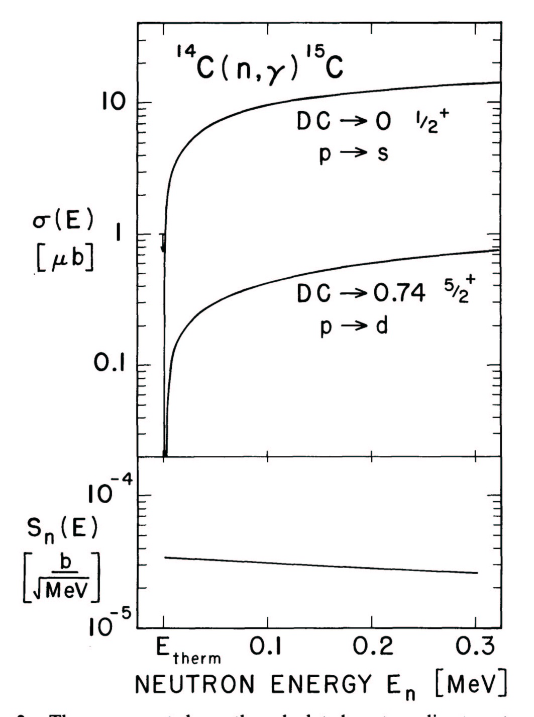
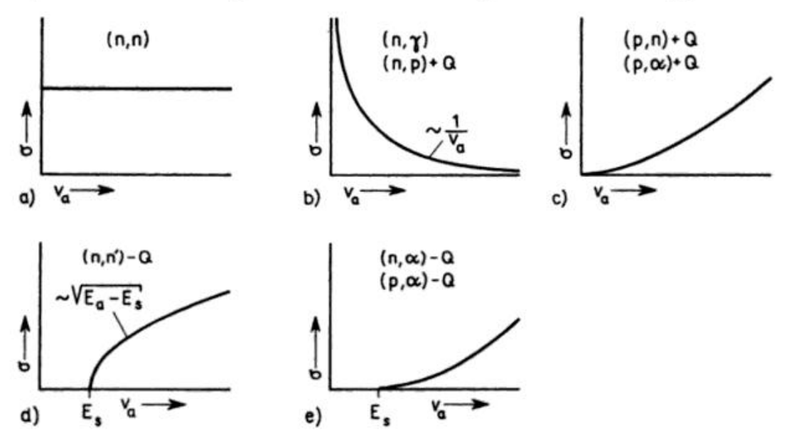
Example: p-wave capture in ¹⁴C(n,γ)¹⁵C
Depending on barrier penetration, cross section can have different energy dependence:
Neg. Q
(always s-waves in incident channel)
(from Wiescher et al. ApJ 363 (1990) 340)

Slide 25
Resonant Reactions
If in the energy range reachable by the incoming projectile there is an excited state
(or part of it, as states have a width) in the Compound nucleus then the cross section
will have a resonant contribution.
If the center of the state is located in this energy range, then:
The resonant contribution to the cross section tends to dominate by far
The cross section becomes extremely sensitive to the properties of the resonant state

Slide 26
Reaction: 1 + T C F+2
With:
Projectile 1
Target nucleus T
Compound nucleus C
Final nucleus F
Outgoing particle 2
For capture 2 is a γ ray and F=C
Step 1
Step 2
E_{r}
Γ
S₁
γ
T+1
C
C = F
S₁: Particle 1 separation energy in C.
Excited states above S₁ are unbound and can decay by emission of particle 1
(in addition to other decay modes). Such states can serve as resonances
For capture, S₁ = Q-value
E_{r}: Resonance energy. Energy needed to populate the center of a resonance state
Reminder:
Center of mass system
Laboratory system

Slide 27
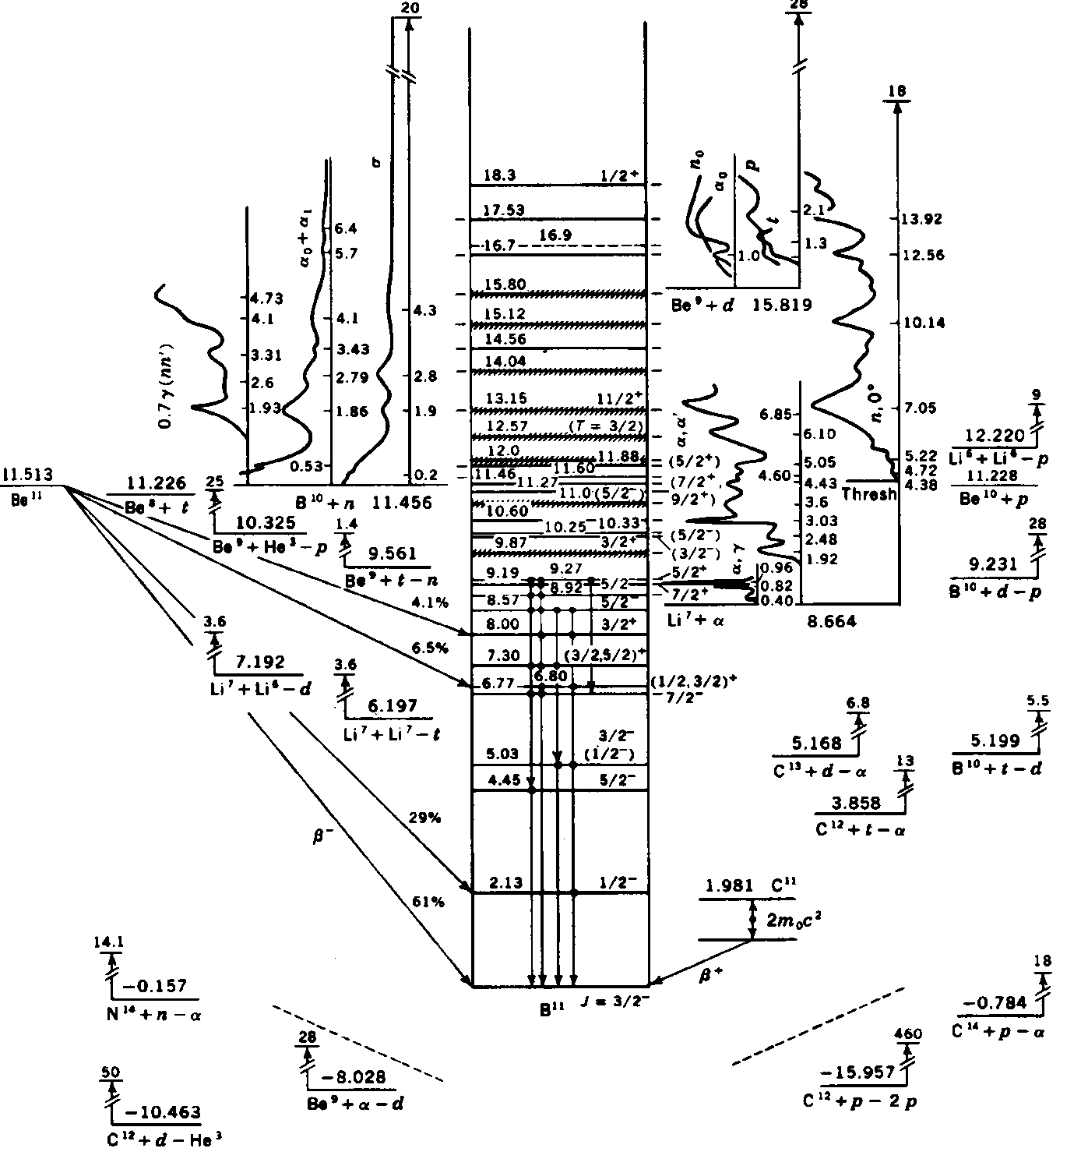
A Real Example
These are not just single-particle states but also configurations from excitations of one or more nucleons within the nucleus!

Slide 28
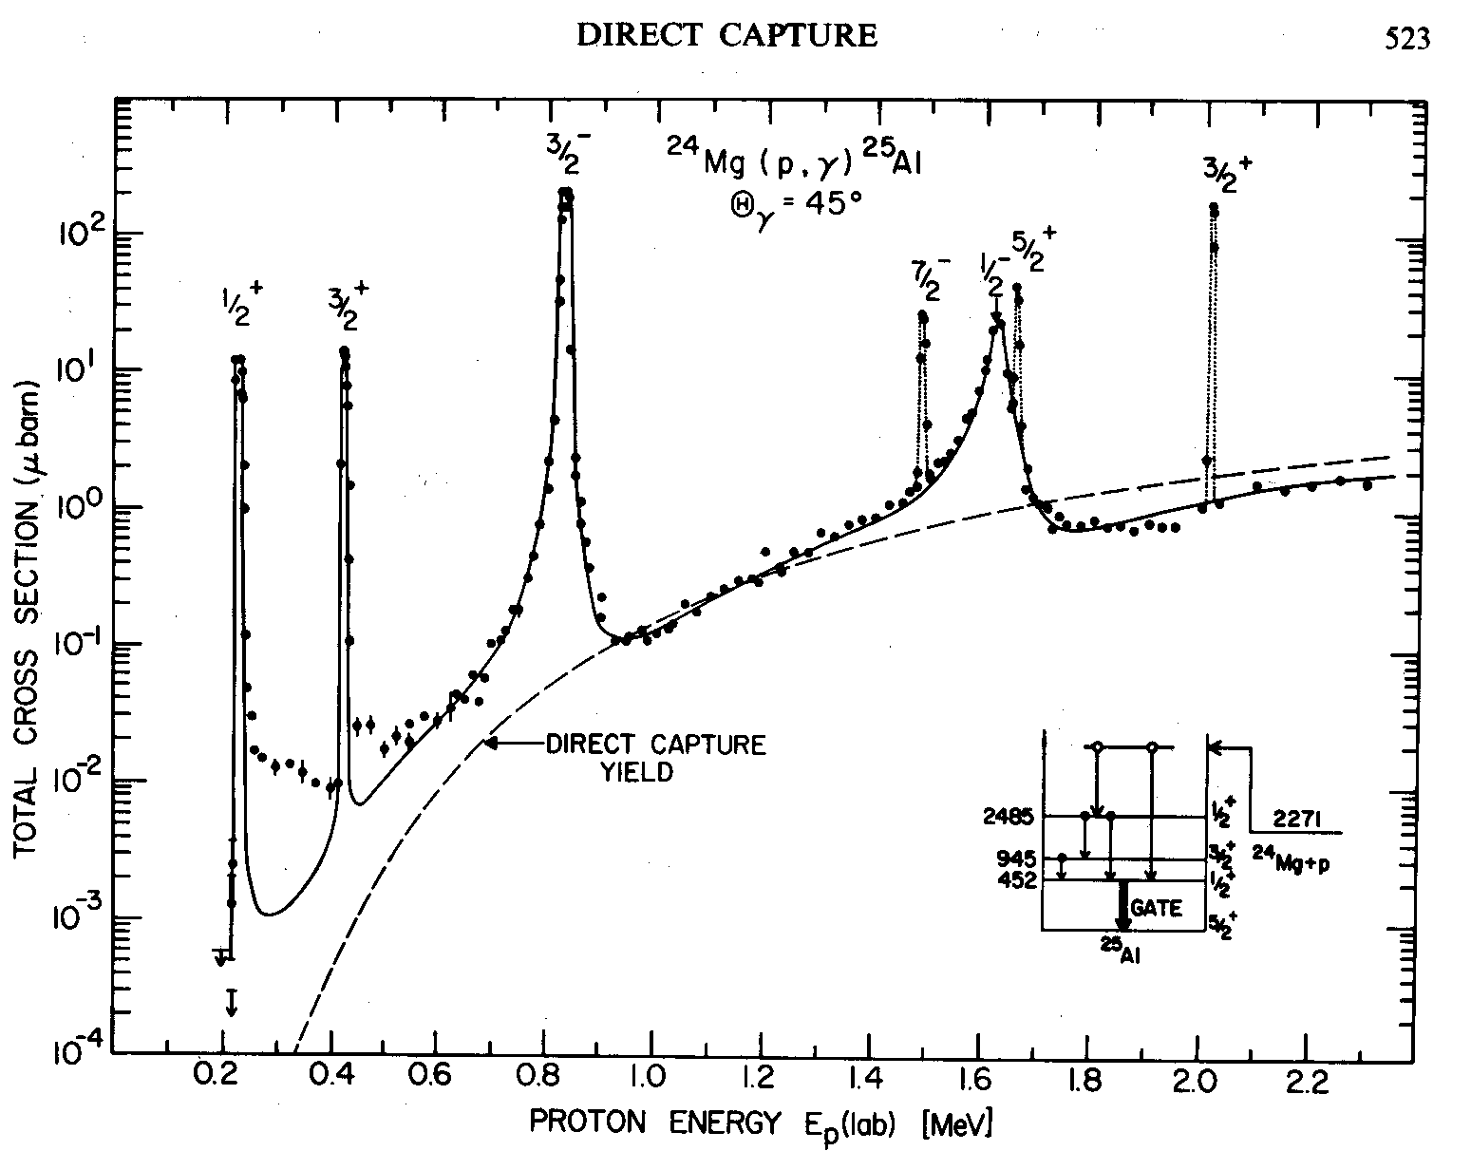
Example:
Resonance contributions are on top of direct capture cross sections

Slide 29
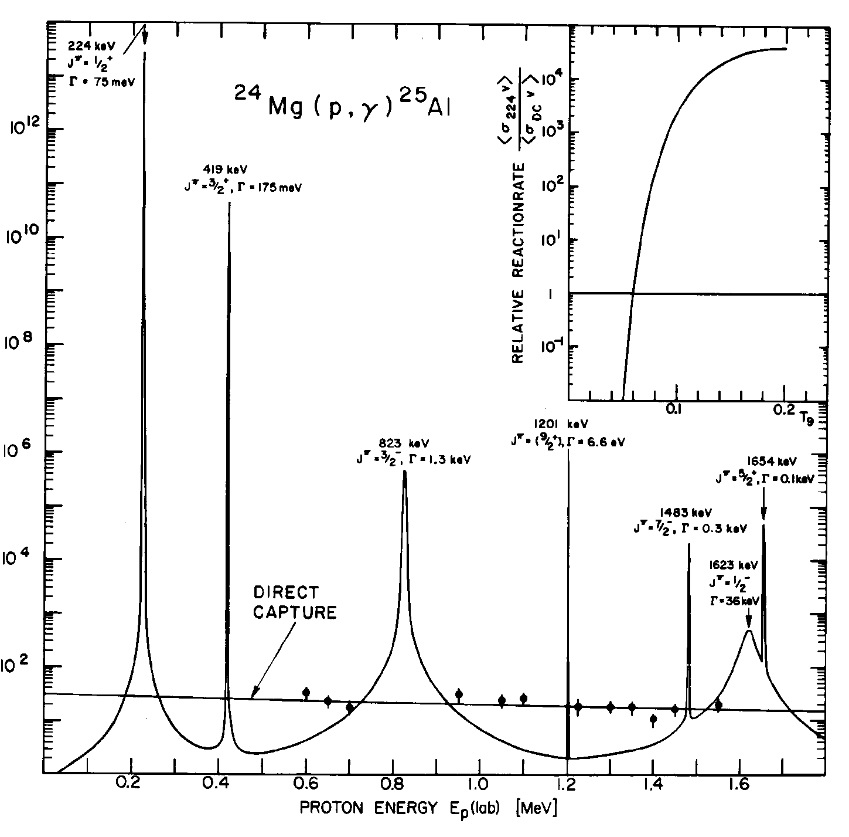
… and the corresponding S-factor
Note varying widths !
S-Factor:
S(E)=σEe^{2πη}, η∝(1/E)Z₁Z₂
Not constant S-factor
for resonances
(log scale !!!!)
Note: no interference here but in generally interference between resonances and direct reaction possible when the same partial waves contribute!
~ constant S-factor
for direct capture

Slide 30
The cross section contribution due to a single resonance is given by the
Breit-Wigner formula:
Usual geometric factor
Partial width for decay of resonance
by emission of particle 1
= Rate for formation of Compound
nucleus state
Spin factor:
Partial width for decay of resonance
by emission of particle 2
= Rate for decay of Compound nucleus
into the right exit channel
Γ= Γ₁+Γ₂+...Total width (including all energetically possible channels) is in the denominator as
a large total width reduces the relative probabilities for formation and decay into specific channels.

Slide 31
Energy dependence of widths
Partial and total widths depend sensitively on the decay energy. Therefore:
  widths depend sensitively on the excitation energy of the state
  widths for a given state are a function of energy !
(they are NOT constants in the Breit Wigner Formula)
Particle widths:
* - see note below
Main energy
dependence
(can be
calculated)
“reduced width”
contains the nuclear
structure
Photon widths:
Reduced matrix element
* Our previously defined P_{l}(E)=vP’_{l}(E) – usually width Γ is used instead of P_{l}(E)

Slide 32
For particle capture:
For other cases:
Typically E_{r} << Q and mostly also E_{r} << S₂ and therefore in many cases:
Γ_{incoming particle} has strong dependence on E_{r} (especially if it is a charged particle !)
Γ_{outgoing particle} has only weak dependence on E_{r}
So, for capture of particle 1, the main energy dependence of the cross section
comes from λ² and Γ₁
Particle partial widths have the same (approximate) energy dependence than the
“Penetrability” factor that we discussed in terms of the direct reaction mechanism.

Slide 33
Note:
Same energy
dependence
than direct
reaction
For E << E_{r} very
weak energy
dependence
Far from the resonance the contribution from wings has a similar energy dependence
than the direct reaction mechanism.
In particular, for s-wave neutron capture there is often a 1/v contribution at
thermal energies through the tails of higher/lower lying s-wave resonances.
Therefore, resonant tail contributions and direct contributions to the reaction rate
can be parametrized in the same way (for example S-factor)
Tails and DC are often mixed up in the literature.
Though they look the same, direct and resonant tail contributions are different things:
in direct reactions, no compound nucleus forms
resonance contributions can be determined from resonance properties measured
at the resonance, far away from the relevant energy range
(but need to consider interference !)

Slide 34

Breit-Wigner Formula
Isolated, non-interfering resonances are described through (partial) widths of states for absorption and emission of particles and photons:
Here, we sum over n resonances in the reaction i(j,k)o , each with a
total width Γ_{n}:

Slide 35

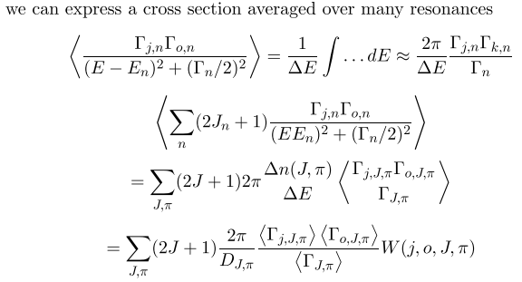
From Breit-Wigner to Hauser-Feshbach
When having many overlapping, indistinguishable resonances
we can make an average:
D is level spacing

Slide 36
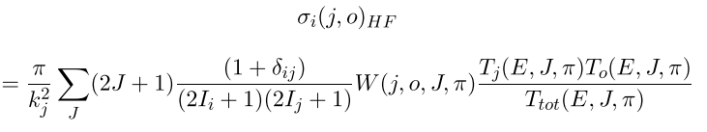

Hauser-Feshbach Averaged Cross Section
(Statistical Model)
Transmission coefficients are solutions of Schrödinger equation:
ρ is level density
Width fluctuation corrections account for non-statistical correlations
between entrance and exit channels; formally:

Slide 37
Is Hauser-Feshbach theory applicable?
YES
Q, S_{x}
(masses)
Excited state
properties
Hauser-Feshbach
code
Level density
Ground state
properties
γ-strength function
Optical potentials
Isospin effects
Width fluctuation
corrections

Slide 38
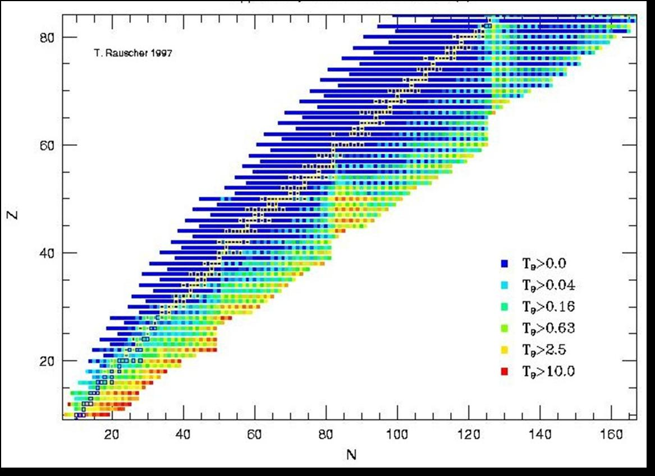
Astrophysical applicability of the Statistical Model (Hauser-Feshbach)
Neutron induced reactions
Rauscher et al. 1997

Slide 39
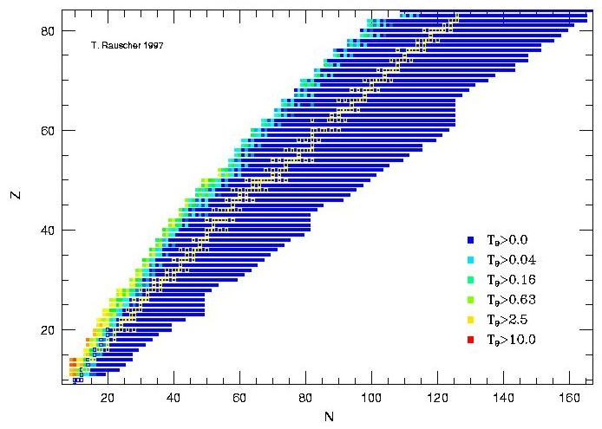
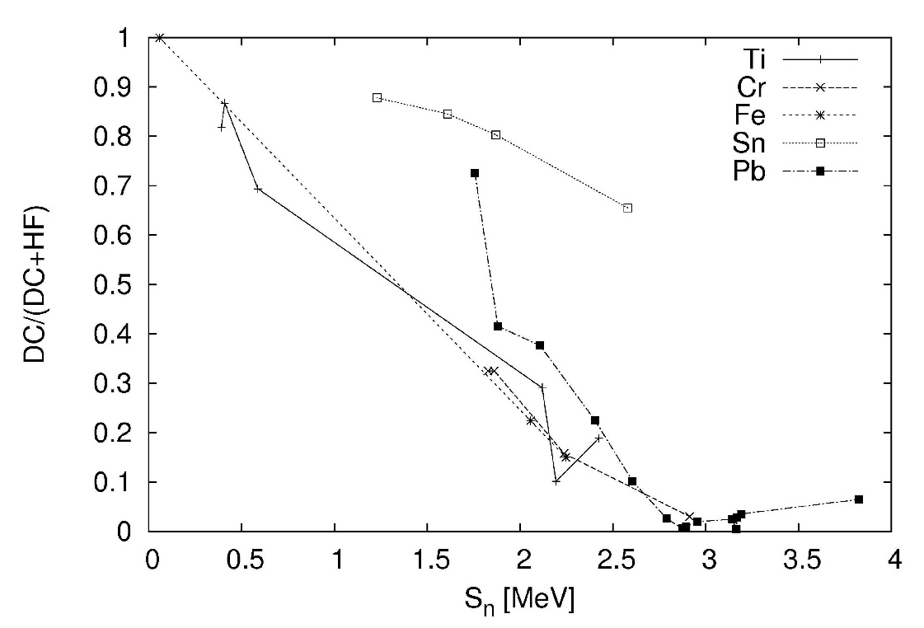
Reactions Far Off Stability
Applicability of statistical model
Neutron induced reactions
Comparison DC and Hauser-Feshbach
Rauscher et al., PRC 56 (1997) 1613
Proton-induced reactions
T. Rauscher; J. Phys. G 35
(2008) 014026

Slide 40
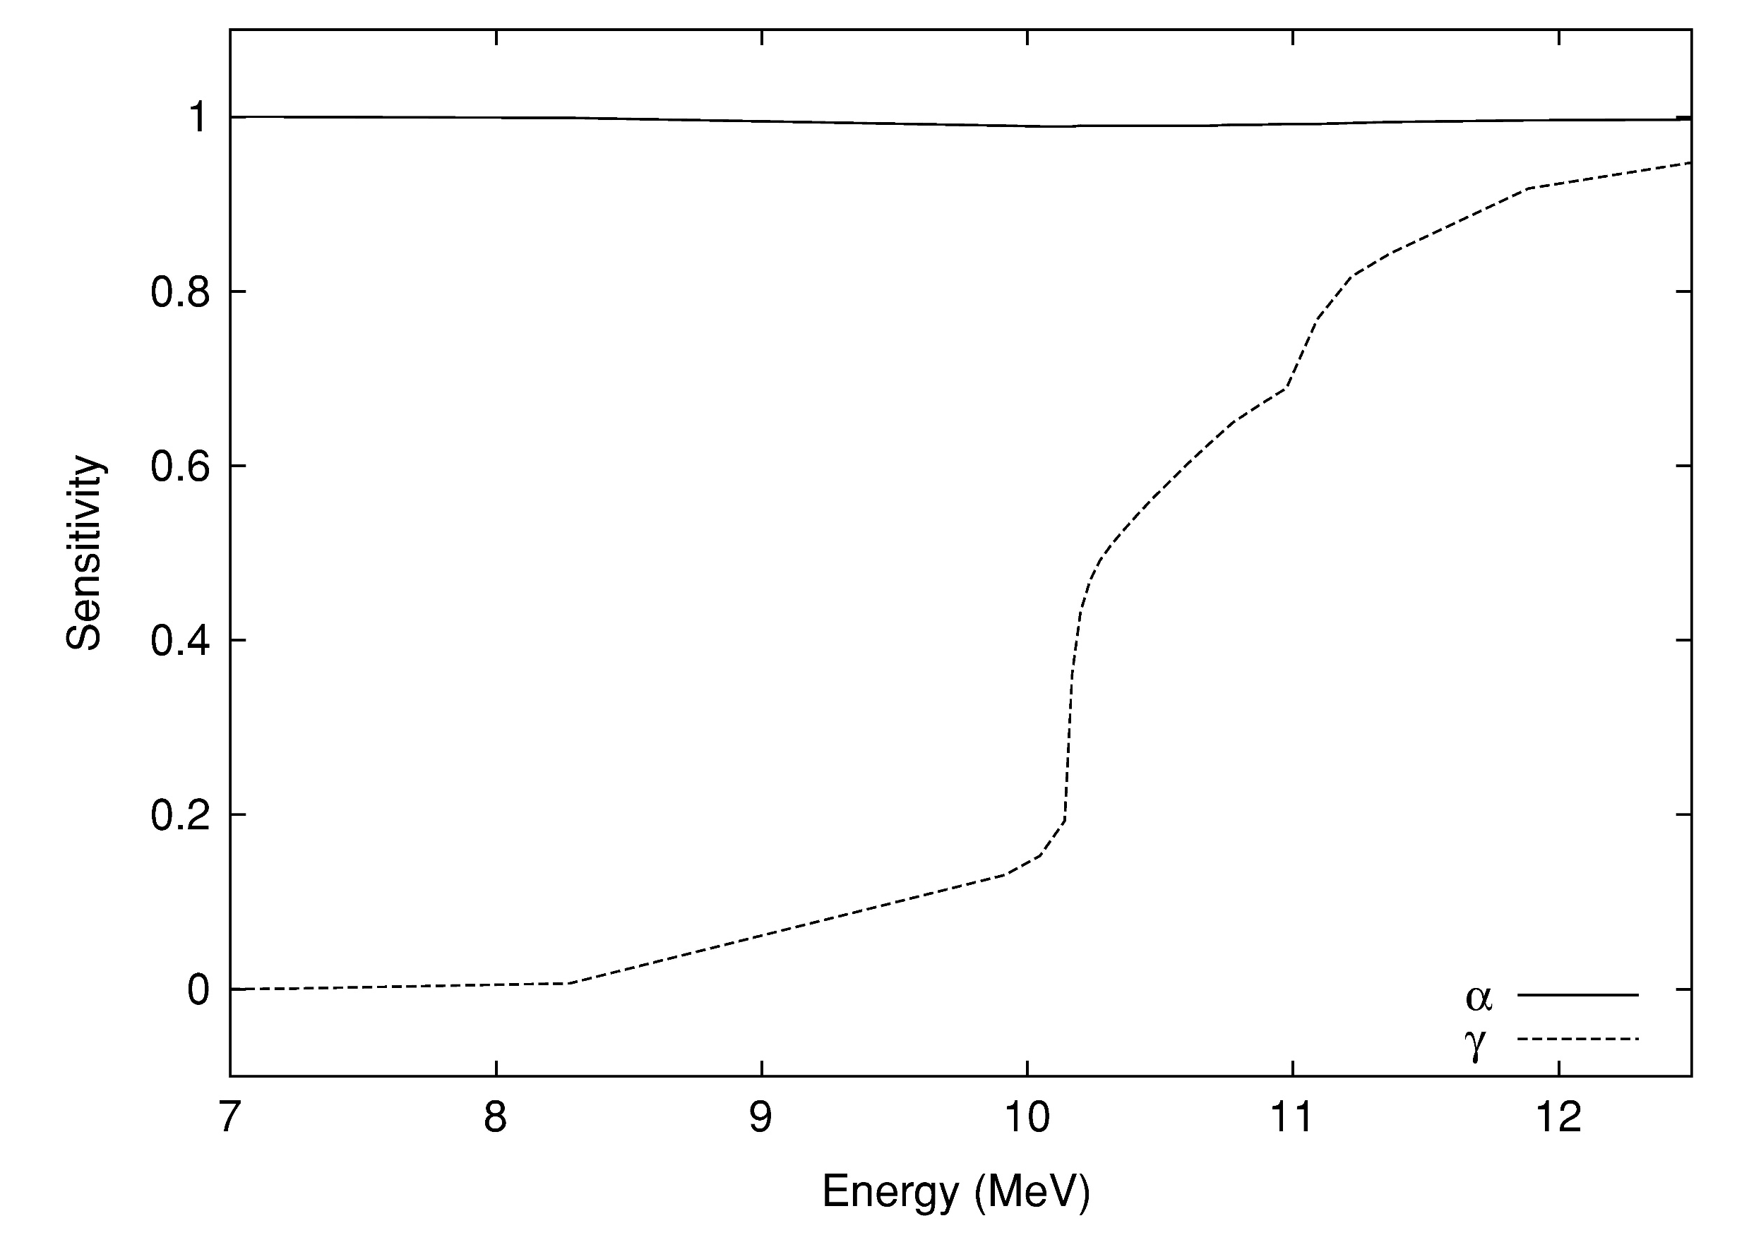
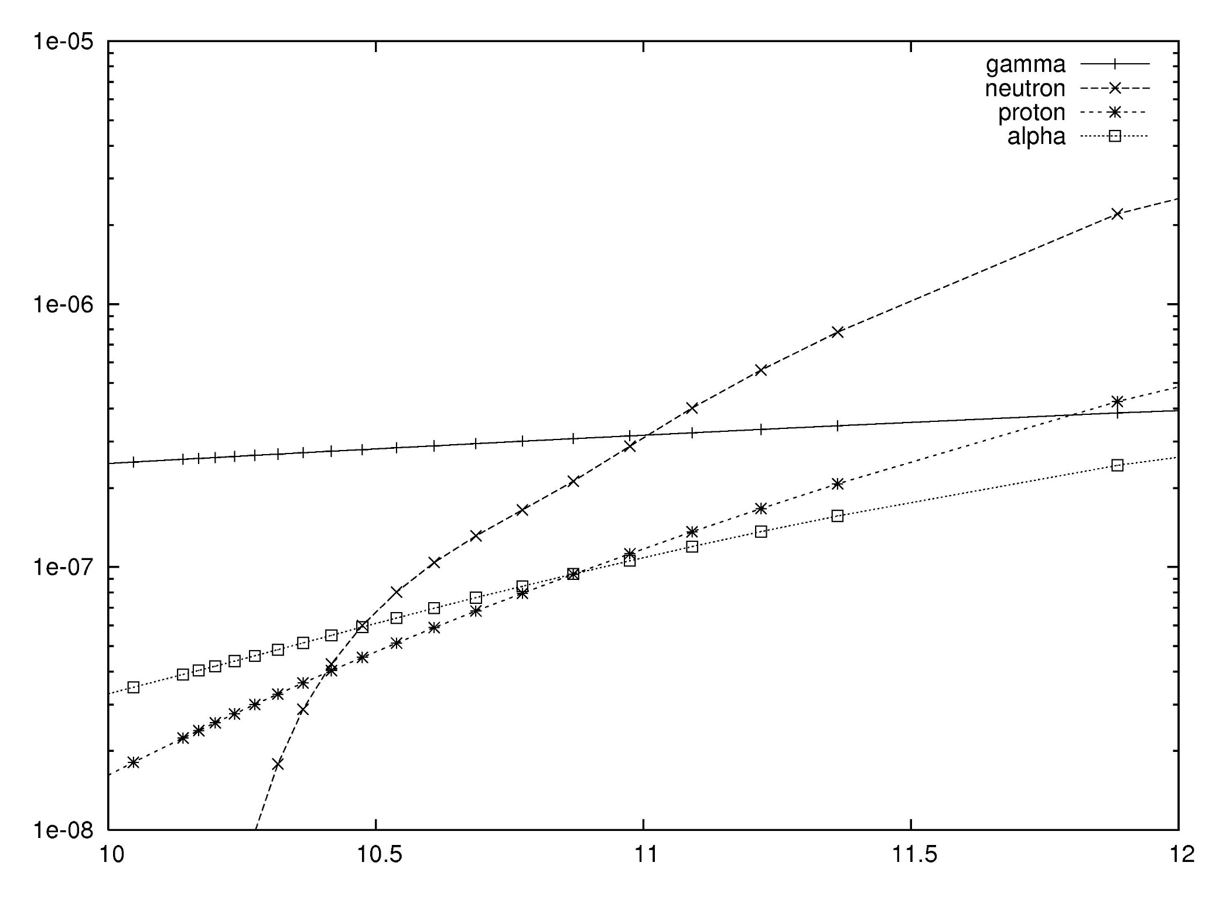
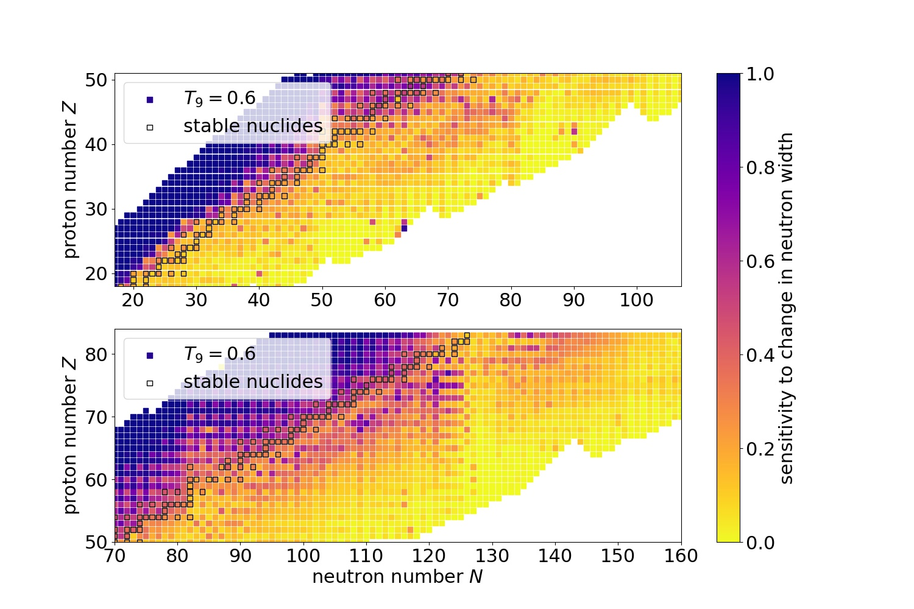
Relative importance of widths
Average widths (=transmission coefficients) determine the Hauser-Feshbach cross section
Smallest transmission (width) determines cross section!
γ-widths not necessarily the smallest ones at astrophysical energies!
¹¹⁰Sn
(n,γ)
¹¹⁰Sn
S-Widths
(α,γ)
E (MeV)

Slide 41
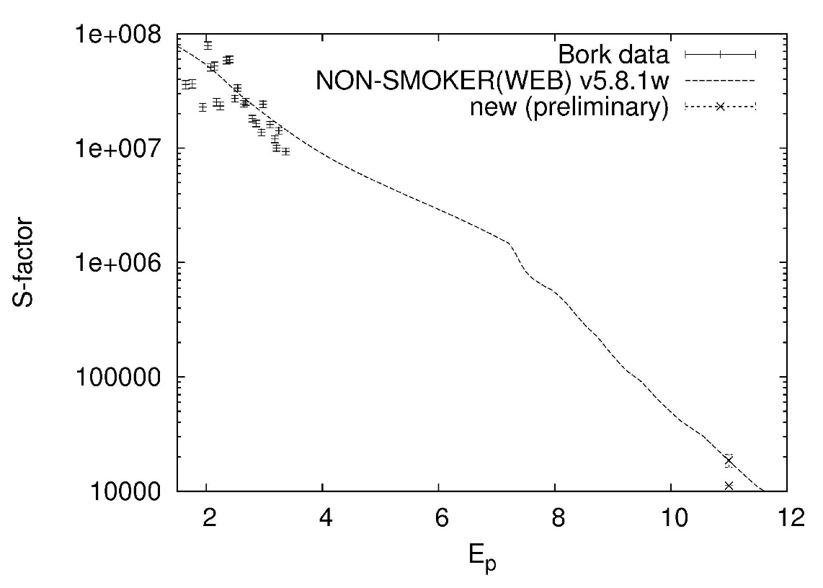
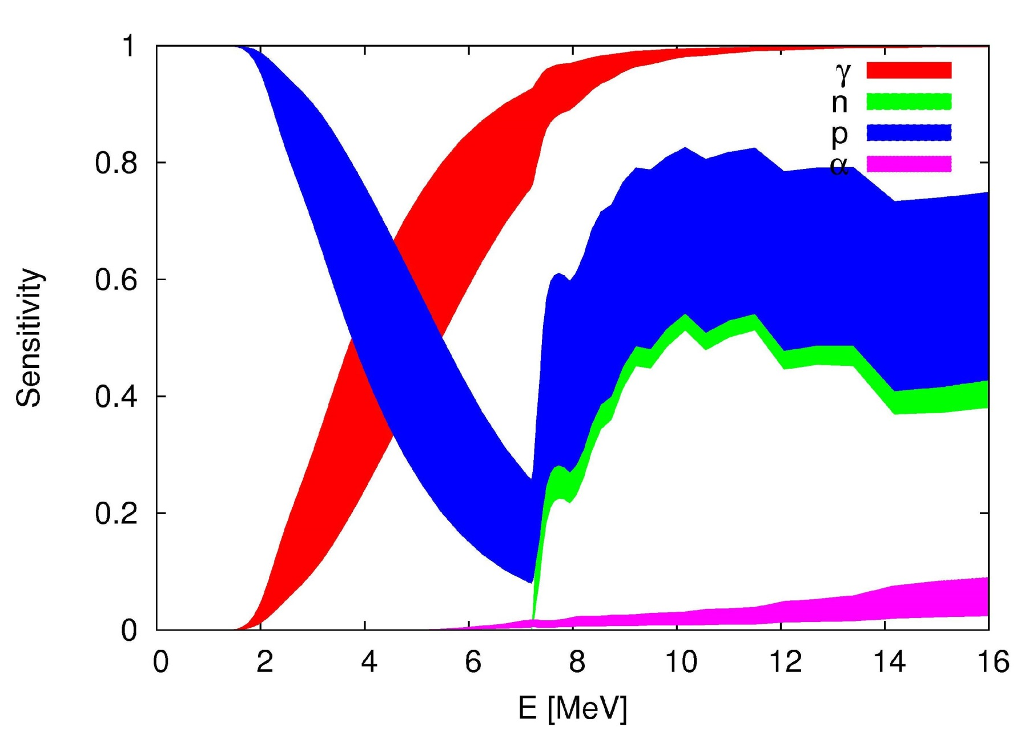
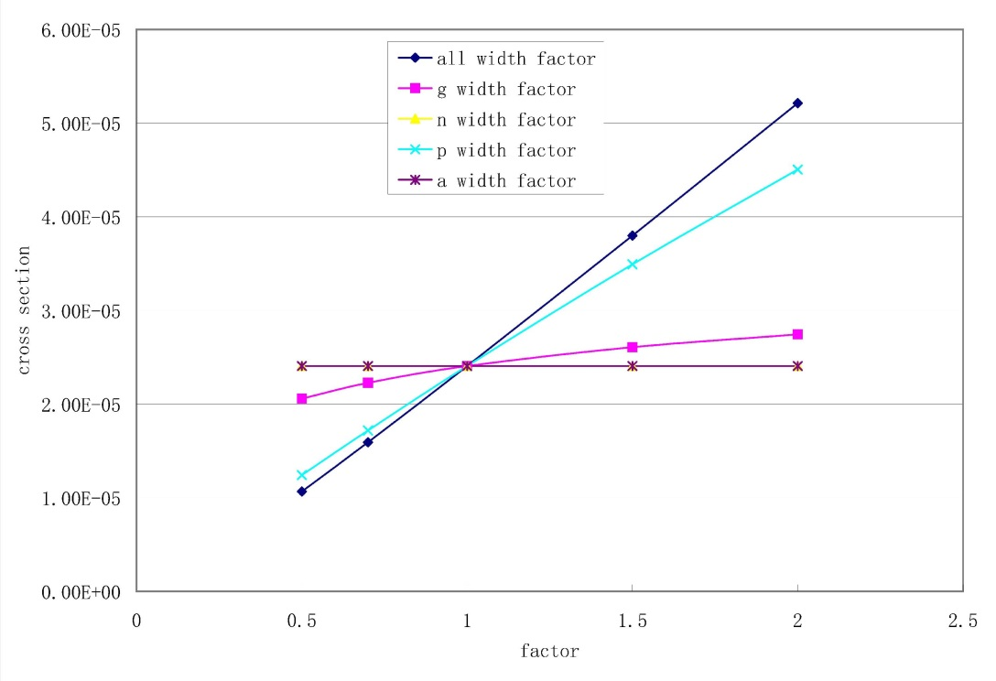
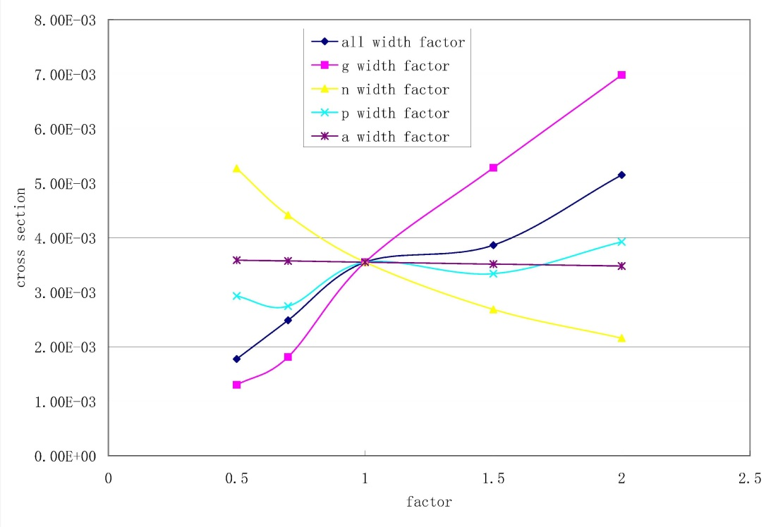
Sensitivity
⁹⁶Ru(p,γ)
data:
Bork et al, PRC 58 (1998) 524
Zhong (GSI) et al, preliminary
2.6 MeV
11 MeV
Gamow window

Slide 42
Reaction networks and
Astrophysical Reaction Rates
(“Stellar” rates)

Slide 43
Astrophysical Definitions
(Mass)Density [g cm⁻³]: ρ_{i}, Σ ρ_{i}=ρ
Number density [cm⁻³]: n_{i}=N_{i}/V, Σ n_{i}=n
Mass fraction: X_{i}=ρ_{i}/ρ, Σ X_{i}=1
Abundance: Y_{i}=n_{i}/(ρN_{A}), Y_{i}=X_{i}/A_{i},
Y_{e}=Σ Z_{i}/A_{i}
Plasma temperature: T₆ [10⁶ K], T₉ [10⁹ K]
Typical Energy (MB distribution): E=kT=T₉/11.6045 MeV
S-Factor [MeV b]:
S(E)=σEe^{2πη}, η∝(1/E)Z₁Z₂

Slide 44
Reaction Networks I
Reactions i(j,k)m lead to change in plasma composition:
NN reactions:
Nγ, NL reactions, decays:

Slide 45
Reaction Networks II
Want density independent measure, interested in changes caused by reactions, not density fluctuations
⇒ use abundances Y_{k}(n_{k}(t),ρ(t))=n_{k}(t)/(ρ(t)N_{A}):
Network equations:
(with M species in the plasma we obtain M equations)

Slide 46
Mass fraction and abundance:
Mass fraction X_{i} is fraction of total mass of sample that is made up by nucleus of species i
ρ : mass density (g/cm³)
m_{i} mass of nucleus of species i
(CGS only !!!)
with
and
as atomic mass unit
(AMU)
note: we neglect here nuclear binding
energy and electrons (mixing atomic
and nuclear masses) - therefore strictly
speaking our ρ is slightly different from
the real ρ, but differences are negligible
in terms of the accuracy needed for densities
in astrophysics
call this abundance Y_{i}
so
with
note: Abundance has no units
only valid in CGS
The abundance Y is proportional to number density but changes only if the
nuclear species gets destroyed or produced. Changes in density are factored out.

Slide 47
Thermonuclear Reaction Rates
Definition: Number of reactions per volume and time
between two components of the stellar plasma:
*
The velocity distribution
depends on the particle statistics and can be derived from
thermodynamics.

Slide 48
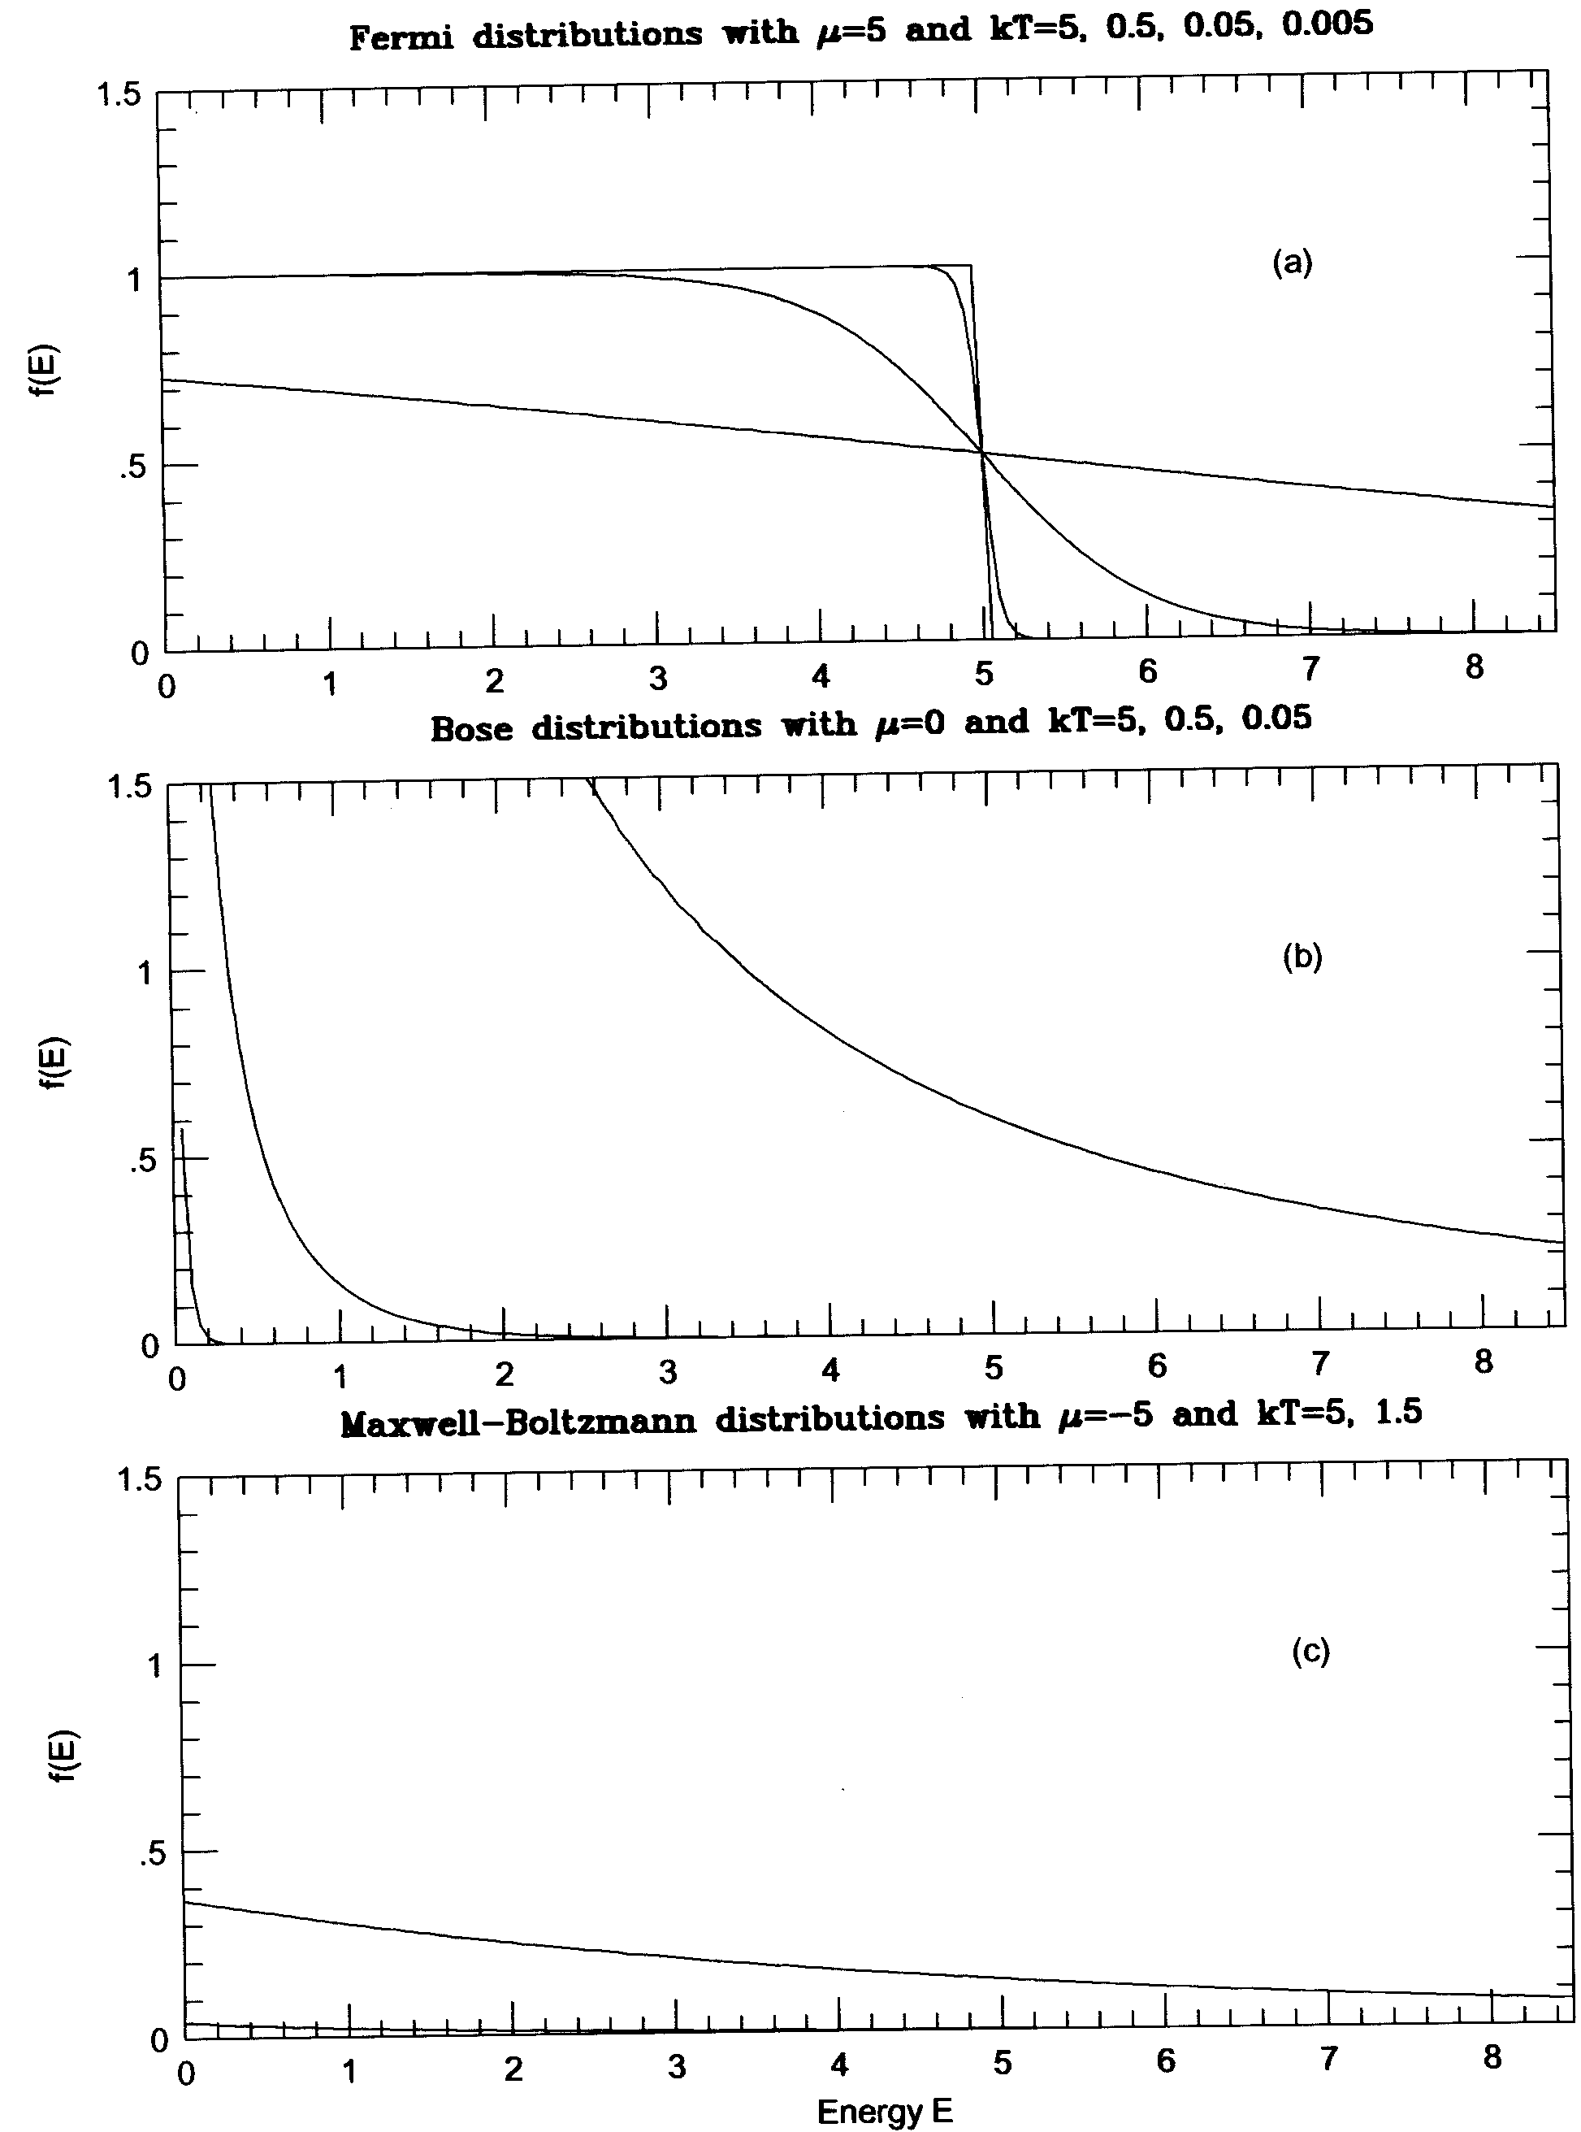
Particle Statistics
Occupation probabilities of states with energy E and chemical potential μ:
Low ρ + high T, -μ/kT→-∞ , then MB applies (H-, He-burning).

Slide 49
Reaction Rate (MB)
Number of reactions per time and volume
σ* … Stellar cross section, see later.
Angle brackets denote reactivity (rate per particle pair): cross section times relative velocity averaged over velocity distribution.
Often, kinetic energy is used instead of velocity (same result).

Slide 50
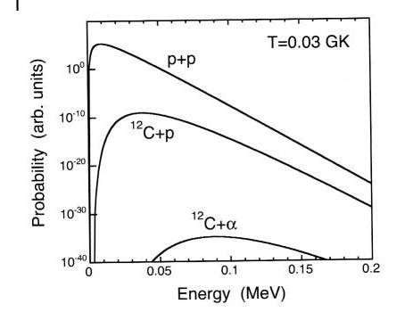
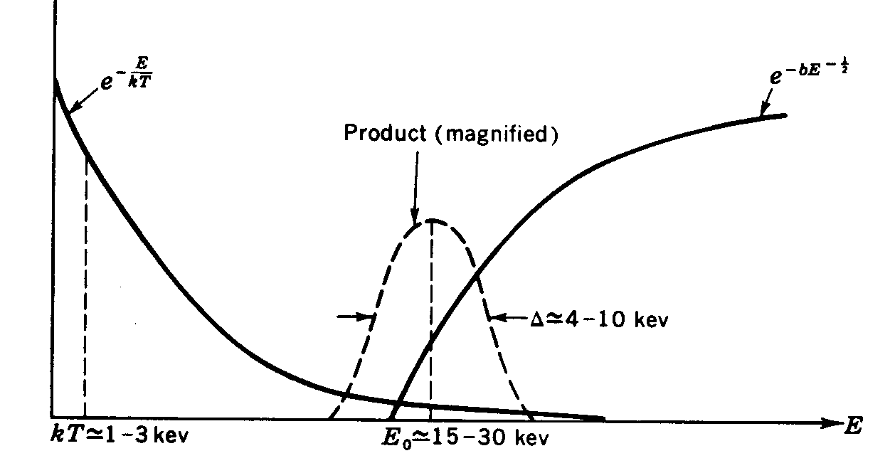
Relevant Energies – Gamow Window
for charged particle reactions, this is the reactivity (rate per particle pair):
Gamow Peak
Astrophysical S-factor
Note: relevant
cross section
in tail of M.B.
distribution,
much larger than
kT (very different
from n-capture !)

Slide 51
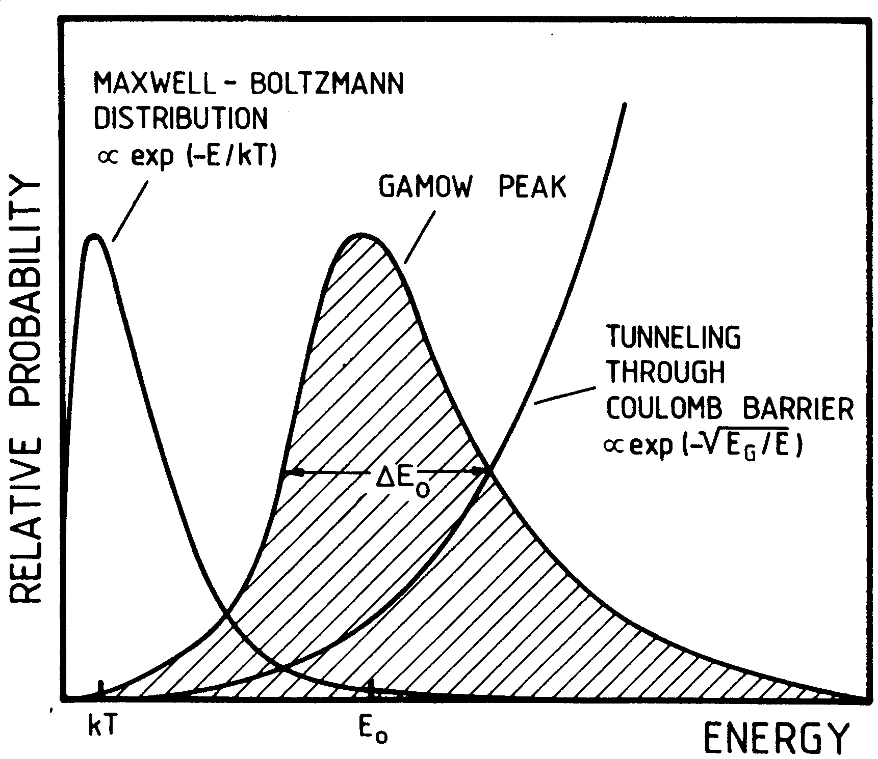
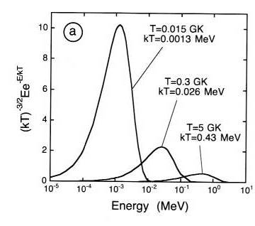
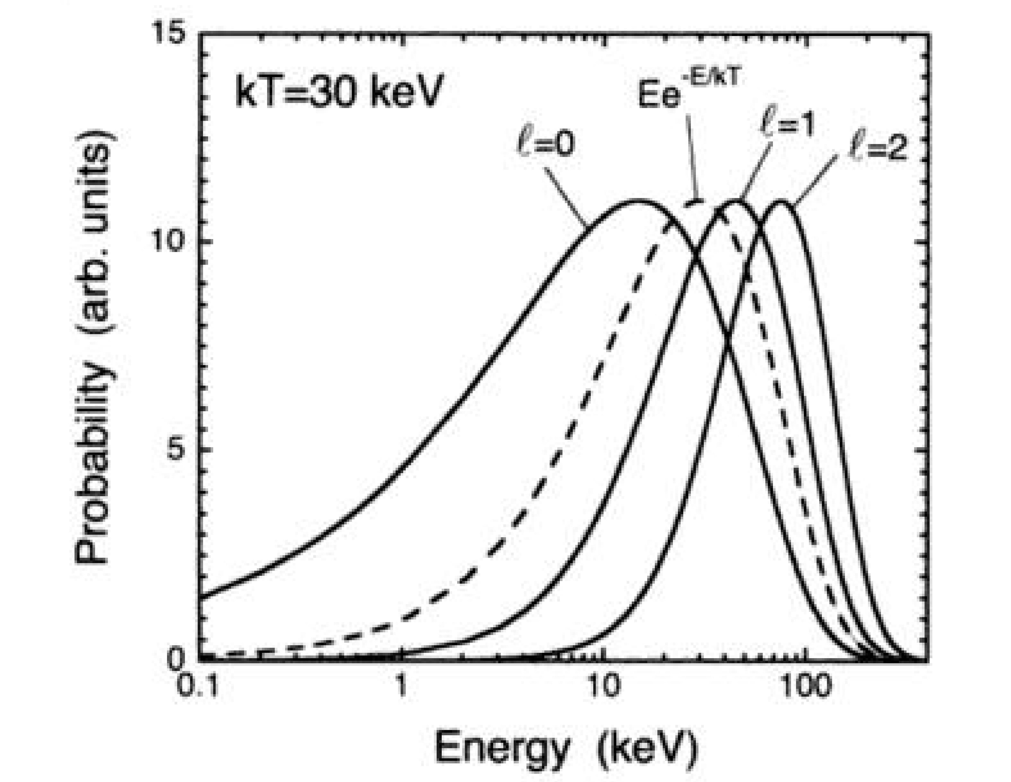
„Gamow peak“ for neutrons
Rolfs & Rodney 1985
Neutrons have
typical energy
kT=T₉/11.605
MeV.
Iliadis 2006

Slide 52
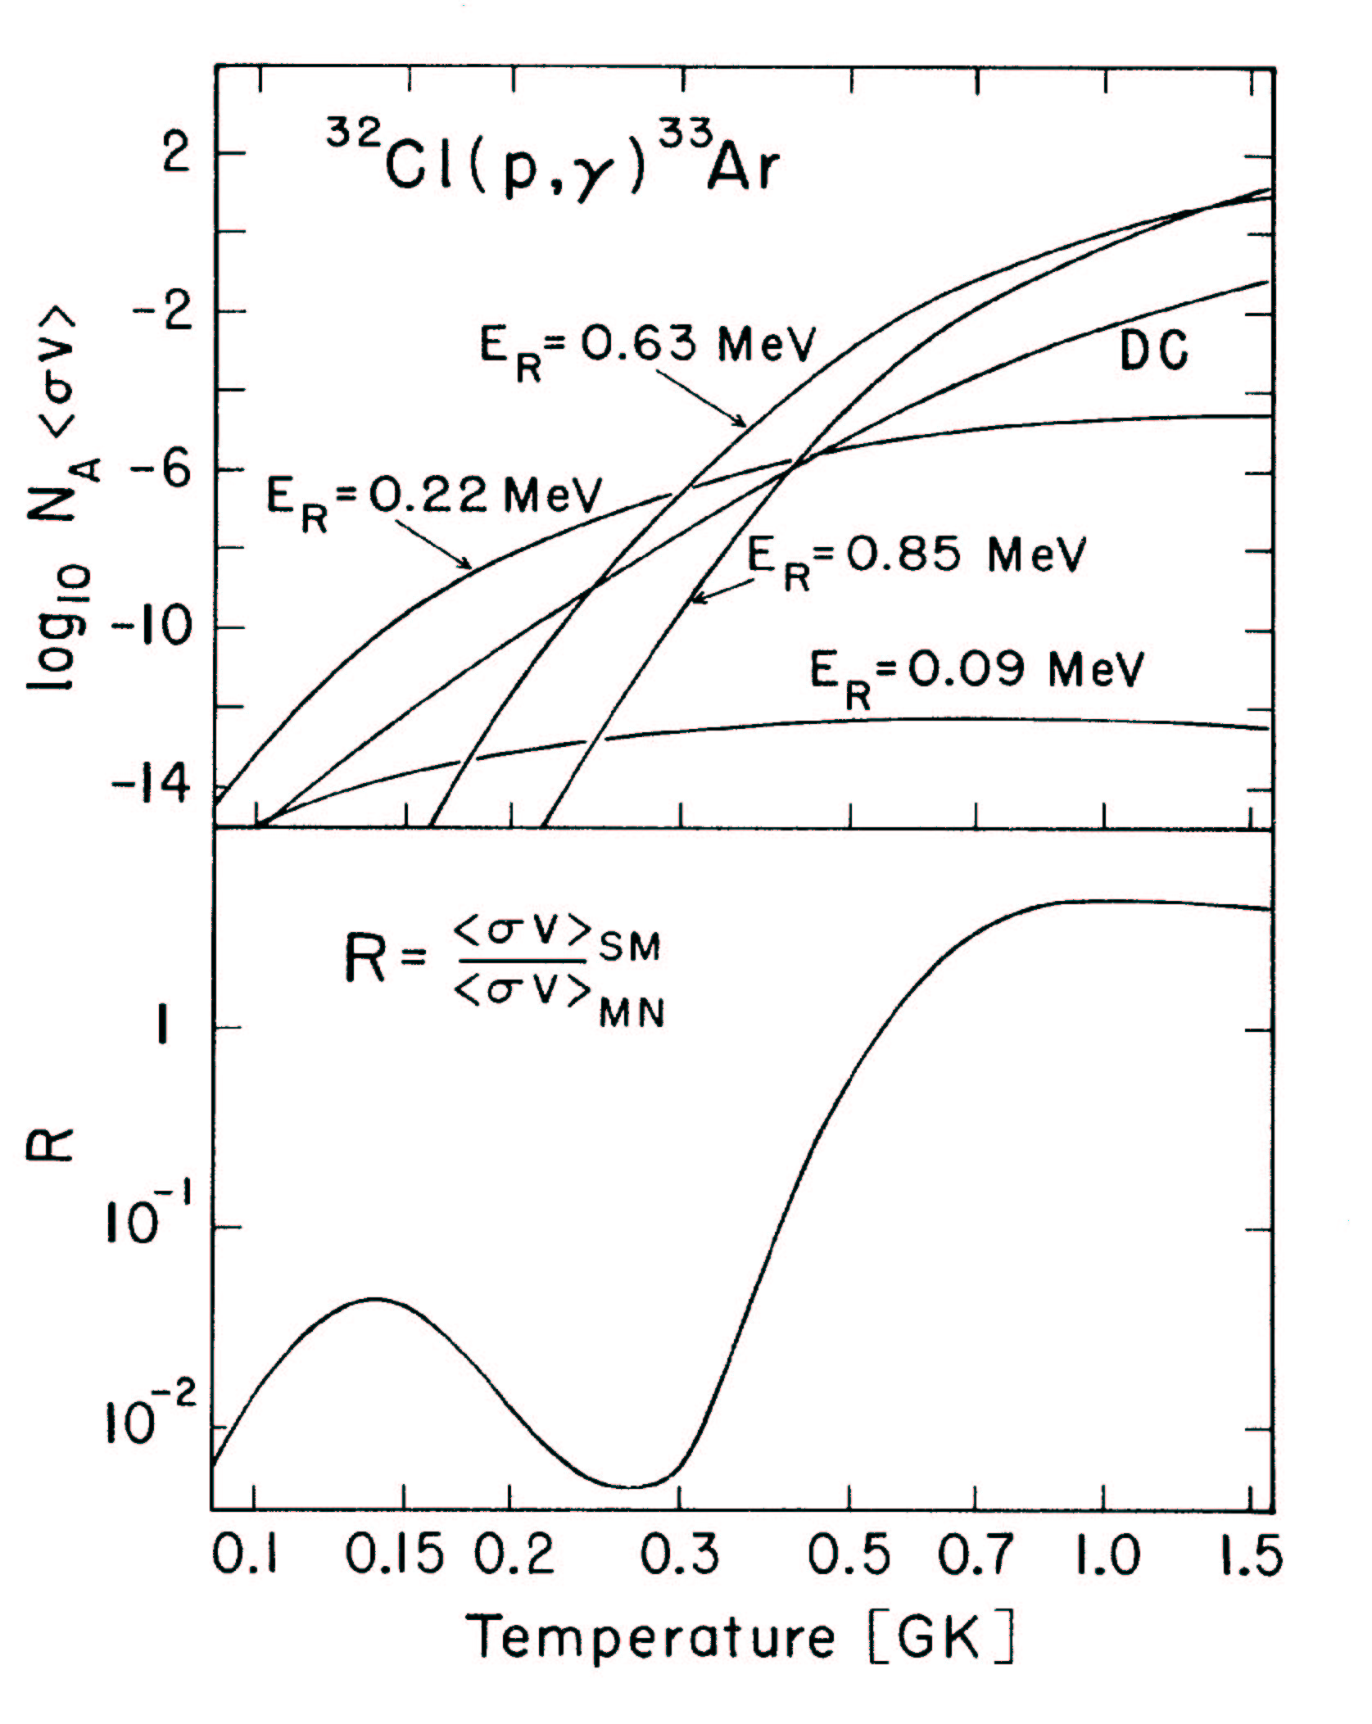
Gamow Window:
0.1 GK: 130-220 keV
0.5 GK: 330-670 keV
1 GK: 500-1100 keV
But note: Gamow window has
been defined for direct reaction
energy dependence !
For heavier nuclides, the Gamow window can be located at several MeV, close to 10 MeV for alpha-particles. This is still below the Coulomb barrier!
The Gamow window moves to higher energies with increasing temperature – therefore
different resonances play a role at different temperatures.

Slide 53
Some other remarks:
If a resonance is in or near the Gamow window it tends to dominate
the reaction rate by orders of magnitude
As the level density increases with excitation energy in nuclei, higher
temperature rates tend to be dominated by resonances, lower
temperature rates by direct reactions.
As can be seen from the equations for resonant rates, the reaction rate is extremely sensitive to the resonance energy.
For p-capture this is due to the exp(E_{r}/kT) term AND Γ_{p}(E) (Penetrability) !
As E_{r}=E_{x}-Q one needs accurate excitation energies and masses !

Slide 54
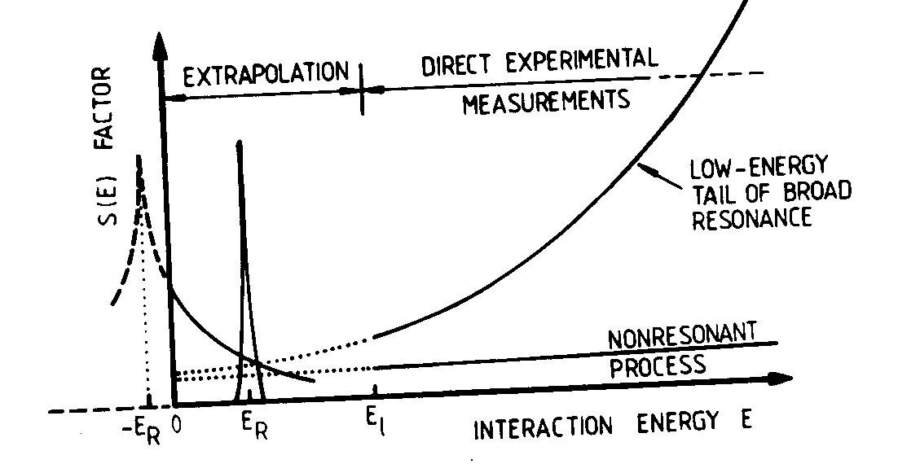
The stellar reaction rate of a nuclear reaction is determined by the sum of
sum of direct transitions to the various bound states
sum of all narrow resonances in the relevant energy window
tail contribution from higher lying resonances
Or as equation:
(Rolfs & Rodney)
Caution: Interference effects are possible (constructive or destructive addition) among
Overlapping resonances with same quantum numbers
Same wave direct capture and resonances

Slide 55
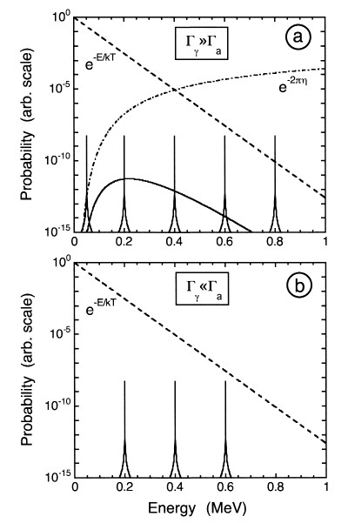
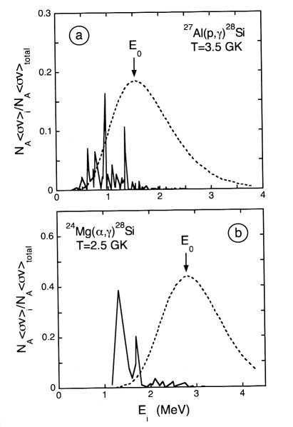
Limitation of Gamow peak concept
Narrow resonances can also be important below the Gamow window when width of
exit channel smaller than width of entrance channel!
No barrier penetration factor for gammas!
Iliadis 2006

Slide 56
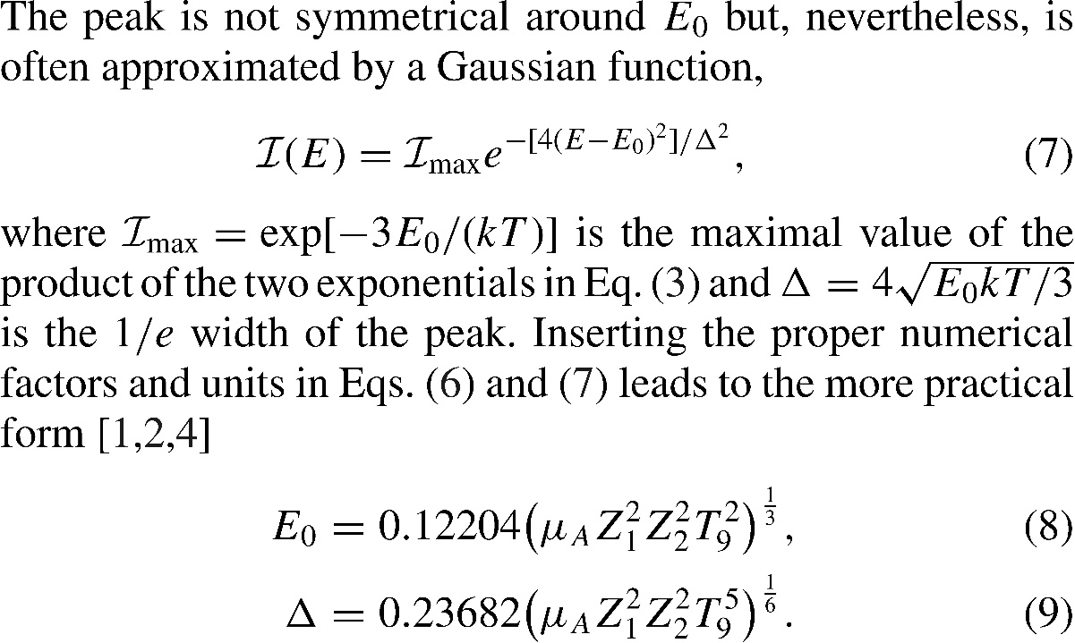
Revised Gamow peaks for intermediate and heavy target nuclides
only valid when entrance channel determines energy dependence
of cross section!
widely used textbook formula!
Easy to see, for example, with (n,p) or (n,α) reactions…

Slide 57
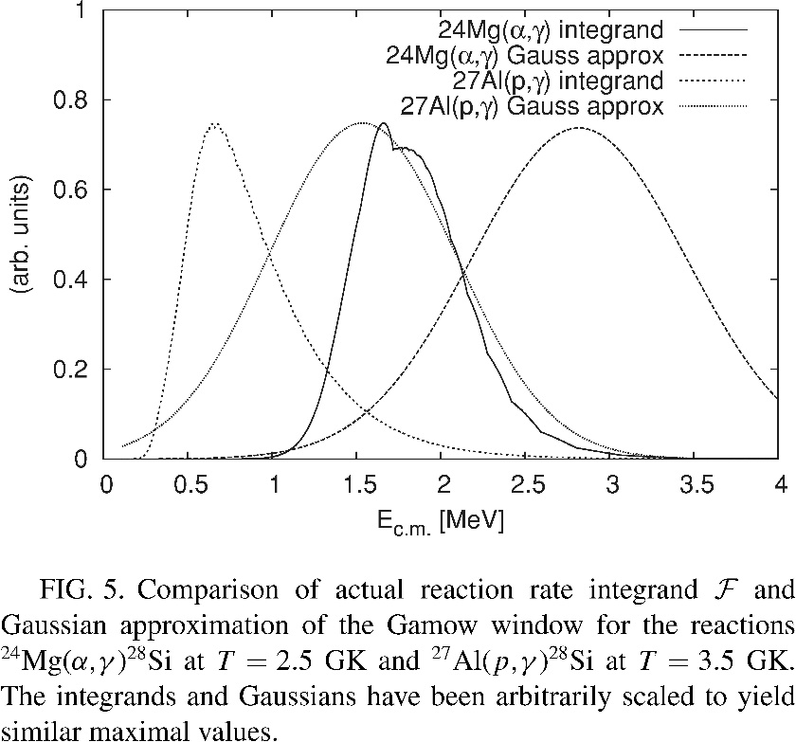
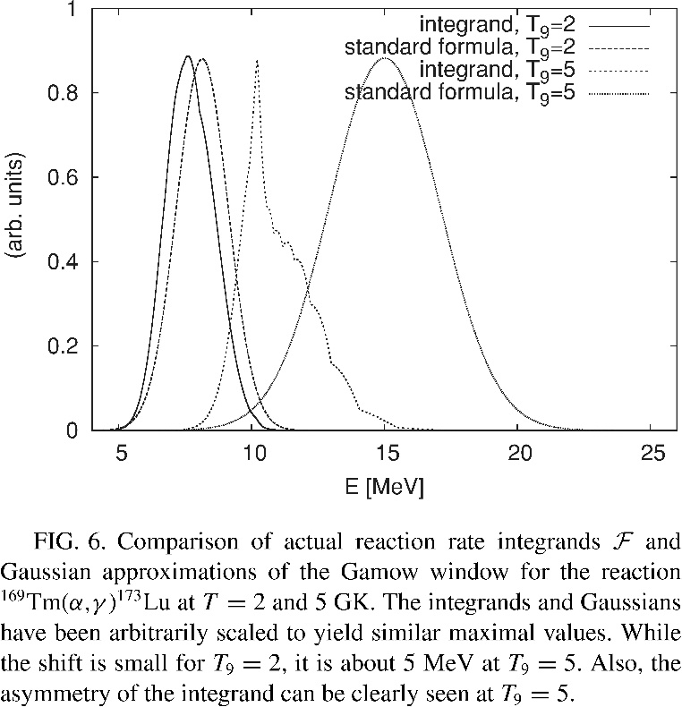
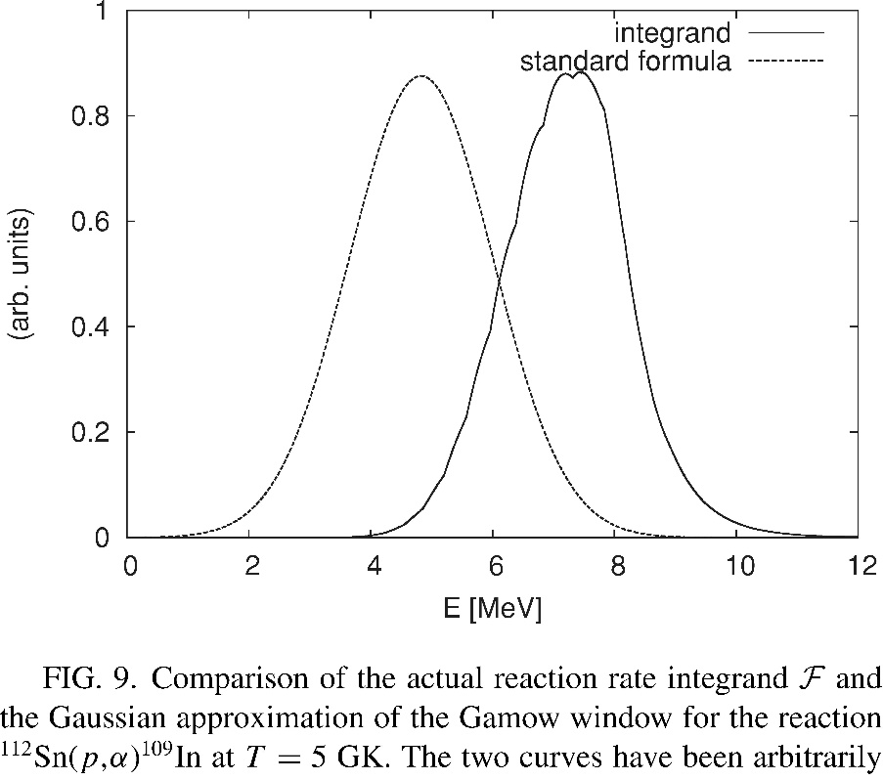
Examples of revised energy windows
revised energy windows can be shifted by several MeV
important to know because experiments measure at the detection limit
  can relevant energy window be reached?

Slide 58
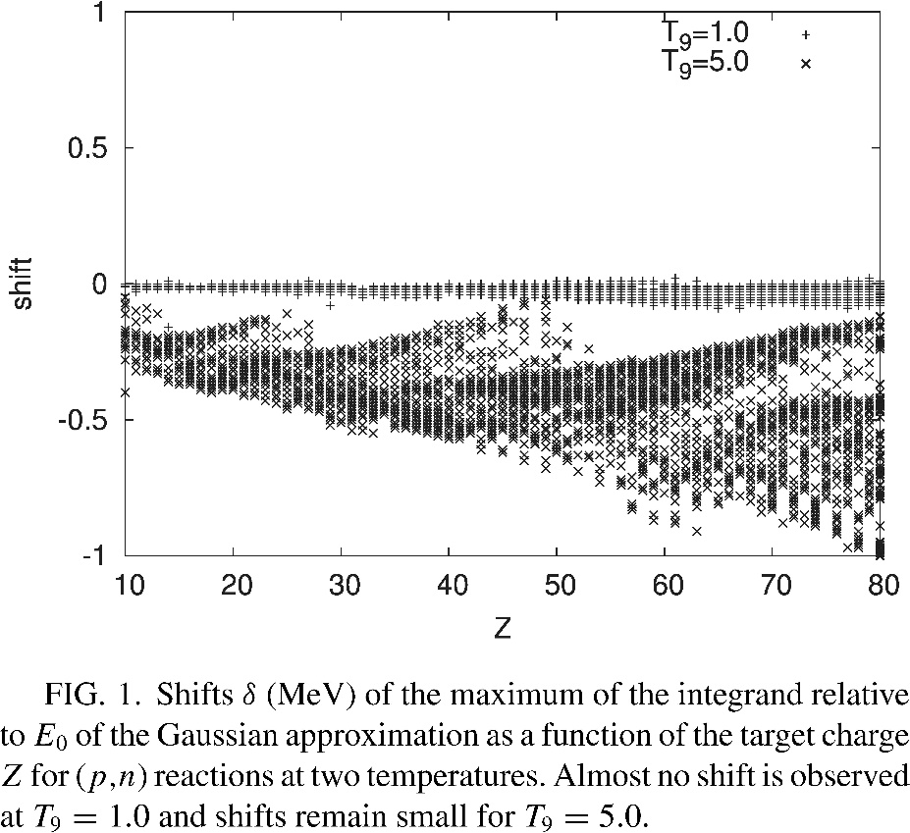



Rauscher, PRC 81, 045807

Slide 59
Rate of reaction through a narrow resonance
Narrow means:
In this case, the resonance energy must be “near” the relevant energy range
ΔE to contribute to the stellar reaction rate.
Recall:
and
For a narrow resonance assume:
M.B. distribution
constant over resonance
All widths Γ(Ε)
constant over resonance
constant over resonance

Slide 60
Then one can carry out the integration analytically and finds:
For the contribution of a single narrow resonance to the stellar reaction rate:
The rate is entirely determined by the “resonance strength”
Which in turn depends mainly on the total and partial widths of the resonance at
resonance energies.
Often
, then for
And reaction rate is determined by the smaller width !

Slide 61
Rate for broad resonances or non-resonant reactions
Often (for example with theoretical reaction rates) one approximates the rate
calculation by assuming the S-factor is constant over the Gamow Window:
S(E)=S(E₀)
Then one finds the useful equation:
(A_{R} reduced mass number A₁A₂/(A₁+A₂))

Slide 62
“Stellar” cross sections

Slide 63

Energetics in Nuclear Reactions
HF: <Γ_{α}>
RC: Γ_{α}
HF: <Γ_{β}> / <Γ_{tot}>
RC: Γ_{β} /Γ_{tot}
E_{ejectile}
E_{projectile}
HF, RC
Level density in
Gamow window
determines reaction
mechanism
DC
S_{proj}=Q_{γ}
Astrophysical complication: thermal excitation!

Slide 64

Thermally excited target nuclei in the stellar plasma
Ratio of nuclei in a thermally populated excited state to nuclei in the ground state
is given by the Saha Equation:
Ratios of order 1 for E_{x}~kT
Only small correction for:
  light nuclei (level spacing several MeV)
  Gamow window at low energy: at low T
LARGE correction, when
  low lying (~100 keV) excited state(s) exist(s) in the target nucleus (heavy nuclei)
  temperatures are high (explosive nucleosynthesis)
  the populated state has a very different rate
The correction for this effect has to be calculated. Importance often underestimated…

Slide 65






Stellar rate and stellar cross section
Stellar rate
Stellar reactivity
Boltzmann weights
The measured cross section σ₀ determines R₀
Stellar cross section
Population factor
Weight of excited state
Using pop. fact. as measure of importance
underestimates impact!
T. Rauscher, Int. J. Mod. Phys. E 20, 1071 (2011)

Slide 66



Effective weights of excited states
Gamow energy
By shifting energy scales of MB distributions to g.s. energy,
weights are modified (Fowler 1975).

Slide 67
Reaction Rate (MB)
Number of reactions per time and volume
stellar reactivity

Slide 68
Simplification of Stellar Rate
MB distributed projectiles act on every excited state, have to do a weighted sum:
with effective cross section
Effective cross section sums over all accessible
excited states μ,ν in initial and final nucleus!

Slide 69

Reciprocity of stellar rates
Reciprocity relation
Lab cross section; no reciprocity with

Slide 70
Reciprocity relation
Reciprocity again!!
For fun, let’s postulate “effective” cross section:
or
But: unmeasureable!

Slide 71
Effective c.s.
P_{A}^{μ}
Reciprocity relation
Step 2: Let’s add thermal population of excited states → Detailed Balance
From Saha equation; G(T) is partition function
Stellar cross section

Slide 72
Effective c.s.
P_{A}^{m}
Reciprocity relation
P_{B}^{n}
Step 3: Insert in stellar rate
One MB distribution instead of many!
Stellar cross section
Stellar rates obey reciprocity! This implies thermal equilibrium in BOTH nuclei A, B!

Slide 73
Stellar cross section
P_{A}^{μ}
P_{B}^{ν}
Prerequisite:
Fast thermal equilibration in all channels!
Fulfilled in most cases, unless there are isomeric states.
Reciprocity relation for stellar rates:
(Similar for photodisintegration)
Always determine rate in direction of positive Q_{Aa} , to maximize g.s. contribution and numerical errors. For numerical stability in reaction networks, forward and backward rates have to be computed from ONE source!

Slide 74
Nucleus-Photon Rate
With Planck distribution of photons:
Connection to capture rate by detailed balance:

Slide 75
Nuclear Partition Functions
G₀ (or G^{norm}) is normalized to the g.s. (2J₀+1). PF is proportional to number of different configurations at given temperature T. Corrections due to loss of nucleons to the continuum may apply at T > 10.

Slide 76
Reciprocity in Stellar Rates
Some considerations:
Detailed balance: thermalization required
  Problematic for nuclei with isomeric states
  e.g., ²⁶Al, ¹⁸⁰Ta
  Use “internal” network to follow all particle and photon transitions between states in a nucleus
ONE source for forward and reverse reaction in network for numerical stability and proper equilibria
  Usually direction of positive Q value (“Q-value rule”)
Photodisintegration in lab tests only few transitions, better use capture and compute reverse rate

Slide 77


Ground state contribution to stellar rate
wrong
stellar enhancement factor
g.s. contribution (X)
  gives g.s. contribution to stellar rate
  =1 at T=0
  confined to 0<=X<=1
  monotonically decreasing to 0
  Uncertainty scales with G₀ and is related to X:
    u=(1-X)u’
neglecting partition function!
drop due to 1/G₀
Partition function G₀ related to g.s. population
T. Rauscher, ApJLett 755, L10 (2012)
Rauscher et al, Ap. J. 738, 143 (2011)

Slide 78

Note: all these captures have positive Q-values (Q-value rule!)

Slide 79


Importance of γ-energies
Rel. contribution to rate
A photodisintegration experiment would only measure transition from/to g.s.!
Not suited to directly constrain the reaction rate!
g.s. contribution much larger in capture direction.

Slide 80



Ground-state contributions to s-process neutron capture?
Ground-state contributions to
γ-process neutron capture?
X directly also gives the maximally possible reduction in (theory) uncertainty by experiments!
Nuclides from KADoNiS
(n,γ) at kT=30 keV
Black squares are nuclei for which error cannot be reduced by more than 80%
T=2.5 GK
Rauscher P. Mohr, I. Dillmann, R. Plag;
Ap. J. 738 (2011) 143.
G₀ known for s-process conditions!

Slide 81


g.s. contribution X₀* for (n,γ)
(2 GK is much higher than s-process temperature
T₉ at which X₀* < 0.8 for (n,γ)

Slide 82

Underestimation of excited state contribution to neutron capture rate when using SEF
(target nuclei along stability)
Rauscher, EPJA 58, 214

Slide 83

Coulomb enhancement of g.s. contribution
It is usually assumed that X_{forw}>X_{rev} and therefore a measurement of the forward reaction will be closer to stellar cross section.
This is relevant for reactions close to the dripline but also for all photodisintegration reactions in intermediate and heavy nuclei!
Therefore capture reactions always have a larger g.s. contribution than their photodisintegration counterparts (exception to the Q-value rule).
However, low energy transitions of charged particles will be suppressed even when they are favored by spin selection. Thus, for reactions with different Coulomb barriers in the channels, an inversion is possible!
forward reaction
Q>0
reverse reaction
Q<0
g.s. contribution:
MB population:
transition probability:

Slide 84


Stellar Reaction Rates
When assessing impact of nuclear physics or planning
experiments, pay attention to:
Relevant energy range!
  simple Gamow peak formula NOT correct!
  incorrect in some text books
Stellar modification of the rates
  Many additional transitions from excited states!
  NOT simple Boltzmann factor!
  incorrect in some text books
Ground state contribution of the measured reaction
  Photodisintegration rate never good for direct measurement
Review: Rauscher, Int. J. Mod. Phys. E 20, 1071 (2011)

Slide 85
Keep in mind
There is a fundamental difference in reactions acting in nucleosynthesis of light nuclei and heavier nuclei (A>30) stemming from differences in Coulomb barrier, level density and stellar plasma temperatures:
Light nuclides: Low level density, large level spacings, low Coulomb barriers, low synthesis temperature.
  Few transitions contributing, g.s. contribution large
  Experiments may be able to probe all contributing transitions and constrain stellar rates
Heavier nuclides: Large level density, small level spacings, high Coulomb barriers, high temperatures in nucleosynthesis site (perhaps except for s-process), large contributions of the excited target states to the stellar rate, unstable nuclei.
  Lab measurement can only constrain a fraction of the stellar rate by c.s. measurement and only a fraction of the relevant transitions (if c.s. measurement not feasible)
  Experiment can be used to test and improve certain features of reaction models or predictions of nuclear properties
  The majority of reaction rates has to come from theory (prediction of resonance properties problematic if individual resonances are important).

Slide 86
AAS-IOP ebook series
IOP Publishing, July 2020
ISBN: 978-0-7503-1149-6 (e-book)
ISBN: 978-0-7503-1150-2 (print)
Contents (summary), 2 parts in 1 volume:
Part 1: Essentials
  Basic definitions, equations of state, stellar structure, nuclear physics and reactions, stellar effects on cross sections, astrophysical reaction rates, reaction networks and reaction equilibria
Part 2: Nucleosynthesis
  Stellar evolution, hydrostatic and explosive burning, origin of the elements beyond Fe, Big Bang nucleosynthesis, Galactic Chemical Evolution
https://iopscience.iop.org/book/978-0-7503-1149-6
https://store.ioppublishing.org/page/detail/Essentials-of-Nucleosynthesis-and-Theoretical-Nuclear-Astrophysics/?K=9780750311496

Slide 87
Additional links/references
The text book shown on the previous slide and references therein:
  Details on nuclear physics as well as astrophysics; covers all theory aspects of nuclear astrophysics topics of the school.
See also the references given on the slides.
Further textbook references:
  Iliadis, Nuclear Physics of Stars, 2nd edition, Wiley 2015
  Krane, Introductory Nuclear Physics, Wiley & Sons 1988
  Blatt & Weisskopf, Theoretical Nuclear Physics, Springer 1988
  Hodgson, Gadioli & Gadioli-Erba, Introductory Nuclear Physics, Clarendon 1997
  Satchler, Direct Nuclear Reactions, Clarendon 1983
  Glendenning, Direct Nuclear Reactions, World Scientific 2004
  Fröbrich & Lipperheide, Theory of Nuclear Reactions, Clarendon 1996
  + those given in other talks.
Sensitivity plots (for cross sections + reactivities) and g.s. contributions (for reactivities) can be found by selecting a reaction at https://nucastro.org/reacs .
Publication list: Many publications for specific reactions and applications to astrophysics can be found at https://thomasrauscher.ch/pubs.html .

Slide 88
What I have no time to talk about in detail
Other types of reactions: decay, fission, …
Screening of reactions in the plasma
Simplifications of reaction networks

Slide 89

Electron screening
The nuclei in an astrophysical plasma undergoing nuclear reactions are
fully ionized.
However, they are immersed in a dense electron gas, which leads to some shielding
of the Coulomb repulsion between projectile and target for charged particle reactions.
Charged particle reaction rates are therefore enhanced in a stellar plasma, compared
to reaction rates for bare nuclei.
The Enhancement depends on the stellar conditions
Bare nucleus
Coulomb
Extra
Screening
potential
(attractive,
so <0)
(Clayton Fig. 4-24)

Slide 90
For weak screening, each ion is surrounded by a sphere of ions and electrons
that are somewhat polarized by the charge of the ion (Debeye Huckel treatment)
More positive ions
(average change
of charge distribution
due to test charge)
Ion under
consideration
(test charge)
More electrons
R_{D}
Debye Radius
Exp: Quicker drop off
due to screening
Then potential around ion
With
Thus, complete screening for r>>R_{D} .

Slide 91
Reaction Equilibria
At high temperatures and/or densities, reaction equilibria can be attained. They simplify the network equations and can be used to speed up the calculations.
NSE: Nuclear statistical equilibrium
  all reactions are fast and equilibrated; individual rates need not to be known, abundances determined by nuclear mass differences
  Si-burning, ejecta from the innermost parts of a core-collapse supernova or neutron star mergers
QSE: Quasi-statistical equilibrium
  groups of equilibrated nuclei, slow connecting reactions have to be known
  O-, Si-burning in massive stars
Waiting Point Approximation, (n,γ)-(γ,n) equilibrium, (p,γ)-(γ,p) equilibrium, β-flow equilibrium
  QSE-type equilibria where isotopic, isotonic or isobaric chains of nuclides are equilibrated
  r-process, rp-process, νp-process
Steady flow
  Reaction chain operating for extended times; s-process, r-process (between peaks), hydrostatic burning phases in stars
Reaction rates cancel between forward and reverse reaction → no cross section needed!

Slide 92
Reaction Equilibria
At high temperatures and/or densities, reaction
equilibria can be attained. They simplify the
network equations and can be used to speed
up the calculations.
NSE
QSE
Waiting Point Approximation

Slide 93
Nuclear Statistical Equilibrium I
T₉ > 4-5: Strong, el.-magn. interactions in equilibrium
⇒ individual reactions not important for abundances:
Y_{n,p}...free neutrons, protons; Y_{e} electron abundance (weak interaction)

Slide 94
Nuclear Statistical Equilibrium II
Term ρ^{A-1}: High densities yield heavy nuclei.
Term (1/kT)^{3/2(A-1)}: High temperatures yield light nuclei.
Term e^{B/kT}: Always nuclei with high binding energy B are favored.

Slide 95

Nuclear Statistical Equilibrium III
Abundances peak at nucleus with Z/A=Y_{e}
Neutron enrichment:
η = 1-2Y_{e}

Slide 96

Examples of NSE distributions from interior region of ccSN
Slope determined by Y_{e}
Extension in mass number is given by ρ, T
Within region most tightly bound nuclei are most abundant
Courtesy of W. R. Hix

Slide 97
Quasi-Statistical Nuclear Equilibrium
Equilibrated groups of nuclei...
...connected by slow reactions
Abundances within a group according to equilibrium equation (no reactions)
Relative abundances between groups determined by connecting reactions (model of connected pools)

Slide 98

r-Process Path and
Waiting Point Approximation

Slide 99
Definition of „Waiting Points“
Isotopic chain
T,n_{n}
Log(Y)
Z
Z+1
Instantaneous equilibration of (n,γ) and (γ,n) in each isotopic chain
β-decay of isotope(s) with highest abundance (i.e. waiting point) populates next chain
„Path“ defined by connecting maximum abundances in each chain

Slide 100
Waiting Point Approximation
Assuming λ_{β} << λ_{n} (r-process):
dY_{(Z,A)}/dt = λ_{γ(A+1)}Y_{(Z,A+1)} – n_{n} <σv>_{nγ(A)} Y_{(Z,A)}
In (n,γ)↔(γ,n) equilibrium dY/dt = 0 and
Y_{(Z,A+1)}/Y_{(Z,A)}= n_{n} <σv>_{nγ(A)} / λ_{γ(A+1)}
Applying detailed balance yields:
Parameters n_{n}, T; r-process path located around S_{n}=2-3 MeV.

Slide 101
Fission in Astrophysics

Slide 102


Fission: Endpoint of the r-Process
Goriely & Clerbaux 1999
Important to know: fission barriers, fission fragment distribution!
Impact on: fission cycling in r-process, production of rare-earth peak, maximal extension of r-process production (endpoint)

Slide 103
Decays
Modification of half-lives in stellar environment:
  Nuclei are thermally excited
  For electron captures:
    Electrons not from atomic K-shell but from free electrons in the plasma
  For β-:
    At extremely high densities, blocking of exit channel energies (Pauli exclusion)

Slide 104
Decay Rate
Lifetime τ=1/λ, half-life T_{1/2}:

Slide 105
Nucleus-Lepton Rate
In reactions with leptons (electrons, positrons, neutrinos)
their masses are negligible:
Use FD or MB distributions according to density and
temperature conditions.

Slide 106
Importance of nuclear input
Energy generation
  Evolution and lifetime of stars (+GCE)
  Timescale and time structure of explosive events (eg. Novae, X-ray bursts, r-process)
Nucleosynthesis
  Products of stars, explosive events ⇒ galactic chemical evolution
  Explain observed stellar and galactic abundances
Equation of state
  Collapse of massive stellar cores
  Neutron star properties
  Black hole formation
Strong sensitivity of astrophysics to nuclear properties!!
  Can rule out astrophysical scenario
  (or point to need for improved nuclear physics)
  Different sensitivities of different scenarios/processes

