Slide 1
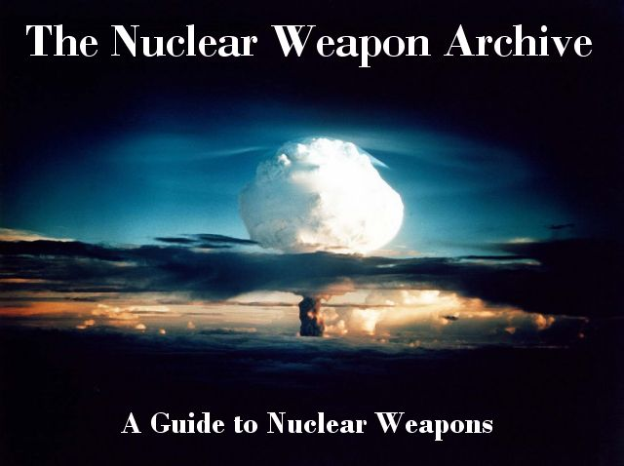
Hands on: Nuclear weapons
nuclearweaponarchive.org
alberto.mengoni@cern.ch

Slide 2
Nuclear technologies 4

Slide 3
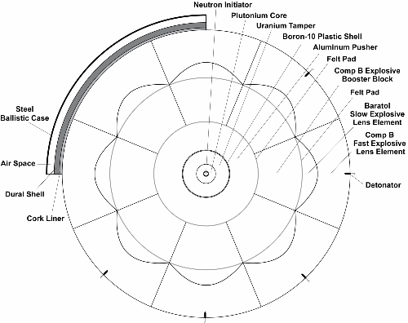
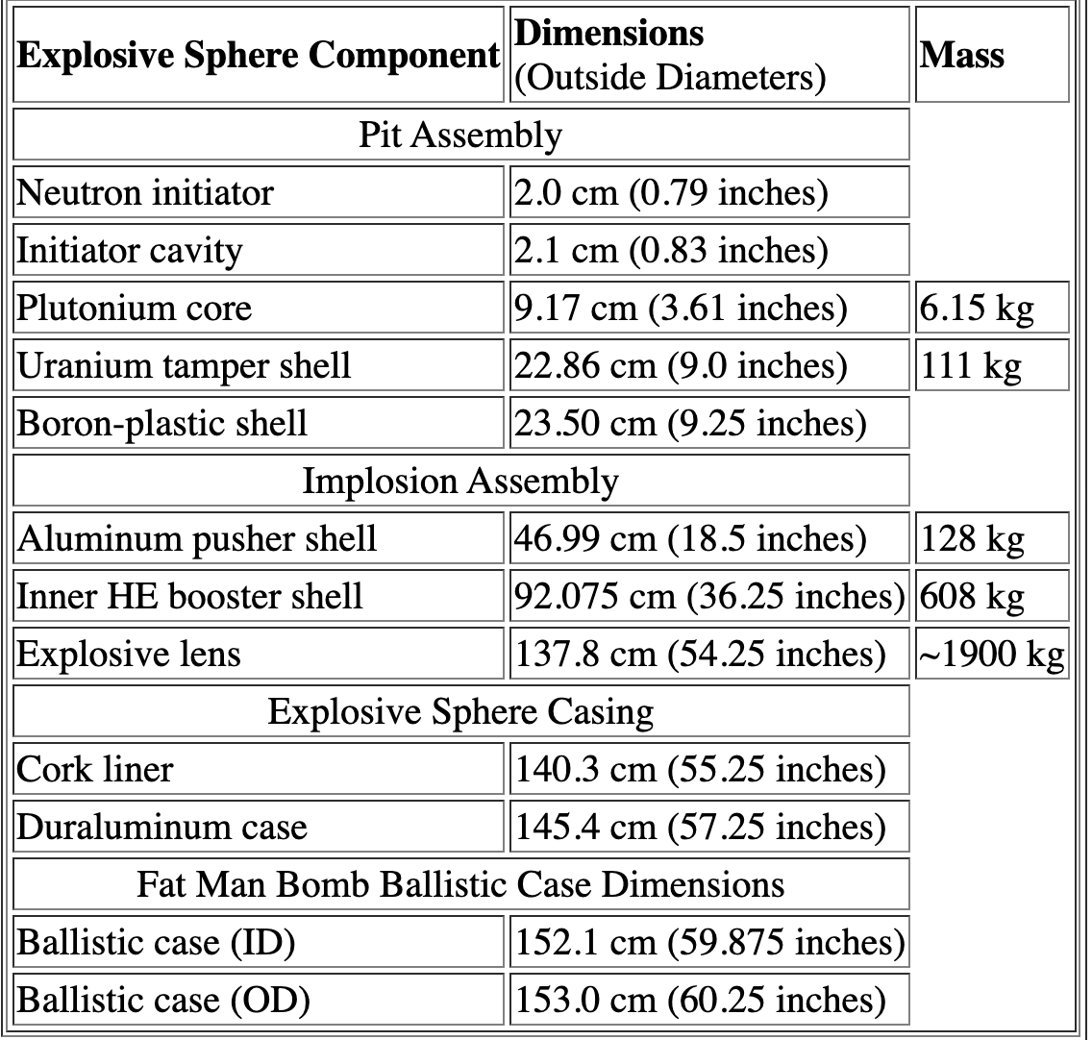
Nuclear technologies 4
source: nuclearweaponarchive.org

Slide 4
Nuclear technologies
Discovery of the neutron by James Chadwick in February 1932.
On May 10, 1934, Fermi's research group published a report on experiments with neutron bombardment of uranium. Appearance of the "Uranium Problem”.
Fermi discovered the extremely important principle of neutron behavior called "moderation" on October 22, 1934.
December 1935, Chadwick won the Nobel Prize for discovery of the neutron.
In November-December 1938, the Otto Hahn and Lise Meitner correctly unravel the Uranium Problem, i.e. evidence of fission.
January 13, 1939 - Otto Frisch observed fission directly by detecting fission fragments in an ionization chamber. With the assistance of William Arnold, he coins the term "fission".
January 26, 1939 - Niels Bohr publicly announces the discovery of fission at an annual theoretical physics conference at George Washington University in Washington, DC. This announcement was the principal revelation of fission in the United States.

Slide 5
Nuclear technologies
January 29, 1939 - Robert Oppenheimer hears about the discovery of fission, within a few minutes he realized that excess neutrons must be emitted, and that it might be possible to build a bomb.
February 5, 1939 - Niels Bohr gained a crucial insight into the principles of fission - that U-235 and U-238 must have different fission properties, that U-238 could be fissioned by fast neutrons but not slow ones, and that U-235 accounted for observed slow fission in uranium. Key uncertainties were:
The number of neutrons emitted per fission
The cross sections for fission and absorption at different energies for the uranium isotopes.
For a chain reaction there would need to be both a sufficient excess of neutrons produced, and the ratio between fission to absorption averaged over the neutron energies present would need to be sufficiently large. The different properties of U-235 and U-238 were essential to understand in determining the feasibility of an atomic bomb, or of any atomic power at all. The only uranium available for study was the isotope mixture of natural uranium, in which U-235 comprised only 0.72%.

Slide 6
Nuclear technologies
March, 1939 - Fermi and Herbert Anderson determine that there are about two neutrons produced for every one consumed in fission. This paper is the first experimental evidence of neutron multiplication. See >>.
June, 1939 - Fermi and Szilard submit a paper to Physical Review describing sub-critical neutron multiplication in a lattice of uranium oxide in water, but it is clear that natural uranium and water cannot make a self-sustaining reaction.
July 3, 1939 - Szilard writes to Fermi describing the idea of using a uranium lattice in carbon (graphite) to create a chain reaction. This is the first proposal of the graphite moderated reactor concept. See >>.
August 31, 1939 - Bohr and John A. Wheeler publish a theoretical analysis of fission. This theory implies U-235 is more fissile than U-238, and that the undiscovered element 94-239 (Plutonium!) is also very fissile. These implications are not immediately recognized.
September 1, 1939 - Germany invades Poland, beginning World War 2.

Slide 7
Basic principles of fission weapon design
The principal issues that must solved to construct a fission weapon are:
Keeping the fissionable material in a subcritical state before detonation;
Bringing the fissionable material into a supercritical mass while keeping it free of neutrons;
Introducing neutrons into the critical mass when it is at the optimum configuration (i.e. at maximum supercriticality);
Keeping the mass together until a substantial portion of the material has fissioned.
Solving issues 1, 2 and 3 together is greatly complicated by the unavoidable presence of naturally occurring neutrons. Neutrons can be generated by cosmic rays (at a low rate), and by spontaneous fission.
The process of assembling the supercritical mass must occur in significantly less time than the average interval between spontaneous fissions to have a reasonable chance of succeeding. This problem is difficult to accomplish due to the very large change in reactivity required in going from a subcritical state to a supercritical one. The time required to raise the value of k from 1 to the maximum value of 2 or so is called the reactivity insertion time, or simply insertion time.

Slide 8

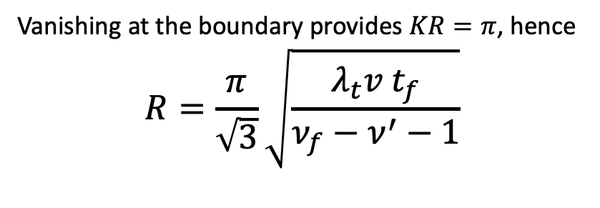
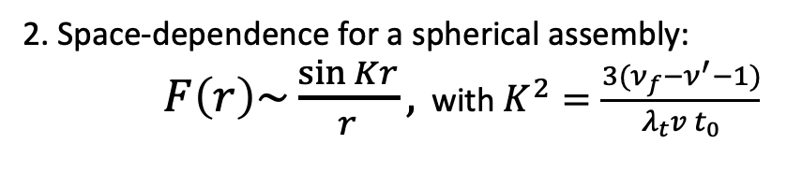
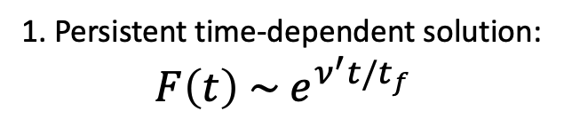
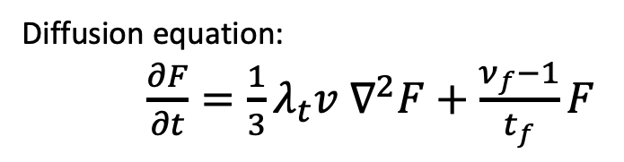
Critical mass of an untampered gadget
Diffusion equation:
$\frac{∂F}{∂t}=\frac{1}{3}λ_{t}v ∇^{2}F+\frac{ν_{f}−1}{t_{f}}F$
1. Persistent time-dependent solution:
$F\left(t\right) \sim e^{ν^{′}t/t_{f}}$
2. Space-dependence for a spherical assembly:
$F\left(r\right)\sim \frac{\sin{Kr}}{r},$ with $K^{2}=\frac{3(ν_{f}−ν^{′}−1)}{λ_{t}v t_{0}}$
Vanishing at the boundary provides $KR=π$, hence
$$R=\frac{π}{\sqrt{3}}\sqrt{\frac{λ_{t}v t_{f}}{ν_{f}−ν^{′}−1}}$$
Mark B. Chadwick (2021) Nuclear Science for the Manhattan Project and Comparison to Today’s ENDF Data, Nuclear Technology, 207:sup1, S24-S61, DOI: 10.1080/00295450.2021.1901002

Slide 9

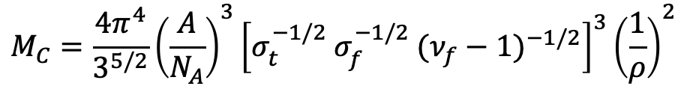
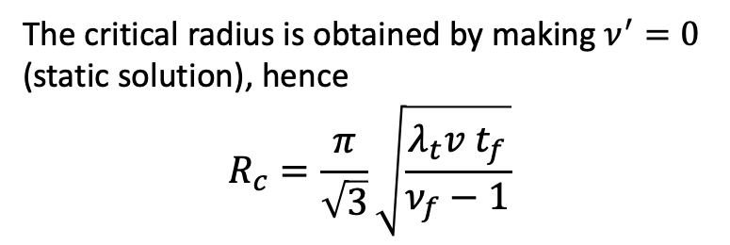
Critical mass of an untampered gadget
The critical radius is obtained by making $ν^{′}=0$
(static solution), hence
$$R_{c}=\frac{π}{\sqrt{3}}\sqrt{\frac{λ_{t}v t_{f}}{ν_{f}−1}}$$
$$M_{C}=\frac{4π^{4}}{3^{5/2}}{\left(\frac{A}{N_{A}}\right)}^{3}{\left[σ_{t}^{−1/2} σ_{f}^{−1/2} {(ν_{f}−1)}^{−1/2}\right]}^{3}{\left(\frac{1}{ρ}\right)}^{2}$$
$$×{\left(1+0.9 (ν_{f}−1)σ_{f}/σ_{t}\right)}^{−3}$$
Mark B. Chadwick (2021) Nuclear Science for the Manhattan Project and Comparison to Today’s ENDF Data, Nuclear Technology, 207:sup1, S24-S61, DOI: 10.1080/00295450.2021.1901002

Slide 10
Critical mass of an untampered gadget
$M_{C}=\frac{4π^{4}}{3^{5/2}}{\left(\frac{A}{N_{A}}\right)}^{3}{\left[σ_{t}^{−1/2} σ_{f}^{−1/2} {(ν_{f}−1)}^{−1/2}\right]}^{3}{\left(\frac{1}{ρ}\right)}^{2}$ ${\left(1+0.9 (ν_{f}−1)σ_{f}/σ_{t}\right)}^{−3}$
Mark B. Chadwick (2021) Nuclear Science for the Manhattan Project and Comparison to Today’s ENDF Data, Nuclear Technology, 207:sup1, S24-S61, DOI: 10.1080/00295450.2021.1901002

Slide 11
Basic principles of fission weapon design
The principal issues that must solved to construct a fission weapon are:
Keeping the fissionable material in a subcritical state before detonation;
Bringing the fissionable material into a supercritical mass while keeping it free of neutrons;
Introducing neutrons into the critical mass when it is at the optimum configuration (i.e. at maximum supercriticality);
Keeping the mass together until a substantial portion of the material has fissioned.
The problem is further complicated by the subcritical neutron multiplication:
This persistence of neutrons in subcritical masses further reduces the time window for assembly and requires that the reactivity of the mass be increased from a value of <0.9 to a value of 2 or so within that window.
Simply splitting a supercritical mass into two identical parts, and bringing the parts together rapidly is unlikely to succeed since neither part will have a sufficiently low k value, nor will the insertion time be rapid enough with achievable assembly speeds.
k | neutron generations before chain stops
0.90 | 10
0.99 | 100

Slide 12
Nuclear weapons: Units
1 kt = 4.18 x 10¹² Joule
= 26.1 x 10²⁴ MeV
1 Joule = 6.24 x 10¹² MeV
= 2.39 x 10⁻¹³ kt (kilotons)
15 kt (Hiroshima) = 3.92/200 x 10²⁶ = 2.0 x 10²⁴ fissions

Slide 13
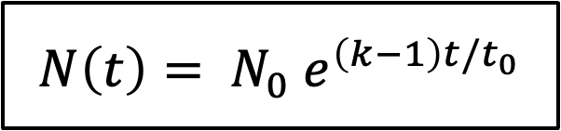
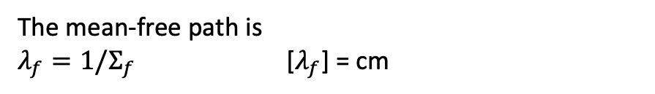
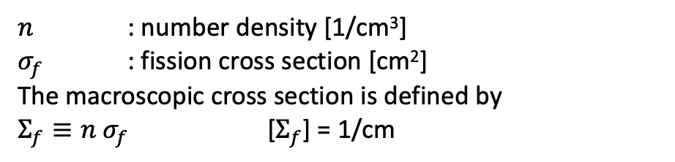
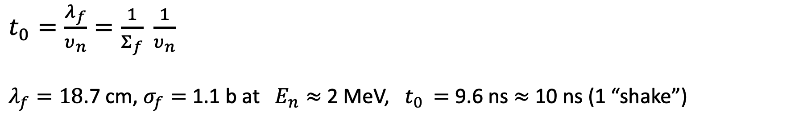
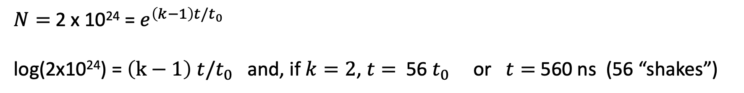
Nuclear weapons: Units
$$N\left(t\right)= N_{0} e^{\left(k−1\right)t/t_{0}}$$
$n$ : number density [1/cm³]
$σ_{f}$ : fission cross section [cm²]
The macroscopic cross section is defined by
$Σ_{f}≡n σ_{f}$ [$Σ_{f}$] = 1/cm
$t_{0}=\frac{λ_{f}}{υ_{n}}=\frac{1}{Σ_{f}} \frac{1}{υ_{n}}$
$λ_{f}=18$.7 cm, $σ_{f}=$ 1.1 b at $E_{n}≈$2 MeV, $t_{0 }=$ 9.6 ns $≈$ 10 ns (1 “shake”)
The mean-free path is
$λ_{f}=1/Σ_{f}$ [$λ_{f}$] = cm
$N=$2 x 10²⁴ = $e^{\left(k−1\right)t/t_{0}}$
log(2x10²⁴) = $\left(k−1\right) t/t_{0}$ and, if $k=2$, $t=$ 56 $t_{0}$ or $t=$ 560 ns (56 “shakes”)

Slide 14
Basic principles of fission weapon design
The principal issues that must solved to construct a fission weapon are:
Keeping the fissionable material in a subcritical state before detonation;
Bringing the fissionable material into a supercritical mass while keeping it free of neutrons;
Introducing neutrons into the critical mass when it is at the optimum configuration (i.e. at maximum supercriticality);
Keeping the mass together until a substantial portion of the material has fissioned.
The problem is further complicated by the subcritical neutron multiplication:
This persistence of neutrons in subcritical masses further reduces the time window for assembly and requires that the reactivity of the mass be increased from a value of <0.9 to a value of 2 or so within that window.
Simply splitting a supercritical mass into two identical parts, and bringing the parts together rapidly is unlikely to succeed since neither part will have a sufficiently low k value, nor will the insertion time be rapid enough with achievable assembly speeds.
k | neutron generations before chain stops
0.90 | 10
0.99 | 100

Slide 15
Nuclear weapons: Implosion assembly

Slide 16
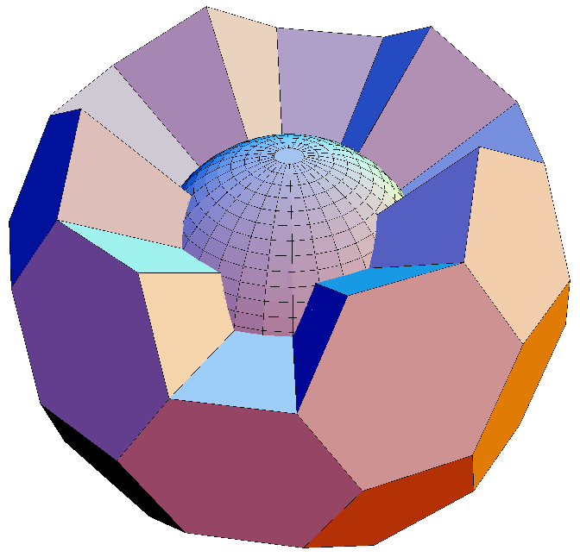
Nuclear weapons: Implosion assembly

Slide 17
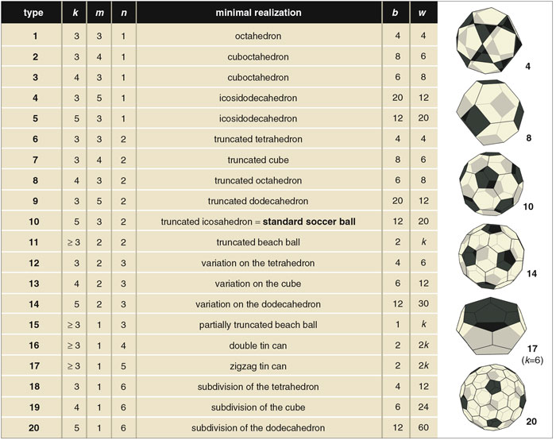
Nuclear weapons: Implosion assembly
32 explosive blocks (20 hexagonal and 12 pentagonal blocks) which fit together in the same pattern as a soccer ball.

Slide 18
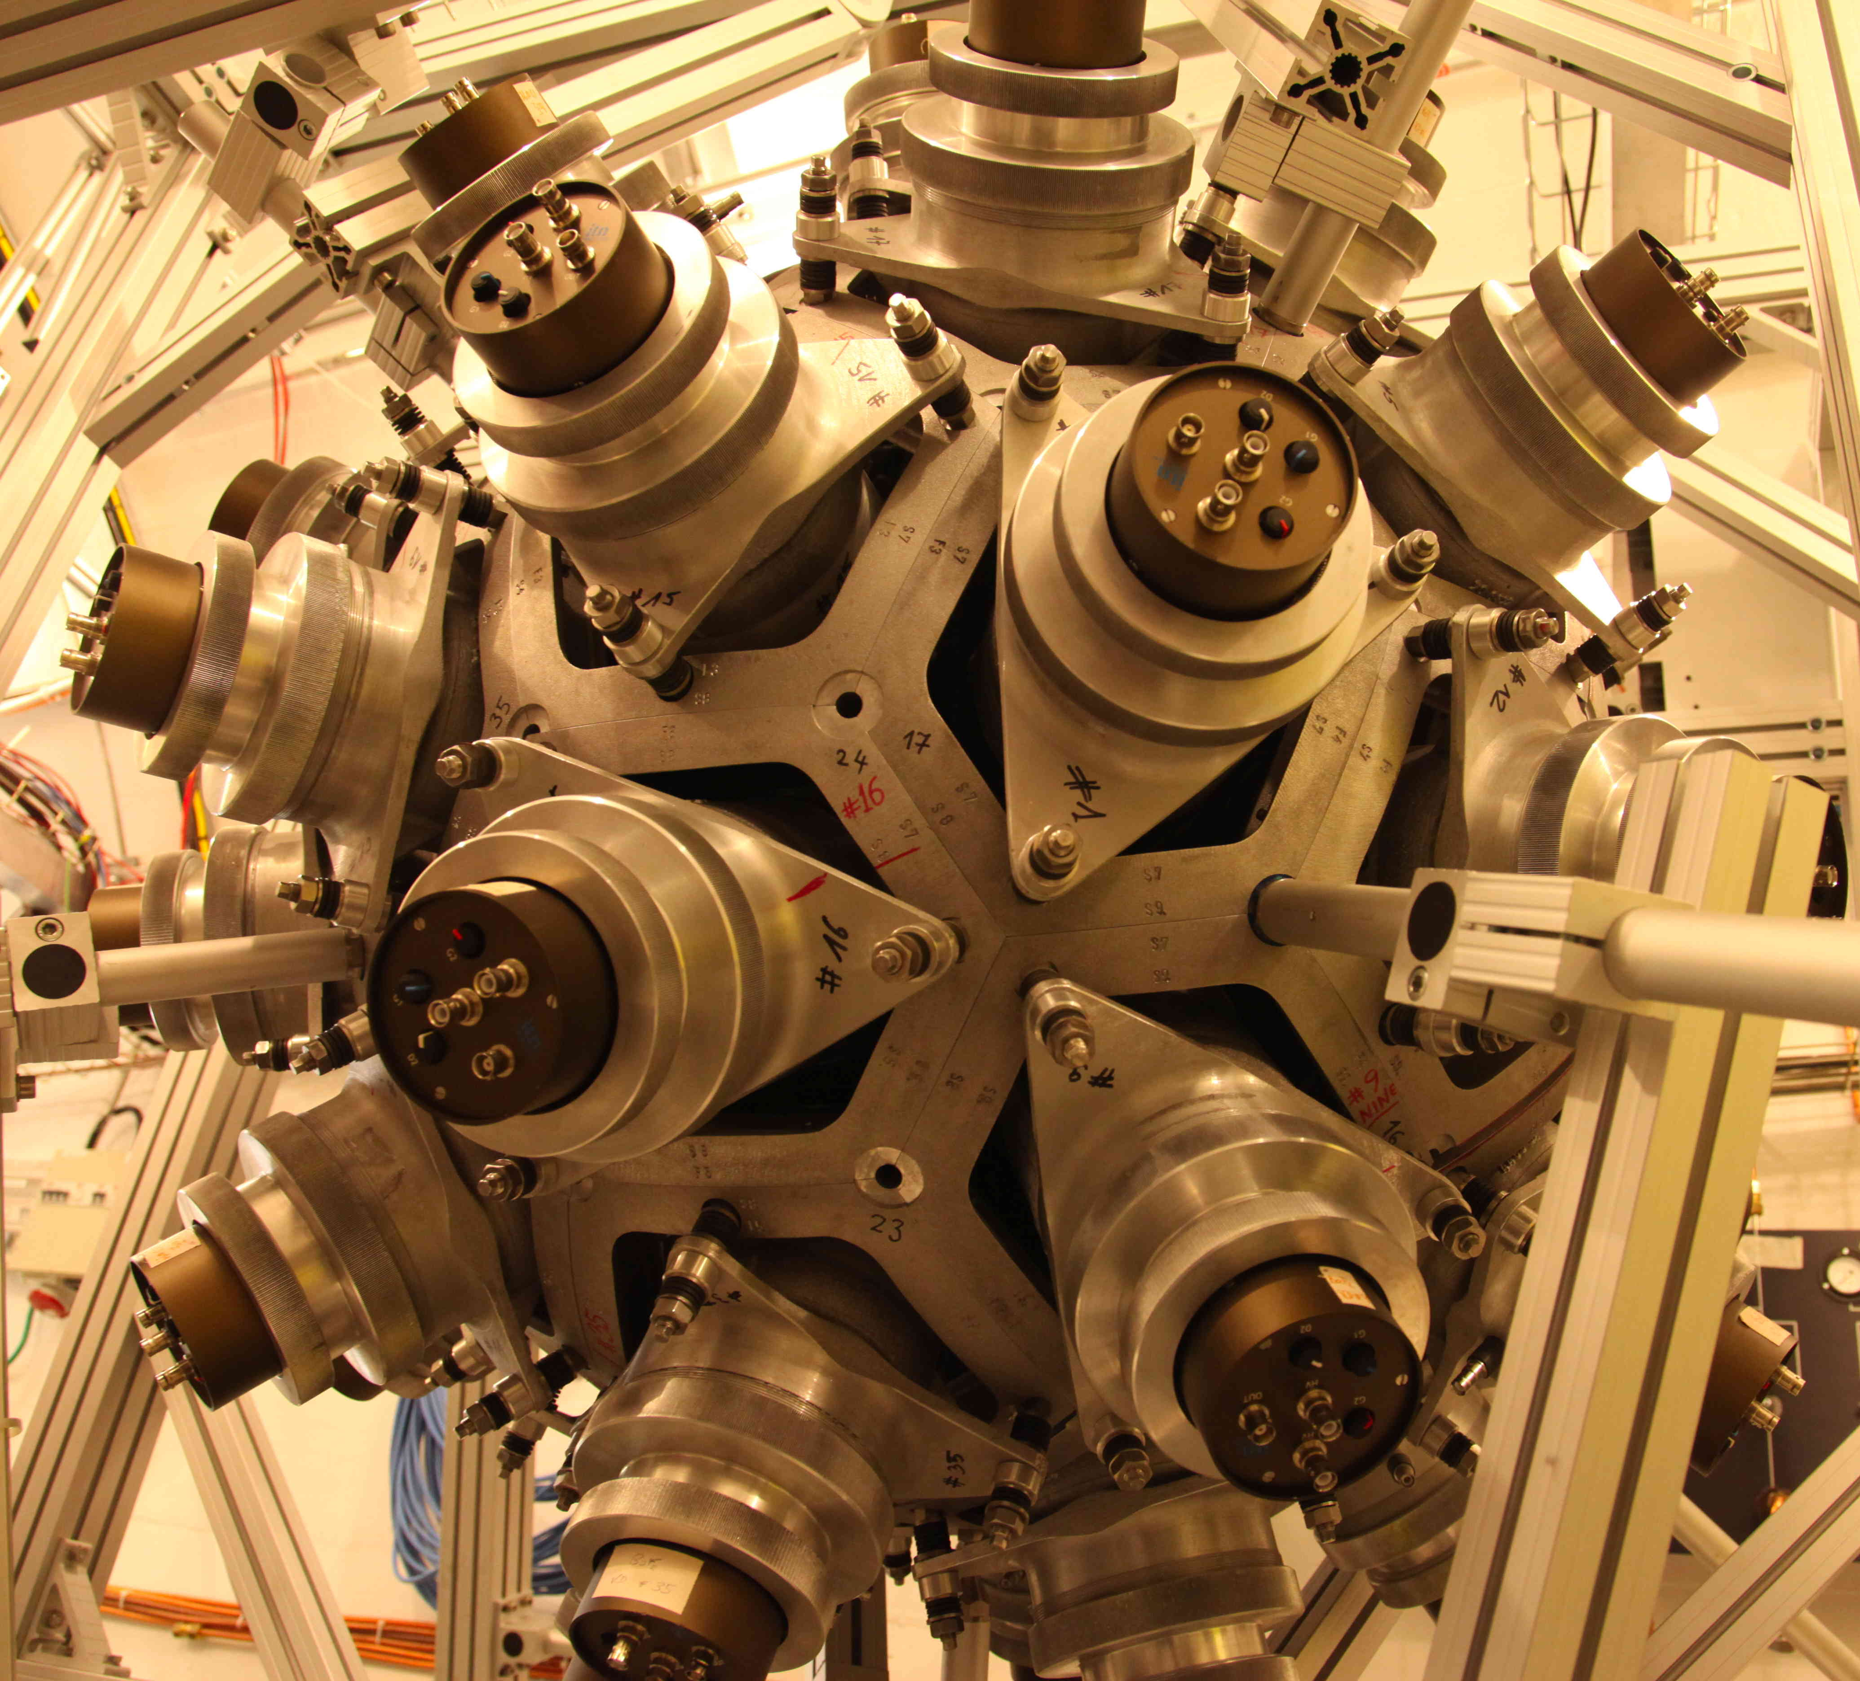
Nuclear weapons: Implosion assembly
32 explosive blocks (20 hexagonal and 12 pentagonal blocks) which fit together in the same pattern as a soccer ball.
40 BaF₂ crystals for 𝛾-ray detection: a 4π Total Absorption
Calorimeter (TAC) at CERN n_TOF

Slide 19
Nuclear weapons: Implosion assembly
A high performance explosive can generate shock wave pressures of 400 kilobars (four hundred thousand atmospheres), implosion convergence and other concentration techniques can boost this to several megabars.
The convergent shock wave of an implosion can compress solid uranium or plutonium by a factor of 2 to 3. The compression occurs very rapidly, typically providing insertion times in the range to 1 to 4 microseconds. The period of maximum compression lasts less than a microsecond.
A two-fold compression will boost a slightly sub-critical solid mass to nearly four critical masses.

Slide 20
Nuclear weapons
In addition to its major objective of achieving supercriticality, compression has another important effect: The increased density reduces the neutron mean free path, which is inversely proportional to density. This reduces the time period for each generation and allows a faster reaction that can progress farther before disassembly occurs. Implosion thus considerably increases a bomb's efficiency.

Slide 21
Initiating fission
There are three different ways to generate the neutrons that starts the chain reaction (10⁷ – 10⁹ n/s needed)
1. ⁹Be + ⍺ -> ⁸Be + ⍺ + n with the ⍺ provided by a ²¹⁰Po source of 3-30 Ci
The major problem with the beryllium/alpha emitter generators is that the strong emitters used have very short half-life (138.4 days for ²¹⁰Po). Maintaining an inventory of weapons thus requires continual manufacture and replacement of generators.
2. Use the implosion to initiate a neutron generating fusion D+T reactions (placed at the center of the imploding device).
This type of implosion initiator is even more difficult to engineer than the Be/²¹⁰Po type since the very high precision implosion is required to achieve the required symmetry. The major advantage is that the short half-life ²¹⁰Po is not needed.
3. Use an electronically controlled particle accelerator (a pulse neutron tube). Can produce 10⁸ – 10⁹ n/s (pulsed or continuous)

Slide 22
Initiating fission

Slide 23
Nuclear weapons: Gun assembly

Slide 24
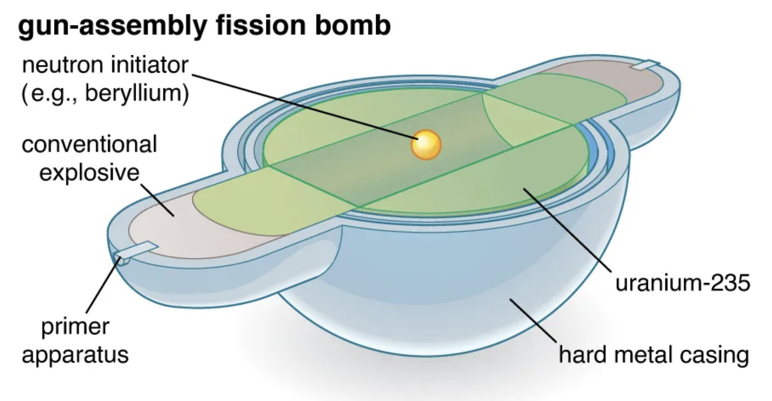
Gun-assembly
Take two subcritical masses and obtain the equivalent of three critical masses by bringing them together.
Imagine a spherical pit made up of about three critical masses of fissionable material. Now remove a core from the pit with a mass slightly less than critical. Since the center of the pit is now hollow, its effective density has been reduced to 2/3 of the original density. Since we now have two critical masses remaining in the pit, and the reduction in density leads to a further reduction of (2/3)^2 = 4/9, the pit now contains only 2*(4/9) = 8/9 of a critical mass.

Slide 25
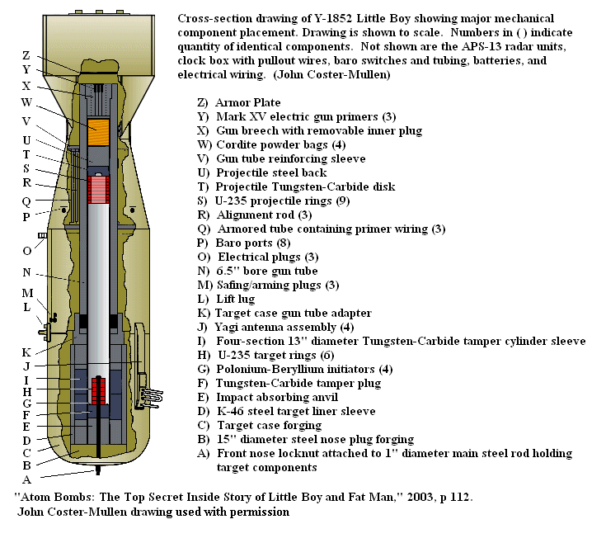
Gun-assembly
Take two subcritical masses and obtain the equivalent of three critical masses by bringing them together.
Imagine a spherical pit made up of about three critical masses of fissionable material. Now remove a core from the pit with a mass slightly less than critical. Since the center of the pit is now hollow, its effective density has been reduced to 2/3 of the original density. Since we now have two critical masses remaining in the pit, and the reduction in density leads to a further reduction of (2/3)^2 = 4/9, the pit now contains only 2*(4/9) = 8/9 of a critical mass.

Slide 26
Nuclear weapons: Efficiency
By the time a significant percentage of the atoms have fissioned, their thermal kinetic energy is so high that the pit will expand enough to shut down the reaction in only a few of shakes.
This severely limits the efficiency of fission weapons (percentage of material fissioned). The practical efficiency limit of a typical pure fission bomb is about 25% and could be much less.
Little Boy (Hiroshima, gun-type) had an efficiency of only 1.4%. The Fat Man implosion bomb (Nagasaki) was 17% efficient (counting only the energy produced by the fissile core, the natural uranium tamper contributed another 4% through fast fission). Very large pure fission bombs can achieve efficiencies approaching 50% but have been supplanted by thermonuclear weapon technology. Anything that will increase the confinement time of the fissionable core or decrease the generation time, even slightly, can cause a significant increase in bomb yield.
all details in: Elements of Fission Weapon Design
source: nuclearweaponarchive.org

Slide 27
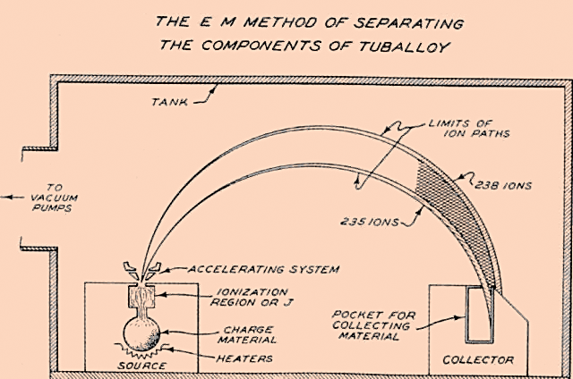
Nuclear weapons: ²³⁹Pu & ²³⁵U production
The three reactors (B and D which went started up for production in December 1944, and F which started up February 1945) at Hanford had a combined design thermal output of 750 MW and were theoretically capable of producing 19.4 kg of plutonium a month (6.5 kg/reactor), enough for over 3 Fat Man bombs. Monthly or annual production figures are unavailable for 1945 and 1946, but by the end of FY 1947 (30 June 1947) 493 kg of plutonium had been produced. Neglecting the startup month of each reactor, this indicates an average plutonium production 5.6 kg/reactor/month even though they were operated at reduced power or even shut down intermittently beginning in 1946.
Enriched uranium production is more difficult to summarize since there were three different enrichment processes in use that had interconnected production. The Y-12 plant calutrons also had reached maximum output early in 1945, but the amount of weapon-grade uranium this translates into varies depending on the enrichment of the feedstock. Initially this was natural uranium giving a production of weapon-grade uranium of some 6 kg/month.
remember the critical masses:
U-233 16 kg
U-235 52 kg
Pu-239 (alpha phase) 10 kg
source: nuclearweaponarchive.org

Slide 28
Fusion weapons

Slide 29
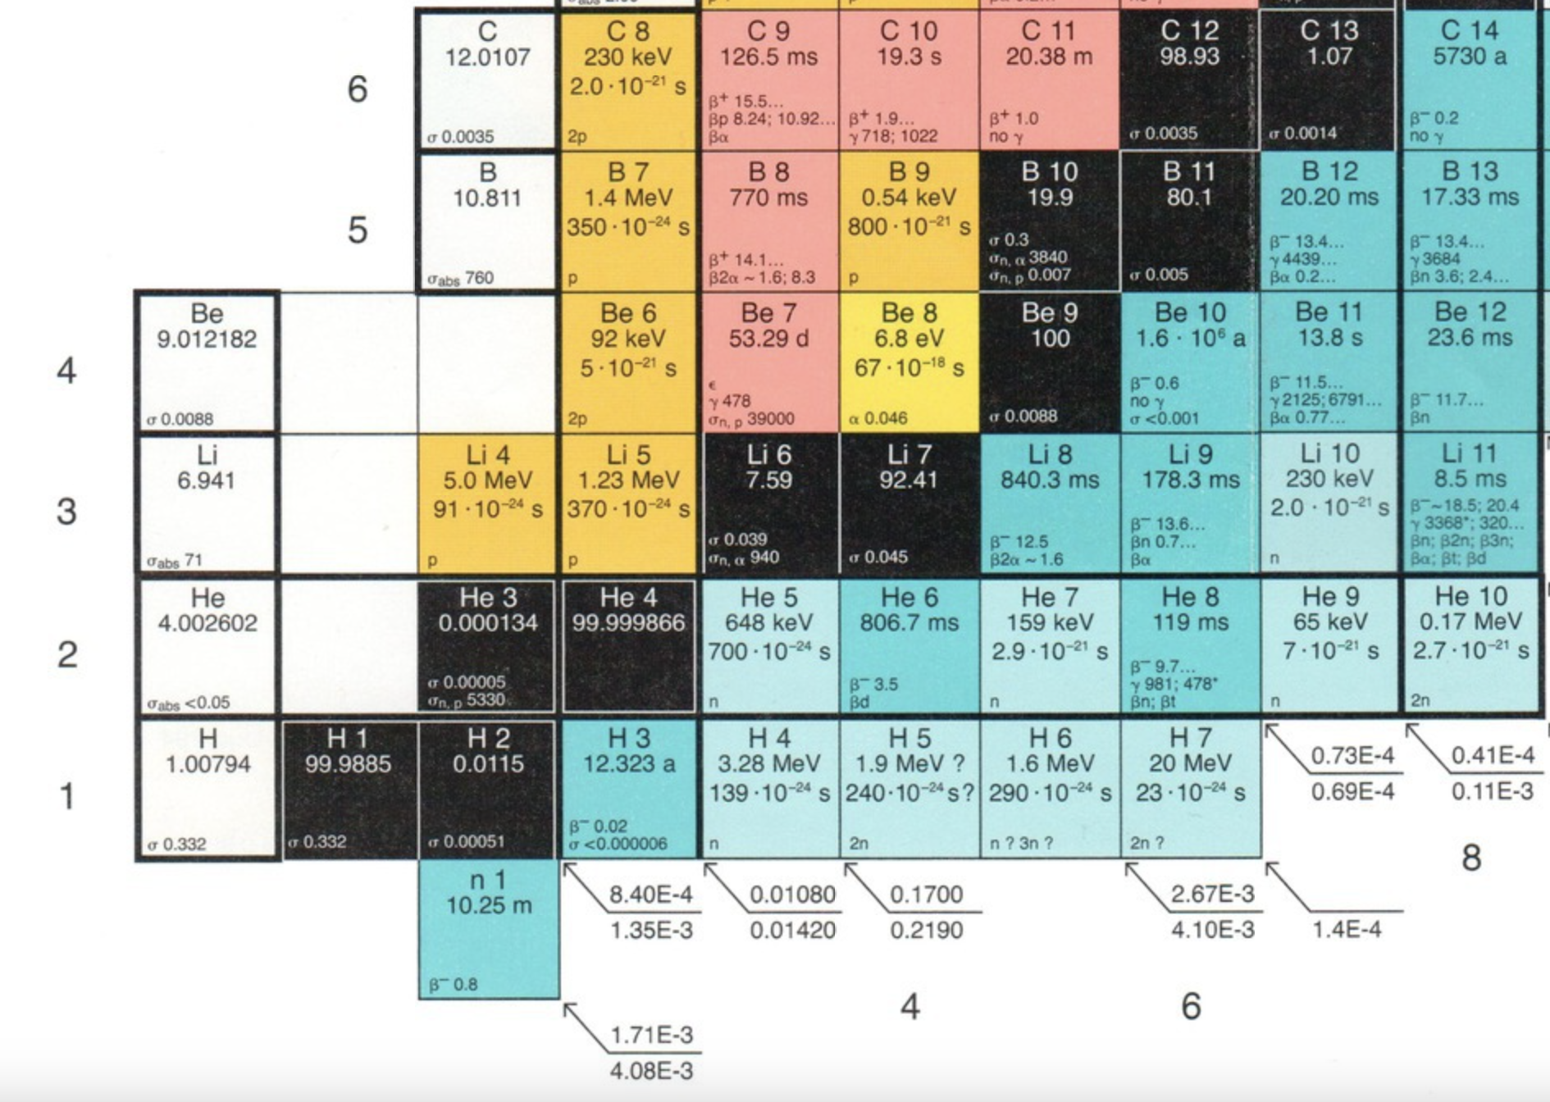
Fusion weapons
The most important fusion reactions for thermonuclear weapons are given below:
D + T → ⁴He + n + 17.588 MeV
D + D → ³He + n + 3.268 MeV
D + D → T + p + 4.03 MeV
³He + D → ⁴He + p + 18.34 MeV
⁶Li + n → T + ⁴He + 4.78 MeV
⁷Li + n → T + ⁴He + n - 2.47 MeV
At ordinary material densities (e.g. liquid hydrogen, compressed hydrogen gas, or hydrogen-rich solids), the D+T reaction is the only reaction that can occur to a significant extent at the temperature of an atomic bomb of 50-100 million degrees. The temperature at the center of the Sun is only 14 million degrees!

Slide 30
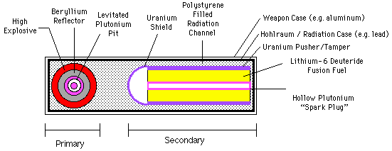
Fusion weapons
At ordinary material densities (e.g. liquid hydrogen, compressed hydrogen gas, or hydrogen-rich solids), the D+T reaction is the only reaction that can occur to a significant extent at the temperature of an atomic bomb of 50-100 million degrees. The temperature at the center of the Sun is only 14 million degrees!
The Teller-Ulam configuration makes use of the fact that at the high temperatures of a fission bomb 80% or more of the energy exists as soft X-rays, not kinetic energy. The transport of energy by radiation from the fission core greatly exceeds the core's expansion rate (a mere 1000 km/sec or so). It is possible then to use this energy to compress, and ignite a physically separate mass of fusion fuel (the second stage) through radiation implosion before the expanding trigger disrupts it.
source: nuclearweaponarchive.org

Slide 31
Fusion weapons
source: nuclearweaponarchive.org

Slide 32
Fusion weapons
At the temperatures achievable in the fission core of the primary (up to 10⁸ degrees K) nearly all of the energy is present as a thermal radiation field (up to 95%) with average photon energies around 10 KeV (moderately energetic X-rays).
As energy flows down the radiation channel, the energy density drops since the photon gas is now filling a greater volume. This means the temperature of the photon gas, and the average photon energy must drop as well. From an initial average energy of 10 KeV, the X-rays soften to around 1-2 KeV. This corresponds to a temperature in the casing of some 10-25 million degrees K.
By applying the blackbody radiation laws we can determine the corresponding radiation intensities and temperatures: 9.8 MK and 5.3 x 10^16 W/cm² for Mike; and 20 MK and 1.0 x 10^18 W/cm^2 for the W-80. The radiation pressures are 73 and 1400 Mbar respectively.
The pressure exerted by the plasma causes cylindrical (or spherical) implosion of the fusion capsule, consisting of the pusher/tamper, fuel, and the axial fissionable rod. The capsule is compressed to perhaps 1/30 of its original diameter for cylindrical compression (1/10 for spherical compression), and thus reaches or exceeds 1000 times its original density. It is noteworthy that at this point the explosive force released by the trigger, an amount of energy sufficient to destroy a small city, is being used simply to squeeze several kilograms of fuel!
source: nuclearweaponarchive.org

Slide 33
Fusion weapons
It is unlikely that the fissionable rod reaches such extreme compression. Located at the center, it will experience an extremely violent shock wave that will heat it to high temperatures but compress it only modestly, increasing its density by a factor of 4 or so. This is sufficient to make the rod super-critical.
Combined with the high temperatures generated by the convergent shock wave, this raises the temperature of the fusion fuel around the rod high enough to initiate the fusion reaction. The temperatures generated by fusion burning can considerably exceed that produced by fission (up to 300 million K). As the temperature rises, the fusion reactions accelerate.
The 2.45 MeV and 14.1 MeV neutrons that escape from the fusion fuel can also contribute greatly to bomb yield by inducing fission in the highly compressed fusion tamper. This extra boost can release most of the explosion energy, and commonly accounts for half of the yield of large fission-fusion-fission bombs and can reach at least 85% of the total yield.
A large part of the fusion fuel can be burned before expansion quenches the reaction by reducing the density, which takes some 20-40 nanoseconds. The power output of a fusion capsule is noteworthy. The largest bomb ever exploded had a yield of 50 Mt, almost all produced by its final fusion stage. Since 50 Mt is 2.1x10¹⁷ joules, the power produced during the burn was around 5.3x10²⁴ watts. This is more than one percent of the entire power output of the Sun (4.3x10²⁶ watts)!!
source: nuclearweaponarchive.org

Slide 34
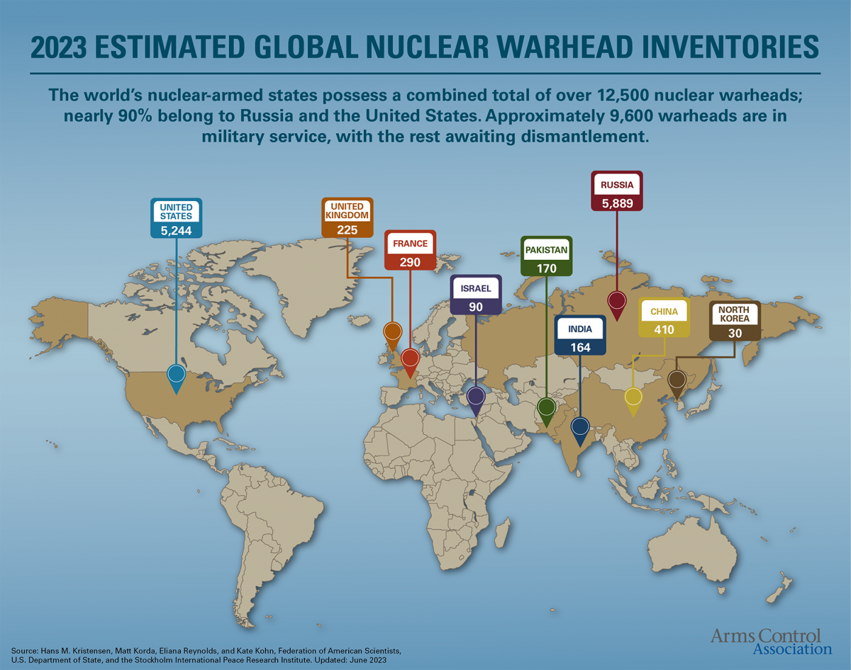

Slide 35

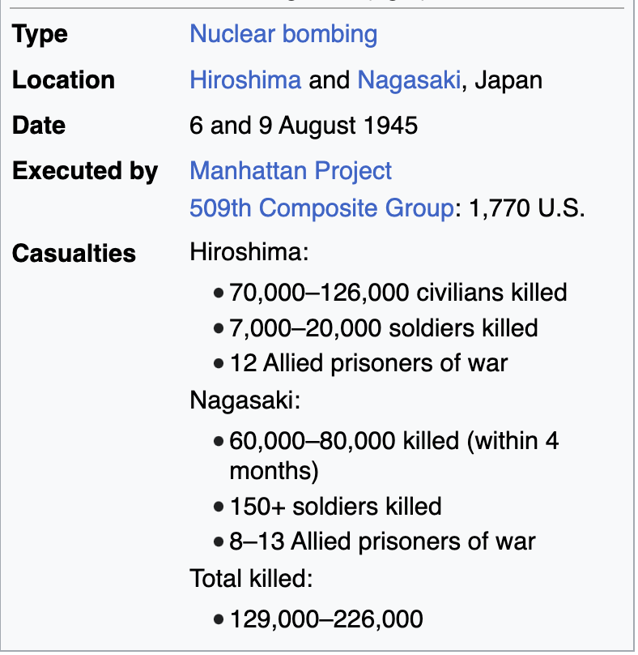
Nuclear weapons
The boy standing by the crematory, Hiroshima (1945)
Joe O'Donnell (photojournalist)

Slide 36

Thank you!

Slide 37
The End

Slide 38
Additional material

Slide 39
Nuclear Reactors
U-fuel, H2O-moderated infinite reactor
<< back

Slide 40
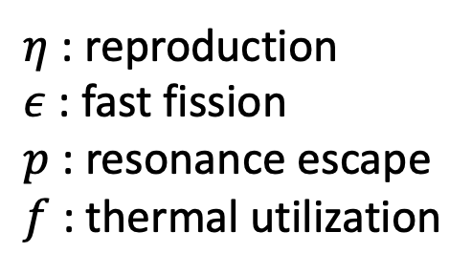
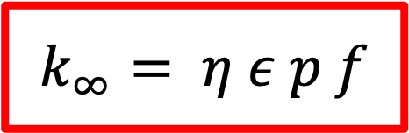
Nuclear Reactors
U-fuel, H2O-moderated infinite reactor
$$k_{∞}= η ε p f$$
$η$ : reproduction
$ε$ : fast fission
$p$ : resonance escape
$f$ : thermal utilization

Slide 41
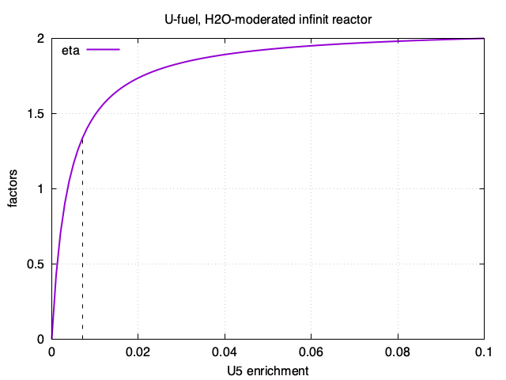
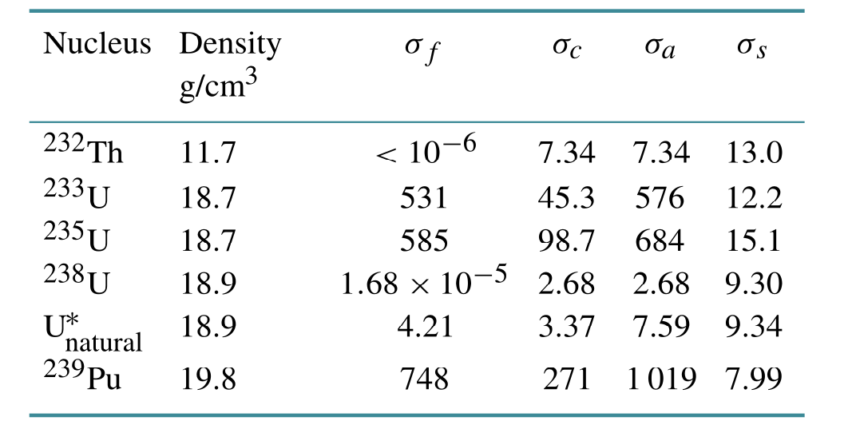
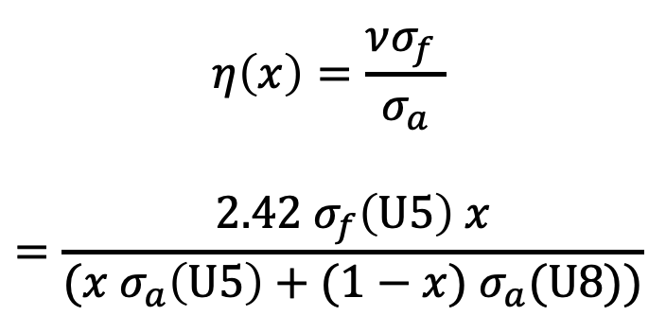
Nuclear Reactors
U-fuel, H2O-moderated infinite reactor
$$η\left(x\right)=\frac{νσ_{f} }{σ_{a}}$$
$$=\frac{2.42 σ_{f}\left(U5\right) x}{(x{ σ}_{a}\left(U5\right)+(1−x){ σ}_{a}(U8))}$$

Slide 42
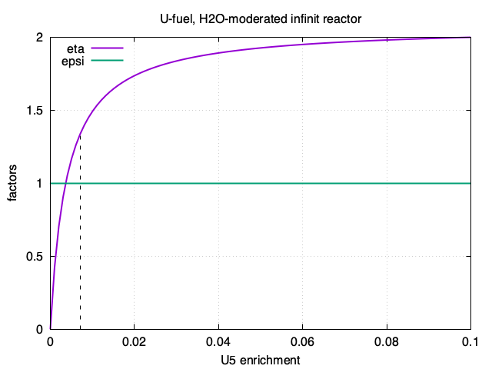

Nuclear Reactors
U-fuel, H2O-moderated infinite reactor
$$ε≈1$$

Slide 43
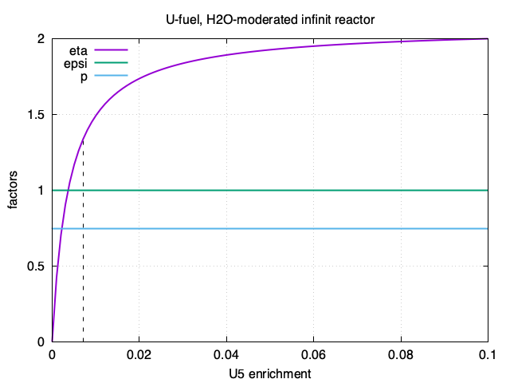

Nuclear Reactors
U-fuel, H2O-moderated infinite reactor
$$p≈0.74$$

Slide 44
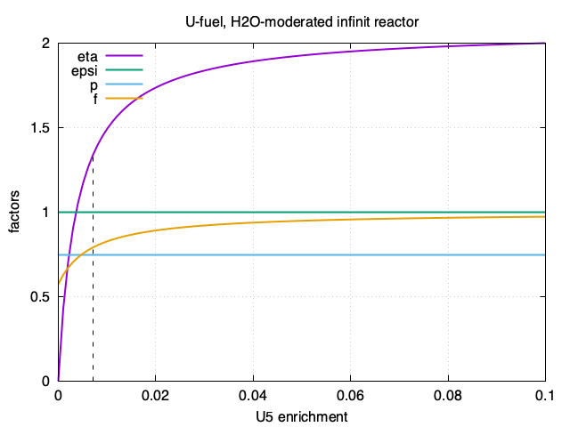
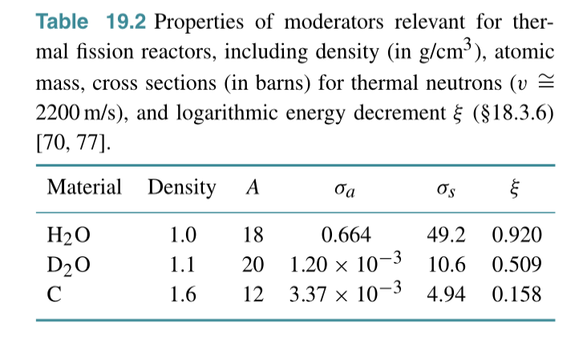

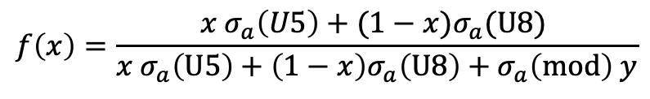
Nuclear Reactors
U-fuel, H2O-moderated infinite reactor
$$f\left(x\right)=\frac{{x σ}_{a}\left(U5\right)+(1−x)σ_{a}(U8) }{{x σ}_{a}\left(U5\right)+\left(1−x\right)σ_{a}\left(U8\right)+σ_{a}\left(mod\right) y}$$
for $y=3$

Slide 45
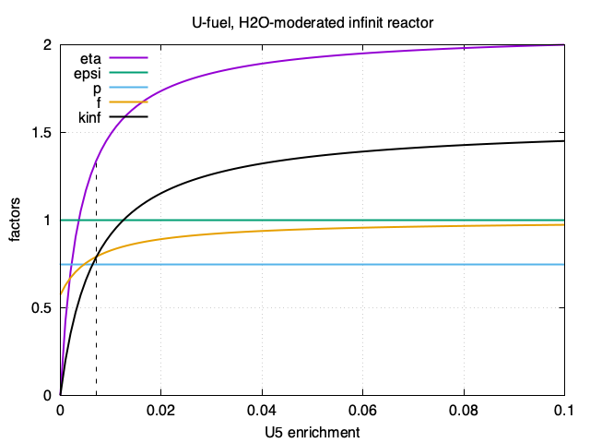
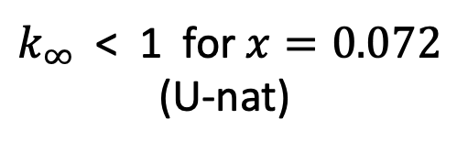


Nuclear Reactors
U-fuel, H2O-moderated infinite reactor
$$k_{∞}= η ε p f$$
$k_{∞}$ < 1 for $x=0.072$
(U-nat)
$x=0.0072$

Slide 46
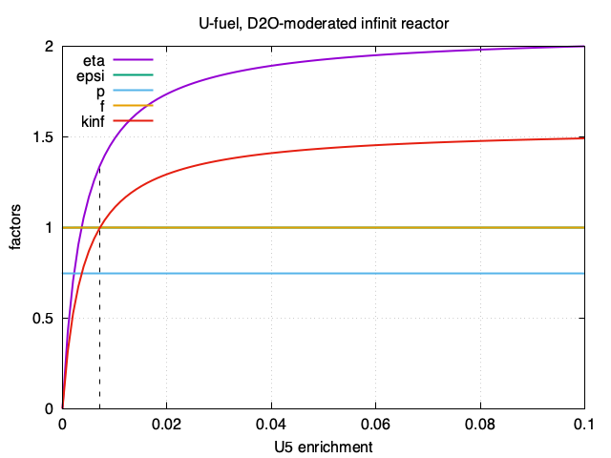
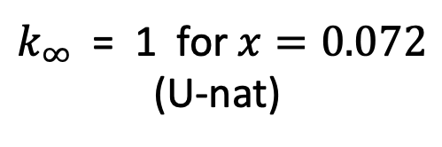
Nuclear Reactors
U-fuel, C-moderated infinite reactor
$$k_{∞}= η ε p f$$
$k_{∞}$ = 1 for $x=0.072$
(U-nat)
<< back
$x=0.0072$

Slide 47
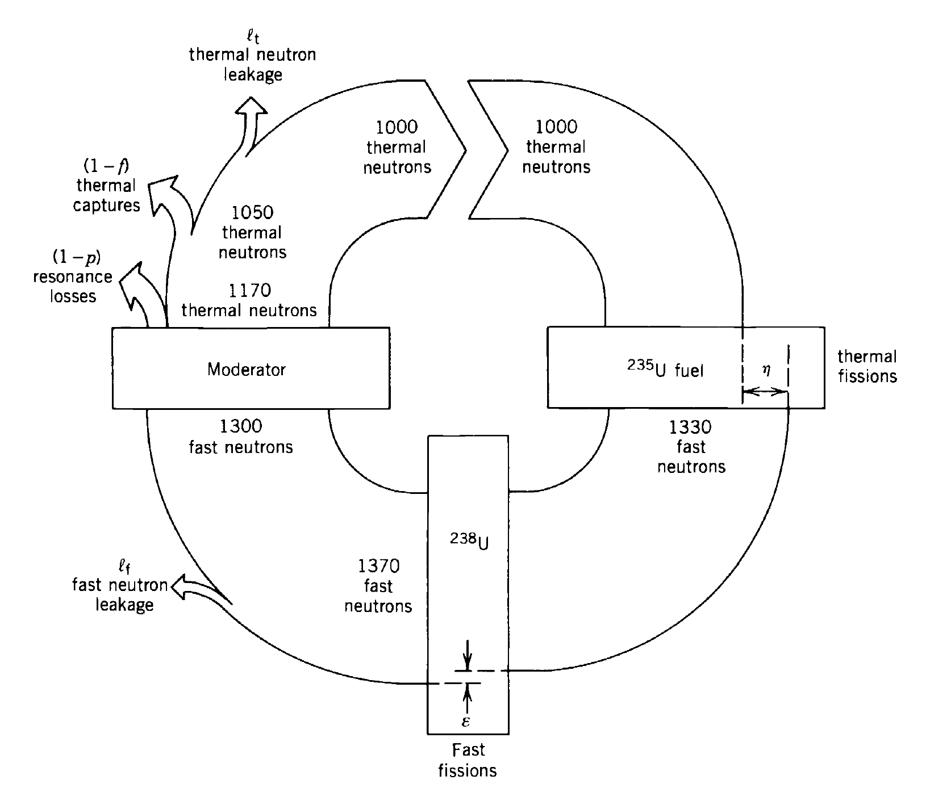
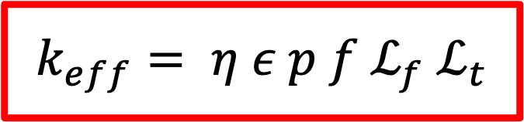
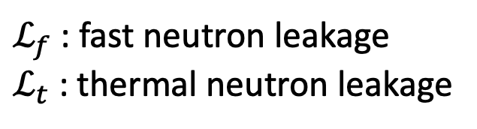
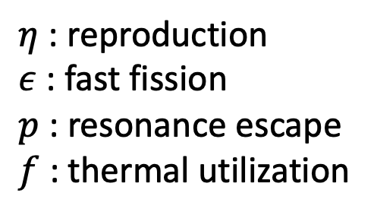
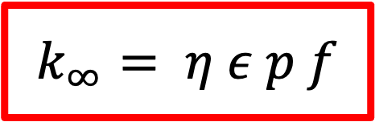
Nuclear Reactors
$$k_{∞}= η ε p f$$
$η$ : reproduction
$ε$ : fast fission
$p$ : resonance escape
$f$ : thermal utilization
$$k_{eff}= η ε p f ℒ_{f}{ ℒ}_{t}$$
$ℒ_{f}$ : fast neutron leakage
$ℒ_{t}$ : thermal neutron leakage
source: Kenneth S Krane, Introductory Nuclear Physics

Slide 48
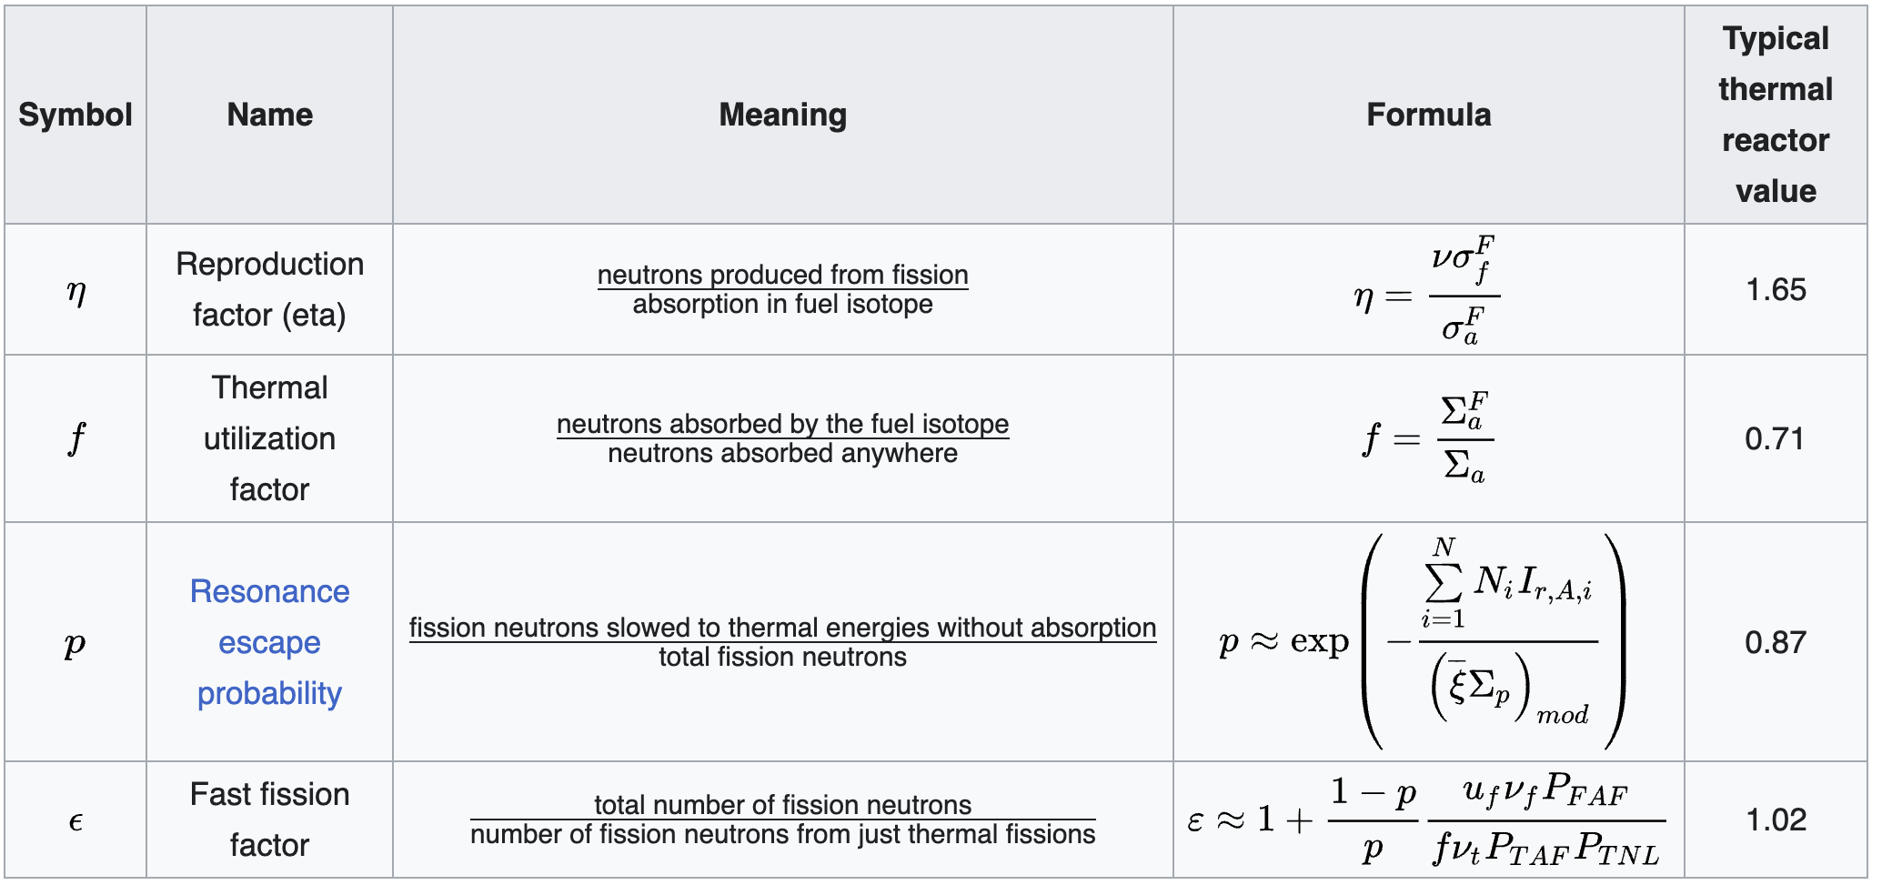
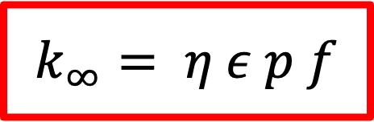
Nuclear Reactors
$$k_{∞}= η ε p f$$
source: wikipedia

Slide 50
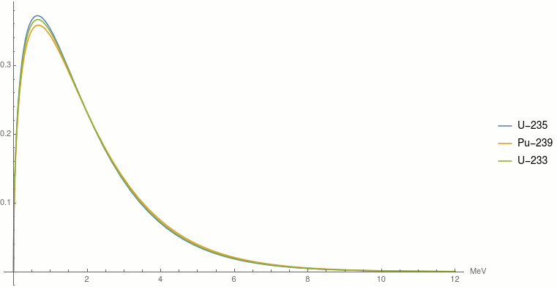
Nuclear Reactors: neutronics
Probability density functions of the fission neutron energies of U-235, Pu-239 and U-233
$P\left(E\right)=0.4865 sinh⁡(\sqrt{2E})e^{−E}$, [E] = MeV, <E> $≈$ 2 MeV

Slide 54
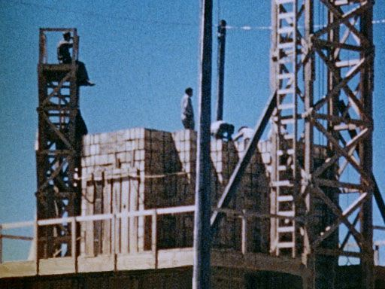
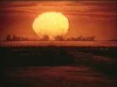
The 100 ton test
The first nuclear explosion in history took place in New Mexico, at the Alamogordo Test Range, on the Jornada del Muerto (Journey of Death) desert, in the test named Trinity.
Before Trinity: May 7, 1945
To help in preparing the instrumentation for the Trinity shot the "100 Ton Test" was fired on 7 May 1945. This test detonated 108 tons of TNT stacked on a wooden platform 800 yards from Trinity ground zero. The pile of high explosive was threaded with tubes containing 1000 curies of reactor fission products. This is the largest instrumented explosion conducted up to this date. The test allowed the calibration of instruments to measure the blast wave, and gave some indication of how fission products might be distributed by the explosion.

Slide 55
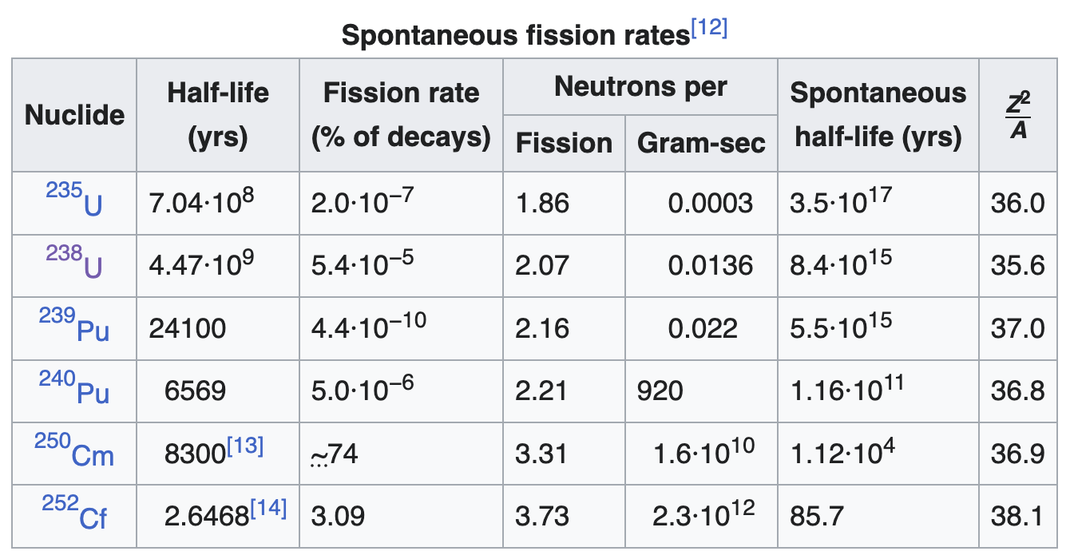
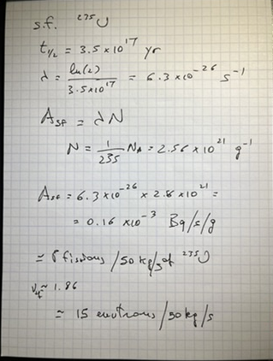
Spontaneous fission

Slide 57



Nuclear Reactors
Number of fissions:
$$N\left(t\right)=N_{0}e^{\left(k−1\right)t/t_{0}}$$
$t_{0}$ is the time needed to go from one generation of neutrons to the next
$$ρ=\frac{k−1}{k}$$
Most neutrons from are emitted within 10⁻¹³ s (prompt)
The slowing-down process takes, typically 10⁻⁴ s
reactivity:
The multiplication factor $k$ represents the number of neutrons of (n+1)st generation, produced
by each neutron of the n-th generation
In an infinite reactor
$$k_{∞}= η ε p f$$

Slide 58

Nucleosynthesis: TRU (1000 Mw_{e} LWR)
²⁴⁴Cm
1.5 Kg/yr
²⁴¹Am:11.6 Kg/yr
²⁴³Am: 4.8 Kg/yr
²³⁹Pu: 125 Kg/yr
²³⁷Np: 16 Kg/yr
LLFP
76.2 Kg/yr
LLFP
source: Actinide and Fission Product Partitioning and Transmutation – NEA (1999)

Slide 59


Criticality
A neutron entering a pure chunk of one of the slow-fissionable isotopes would have a high probability of causing fission compared with the chance of unproductive neutron capture. If the chunk is large and compact enough, then the rate of neutron escape from its surface will be so low that it becomes a "critical mass", a mass in which a self-sustaining chain reaction occurs. Non-fissionable materials mixed with these isotopes tend to absorb some of the neutrons uselessly and increase the required size of the critical mass or may even make it impossible to achieve altogether.
Typical figures for critical masses for bare (unreflected) spheres of fissionable materials are:
U-233 16 kg
U-235 52 kg
Pu-239 (alpha phase) 10 kg

Slide 60





Criticality: HEU
The macroscopic cross section is defined by
$Σ_{f}≡n σ_{f}$ [$Σ_{f}$] = 1/cm
The mean-free path is
$λ_{f}=1/Σ_{f}$ [$λ_{f}$] = cm
Considering that $σ_{t}=σ_{f}+σ_{el}$ the criticality radius
is given by
$$R_{C}=k \sqrt{λ_{f}λ_{t}}$$
With the constant $k$ related to the effective number
of neutrons emitted/fission, given by
$$k= \frac{1.82}{\sqrt{log⁡(ν)}}$$
B Cameron Reed, Am. J. Phys., Vol. 75, No. 12, December 2007

Slide 61





Criticality: HEU
The macroscopic cross section is defined by
$Σ_{f}≡n σ_{f}$ [$Σ_{f}$] = 1/cm
The mean-free path is
$λ_{f}=1/Σ_{f}$ [$λ_{f}$] = cm
The radius of a critical assembly is
$$R_{C}=λ_{f}\sqrt{s}$$
where $s$ is the number of steps in a random walk. Then,
considering that $n=\frac{ρ}{A}N_{A}$
$$1 = \frac{f σ_{f}}{A \sqrt{s}}ρ^{2/3} M_{C}^{1/3}$$
$f$ is a “fudge” factor incorporating constants and
geometrical factors. It follows that:
$$M_{C}∝1/ρ^{2}$$
B Cameron Reed, Am. J. Phys., Vol. 75, No. 12, December 2007

