Slide 1


Identifying the Key Aims of Science Shows
Ruadh Duggan
CERN, Switzerland, and Utrecht University, the Netherlands
        Supervisors: Wouter van Joolingen, Utrecht University
        Anja Kranjc Horvat, CERN, Switzerland
        Sascha Schmeling, CERN, Switzerland
IMPRESS Symposium, June 2023 – Sparkle Talk

Slide 2
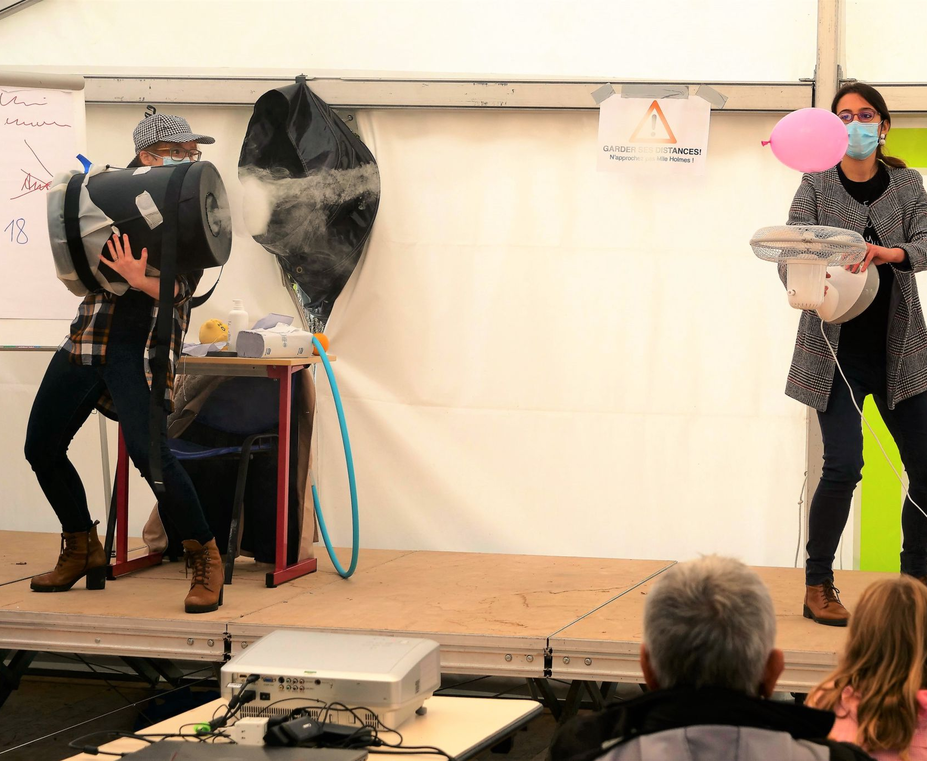
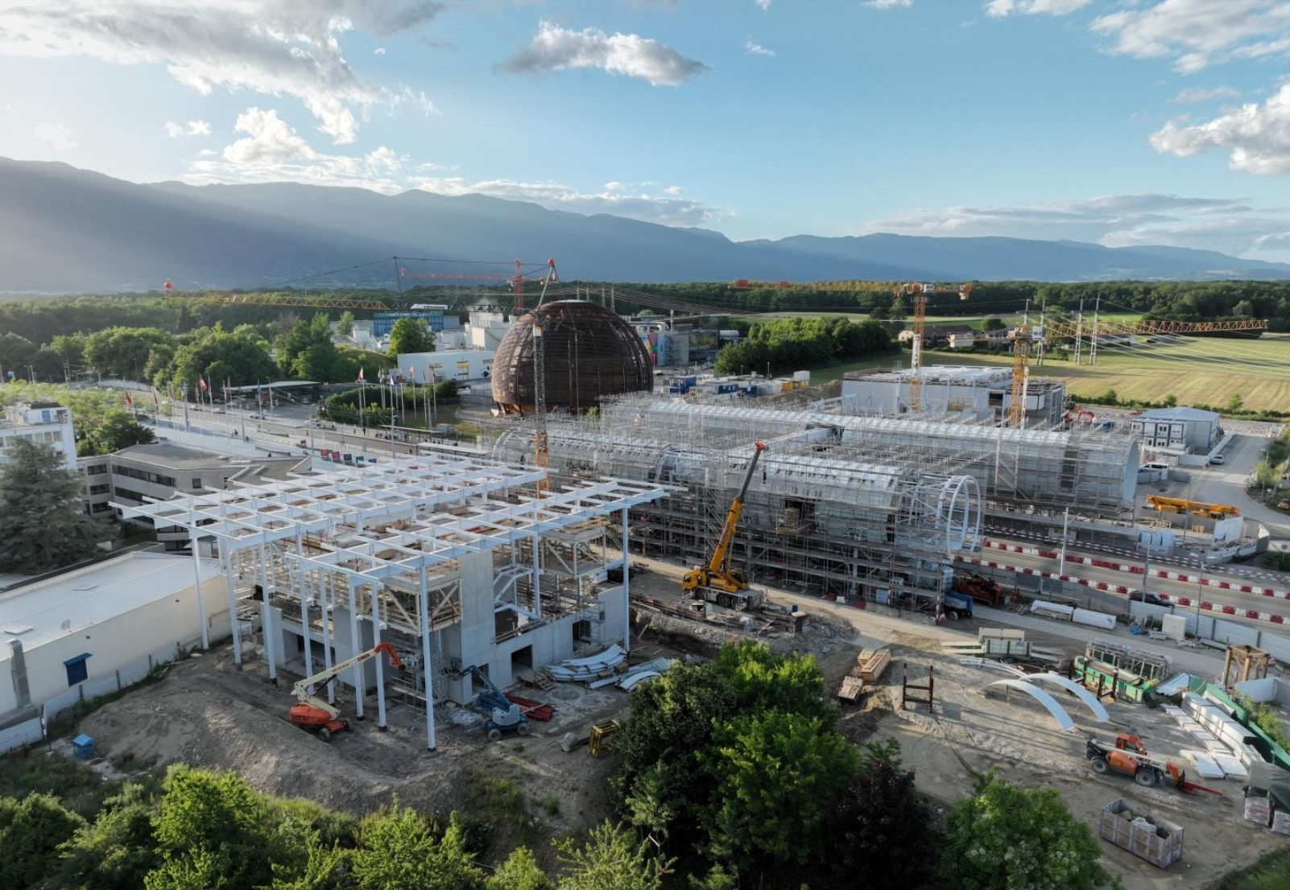
Science shows are widely used in informal learning contexts to communicate science
Science shows,
“done well, can lead to:
increased learning, improved cognitive and affective outcomes, and
behavioural changes”
(Austin and Sullivan, 2019)
In October 2023, CERN will open a new science centre, Science Gateway
Science centres “provide memorable learning which can have a lasting impact on attitudes and behaviour” and can “increase visitors’ knowledge and understanding of science” (Ecsite-uk, 2008).

Slide 3
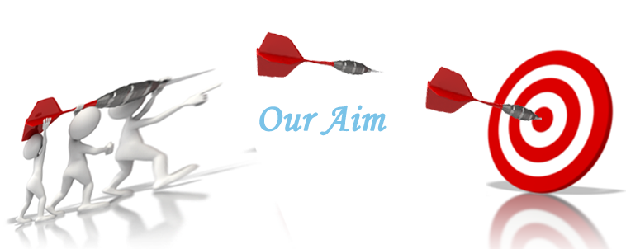

To maximise the potential of the science shows, it is necessary to:
Define the key aims
Evaluate effectiveness
Senior CERN employees
- 10 senior CERN employees, linked to Education and Outreach
Interviews with two expert groups
Science show presenters
- 10 expert practitioners from around the world
(Australia: 1; USA: 1; South Africa: 1; Switzerland: 1; UK:6
What do you consider to be the key aims of science shows?

Slide 4
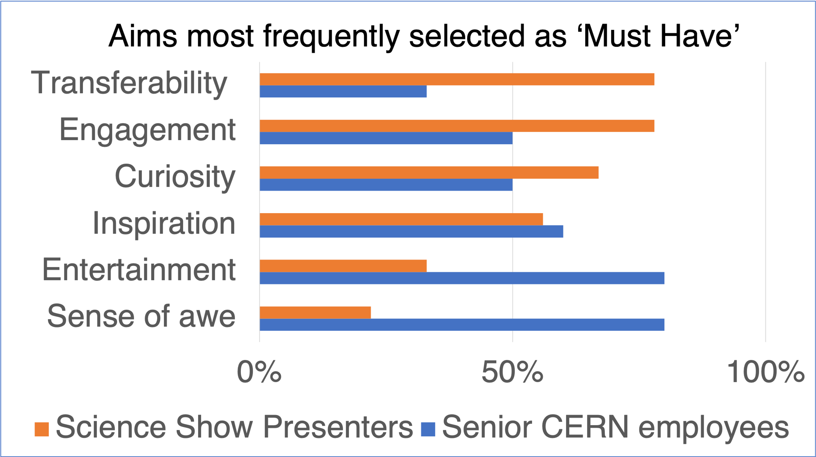
Participants prioritised 13 potential aims using a MoSCoW prioritisation grid
MoSCoW Prioritisation
Must have…
Should have…
Could have…
Would not have…
Transferability
Seeing science as relevant to everyday life

Slide 5
The preliminary results suggest that the two groups prioritise aims differently.
Science show presenters
Transferability
Engagement
Curiosity
Senior CERN employees
Sense of awe
Entertainment
…want to entertain the audience and provide a ‘wow’ factor
…want to engage the audience and show them how science relates to their everyday lives.
It's about this awe-inspiring experience
We try to have what I call an emotional ‘woah’, not just a visceral ‘wow’
I’m one who kind of flinches at the idea of being an entertainer
For me a show is a kind of like bang, pop, whiz, wow
It has to be entertaining to be engaging, and to initiate that curiosity and create the memory.
So entertainment is an ingredient that's essential to make it work.
The awe is something we feel a bit torn about because although it's a strong emotional hook, the risk [is that] if you're awe-inspired by something, it puts a gap between you and the thing

Slide 6
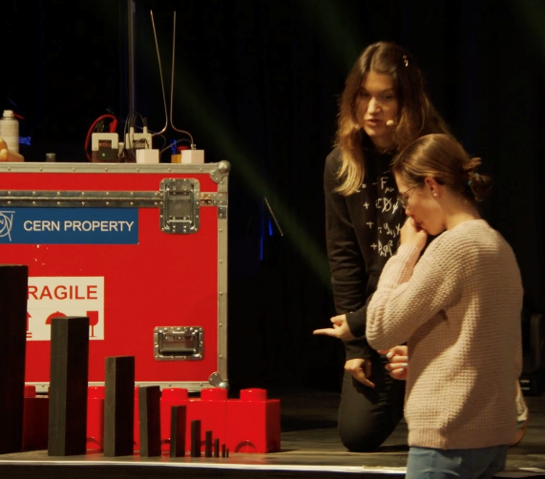
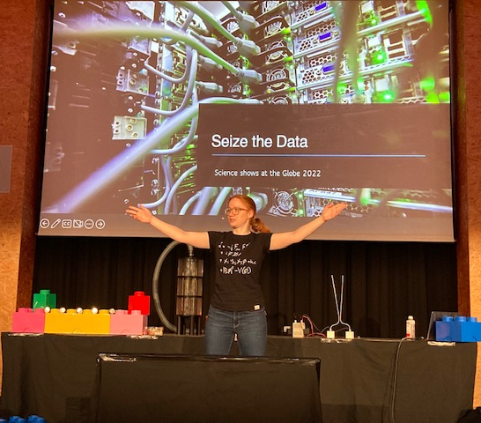
This research project will:
Inform the literature on the key aims of science shows
Increase the positive outcomes for audiences
pave the way for future evaluation of science shows
Thank you for listening

