Slide 1
Status report: D* analysis
Evaluate possible difference in the trigger efficiency between D* jets and QCD jets (if small, trigger efficiencies should cancel in the ratio)
Plot ratio R=N(D* jets)/N(QCD jets):
  Without any trigger requirement
  (MinBias stream, periods A-I, ~1nb⁻¹)
  Requiring L1_J5 || L1_J10 || L1_J15 jet triggers
  (L1Calo stream, periods A-D, ~314 nb⁻¹)
  Using Monte Carlo with and without jet triggers
    Dedicated JX samples with a D* filter for the numerator
    Standard JX samples for the denominator
Plot double ratio RR=R(w/ trigger)/R(w/o trigger) and compare data and Monte Carlo
Study ratio as a function of different kinematic variables such as:
z, jet p_{T}, jet eta and jet multiplicity

Slide 2
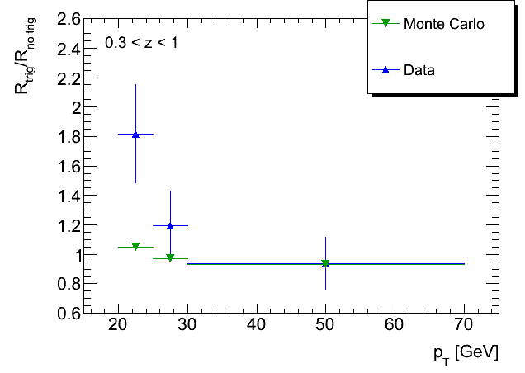
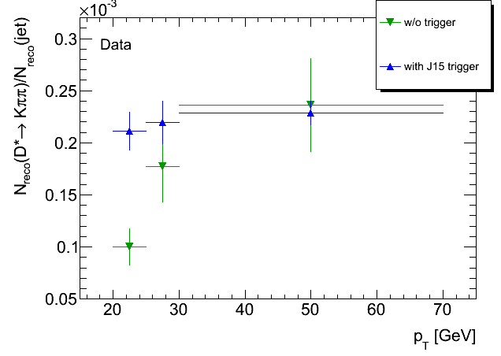
Status report: D* analysis
Preliminary results:
Next steps:
  Repeat plots not requiring L1_J15 in the first jet pT bin (20-25 GeV)
  Assign a systematic uncertainty

Slide 3
Status report: E/gamma trigger
Some savannah bugs assigned:
  https://savannah.cern.ch/bugs/?76867
  https://savannah.cern.ch/bugs/?77077
  https://savannah.cern.ch/bugs/?77111
Some pending software issues in the to do list:
  Store IsEM in AOD files
  Problem in the IDTrkNoCut chains
Shifts for tau/egamma combined trigger expert on call open in OTP

