Slide 1

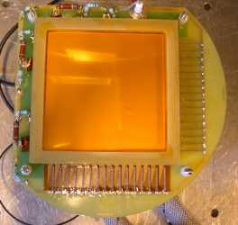
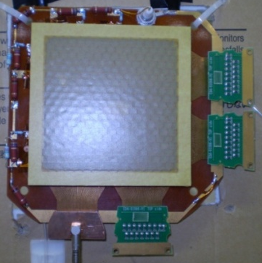
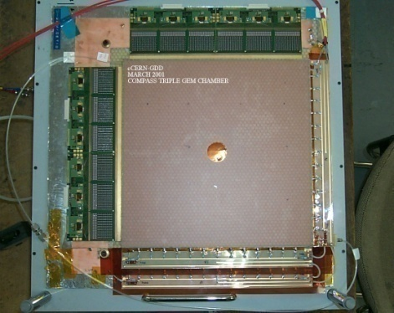
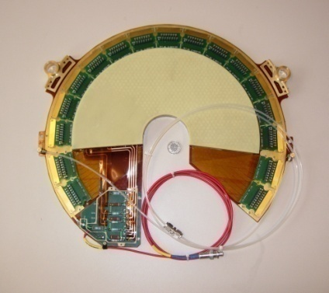
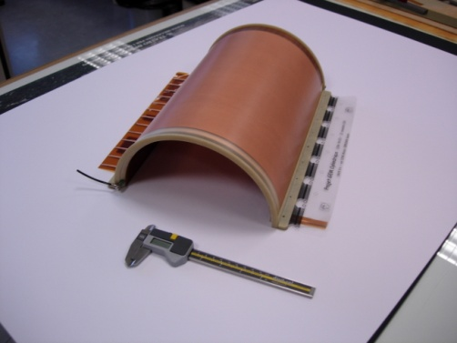
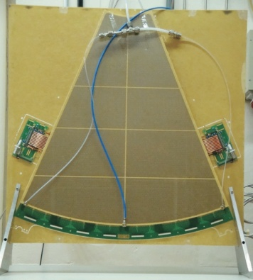
Gaseous Detectors
Introduction
Leszek Ropelewski CERN-PH-DT
10 cm
10 cm
33 cm
30 cm
20 cm
66 cm
Compass
Totem
NA61
Totem Upgrade

Slide 2
Outline
Gaseous Detectors
  Ionization of Gases
  Gas Amplification
  Single Wire Proportional Chamber
  Drift Chamber
  Drift and Diffusion of Charge Carriers in Gases
  Examples of Detectors (MWPC, CSC, RPC, TPC)
  New Technologies – Micropattern Detectors (MSGC, Micromegas, GEM)
  Limitations of Gas Detectors
  Gas Detectors Simulations
  Applications
  Production Aspects

Slide 3
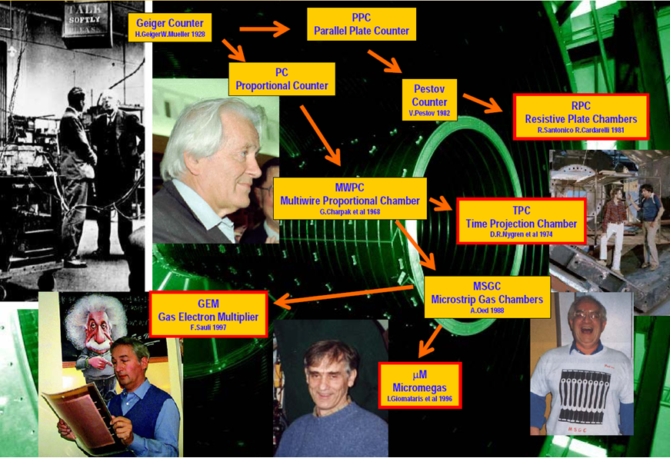
Gas Detectors History

Slide 4
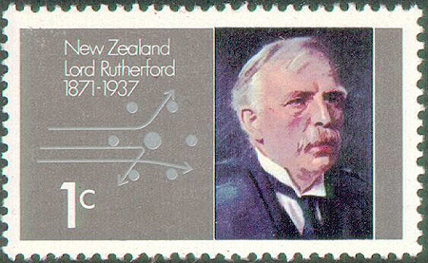
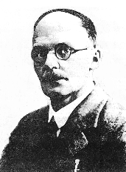
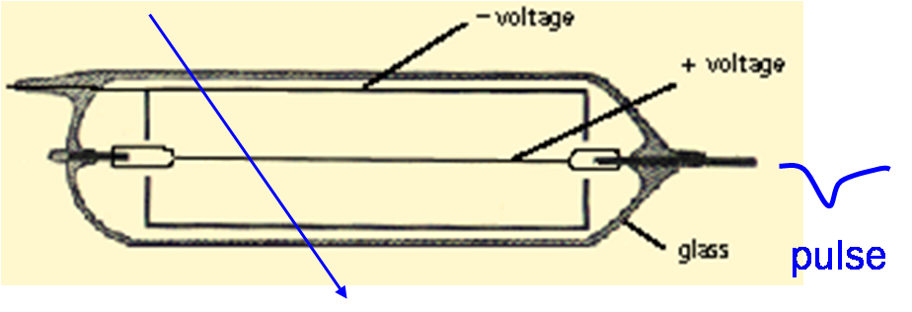
“Classic” Particle Detectors
The Geiger-Müller tube (1928 by Hans Geiger and Walther Müller)
  Tube filled with inert gas (He, Ne, Ar) + organic vapour
  Central thin wire (20 – 50 µm ∅) , high voltage (several 100 Volts) between wire and tube
  Strong increase of E-field close to the wire
    electron gains more and more energy
  above some threshold (>10 kV/cm)
    electron energy high enough to ionize other gas molecules
    newly created electrons also start ionizing
  avalanche effect: exponential increase of # electrons (and ions)
  measurable signal on wire
    organic substances responsible for “quenching” (stopping) the discharge
E. Rutherford 1909
H. Geiger 1927
E. Rutherford and H. Geiger, Proc. Royall Soc. A81 (1908) 141
First electrical signal from a particle
H. Geiger and W. Müller, Phys. Zeits. 29 (1928) 839

Slide 5
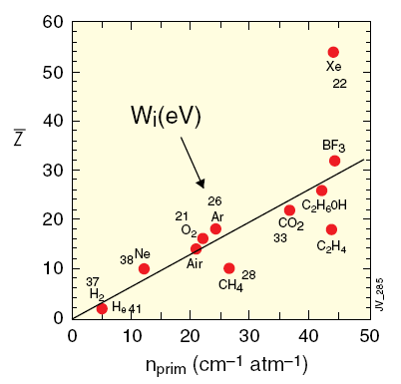
Ionization of Gases
Primary ionization
Total ionization
Lohse and Witzeling, Instrumentation In High
Energy Physics, World Scientific,1992
Fast charged particles ionize atoms of gas.
Often resulting primary electron will have
enough kinetic energy to ionize other atoms.
n_{total} - number of created
electron-ion pairs
ΔE = total energy loss
W_{i} = effective <energy loss>/pair
Number of primary electron/ion pairs in
frequently used gases.

Slide 6
Ionization of Gases
The actual number of primary electron/ion pairs is Poisson distributed.
The detection efficiency is therefore limited to :
For thin layers ε_{det} can be significantly lower than 1.
For example for 1 mm layer of Ar n_{primary}= 2.5 → ε_{det} = 0.92 .
100 electron/ion pairs created during ionization process is not easy to detect.
Typical noise of the amplifier ≈ 1000 e⁻ (ENC) → gas amplification .

Slide 7
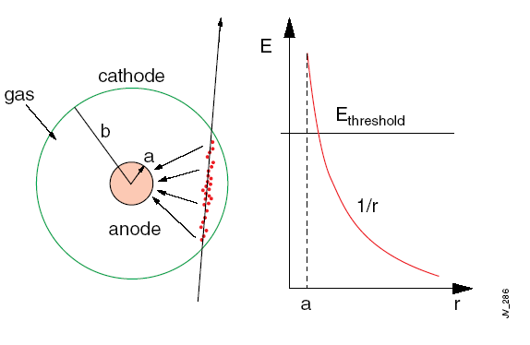
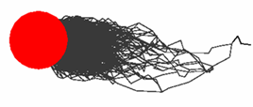
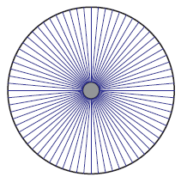
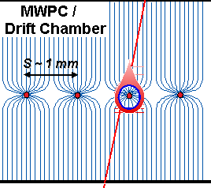
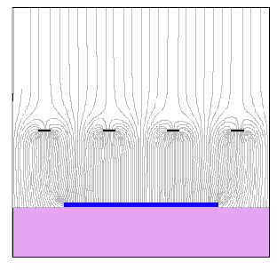
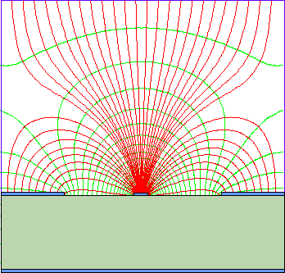
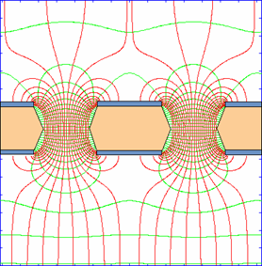
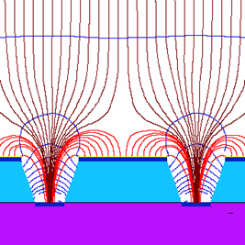
Single Wire Proportional Chamber
Electrons liberated by ionization drift towards
the anode wire.
Electrical field close to the wire (typical wire Ø
~few tens of μm) is sufficiently high for electrons
(above 10 kV/cm) to gain enough energy to ionize
further → avalanche – exponential increase of
number of electron ion pairs.
anode
C – capacitance/unit length
e⁻
primary electron
Cylindrical geometry is not the only one able to generate strong electric field:
wire
mwpc
parallel plate
strip
hole
groove/well

Slide 8
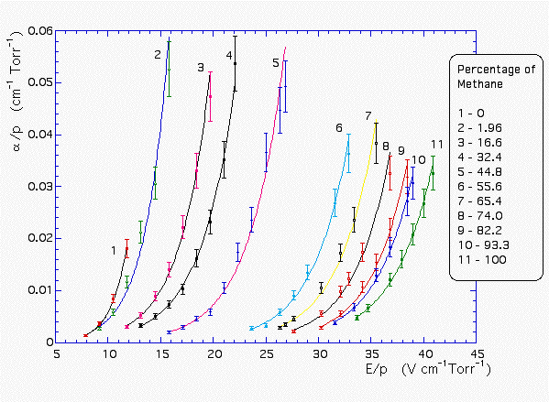
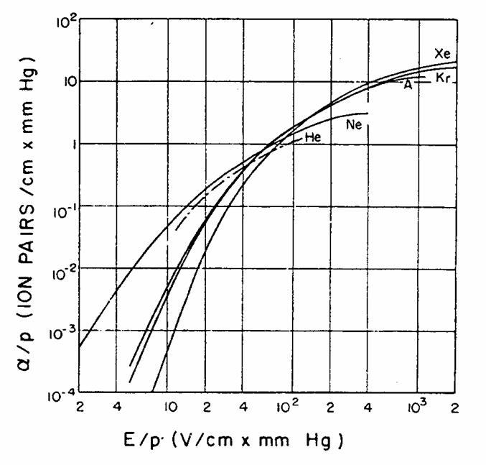
Single Wire Proportional Chamber
Multiplication of ionization is described by
the first Townsend coefficient α(Ε)
Ar-CH₄
dn = nαdx
λ – mean free path
α(Ε) is determined by the excitation and
ionization cross sections of the electrons
in the gas.
It depends also on various and complex
energy transfer mechanisms between gas molecules.
There is no fundamental expression
for α(Ε) → it has to be measured for every
gas mixture.
A. Sharma and F. Sauli, NIM A334(1993)420
Amplification factor or
Gain
S.C. Brown, Basic data of plasma physics (MIT Press, 1959)

Slide 9
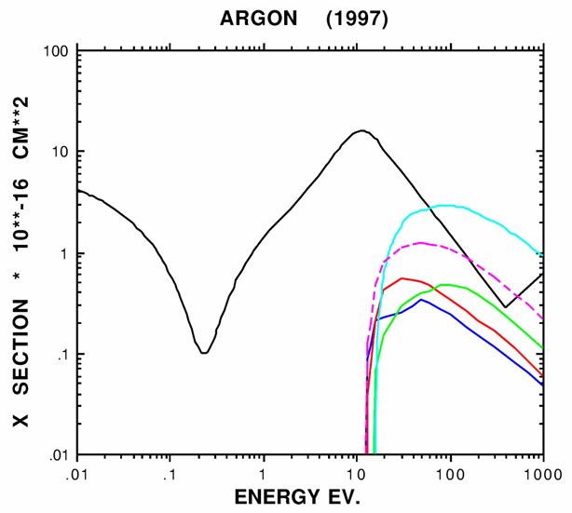
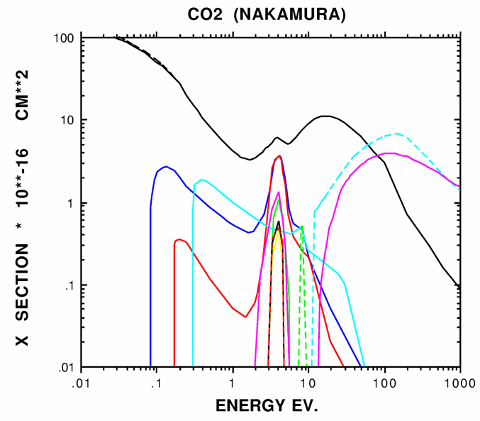
SWPC – Choice of Gas
In the avalanche process molecules of the
gas can be brought to excited states.
Solution: addition of polyatomic gas as a
quencher
S. Biagi, NIM A421 (1999) 234
Absorption of photons in a large energy
range (many vibrational and rotational
energy levels).
ELASTIC
IONIZATION
SUM OF EXCITATION
Energy dissipation by collisions or
dissociation into smaller molecules.
S. Biagi, NIM A421 (1999) 234
ELASTIC
De-excitation of noble gases
only via emission of photons;
e.g. 11.6 eV for Ar.
This is above ionization
threshold of metals;
e.g. Cu 7.7 eV.
IONIZATION
vibrational levels
excitation levels
new avalanches → permanent discharges

Slide 10
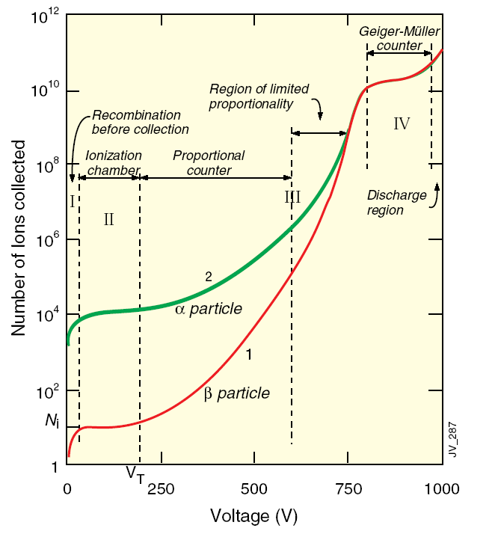
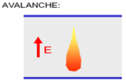
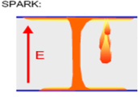
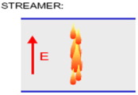
SWPC – Operation Modes
no collection – ions recombine before collection
ionization mode – full charge collection, but no charge multiplication; gain ~ 1
proportional mode – multiplication of ionization starts; detected signal proportional to original ionization → possible energy measurement (dE/dx); secondary avalanches have to be quenched; gain ~ 10⁴ – 10⁵
limited proportional mode (saturated, streamer) –strong photoemission; secondary avalanches merging with original avalanche; requires strong quenchers or pulsed HV; large signals → simple electronics; gain ~ 10¹⁰
Geiger mode – massive photoemission; full length of the anode wire affected; discharge stopped by HV cut; strong quenchers needed as well
High Voltage

Slide 11
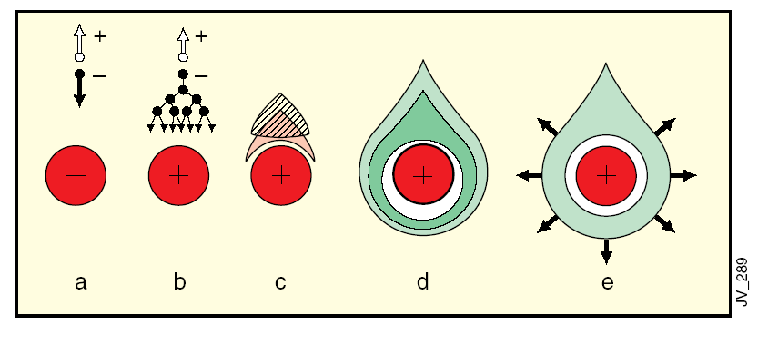
SWPC – Signal Formation
Avalanche formation within a few
wire radii and within t < 1 ns.
Signal induction both on anode and
cathode due to moving charges
(both electrons and ions).
+
+
-
+
-
50 ns
v(t)
Electrons collected by the anode wire i.e. dr is
very small (few μm). Electrons contribute only
very little to detected signal (few %).
Ions have to drift back to cathode i.e. dr is large
(few mm). Signal duration limited by total ion drift
time.
100 ns
300 ns
0
100
200
300
400
500
Need electronic signal differentiation to limit dead time.
t (ns)

Slide 12

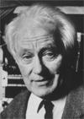
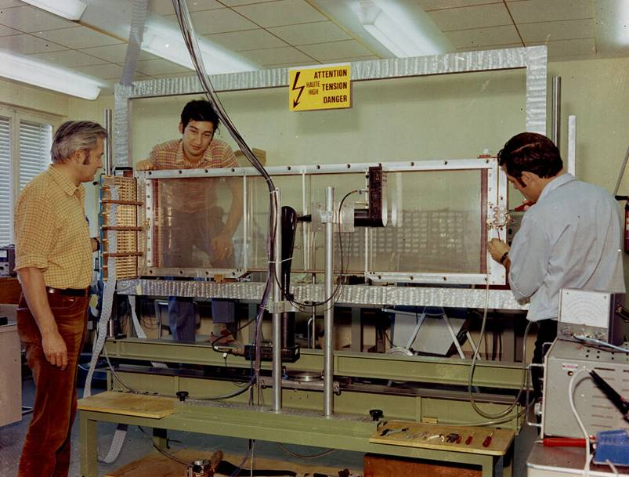
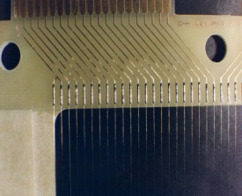
Multiwire Proportional Chamber
Simple idea to multiply SWPC cell : Nobel Prize 1992
First electronic device allowing high statistics experiments !!
d ~ 1 mm
Georges Charpak
Typical geometry
5mm, 1mm, 20 μm
Normally digital readout :
spatial resolution limited to
for d = 1 mm σ_{x} = 300 μm
G. Charpak, F. Sauli and J.C. Santiard

Slide 13
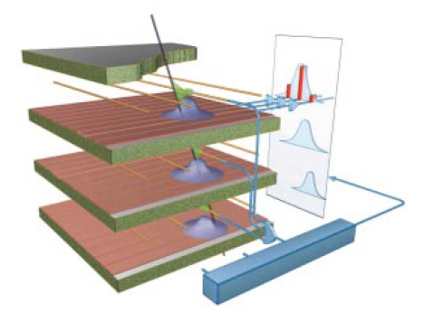
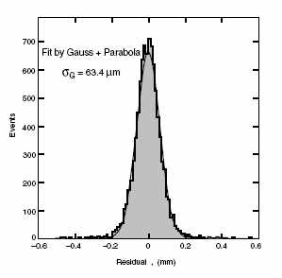
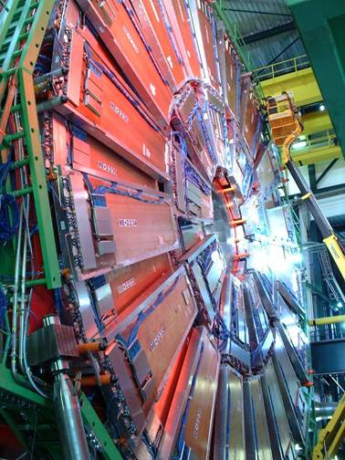
CSC – Cathode Strip Chamber
Precise measurement of the second coordinate
by interpolation of the signal induced on pads.
Closely spaced wires makes CSC fast detector.
σ = 64 μm
Center of gravity of induced
signal method.
Space resolution
CMS

Slide 14
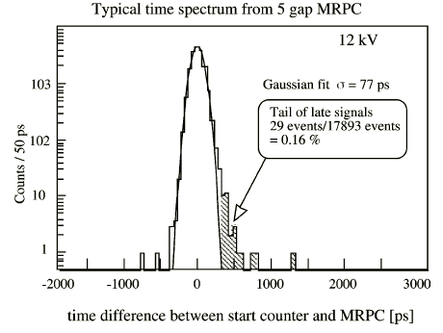
RPC – Resistive Plate Chamber
useful gap
readout strips
HV
Rate capability strong function of the resistivity
of electrodes in streamer mode.
resistive electrode
gas gap
2 mm
A. Akindinov et al., NIM A456(2000)16
resistive electrode
GND
readout strips
σ = 77 ps
MRPC
HV
GND
Multigap RPC - exceptional time resolution
suited for the trigger applications
Time resolution

Slide 15
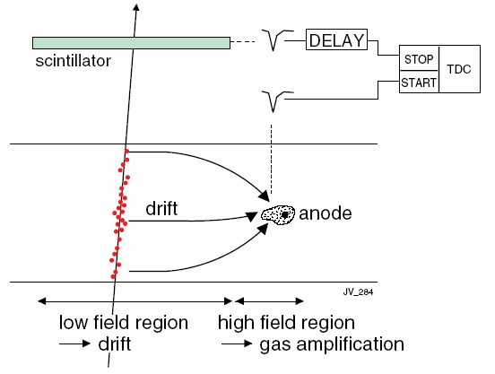
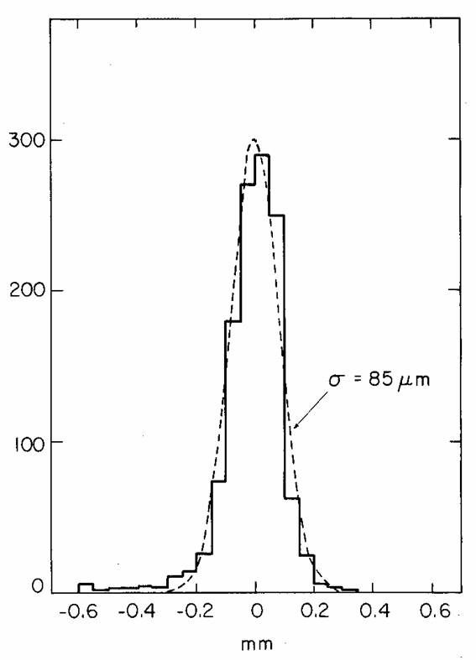
Drift Chambers
Spatial information obtained by measuring time of drift of electrons
Measure arrival time of electrons at sense
wire relative to a time t₀.
Need a trigger (bunch crossing or scintillator).
Drift velocity independent from E.
F. Sauli, NIM 156(1978)147
Advantages: smaller number of electronics channels.
Resolution determined by diffusion,
primary ionization statistics, path
fluctuations and electronics.

Slide 16
Drift Chambers
Planar drift chamber designs
Essential: linear space-time relation; constant E-field; little dpendence of v_{D} on E.
U. Becker in Instrumentation in High Energy Physics, World Scientific

Slide 17
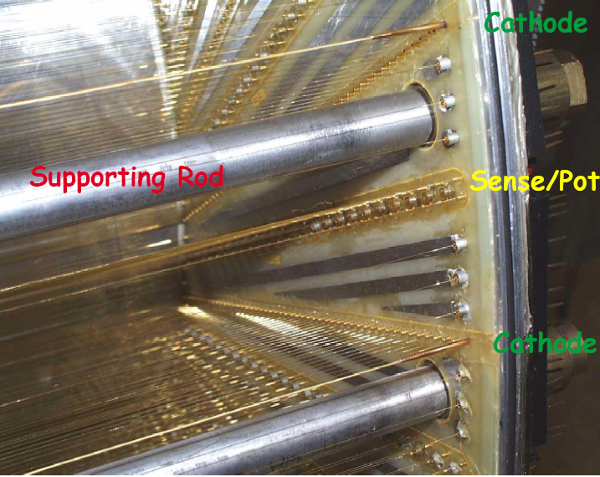
Drift Chambers
Various geometries of cylindrical drift chambers

Slide 18
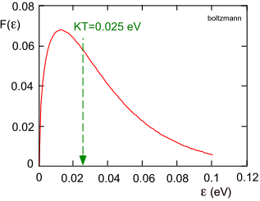
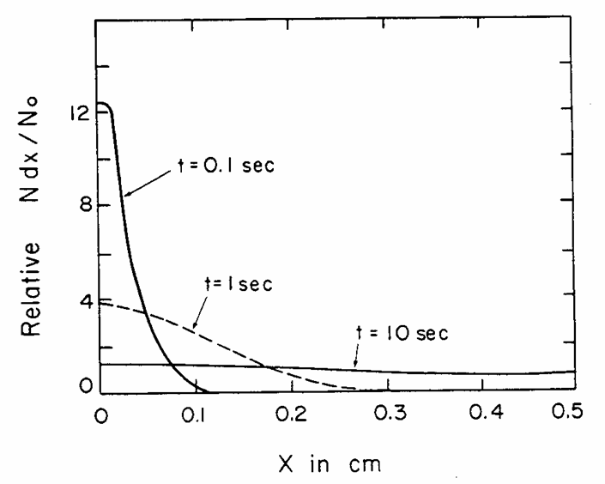
Diffusion of Free Charges
F. Sauli, IEEE Short Course on Radiation Detection and Measurement,
Norfolk (Virginia) November 10-11, 2002
Free ionization charges lose energy in collisions
with gas atoms and molecules (thermalization).
Maxwell - Boltzmann energy distribution:
Average (thermal) energy:
Diffusion equation:
Fraction of free charges at distance x after time t.
ions in air
D: diffusion coefficient
RMS of linear diffusion:
L.B. Loeb, Basic processes of gaseous electronics
Univ. of California Press, Berkeley, 1961

Slide 19

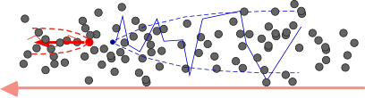
Drift and Diffusion in Presence of E field
E=0 thermal diffusion
A⁺
e⁻
E>0 charge transport and
diffusion
Electric Field
Electron swarm drift
Drift velocity
Δs, Δt
s
Diffusion

Slide 20
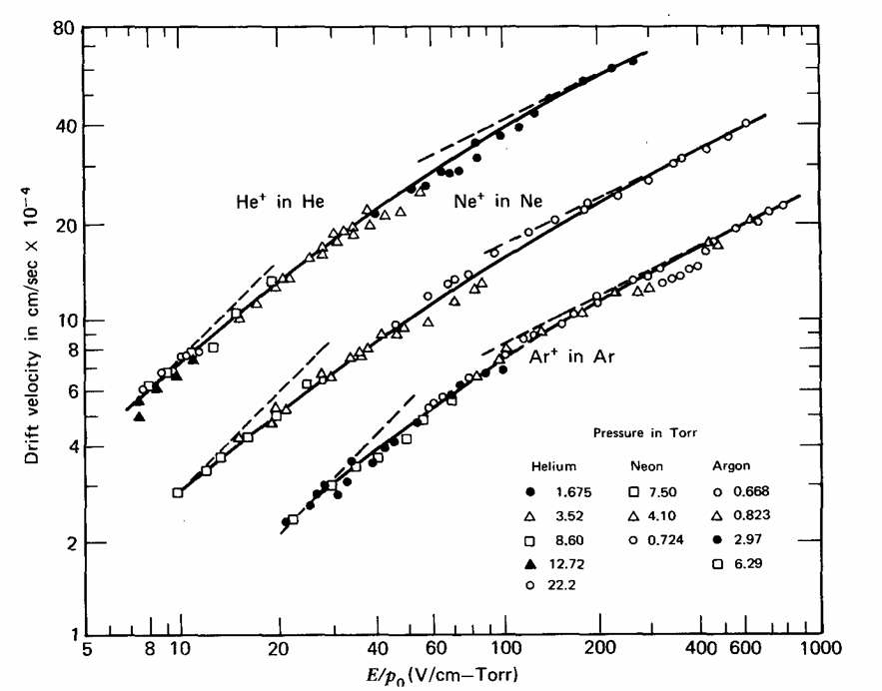
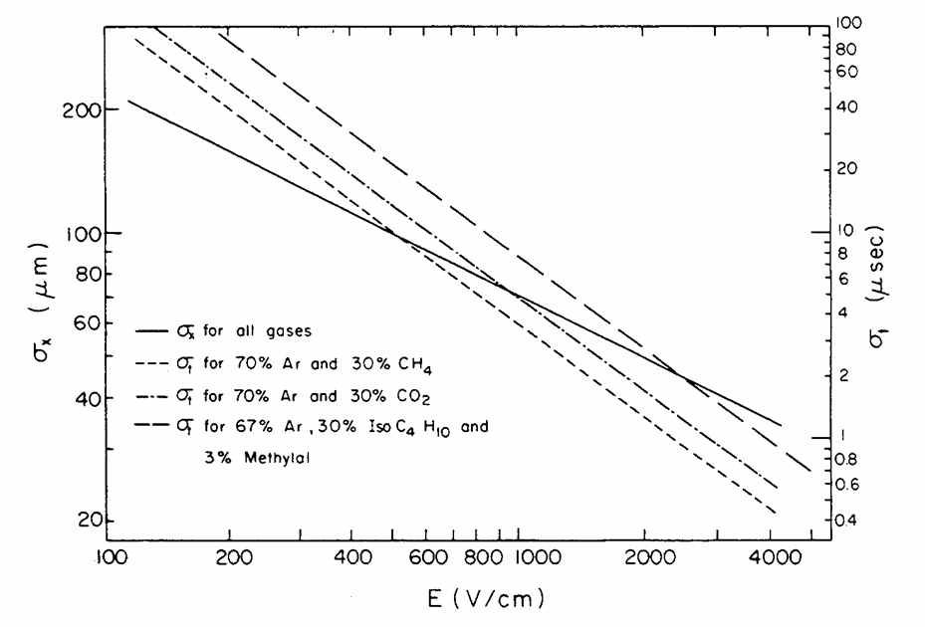
Drift and Diffusion of Ions in Presence of E Field
Drift velocity of ions
is almost linear function of E
He
Ne
Mobility:
is
Ar
constant for given gas at fixed P and T,
direct consequence of the fact that
average energy of ion is unchanged
up to very high E fields.
Drift velocity of ions
E. McDaniel and E. Mason
The mobility and diffusion of ions in gases, Wiley 1973
Diffusion of ions
E/p (V/cm/torr)
from microscopic picture can be shown:
σ_{x} (μm)
→
thermal limit
the same for all gases !!
E (V/cm)

Slide 21
Simplified Electron Transport Theory
Townsend expression;
acceleration in the field times time between collisions
balance between energy acquired from the field and collision losses
number of collisions;
fractional energy loss per collision
part of equilibrium energy not containing thermal motion
time between collisions;
instantaneous velocity
total energy
λ(ε)
σ(ε)
ε
ε
B. Schmidt, thesis, unpublished, 1986

Slide 22
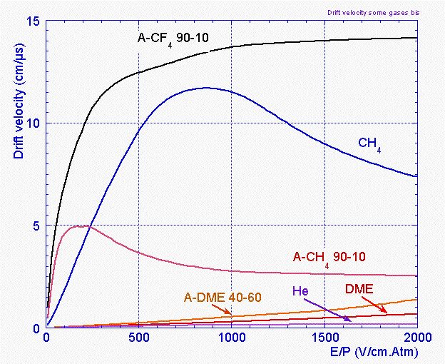
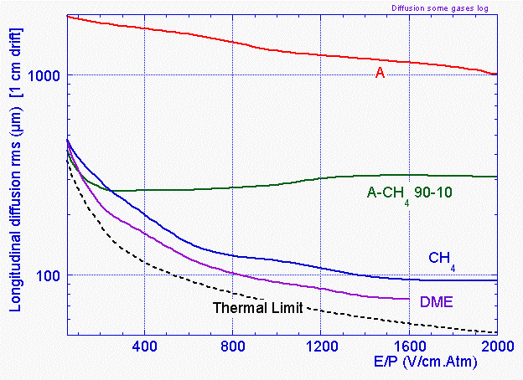
Drift and Diffusion of Electrons in Gases
Large range of drift velocity and diffusion:
F. Sauli, IEEE Short Course on Radiation Detection and Measurement, Norfolk (Virginia) November 10-11, 2002

Slide 23
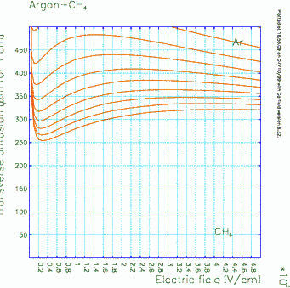
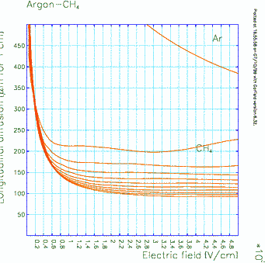
Diffusion Electric Anisotropy
σ_{T}
Influence of gas mixture composition on two diffusion coefficients
E Field
σ_{L}
Drift
Longitudinal diffusion ( µm for 1 cm drift)
Transverse diffusion ( µm for 1 cm drift)
E (V/cm)
E(V/cm)
S. Biagi http://consult.cern.ch/writeup/magboltz/

Slide 24
Drift in Presence of E and B Fields
Equation of motion of free charge carriers in presence of E and B fields:
where
stochastic force resulting from collisions
Time averaged solutions with assumptions:
;
friction force
τ mean time between collisions
mobility
cyclotron frequency
B=0 →
→
→
In general drift velocity has 3 components:
Lorentz angle
particles follow E-field
particles follow B-field

Slide 25
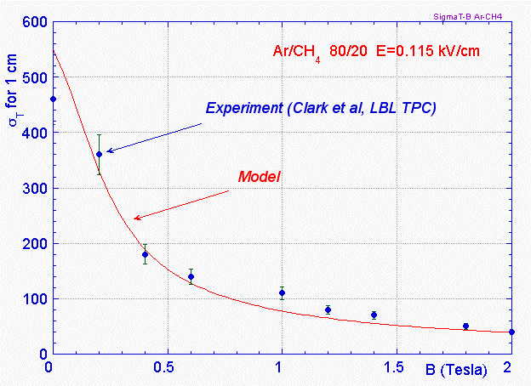
Diffusion Magnetic Anisotropy
σ
T
σ
L
r
B
F. Sauli, IEEE Short Course on Radiation Detection and Measurement, Norfolk (Virginia) November 10-11, 2002

Slide 26
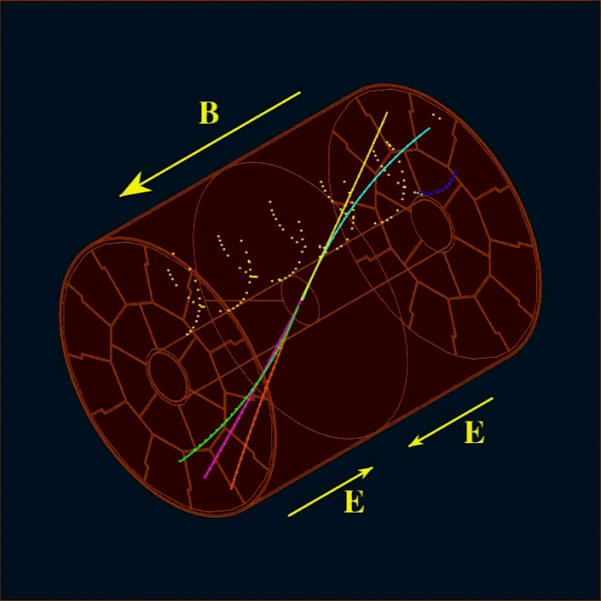
TPC – Time Projection Chamber
neg. high voltage plane
particle track
E
liberated e⁻
Z (e⁻drift time)
gating plane
cathode plane
Y
anode plane
pads
Time Projection Chamber
full 3D track reconstruction: x-y from wires and segmented cathode of MWPC (or MPGD); z = v_{drift} x t_{drift} from drift time
momentum resolution
space resolution + B field
(multiple scattering)
energy resolution
measurement of primary ionization
X
Induced charge on the plane

Slide 27
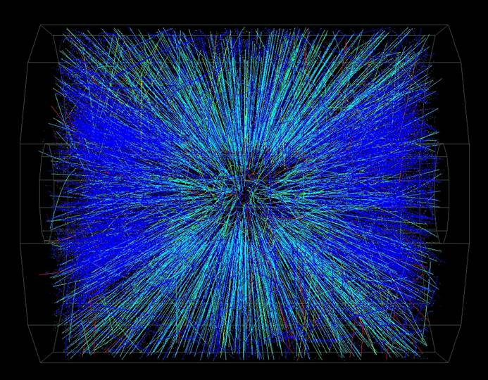


TPC – Time Projection Chamber
E
E
E
E
88µs
560
cm
520 cm
Alice TPC
HV central electrode at –100 kV
Drift lenght 250 cm at E=400 V/cm
Gas Ne-CO₂ 90-10
Space point resolution ~500 μm
dp/p 2%@1GeV; 10%@10GeV
Events from STAR TPC at RHIC
Au-Au collisions at CM energy of 130 GeV/n
Typically ~2000 tracks/event

Slide 28


TPC – Time Projection Chamber
Positive ion backflow modifies electric field resulting in track distortion.
Solution : gating (or GEM)
Prevents electrons to enter amplification region in case of uninteresting event;
Prevents ions created in avalanches to flow back to drift region.
gate open
gate closed
gating plane
cathode plane
anode wires
readout pads
ALEPH coll., NIM A294(1990)121

Slide 29





TPC – Time Projection Chamber
PEP4 (SLAC)
STAR (LBL)
ALEPH (CERN)
DELPHI (CERN)
TOPAZ (KEK)

Slide 30


Micropattern Gas Detectors
Advantages of gas detectors:
low radiation length
large areas at low price
flexible geometry
spatial, energy resolution …
Problem:
rate capability limited by space charge defined by
the time of evacuation of positive ions
Solution:
reduction of the size of the detecting cell (limitation
of the length of the ion path) using chemical
etching techniques developed for microelectronics
and keeping at same time similar field shape.
scale factor
MWPC
1
MSGC
5
MGC
10
R. Bellazzini et al.

Slide 31






Current Trends in Micro-Pattern Gas Detectors (Technologies)
Semiconductor Industry technology:
Photolithography
Etching
Coating
Doping
Amplifying cell
reduction by
factor of 10
Operational instabilities:
Substrate charging-up
Discharges
Polymer deposition (ageing)
Rate Capability>10⁶/mm²
Position Resolution ~40μm
2-track Resolution ~400μm
MWPC
MSGC

Slide 32





MSGC – MicroStrip Gas Chamber
Thin metal anodes and cathodes on
insulating support (glass, flexible polyimide ..)
Problems:
High discharge probability under exposure
to highly ionizing particles caused by the
regions of very high E field on the border
between conductor and insulator.
Charging up of the insulator and modification
of the E field → time evolution of the gain.
Anton Oed
200 μm
insulating support
slightly conductive support
Solutions:
slightly conductive support
multistage amplification
R. Bellazzini et al.

Slide 33




MSGC – MicroStrip Gas Chamber
Surface charging
Bulk resistivity of the support material
Surface modification by doping or deposition
Ageing
Gas, Gas system, MSGC support, Construction material
Discharges

Slide 34


MSGC – MicroStrip Gas Chamber
MSGC: Discharge mechanisms
Electric field strength close to support plane in MSGC
Field emission from the cathode edge
Charge pre-amplification for ionization
released in high field close to cathode
Coated MSGC
Uncoated MSGC
Surface resistivity modification
Very high ionization release:
avalanche size exceeds Reather’s limit
Q ~ 10⁷

Slide 35


MSGC – MicroStrip Gas Chamber
Cathode edge passivation
Advanced passivation
Standard passivation
Bellazzini et al.

Slide 36


MSGC – MicroStrip Gas Chamber
Energy resolution ~11% for 5.9 keV
Single event wire map
Ne(25)-DME(75)
Vcath= -530 V
Vdrift= -3000 V
Surface resistivity !!
Spatial resolution = 34.5 ± 0.4 μm
2-track resolution ~400 μm
Rate capability > 1 MHz/mm²

Slide 37





Micromegas – Micromesh Gaseous Structure
Micromesh mounted above readout
structure (typically strips).
E field similar to parallel plate detector.
E_{a}/E_{i} ~ 50 to secure electron transparency
and positive ion flowback supression.
100 μm
E_{i}
Ioannis Giomataris
E_{a}
Y.Giomataris et al, NIM A 376 (1996) 29

Slide 38



Micromegas – Micromesh Gaseous Structure
gain
efficiency & discharge probability
10⁻⁴
gain
1
0.9
10⁻⁵
10⁵
10⁵
efficiency
discharge probability
10⁻⁶
10⁴
0.8
0.7
10⁻⁷
10³
10⁻⁸
0.6
10²
350
400
450
500
550
600
650
High Voltage [V]
High voltage [V]
energy resolution ~ 10%
ageing:Ar-iC₄H₁₀ 94-6% up to 24.3mC/mm²
1
0.8
0.6
0.4
0.2
⁵⁵ Fe
Ar + 10% C₄H₁₀
1.8*10¹² particles/mm²
10 years LHC
1000 10000 20000 30000 time[min]
D.Thers et al NIM A 469 (2001) 133

Slide 39




Micromegas – Micromesh Gaseous Structure
σ =70 µm
420 V operating point
~3-4.10³ Gain
Large efficiency plateau > 40 V
Spatial resolution < 70 µm
σ = 9 ns
300mm
Time resolution : 9 ns
D.Thers et al NIM A 469 (2001) 133

Slide 40





GEM – Gas Electron Multiplier
Ions
I⁺
e⁻
40 %
Induction gap
60 %
e⁻
5 µm
50 µm
Electrons
55 µm
70 µm
Fabio Sauli
Thin, metal coated polyimide foil perforated
with high density holes.
Electrons are collected on patterned readout board.
A fast signal can be detected on the lower GEM electrode
for triggering or energy discrimination.
All readout electrodes are at ground potential.
Positive ions partially collected on the GEM electrodes.

Slide 41







GEM – Gas Electron Multiplier
Full decoupling of the charge amplification
structure from the charge collection and
readout structure.
Both structures can be optimized
independently !
Cartesian
Compass, LHCb
A. Bressan et al, Nucl. Instr. and Meth. A425(1999)254
Small angle
33 cm
Hexaboard, pads
MICE
Compass
Totem
Both detectors use three GEM foils in cascade for amplification
to reduce discharge probability by reducing field strenght.
Mixed
Totem

Slide 42






GEM – Gas Electron Multiplier
9.7 ns
5.3 ns
4.5 ns
4.8 ns
Time resolution
Charge corellation (cartesian readout)

Slide 43




GEM – Gas Electron Multiplier
3.10⁶ particles/mm²
Efficiency for minimum ionizing particles with 3 mm gap
A. Bressan et al, Nucl. Instr. And Meth. A425(1999)262
Rate capability > 10⁶ Hz mm⁻²
GAIN ~ 10⁴
Ar-CO₂ 70-30
1 mC~2.10¹⁰ min.ion. particles
Space resolution ~ 40 μm rms
Cluster size ~ 500 μm FWHM
C. Altunbas et al, DESY Aging Workshop (Nov. 2001) Nucl. Instr. and Meth. A
J. Benlloch et al, IEEE NS-45(1998)234

Slide 44







Current Trends in Micro-Pattern Gas Detectors (Technologies)
MSGC
Micromegas
GEM
Thick-GEM, Hole-Type Detectors and RETGEM
MPDG with CMOS pixel ASICs
Ingrid Technology
0.18 μm CMOS VLSI
CMOS high density
readout electronics
Ions
40 %
60 %
Electrons
Micromegas
GEM
THGEM
MHSP
Ingrid

Slide 45



Current Trends in Micro-Pattern Gas Detectors (Performance)
GEM
THGEM
Rate Capability
High Gain
Space Resolution
Time Resolution
Energy Resolution
Ageing Properties
Ion Backflow Reduction
Photon Feedback Reduction
2x10⁶ p/mm²
Micromegas
GEM
Ar/CO2/CF4
(45/15/40)
rms = 4.5ns
Spatial
resolution
σ ~ 12 mm
MHSP
Micromegas
Micromegas

Slide 46










Development of large-area MPGDs
Bulk Micromegas
Single mask GEM
THGEM
Ions
40 %
60 %
Electrons
Notes:
46

Slide 47





Development of large-area Micro-Pattern Gas Detectors
Bulk Micromegas
Single mask GEM
Read-out board
Laminated Photo-image-able cover lay
Raw material
Stretched mesh
on frame
Single side copper patterning
frame
Laminated Photo-image-able cover lay
Polyimide etching
Copper reduction

Slide 48




Limitations of Gas Detectors
Classical ageing
Avalanche region → plasma formation
(complicated plasma chemistry)
Dissociation of detector gas and pollutants
Highly active radicals formation
Polymerization (organic quenchers)
Insulating deposits on anodes and cathodes
Anode: increase of the wire
diameter, reduced and variable
field, variable gain and energy
resolution.
Cathode: formation of strong
dipoles, field emmision and
microdischarges (Malter effect).

Slide 49
Limitations of Gas Detectors
Solutions: carefull material selection for the detector construction and gas system,
detector type (GEM is resitant to classical ageing), working point,
non-polymerizing gases, additives supressing polymerization (alkohols, methylal),
additives increasing surface conductivity (H₂O vapour), clening additives (CF₄).
Creation of database of "radiation-hard" materials &
detectors depending on application, commercially available materials
Low Outgassing room-T epoxies
Outgassing room-T epoxies

Slide 50


Limitations of Gas Detectors
Discharges
Field and charge density dependent effect.
Solution: multistep amplification
resistive electrodes
Insulator charging up resulting in gain variable with time and rate
Solution: slightly conductive materials

Slide 51
Computer Simulations
MAXWELL (Ansoft)
electrical field maps in 2D& 3D, finite element calculation for arbitrary electrodes & dielectrics
HEED (I.Smirnov)
energy loss, ionization
MAGBOLTZ (S.Biagi)
electron transport properties: drift, diffusion, multiplication, attachment
Garfield (R.Veenhof)
fields, drift properties, signals (interfaced to programs above)
PSpice (Cadence D.S.) electronic signal

Slide 52


Computer Simulations
Input: detector geometry, materials and elctrodes potentials, gas cross sections.
Maxwell
Magboltz
GEM
Field Strenght
Townsend coefficient
P. Cwetanski, http://pcwetans.home.cern.ch/pcwetans/

Slide 53


Computer Simulations
Magboltz
Magboltz
Longitudinal, transverse diffusion
Drift velocity
P. Cwetanski, http://pcwetans.home.cern.ch/pcwetans/

Slide 54


Computer Simulations
P. Cwetanski, http://pcwetans.home.cern.ch/pcwetans/
R. Veenhof – CERN detector seminar
Garfield
Garfield
Micromegas
CSC-microtracking in Garfield
Positive ion backflow
Conclusion: we don’t need to built detector to know its performance

Slide 55




Detector design optimization, fabrication methods and new geometries
THGEM Example
Drilling + chemical rim etching without mask
Mask etching + drilling; rim = 0.1mm
10⁴
6 keV X-ray
pitch = 1 mm; diameter = 0.5 mm;
rim=40; 60; 80; 100; 120 μm

Slide 56



GEM charging up simulations
G. Croci (CERN) - 3rd RD51 collaboration meeting - Crete - 16-17 June 2009

Slide 57

Micromegas Electron Transparency : Simulation vs Measurements
S_{Total}
S_{Drift}
S_{Amplification}
P(e-collection) = S_{Drift} / S_{Total}
=S_{Amplification} × Field-Ratio / S_{Total}
~ (hole diameter)²
~ (wires pitch)²
Efficiency decrease starts at same drift field with the data ( Ea/Ed ~ 55 )
- Predicted efficiency in the falling slope within 10% from the measurement

Slide 58
Gas Detectors in LHC Experiments
ALICE: TPC (tracker), TRD (transition rad.), TOF (MRPC), HMPID (RICH-pad chamber),
Muon tracking (pad chamber), Muon trigger (RPC)
ATLAS: TRD (straw tubes), MDT (muon drift tubes), Muon trigger (RPC, thin gap chambers)
CMS: Muon detector (drift tubes, CSC), RPC (muon trigger)
LHCb: Tracker (straw tubes), Muon detector (MWPC, GEM)
TOTEM: Tracker & trigger (CSC , GEM)

Slide 59









Current Trends in Micro-Pattern Gas Detectors (Applications)
High-Rate Particle Tracking and Triggering
Time Projection Chamber Readout
Photon Detectors for Cherenkov Imaging Counters
X-Ray Astronomy
Neutron Detection and Low Background Experiments
Cryogenic Detectors
Medical Applications
Homeland Security and Prevention of Planetary Disasters
Tracking - Micromegas
TPC readout - GEM
UV photon detection - GEM
Neutron detection - GEM
Radiography - GEM

Slide 60












Production Aspects
Detector Design
Services
and Connectivity
Soldering
Bonding
ZIF connectors
Soldering

Slide 61




















Production Aspects
Component Production
Infrastructure
and Assembly Tools

Slide 62











Production Aspects
Component Quality Control
APV
VFAT
GP5
ALTRO
MEDIPIX
Electronics
PANalytical
3M
TechEtch
Techtra
Centronic
G&A
Industrialization

Slide 63
Acknowledgments
F. Sauli, IEEE Short Course on Radiation Detection and Measurement, Norfolk (Virginia)
November 10-11, 2002
C. Joram, CERN Academic Training, Particle Detectors 1998
P. Cwetanski , http://pcwetans.home.cern.ch/pcwetans/
M. Hoch, Trends and new developments in gaseous detectors, NIM A535(2004)1-15
Literature:
F. Sauli, Principlies of operation of multiwire proportional and drift chambers, CERN 77-09
W. Blum and L. Rolandi, Particle Detection with Drift Chambers, Springer 1994
C. Grupen, Particle Detectors, Cambridge University Press, 1996
F. Sauli and A. Sharma, Micropattern Gaseous Detectors, Annu. Rev. Nucl. Part. Sci. 1999.49:341-88
http://gdd.web.cern.ch/GDD/

