Slide 1
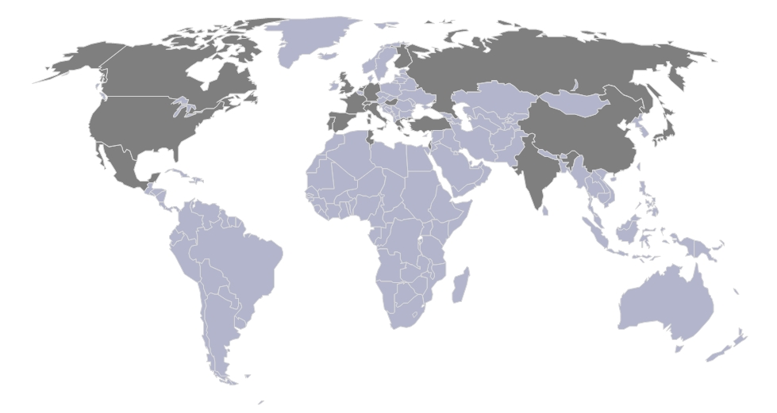
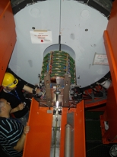
Recent Developments of Gaseous Detectors
and MPGDs
Leszek Ropelewski
RD51 & CERN – PH - DT
RD51 Collaboration Site
MPGD2009 (12-17 June 2009)
RICH2010, Cassis, 4th May2010

Slide 2
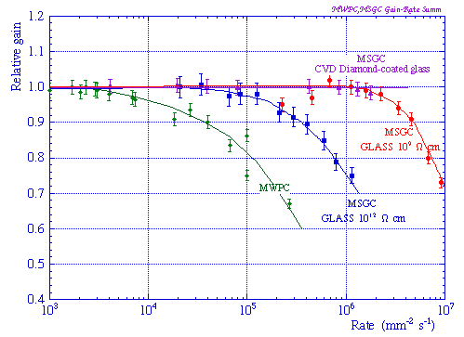
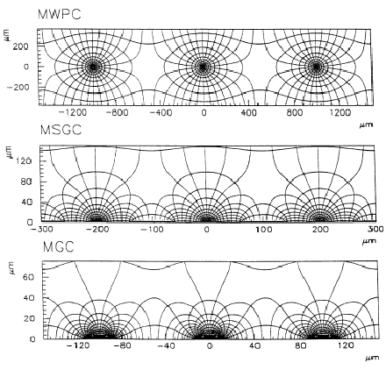
Gaseous Detectors
Advantages of gas detectors:
low radiation length
large areas at low price
flexible geometry
spatial, energy resolution …
Limitation:
rate capability limited by space charge defined by
the time of evacuation of positive ions
Solution:
reduction of the size of the detecting cell (limitation
of the length of the ion path) using chemical
etching techniques developed for microelectronics
and keeping at the same time similar field shape.
scale factor
MWPC
1
MSGC
5
MGC
10
R. Bellazzini et al.

Slide 3
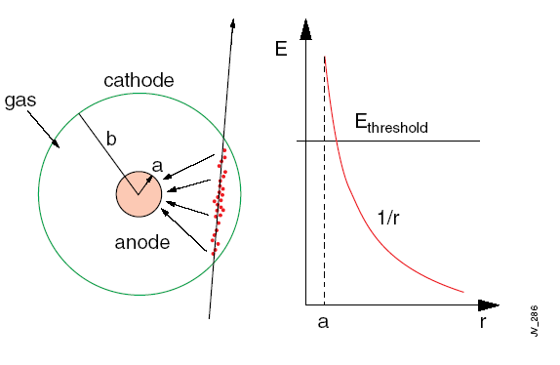

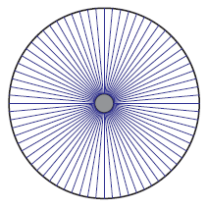
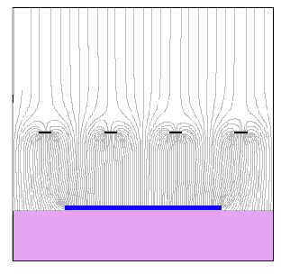
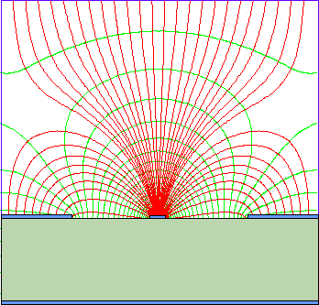
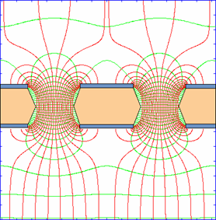
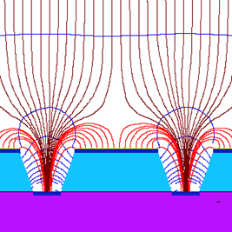
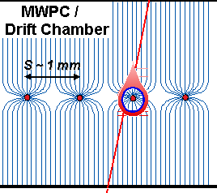
Single Wire Proportional Chamber
Electrons liberated by ionization drift towards
the anode wire.
Electrical field close to the wire (typical wire Ø
~few tens of μm) is sufficiently high for electrons
(above 10 kV/cm) to gain enough energy to ionize
further → avalanche – exponential increase of
number of electron ion pairs.
anode
C – capacitance/unit length
e⁻
primary electron
Cylindrical geometry is not the only one able to generate strong electric field:
wire
mwpc
parallel plate
strip
hole
groove/well

Slide 4
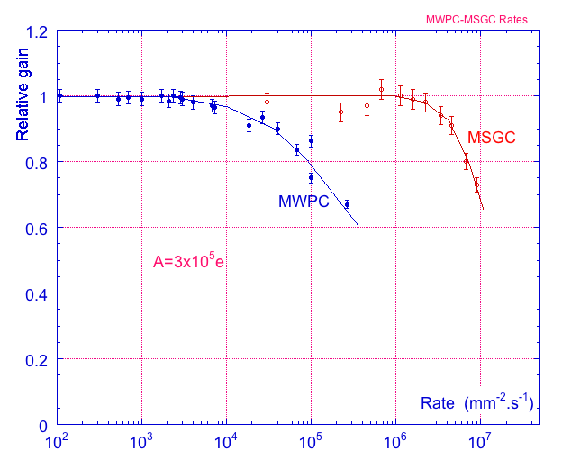
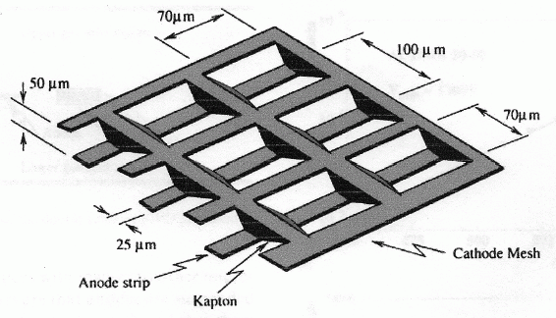
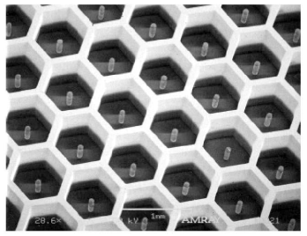
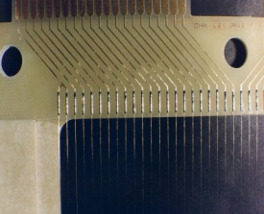
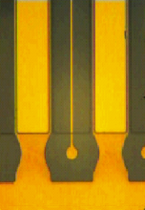
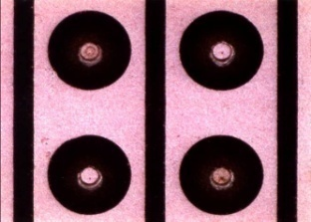
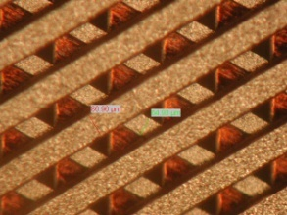
Current Trends in Micro-Pattern Gas Detectors (Technologies)
Semiconductor Industry technology:
Photolithography
Etching
Coating
Doping
Wafer postprocessing
Amplifying cell
reduction by
factor of 10
Operational instabilities:
Substrate charging-up
Discharges
Polymer deposition (ageing)
Rate Capability>10⁶/mm²
Position Resolution ~40μm
2-track Resolution ~400μm
MWPC
MSGC

Slide 5
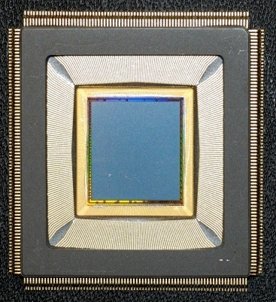
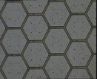
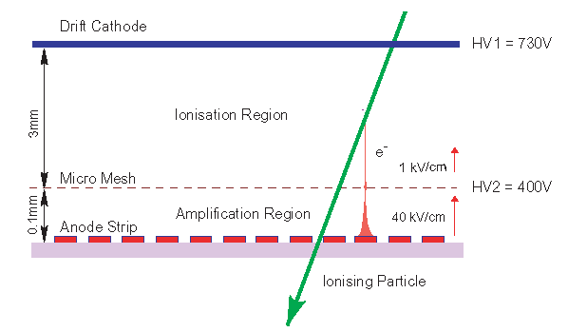
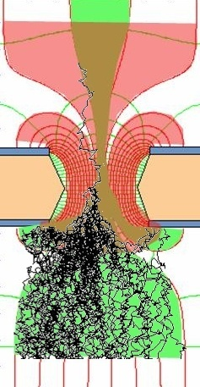
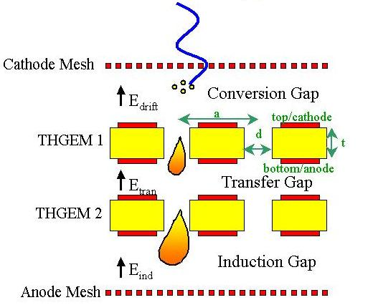
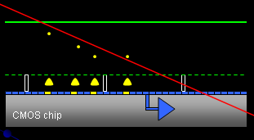
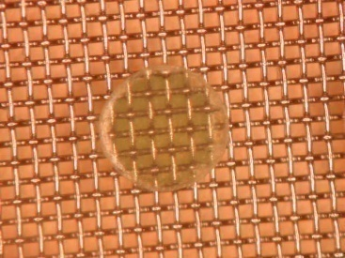
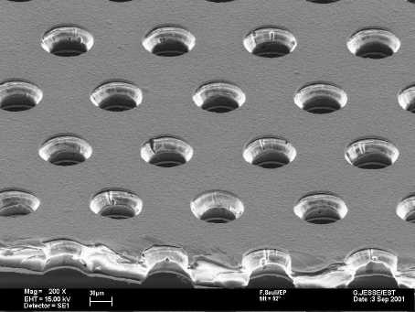
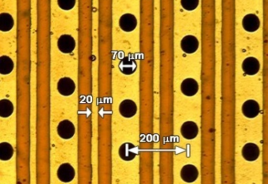
Current Trends in Micro-Pattern Gas Detectors (Technologies)
MSGC
Micromegas
GEM
Thick-GEM, Hole-Type Detectors and RETGEM
MPDG with CMOS pixel ASICs
Ingrid Technology
0.18 μm CMOS VLSI
CMOS high density
readout electronics
Ions
40 %
60 %
Electrons
Micromegas
GEM
THGEM
MHSP
Ingrid
5

Slide 6
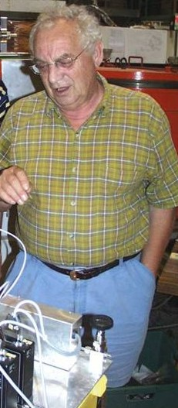
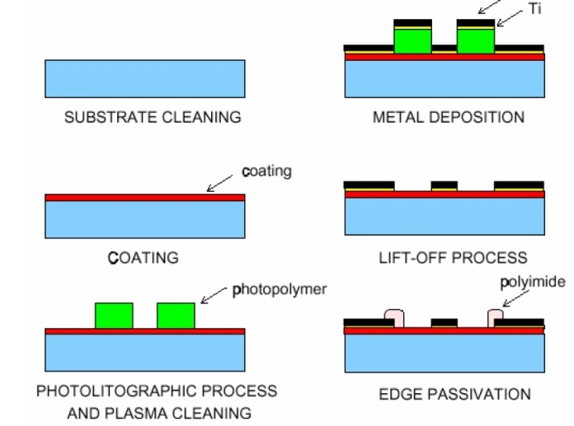
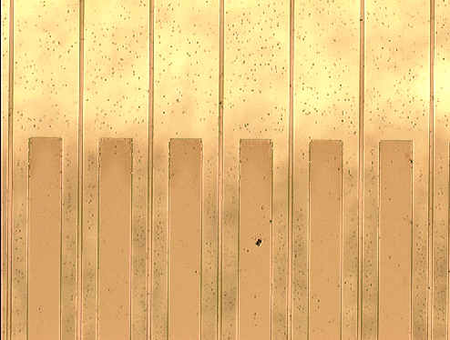
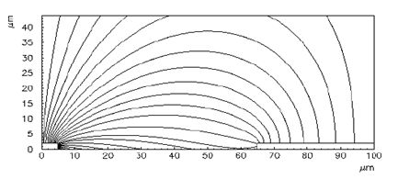
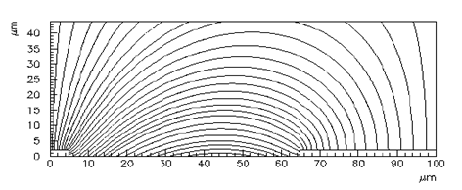
MSGC – MicroStrip Gas Chamber
Thin metal anodes and cathodes on
insulating support (glass, flexible polyimide ..)
Problems:
High discharge probability under exposure
to highly ionizing particles caused by the
regions of very high E field on the border
between conductor and insulator.
Charging up of the insulator and modification
of the E field → time evolution of the gain.
Anton Oed
200 μm
insulating support
slightly conductive support
Solutions:
slightly conductive support
multistage amplification
R. Bellazzini et al.

Slide 7
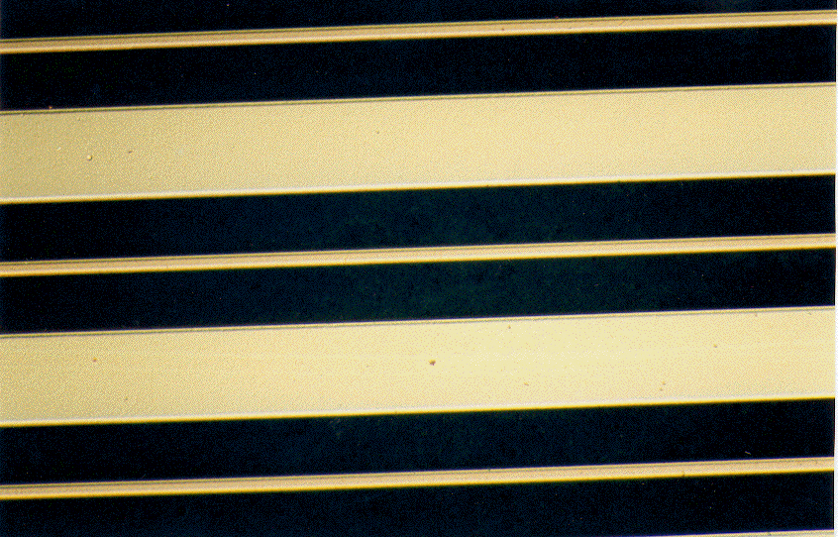
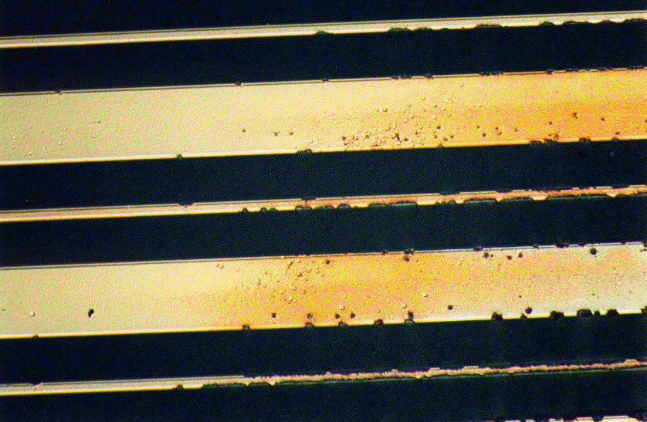
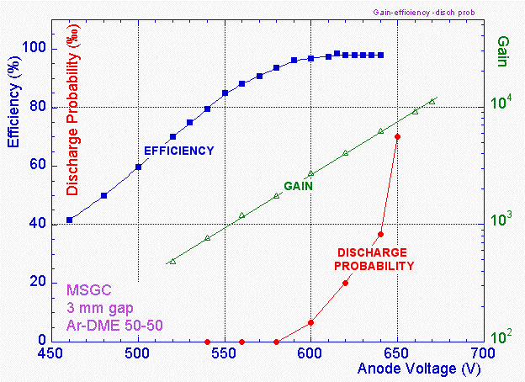
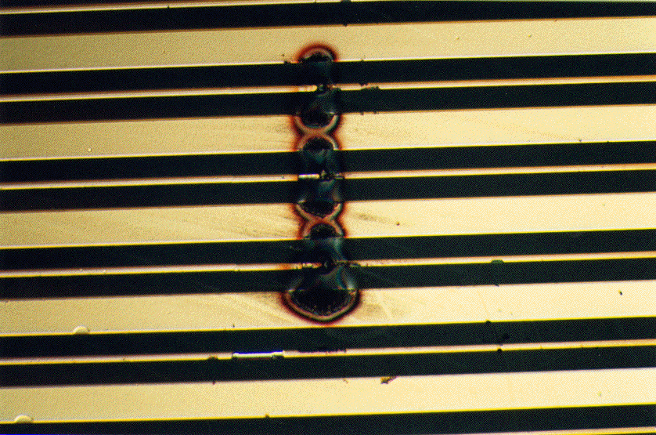
MSGC – MicroStrip Gas Chamber
Surface charging
Bulk resistivity of the support material
Surface modification by doping or deposition
Ageing
Gas, Gas system, MSGC support, Construction material
Discharges

Slide 8
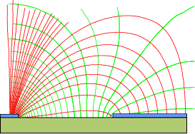
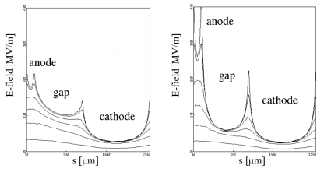
MSGC – MicroStrip Gas Chamber
MSGC: Discharge mechanisms
Electric field strength close to support plane in MSGC
Field emission from the cathode edge
Charge pre-amplification for ionization
released in high field close to cathode
Coated MSGC
Uncoated MSGC
Surface resistivity modification
Very high ionization release:
avalanche size exceeds Reather’s limit: Q ~ 10⁷

Slide 9
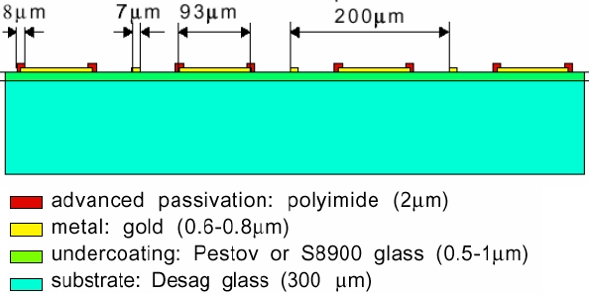
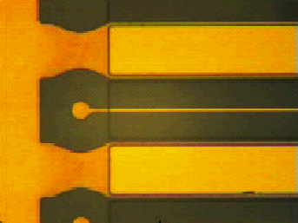
MSGC – MicroStrip Gas Chamber
Cathode edge passivation
Advanced passivation
Standard passivation
Bellazzini et al.

Slide 10
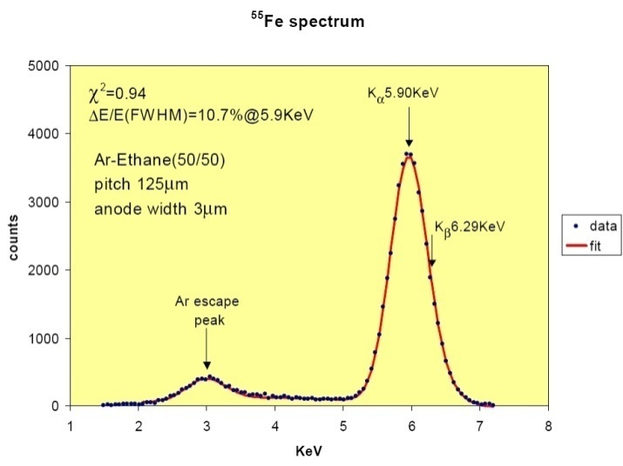
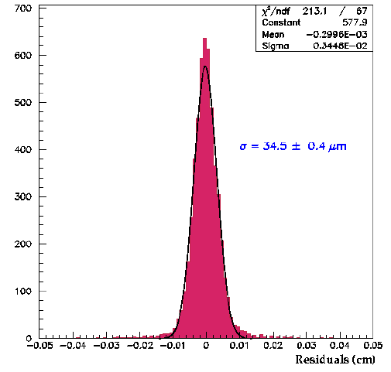
MSGC – MicroStrip Gas Chamber
Energy resolution ~11% for 5.9 keV
Single event wire map
Ne(25)-DME(75)
Vcath= -530 V
Vdrift= -3000 V
Surface resistivity !!
Spatial resolution = 34.5 ± 0.4 μm
2-track resolution ~400 μm
Rate capability > 1 MHz/mm²

Slide 11
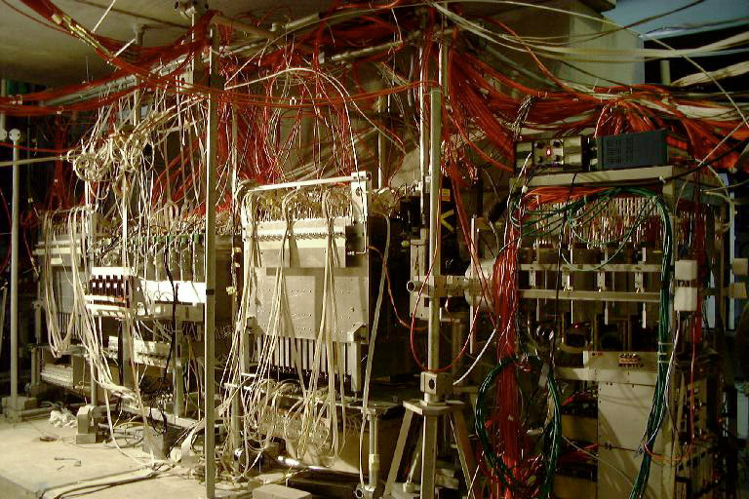
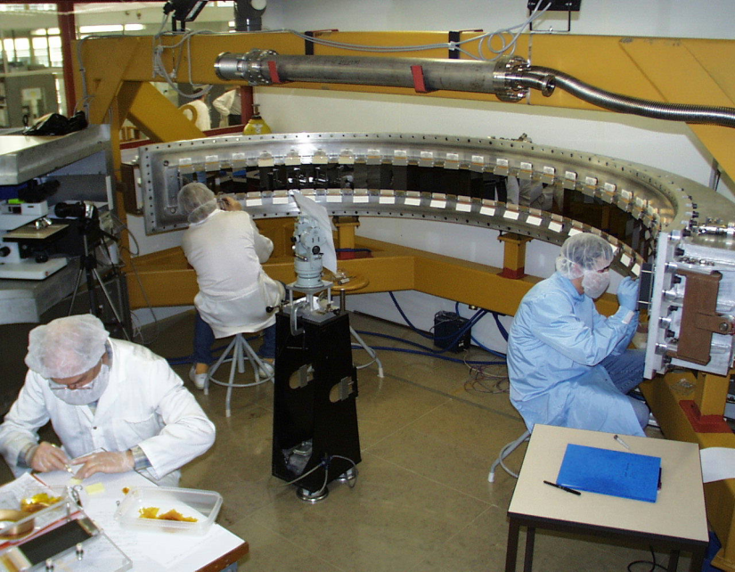
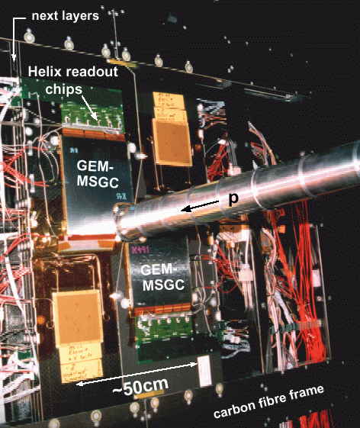
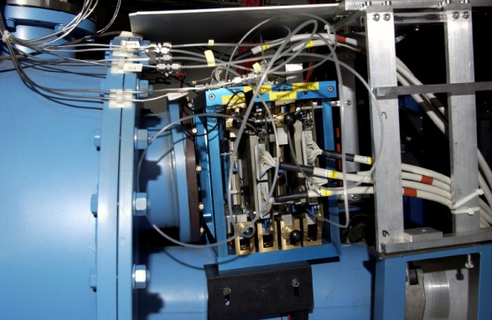
MSGC – MicroStrip Gas Chamber
Telescope of 32 MSGCs tested at PSI in Nov99 (CMS Milestone)
HERA-B Inner Tracker
MSGC-GEM detectors
R_{min} ~ 6 cm
⇒ 10⁶ particles/cm²•sec
300 μm pitch
184 chambers: max 25x25 cm²
~ 10 m²; 140.000 channels
The D20 diffractometer MSGC
is working since Sept 2000
1D localisation
48 MSGC plates (8 cm x 15 cm)
Substrate: Schott S8900
Angular coverage : 160° x 5,8°
Position resolution : 2.57 mm ( 0,1°)
5 cm gap; 1.2 bar CF4 + 2.8 bars 3He
Efficiency 60% @ 0.8 Å
DIRAC
4 planes MSGC-GEM
Planes 10x10 cm²

Slide 12
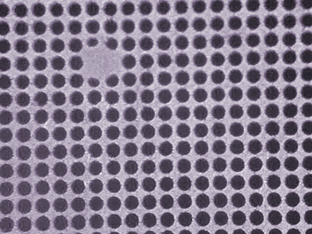
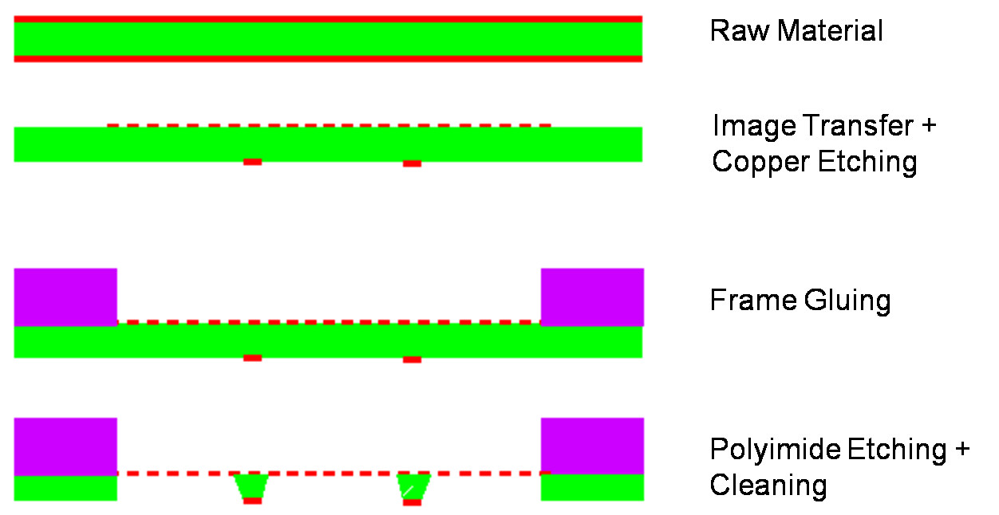
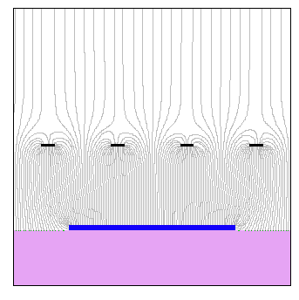
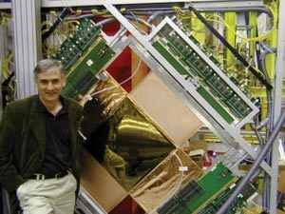
Micromegas – Micromesh Gaseous Structure
Micromesh mounted above readout
structure (typically strips).
E field similar to parallel plate detector.
E_{a}/E_{i} ~ 50 to secure electron transparency
and positive ion flow back suppression.
100 μm
E_{i}
Ioannis Giomataris
E_{a}
Y.Giomataris et al, NIM A 376 (1996) 29

Slide 13



Micromegas – Micromesh Gaseous Structure
gain
efficiency & discharge probability
10⁻⁴
gain
1
0.9
10⁻⁵
10⁵
efficiency
discharge probability
10⁵
10⁻⁶
10⁴
0.8
0.7
10⁻⁷
10³
10⁻⁸
0.6
10²
350
400
450
500
550
600
650
High Voltage [V]
High voltage [V]
energy resolution ~ 10%
ageing:Ar-iC₄H₁₀ 94-6% up to 24.3mC/mm²
1
0.8
0.6
0.4
0.2
⁵⁵ Fe
Ar + 10% C₄H₁₀
1.8*10¹² particles/mm²
10 years LHC
1000 10000 20000 30000 time[min]
D.Thers et al NIM A 469 (2001) 133

Slide 14




Micromegas – Micromesh Gaseous Structure
σ =70 µm
420 V operating point
~3-4.10³ Gain
Large efficiency plateau > 40 V
Spatial resolution < 70 µm
σ = 9 ns
300mm
Time resolution : 9 ns
D.Thers et al NIM A 469 (2001) 133

Slide 15




Micromegas – Micromesh Gaseous Structure
COMPASS Micromegas
D. Neyret
Pixelized Micromegas

Slide 16



Micro-Bulk Micromegas
Th. Papaevangelou
Low background Micromegas,
J. Galan, E. Ferrer, A. Tomas
Micromesh
5µm copper
Readout plane + mesh all in one
Kapton 50 µm
Readout pads
An I. Giomataris and R. De Oliveira idea
Lower capacitance
Under development
⁵⁵Fe Calibration with Ar – 5% isobutane @ 1 bar
Collimated source to avoid border effects
FWHM @ 6 keV = 11.5 %

Slide 17


2D MM Readout schemes
Square pads connected through 2 extra layers
Combination of “strips” and pads connected through one extra layer:
  Detector thickness ~80 μm
  Simpler process
  Charge distribution in x-y is determined by the hole geometry
Possibility of more etching around holes
Low background Micromegas,
J. Galan, E. Ferrer, A. Tomas

Slide 18


ATLAS Micromegas R&D (MAMMA)
Purpose: Development of large-area muon chambers based on bulk Micromegas technology
Collaboration: 19 institutes (most) in ATLAS, but also active in RD51
Main lines of R&D activities:
Spark neutralization and/or suppression
  Resistive coating on readout strips
  Multi-stage amplification schemes
Large-area chambers
  P3 (1.5 x 0.5 m²) successfully tested in H6; strips of 400 and 1000 mm length, strip pitches 250 and 500 µm
  Full-size chamber (1.2 x 1.2 m²) under construction; with front-end electronics (demonstrator project with APV25 ) and services integration.
  To be tested in 2010 test beam (October)
Front-end end readout electronics
  Scalable Readout System (RD51, H. Muller)
  Readout chip specs and design (BNL, LAPP, CEA, CERN)
H6 Test beam Nov 2009
1.5 x 0.5 m² prototype

Slide 19


Micromegas – Micromesh Gaseous Structure
T2K TPC, J. Beucher
24 bulk-Micromegas + FEE + mechanicals
3 m² of bulk Micromegas
41472 FEE channels
Reconstructed cosmics
by a readout plane
(beam tests @ TRIUMF on-going

Slide 20


Micromegas – Micromesh Gaseous Structure
Curved Micromegas CAS12,
S. Aune
Micromegas ILC-TPC,
D. Attie
Red – thick
Micromegas
Blue – thin curved
Micromegas

Slide 21




GEM – Gas Electron Multiplier
Ions
I⁺
e⁻
40 %
Induction gap
60 %
e⁻
5 µm
50 µm
Electrons
55 µm
70 µm
Fabio Sauli
Thin, metal coated polyimide foil perforated
with high density holes.
Electrons are collected on patterned readout board.
A fast signal can be detected on the lower GEM electrode
for triggering or energy discrimination.
All readout electrodes are at ground potential.
Positive ions partially collected on the GEM electrodes.

Slide 22







GEM – Gas Electron Multiplier
Full decoupling of the charge amplification
structure from the charge collection and
readout structure.
Both structures can be optimized
independently !
Cartesian
Compass, LHCb
A. Bressan et al, Nucl. Instr. and Meth. A425(1999)254
Small angle
33 cm
Hexaboard, pads
MICE
Compass
Totem
Both detectors use three GEM foils in cascade for amplification
to reduce discharge probability by reducing field strength.
Mixed
Totem

Slide 23


Multi-GEM Detectors
Discharge Probability on Exposure to 5 MeV Alphas
Multiple structures provide equal gain at lower voltage.
Discharge probability on exposure to a particles is strongly reduced.
S. Bachmann et al Nucl. Instr. and Meth. A479(2002)294

Slide 24






GEM – Gas Electron Multiplier
9.7 ns
5.3 ns
4.5 ns
4.8 ns
Time resolution
Charge correlation (Cartesian readout)

Slide 25




GEM – Gas Electron Multiplier
3.10⁶ particles/mm²
A. Bressan et al, Nucl. Instr. And Meth. A425(1999)262
Efficiency for minimum ionizing particles with 3 mm gap
Rate capability > 10⁶ Hz mm⁻²
GAIN ~ 10⁴
Ar-CO₂ 70-30
1 mC~2.10¹⁰ min.ion. particles
Space resolution ~ 40 μm rms
Cluster size ~ 500 μm FWHM
C. Altunbas et al, DESY Aging Workshop (Nov. 2001) Nucl. Instr. and Meth. A
J. Benlloch et al, IEEE NS-45(1998)234

Slide 26





GEM – Gas Electron Multiplier
Pixel GEM
COMPASS

Slide 27




LHCb Muon Trigger
Fast TripleGEM Detectors for LHCb Muon Trigger
12 double TGEM detectors operated with fast gas mixture (Ar-CO₂-CF₄)
Rate - 5 kHz mm⁻²
Time resolution 4.5 ns rms
Radiation hard up to integrated charge of 20 mC mm⁻² (15 LHCb years)
20x24 cm² GEM modules
Pad readout plane
M. Alfonsi et al, Nucl. Instr. and Meth. A535(2004)319

Slide 28



GEM – Gas Electron Multiplier
TOTEM GEMs, T. Hilden,V. Greco…
KLOE2 - Cylindrical Triple GEM
Coincidence
Chips
VFAT Hybrids
11thCard
GEM
Chamber
Horse Shoe
Card
HV cables
Electronics cooling
Read-out
Induction
Transfer 2
Anode
2 mm
Transfer 1
GEM 3
2 mm
GEM 2
2 mm
Conversion & Drift
GEM 1
3 mm
Cathode

Slide 29



TOTEM GEM - Readout Board
pads
radial strips
bonding contact
for pads
Ni Au
15 μm Cu
50 μm Polyimide
15 μm Cu
Epoxy glue
25 μm Polyimide
5 μm Cu
10 μm Cu
Epoxy glue
2004 prototype
125 μm FR4

Slide 30




GEM – Gas Electron Multiplier
GEM HCAL, A. White
GEM ILC TPC,
T. Matsuda

Slide 31





GEM – Gas Electron Multiplier
PANDA TPC and Planar Trackers ,
X. Zhang
B. Surrow, STAR GEM
Window
GEM stack
Pad Plane Support & Media-Distribution
Cooling Support & LV- Distribution
Front-End Electronic
Drift electrode
Shielding Cover
&
Read-out Plane

Slide 32







GEM – Gas Electron Multiplier
Spherical GEM, S. D. Pinto
Spherical GEM
for X-Ray diffraction application
Japanese GEMs
S. Uno
10cm
10cm

Slide 33


THGEM – Thick GEM / RetGEM Resistive Thick GEM
Standard GEM
THGEM
1mm
1mm
PCB tech - etching + drilling
Simple and robust
V_{TGEM}~2KV (at atmospheric pressure)
10⁵ gain in single- & 10⁷ double-TGEM
Sub-mm to mm special resolution
Fast (ns)
Low pressure (<1Torr) gain 10⁴
Microlithography + etching
High Spatial resolution (tens of microns); V_{GEM}~400V
>10³ gain in single GEM
10⁶ gain in cascaded GEMs
Fast (ns)
Low pressure – gain~30
V. Peskov, A. Breskin …

Slide 34
THGEM – Thick GEM / RetGEM Resistive Thick GEM

Slide 35




THGEM – Thick GEM / RetGEM Resistive Thick GEM
Drilling + chemical rim etching without mask
Mask etching + drilling; rim = 0.1mm
10⁴
6 keV X-ray
pitch = 1 mm; diameter = 0.5 mm;
rim=40; 60; 80; 100; 120 μm

Slide 36






THGEM – Thick GEM / RetGEM Resistive Thick GEM
RET-thick GEM
R. Akimoto
Thick GEM
F. Tessaroto
THGEM 1
CsI
drift
Gain increase → stability gets worsen.
At first few hours, gain drops down.
After that, the fluctuation of gain is within ±4%.
THGEM 2
2.0 mm
THGEM 3
2.0 mm
E_{transfer}
anode
2.0 mm
Notes:
36

Slide 37






Pixel MPGDs
Cosmic track: short Drift
Triple GEM TPC with Solid State Pixel Readout
TIMEPIX
256x256 pixels, 55x55µm²
14x14 mm² active area
Long Drift:
Field Cage 26 cm
RWTH Aachen
J. Kaminski, RD51 Workshop, Paris (October 2008)
Bonn University ILC-TPC

Slide 38



INGRID
Integrated Micromegas and Pixel Sensor
Postprocessing of the TIMEPIX chip to build a metal mesh on insulating pillars
Electron tracks from⁹⁰Sr in magnetic field (0.2 T):
Cosmic track in He-iC₄H₁₀
H. Van der Graaf ,
IEEE Nucl. Sci. Symp. Conf. Rec. (Dresden, October 2008)

Slide 39


Singe Electron Count
Intrinsic Energy Resolution
Due to low pixel capacitance and noise, the device can detect individual electrons released in the gas by an X-ray source.The pixel count provides the best energy resolution (statistical limit):
For 5.9 keV in Argon (N≈220):
⁵⁵Fe rays conversions in Argon
⁵⁵Fe 5.9 keV
5.6% rms
P. Colas, IEEE Nucl. Sci. Symp. Conf. Rec. (Dresden, Oct. 2008)

Slide 40



Micro-Pattern Gas Detectors Performance Summary
GEM
THGEM
Rate Capability
High Gain
Space Resolution
Time Resolution
Energy Resolution
Ageing Properties
Ion Backflow Reduction
Photon Feedback Reduction
2x10⁶ p/mm²
Micromegas
GEM
Ar/CO2/CF4
(45/15/40)
rms = 4.5ns
Spatial
resolution
σ ~ 12 μm
MHSP
Micromegas
Micromegas

Slide 41
Spare Slides

Slide 42












Production Aspects
Detector Design
Services
and Connectivity
Soldering
Bonding
ZIF connectors
Soldering

Slide 43




















Production Aspects
Component Production
Infrastructure
and Assembly Tools

Slide 44











Production Aspects
Component Quality Control
APV
VFAT
GP5
ALTRO
MEDIPIX
Electronics
PANalytical
3M
TechEtch
Techtra
Centronic
G&A
Industrialization

Slide 45
RD51 Collaboration: Motivation and Main Objectives
The main objective of the R&D programme is to advance technological development of Micropattern Gas Detectors
Estimated time scale – 5 years
Optimize detectors design, develop new multiplier geometries and techniques
Develop common test and quality standards
Share common infrastructure (e.g. test beam and radiation hardness facilities, detectors and electronics production and test facilities)
Share investment of common projects (e.g. technology development, electronics development, submissions/production)
Setup a common maintainable software package for gas detectors simulations
Common production facility
Optimize communication and sharing of knowledge/experience/results
Collaboration with industrial partners
The existence of the RD51 collaboration, endorsed by the LHCC, will support and facilitate the acquisition of funding from national and other agencies.

Slide 46

RD51 Collaboration
350 authors from 64 Institutes
from 23 countries and 4 continents

Slide 47


RD51 Collaboration
400 authors from 70 Institutes
from 23 countries and 4 continents
CERN MPGD workshop (10-11 September 2007)
Micro Pattern Gas Detectors. Towards an R&D Collaboration. (10-11 September 2007)
1st draft of the proposal presentation during Nikhef meeting (17 April 2008)
Micro-Pattern Gas Detectors (RD-51) Workshop, Nikhef, April 16-18, 2008
Gas detectors advance into a second century - CERN Courier
Collaboration and Management Board meetings in Amsterdam (17-18 April 2008)
Conveners and Management Board meetings (10+15) RD51 MB meeting (2 October2009)
Proposal sent to CB members (23 June 2008)
Proposal presentation in LHCC open session (2 July 2008)
94th LHCC Meeting Agenda (02-03 July 2008)
CERN‐LHCC‐2008‐011 (LHCC‐P‐011)
Meeting with LHCC referees (23 September 2008)
Meeting with LHCC referees (23 September 2008)
LHCC meeting closed session (24 September 2008) LHCC-095 minutes
2nd RD51 Collaboration meeting (Paris 13-15 October 2008)
2nd RD51 Collaboration Meeting (13-15 October 2008) ~100 participants; parallel session; ~60 presentations.
Research Board approval(5 December 2008) 186th Research Board meeting minutes
Memorandum of Understanding (37 signed; Common fund)
Consolidation around common projects; DEM workshop upgrade, beam tests, electronics, software tools
WG2 meeting (10 December 2008)
WG1-Task 1 meeting: large area MPGDs (21 January 2009)
GEM & Micromegas detector design & assembly training: Lecture Session (16 February 2009)
RD51 week (27-29 April 2009)
3rd RD51 Collaboration Meeting (Kolympari, Crete, June 16-17, 2009) and MPGD2009 Conference
RD51 Week (CERN, September 23-25, 2009)
4th RD51 Collaboration Meeting (CERN, November 23-25, 2009)

Slide 48

RD51 Collaboration – Working Groups

Slide 49

RD51 Scientific Organization:
Home - RD51 Collaboration
Collaboration Web Page
Members of the RD51 Collaboration Management Board (MB):
the two Co-Spokespersons: L.Ropelewski, M.Titov
the CB Chairperson and its deputy: S.Dalla Torre, A. White
MB members: A.Breskin, I.Giomataris, F.Sauli, H. van der Graaf, P. Colas, H. Taureg
Working Groups Conveners:
·
WG1 MPGD Technology & New Structures P.Colas, S. Duarte Pinto
WG2 Common Characterization & Physics H. van der Graaf , M. Chefdeville ·
WG3 Applications F.Simon, A.White
WG4 Software & Simulations A.Bellerive, R.Veenhof
WG5 Electronics H. Muller, J. Kaminski
WG6 Production R. de Oliveira, I.Giomataris, H.Taureg
WG7 Common Test Facilities M.Alfonsi, Y. Tsipolitis

Slide 50
RD51 Collaboration status and organization
Consolidation around common projects: large area MPGD R&D, CERN/MPGD
Production Facility, electronics developments, software tools, beam tests
WG1: large area Micromegas, GEM; THGEM R&D; MM resistive anode readout (discharge protection); design and detector assembly optimization; large area readout electrodes and electronics interface
WG2: radiation tolerance, discharge protection, rate effects, single-electron response, avalanche fluctuations, photo detection with THGEM, TPC (IBF) readout optimization
WG3: applications beyond HEP, industrial applications (X-ray diffraction, homeland security)
WG4: microtracking; neBEM field solver, electroluminescence simulation tool, Penning transfers, GEM charging up; MM transparency and signal, MM discharges
WG5: scalable readout system; Timepix multi-chip MPGD readout
WG6: CERN MPGD Production Facility; TT Network
WG7: RD51 test beam facility (November 2009 - 8 groups/5 setups)
50

Slide 51









Development of large-area MPGDs
Bulk Micromegas
Single mask GEM
THGEM
Ions
40 %
60 %
Electrons
Notes:
51

Slide 52





Development of large-area MPGDs
Bulk Micromegas
Single mask GEM
Read-out board
Laminated Photo-image-able cover lay
Raw material
Stretched mesh
on frame
Single side copper patterning
frame
Polyimide etching
Laminated Photo-image-able cover lay
Copper reduction

Slide 53
RD51 WG6 – MPGD Production
Objective: Development of cost-effective technologies and industrialization
1) Current: CERN-MPGD workshop is the UNIQUE MPGD production facility
(generic R&D, detector components production, quality control)
Detector Technology | Currently produced | Future Requirements
 | cm * cm | cm * cm
GEM | 40 * 40 | 50 * 50
GEM, single mask | 70 * 40 | 200 * 50
THGEM | 70 * 50 | 200 * 100
RTHGEM, serial graphics | 20 * 10 | 100 * 50
RTHGEM, Kapton | 50 * 50 | 200 * 100
Micromegas, bulk | 150 * 50 | 200 * 100
Micromegas, microbulk | 10 * 10 | 30 * 30
RD51
Collaboration
Survey:
2) Future MPGD R&D: Reinforcement of CERN-MPGD workshop infrastructure to produce 2x1m
Bulk Micromegas and 2x0.5 m GEMs has been approved by CERN Management (Nov. 2009)
Participation the AIDA proposal
3) Technology Industrialization → transfer “know-how” from
CERN workshop to industrial partners for MASS PRODUCTION
53

Slide 54


MPGD in the sLHC upgrades – requests from experiments
Atlas - Nigel Hessey
CMS - Jordan Nash
LHCb - Sheldon Stone
ALICE - Paolo Giubellino
TOTEM - Angelo Scribano
PANDA - Bernd Voss

Slide 55

MPGD in the sLHC upgrades – requests from experiments
ATLAS – Micromegas (muon)
CMS – GEM (muon)
LHCb – GEM (muon)
ALICE – THGEM (photon detector)
TOTEM – GEM (tracker & trigger)
Panda & GSI – GEM (tracker)
LC Time Projection Chamber – Micromegas & GEM
LC Hadronic Calorimeter (DHCAL) - Micromegas & GEM
STAR & RHIC – GEM (tracker)
KLOE2 – GEM (tracker)
JLAB – GEM & Micromegas
Potential clients from neutrino community

Slide 56

Technology Industrialization (potential partners)
THGEM Technology – ELTOS S.p.A. (Italy)
GEM Technology
New Flex (Korea, Seoul)
Tech-ETCH (USA, Boston)
Scienergy (Japan, Tokyo)
Micromegas Technology
TRIANGLE LABS (USA, Nevada)
SOMACIS (Italy, Castelfidarco)
CIRE (France, Paris)
Scienergy, Japan signed license contract for GEMs
Partnership agreement for the development and implementation of
spherical GEMs for X-Ray diffraction detectors
56

Slide 57
RD51 WG6 – MPGD Electronics Development
Objective: Readout electronics optimization and integration with detectors.
Definition of front-end electronics requirements for MPGDs
Survey of existing conventional readout systems:
GASSIPLEX, ASDQ, CARIOCA, ALTRO, SUPER ALTRO; APV, VFAT
From Chip Matrix to the “Ideal
MPGD Chip” →
develop 2-3
chip concepts
for the MPGDs
S. Martoiu, RD51 Collab. Meet., Nov.23-25, 2009, WG5 Meeting
57

Slide 58

Electronics: Scalable Readout System
“RD51 Common Project”
(financed by the RD51)→
First prototype system
to be ready in June 2010
Scalability from small to large system
Common interface for replacing the chip
frontend
Integration of proven and commercial
solutions for a minimum of development
Default availability of a very robust and
supported DAQ software package.
→ Scalable Readout System
H. Muller, RD51 Collab. Meet., Nov.23-25, 2009, WG5 Meeting
58

Slide 59





Beam facility for RD51 in H4@SPS
Beam direction
RD51 setup
Goliath magnet
Photonis XP2040B PMT
Initial Safety Discussion: RD51 (21 April 2009)
RD51 test beam periods: 21.06-6.07 - 4 groups/2 setups; 22.10-1.11 8 groups/4 setups

Slide 60




Beam facility for RD51 in H4@SPS
Objective: Design and maintenance of common infrastructure for detector
characterization (“semi-permanent” test-beam infrastructure at CERN SPS@H4 beam)
Bonn setup
(ILC TPC)
SACLAY setup
(CLAS12, COMPASS)
RD51 GEM & Micromegas Telescope
Trieste setup
(COMPASS RICH)
INFN setup (KLOE2)
Common infrastructure:
Services, trigger, tracking
Telescope, DAQ, Slow control
8 RD51 groups have been taking data in parallel during
the last test beam campaign (Oct. 22 – Nov. 2, 2009)
60

Slide 61






RD51 Collaboration : WG meetings and Training session

Slide 62





Education & Training
Dear Colleagues,
It is my pleasure to inform you that the talk “Activity of CERN and LNF Groups on Large Area GEM Detectors”, presented by Danilo Domenici (LNF-Frascati) on behalf of the RD51 Collaboration at the "Frontier Detectors for Frontier Physics - 11th Pisa Meeting on Advanced Detectors", held in Isola d'Elba, Italy, has won the "Young Scientist Award" for the "contribution to the development and test of large area planar and cylindrical Gas Electron Multiplier detectors (GEM) in view of their use for various detector upgrades at SLHC and KLOE at LNF-Frascati”. I hope that this Award will motivate even stronger our younger collaborators to devote their efforts to the MPGD developments.
Congratulations !
Leszek Ropelewski

Slide 63
Summary:
consolidation of the Collaboration and MPGD community integration
considerable progress in MPGD technologies in particular large area GEM ,THGEM, Micromegas; some picked up by experiments (including sLHC upgrades) for feasibility studies and prototyping
secured future of the MPGD technologies development through the TS DEM workshop upgrade and eventually FP7 AIDA contribution
improved MPGD simulation software framework allows for the first applications
Infrastructure for common RD51 test beam facility
Development of common, scalable electronics (financed by RD51)
TT, IP issues and contacts with industry
Education and training
63

