Slide 1
The RD51 Collaboration,
Development of Micro-Pattern Gas Detector Technologies
Leszek Ropelewski, CERN, Switzerland
Maxim Titov, CEA Saclay, France
OUTLINE:
RD51 Motivation and Main Objectives
RD51 Collaboration Activities and Results
Summary and Outlook
105th LHCC Meeting, CERN, 23-24 March 2011

Slide 2
RD51 Collaboration: Motivation and Main Objectives
World-wide coordination of the research in the field to advance
technological development of Micropattern Gas Detectors
Foster collaboration between different R&D groups; optimize communication and sharing of knowledge/experience/results concerning MPGD technology within and beyond the particle physics community
Investigate world-wide needs of different scientific communities in the MPGD technology
Optimize R&D financing by creation of common projects (e.g. technology and electronics development) and common infrastructure (e.g. test beam and radiation hardness facilities, detectors and electronics production facilities)
The RD51 collaboration will steer ongoing R&D activities but will not direct the effort and direction of individual R&D projects
Applications area will benefit from the technological developments developed by the collaborative effort; however the responsibility for the completion of the application projects lies with the institutes themselves.
2

Slide 3
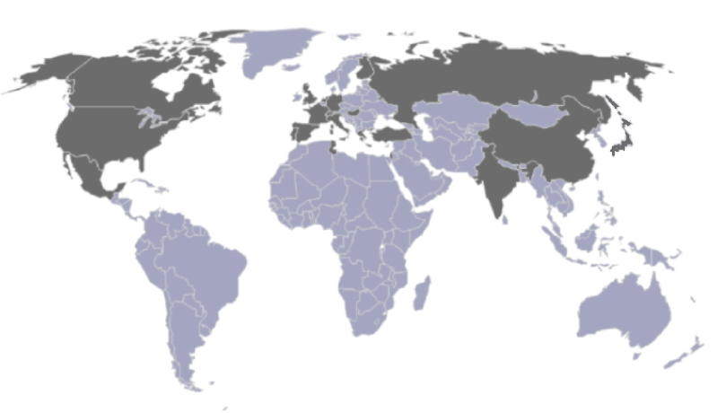
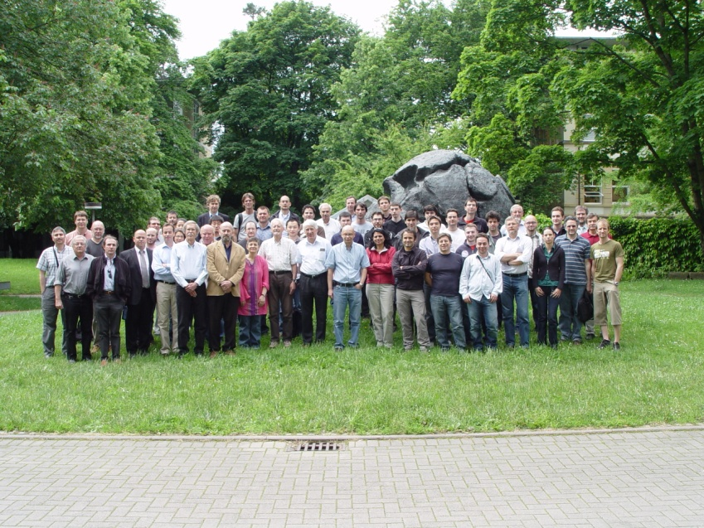
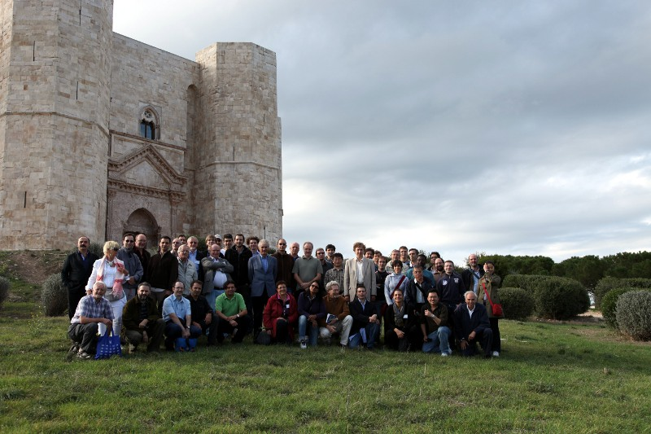
RD51 Collaboration
75 institutes
~ 450 people involved
Representation (Europe, North America, Asia, South America, Africa)
Freiburg , Germany, May 2010
Collaboration meetings:
RD51 mini week (22-25 February 2010)
RD51 mini week (19-20 July 2010)
RD51 mini week (17-18 January 2011)
5th RD51 Collaboration Meeting; Freiburg (24-27 May 2010)
6th RD51 Collaboration Meeting, Bari (07-10 October 2010)
Bari, Italy, October 2010
3

Slide 4
MPGD2011 2nd International Conference on Micro Pattern Gaseous Detectors

Slide 5
RD51 Collaboration Internal Notes
2011
RD51-Note-2011-005 –“ Modelling of avalanches and streamers by finite elements with
COMSOL: step-by-step guide”, Notes for the RD51 Simulation School, CERN, Jan. 19-21
2011, (by P. Fonte)
RD51-Note-2011-004 –“Thermal Stretching of Large-Area GEM Foils Using an Infrared
Heating Method” (by Michael Staib, Bryant Benson, Kondo Gnanvo, Marcus Hohlmann,
Amilkar Quintero)
RD51-Note-2011-003 –“On the operation of a Micropattern Gaseous UV Photomultiplier
in Liquid-Xenon” (by S. Duval, A. Breskin, R. Budnik, W.T. Chen, H. Carduner, M. Cortesi,
J.P. Cussonneau , J. Donnard, J. Lamblin, P. Le Ray, E. Morteau, T. Oger, J.S. Stutzmann
and D. Thers)
RD51-Note-2011-002 –“Infrared scintillation yield in gaseous and liquid argon for rareevent
experiments” (by A. Buzulutskov, A. Bondar, A. Grebenuk)
RD51-Note-2011-001 - "Further Developments and Tests of Microstrip Gas Counters
with Resistive Electrodes" (by R. Oliveira, V. Peskov, Pietropaolo, P.Picchi).
2010
RD51-Note-2010-009 – "Gas Flow Simulations for gaseous detectors" (by D. Abbaneo,
S. Bally, H. Postema, A. Conde Garcia, J. P. Chatelain, G. Faber, L. Ropelewski, S. Duarte
Pinto, G. Croci, M. Alfonsi, M. Van Stenis, A. Sharma, L. Benussi, S. Bianco, S.
Colafranceschi, F. Fabbri, L. Passamonti, D. Piccolo, D. Pierluigi, A. Russo, G. Saviano, A.
Marinov, N. Zaganidis, N. Turini, E. Oliveri, G. Magazzu, Y. Ban, H. Teng, J. Cai)
RD51-Note-2010-008 – "Construction of the first full-size GEM-based prototype for the
CMS high-eta muon system" (by D. Abbaneo, S. Bally, H. Postema, A. Conde Garcia, J. P.
Chatelain, G. Faber, L. Ropelewski, S. Duarte Pinto, G. Croci, M. Alfonsi, M. Van Stenis, A.
Sharma, L. Benussi, S. Bianco, S. Colafranceschi, F. Fabbri, L. Passamonti, D. Piccolo, D.
Pierluigi, G. Raffone, A. Russo, G. Saviano, A. Marinov, M. Tytgat, N. Zaganidis, M.
Hohlmann, K. Gnanvo, M.G. Bagliesi, R. Cecchi, N. Turini, E. Oliveri, G. Magazz`u, Y. Ban,
H. Teng, J. Cai)
RD51-Note-2010-007 – “First tests of “bulk” MICROMEGAS with resistive cathode
mesh” (by R. Oliveira, V. Peskov, Pietropaolo, P.Picchi)
RD51-Note-2010-006 – “A spark-resistant bulk-micromegas chamber for high-rate
applications" (by T. Alexopoulos, J. Burnens, R. de Oliveira, G. Glonti, O. Pizzirusso, V.
Polychronakos, G. Sekhniaidze, G. Tsipolitis, J. Wotschack)
RD51-Note-2010-005 – “Characterization of GEM Detectors for Application in the CMS
Muon Detection System" (by D. Abbaneo, S. Bally, H. Postema, A. Conde Garcia, J. P.
Chatelain, G. Faber, L. Ropelewski, E. David, S. Duarte Pinto, G. Croci, M. Alfonsi, M. van
Stenis, A. Sharma, L. Benussi, S. Bianco, S. Colafranceschi, D. Piccolo, G. Saviano, N.
Turini, E. Oliveri, G. Magazzu’, A. Marinov, M. Tytgat*, N. Zaganidis, M. Hohlmann, K.
Gnanvo, Y. Ban, H. Teng, J. Cai)
RD51-Note-2010-004 - "Detection and Imaging of High-Z Materials with a Muon
Tomography Station Using GEM Detectors" (by K. Gnanvo, B. Benson, W. Bittner, F.
Costa, L. Grasso, M. Hohlmann, J.B. Locke, S. Martoiu, H. Muller, and M. Staib)
RD51-Note-2010-003 - "Further evaluation of a THGEM UV-photon detector for RICH
and comparison with MWPC" (by V. Peskov, M. Cortesi, R. Chechik and A. Breskin)
RD51-Note-2010-002 - "Imaging of high-Z material for nuclear contraband detection
with a minimal prototype of a Muon Tomography station based on GEM detectors" (by
Kondo Gnanvo, Leonard V. Grasso III, Marcus Hohlmann, Judson B. Locke, Amilkar S.
Quintero, Debasis Mitra)
RD51-Note-2010-001 - "First Tests of MICROMEGAS and GEM-like Detectors Made of a
Resistive Mesh" (by R. Oliveira, V. Peskov, F. Pietropaolo, P. Picchi)
Internal Notes:
2009 – 7
2010 – 9
2011 – 5
5

Slide 6
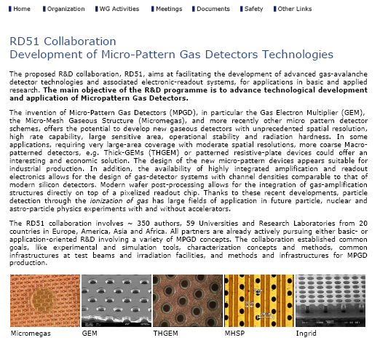
RD51 Collaboration Web Page
http://rd51-public.web.cern.ch/RD51-Public
RD51 Conference Contributions, Seminars
http://rd51-public.web.cern.ch/RD51-Public/Documents/ConferenceContributions.html
http://rd51-public.web.cern.ch/RD51-Public/Documents/Seminars.html

Slide 7
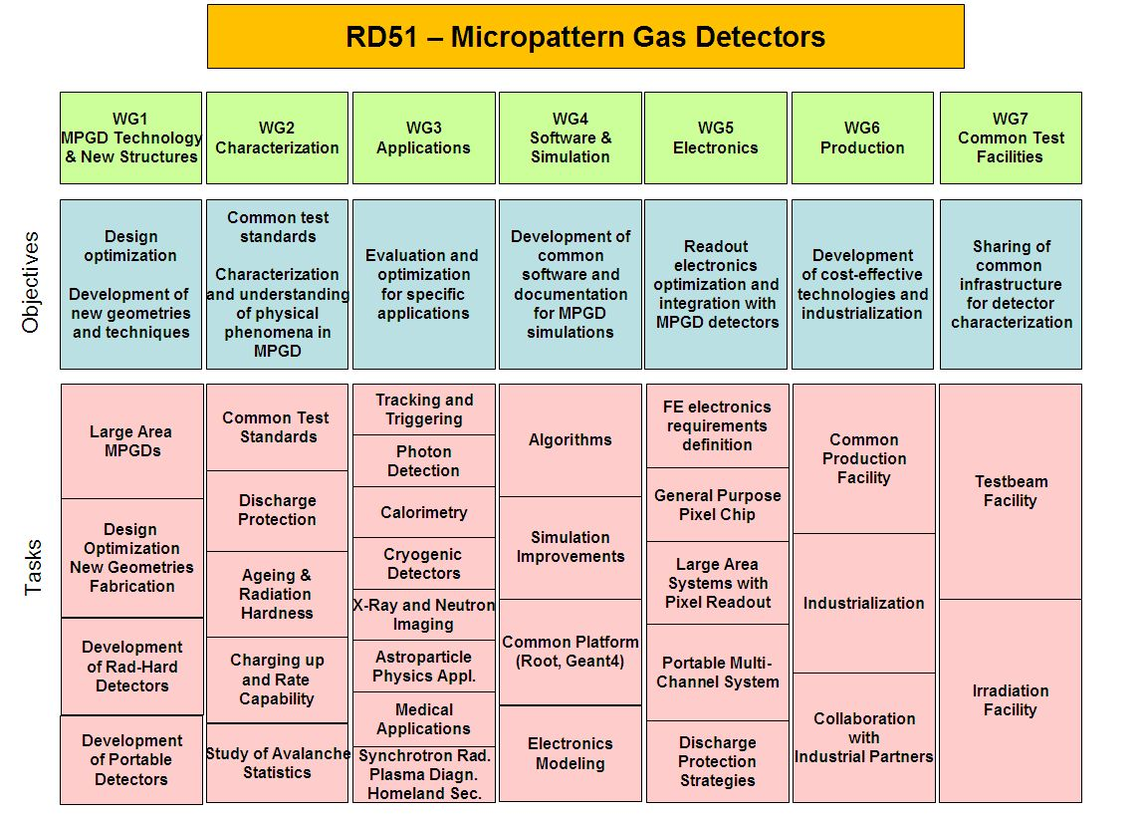
RD51 Collaboration – Working Groups
“Transverse organization” of MPGD activities in 7 Working Groups
7

Slide 8
RD51 Collaboration Organization
RD51 Collaboration Organization
Consolidation around common projects: large area MPGD R&D, CERN/MPGD
production facility, common electronics developments, software tools, beam tests
WG1: large area Micromegas, GEM; THGEM R&D; MM resistive anode readout (discharge protection); design and detector assembly optimization; large area readout electrodes and electronics interface
WG2: double phase operation, radiation tolerance, discharge protection, rate effects, single-electron response, avalanche fluctuations, photo detection with THGEM and GridPix
WG3: applications beyond HEP, industrial applications (X-ray diffraction, homeland security)
WG4: development of the software tools; microtracking; neBEM field solver, electroluminescence simulation tool, Penning transfers, GEM charging up; MM transparency and signal, MM discharges
WG5: scalable readout system; Timepix multi-chip MPGD readout
WG6: CERN MPGD Production Facility; industrialisation; TT Network
WG7: RD51 test beam facility
8

Slide 9
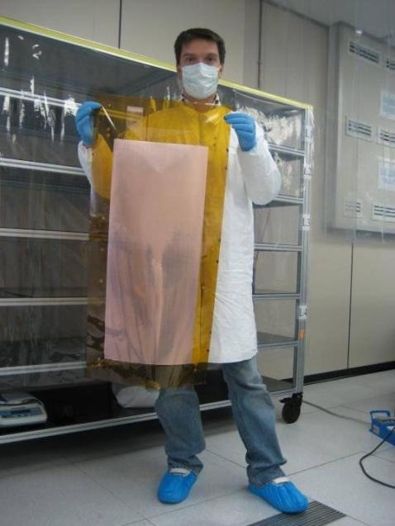
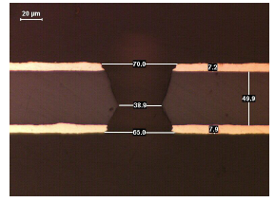
WG1: Large area detectors
Single mask GEM technology
Chemical Polyimide etching
Copper electro etching
Stripping
Second Polyimide etching
Result
9

Slide 10
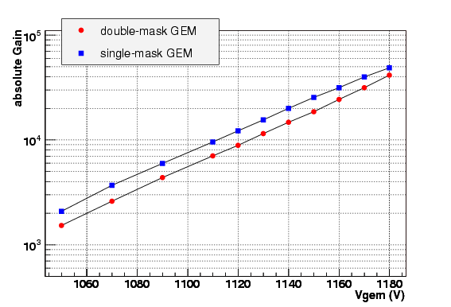
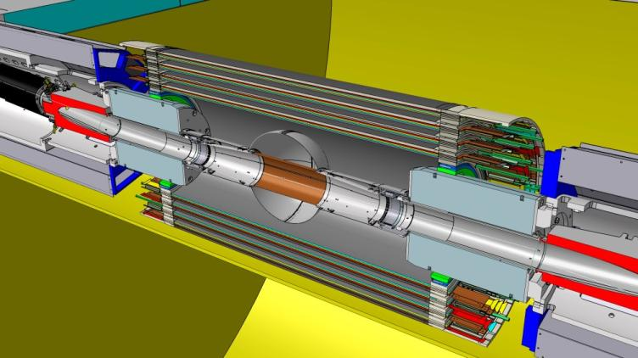
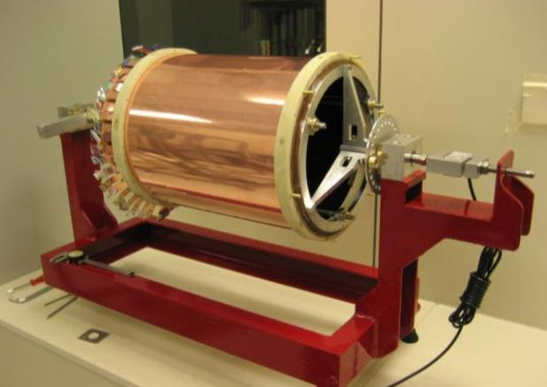
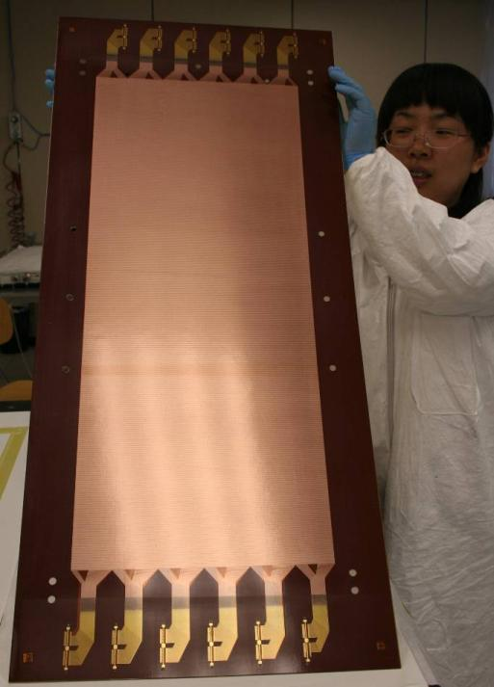
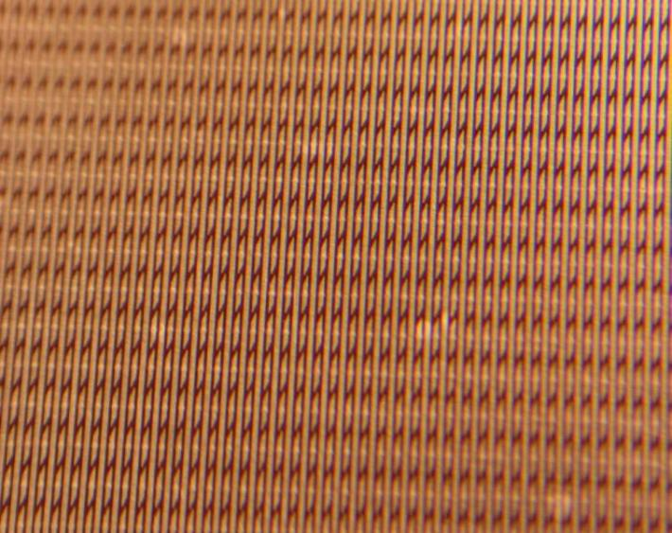
Large area GEMs for KLOE2 tracker

Slide 11
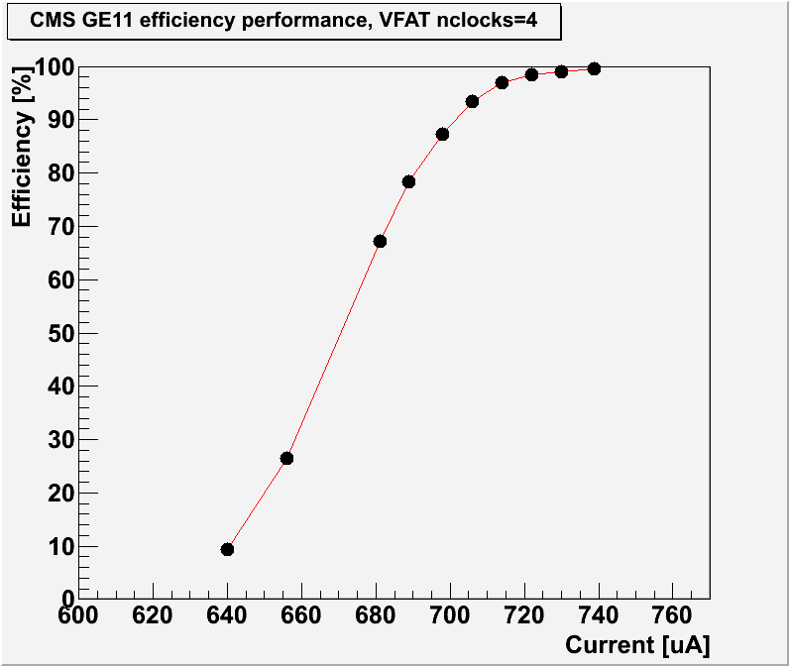
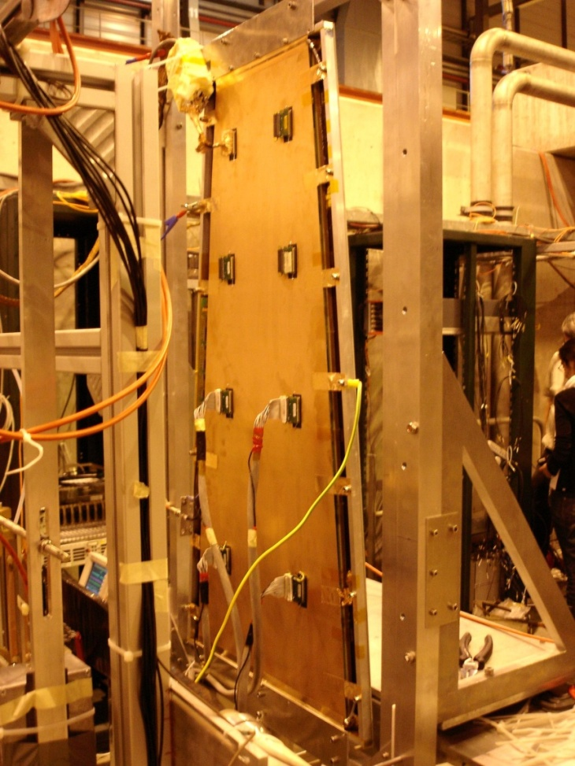
CMS GE1/1 1.6>η>2.1
CMS High Eta MPGD - Workshop (30 September 2010)
15 institutes, 60 participants
Large Prototype: GE1/1
Beam Test @ RD51 setup
October 2010
Rate capability : 10⁴/mm²
Space/Time resolution: ~ 100 μm / ~ 4-5 ns
Efficiency > 98% ; Excellent Long Term Operation
Gas Mixture: Argon CO2 (non flammable mixture)
Large areas ~ 1m x 2m with industrial processes
11

Slide 12
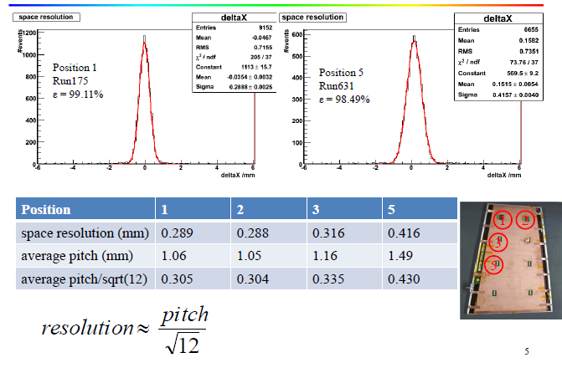
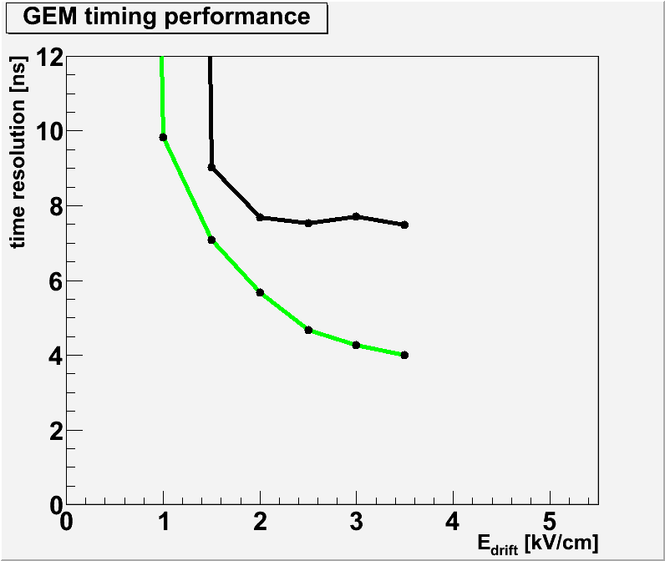
CMS GE1/1 1.6>η>2.1 project
  Time resolution for different
  gas mixtures and geometry:
  Ar(45):CO₂ (15):CF₄ (40)
  [gaps 3/1/2/1]
  Ar(70):CO₂(30)
  [gaps 3/2/2/2]
12

Slide 13
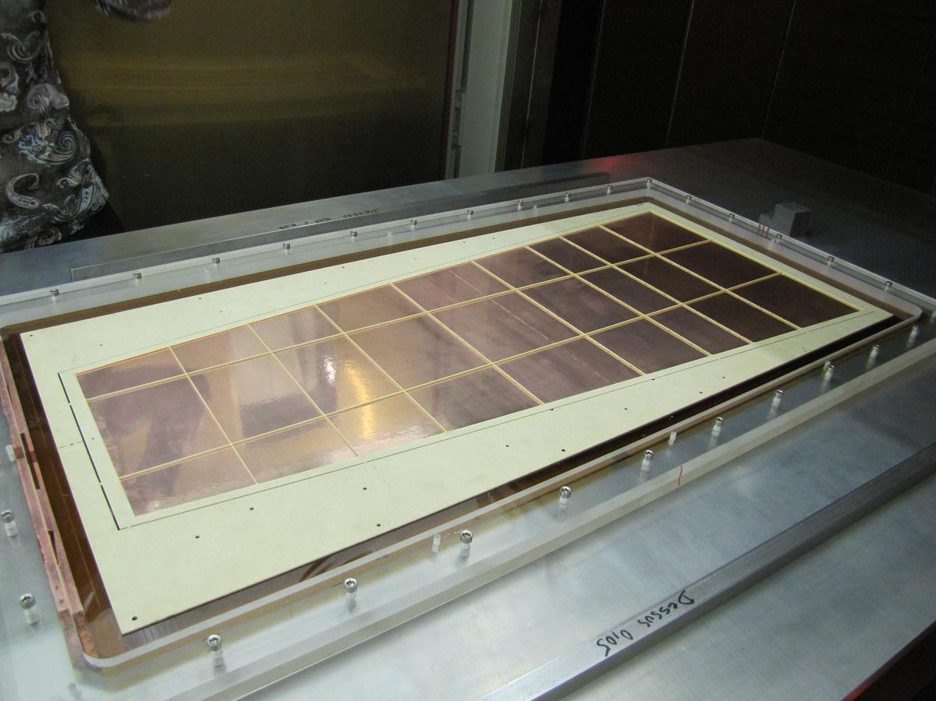
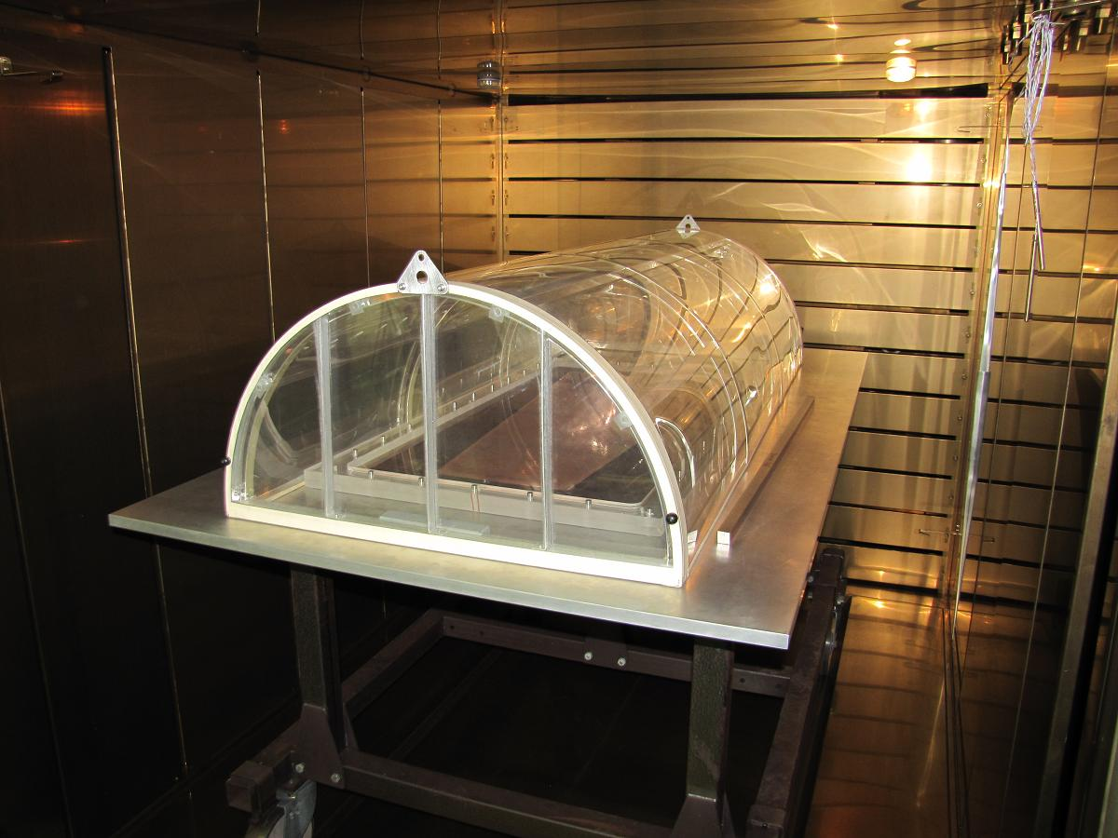
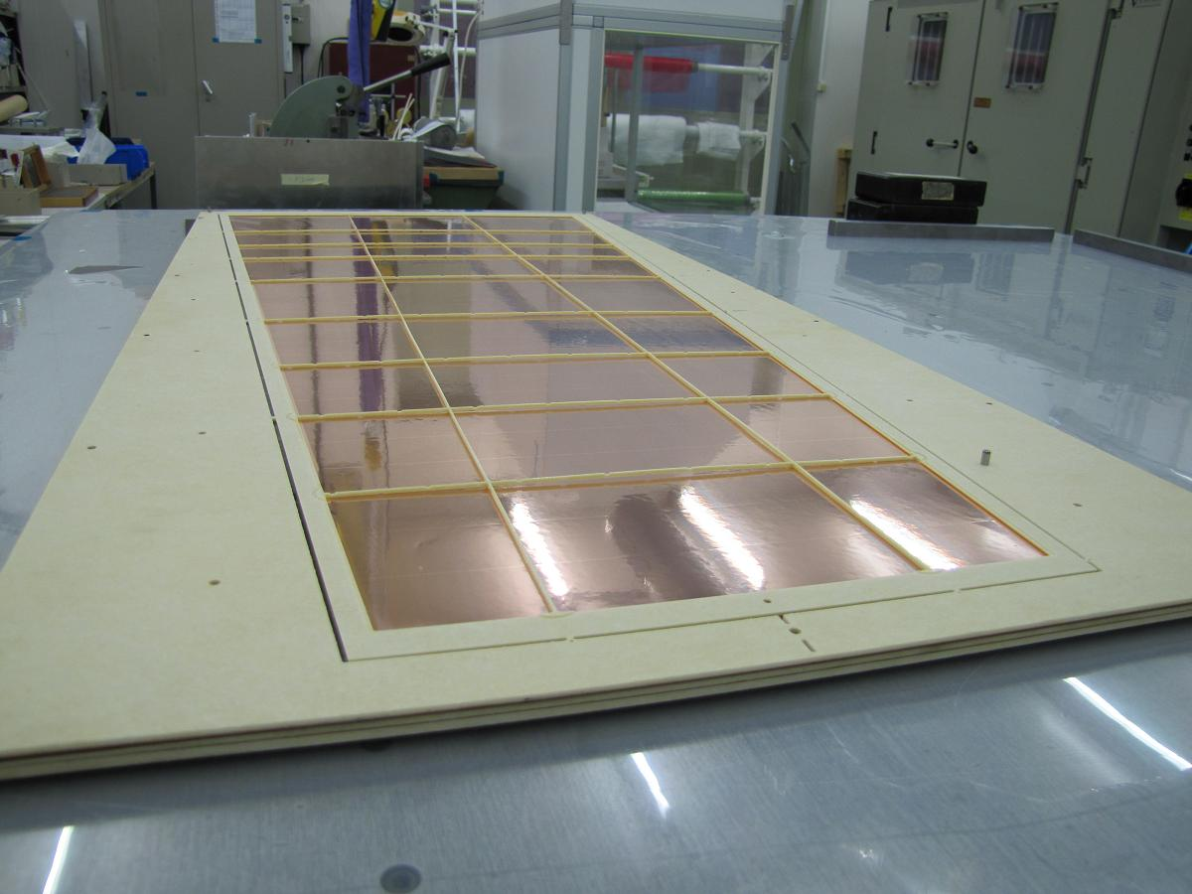
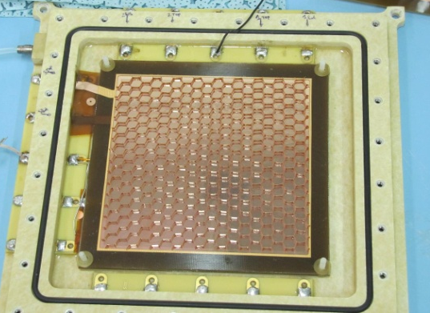
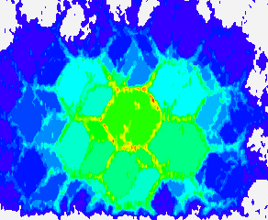
CMS GE1/1 1.6>η>2.1 project
13

Slide 14
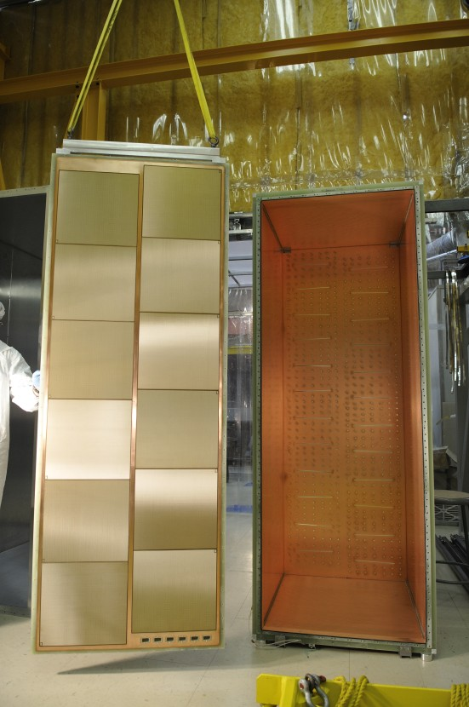
WG1: Large area detectors
Bulk MicroMegas technology
PCB
lamination
Mesh deposit
lamination
development
14

Slide 15
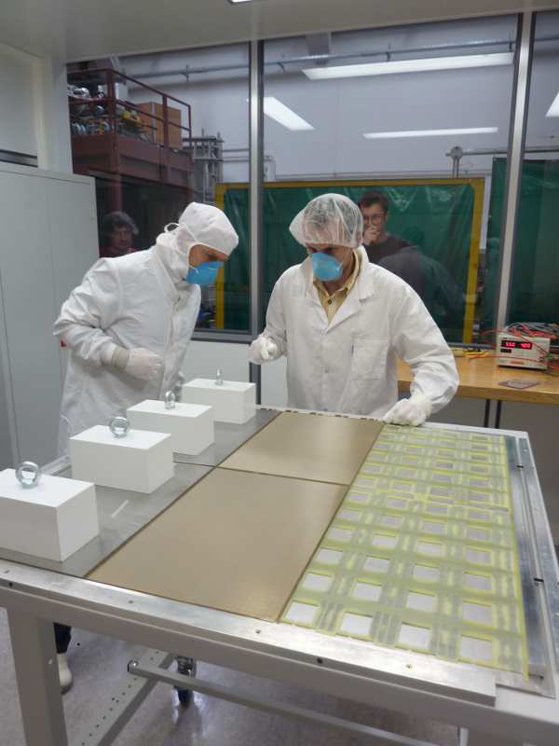
WG1: Bulk Micromegas
DHCAL first m²
Fine segmentation 1cm², thickness 8mm for ILC hadronic calorimetry
Tested in 1kHz beam
Future microROC much better suited (low noise, longer shaping)
Tested in the RD51 beam facility

Slide 16
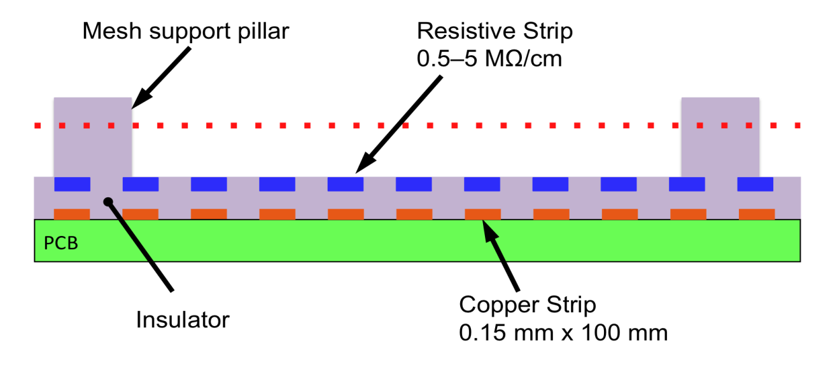

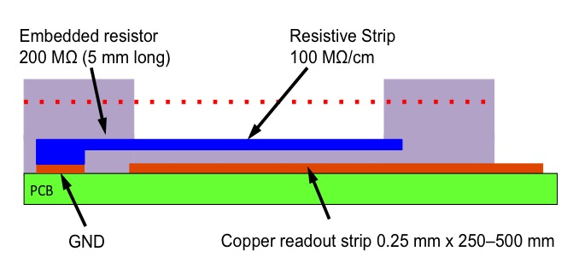
WG1: Large area detectors
Bulk MicroMegas resistive anode and 2D readout
Resistive strips
16

Slide 17
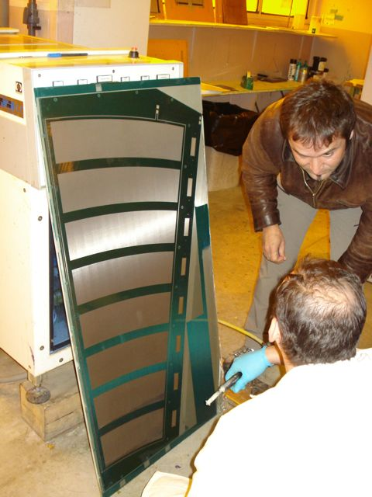
MicroMegas detectors for the upgrade of the ATLAS muon system
Goal: development of large-area (≈2 x 1 m²) bulk-micromegas chambers for high-rate applications that combine precision measurement and trigger functionality
MAMMA Collaboration (21 institutes, including Arizona, Athens, BNL, CEA Saclay, CERN, Naples) in close collaboration with CERN/TE-MPE (R. de Oliveira) & CERN/PH-DT
Underlying philosophy:
  Development and evaluation of full-size prototype chambers at CERN and in the collaborating institutes
  Transfer of know-how to competent industry
  Large-scale production in industry
March 2011
1.2 x 0.6 m² prototype chamber with 2048 readout strips (0.5 mm strip pitch) during construction in CERN/TE-MPE workshop

Slide 18
MAMMA achievements 2010/11
Development of resistive-strip protection layer to render MMs insensitive to sparking (paper accepted by NIMA, DOI: 10.1016/j.nima.2011.03.025)
Extensive tests of the spark-protection scheme in hadron and neutron beams demonstrating excellent performance
  Stable HV and low currents despite sparks
  Small gain drop (25% at 1 MHz/cm²)
  Spatial resolution: ≤ 40 µm (500 µm strips)
  Excellent two-track separation
Development and successful test of 2D readout for MMs with resistive-strip protection
Construction of 0.6 x 1.2 m² MM with resistive-strip protection (0.6 m width is the present limit of machines at CERN; this summer 1.2 m will be possible)
Example of measurement of two tracks separated by 1.5 mm in space and ≈100 ns in time (250 µm pitch)

Slide 19
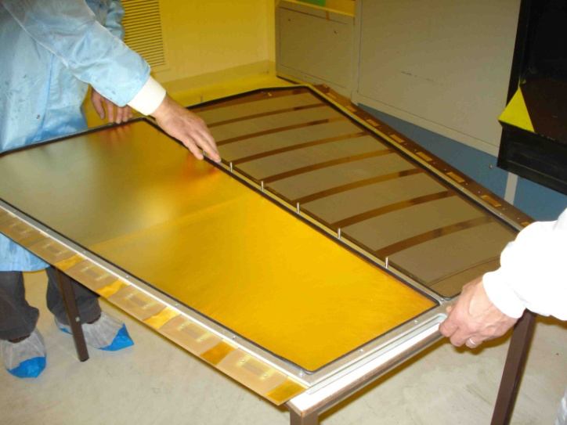
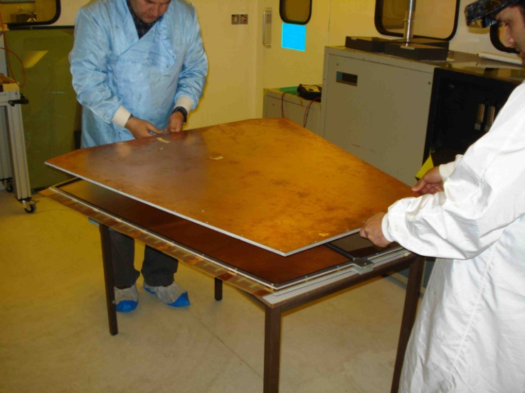
MAMMA plans for 2011/12
Summer/Fall 2011:
Construction of second 0.6 x 1.2 m² module to be assembled into 2-plane chamber; evaluation in neutron beam (Demokritos/Athens) in May (tbc) and CERN H6 test beam in July
Construction of 1.2 x 1.2 m² chamber with several (4) planes and xy readout (to be installed in ATLAS); evaluation in H6 beam in October
Development of new VMM1 front-end readout chip (ongoing at BNL); first version expected for October test beam to be read out through SRS (CERN & Arizona)
Detector long-term tests and ageing studies (CEA Saclay and others)
2012:
Construction of full-size module-0 chamber with two multilayers and xy readout, compatible with new ATLAS Small Wheel design
0.6 x 1.2 m² MicroMegas with resistive-strip protection
Dummy
Chamber of same dimensions as large CSC chambers presently installed in ATLAS

Slide 20
WG4: MPGD Simulation Tools
C++ version of Garfield:
C++ class that has the functionality of the Garfield Fortran for gas has been developed. Lots of effort went into benchmarking and validating the new C++ code.
Gas properties (i.e. Magboltz) and primary ionization (i.e. Heed) have been implemented.
Drift path integration algorithms and analytic field calculations had already been translated, and it opens the path to TPC-like calculations.
Microscopic, MC and Runge-Kutta charge transport techniques are in place.
Progress is being made in a second generation and final interface to Geant4 from Garfield C++.
Silicon detectors implementation in Garfield
Maintenance:
Ionization processes – Heed and MIP (cluster size distribution, electron range and Fano limit)
Field calculations – BEM method validated for MPGD
Gas properties – Magboltz tables extended and updated (Ar, Xe, He, Ne; GeH₄,SiH₄, C₂H₂F₄ )
(Import ant in view of the next generation electroluminescent detectors for dark matter and double beta decays searches)
Generic studies:
Penning transfers – published (2010 JINST 5 P05002)
Avalanche statistics and gain fluctuations –published (NIM 624 (2010)78-84)
Neutron detection in gases – in progress
Photon feedback (ALICE TPC & MicroMegas) – in progress
Modeling:
MicroMegas transfer properties
GEM charging up
20

Slide 21
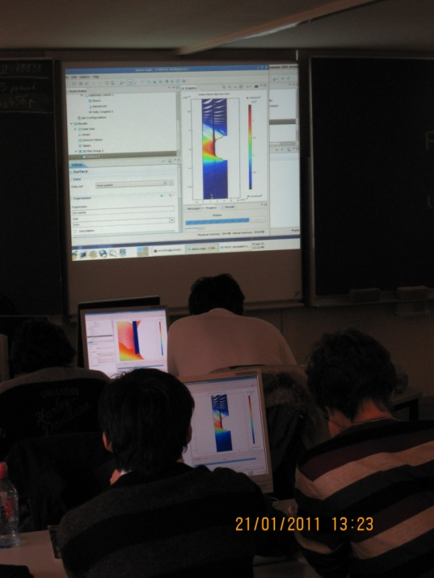
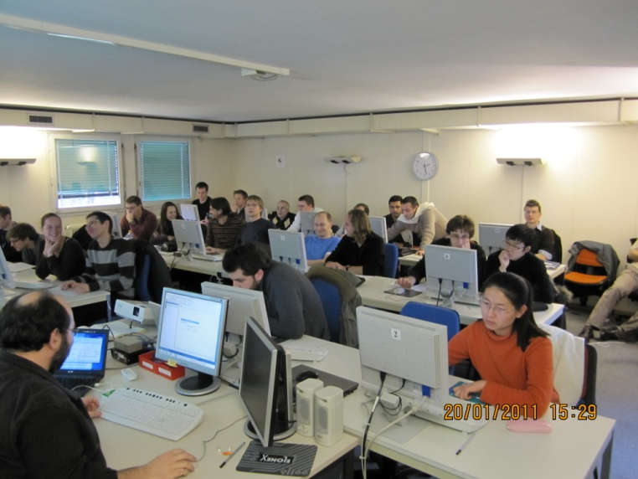
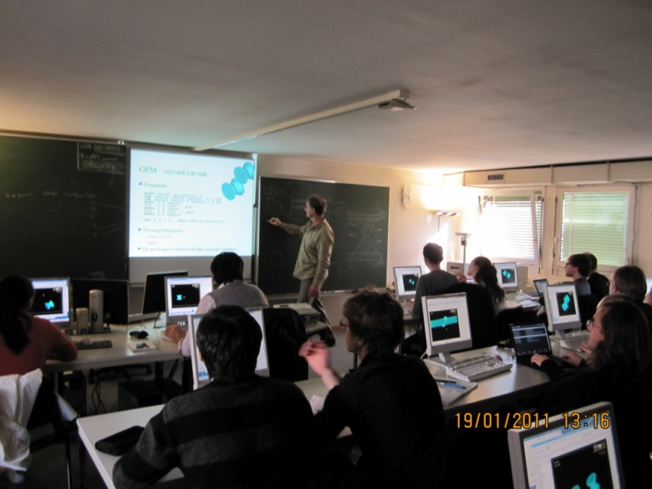
RD51 Simulation School
RD51 Simulation School (19-21 January 2011)
Contents:
Introduction to Geant4
Introduction to FEM, COMSOL
Field calculations
Transport of electrons in small-scale devices
Calculation of signals and their processing
25 participants; enthusiastic feedback
21

Slide 22
WG5: Electronics for MPGDs
SRS general readout architecture
Online/
Offline
DATE
Root-based offline Analysis
DAQ
HLT
Test systems:
LHC machine:
1000 BASE-SX up 500 m Multimode fiber (1 Gbit)
10 GBASE-SR up 300 m Multimode fiber ( 10 Gbit)
Trigger, clock and control
Control
PC
Clock
&
Trigger
TTC
GBE copper
10 GBE
network
Single mode fiber
Common
GBE switch
fibers / CAT6
Clock & timing
Data + Control
(only for multi-SRU architectures)
ethernet
GB-ethernet MM fiber or copper
Readout Units
Control
SRU
SRU
. . . .
40x
. . . .
40x
DTC point-to-point links
simultaneous data up 200Mbit/s per FEC
. . . .
FEC
FEC
FEC
FEC
FEC
Chip link interface
Application specific chip-carriers
chips
chips
chips
chips
Specific
…
DETECTOR

Slide 23
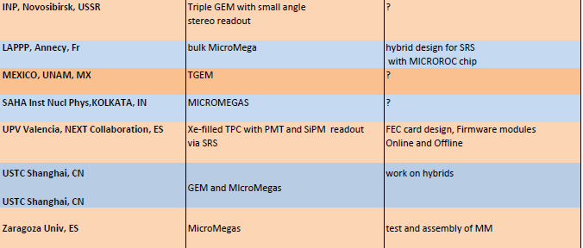
WG5: Electronics for MPGDs
SRS registered developers and users
CERN experiments (large systems)
ATLAS CSC upgrade MicroMegas
ALICE EMCaL new readout backend
NA62 Straw tracker MicroMegas
HEP experiments (medium systems)
NEXT Collaboration, dual Beta decay
BUDKER, INP, triple-GEM Deuteron
Public usage with Cosmic Tomography
FIT Florida, homeland security, GEMs
Geoscienes Azur CRNS - Water quality
R&D with MPGD’s ( small systems)
Weizmann Inst, THGEM tests
Tsinghua Univ, GEM Imaging
Bonn/Mainz Univ, Timepix readout
Helsinki HIP, GEM detector
LIP Coimbra, micropatten RPC, for PET
INFN Trieste, THGEM photon detection
MEXICO UNAM, THGEM
SAHA Kolkatta, MicroMegas
USTC Shanghai, GEM and MicroMegas
Zaragoza Univ, GEM and MicroMegas
CE Saclay, MicroMegas
..... some more non-confirmed
23

Slide 24
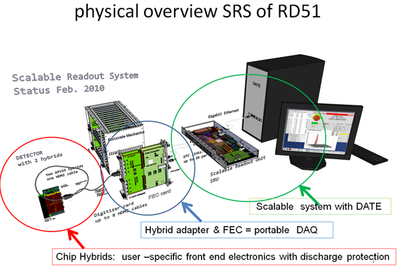
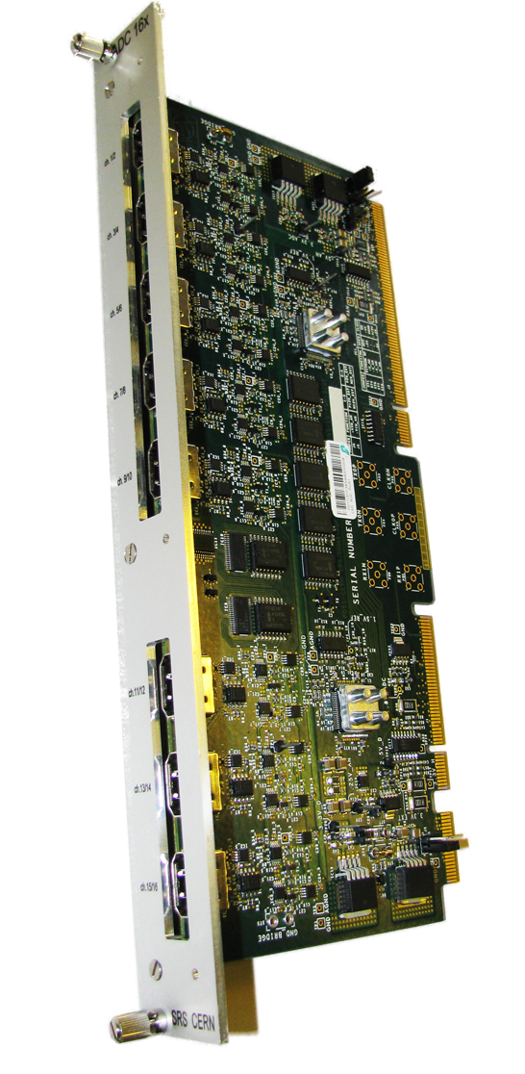
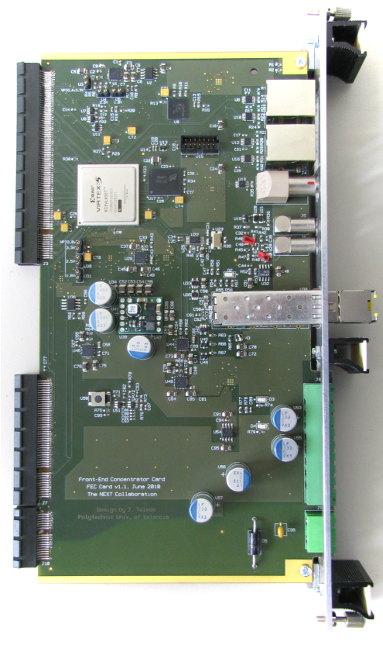
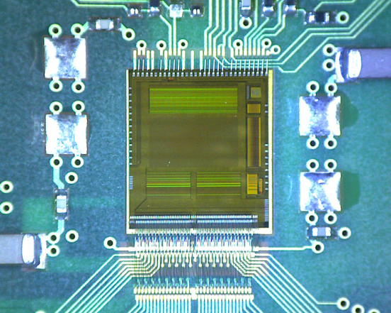
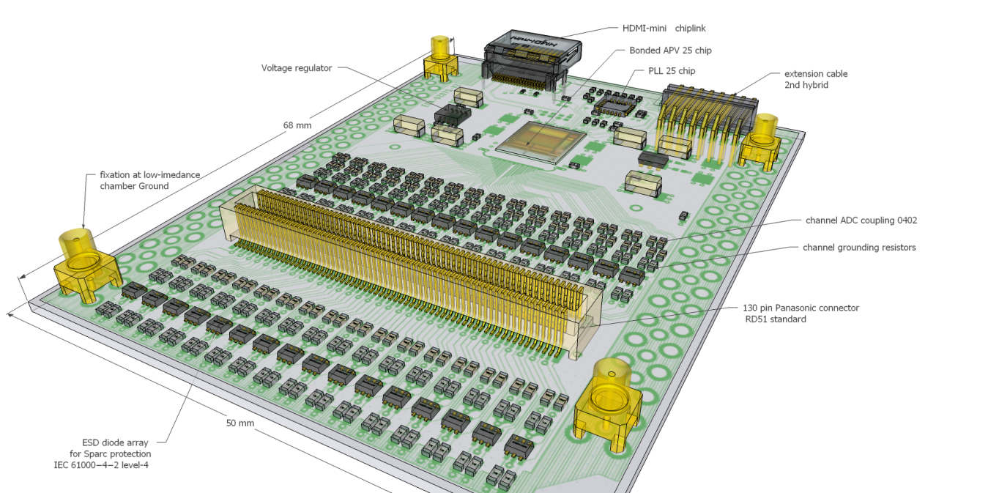
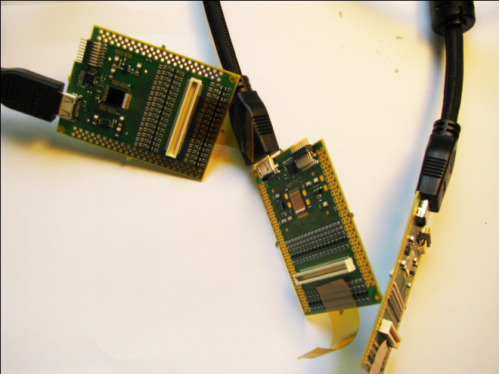
ADC frontend adapter
for APV and Beetle chips
ADC plugs into FEC to make a 6U readout
unit for up to 2048 channels
18 ADC V1.0 produced in 2010
18 ADC V1.1 waiting for production 2011
Frontend hybrids
so far all based on APV25 chip
Version 1 proto: 5 working
Version 2 users: 11
Version 3 systems: 16 (CERN PCB + bonding workshops)
320 (ELTOS + Hybrid SA ) = ongoing
FEC cards
Virtex-5 FPGA, Gb-Ethernet, DDR buffer, NIM and LVDS pulse I/O
High speed Interface connectors to frontend adapter cards
22 FECs V1.1 produced in 2010
16 FEC V1.3 ready for production
all users booked
Industrial partners survey for the production
24

Slide 25
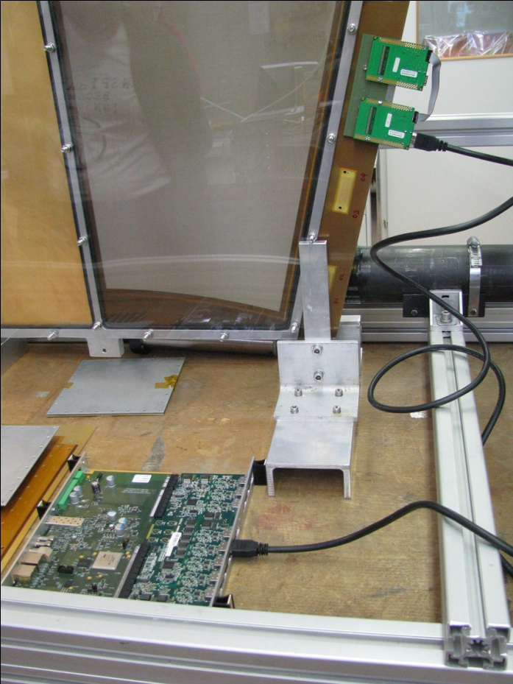
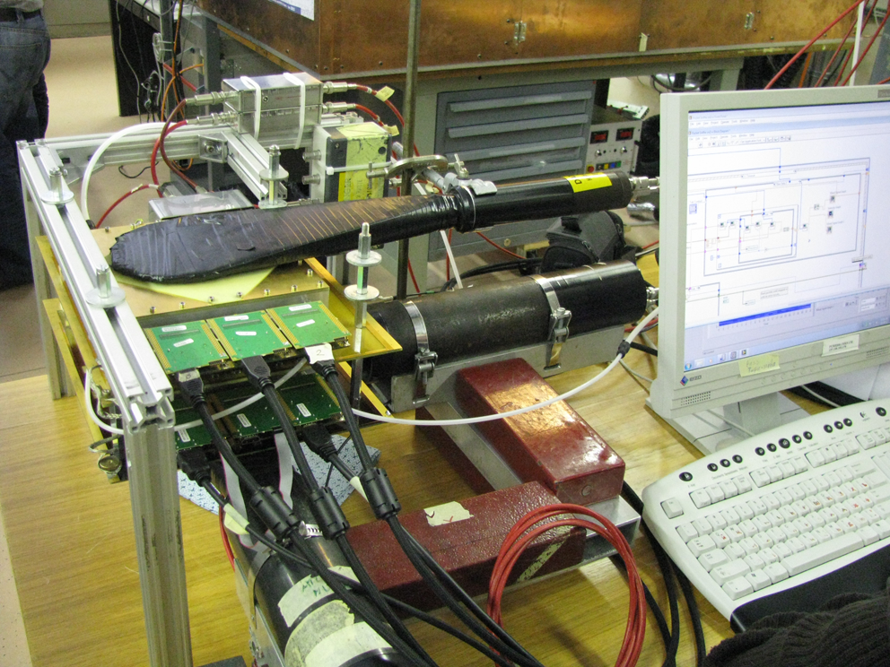
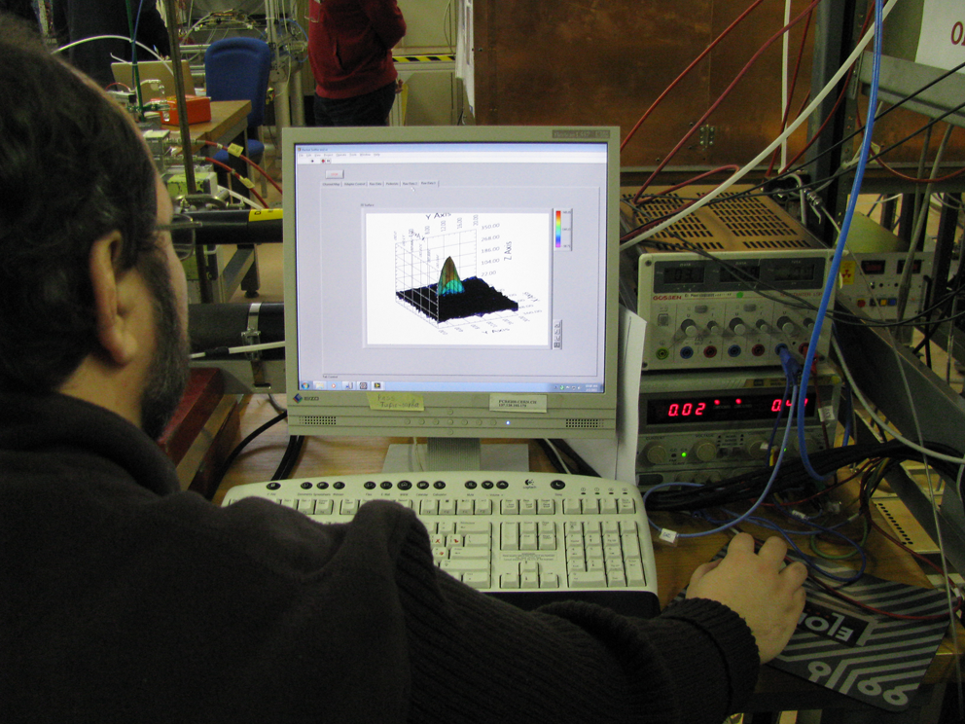
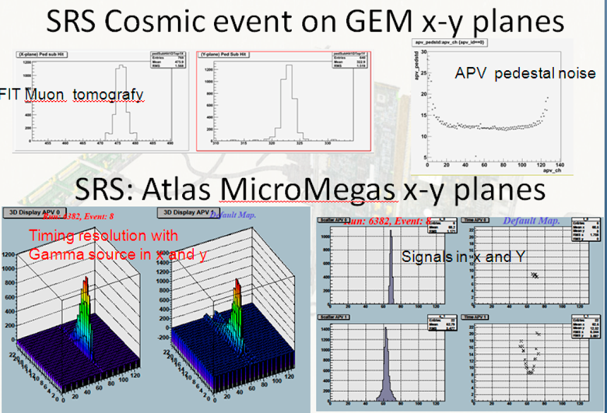
First SRS systems: ATLAS MAMMA
MicroMegas test with cosmic trigger
CSC –sized Micromegas
Online display

Slide 26
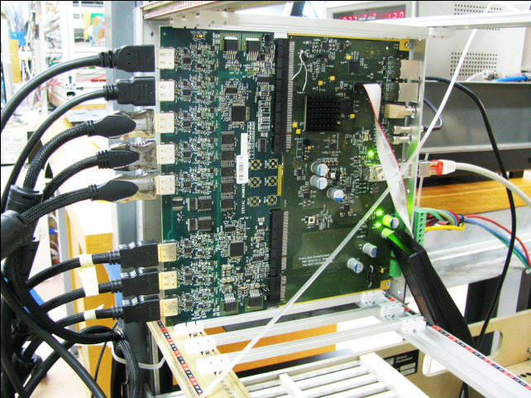
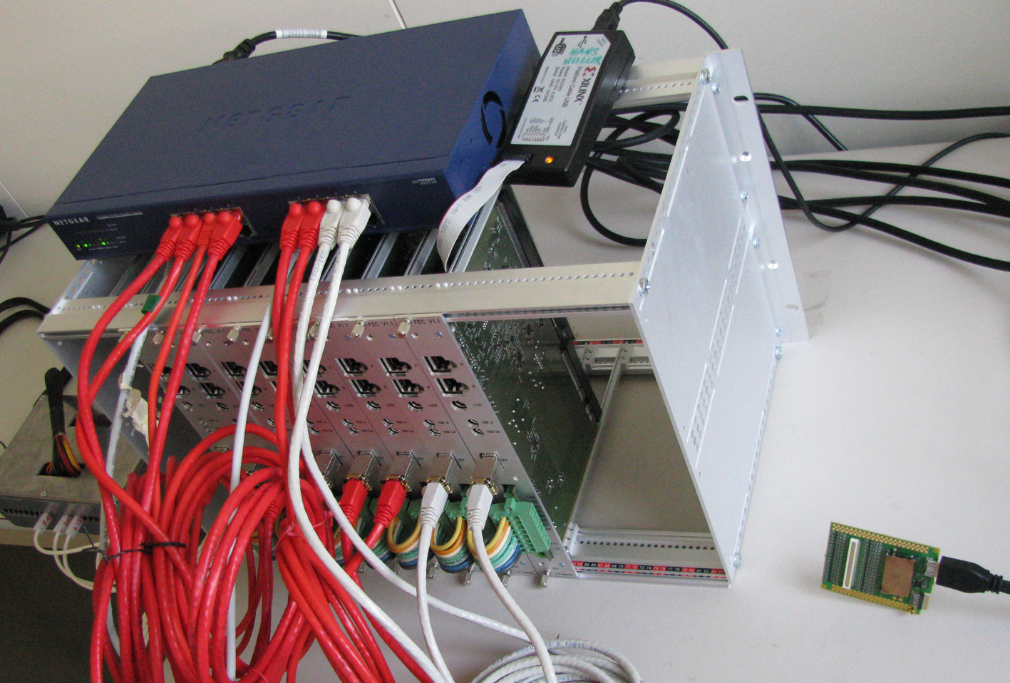
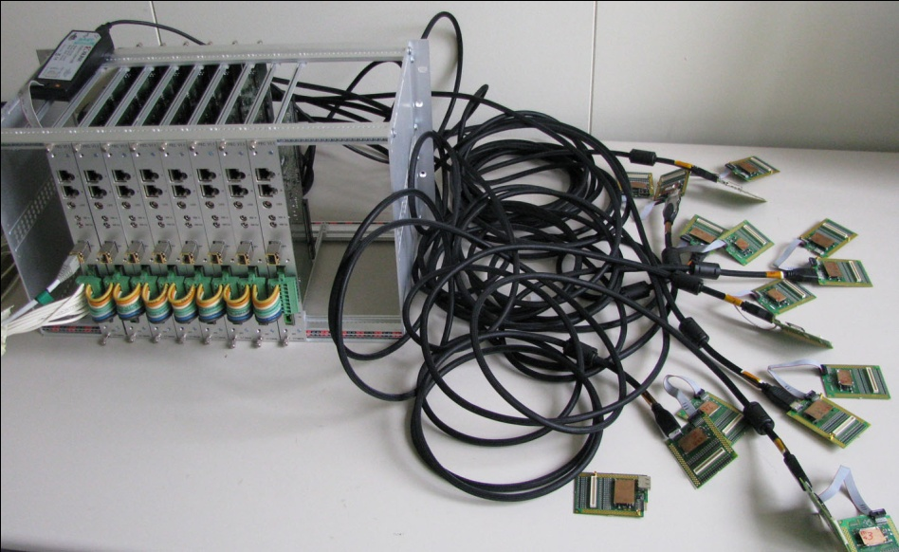
First SRS systems:
Florida Tech – muon tomography: 16 k channels
2010: first readout of cosmics with GEM
2011, March
Readout of 8 FEC’s via DATE/UDP and 1 GB switch successful
Now 2011: gearing up for 16 ch system
RD51 SRS system for homeland security
16k GEM channels-> 8 FECs -> GBe->DATE
16 of 148 APV hybrids 128 channels each

Slide 27
WG6: EN/ICE Workshop upgrade
History
  GEM 25mm x 25mm 1996
  THGEM 100mm x 100mm 1996
  GEM 330mm x 330mm 1998
  MicroMegas BULK 100mm x 100mm 2001
  MicroMegas BULK 600mm x 400mm 2003
  Total review of the processes
  GEM 1m x 450mm 2009
  MicroMegas BULK 1.5m x 500mm 2010
  THGEM 800mm x 400mm 2010

Slide 28
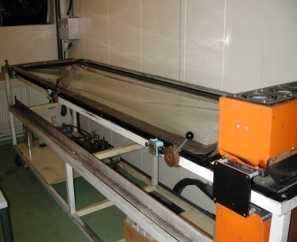
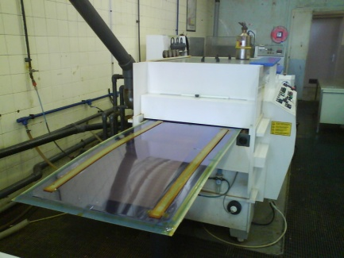
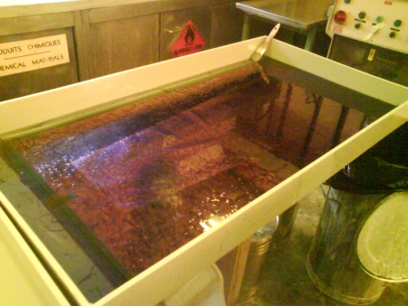
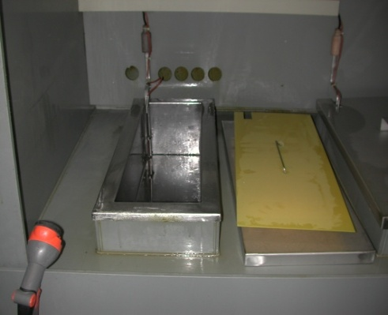
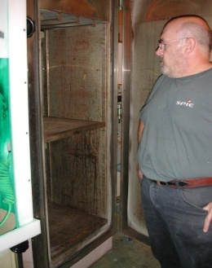
UV exposure unit limited to 2m x 0.6x → 2.2m x 1.4m
Resist developer limited to 0.6m width → 1.2m
Resist stripper
Copper etcher
Dryer
GEM resist stripping limited to 1m → 2m
GEM electro etch
GEM polyimide etch limited to 1m → 2m
Ovens limited to 1.5m x 0.6m → 2.2m x 1.4m

Slide 29
WG6: EN/ICE Workshop upgrade
Last year, agreement was reached with CERN management to purchase the subset of machines necessary to carry out R&D on large size GEM
(2m x 0.5 m) & Micromegas (2m x 1m) and the associated large size
read-out boards in the current CERN EN/ICE facility.
Additional funds for the workshop will come from the FP7 AIDA project
GEM market call for order ready
survey tender
  1 continuous polyimide etcher x x x 06/2011
  1 Cu electroetch line x x 06/2011
Micromegas
  1 large laminator x x x 06/2011
  1 large Cu etcher x 09/2011
  1 large UV exposure unit x x x 06/2011
  1 large resist developer x 09/2011
  1 large resist stripper x 09/2011
  1 large dryer x x x 06/2011
Machines should be available in 2011 → according to the schedule
29

Slide 30
MPGD production plan
Set up a production line being able to face most of the future requests for large
  MPGD productions (prototype and/or small productions)
First step: Find adapted machines for large size objects production
    -We are still in the purchasing process
    We need 9 new machines
    4 are at the installation process level
    2 are not yet delivered but the ordering process is done
    3 are at the market survey level
    Initial planning : all machines running mid 2011
    realistic planning : all machines running September 2011
Second step:
    -redefinition of all the process parameter related to the new equipments
    -small prototypes production for

Slide 31
WG6: EN/ICE Workshop upgrade
CERN investment:
  Equipments for large size GEM manufacturing (2m x 0.5m)
  Equipments for large size MicroMegas manufacturing (2m x 1m)
  Participation of 4 technicians (15% of their time)
AIDA contribution:
  Finance a technician during 2 years to:
    Set up the equipments
    Produce large prototypes for: (non exhaustive list)
      SLHC ATLAS Muon detector upgrade
      CMS Muon detector upgrade
      KLOE2 inner tracker (Frascati)
      STAR tracker
      Panda inner tracker (Munich)
      Florida Tech university (homeland security)
      ILC calorimeters (Lapp Annecy, Arlington Texas)
      Large area, High spatial resolution Tracker at Jefferson Lab
      Etc…

Slide 32

WG6: Technology Industrialization
Potential partners
THGEM Technology – ELTOS S.p.A. (Italy)
GEM Technology
New Flex (Korea, Seoul)
Tech-ETCH (USA, Boston)
Scienergy (Japan, Tokyo)
Keerthi Industries (India)
MicroMETAL GmbH (Germany, Muellheim)
Micromegas Technology
TRIANGLE LABS (USA, Nevada)
SOMACIS (Italy, Castelfidarco)
CIREA (France, CHOLET)
Industrial test runs for each technology foreseen in 2011 after selection of the best candidates
SACLAY bulk MicroMegas workshop
Very inventive detectors being tried.
Double-sided : coarse readout on one side, finer multiplexed readout on the other side
Bulk with thin meshes
Also trying thick meshes (90% cheaper)
The Saclay bulk workshop is now ready to help
Clas12 double sided bulk MicroMegas
32

Slide 33
WG6: Technology Transfer Network
CERN-Council-S/049,
September 7, 2009)
CERN-Council-S/068,
September 7, 2010)
2009: RD51 was proposed as a pilot case for the technology pooling
(MPGD technologies are owned by the organizations, members of the TTN)
“One-stop licensing for industry” (bridging the gap between institutes and industry)
The IP coming from the HEP research community is better identified and more visible
2010: In collaboration with RD51, TTN conducted an inventory of the technologies, expertise, production methods, test facilities and patents used
TTN plans to build several technology offers for the RD51/MPGD devices and developments (e.g. industrialization of SRS production )
33

Slide 34

WG6: Technology Transfer Network
Institution* | Country
CEA/IRFU | France
CERN
CHALMERS | Sweden
Copenhagen University | Denmark
CNRS/IN2P3 | France
DESY | Germany
EPFL | Switzerland
GSI | Germany
INFN | Italy
JSI Jožef Stefan Institute | Slovenia
PSI Paul Scherrer Institute | Switzerland
National Technical University of Athens | Greece
LIP | Portugal
STFC, Scientific & Technology Facilities Council | UK
University of Sofia | Bulgaria
inventory of the technologies, expertise, production methods, test facilities and patents
*TT Network members on September 2010,
CPAN/SPAIN officially applied for full membership,
KFKI, Hungary observer status
34

Slide 35




WG6: Technology Transfer Network
Cargo container
MPGD Tracking Detector (GEMs)
Example
hidden &
shielded
high-Z
nuclear
material
Θ
Θ
Gas
Electron
Multiplier
Detector
~ 1.5 cm
35
M. Hohlmann, RD51 Freiburg 2010

Slide 36




WG7: Test Beam Facility at H4 SPS
2011 RD51 beam allocation
24/June - 4/July (10 days)
9/August - 21/August (13 days)
17/October - 24/October (7 days)
GOSSIP/GridPix
THGEM for HCAL
THGEM for RICH
36

Slide 37


WG7: Test Beam Facility at H4 SPS
THGEM for RICH (upgrade for COMPASS)
GOSSIP/GridPix (NIKHEF) ATLAS inner tracker upgrade
THGEM for HCALs (Aveiro/Coimbra/UTA/Weizmann)
Resistive MicroMegas for JLAB and COMPASS (Saclay)
MicroMegas TPC for nuclear physics (Demokritos Athens)
GEM for CMS High-Eta upgrade
GEM for TOTEM T1 upgrade
Micromegas TPC for ILC (Saclay)
DHCAL Micromegas for CALICE
THGEM for HCALs (Aveiro/Coimbra/UTA/Weizmann)
DHCAL Micromegas
CMS High-Eta & TOTEM T1 upgrades
37

Slide 38
Summary and Outlook
consolidation of the Collaboration and MPGD community integration
considerable progress in MPGD technologies in particular large area GEM ,THGEM, Micromegas; some picked up by experiments (including sLHC upgrades) for feasibility studies and prototyping
secured future of the MPGD technologies development through the EN DEM workshop upgrade and FP7 AIDA contribution (upgrade in progress)
improved MPGD simulation software framework allows for the first applications
Infrastructure for common RD51 test beam facility (~20 user groups)
Development of common, scalable electronics (17 development and user groups)
TTN; contacts with industry for large volume production
38

Slide 39
2011 RD51 request
Resources requested from CERN as a host lab:
RD51 does not request a direct financial contribution from CERN.
The collaboration would like to ask for the following resources and infrastructure at CERN:
• Access to irradiation and test beam facilities (including the possibility to keep “semipermanent” setup). The collaboration foresees typically 2 annual test beam campaigns each of a few weeks duration.
• Privileged access to CERN TS-DEM Printed Circuit Workshop (similar to present
availability level). Participation in investments for production infrastructure to stay in line
with technology advances.
• Access to Silicon Bonding Laboratory
• Access to central computing resources and Grid access for MPGD simulations.
• Limited amount of office space

Slide 40


Excellence in Detectors and Instrumentation Technologies
CERN, Geneva, Switzerland - 31 January - 10 February 2011
“GEM Detectors”
The principles of GEM-based detectors and their applications will be explained. GEM detectors will be
assembled, and afterwards tested in X-ray stands. Concepts such as detection of X-rays will be explained and
pulse height gain, and counting rate measurements will be carried out.
Professors of excellence and Tutors: L.Ropelewski, G.Bencivenni
“GridPix and Micromegas”
The set-up consists of two tests stations:
A complete GridPix/Gossip detector(s): PolaPix, Dice, Gossip including gas system, new miniHV supplies and
readout systems. Students will operate the set-up and take data with various sources and cosmic rays, followed
by data analysis: track fitting, dE/dX, interaction of ionization radiation with gas.
The second set-up consists of a 10x10 cm2 bulk Micromegas read out by a charge preamp, amplifier- shaper and
a Multi-Channel analyzer, and a 1726-channel TPC in a gasbox, read out by T2K electronics. Fundamental
concepts such as X-ray conversion, diffusion, electron collection and gas amplification will be understood via
measurements with a full DAQ and analysis chain.
Professors of excellence and Tutors: H.van der Graaf, P.Colas
40

