Slide 1
Do physics textbook writers understand physics?
Oliver Zajkov, Boce Mitrevski
Ss Cyril and Methodius University,
Faculty of Natural Sciences and Mathematics,
Skopje, Macedonia
International Conference on Physics In Memoriam Acad. Matey Mateev
Sofia University “St. Kliment Ohridski, Sofia, Bulgaria, April 10-12, 2011

Slide 2
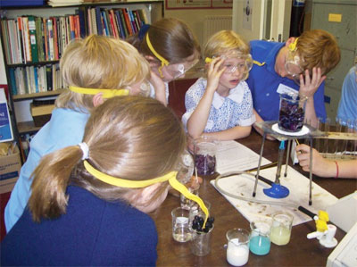
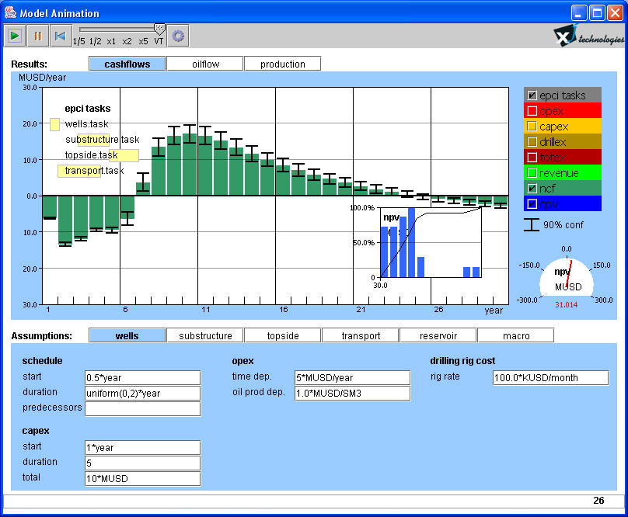





Slide 3
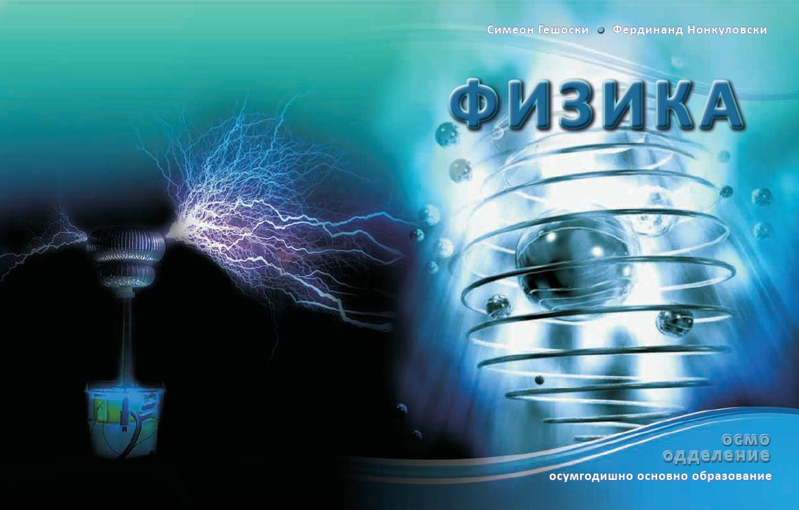
Electricity and magnetism
Electricity and magnetism
Oscillations and waves. Sound
Optical phenomena
Atomic and nuclear physics
Interaction electric current –
- magnetic field
Electromagnetic induction

Slide 4
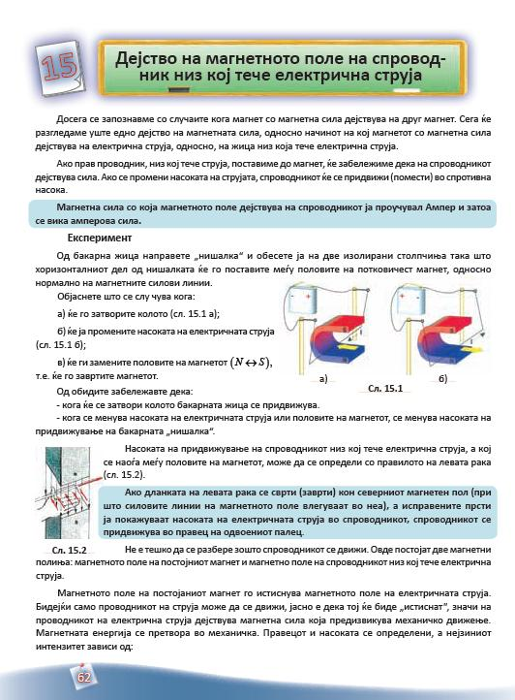
If a strait wire, through which electric current flows, is set close to a magnet, we will see that a force acts on the wire.
We can not see that a force acts on the wire. We will see that the wire is moving from which we can assume, or make a hypothesis, that there is a force acting on the wire. This is good way of training students how to analyze and teach them how to make wrong assumptions and conclusions.

Slide 5
It is not difficult to understand why the wire moves. There are two magnetic fields: one of the permanent magnet and the other one of the wire through which electric current flows.
From the critical thinking point of view this approach does not stimulate higher order thinking. Instead of convincing the student that it is not difficult to understand the reason why the wire is moving, the writer should give questions and activities.

Slide 6
The permanent magnet magnetic field squeezes out the magnetic field of the wire. Since only the wire can move, it is clear that the wire will be squeezed out, that is magnetic force acts on the wire which produces mechanical motion.
The word "squeeze" is suitable for toothpaste, but not for magnetic fields.

Slide 7
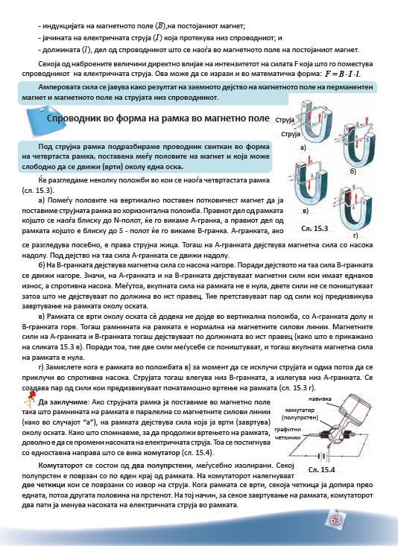
The Ampere's force appears as a result of the interaction between magnetic field of the permanent magnet and magnetic field of the current through the wire.
This is a good source of misconception. The students can easily conclude that there is a magnetic field in the wire, which is a common misconception among the students.

Slide 8
Current frame is a conductor in the form of a rectangle, placed between the poles of a magnet and that can rotate around an axis...
Should the current frame always be in a form of a rectangle?

Slide 9
Then, a magnetic force acts on the A - branch directed downwards.
There is no application of the knowledge acquired earlier - the rule of the left hand. The information is given straight, without explanation. The same is with the case of B - branch.

Slide 10
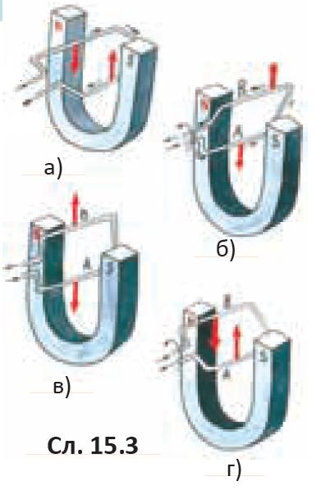
Imagine, when the frame is in the position (v) if we disconnect the electric current and immediately connect again in the opposite direction. Then, the current goes into the B - branch, and comes out from the A - branch. A pair of forces is created which causes further rotating of the frame.
The students can get a wrong impression that when the current changes its direction, the forces start acting in the directions which are normal to the previous ones, and not opposite. Actually, the directions of the forces will be opposite and the forces will be in equilibrium, like they were before.

Slide 11
Imagine, when the frame is in the position (v) if we disconnect the electric current and immediately connect again in the opposite direction. Then, the current goes into the B - branch, and comes out from the A - branch. A pair of forces is created which causes further rotating of the frame.

Slide 12
F
B
F

Slide 13
F
I
Imagine, when the frame is in the position (v)
if we disconnect the electric current and immediately connect it again in the opposite direction,
a pair of forces is created which causes further rotating of the frame
B
I
F

Slide 14
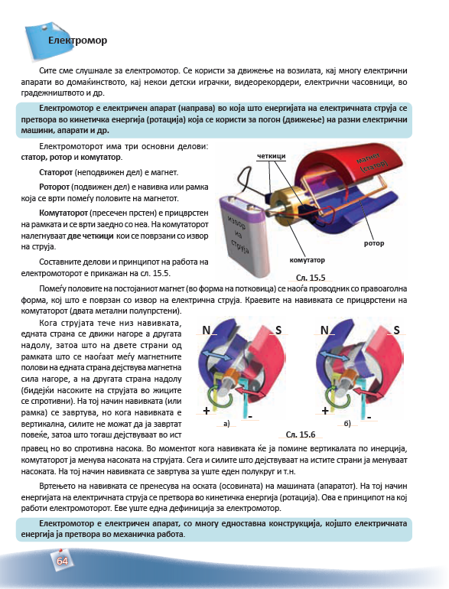
There is a rectangular conductor between the poles of a permanent magnet, which is connected to electric power source.
Before this, the writer explains that the electric motor consists of armature (rotor), commutator and a field magnet (stator).
After that the writer explains that "there is a conductor in a rectangular shape, between the poles of a permanent magnet", which implies that beside the armature there is another frame.

Slide 15
Electric motor is a device in which the energy of the electricity is converted into kinetic energy (rotation), that can be used for versatile electric devices.
The authors give two definitions for electric motor. They use different words, so the definitions are slightly different, for an experienced person. But for students, it can be confusing. Is this a new definition? Do I have to know both definitions? ...
Electric motor is a electric device with very simple construction, which converts the electrical energy into mechanical work.

Slide 16
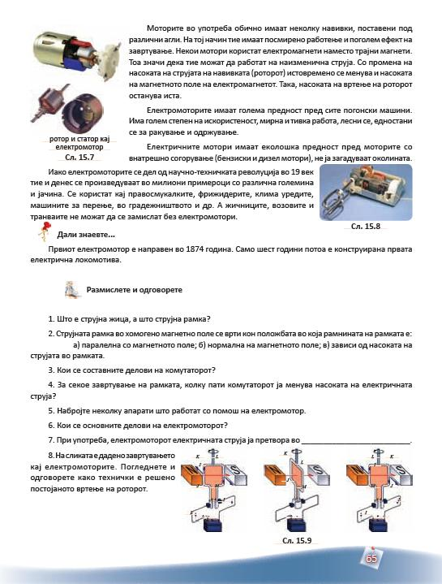
There are several coils in the electric motors which are in use, placed in different angles. In that way, they work more calm and have bigger turning effect.
What does "placed in different angles" mean?
What does "they work more calm" mean? And who are “they”? Motors or coils?
Does it mean that they rotate slower?

Slide 17
Some electric motors use electromagnets rather then permanent magnets. Thus, they can work with alternating current.
Just by replacing the permanent magnets with electromagnets, they are able to use alternating instead direct current ???

Slide 18
When was the FIRST electric motor invented?
1821 Michael Faraday , the first device that converts electrical into mechanical energy.
1828 Anyos Jedlik, the first device that contain three main components: stator, rotor and commutator.
1832 William Sturgeon, the first electric motor capable of turning machinery.
1837 Emily and Thomas Davenport, the first commercial electric motor.
1873 Zenobe Gramme, the first modern electric motor.
1886 Frank Julian Sprague, the first non-sparking DC motor.
1887 The first electric trolley system with Sprague’s motors.
1892 The first electric subway.
1888 Nikola Tesla, the first practical AC motor
The first electric motor was constructed in 1874. Only 6 years later, the first electric train was constructed.

Slide 19
?????
What is current wire and what is current frame?

Slide 20
CURRENT
2.
3. What are the parts the commutator consists of?
4. How many times the commutator changes the direction of the current for each turn of the frame?
5. List few devices that use electric motor.
6. Which are the basic parts of an electric motor?
7. The electric motor converts the electric current into _________________.
Knowledge of the first lowest level according to the Bloom’s taxonomy

Slide 21
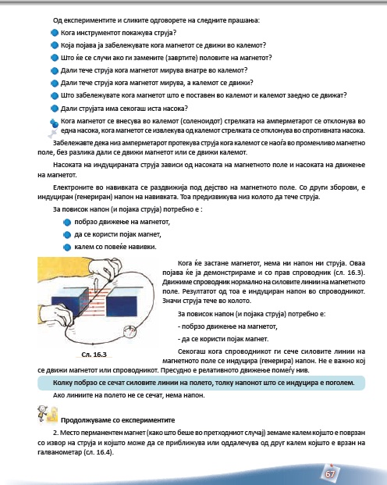
With help of the experiments and the figures give answers to the followingquestions:
...
What will happen if you change (rotate) the poles of the magnet?
If the students are supposed to give answers on the basis of the experiments and figures in the textbook then they can not give answer to this question, because it is not explained.
This can be a new task, new experiment for the students, but not question.

Slide 22
You have noticed that electric current flows through the coil, when it is placed in an alternating magnetic field.
I am not sure that the children will find where is this alternating magnetic field, when permanent magnet is used.
Alternating magnetic field is not mentioned in any moment in the textbook.
Relation motion/alternating magnetic field

Slide 23
The electrons in the coil are animated by the magnetic field. In another words, voltage is induced in the coil. This causes current to flow through the circuit.
The term "animated" is not suitable in this case. The electrons are in motion all the time. The difference in potential only directs them …
The next sentences are not wrong, but if it is left on this level, without any further explanation, then it is good bases for misconceptions. The students will think that whenever there is voltage, then there is always electric current, which is a common misconception.

Slide 24
In order to obtain higher voltage (higher current) it is necessary to:
This is also a good ground for same voltage-current misconception.

Slide 25
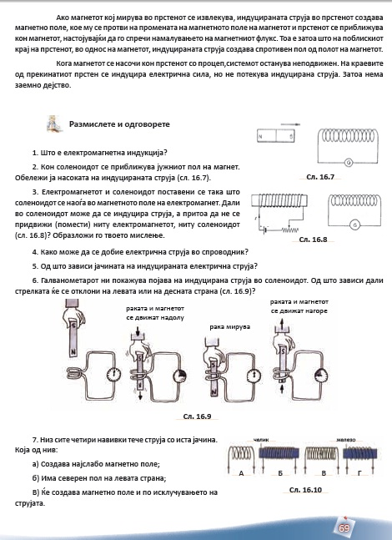
How can we obtain electric current in the conductor?
Another sentence which may give rise to development of the voltage-electric current misconception.

Slide 26
The galvanometer shows that there is induced current in the solenoid. In which case the indicator will deflect on the left and in which case on the right side?
This is repetition. This task was already done before. Is this a new experiment or question...?

Slide 27
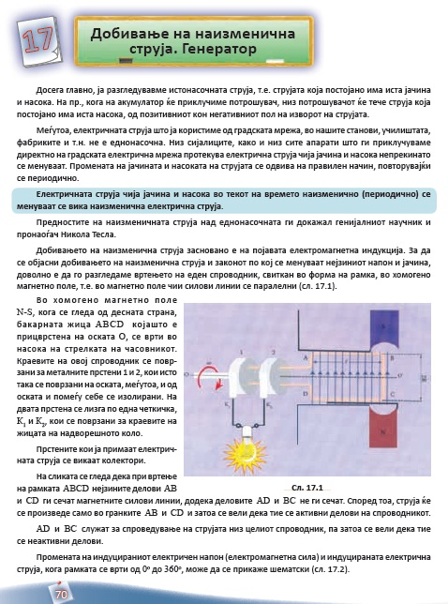
All of a sudden the authors introduce a concept "electromagnetic force", which is confusing.
There three errors.
1.“electromagnetic force” -> "electromotive force".
2. Didactical point of view. This concept should have been introduced earlier.
3. Scheme -> diagram
The scheme of the change of the induced voltage (electromagnetic force) and the induced electric current, when the frame rotates is shown in fig 17.2.

Slide 28
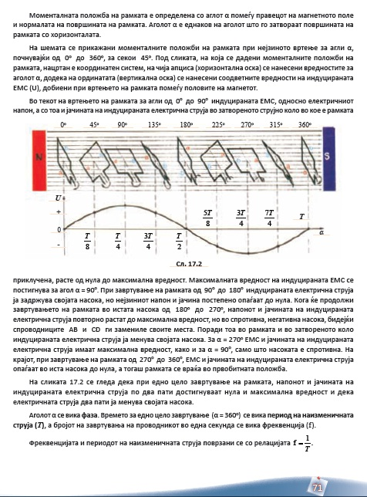
The position of the frame is defined by the angle α, between the direction of the magnetic field and the normal of the plane in which the frame lies. The angle α is equal to the angle between the plane and the horizontal direction.
The difference between α and Angle (Frame, Horiz.) is 90º

Slide 29
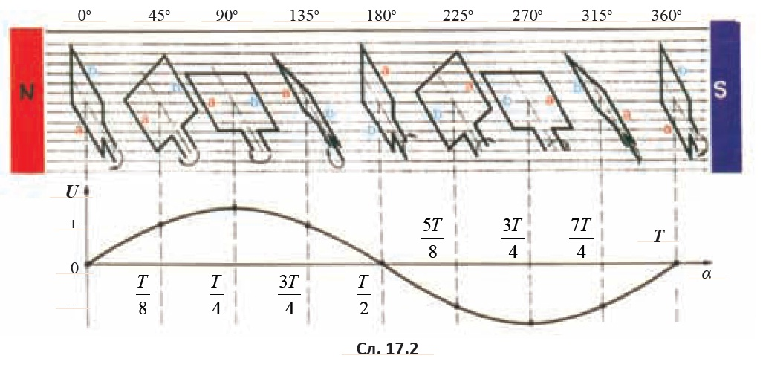
... on the horizontal axis of the diagram are the values for the angle α
Angle α in time units
Wrong values on the horizontal axis

Slide 30
... on the vertical axis of the diagram are the values for the EMF (U)…
EMF ???
... but the voltage and the current gradually decrease …
Voltage – current misconception

Slide 31
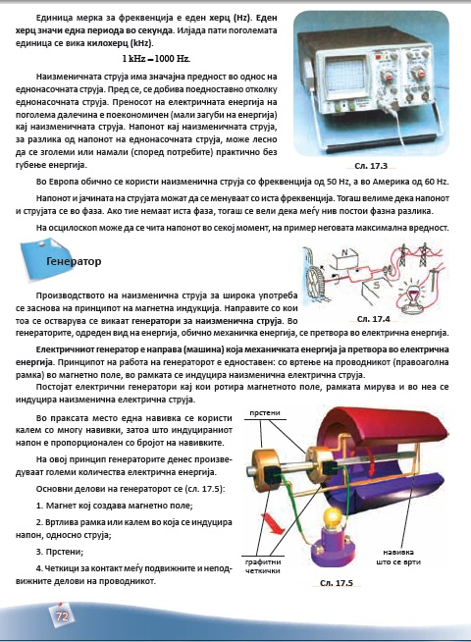
One hertz is one period per second.
The alternating current have significant advantages compared to the direct one. Before all, it is easier to produce it then the direct current.
The voltage and the current can have the same frequency ... In this case we say that there is not phase difference between the voltage and the current.
In practice, instead of one frame, a coil with many loops is used, because the induced voltage is proportional with the number of the loops.

Slide 32
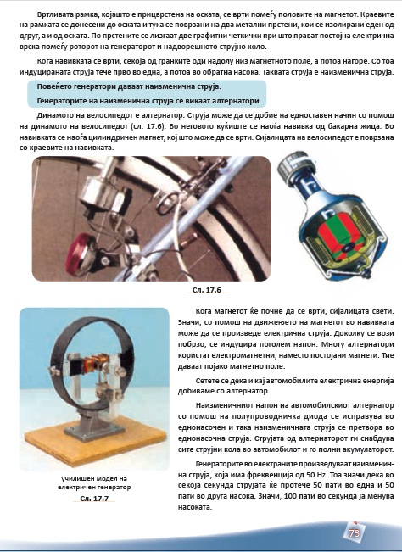
The children can not recall an information if it is not given before. Instead, they can be given a task, to obtain an information how the electric energy is produced in the cars.
Recall that the electric energy in cars is produced by alternators.
The alternating voltage in the cars is transformed into direct voltage by the semiconductor diode.
The students will learn about semiconductors and diodes later.

Slide 33
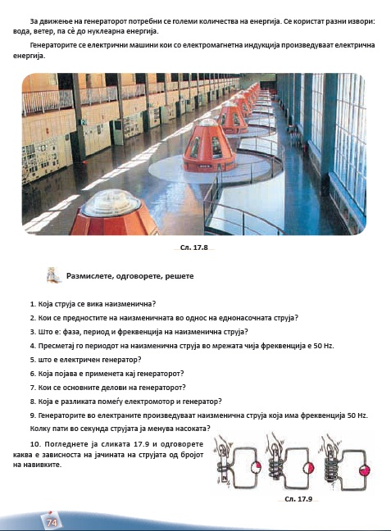

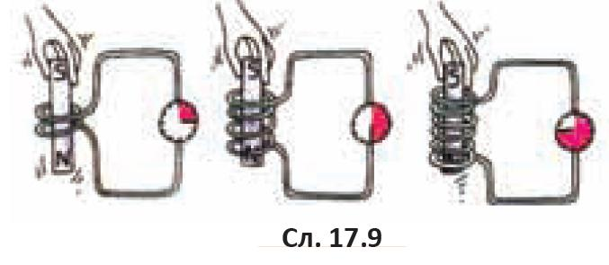
misconception
Voltage - current
The students will learn about semiconductors and diodes later.
See fig. 17.9 and answer how the electric current depends on the number of loops.

Slide 34
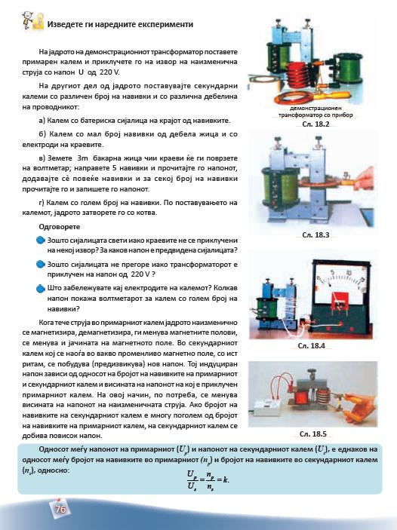
Place the primary coil on the core of the transformer and plug it into the mains with voltage of 220 V.
Take cooper wire 3 m long, make 5 loops, connect it to a voltmeter and look at the scale. What is the voltage? Add more and more loops read the voltage for each change of the loops.
The authors propose to the children to use the mains and voltage of 220 V very easy, without any safety recommendations.
Is this possible?

Slide 35
Why the light bulb did not burn although it is connected to 220 V?
I am not sure that the bulb will not burn. It depends on the number of loops in the secondary coil, the voltage in it and the operational voltage of the bulb. The experiment is not well prepared, like may other experiments in the textbook.

Slide 36
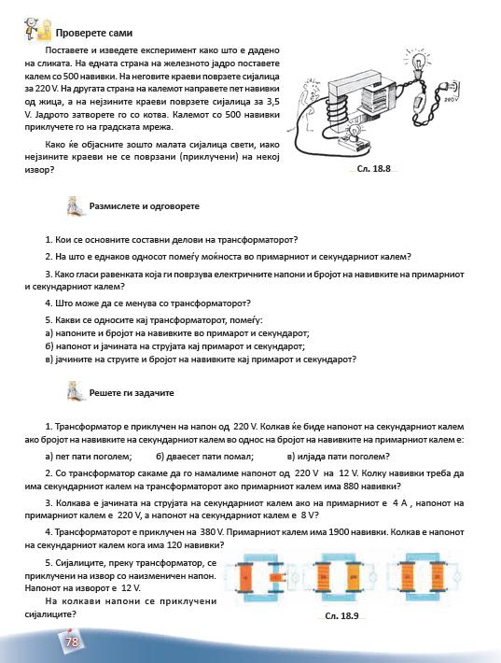
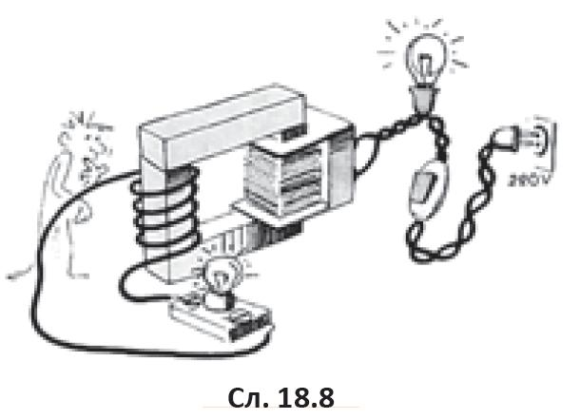
Set and perform the experiment as it is given in the figure. On one side of the core place coil with 500 loops. Connect light bulb with operating voltage of 220 V. On the other side make 5 loops and connect light bulb with operating voltage of 3,5 V. The coil with 500 loops connect to the mains.
It is not possible to see how to build the circuit. One can only guess.

Slide 37
Conclusion
Beware of textbooks
simulation creators
learning tools creators
Do physics textbook writers understand physics?

Slide 38
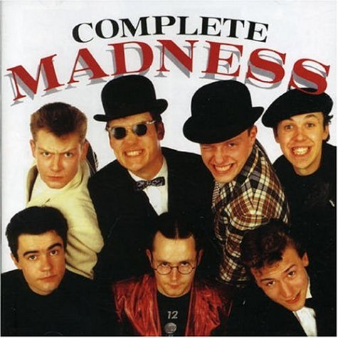
Conclusion

