Slide 1
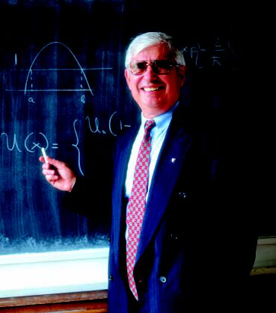
Scientific Activity of Professor M. Mateev (1940 – 2010)
(in memoriam)

Slide 2
A) Main research topics of Matey
B) Activity of Acad. M. Mateev in Scientific organizations and in scientific institutions
General directions of the talk

Slide 3
Main research topics
Quantum field theory
A.1Quasipotential approach to the relativistic two-body problem
A.2 Quantum field theory and the hypothesis of the fundamental length. The model of maximal mass.
Condensed matter physics
B.1 Studies on high temperature superconductivity
B.2 Microgravity experiment
Neutrino and astroparticle physics
Experiment Na-49, CERN

Slide 4
Activity of Acad. M. Mateev in scientific organizations and scientific institutions
Activity in
ICTP (International Center for Theoretical Physics – Trieste)
JINR – Dubna
Committee of Science (bulgarian government body)
University Center for Space Research (Sofia University)
CERN
contribution for bulgarian membership in CERN
Research and organizational activity

Slide 5
Union of Physicists in Bulgaria (President 2001 – 2010)
European Physical Society
Balkan Physical Union (Vice – President 1997 – 2003)
IV- th General Conference of BPU (Velico Tirnovo, 2000, Chairman of the Organizing Committee)
Bulgarian Journal of Physics (Editor-in-Chief, 1993-2010)
Bulgarian representative for ITER (2006 – 2009)

Slide 6
Conclusion
Professor Mateev as lecturer:
The capability to expose the most complicated problems using understandable, profound and precise manner.
Matey liked life.
Let we preserve good memory for him!

