Slide 1

A boost for a whole life
Dedicated to the memory of my teacher Prof. Mateev
M.V. Chizhov
(Sofia University and JINR)

Slide 2
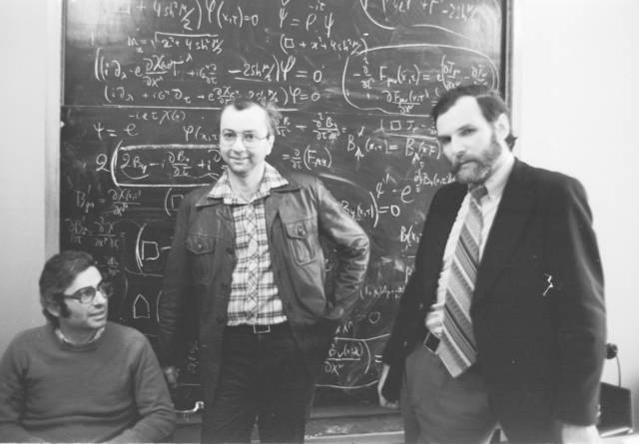
Beginning in Dubna …

Slide 3
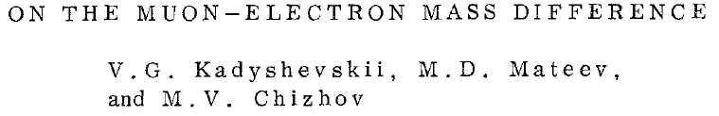
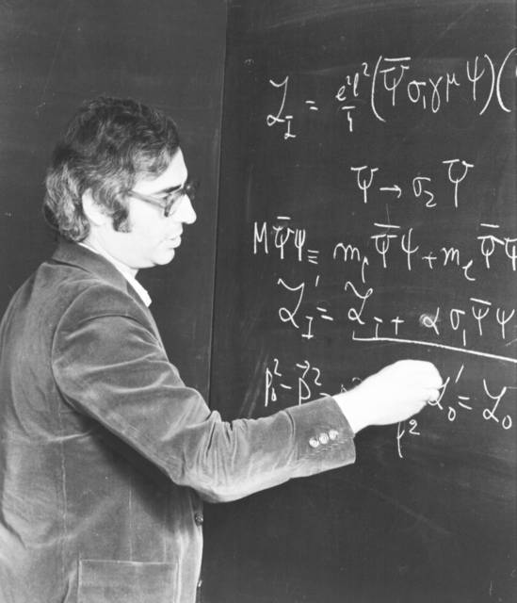
Heisenberg
Schwinger
Bogolyubov
Fröhlich
Thirring
Nambu – Jona-Lasinio
Vaks – Larkin
Arbuzov – Tavkhelidze
– Faustov
Kirzhnits
Gross – Neveu

Slide 4
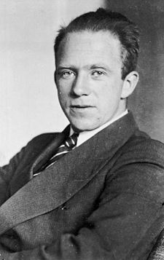
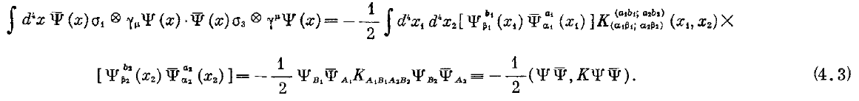
Fundamental interaction
Heisenberg’s four-fermion
universal interaction
Γ
Γ

Slide 5
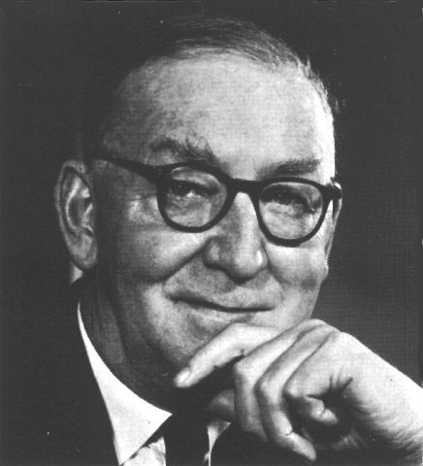
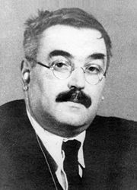

Mean-field approximation method
Hartree
Fock
Bogolyubov

Slide 6
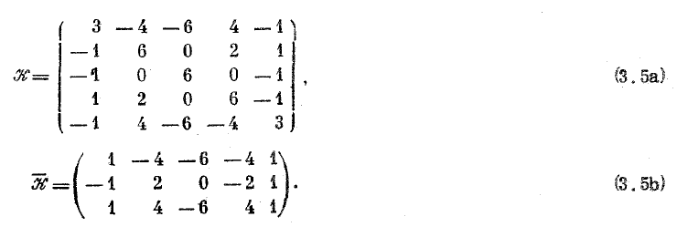
New Fierz identities
for ΨΨ and ΨΨ
Diquark excitations, color superconductivity…

Slide 7
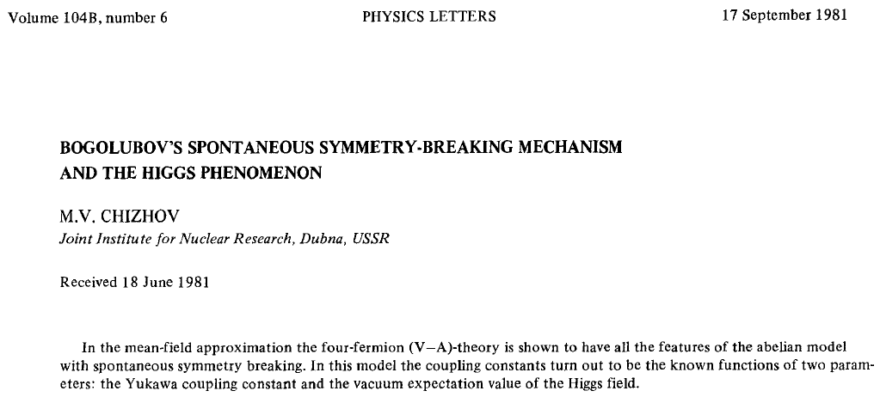
Dynamical generation of composite particles

Slide 8
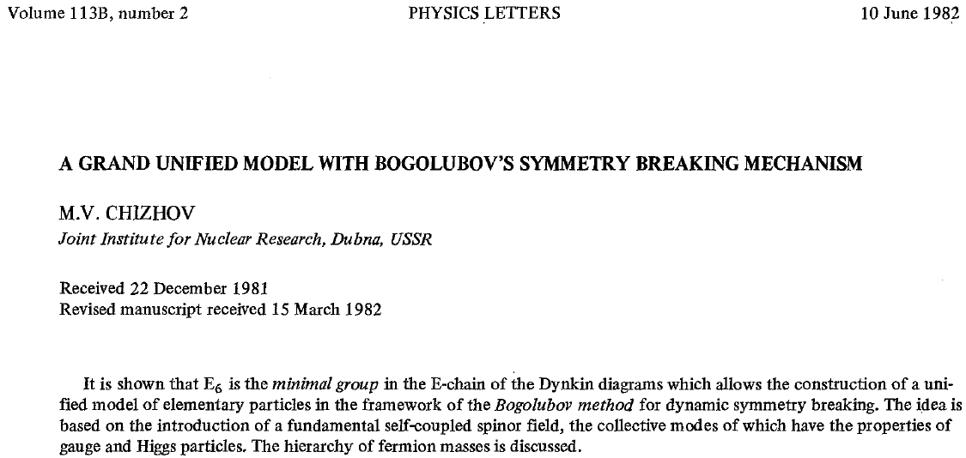
E₆ as the minimal group for BSBM

Slide 9
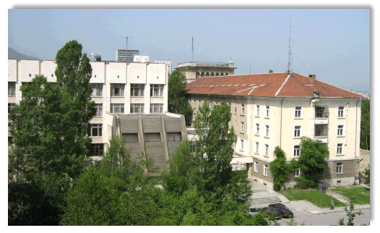


… continuation in Sofia
(and Pravetz)

Slide 10
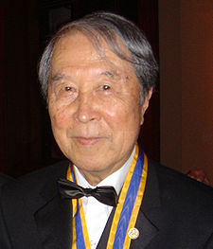
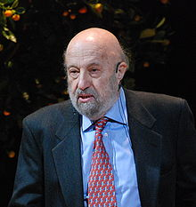
Nambu – Jona-Lasinio extended model

Slide 11
Lorentz group representation
Parity transformation
Charge conjugation
S=1/2
S=1
W*
W
W’
W*

Slide 12
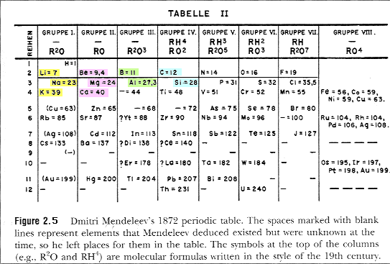
Mendeleev’s table

Slide 13
Lorentz group representations
χ
-2 -3/2 -1 -1/2 0 +1/2 +1 +3/2 +2
S
0
1/2
1
3/2
2
(0,0)
(1/2,0)
(0,1/2)
(1,0)
(1/2,1/2)
(0,1)
(3/2,0)
(1,1/2)
(1/2,1)
(0,3/2)
(2,0)
(3/2,1/2)
(1,1)
(1/2,3/2)
(0,2)

Slide 14
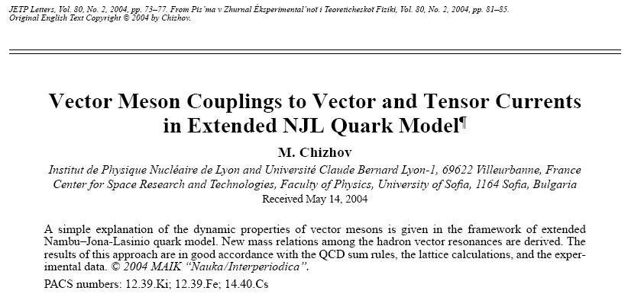

Slide 15
Spin-1 states
Chiral representation
V_{μ} + A_{μ}
(Parity)
~
~
T_{μν} + T_{μν}
T_{μν} − T_{μν}
V_{μ} − A_{μ}
Polar-Axial representation
mixing
V_{μ} (1⁻ ⁻)
(1⁻ ⁻)V_{μ}*
^{ν}T_{μν}
(J^{PC})
(1⁺ ⁻)A_{μ}*
~
A_{μ} (1⁺ ⁺)
^{ν}T_{μν}

Slide 16
Spin-1 meson table
I
1 0 1/2
J^{PC}
1⁻ ⁻ ρ, ρ’ ω, ω’; φ, φ’ K*, K’*
1⁺ ⁺ a₁ f₁ K_{a1}
1⁺ ⁻ b₁ h₁ K_{b1}

Slide 17
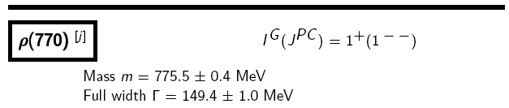
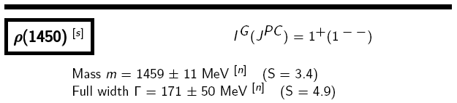
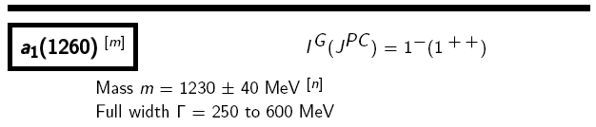
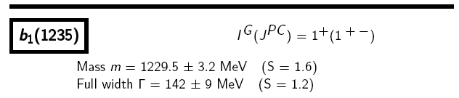
Spin-1 hadron resonances
M.Chizhov, JETP Lett. 80 (2004) 73
mixing

Slide 18
New mass relation

Slide 19
Other new mass relations
2(m_{ρ’} −m_{ρ})² + 3m_{ρ’} m_{ρ}
I^{G} = 1⁺:
= 0.96 ± 0.03
3(m_{b} )²
2(m_{ω’} −m_{ω})² + 3m_{ω’} m_{ω}
I^{G} = 0⁻:
= 1.01 ± 0.07
3(m_{h} )²
I^{G} = 0⁻: h₁(ss)? m_{h} (m_{φ’} ,m_{φ}) = (1415 ± 13) MeV

Slide 20
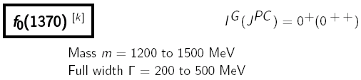
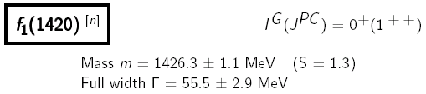
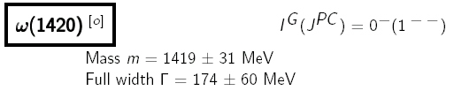
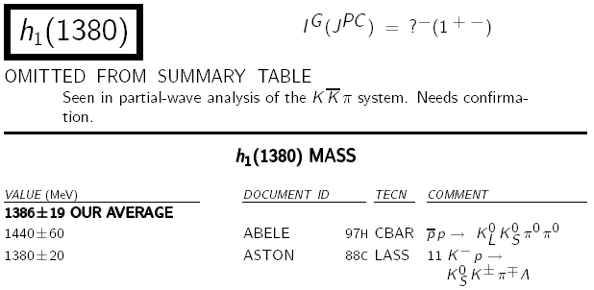
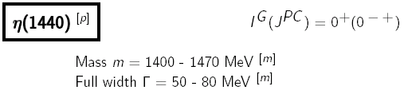
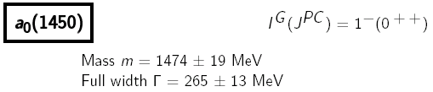
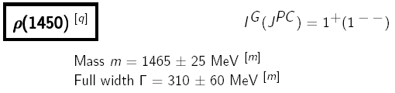
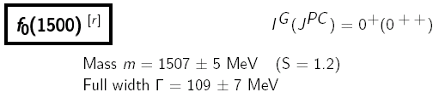
Meson Summary Table
0⁻ (1⁺ ⁻ )
m = 1415 ± 13 MeV ?

Slide 21
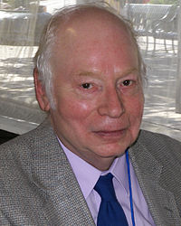
“The making of the Standard model”
S. Weinberg, Eur. Phys. J. C 34 (2004) 5
“I supposed that the vector gauge boson of this theory (of the strong interactions) would be the ρ-meson, while the axial-vector gauge boson would be the a₁ meson.”
“… but I was applying it to the wrong kind of interactions.
The right place to apply these ideas was not the strong
interactions, but to the weak and electromagnetic
interactions.”
Nature provides us with one more type of
axial-vector bosons b₁ and h₁.
What is their role for the high energy physics?

Slide 22
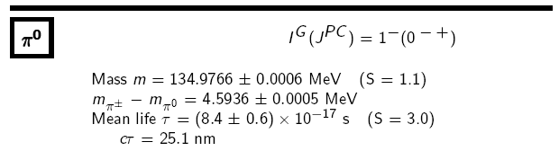
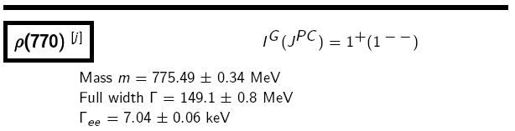
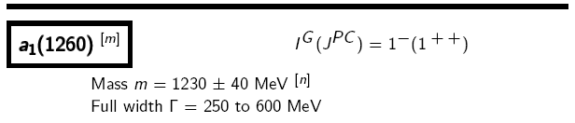
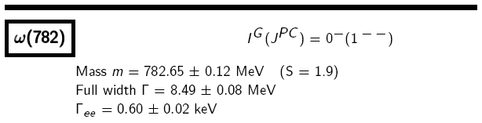
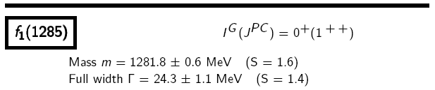
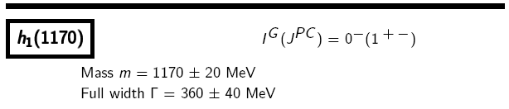
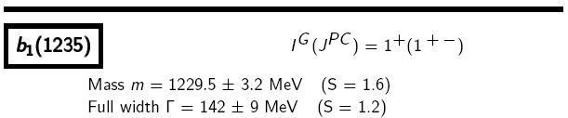
Technicolor
techni-pion, techni-ρ, techni-ω …
What’s esle?
?
?
?

Slide 23
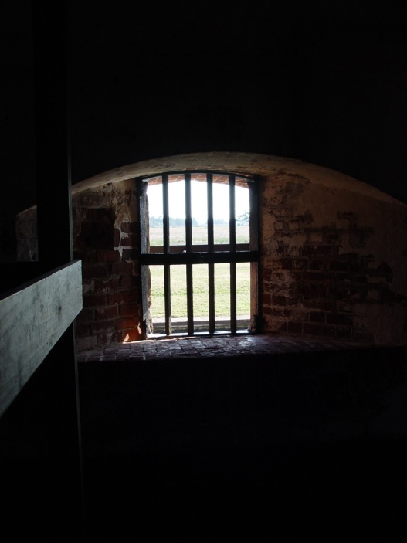
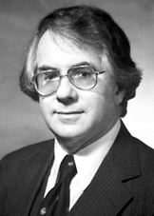

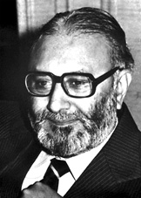
Can we escape from SM prison?
Dark
matter
Inflation
Gravitation
Baryon
asymmetry
Hierarchy
problem
SM slave

Slide 24
Motivation for SM extension
The main theoretical motivation for beyond the Standard Model physics around TeV energies (LHC) is provided by the Hierarchy Problem, an inexplicable the UltraViolet stability of the weak interaction scale
(M_{W,Z} = 10² GeV) versus the Planck mass (M_{P} = 10¹⁹ GeV),
WHY IS M²_{W,Z}/M²_{P} = 10⁻³⁴ ?
Introduction of new spin-1 bosons with the internal quantum numbers identical to the Standard Model Higgs doublet can help to solve by the Hierarchy Problem.
M_{W,Z}
M_{W*,Z*}
M_{P}
10² GeV
10³ GeV
10¹⁹ GeV
M. Chizhov and G. Dvali “Origin and Phenomenology of Weak-Doublet Spin-1 Bosons”, arXiv:0908.0924

Slide 25
We predict an existence of new excited
chiral particles W* and Z* with new
unique properties.

Slide 26
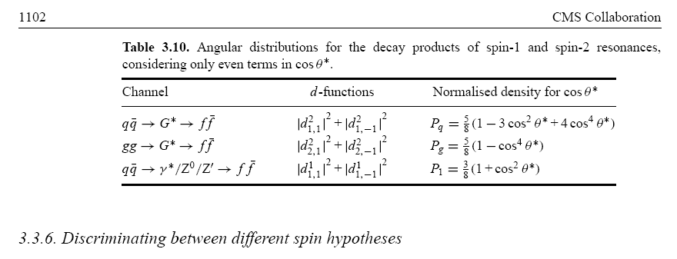
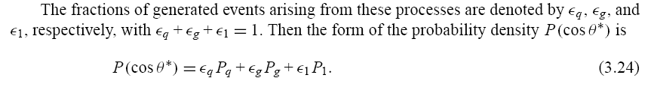
Z’, graviton and Z* angular distributions
ATLAS is already looking for them!

Slide 27
Theoretical comparision between Z’ and Z*
M. Chizhov, Disentangling between Z’ and Z* with first LHC data, arXiv:0807.5087
invariant mass
transverse momentum
pseudorapidity difference
angular distribution

Slide 28
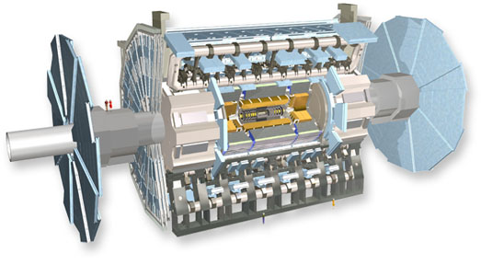

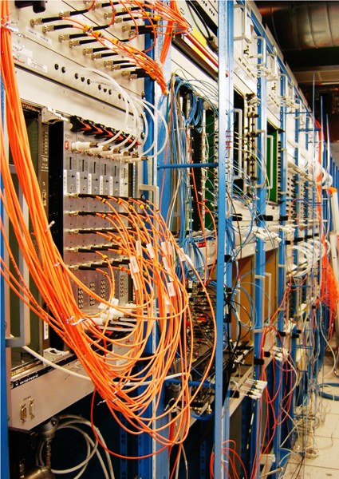
The ATLAS project is an international collaboration involving 38 countries, more than 3000 physicists and 1000 students from more than 174 universities and laboratories.

Slide 29
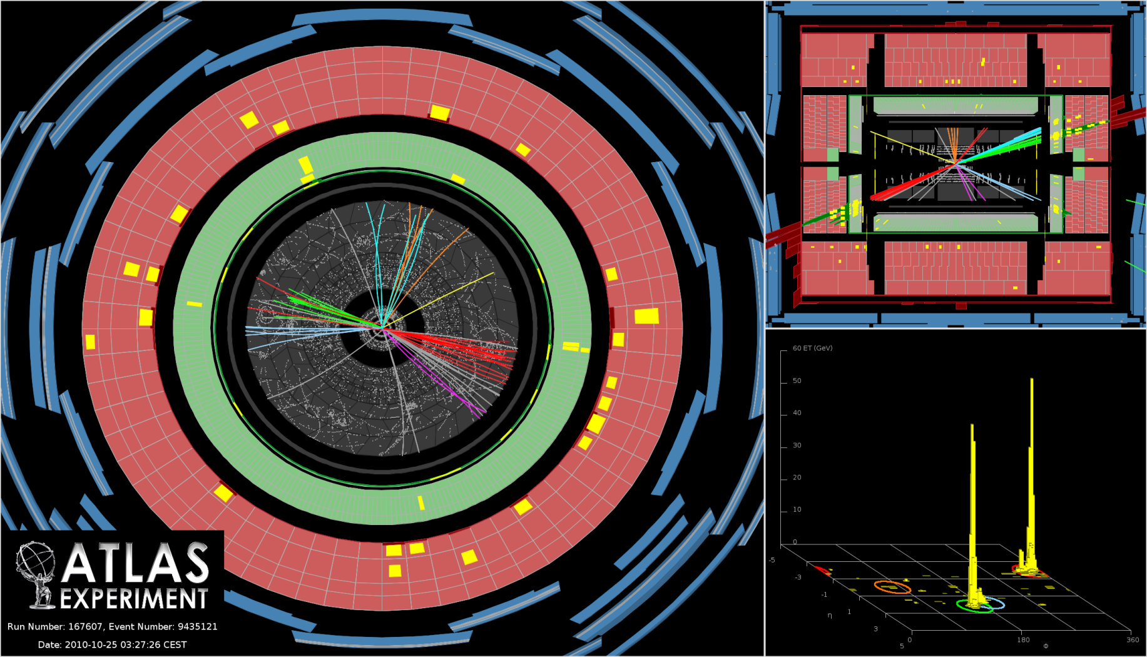
Event display of Run 167607, Event 9435121.
This shows the highest-mass dijet event collected during 2010, where the two leading
jets in a forward-backward dijet system produce an invariant mass of 4.0 TeV. The two
leading jets have (p_{T}, y) of (510 GeV, -1.9) and (510 GeV, 2.2), respectively. The missing
E_{T} in the event is 31 GeV.
4 TeV ~ 50 zm (zeptometer = 10⁻²¹ m) !
17,000 times smaller than the proton size!

Slide 30
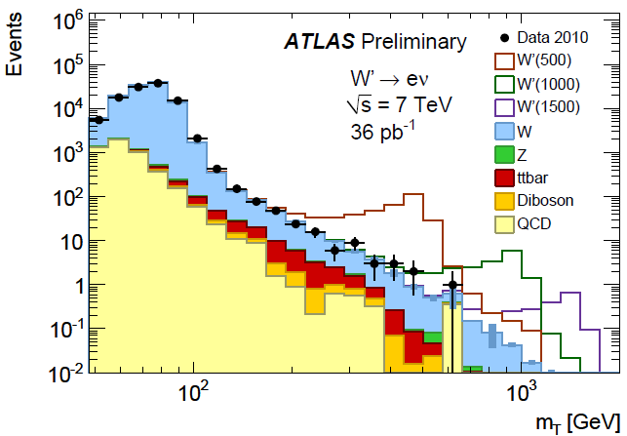
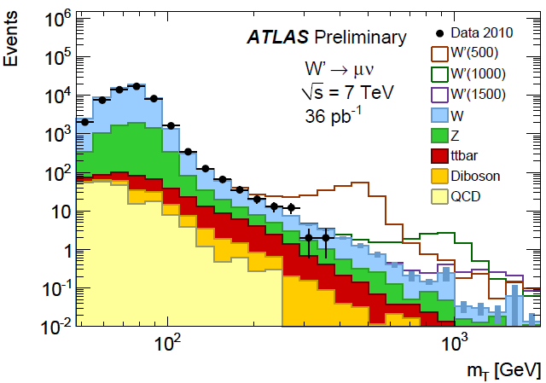
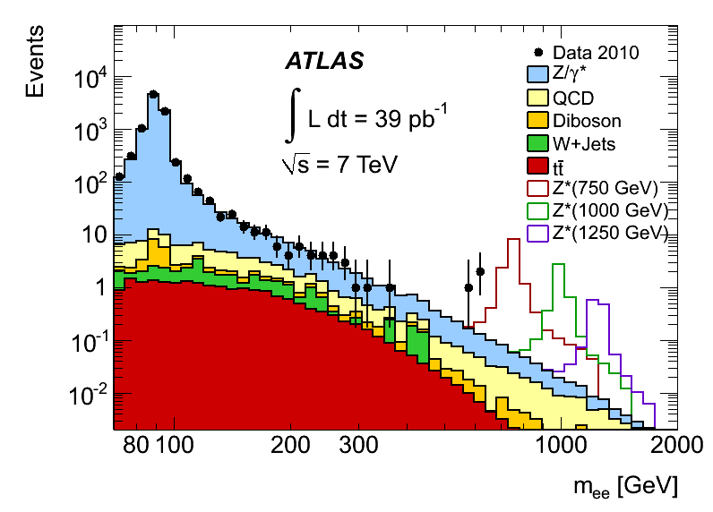
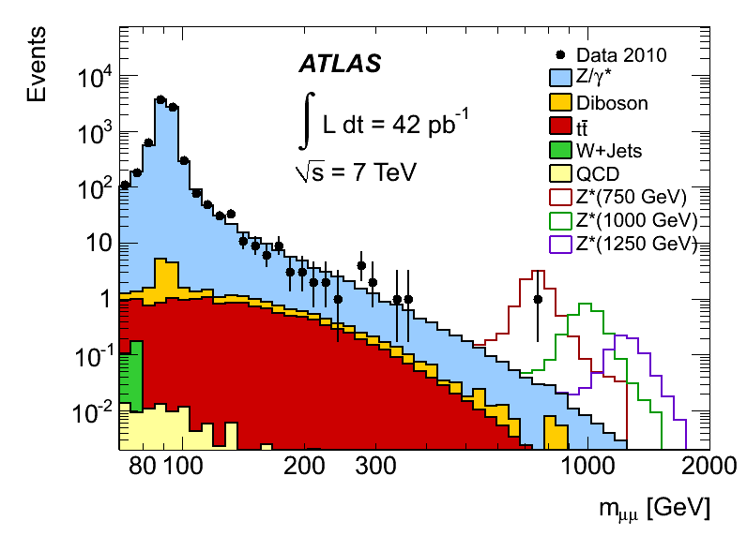

Slide 31
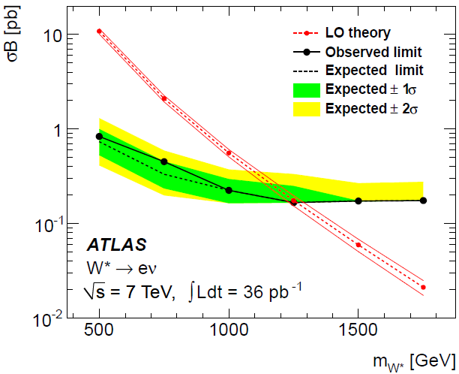
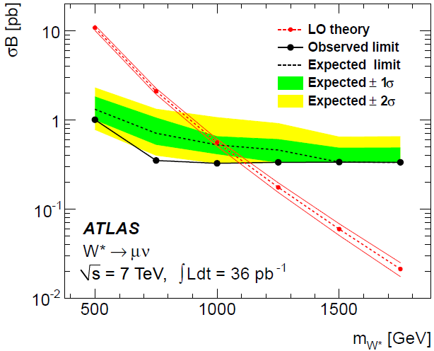
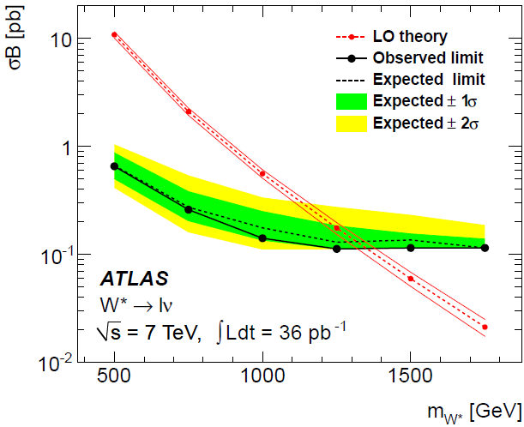

The ATLAS Collaboration “Search for high-mass states with one lepton plus missing transverse momentum in proton-proton collisions at √s = 7 TeV with the ATLAS detector”,
arXiv:1103.1391, submitted to Physics Letter B

Slide 32






Z*
Z*
Z*
The ATLAS Collaboration “Search for high mass dilepton resonances in pp collisions at √s=7 TeV with the ATLAS experiment”, arXiv:1103.6218, submitted to Physics Letter B

Slide 33

We were lucky – shortly after colliding beams were announced, at 14:22 an interesting event appeared on our screens

Slide 34


Slide 35



Pile Up!

Slide 36

Production of new chiral particles
stay tuned …

Slide 38



Slide 39
Excited particles (compositeness)
Searches for excited fermions ψ ∗ have been performed at LEP, HERA and the Tevatron, and are also planned for the CMS and ATLAS experiments at the LHC.
ψ* why not Z* ?
M. C., V. A. Bednyakov, and J. A. Budagov, Proposal for chiral bosons search at LHC
via their unique new signature, Phys. Atom. Nucl. 71 (2008) 2096; arXiv:0801.4235
Z* has different interactions than Z’ !

Slide 40

Jacobian factor for
M=1 TeV
Z’
Z*
“The divergence at θ = π/2 which is the upper endpoint p_{T} ≈ Μ/2 of the p_{T} distribution stem from the Jacobian factor and is known as a Jacobian peak ; it is characteristic of all two-body decays …”
V. Barger “Collider physics”
w r o n g !

Slide 41
Hadron colliders or search for heavy bosons beyond W± and Z
A hadron collider is the discovery machine. The production mechanism for new bosons at a hadron collider is qq annihilation. A presence of partons with a broad range of different momenta allows to flush the whole energetically accessible region, roughly, up to
(rule of thumb)
p p colliders (Tevatron: 6.3 km)
(−)
(LHC: 27 km)

Slide 42

From Aurelio Juste talk

Slide 43


