Slide 1
International Conference on Physics
Sofia, April, 10-12,2011
In Memoriam
Acad. Prof. Matey Mateev
Target Definition and Target Tracking in Radiation Therapy – Resolved and Unresolved Problems
Assen S Kirov, Ph.D.
Department of Medical Physics
Memorial Sloan-Kettering Cancer Center
New York
Notes:
I am both honored and humbled to speak at a physics conference organized in memory of Acad. Prof. Matey Mateev. Although my interests were mostly directed towards experimental nuclear physics I really enjoyed the quantum field theory course of Prof. Mateev. He was one of ours most respected and loved professors. He was also the one who handed me my diploma in this auditorium 27 years ago.
When Dr. Kirilova sent me the first e-mail, first I objected since I am not working in theoretical physics. Later I agreed, since the applied field of Rad Onc provides problems which could be challenges for both experimental and nuclear physicists alike as well as a possible route for the younger generation for which Prof. Mateev cared so much.

Slide 2
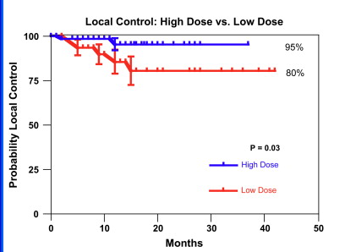
Introduction: A significant dose response has been observed in high dose single-fraction treatments
Radiographic Local Control
Single irradiation:
High dose: 24 Gy
Low dose: 18-23 Gy
Courtesy M. Lovelock Yamada et al IJROBP 71(2) 2008 p 484-90
Notes:
The goal of radiation therapy is to kill the cells of the tumor being irradiated. The success is called local control, implying that this may not mean curing the patient if it has spread.
On this first slide shared by a colleague is plotted the probability for local control from high dose single fraction treatments of metastatic lesions close to the spinal cord. The observation that probability of tumor kill increases with dose is trivial. Two points are not trivial: 1) that this dependence is so strong; that 95% success rate can be reached.
In comparison, the probability for local control for lower doses with multifraction (MSK: 30Gy in 10 Fx) treatments is much lower than the red curve.
-----
Also recent developments in cancer cell biology (L Norton et al)are rising suspicions that if the tumor has seeded cancer stem cells, it may serve as a sponge collecting them back, since they are attracted by the known host, and in this way slowing down the development of methastases, which in few cases were found to increase after removal and disruption of the primary tumor.
-----------
I will start with a plot of …survival probability for treating ….tumors with …
…
multiple fraction IMRT
Single fraction SRS
Вероятност за оцеляване без признаци за болестта – многократно облъчване със свръхточна радиохирургия (stereotactic radiosurgery ?) и еднократно - еднократно с голяма доза унищожава жизнената среда на тумора

Slide 3

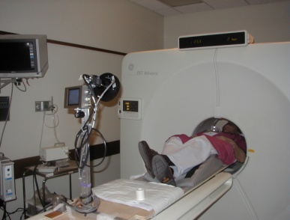
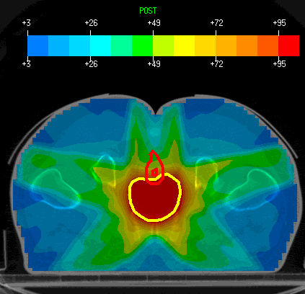
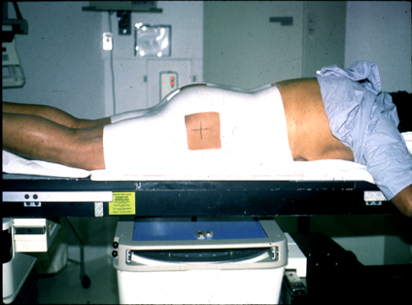
How fast should the dose be delivered,
or in how many fractions: 1, 3, … 36 ?
Diagnosis and Workup
Simulation
Treatment Planning
Fractionated Radiotherapy
At the low dose range normal tissues repair radiation damage more proficiently than tumors
Fractionated radiation enables tumor dose buildup with reduced normal tissue toxicity
For Hypo- or Single- Fraction the Normal
Tissue Complication Curve will move left
Need to pull the two curves apart
Tumor Control Prob
Normal Tissue Comp
Dose =>
Courtesy M. Lovelock
Notes:
Now a second question: how fast should the dose be delivered slowly, fractionated as shown here, or quickly ? Here at the top is depicted fractionated therapy after imaging, CT simulation, and planning.
Here the blue curve represents the probability for tumor cell kill, while the green curve represents the probability for normal cell kill. Since life has emerged in low dose-rate radiation environment, normal cells have the capability to repair more efficiently than tumor cells, which means that there is a therapeutic window between the two curves. This window is wider at lower dose rates, which points to brachytherapy (using implanted rad. Sources) and treatments consisting of many fractions, more beneficial. One reason is that at low doses, the tumor cell may not repair itself and may initiate a suicide (called apoptosis), which is also a result from evolution to avoid possibility of mutation.
However, there is financial and convenience/accuracy benefit for the patient to perform the treatments quickly. High dose single fraction treatments turn however to be very successful - the hypothesis is that at such high single doses the tumor environment is destroyed, which leads to such high success rate.
------
At higher dose rates however, the repair for the tumor may get activated moving the tumor kill curve to the right. At even higher doses the repair capabilities of the normal cells may get exhausted, moving in this way the green curve left which narrows the therapeutic window.
So one needs either to make the tumor more radiation sensitive by using special drugs, or to reduce the dose or the fraction of the volume of the normal tissue.
_________________________
Problem with hypo-fractionation:
late responding tissues (normal tissues) have lower α/β than the tumor, thus the curves will get closer together
Strategies to shift the tumor control curve to the left
↑ BED or radiosensitizer
Limit volume of critical structures: ie lung

Slide 4
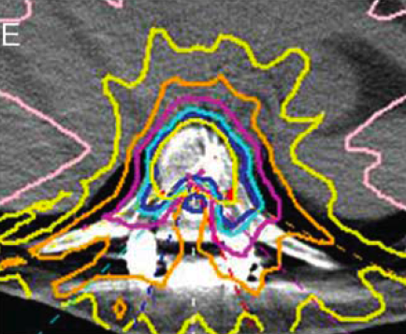
What is required to deliver such high doses in a single fraction?
Accurate target definition
High treatment delivery accuracy:
- Dosimetric – under 3 %
- Spatial
- stationary tumors < 1 mm
Courtesy M. Lovelock
Notes:
However, it is not without penalty that one can do this increase: the maximum dose to the spinal cord is limited to 14 Gy for SFRT (historically 45 Gy from multifraction treatments when much higher doses are possible). The color coded curves here indicate dose levels from a TP corresponding to 100 to 10% of the max dose. The critical structure to be spared here is obviously the spinal cord.
In order to be able to do this one needs :

Slide 5
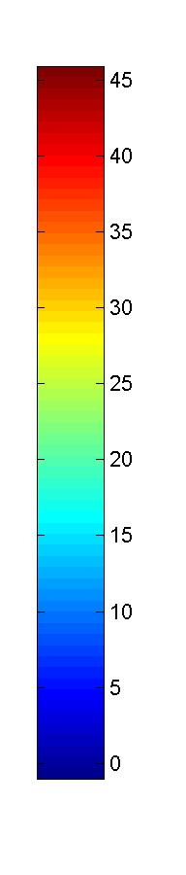
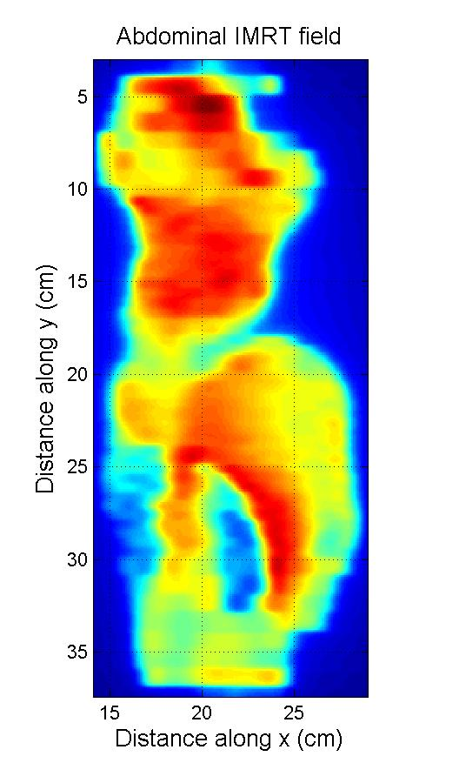
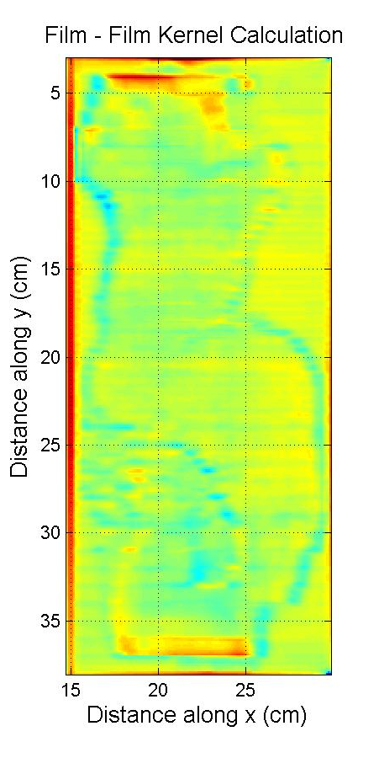

High Dose Delivery Accuracy using Intensity Modulated Radiation therapy
cGy
cGy
Film dose
Film – calculation
Med. Phys. 2006
Notes:
One of the conditions required for delivering very high doses is High Dose Delivery Accuracy. Therapy has achieved this very high treatment delivery accuracy using IMRT, which we have shown here for a very large 35 x15 cm radiation field. On the left is …

Slide 6
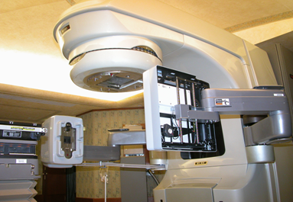
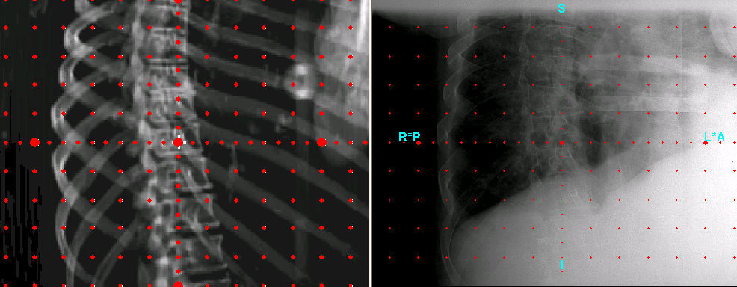
Patient set-up and positioning using planar imaging
Electronic portal imaging, kV radiographs
effective at correcting setup error (positioning of skeletal anatomy)
Poor visualization of soft tissue
Projection of anatomy onto a planar image: difficult to discriminate different structures
Varian kV imaging system DRR kV radiograph
Notes:
The second necessary condition for high dose SFRT is accurate imaging during treatment to make sure that the tumor is where expected. For that modern linacs are supplied with plannar imagers which rotate with the gantry which emits the treatment beam. They can produce planar images as shown here for verification of the patient position prior to treatment – here is shown Tx set-up verification performed by comparison of a digitally reconstructed radiograph from the CT on the left to a kV x-ray obtained with the planar imager

Slide 7
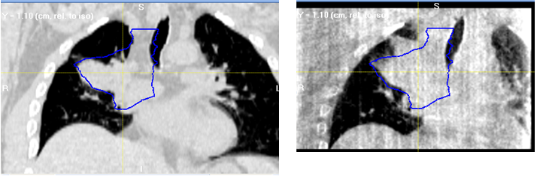
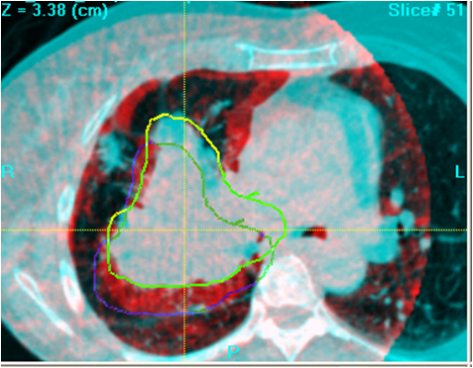
CBCT reveals tumor changes not seen in radiographs
Tumor tracking between simulation and treatment
Pt 1
Tumor growth
Pt 7
Shift in tumor position
GTV
RCCT (End exp.) Tx #1 CBCT – 19 days later
GTV_{RCCT}
Tx #1 CBCT – 12 days later
GTV_{CBCT}
Courtesy G. Mageras
(Santoro astro 2010)
Notes:
If one takes many x-rays with the plannar imager under differenet angles you get a CT scan, called cone beam CT, which shows boundaries of soft tissues with lung and bones. Here is shown that such CBCT is very helpful in observing tumor growth and tumor shifts from time of simulation to start of therapy.

Slide 8
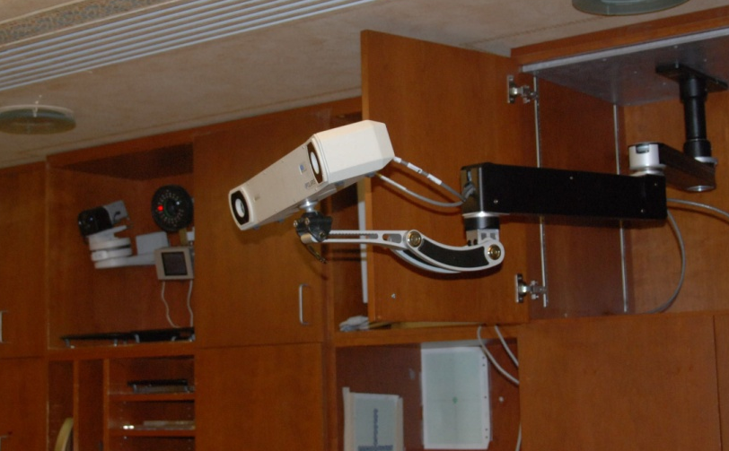
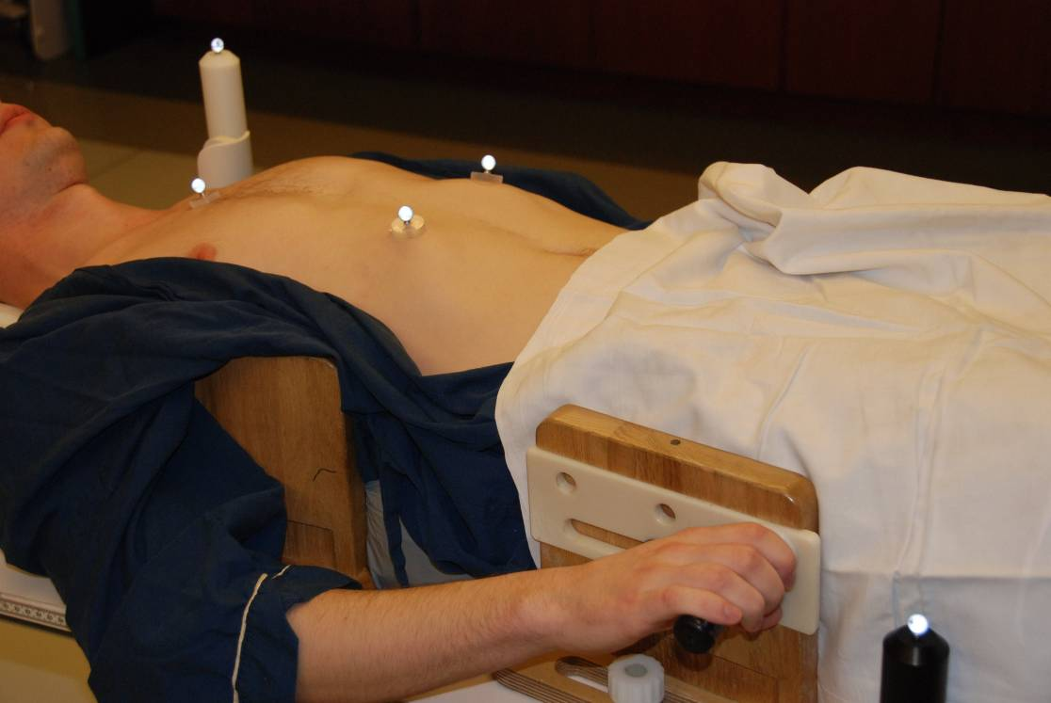
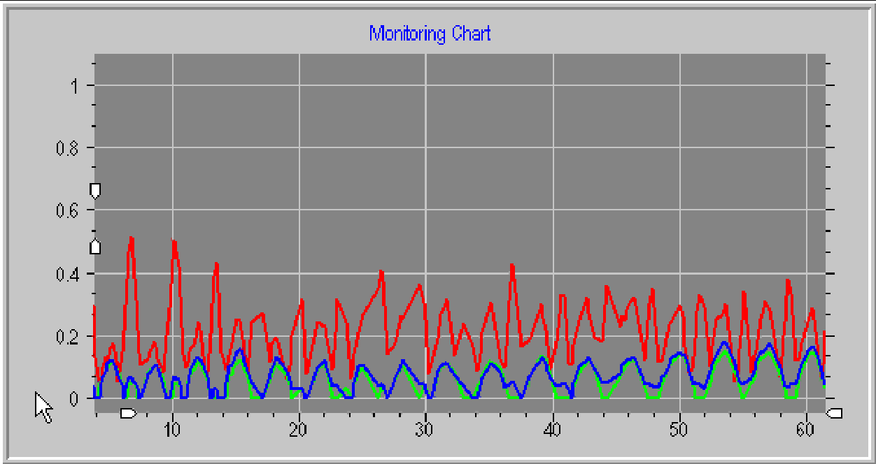
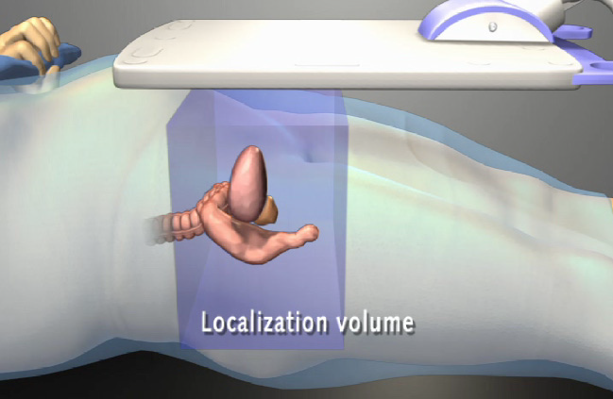
Patient and target tracking during treatment
Infrared or Optical
monitoring system
Internal Markers
Tracking
Calypso
Stereoscopic infra-red camera
LE
El. circuit
1.85 mm
8.7 mm
Marker Locations
- Left chest
- Right chest
- Belly
Courtesy M. Lovelock

Slide 9
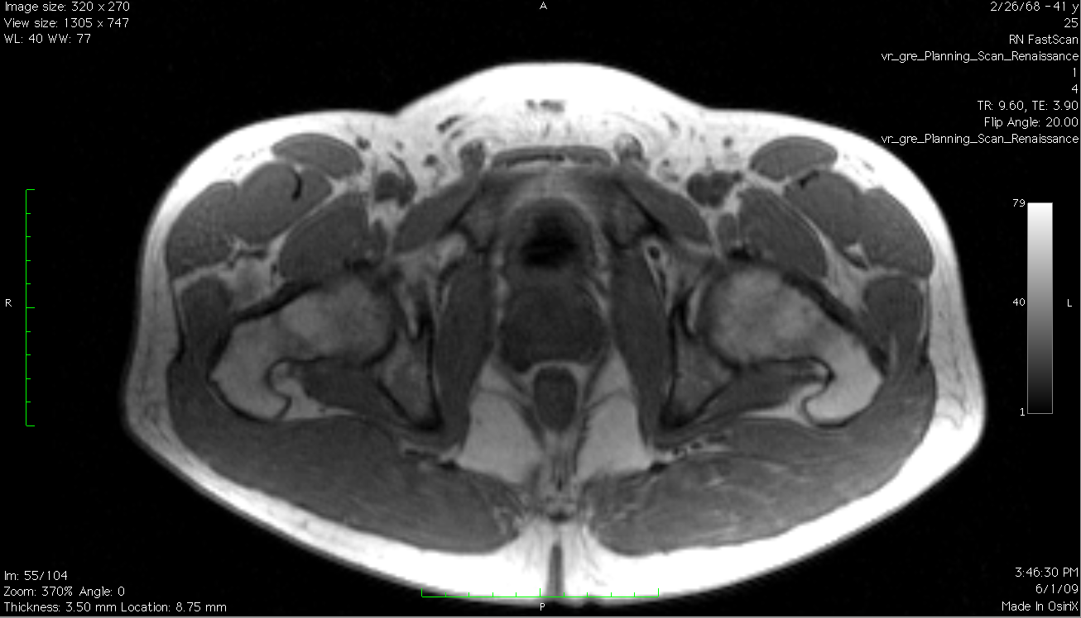
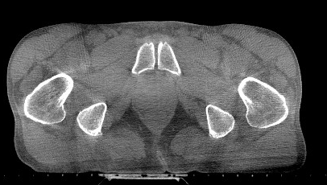
To Treat Better you need to See Better
Set-up and tracking
Bladder?
Bladder
Prostate?
Prostate
Rectum
Rectum?
MR
Cone Beam CT
Courtesy J Dempsey, ViewRay Inc.
The ViewRay system has not been cleared by the U.S. Food and Drug Administration (FDA) for commercial distribution in the U.S.
Notes:
CBCT can visualize lung-soft tissues differences, however it can not distinguish between different soft tissues as shown here on the right.
MRI however can. So can we add and MRI to the RT linac? It is not so simple, since the magnetic fields of the MRI and the linac interfere- the MRI interferes with focusing the electron beams, and the magnetic field of the beam deteriorates the MR image.

Slide 10
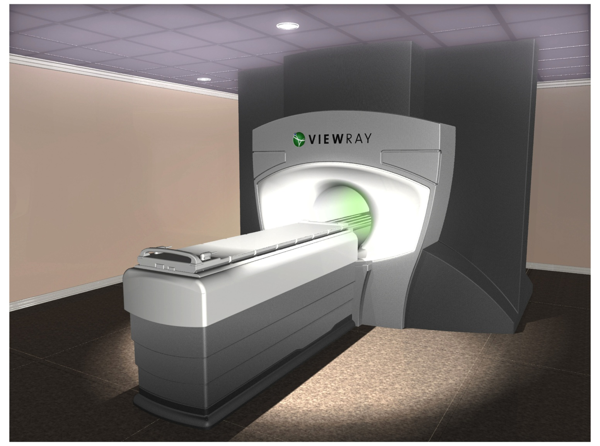
Set-up and tracking using MRI
The ViewRay System
3 Co-60 heads
MRI
Courtesy J Dempsey, ViewRay Inc.
The ViewRay system has not been cleared by the U.S. Food and Drug Administration (FDA) for commercial distribution in the U.S.
Notes:
Dr. J Dempsey, a close friend with whom we met as graduate students in nuclear physics,
Was playing with an old Co-60 Tx machine about 8 years back and realized that one can avoid the interference between the MRI and the beam if he uses a Co-60 instead of a linac. He patented the idea and is currently building such a treatment machine which you can google by the name ViewRay.

Slide 11
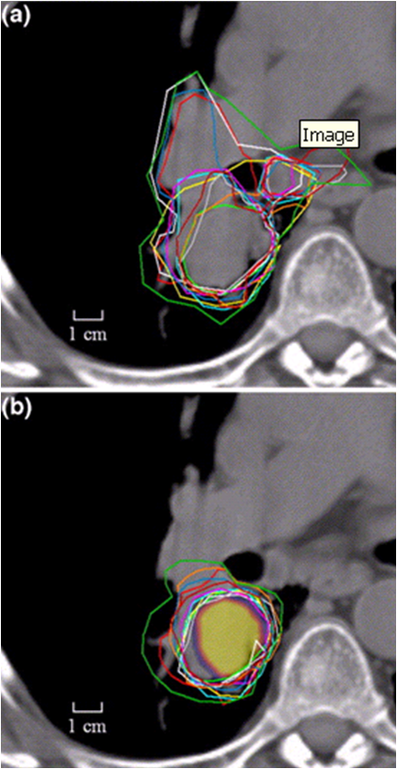
Target Definition
& Organ at Risk Delineation
Large uncertainties based on CT alone:
  Intra- & inter-observer variation, tumor/atelectasis, lymph nodes
Use of FDG-PET to reduce, from 1cm SD to 0.4cm
CT alone
CT + PET
Courtesy G. Mageras
Steenbakkers, IJROBP ,2006
Notes:
In all I said so far, it sounded as if we know where the tumor is sufficiently well. For larger fields with smaller dose may be, But now for high dose SFRT, you really want to know with very accuracy the tumor boundaries as more accurate possible.
So here you see physician drawn contours which have large uncertainties when drawn on CT alone.
Agreement is much better when PET is added. The reason is that PET shows the spots with increased matebolism and currently is the most sensitive and specific method for lesion discovery.
Where exactly is the tumor boundary?
Computer Tomography (CT)
Nuclear Magnetic Resonance (MR Imaging)
Positron Emission Tomography
Biopsy

Slide 12
PET Modification of the GTV and Desired Accuracy
NO ! Since PET biological and the physical uncertainties are not known !
Can we trust the PET contour to ~ 1 mm accuracy ?
Notes:
Here is shown how PET (red contour) has lead to alteration, this time in increase of a CT defined GTV (blue) and the final PTV, which accounts for microscopic spread and for motion.
The position of this contour illustrates the difference between the use of PET for diagnostic purposes and for RTP purposes. It is nice that we see all this activity outside the CT GTV. But can we trust the PET contour to 1 mm accuracy which is achievable in RT? Unfortunately not: due to both biological and physical uncertainties. The biological uncertainties are due to the fact that different processes may cause increased uptake including inflamation and perfusion in addition to increased metabolism. In the rest of this lecture I will describe some of the physical factors preturbing the PET image.
For RTP it would be ideal if one can draw these contours really accurately with ~ 1 mm precision, which is determined from the high RT delivery accuracy today. This high precision requirement places new challenges in front of PET. So now we will see what is the physical basis for some of these challenges.
Management changes: Gambhir et al. 2001 (5062 pts, FDG) : 30%
Heron et al. 2008 (PET/CT): ~ 1/3
Combining PET and CT increases the sensitivity and
the specificity for many tumors from ~ 60-70 to 80-90% and has lead to altering the management roughly of ~1/3 of the patients on average.
----
PET significantly improves the sensitivity and the specificity for diagnosing a lesion. According to an already somewhat dated overview paper by Gambir et al, across all oncologic applications the 18-F FDG PET sensitivity is 84% and specificity is 88%.
For lung cancer adding PET to CT increases
sensitivity from 67 % to 96 % for diagnosis
and
specificity from 74% to 91 % for staging.
The heterogeneous attenuation properties and the non-uniform PET background for such tumors present a challenge for PET based tumor delineation. At this point we can not be sure that the mismatch between the CT and PET based contours is not due to an imaging artifact. Today I will discuss these potential artifacts.
Hillner, B.E., et al., The impact of positron emission tomography (PET) on expected management during cancer treatment: findings of the National Oncologic PET Registry. Cancer, 2008.
Heron, D.E., et al., PET-CT in radiation oncology: the impact on diagnosis, treatment planning, and assessment of treatment response. Am J Clin Oncol, 2008. 31(4): p. 352-62.
Here you see Gross (GTV) and planning tumor volumes (PTV) on registered CT (left) and PET (right) images from a PET/CT scan of a mediastinal lung lesion.

Slide 13
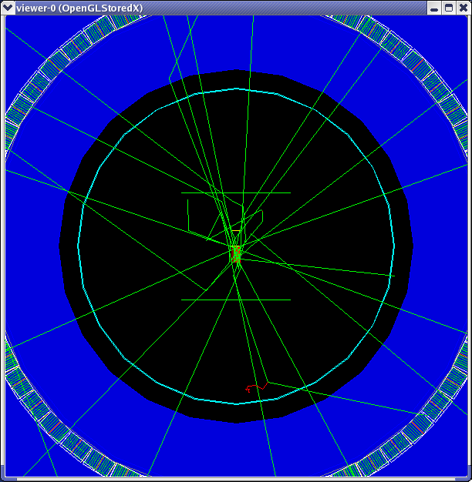
Monte Carlo simulation of annihilation photons propagating in a PET scanner
Detector ring
Annihilation
Photons
Compton events
in the phantom
Cavity
FDG Source
Water
phantom
Shields
Compton event in air
Simulated with the
GATE Monte Carlo
code
Notes:
In PET the e+ emitter is brought to a location with increase metabolism by a tracer molecule. Then the annihilation photons are detected in the detector ring.
These photons may undergo:
Photon Scatter
Photon Attenuation
Random Coincidences
Limited Resolution
Limited Statistics (SU-DD-A4-01)
Cascade γ−rays, pulse pile-up
Arc Effects
Electronics Dead Time
Image Reconstruction
Registration
Motion
---------------
I will talk about the limitations for PET arising from the physics of positron annihilation and annihilation photon propagation and from the technological realization of PET scanners. At the end I will briefly go over the PET image segmentation challenges.
Here you see simulated annihilation events from an FDG cylinder to investigate the effect of an air cavity placed next to it, the results of which will be shown later in this lecture.
One can see that many photons scatter in the phantom and one even in air producing a delta e- with a long enough track to be visible. Some photons are absorbed in the phantom or scattered outside the solid angle of the scanner.

Slide 14
Attenuation Correction
For each LOR (Line of Response) i-j:
using
Annihilation photons or CT –X-rays in PET/CT
i
too low
511 keV
~ 75 keV
j
Notes:
So let us look first at photon attenuation, the correction for which is determined for each line of response i-j from the ratio of the transmitted photon intensity with the patient in place to the transmitted intensity without the patient.
The AC can be obtained by a line e+ source, an ordinary Gamma source (137-Cs, 662 keV) or from the CT scan.
Using a positron source (Ge-68/Ga-68), uses the same energy photons as these in PET and is accurate, but noisy and slow ( ~ 20 min), and high dead time can be seen in the proximal detector.
In PET/CT the x-rays form in few seconds a very low noise CT image which can be used for the AC, but CT uses a different energy ~ 75 keV, and this causes problems.

Slide 15
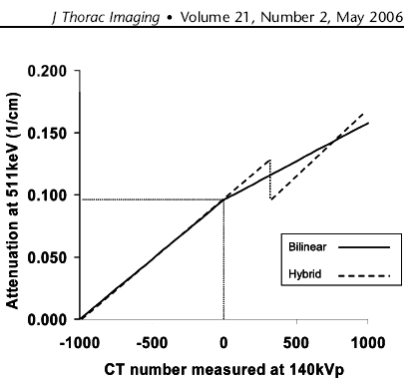
CT-based Attenuation Correction Challenge
Scaling Methods:
Current Transforms:
  Bi-linear, Tri-linear
  Hybrid
Under investigation:
  Dual Energy CT (Kinahan et al, 2006)
  Energy sensitive CT
Mawlawi , Pan, Macapinlac
Illustration: basis for dual energy CT(Rehfeld et al , Med. Phys.35,5,2008 ):
where, i=1 (140kVp), 2 (80kVp), a_{eff}~Z^{m}/A , m= 3 to 4, n= - 3 to - 3.5
Notes:
CT#=1000*(mu-mu(h2o))/mu(h2o)
Thе difference in scaling is handled in different ways.
For Higher Z materials the CT number will change much faster than mu_511 due to the photo-effect, which results in a smaller slope on a plot of mu_511 as a function of CT#.
So if here one uses the portion of the transform corresponding to bone, one would get overestimation of the attenuation at 511 keV which would result in overestimated AC and an artificial hot spot.
Here at the bottom is given an illustration of the basis for dual energy CT scaling using the Compton and Photoeffect. The effective atten. Coeff. can be presented by a weighted sum of the atten coef. for each element which are due exclusively to Compton and Photoeffect.
Then assuming this sum can be partitioned into independent Compton and Photoeffect terms, one can obtain the effective coefficients in each of them by taking measurements of mu_eff at two effective energies. Then using these coefficients one can obtain the AC for each energy and for 511 keV in particular.
The authors called this scaling : Compton-Photon Scaling, but obtaine better results with Hybrid DECTAC in which the extrapolation is performed directly of the hybrid scaling using the difference in Hounsfeld units between the two peak energies. More details about this method are given in their paper

Slide 16
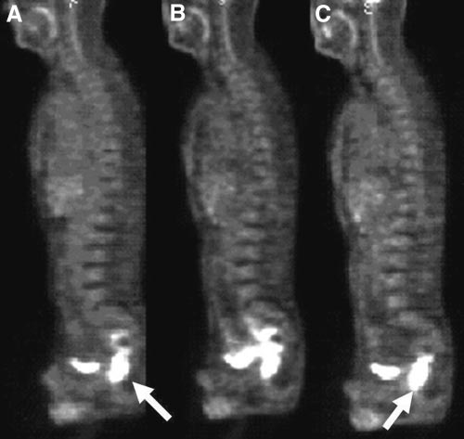
CT - based Attenuation Correction artifacts: Contrast
⁶⁸Ge
CT AC
CT AC + Segmented
Contrast Correction
Nehmeh et. al., J. Nuc. Med. 44, 1940, 2003
Notes:
This is an illustration from an older paper. Here on the left you see the PET image obtained with Ge-68 source, for which there is no bias and no AC contrast artifact is seen, this is the bladder, and the lesion is indicated by the arrow.
In the middle is shown a CT AC artifact as a result of focal accumulation of oral contrast, resulting in an overestimated uptake in the bowel and inability to determine the extent of the lesion when a bilinear transform from the CT x-rays to 511 photons was used.
On the right the problem was corrected when the contrast was segmented out from the CT image based on CT threshold of 150 HU, and correct AC was computed for it (BaSO4).
This artifact is claimed to be reduced in newer algorithms in which separate scaling for the contrast is used.
It depends strongly on the concentration and time of Contrast injection
-------
On some scanners, when contrast correction is switched on for the reconstruction, both bones and contrast are considered water (i.e. boneless patient), which for 511 does not make much difference, but will slightly affect the bone AC and lower the bone uptake.
Dual energy CTAC (Kinahan, 2006, Rehfeld et al 2008) methods are being investigated for future use.

Slide 17
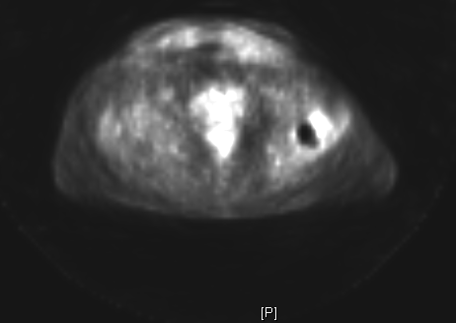
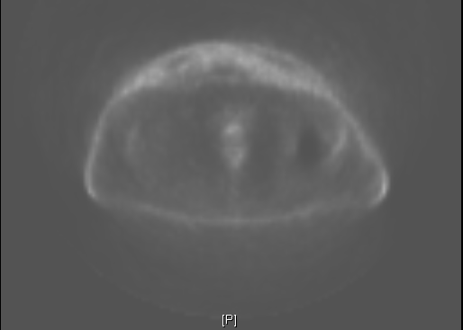
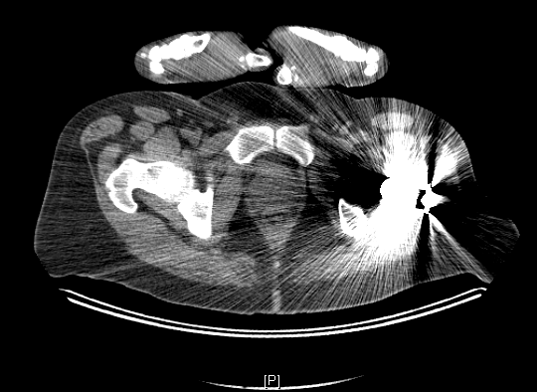
Example of CT -based Attenuation Correction Artifact:
Leg prosthesis
CT PET PET no AC
Notes:
Also metals block some projections which cause under sampling, which confuses the FBP algorithm which in turns produces streaking artifacts.
Here are shown CT and PET images of a patient with hip prosthesis with and without AC from an older generation PET/CT scanner. The CT streaking artifact is well seen, which one would expect to cause a significant PET artifact. Looking at the non-AC corrected image, indicates this artifact to be clearly visible just above the prosthesis.
The artifact is less on the most recent generation scanners.
In addition, bulky prosthesis can cause photopenia – underestimation of activity in the region due to loss of photons.
(older PET/CT Siemens Reveal)

Slide 18
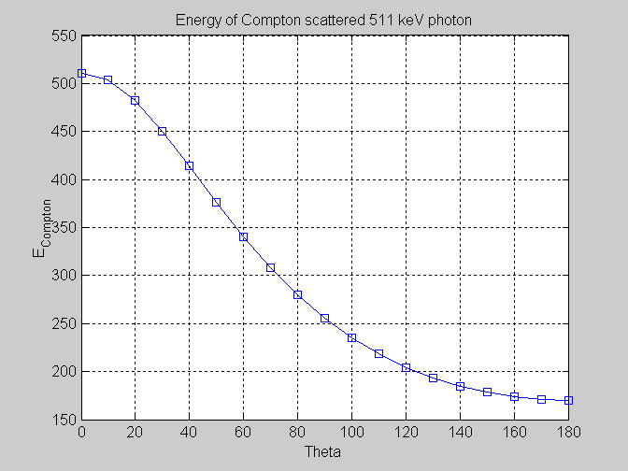


Photon scatter
L
LOR
Energy
of scattered photon
375 keV
R
L
60 deg
Angle of scatter
2D PET
S
3D PET
S
~50
kcps
19 %
scatter
~300
kcps
45 %
scatter
I
I
Notes:
Photon scatter can lead to erroneous lines of response.
In the inset is shown the energy of a photon Compton scattered at angle theta. One can see that photons scattered up to 60 degree will fall inside a coincident photon energy window above 375 keV.
3D PET, i.e. when the septa between the detector rings is retracted, provides much higher sensitivity, but scatter is also much higher for 3D. The numbers shown are for 20 cm diameter cylinder.

Slide 19
Spectra of coincident photons for 3D PET
Scatter Corrections
-uniform tail fitting
-multiple energy windows
-modeling of the single scatter
-full Monte Carlo
…
Energy window
Notes:
This is shown also with Monte Carlo simulated photon spectra here, where you see the number of photons in a 375 keV to 650 keV coinc. energy window –
Violet – photons from all coinc.
Blue – photons from coinc. of which at least one photon was scattered,
Yellow – spectra of only single scattered photons
Cyan: - spectra of only multiple scattered photons
The following corrections can been applied:
-uniform tail fitting methods – outdated, good for uniform phantoms only
-dual or multiple energy windows –experimental – a window at < 375 keV: scattered only
-model based K-N modeling of the single scatter probability for each LOR: becomes the standard
-and most detailed and capable to account for the multiple scatter: full Monte Carlo, which is still being developed due to still insufficient computer efficiency
__________
The correction for scatter can be performed at different levels of accuracy: uniform- approximated with a smooth function or based on the attenuation correction (AC) image. Calculating the scatter from the AC image was initiated by Olinger [9] and can be performed either analytically using the Klein-Nishina formula or using Monte Carlo. The latter is a more accurate method but very time consuming and currently different groups are working on improving the efficiency of such calculations.
Other possibilities are
-experimental determination from certain types of objects,
-dual energy windows (i) estimate the scatter by measuring the counts in a low energy window below the Compton edge,
ii)Estimation of trues method- higher energy window> 511, where scatter can not contribuite
-convolution with a scatter function
-f estimation by fitting of scatter outside the object

Slide 20
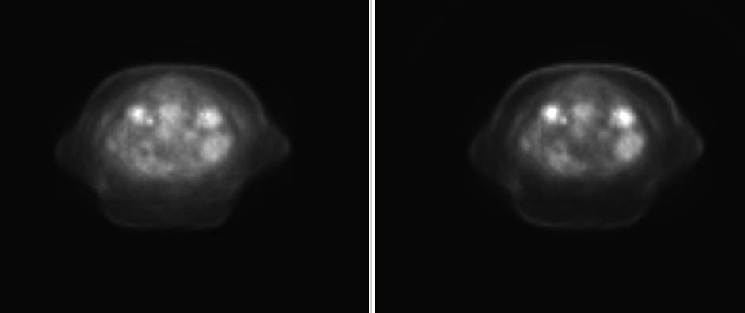
Effect of scatter correction
Without Correction
With Correction
Notes:
Chang and others in Dr. Mawlawi’s group have shown data which indIcates ~ 15 % UNDERCORRECTION OF SCATTTER
FOR TEFLON INSERTS In SU-FF-I-149

Slide 21
Random coincidences and corrections for randoms
Delayed window
timing
window
Smoothed delayed coincidences
From Singles
L
Prompt Delayed
R
L
LOR
Timing window
~ 12 ns
Single Event Rates
Notes:
Random Coinc. Between uncorrelated decays can exceed all other types of coincidences at Activity concentrations above ~5 to 10 kBq/mL, but are not that much of a problem since they are accurately corrected for.
delayed window technique gives an accurate but very noisy estimate of the randoms
smoothing the delayed coinc. sinogram and applying the correction at a later time – much less noisy
-Calculating the Randoms from Coinc. Timing window and the Single Event Rates in both detectors, can lead to reduction of patient scan time – it frees bandwidth of the coincidence processor for prompt events only, but needs accurate knowledge of dead time for each detector and det. pair
--------
by - using a delayed window - where no true coinc. are possible: accurate but very noisy estimate (typical flight time 0.35 m / 3e8m/s ~ 1 ns)
by – smoothing the delayed coinc. sinogram and applying the correction at a later time – much less noisy
Calculating the Randoms from Coinc. Timing window and the Single Event Rates in both detectors, which can lead to reduction of patient scan time – it frees bandwidth of the coincidence processor for prompt events only, but needs accurate knowledge of dead time for each detector and det. pair
____
Brasse at al have shown that while smoothed random estimates provide the lowest noise images, singles-based random estimates perform only marginally worse, but are most time efficient and frees bandwidth of the coincidence processor for prompt events only

Slide 22
Effect of Scatter and Random Counts on the image quality: Image Quality Phantom - simulated
With scatter and random events
No scatter and random events
No Attenuation Correction
random
counts
image
scatter
counts
image
from C. Ross Schmidtlein
Courtesy C. Ross Schmidtlein
Notes:
Here you see the ….
On the left is shown a Monte Carlo image with all events, and on the right with true coincidences only with AC. On the bottom you see the distribution of scattered and random coinc. for this phantom: images of random and scatter counts without AC.

Slide 23
Effect of Scatter and Random Counts on the image quality: Image Quality Phantom - simulated
With scatter and random events
No scatter and random events
with Attenuation Correction
random
counts
image
scatter
counts
image
from C. Ross Schmidtlein
Courtesy C. Ross Schmidtlein
Notes:
Applying the AC to the random and scatter images throws the activity into the regions of the phantom or patient with high attenuation.
These scatter and random counts will be even more unevenly distributed for a patient where the activity and the atten. properties are much more non-uniform.
Therefore imperfect scatter correction – leads to loss of contrast, loss of quantification accuracy.

Slide 24
PET resolution components
Det.#3
Det.
#1
e⁻
511 keV
Positron range
Photon non-colinearity
Detector size and distance to detector
Block detector effect
Arc effect and depth of interaction
Spatial and angular sampling
Reconstruction
β⁺
¹⁸F
p
511 keV
Levin & Hoffman , PMB, 1999;
Cherry, Sorenson, Phelps, Physics in Nuclear Medicine,
Third Edition, Sounders –Elsevier, 2003
Det.
#2
Notes:
The PET resolution is affected by the positron annihilation physics, and by the instrument related artifacts dependent on. Here on the right are shown the positron range, the effective positron range and the photon non-colinearity effects
Scattering in the neighboring crystals leads to additional broadening known as block effect.
For LORs close to the periphery, the solid angle under which the detectors are seen change and it becomes more likely that a photon may go through one detector and interact in the neighboring detector.
Sampling step in both spacial domain and angular domain will affect the resolution as well as the size of the PET voxel.
All reconstruction methods use some filtering to decrease noise, which also leads to resolution degradation.
The overall resolution is obtained from each of these factors by adding them in quadrature and for more details I would recommend the book of ..
_________
Sampling:
three samples needed per det width – 2 ok - interlacing , # angles x1/2

Slide 25
Resolution Correction methods:
Classification of Soret et al. JNM, 48, 2007
А. At a Regional level
1. Recovery coefficients (Piper et al, SU-FF-I-92)
2. Geometric transfer matrix (Rousset et al, 1998)
B. At a Voxel level
Partition based:Convolution of every sub-structure with the PSF and then using the difference for correction (Meltzer et al. 1996, Teo et al, 2007)
Multi-resolution approach: Merge Wavelet Transformations of PET and MR images (Boussion et al. 2006)
The PSF is incorporated in the reconstruction process (Alleviat et al. 2006, Rizzo et al, 2007,…)
Iterative deconvolution (Boussion et al, 2007, Kirov et al 2008 )
Notes:
In an already somewhat dated review Soret and others have classified the resolution correction methods into methods acting at a
1 by using the recovery coefficients measured for spheres with different known diameter
2- account for the spill over of activity from one structure to the other using the so called geometric transfer matrix.
-------
A.: свойство на структурата се използвува за корегиране на активността в тази структура
1- рисунка; 2- пресмята се преливане м/у всички структури (рисунка от H. Merrisaari et al. J Med Phys India)

Slide 26
Partial volume effect correction
PET scan 1
(simulation)
PET scan 2
Before
After
the PVE
correction
Phys. Med. Biol. 53, 2008, p. 2577
Notes:
Here I am showing the results of a PVEC method we developed using iterative Lucy –Richardson like deconvolution and variance control base on local topology, without any other images
The increased visibility of the smallest lesions is shown without variance increase throughout most of the image
If one draws a profile across the two smallest spheres.
_______
The limited resolution can make small objects like the 10 and 13 mm diameter spheres imaged here in a phantom with ~ 4:1 activity ratio, hard to see, an effect known as partial volume effect.
(Sphere diameters: 10,13, 17, 22, 28, 37 no activity)
The PVEC methods are divided into region based and voxel based as well as into methods applied during or after reconstruction.
Applying a post reconstruction voxel based PVE correction using deconvolution with a topology adapted variance control we were able to increase the visibility of these small lesions at the expense of some increased variation in the regions around them.
If we look at an activity profile through the two smallest spheres
--------
The region base methods calculate the spill off from one anatomically predefined region to another which obviously
Is not applicable to oncologic applications.

Slide 27
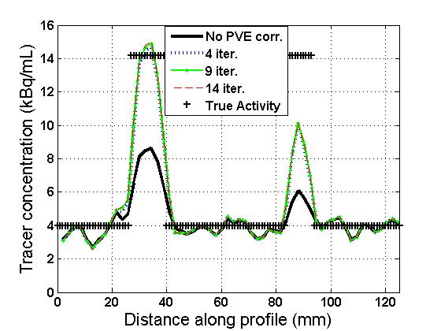
Partial Volume Effect Correction
Phys. Med. Biol. 53, 2008, p. 2577
Notes:
Here is shown the loss of quantitative accuracy, which is reduced but not fully corrected for the 10 mm diameter sphere.
Here are the true activity levels and also PET before and after the correction.

Slide 28
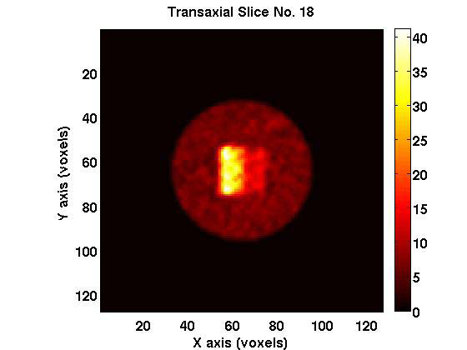
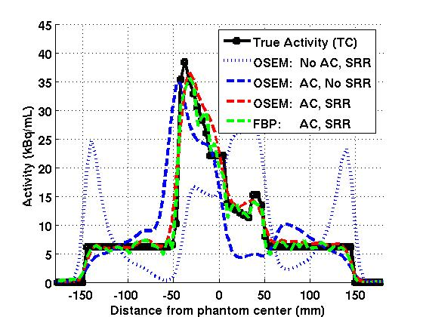
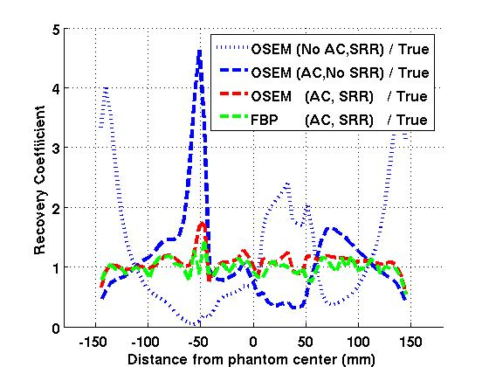
12 cm non-uniform activity and non-uniform attenuation cube inserted in a 30 cm diameter water cylinder
Activity profiles
Recovery coefficients
Normalization
point
Bone
Muscle
Lung
Bone
Muscle
Lung
2007 IEEE Nuclear Science Symposium Med. Imaging Conference Record , M13-5, 2838-2841
Notes:
Here is illustrated the combined inaccuracy of PET with respect to the true activity (solid black curve) in a Monte Carlo simulation for a 12 cm …
The two graphs show activity profiles (left) and recovery coefficients (right)
The phantom in addition to having such activity variation was divided into regions of water bone, muscle lung atten. properties.
On the left the black curve is the true activity and …
The ratio of PET vs. true activity on the right shows the effect of turning off the attenuation correction (dots) , the scatter and random corrections (blue) as well as with ideal such corrections for OSEM and FBP reconstruction.
Even with ideal corrections for activity and AC varying in 1D only, inaccuracies of 70 % can be seen close to strong activity and AC gradients.

Slide 29
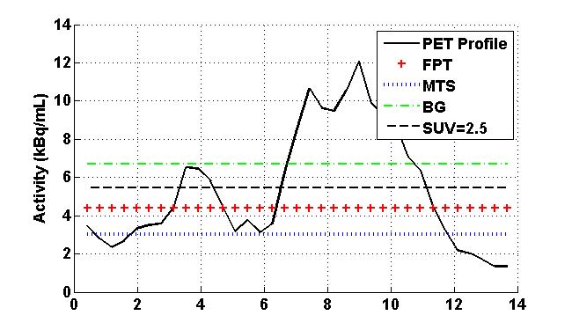
Threshold levels from different fixed threshold methods on top of the activity profile of a lesion
AAPM 2006, Med. Phys. 33, p 2039,
Notes:
Here you see PET segmentation thresholds obtained with different automatic segmentation algorithms which use a fixed threshold on top of a profile of the activity across a real lesion. The methods’ thresholds are plotted without optimization for our scanners and protocols to show how different the segmented volumes would be and to point that one should never use a published segmentation protocol without optimization for their particular scans.

Slide 30
Challenges for PET based tumor segmentation
Ratios of volumes segmented with the same four protocols
AAPM 2006, Med. Phys. 33, p 2039,
Notes:
Applying these same methods to uniform …
And plotting
One can see that the variations in the segmented volumes are much larger for real tumors than for the uniform cylinders and spheres, for which these methods were derived, indicating the limited reliability of such methods in the clinic, especially when the tumors do not have symmetrical shapes and uniform activity distribution.

Slide 31

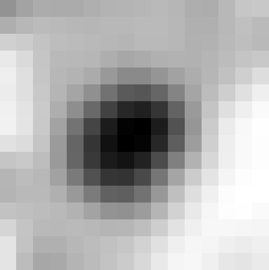

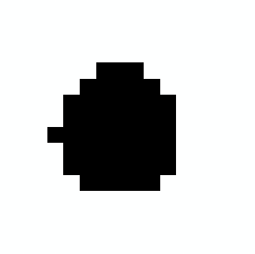





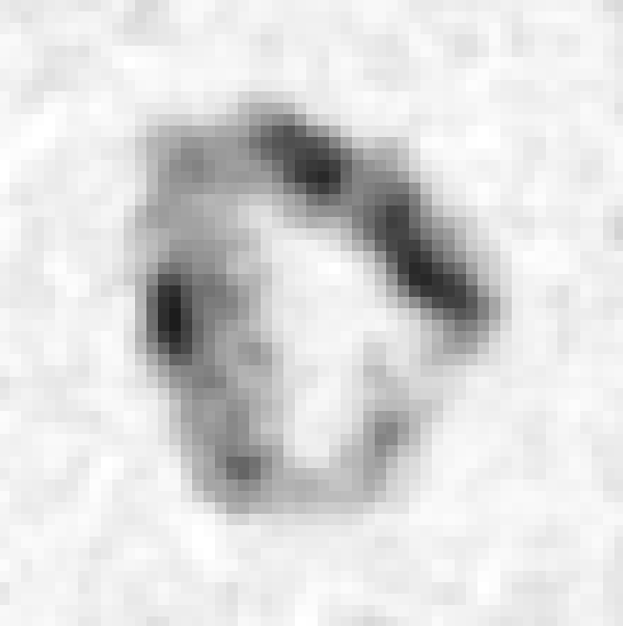

M. Hatt et al, “A fuzzy locally adaptive Bayesian segmentation approach for volume determination in PET” IEEE Transactions on Medical Imaging, 2008, and 2007 IEEE NSS/MIC Conference Record, 3939-3945
Courtesy Dimitris Visvikis (INSERM U650, Image proc. lab, Brest)
simulated tumors
T42
FCM
SBR
FLAB
Segmentation
Ground-truth
Simulated PET
Classif. error:
> 100%
20%
14%
6%
Simulated PET
Volume error
-62%
Volume error
+37%
Ground-truth
1
2
3
T42
SBR
Classif. error
C2: 4%
C3: 2%
Segmentation
FLAB
Notes:
In contrast the locally adaptive techniques are capable to give very accurate results for irreg. shape non-unif. uptake tumors.
Here is shown the performance of one of these methods – FLAB, which uses separate classification to voxels of the three hard classes and six fuzzy levels in comparison to other methods: T= 42%, Fuzzy Markov Chains, Signal-to Background ratio and the FLAB
for two simulated lesions: One with a more symmetric shape and one with an irregular shape and non-uniform uptake.
One can see that both the images and the fraction of miss-classified voxels is smallest for the FLAB method.
___
(3 classes divided in two levels) between each of the three hard classes. Then applies maximum posterior likelihood to segment, and finally the resulting segmentation map is clustered to go from 9 classes back to three.
A slide demonstrating the ability of the FLAB approach to provide segmentation of variable activity distributions within the overall segmented tumor outlines; an approach that could eventually facilitate the application of “dose painting” and variable dose delivery within the tumor depending on specific tumor physiological properties imaged with PET
FCM -> FMC Fuzzy Markov Chains, For each voxel the probability to be assigned to a particular structure or fuzzy level between them is calculated using iterative ML algorithm assuming Markov chain type dependence of the activity in each voxel from one neighboring voxel, determined from a Hilbert- Peano space curve filling of a volume.
31

Slide 32
The problem: What would be PET assisted dose painting ?
(artists view)
UPTAKE
PET
0.94 cm
HYPOXIA
Tumor Cells
Notes:
However, even the impeccable segmentation methods will be limited by the accuracy of the tracer in identifying the biological target and the instrumental accuracy of the PET images, which was discussed in the present lecture.
The correlations between the clonogenic Tumor Cell Concentration (blue) and hypoxia distributions are currently being investigated.
There are many groups including this dept working on the effect of the green curve (hypoxia) on the red (tracer uptake)
_______
There are few more curves one can add :
the RT dose plan
the delivered dose
the after Tx uptake curve

Slide 33
Summary:
Problems in Radiation Therapy
Un- Resolved
Target definition
PET,
MRI,
SPECT ?
Resolved
Accurate dose delivery
Patient and tumor tracking
Are we doing the right thing with the tumor ?

Slide 34
People
C. Ross Schmidtlein, Ph.D.
Hyejoo Kang, Ph.D.
Amols H., Ph.D.
Nehmeh S, Ph.D.
Humm J, Ph.D.
Mageras, G.S.
Lovelock, M
Joe Piao, Cleveland Clinic Foundation
Chris Danford, Duke Medical School
Krasimir Mitev Ph.D. , Georgi Gerganov, Jordan Madzhunkov : Sofia University
Memorial Sloan -
Kettering Cancer
Center

