Slide 1





Status of interaction region magnets (WP3) with focus on MQXF
E. Todesco, on behalf of HL-LHC WP3
KEK, Tsukuba, 13 January 2023

Slide 2
List of contributors (from East to West)
KEK: T. Nakamoto, M. Sugano, K. Suzuki, N. Kimura et al.
IHEP: Q. Xu, Y. Wang, D. Ni, W. Wu, L. Li, Q. Peng, et al.
FREIA: K. Pepitone, R. Ruber, et al.
INFN-LASA: M. Statera, M. Sorbi, M. Prioli, S. Mariotto, et al.
INFN-Genova: P. Fabbricatore, S. Farinon, B. Caiffi, A. Bersani, R. Cereseto, et al.
CERN: S. Izquierdo Bermudez, E. Gautheron, G. Kirby, A. Foussat, J. Carlos Perez, F. Rodriguez Mateos, N- Lusa, E. Ravaioli, M. Bednarek, J. Ferradas Troitino, F. Mangiarotti, M. Bajko, A. Devred, H. Felice, D. Perini, G. Willering, S. Ferradas Troitino, H. Prin, A. Milanese, J. Ferradas Troitino, E. Takala, R. Principe, A. Ballarino, D. Tommasini, B. Bordini, J. Fleiter, C. Barth, S. Hopkins, F. Savary, D. Duarte Ramos, Y. Leclercq, M. Struik, L. Fiscarelli, S. Russenschuck, C. Petrone, G. de Rijk, L. Rossi, P. Fessia, S. Riebe, H. Garcia Gavela, L. Carlos, S. Fleury, G. Vandoni, L. Quain Solis, A. Dallocchio, P. Moyret, S. Sgobba, A. Moros, M. Crouvizier, B. Bulat, M. Guinchard and its team, et al.
CEA: H. Felice, D. Simon, et al.,
CIEMAT: F. Toral, C. Martins Jardim, J. Garcia Matos, et al.
AUP: G. Ambrosio, S. Feher, R. Carcagno, G. Apollinari, B. Ahia, P. Joshi, K. Amm, M. Yu, A. Nobrega, J. Schmalzle, M. Anarella, A Vouris, G. Chlachidze, S. Stoynev, R. Bossert, M. Baldini, P. Ferracin, D. Cheng, S. Prestemon, G. L. Sabbi, L. Cooley, V. Lombardo et al.,
In red: management at CERN and in collaborations

Slide 3
CONTENTS
A short review of the interaction region magnets in the HL-LHC project
The short model program of MQXF
The US contribution (MQXFA)
The CERN contribution (MQXFB)

Slide 4
Back to the 90’s: LHC vs SSC
At the beginning of the 90’s, two projects were in competition: SSC and LHC
LHC was designed to compensate the 3 times lower energy (7 TeV rather than 20 TeV) with 10 times higher luminosity (10³⁴ cm⁻² s⁻¹ compared to 10³³ cm⁻² s⁻¹)
SSC ring: 83 km, 6 T Nb-Ti magnets at 4.5 K, 20 TeV, lumi 10³³ cm⁻² s⁻¹
LHC ring: 27 km, 8 T Nb-Ti magnets at 1.9 K, 7 TeV, lumi 10³⁴ cm⁻² s⁻¹
Cost escalation lead the US congress to cancel SSC in 1993
LHC is approved in 1994
Therefore LHC design in terms of luminosity was considered extremely challenging
On the top of this, LHC also had an ultimate luminosity defined as twice the nominal:
2×10³⁴ cm⁻² s⁻¹

Slide 5
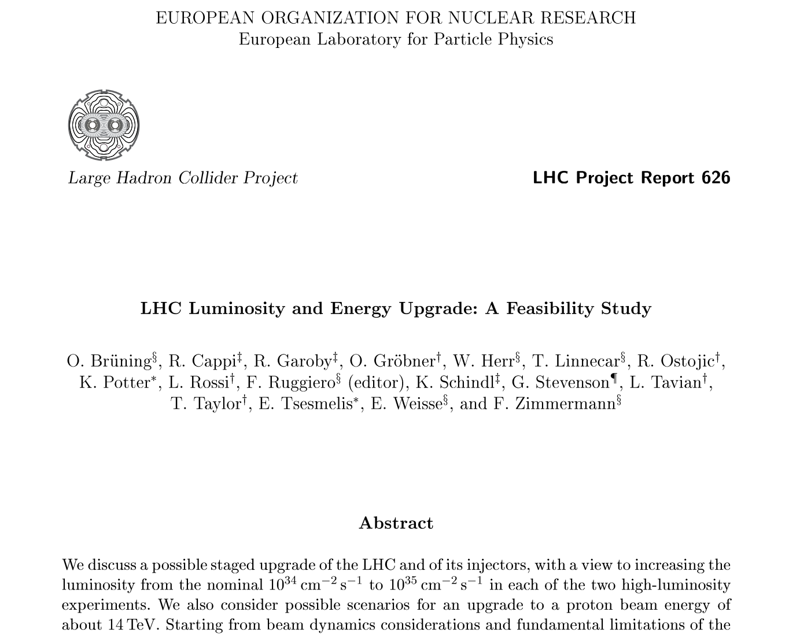

Let be even more light …
Notwithstanding the challenging design, at the beginning of the 21st century plans for further increasing LHC luminosity started
More fuel (more protons per bunch)
Burning more rapidly (smaller beam size)
Target: gather 10 times more data
via 5 times increase: 1 → 5×10³⁴ cm⁻² s⁻¹
Smaller beam size in the interaction
requires larger quadrupole magnets
just after the interaction
Double quadrupole aperture, half beam size,
four times larger luminosity
So the keyword of higher luminosity is
larger aperture triplet and IR magnets

Slide 6
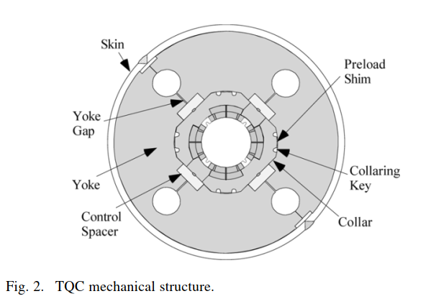
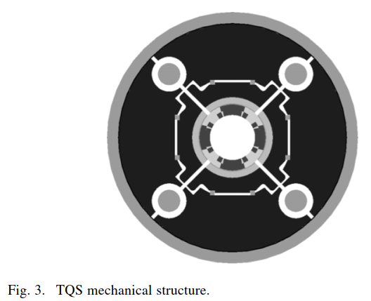
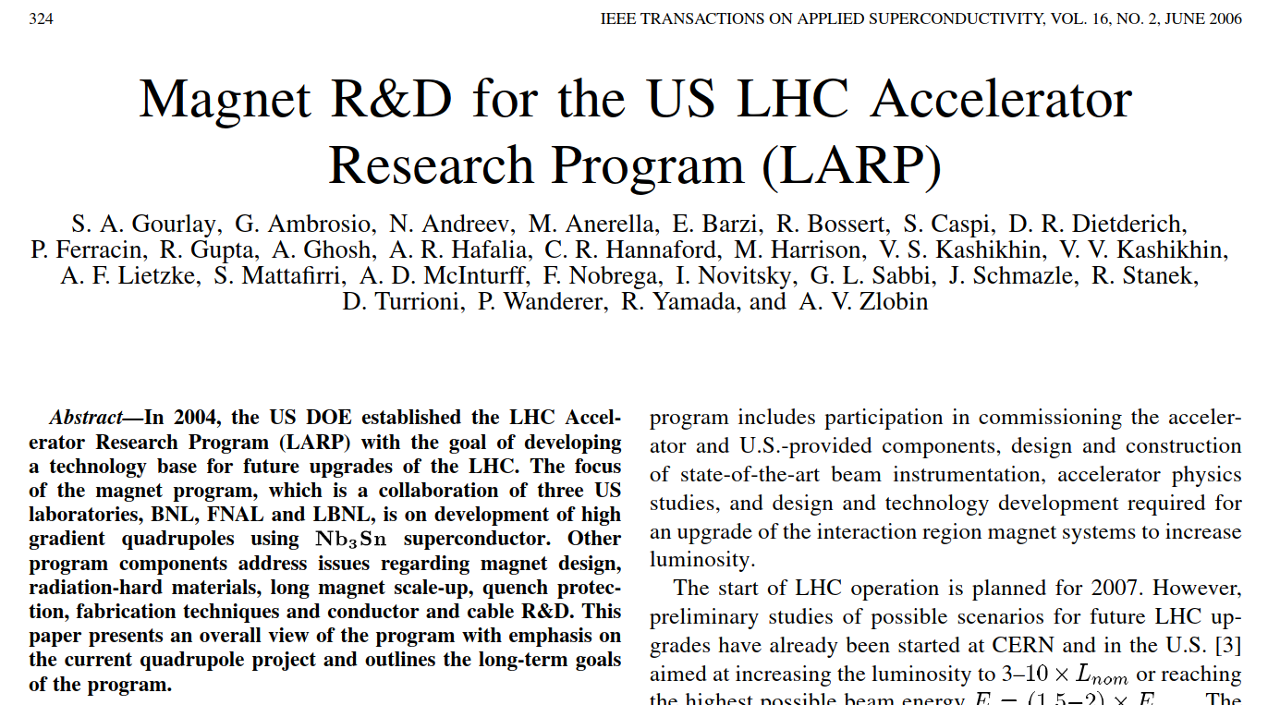
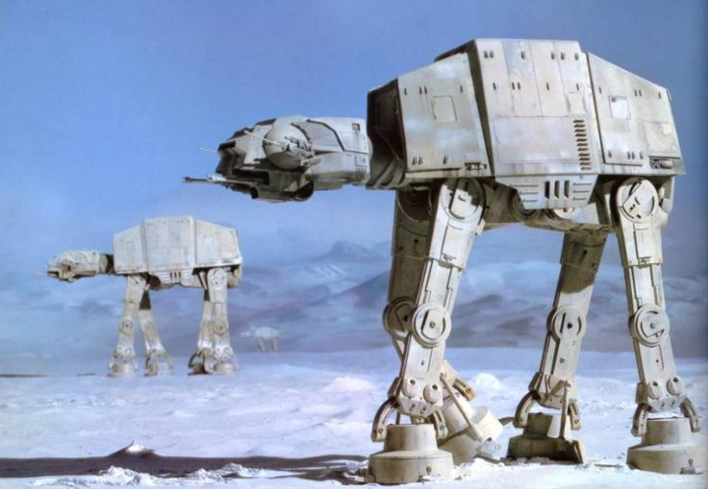
The US program for the luminosity upgrade
At the beginning of the 00’s, the US DOE launches a massive program to develop Nb₃Sn quadrupoles for the LHC upgrade (LARP)
Two structures to be compared, subscale models, radiation hard materials, quench protection, …
In eight years (2003-2011) LARP proves
90 mm and 120 mm aperture quadrupoles reaching
>80% short sample, 1.5 m long
Preference for the Al ring structure with b&k loading
Protection is at the edge, not redundant as needed for operation
Scaling to 3.4 m long for Al structure,
but without integration in cold mass

Slide 7
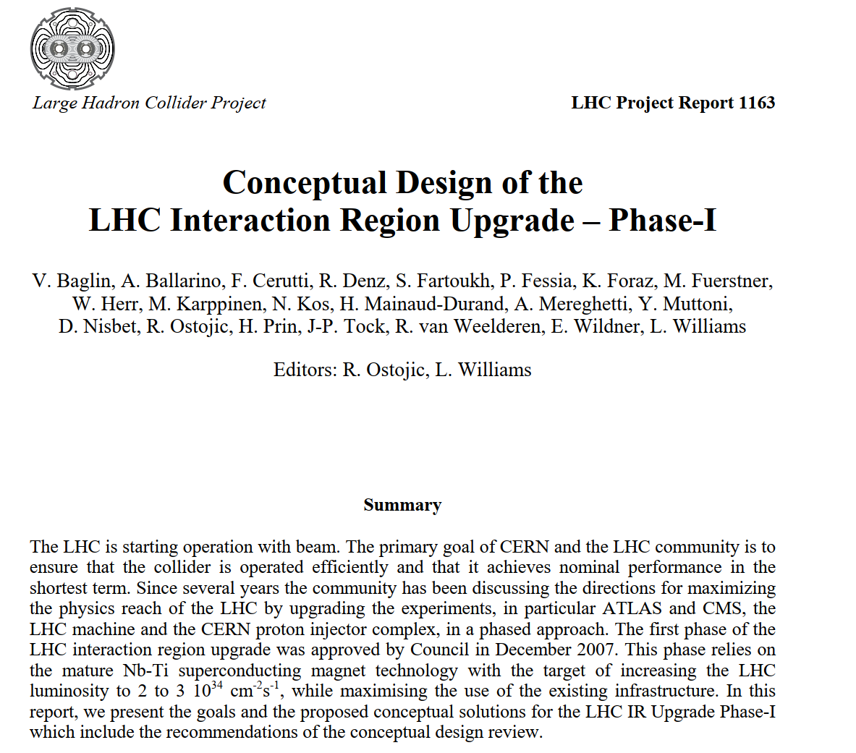
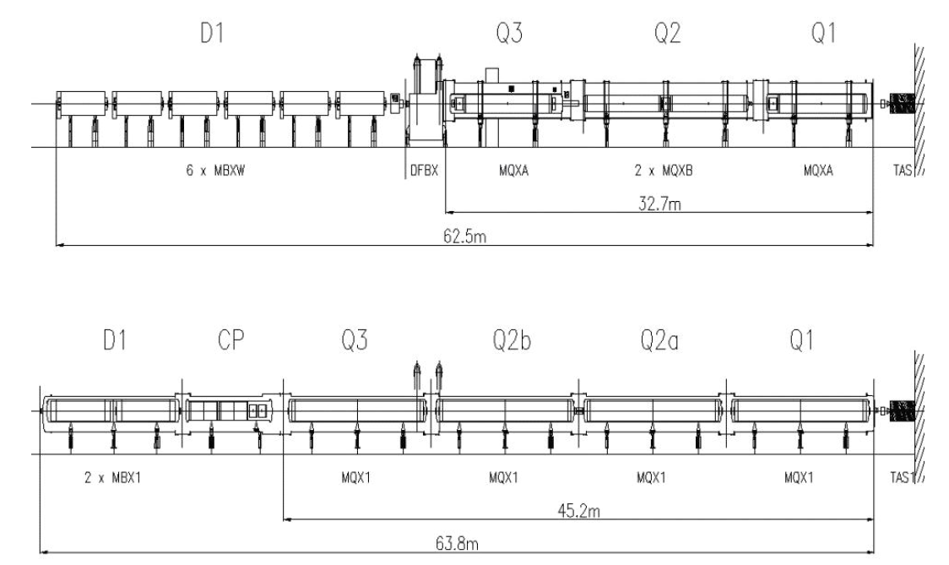
S-LHC and PhaseI upgrade
The LHC upgrade was initially split in two
PhaseI with Nb-Ti, to reach 2-3×10³⁴ cm⁻² s⁻¹
PhaseII with Nb₃Sn to reach 5×10³⁴ cm⁻² s⁻¹
An MQXC, 120 mm and 120 T/m Nb-Ti magnet was succesfully built (G. Kirby, P. Fessia, S. Russenschuck, J. C. Perez, et al.)
Some ideas were taken later in HL-LHC, as grouping correctors in the CP , nested collars for MCBX, superferric design for HO correctors
PhaseI upgrade was canceled in 2011
LHC
layout
PhaseI upgrade
layout

Slide 8
LHC luminosity in the 10’s
In the 10’s, ultimate LHC luminosity was achieved (3.5 TeV, then 4 TeV, then 6.5 TeV) – the accelerator performs according to the most optimistic plans!
PhaseI upgrade targets achieved in LHC operation in 2018
In 2022, first year of Run 3, ultimate luminosity achieved also at 6.8 TeV
Ultimate luminosity
Nominal luminosity
LHC luminosity ramp up in the 10’s (M. Lamont, J. Wenninger, and many many others)

Slide 9
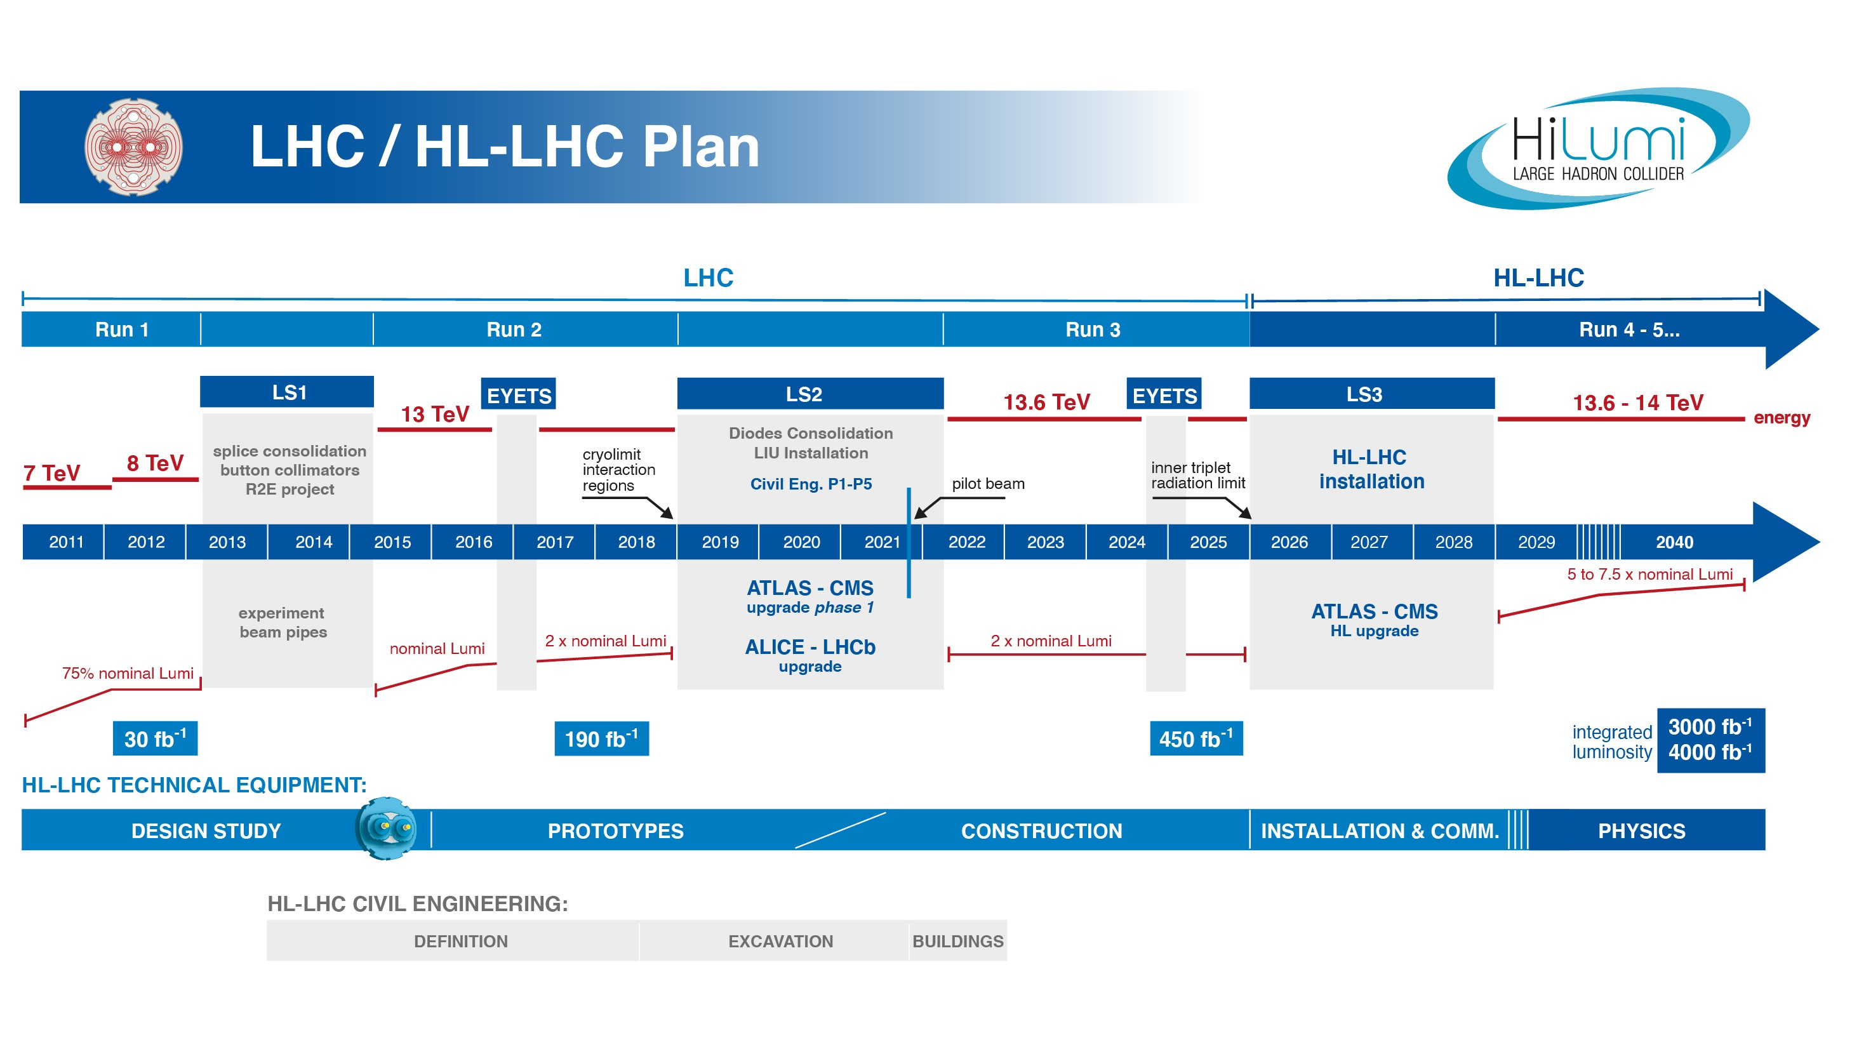
The HL-LHC project
Luminosity upgrade of LHC
~1 BCHF project, CERN flagship
L. Rossi steers the efforts from 2011,
and O. Bruning from 2021
HiLumi design studies in 2012-2014
Project approved in 2015
Installation in 2026-28
Larger aperture triplet and crab cavities are the enabling technologies
SC technologies: interaction region magnets (this talk), MgB₂ link to power the main magnets (A. Ballarino), 11 T dipoles (A. Devred, D. Perini, installation on hold)
IR magnets: replacing magnets in the 160 m left and right of ATLAS and CMS with larger (double) aperture magnets
~220 MCHF budget (w/o personnel), including 8 collaborations/in kind contributions

Slide 10
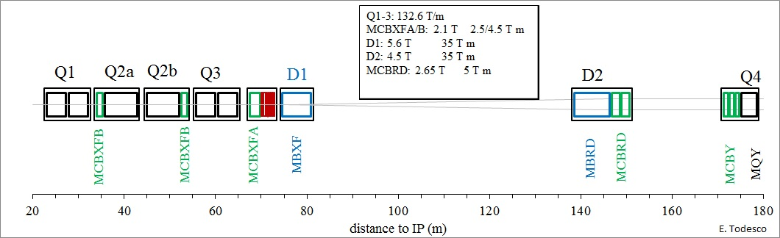

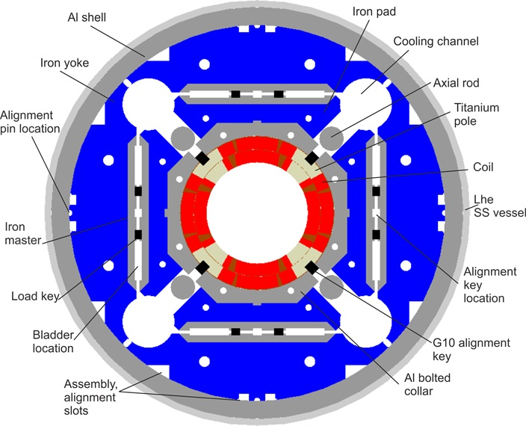
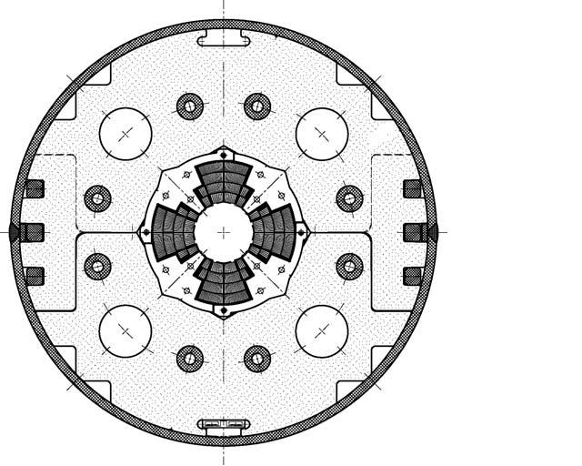
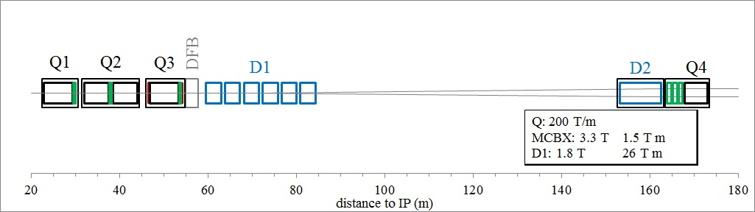

Interaction region magnets: from LHC to HL-LHC
Triplet: from 70 mm aperture Nb-Ti quadrupoles (8.4 T peak field, two types MQXA and MQXB) to 150 mm aperture Nb₃Sn quadrupoles (11.3 T peak field, two lengths with same cross-section, made at CERN and in the US
Thanks to Nb₃Sn, the triplet is only 19 m longer than in the LHC – space is given thanks to D1
MQXF cross-section
MQXA cross-section

Slide 11
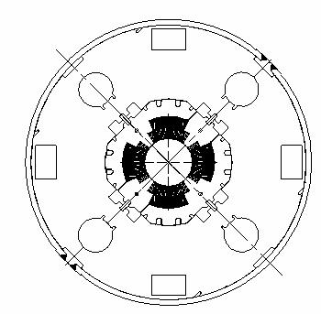
Interaction region magnets: from LHC to HL-LHC
Triplet design: scaling of LARP HQ design from 120 to 150 mm, Al ring structure with B&K loading, operating ≈80% of short sample, 110 MPa accumulated stress due to e.m. forces
In 2014, CLIQ is developed at CERN and provides protection with redundancy together with the QH (G. Kirby, E. Ravaioli, et al.)
MQXF cross-section
MQXB cross-section

Slide 12
Interaction region magnets: from LHC to HL-LHC
LARP had already build 3.4 m long magnets, and proposed 4.2 m long magnets – a project of 8.5 m long magnet would have not been approved by DOE (16 magnets to install plus 4 spares)
CERN decided to go for 7 m long magnets to open a way for the final scaling to 15 m (8 magnets to install plus 2 spares)

Slide 13
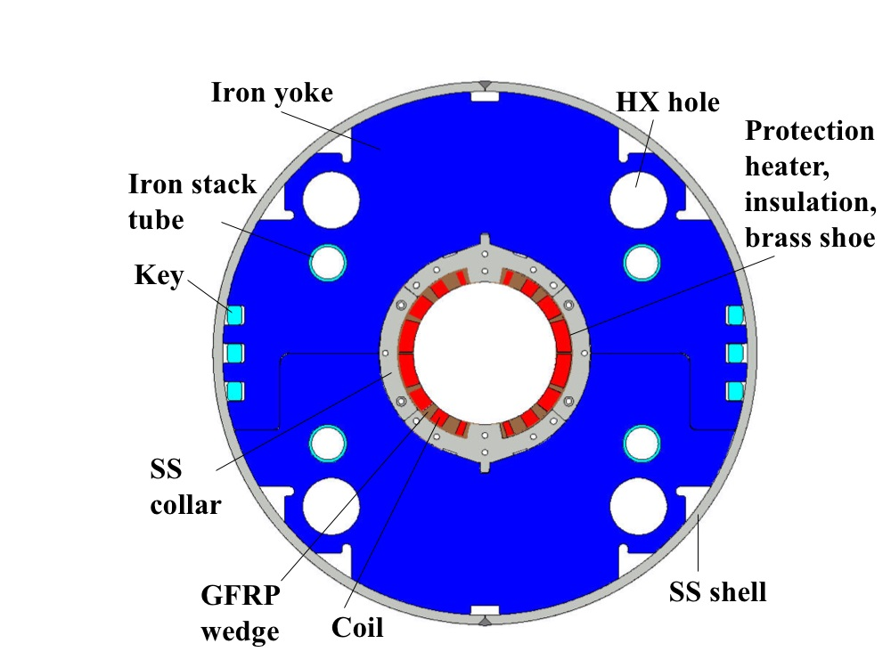
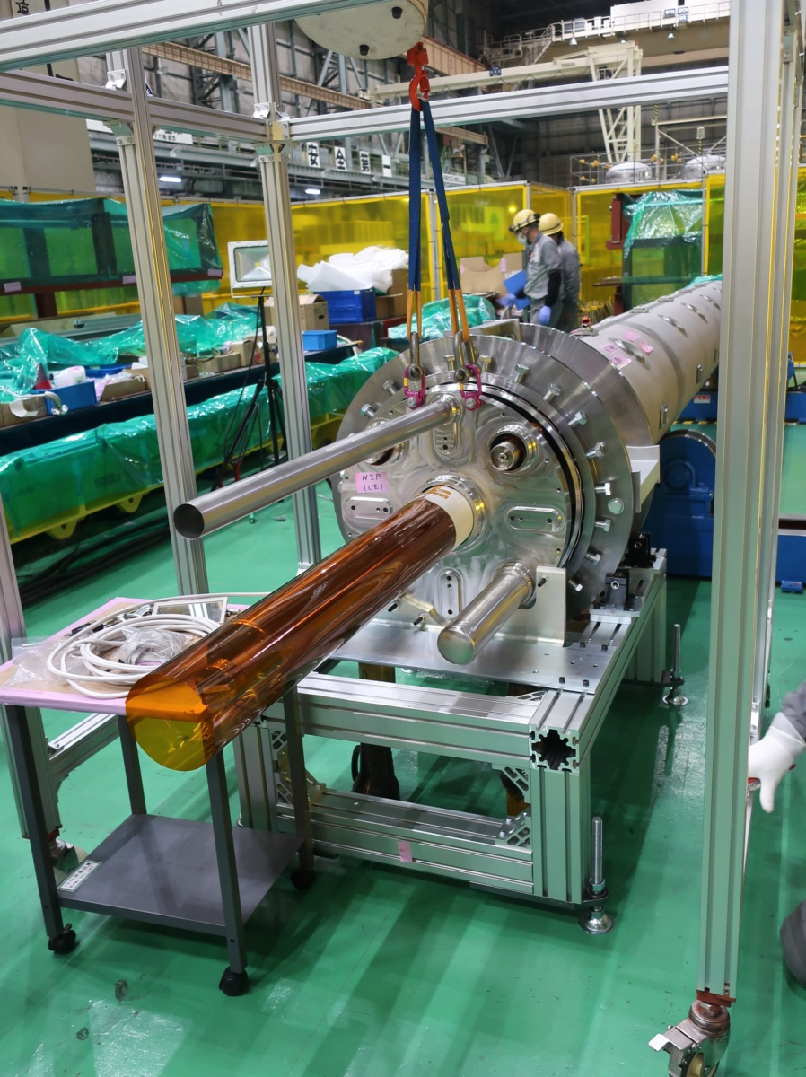
Interaction region magnets: from LHC to HL-LHC
D1 today is a resistive magnet, 6 module 3.4 m long, 1.28 T
The 10 m longer triplet makes use of this space, since the magnet is replaced by a Nb-Ti dipole with 5.6 T field, provided by KEK, Japan – very challenging magnet with 100 MPa e.m. stress

Slide 14
CONTENTS
A short review of the interaction region magnets in the HL LHC project
The short model program of MQXF
The US contribution (MQXFA)
The CERN contribution (MQXFB)

Slide 15
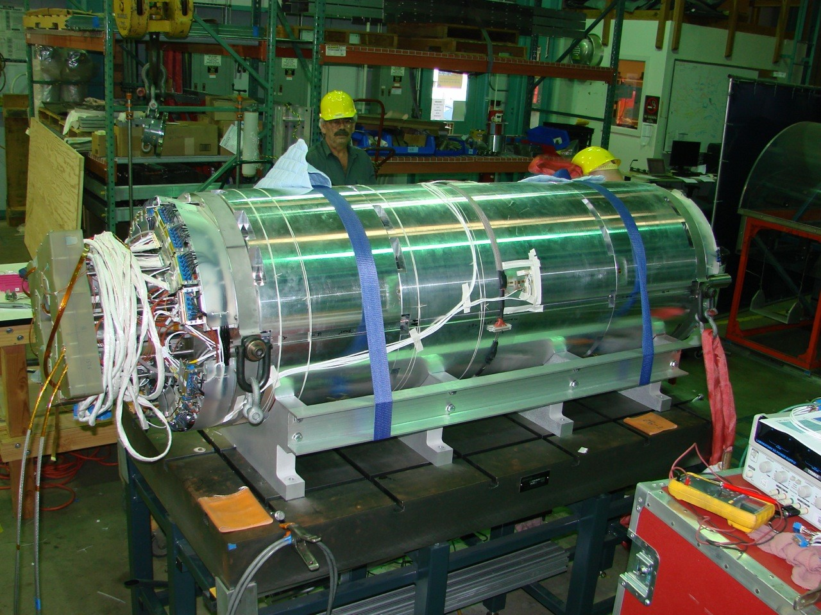
MQXF short model synoptic
6 short models built, 5 conform
MQXFS1: ≥12.9 T
MQXFS3: ~10.6 T
MQXFS5: ≥12.7 T
MQXFS4: ≥13.1 T
T₀: aperture and cable selection
MQXFS6: ≥13.4 T
RED indicates conform magnets
MQXFS7: ≥12.7 T
MQXFS8
2013
2014
2015
2016
2017
2018
2019
2020
2021
2022
2023
T₀+3

Slide 16
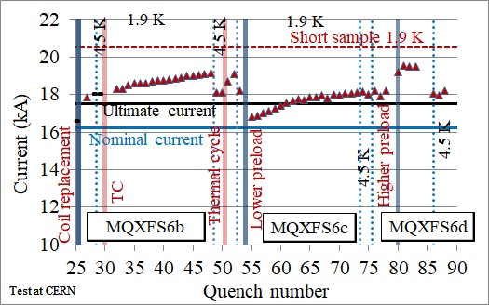
MQXF short model results
Ability to operate at nominal current both at 1.9 K and at 4.5 K
Large margin: ability to achieve 1 to 2 T conductor peak field in excess of what required
Perfect memory: no retraining after thermal cycle up to ultimate current
Reproducibility: 5 out of 6 magnets reached operation >7.5 TeV
Endurance (see next slides)
13.4 T peak field
7.5 TeV
7 TeV
11.3 T peak field
Preload experiment on MQXFS6 (S. Izquierdo Bermudez, F. Mangiarotti, et al.)

Slide 17
CONTENTS
A short review of the interaction region magnets in the HL LHC project
The short model program of MQXF
The US contribution (MQXFA)
The CERN contribution (MQXFB)

Slide 18


MQXFA synoptic
10 out of 22 magnets built and V tested (including 2 prototypes)
6 conform
MQXFA10: ≥11.6 T
MQXFAP1: ≥11.6 T, but electrical short
MQXFAP2: ~10 T, broken structure
MQXFA11: ≥11.6 T
MQXFA03: ≥11.6 T
MQXFA08b
MQXFA04: ≥11.6 T
T₀: aperture and cable selection
MQXFA05: ≥11.6 T
MQXFA06: ≥11.6 T
Red: conform
Black: non conform
Grey: coming in 2022
DOE approval
MQXFA07: ~10.7 T
T₀+4
MQXFA08: <6 TeV
2013
2014
2015
2016
2017
2018
2019
2020
2021
2022
2023
2024
10 magnet tested, 13 more new magnets to test (9 and 12-23), plus re-assemblies

Slide 19
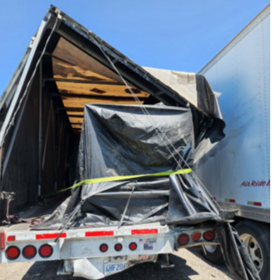

MQXFA conform magnets
MQXFA program confirms
Operation at nominal current plus 300 A, both at 1.9 K and 4.5 K
Perfect memory, i.e. no retraining, and robustness
Powering test of conform MQXFA magnets (J. Muratore, B. Ahia, S. Feher et al.)
Non conform MQXFA11 transport

Slide 20
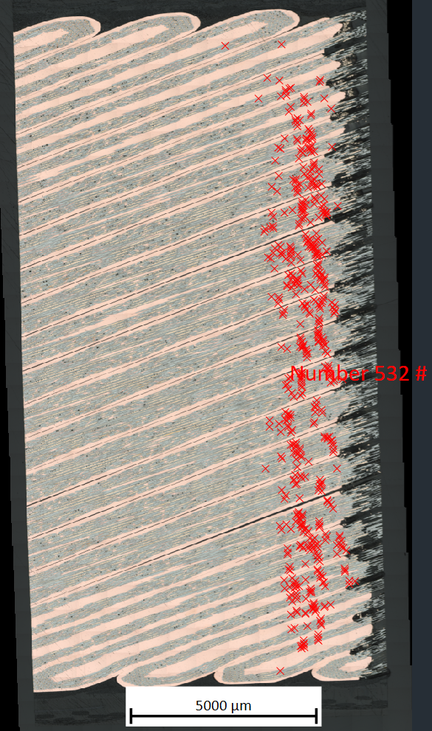
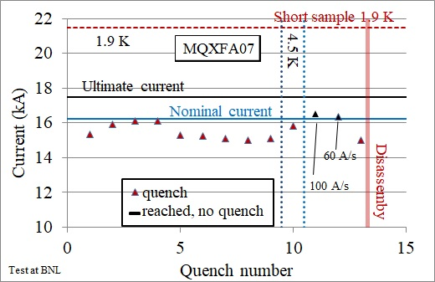
MQXFA performance limitations
MQXFA07 and MQXFA08 showed performance limitations with reverse behaviour
Issue identified in an asymmetry in the assembly, at the transition straight part-end
MQXFA07 limiting coil has been inspected via tomography/mterialography at CERN: large number of longitudinal cracks in the filaments in that region
Feedback on the assembly procedures was implemented starting from MQXFA10 that reached performance
Power test of MQXFA07 (J. Muratore, S. Feher, G. Ambrosio et al.)
Presence of cracks (red crosses) in coil 214 (M. Crouvizier, A. Moros, S. Sgobba)

Slide 21
CONTENTS
A short review of the interaction region magnets in the HL LHC project
The short model program of MQXF
The US contribution (MQXFA)
The CERN contribution (MQXFB)

Slide 22
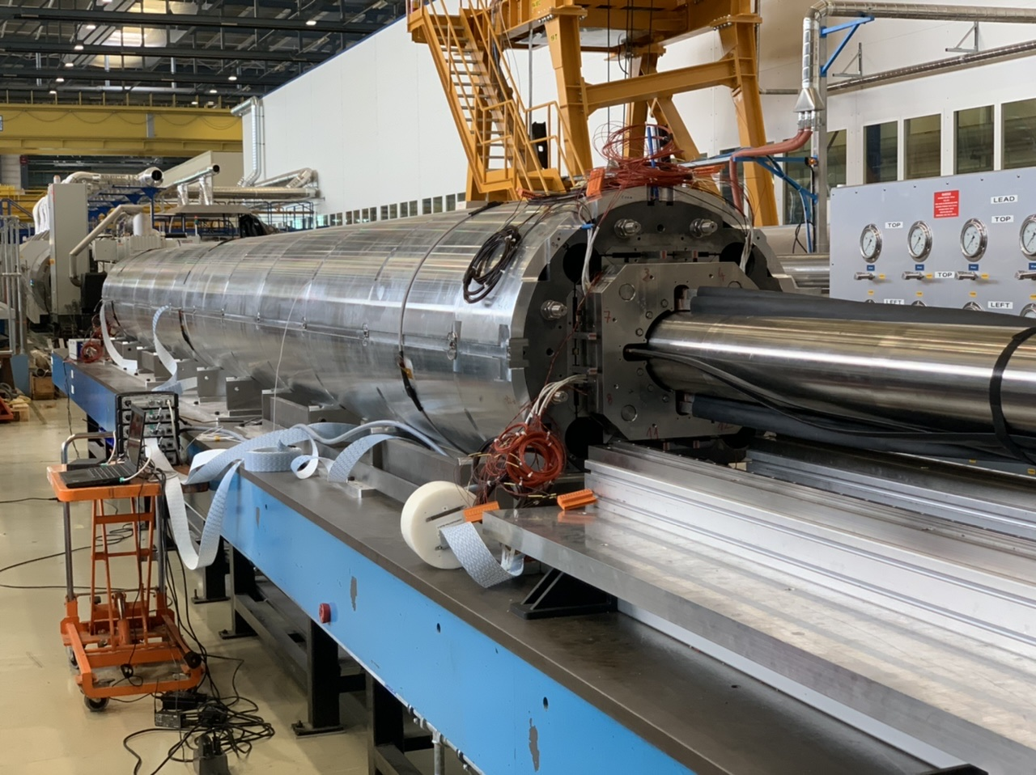
MQXFB synoptic
3 prototypes and 1 series horizontally tested, directly in a cold mass
MQXFBP1: ~10.5 T
MQXFBP2: ~11.2 T
MQXFBP3: ≥ 11.6 T
MQXFB02: ≥ 11.6 T
T₀: aperture and cable selection
2013
2014
2015
2016
2017
2018
2019
2020
2021
2022
2023
T₀+7
9 to 11 more magnets to test

Slide 23
MQXFB performance limitations
MQXFBP1 and MQXFBP2 were limited below nominal current
Contrary to MQXFA, no reverse behaviour, i.e., 4.5 K performance consistent with 1.9 K (70% and 74% of short sample) – quenches in straight part
MQXFBP1 was disassembled, and longitudinally broken filaments were found in the limiting coil, in agreement with quench antenna and voltage tap locations
MQXFBP1 and MQXFBP2 prototype performance
(F. Mangiarotti, S. Izquierdo Bermudez, et al.)
Broken filaments in coil 108, limiting MQXFBP1
(M. Crouvizier, A. Moros, S. Sgobba, et al.)

Slide 24
MQXFB performance limitations
In April 2021, date of the test of second prototype, third magnet (MQXFBP3) was assembled and coils for the fourth (MQXFB02) were completed
Coil production was paused and a plan addressing possible causes were defined and addressed

Slide 25
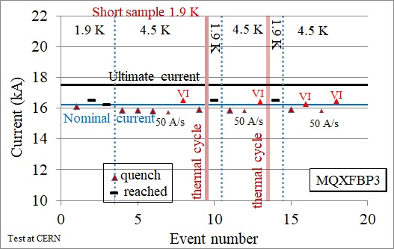
MQXFBP3
MQXFBP3 used a new procedure to weld the LHe vessel minimizing the mechanical coupling with the magnet
Nominal plus 300 A reached during first powering with one training quench,
At 4.5 K, we see the same type of limitation observed in MQXFBP1 and P2 but at much higher levels
No degradation after three cool-downs
Test results of MQXFBP3 and comparison to MQXFBP1 and MQXFBP2, and short models
(PE: S. Izquierdo Bermudez, test eng.: F. Mangiarotti, et al.)

Slide 26
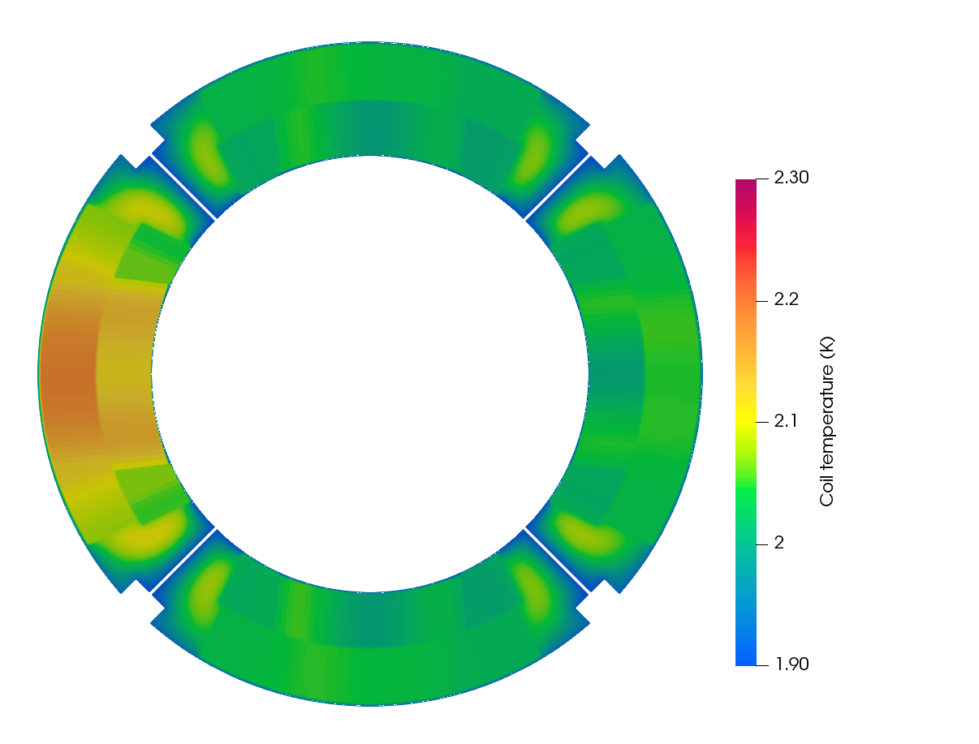
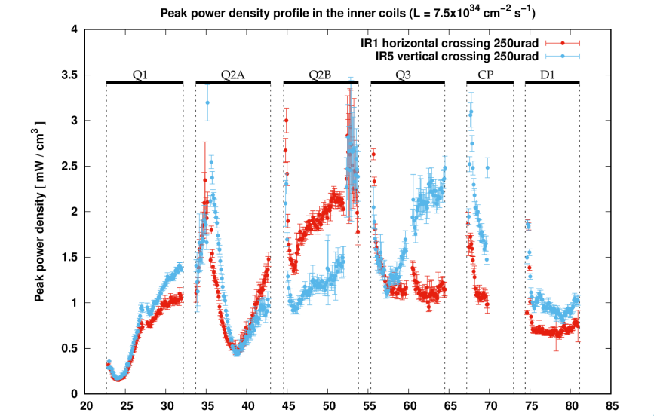
MQXF temperature margin
The collision debris coming from the interaction point heat locally the magnet to 2.2 K: therefore a temperature margin larger than 0.3 K is needed for operation
MQXF nominal current is at 78% of the loadline, corresponding to temperature margin of 5.0 K
The presence of a temparture margin >2.6 K is checked for all magnets via a test at 4.5 K
MQXFBP3 has 2.0 K temperature margin, all short models and US magnets have >2.6 K
Peak power density on the coil
(F: Cerutti, et al.)
Temperture map in the coil
(P. De Sousa, R. van Weelderen, et al.)

Slide 27
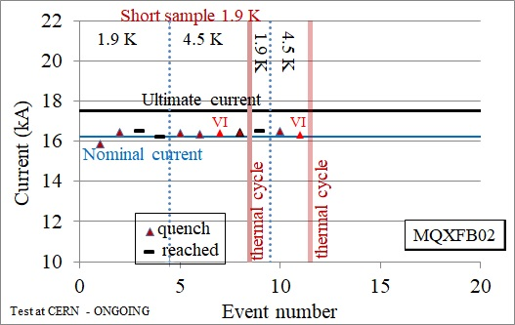
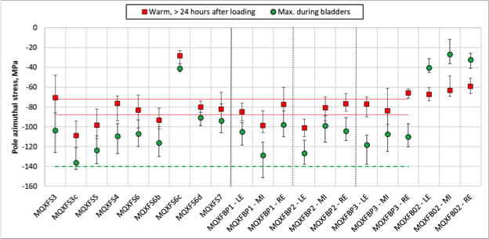
MQXFB02
MQXFB02 used a revised procedure to assemble the magnet, reducing the peak stress
(plus the LHe vessel welding procedure already implemented in MQXFBP3)
Peak stress during assembly is now below 100 MPa, note that succesful short models were asselbmed with peak stresses up to 140 MPa – large margin in terms of prestress for the long magnets
Nominal plus 300 A reached during first powering with two training quench,
At 4.5 K same type of limitation observed in MQXFBP1 and P2 but with 2.6 K temperature margin
MQXFBP1
Short models
MQXFBP2
MQXFBP3
TEST ONGOING
MQXFB02
Test results of MQXFB02 (left) and peak stress during assembly (right)
(PE: S. Izquierdo Bermudez, test eng.: F. Mangiarotti, et al.)

Slide 28
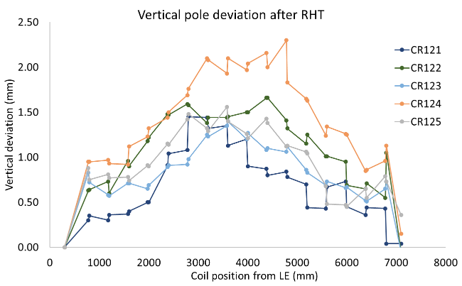
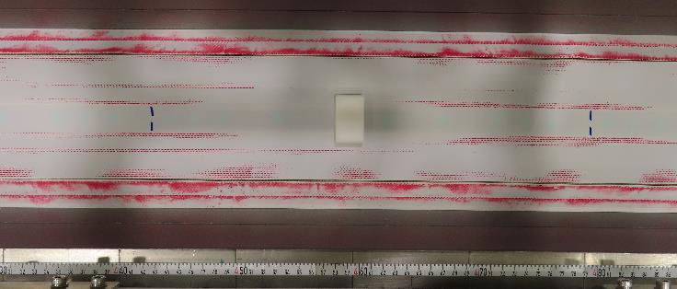
Coil manufacturing
Several actions ongoing to improve the coil manufacturing
Analysis of 108 (limiting coil of MQXFBP1) shows that breakages are close to pole transitions
Analysis of 126 shows that (few) events are also present in a virgin coil (not tested)
Efforts are focusing on the «hump»
Fast-tracks have been defined to assess the performance of the two coils manufactured after the 1 year long pause
MQXFBMT4 and MQXFBMT5, where new coils are assembled with existing coils – to be tested in April and August 2023
MQXFB03, the first magnet using 4 coils manufactured after the pause, will be tested at the end of the year 2023
The hump (S. Izquierdo Bermudez, A. Milanese, N. Lusa, et al.)

Slide 29
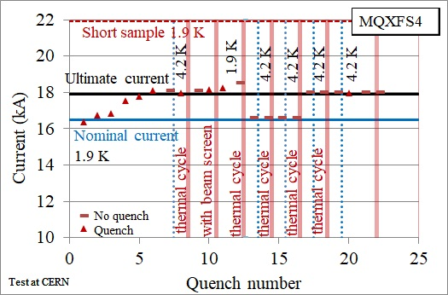
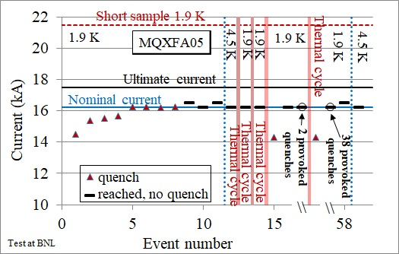
Endurance tests
Degradation of Nb₃Sn magnets after thermal cycle has become a major concern in the community after the results in 2018-2020 of the 11 T long magnets
Three short models succesfully went through endurance tests: MQXFS1, MQXFS4, MQXFS6
One full-length MQXFA magnet (without integration in the LHe vessel) succesfully went through endurance tests – no degradation observed after 5 thermal cycles and 50 quenches
Short magnet endurance test
(P. Ferracin, F. Mangiarotti , et al.)
Long magnet endurance test
(B. Ahia, S. Feher, G. Ambrosio, et al.)

Slide 30
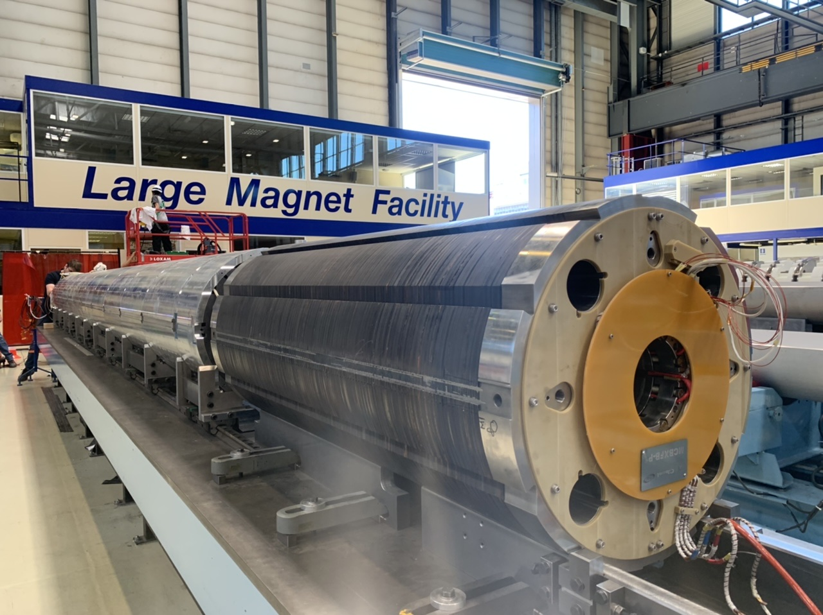
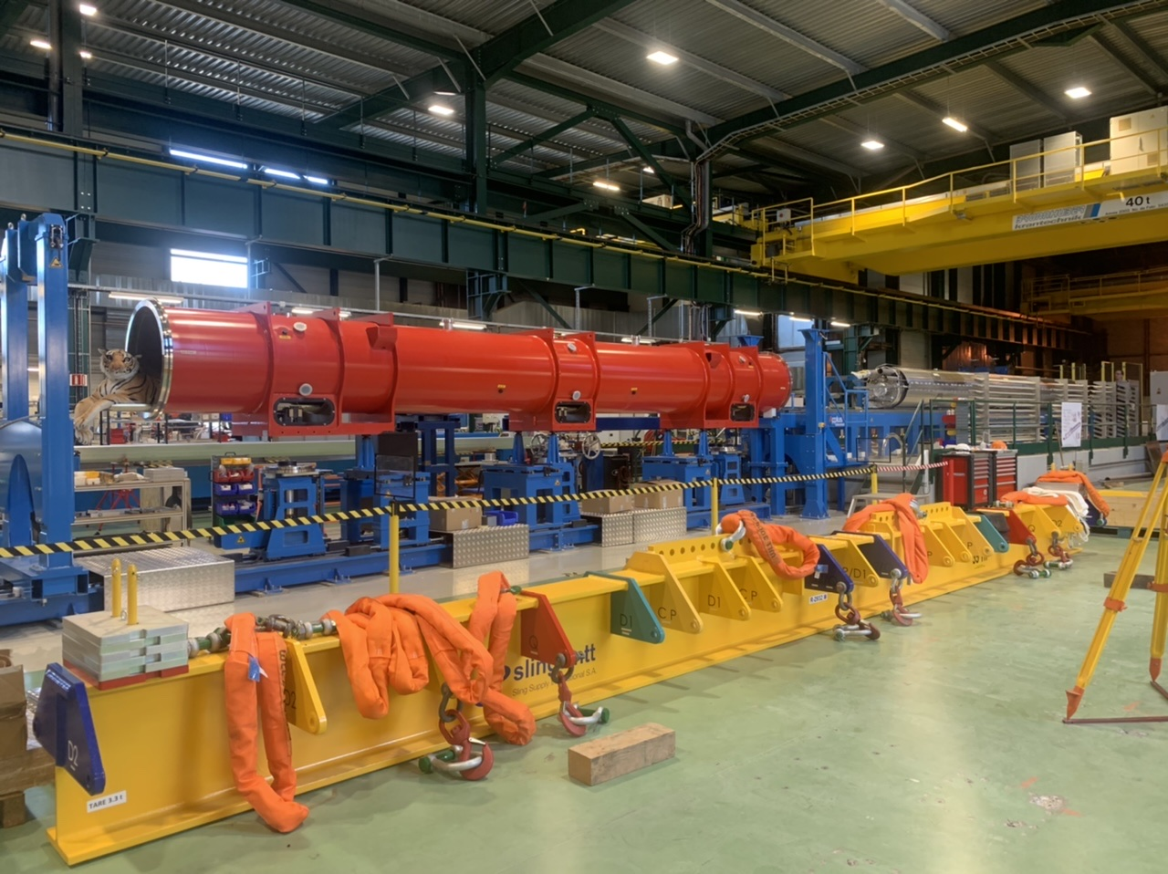
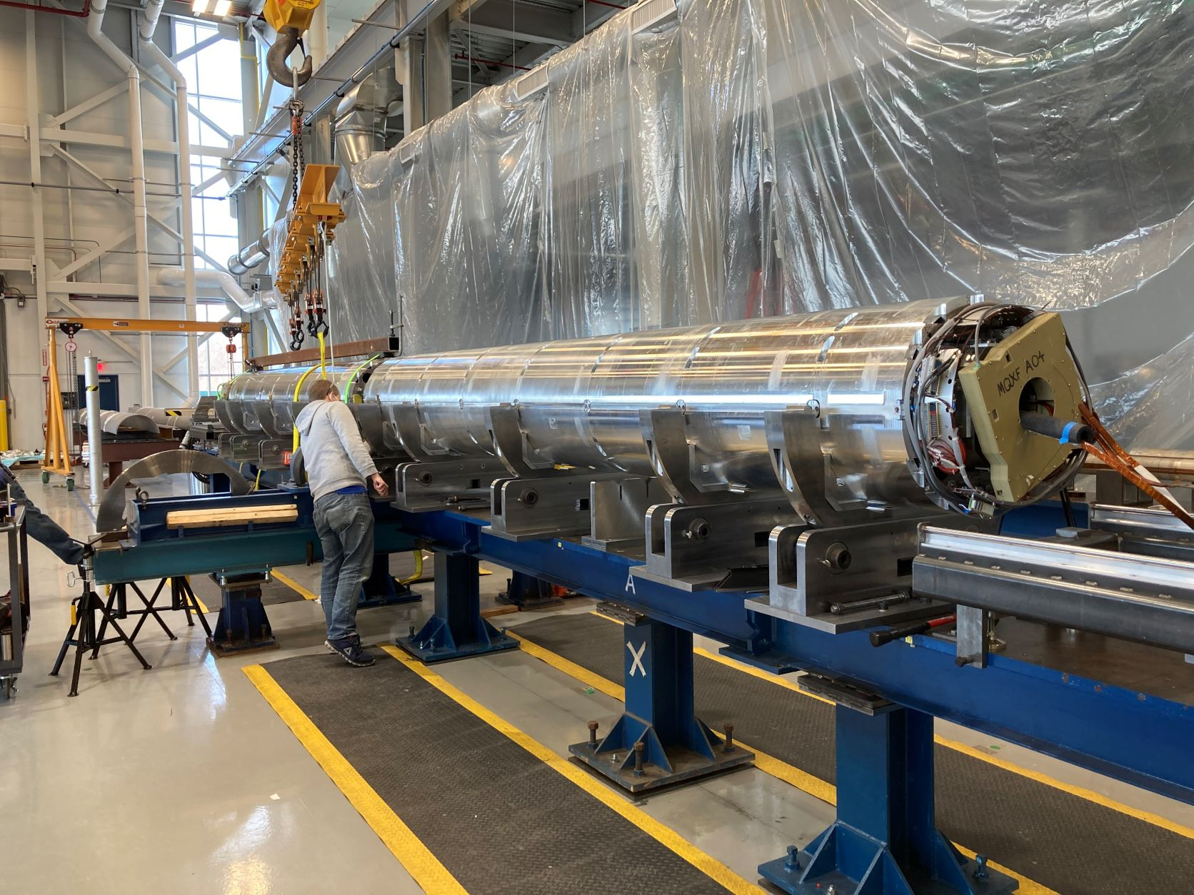
THE STRING COMING SOON
The string will assemble Q1 to D1 cryomagnets to test the system, to be commissioned in 2024 (M. Bajko)
MQXFBP2 on assembly bench with
nested corrector MCBXFBP1 (H. Prin, et al.)
First cryostating of MQXFB cold mass
(D. Duarte Ramos, et al.)
Alignment of first MQXFA cold mass
(S. Feher, et al.)

Slide 31
CONCLUSIONS
MQXFS
Short model program proved ability to reach 1-2 T in excess of requirements, and endurance
MQXFA
Successful endurance test of the first Nb₃Sn full length magnet – major milestone
Six conform magnets, but integration in the cold mass still to be proven
Issues with MQXFA07 and MQXFA08 performance seem to be understood and MQXFA10 is conform
Next critical steps before end of the year: test of the first cold mass in horizontal position and validation of coil replacement in MQXFA08b
MQXFB
Fully redundant protection has been proved
Last prototype has achieved nominal plus 300 A, with memory and no degradation – first Nb₃Sn magnet in a cold mass configuration
Repeatability of this result is being assessed in test of MQXFB02
Efforts still ongoing to improve coil manufacturing to have 7 m long magnet with the full performance shown in short models

Slide 32
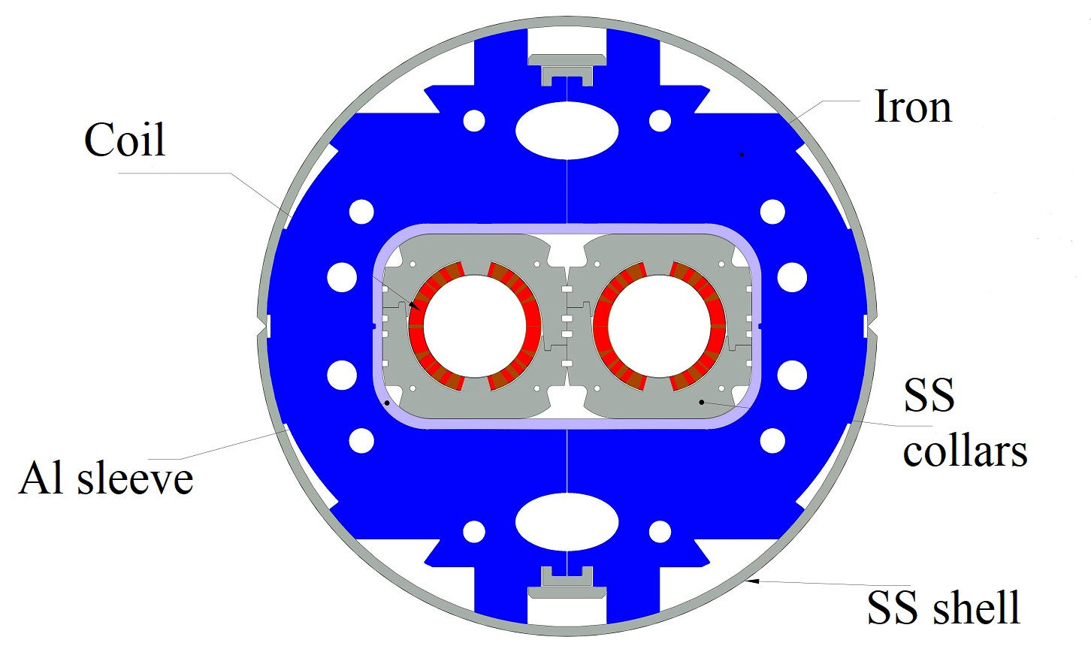
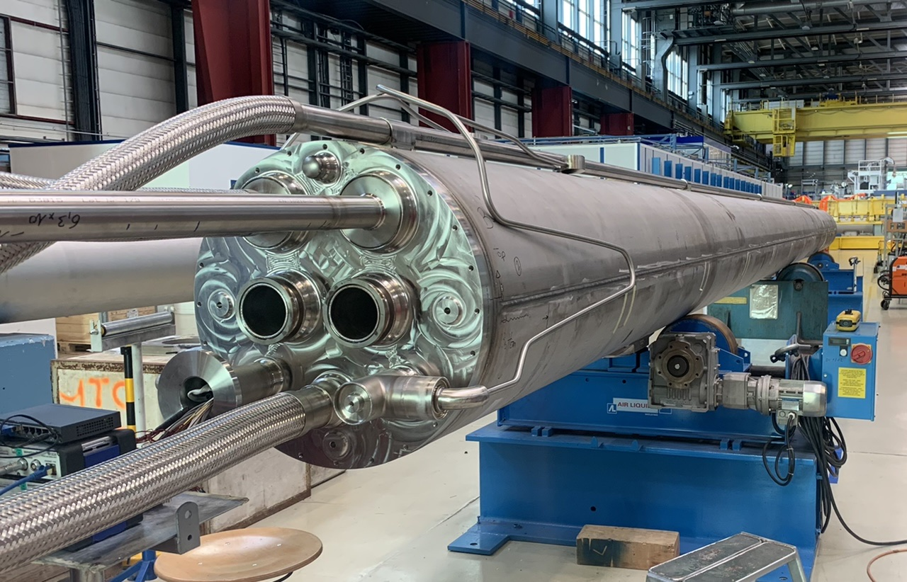

Interaction region magnets: from LHC to HL-LHC
D2 today is a Nb-Ti magnet, 2.8/3.5 T, 9.5 m long (from BNL, same design of BNL dipole coils)
D2 in HL-LHC is a Nb-Ti 4.5 T magnet, 7.9 m long (from INFN-Ge, similar design to SIS-300 dipole)
INFN-Ge and ASG make the magnet – cold mass, cryostating and horizontal test made at CERN

Slide 33
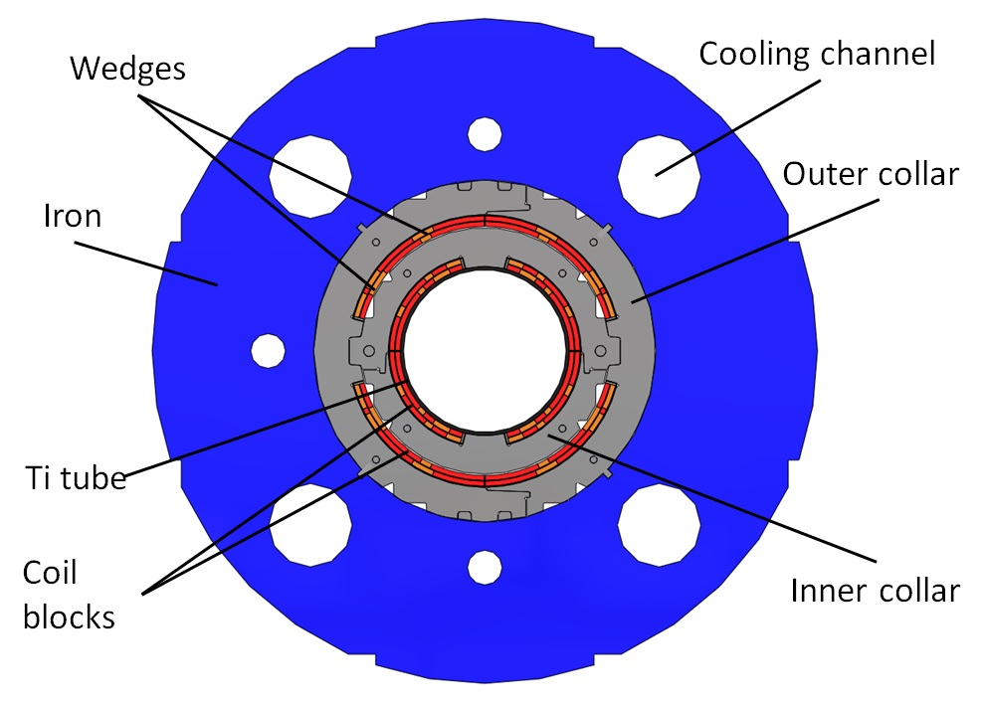
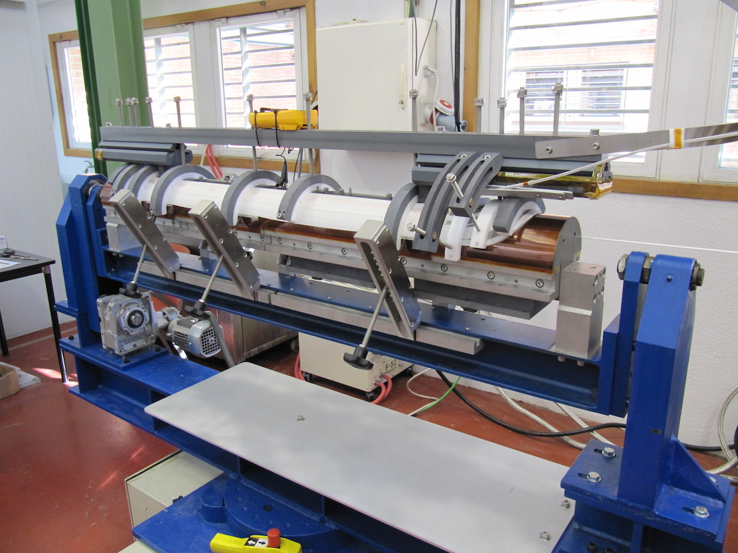
Interaction region magnets: from LHC to HL-LHC
MCBX today is a Nb-Ti magnet, 3 T field, 2 T m integrated field, combined function H and V field
MCBXF is a Nb-Ti magnet, 2.1 T field, 2.5/4.5 T m integrated field, combined function H and V field
Double collared structure, very large aperture and thin coil, made in CIEMAT/Elytt
Integration in the cold mass, cryostating, V and H test at CERN

Slide 34
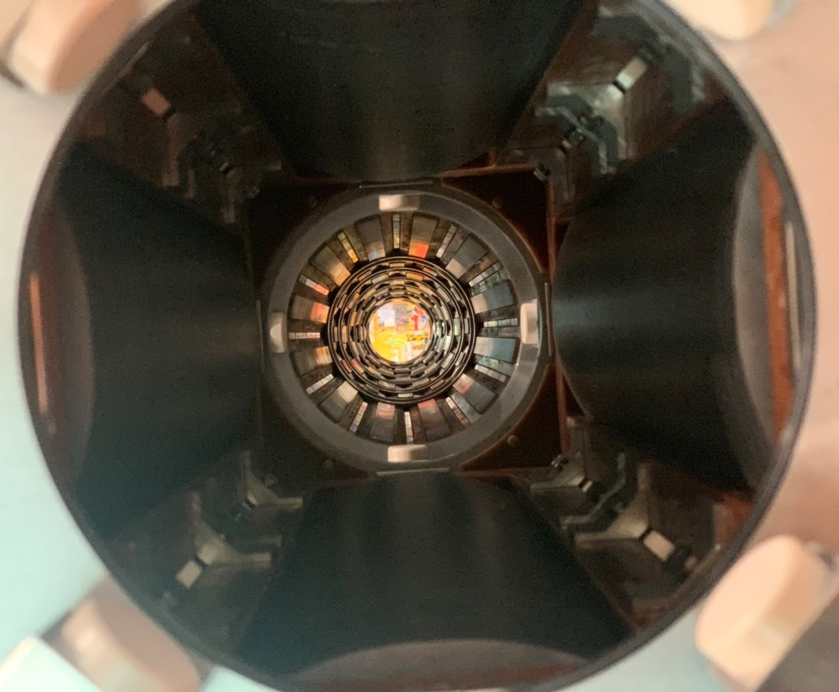
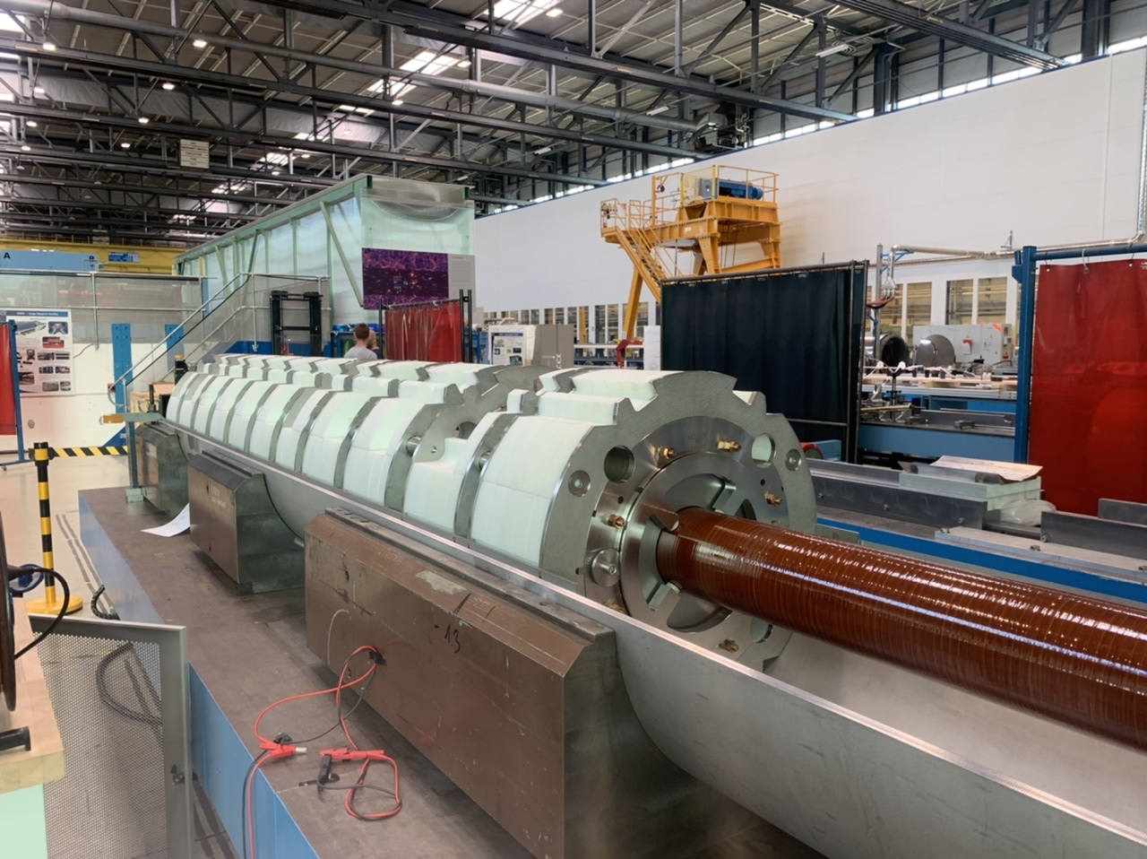
Interaction region magnets: from LHC to HL-LHC
HO correctors, based on Nb-Ti superferric technology: nine magnets gathered in the corrector package
Design developed for S-LHC, CIEMAT, and adapted by INFN-LASA
Integration in the cold mass, cryostating, H test at CERN

Slide 35
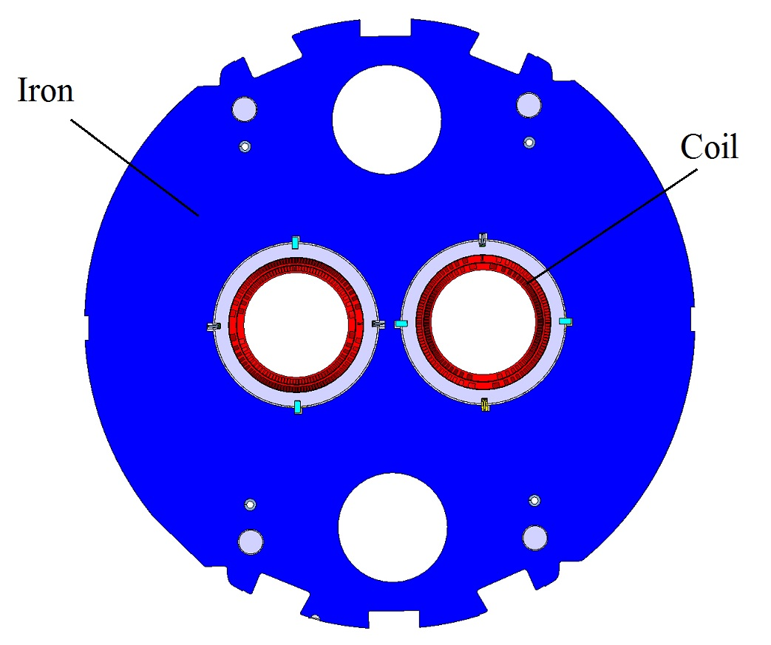
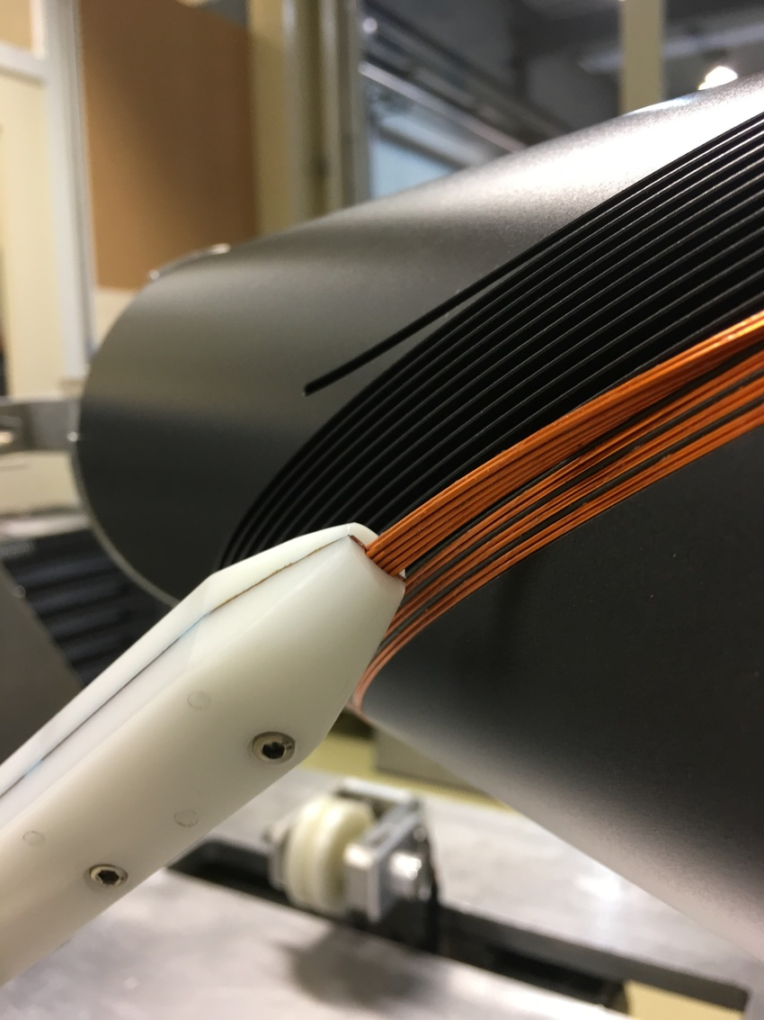
Interaction region magnets: from LHC to HL-LHC
D2 correctors (merged with Q4 in LHC) are 2.8 T magnets, 4.5 T m integrated field
CCT design was adopted, a prima for CERN – design and prototypes developed in 927
China in-kind contribution (magnets and V test), integration in D2 cold mass in 180

Slide 36

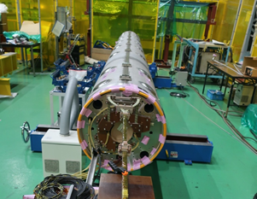
D1 (see T. Nakamoto talk)
After the test of the prototype in vertical KEK test station (May 2021), past year has been dedicated to cold mass manufacturing and test facility upgrade
Shipping to CERN before the end of 2022, and horizontal test in SM18 in early 2023
The winding at Hitachi of the coils of first (MXBF5) and second (MBXF1)
series magnet has been completed (1/3 of total production!)
These coils had a fine tuning of cross-section to
correct 5 units of b₃ and -5 of b₅
Collaring of MBXF5 completed, but issue
with procedures has been found → decollaring
Vertical test of MBXF1 expected for end of 2022
Cold mass of MBXFP1 (T. Nakamoto, M. Sugano, K. Suzuki, H. Felice, et al)

Slide 37

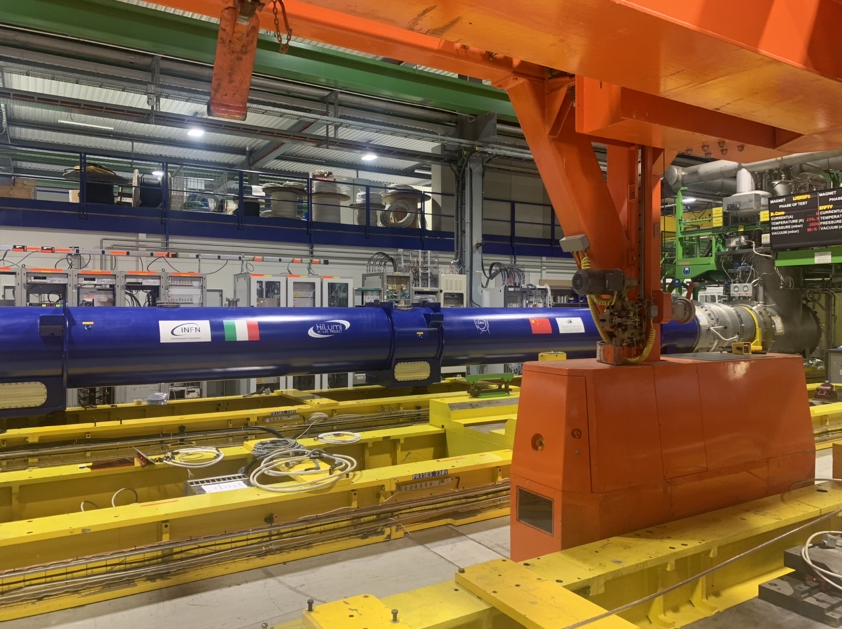
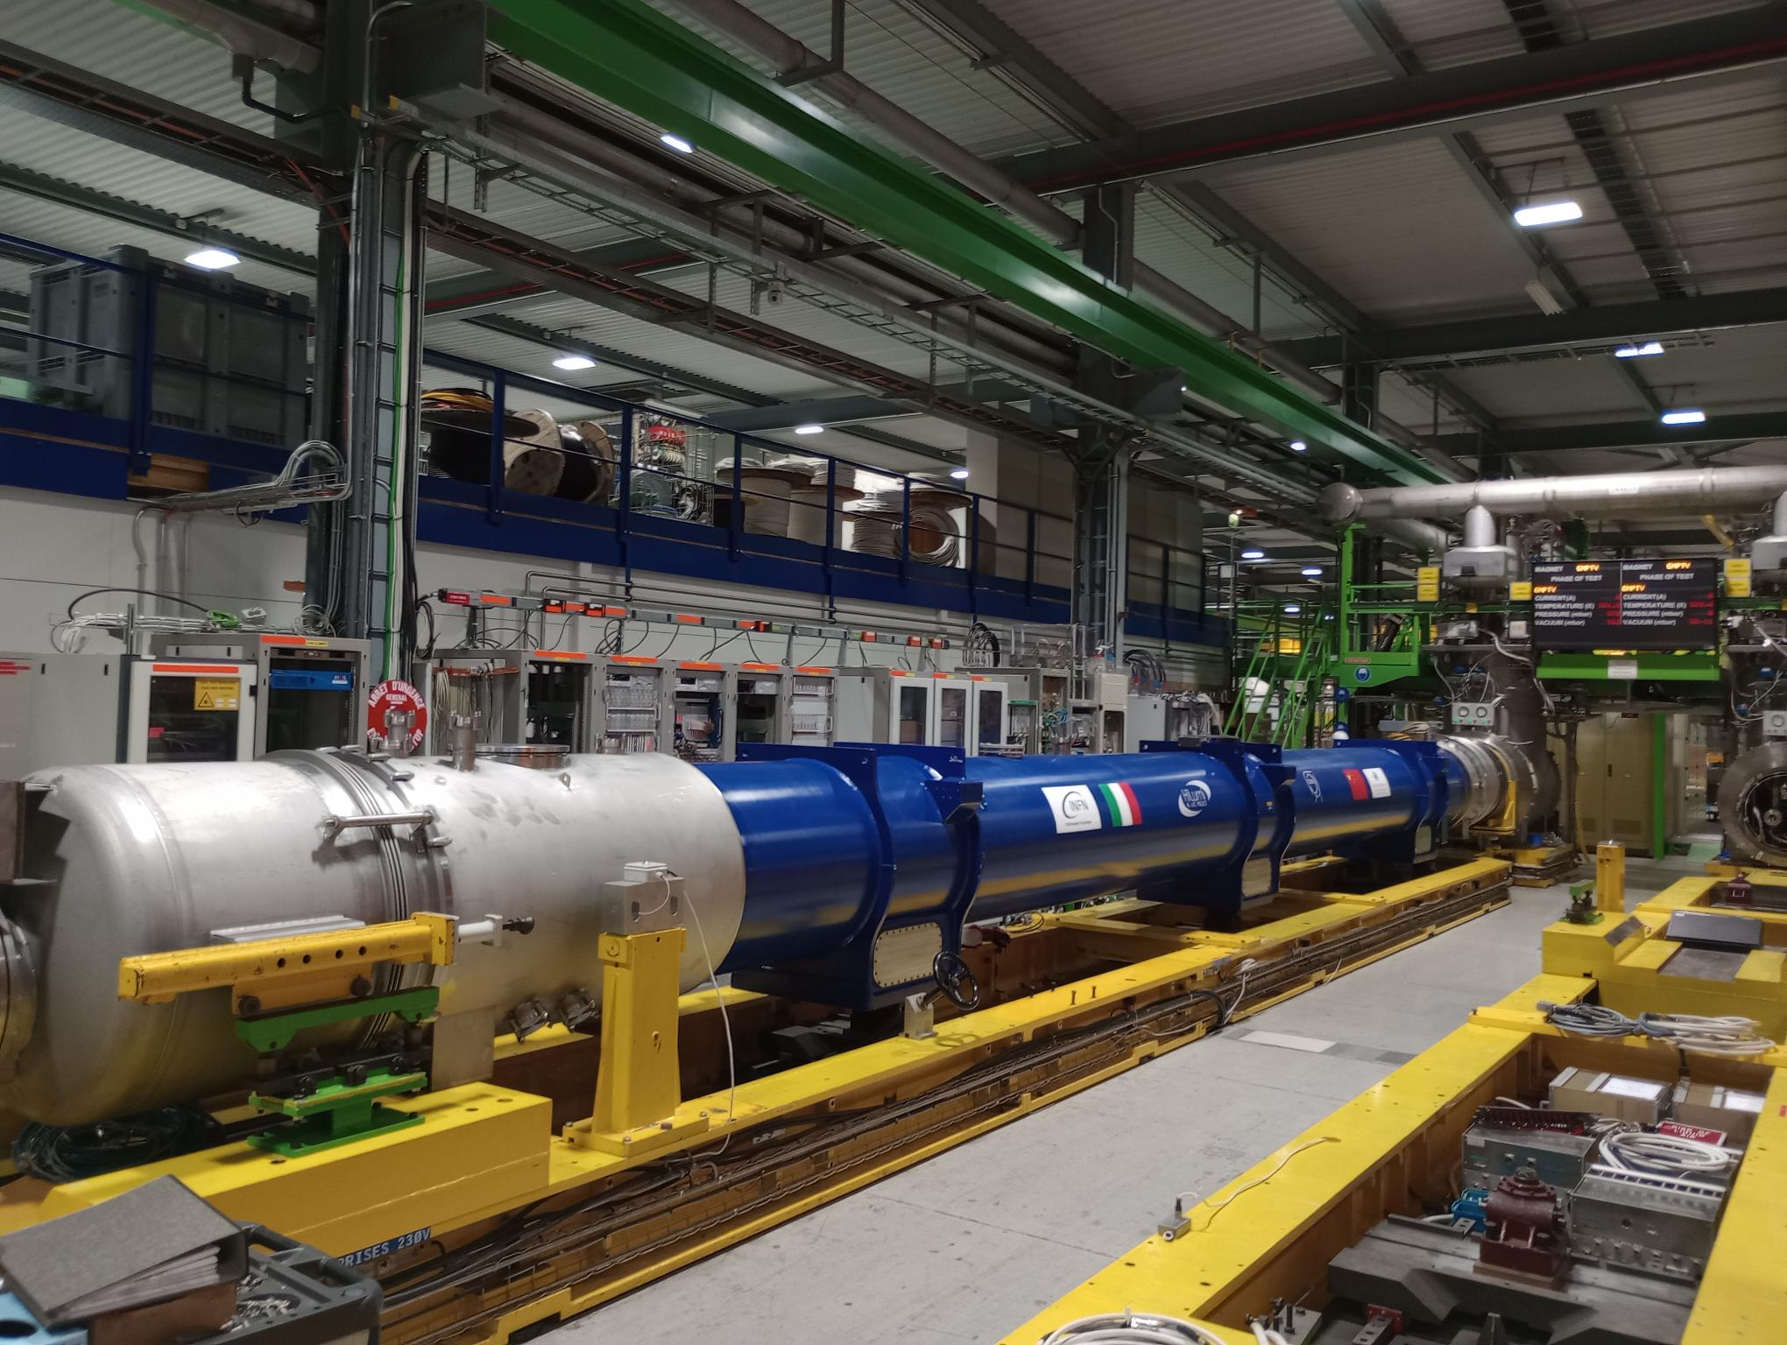
D2 (see B. Caiffi talk)
D2 prototype (fully made in ASG) test at 1.9 K in SM18 is ongoing
Final cold mass configuration, with one D2 corrector from CERN and one from China in-kind contribution
First use of cryostating tooling for HL-LHC at CERN
Manufacturing of first series coil completed
Fine tuning of cross-section to optimize b₃ and b₅
First series magnet at CERN in mid 2023,
test in early 2024
D2 cold mass on the test bench in SM18 (S. Farinon, B. Caiffi, A. Bersani, A. Foussat, et al)

Slide 38
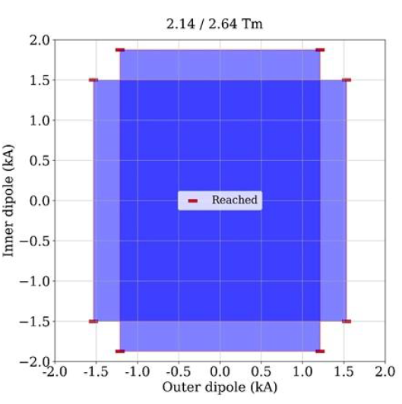
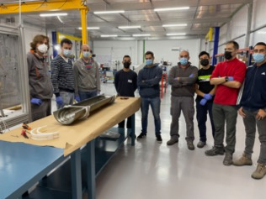

Nested correctors (see F. Toral talk)
The performance limitation seen on the retraining after change of torque in prototype MCBXFBP1 and MCBXFBP2 (short nested correctors) was overcome after a design iteration executed on MCBXFB01
The second prototype had the inner layer changed with a new inner layer made by Elytt, both to validate the first production coils and to verify the reproducibility of the design change
Magnet reached performance at 7.5 TeV equivalent without retraining after thermal cycle – second magnet conform
First short corrector fully manufactured in Elytt is being completed (MCBXFB02)
To be tested in October 2022 at CERN
First long prototype to be assembled in October at CERN
Test results of MCBXFP2c
(S. Ferradas Troitino, F. Toral, J. C. Perez, C. Martins, et al)

Slide 39


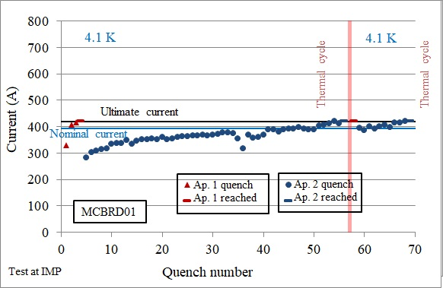
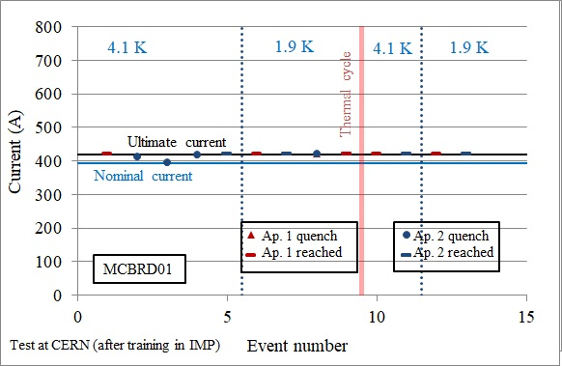
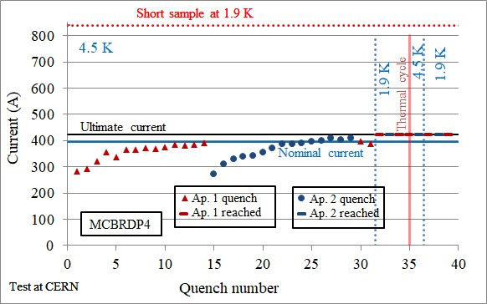
D2 correctors (see Q. Xu) talk
D2 correctors (see also A. Foussat talk on Wednesday at 9h)
Issue of very long training at 4.5 K observed in inital production at BAMA has been solved (iteration on impregnation prodecures, and size of the channel gap)
First fast training coils to be tested in MCBRD03
MCBRD01 and 02 reached performance at 4.5 K in IMP (non conformity in retraining and HV test)
MCBRD01 retested at CERN at 1.9 K and achieved training requirements – pending issue on insulation
MCBRD02 to be tested at CERN in October 2022
Additional magnet completed at CERN (MCBRDP4) - conform
Training of MCBRD01 (PE: Q. Xu, test: W. Wu, G. Willering et al)
Training of MCBRDP4
(WPE: A. Foussat, G. Kirby, test: G. Willering et al)

Slide 40

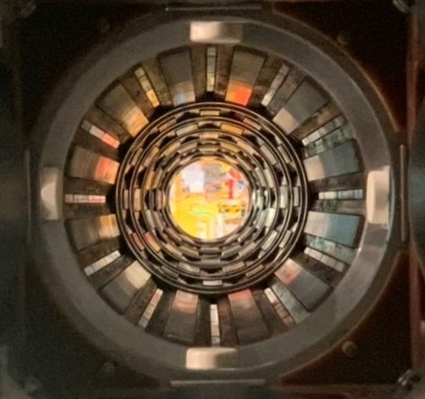
High order correctors (see M. Statera talk)
Production completed in SAES-RIAL vacuum (54 magnets)
37 magnets tested and accepted (2/3)
Cold mass assembly operations started at CERN, including alignment
The nine high order correctors assembled in the prototype cold mass
(M. Statera, E. Gautheron, H. Prin, et al)

