Slide 1

UPDATE ON BBM3 FLOW DISTRIBUTION SYSTEM
ITS3 plenary
Tuesday 17th January 2023
Aitor Amatriain

Slide 2
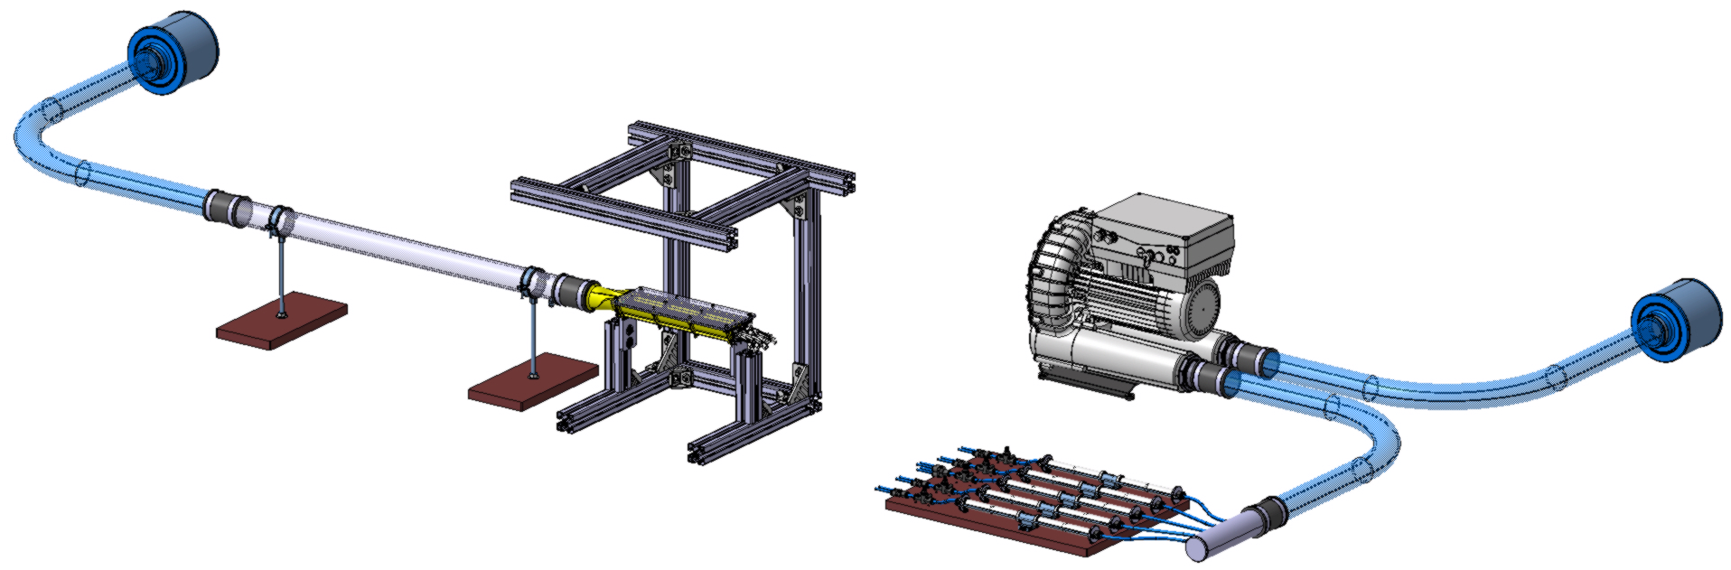
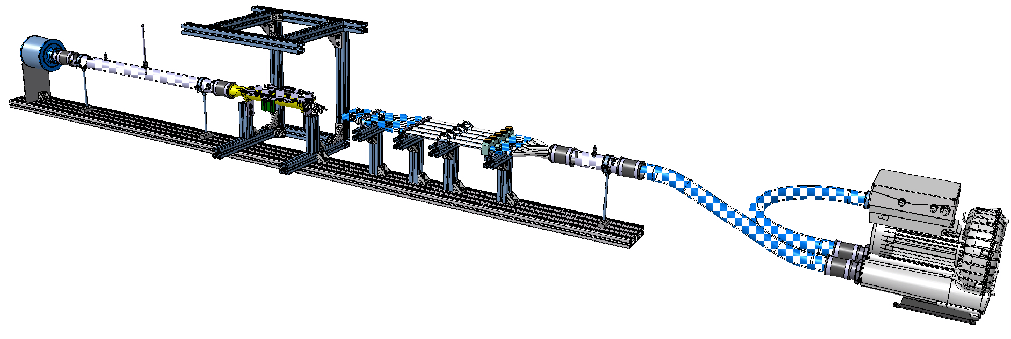
Air filter
Setup frame
Distributor
Fan
OLD
NEW

Slide 3
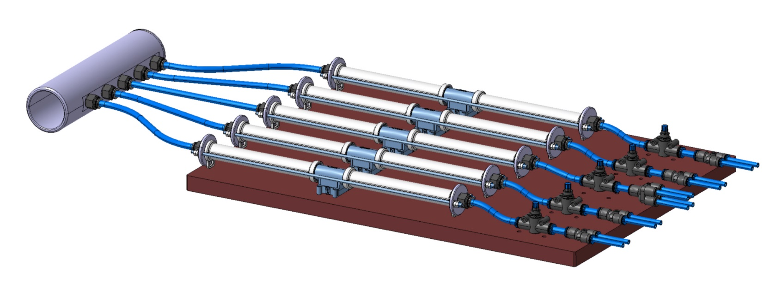
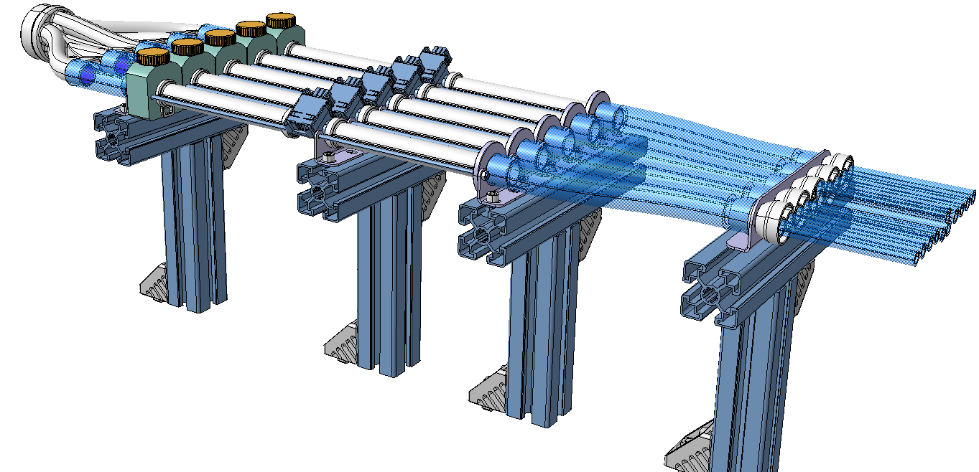
Manifold
Flow meter
Flow control valve
OLD
NEW

Slide 4
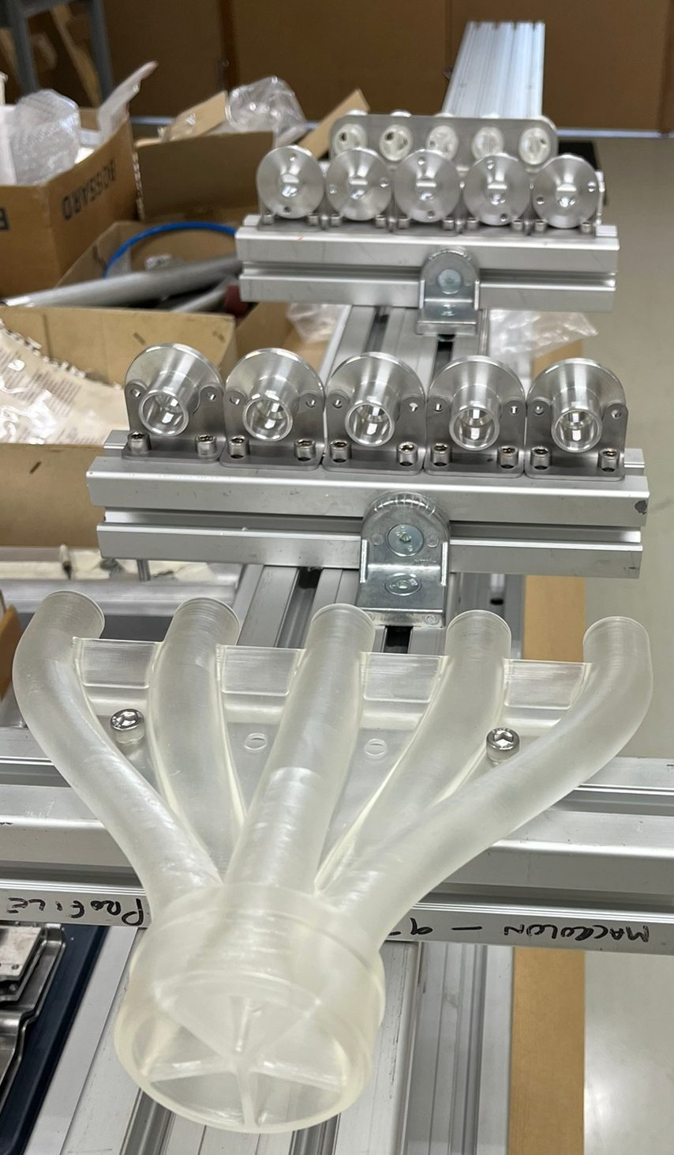
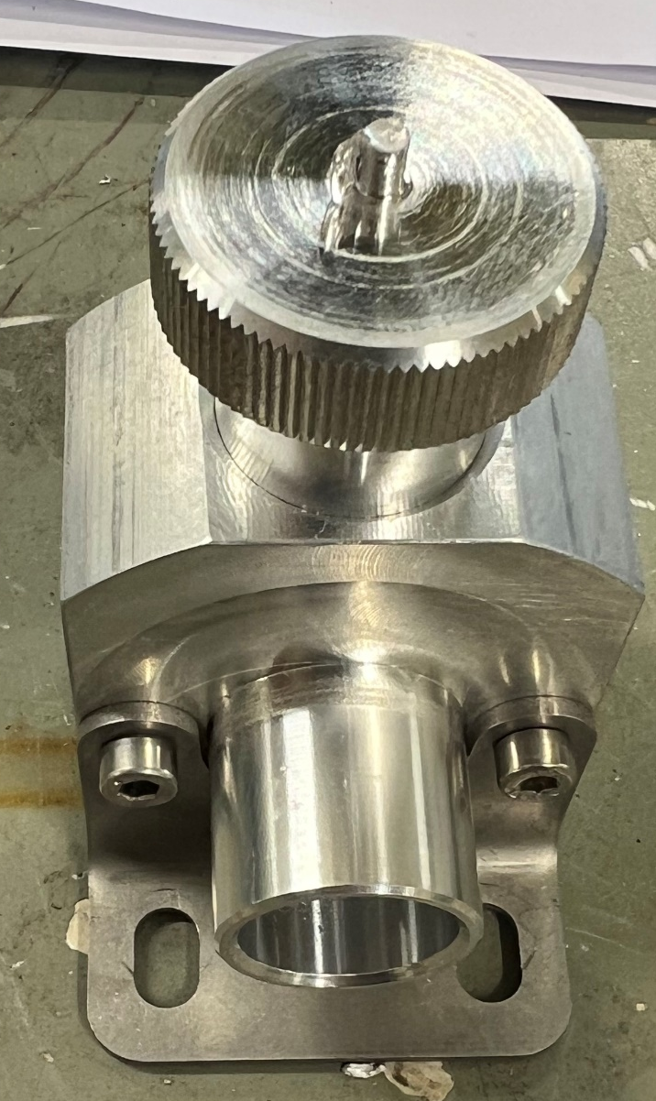
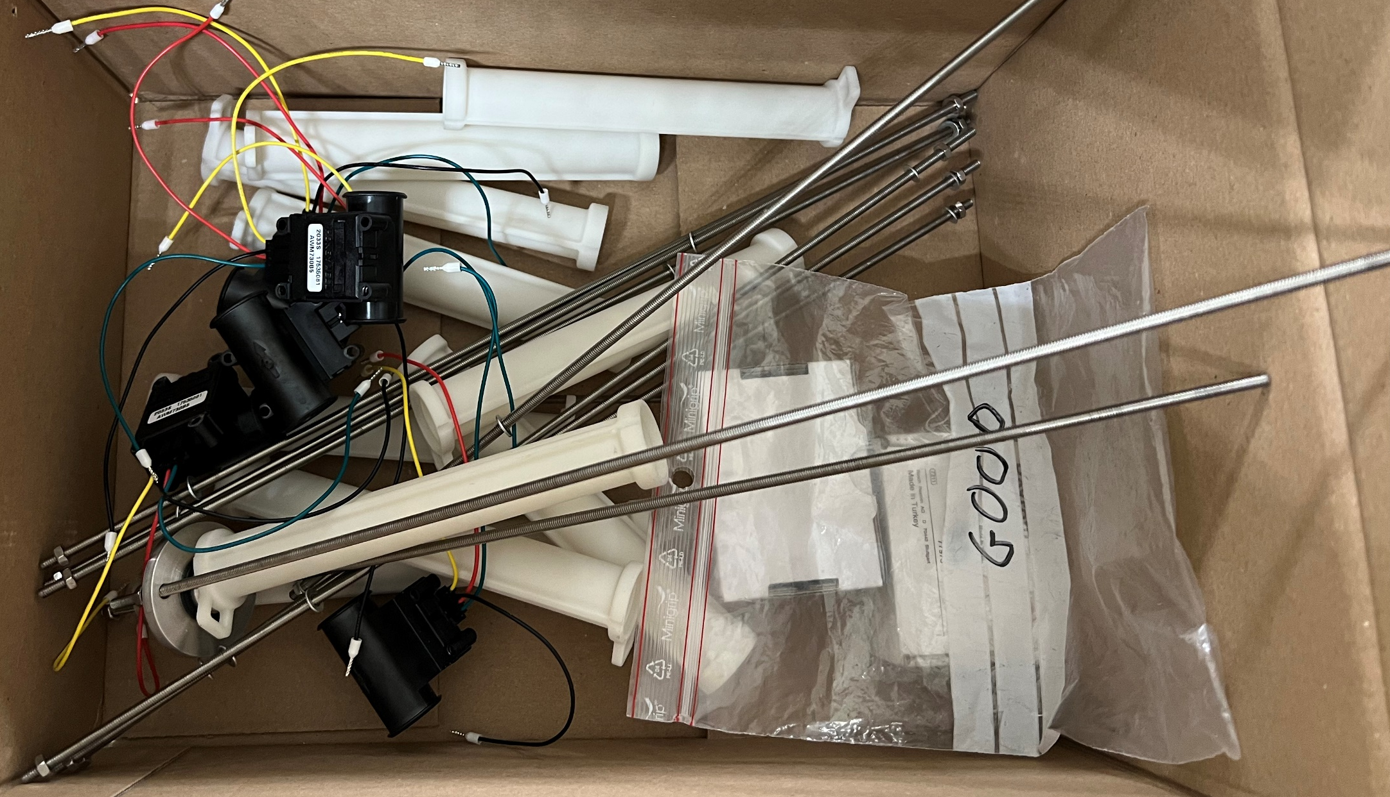
Manifold
Valves
3D-printed pipes, fan, and supports
Adaptors
Adaptors
Blue transparent tubes are silicon tubes (received in December)
Manifold
Valve
(o-ring missing)
3D-printed pipes, fan, and supports (same as in the old setup)

Slide 5
SUMMARY
Valves expected to be finished tomorrow
The distribution system can be assembled in one day
Next week the distribution system will be installed in the composite lab
Tests expected to start at the end of next week

