Slide 1
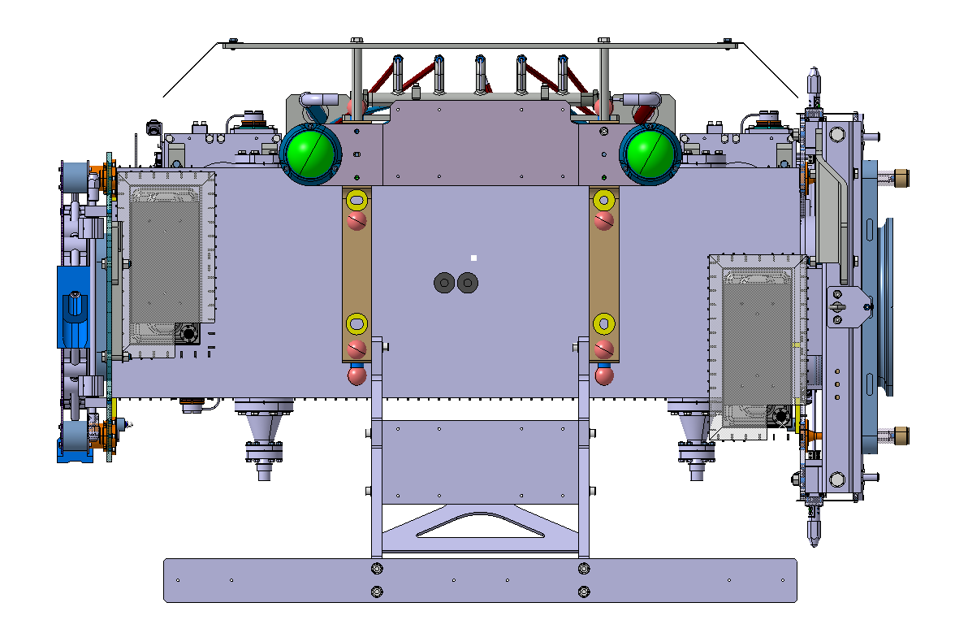
Description | During assembly | For metrology | Leak test with dummy cover option 1 | Leak test with dummy cover option 2 | Leak test with dummy cover option 3 | Leak test with dummy cover option 4 | VSC tests | Final collimators (storage – mockup)
DN63 - blank (provided by 40/30) | 0 | 0 | 3 | 4 | 1 | 5 | 1 | 0
DN63 with pumping port (provided by 40/30) | 0 | 0 | 1 | 1 | 1 | 1 | 0 | 0
DN300 – blank (provided by STI, and VSC?) | 0 | 0 | 2 -> second flange shall be provided by VSC | 1 | 0 | 1 | 0 | 1
DN300 – Pinch off (provided by STI) | 0 | 0 | 0 | 0 | 0 | 0 | 0 | 1
DN300 – Transitions (provided by VSC) | 0 | 0 | 0 | 1 | 2 | 2 | 2 | 0
NEG Cartridges (provided by VSC) | 0 | 0 | 0 | 0 | 2 | 0 | 2 | 2
BPM flanges (provided by BI) | 0 | 0 | 2 | 2 | 2 | 2 | 2 | 2
Ionic pumps (provided by VSC) | 0 | 0 | 0 | 0 | 2 | 0 | 2 | 2
Pumping port
Pumping port
Pumping port

