Slide 1
ProtoDUNE-VD HV System
Jan 18, 2023

Slide 2
Outline
ProtoDUNE-VD HVS Configuration (Differences from FD2)
  Cathode
  Field cage
  HV delivery
List of Deliverables
Interfaces
  CRP
  BDE
  PDS
  I&I

Slide 3
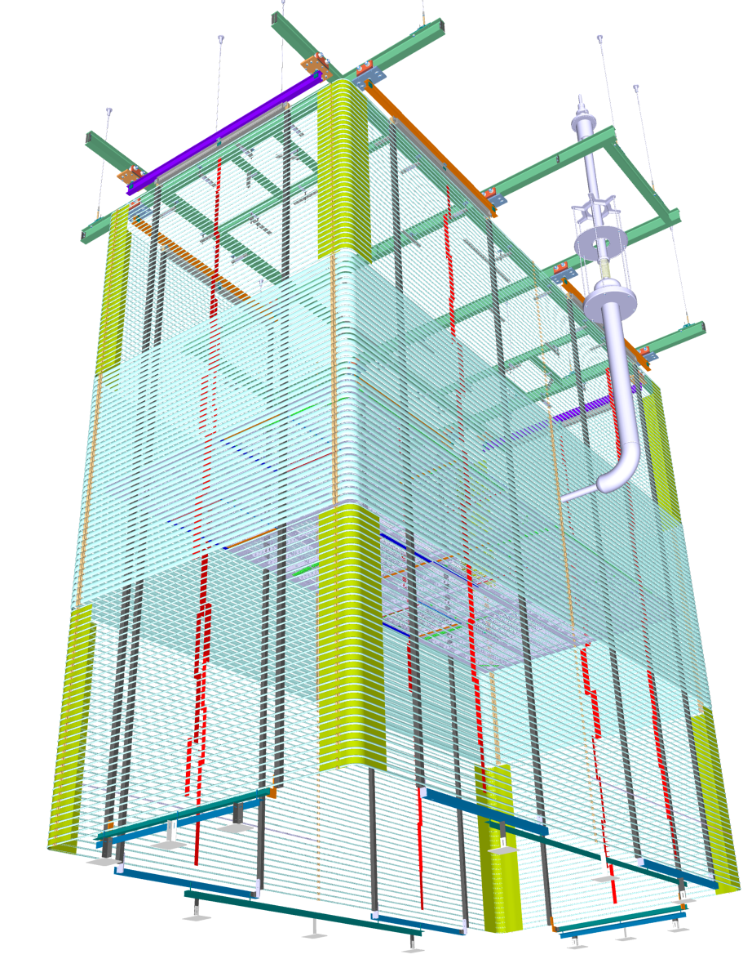
The HV System in ProtoDUNE-VD
o
j
HV Delivery System
  1. HV feedthrough
  2. HV extender
Cathode
  3. Cathode modules (2x)
Field Cage
  4. Field cage modules (18x)
  5. FC Bottom Stabilizers (4x)
6. FC support structure (I&I)
Not shown in the picture
  HV power supply, HV cable
  Cold cameras
  Beam plug (not official HVS scope)
k
l
m
n

Slide 4
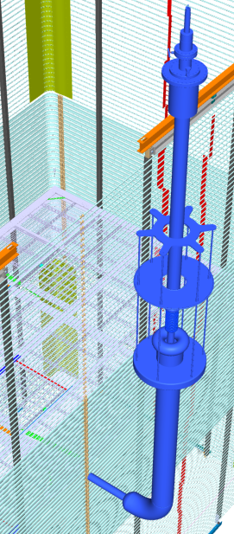
The HV Delivery System
Key components
  Heinzinger 300kV HVPS
  HV cable with integrated filter resistors
  HV feedthrough
  Extender support wheel
  Ground plane
  Extender-FT interface
  Extender body
  Cathode connection
The new HVFT is expected to be identical to the one for FD2.
The extender is a shortened version of FD2 (3m vs 6m)
j
k
l
m
o
n

Slide 5
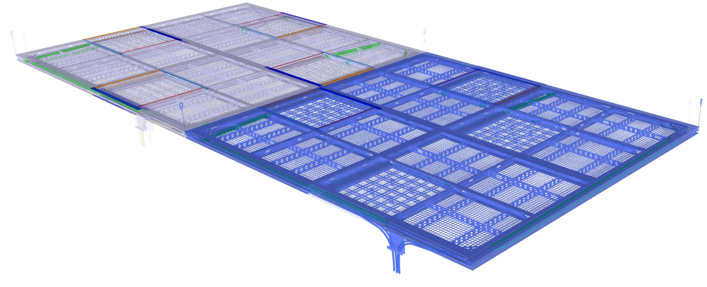
The Cathode
Key components
  FRP frame
  Xarapuca module
  Resistive mesh
  Mesh support rib
  Suspension rope
  Optical fiber bundle
  Length Adjusting Device & Top Adjusting Device
The cathode modules are identical to the FD2 design
The suspension ropes are 3m instead of 6m long
The locations of the PD modules in FD2 may be slightly different from NP02.
n
j
k
l
m
o

Slide 6
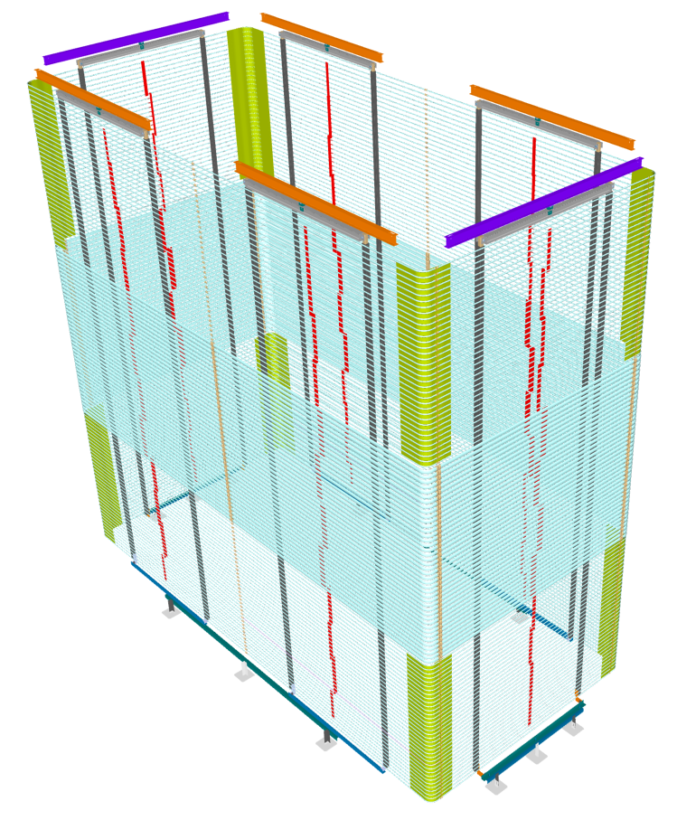
The Field Cage
o
n
l
p
Key components
  Short wall T/B module
  Short wall middle module
  Long wall T/B module (with bent profiles)
  Long wall middle module (with bent profiles)
  Corner field shaping sheet
  Upper support beam and yoke
  Resistive divider board
  Bottom Stabilizer
The FC modules have similar widths to their FD2
counterparts. But their heights are different from FD2
for ease of module-0 installation.
The vertical span of the wide profile coverage is ½ of that of FD2
The vertical span of the thin profile section (top or bottom) is
180mm more that ½ of the FD version.
The RDBs on the middle modules are recycled NP02 boards
FC to active volume boundary offset is 10cm instead of 5cm in FD2 to minmic
the field cage to wall distance in FD2.
j
k
m
q

Slide 7
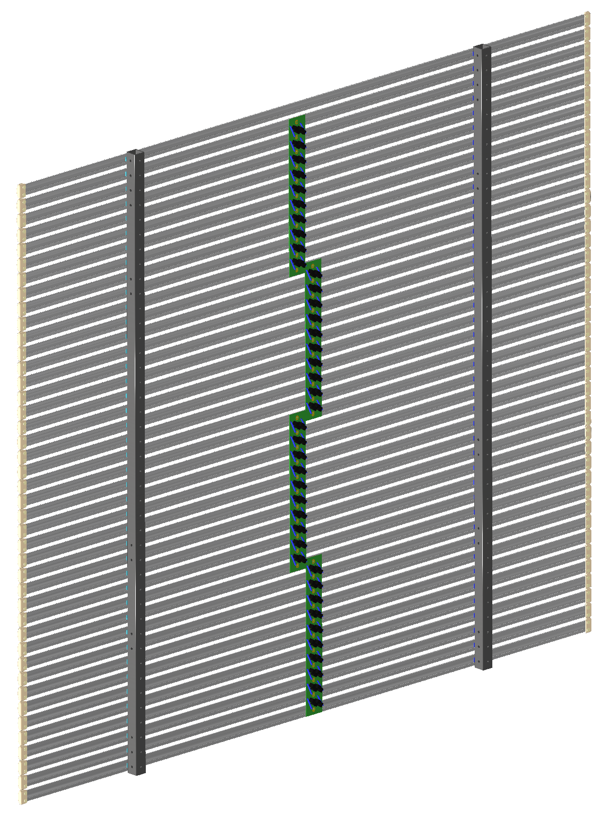
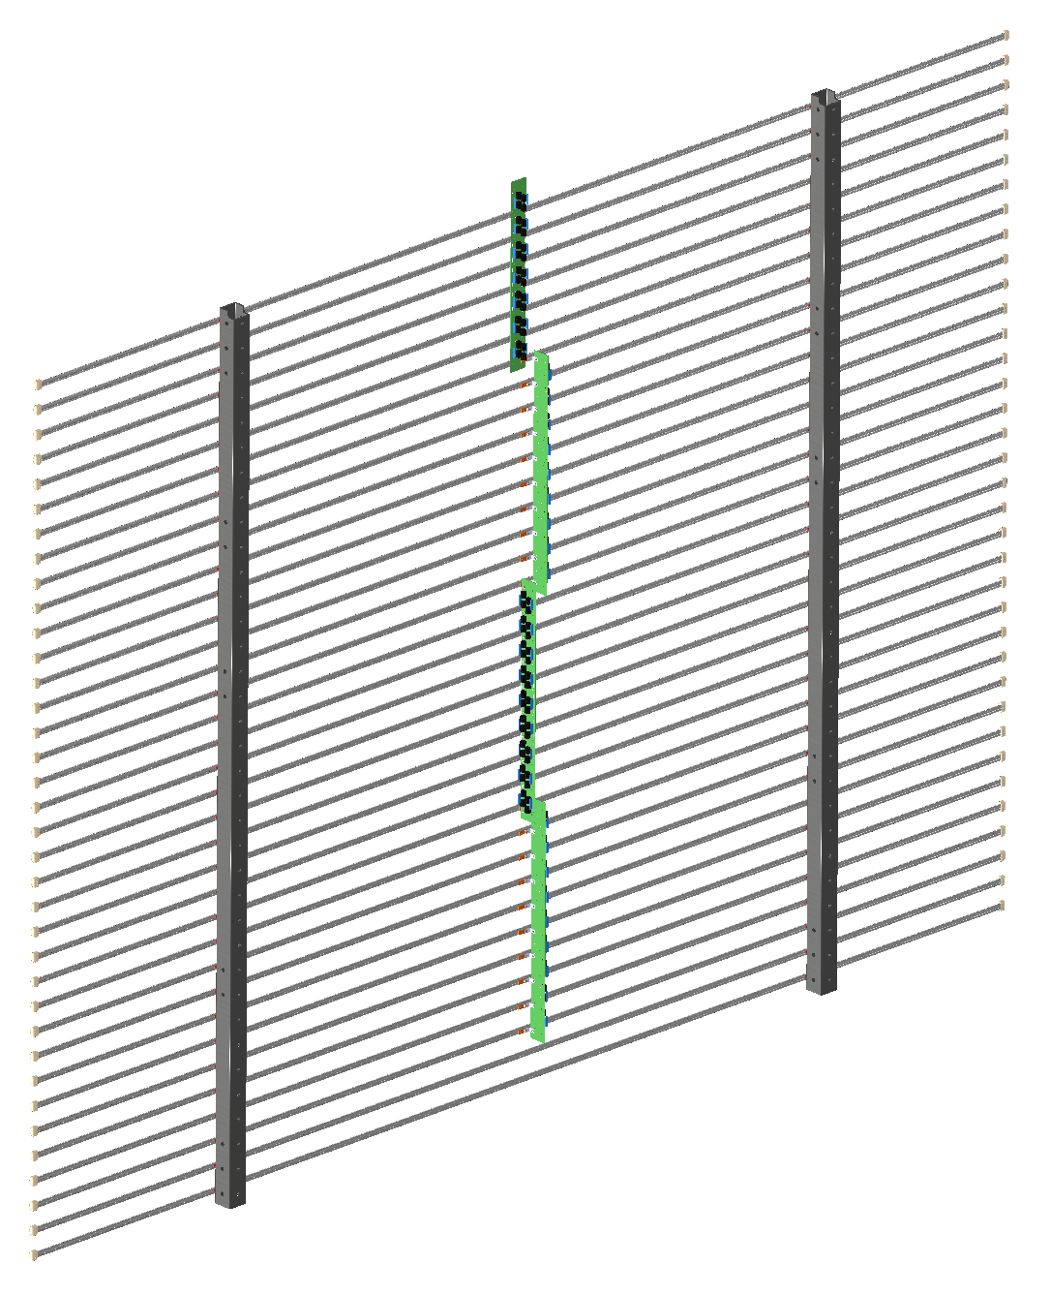
The Field Cage Modules, Short Wall
36 thin profiles @ 6cm pitch. 2962mm wide, 2160mm high. ~20kg weight.
36 wide profiles @ 6cm pitch. 2962mm wide, 2520mm high. ~45kg weight.

Slide 8
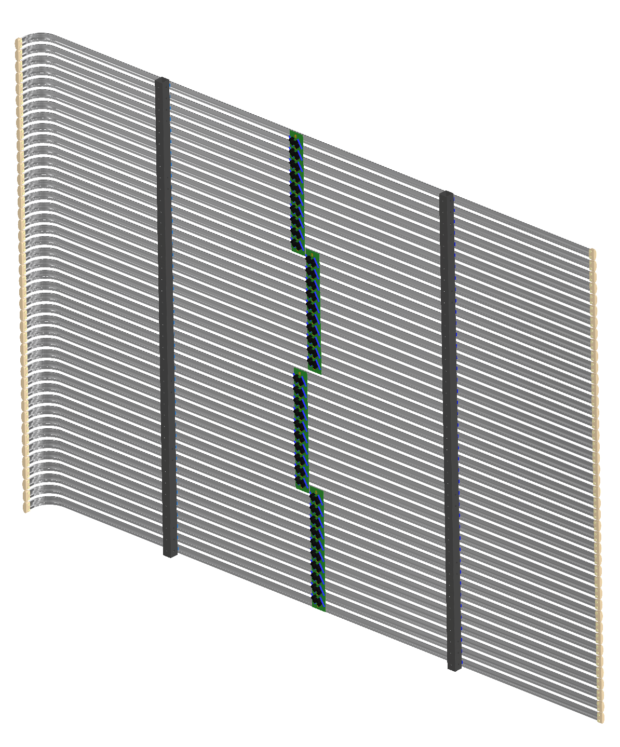
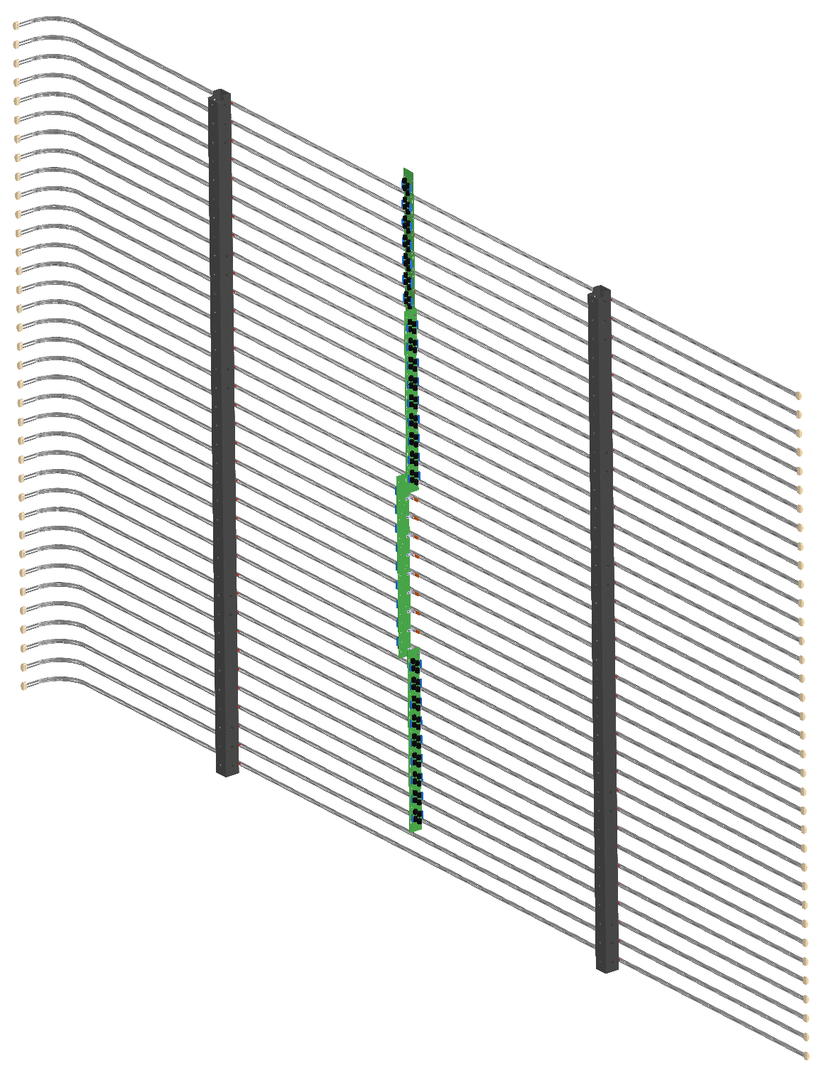
The Field Cage Modules, Long Wall
36 thin profiles @ 6cm pitch. 3530mm wide, 2160mm high. ~25kg weight.
36 wide profiles @ 6cm pitch. 3535mm wide, 2520mm high. ~50kg weight.

Slide 9
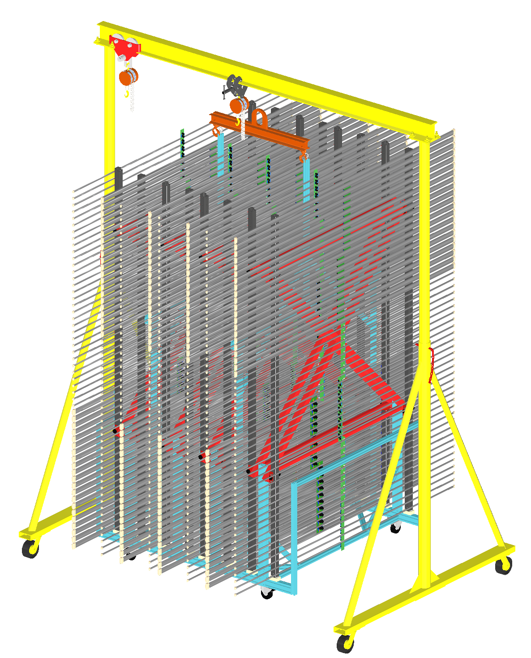
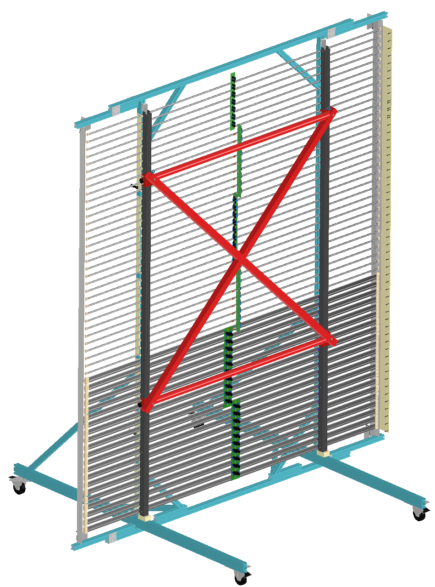
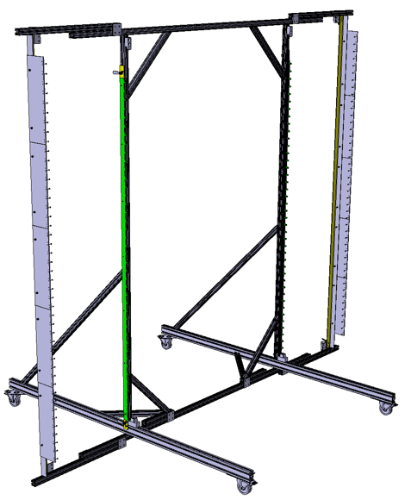
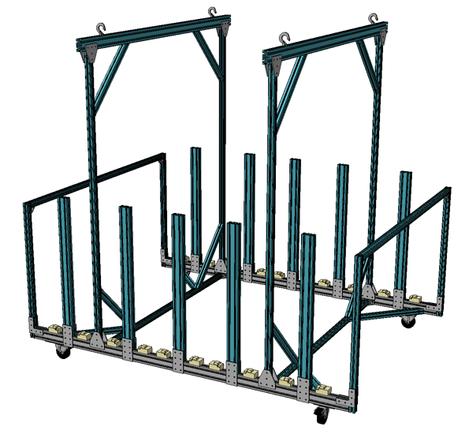
The Field Cage Tools
FC Assembly Station (with FD2 FC module).
FC storage cart with FD2 style FC modules

Slide 10
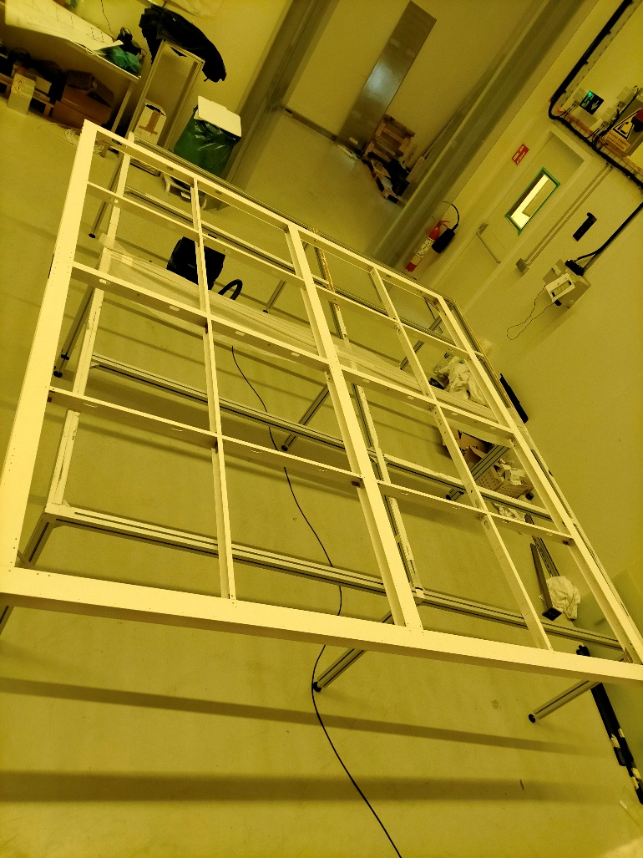
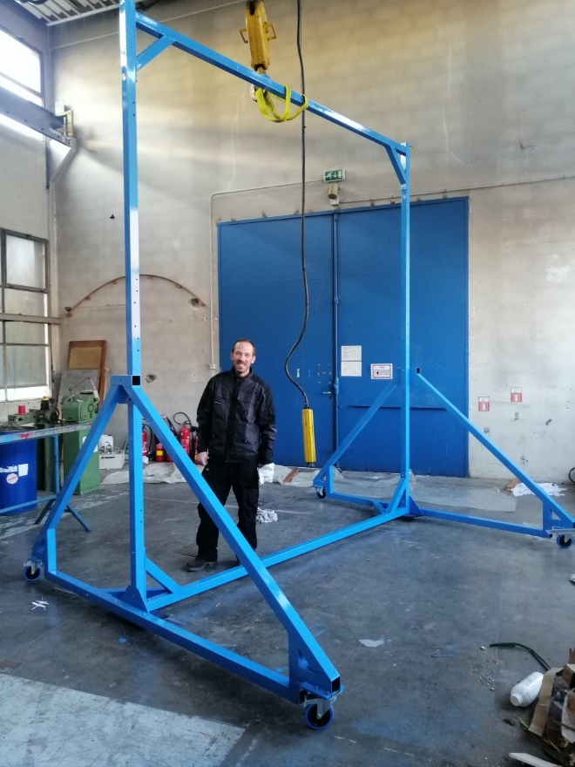
Cathode Status
Hardware Status:
  Frame for cathode 1 assembled and in NP04 clean room
  Frame for cathode 2 to be assembled today
  Cartwall built @IJCLab, assembled @CERN today
  Frame 1 on cartwall today or tomorrow
  Resistive meshes sent on Jan 13th, expected @CERN this week
  Resistive meshes installed next week
  Metallic meshes and resistive protection plates @CERN
  Top Adjusting Devices @CERN, installed on CRP structure today
  Length Adjusting Devices @IJCLab, to be brought @CERN
  Dyneema ropes characterized at warm and cold @IJCLab => to be brought @CERN with LADs
  Cathode-field cage interconnect (jumper wires): to be fully defined
All cathode parts are available

Slide 11
Deliverables
Field cage:
  FC assembly station to be completed this week at CERN (CERN, UTA)
  Profile bending/cutting started (CERN, UTA)
  FRP beam fabrication starting next week (CERN)
  FC module assembly trial start next week (CERN/UTA)
  RDBs component selection started, board shipping by end of Jan. (W&M)
  FC storage cart construction starts in 2 weeks
  Undefined items:
    Routing of the FC termination cables to roof penetration(s)
    Camera locations and cable routing paths (not urgent)

Slide 12
Deliverables
HV Delivery
  First HVFT parts at CERN, cryo-fitting next week
  Extender modification (shortening, change HVFT interface) ???
  HVPS / cable, HVPS monitoring system are at CERN
Cold cameras
  A number of old and new cameras are available. Need to define locations and split between NP04 & NP02

Slide 13
Interfaces to CRP
To support the weight of all cathode modules under the CRP superstructure, and ensure precise locations and stability of the cathode modules
  TAD installed and tuned today
  Ropes to be installed (before CRP installation)
  There is new discussion about whether the cathode will be raised with the CRPs or independently.
To avoid interference between the field cage and the top CRP/cathode structure during the FC installation, and at the field cage final positions.
  FC to CRP active volume boundary offset increased from 5cm in FD2 to 10cm in NP02. NP02 FC walls can also be moved away from final position by ~ 0.5m.
To allow the final closure of the TCO side endwall FC after the bottom CRP installation.
  In NP02, the long wall FC on the TCO side will be partially installed initially to allow bottom CRP installation. The rest of the FC walls can be moved out by ~0.5m to provide additional CRP installation space if needed.
To Implement SHV feedthroughs to allow the top CRP bias voltage channels to be brought out of the cryostat through the FC support penetrations.
  HVS assumes the previous CRP bias power feedthroughs will be used (provided by CERN/I&I)
To provide the bias power supplies and warm cables for all CRPs, as well as the cold cables for the top CRPs.
  HVS assumes the previous CRP bias power supplies and cables will be used (provided by CERN/I&I).

Slide 14
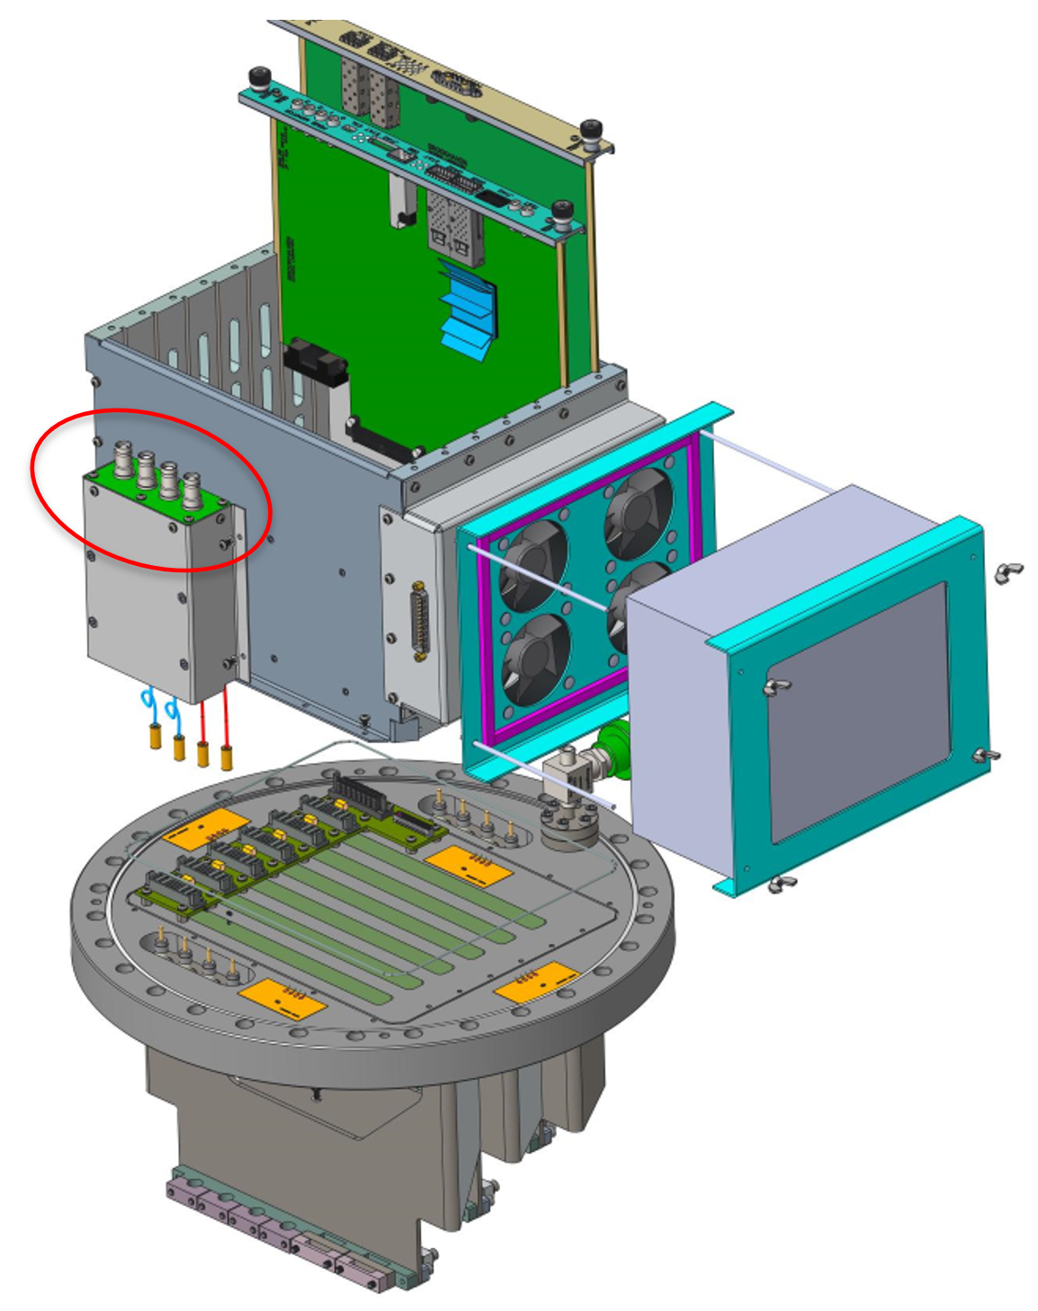
Interfaces to BDE
In FD2, the physical interfaces between the HVS and the BDE Consortia involve the warm SHV CRP bias cables and the SHV connectors provided on the warm filter boxes mounted to the BDE warm interface crates. Each BDE signal feedthrough flange will allocate 3 SHV channels with 5kV SHV connectors on the warm low pass filter.
In NP02, HVS has assumed that the CRP bias power supplies and warm SHV
cables will be the existing ones from the previous NP02 runs provided by
CERN (I&I)

Slide 15
Interfaces to PDS
The design and distribution of the conductor network for the cathode mounted photon detectors
  NP02 cathode and cathode mounted PDS modules follows their FD2 designs
Mounting of the photon detectors and its associated electronics modules and cables/fibers on the cathode modules
  NP02 cathode and cathode mounted PDS modules follows their FD2 designs
  Frame 1 on cartwall today or tomorrow for easy access and PD installation
  Fiber routing up to the edges of the cathodes is defined
Routing of the PD cables and fibers leading to the cable trays along the cathode and field cage modules
  PDS cable routing is not available on EDMS yet. In general, routing fiber bundles down next to the FC box beams is expected. However, we need to work out the cable strain relief details, especially if the FC modules are to be moved to facilitate bottom CRP installation
Vertical span of the 70% transparent field cage modules
  In NP02, the height of the transparent FC section is 1/2 of the FD2 value + 180mm.
Shielding of the wall mounted PD modules and cables
  PDS has implemented a shielding mesh frame to cover the wall mounted PD modules.

Slide 16
Interfaces to CERN NP/I&I
Outside of the cryostat:
  HVFT port, HVPS rack, HV cable routing: existing. Check HVFT port flange size
  CRP/FC bias power supplies, warm SHV cables, cold SHV cables: reuse NP02 parts.
  Camera power supplies/warm cables: CERN provide (reuse NP02)
Inside of the cryostat
  HVFT/extender ceiling support: CERN provide, similar to FD2
  Field cage support structure: CERN provide. completely different structure, and different installation scheme from FD2.
  Field cage termination cable routing: using existing NP02 port(s). Routing paths TBD
  Bottom stabilizers: HVS provide, similar to FD2, need to tailor to the membrane corrugation pattern.
  Cathode installation: Interface with TCO transfer tool defined. How to raise the cathode modules in discussion. May need CERN to provide cables/hoists on FC support structure.
  FC installation: FC modules raised by two scissor lifts. Need scaffold on none TCO side of the long wall to install HVFT/Extender, as well as lateral movement of the FC walls.
  Detailed installation sequence depends on CRP and PDS installation scheme.
Cleanroom space allocation
  Cathode assembly (on cart wall) in NP04 cleanroom. Finished cathode moves into NP02 cryostat.
  Field cage assembly (on assembly station) in NP04 cleanroom, stored on one storage cart in NP04, and one storage cart in NP02 cleanroom.

Slide 17
Difference between Module-0 and FD2-VD
Foreseen installation in FD2-VD seems too complex for safety reasons
The cathodes have to be raised at 6 (or 3) meters independently of the CRP superstructure
Discussions for solutions started last Friday

Slide 18
Possible Solutions for Module-0
  Keep the old scheme “Cathode raised with the CRP”
    Pros: No additional hardware to procure
    Cons:
      Requires installation of PDs on the cathodes before CRP raise and cabling
      Lowering the cathode requires CRP uncabling
  Put winches on the Field Cage structure in order to raise the cathodes
    Pros:
      Decoupling from CRP raise
      Raise and lower the cathode whenever you need before Field Cage installation
    Cons:
      Installation of winches on the Field Cage structure to be studied carefully
      Could prevent Field Cage reaching final position before Cathode raise
      Possible damage of the mesh borders during disconnection of winch cable and connection to the Dyneema ropes
      Cannot be extended to FD2-VD

Slide 19
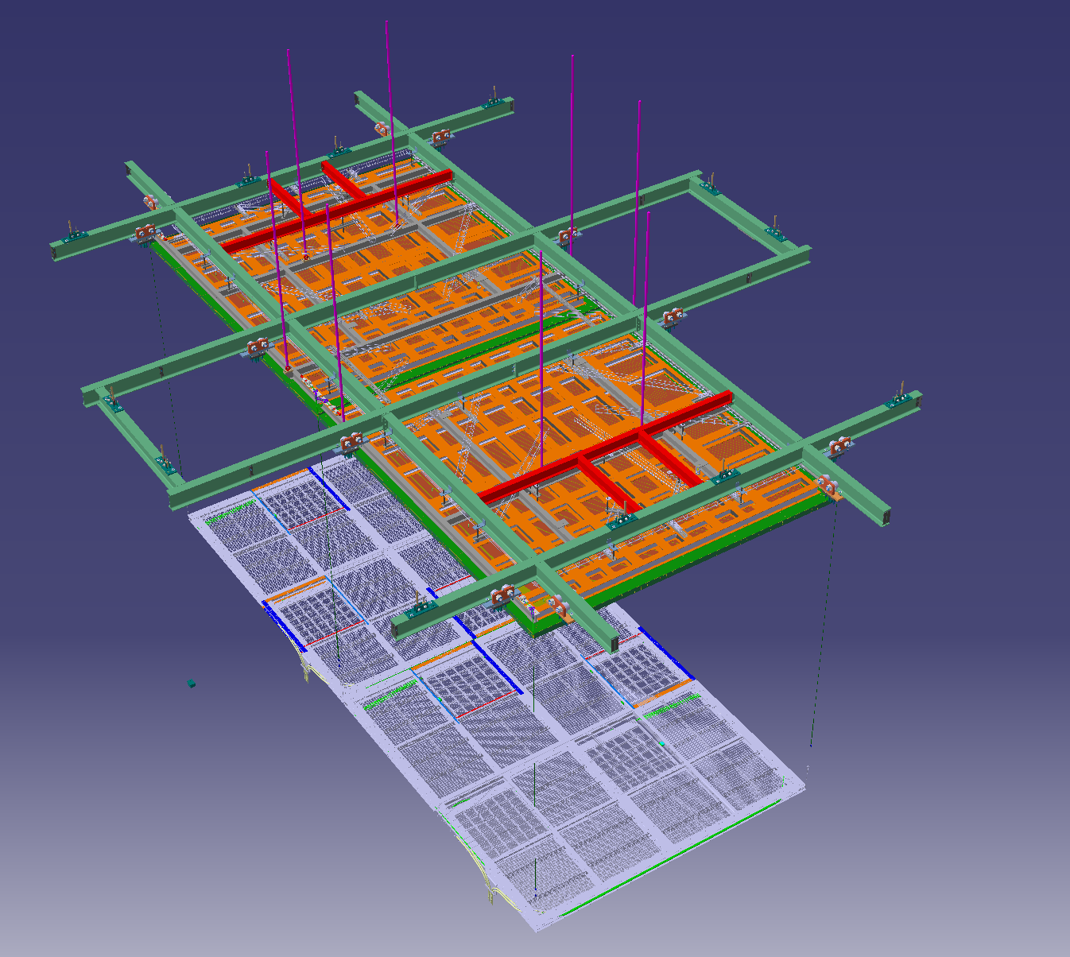
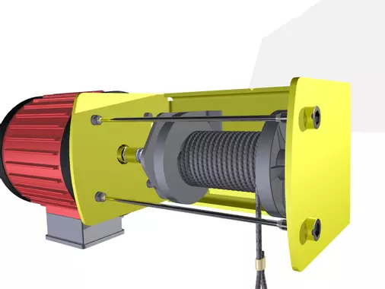
Solution 2

Slide 20
Possible Solutions for Module-0
  Put pulleys on the 3-meter Dyneema ropes anchored on CRP structure and raise the cathode with additional ropes and winches on the cryostat floor
    Pros:
      Decoupling from CRP raise
      Raise and lower the cathode whenever you need before Field Cage installation (Top section of the FC can be installed without impact but not the middle and bottom sections)
      Could be a possible solution for FD2-VD
    Cons: Possible damage of the mesh borders during disconnection of winch cable and connection to the Dyneema ropes
In any case, no clear added value but clear extra work for cathode team to raise the cathode without the PDs installed on it

Slide 21
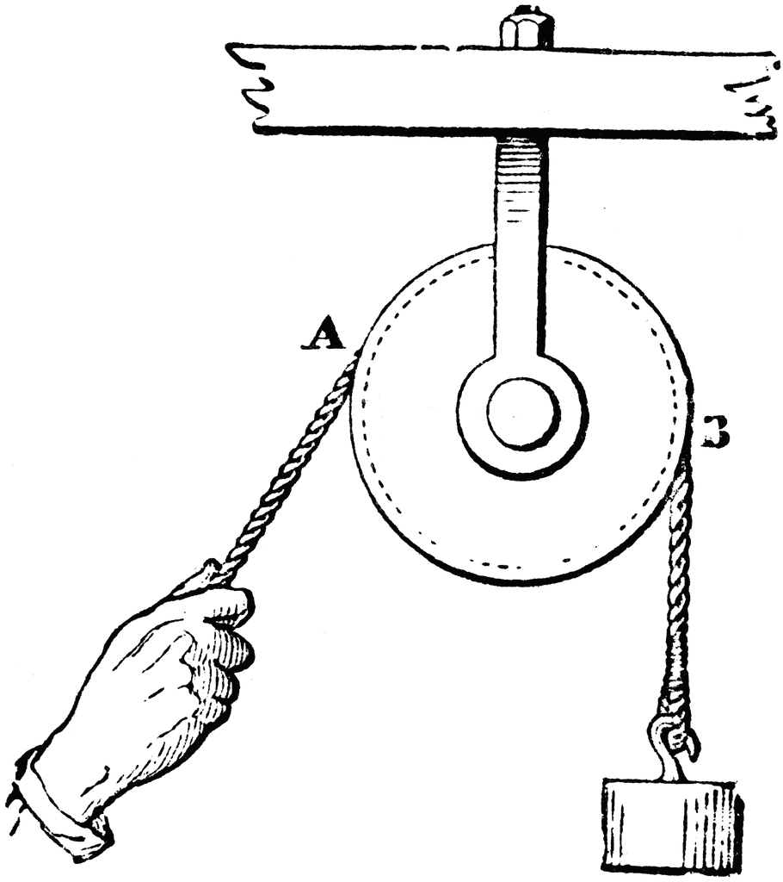
Solution 3
CRP SuperStructure
Dyneema Ropes (they are ended by a splice)
Cathode

Slide 22
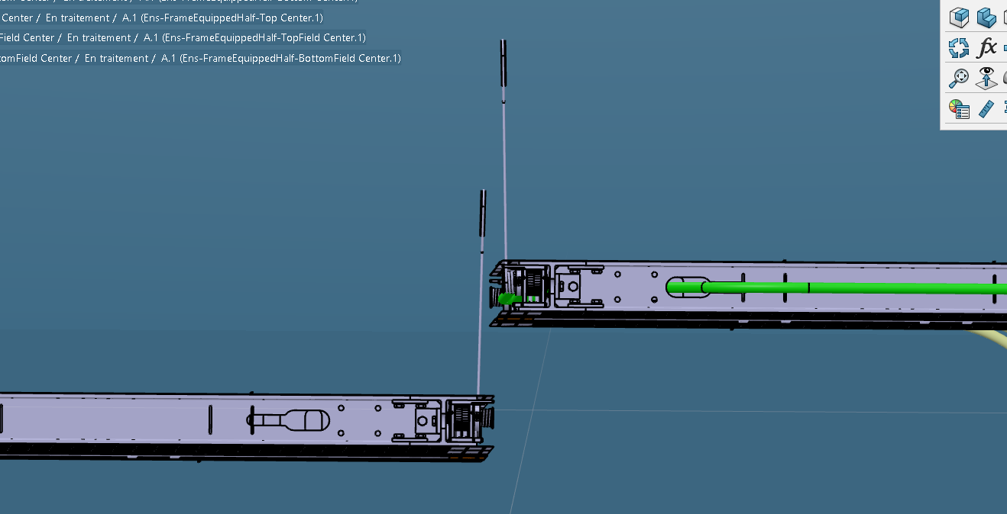
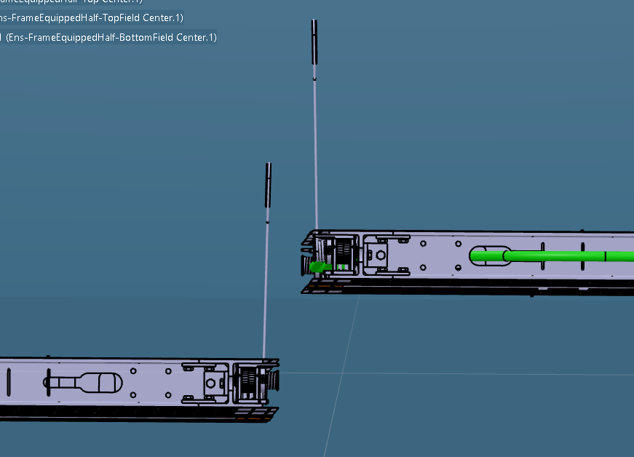
Vertical shift only of 150 mm with LAD (185 mm full range)
150 mm to get access on the upper cable point BUT …
Vertical and lateral shift
50 mm lateral (or more) shift to get free running of the pulley ropes without damaging the mesh borders

Slide 23
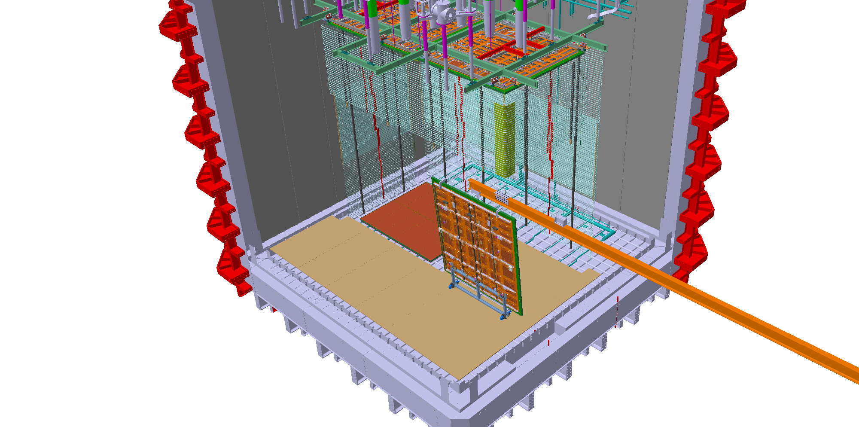
Field Cage Installation Issue
The transportation beam through the TCO blocks the middle field
cage module from being installed.
In this picture, the middle and bottom FC modules next to the TCO are installed after bottom CRP installation. This makes the cathode to field cage connection challenging.
Can we have the middle row FC installed before bottom CRP? This requires the bottom CRPs stored inside the cryostat and the orange beam removed.

Slide 24
CRP 5 insertion

