Slide 1
ProtoDUNE Cable Tray Design Update
Nicholas Joniak
01/18/2023

Slide 2
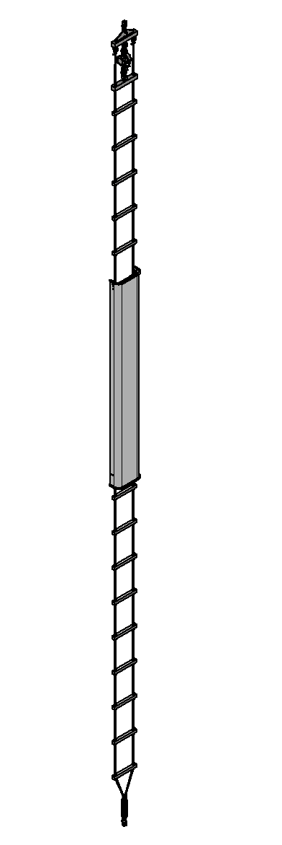
Design Overview
Upper Assembly
A cable tray system was designed to allow for the routing of cables vertically along the wall of the cryostat.
  The cables being routed would include the bottom drift electronics cables and the PD fibers.
An integral cable shield would prevent interferences with the high field area at the cathode plane.
A rope ladder-style construction would allow for pre-installation of the BDE cables during fabrication.
  This would speed up and simplify the installation of the cable tray within the cryostat.
Hoist Assembly
25’- 7 7/8” [7820mm]
Approx.
(spring not extended)
Cable Shield System
Lower Assembly

Slide 3
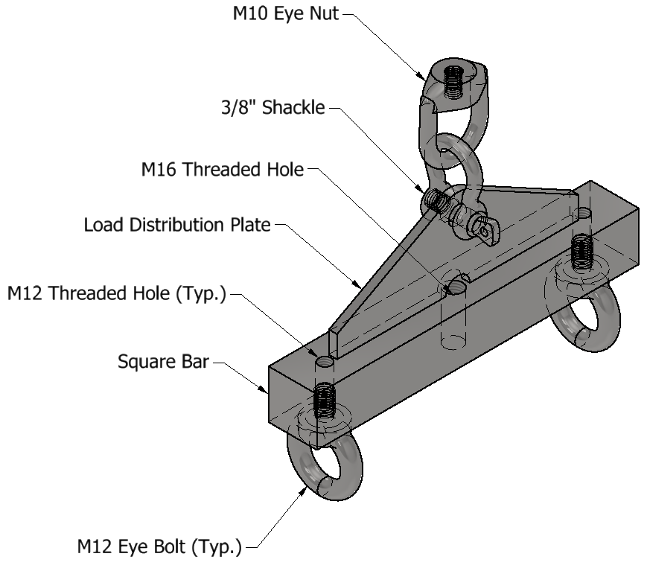
Upper Assembly
Stainless steel square bar with a load distribution plate welded on top.
The plate has a hole at the top to facilitate the attachment of a shackle connector.
The square bar has threaded holes to allow for eye bolt attachment.
  The central hole is for the attachment of the hoist system.
  The outer holes are for the attachment of the eye bolts supporting the lower assembly cables.

Slide 4
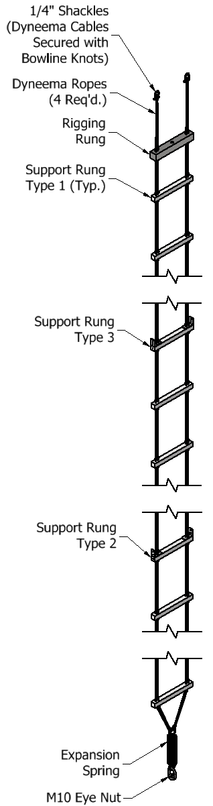
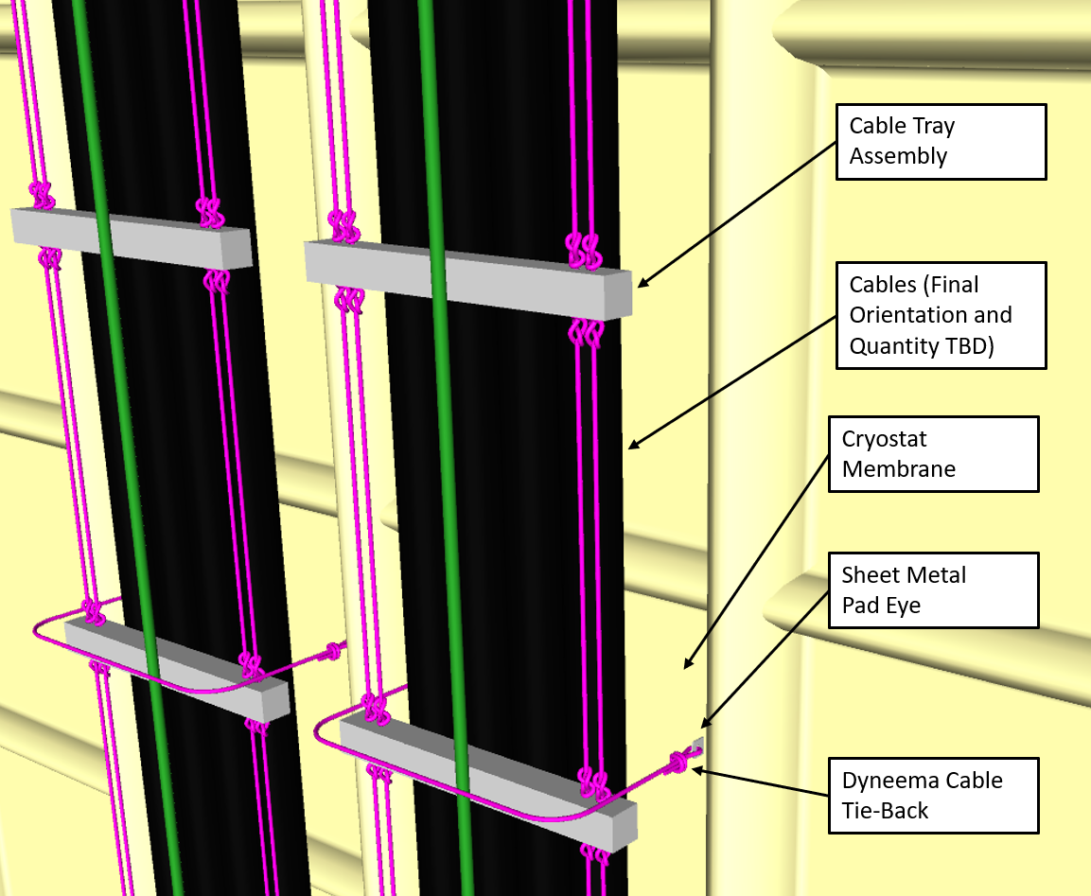
Lower Assembly
The lower assembly consists of a stainless steel rigging rung and a series of FRP square bars connected with (4) Dyneema cables.
  The cables pass through holes in each rung and will hold them in place using Figure-8 knots top and bottom.
  The rigging rung has a central threaded rod to allow for the attachment of the hoist system.
  The FRP bars will act as the main attachment point for all cables being routed (using cable ties).
  An extension spring at the bottom will connect to the lower membrane using an eye nut and will help the system remain taut during thermal cycling of the cryostat.
A series of Dyneema cable tie-backs can be used to attach to wall-mounted pad eyes to help the system remain in place.
  The single attachment point at both the top and bottom could lead to rotation of the assembly.

Slide 5
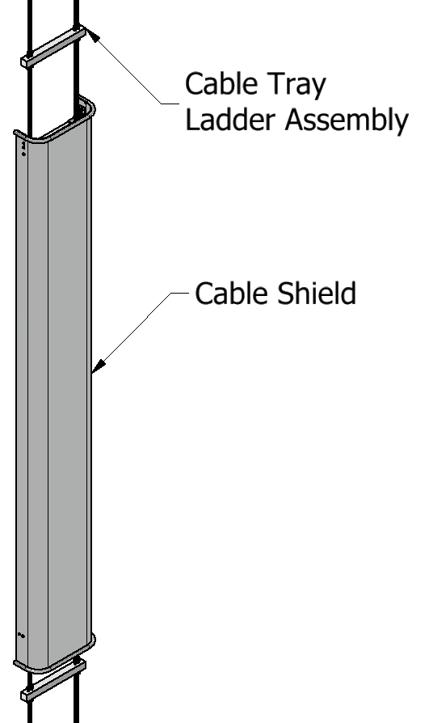
Cable Shield System
The cable shield is an aluminum sheet metal piece that is mounted at the center of the cable tray assembly.
The design is intended to limit the interference of the cable tray assembly in the high field area at the cathode plane.
A set of bent aluminum tubes is attached at each end to mask the sharp edges present.
The fabrication and testing of this part has not yet been finalized.

Slide 6
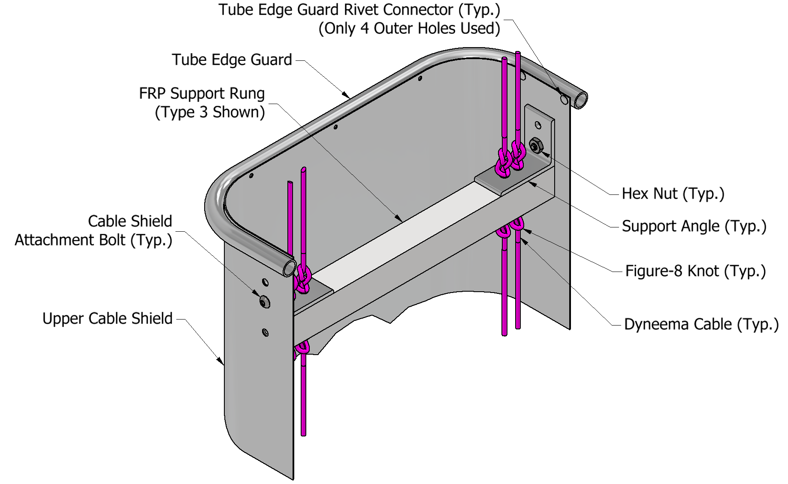
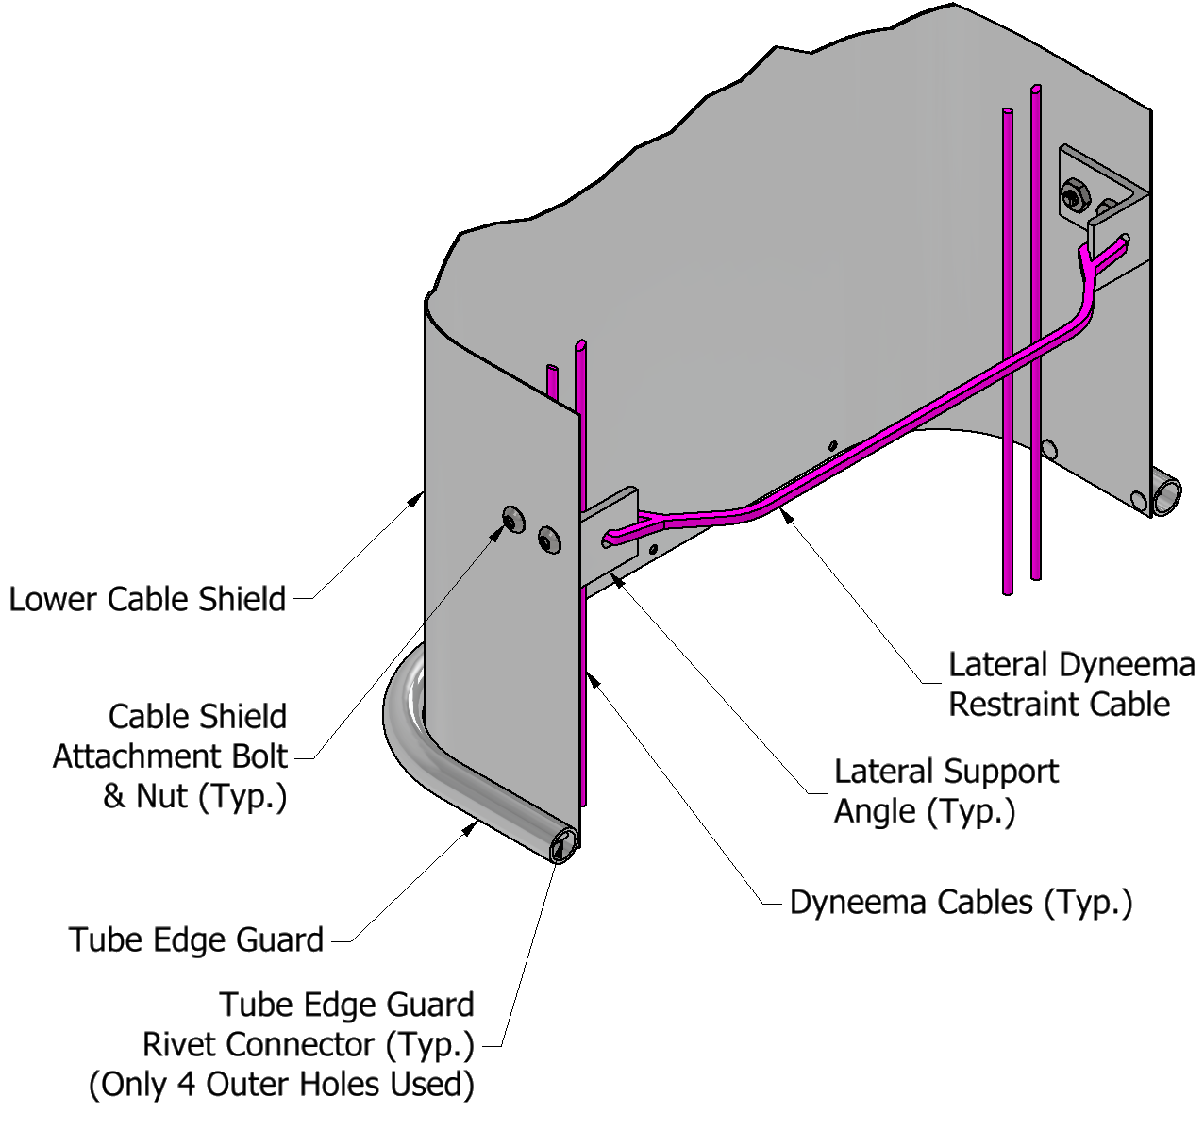
Cable Shield System (Cont.)
The cable shield will attach to the lower assembly support angle with a single pair of #10-24 bolts.
The tube edge guards will be attached to the sheet metal with rivets.
  The quantity and attachment method will need to be verified with prototype testing.
The single attachment point at the top is to minimize overstressing of the metal due to thermal effects.
The lower section of the shield would be loosely secured to the lower assembly with a lateral Dyneema restraint cable.

Slide 7
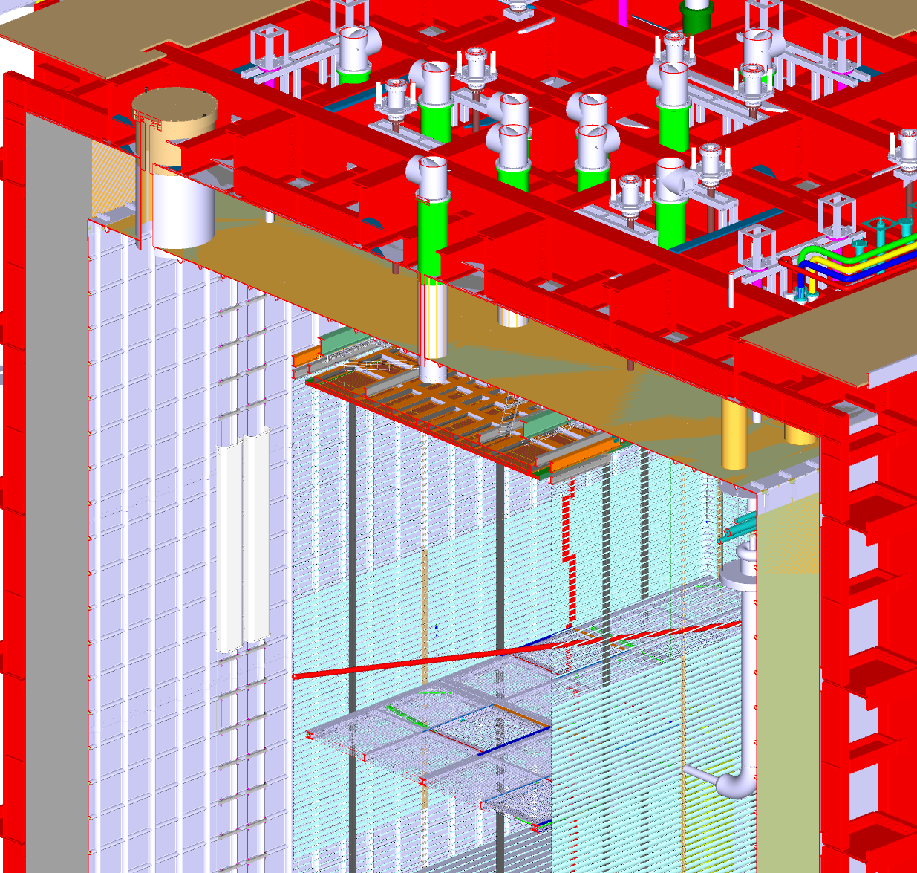
Design Requirements – Installation Location
There are very few mounting locations available along the cryostat walls.
(2) Cable trays will be required to be installed in the ProtoDUNE cryostat.
  The precise location has not yet been finalized.
The sole location available for the attachment of these cable trays is the upper and lower M10 threaded rods that penetrate through the membrane.
  The 340mm spacing and 95mm distance of the threaded rod to the membrane wall limited the size and design of the cable tray.
A threaded eye nut would be used to attach the upper rung assembly and the lower extension spring to the threaded rods.

Slide 8
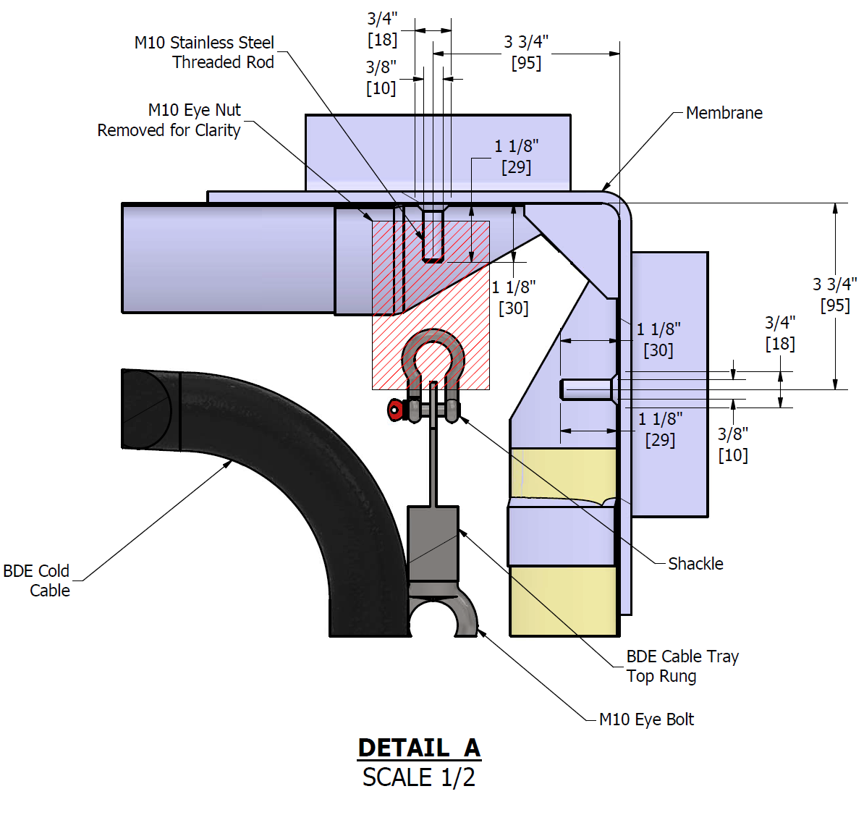
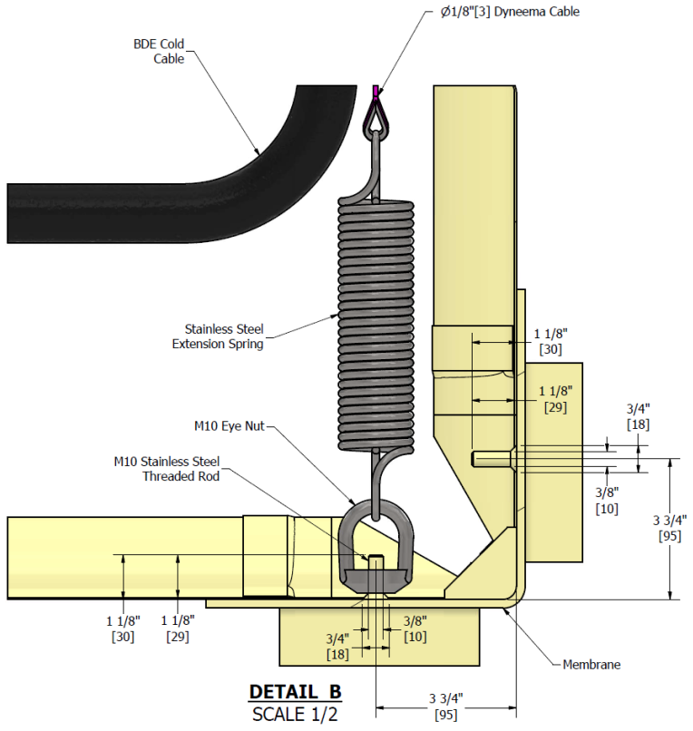
Design Requirements – Installation Location (Cont.)

Slide 9
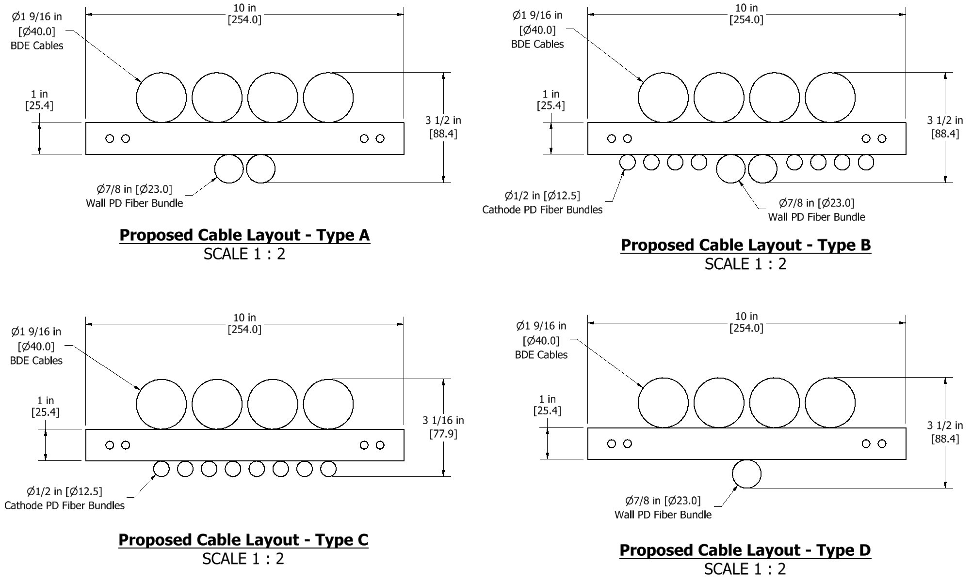
Design Requirements – Cable Routing
The assembly was designed to be capable of supporting the worst-case cabling required for the FD2 cryostat.
  Routed behind (on the wall-facing side)
    (4) Ø40mm BDE bundles
  Routed in front
    (2) Ø23mm Wall PD bundles
    (8) Ø12.5mm Cathode PD bundles
The worst-case cable load for the full-height FD2 cryostat is 487 lb. [221 kg].
The ProtoDUNE cable routing is expected to be similar, but with a reduced load due to the shorter cryostat wall height.
  The cable tray load-bearing components (rungs) for both the FD2 and ProtoDUNE assemblies are identical.

Slide 10
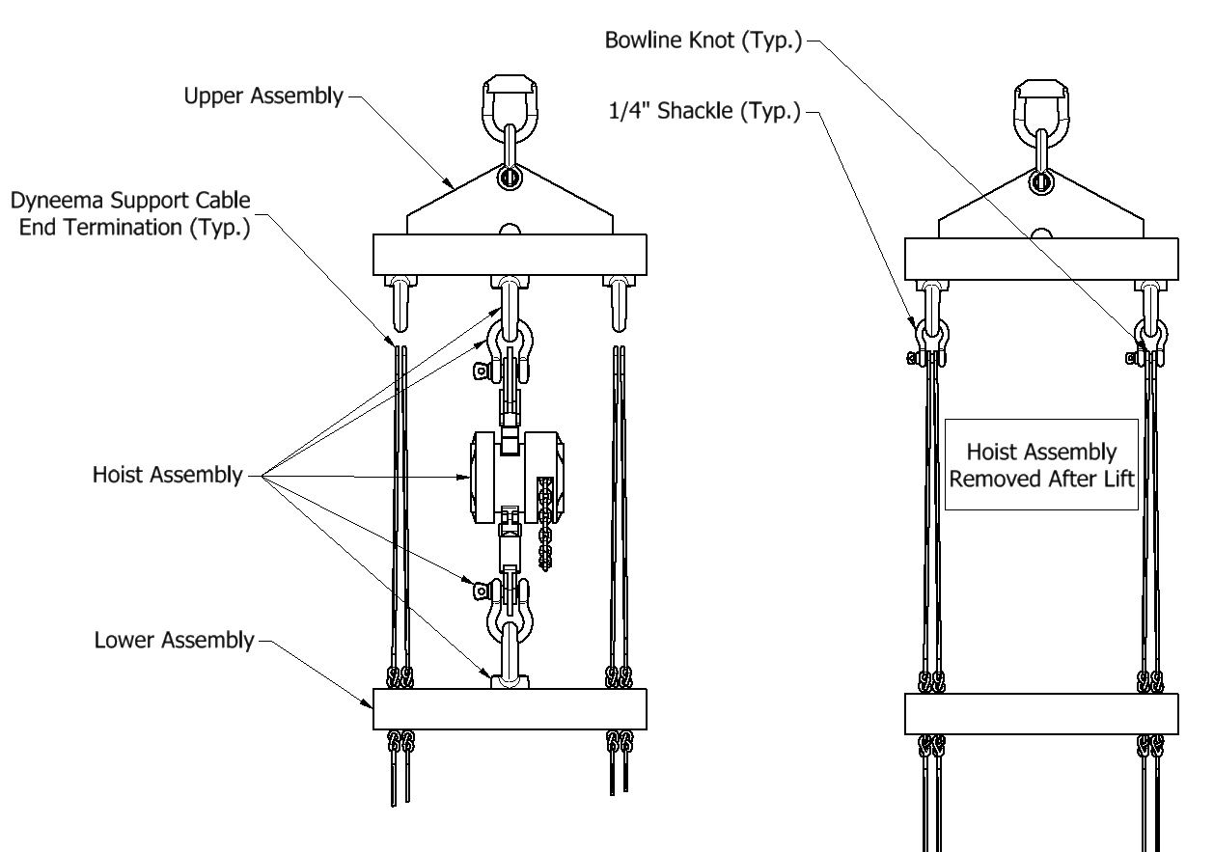
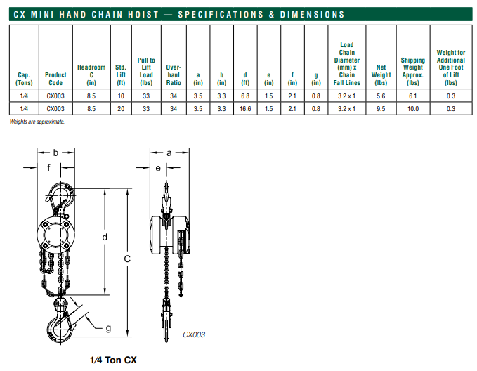
Design Requirements – Installation
The main benefit of the ladder-style cable tray design is the ability to minimize the installation time within the cryostat.
  The main BDE cables can be installed during fabrication off site onto the lower assembly.
  The lower assembly would be rolled onto a custom cable reel and transported to the installation site.
  After the upper assembly is attached to the top membrane, a hoist system utilizing a CX003 ¼ US ton chain hoist can be attached to both the top and rigging rungs using eye bolts and shackles.

Slide 11
Design Requirements – Installation (Cont.)
After connecting the lower assembly to the bottom membrane with the extension spring, this component would then be lifted using this hoist and brought to its final installation elevation.
  During this process, the hoist would also stretch the extension spring to help keep the entire ladder taut.
The upper Dyneema cables would then have knots formed around the top rung eye bolts and shackles.
  This process would need to be validated – would these knots need to be tested in the cryostat after formation?
After the cables have secured the lower assembly to the top rung, the hoist system can be removed and shifted to the next cable tray installation location.

Slide 12
Engineering Status
An engineering note for the FD2 cable tray was submitted to the compliance office for review, and if possible, would cover both the FD2 and ProtoDUNE designs.
  The main differences between the designs are the assembly height, the cable shield size, and the extension spring.
  The FD2 loads checked are greater than the cable loads expected in ProtoDUNE.
Prototype testing is still required to fully validate the design.
  While the rungs were checked using FEA software, the knots integral to the design would need to be physically tested.
  The extension spring capacity and selection would need to be verified.
  The cable shield would need to be fabricated and tested in a cold box.

Slide 13
Engineering Status (Cont.)
This design seems promising but will require further testing to ensure that all components can withstand the applied loads in a cryogenic environment for an extended amount of time.
In addition, the formation of the main load-bearing knots in the cryostat will need to be analyzed.
  Need to determine how this knot would be tested to certify that it meets all design and safety standards.
Two prototype assemblies have been delivered to ProtoDUNE.
  Further analysis and testing are required before these are allowed to be installed.
  The upper cables were cut short and may prevent the intended installation method from being used.
  The cable shield has not been fabricated at this time.
A possible alternative would be to switch to a commercially available vertical cable tray.
  The main drawback would be reintroducing the bulk of the cable installation to inside the cryostat.

