Slide 1
ASACUSA status report
2022 and plans for 2023
148th Meeting of the SPSC
7 February 2023
M. Hori, JGU Mainz (from summer Imperial College London)
E. Widmann, Stefan Meyer Institute, Vienna
Co-spokespersons, ASACUSA

Slide 2

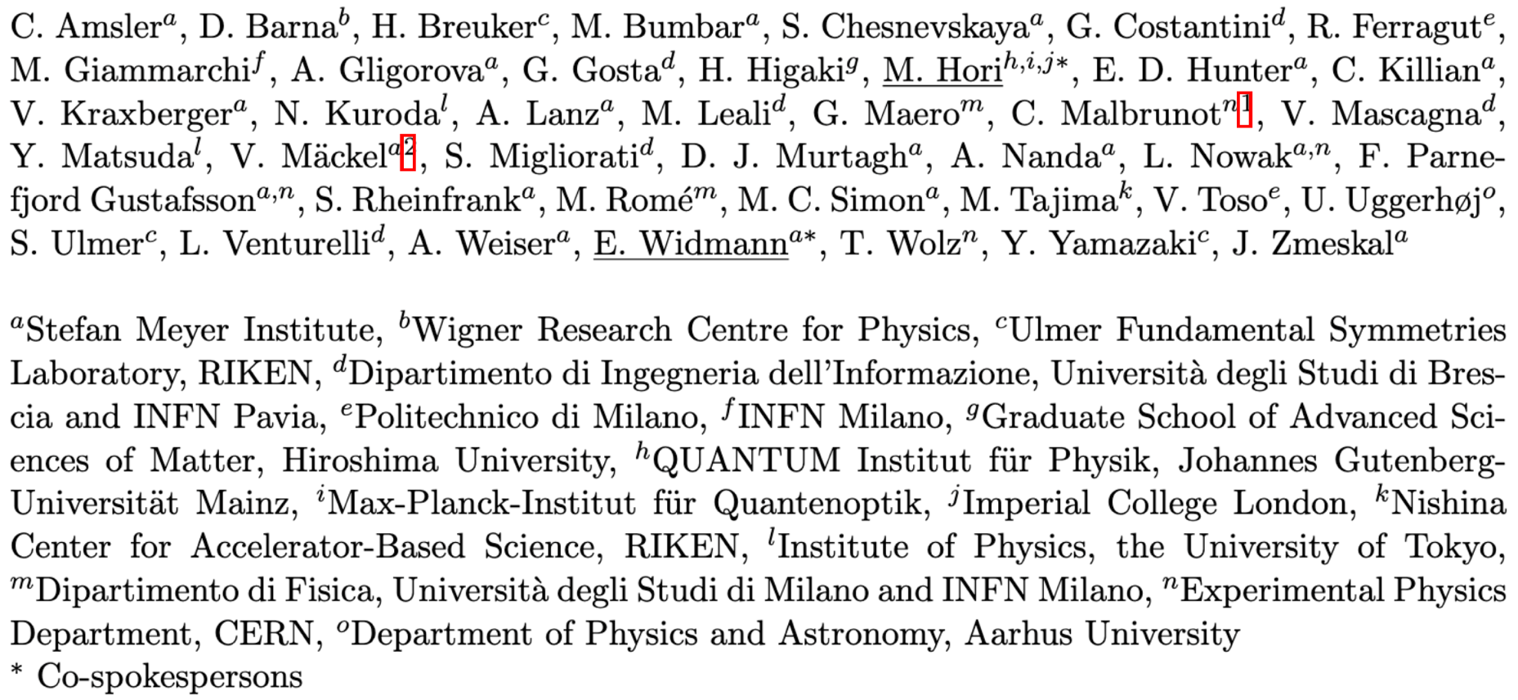











ASACUSA collaboration
6 long-time collaborators obtained tenure-track or permanent jobs in academia or industry in 2021-2022. Vital for continuation of collaboration.
M. Hori / E. Widmann SPSC148 7 Feb 2023

Slide 3
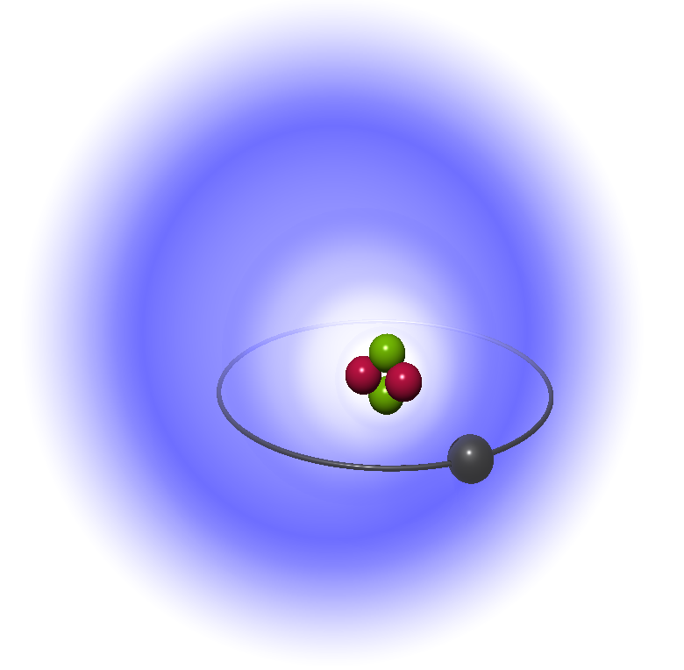
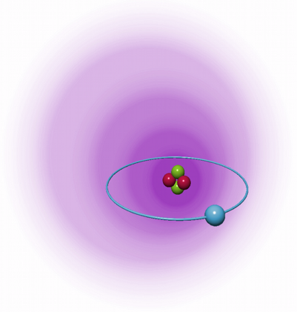
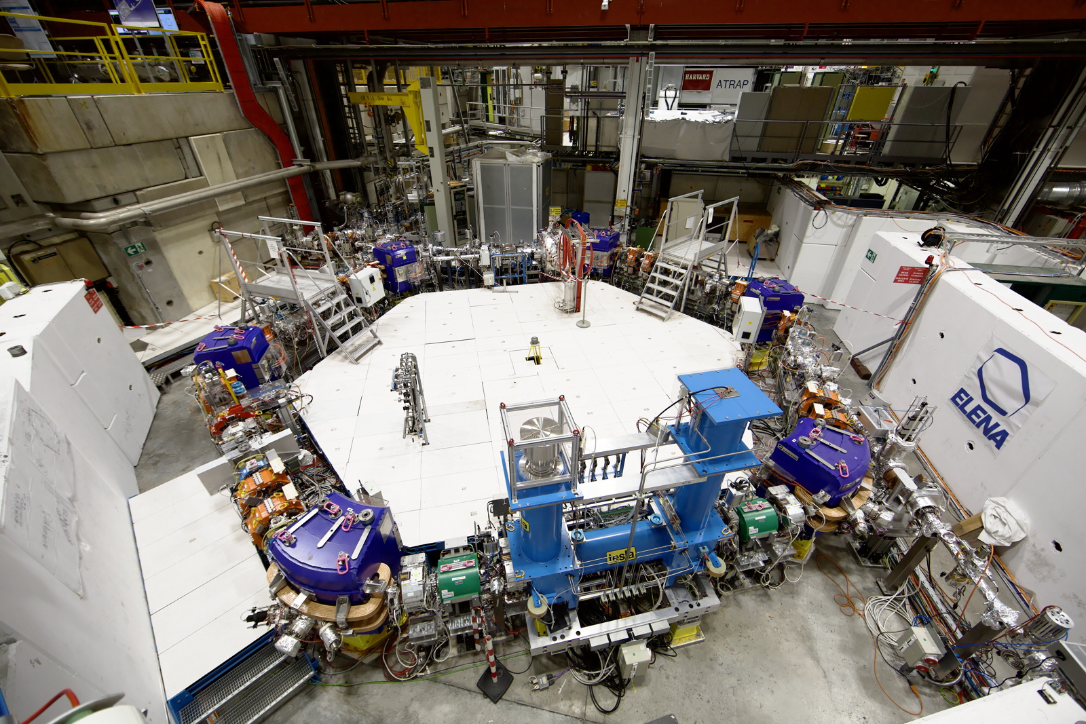
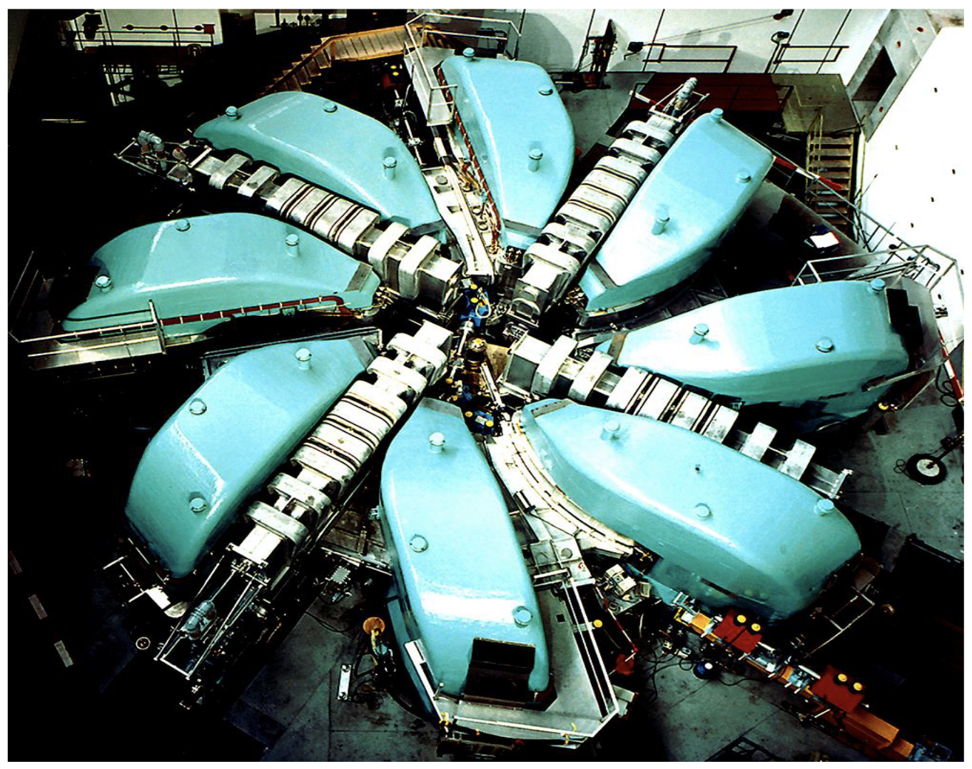
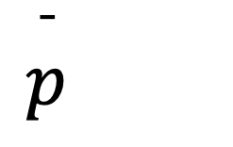
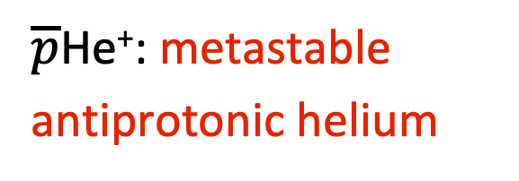
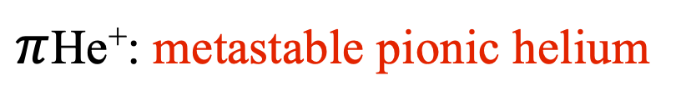
I Antiprotonic helium
e⁻
e⁻
$$\overset{¯}{p}$$
π⁻
$\overline{p}$He⁺: metastable antiprotonic helium
$π$He⁺: metastable pionic helium
CERN
PSI

Slide 4

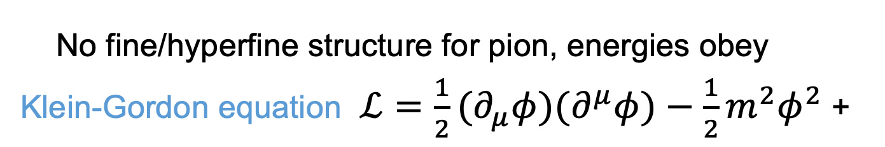
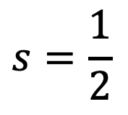



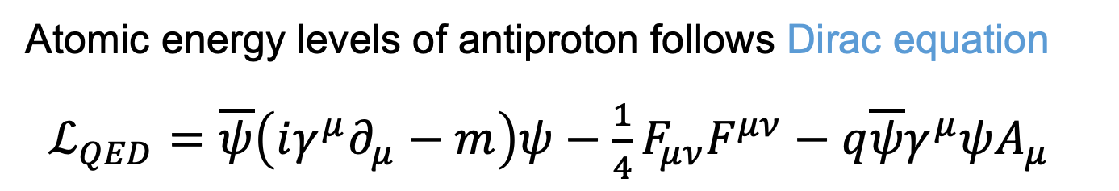

Theoretical progress during 2022
⁴$He$
$$\overset{¯}{p}$$
$$s=\frac{1}{2}$$
$$π^{−}$$
$$s=0$$
$$s=0$$
Atomic energy levels of antiproton follows Dirac equation
$ℒ_{QED}=\overline{ψ}\left(iγ^{μ}∂_{μ}−m\right)ψ−\frac{1}{4}F_{μν}F^{μν}−q\overline{ψ}γ^{μ}ψA_{μ}$
No fine/hyperfine structure for pion, energies obey Klein-Gordon equation $ℒ=\frac{1}{2}(∂_{μ}φ)(∂^{μ}φ)−\frac{1}{2}m^{2}φ^{2}$ +
Antiproton two-photon transition (n,l)=(36,34)→(34,32)
Non-relativistic energy 1 522 150 208.13 MHz
mα⁴ order corrections -50320.64
mα⁵ order corrections 7070.28
mα⁶ order corrections 113.11
mα⁷ order corrections -10.46(20)
mα⁸ order corrections -0.12(12)
Transition frequency 1 522 107 060.3(2)
Uncertainty alpha charge radius +/-0.007
Uncertainty antiproton charge radius < 0.0007
Korobov, Hilico, Karr, Phys. Rev. Lett. 112, 103003 (2014)
Pion transition (n,l)=(17,16)→(16,15)
Non-relativistic energy 1 125 369 104.121(7) MHz
mα⁴ order corrections -73281.2(9)
mα⁵ order corrections 10376.5(5)
mα⁶ order corrections 155.5(32)
mα⁷ order corrections -15.5(31)
Transition frequency 1 125 306 339.4(45)
Uncertainty from alpha charge radius +/-0.006
Uncertainty from pion charge radius < 0.001
Z.-Da. Bai et al., Phys. Rev. Lett. 128, 183001 (2022)
Matter-antimatter CPT symmetries
Particle masses to 10⁻⁹ to 10⁻¹² scale precision
Bound-state quantum electrodynamics
Search for physics beyond the Standard Model
Fifth forces at angstrom length scales
Condensed matter using antimatter?
Astrophysical interests?
4

Slide 5
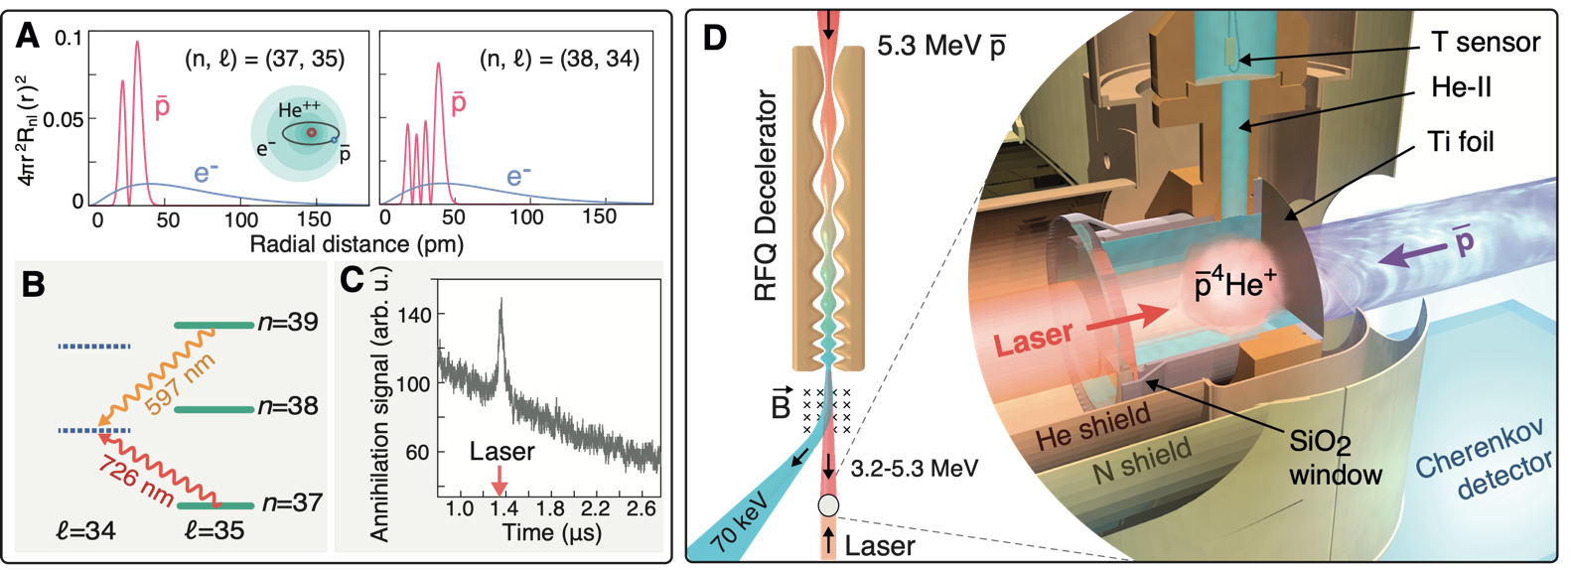
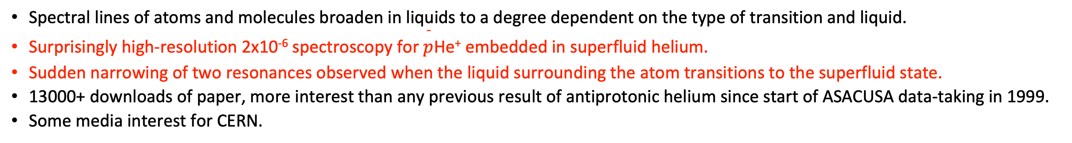
Published in 2022: condensed-matter effects observed for antiprotonic helium atoms suspended in superfluid helium
Anna Sótér et al., Nature 603, 411 (2022)
Spectral lines of atoms and molecules broaden in liquids to a degree dependent on the type of transition and liquid.
Surprisingly high-resolution 2x10⁻⁶ spectroscopy for $\overset{¯}{p}$He⁺ embedded in superfluid helium.
Sudden narrowing of two resonances observed when the liquid surrounding the atom transitions to the superfluid state.
13000+ downloads of paper, more interest than any previous result of antiprotonic helium since start of ASACUSA data-taking in 1999.
Some media interest for CERN.
M. Hori / E. Widmann SPSC148 7 Feb 2023
5

Slide 6
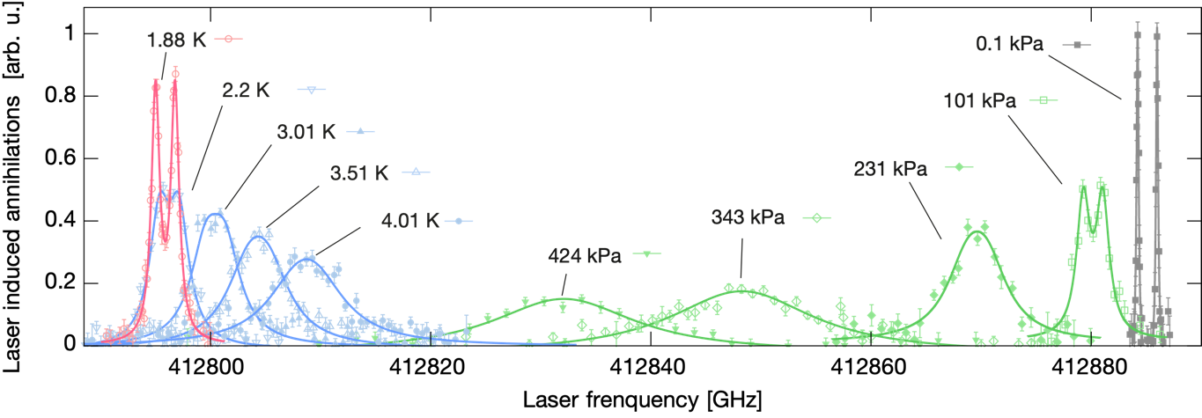
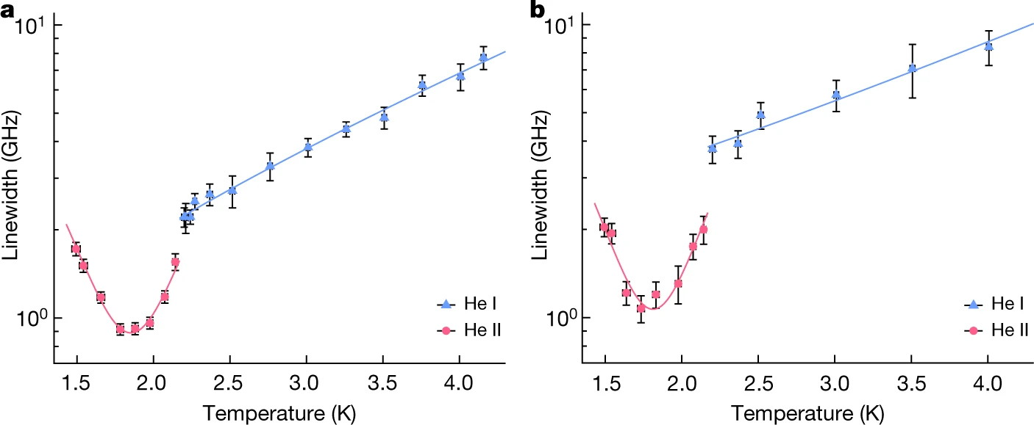
Collisional narrowing of resonance line
liquid
6 K gas / supercritical
Spectral lines in liquid are narrower than those in gaseous or supercritical helium at 6 K.
Sudden narrowing to sub-GHz linewidth reveals the hyperfine structure when the liquid surrounding the atom transitioned to the superfluid state.
Observed in two transitions.
6

Slide 7
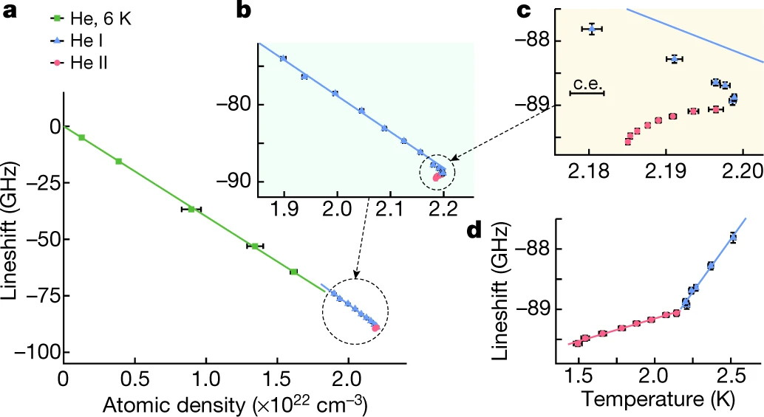
Collisional shift of resonance line
M. Hori / E. Widmann SPSC148 7 Feb 2023
7

Slide 8
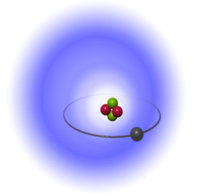
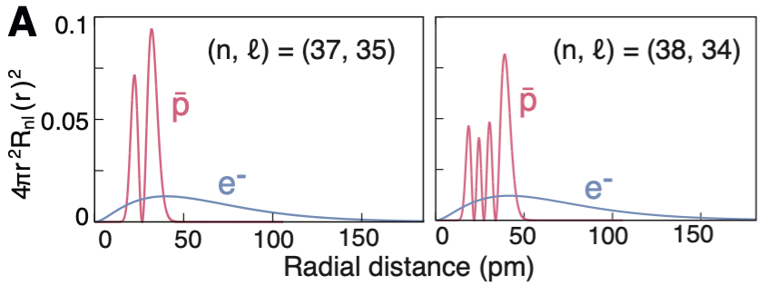

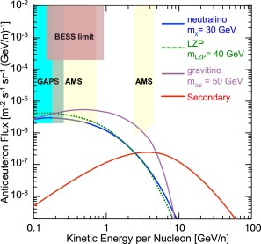
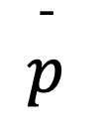
e⁻
?
$$\overset{¯}{p}$$
No quantitative theoretical understanding of phenomenon so far, work ongoing by two or three theoretical groups.
In models invoked in the field since the 1980’s, atoms and molecules in superfluid helium are “trapped” in a 1 nm scale diameter quantum defect.
When the laser excites the atom, its wavefunction expands within 1 fs, bubble diameter increases by >200 pm within 1 ps causing vibrations on its surface.
This couples to roton and phonon elementary excitations of superfluid helium so phonons of meV energies are emitted. The damping causes broadening.
If we naively apply this model to antiprotonic helium, the "expansion" of the atom during laser excitation is <2 pm. Sensitive to minute superfluid effects?
Interest from ISS -AMS collaborators for searches of antiprotons and antideuterons in cosmic rays at very low momenta (?).
GAPS collaboration
M. Hori / E. Widmann SPSC148 7 Feb 2023
8

Slide 9
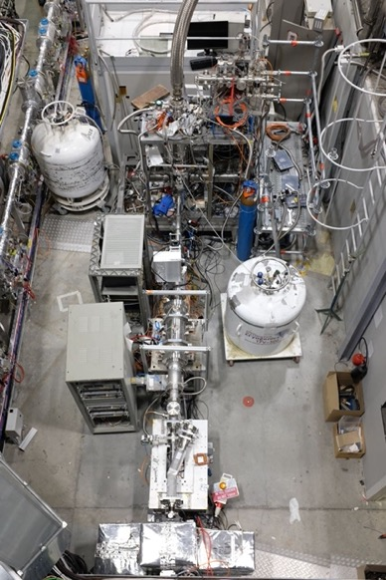
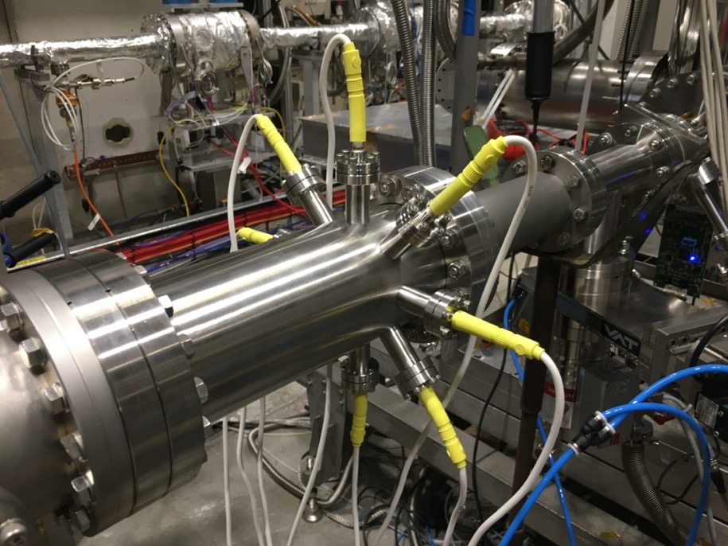
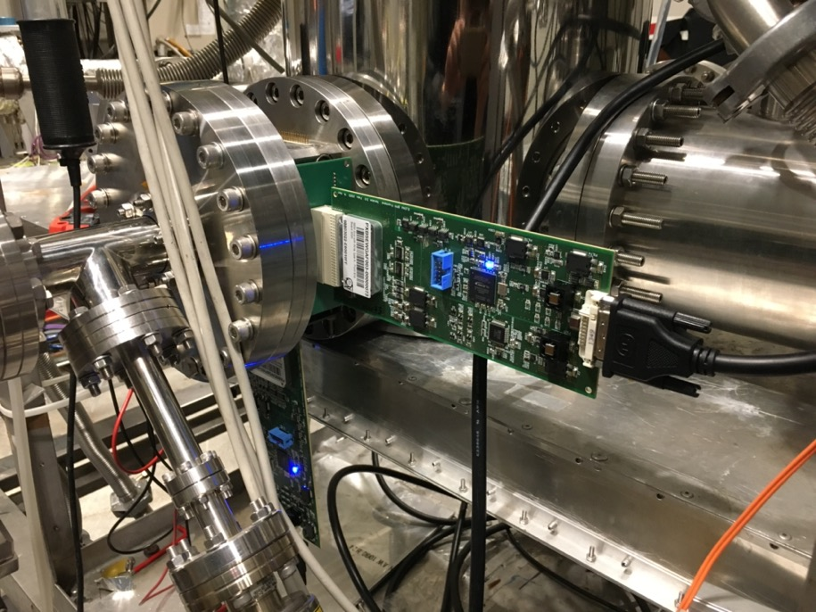
Modifications of beamline in 2022
Differential pumping irises
Octupole steer + lens
Beam monitor
Differential pumping irises
Beam monitor
Electrostatic
quadrupoles
<1e-9 mb
UHV
1 mb
1.5 K
helium
Pbar
beam
Laser
Electrostatic
quadrupoles
Ion
pump
Turbo
pump
Turbo
pump
Turbo
pump
Differential pumping must sustain 11 orders of magnitude pressure difference between cryogenic helium target and ELENA beamline.
During first commissioning in 2021, the beam in the target was too large.
Beam was scraped during transport.
In 2022 added new lenses, deflectors, irises, and beam monitors.
New optics with help from ELENA team.
New octupole deflector/focuser
New BPM based on charge-sensitive ASIC read out by FPGA, PCB developed by ASACUSA.
M. Hori / E. Widmann SPSC148 7 Feb 2023
9

Slide 10
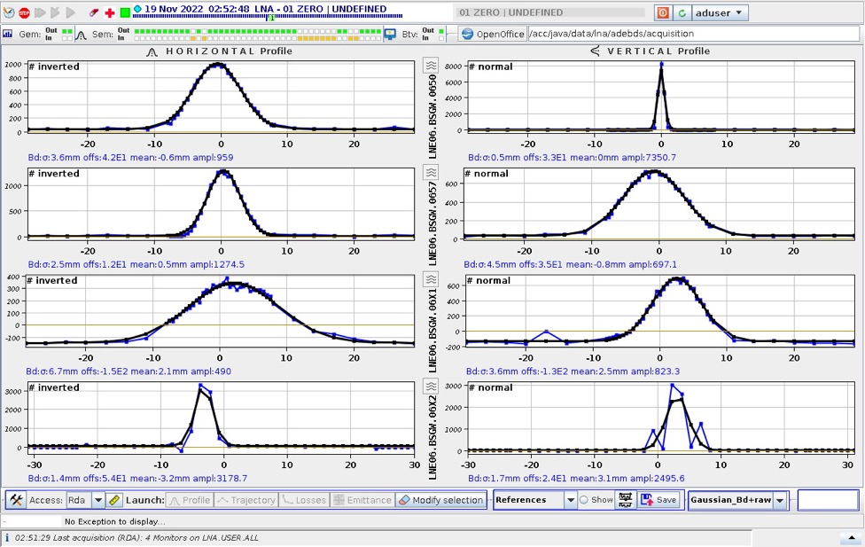
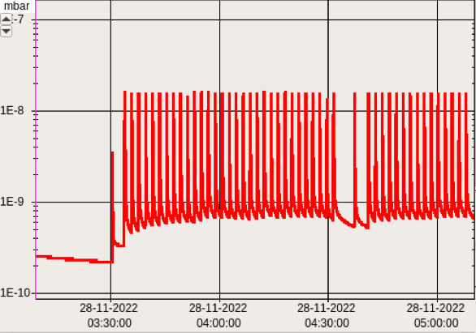
Outcomes of 2022 beamtime
Achieved a beam size of 1.5 mm sigma at the target, great improvement compared to 2021. Still larger than expected (ELENA emittance?)
MD-RIA simulation of antiprotons traversing polymer foils published in PRA 106, 012803 (2022). Used to design foil.
Laser spectroscopy of known infrared transition in antiprotonic helium atoms was successful and the hyperfine structure resolved.
High stability of spectroscopic signal compared to RFQD pre 2018.
Lower-than-expected laser resonance signal intensity due to lower (40% less than RFQD) antiproton beam intensity and 100 keV beam energy, 80 keV preferred. Will achieve by future induction decelerator.
Helium gas from target entered ELENA and resulted in 20% beam intensity losses, prevented prolonged operation of spectroscopy experiment. ELENA pump system is not designed to pump inert helium.
M. Hori / E. Widmann SPSC148 7 Feb 2023
10

Slide 11
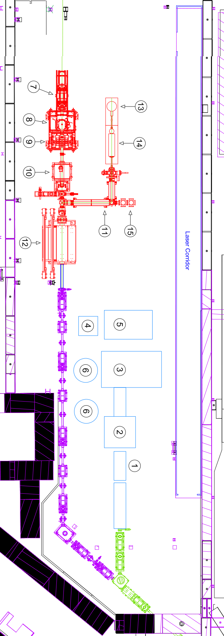
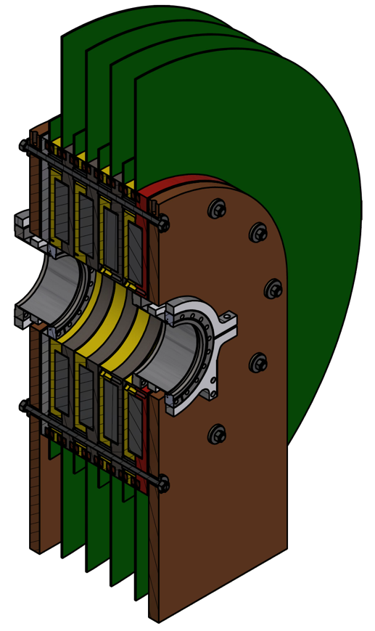
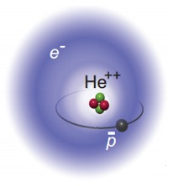
Plans for 2023
Extend the beamline by 4 m to reduce the helium gas entering ELENA. Construction of a quadrupole lens triplet, pumping aperatures, beam detectors ongoing.
Continue construction of induction decelerator to slow down the antiprotons, develop better lasers.
Search for four two-photon transitions with strongest intensity.
Ultrastable optical reference clock signal transmitted via optical fibers from France, Poland, and Switzerland (national infrastructure) may be utilized by the AD community in the longer term.
GPS
Hydrogen Maser
Comb
Ti:S
1560 nm
SubHz
ULE
cavity
M. Hori / E. Widmann SPSC148 7 Feb 2023
11

Slide 12
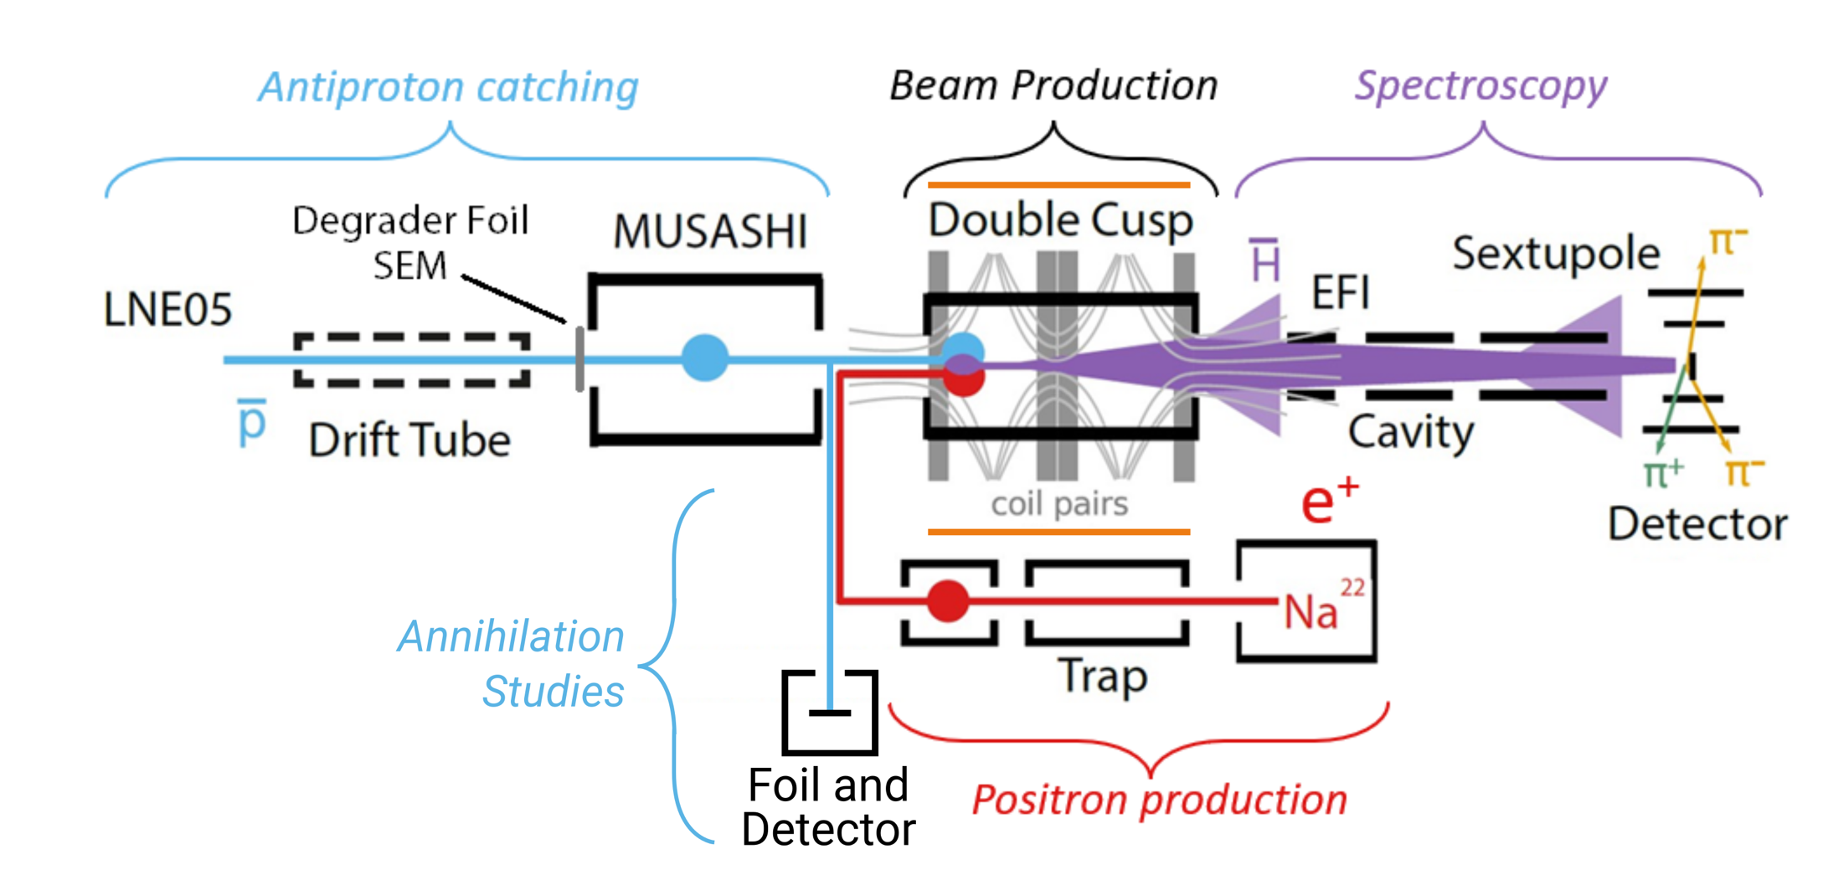
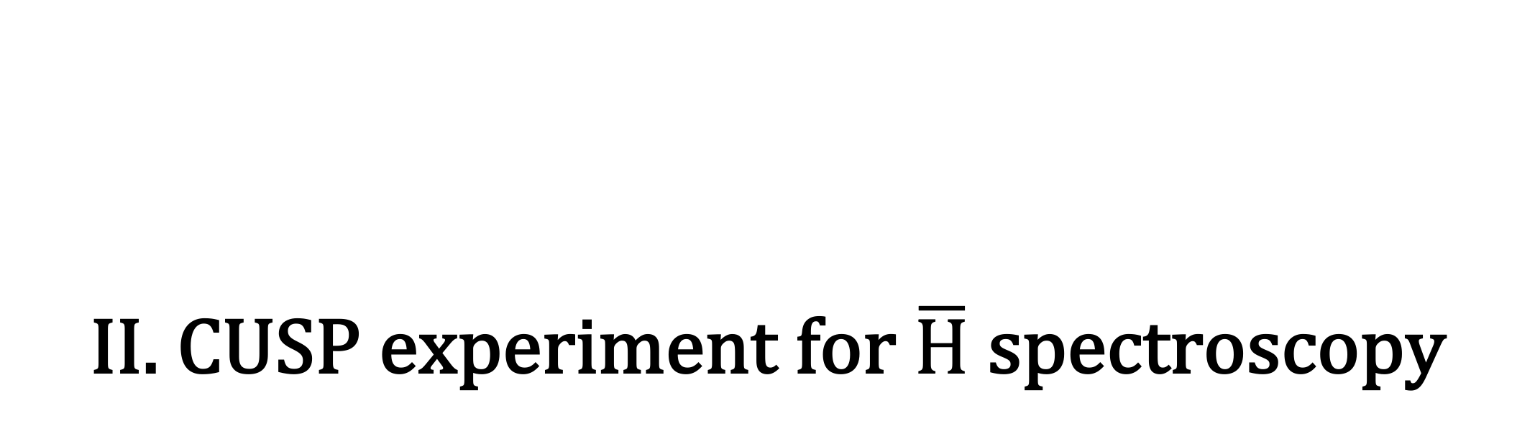
II. CUSP experiment for $\overline{H}$ spectroscopy
M. Hori / E. Widmann SPSC148 7 Feb 2023
12

Slide 13
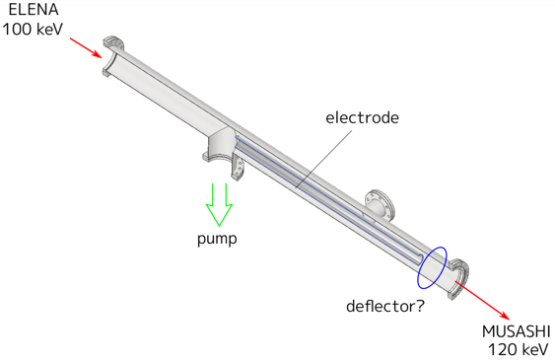
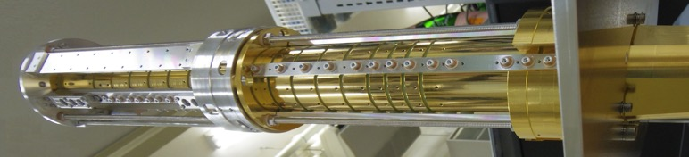
All planned upgrades finished in 2022!
Exchanged for Aarhus trap ü
Upgraded Hodoscope ü
New Positron Accumulator ü
SC Magnet recommissioned ü
New Cold Bore ü
New Electrode Stack ü
Upgraded Scintilating Bar
Detectors ü
Previous results for cooling electron plasma in the new Cusp trap were published: Physics of Plasmas 29, 083303 (2022)
Upgrade for ELENA beam ü
M. Hori / E. Widmann SPSC148 7 Feb 2023
13

Slide 14
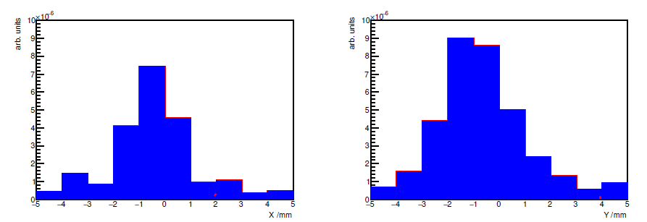
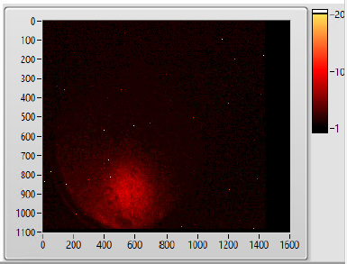
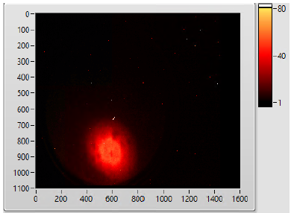
Antiprotons
Line was realigned by CERN to correct an offset.
Beam tuning continued in 2022 with help from Yann → Spot is still elliptical.
Trapping efficiency agrees with MD-RIA simulation of antiprotons traversing Ag-coated Mylar. Future change to Al coating to trap more pbars?
Control system upgraded
Cycle time shortened to ~110s (one ELENA cycle)
Antiprotons transferred into the new Cusp trap
Scintillating Bar Detectors
  Upgraded from multi-anode PMT to SiPM
  Upgraded front end electronics
  Antiproton annihilation data taken in 2022 used to calibrate detectors
M. Hori / E. Widmann SPSC148 7 Feb 2023
14

Slide 15
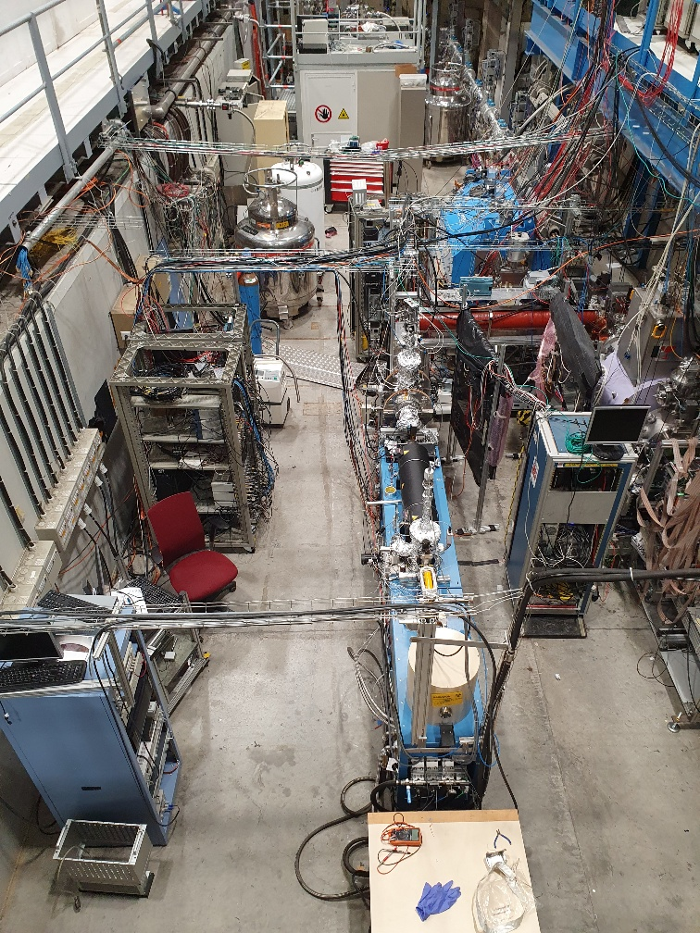
Positrons
We replaced the previous positron trap employing a superconducting magnet, with a commercial room temperature model
  Removed weekly requirement for 1000l of LHe
Moderator and trap damaged during shipping from Aarhus to CERN, had to be repaired.
Positron beam produced and trapped, but efficiencies were much lower than nominal.
Multiple bunches were transferred to the new accumulation stage. The lifetime was shorter than expected when cooling gas was present.
Nevertheless, all new techniques and methods were demonstrated.
New source ordered from supplier delayed to 2023.
  Should increase intensity by factor of 20.
Accumulator
Trap
Moderator
&
Source
M. Hori / E. Widmann SPSC148 7 Feb 2023
15

Slide 16
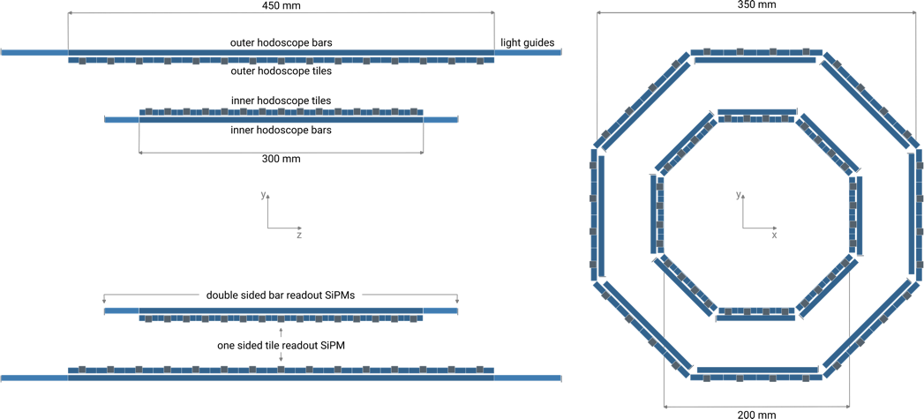
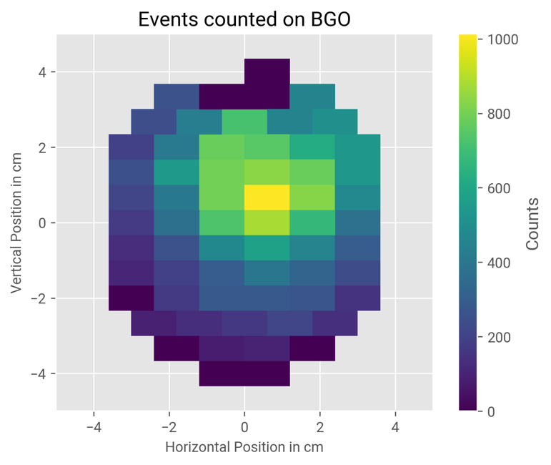
Spectroscopy beam line
Superconducting sextupole magnet was recommissioned reaching a stable current (380A) suitable for spectroscopy (>350A)
Antihydrogen detector returned from Vienna after upgrades
  Faster read out speed to match faster mixing cycles (1kHz)
  Fibre layer replaced by scintillating tiles to improve the Z-resolution (?)
Antiprotons from the Cusp trap were extracted onto the BGO for testing
M. Hori / E. Widmann SPSC148 7 Feb 2023
16

Slide 17
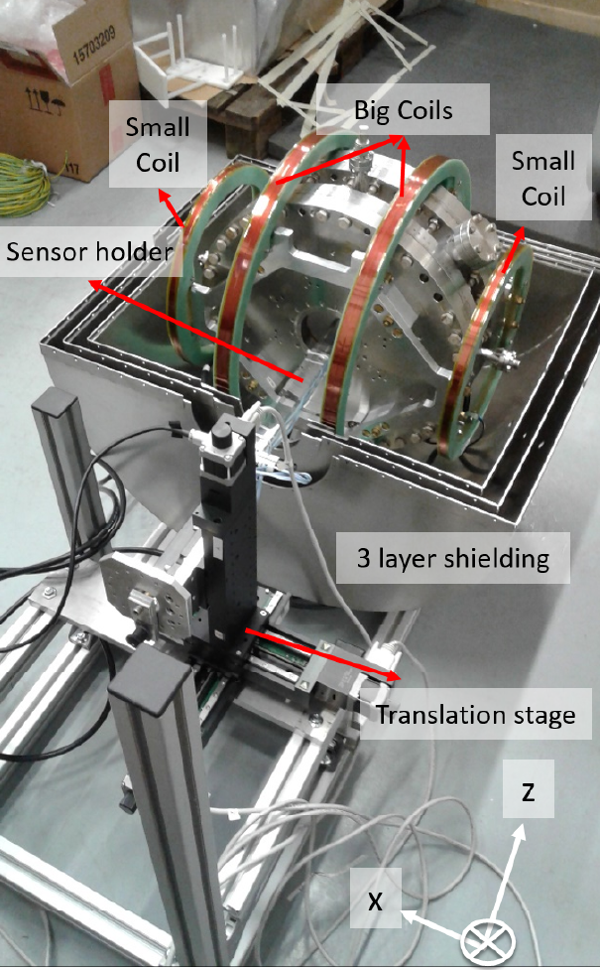
Hydrogen beam: characterise cavity & B_{ext}
Polarised H beam at CERN Bat. 275
  Experiments conclude, apparatus removed from CERN
Characterise microwave cavity for antihydrogen spectroscopy
  External magnetic field B_{ext} homogeneity
  Reference measurement with hydrogen done
Move to AD/ELENA
  Cusp magnet stray field compensation needed
SME measurements done with H
  B_{ext} orientation dependence
  Analysis to be finished soon
B_{ext}
@CERN B275 (2015-2022)
M. Hori / E. Widmann SPSC148 7 Feb 2023
17

Slide 18
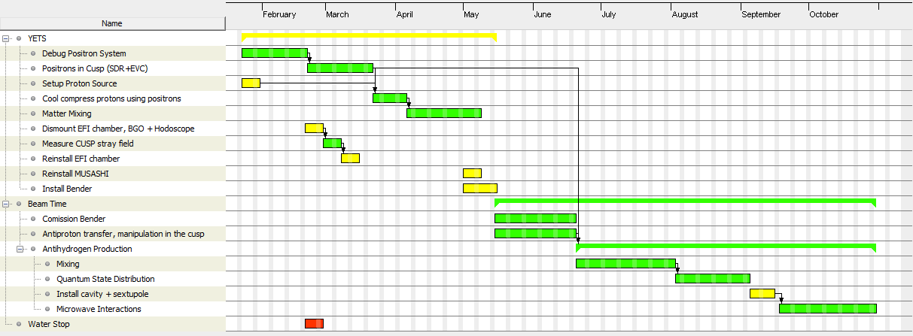
Plan for 2023
Beamtime progress as quickly as possible to beam production and spectroscopy
YETS – Focus on positron system and working with matter
All apparatus for spectroscopy is in the zone and has been commissioned
Work on optimising and improving the positron system will continue during YETS
The ASACUSA proton source has been installed to continue beam development before the antiprotons return in May
Beamtime this year will focus on beam production and finding the quickest route to microwave interactions
M. Hori / E. Widmann SPSC148 7 Feb 2023
18

Slide 19
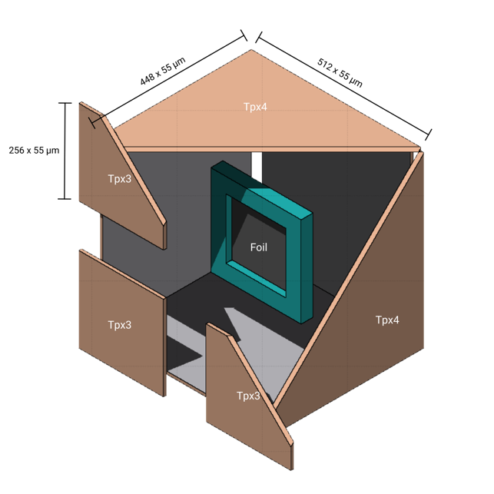
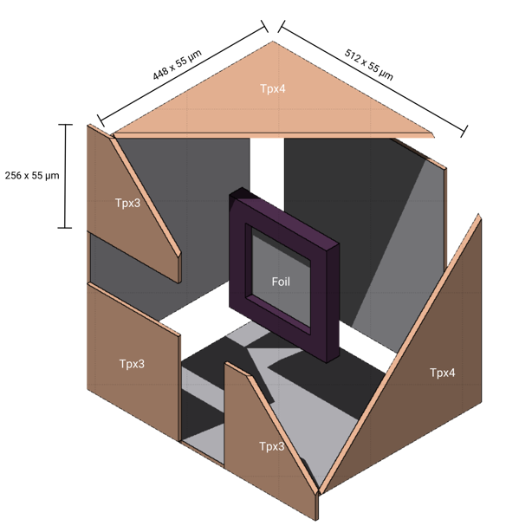
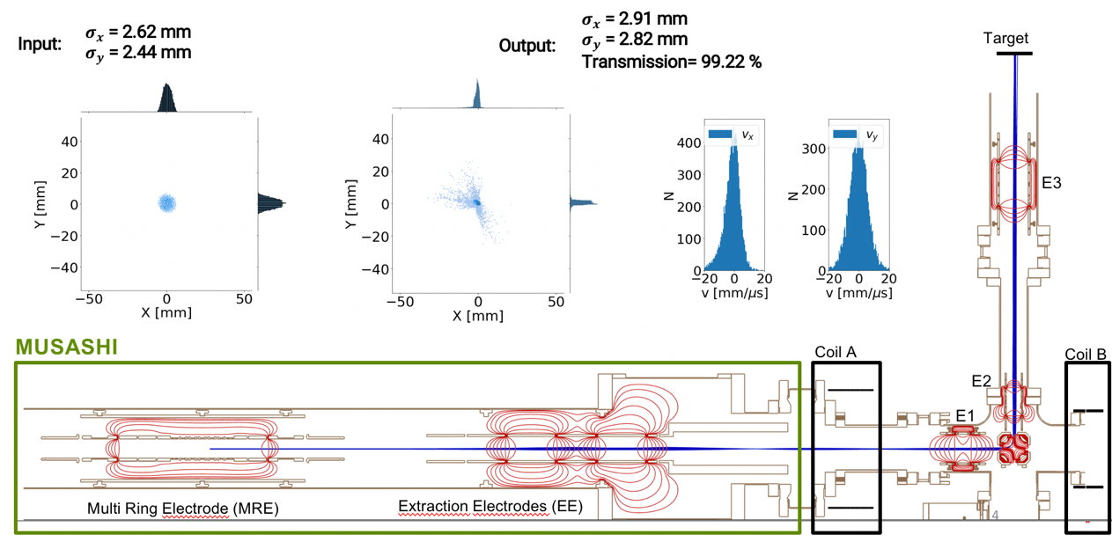
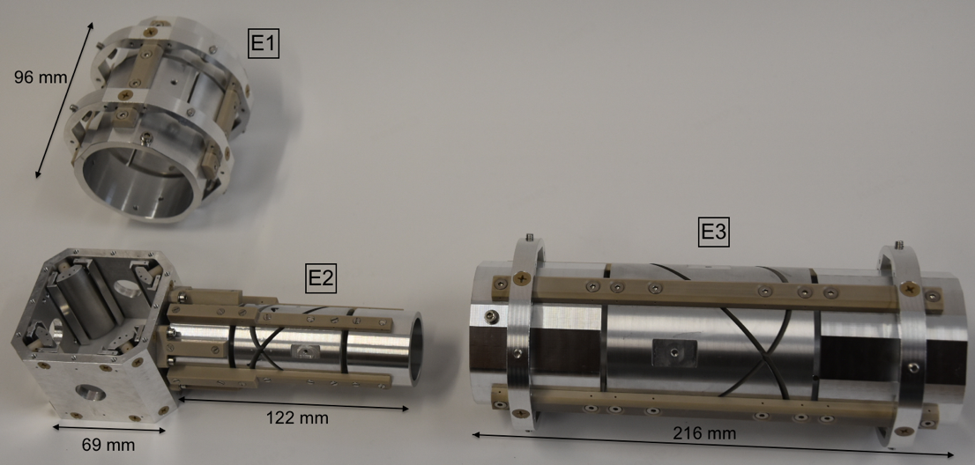
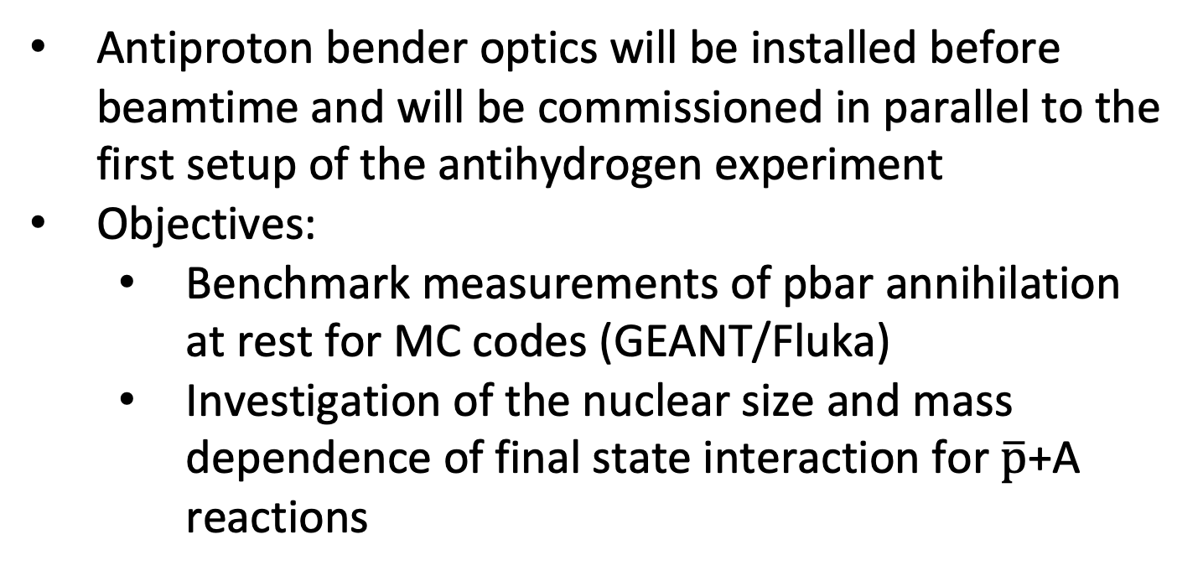
Annihilation Studies
Possible detector configurations
Antiproton bender optics will be installed before beamtime and will be commissioned in parallel to the first setup of the antihydrogen experiment
Objectives:
  Benchmark measurements of pbar annihilation at rest for MC codes (GEANT/Fluka)
  Investigation of the nuclear size and mass dependence of final state interaction for $\overline{p}$+A reactions
M. Hori / E. Widmann SPSC148 7 Feb 2023
19

Slide 20
Conclusions
Published observation of anomalous spectral narrowing of antiprotonic helium atoms embedded in superfluid helium, theoretical work ongoing. (“Antiprotons for condensed matter research”?)
First laser spectroscopy of antiprotonic helium atoms using the ELENA beam, hyperfine structure was resolved.
Numerous modifications needed in 2023 to reduce cryogenic helium gas contamination into ELENA as we iteratively move towards high-precision spectroscopy.
Published results showing the production of cold electron plasmas over a wide range of particle densities in the cusp trap. Essential for cold antihydrogen production.
Antiproton trap was optimized for rapid accumulation and cooling.
New positron source, trap, and accumulator that do not use liquid helium were installed. Positron intensity is still low, commissioning ongoing.
Upgraded antiproton and antihydrogen detectors, and data acquistion.
Antihydrogen spectroscopy beamline being readied for first measurements in 2023.
Job consolidation to secure long-term future of collaboration ongoing.
M. Hori / E. Widmann SPSC148 7 Feb 2023
20

Slide 21
Backup slides
M. Hori / E. Widmann SPSC148 7 Feb 2023

Slide 22
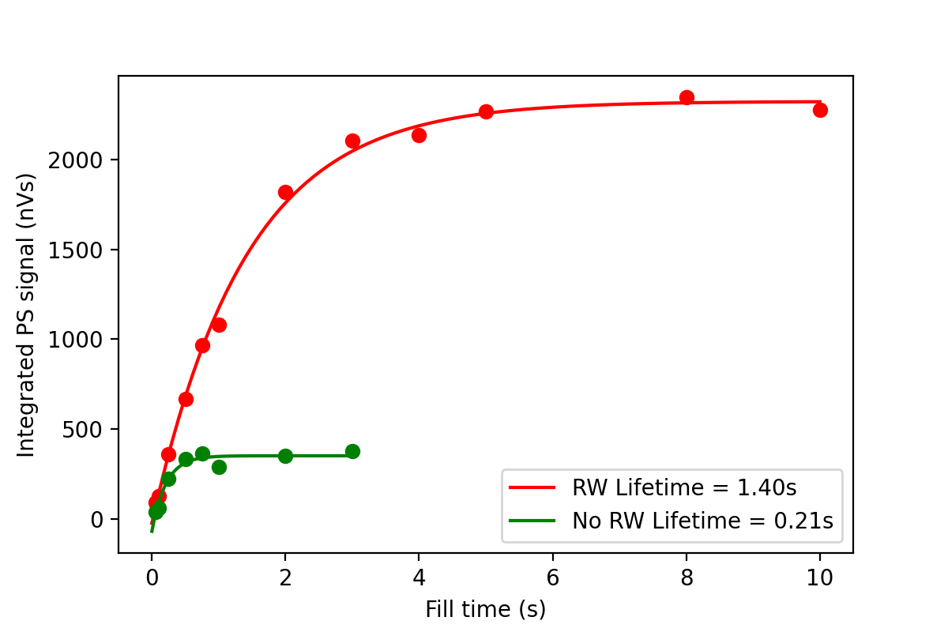
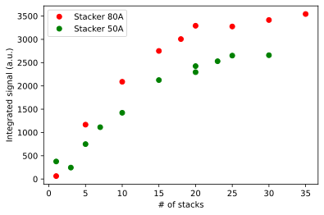
Positrons
Trap
Positron beam produced ü
  Moderation efficiency factor of 5 lower than expected ✗
Positrons Trapped ü
  Trapping efficiency factor of 20 lower than expected ✗
Multiple bunches were transferred to the new accumulation stage ü
  The lifetime was shorter than expected when cooling gas was present ✗
All new techniques and methods demonstrated with lower than optimal efficiency
Accumulator
M. Hori / E. Widmann SPSC148 7 Feb 2023

Slide 23
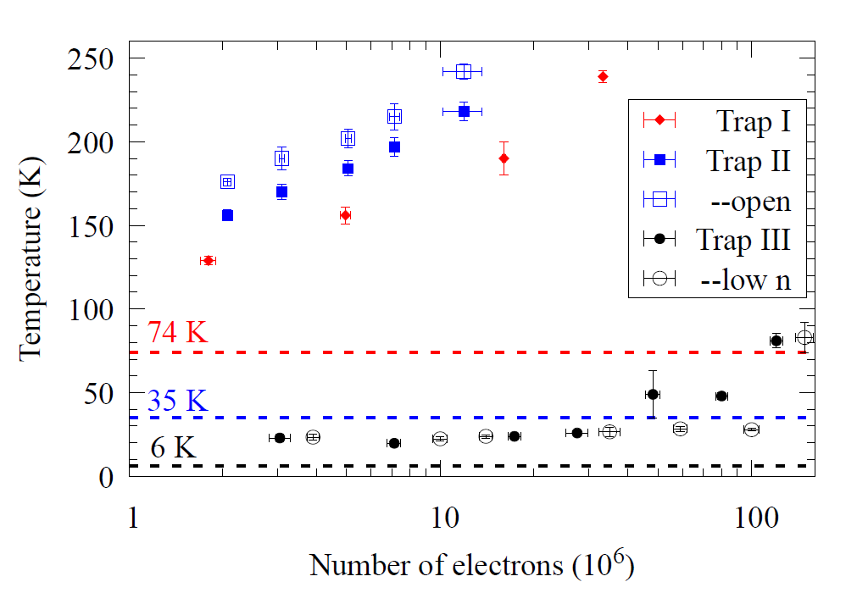
Towards colder plasmas
Previous results for electron plasma in the new Cusp trap were published
  Reducing the background temperature for cyclotron cooling in a cryogenic Penning–Malmberg trap - Physics of Plasmas 29, 083303 (2022)
These results show we are able to produce cold plasma over a wide range of densities
M. Hori / E. Widmann SPSC148 7 Feb 2023

