Slide 1



















Antihydrogen Laser PHysics Apparatus
THE ALPHA COLLABORATION
Aarhus University,
Denmark
University of Brescia,
Italy
University of British
Columbia, Canada
University of California
Berkeley, USA
University of Calgary,
Canada
University of Liverpool, UK
University of Manchester, UK
Purdue University,
USA
Federal University of
Rio de Janeiro, Brazil
University of Pisa
Italy
NRCN - Nuclear Res.
Center Negev, Israel
Stockholm University,
Sweden
TRIUMF,
Canada
Simon Fraser University,
Canada `
York University,
Canada
University of Wales
Swansea, UK
Cockcroft Institute, UK

Slide 2
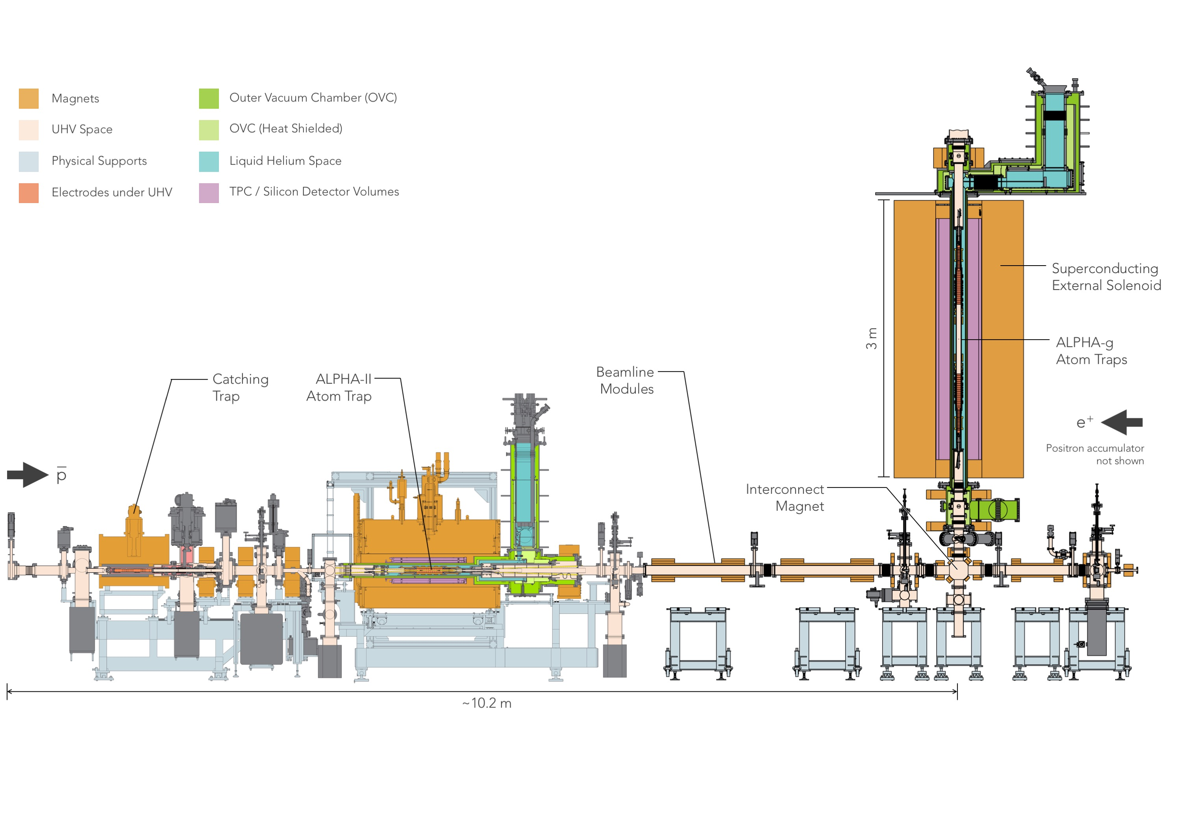
ALPHA Schematic

Slide 3
From last year’s report: Next Steps and 2022 Run
Pre-run
continue studies of particle temperatures in ALPHA-g
prepare new degrading foils for the Catching Trap
prepare alternative Penning traps in case we cannot work with the current one (plating,
coating, etc.)
continue magnet commissioning in ALPHA-g
minor mods to ALPHA-g cryostat
work on frequency metrology and spectroscopy: ALPHA-3
work on magnetrometry for ALPHA-g
continue characterisation of the detectors
prepare microwave hardware for ALPHA-g
prepare Lyman-alpha light for ALPHA-g (focussed on ALPHA-2 instead)
Run 2022
we aim to start up with ALPHA-g again in April The priority is the up/down measurement
hope to also improve the precision of the 1s-2s transition frequency measurement in 2022

Slide 4
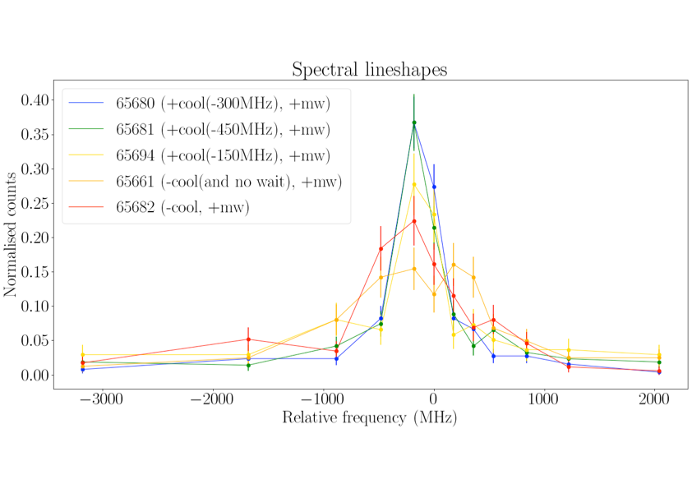
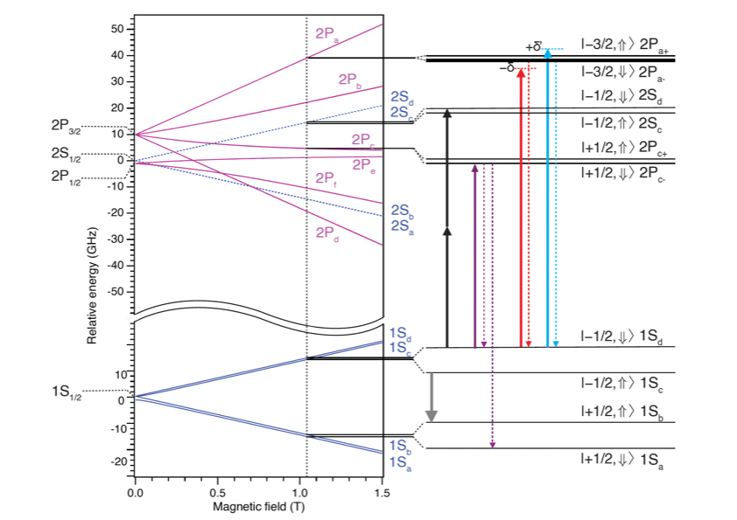
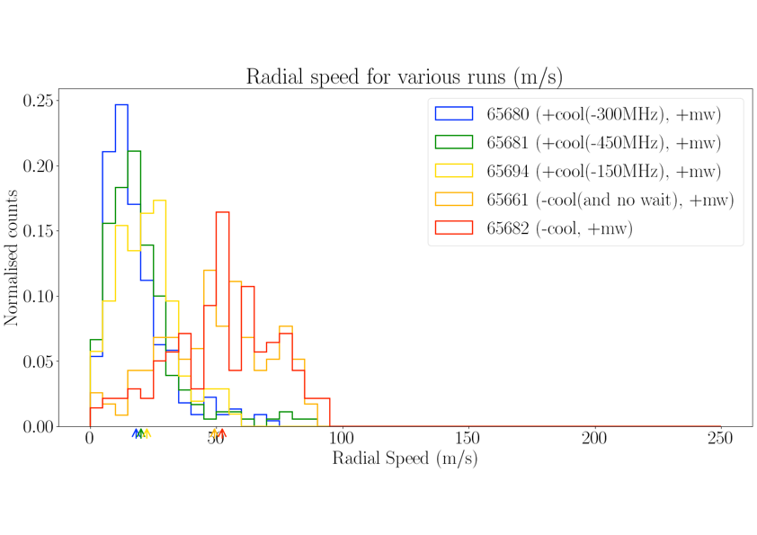
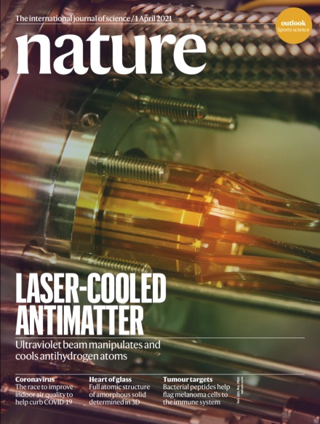
Laser Cooling in ALPHA-2 re-established
ALPHA Preliminary

Slide 5
1s-2s transition for uncooled atoms
total of 3 weeks of beamtime for
laser cooling and spectroscopy
about 15 trapped atoms per mixing
everything works – no time for improvements
focus for 2023
ALPHA Preliminary

Slide 6
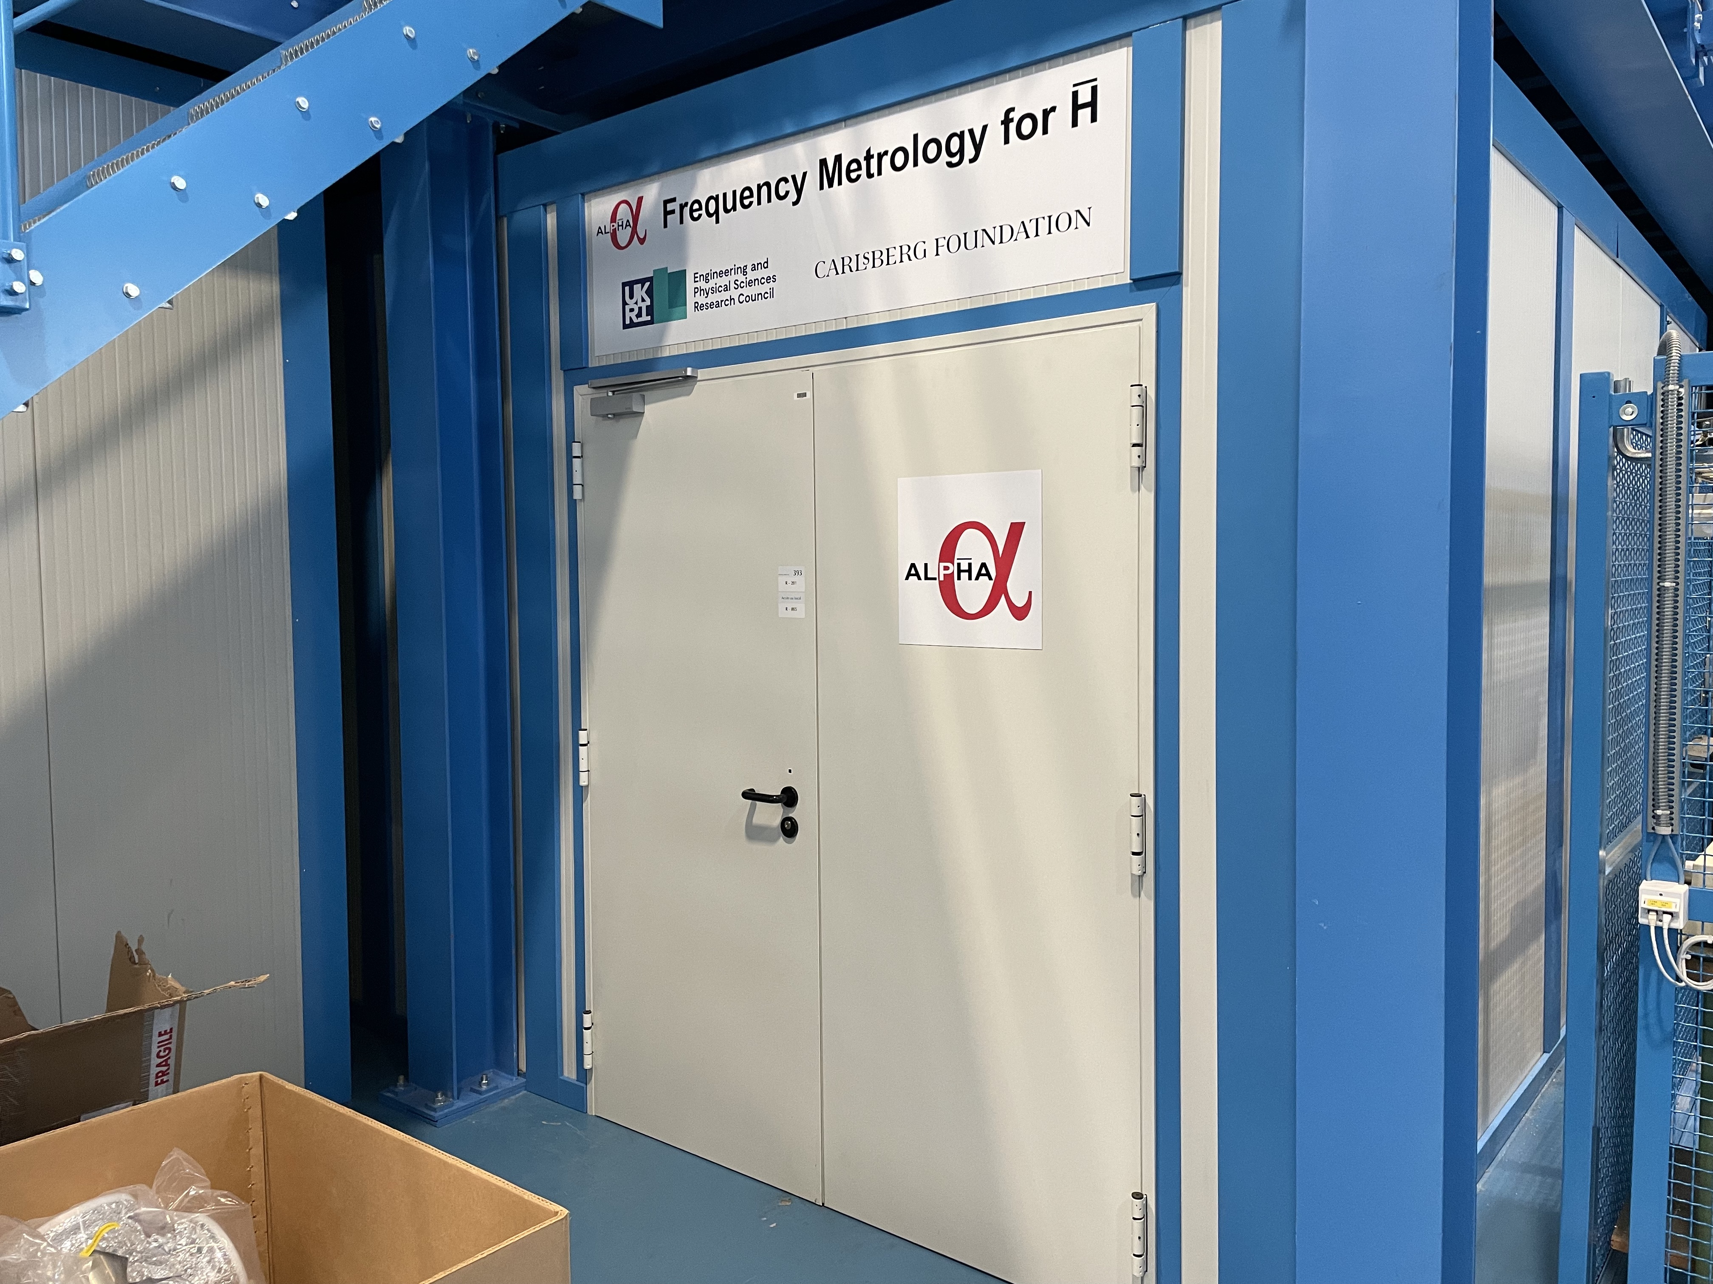
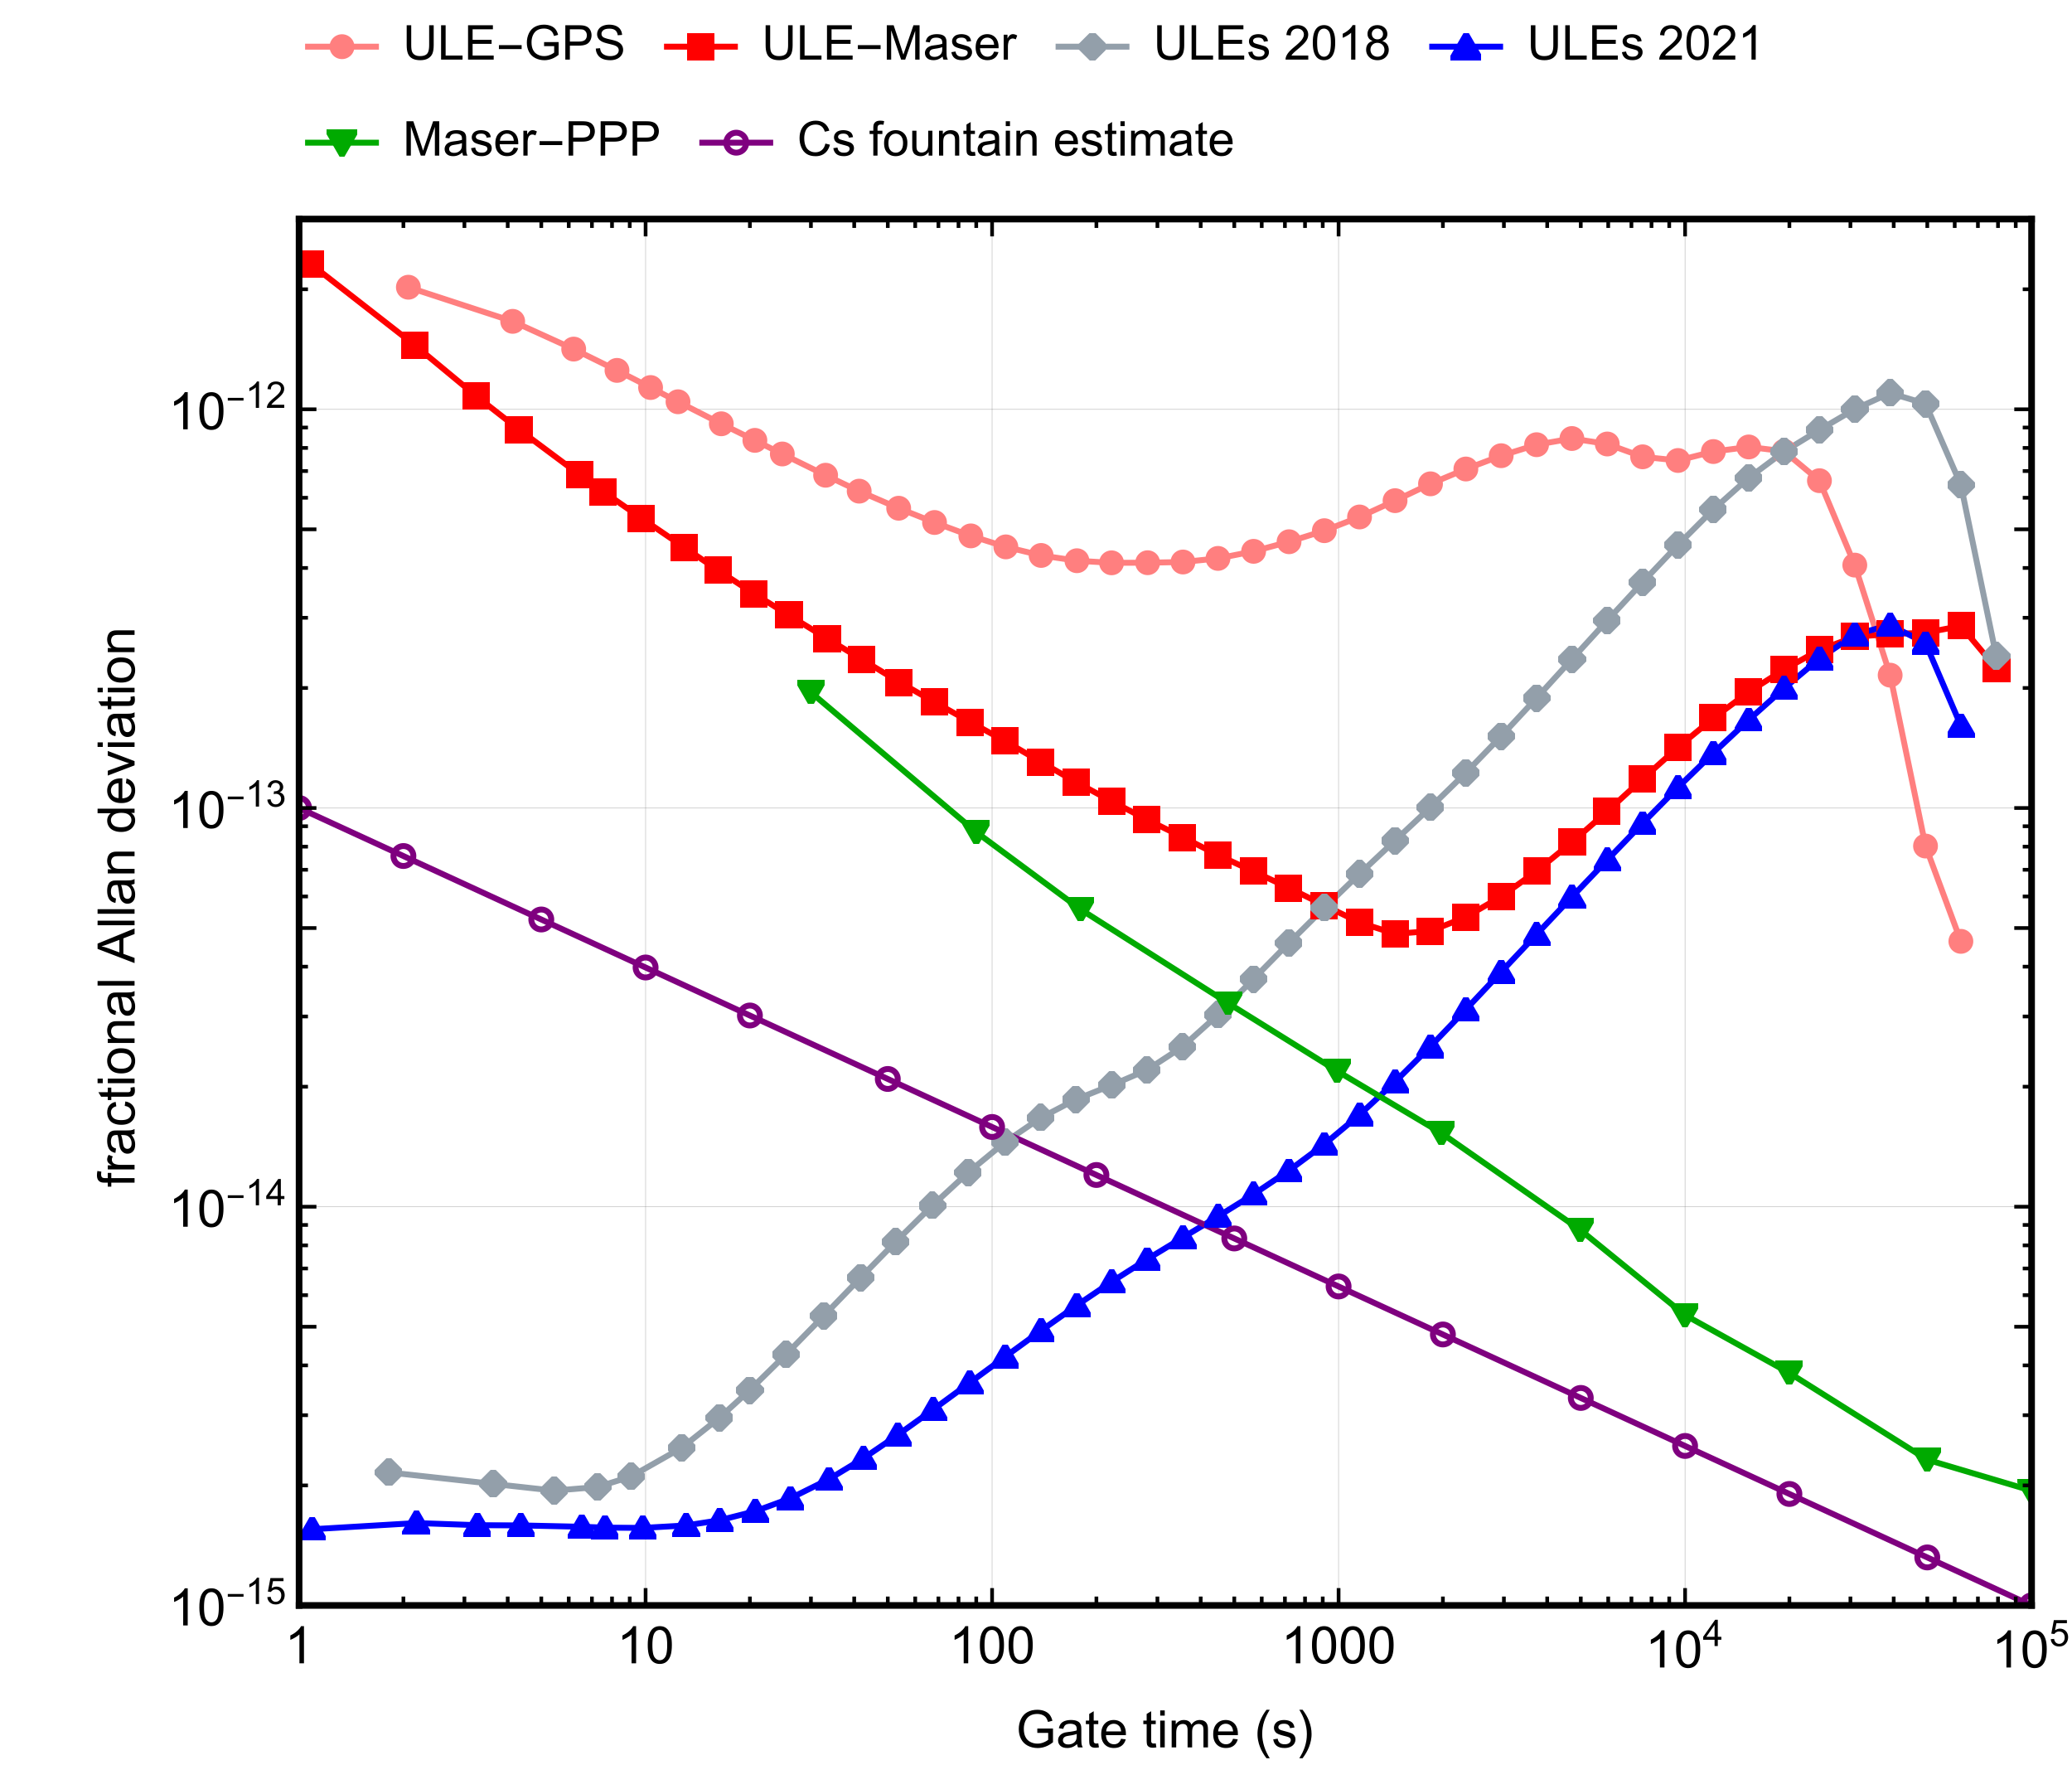
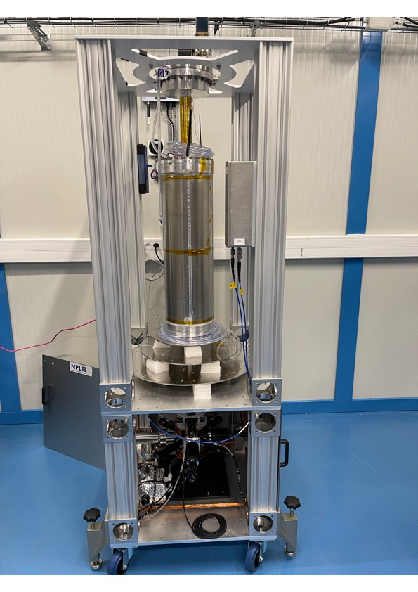
ALPHA Frequency Metrology
Past performance
ALPHA-preliminary
The CFC arrived in
September 2022.
Some small technical issues
Maximum three weeks of
averaging so far.
Appears to have the same
performance as twin in UK
so far.
Current
performance
Future performance

Slide 7
ALPHA-g bottom trap

Slide 8
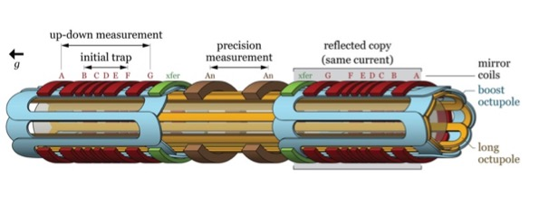
ALPHA-g magnets
short octupole
short octupole
17 superconducting circuits with 34 HTS current leads

Slide 9
Magnetic Bias (J. Fajans)
The strategy:
accumulate antihydrogen atoms
slowly ramp down the end mirror coils,
maintaining the bias
record annihilations going up or down
repeat for various bias values
ECR field measurements at start and end
lots of offline magnetometry
ALPHA Preliminary
illustration of balance point concept
for matter – in one dimension

Slide 10
Simulated ‘s-curves’
gravity strength
1.0g
0.5g
0g
-1.0g
ALPHA Preliminary

Slide 11
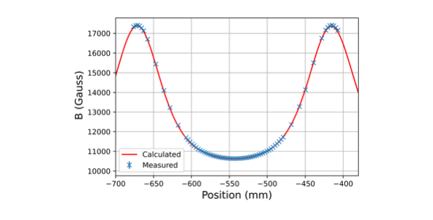
ECR of full trap at high field
ALPHA Preliminary

Slide 12
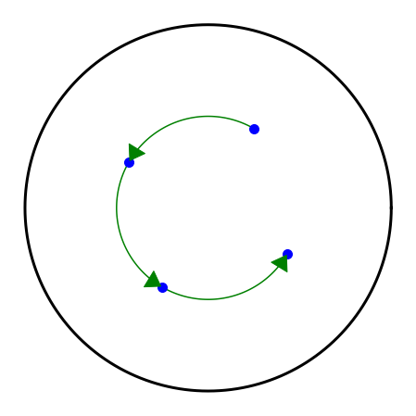
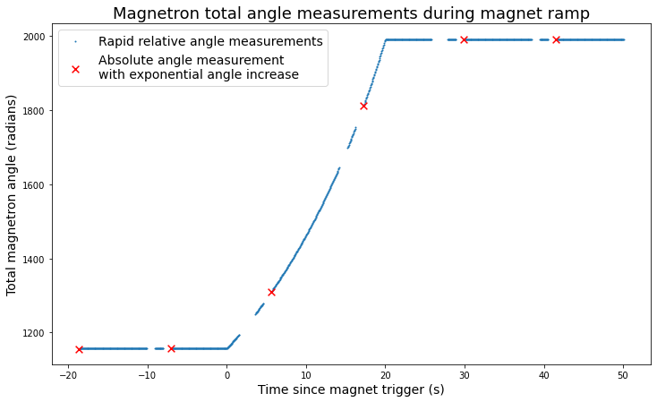
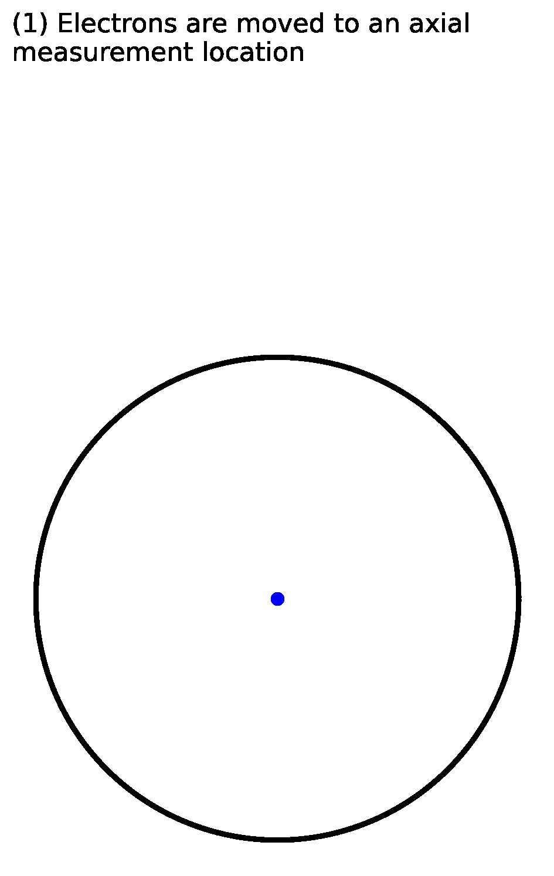
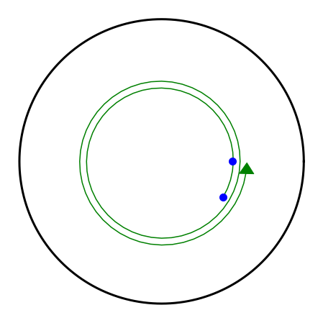
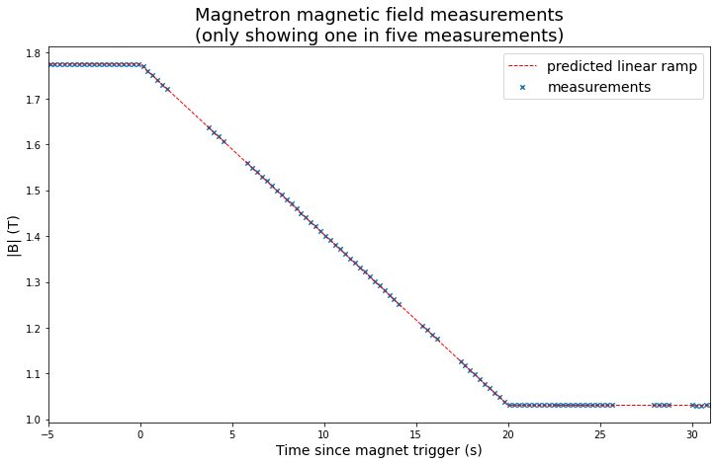
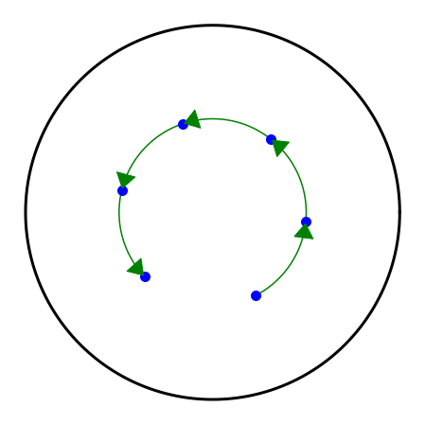


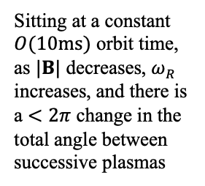
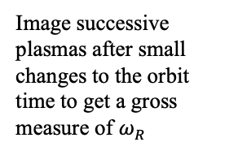
Magnetron-based magnetic field measurement
$$v_{E×B}=\frac{E×B}{{\left|B\right|}^{2}}$$
Image successive plasmas after small changes to the orbit time to get a gross measure of $ω_{R}$
$$ω_{R}(r)=\frac{E_{r}\left(r\right)}{rB_{z}\left(r\right)}$$
Exponentially increase orbit time without losing track of the total orbit count to increase precision
ALPHA Preliminary
Sitting at a constant $O(10ms)$ orbit time, as $|B|$ decreases, $ω_{R}$ increases, and there is a $<2π$ change in the total angle between successive plasmas

Slide 13
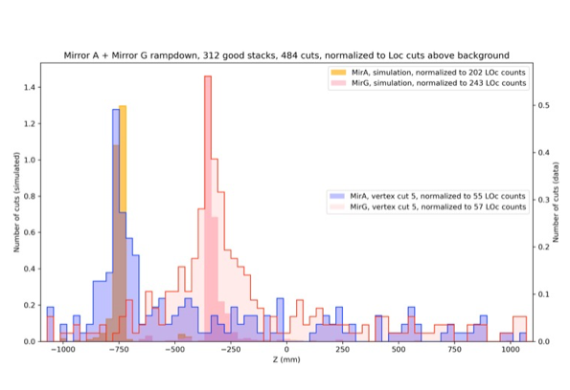
ALPHA-g single mirror release – proof of principle
ALPHA Preliminary
DOWN
UP
The first ALPHA-g trap is fully commissioned and capable of systematic
investigations of the effect of gravity on antimatter.

Slide 14
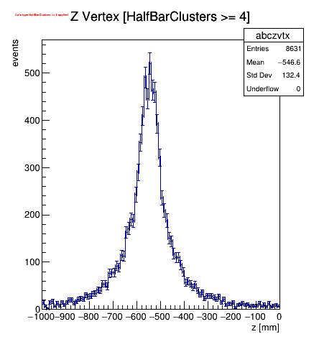
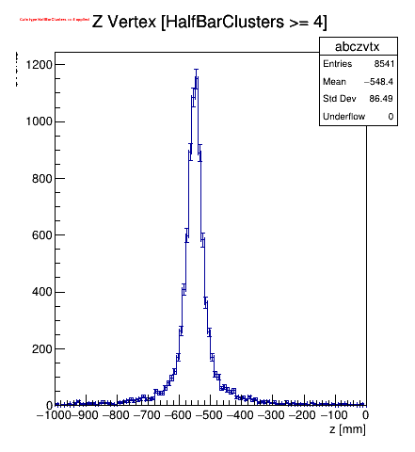
Detecor Analysis Ongoing – pbar loss from short well
State of the Art
February 2022
ALPHA Preliminary

Slide 15
Positron cooling using laser-cooled Be ions
motivation: antihydrogen trapping efficiency is a strong function of positron temperature
state of the art is 30 atoms trapped for 50K atoms produced
we typically have 20-30K positron temperature in ALPHA-2 – after many
years of development
have achieved 7 K with Be ions; but never implemented in antihydrogen production
no positron work in 2022 due to ALPHA-g

Slide 16
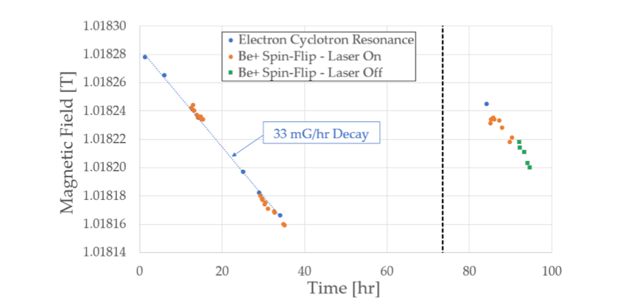
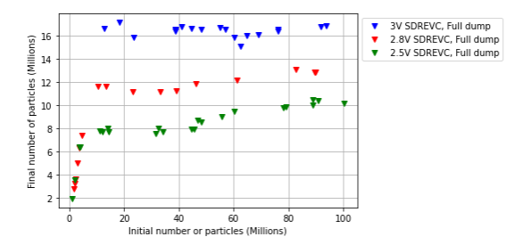
Positron cooling using laser-cooled Be ions
SDREVC on Be ions
to create consistent ion plasmas
magnetometry with Be ions
in ALPHA 2: use microwaves to drive
to a dark state; monitor fluorescence

Slide 17
Status and Outlook
For 2023
emphasis on ALPHA-2: laser cooling, 1S-2S spectroscopy with new metrology,
and microwave spin-flip (HFS ground state) improvement; direct Lamb shift
hoping to improve ALPHA-g solenoid cooling system, waiting for new coldheads
from Sumitomo
if ALPHA-g runs in 2023: study systematics and begin using laser cooling and the
precision trap
try to implement Be-cooled positrons for antihydrogen production
new trap insert for spectroscopy in 2024 – ‘ALPHA-3’ – with photon detection
and other improvements

Slide 18
Thanks to the CERN antiproton crew
and support infrastructure!!!
…ELENA is simply amazing

