Slide 1
IPv4 to IPv6 Worker Node migration in WLCG
Bruno Hoeft, Matthias Schnepf, Max Fischer, Andreas Petzold
Karlsruhe Institute of Technology, Hermann-von-Helmholtz-Platz 1, 76344 Eggenstein-Leopoldshafen
{first-.familyname}@kit.edu

Slide 2
Building IPv6 Textbed
HEPiX- IPv6 working group asking for IPv6 only testbed
PXE boot
DHCPv6
WorkerNode
installation process
DNS
IPv6 only testbed
Squids
LRMS batch processing
CVMFS
Monitoring (Ganglia)

Slide 3
DE-KIT – workernode farm migration towards IPv6
for identifying migration tasks a
-- Pro-active Monitoring at DE-KIT – is deployed
Monitor all communications between WorkerNodes
and
  administration
  job submission
  Storage
  …

Slide 4
monitoring of process inter-comunication at DE-KIT (GridKa)
  - Packetbeat is collecting the network data
  logstach is pushing the data to opensearch
  (former elastic search) for storing the data
  kibana for visualizing
    → the monitoring started with a small set of workernodes
    (storing the data „longterm“ → ~ 6 weeks)
    → while enlarging the set of workernodes graduately
    data keeping time had to be limited to less than one week only
    (for not exceeding the storage size of 0,5 Tbyte)
Identify IPv4 protocol usage

Slide 5
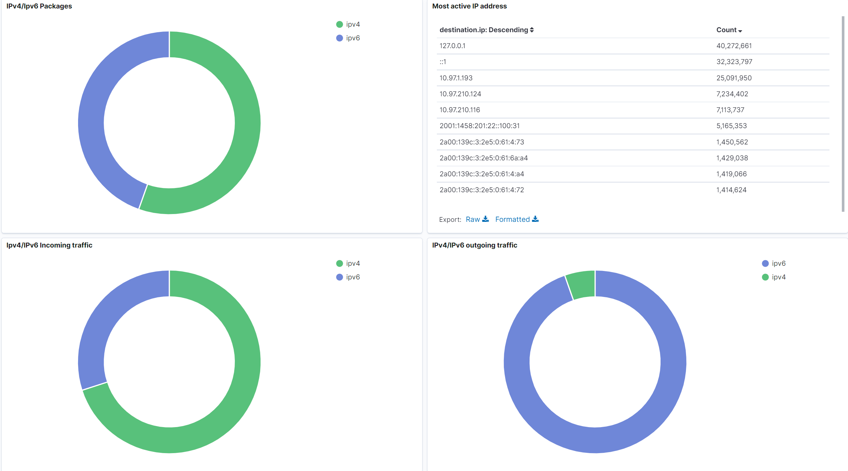
Snapshot at Sept. 2022

Slide 6
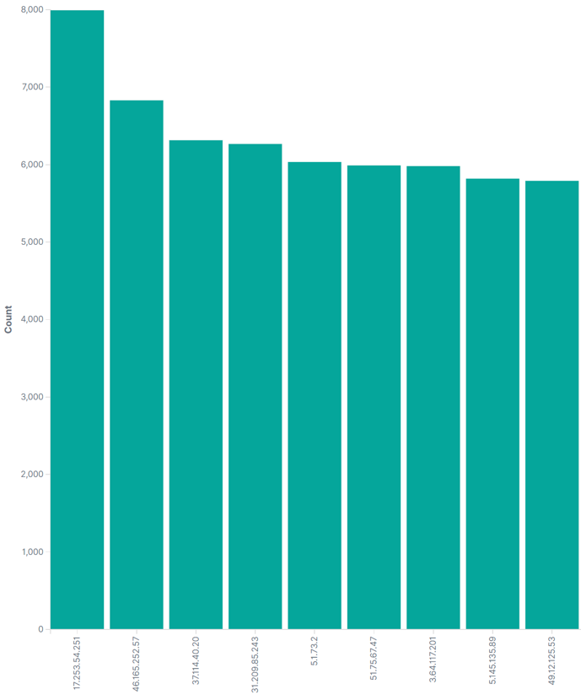
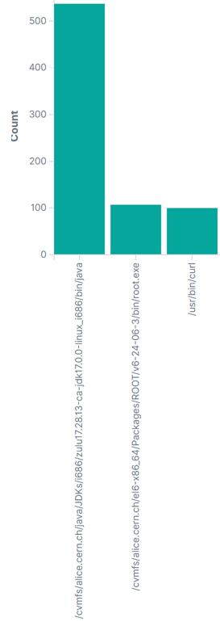
NTP ?
java
Many NTP / port 123 connections
  During 24 hours approx. 210.000
  NTP → IPv4 only (depending on dualstack enabling of rack-manager (40.000 internal))
  Monitoring was first pointing especially to certain subnets 10.1.12.0/24 and 10.1.18.0/24
  → futher investigation showed that much more racks running ntp check via private addr. (NAT)
  160.000 external communications → some of the destination server have quite dubious „names“
root
curl
process-tracking
  The numbers of NTP communication process and matched process is not matching yet
5.199.135.170
S O L V E D
pmg.jonasled.de.
ntp.creoline.net.
srv102.gosix.net.
radio-sunshine.org.
47.ip-51-75-67.eu.
telesto.hot-chilli.net.
defra1-ntp-004.aaplimg.com.
ve1124.venus.
servdiscount-customer.com.
ec2-3-64-117-201.eu-central-1.
compute.amazonaws.com.
NTP.ORG
  → returns sometimes funny addresses

Slide 7
dCache upgrade to 7.2.15
Upgrade from dCache version 6.2.34 to 7.2.15
  Two day downtime at June 20th and 21st 2022
HTTP-TPC transfers now prefer IPv6 address,
if both endpoints support it.
fixed handling of Storage Resource Reporting (SRR)
requests over IPv6
Handle IPv6 address when running HTTP(s)
Third Party Copy (TPC) with gridsite delegation
Storage Resource Manager (SRM) : Fix IPV6 logging for SRM

Slide 8
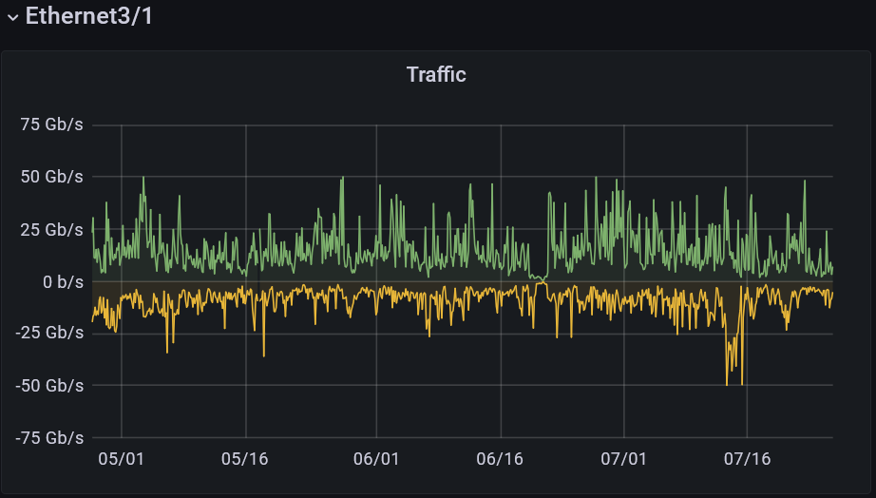
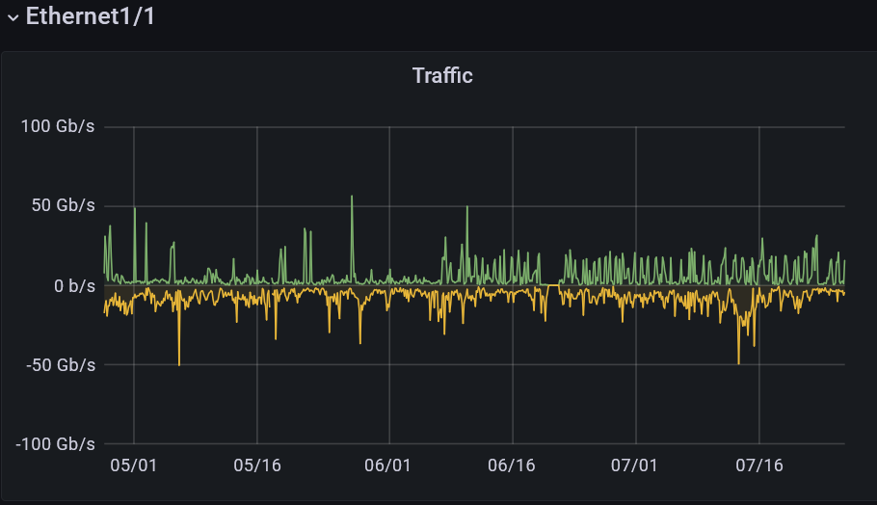
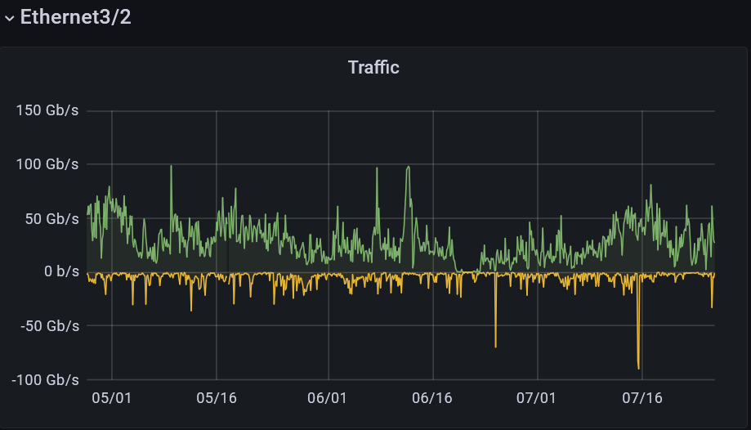
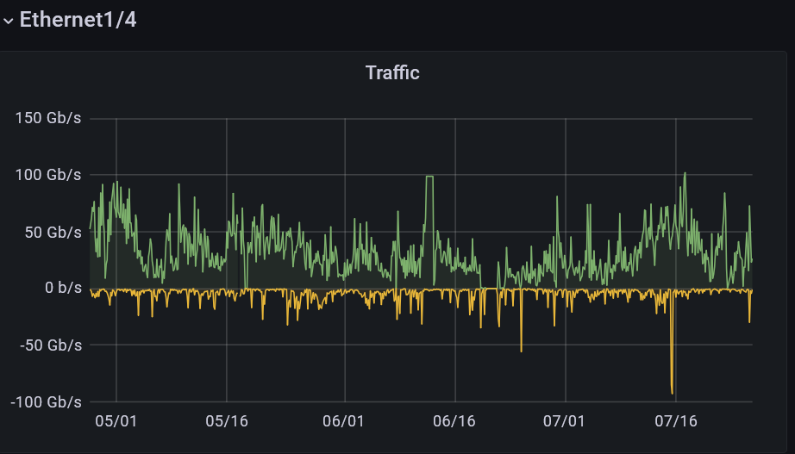
WAN Interfaces
D o w n t i m e
r-ig-I
L H C O N E
r-ig-II
r-ig-I (DE-KIT Border Router):
left two Interfaces
Ethernet 3/1 (Internet + LHCONE) +
Ethernet 3/2 (LHCOPN)
L H C O P N
r-ig-II (DE-KIT second Border Router):
right two Interfaces
Ethernet 1/1 (Internet + LHCONE) +
Ethernet 1/4 (LHCOPN)

Slide 9
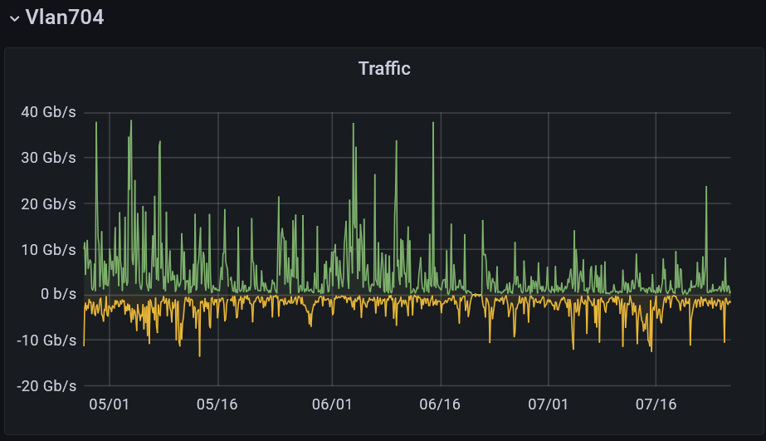
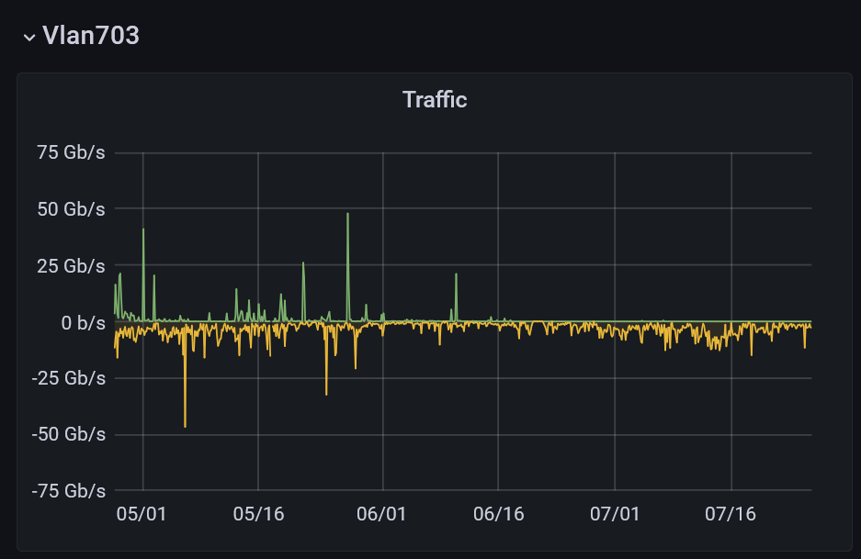
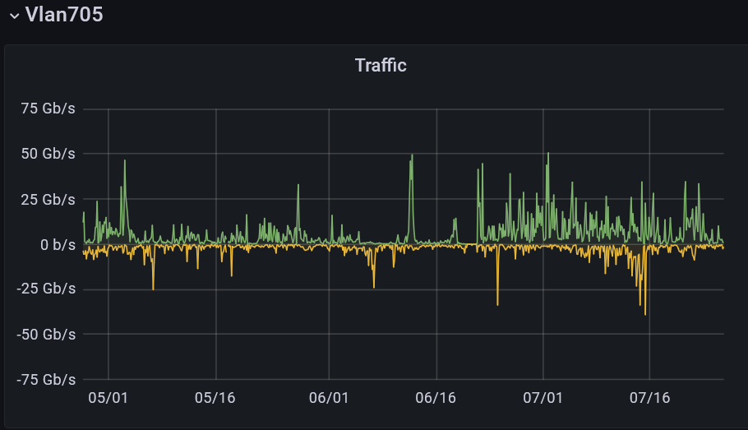
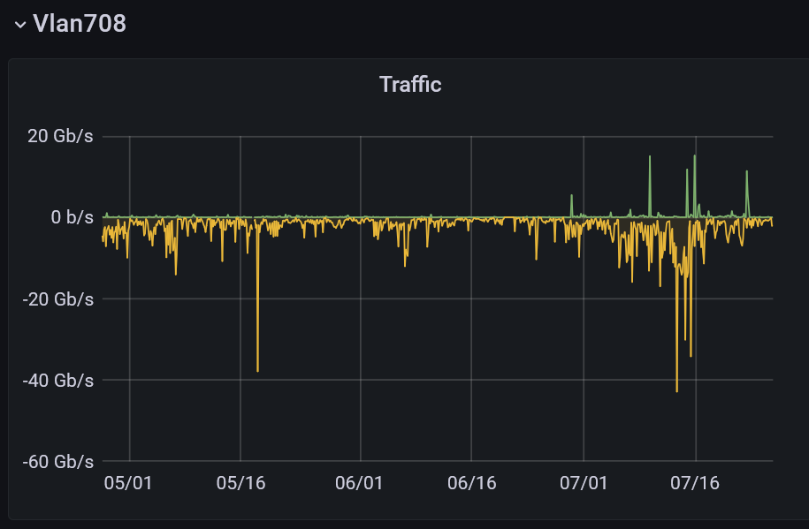
LHCONE IPv4 / IPv6
transfer pattern after downtime
D o w n t i m e
r-ig-I
r-ig-II
Graph over 90 days
Traffic of LHCONE
moved partioly from the IPv4 vlans
after the downtime to the IPv6 Vlans

Slide 10
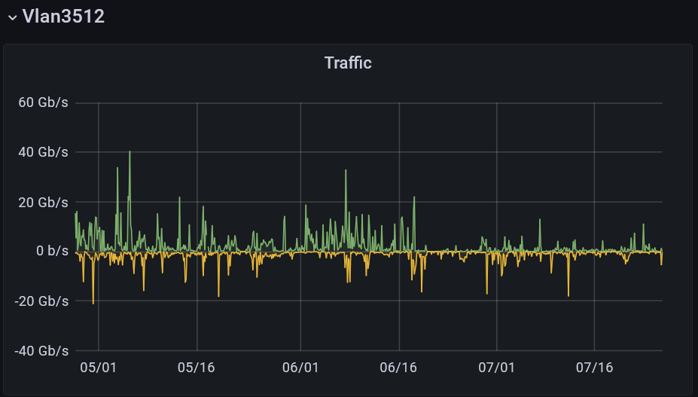
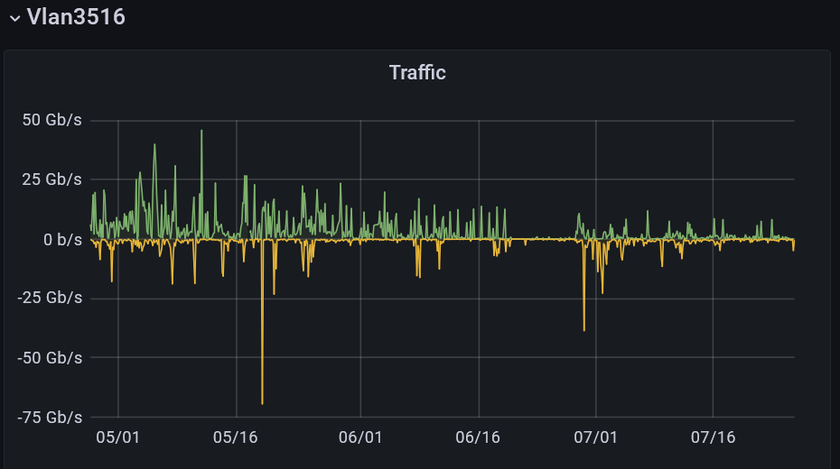
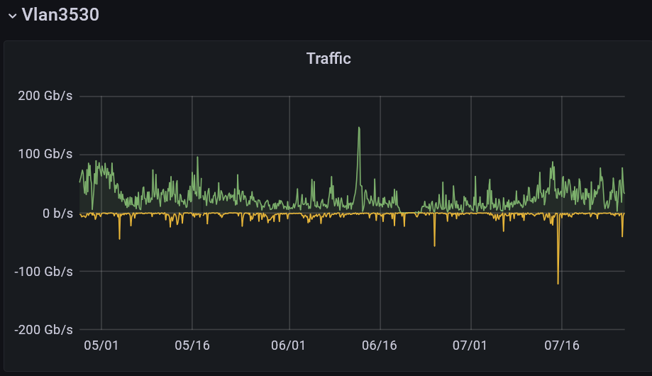
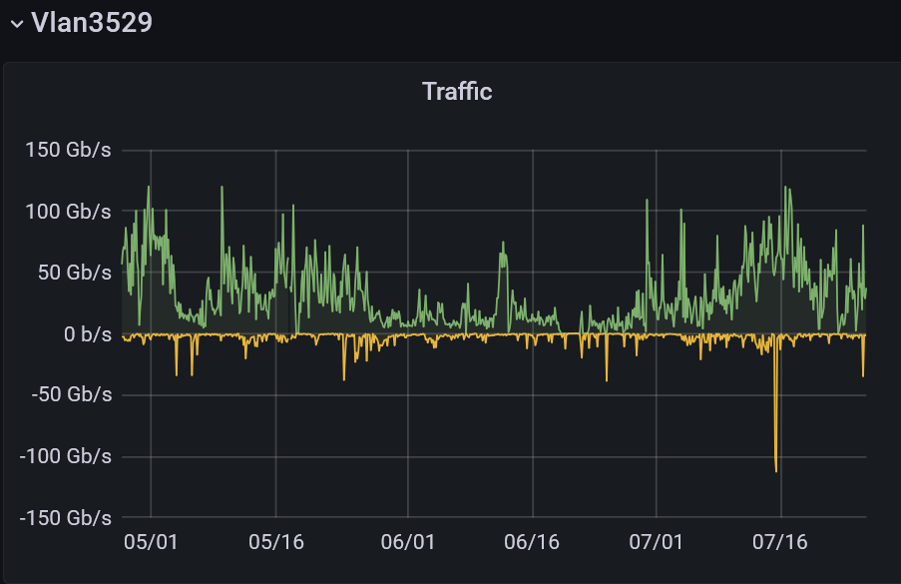
LHCOPN IPv4 / IPv6
transfer pattern after downtime
D o w n t i m e
r-ig-I
r-ig-II
IPv4
IPv4
Graph over 90 days
Traffic of LHCOPN
moved from the IPv4 vlans
after the downtime to the IPv6 Vlans
IPv6
IPv6

Slide 11
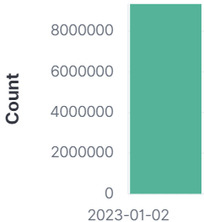

Closer look at DNS
9.412.871
GridKa DNS( Port 53):
  IPv4 only count : 9,412,871 (24 hours)
  DNS (Bind) Server and WN is already dual-stack
  at WN resolve.conf first lines IPv4
    Make sure IPv6 DNS server addresses listed and
    place it before IPv4
IPv4
every new deployed host:
the first lines are IPv6 resolver addresses of the resolve.conf file followed by the IPv4 addresses
  nameserver 2a00:139c:address
  nameserver 2a00:139c:address
  nameserver 10.privat-address
  nameserver 10.privat-address
124.425
IPv6
→ Resolve.conf update: reprovisioning required
53

Slide 12
Details of Squid
SQUIDS (Proxyserver and Web-Cache):
  some SQUIDS still IPv4 only (migration to dualstack in proccess)
  Significant part of connections via public IPv4
  => to check: if CVMFS can prefer IPv6?
  (CVMFS → CernVM-File-System)
    CVMFS sending via http request to squid
    CVMFS has DN configuriert that needs to be resolved
    → default chooses IPv4 address
    Solution => cvmfs_ipfamily_prefer=6 → not tested yet

Slide 13
SQUIDS migrated all to dual-stack
  During the second half of 2022 all SQUIDS migrated to dual-stack deployment
  CVMFS now
  - manly IPv6 but:
    - on WorkerNodes uses IPv6 (with deployed flag: CVMFS_IPFAMILY_PREFER=6 )
    - CVMFS frontier uses still IPv4 even while both systems dual-stack
- but switching of IPv4 → froniters will operate over IPv6
    - statistic:
              July : IPv4 : 1,25 mio. IPv6: 9,6 mio. (tcp port 3128, 3401)
        October : IPv4 : 4,44 mio. IPv6: 18 mio. (tcp port 3128, 3401)
        December : IPv4 : 1,47 mio. IPv6 : 2,29 mio. (tcp port 3128, 3401)

Slide 14
Batch-Processing -- LRMS
(HT-Condor) all dual-stack
  LRMS (Local Resource Management System)
  HTCondor at GridKa (all dual-stack and set to prefer the protocoll IPv6 (Port 9618/9)
      4080 – HTCondor (rooster-deamon) → migrated all towards IPv6 (HTCondor → startd)
    Ratio increased toward IPv6 at 20220628→ IPv4: 895k to IPv6: 255k
    Ratio today 20220728 → IPv4: 27k, IPv6: 2,17 mio. (per 24 hour)
    Ratio today 20221023 → IPv4: 10k, IPv6: 3,38 mio. (per 24 hour)
    Ratio today 20230102 → IPv4: 287k, IPv6: 2,28 mio. (per 24 hour)
  Less then 20% of IPv4 is internal traffic
  (communication with home → the LRMS demons uses protocol of Home-Institution)

Slide 15
Logstash → is now IPv6
Logstash → dual-stack deployed
Ratio 20220728 → IPv4 385k – IPv6 1,41M
Ratio 20221023 → IPv4 476k – IPv6 1,39M
Ratio today 20221223 → IPv4 227k – IPv6 450k
migration still in progress

Slide 16
administatrative Services
  at each rack is a Rack Manager deployed:
    Starting in 2001 with private IPv4 only
    Migration process initiated (but still in progress)
    → enable dual-stack (AAAA)
      NTP
      rsyslog (→ migration → still pending (port 514))
      Monitoring (GmonD → Ganglia Client)
      DHCP (→ migration to DHCPv6 pending)

Slide 17
WN – deployment process
Redhat Satellite Server (foreman)
  Used for management of most GridKa hosts:
    Manages redhat Subscriptions
    Controlls kickstart installations (DHCP / PXE)
    Provides yum repos
    Provides CA (certificate authority) and ENC (encryptor) functionalities for puppet
  Uses modular architecture. Additional functionalities can be added via so called capsules
    TFTP server (IPv6 ready - dual-stack)
    Puppetmaster (IPv6 ready - dual-stack)
    Pulp (software repository management (IPv6 ready - dual-stack))
    DNS (IPv6 ready - dual-stack)
    DHCP (currently DHCPv6 capsule not available)

Slide 18
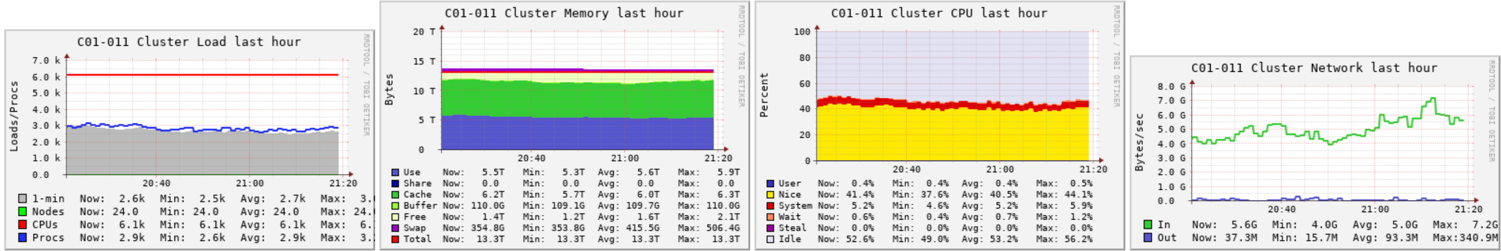
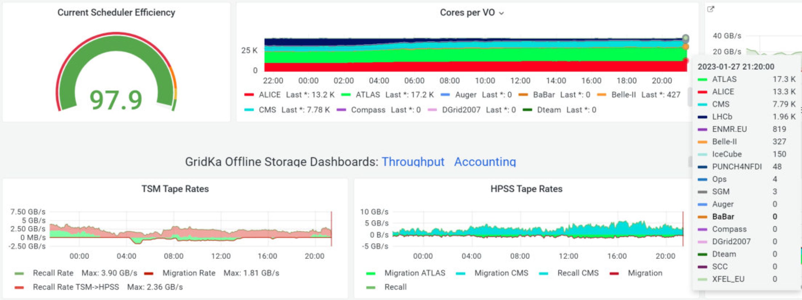
Monitoring
G A N G L I A
- Migration of Ganglia to IPv6 will not persuit
- Ganglia will be replaced by opensearch, kibana and grafana

Slide 19
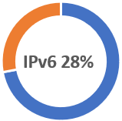
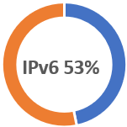
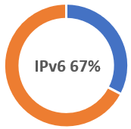
A view statistics
20221220:
  IPv4: → 42 Mio
  IPv6: → 86 Mio
20220415:
  IPv4: → 80 Mio
  IPv6: → 31 Mio
20220726:
  Ipv4 → 44 Mio
  Ipv6 → 50 Mio
20221023:
  IPv4 → 69 Mio
  IPv6 → 142 Mio
IPv6 67%
(packets in 24 hours)
# of WorkerNodes included in the statistic expanded

Slide 20
Details of Alice VOBoxes:
ALICE VOBoxes:
  Client to VOBox prefers IPv4 (ALICE Monitoring (UDP))
  => to check the possibility of IPv6 migration with ALICE (still ongoing)
    dual-stack enabling works and
    if Preference towards IPv6 is possible
    ALICE is constrained by IPv6 unavailability on other sites
  → advice of Alice : switch of IPv4 at VO-BOX (the none monitoring VO-BOX)
    Timing still under discussion
  Monitoring (port 8884 / IPv4 only) → 11 Mio. (/24 hours)
XRootD:
  via public IPv4 (ALICE)
  All ALICE XRootD SE are dual-stack deployed
  older version of XRootD → upgrade to current XRootD should improve, is still pending
  → advice of Alice : get IPv6 ready – but wait for switching it on till complete Alice is IPv6 ready
Dest port 1094 –Ipv4/ipv6 → XRootD (alice, belle2, atlas, cms)

Slide 21


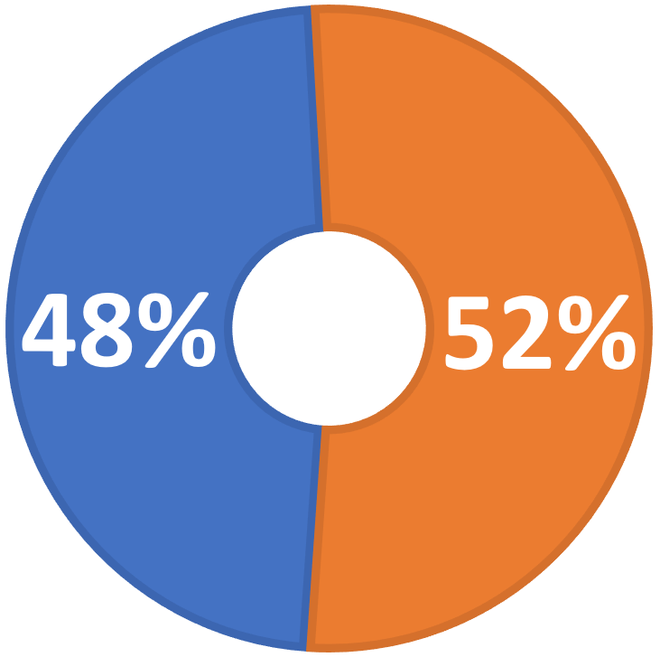
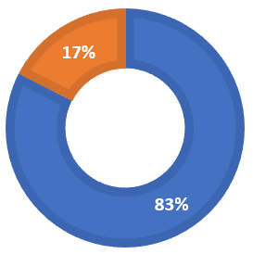
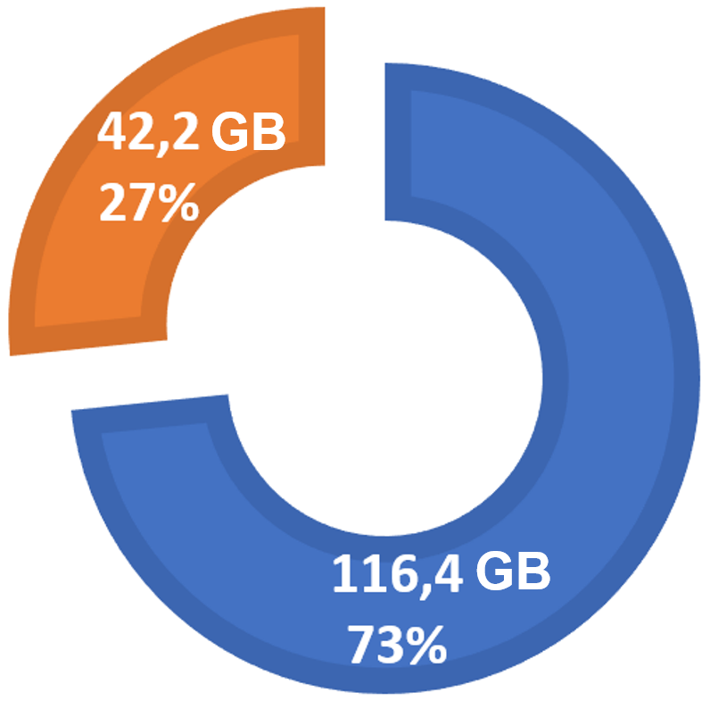
Japan KEK Belle-2
Sites with Dual Stack Storage: 34%
Sites with Dual Stack WN: 13%
Sites within LHCONE: 48%
Sites at General IP: 52%
Snapshot of 2022 Sept. – external FileServer throughput (7 days)
detector DB status data (non-/operational) → Ipv4 only
Snapshot (24 hours) End of Jan. 2023

Slide 22
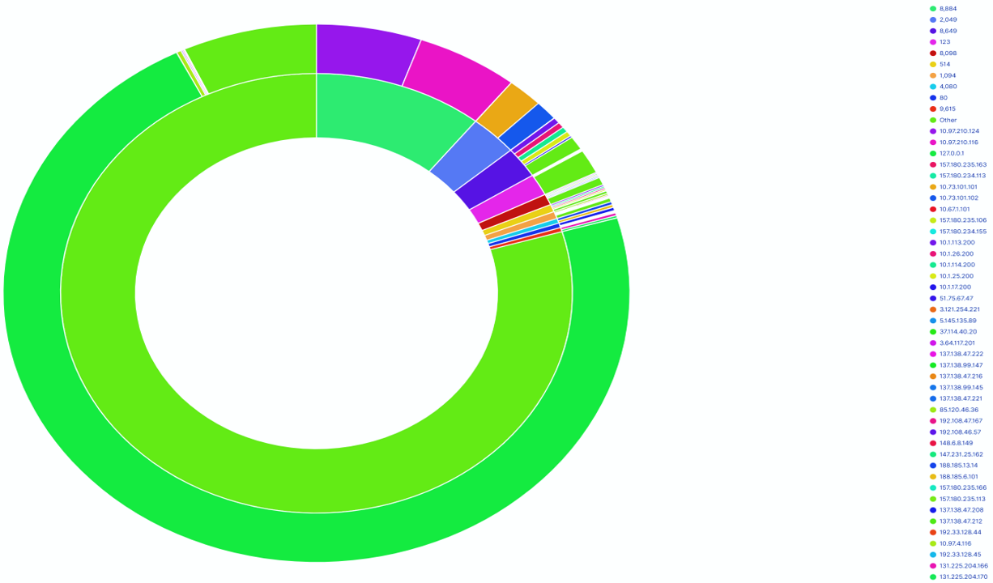
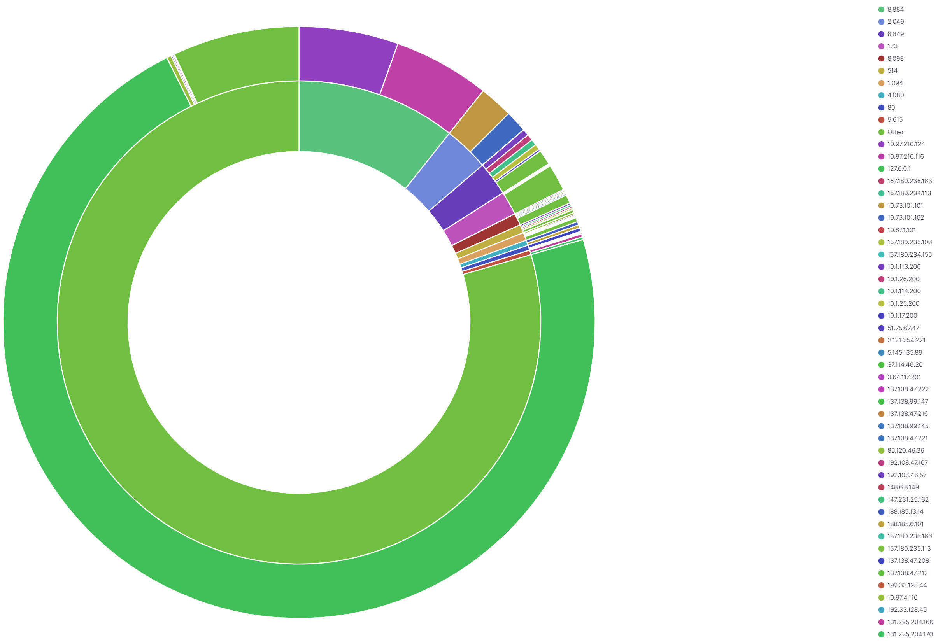
Next steps
Ports
migration of Rackmanager – work in progress
Narrow down the still IPv4 communication
IPv4
Adresses
  packet monitoring configured
    to list all unhandled IPv4 packets
      4080 – Condor rooster Monitor deamon → solved
      8884 – Alice: operation report
      2049 – NFS
      8649 – Ganglia gmond
      1094 – XrootD
      961[89] – LRMS (20% only internal to WN-Farm)
  PXE – Boot + DHCPv6 (first boot addr. Distribution)
Identify the next service for IPv6 migration tasks

Slide 23
Thx for your attention

Slide 24
Statistic → 20.02.23
IPv4 43,7 Mio. – IPv6 80 Mio. Packets
Port 53 (DNS) → IPv4: 7,8Mio – IPv6: 143k
→ Port 53 (DNS) → IPv4: 7,8Mio – IPv6: 95k
    resolv.conf order ?
CVMFS (port 3128, 3401) IPv4: 1,73Mio. -- IPv6: 2,16 Mio.
→ today: CVMFS (port 3128, 3401) IPv4: 4,367Mio. -- IPv6: 2,123 Mio.
LRMS (port 9618) IPv4: 427k -- IPv6: 1.18 Mio.
→ today: LRMS (port 9618) IPv4: 212k -- IPv6: 1.712 Mio.
XrootD (port 1094) IPv4: 376k -- IPv6: 905k
→ today: XrootD (port 1094) IPv4: 550k -- IPv6: 2,7M
Das sieht alles nicht aus als würde es sich Richtung IPv6 bewegen, oder?
logstash-01-e.gridka.de (5047)
→ IPv4: 137k IPv6: 500k

