Slide 1
SPS YETS22-23:
Controls Activities
Vacuum Seminar, 04th April 2023
A. Gutiérrez, TE-VSC-ICM

Slide 2
Outline:
SPS complex in the CERN accelerator complex
YETS22-23 Scope:
  Consolidation projects
  Layout modifications
  Mitigation of control system weaknesses
  De-cabling & cabling campaigns
  Commissioning and methodology
Problems
Where we are now?
Out of the SPS ring
Abel Gutiérrez – VSC seminar – April 2023

Slide 3
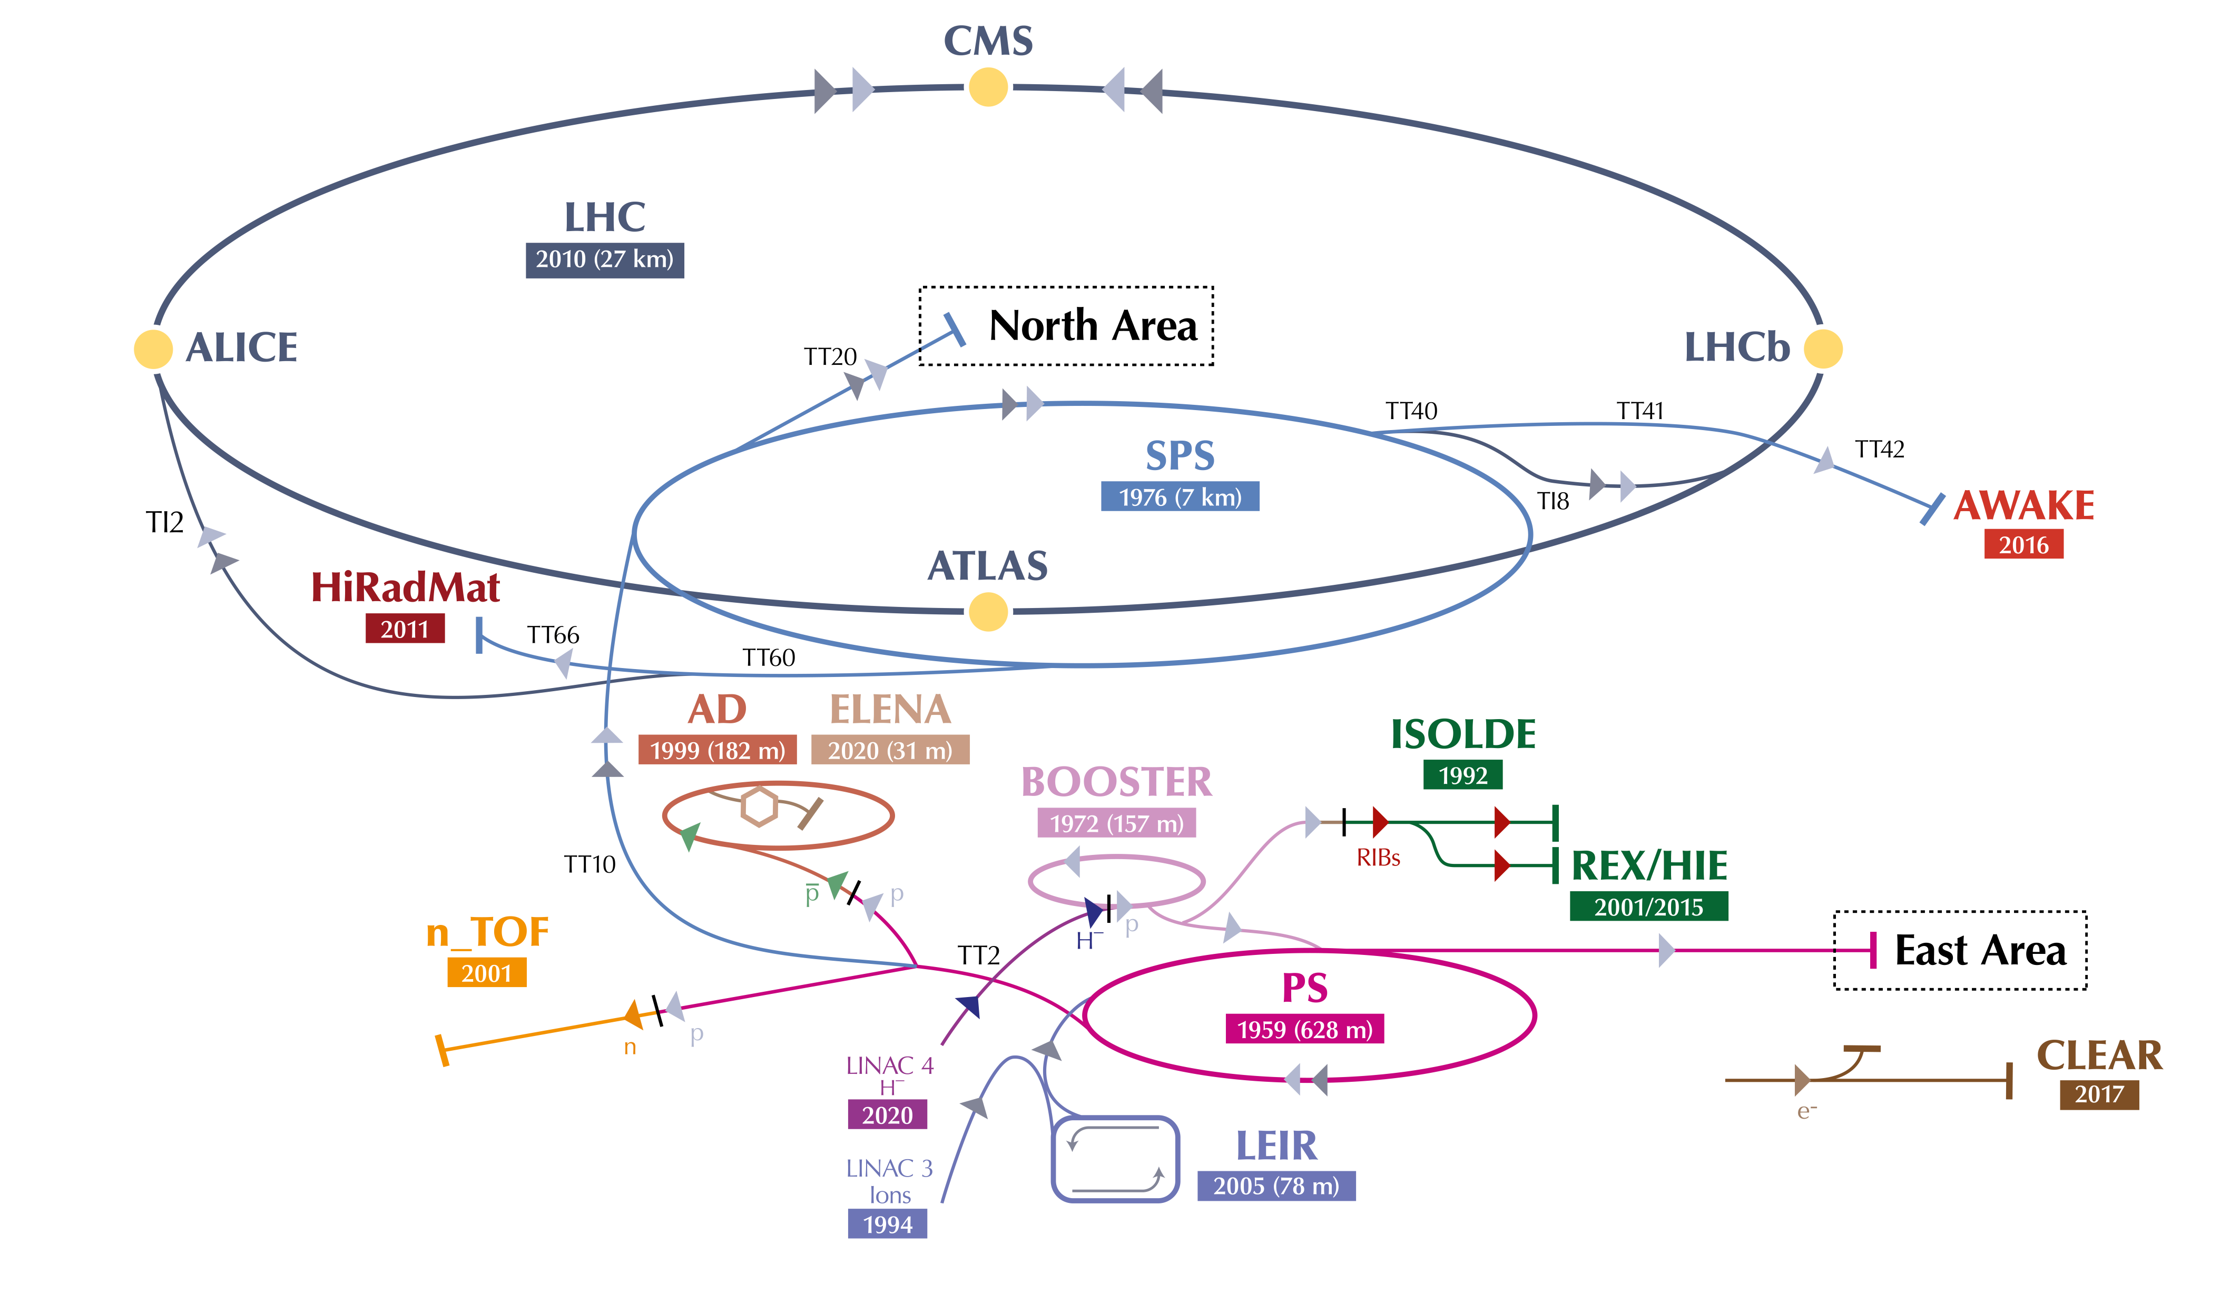
SPS complex in the CERN accelerator complex
North Area
AWAKE
Vacuum instrumentation in SPS
P [mb] | -9
Pirani | 141
Penning | 157
Full Range | 12
Ion Pumps | 1518
Sector Valves | 117
Fast Valves | 10
Abel Gutiérrez – VSC seminar – April 2023

Slide 4
Consolidation campaigns: Ion pump controllers
Why?
To replace the existing old ion pump controllers (+30 years of operation)
By what?
New Agilent controllers (better performance and diagnostic, new features…)
How?
Coupling it with the consolidation of the ion pumps and layout modifications
LS2:
LSS2, LSS3, LSS5, Arc 5+
YETS21-22:
LSS4, Arc 4-
YETS22-23:
LSS6, Arc 6+
YETS23-24:
LSS1, Arc 1-
EYETS24-25:
Arcs 3- & 3+
LS3:
6 remaining arcs
Abel Gutiérrez – VSC seminar – April 2023

Slide 5
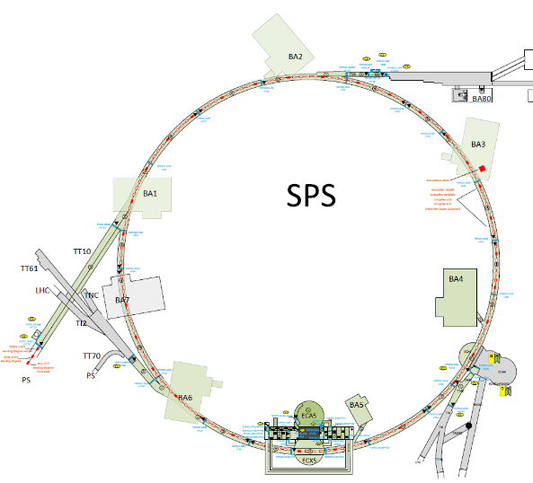
Consolidation campaigns: Ion pump controllers
 | Old | Agilent | Total
BA1 | 183 | 20 | 203
BA2 | 156 | 51 | 207
BA3 | 161 | 45 | 206
BA4 | 81 | 118 | 199
BA5 | 73 | 123 | 196
BA6 | 73 | 126 | 199
Total | 727 | 483 | 1210
LSS2
LSS3
~40% of the total!
Ion pumps in SPS; per point (2023)
 | Old | Agilent | Total
BA1 | 104 | 9 | 113
BA2 | 79 | 28 | 107
BA3 | 84 | 25 | 109
BA4 | 40 | 48 | 88
BA5 | 40 | 42 | 82
BA6 | 38 | 46 | 84
Total | 385 | 198 | 583
Arc4-
Arc6+
LSS4
LSS6
~34% but 1x Agilent = 2x Old
Arc5+
LSS5
Ion pump controllers in SPS; per point (2023)
SPS ring: consolidated ion pumps controllers
LSS done
Arc done
Abel Gutiérrez – VSC seminar – April 2023

Slide 6
Consolidation campaigns: Ion pump controllers
Purchase
Controllers
Crates
Cables
Connectors
Profibus
Test
Controllers
Crates
Local Cables
Installation
Controllers
Crates
Local Cables
Profibus
Fabrication
Crates
Local Cables
Hardware
Analysis
What?
Where?
When?
Who?
Design
Rack layout
Interlocks
Alarms
Profibus
Commissioning
Insulation tests
Communication tests
Open cable tests
Measurement tests
Interlock tests
Software
Database
New ctrl types
PLC
HW config
Validation
SCADA test
Deployment
SCADA & PLC
Process of ion pump controller consolidation
Abel Gutiérrez – VSC seminar – April 2023

Slide 7
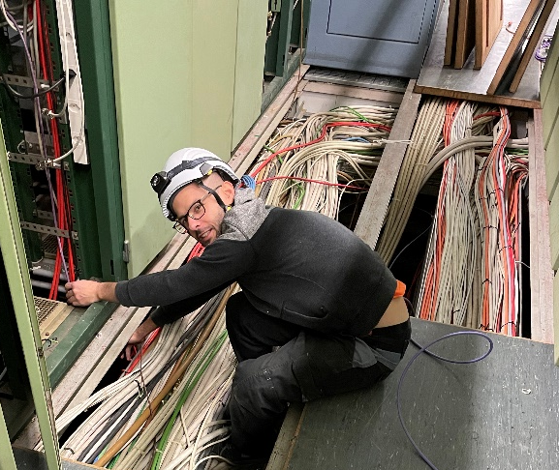
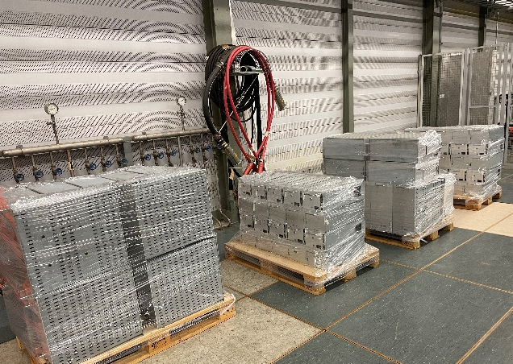
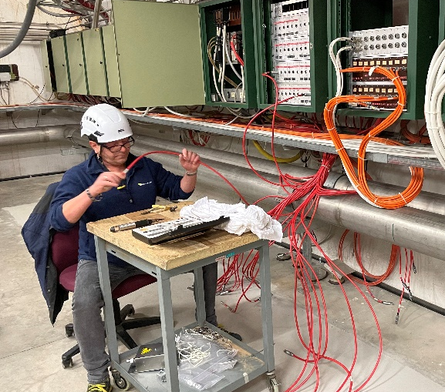
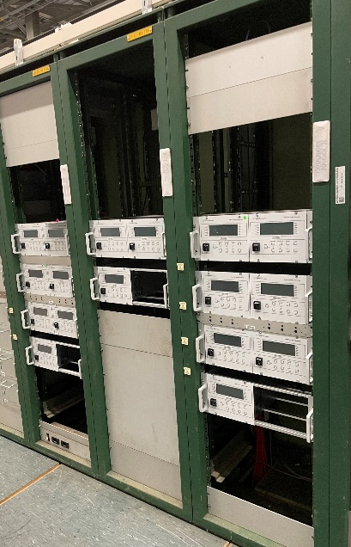
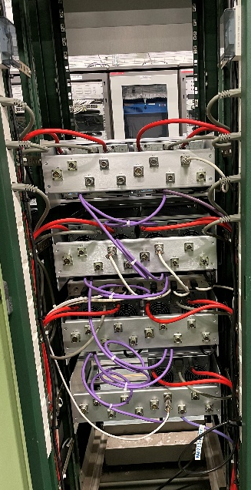
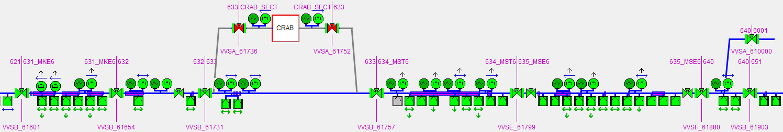
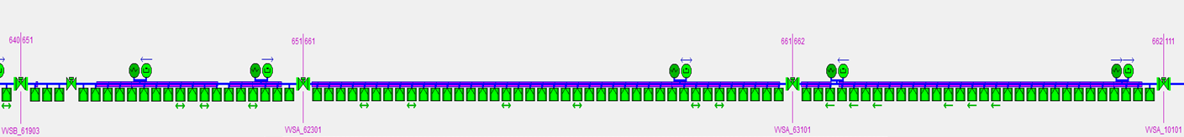
Consolidation campaigns: Ion pump controllers
Old controller removal
New controller installation
Profibus network installation
Wiring convention modification
Old controllers removed | New controllers installed | Pumps consolidated | Connectors modified
71 | 46 | 126 | 282
Summary of ion pumps consolidated in BA6 (YETS22-23)
LSS6
Arc 6+
All VPI controllers in LSS6 & Arc 6+ consolidated to Agilent
Abel Gutiérrez – VSC seminar – April 2023
Notes:
So here you can see some pictures of the consolidation campaign in point 6 during this last YETS, for example with the removal of the obsolete controllers and the installation of the ones, as well as the installation of the new Profibus network and the wiring convention modification of the ion pump cables. And to have a graphical idea, you can see here how all the LSS and arc 6+ was consolidate to Agilent. About the numbers, 71 controllers were removed, 46 new controllers installed, 126 ion pumps consolidated to Agilent control and 282 connectors modified, and you may wonder, why do we have to modify the connectors?

Slide 8
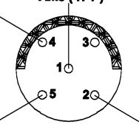
Consolidation campaigns: Ion pump controllers
But…why do we have to modify the wiring in the connectors? Because in SPS we are different!
Internal & External
Shielding
HV
HV
HV
Internal
Shielding
Brown
Red
Red
Brown
Red
Internal & External
Shielding
External
Shielding
Brown
VRP04
(SPS convention)
VRP03
(SPS convention)
VPI003
(LHC convention)
HV conductor | 1 | Pump supply & Current measurement
Brown wire | 2
Red wire | 5 | Interlock loop
Internal shielding | 4
External shielding | 4
HV conductor | 1 | Pump supply & Current measurement
Internal shielding | 2
External shielding | 2
Brown wire | 4 | Interlock loop
Red wire | 5 | Interlock loop
HV conductor | 1 | Pump supply & Current measurement
External shielding | 5
Internal shielding | 3 | Noise mitigation
Brown wire | 2 | Interlock loop
Red wire | 4 | Interlock loop
Shielding used to lower the resistance and voltage drop in the interlock circuit (relay actuation)
Abel Gutiérrez – VSC seminar – April 2023

Slide 9
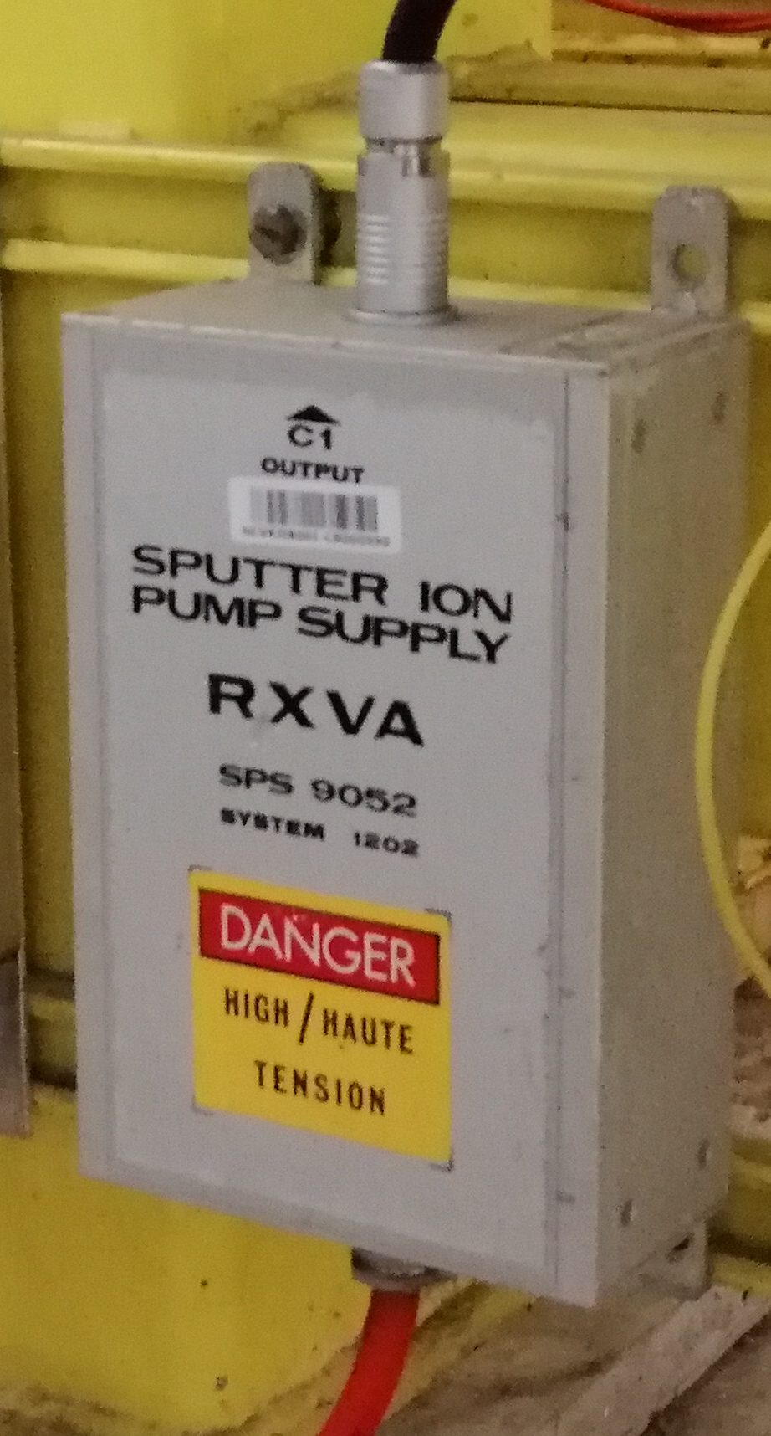
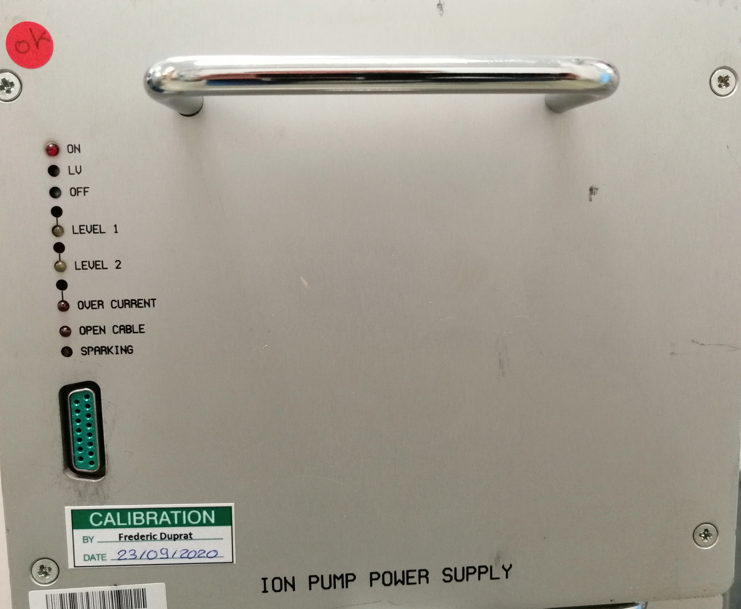
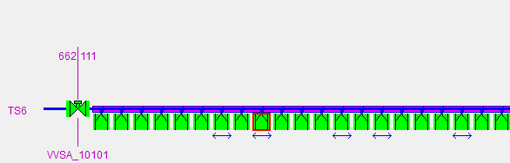
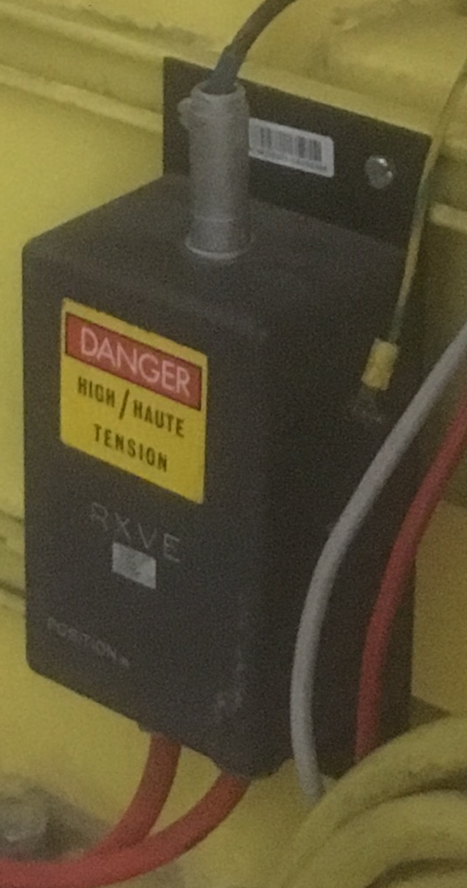
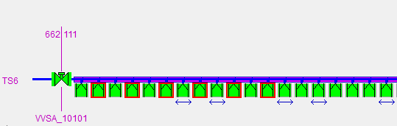
Consolidation campaigns: Ion pump controllers
Standard (old) SPS convention (1 single pump)
Convention:
VRP04
Convention:
VRP04
SPS type
Ion Pump
Controller
RXVA
E.g.: one single ion pump in SPS
Ion
Pump
Standard (old) SPS convention (chain of ion pumps)
Convention:
VRP04
Convention:
VRP04
Convention:
VRP03
Convention:
VRP03
Convention:
VRP03
Convention:
VRP03
SPS type
Ion Pump
Controller
RXVA
RXVE
RXVE
E.g.: chain of six ion pumps in SPS
Ion
Pump
Ion
Pump
Abel Gutiérrez – VSC seminar – April 2023

Slide 10
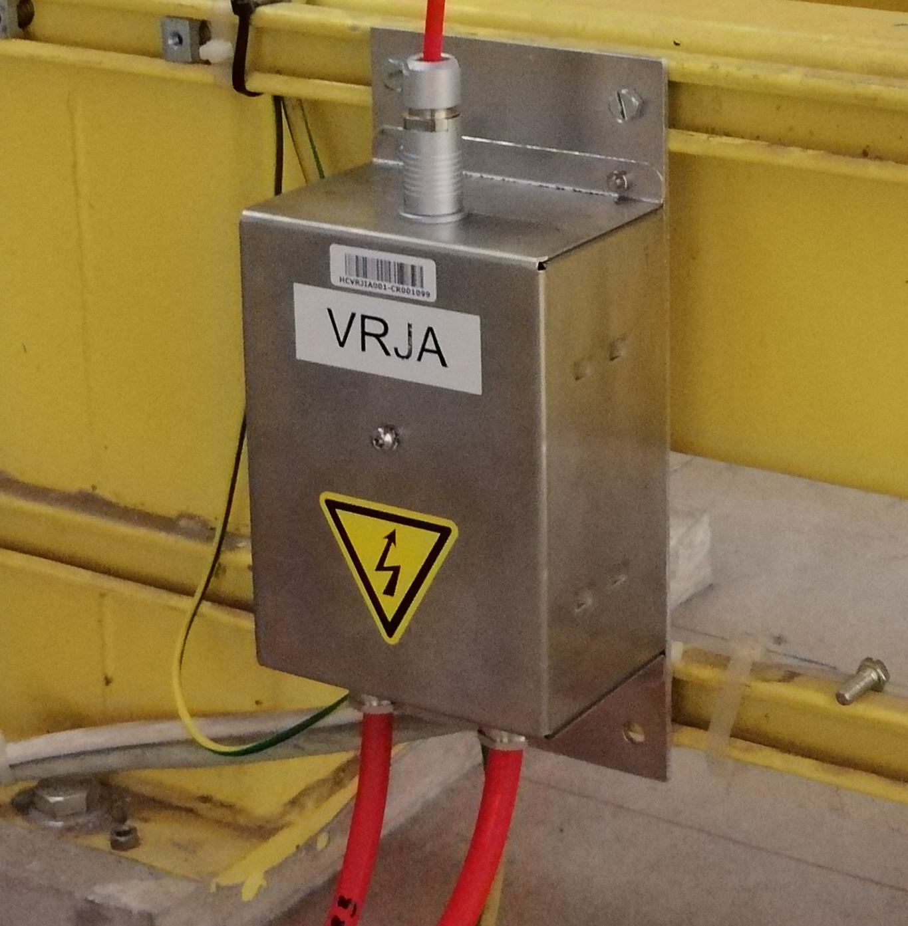



Consolidation campaigns: Ion pump controllers
Convention:
VRP04
Convention:
VRP04
Convention:
VRP03
Convention:
VRP03
Convention:
VRP03
Convention:
VRP03
SPS type
Ion Pump
Controller
RXVA
RXVE
RXVE
Ion
Pump
Ion
Pump
cPS/LHC type convention applied everywhere:
Same HW for all machines (local cables & local boxes)
Easier troubleshooting (unique convention)
Easier maintenance
Much more reliability
Time consuming implementation
More manpower
PROS
Convention:
VPI003
Convention:
VPI003
Convention:
VPI003
Convention:
VPI003
Agilent
Ion Pump
Controller
Local Box 1
Local Box
2
CONS
Ion
Pump
Ion
Pump
Abel Gutiérrez – VSC seminar – April 2023

Slide 11
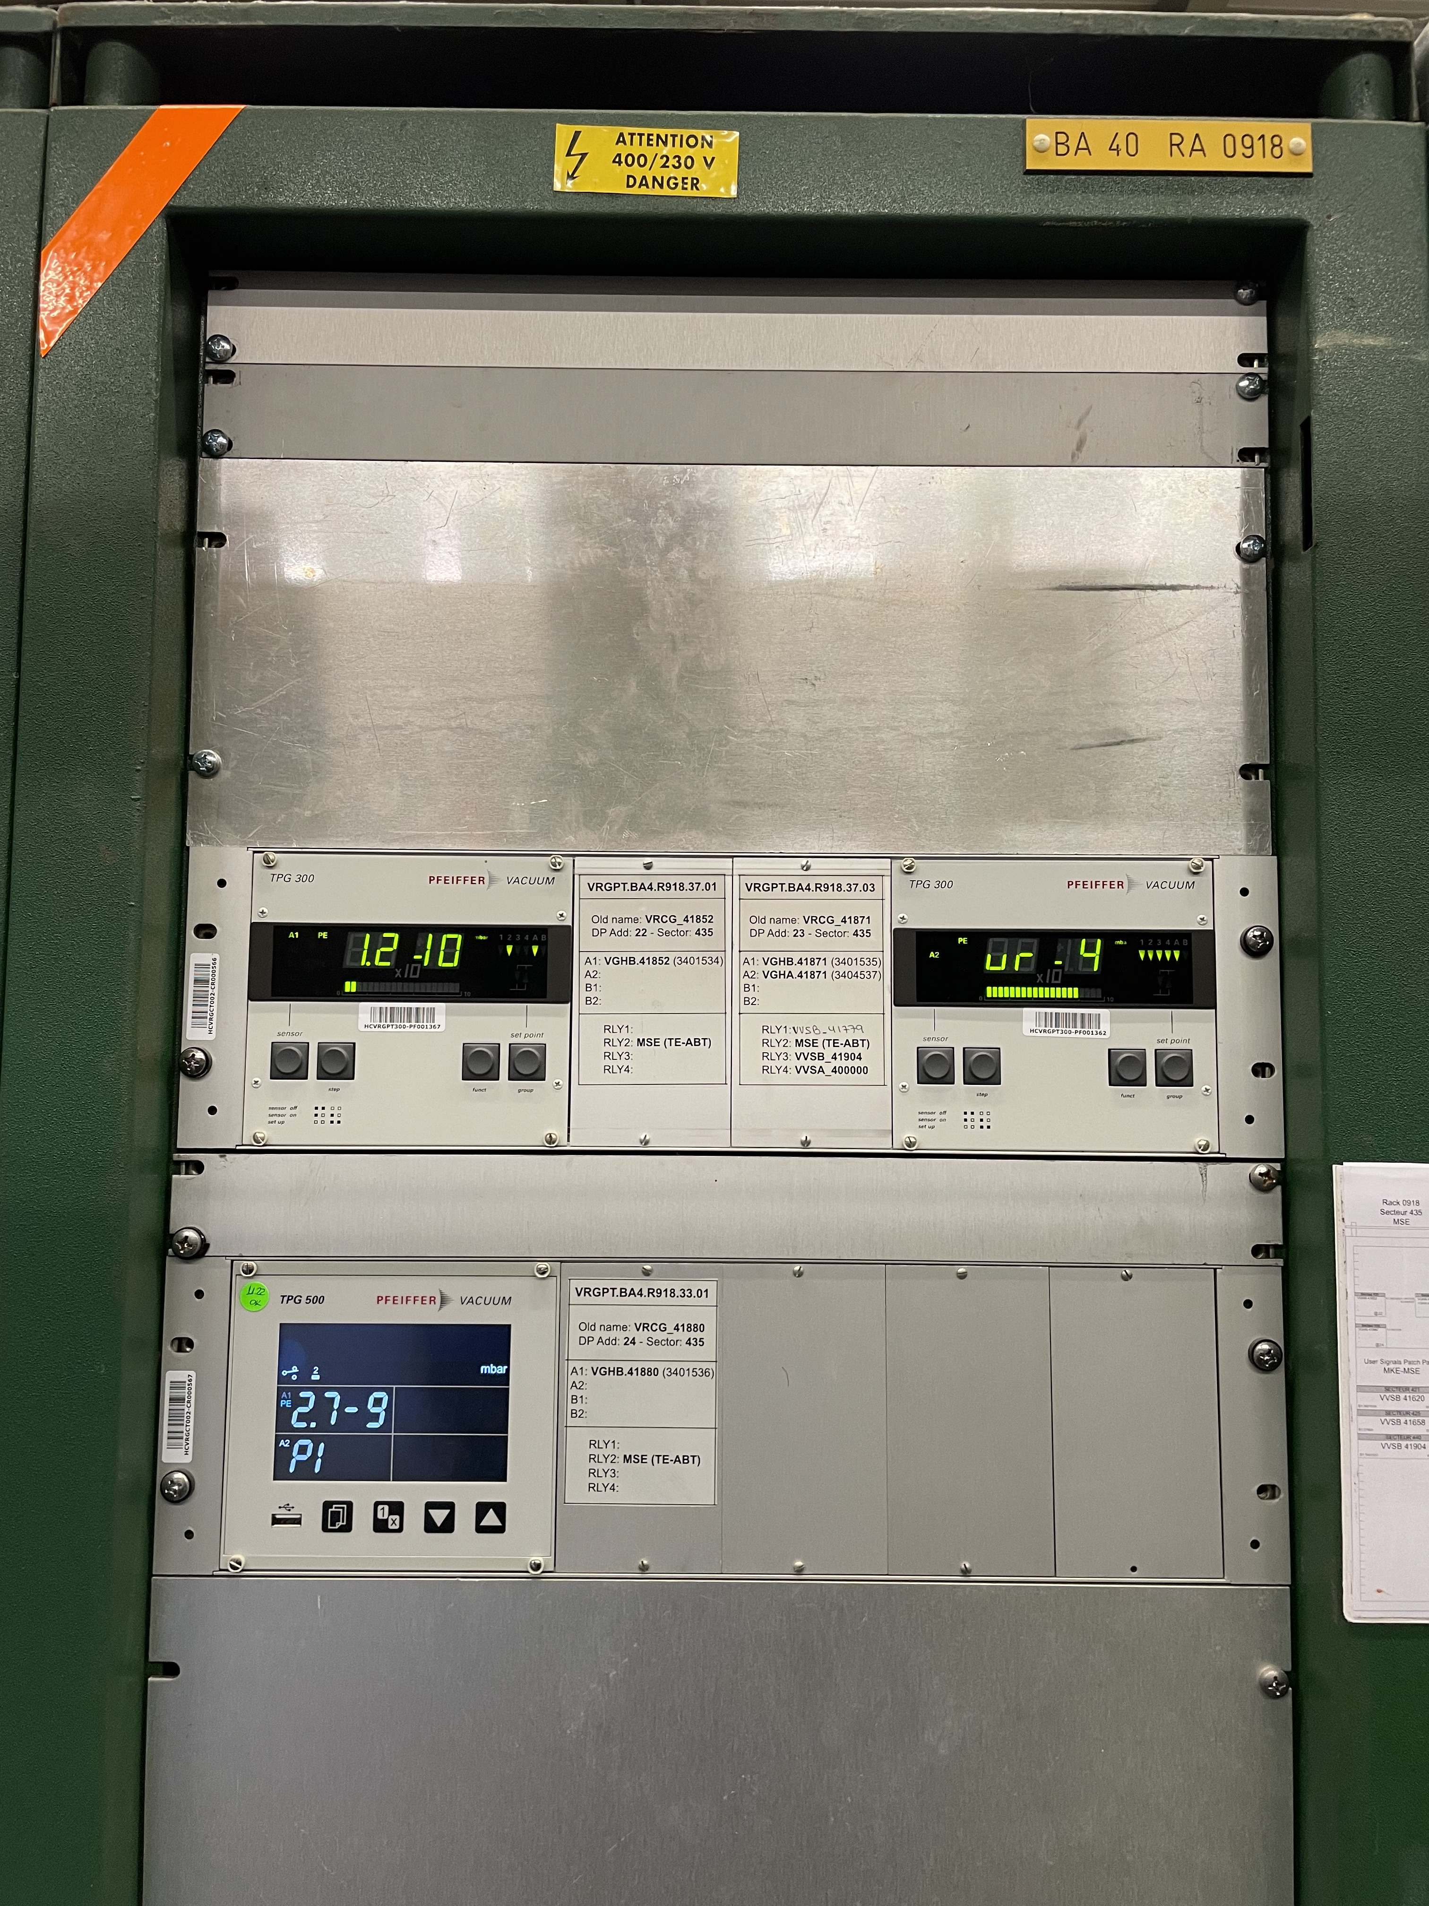
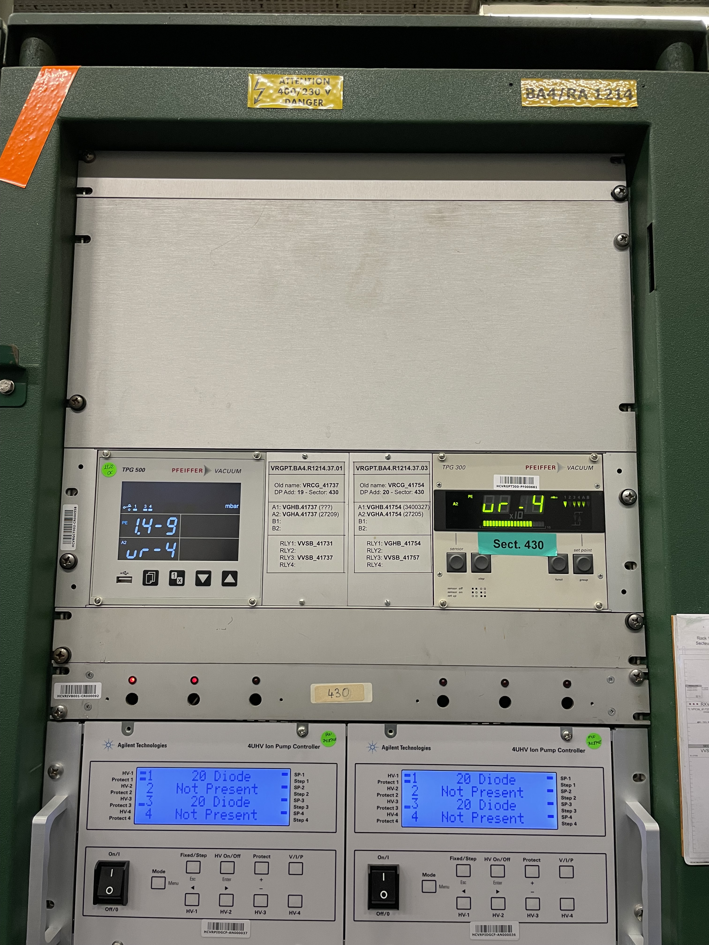
Consolidation campaigns: Passive gauge controllers
Consolidation of old TPG 300 controllers providing interlocks:
TPG 300 controllers with +30 years of operation still installed
Some of them providing interlocks and vacuum alarms
Susceptible to failure due to electrical glitches
12x new TPG 500 controllers replaced TPG 300 providing interlocks/alarms
Running to failure as replacement strategy can be an option (if no interlock)
Smooth transition to TPG 500
PROBLEMS
SOLUTION
TPG500 controllers in BA4 (MSE4 & sector 430)
Abel Gutiérrez – VSC seminar – April 2023

Slide 12
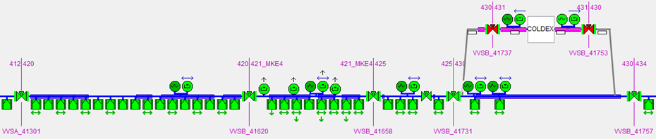
Layout modifications
Sector valves relocation of MKE4 sector:
VPIA_41620 & VVSB_41620 switching positions
No need of pulling new cables due to proximity of the affected equipment
Database, SCADA & PLC update, equipment reconnection, and test
MKE4 sector valve relocation
Abel Gutiérrez – VSC seminar – April 2023

Slide 13
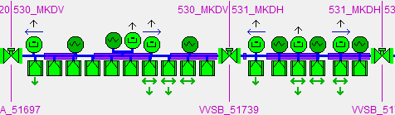
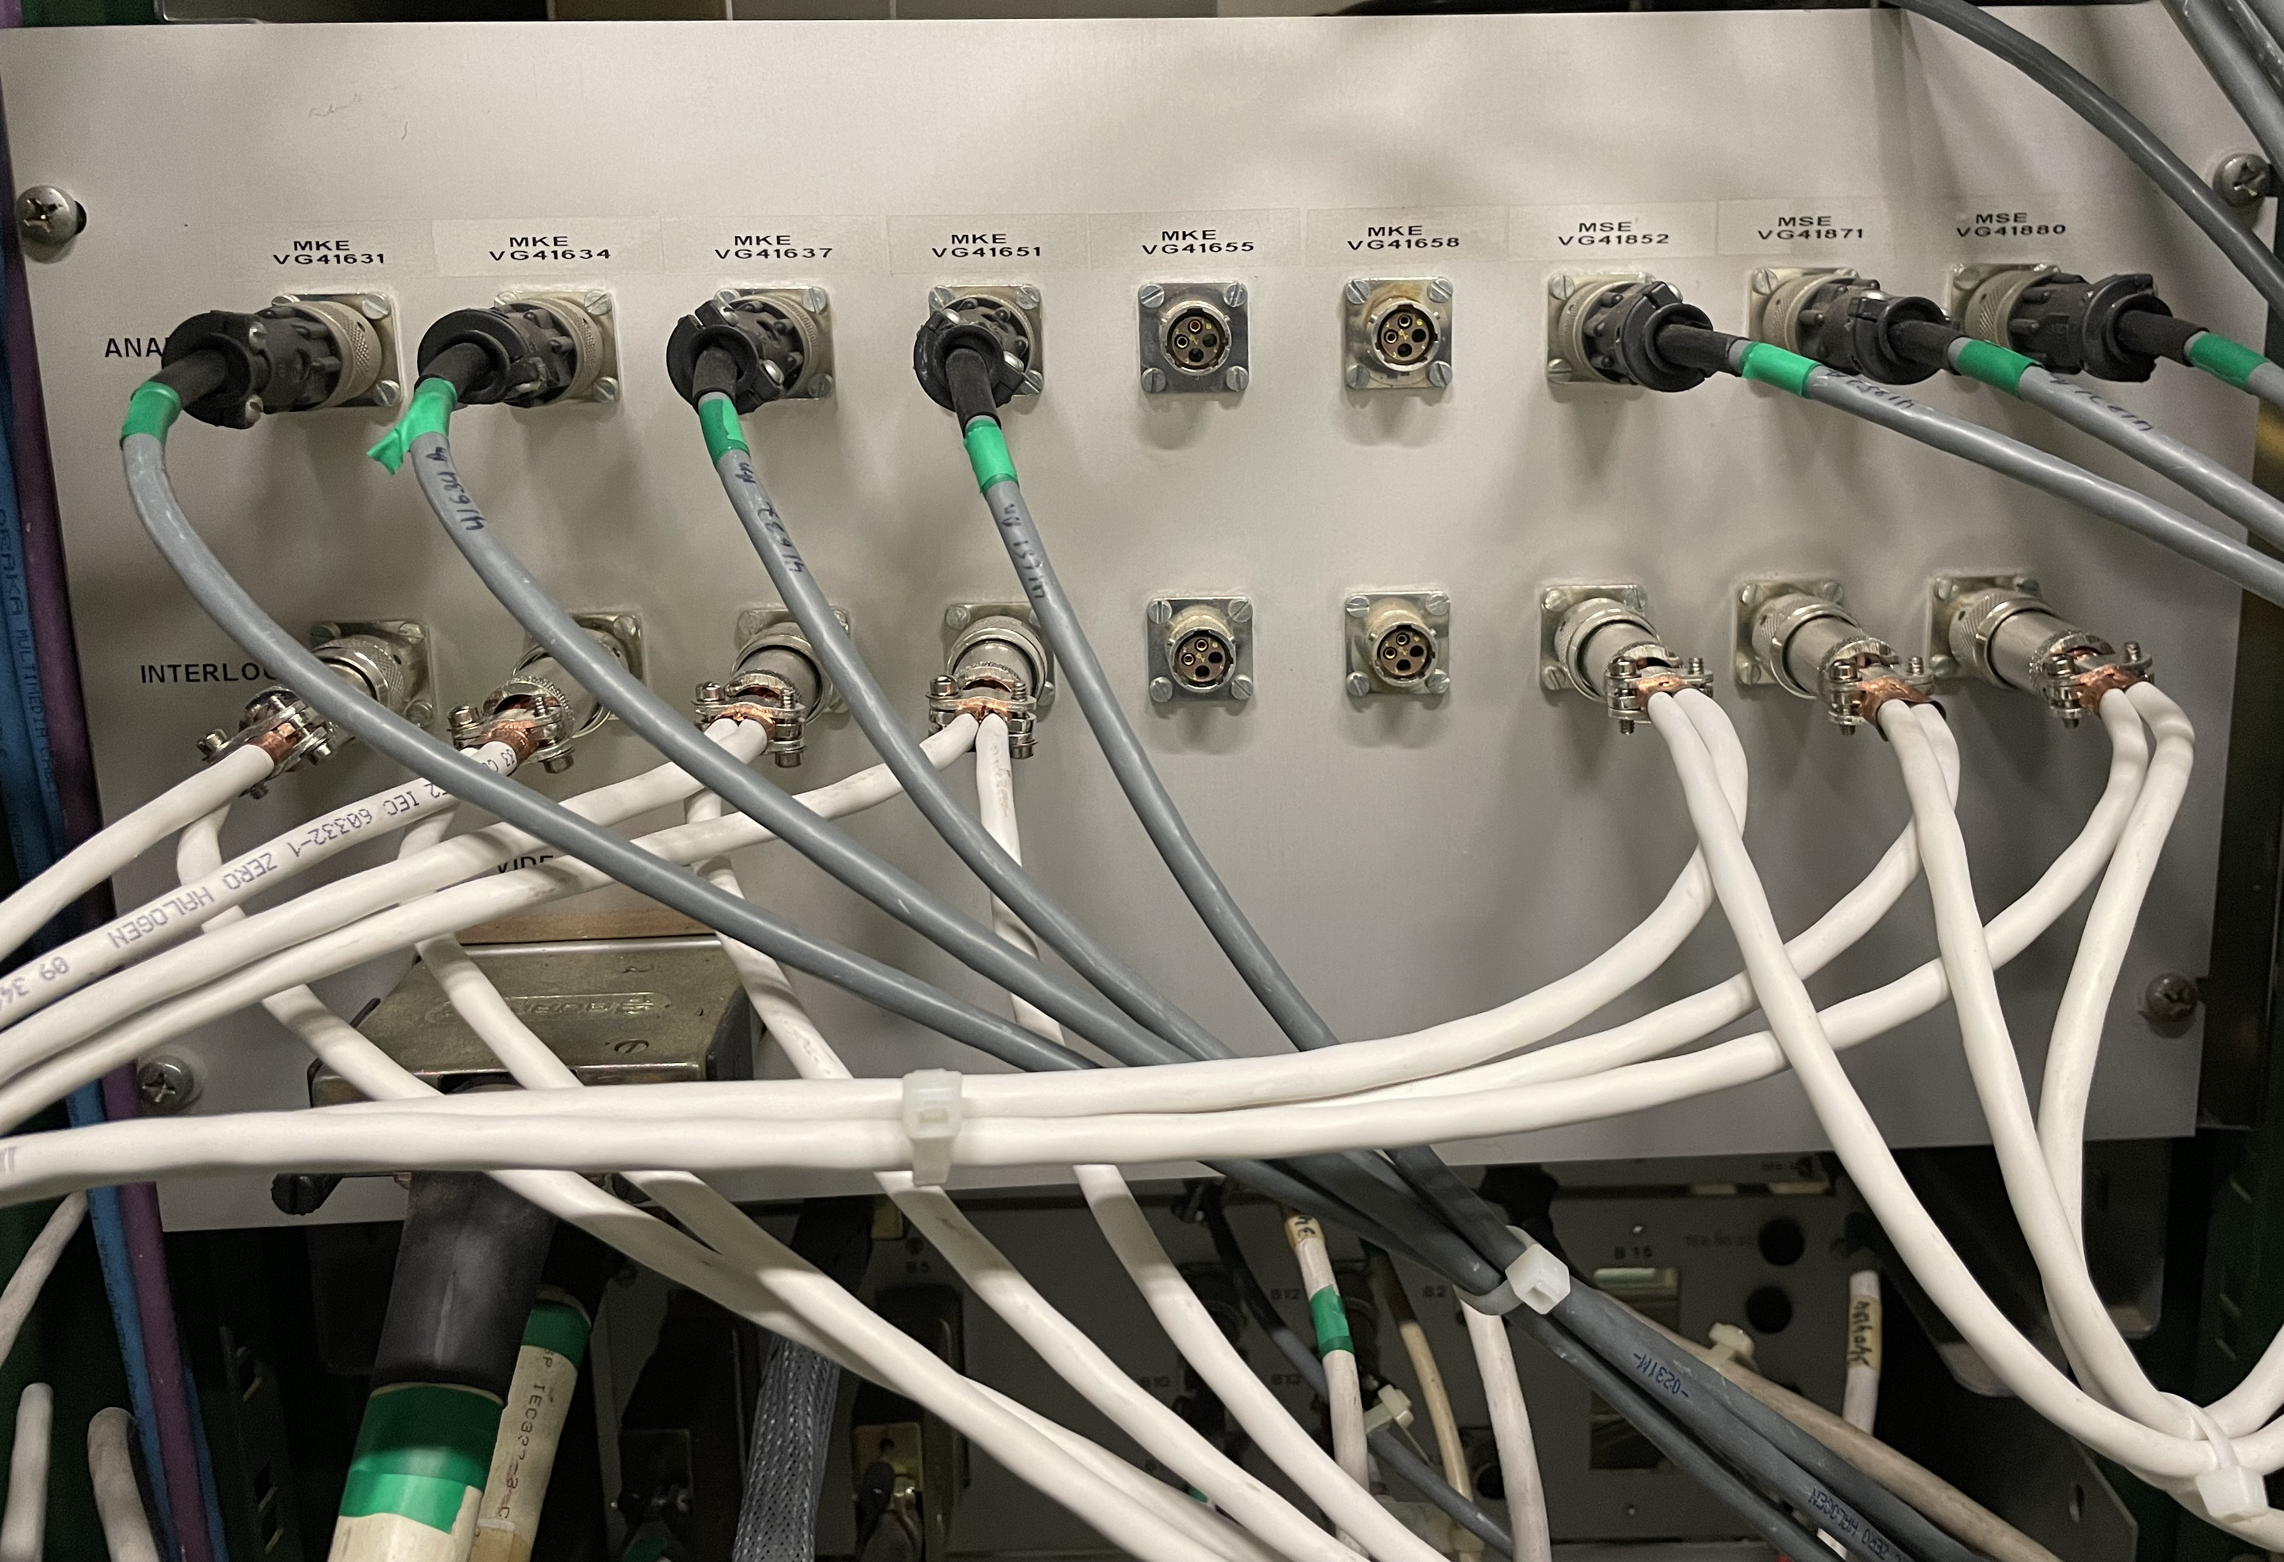
Mitigation of control system weaknesses
Implementation of new redundant interlocks for external alarms:
Several vacuum alarms generated during the Run 2022 due to pressure spikes (MKDVs & MKDHs)
Single source providing vacuum alarms (Penning gauge)
Specially annoying during the scrubbing run
New signals added in parallel from the ion pumps controlled by Agilent
Relay status from Agilent controller available at 1Hz
Kickers, septa, and ZS tanks (except BA1 which will be done in YETS23-24)
So far, no vacuum alarms reported during scrubbing run!
PROBLEMS
SOLUTION
Redundant vacuum alarms to kickers system in BA5
Cabling of vacuum alarms to kickers system in BA4
Abel Gutiérrez – VSC seminar – April 2023

Slide 14
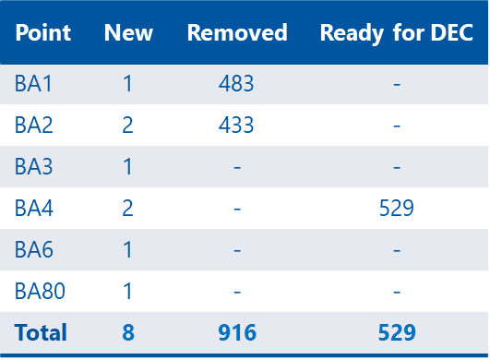
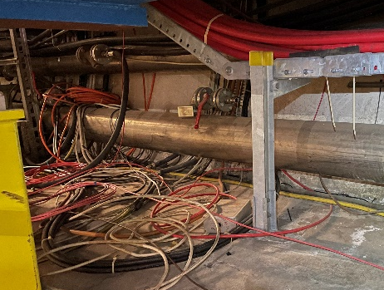
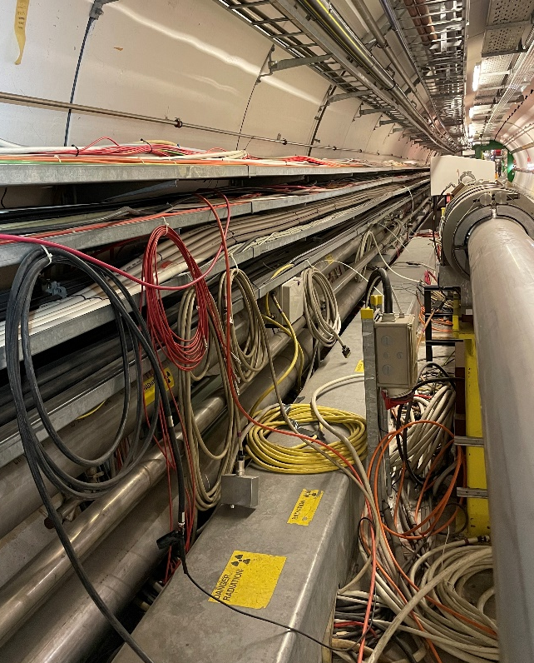
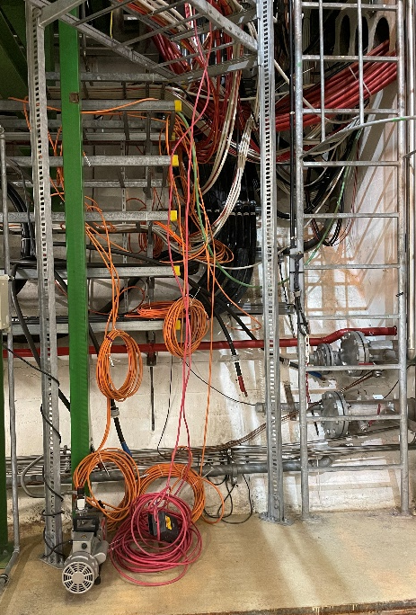
De-cabling and cabling campaigns
Two de-cabling campaigns running in parallel (BA1 & BA2):
Racks power consigned during ~6w:
  Consignation & de-consignation of power outlets and Penning cables
Limited monitoring (only sector valves and Pirani gauges):
  Risk of not identifying problems until the end
Ion pumps in critical sectors supplied locally in the tunnel (e.g.: kickers, septa):
  Requiring on-site weekly supervision specially after AUG tests
Limited time to restart the vacuum system and troubleshoot (<10 days):
  With high probability of finding damaged cables (3x damaged cables during this YETS)
Summary of cabling and de-cabling in SPS
Cables identified and to be removed during YETS23-24 in BA4
Abel Gutiérrez – VSC seminar – April 2023

Slide 15
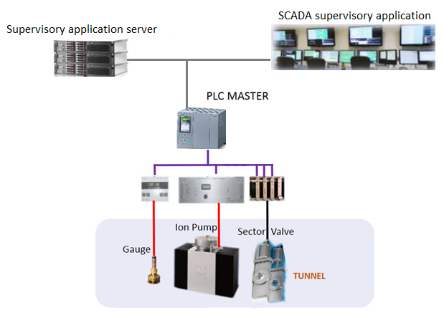
Commissioning and methodology
Commissioning criteria:
New equipment
Modified equipment:
(e.g. new cabling convention)
Critical equipment:
(e.g. sector valves, interlocks)
IT Infrastructure
1
Rack Area
2
3
3 validation phases:
Tunnel Area
SCADA
Controller
SCADA
Controller
Cable
(w/simulator)
SCADA
Controller
Cable
Instrument
+120 ion pumps fully validated!
Abel Gutiérrez – VSC seminar – April 2023

Slide 16
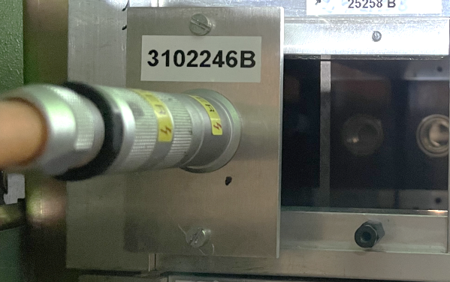
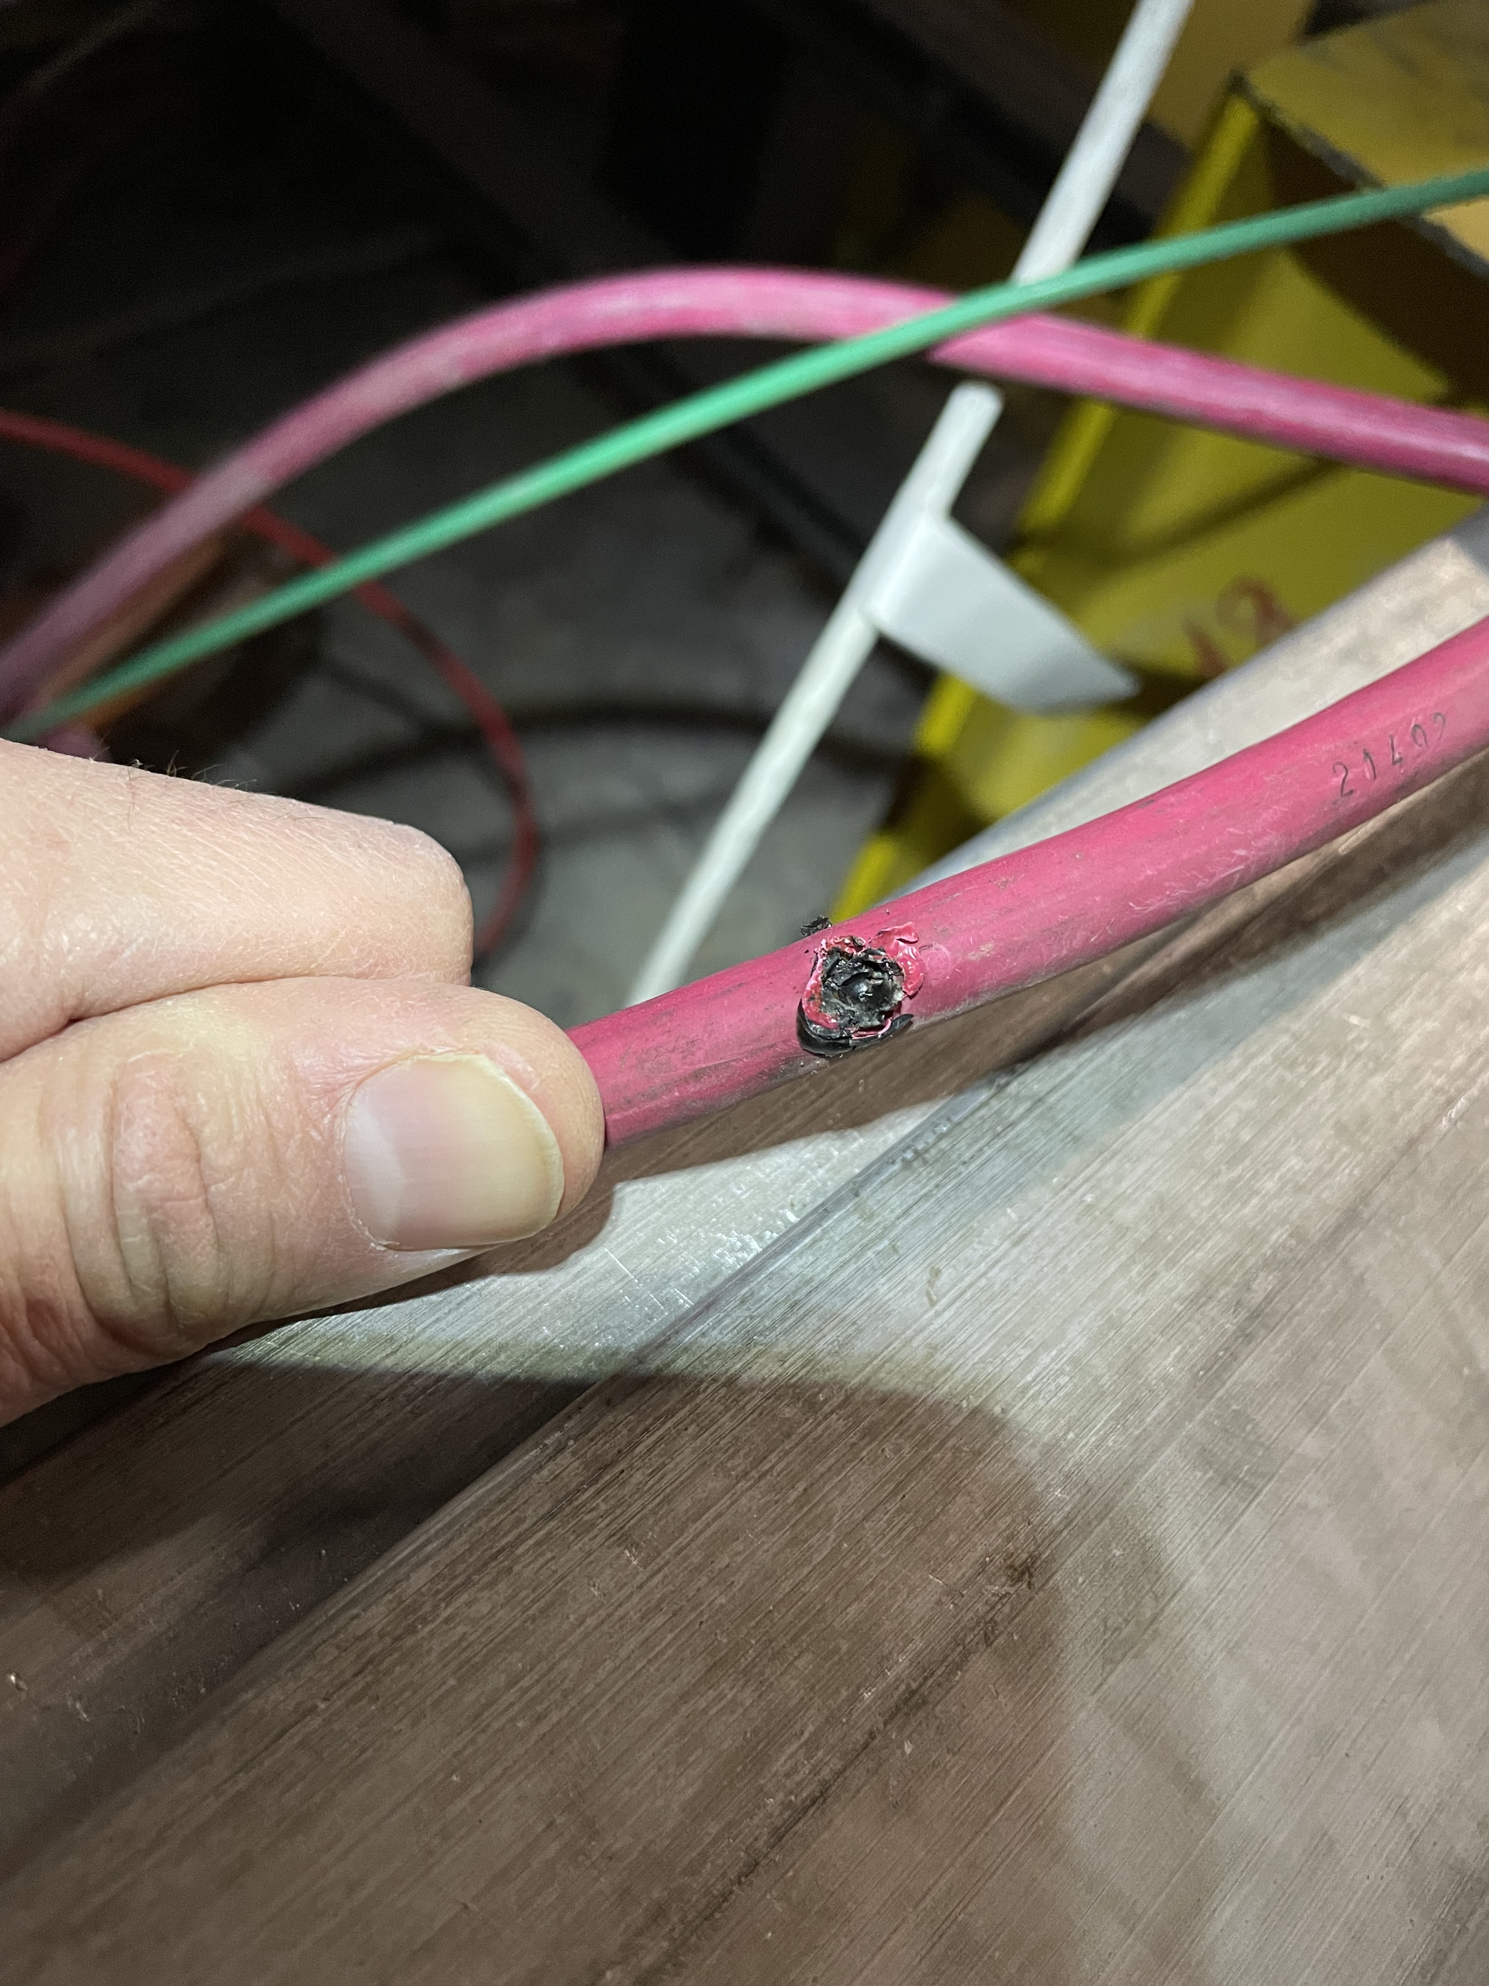
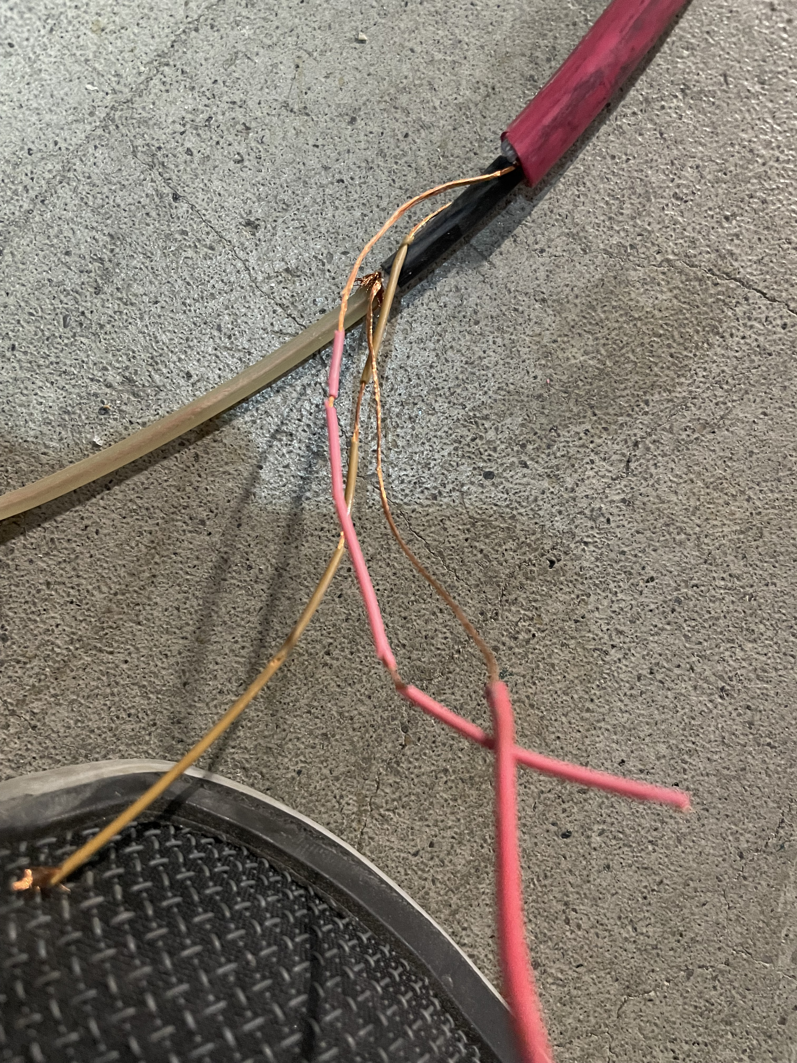
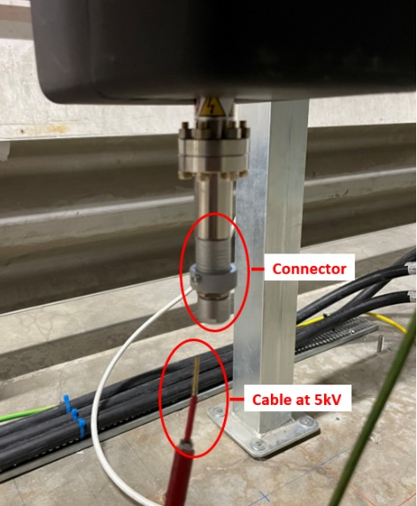
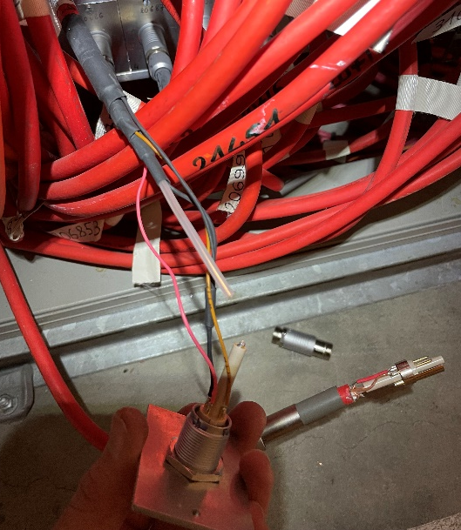
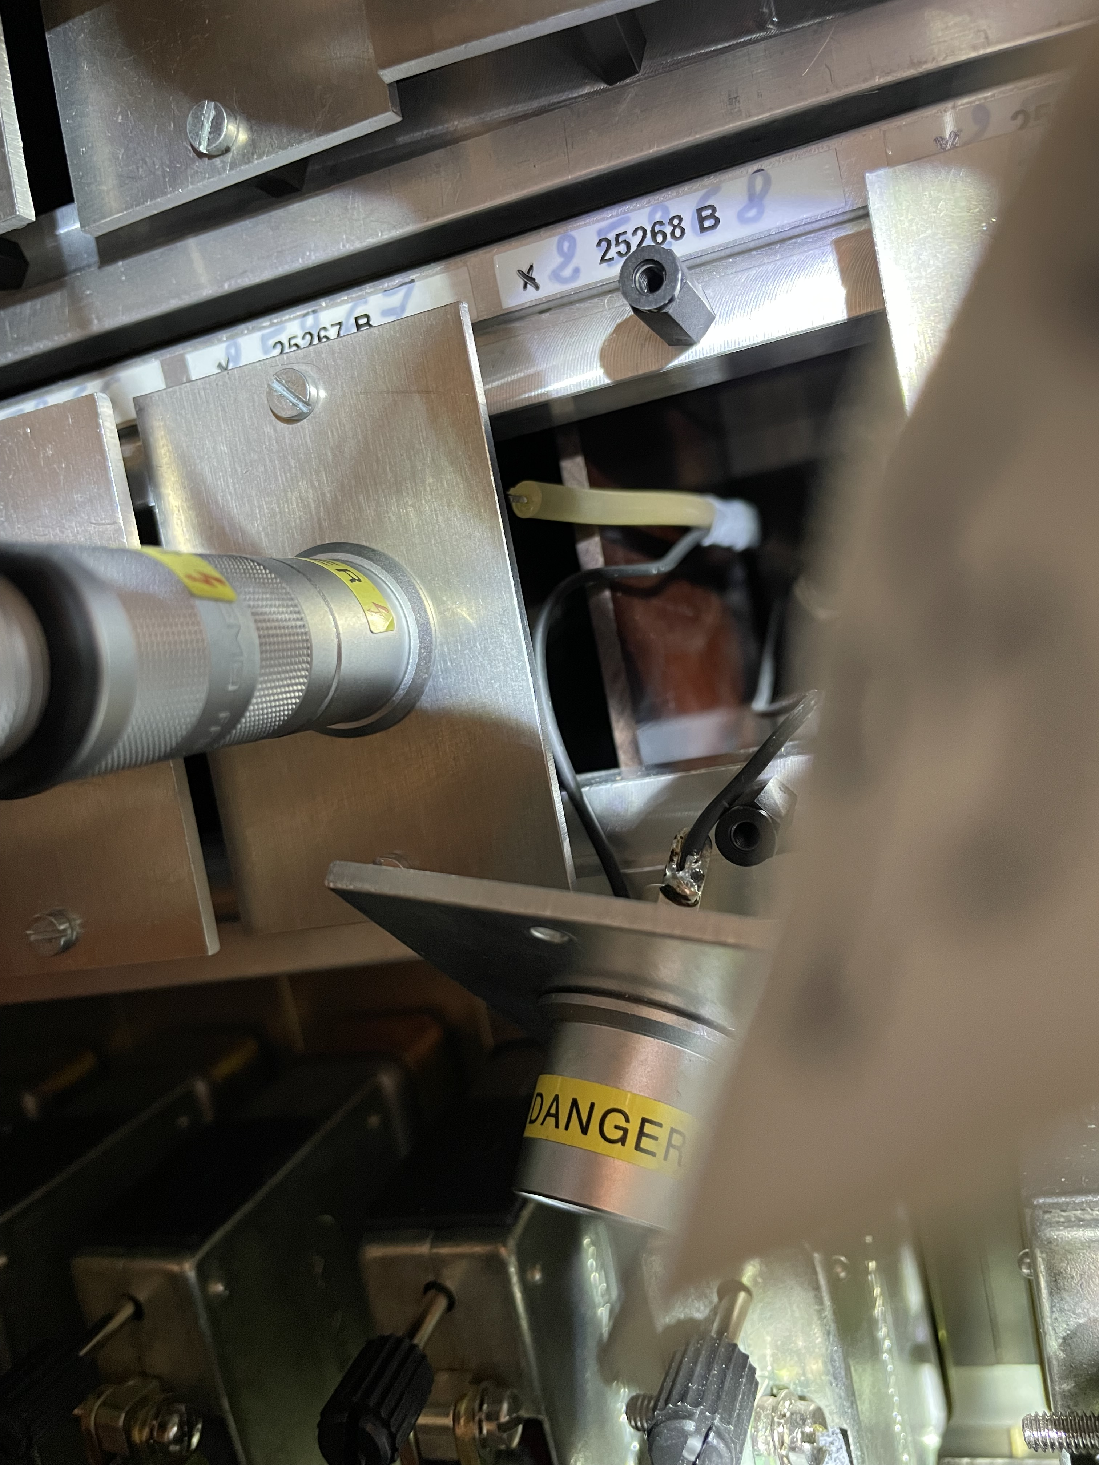
Problems found
Spacer damaged after de-cabling campaign
Cable damaged due to radiation exposure
High-voltage conductors ripped from connectors during de-cabling campaigns
Abel Gutiérrez – VSC seminar – April 2023

Slide 17
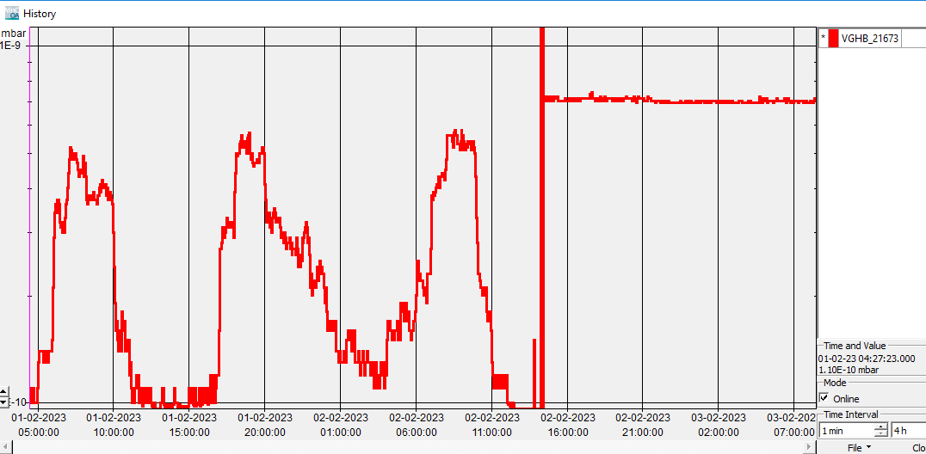
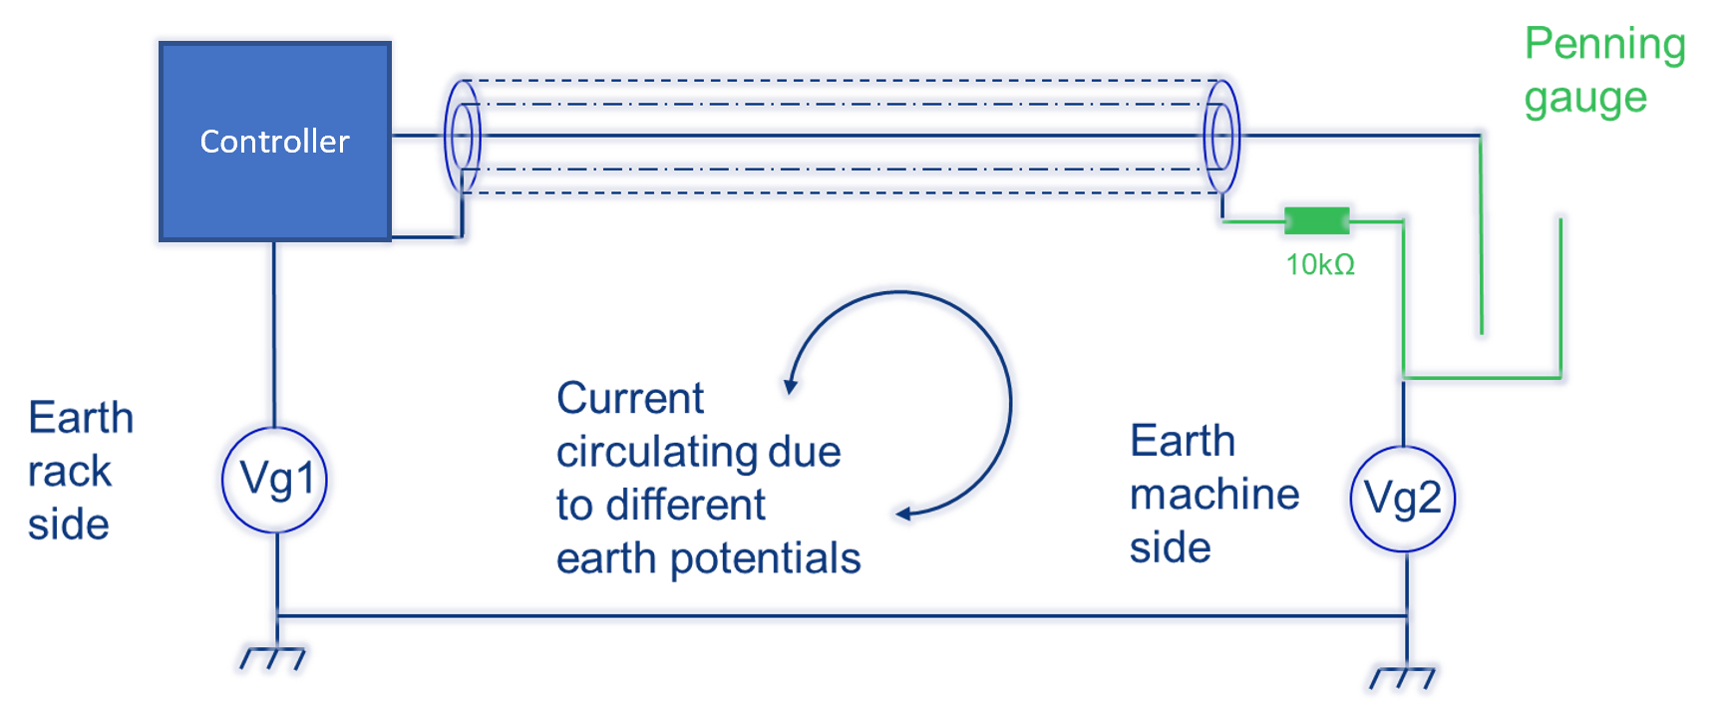
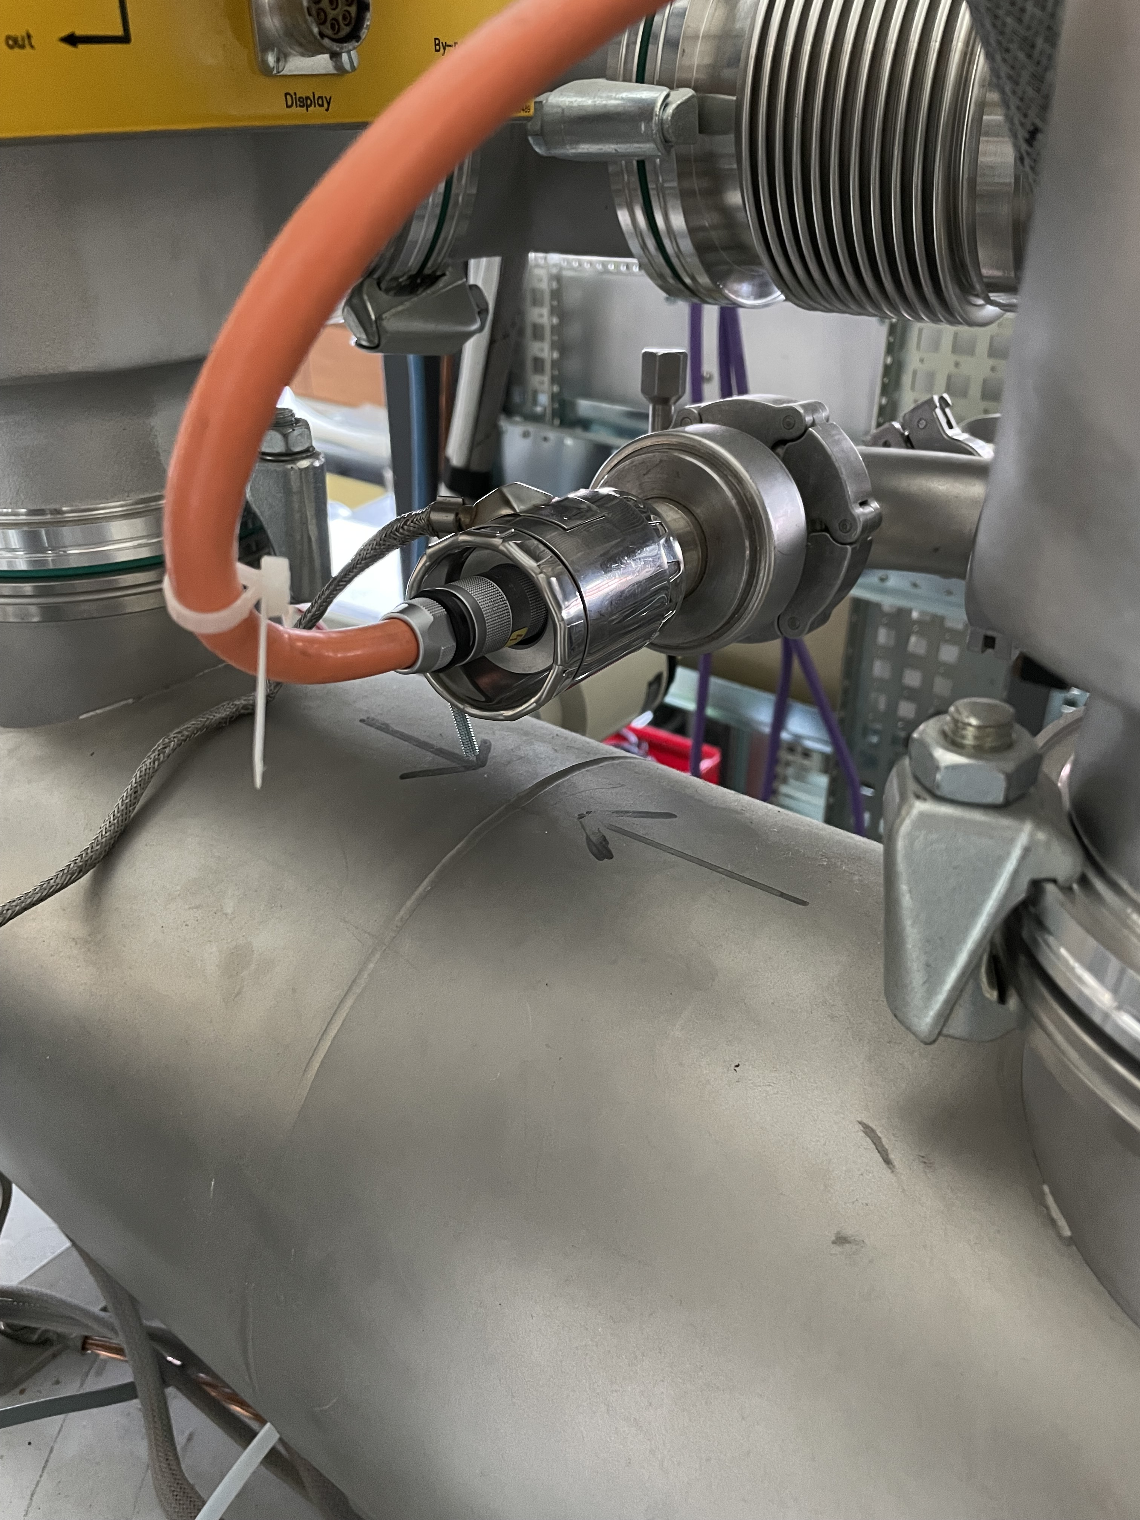
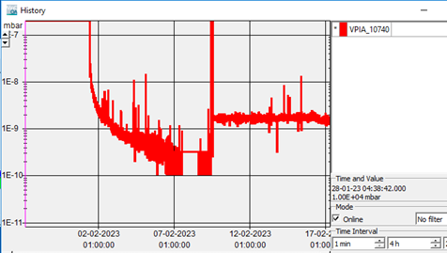
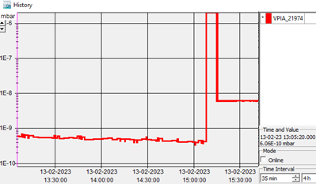
Problems found
Penning gauge measurement: before and after earth removal from heating collar
Heating collar short-circuiting cable shielding with earth
Ion pumps measurement: before and after the wrong convention modification
Abel Gutiérrez – VSC seminar – April 2023

Slide 18
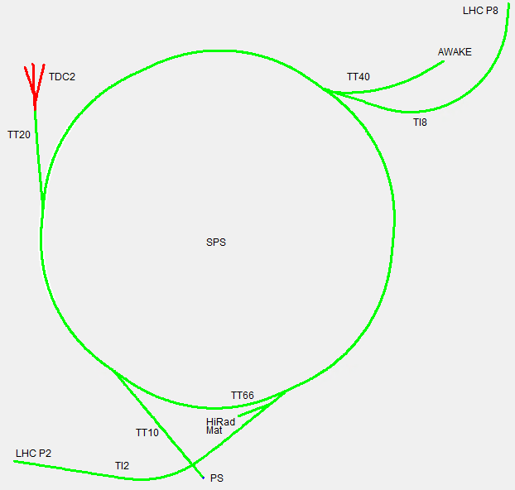
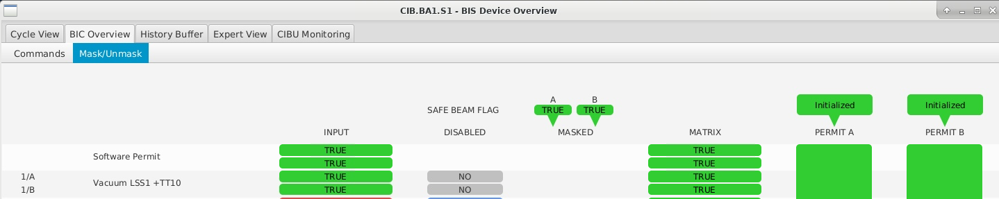

Where we are now?
Sector valves interlock test: manually triggering the interlock sources
BIS (Beam Interlock System) test: opening/closing sector valves one by one
Vacuum alarms test (ZS, kickers, septa): manually triggering the alarm sources
Only one intervention during Hardware Commissioning period
  Water leak in LSS5- generating sparking in ion pump local box -> 20m cable replaced on the fly
Beam Interlock System monitoring view
Smooth scrubbing run!
Good start for the 2023 Run!
SCADA main view of SPS
Abel Gutiérrez – VSC seminar – April 2023

Slide 19
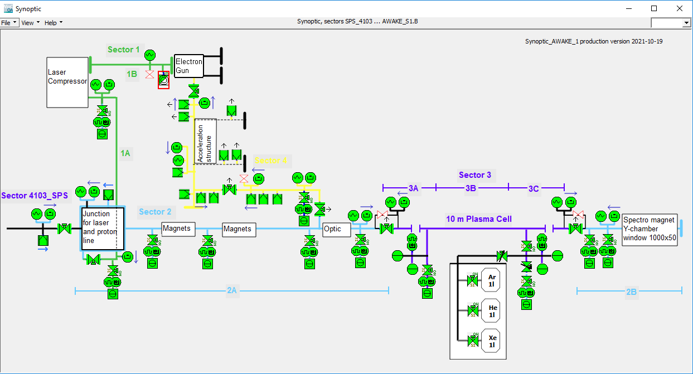



Out of the SPS ring: AWAKE-DPS
New control system:
  2x Motorized injection valves
  5x Insulation valves
  2x Full-range gauges
  2x Capacitive gauges
  2x Piezo gauges
  Software interlocks
  1x New PLC Remote IO
SCADA synoptic of AWAKE
Abel Gutiérrez – VSC seminar – April 2023

Slide 20
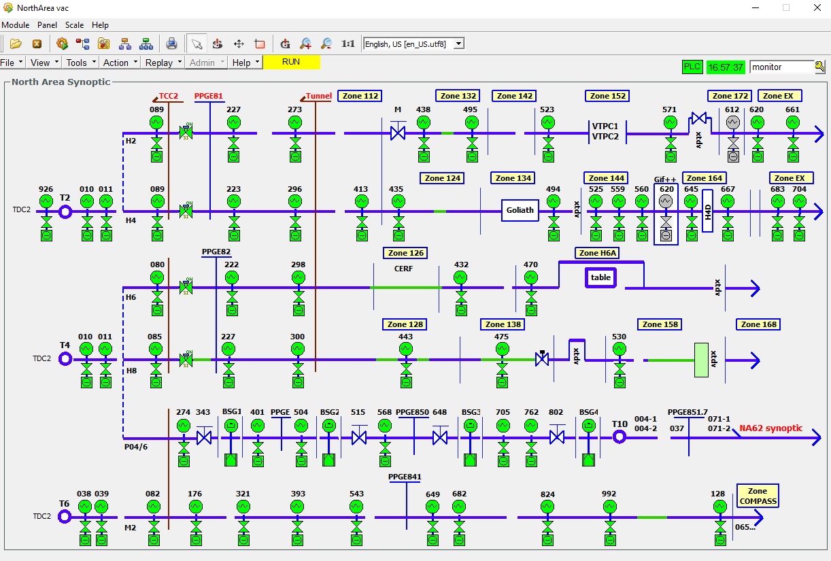
Out of the SPS ring: new BSGs in North Area
SCADA synoptic of North Area
New instrumentation:
  4x Ion pumps
  4x Penning gauges
  1x Master PLC
Abel Gutiérrez – VSC seminar – April 2023

Slide 21





Benjamin Bayliss
André Rocha
Joao Rebelo
Nicolas Levorin
Philippe Bouvard
Chiara Pasquino
Anthony Harrison
Jarmo Kortesmaa
Alban Sublet
Carolina Amoedo
Abel Gutiérrez – VSC seminar – April 2023

Slide 22
Any
Questions?
Abel Gutiérrez – VSC seminar – April 2023

