Slide 1
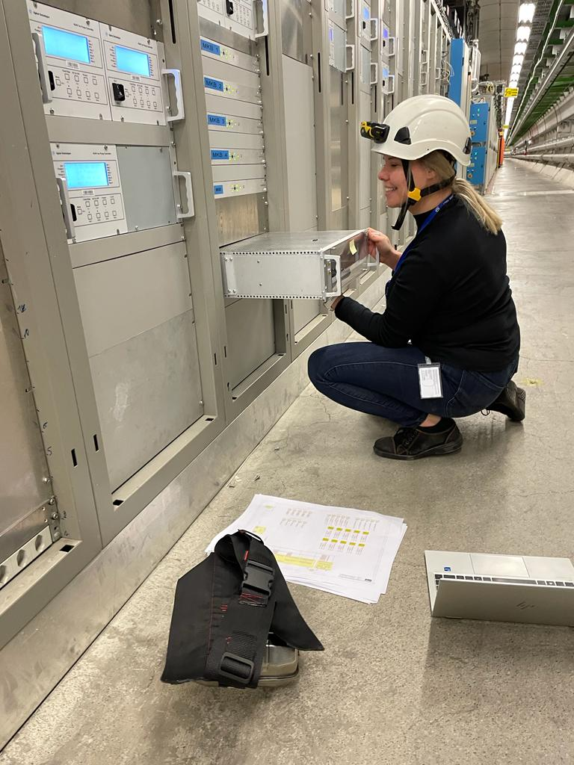
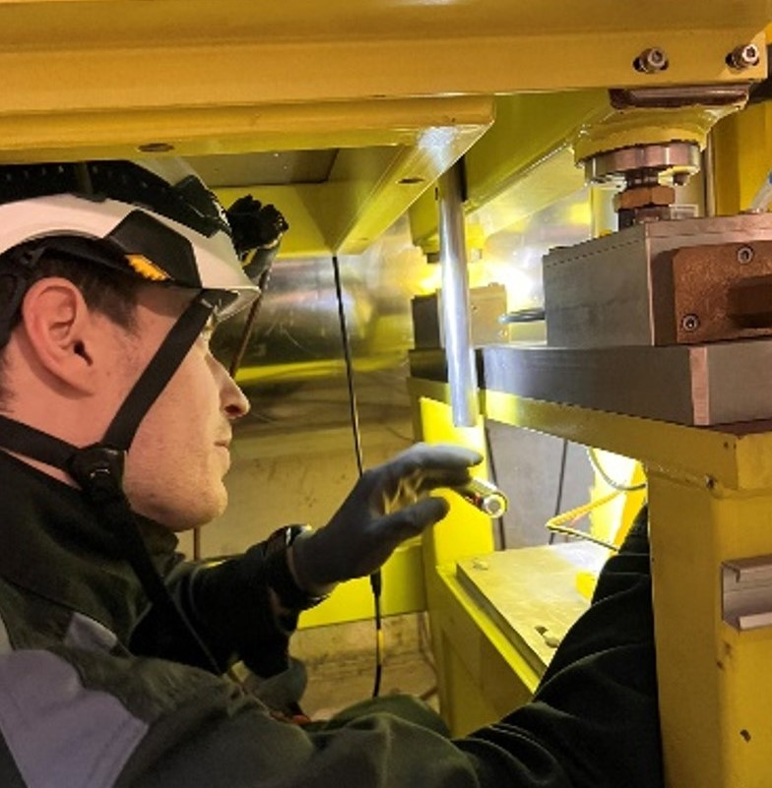
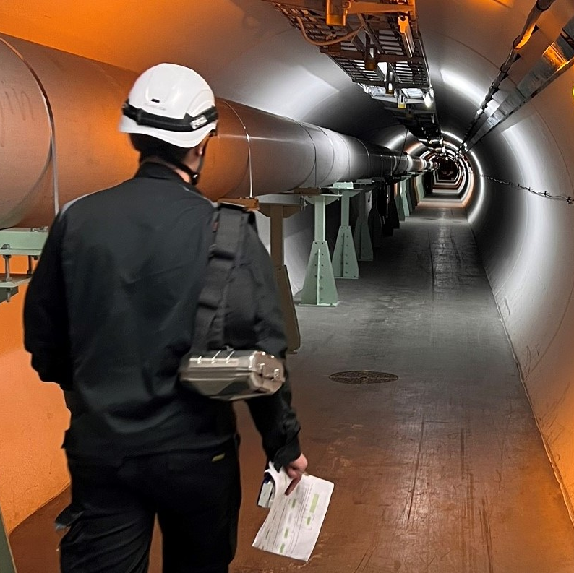
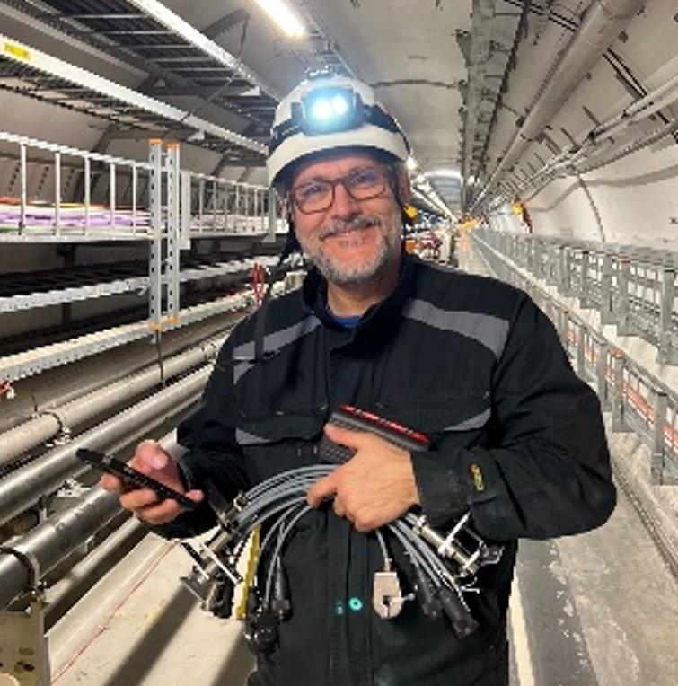
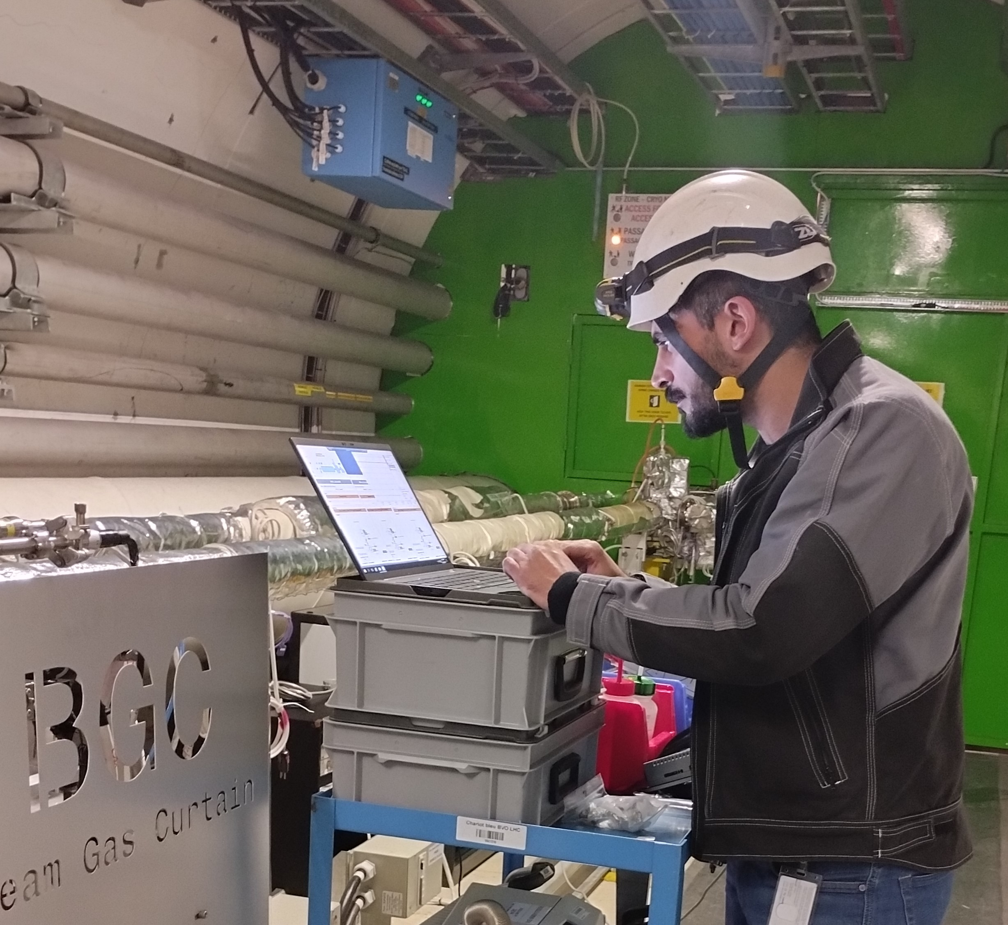
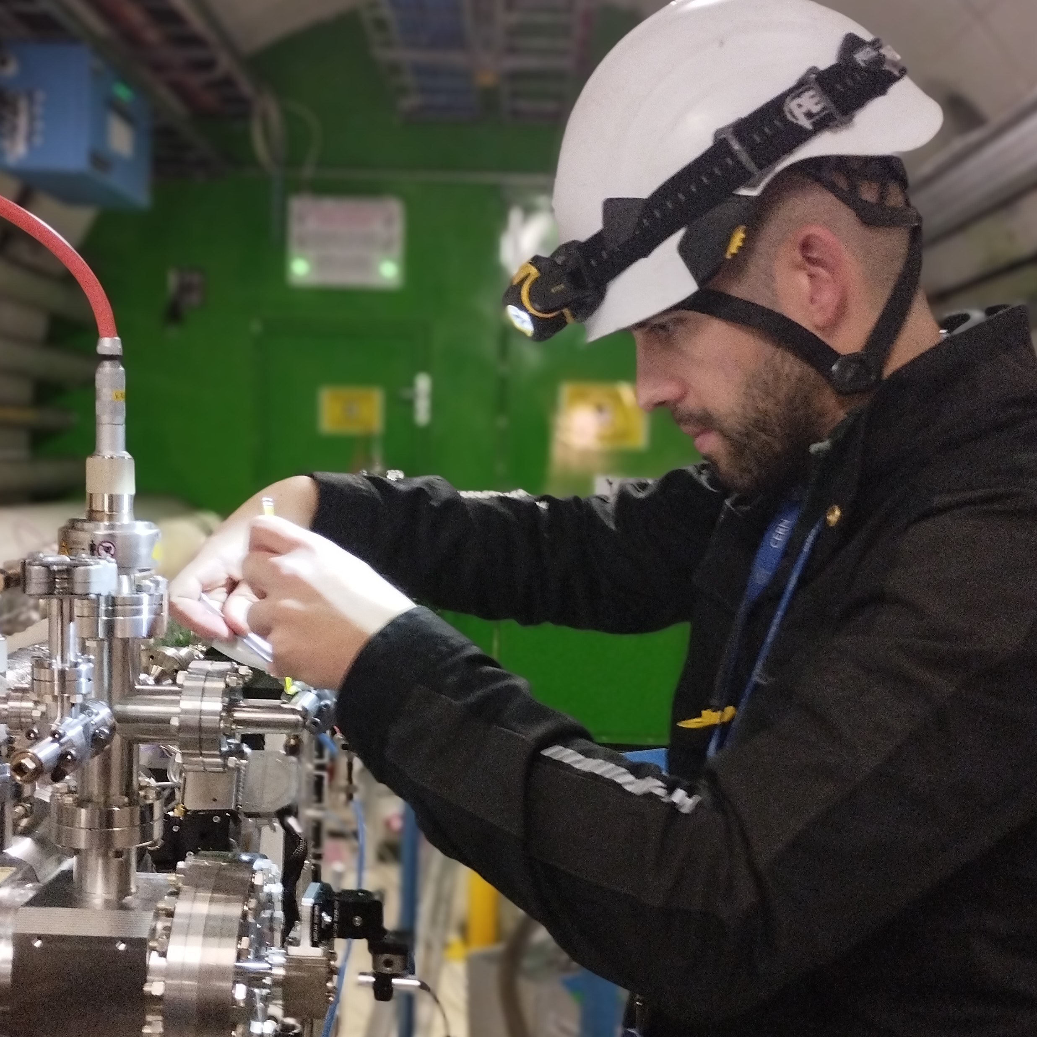
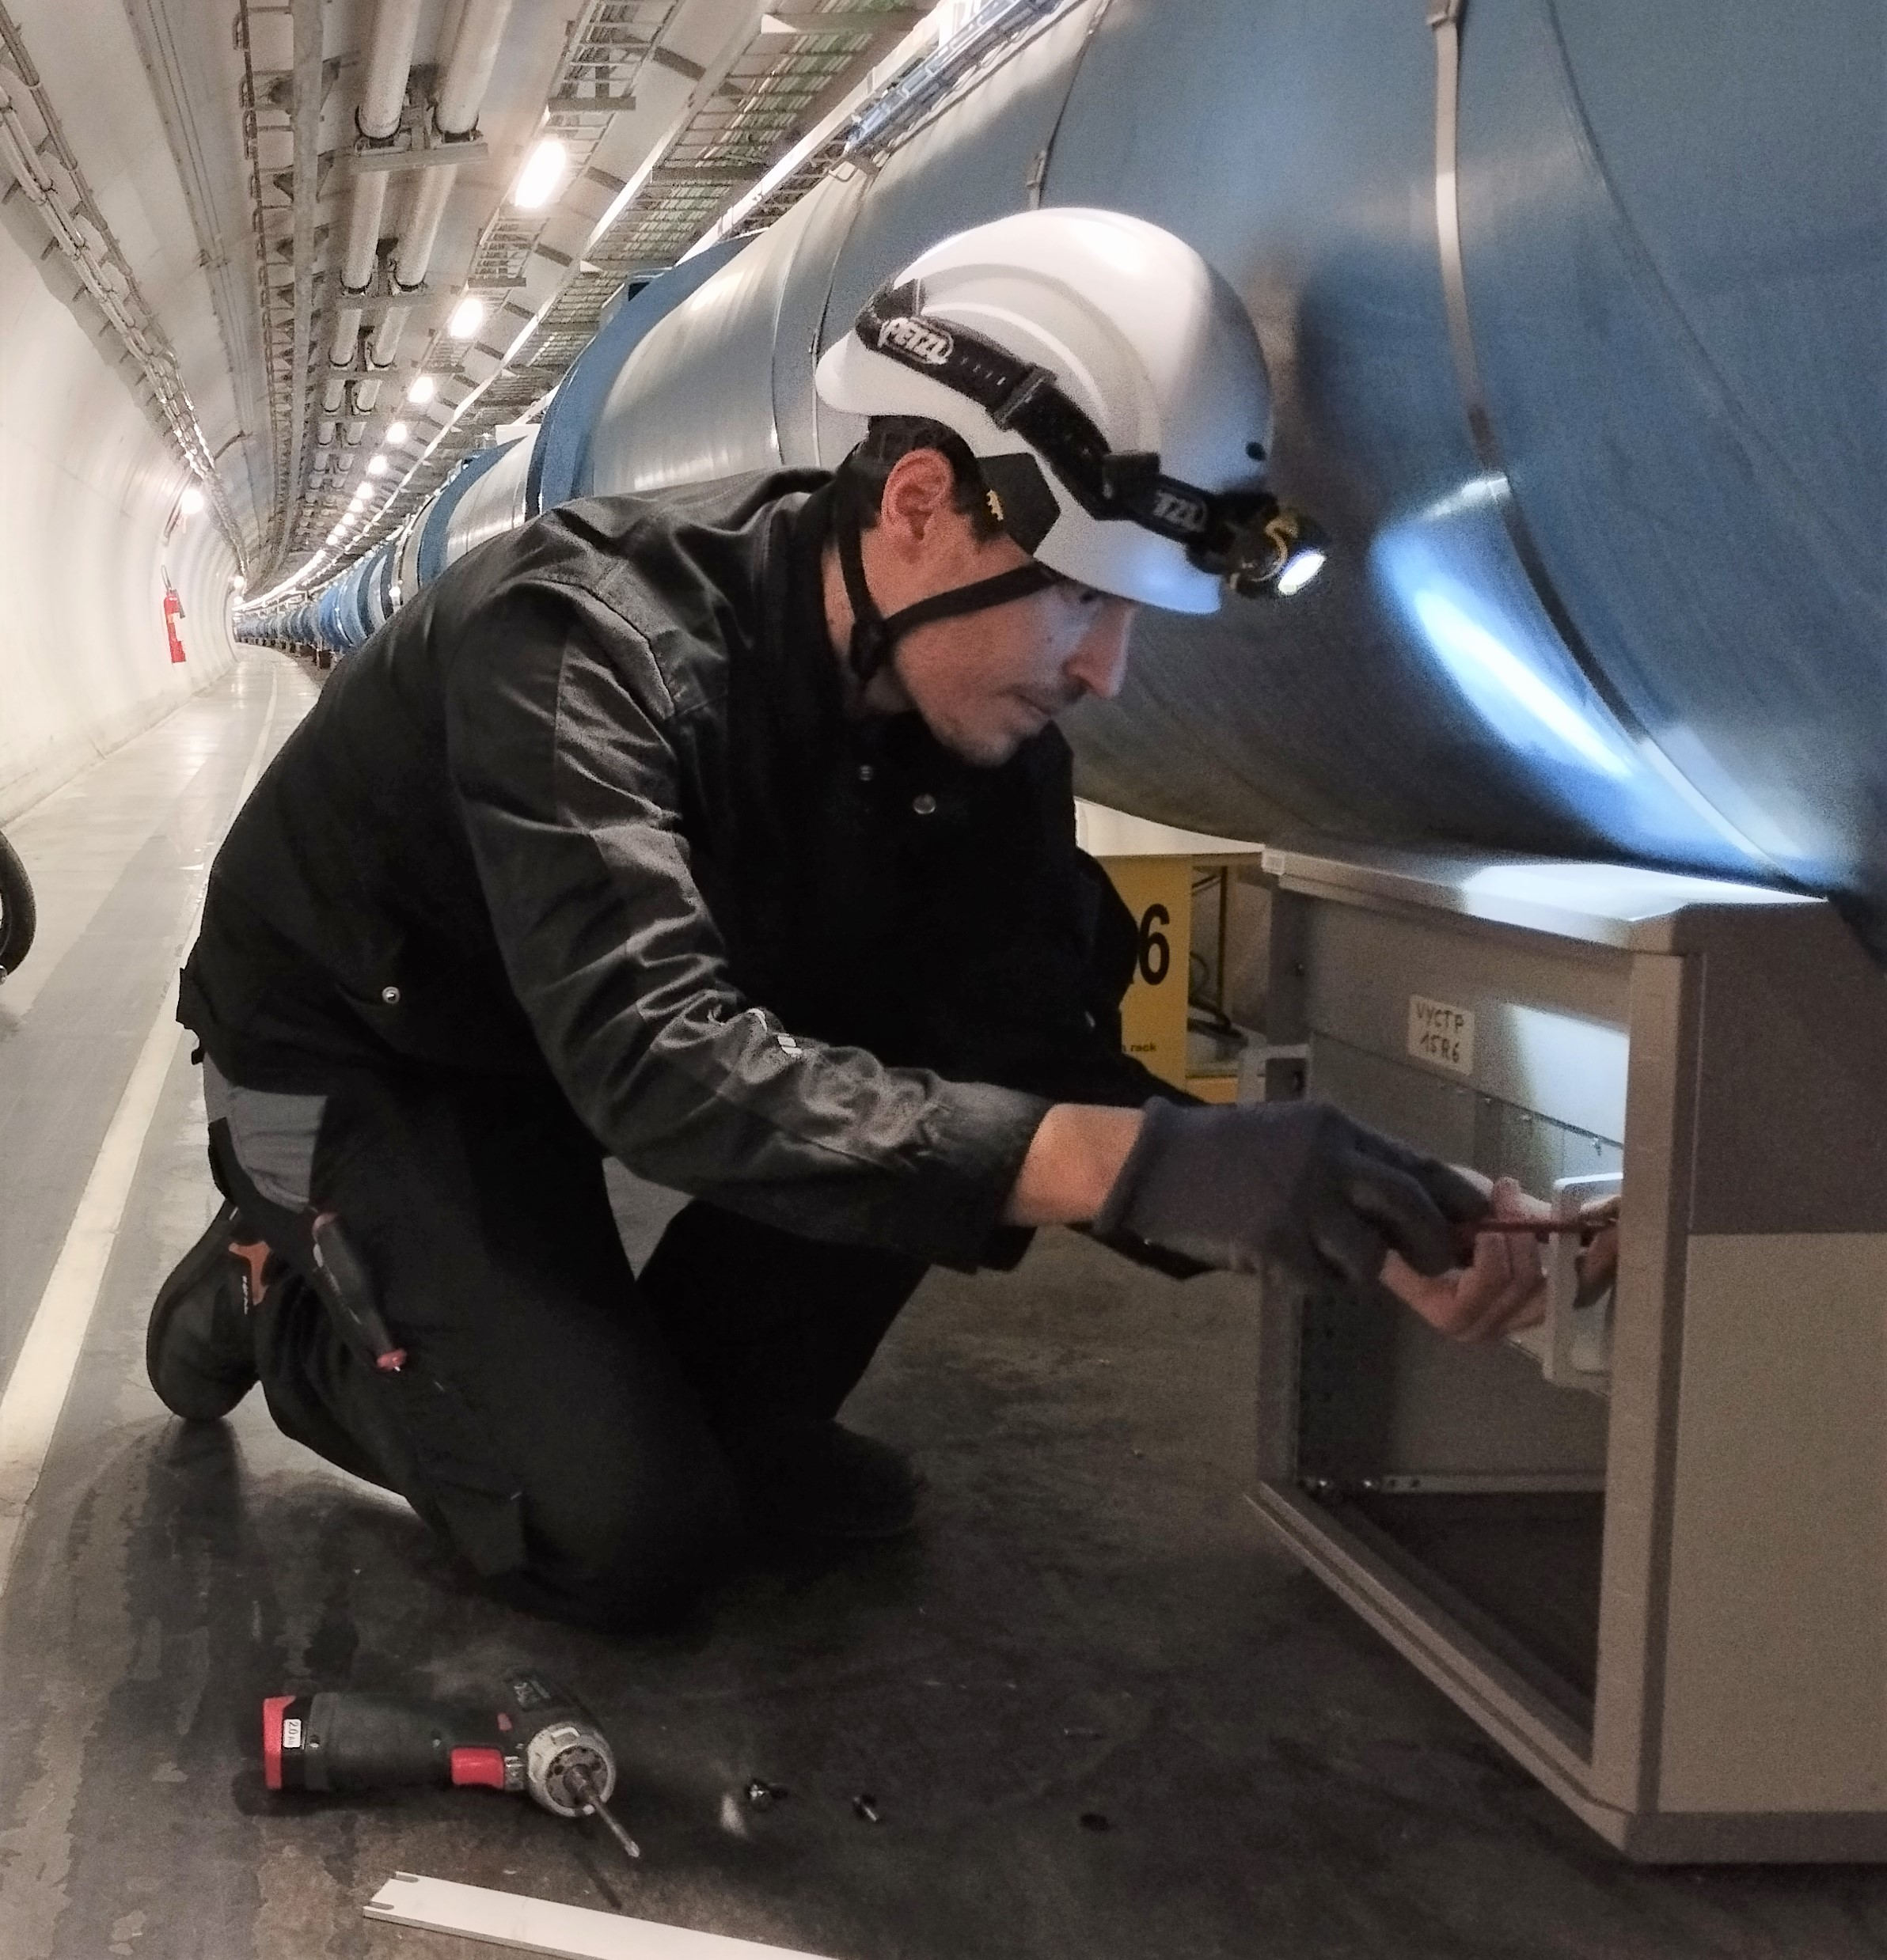
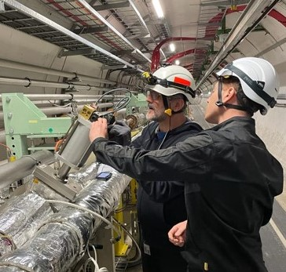
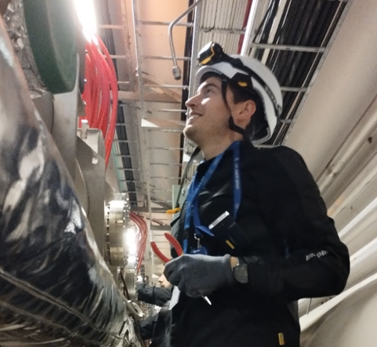
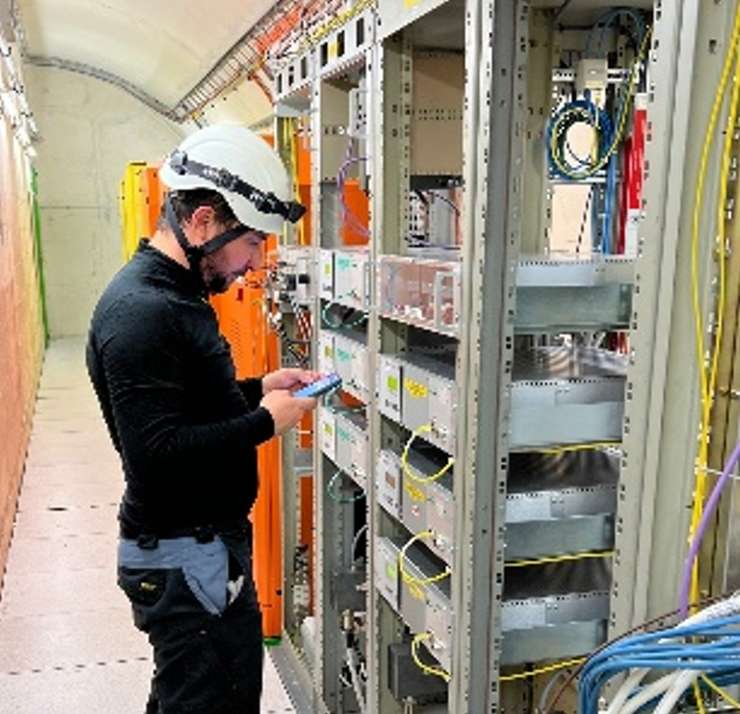
LHC YETS 22-23 Controls Activities
VSC Seminar 4 April 2023 - Lampros Zygaropoulos - TE-VSC-ICM

Slide 2
Outlook
Fixed Pumping Groups consolidations
Ion pumps consolidation Point 6
MKB vacuum alarms PLC crates
Sector valves consolidation
Profibus network consolidation Point 6, Alice, CMS & LHCb
Electrical non-conformities campaign
BGC installation
BVO & IVO co-activities
VPI heating collars installation P7
SCADA & PLC updates
Machine check-out

Slide 3
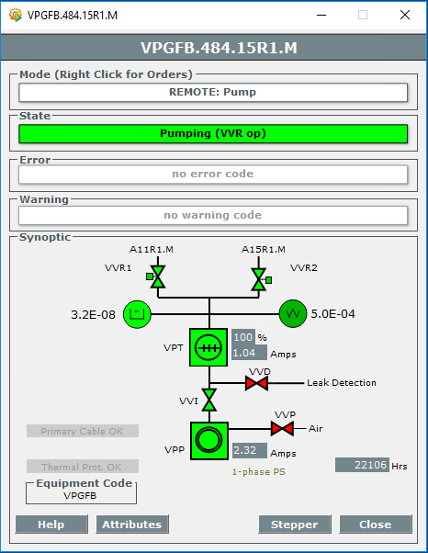
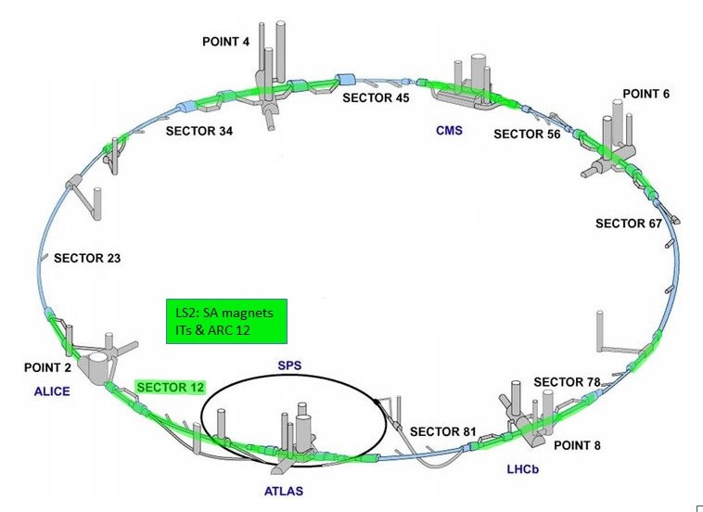
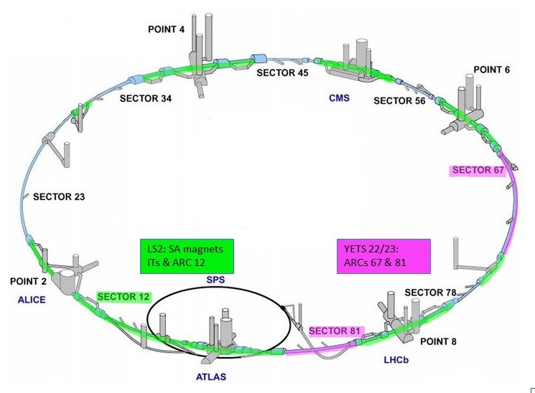
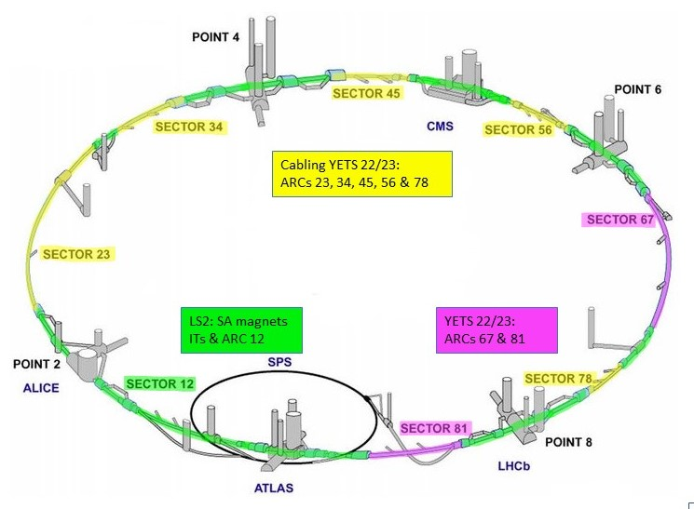
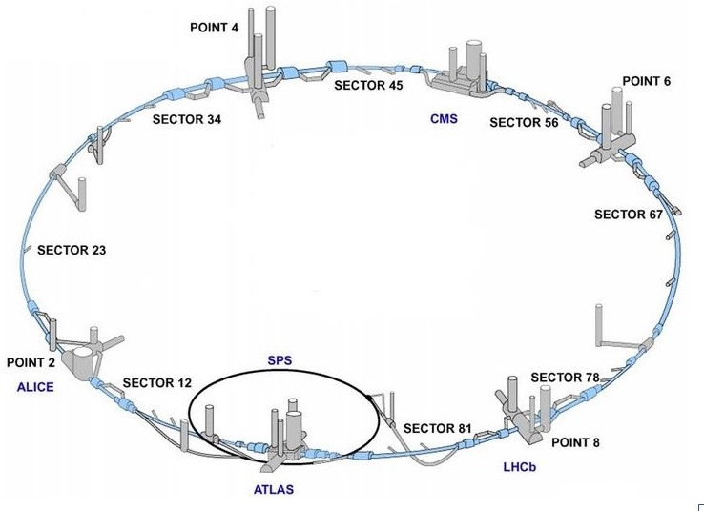
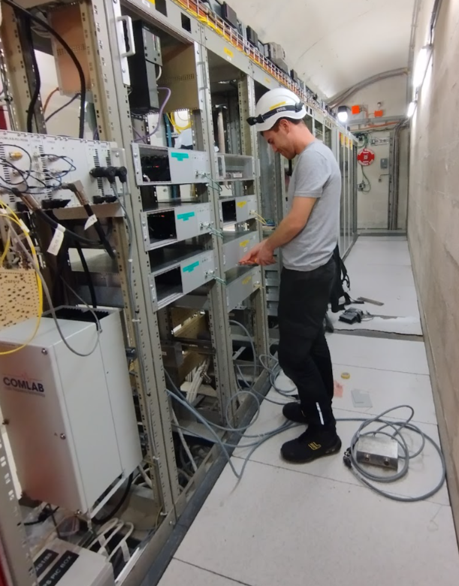
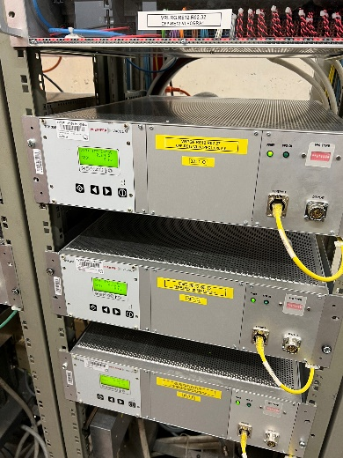
Fixed Pumping Groups consolidations
Exchange of Turbo Pumps for fixed pumping groups: Alcatel 300ATH->Pfeiffer HiPace 300
LS2: SA magnets, IT & ARC 12.
YETS 22/23: ARCs 67 & 81.
Turbo controller exchange:
Removed old Alcatel ACT250R installed in the tunnel.
Install Pfeiffer TCP350 in service areas.
Rotation speed & current consumption.
Cabling campaigns ARCs:
LS2: ARC 12 & 67.
YETS 21-22: ARC 81 .
YETS22-23: ARC 23, 34, 45, 56 et 78.
Alcove RE82 TCP350 installation
3

Slide 4
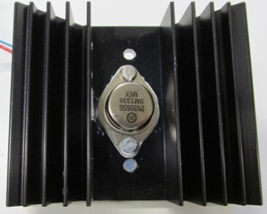

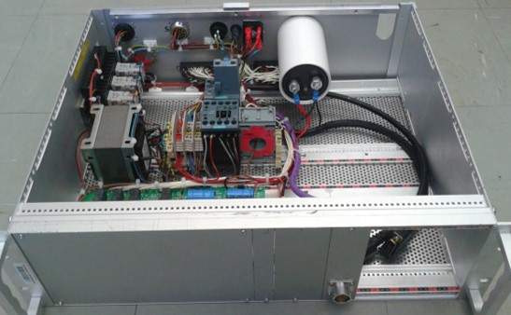
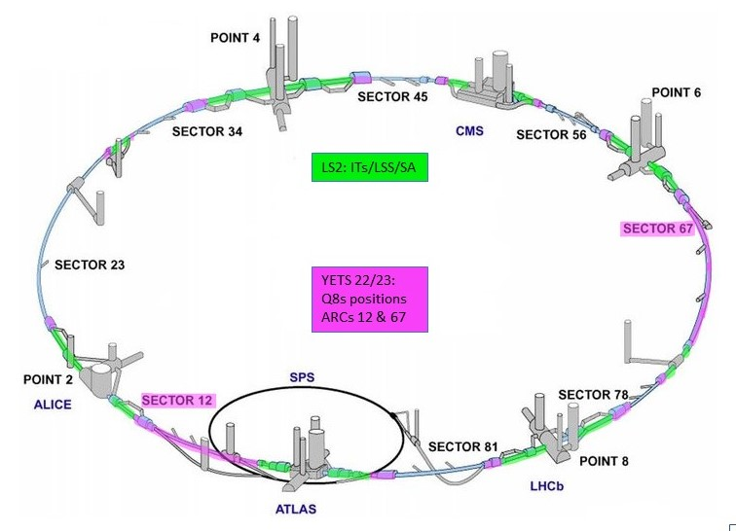
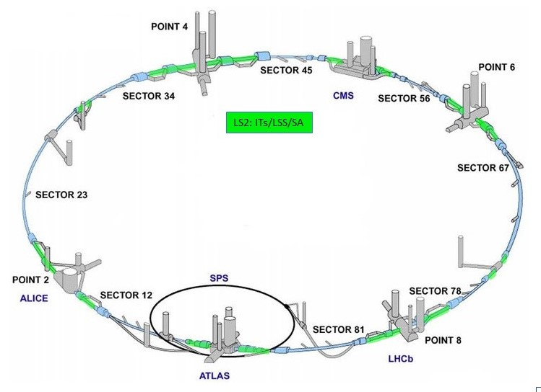
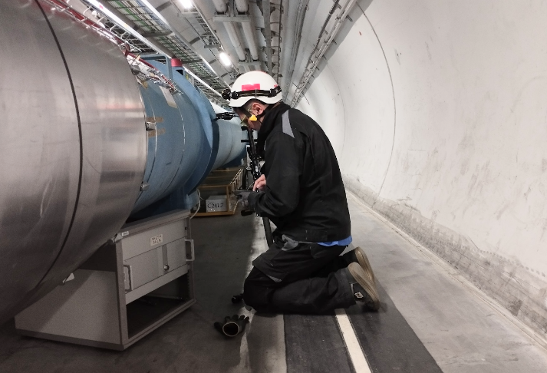
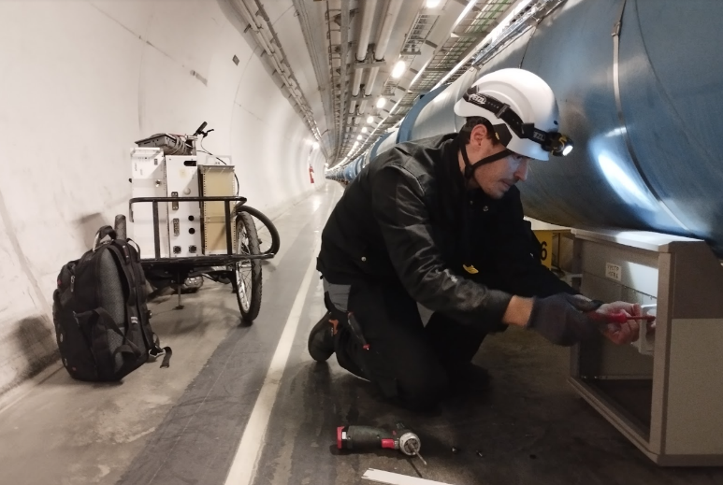
Fixed Pumping Groups consolidations
Local Crates exchange:
VPG New Local Crate.
Provides power locally, in the tunnel to Primary pump & VPG valves.
Re-designed, radiation tolerant, no active components.
Additional functionalities: Primary pump current, remote thermal relay reset.
VPG valve status provided by PLC voltage: Reliability.
LS2: IT/LSS/SA positions.
YETS 22/23: Q8s positions and ARCs 12 & 67.
Local crate installation at Sector 67
4

Slide 5
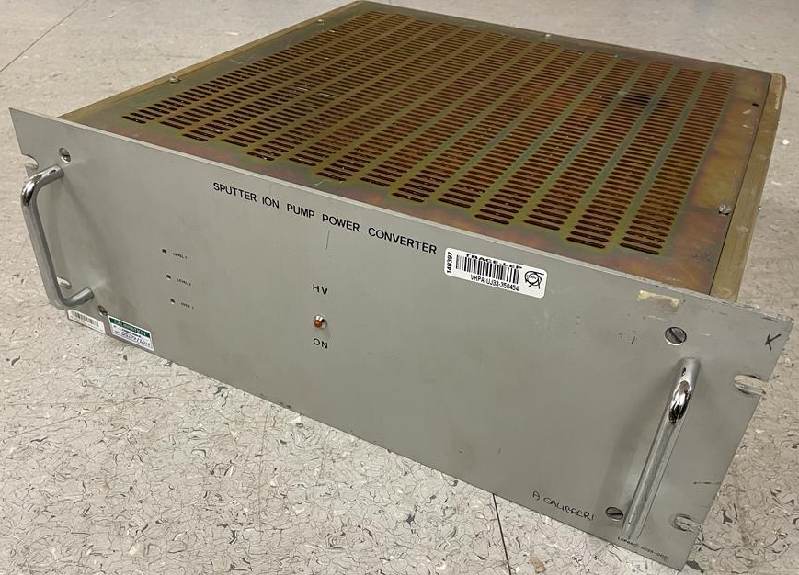
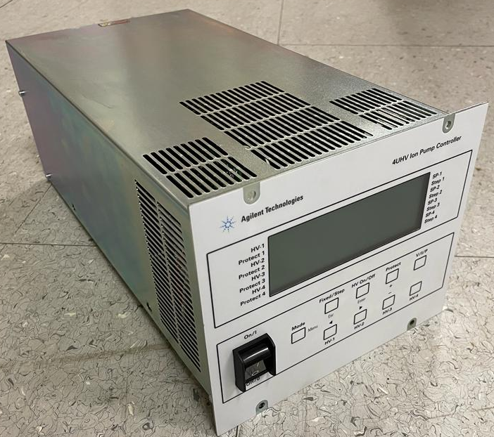
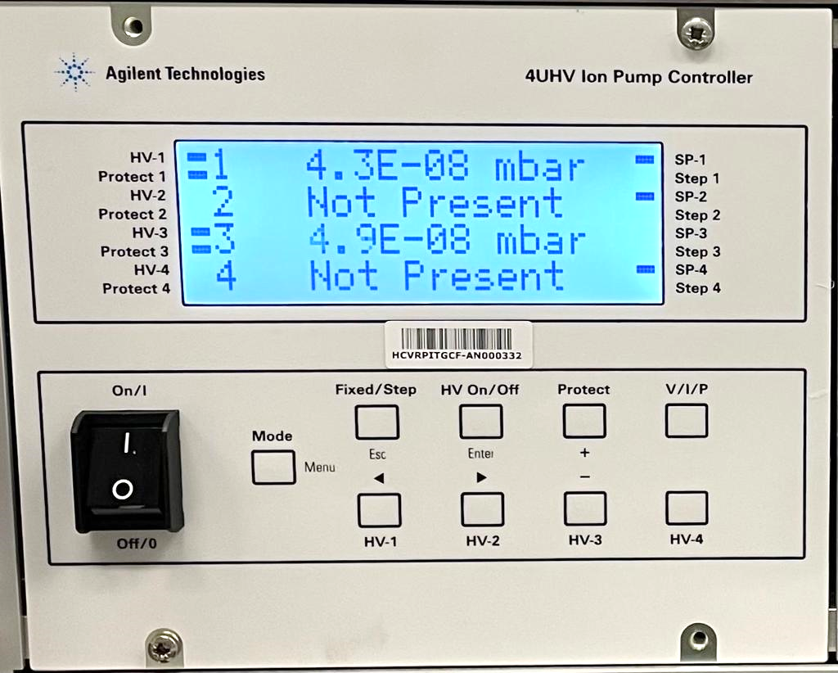
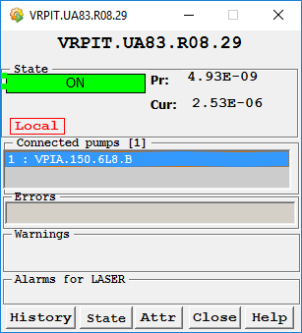
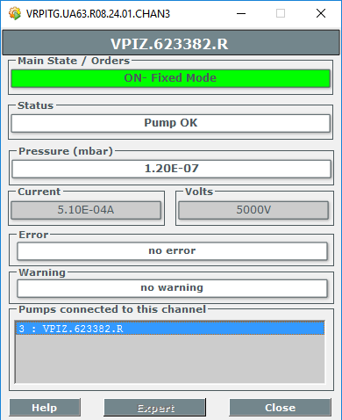
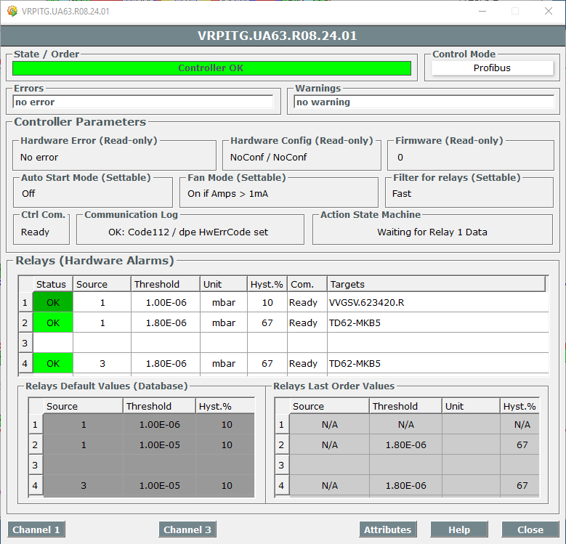
Ion pump controllers consolidation Point 6
    Agilent Ion Pump controllers installation campaign (HL-LHC)
    LEP type ion pump controllers
    Manual calibration needed
    1 HV channel per controller
    Heavy weight (~20kg)
    IO interface
    Locally adjustable relay threshold level
    Fixed power and voltage
    Agilent 4UHV controllers
    No calibration needed
    2 HV channels per controller
    Lighter (~6kg) and smaller (x2 per 4H crate)
    Profibus interface
    Remotely adjustable relays and thresholds
    Adjustable power, voltage and settings
5

Slide 6
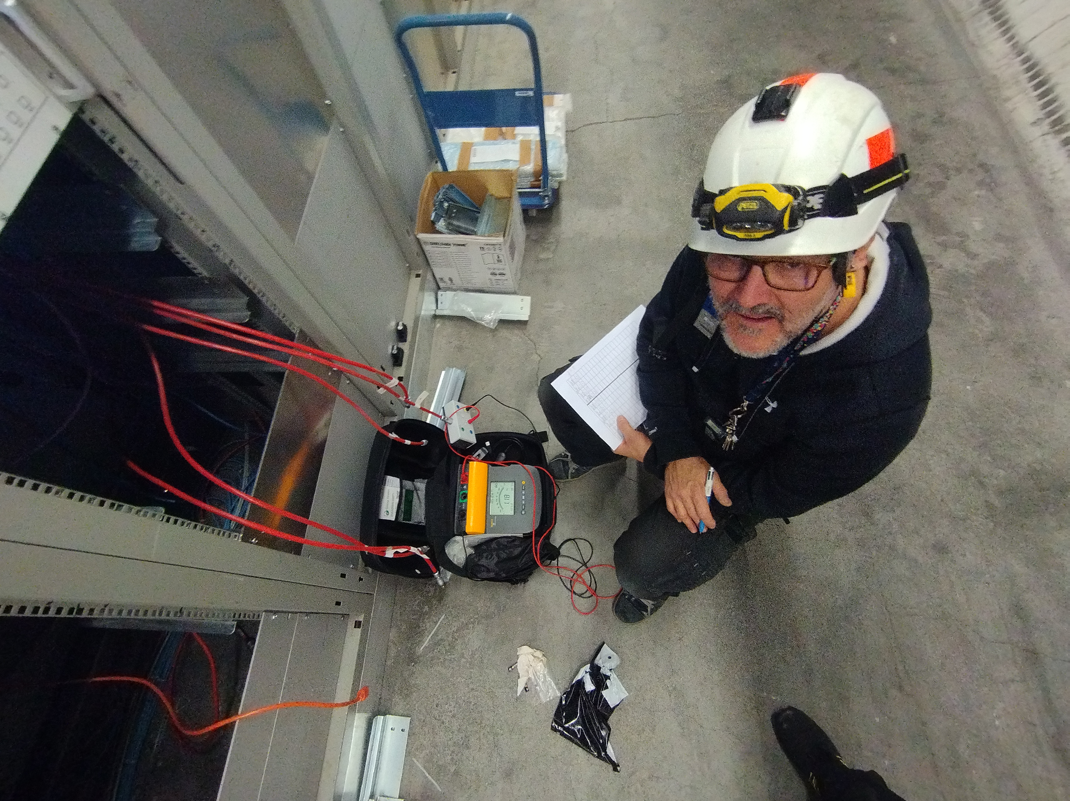
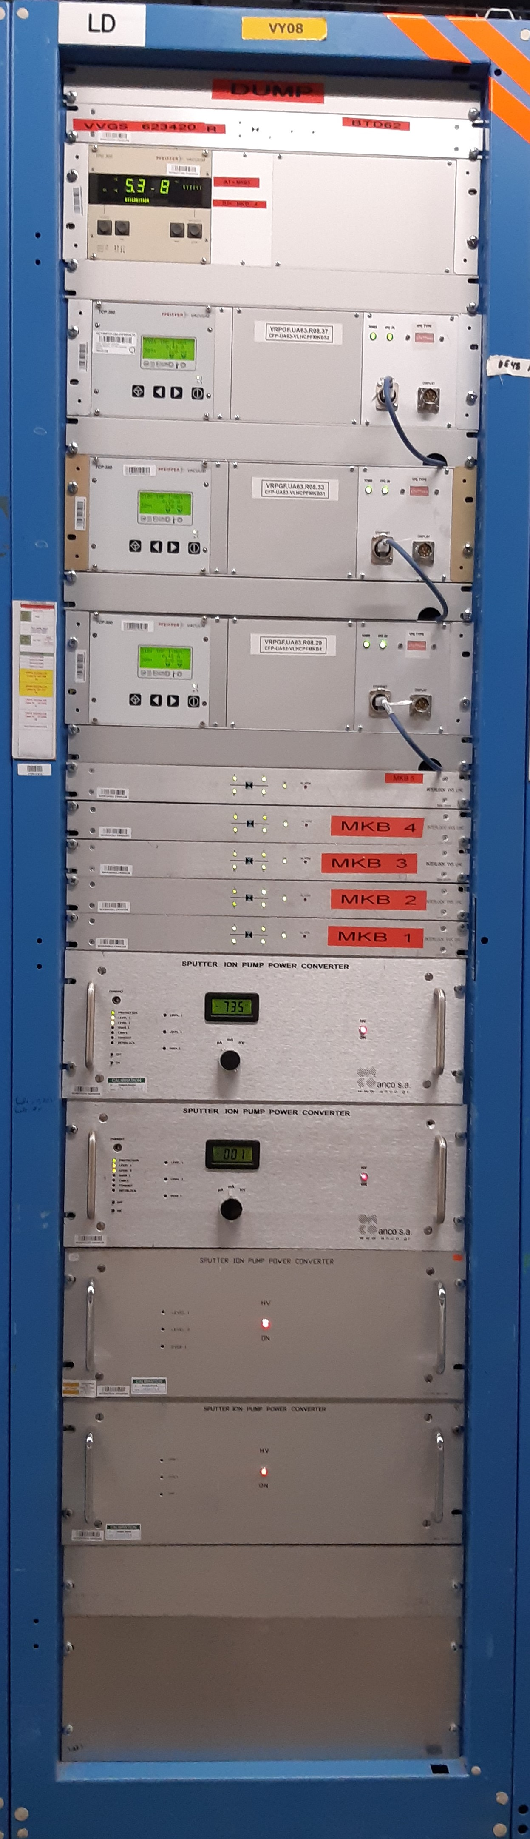
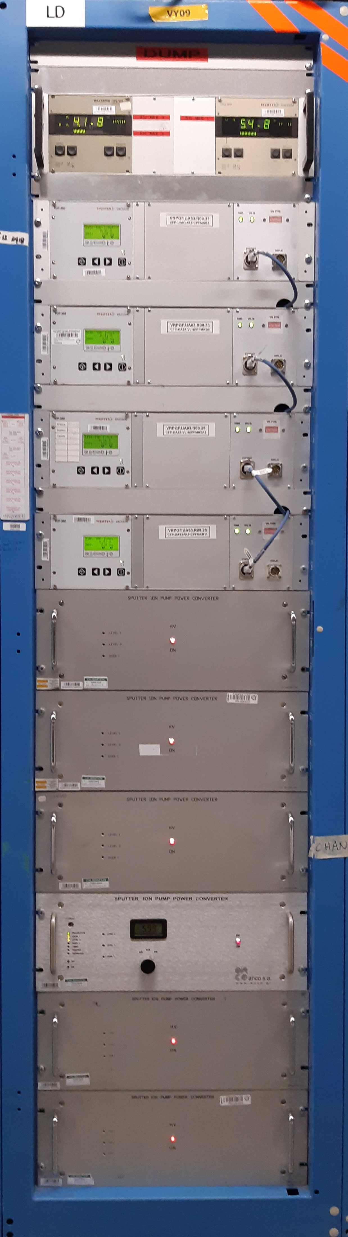
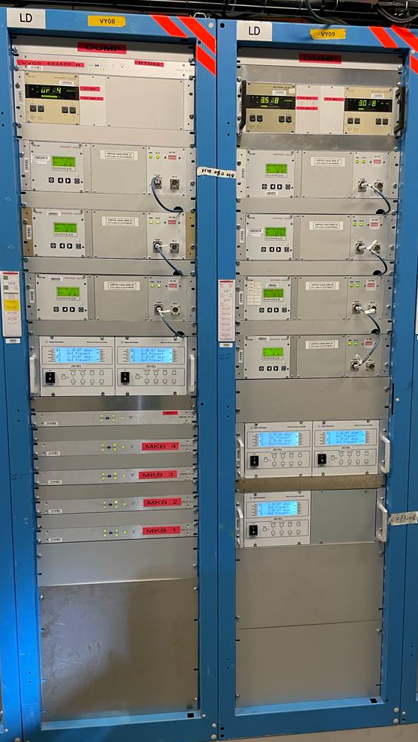
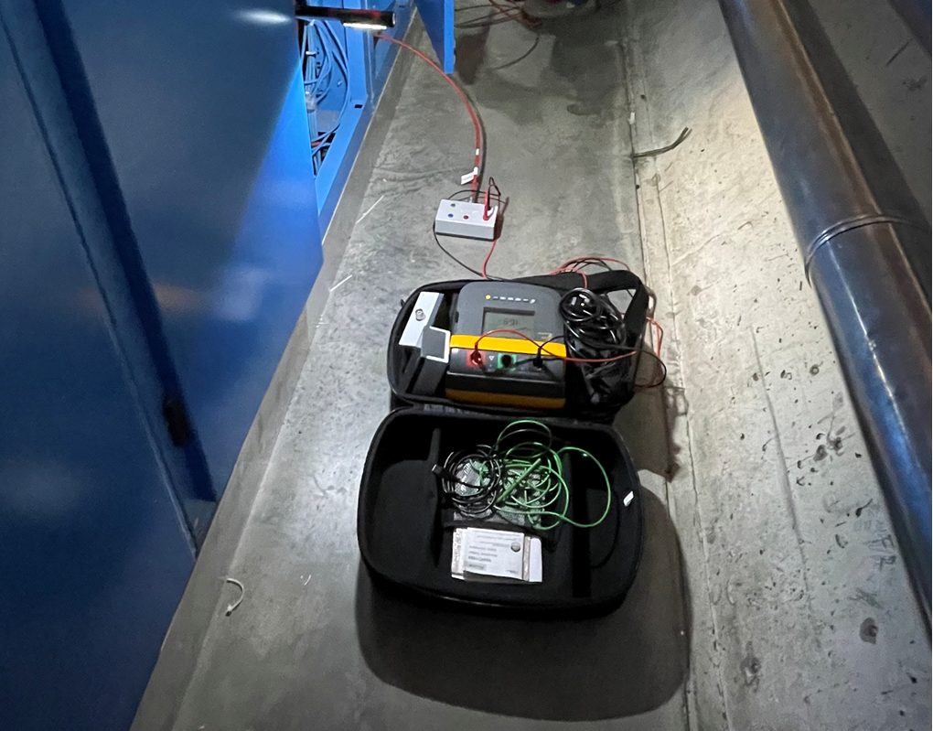
Ion pump controllers consolidation Point 6
    Racks installation at UA63 and UA67.
x75 LEP/LHC ion pump controllers exchanged - replaced by x39 Agilent 4UHV controllers.
More than x60 HV connectors changed from Jupiter to Fischer.
x74 HV insulation tests performed – x1 faulty cable replaced (DEC +DIC).
Interlock connectors changed from Binder 2P to Burndy 4P.
Testing and commissioning.
Labelling and asset updating at Infor EAM.
Vacuum Data Base updates.
High Voltage insulation test at UA67
1
5
2
6
3
7
4
8
9
10
6

Slide 7
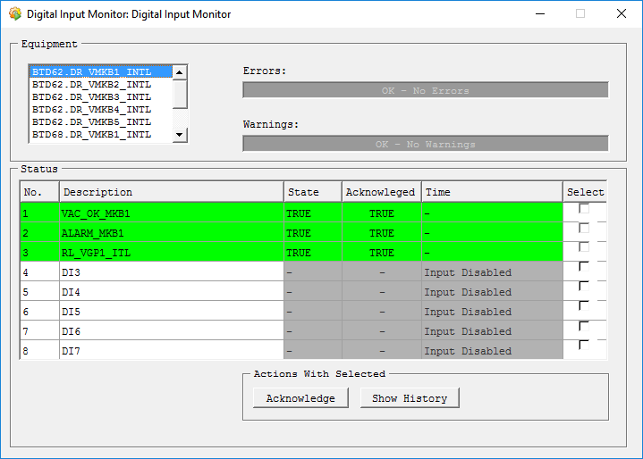
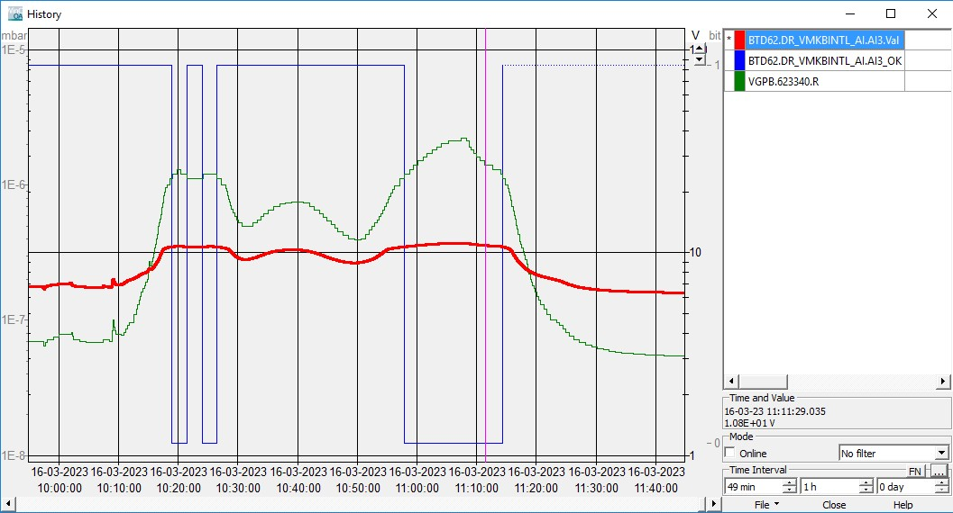
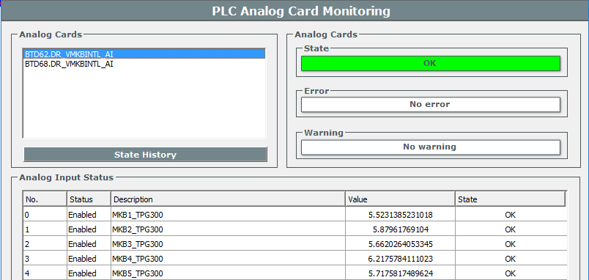
MKB vacuum alarm PLC crates
    MKB vacuum alarms monitoring PLC crate installation
Two PLC crates designed, manufactured and installed at UA63 and UA67 racks in order to monitor the MKB vacuum alarms that we send to SY-ABT.
Ensures the reading of essential events even if the signal changes faster than the SCADA acquisition time.
Isolation amplifiers used to send the signal in mA to the users, instead of Volts.
Analog input monitoring Penning signals.
Digital inputs monitoring Ion Pumps and Penning gauge digital signals.
New control type developed and tested – 8AI_VPLC
Testing and commissioning of the interlock signals with the users.
MKB interlock PLC installation
7

Slide 8
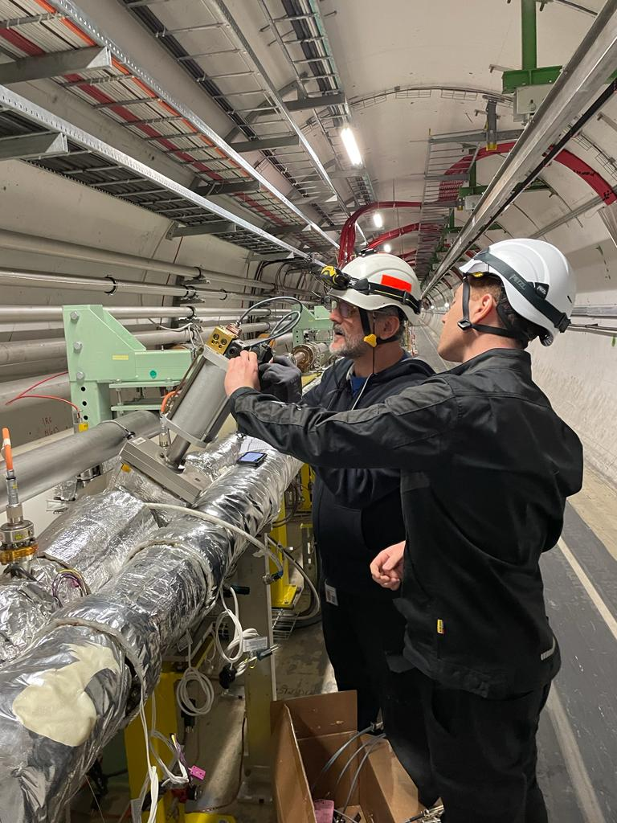
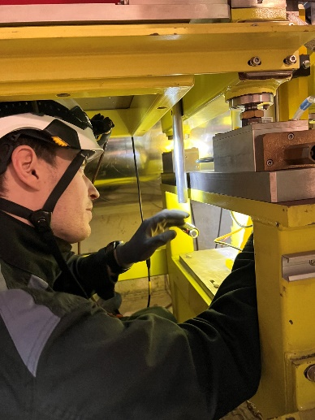
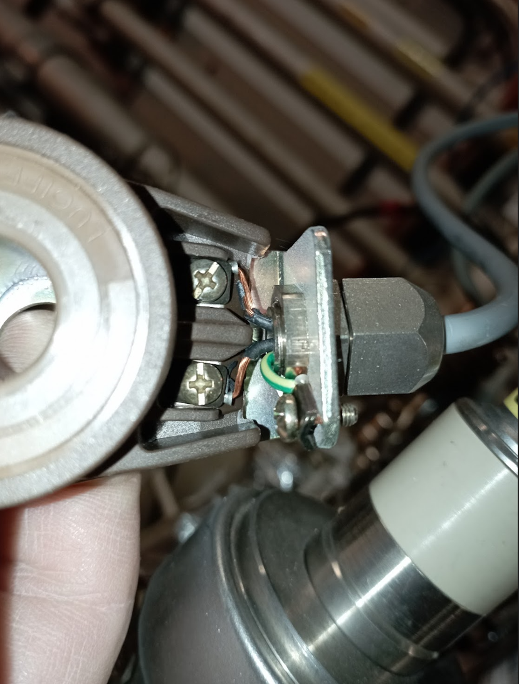
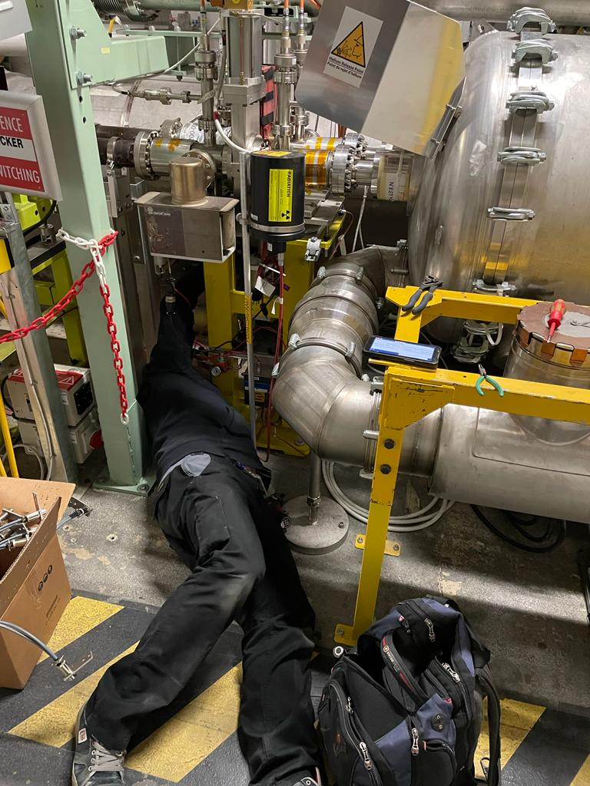
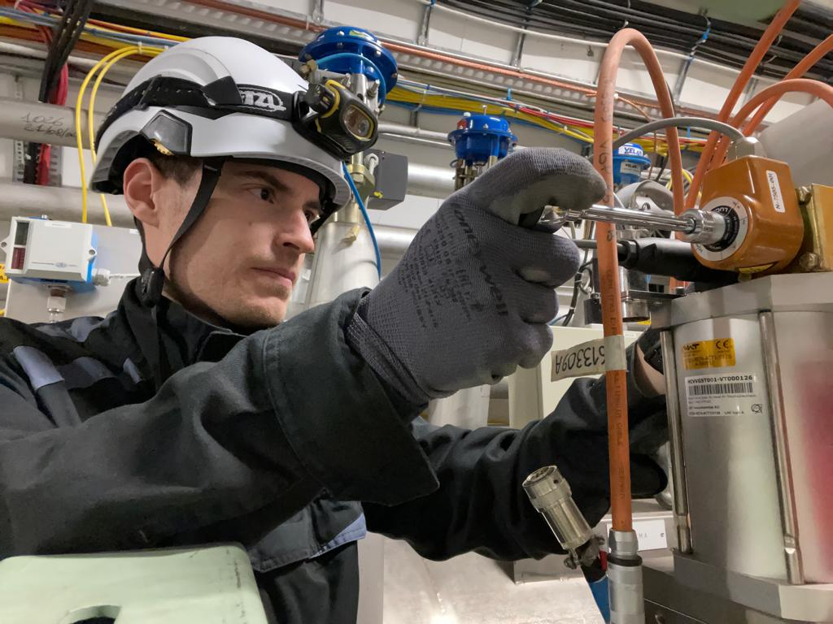
Sector valves consolidation
Coil & cable harness exchange due to radiation & temperature.
300 valves consolidated along w/BVO.
New cabling harness produced with
radiation & temperature resistant cable.
130 new coils installed.
Exchange of pneumatic distribution by BVO.
After installation, valves were commissioned.
Sector Valve coil cabling damage
8

Slide 9
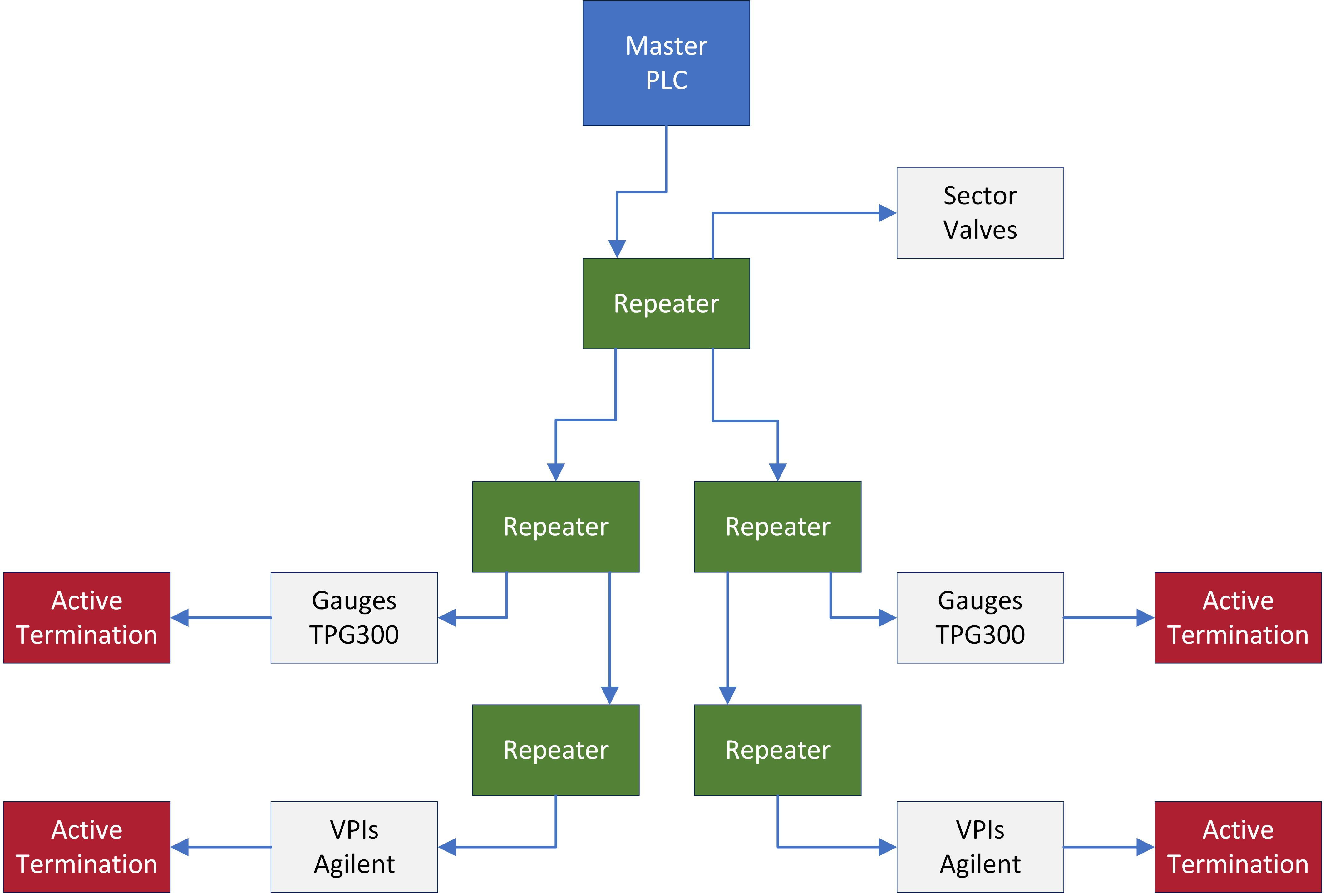
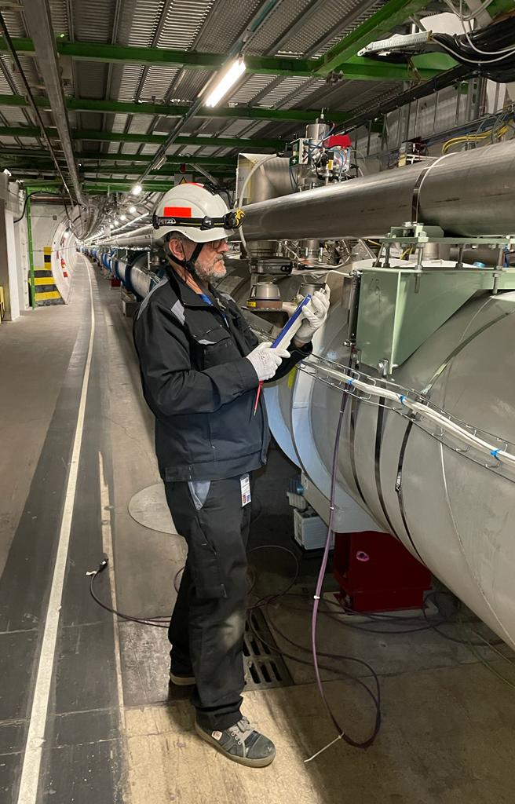
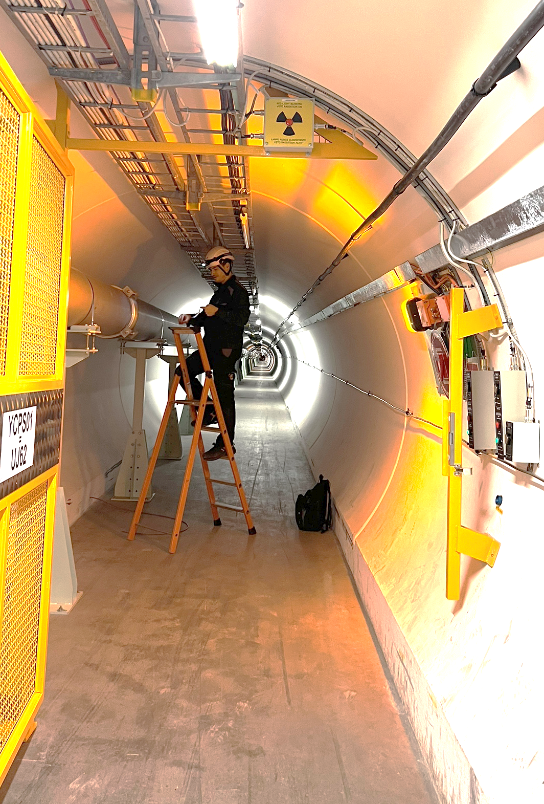
Profibus network consolidations
New Profibus network architecture for Point 6, Alice, CMS , LHCb & Point 3
Introduced a new Profibus architecture:
  Different segments according the equipment or site. 32 devices max per segment.
  Galvanic isolated with repeaters and active termination connected to UPS.
  Ensuring the strength of the data signal and improving reliability.
Point 6:
New Profibus cables pulled.
Different segments per controller type.
Full testing and commissioning of the lines.
Dump profibus line upgrades.
Alice, CMS & LHCb:
Cabling campaigns.
Isolation of mobile network between experiment and tunnel.
Point 3:
Isolation of Sector Valves network and Rack devices.
LHC tunnel profibus commissioning
Racks left side
Racks right side
UA63/UA67 Profibus architecture
9

Slide 10

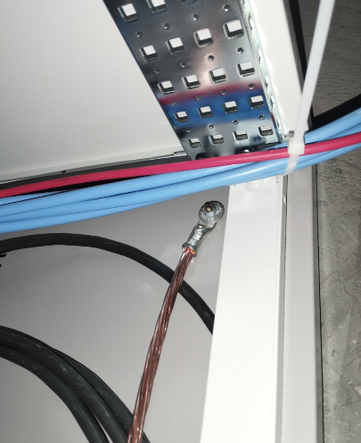
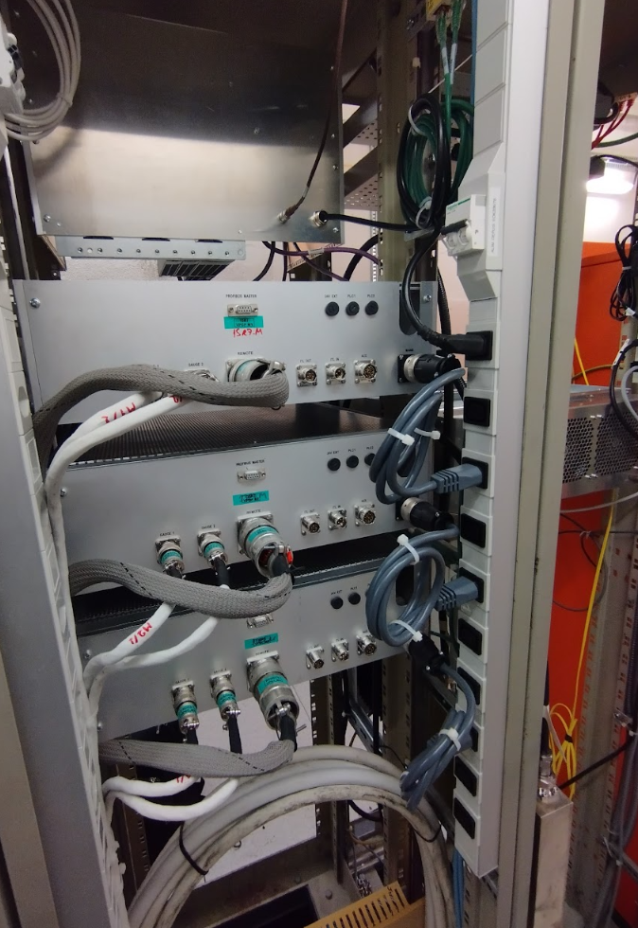
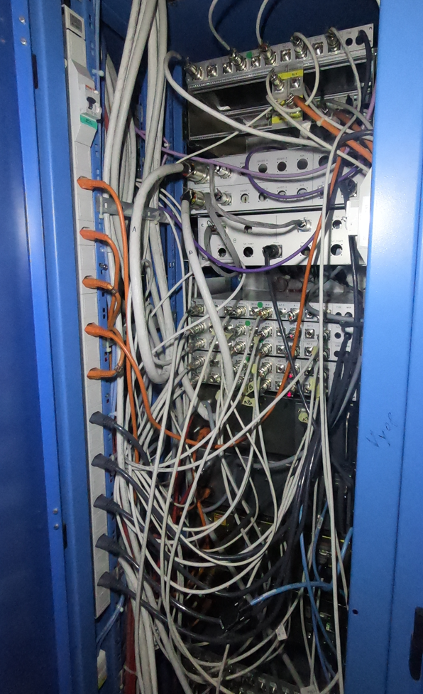
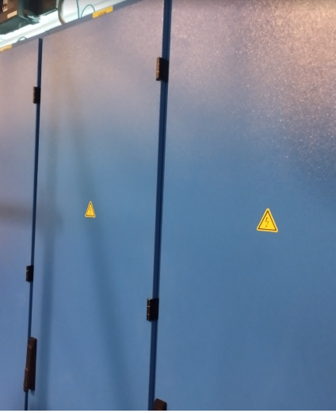
Electrical non-conformities campaign
Survey with DEKRA for all ICM Racks & equipment
Technical report made and notified to HSE.
Grounding of 250 mini-racks located in the tunnel.
Racks power strip sockets exchange:
  IEC type for UPS without RCD.
  Swiss type for general service with RCD 30mA.
  52 strip sockets installed in Alcoves and service areas.
All devices IP2X rating protection compatible.
Rack doors High voltage identification.
Mini-racks grounding
Alcove & service areas sockets installation
Electrical hazard identification
10

Slide 11
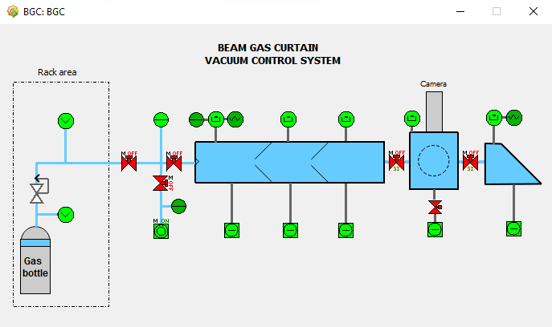





Beam Gas Curtain installation
De-Installation of BGI
Cabling campaign
Rack installation
Tunnel installation
SCADA development
Hardware tests
Gauge calibration & testing.
Commissioning
Beam Gas Curtain SCADA
BGC commissioning
TE/VSC/ICM – BVO – VSM
SY/BI/ML
BE-EA-EC
Cockroft Institute
11

Slide 12



BVO & IVO co-activities
ATLAS mobile profibus connection
MKB replacement:
Intervention at P6 to disconnect VPG, VPI, VGP & VGR cables.
Displacement of VPG mini rack & cable arrangement.
Reconnection, commissioning & re-starting of VPGs.
MKI Point 8 replacement:
Support to connect to Profibus mobile VPGs.
Sector Valves Interlock by-pass installation.
Gauges & VPI disconnection & re-connection.
ATLAS, CMS & LHCb
Support for Bake-Out rack Profibus connection.
VVGST.212.1L1.X sector valve by-pass installation & after removal.
VPIs & VGI lock out.
Insulation Vacuum:
Failed turbo pump controllers replacements.
MKB replacement
12

Slide 13



VPI heating collars installation Point 7
Cabling campaign
Upgrade of electrical distribution boxes. (EN/EL)
ECR made: LHC-VPI-EC-0001 v.1.0 EDMS 2804071.
New collars installation.
Heating collars installation Point 7
13

Slide 14


SCADA & PLC updates
Deployment of BGC system in LSSV4 (and removal of BGI)
LSSV6 changes:
  Consolidation of ion pump controllers to Agilent at LSS6V6.
  Re-arrangement of dynamic interlocks given by the Agilent controllers for the MKBs.
  Re-arrangement ion pump chains and interlocks.
  Deployment of MKB vacuum alarm PLC crate.
Insulation Vacuum VPGs:
  Primary pump current measurement added for all Q8s, ARC 12, 67 and 81.
  Turbo Pump Profibus communication for Sector 67 and 81
Release of latest Vacuum Framework SCADA.
14

Slide 15



Machine Check-out
Full BV vacuum testing and commissioning following Machine Protection procedure EDMS-896391
Automatic test script of Vacuum Sector Valves & interlocks
All BV interlocks and alarms shared with other systems checked (BIS, RF, MKI, MKB)
  Except cryogenics vacuum alarms (done end of LS2)
Minor issues found and corrected:
  Wrong cable connection (UA63)
  Wrong plugs connection (TZ76)
  Bad contact of one 24VDC PS in VR_BIC crate (UA87)
Vacuum / Machine Protection checkout reporting

Slide 16

Thank you!
Big thank you to all the colleagues from VSC & collaborators.
Questions?
Profibus consolidation leftovers

