Slide 1
ALICE Experimental Beam Vacuum Layout Upgrade in LS3
Orlando Santos on Behalf of the LHC Experiments Beam Vacuum Team
VSC Seminar
April18th 2023

Slide 2
Contents
Design Challenges and Approach
The ALICE Experiment
Overview of Changes During LS3
Structural Validation of the New Beam Pipes
Vacuum Performance Validation of the New Layout
Next Steps
Conclusion

Slide 3
How do we approach an Experiment’s Beam Vacuum Layout Change?

Slide 4

Project Requirements
See also Josef’s Seminar
April 12th 2019
Detector Performance
Machine Performance
Vacuum Performance
Structural Integrity
Safety
Integration
…
Vacuum Performance
Structural Stability
Manufacturability
Maintainability
Safety
Cost
Layout Transparency
Optimize Supports position and quantity
Integration Constraints
Ideal Layout
The best solutions come from the cooperative effort of many stakeholders.
A delicate balancing act several seemingly conflicting objectives!

Slide 5
Vacuum Design Approach
PROJECT REQUIREMENTS
DETAILED DESIGN
Detector Performance
Machine Performance
Vacuum Performance
Structural Integrity
Safety
Integration
…
YES
Conformity with all project requirements?
NO
CONCEPT SELECTION
VACUUM AND STRUCTURAL VALIDATION
Vacuum Performance
Pump-down;
Static Vacuum
Dynamic Vacuum
Structural Integrity
Support Reactions
Deformation Under Load
Yielding
Buckling
Also Important:
Manufacturability
Integration
Installation
Maintenance
PRELIMINARY DESIGNS
Evaluate Different Alternatives
Preliminary Layouts
Simplified Analysis Models

Slide 6
The ALICE Experiment

Slide 7
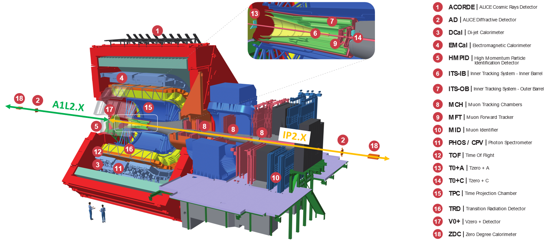
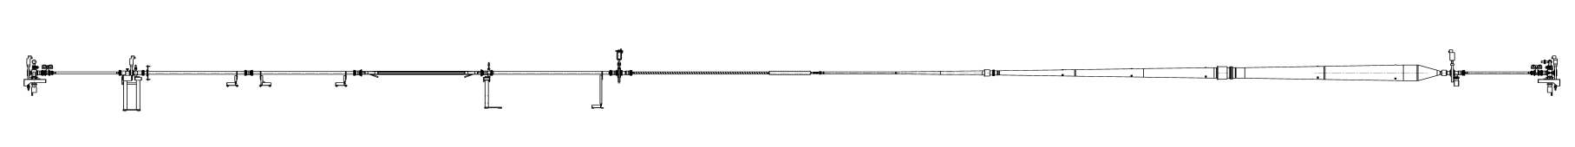
The ALICE Experiment
A1L2.X
IP2.X
A1L2.X
IP2.X
14.3 m
24.0 m
Mini-Frame Platform
Notes:
The ALICE (A Large Ion Collider Experiment) is an LHC Experiment designed to study the Quark-Gluon Plasma (QGP) formed in heavy-ion collisions.

Slide 8
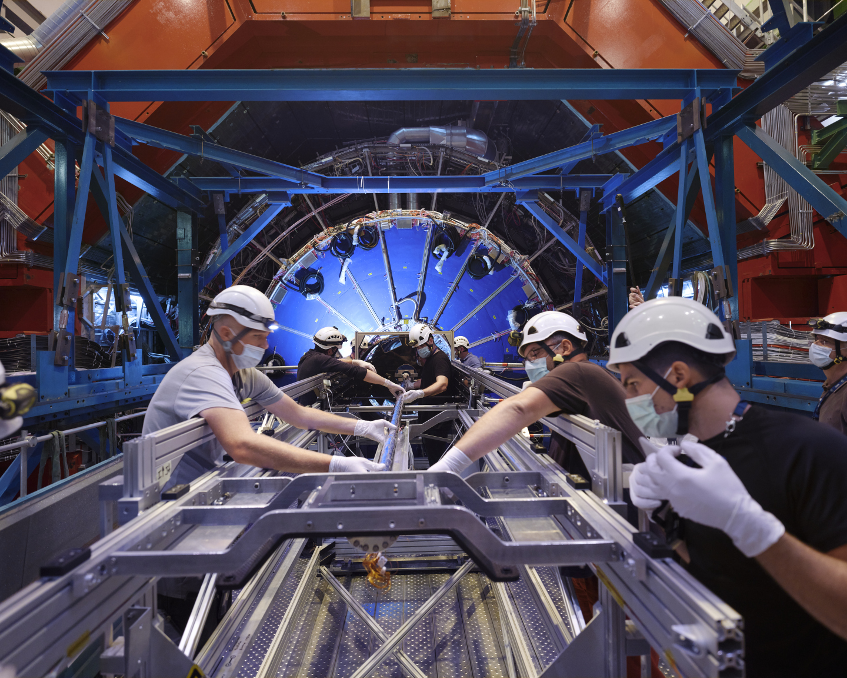
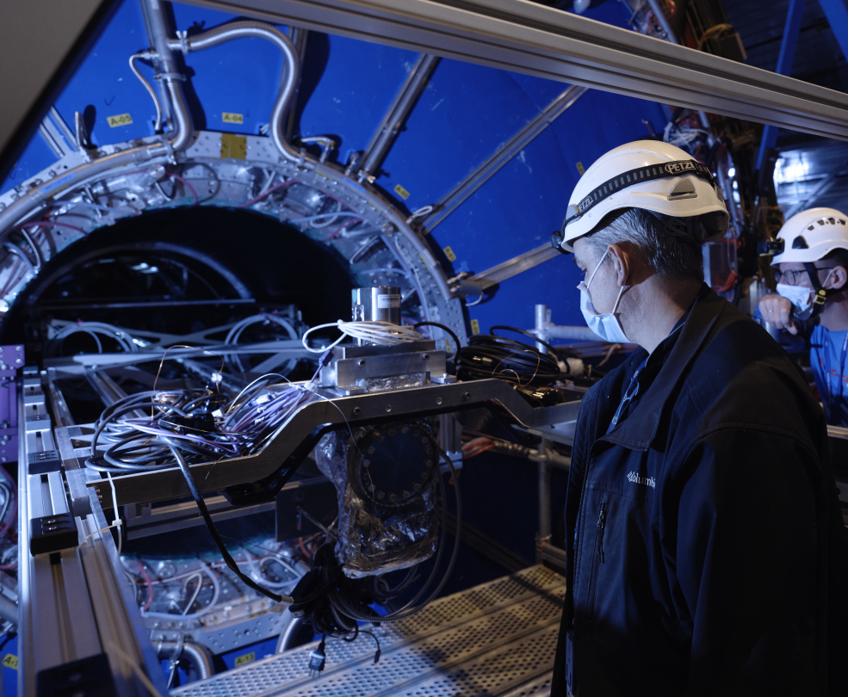
Installation of the central chamber through Time Projection Chamber (TPC)

Slide 9
Carbon Table with Valve Between IP2.X and A1L2.X
Mini-Frame Area as Installed During the LS2

Slide 10
What Changes In LS3?

Slide 11
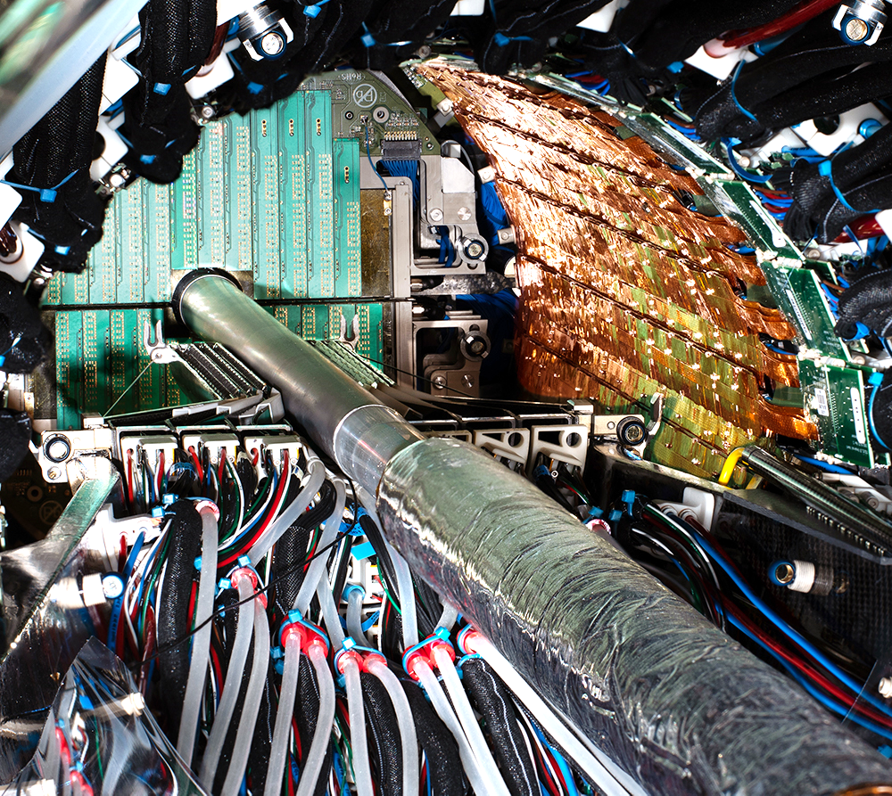
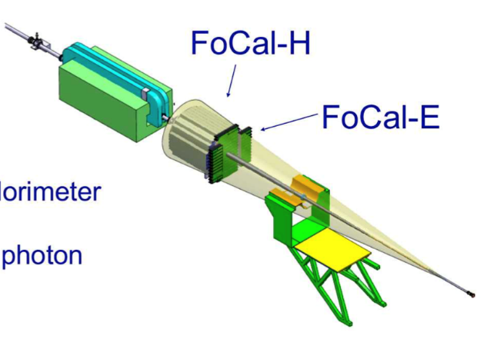
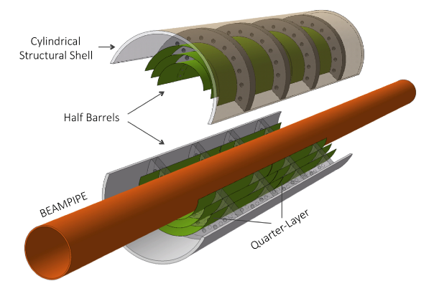
What upgrades does ALICE foresee for LS3?
Two projects with a significant impact on the vacuum layout are expected in LS3:
  New vertex detector (ITS3) with the innermost layer positioned at only 18 mm radial distance from the interaction point.
  New Forward Calorimeter (FoCal), 7m to the IP’s left, requires a low material budget in 3 < η < 6.
ITS3
Current Central Beam Pipe With half of the Inner Tracker (ITS) and Muon Forward Tracker (MFT)
The upgrades already obtained the approval of the TREX working group and the LMC Committees.
A. Collaboration, "Letter of Intent for an ALICE ITS Upgrade in LS3," ALICE-PUBLIC-2018-013, 2018.
A. Collaboration, "Letter of Intent : A Forward Calorimeter (FoCal) in the ALICE experiment," CERN-LHCC-2020-009, 2020.

Slide 12
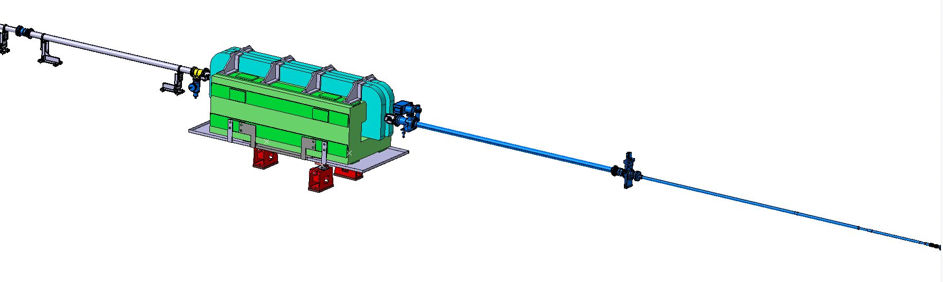
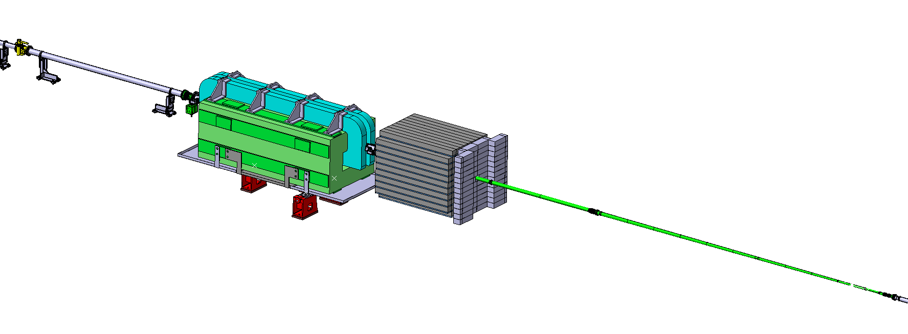
LS3 ALICE Vacuum Layout
Sector valve assembly Suppression:
Neon Venting during YETS (as in the other IPs)
RUN3
(LS2)
  Suppression of valve between sectors IP2.X and A1L2.X
X
2
  Relocation of vacuum pumps and instrumentation
X
4
X
RUN4
(LS3)
  New Beam Pipe for the FoCal region
3
  New Central Beam Pipe
1
Opportunity to Improve:
  Pressure Measurement Reliability
  Pumping Configuration
  Mechanical Supporting

Slide 13
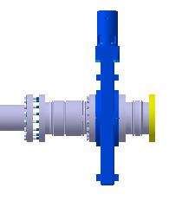

New Central Beam Pipe
Spare Beam Pipe Strategy:
Al Conical Section
0.8mm-thick Be Central Segment
The new central beam pipe has been optimized for transparency.
RUN3:
 | Aluminium
 | Beryllium
ID=36.4mm ; t= 0.8 mm
1
158 mm Longer
5643 mm (Free Length)
Sliding Point Interface Kept
Central Section with Reduced Dimensions
IP
Same Bellows
4
RUN4:
5
2
ID=32mm ; t= 0.5 mm
LHCVC2C_0092
3
Conical Be Section with ≈9 segments
Transition ID 32 → 58mm (~0.34°/Ø)
Gradual thickness increase (0.8 → 1 mm)
4
Same Bellow Design as that of RUN3
  Reduced Stroke requirements
  Same 15mm pre-extension
  No need for design qualification
  Production tooling already available
D_{in}=41.4
D_{out}=56.2
  ID 58mm Helicoflex Flange
  Support Collar
289 (Free Length)
6

Slide 14
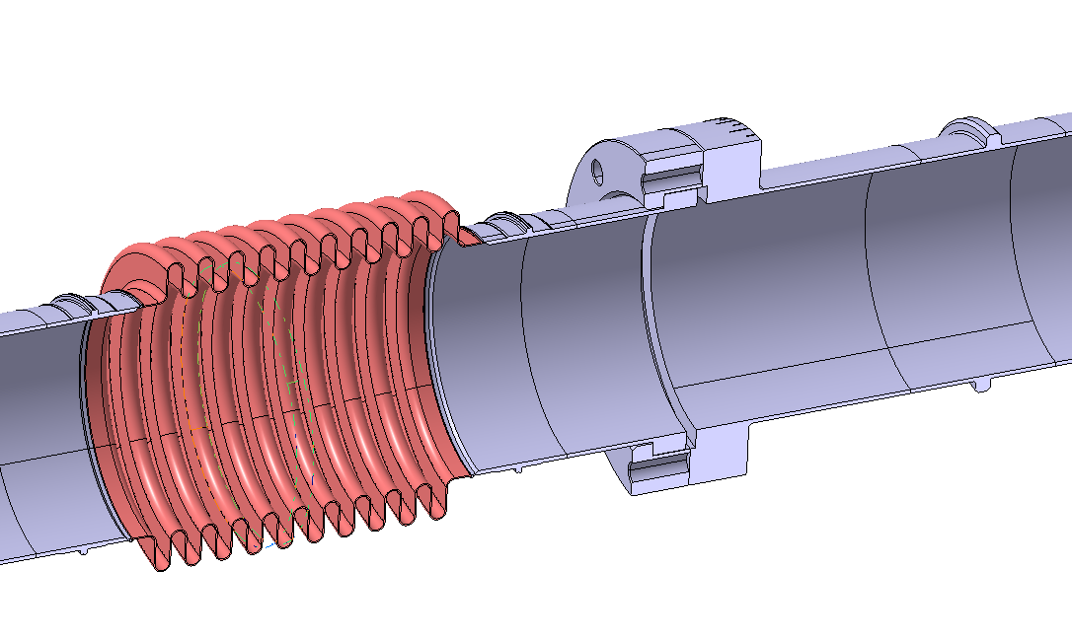
New FoCal Beam Pipe
3872.5mm
FoCal-H
FoCal-E
LHCVC2F_0001
5
1
EN AW-2219
4 segments
ID=58 mm; t=1mm
(During Bake-Out)
DN100 Bi-Metallic CF flange
Transition ID 58→63mm
  Minimized Sliding Collar Interfaces
2
ID 58mm Helicoflex Flange
New aluminum beam pipe optimized for transparency, crucial for the FoCal.
Optimized supporting within FoCal “blind spot”.
The bellow must be between the central and the new forward calorimeter:
  Accommodate the focal beam pipe’s thermal expansion during bake-out/NEG activation.
  Independent alignment of the TPC and mini-frame platform
4
D_{e} =79 mm
3
D_{i} =58 mm
Integrated Bellow:
Design based of ATLAS VA Bellows
EN AW-5083
10 Convolutions
Thickness=0.3 mm
Notes:
Add a note explaining that the fix point will be included in the bellow
Add ST Numbers

Slide 15
Ion Pump Configuration
Different configurations were evaluated:
Vacuum performance
System redundancy
Risk of equipment damage
Integration Possibilities
Preferred Solution:
Two ion pumps (20 l/s) upstream of the compensator magnet.
Final design to optimize as function of the magnetic field
A) Maintain RUN3 Configuration: VPIAN Downstream of Compensator Magnet
B) 2 x VPIXD Downstream of Compensator Magnet
Preferred Solution
C)2x 20 l/s Pumps (VPIXD) Upstream of Compensator Magnet

Slide 16
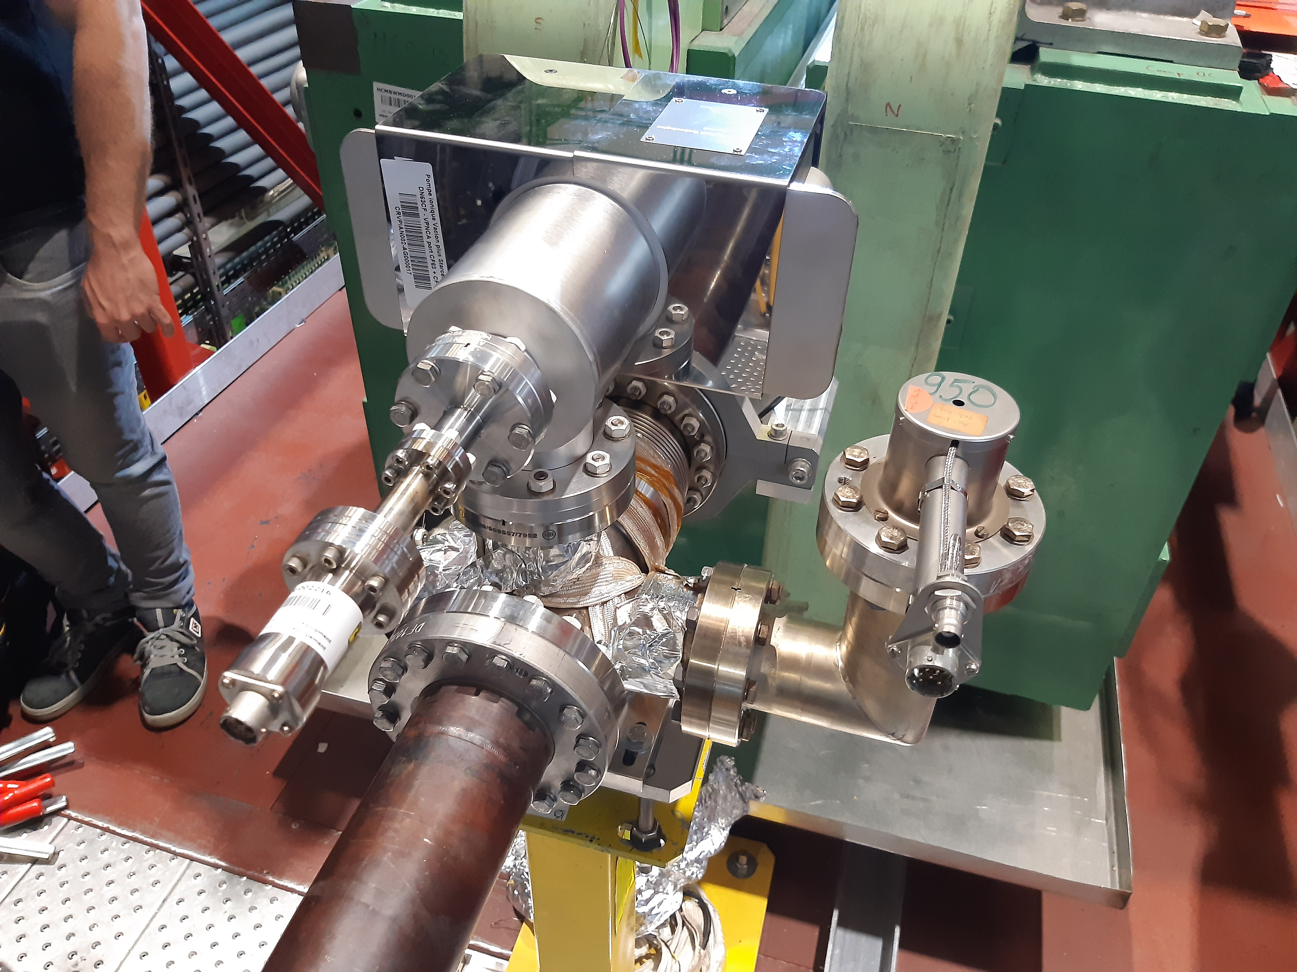
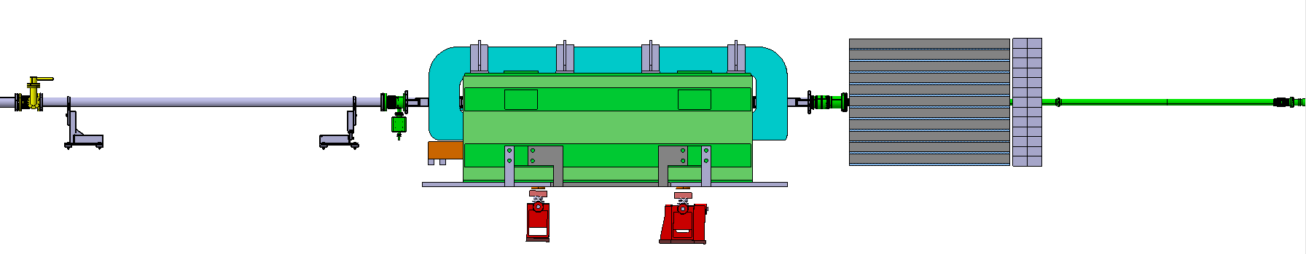
Other Changes to the Forward Region
Displacement of the VGI next to the compensator magnet:
Unclutter FoCal Area
Reduce magnetic field induced errors
Removal of the VVFMF pumping port of the current A1L2.X for system safety
LS3
LS2
Notes:
A deformable RF bridge for IP2.X warm modules is under study (more reliable solution).

Slide 17
Structural Validation of New Beam Pipes

Slide 18
Load Cases Analysis
Full Report
EDMS 2795087
The impact of each load case on the beam pipe’s structural integrity must be analysed.
Phase | Potential Impact on Mechanical Design
Vacuum tests & NEG coating | He-leak test with a 1.5 bar external pressure Local and global buckling (worst case) Exceptional load cases for mishandling: Shock Inadequate Supporting The twisting moment applied upon screw tightening
Installation | Bellow radial misalignment. Inadequate supporting
Bake-out of Experiment | Sag evaluation with bake-out equipment installation Safety against yielding
Operation | Safety against yielding Sag must be compatible with the machine aperture Natural frequencies in operation configuration
Maintenance | Accidental System Over-Pressure with 1.5 bar of Ne during venting
Phase | Potential Impact on Mechanical Design
Vacuum tests & NEG coating | He-leak test with a 1.5 bar external pressure Local and global buckling (worst case) Exceptional load cases for mishandling: Shock Inadequate Supporting The twisting moment applied upon screw tightening
Installation | Bellow radial misalignment. Inadequate supporting
Bake-out of Experiment | Sag evaluation with bake-out equipment installation Safety against yielding
Operation | Safety against yielding Sag must be compatible with the machine aperture Natural frequencies in operation configuration
Maintenance | Accidental System Over-Pressure with 1.5 bar of Ne during venting

Slide 19
Load Cases
Two main groups of simulations, w.r.t. supporting configurations:
Assembly of both beam-pipes (with bellows) as installed on IP2.X
  Stepped sequence with installation, pump-down, bake-out, and operation loading cases
  More accurate; Accounts for bellows’ plastization effects.
IP
2) Beam Pipe Supporting Configuration in Vacuum Acceptance Test
  Bake-out of acceptance tests is worst case scenario for buckling.
  Lower Elasticity Moduli, Greatest Compressive Load
Bellow Stiffener
P_{atm}

Slide 20
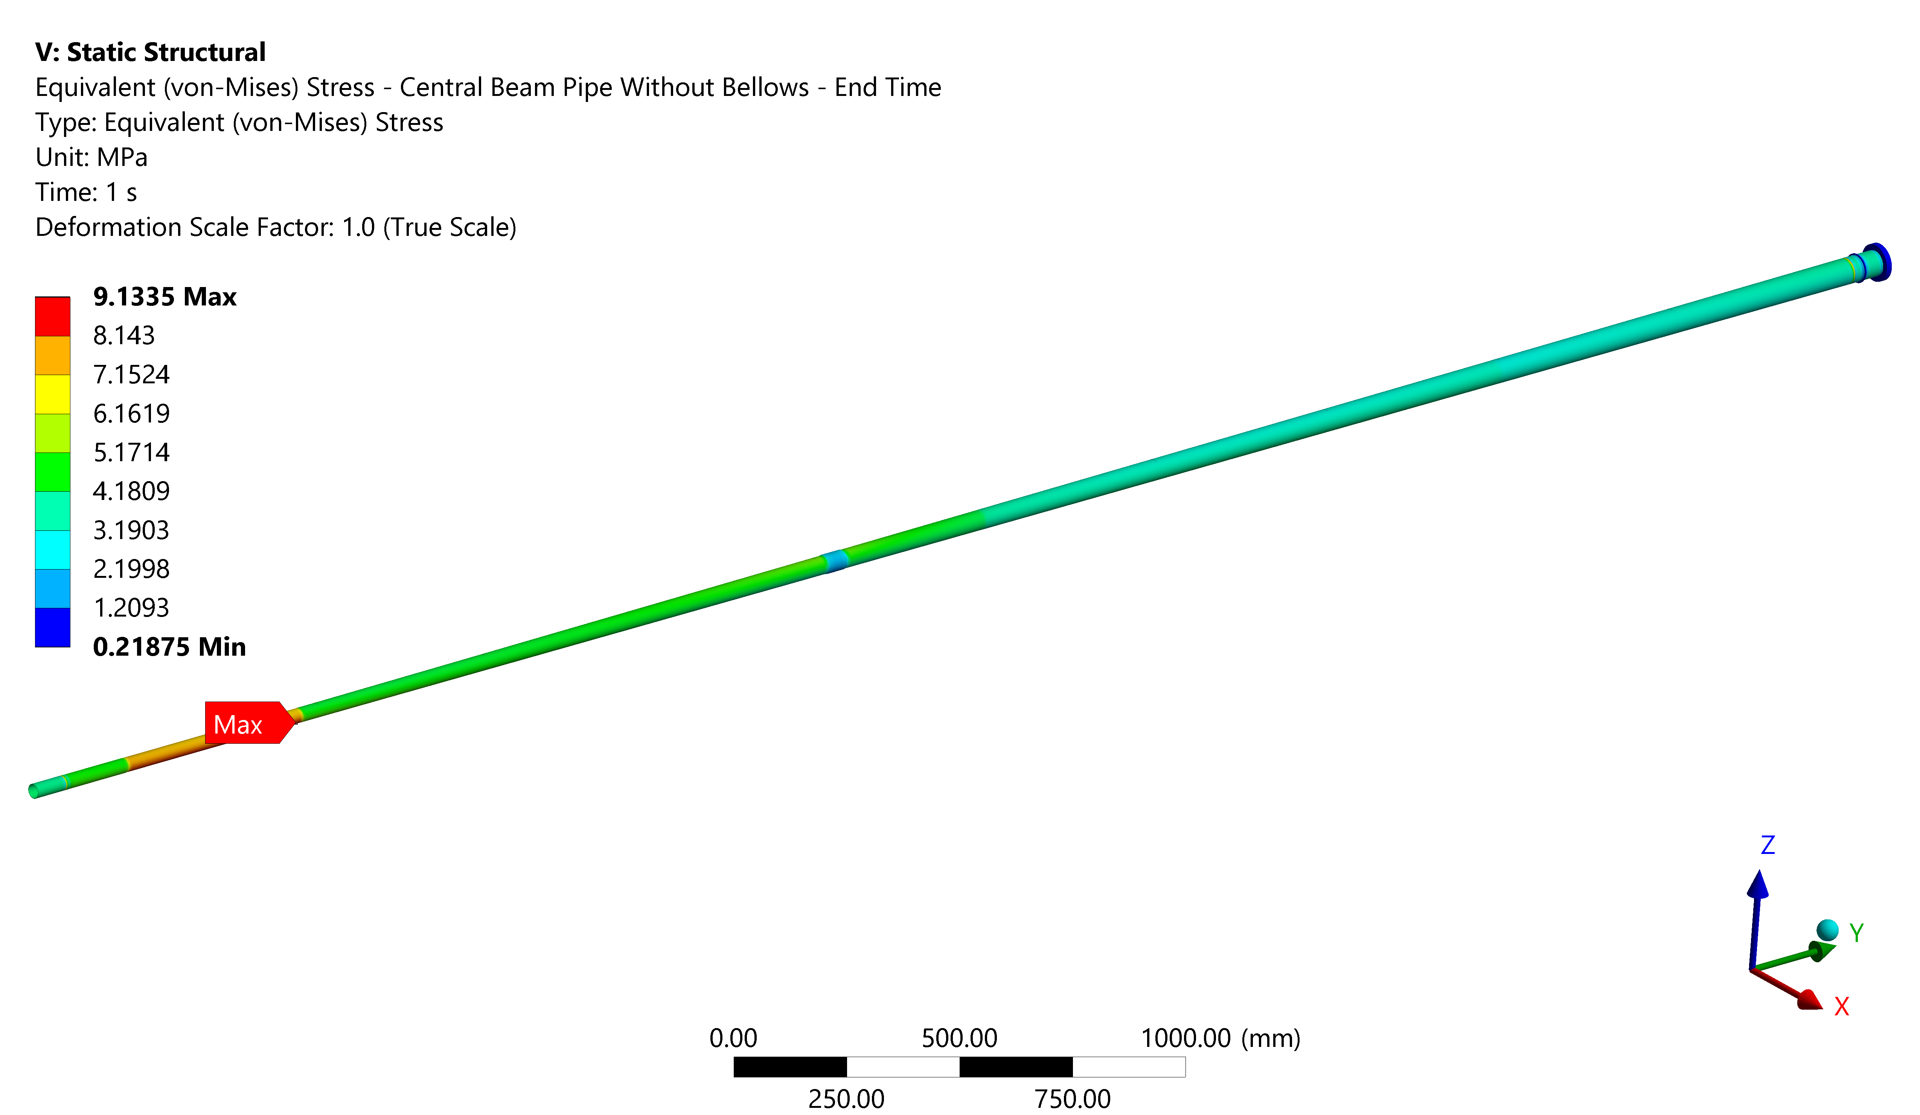
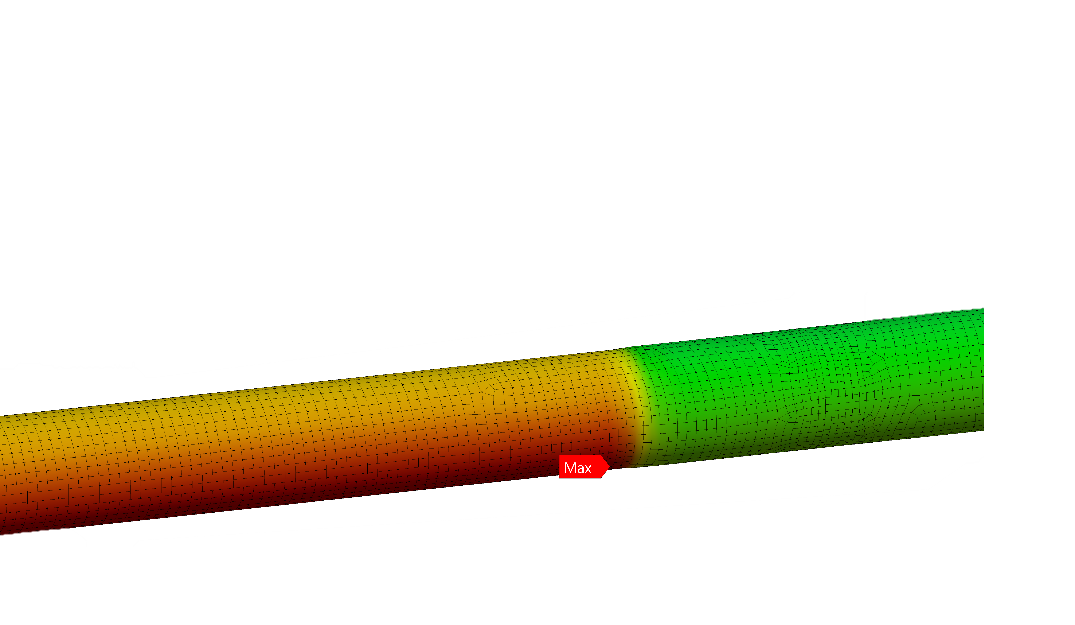
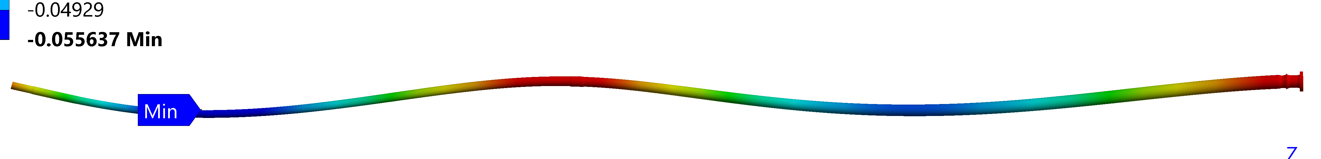
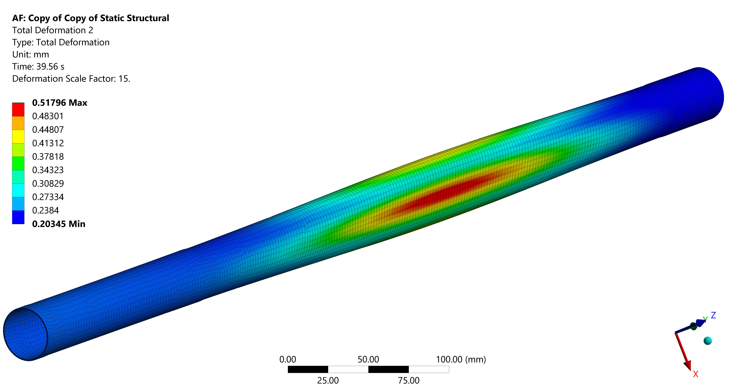
Central Beam Pipe Structural Studies
Operation
Buckling Analysis in Acceptance Test Configuration
Eq. Stress (Von-Mises) - Operation
(Bake-Out Expansion : 20 mm [@250ºC])
Linear Local Buckling Analysis
Segment | P_{crit} [bar]
Be t=0.5mm | 24.5
Be Cone t=0.8 mm | 43.8
Be Cone t=0.9 mm | 35
Be Cone t=1mm | 35
Max = 9.1 MPa
Non-Linear Analysis of most critical segment:
Beam Pipe Sag - Operation
Non-linear Buckling
Maximum Vertical Displacement = 0.06 mm
P_{crit} = 15 Bar
Natural Frequencies in Operation [Hz]: 52.3, 79, 183, 229.3
P_{crit} ≈ 15 bar

Slide 21
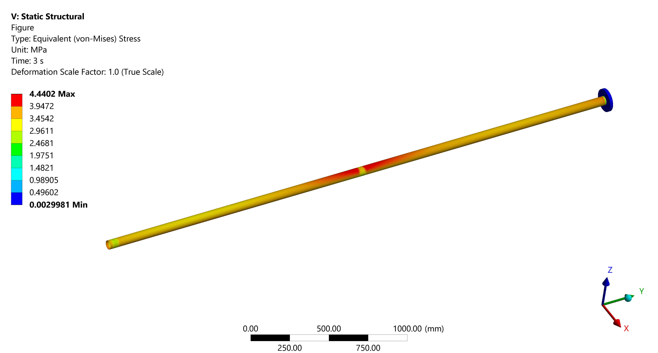
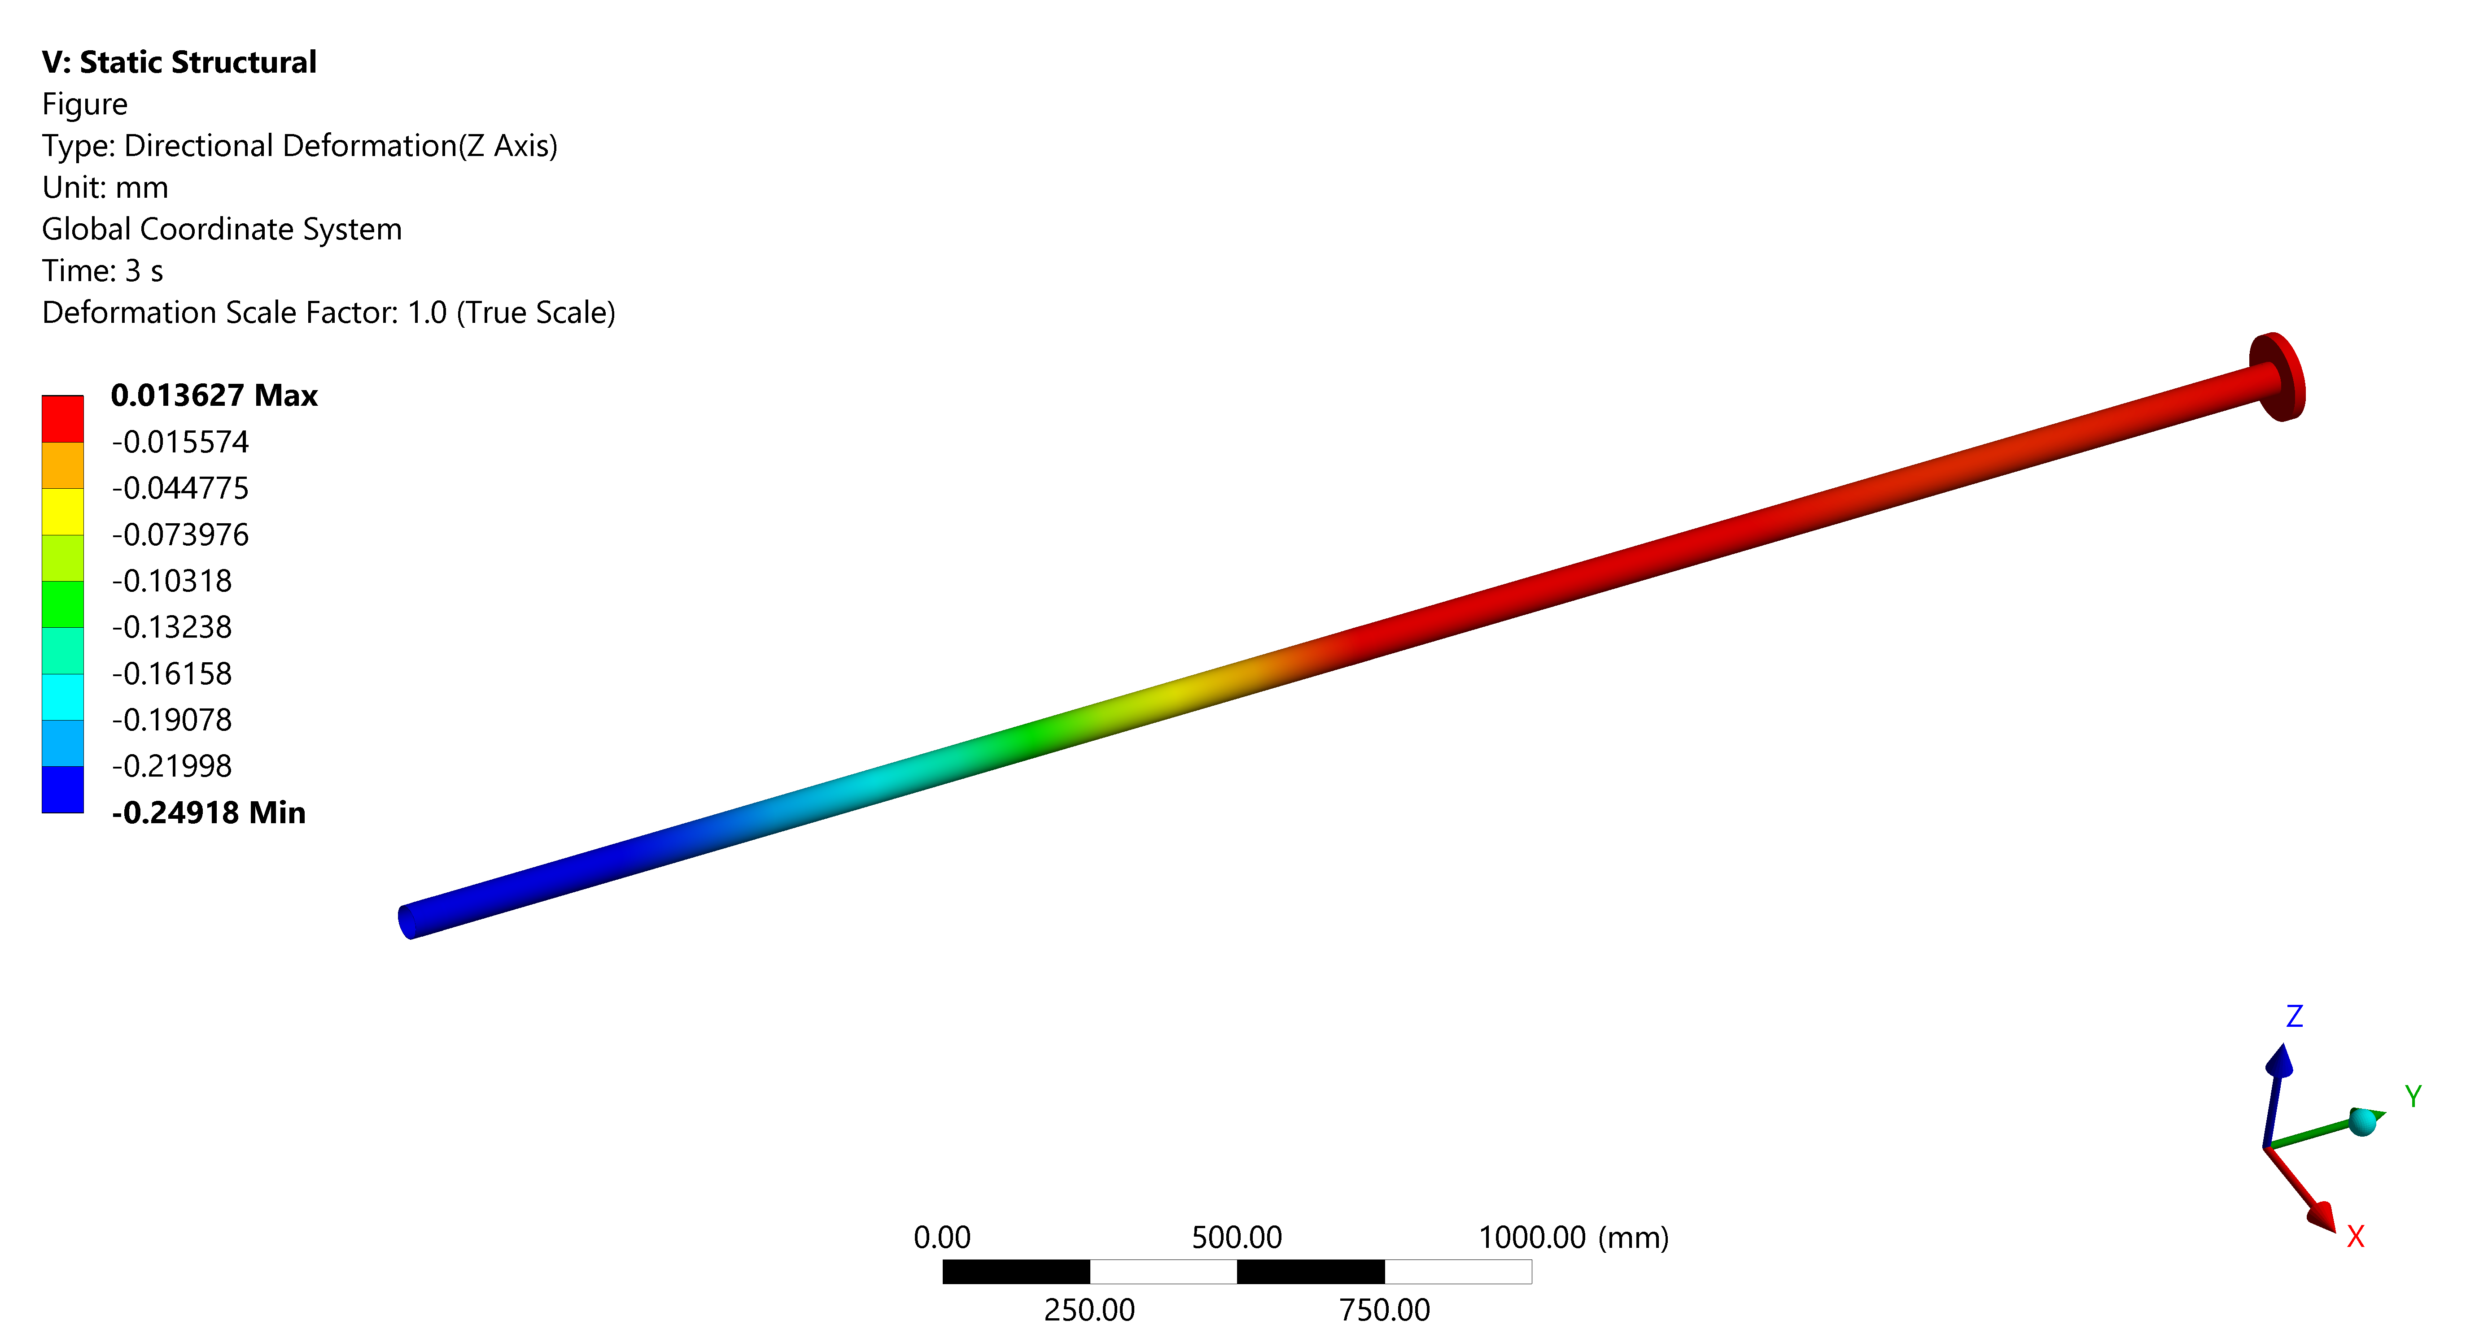
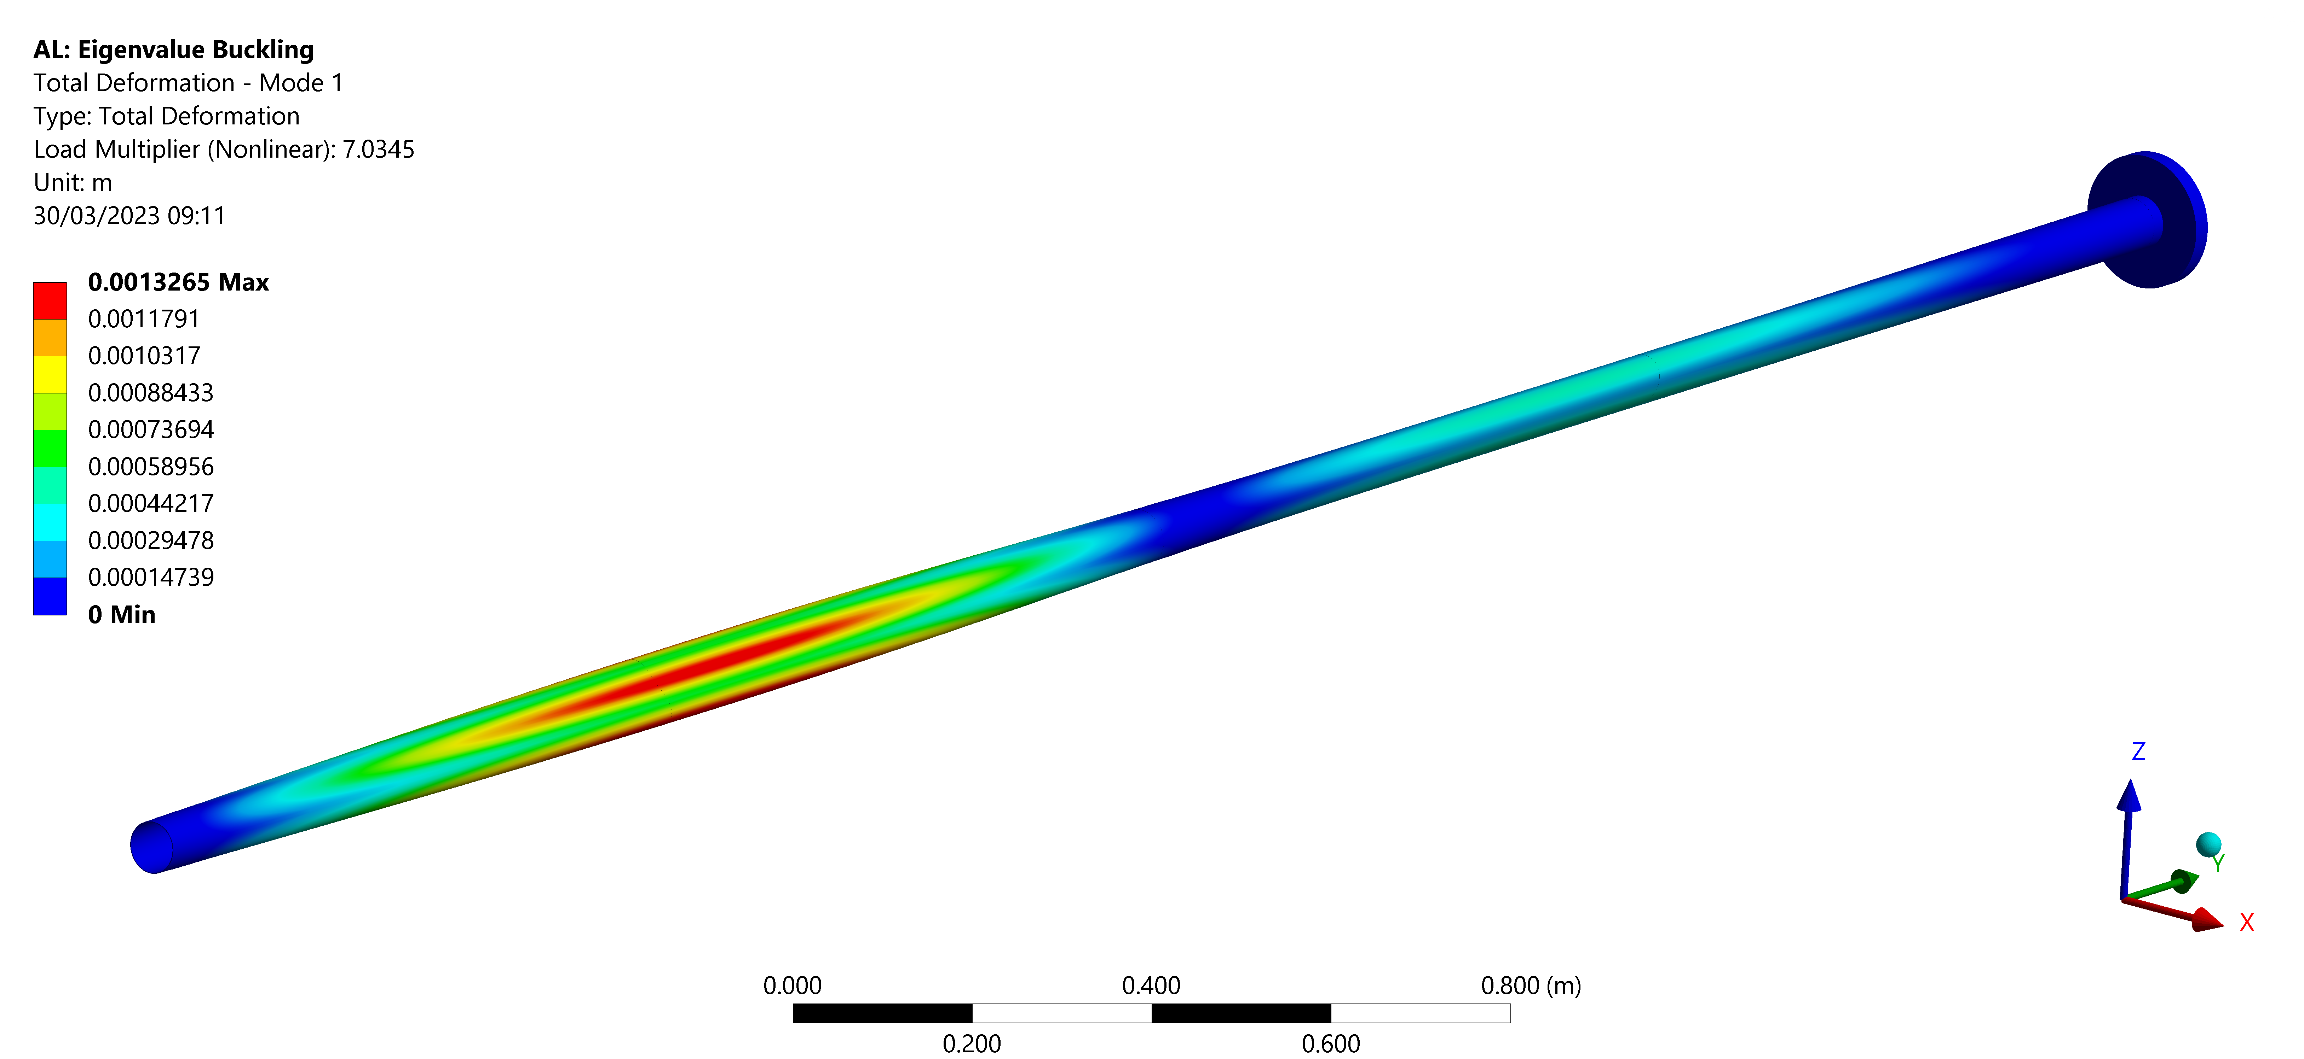
FoCal Beam Pipe Structural Studies
Operation
Eq. Stress (Von-Mises) – Operation [MPa]
Beam Pipe Sag – Operation [mm]
Max = 4.4 MPa
Max Sag = 0.25 mm
Natural Frequencies In Operation [Hz]: 40, 47, 85, 114,…
Buckling Analysis
Acceptance Test Configuration
Non-linear Buckling – BO during Vac Acceptance
P_{crit} = 6.6 bar
(Bake-Out Expansion: 20 mm [@250ºC])

Slide 22
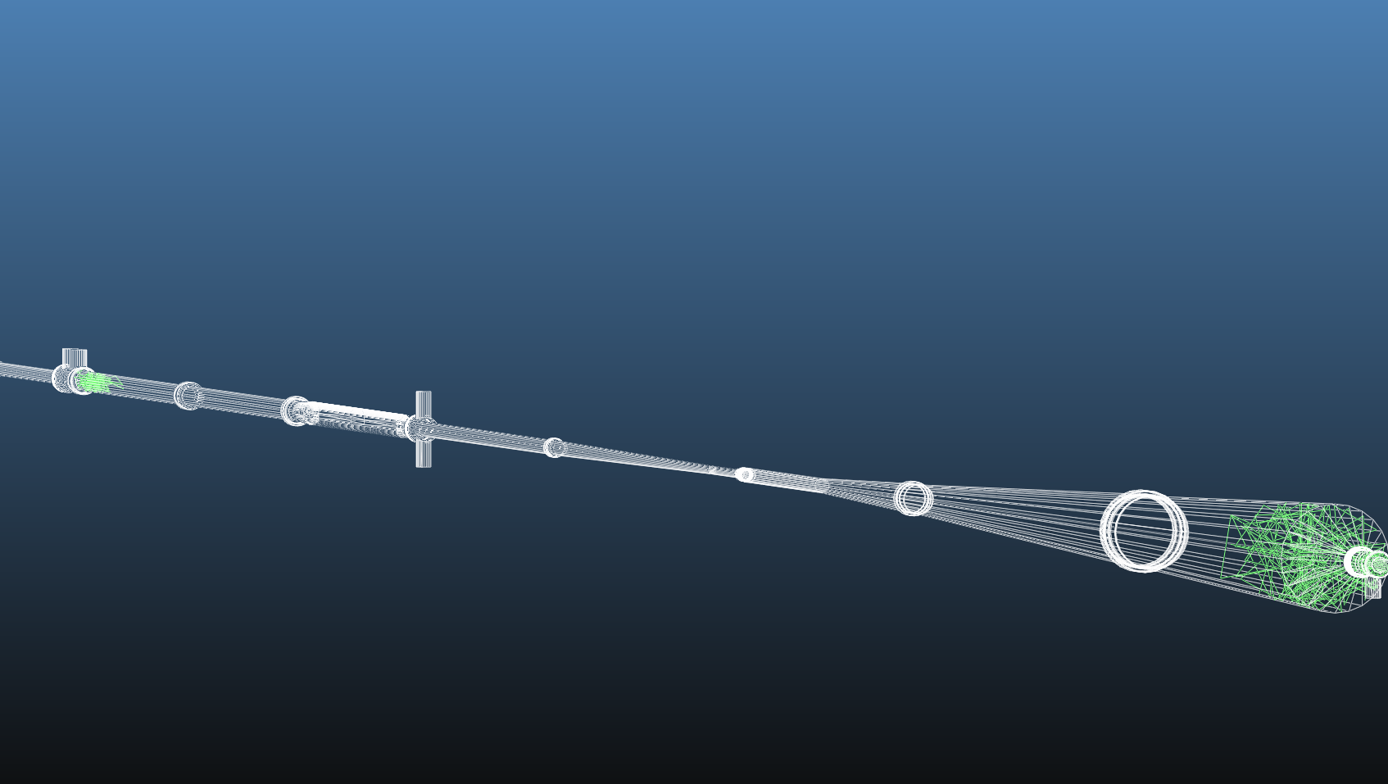
Vacuum Performance Simulations

Slide 23
Vacuum Performance Simulations
Full Report Under Review
EDMS 2883307
Different operation scenarios simulated for with different ion pump models and locations.
With the suppression of the sector valve assembly, vacuum performance improved for all configurations.
Preferred Choice:
Two 20 l/s ion pumps (VPIXD) upstream of the magnet:
  Improved vacuum performance.
  Unclutters the area new the new FoCal detector.
  System redundancy in case of failure.
Pressure profile calculated for all operation stages accounting for dynamic effects with the new version of VASCO.
Approximate photon flux obtained with SynRad.
Same Input parameters used for HL-LHC simulations (EDMS 2694563)

Slide 24
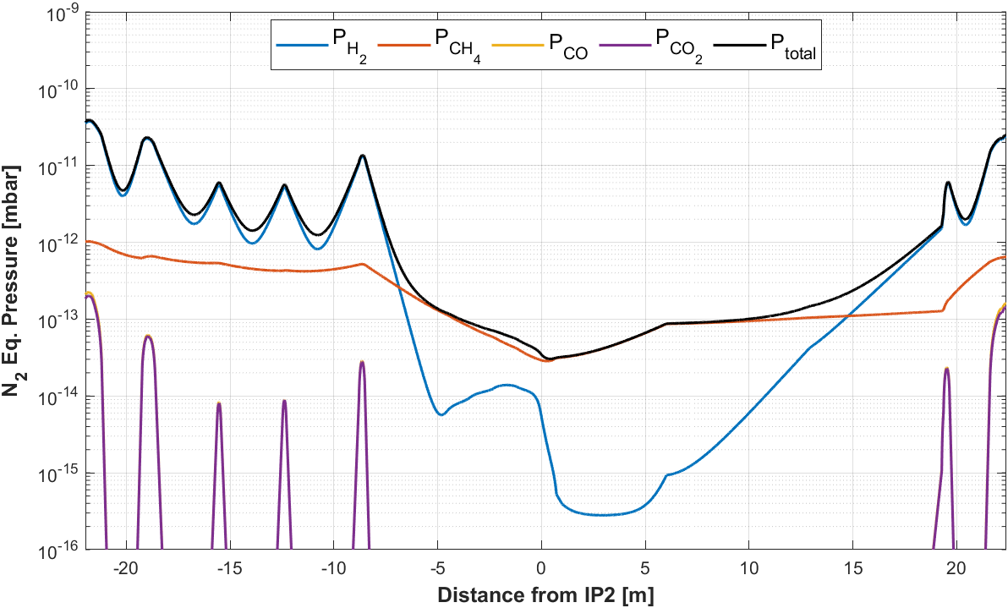
Expected Pressure Profile
Pressure with nominal HL-LHC beam
(After Complete Conditioning)
Static Pressure
CH₄ is the dominant gas in the central region (-7 to +15m), where the pressure is at or below the 10⁻¹² mbar range.
H₂ dominates in the VAX sectors and IP extremities, with maximum pressures in the 10⁻¹¹ mbar range.
No vacuum stability problems are expected.
Simulations of pump-down and degradated neg performance available in the spare slide.

Slide 25
Conclusion

Slide 26
Summary
A new vertex detector (ITS3) and a new forward calorimeter (FoCal) require the upgrade of the IP2.X vacuum sector during LS3. The key changes are:
    Suppression of the sector valve assembly between IP2.X and A1L2.X
    A new central beam pipe, with a complex geometry and made almost entirely of Beryllium
    A new aluminum beam pipe with an integrated bellow in the FoCal region of the detector
The proposed design is valid from the structural and vacuum stability points of view. With the suppression of the sector valve assembly, there will be a substantial reduction of the residual gas density at the level of the IP.
Next Steps
Invitation to tender for beryllium chamber
Detailed design of new instrumented assemblies
Detailed design of new supports (Interface with experiment -> Design in collaboration with the ALICE team)
Detailed analysis of installation procedure
Design of Installation Tooling (Central Beam Pipe Installation Frame, Temporary Supports,…)
Detailed design of a bake-out solution (BO Oven or Light Heating Jackets)
Investigate the feasibility of a new GIS on the A-Side of the UX25.

Slide 27
Thank you for your attention!

Slide 28
Spare Slides

Slide 29
Design

Slide 30
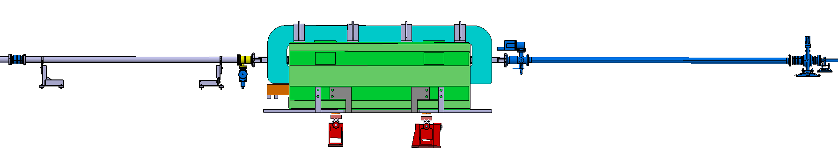

Other Changes to the Forward Region
RUN3 (LS2):
1
Suppression of the ID 80 Beam Pipe
4
Module Replacement
3
Suppression of pumping valve
2
Assembly Suppression:
VGRB; VGI;VPI
1
Suppression of the sector valve and 2 bellows with RF inserts
New Forward Calorimeter
RUN4 (LS3):
2
2
1
2
VMAAQ Module with Displaced VGI
Pumping Configuration Optimisation
New warm module:
  Transition from ID63 to 80
  New fixed support to be optimized.
New FoCal Beam-Pipe:
  1mm thick Al with ID 58mm
  Integrated below.
  Transition to ID58/ ID63 mm on flange.
4
3

Slide 31
Structural Simulations

Slide 32


Mechanical Design Technical Requirements
The beam pipe mechanical design must minimize interactions with collision products. Material and wall thicknesses are optimized while meeting the following requirements:
Manufacturing tolerances and sagging in operation: Compatible with the allowable installation envelope and avoid interaction with the circulating beam.
    Reasonable to assume the same manufacturing tolerances as in the RUN3 central beam pipe:
Yielding: Safety Factor >2 with respect to the material offset yield strength
  Weld Regions: Safety factor > 3
Buckling: Pcr> 6 bar; If verified with a non-linear analysis Pcr>3 bar.

Slide 33
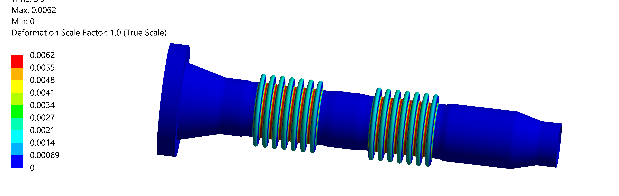
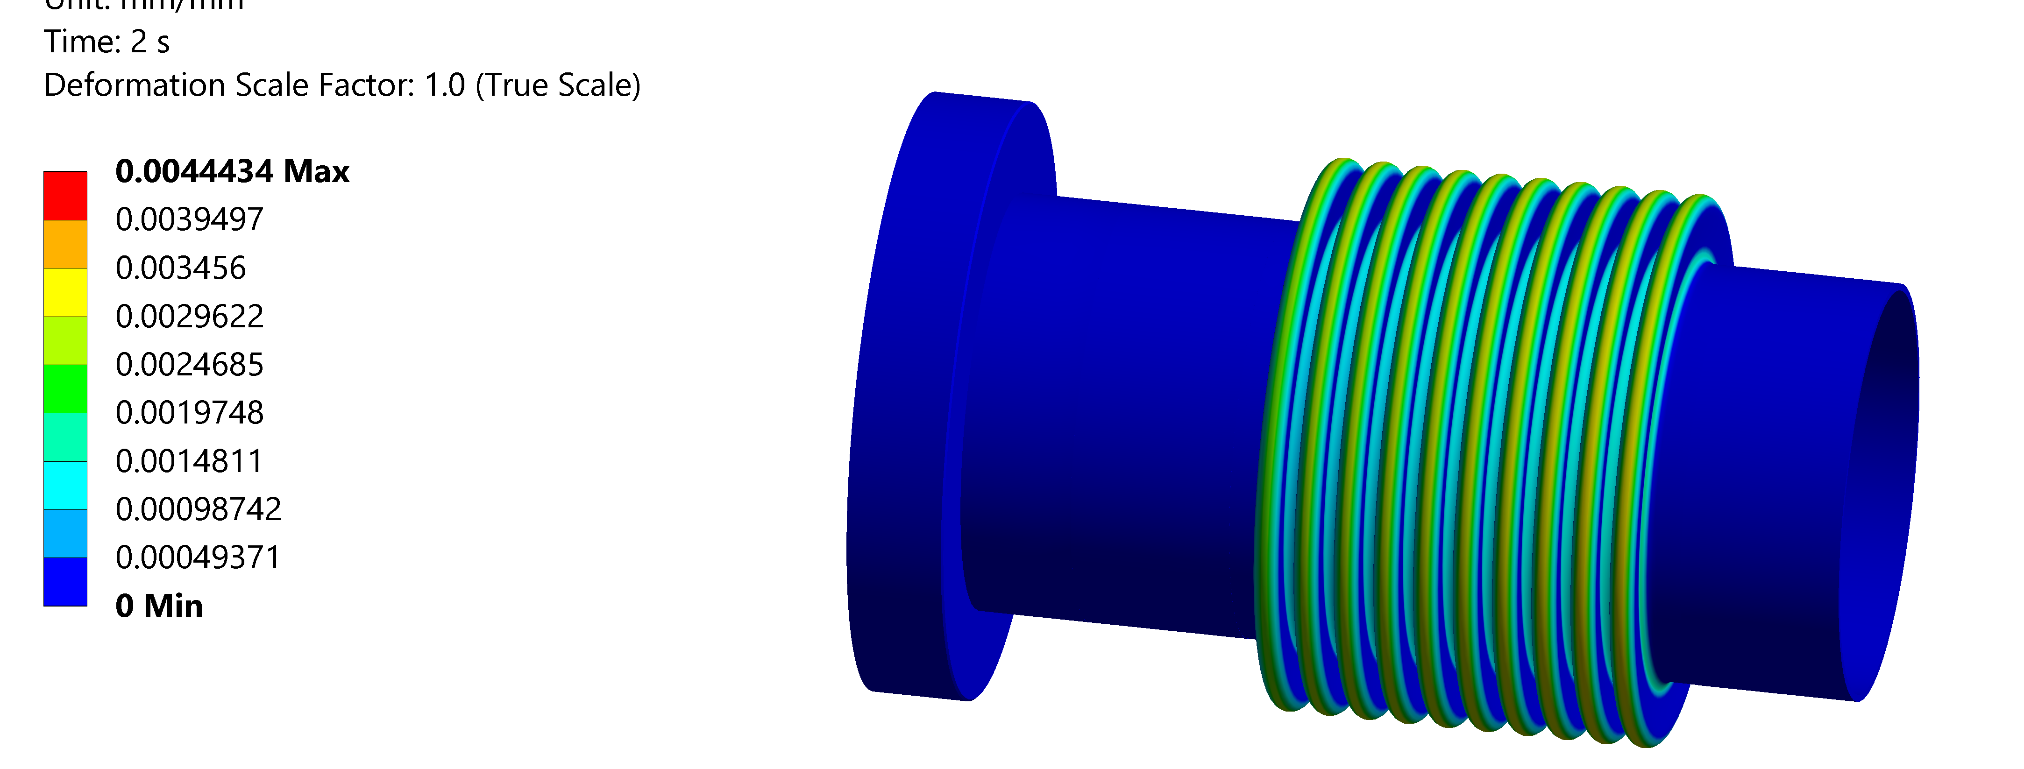
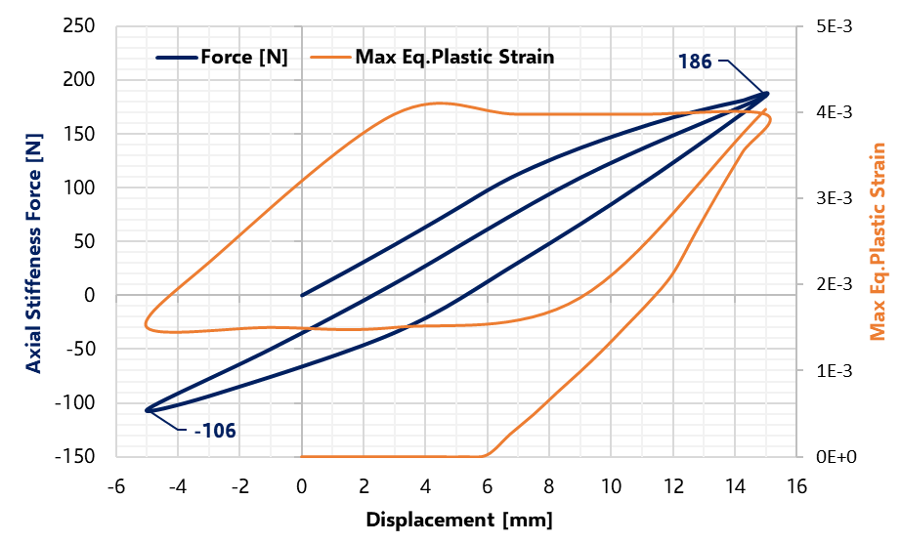
Bellow Analysis
Structural integrity of bellow assemblies evaluated in two ways:
Bellows’ axial and transversal stiffness behaviors evaluated by cycling with the maximum strokes.
  Plasticity effects were considered with a multi-linear kinematic hardening law for EN AW-5083-H111.
  Stiffness and axial force closely match the calculations with EN standard and laboratory measurements.
Bellows stress and strain evaluated in combined beam pipe model, considering load history
Eq. Plastic Strain - Operation
(15 mm extension)
Max Plastic Strain ≈0.6% <1%
Eq. Plastic Strain – Bake-Out
(15.5mm compression)
Central BP Double-Bellows
Axial Force [N]
 | OP | Bake-Out
Axial Stiffness | 186 | -106
Vacuum | 188.6 | 58.5
Max Plastic Strain≈0.44% <1%
Same Magnitude!
History is Important!

Slide 34
Vacuum Simulations

Slide 35
Vacuum Simulations – Different Operation Scenarios
The following operation scenarios were simulated with 20 l/s ion pumps upstream the compensator magnet:
Configuration | Current per beam | Energy | ISD | PSD | ESD | Critical Current
Static vacuum | N/A | N/A | N/A | N/A | N/A | N/A
Machine start-up (scrubbing) | 0.59 A | 450 GeV | Relevant | Negligible | Relevant SS/Cu NEG Negligible | Relevant
Energy ramp-up | 0.59 A | 7 TeV | Reduced | Relevant | Reduced SS/Cu NEG Negligible | Negligible
Intensity ramp-up | 1.08 A | 7 TeV | Reduced | Relevant | Reduced SS/Cu NEG Negligible | Negligible
Nominal operation (complete conditioning) | 1.08 A | 7 TeV | Reduced | Reduced | Negligible | Negligible
2xVPIXD Upstream of Compensator Magnet

Slide 36
Pressure Profile with Degraded NEG Performance
Static pressure Profile
NEG Sticking Coefficients Reduced by a Factor 10
Dynamic Pressure Profile After Complete Conditioning
NEG performance reduced by a factor 10
Even with degraded NEG pumping properties, the pressure in the IP region is expected to remain in the low 10⁻¹² mbar range.

Slide 37
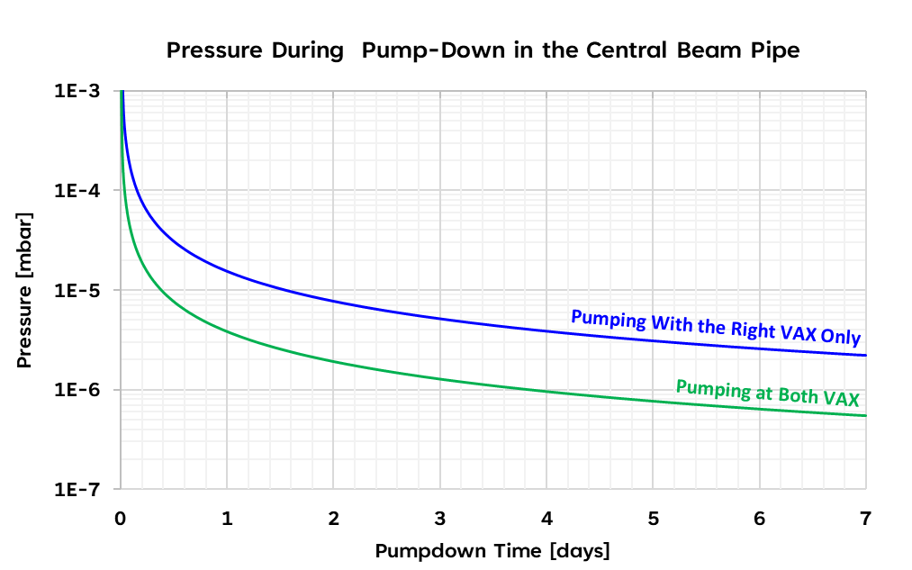
Pump-Down Profile Simulation
Pump-down of a long sector with a severe conductance limitation at the IP.
Pumping groups should be ideally installed on both sides for pump-down and bake-out.
One week of pump-down to be the high 10⁻⁷ mbar range in the IP.
Simulation with LTSpice
Installation of a second Gas Injection System (GIS) on the left side of the experiment is being considered.

Slide 38
Vacuum Simulations – Critical Current at Machine Start-up
The highest risk of pressure runaway occurs during scrubbing when ion-stimulated desorption yields are high.
Simulations were conducted in this operation scenario:
  With beam-pumping effect: ion-induced pressure runaway is not a problem, and the resulting critical current is very high: 331 A.
  Without beam-pumping effect:
    With VPIXD upstream of compensator magnet: 5 A per beam
    Without VPIXD: 4.3A
Note:
The beam pumping effect is crucial in this calculation because it was simulated by subtracting 1 from the ion-induced desorption coefficient matrix diagonal. This can ultimately even cause the vacuum system to be unconditionally stable.

Slide 39
Static Pressure Profile
CH₄ dominates the residual gas composition in the central region (-7 to +15m), where the pressure is at or below the 10⁻¹² mbar range.
In the sector extremities, the dominant gas is H₂, with maximum pressure in the low 10⁻¹¹ mbar.

Slide 40
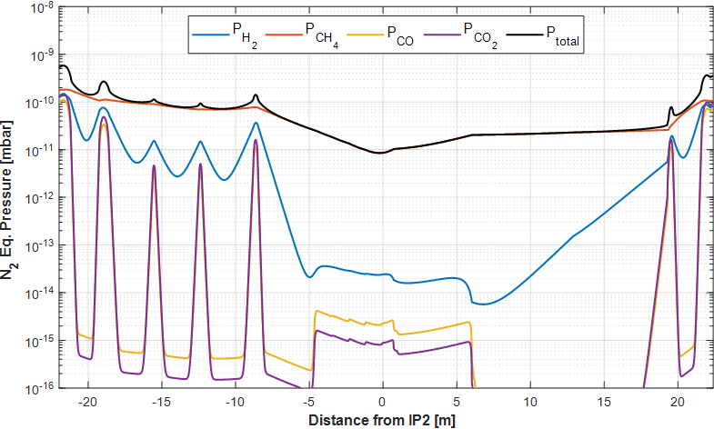
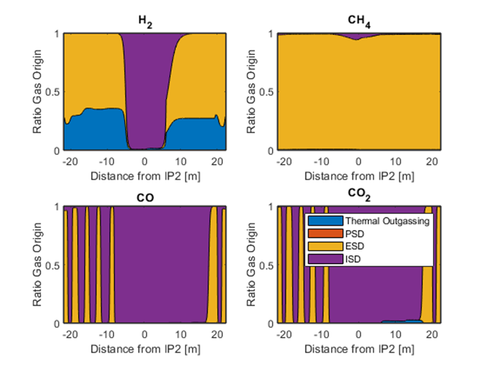
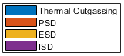
Vacuum Simulations – During Machine Start-up
Nominal operation pressure profile during machine start-up
Ratio of the residual gas origin during machine start-up
Pressure profile is dominated by CH₄ in the 10⁻¹¹ mbar range resulting mainly from ESD.

Slide 41
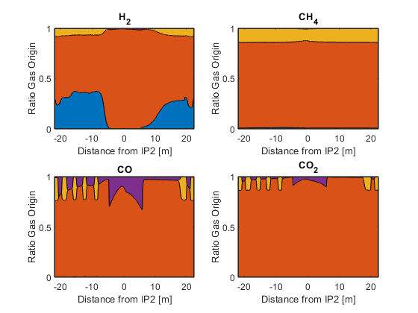
Vacuum Simulations – Initial Nominal Operation
Pressure profile in the beginning of nominal operation
Ratio of the residual gas origin during initial nominal operation
CH4 dominates the residual gas composition.
Pressures are in the 10⁻¹² mbar range until ±5m from the IP and then in the 10⁻¹¹ range going towards the sector extremities.

Slide 42
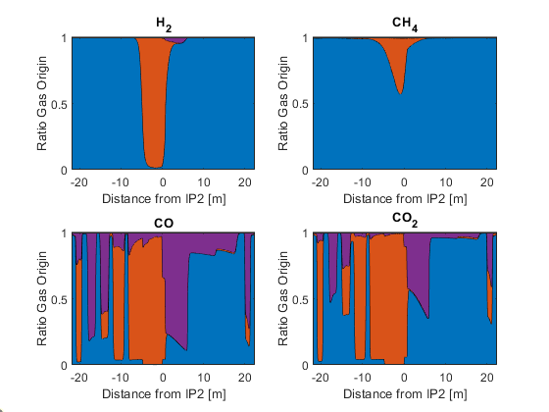
Vacuum Performance After Complete Conditioning
Nominal operation pressure profile after complete conditioning
Ratio of the residual gas origin after complete conditioning
Low pressure in the IP after 1 year of operation, in low 10⁻¹³ mbar range.
Again, CH₄ dominates the residual gas in the IP's central region.
At this stage, the main gas source is thermal outgassing.

