Slide 1
ATLAS Experimental Beam Vacuum Layout Upgrade in LS3
Tomas Raska on Behalf of the LHC Experiments Beam Vacuum Team
VSC Seminar
April 18th 2023

Slide 2
Contents
ATLAS experiment
Layout Within the Forward Zone
HL-LHC Impact on the Experimental Layout and Foreseen Changes
New Experimental Vacuum Chambers
Structural Support Design in the ATLAS forward region
Vacuum Simulations

Slide 3
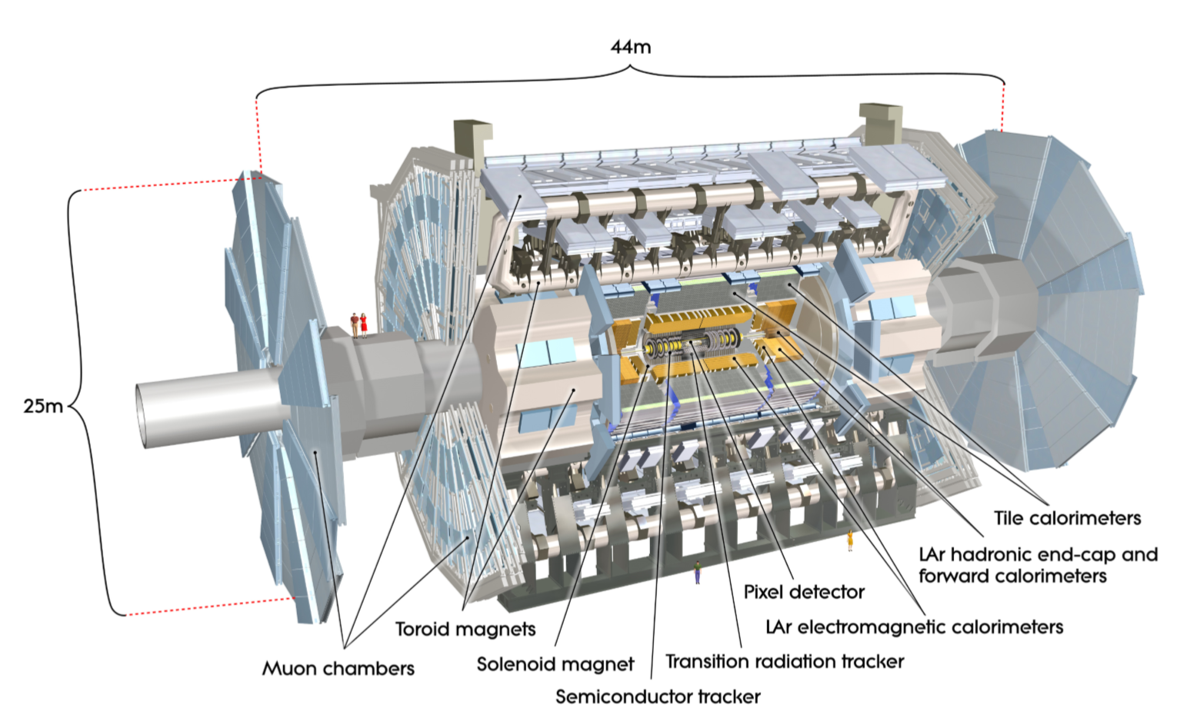
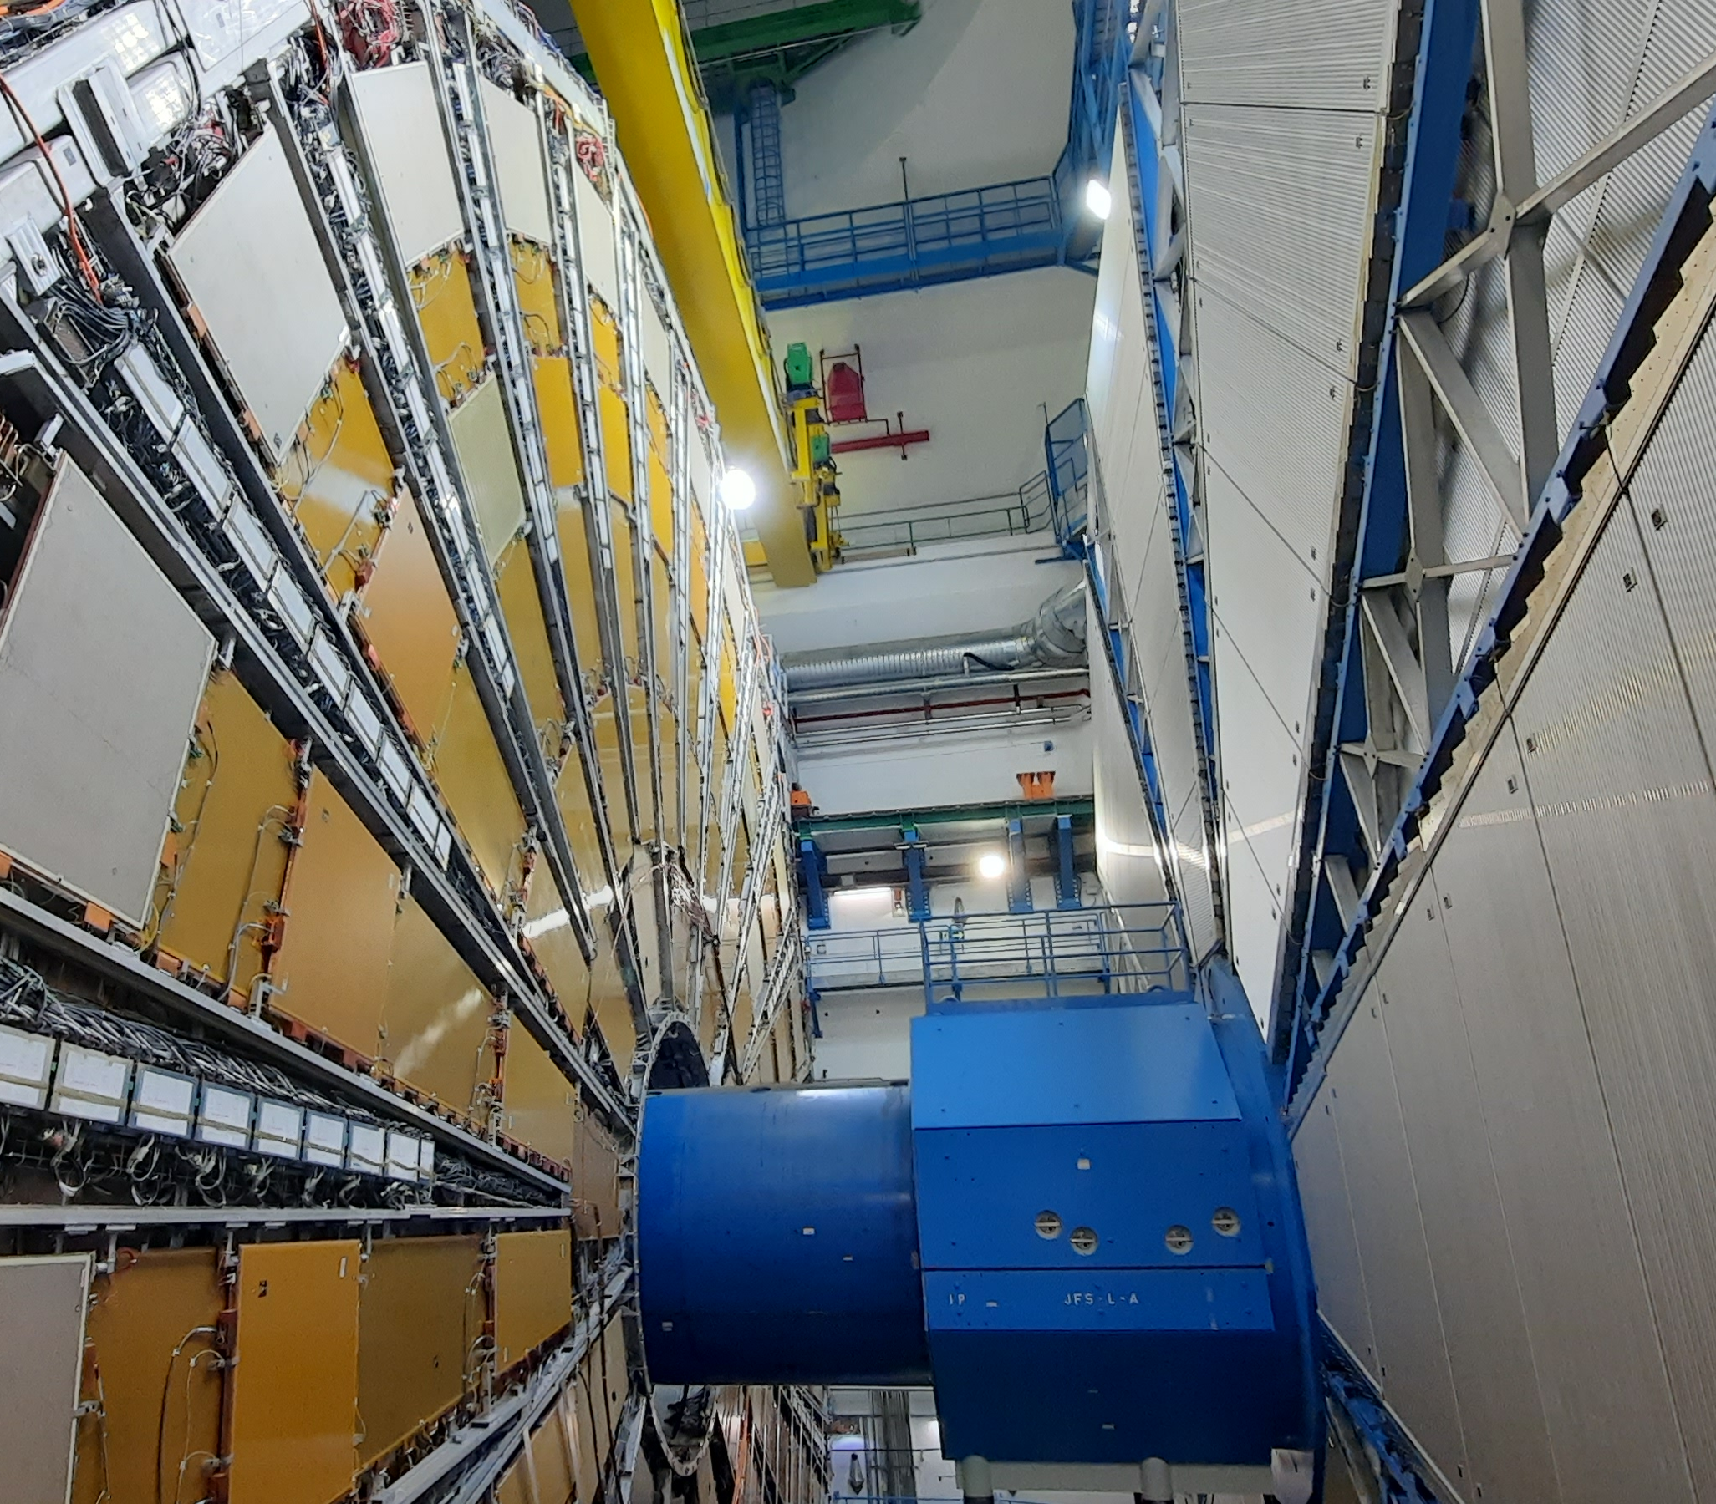
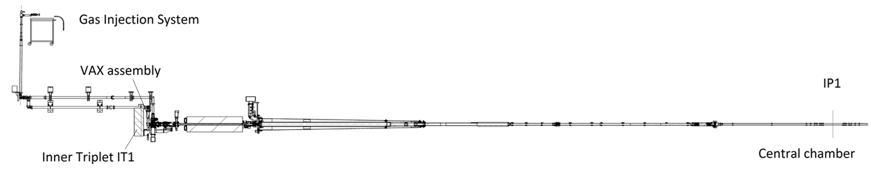
ATLAS Experiment
VC1T chamber
(traversing the End-Cap Toroid)
VC1JX & VC1JP
(traversing the Forward shielding)
VC1AX & VC1AP chamber
(traversing the End-Cap “Argon” barrel)
VC1I central chamber
(traversing the Inner Barrel)

Slide 4
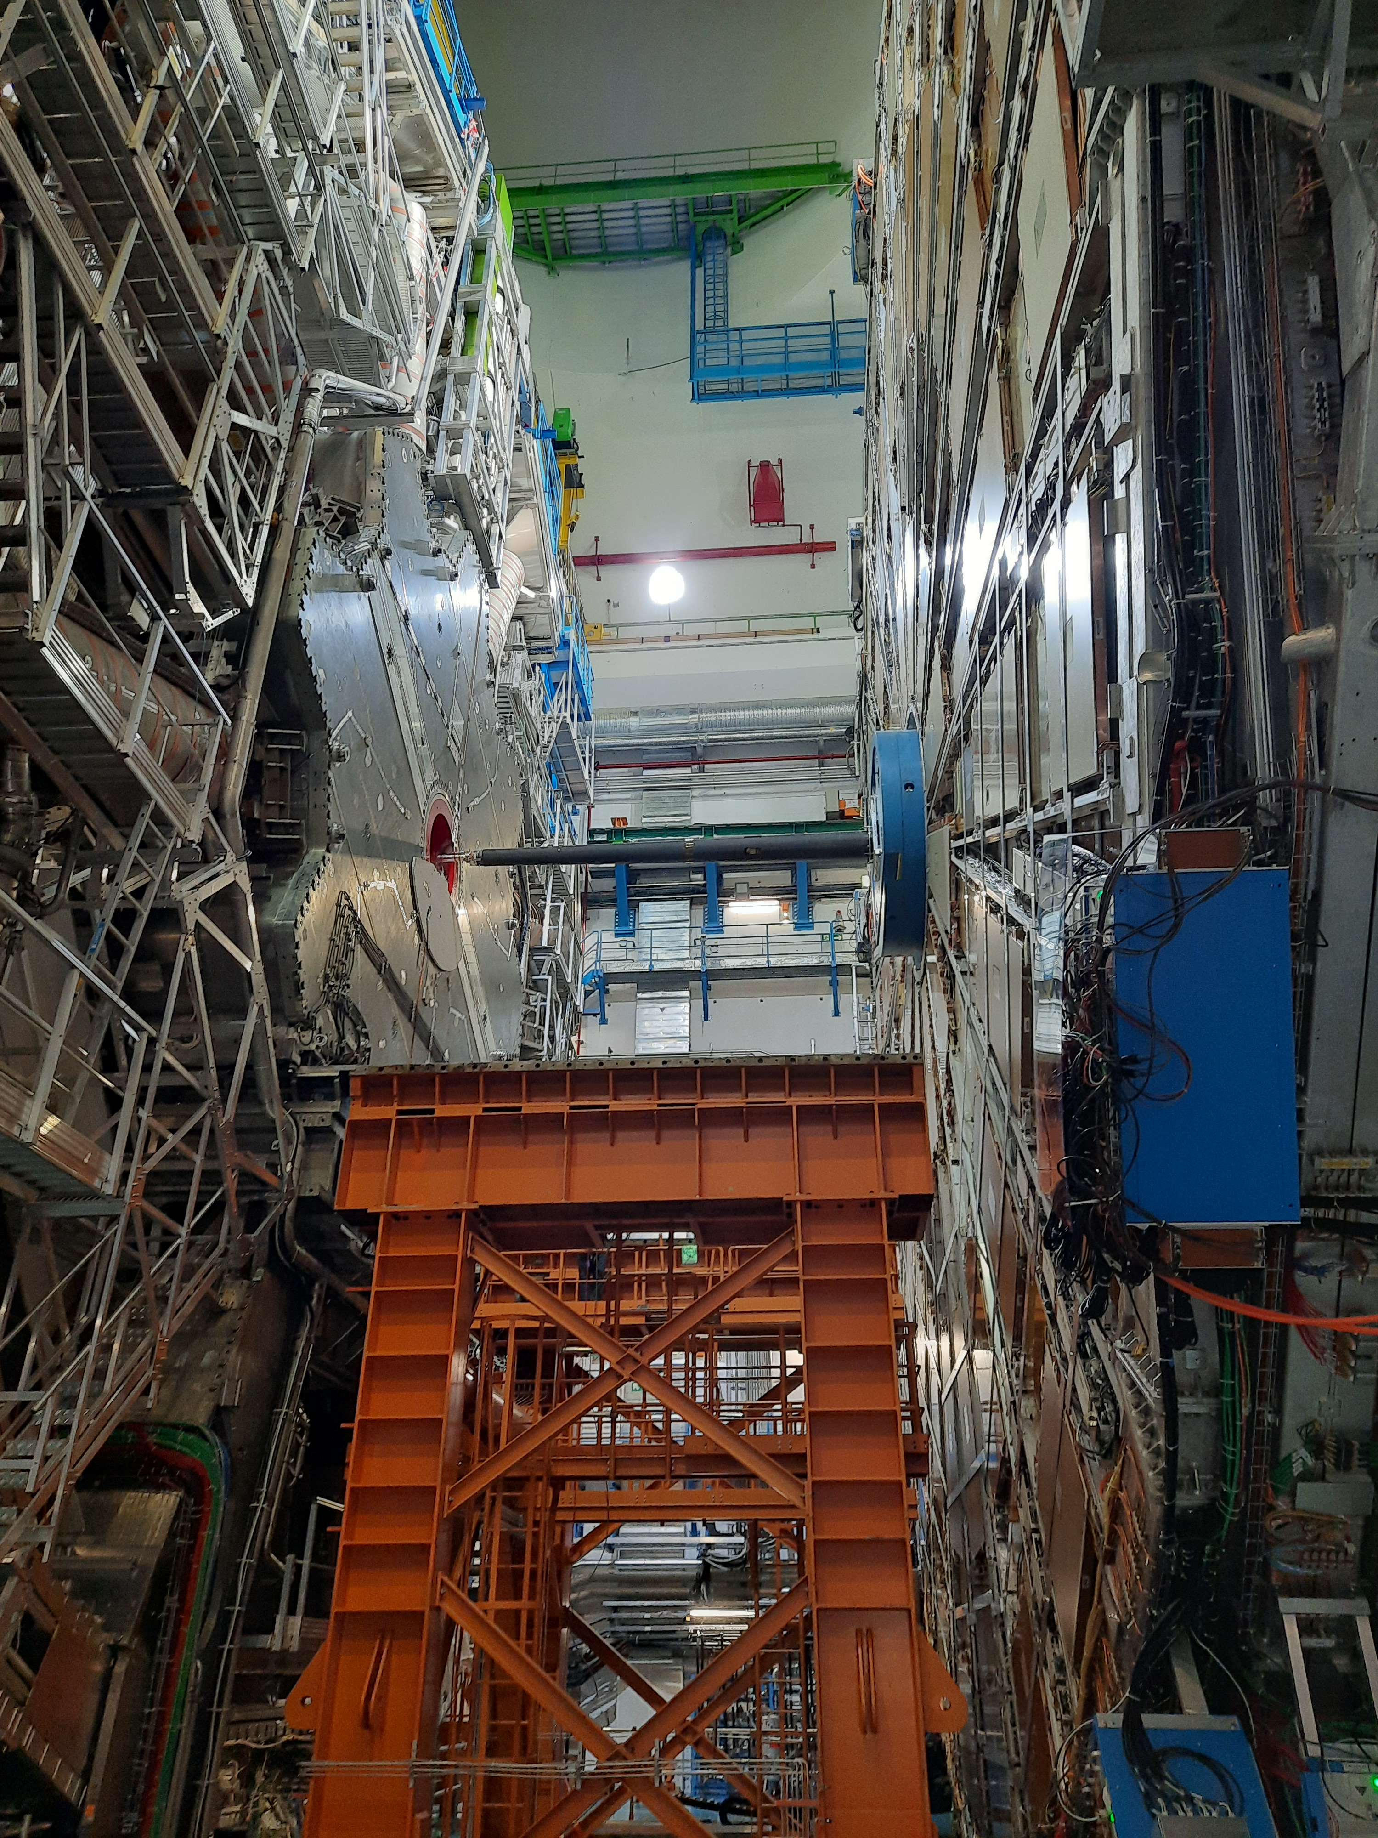
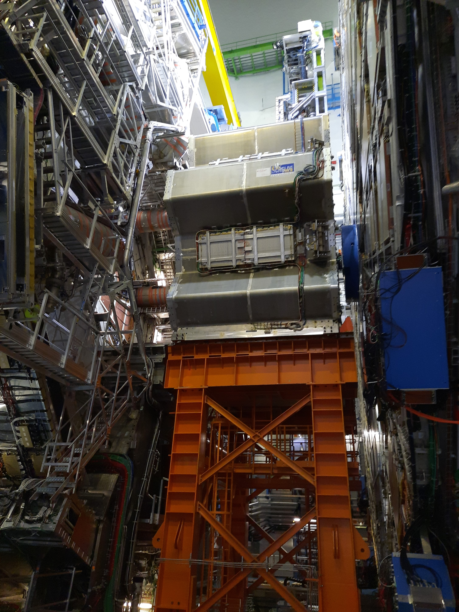
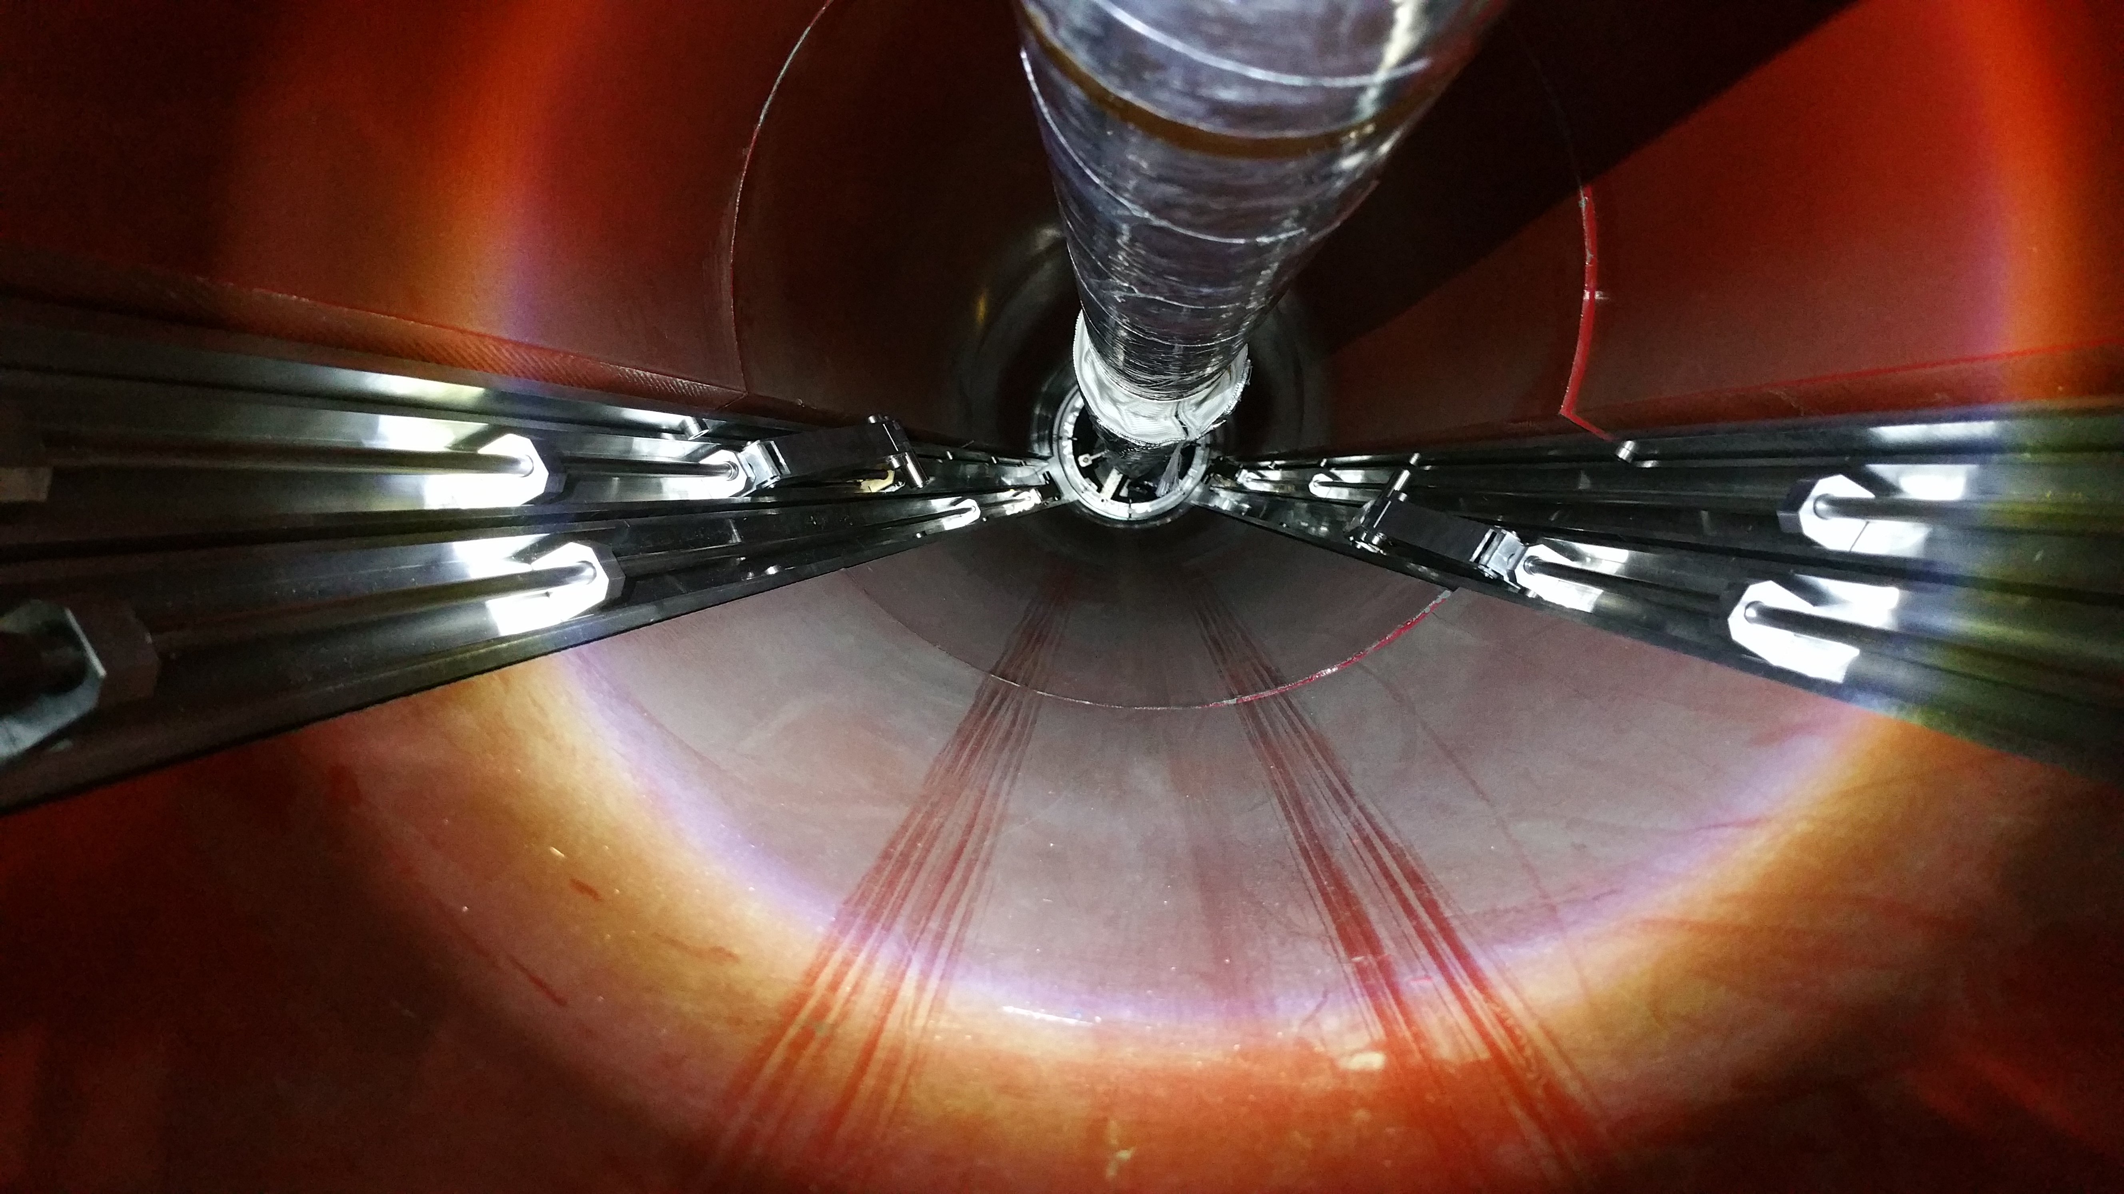
ATLAS Experiment End-cap Toroid Opening
End-cap toroid in Run position
Remote retraction of VT supports
End-cap toroid in YETS Standard Access Position

Slide 5
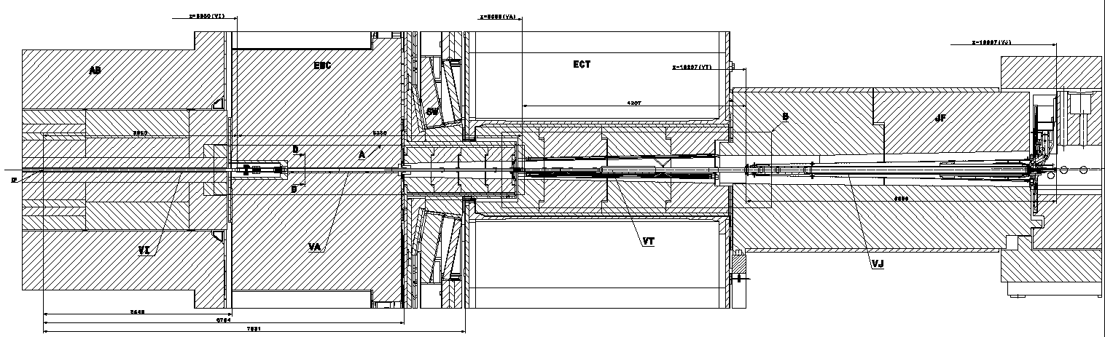
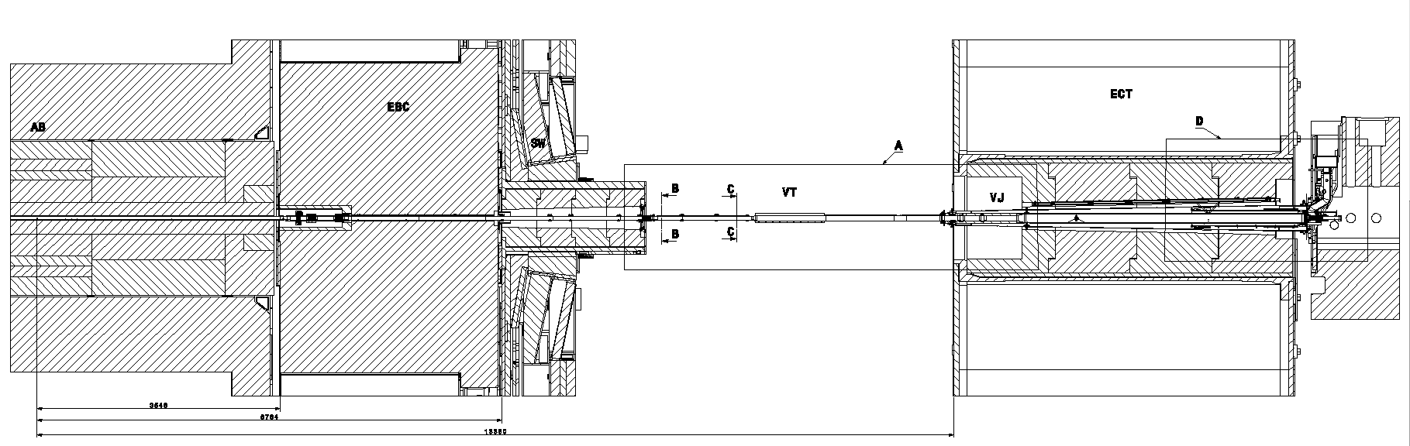
End-cap toroid in Run position
End-cap toroid in Standard Access position

Slide 6
Layout Within the Forward Zone

Slide 7
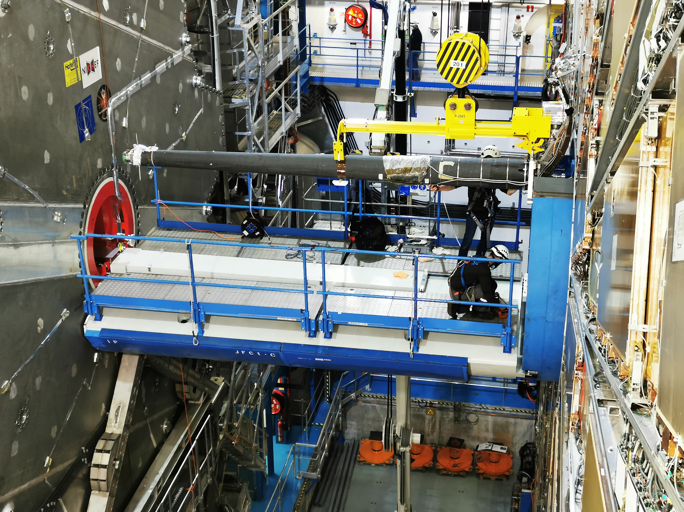
Current Layout
VJ assembly (Phase 1) contains
  VJ chamber (aluminium EN AW-2219)
    5.3m chamber (EN AW-2219)
    Double bellows (EN AW-5083)
    NEG coating;
    Integrated bake-out system;
  Structural support
    CFRP cone support
Assembly drawing
LHCVC1J_0065

Slide 8
Instrumented chimney
detail
Instrumented chimney
Ion pump
  VJ instrumented chimney (stainless steel)
    0.5m chimney 316L
    RF contact
    TAS interface
    Phase 0 equipment reused;
  Bayard-Alpert gauge, Penning gauge, Pirani gauge
  NEG cartridge

Slide 9
HL-LHC Impact on the Experimental Layout and Foreseen Changes

Slide 10
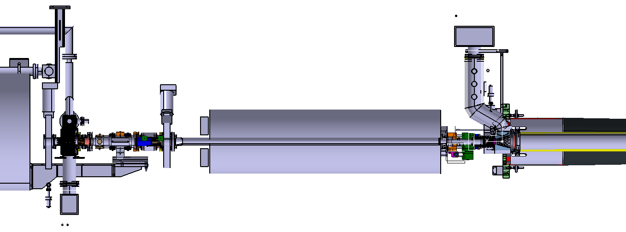
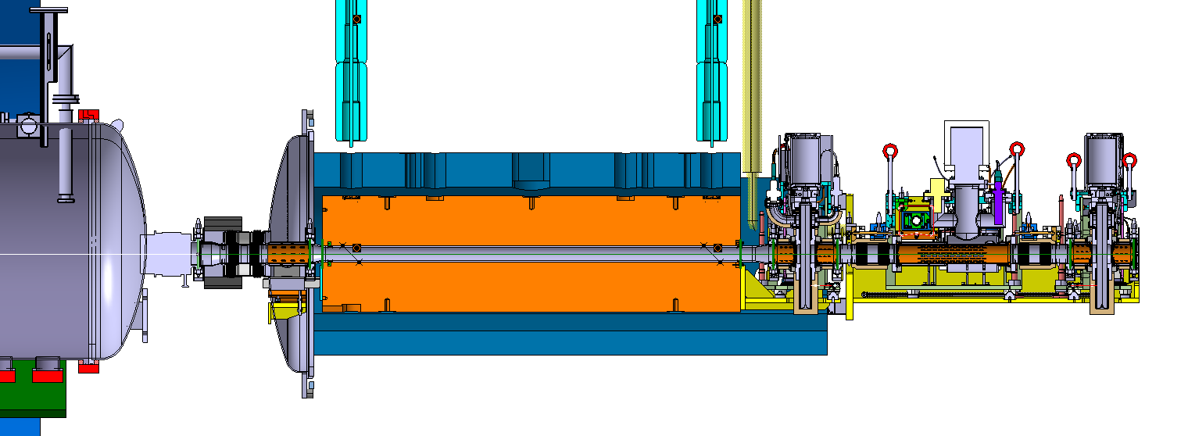
Evolution for the vacuum layout after LS3
Vacuum assembly for the experiment (VAX) with GIS connection
Front Quadrupole Absorber (TAS)
Forward chambers
Q1 cryo-magnet assembly
Run 3
Run 4
Q1 cryo-magnet assembly for HL-LHC
Front Quadrupole Absorber for HL-LHC (TAXS)

Slide 11
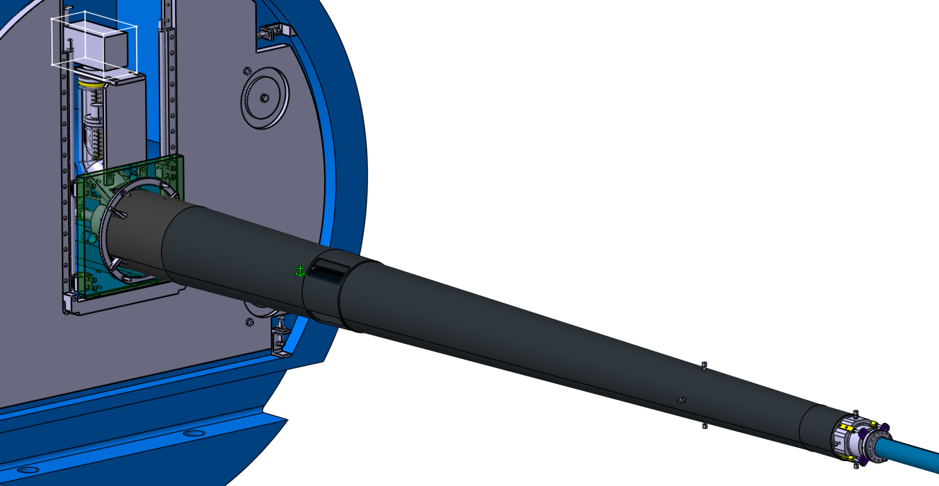
Evolution for the vacuum layout after LS3
18m Chimney zone
Current layout of the forward zone
TAX1S Monoblock shielding
VJ Fix-point
VJ Position adjustment system
VJ/VT Fix-point
CFRP cone support for VJ assembly

Slide 12
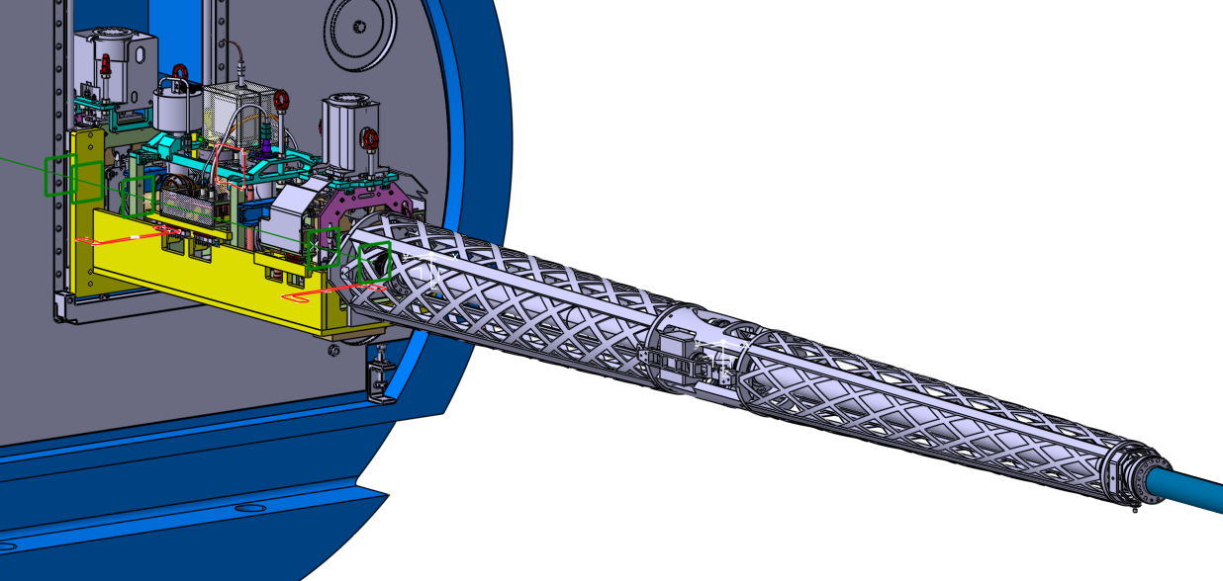
Evolution for the vacuum layout after LS3
Vacuum assembly for the experiment (VAX)
Instrumented chimney replaced by new vacuum assembly for the experiment (VAX)
Total length of forward chambers reduced by ~1.6 m
New VJ chambers and structural support
HL-LHC motivated upgrade of Forward region

Slide 13
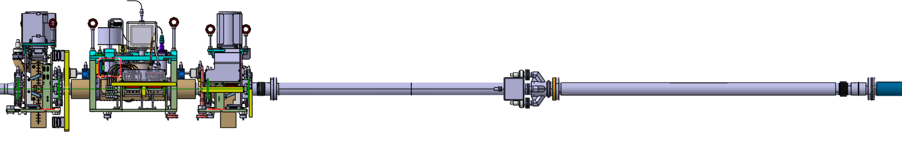
Vacuum Chambers
The VAX displacement inside the experimental cavern entails:
  Suppression of the 18 m chimney (VC1JP) and installation of the VAX assembly at its place;
  Existing vacuum layout and CFRP Cone are not compatible and new layout must be installed
  In case of a closed sector valve, no vacuum measurement nor pumping of non-getterable gasses available in IP1.X
Pressure measurement and pumping to be installed on new VJ chambers assembly
New VJ area proposal consist of 2 chambers & stainless steel bellow module
  VC1JE (Extension)
  VC1JPX (Pumping)
  Bellow module

Slide 14
New Experimental Vacuum Chambers Proposal

Slide 15
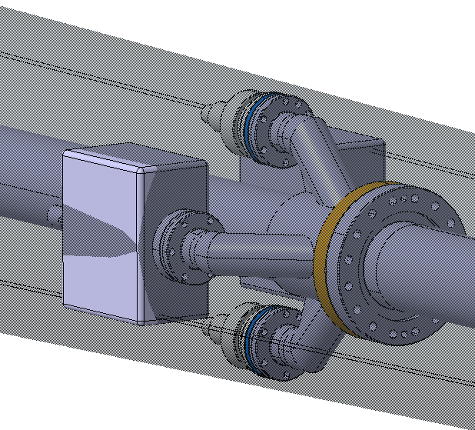
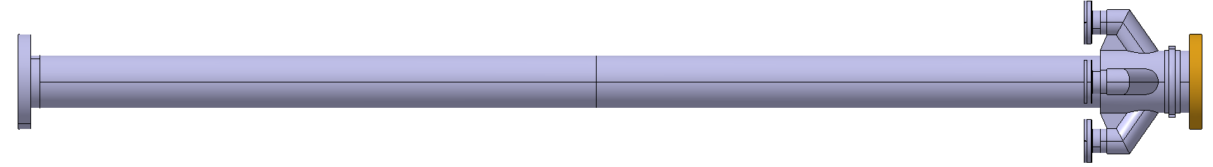
Forward vacuum chamber #1 (VC1JPX)
New instrumented assembly for the IP1.X
Chamber design
  Material - Aluminium 2219-T6 || NEG coated (machined from 3D forged block);
  2 CF100 bimetallic flanges
  4 CF DN40 ports with bimetallic flanges for instrumentation;
  Fix point collar
  Ion pumps protrude from the CFRP cone envelope (~15 mm in radial direction);
    JTT envelope will be respected → No collision expected
Permanent bake-out (max 250 °C);
Thermal expansion 10 mm;
  Covered by a stainless steel bellow module
New Vacuum Instrumentation
2x Ion pump VPIXD (20l·s⁻¹)
2x Penning gauge
Per side
4 CF DN40 ports
CF100 bimetallic
CF100 bimetallic
Fix point collar
Constant aperture 80 mm
~ 1900 mm

Slide 16
Forward vacuum chamber #2 (VC1JE)
Chamber design
  Tube Ø80 mm - Aluminium 2219-T6 || NEG coated;
  EN AW-5083 aluminium bellow;
  Bimetallic CF-100 flanges;
  Adjustment fixed-point shoulder to be designed.
Permanent bake-out (max 250 °C)
Thermal expansion 11.5 mm (covered by the aluminium bellow);
Existing EN AW-5083 bellow design to be used
Availability in stock TBC
Fix point collar – same functionality as current VJ
CF100 bimetallic
CF100 bimetallic
Aluminium Bellow ID 80, stroke -15/+5 mm
Constant aperture 80 mm
~ 2100 mm
Design approach follows existing base-line → no issues with structural stability

Slide 17
Structural Support Design in the ATLAS Forward Region

Slide 18
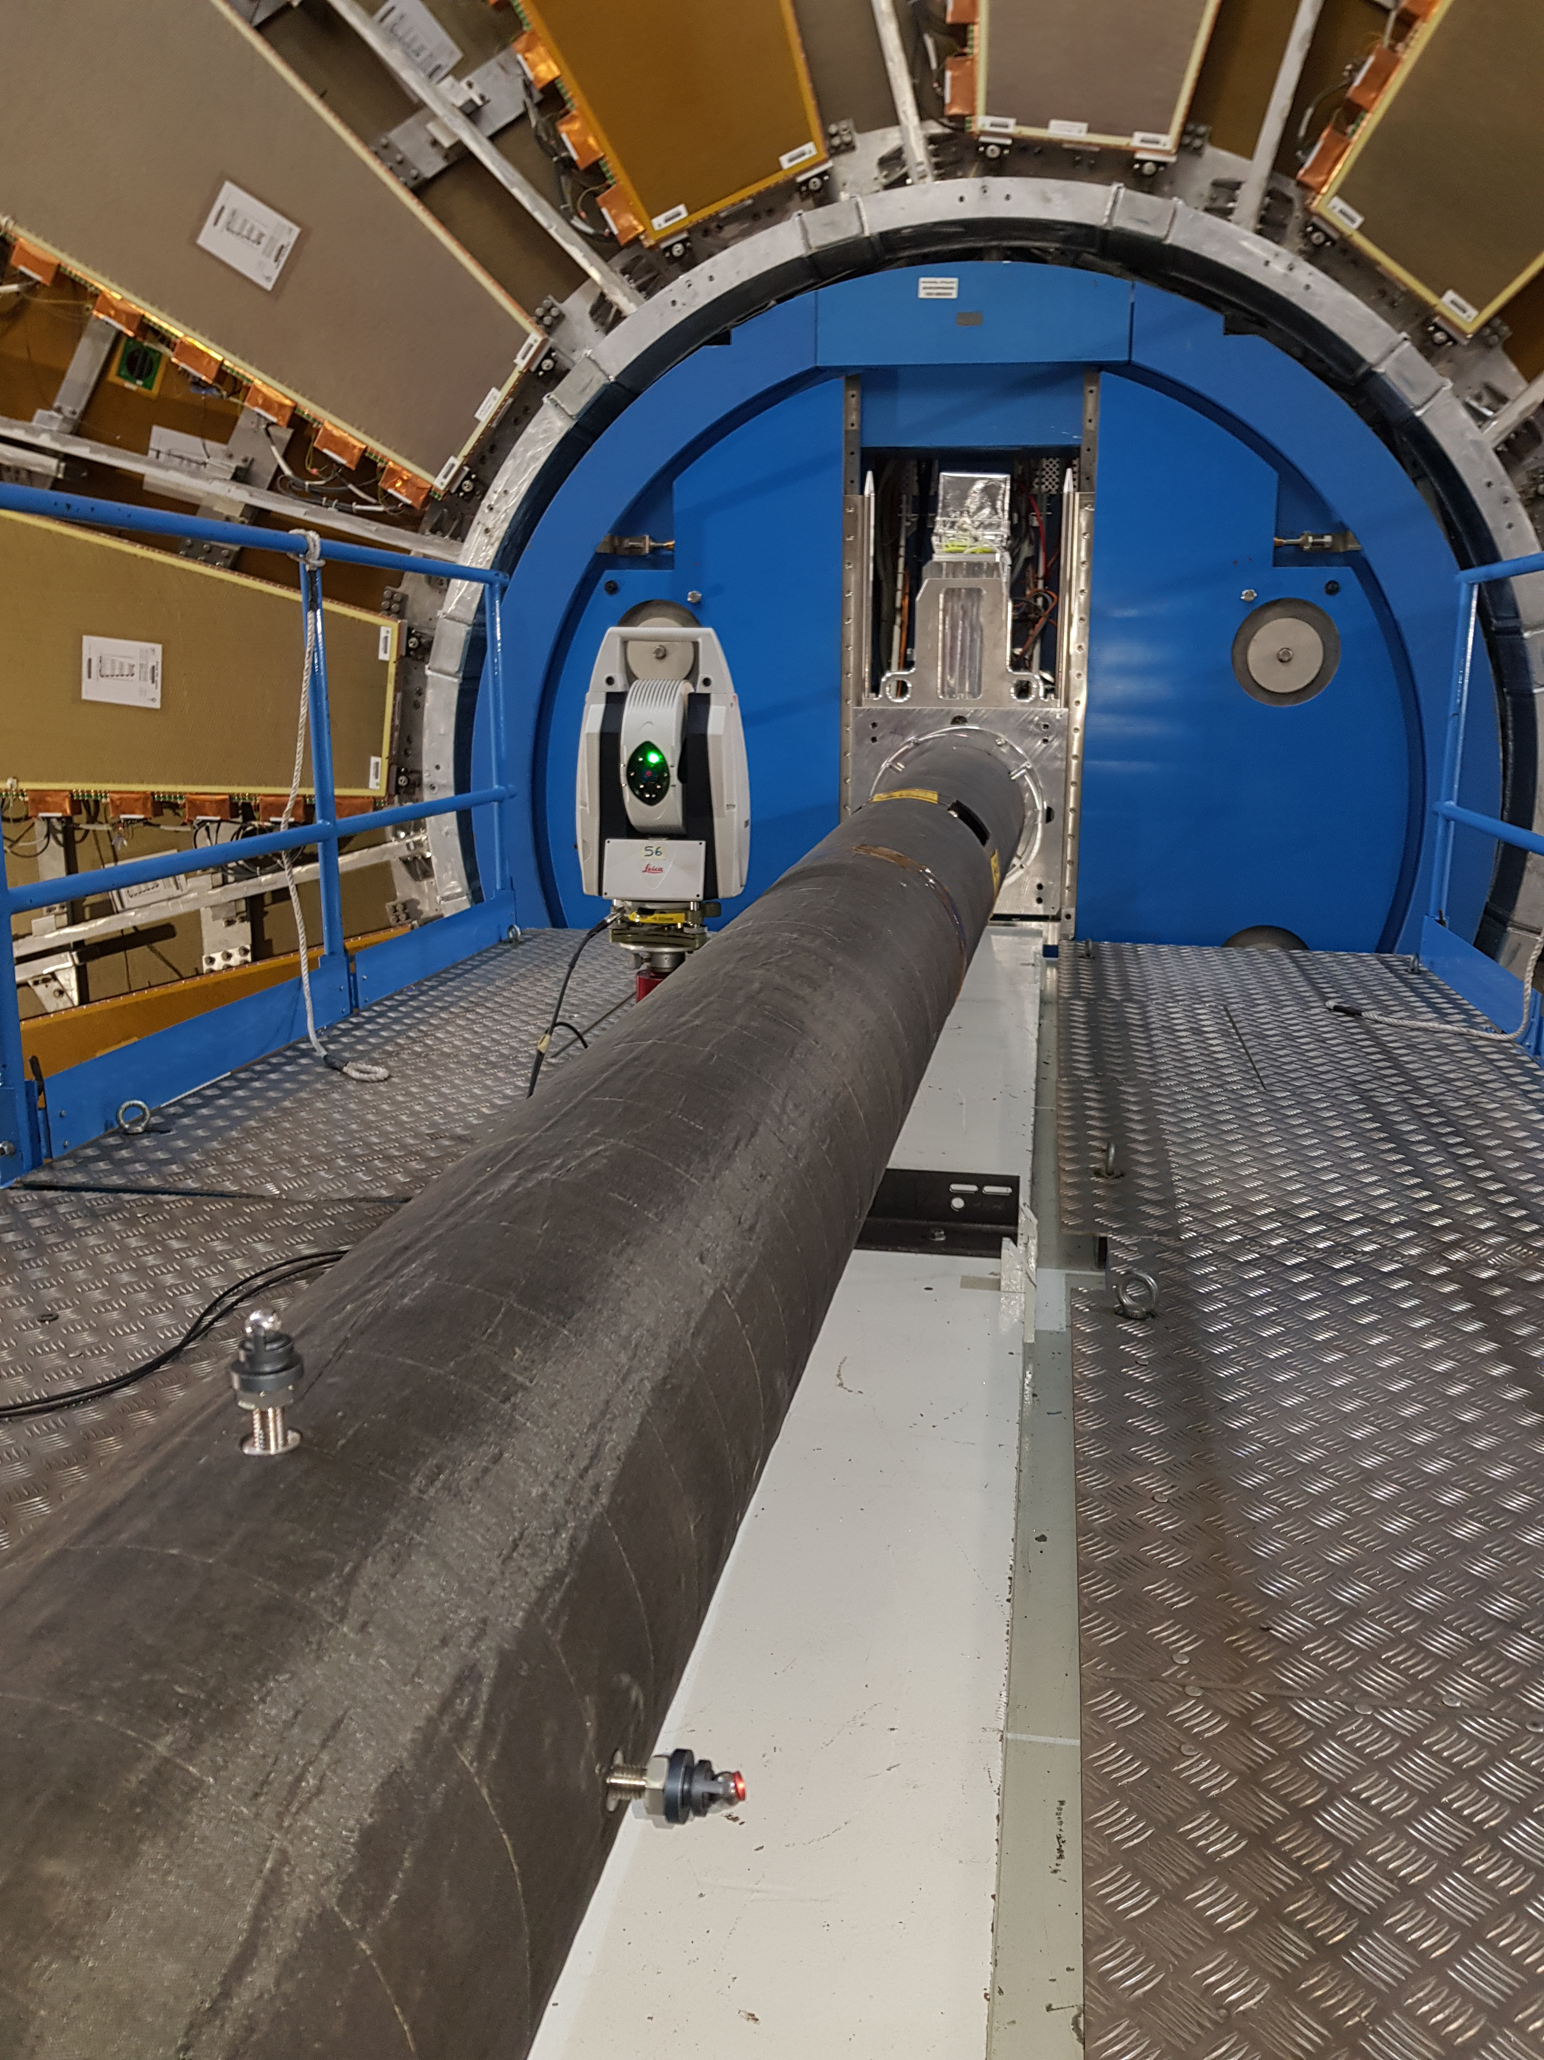
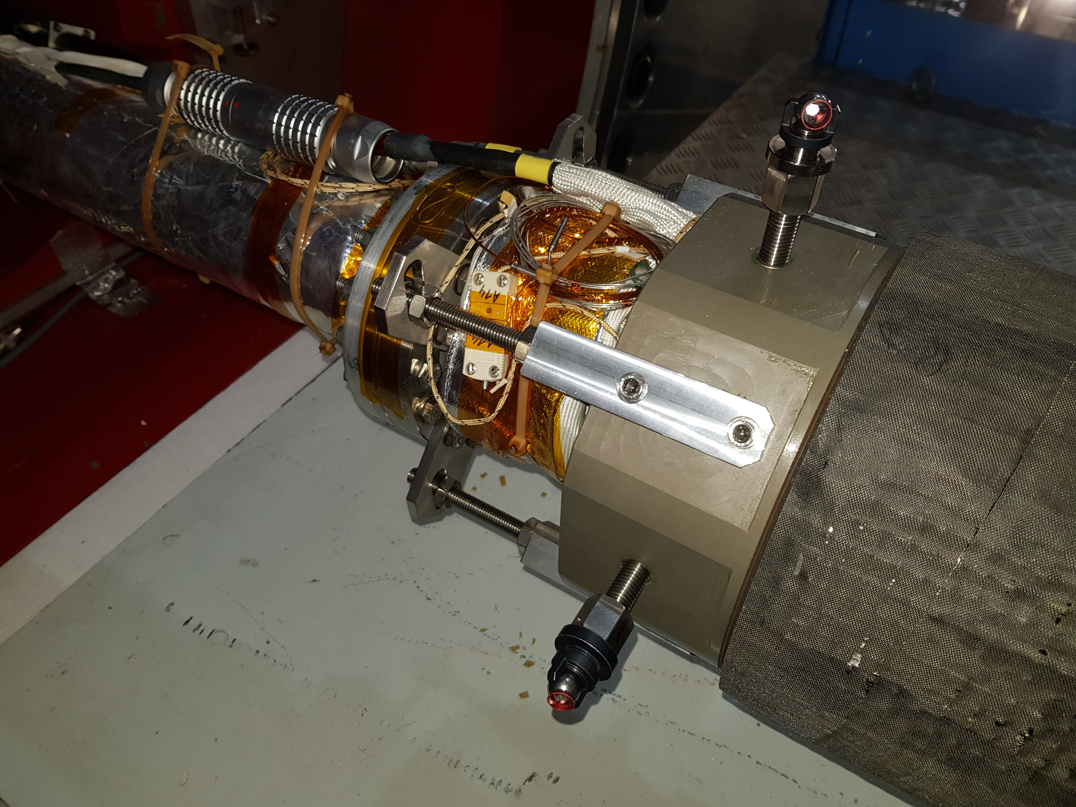
Interventions & Lessons Learned
Standard access YETS interventions in VJ region
  VT supports insertion & retraction (cherry-picker or JFC1 if in place);
    TE-VSC-BVO team surveying conformity of the movement;
  Survey of the VT and VJ position (JFC1 in place);
    Survey team installs laser tracker;
    TE-VSC-BVO team adjusts the position of the chambers.
ALARA optimization for the LS3
Intervention on the JFC1 platform for survey and alignment of the VJ assembly

Slide 19
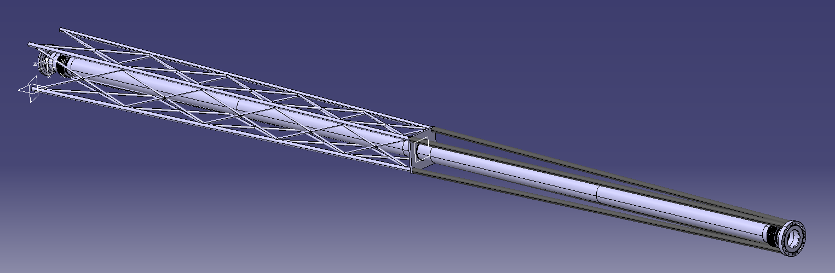
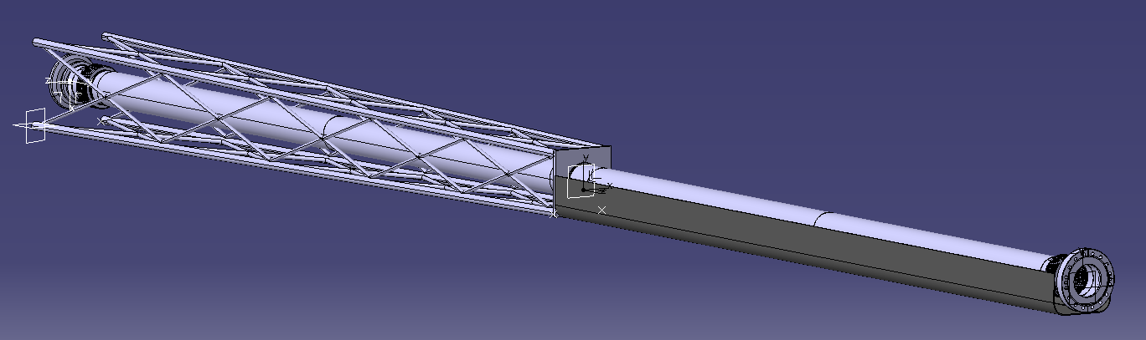
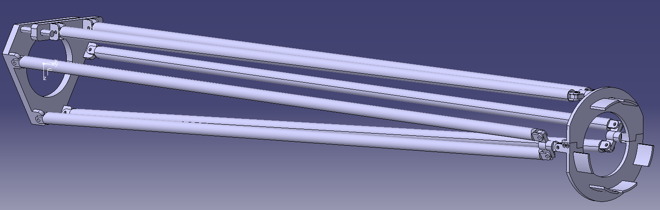
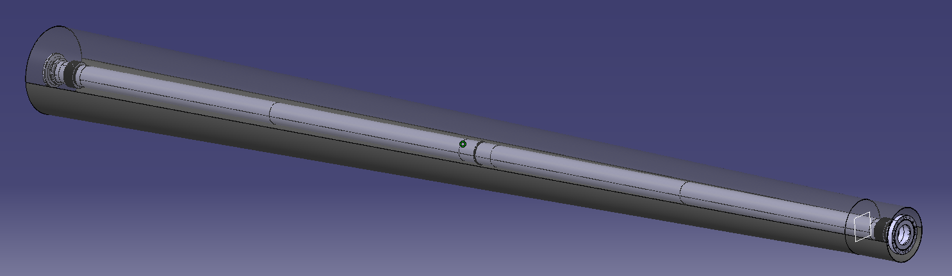
Supporting Structures
Design requirements
  The deflection should not exceed 6 mm (CFRP Cone had 6 mm requirement including safety factor 2)
  Yield strength margin of safety (MoS) shall be positive
  Dimensions shall be equivalent or smaller than current CFRP cone
  It shall provide beam pipe protection and easy access to the beam pipe for interventions and installation/extraction
  It shall include 3 adjustment points, VAX side, centre and IP side.
Various structural solutions were studied
Concepts not pursued due to unsatisfactory performance or design aspects, e.g. insufficient stiffness
Full cone
Hexapod
Truss structure + carbon cradle
Truss structure + rods

Slide 20
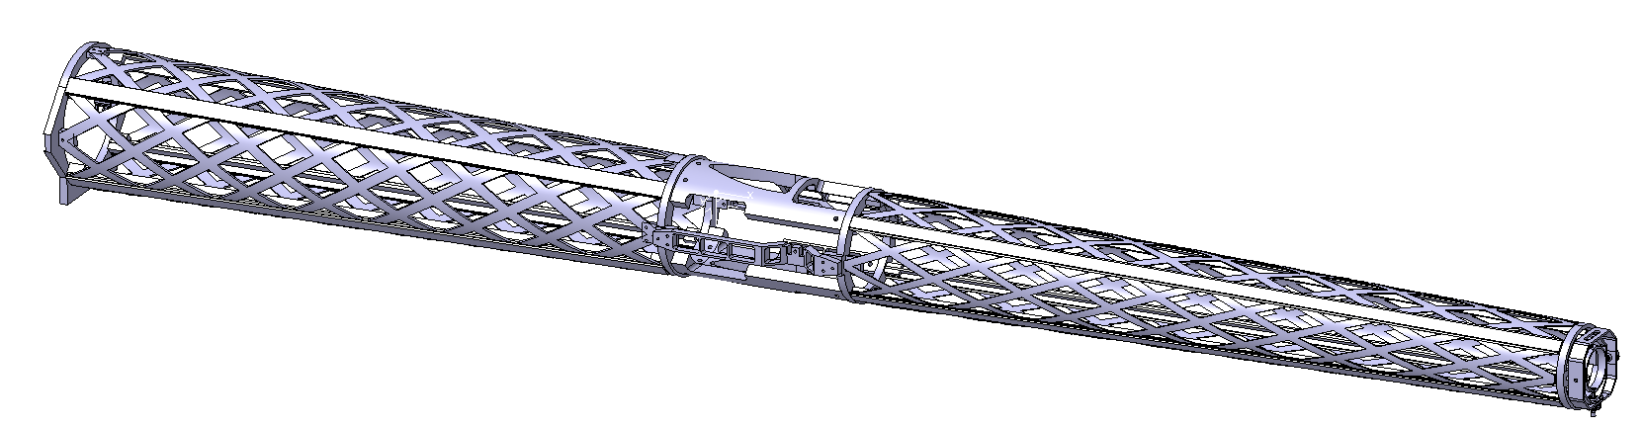
Design description
Full aluminium structure
2 “Isogrid” cones
Cones joined by the connector
with access to:
    Instrumentation;
    Vacuum chambers’ flanges;
    Fix-point adjustment
4 m long
340 mm to 200 mm diameter
Aluminium
Good mechanical performance
Fewer manufacturing constrains
Higher mass
Cost efficient
CFRP
Very good mechanical performance
Lower material activation
Complex manufacturing
High cost

Slide 21
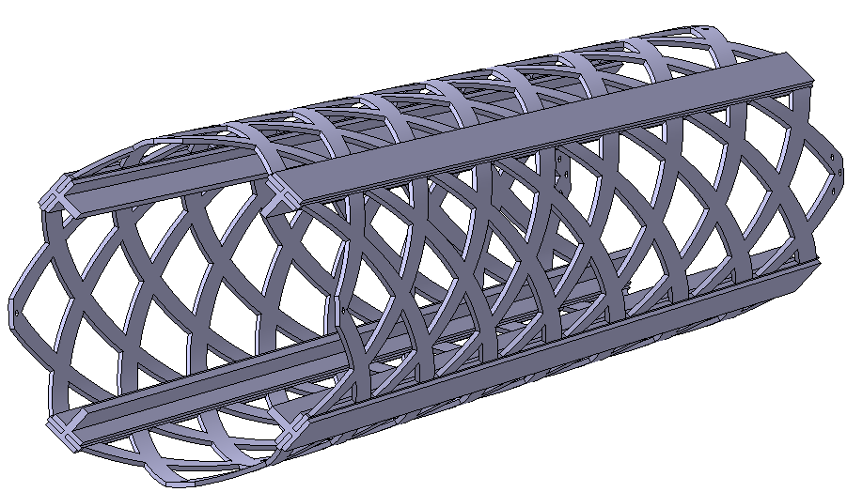
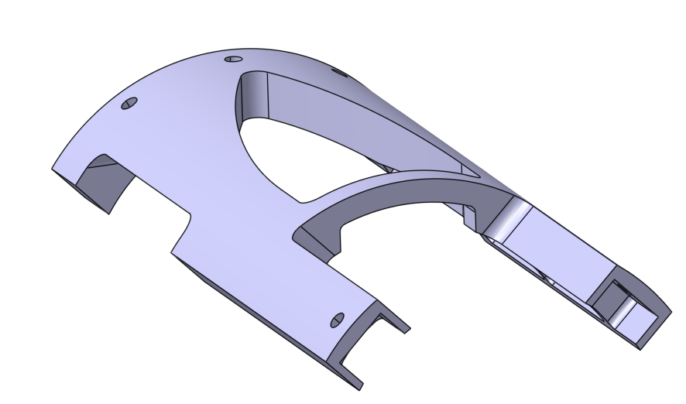
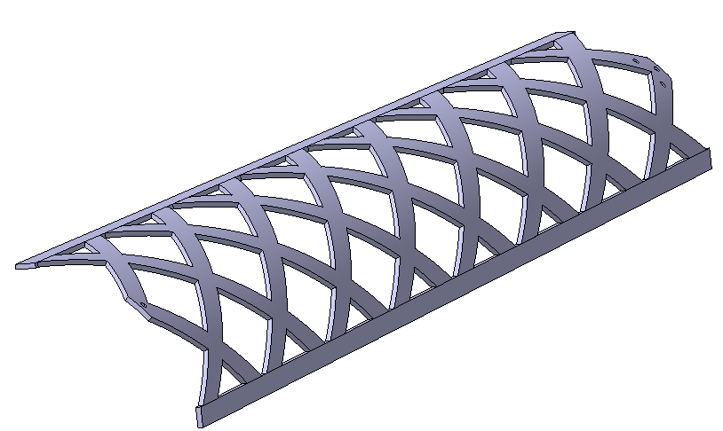
Design Description Details
Main structure assembled from isogrid quarters with reinforcing beams
Isogrid allows:
  Visual contact with beam pipe
  Beam pipe access
  Air flow during bake-out
Connector design based on
structural optimisation

Slide 22
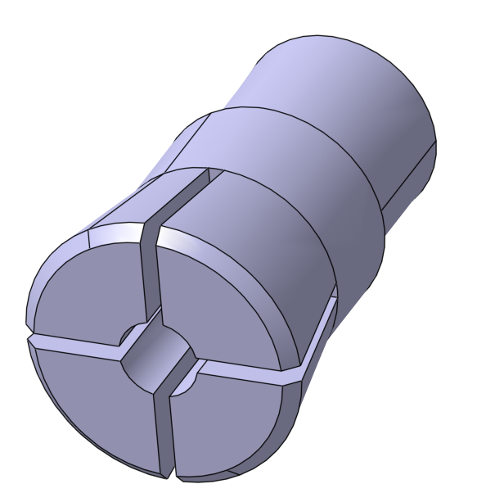
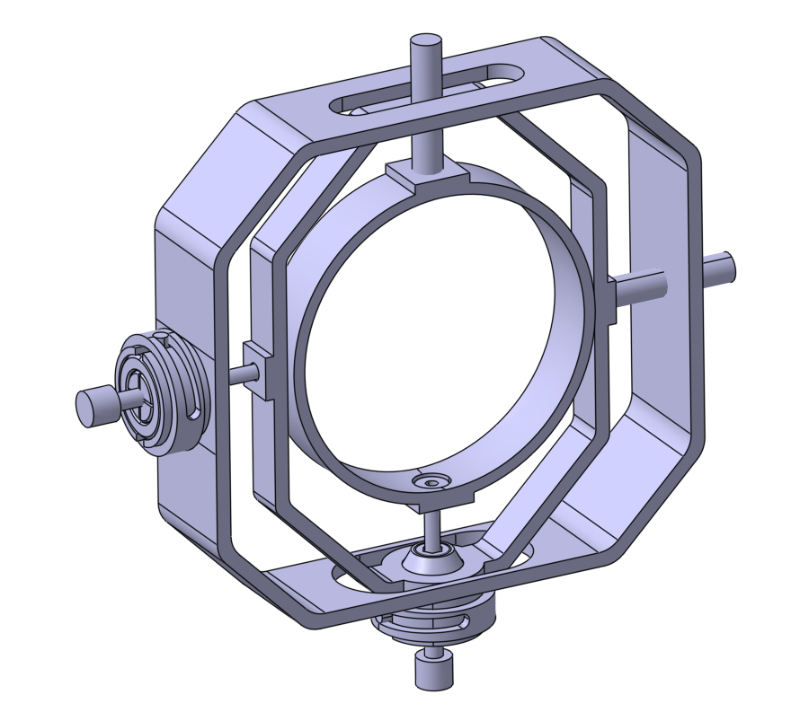
Design Description Details
Adjustment mechanisms
  To be remotely actuated
  30 mm vertical and horizontal stroke
  0.1 mm precision
  No lubrication to avoid seizing due its degradation
  Can be operated manually, if necessary

Slide 23
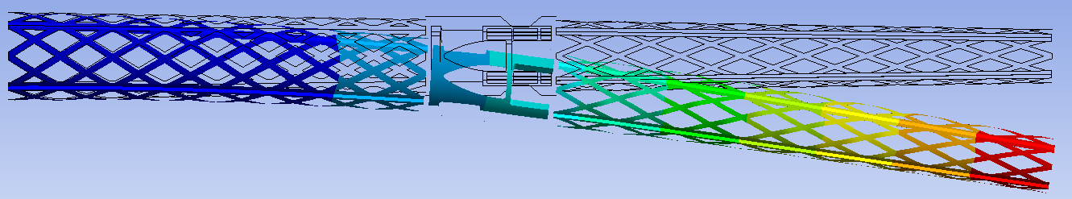
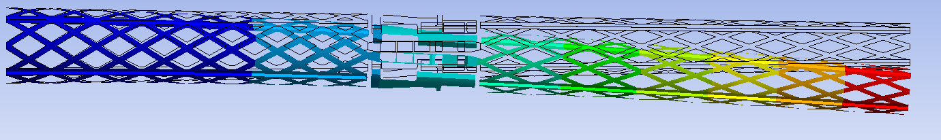
Mechanical performance
Modal Analysis
  1st mode 21.8 Hz // Current CFRP cone ~35 Hz
Static structural analysis
  Maximal deflection: 2.4 mm → Sufficient margin for 6 mm requirement
  Maximal stress: 9.5 MPa → Large margin of safety

Slide 24
Vacuum simulations

Slide 25
Vacuum Performance Simulations
See Alessio’s Seminar:
08/03/2022
ATLAS DYNAMIC PRESSURE PROFILE AFTER LS3
(After Full Conditioning – 2nd Year Operation)
LSS1 Pressure Profile after LS3 now updated with the last version of the IP1 layout.
Dynamic pressure studied at all stages of operation and accounting for all dynamic desorption effects.
  Residual pressure in centre region dominated by CH₄ but bellow 10⁻¹²mbar.
  Inclusion of 2 VPIXD (20 l·s⁻¹) helped reduce CH₄ partial pressure in IP1.X
No vacuum stability issues expected.
Residual Gas Pressure Compliant With Vacuum and Detector Requirements

Slide 26
Conclusion
HL-LHC brings changes to the ATLAS forward region requiring
  New vacuum chambers and associated cabling for bake-out, pumps and gauges
  New structural support optimised for quick or remote handling (including survey targets)
New VJ chambers are proposed to supplement the new VAX area design
VJ support replacing CFRP cone is developed
Next steps
  Prepare detailed design file for the new vacuum chambers
  Optimise and finalise design of the structural support
    Fix-point adjustment mechanism prototype
    Structure assembly procedure

