Slide 1


NIOBIUM THIN FILMS:
CORRELATION BETWEEN MICROSTRUCUTRE AND SUPERCONDUCTING PROPERTIES
Carlota Pereira, S. Leith, G. Rosaz, , M. Taborelli, M. Bonura, C. Senatore, S. Pfeiffer, A. -T. P. Fontenla, G. Belini, L. Ferreira, L. Vega-Cid, A. Bianchi, W. Venturini-Delsolaro
02/05/2023

Slide 2
Outline
Background & Motivation
Thin film optimization for superconducting radiofrequency (SRF) accelerating cavities
Summary
Additional studies for improving SRF cavity performance
Summary
Recent results 400 MHz SRF cavities

Slide 3
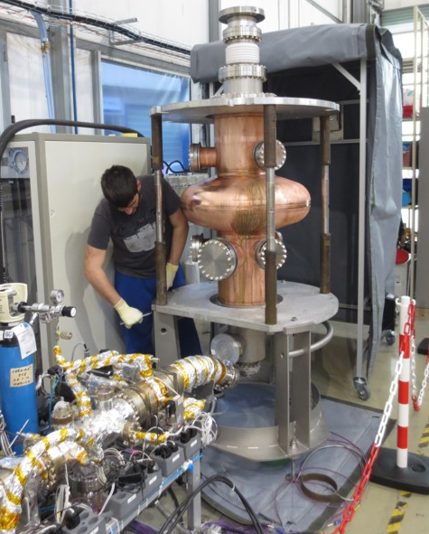
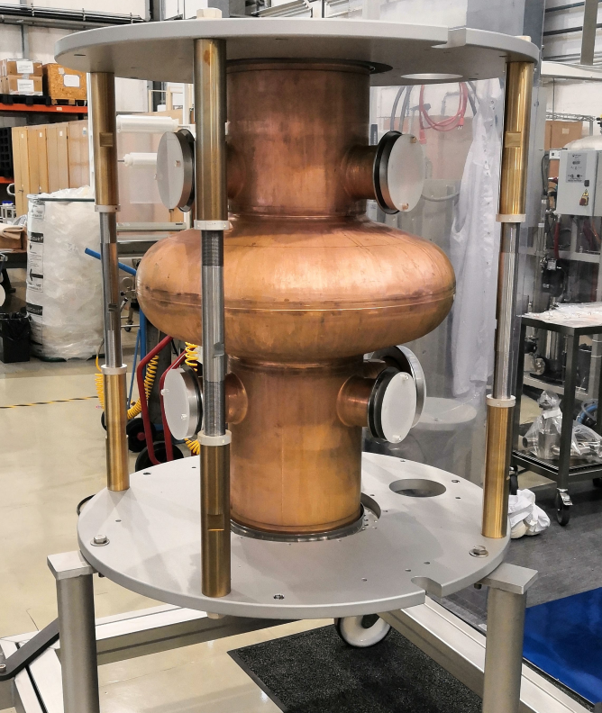
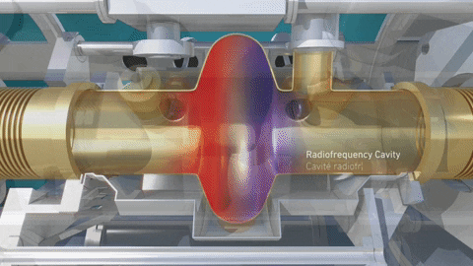
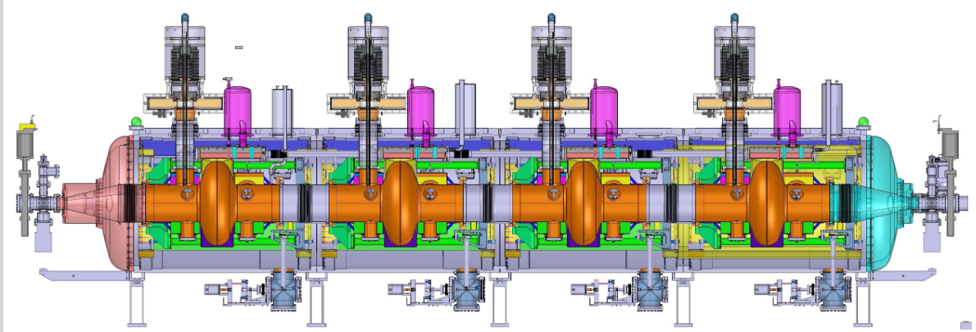
Background
Particle acceleration
400 MHz cavity, LHC
Superconducting radiofrequency (SRF)
cavities

Slide 4

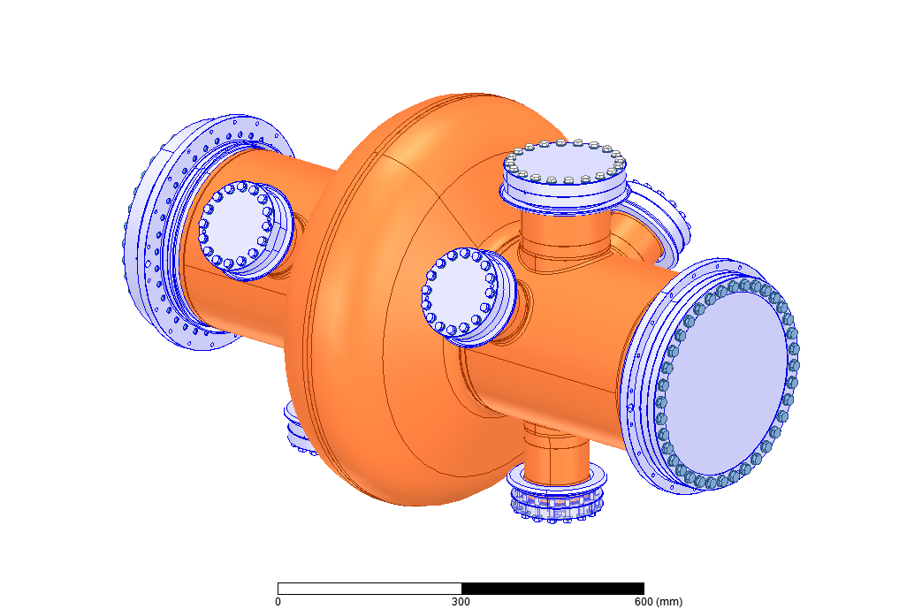

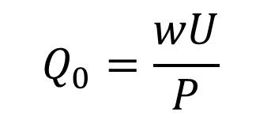

Background: SRF cavities
  ω - resonant frequency
  U - energy stored in the cavity
  P - dissipated power
Superconductor
4.5 K
$$Q_{0}=\frac{wU}{P}$$
$$\frac{stored energy}{dissipated power}$$
Cu substrate
Nb coating
Notes:
Geometry Factor ranks the cavity's effectiveness of providing accelerating electric field due to the influence of its shape alone

Slide 5
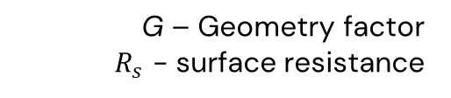
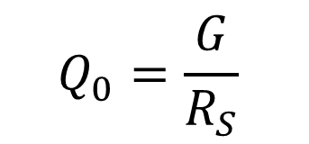


Background: SRF cavities
Superconductor
  G – Geometry factor
  $R_{s}$ - surface resistance
4.5 K
$$Q_{0}=\frac{G}{R_{S}}$$
R_{s copper} $\sim$mΩ
Cu substrate
Nb coating
R_{s sc niobium} $\sim$ nΩ
Higher quality factor
Notes:
Geometry Factor ranks the cavity's effectiveness of providing accelerating electric field due to the influence of its shape alone

Slide 6
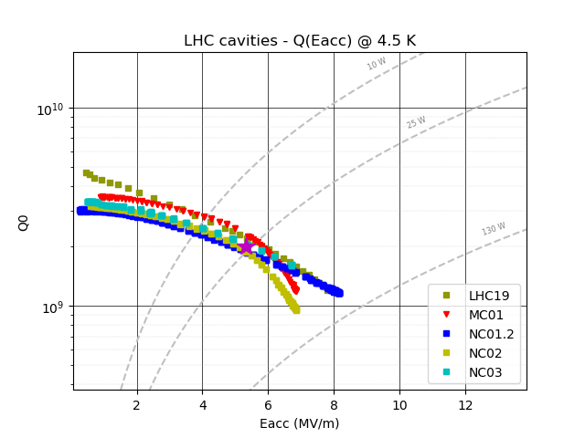



Motivation
LHC cavities Q vs E_{acc} @4.5 K
Degradation of Q₀ with increasing E_{acc}: Q-slope
FCC-ee 400 MHz Nb/Cu
Q₀
1-cell
2-cell
LHC
E_{acc} (MV/m)

Slide 7
Motivation
LHC cavities Q vs E_{acc} @4.5 K
Degradation of Q₀ with increasing E_{acc}: Q-slope
FCC-ee 400 MHz Nb/Cu
Q₀
1-cell
2-cell
LHC
Cure Q-slope & extend field reach!
How?
E_{acc} (MV/m)

Slide 8
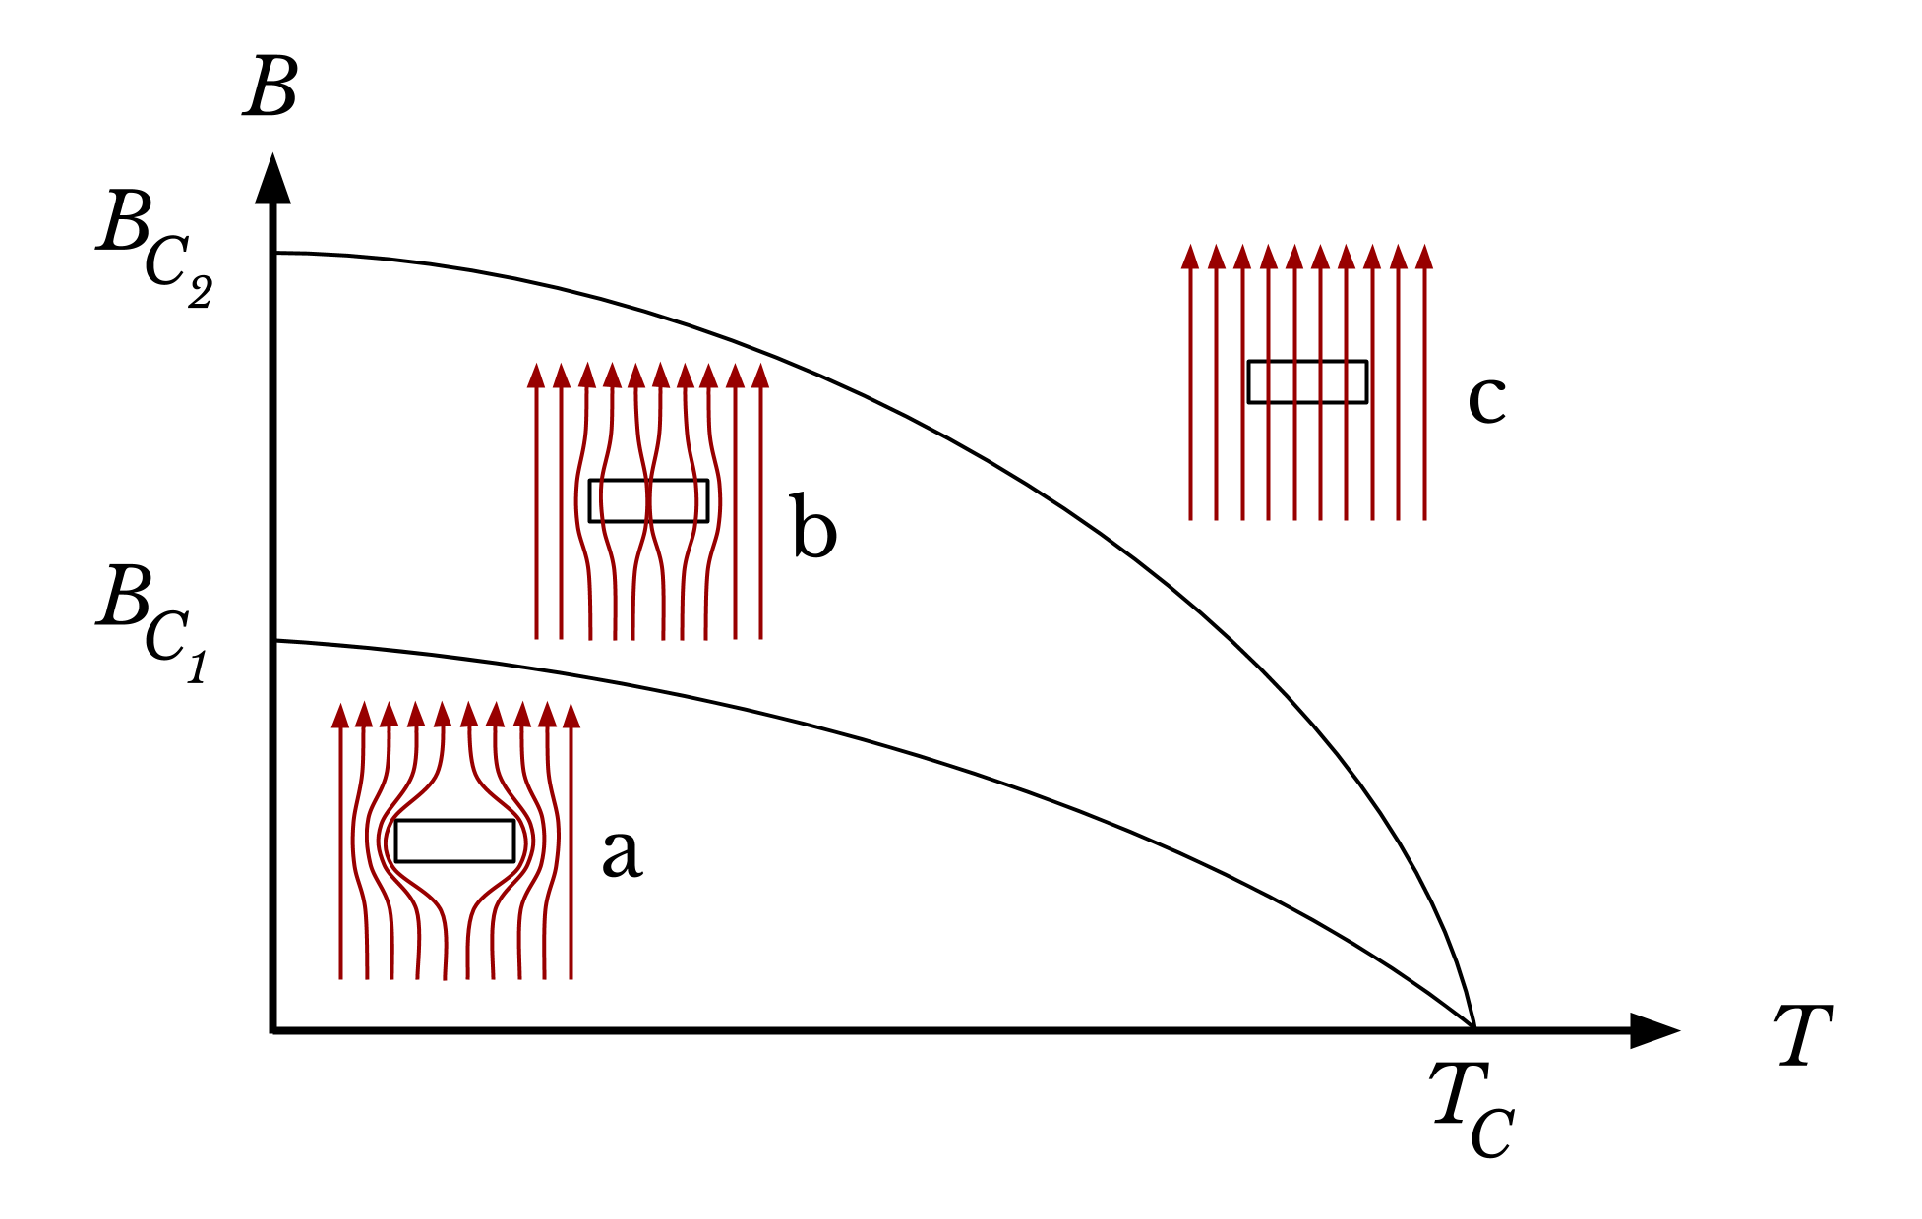

RF superconductivity
Superconducting
Pinning centers = defects in the layer
Under RF field, fluxon oscillation leads to energy dissipation
Mixed
state
flux pinning
Normal conducting
Performance optimization
Meissner state
flux expulsion
Defect density minimization
Magnetic flux lines

Slide 9
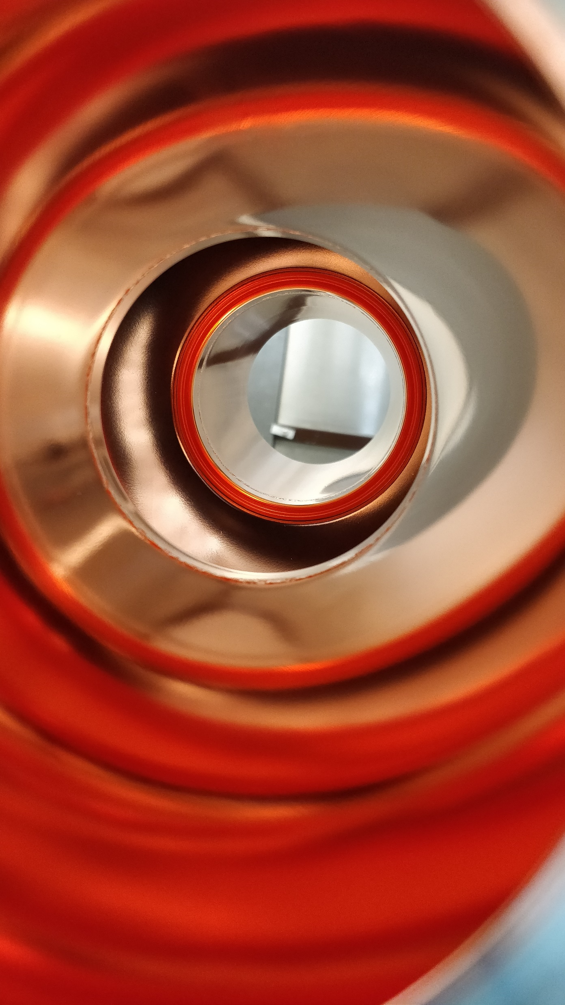
SRF cavities R&D
Thin film
Interface
Substrate

Slide 10
Thin film optimization
Coating technique

Slide 11




Coating technique
See talks by F. Avino, S. Fiotakis:
https://indico.cern.ch/event/876252/
https://indico.cern.ch/event/1129796/
Kr+
Nb atoms
Switch deposition method
Nb target
Sheath
LHC: DC Magnetron Sputtering
$$\vec{E}$$
HiPIMS
High Power Impulse
Magnetron Sputtering
Plasma
Sheath

Slide 12

Coating technique
Kr⁺
HiPIMS
Nb⁺
Sheath
Pulsed sputtering
Nb⁺
Nb⁺
Target material becomes
ionized (~70%)
$$\vec{E}$$
Plasma
-V
Sheath
DC bias
power supply

Slide 13
Coating technique
Kr⁺
HiPIMS
Nb⁺
Sheath
biasing potential: allows the control of the particles’ trajectory and increases the incident bombardment energy
Nb⁺
Nb⁺
$$\vec{E}$$
Plasma
-V
Sheath
Energetic condensation
DC bias
power supply

Slide 14
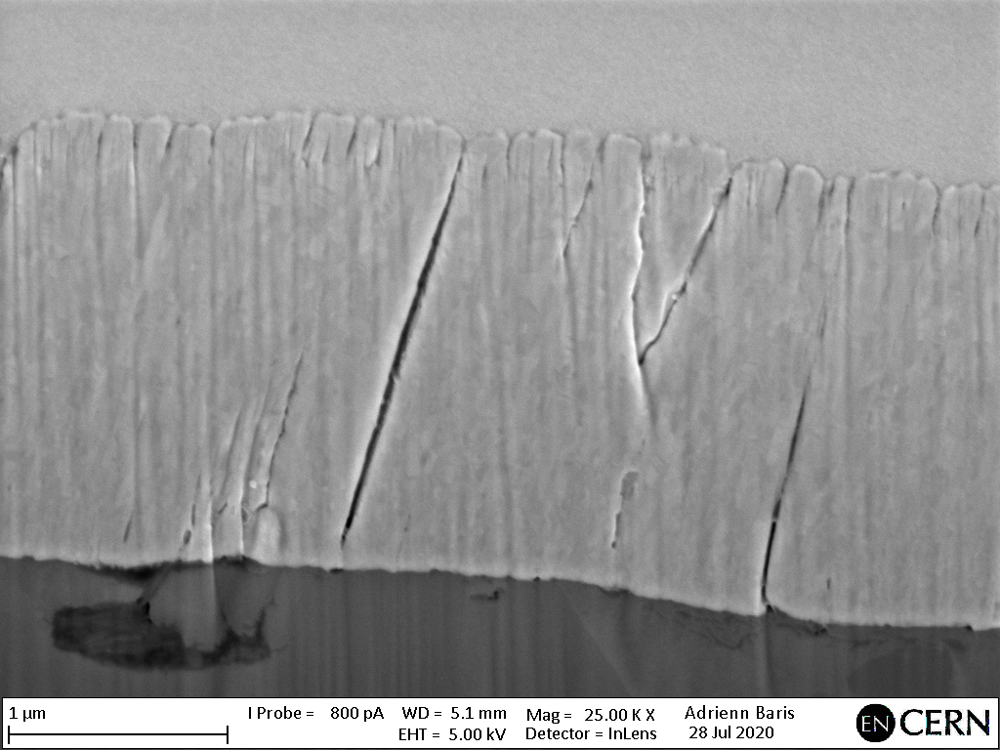
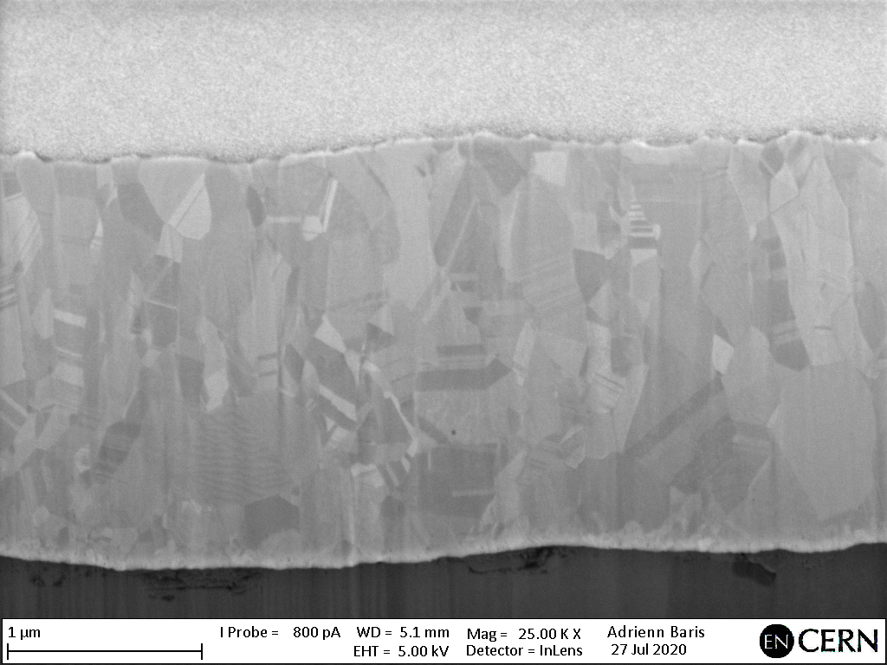
Coating technique
Kr⁺
HiPIMS
Nb⁺
Sheath
1 µm
Nb⁺
Nb⁺
DCMS
HiPIMS
$$\vec{E}$$
Plasma
-V
Sheath
Energetic condensation
DC bias
power supply

Slide 15
Thin film optimization

Slide 16

Current strategy
Scale-up
Optimize HiPIMS process
Small samples
1.3 GHz test cavities
400 MHz
Correlate microstructure of HiPIMS Nb films with their superconducting properties and lower RF surface resistance

Slide 17
How to quantify film performance?
RF testing
Ultimate test
400 MHz cavities: max 3/year
1.3 GHz cavities: max 15/year
Q₀
Hard to single out the effects of an individual coating parameter
LHC
E_{acc} (MV/m)
Intermediate method that could be used on samples

Slide 18
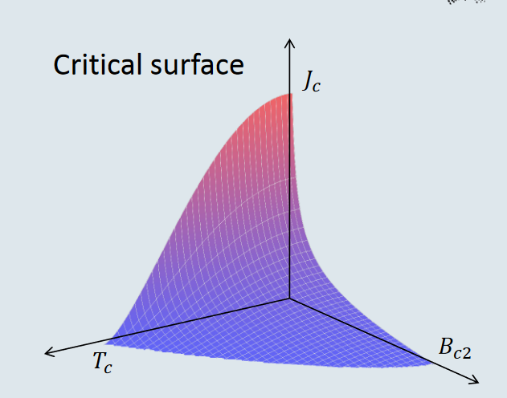

How to quantify film performance?
Critical current density J_{C}
Critical surface of a superconductor
Max current a superconductor can carry without breaking superconductivity
Extracted using VSM SQUID measurements
Depends on pinning centres (structural defects)
The higher the defect density, the higher the J_{C}
Defect density minimization
J_{C} minimization

Slide 19
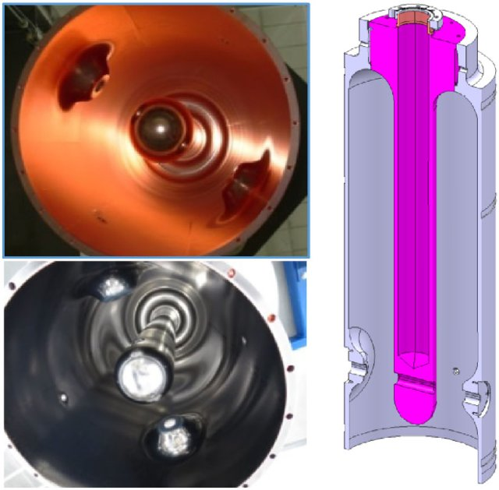

J_{C} minimization
HiPIMS +DC Bias
Bulk Nb: E_{acc} 49 MV/m with Q₀ above 10¹⁰
Nb/Cu samples
HIE-ISOLDE reached fields up to 120mT (~30 MV/m in an elliptical cavity)
J_{C} of our HiPIMS samples is orders of magnitude higher
HIE-ISOLDE
Bulk Nb
4K, 250mT
There’s room for improvement

Slide 20
Thickness
Ion bombardment energy
J_{C} minimization
Post coating annealing
Coating temperature
Substrate treatment
…

Slide 21
J_{C} minimization vs thickness

Slide 22

J_{C} minimization vs thickness
HiPIMS +DC Bias
J_{C} decreases with increasing film thickness
Nb/Cu samples
Independently of bias
What morphological property is responsible for this?
HIE-ISOLDE
Bulk Nb
4K, 250mT
i. e. which defect family disappears gradually with increasing thickness?
Notes:
HIE-ISOLDE – Coated in diode mode w/ high pressure 10^-1 mbar and high temperature 300-650C. 80V bias

Slide 23


Microstructure Analysis
Evaluated films with different thicknesses:
Impact on J_{C}?
Focus Ion Beam
Grain size
Optical profilometry
Roughness
Grazing incidence XRD
Dislocation density
…

Slide 24
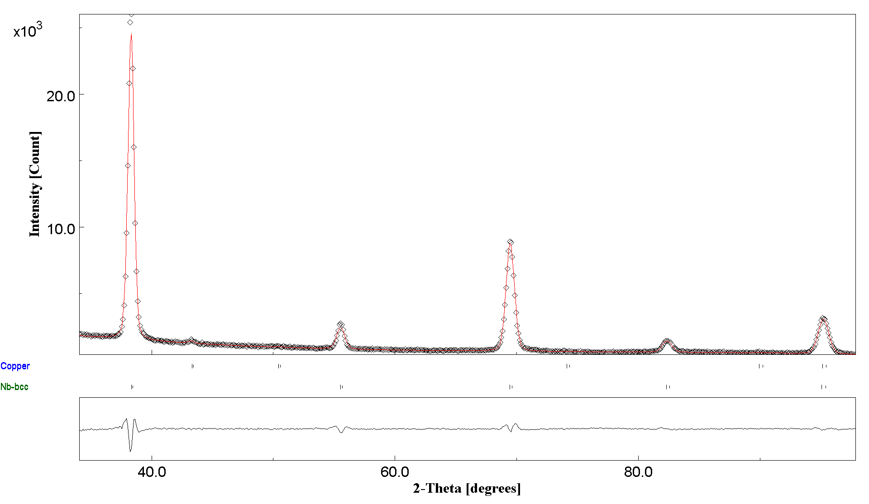






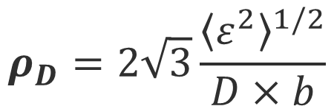
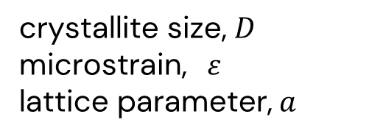
Dislocation density
We quantified the dislocations density in our Nb films through Grazing Incidence XRD
x10³
crystallite size, $D$
microstrain, $ε$
lattice parameter, $a$
20.0
Intensity (a.u.)
10.0
Dislocation density, $ρ_{D}$
$$ρ_{D}=2\sqrt{3}\frac{{\left\langle ε^{2}\right\rangle }^{1/2}}{D×b}$$
Nb-bcc
Cu-fcc
40.0
60.0
80.0
2theta (degrees)
b = Burger vector expressed as $\frac{a√3}{2}$ (m) for BCC materials

Slide 25
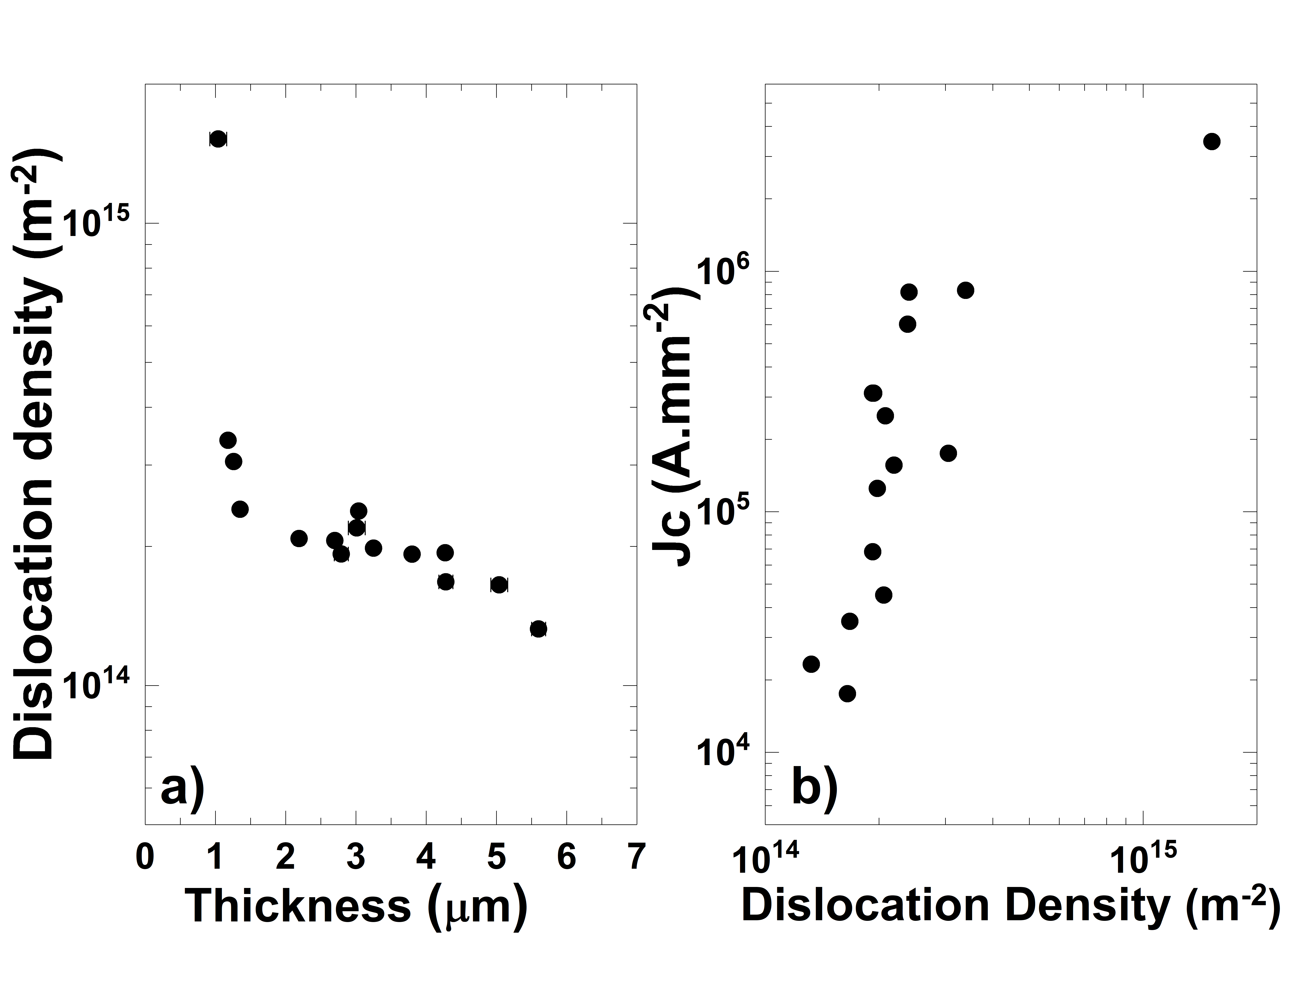

Dislocation density vs J_{C}
Data from all films
Dislocations are driving defects for Jc minimization
Promising for optimization of RF performance

Slide 26
J_{C} minimization vs
DC bias

Slide 27
J_{C} minimization vs DC bias
HiPIMS +DC Bias
Nonlinear relation:
Nb/Cu samples
optimum J_{C} with
-75 V applied DC bias
Bias voltage applied U_{B} changes the ion energy impinging the surface
HIE-ISOLDE
Bulk Nb
E_{ion} = |eU_{B}|
4K, 250mT
-75 V bias corresponds to 75 eV of ion bombardment energy

Slide 28
Ion bombardment energy vs J_{C}
(same thickness)
Optimum J_{C} for ion bombardment energy around 75 eV.
4K, 250mT
How are the different bombardment energies interacting with the growing film?

Slide 29
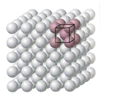
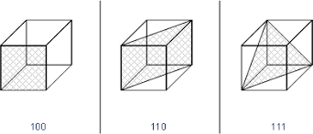


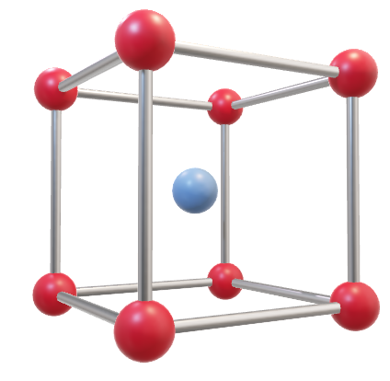





Ion bombardment energy vs J_{C}
1 µm
Body-centered cubic unit cell
{100}
{110}
{111}
surface
For each ion bombardment energy, we calculated the deposited energy at the surface and in the bulk of the film along the different crystalline planes
bulk

Slide 30

Ion bombardment energy vs J_{C}
(same thickness)
difference between deposited energy the {100} and {110} planes as a function of
impinging ion energy @ the surface
4K, 250mT
{100}
Optimum Jc when the energy is equally spread among the {100} and {110} crystalline planes
*
*
binary collision approximation [1][2]
[1] D. K. Brrce et al. Nuclear Instruments and Methods in Physics Research, 44 1989 68-78
[2] Z.Q. Ma et al. Applied Surface Science 137 1999 184–190M

Slide 31
Summary
Thin film optimization
energetic condensation of the film
J_{C}
HiPIMS
as a metric of thin film quality for SRF applications
performance boost achieve FCC-ee target
Better RF performance with:
HiPIMS +DC Bias
Reduction of dislocation density
Bombardment energy equilibrium across the {100} and {110} crystalline planes
HIE-ISOLDE
Bulk Nb
Future work: study other deposition parameters on how they impact J_{C}

Slide 32
Additional ongoing studies
for SRF cavity performance optimization

Slide 33
SRF cavities R&D
Post- coating processing
Thin film
Interface
Substrate

Slide 34
High Pressure Water Rinsing
Control system upgraded (ICM section, 2021)
See talk by Joana Staniszewska
https://indico.cern.ch/event/1129767/
Effect of HWPR duration on film surface?
(smoothening, hardening…)
30 min: no effect
(normal rinsing time)
Roughness
1-2 h smoothens the surface
3-4 h improved
3 h rinsing to be implemented on future cavities
5 h roughening
Power Spectral Distribution (mm µm²)
3-4h optimum
Frequency (1/mm)

Slide 35
SRF cavities R&D
Thin film
Interface
Substrate

Slide 36
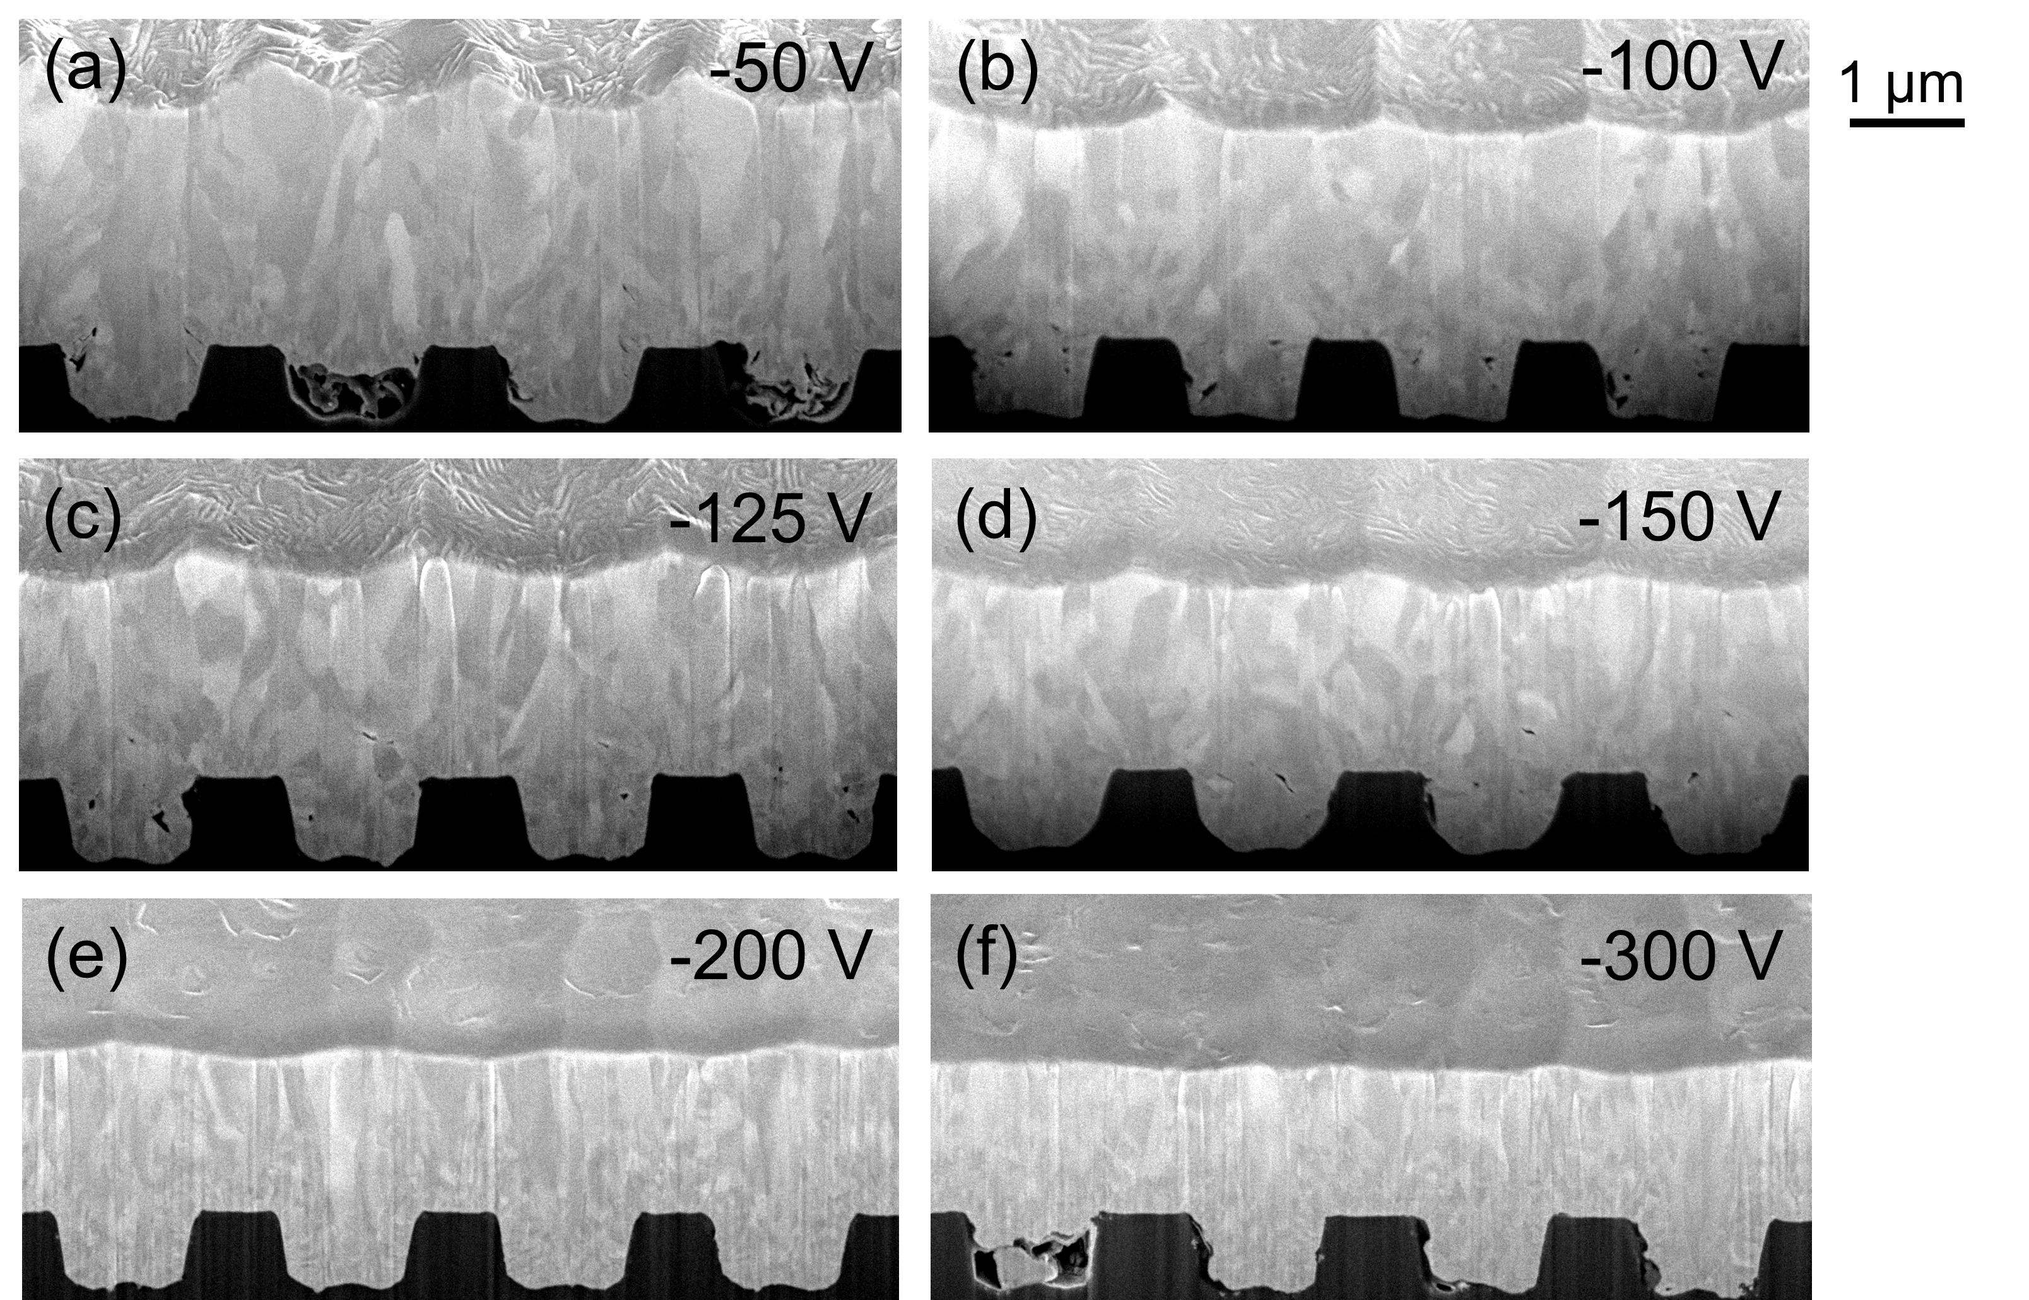
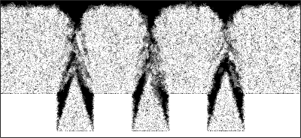
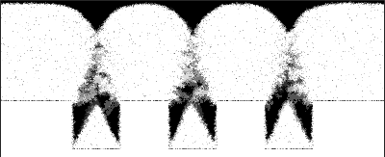
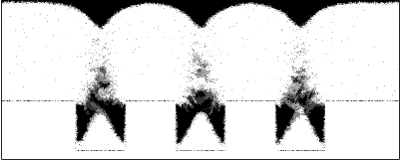
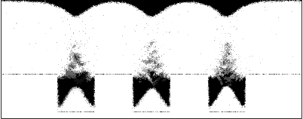
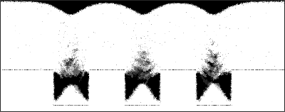
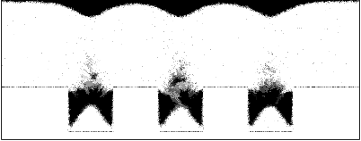
Film planarization
Suppress surface defects “propagation”
Produce flat layer independently of substrate’s roughness
(a)
(b)
-50V
-100V
-75V
(c)
(d)
-125V
-150V
(e)
(f)
-200V
-300V
Simulations
Experimental results

Slide 37
SRF cavities R&D
Thin film
Interface
Substrate

Slide 38
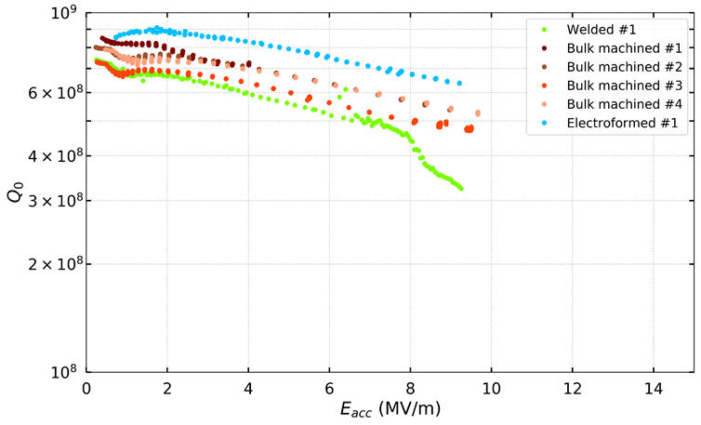
Seamless substrates + Electropolishing
Electropolishing: see talk by Gloria Bellini
https://indico.cern.ch/event/1129762/
Recent RF results 1.3GHz test cavities
seamless cavities (no welds)
bulk machined + electroformed substrates
+ Electropolishing
Scaled FCC-ee
targets
+ Optimized recipe
Cavities were coated with parameters found to optimize J_{C}, -75 V DC bias and 6 µm thickness (cell)
Improved performance with minimum Q-slope
@4.5 K

Slide 39

Summary
Additional studies
HPWR optimization:
3 h smoothening of the
surface
Thin film
Coating recipe to apply this to cavities under investigation
Interface
Nb planarization:
@ -300 V DC bias
Stop defects from propagating from substrate to film
Substrate
Seamless cavities + EP +
optimized coating recipe:
Improved performance
and minimized Q-slope

Slide 40
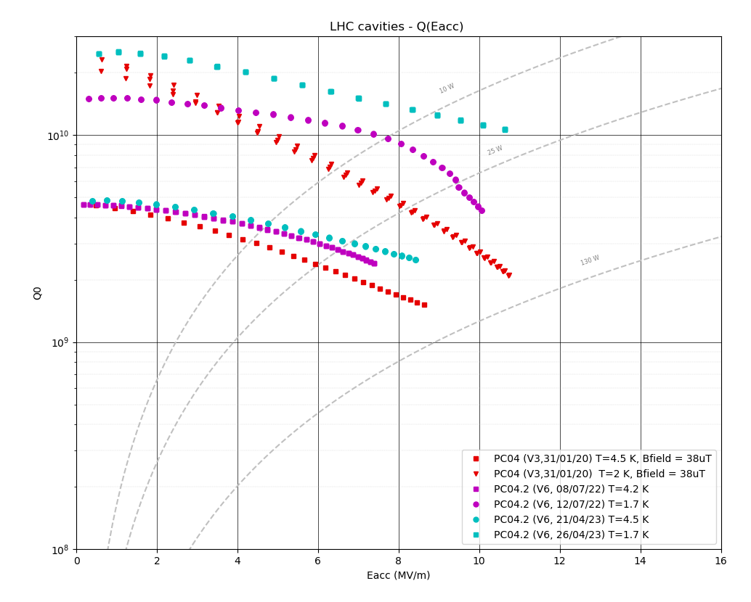

1st HiPIMS-coated 400MHz SRF cavity
Scale-up
@2K
10¹⁰
FCC-ee
Q₀
@4.5K
400 MHz
10⁹
SUBU (not Electropolished)
HiPIMS hardware limitations
10⁸
0
2
4
6
8
10
12
14
16
E_{acc} (MV/m)

Slide 41
Thank You!

