Slide 1
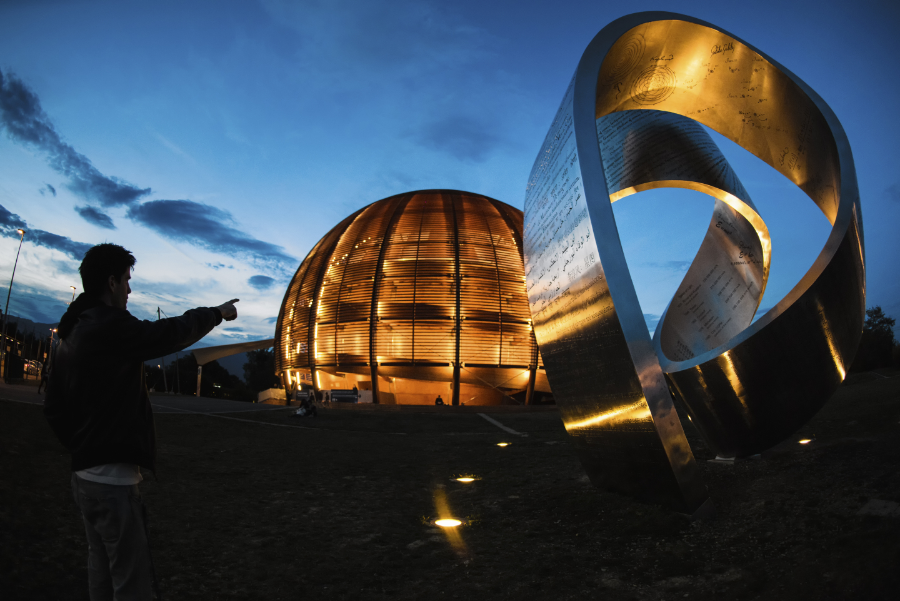
Time Stamped Push Protocol
TSPP for Vacuum Framework
TE-VSC Seminars | 02/05/2023
R. Ferreira / J. Staniszewska
TE-VSC-ICM

Slide 2
Table of Contents
From Field to SCADA
Polling and the Vacuum Framework
The need for TSPP
Vacuum Framework TSPP Manager
Results
Conclusion
(EDMS 1576467)

Slide 3
Introduction
PLC Sampling and SCADA data acquisition
The limitations of Polling
TSPP to the Rescue
Notes:
What I would like to do now is to go through a few projects which I feel to be a good showcase of my skills

Slide 4
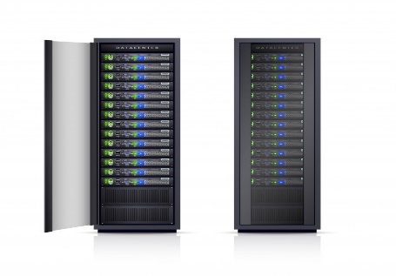
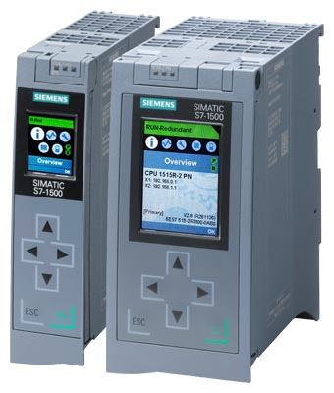

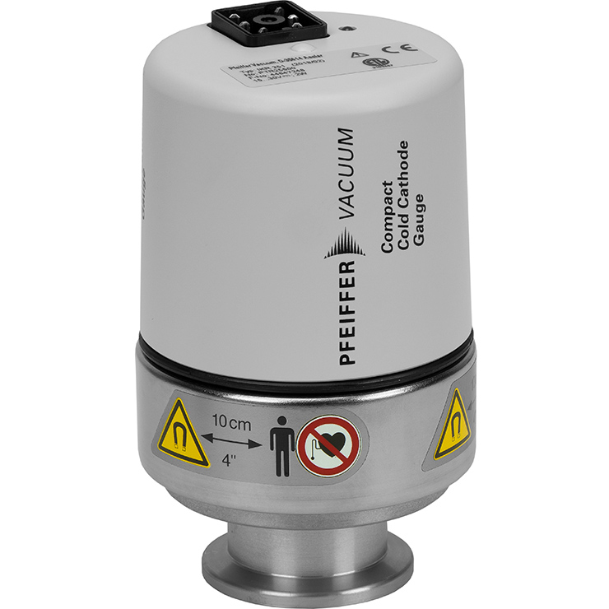
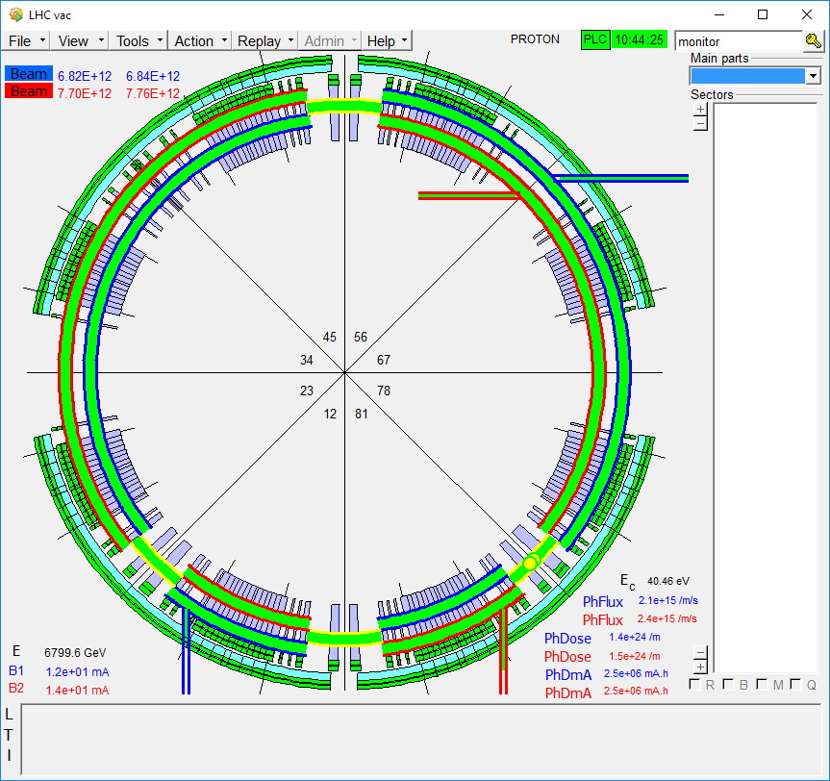
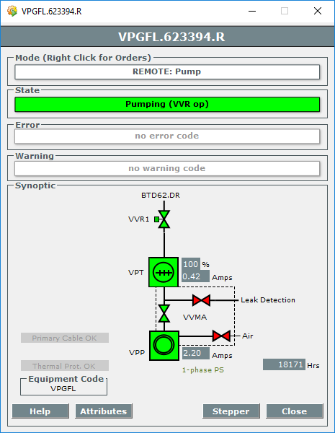
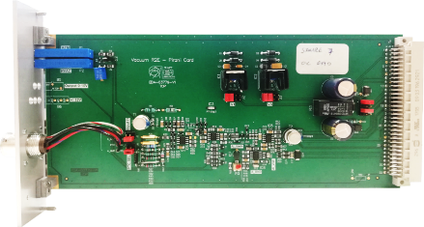
Data Acquisition
From Field to SCADA
Equipment Values (discretized)
0 – 10 V
4 – 20 mA
Operator Terminal
Vacuum SCADA
SCADA Server
Supervisory Control and Data Acquisition
PLC
Programmable Logic Controller
Conditioning Electronics
Vacuum Gauge
Data is shown to Operator
SCADA Polls the PLC for equipment data
Signal is Sampled (time discretization) Quantized (value discretization) and Converted (to physical value)
Physical Value is transformed in an Analog Signal, based on the operating principle of the gauge.
1s
~ 20ms
(EDMS 1576467)

Slide 5
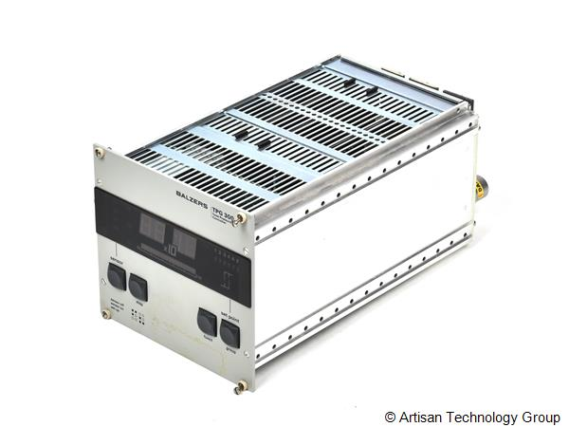
Data Acquisition
From Field to SCADA
Equipment Values (discretized)
Equipment Values (discretized)
Operator Terminal
Vacuum SCADA
SCADA Server
Supervisory Control and Data Acquisition
PLC
Programmable Logic Controller
Gauge
Controller
Vacuum Gauge
Data is shown to Operator
SCADA Polls the PLC for equipment data
Physical Value is read from the controller over a Fieldbus Network
Controller manages the conditioning, sampling and conversion of physical quantity to digital value
1s
~ 20ms
(EDMS 1576467)

Slide 6
Data Acquisition
Programmable Logic Controllers
PLC Execution Cycle
PLCs run in continuous cycles.
Cycle time can be fixed or variable but is usually < 100ms.
Digital and Analog Inputs read at the beginning of every cycle.
Equipment status (valve states, interlock values, gauges, …) is processed or calculated every cycle.
PLC
Programmable Logic Controller
~ 20ms
(EDMS 1576467)

Slide 7
Data Acquisition
The Limitations of Polling
Every polling interval the SCADA requests all data from the PLC. The same timestamp is applied to all of them.
Poll
Request
Poll
Request
1s
20ms
20ms
20ms
20ms
20ms
20ms
t
(...)
PLC Cycles
The limitations of this method are clear:
Decreased sampling frequency for analog data (fixed at 1Hz)
Possible loss of data for fast events (pressure peaks, momentary interlocks, glitches, …)
Might be difficult or impossible to establish cause and effect relations for events that happen in between poll requests
(EDMS 1576467)

Slide 8
Data Acquisition
Time Stamped Push Protocol to the Rescue
Polling (1s period)
Send me the vales for all these datapoints
Datapoint values
Values processed, timestamped with current
date and time, saved and archived
TSPP (arbitrary period)
Here are the new values for the following datapoints and the times at which they changed
Values processed, saved and archived
SCADA Server
Supervisory Control and Data Acquisition
PLC
Programmable Logic Controller
In TSPP – Time Stamped Push Protocol – data is timestamped at the source, and it is the PLC that takes the initiative to push it to the SCADA.
(EDMS 1576467)

Slide 9

Data Acquisition
Time Stamped Push Protocol to the Rescue
There are clear benefits to using TSPP:
Sampling frequency is – theoretically - only limited to the PLC cycle time
No loss of data – events can be timestamped as soon as they happen, saved, and pushed to the SCADA (immediately or with a delay)
Precise timestamping makes it much easier to establish causality between events
(EDMS 1576467)

Slide 10
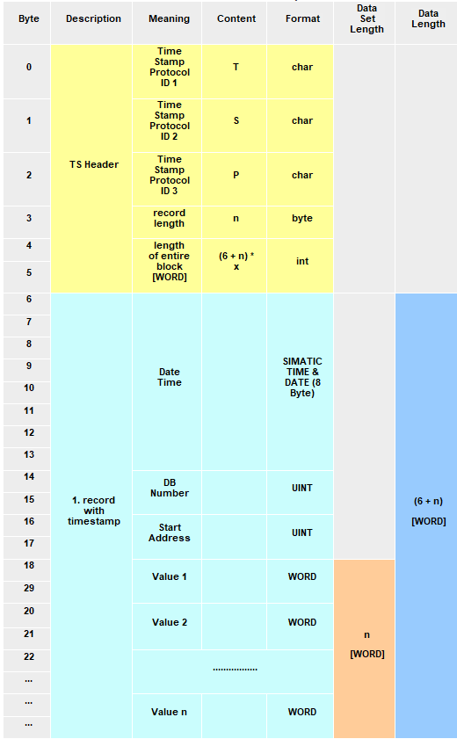
TSPP
Protocol Description
A permanent S7 connection is configured between PLC and SCADA so that the PLC knows where to send data.
PLC creates a data frame with a special format which includes
  Fixed Header (“TSP”)
  Size information
  List of memory addresses, values, and timestamps
Frame is pushed by the PLC to the SCADA.
SCADA processes the frame and updates datapoint values and times.
TSPP was a joint development between Siemens and CERN, originally implemented for the UNICOS framework.
(EDMS 1576467)

Slide 11
TSPP
Vacuum Framework TSPP Manager
TSPP only defines a protocol for PLCs to push timestamped data to the SCADA. Additional software on the PLC must manage:
What, when, and how often should data be pushed
How data should be filtered (in terms of value and time)
How to guarantee that no data is lost
How to avoid flooding the SCADA with irrelevant data
Vacuum Framework TSPP Manager
(EDMS 1576467)

Slide 12
Vacuum Framework TSPP Manager
Read Registers in Vacuum Framework
Manager Description

Slide 13
Vacuum Framework
Data Storage in PLCs
PLCs store data in units called Data Blocks (DB) which are essentially Arrays of Bytes.
All equipment data read by the SCADA is stored in a single DB - the Read Register (RR).
Each device is allocated a dedicated memory block inside the Read Register.
( … ) | …
n- 1 | Byte n – 1
n | Byte n
n + 1 | Byte n + 1
n + 2 | Byte n + 2
n + 3 | Byte n + 3
n + 4 | Byte n + 4
n + 5 | Byte n + 5
n + 6 | Byte n + 6
n + 7 | Byte n + 7
n + 8 | Byte n + 8
n + 9 | Byte n + 9
( … ) | …
n | Gauge Status
n + 1
n + 2 | Error Code
n + 3 | Warning Code
n + 4 | Measurement Status
n + 5 | Pressure Value
n + 6
n + 7
n + 8
Data Points (DPs) in the SCADA point to the individual blocks that comprise the device memory area in the RR.
TSPP is used to push the values of these blocks.
Memory area
of a Standard Gauge
Read Register

Slide 14
TSPP
Algorithm Overview
Evaluate if there is new data in the RR
DPs which have changed
Apply filtering
(Time and Value based filtering)
DPs which have changed and match filter criteria
Every PLC Cycle
Timestamp Data & add Values / Addresses to Queue
Timestamped DPs with new values that meet filter criteria
Process Queue and build TSPP packet
Data packet in TSPP format
Push data to SCADA over S7 Connection
On a user-configured period
(EDMS 1576467)

Slide 15
TSPP
Data Model
DataType (CHAR)
Start Offset (INT)
Device Address (INT)
Device Length (INT)
LSD Index (INT)
TimeStamp (Date and Time)
Value (DWORD)
( … ) | …
n- 1 | Byte n – 1
n | Byte n
n + 1 | Byte n + 1
n + 2 | Byte n + 2
n + 3 | Byte n + 3
n + 4 | Byte n + 4
( … ) | …
( … ) | …
n- 1 | Byte n – 1
n | Byte n
n + 1 | Byte n + 1
n + 2 | Byte n + 2
n + 3 | Byte n + 3
n + 4 | Byte n + 4
( … ) | …
( … ) | …
n 1 | Metadata [n – 1]
n | Metadata n
n + 1 | Metadata [n + 1]
n + 2 | Metadata [n + 2]
n + 3 | Metadata [n + 3]
n + 4 | Metadata [n + 4]
( … ) | …
( … ) | …
y- 1 | Last Sent Data [y – 1]
y | Last Sent Data [y]
y + 1 | Last Sent Data [y + 1]
y + 2 | Last Sent Data [y + 2]
y + 3 | Last Sent Data [y + 3]
y + 4 | Last Sent Data [y + 4]
( … ) | …
Read Register
Previous Read Register
Metadata
Last Sent Data
Data for Vacuum Devices
Saved RR from previous PLC cycle
Information about each RR Byte
Last Values and Timestamps sent to the SCADA, per DP
(EDMS 1576467)

Slide 16
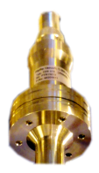
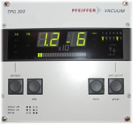
TSPP
Processing the Read Register
( … ) | …
n- 1 | Byte n – 1
n | Byte n
n + 1 | Byte n + 1
n + 2 | Byte n + 2
n + 3 | Byte n + 3
n + 4 | Byte n + 4
n + 5 | Byte n + 5
n + 6 | Byte n + 6
n + 7 | Byte n + 7
n + 8 | Byte n + 8
n + 9 | Byte n + 9
( … ) | …
Pirani Gauge
n + 4 | Byte n + 4
n + 5 | Pressure Value
n + 6
n + 7
n + 8
Pressure
DPE
Gauge Controller
(TPG300)
Read Register
SCADA Server
(EDMS 1576467)

Slide 17

TSPP
Processing the Read Register
( … ) | …
Metadata [n+7] | DataType (CHAR)
k | Start Offset (INT)
Metadata [n + 2] | Device Address (INT)
k + 2 | Device Length (INT)
( … ) | LSD Index (INT)
Metadata [n+8] | DataType (CHAR)
k | Start Offset (INT)
Metadata [n + 2] | Device Address (INT)
k + 2 | Device Length (INT)
( … ) | LSD Index (INT)
Metadata [n+9] | DataType (CHAR)
k | Start Offset (INT)
Metadata [n + 2] | Device Address (INT)
k + 2 | Device Length (INT)
( … ) | LSD Index (INT)
( … ) | …
( … ) | …
n- 1 | Byte n – 1
n | Byte n
n + 1 | Byte n + 1
n + 2 | Byte n + 2
n + 3 | Byte n + 3
n + 4 | Byte n + 4
n + 5 | Byte n + 5
n + 6 | Byte n + 6
n + 7 | Byte n + 7
n + 8 | Byte n + 8
n + 9 | Byte n + 9
( … ) | …
( … ) | …
n- 1 | Byte n – 1
n | Byte n
n + 1 | Byte n + 1
n + 2 | Byte n + 2
n + 3 | Byte n + 3
n + 4 | Byte n + 4
n + 5 | Byte n + 5
n + 6 | Byte n + 6
n + 7 | Byte n + 7
n + 8 | Byte n + 8
n + 9 | Byte n + 9
( … ) | …
n | Gauge Status
n + 1
n + 2 | Error Code
n + 3 | Warning Code
n + 4 | Measurement Status
n + 5 | Pressure Value
n + 6
n + 7
n + 8
Byte Address of the event in RR
TSPP
Manager
Data Type Register Offset in RR
Read Register
Metadata
(EDMS 1576467)

Slide 18
TSPP
Data Filtering
Reduction of noise from analog measurements.
Reduction of the amount of data pushed, which can improve the performance and efficiency of the system.
( … ) | …
LastSentData [k] | Time Stamp
k | Value
LastSentData [k + 1] | Time Stamp
k + 2 | Last Value pushed to SCADA
LastSentData [k + 2] | Time Stamp
k + 4 | Value
( … ) | …
( … ) | …
LastSentData [k] | Time Stamp
k | Value
LastSentData [k + 1] | Time Stamp
k + 2 | Value
LastSentData [k + 2] | Time Stamp
k + 4 | Value
( … ) | …
( … ) | …
n- 1 | Byte n – 1
n | Byte n
n + 1 | Byte n + 1
n + 2 | Byte n + 2
n + 3 | Byte n + 3
n + 4 | Byte n + 4
( … ) | …
n | Byte n
n + 1 | New Value
n + 2
n + 3
n + 4
TSPP
Manager
Read Register
Last Sent Data
Value Filtering
Data is only sent if it has changed from the last pushed value by more than a given percentage, configurable by the user.
Time Filtering
Data is only sent if it was last pushed to the SCADA more than a configurable time ago.

Slide 19
TSPP
Timestamping and Data Queues
New data which meets filtering criteria is timestamped and packed into the appropriate format.
Data packets are stored data queues to be pushed out later.
Four distinct data queues are used, one per data type.
( … ) | …
k- 1 | VacTSPP_DATA [k– 1]
k | VacTSPP_DATA [k]
k + 1 | VacTSPP_DATA [k + 1]
k + 2 | VacTSPP_DATA [k + 2]
k + 3 | VacTSPP_DATA [k + 3]
k + 4 | VacTSPP_DATA [k + 4]
k + 5 | VacTSPP_DATA [k +5]
k + 6 | VacTSPP_DATA [k +6]
k + 7 | VacTSPP_DATA [k + 7]
k + 8 | VacTSPP_DATA [k + 8]
k + 9 | VacTSPP_DATA [k + 9]
( … ) | …
Active (BOOL)
Value (DWORD)
Active (BOOL)
TimeStamp (DATE AND TIME)
Value (DWORD)
Active (BOOL)
TimeStamp (DATE AND TIME)
DB Number (INT)
Address (INT)
Value (DWORD)
Active (BOOL)
TimeStamp (DATE AND TIME)
DB Number (INT)
Address (INT)
DataType (CHAR)
Value (DWORD)
n | Byte n
n + 1 | New Value
n + 2
n + 3
n + 4
TSPP
Manager
VacTSPP DATA
Data Queue

Slide 20
TSPP
Building the TSPP Frame
The timestamped values stored in the Data Queues are processed and a TSPP frame is prepared.
The TSPP frame is recognized by the driver on the SCADA and the datapoint values are updated
1
T
S
P
Record length
2
VacTSPP Data
In
3
1
1
VacTSPP Data
Out
Date & Time
DB Number
Start Address
Value 1
2
2
Data packed into TSPP frame
Data sent to SCADA
3
3
SCADA Server
FIFO Queue
First values added are the first ones to be processed
Date & Time
DB Number
Start Address
Value n
(EDMS 1576467)

Slide 21
Results

Slide 22
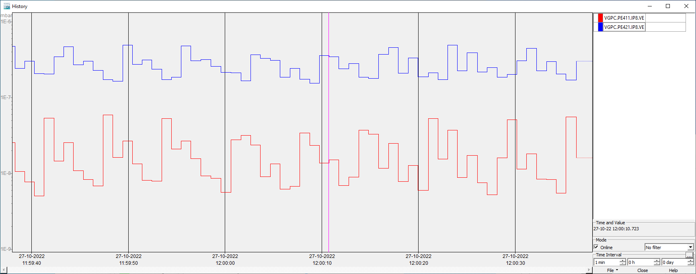
TSPP Performance
Continuously changing values
Semi-random noise added to the value of two gauges (0 – 100% of base value, 10Hz).
SCADA Polling – 1s period
(EDMS 1576467)

Slide 23
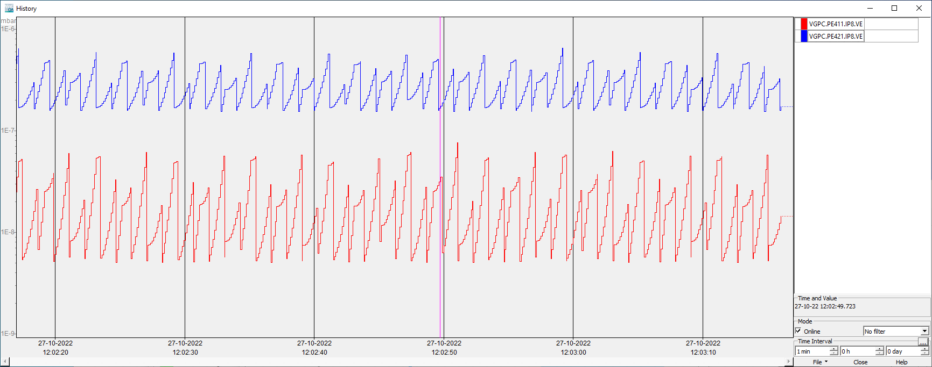
TSPP Performance
Continuously changing values
TSPP - Unfiltered
(EDMS 1576467)

Slide 24
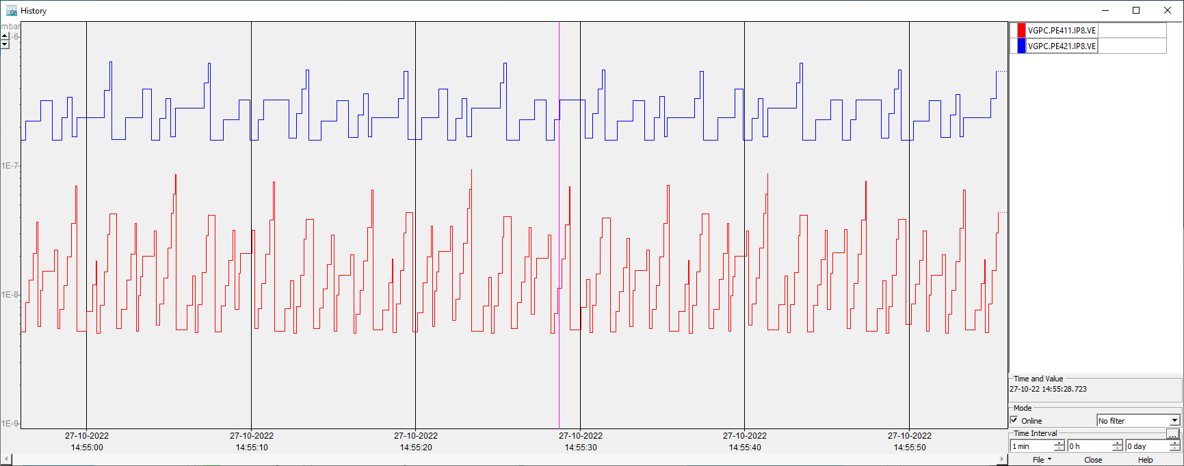
TSPP Performance
Continuously changing values
TSPP – Value Filtering (40%)
(EDMS 1576467)

Slide 25
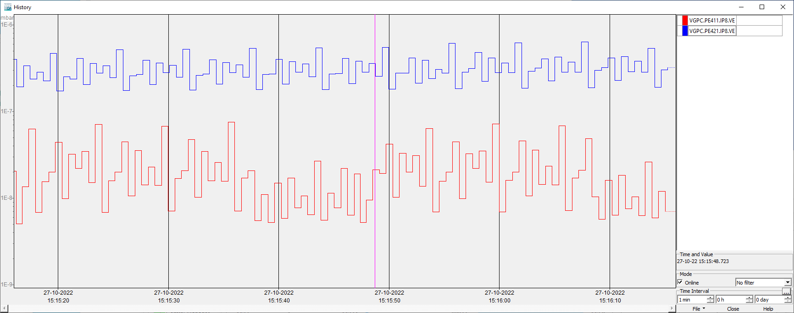
TSPP Performance
Continuously changing values
TSPP – Time Filtering (500ms)
(EDMS 1576467)

Slide 26
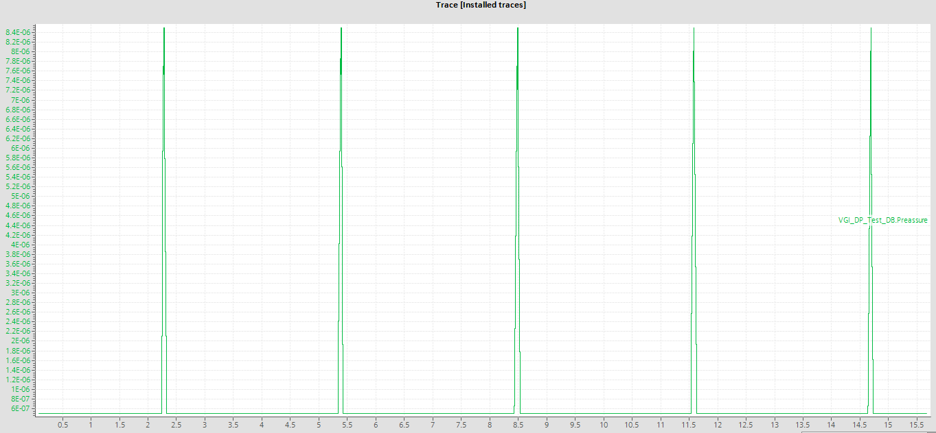
TSPP Performance
Fast Spikes
Simulated fast pressure spikes (16x the base value, 100ms duration, 0.33Hz).
PLC Trace (original signal)
(EDMS 1576467)

Slide 27
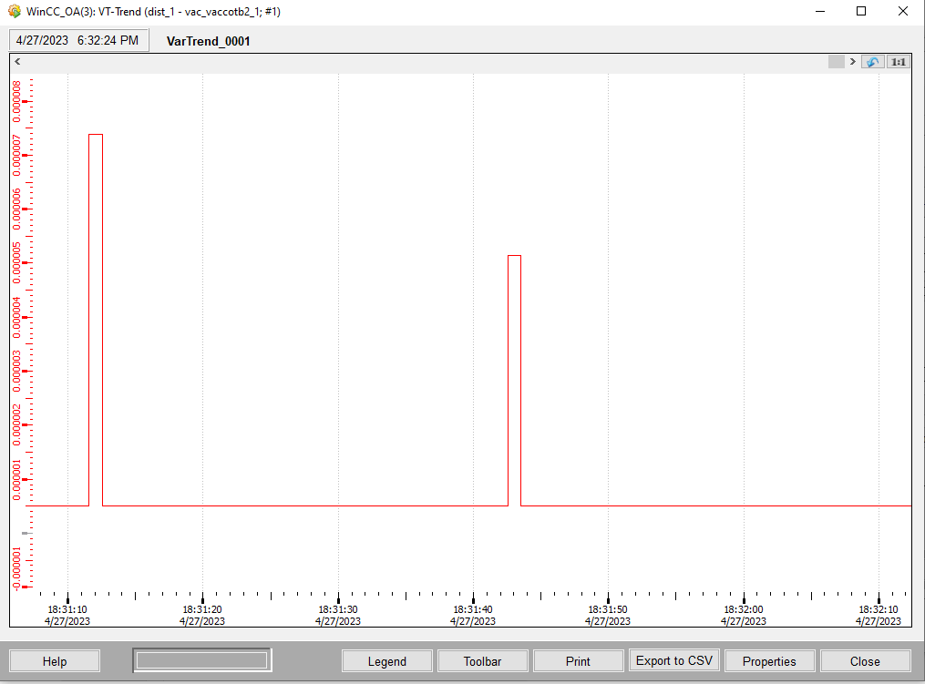
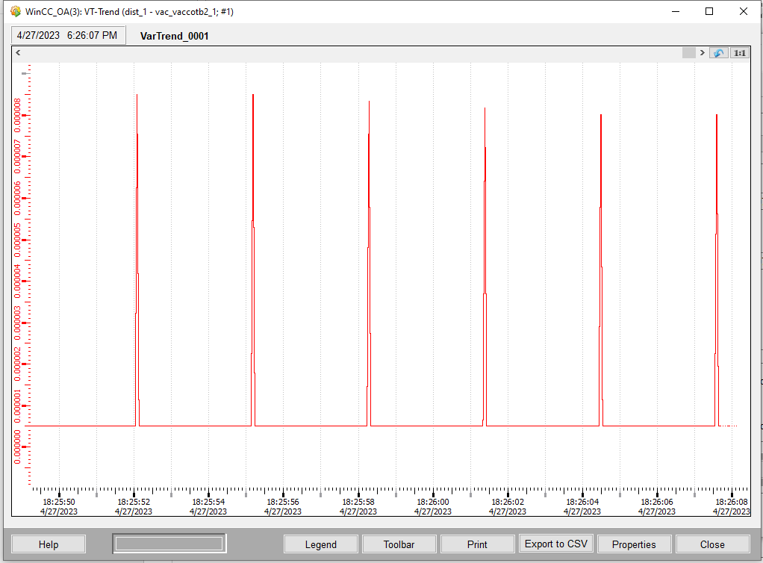
TSPP Performance
Fast Spikes
Polling (1s)
TSPP
(EDMS 1576467)

Slide 28
Conclusion
Notes:
What I would like to do now is to go through a few projects which I feel to be a good showcase of my skills

Slide 29
Summary
In Conclusion
TSPP is useable in Vacuum Framework and provides considerable improvements in data acquisition quality compared to polling.
  TSPP can be implemented on S7-300/S7-400/S7-1500 PLCs but not possible on S7-1200 (VPGs)
PLC-side development is quite advanced, but work is still required on the SCADA and Exporter to automate transition to TSPP.
Extensive testing will be conducted before any production deployment
  It remains to be investigated if many PLCs pushing data to the SCADA simultaneously have any impact on any other parts of the system
Deployment will be phased, starting in the smaller machines or experiments (AWAKE, AD)
Notes:
Working in teams
Mention collaboration with other sections
Demonstrating flexibility
Going for a new solution
Solving problems

