Slide 1

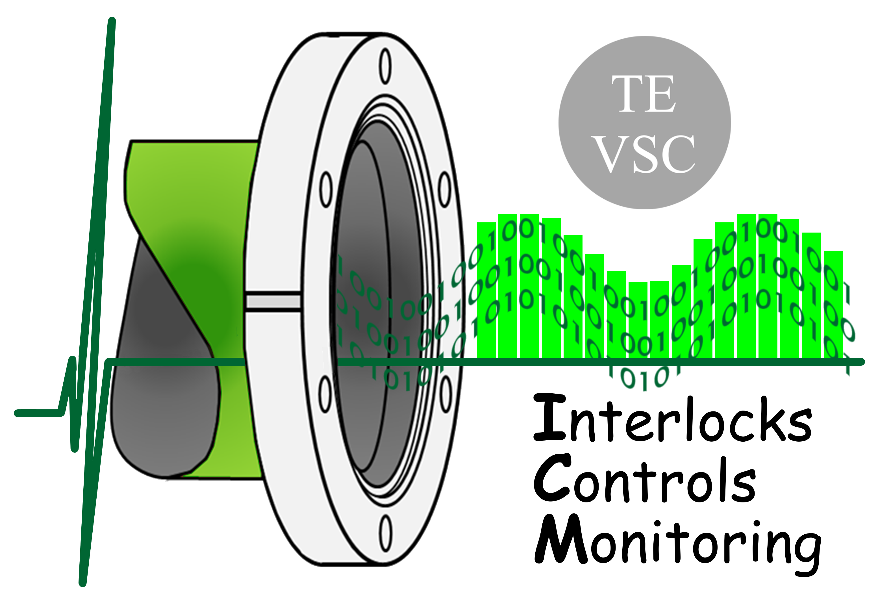

Piezo resistive gauge irradiation test results
Nikolaos Chatzigeorgiou
VSC seminar on the 13th of June 2023
https://indico.cern.ch/event/1242517/

Slide 2
Agenda
About piezo resistive gauges
Their use in the LHC
HL-LHC requirements
Irradiation test results:
  External facility
  Internal facility
Conclusions
Future work

Slide 3
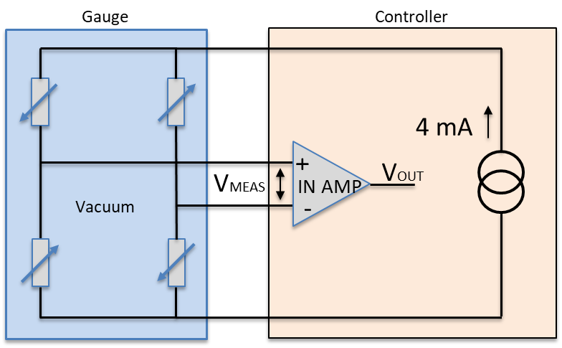
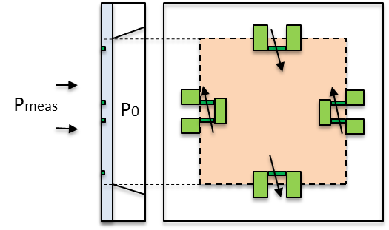
Piezo resistive gauges
The word piezo derives from ancient Greek “piezein” which means to squeeze or press
When pressure is applied in a piezoresistive material (silicon):
Shift in the atomic positions -> affects the electric charge transport -> change in conductivity
Thin silicon crystal layer used as a membrane:
Membrane deformation -> piezo resistive effect
Piezo resistive elements form a Wheatstone bridge which can be excited with constant current
Vmeas [mV] is a measure of the membrane deformation and therefore the pressure

Slide 4
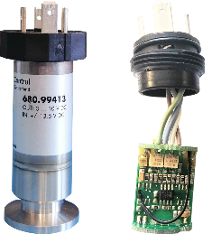
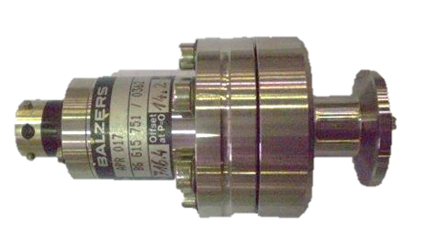
Piezo gauge variants based on location in LHC
High-radiation areas
Only passive gauges
Low-radiation areas
Active RadTol gauges
LSS
DS
ARC
Balzers APR017
x65 units
HUBA 680.99413
x168 units

Slide 5
HL-LHC requirements
For HL at P1 and P5 the IV volumes increase and x32 additional piezo gauges are needed:
QXL (x4)
Crab cavities (x8)
D2 (x4)
Cold powering (x16)
IT-String (x3)
BGC (x2)
The present IV inventory cannot cover the HL needs using APR gauge
Just few spares in stock for LHC operation
Not manufactured any more

Slide 6
New gauge technical specifications
Same range of pressure measurement
  0 – 2000 mbar
  Sensitivity in the order of 77 uV/(mbar.mA)
Same flange (KF16)
Same or similar electrical connection to Burndy 4
Less than ±1% FS accuracy
EPDM seals or preferably fully welded sensor
Compatible with current controller and cabling infrastructure
  Bridge excitation in the order of 4mA
  Differential measurement in the order of 600mV
Passive gauge with a tolerance to radiation
  200 kGy

Slide 7
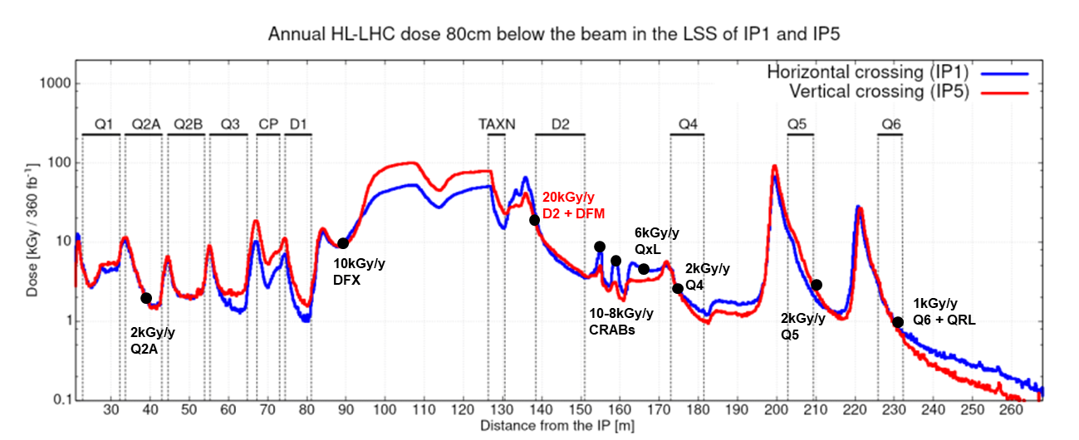
Radiation levels in LSS1/5
Optics v1.5
May 2019
Radiation Level Specifications for HL-LHC, G. Lerner, EDMS 2302154

Slide 8



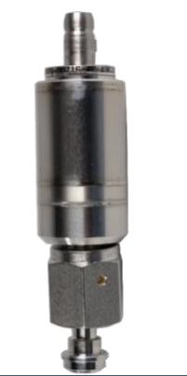
The STS company
Swiss company with applications in several industries
Main products include sensors for:
  Pressure
  Level
Very friendly staff and available for custom solution
  without a minimum order quantity
Manage development & productions for other companies
  HUBA piezo sensor for DS/ARCs manufactured by STS
Involved with ITER for piezo resistive sensors
https://www.stssensors.com/
STS article

Slide 9
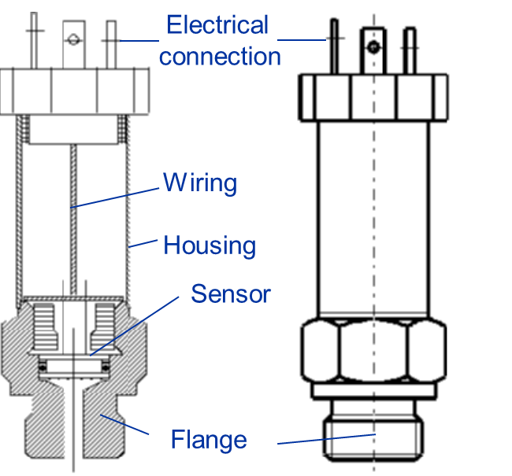
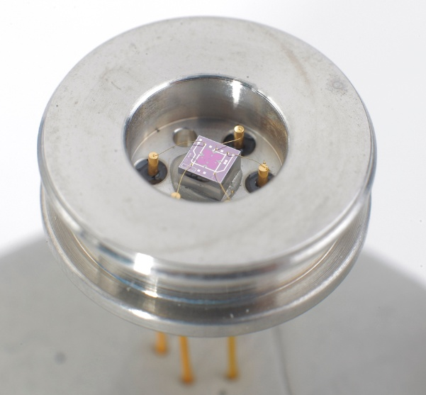
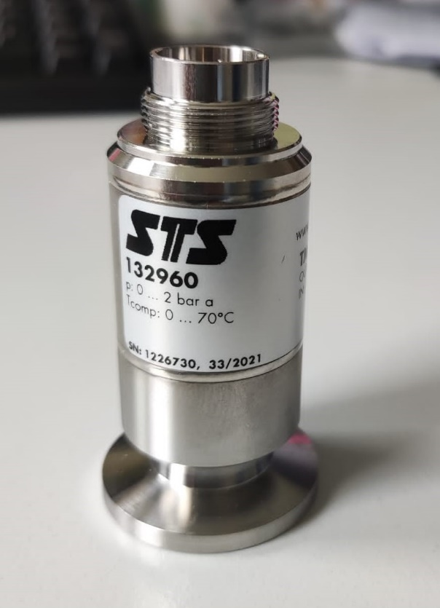
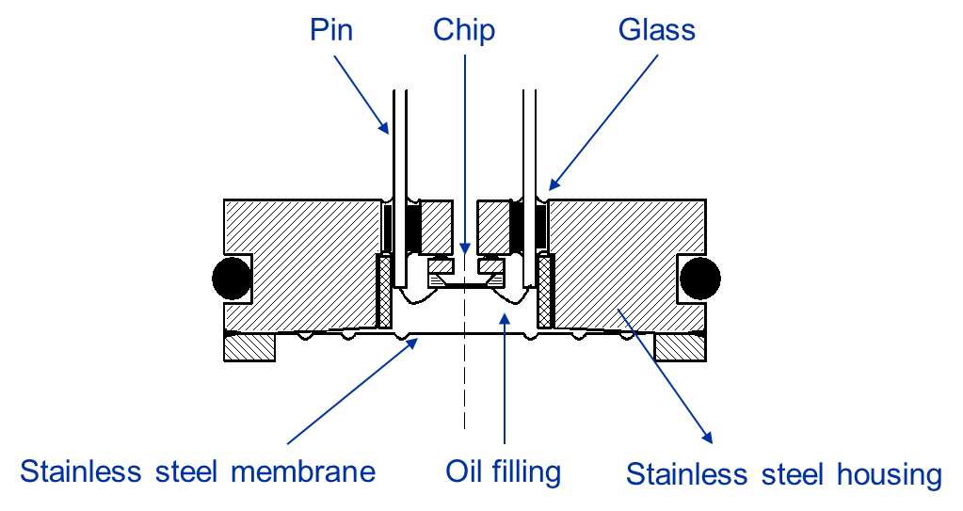
STS gauge construction
Welding point of the sensor

Slide 10
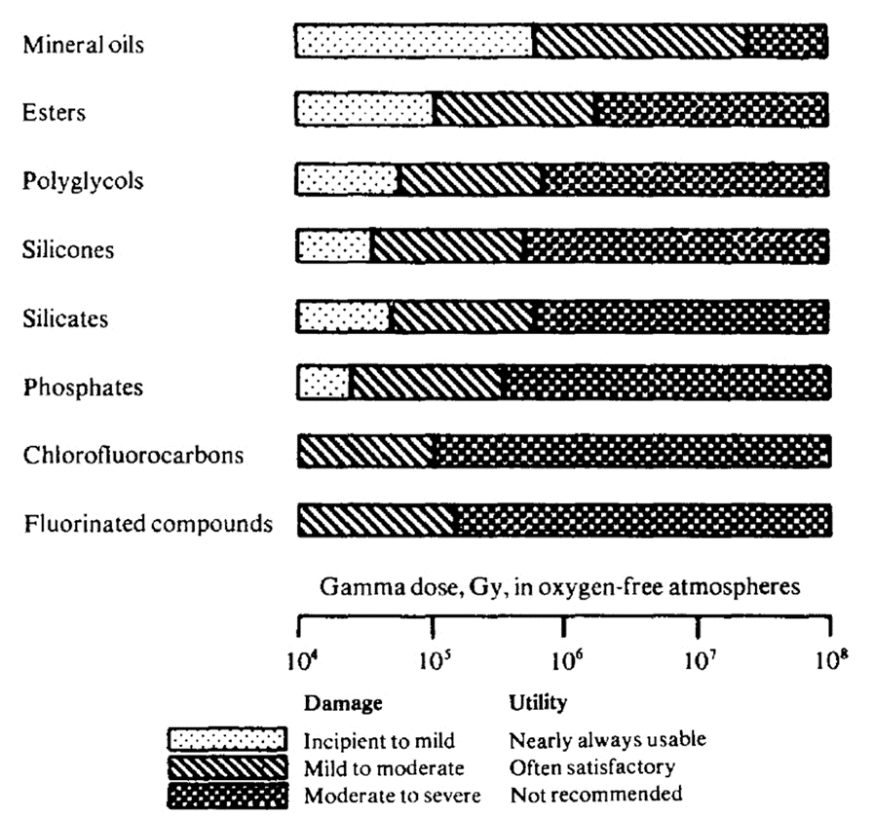
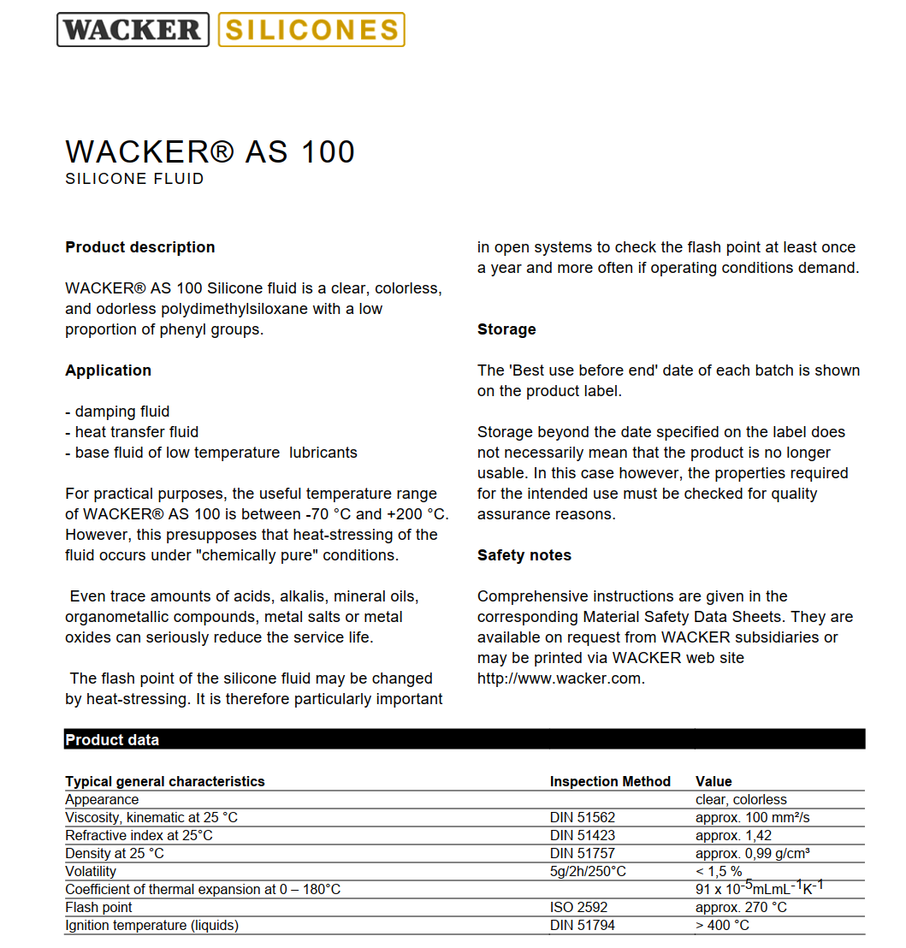
Radiation effects on oils and lubricants
Q6
D2
Viscosity change
Depends on the exact silicon-based oil chemical composition, the type of radiation, flux and duration
Chain scission and crosslinking of molecules
Radiation induced oxidation (caused by production of free radicals)
many other mechanisms..
Production of gasses
Radicals recombination into gaseous hydrocarbons (ethane, methane, etc..) depending on temperature and pressure

Slide 11
Irradiation test workflow
STS
Materials damage
Electrical degradation
Internal facility CC60
External facility STERIS

Slide 12
Irradiation at external facility - STERIS

Slide 13
Test procedure
Passive Gamma irradiation at atmospheric pressure
  Pre-irradiation leak test (AL4030)
  8 samples sent in total:
    2 samples at 50kGy
    2 samples at 100kGy
    2 samples at 500kGy
    2 samples at 1MGy
  Post-irradiation leak test (AL4030)

Slide 14
Leak detection pre- and post-irradiation
Sample | Pre-irradiation [mbar.l/s] | Post-irradiation [mbar.l/s]
A1 – 50kGy | 4.10⁻⁸ | 1,8.10⁻⁸
A2 – 50kGy | 2,2.10⁻⁸ | 1,6.10⁻⁸
B1 – 100kGy | 2,5.10⁻⁸ | 5,7.10⁻⁸
B2 – 100kGy | 4,8.10⁻⁸ | 4.10⁻⁸
C1 – 500kGy | 2,4.10⁻⁸ | 2,8.10⁻⁸
C2 – 500kGy | 5,4.10⁻⁸ | 6,8.10⁻⁸
D1 – 1MGy | 2,4.10⁻⁸ | 3,6.10⁻⁸
D2 – 1MGy | 2,6.10⁻⁸ | 4.10⁻⁸
No significant differences between pre- and post-irradiation

Slide 15
Irradiation at internal facility – CC60

Slide 16
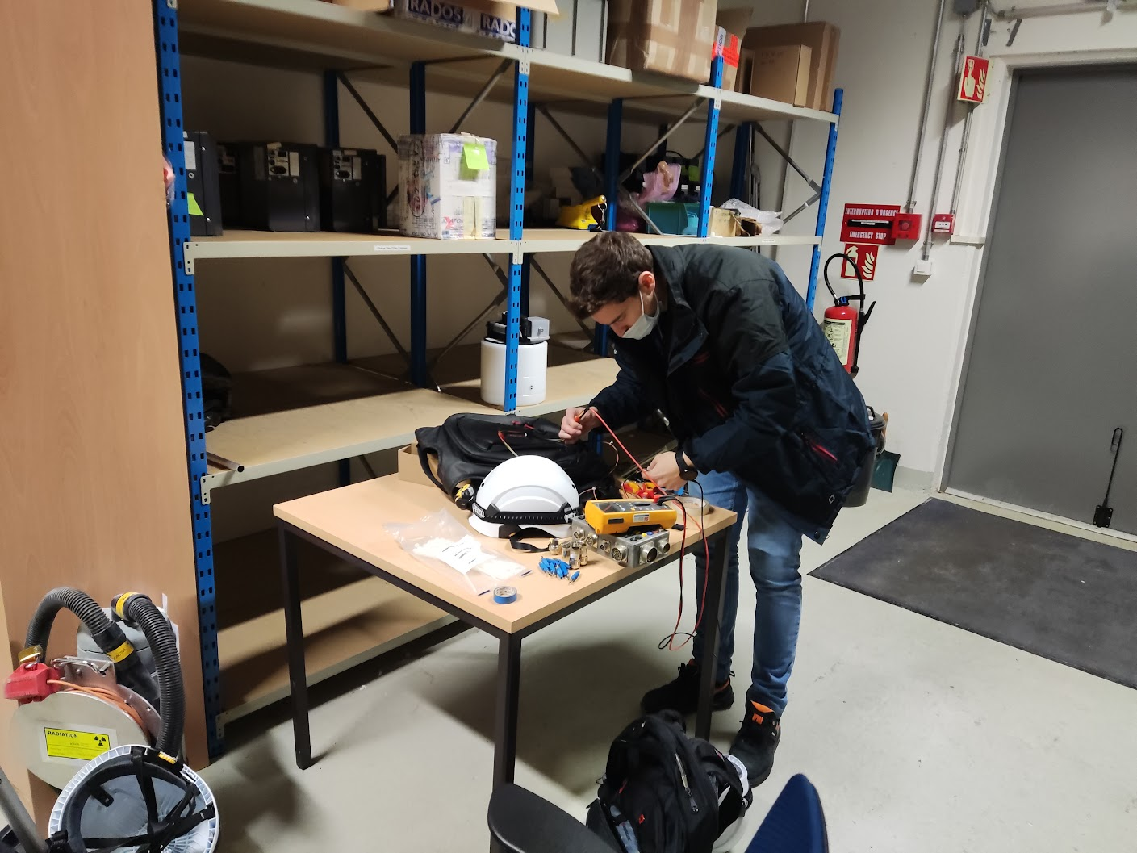
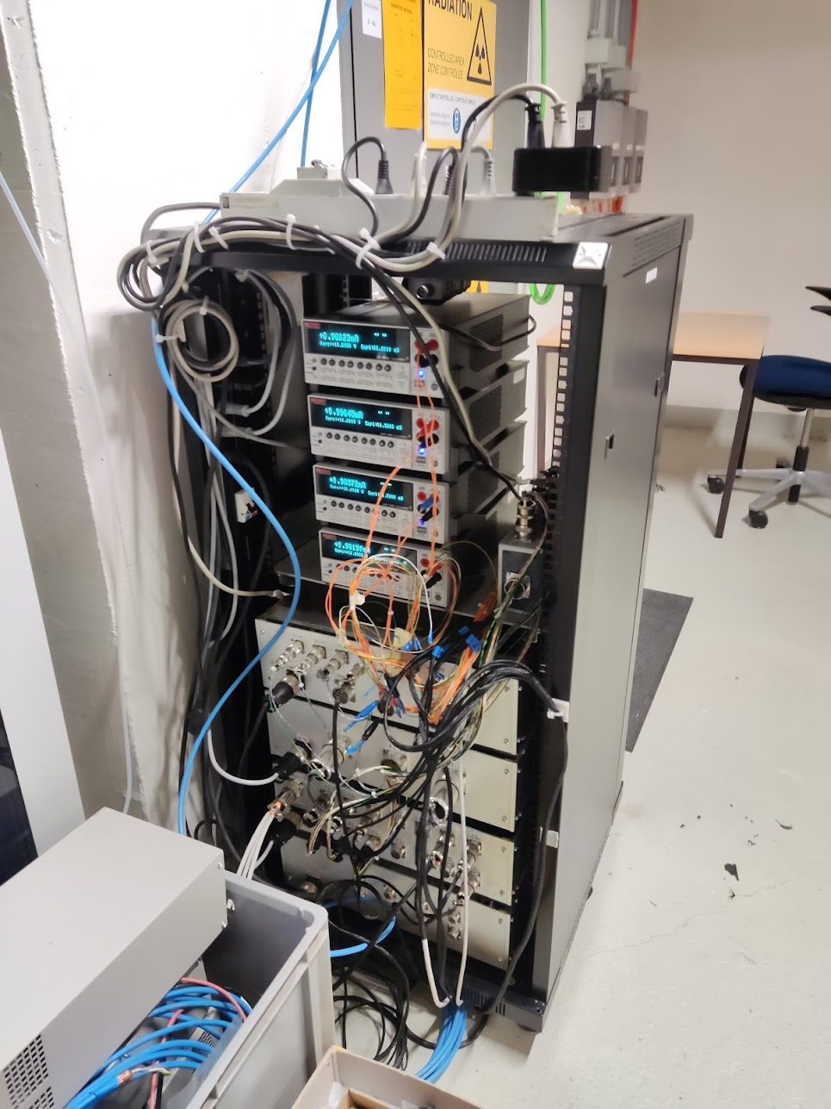

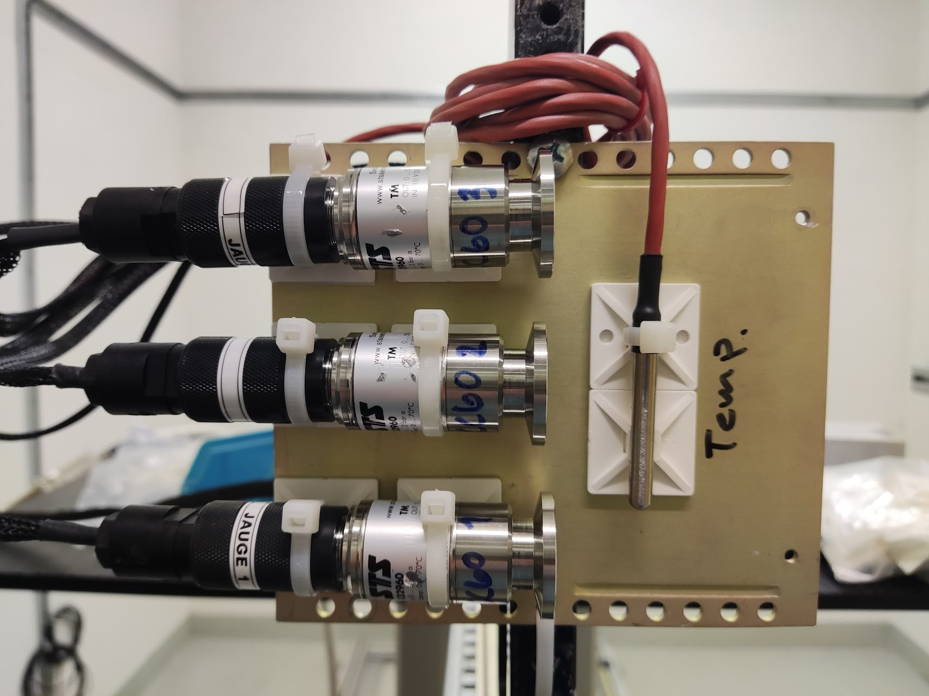
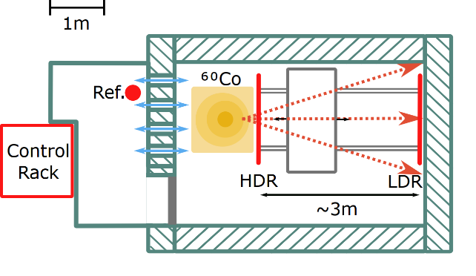
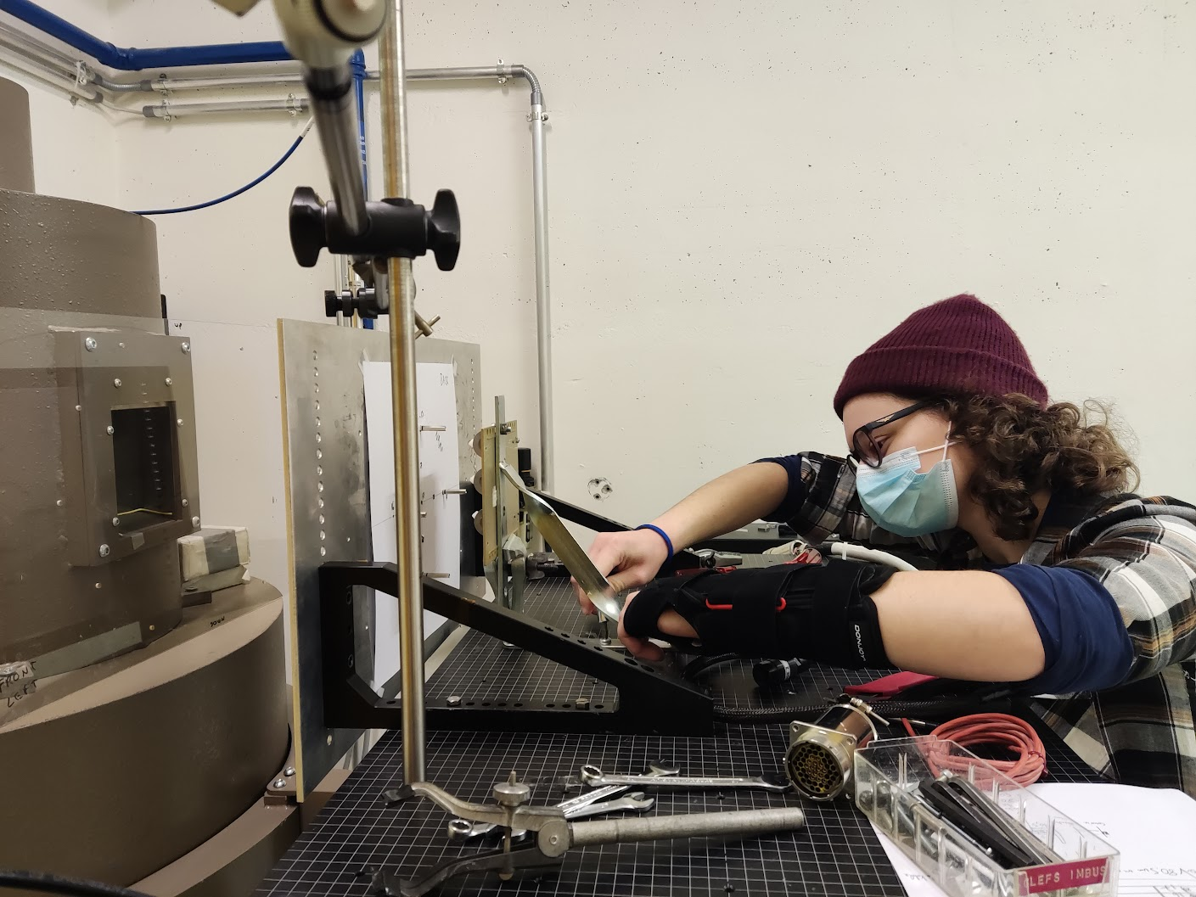
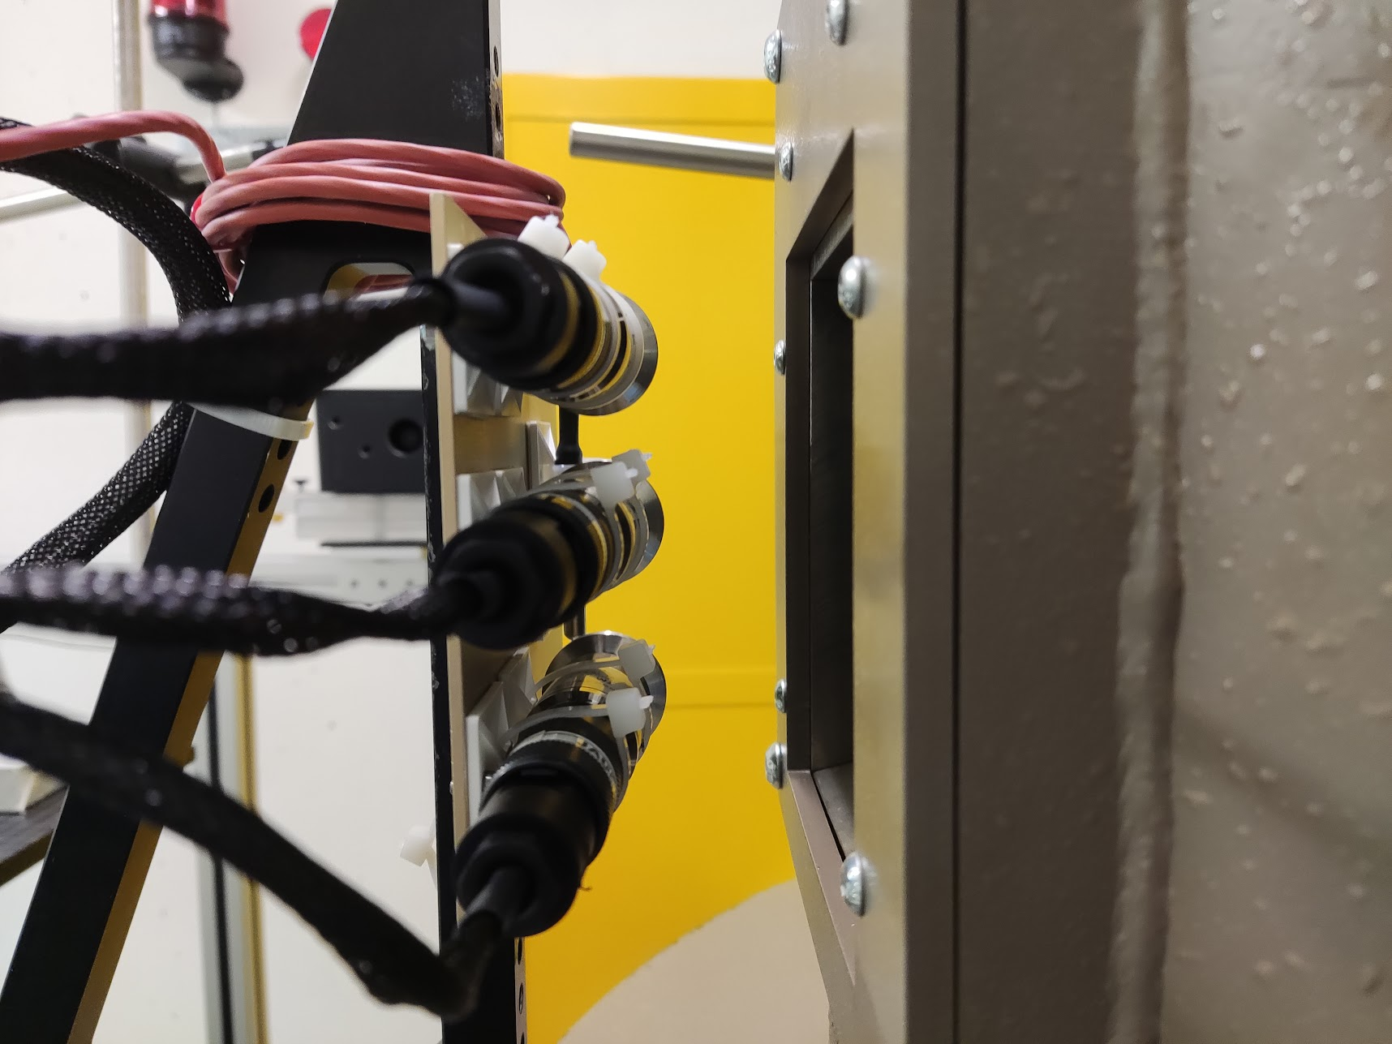
Internal facility CC60
Located in 772 at Prevessin site
Equipped with a 110TBq gamma source
Dose rates from 436 Gy/h to 0.36 Gy/h

Slide 17


Test procedure
Active Gamma irradiation at atmospheric pressure
  Pre-irradiation leak test (AL4030)
  Pre-irradiation characterization (lab)
  3 samples and 1 reference with online monitoring every 1s:
    1 campaign in 2022 up to 60kGy with a dose rate of 65Gy/h
    1 campaign in 2023 from 60kGy to 180kGy with a dose rate of 400Gy/h
  Post-irradiation leak test (AL4030)
  Post-irradiation characterization (lab)
Reference gauges
CMR 0.1 – 1000 mbar
APR 1000 – 2000 mbar
STS
CMR
APR
Compressed air
Pump
Chamber

Slide 18
Leak detection pre- and post-irradiation
2022 campaign
2023 campaign
Gauges | Pre-irradiation [mbar.l/s] | Post-irradiation @ 60kGy [mbar.l/s] | Post-irradiation @ 180kGy [mbar.l/s]
Reference | 1,3.10⁻⁷ | 1,3.10⁻⁷ | 1.10⁻⁸
DUT1 | 9,2.10⁻⁸ | 1,5.10⁻⁷ | 2,3.10⁻⁸
DUT2 | 9,4.10⁻⁸ | 7,3.10⁻⁸ | 7,6.10⁻⁸
DUT3 | 1,2.10⁻⁷ | 1.10⁻⁷ | 1,7.10⁻⁸
Not increased leak rate due to radiation

Slide 19
Measurement error from the online monitoring
2022 Campaign – 65Gy/h
2023 Campaign – 400Gy/h
0.075%/kGy at ATM
4.5%
@60kGy

Slide 20
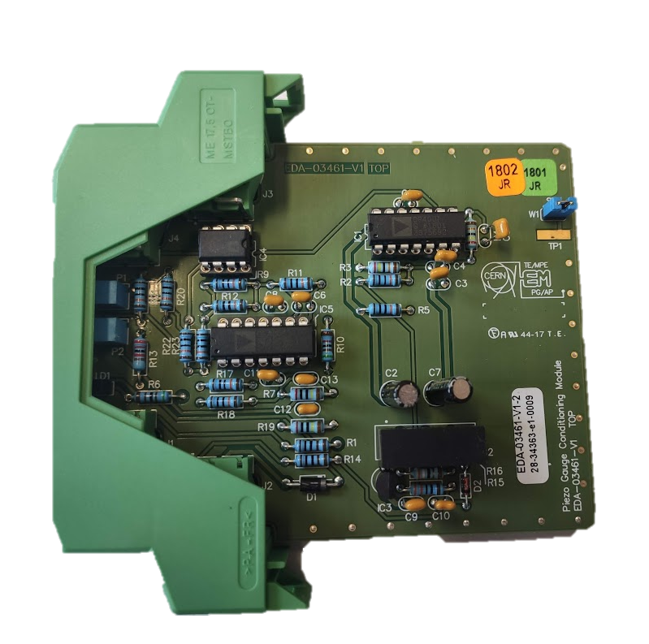
Measurement error from 2022 campaign
40mbar
offset
+12% drift @500mbar
Full compensation using conditioning electronics
Error < 1% FS
+4.5% drift @2000mbar

Slide 21
Description of issues from 2023 campaign
The gauges start failing during the 2nd campaign at around 70 – 75 kGy
Apart from the very high dose rate (400Gy/h), no other apparent reason for these failures
Control system and cabling cross-checked and OK
No failure of the reference gauge
No indication of sudden temperature rise
Similar behavior to a load changing its resistance
2 DUT sent to STS company for debugging & 1 DUT remained at CERN

Slide 22
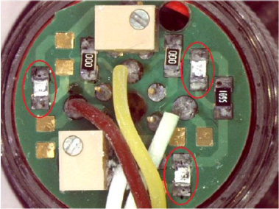
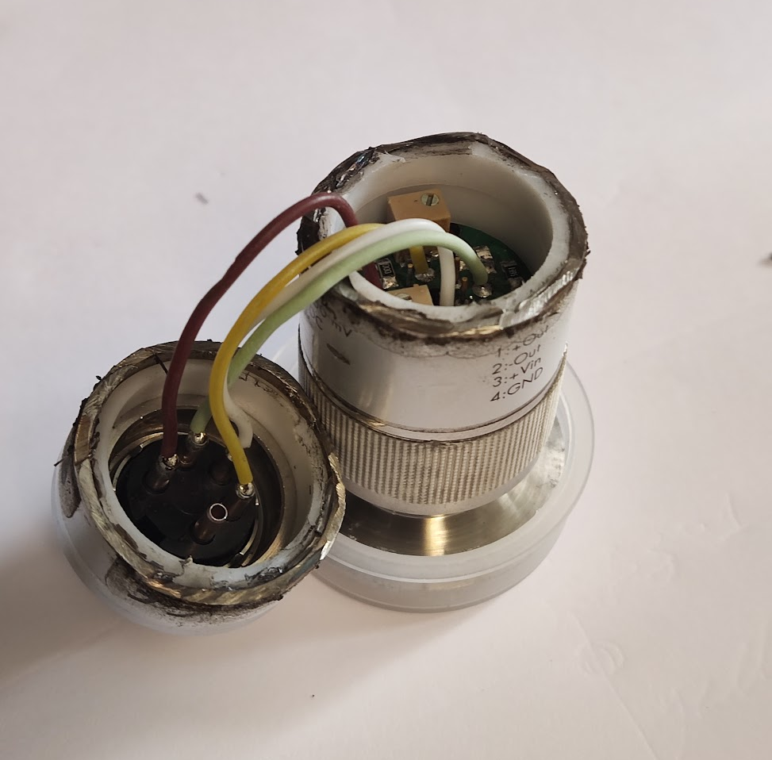
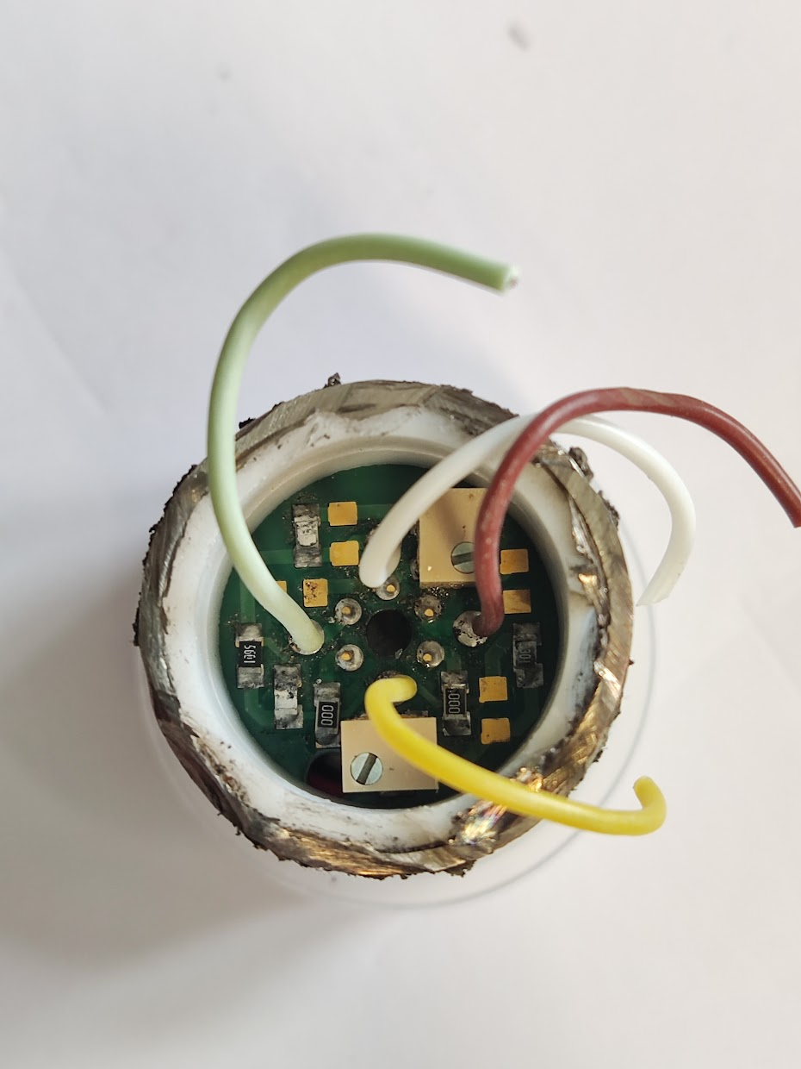
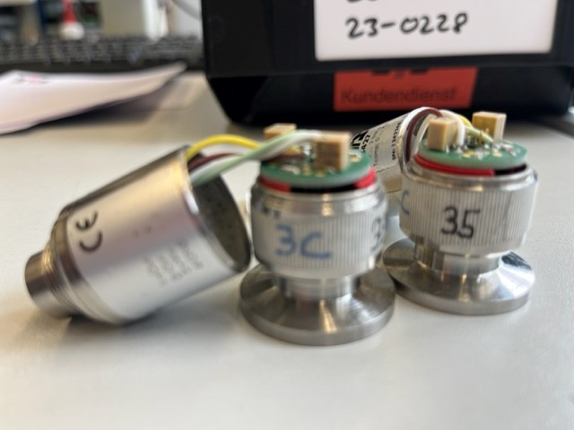
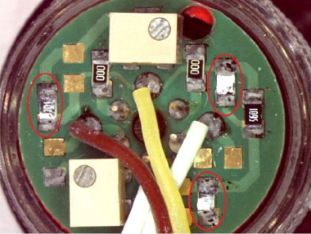
Visual inspection
CERN analysis
STS analysis
Sample CC60 2C
Sample CC60 1C
Samples CC60 2C & 3C
Sample CC60 3C
CERN and STS have seen the same issue for all 3 samples: resistors!

Slide 23

CERN analysis
Iin
4.5k
@180kGy
3.3k
Reverse engineered the PCB
3.3k resistors seems to be part of the calibration for gain and offset
68k resistor seems to be balancing the bridge (possibly temperature compensation – TBC by STS)
Each individual resistor was measured
68k increased to 119k
3.3k increased to 4.5k and 3.5k
Measured the measuring cell
Fully operational with a small resistance deviation
R ratio from 0Gy to 180kGy deviated by 0.01kOhm
2.32k
2.27k
Out-
2.46k
@180kGy
2.4k
@180kGy
Out+
5.6k
68k
2.27k
2.4k
@180kGy
2.46k
@180kGy
3.5k
@ 1bar
2.32k
119k
@180kGy
0R
0R
3.5k
@180kGy
3.3k
GND

Slide 24
CERN analysis
Understand if the measuring cell is functional
Replaced all the resistors of the PCB
Not possible to replace the potentiometers
Mounted the gauge back to the chamber
The set of cell and potentiometers are degraded but functional
offset of about 20mbar
5% drift at 500mbar
2.5% at 2000mbar
The offset and FS error is less comparing to 60kGy plot
Error can be compensated with the conditioning electronics
Compensation works at 60kGy (slide 20)
To be tested in the lab
20mbar
offset
On-going work
+5% drift @500mbar
+2.5% drift @2000mbar

Slide 25
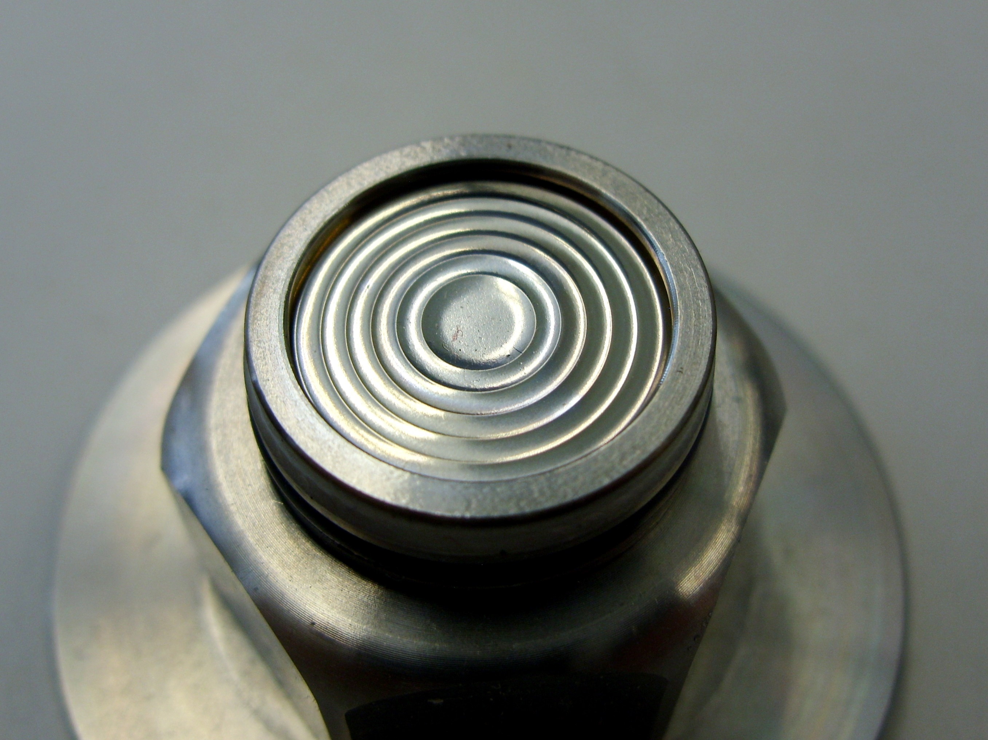
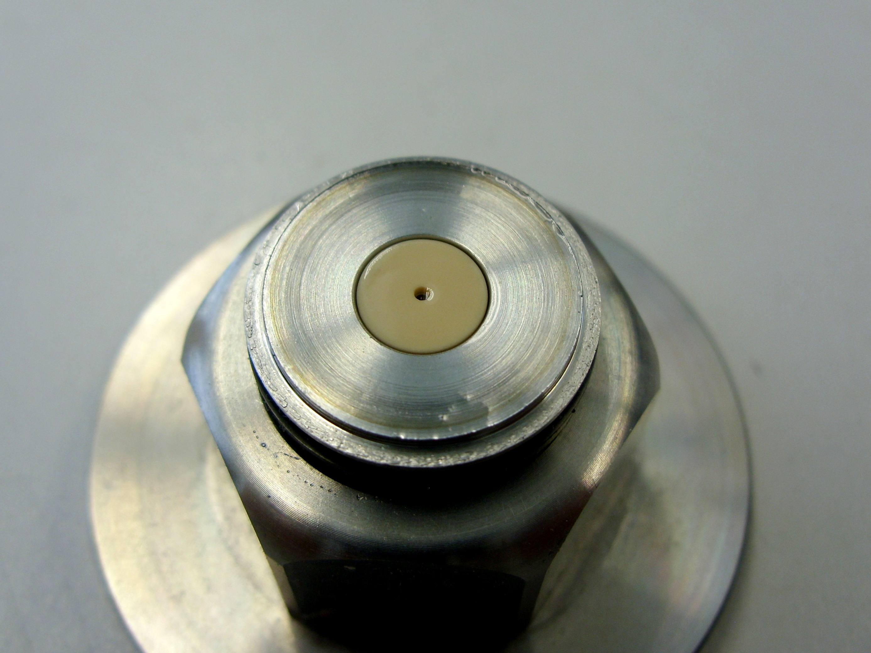
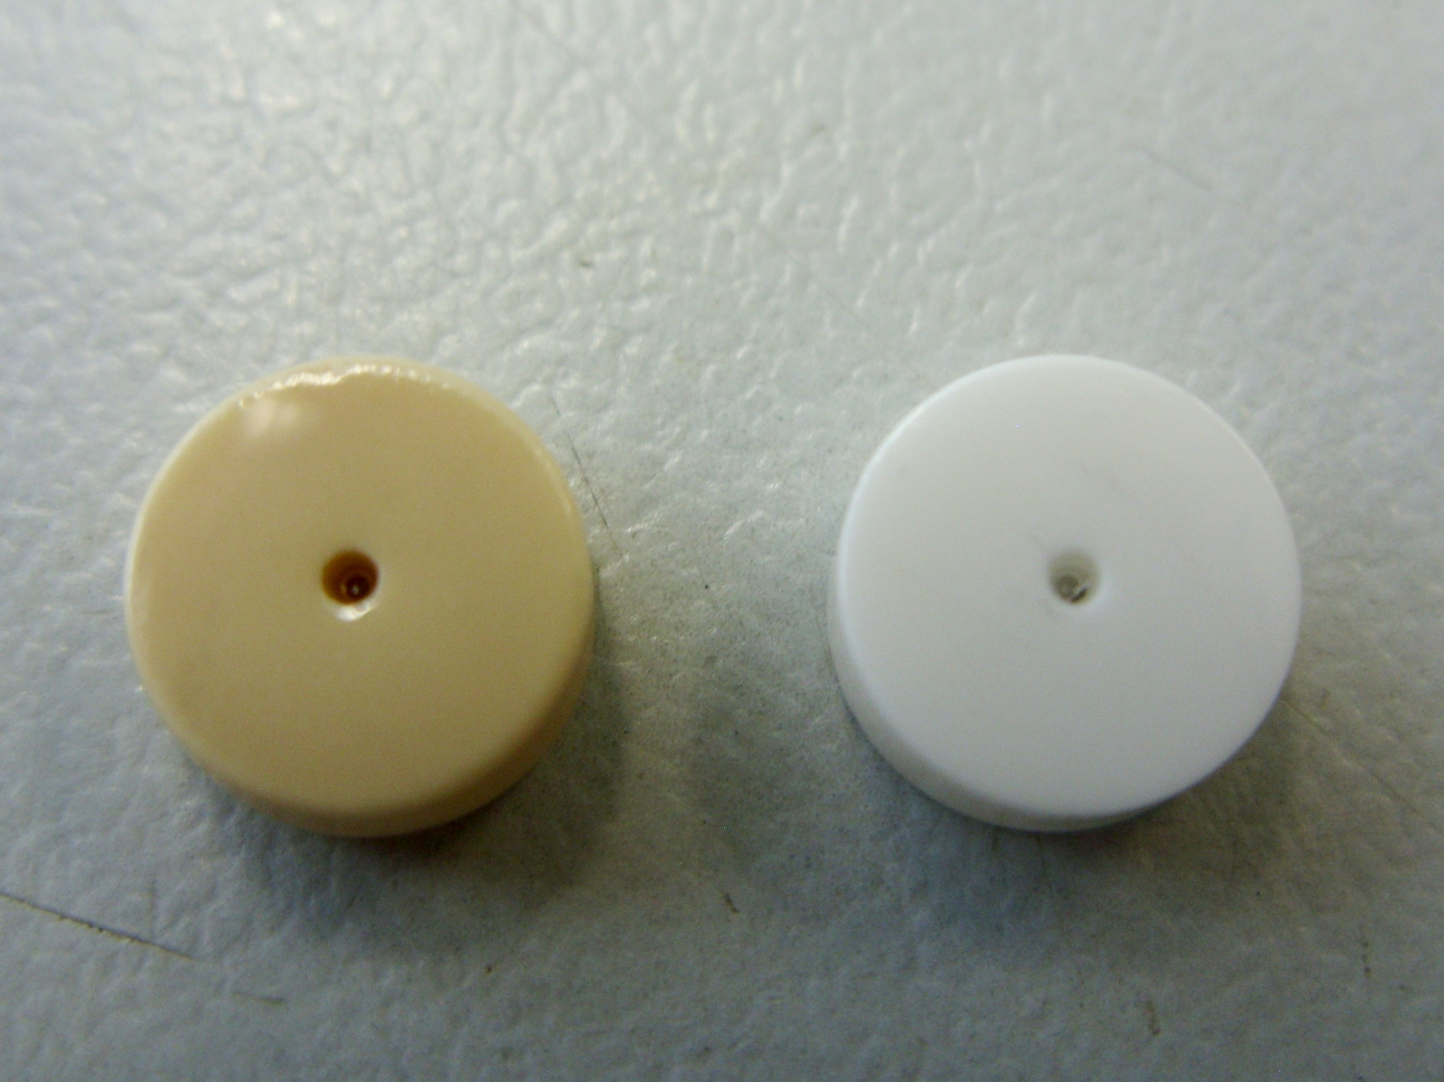
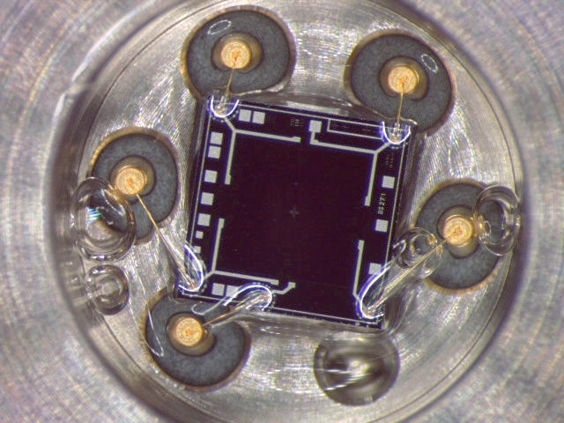
STS analysis
irradiated
new
Stainless steel membrane in normal condition
Membrane removed
Discoloration of sintered ceramic
Comparison of sintered ceramic
Chip no abnormality
Viscosity of oil seems unchanged
Degradation of the measuring cell
Increased bridge resistance from 3.256 to 3.439 kΩ @ 2bar
Increased errors
Unable to comment about the contribution of the oil on these results
On-going work

Slide 26
Remarks and conclusions
STS makes compatible gauges to the APR which fit well within the control's architecture
The STS gauge show no differences pre- and post-irradiation on leak tightness
The use of oil in the measuring cell is not ideal but can be safely used
  Oil can burst only to the outside
  Burst pressure >200 bar
Reasonable errors up to 60kGy
  At the beginning of LS offsets may be observed during venting
  During each LS calibration shall take place (standard procedure)
  Replacement of gauges when TID of 60-70kGy is reached
    Small cost impact ( gauge < 350CHF)
HL-LHC Location | Annual Dose [kGy/y] | TID [kGy] Run 4 | TID [kGy] Run 5
Q2A | 2 | 7 | 14
DFX | 10 | 35 | 70 (replacement)
D2 & DFM | 20 | 70 (replacement) | 70 (replacement)
CRAB 1 | 10 | 35 | 70 (replacement)
CRAB 2 | 8 | 28 | 56 (replacement)
QXL | 6 | 21 | 42
Q4 | 2 | 7 | 14
Q5 | 2 | 7 | 14
Q6 | 1 | 3.5 | 7
QRL | 1 | 3.5 | 7

Slide 27
Future work
The R2E community at CERN has no explanation so far for the resistor issues
  Effort to understand if the high dose rate of the second run had an impact on the resistor failure
  Several tests are being prepared at CC60 to validate this hypothesis
    Gauges in HDR and LDR either in active or passive gamma test
    Test PCBs with a variety of resistors technologies, sizes that can be tested in HDR or LDR
Continue the collaboration with STS
  Aim to decouple the radiation effects on the chip, on the oil and on the PCB
  Create a custom product that could replace APR017 and survive the radiation environment of HL-LHC
Evaluate other solutions in collaboration with TE-CRG
  Baumer strain gauge 0 - 4bar
    Tested up to 1kGy by TE-CRG
    Very small sensitivity (1.75 uV/(mbar.mA) vs 25 uV/(mbar.mA) -> has an impact on our electronics)
    Can be bought in multiples of 100 units (1.3kCHF per gauge)
  ABB (similar technology with STS; oil filling)
  Radiation hard gauges from SIGMANETIC and EFE
    Thin film metal membrane without oil. Very small sensitivity. High price

Slide 28
Thank you!
Any questions?

