Slide 1

Status of PUMA beam lines @ ELENA and ISOLDE
WHERE ARE WE?
WHAT WE DO?
MOTIVATION
TRANSPORT
BEAM LINE @ ELENA
BEAM LINE @ ISOLDE
SCHEDULE

Slide 2
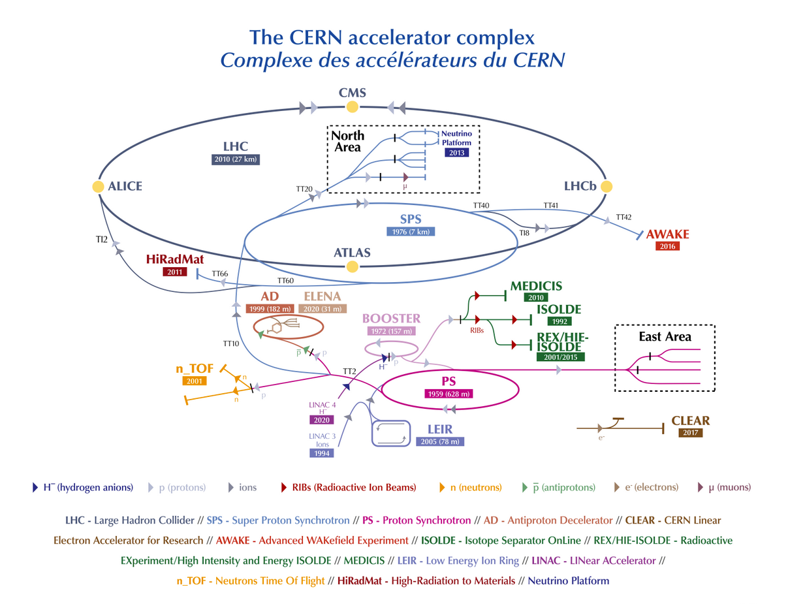
WHERE ARE WE?

Slide 3
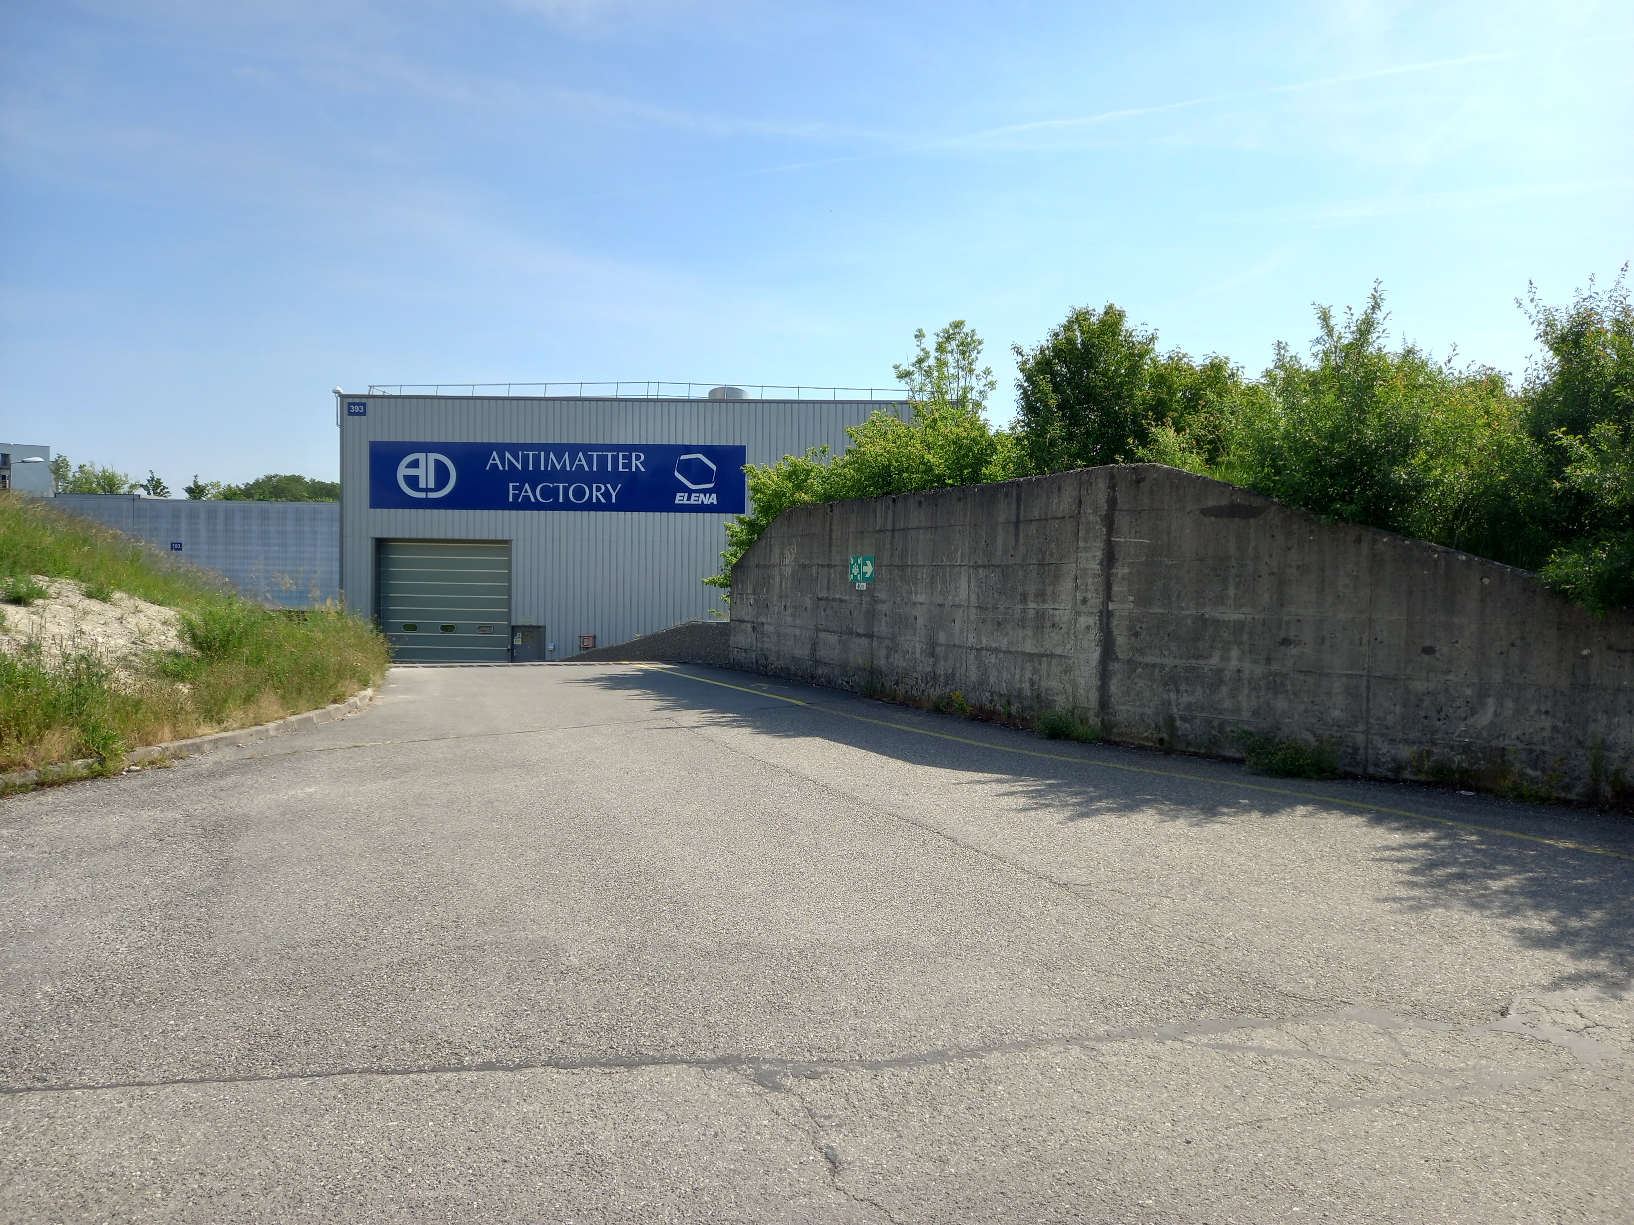
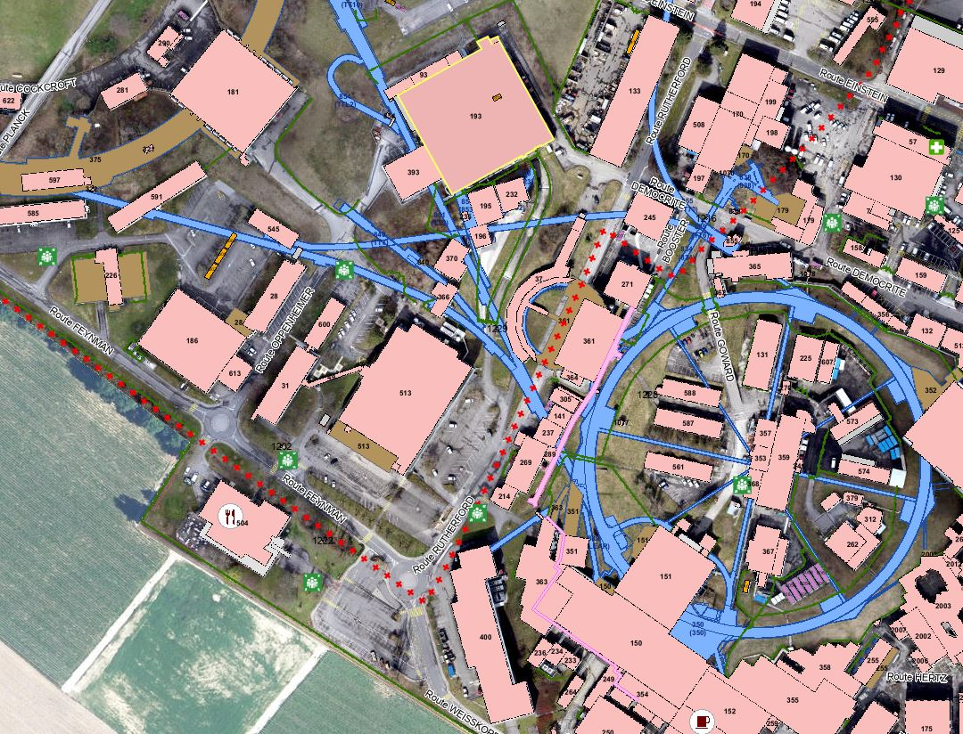
WHERE ARE WE?

Slide 4
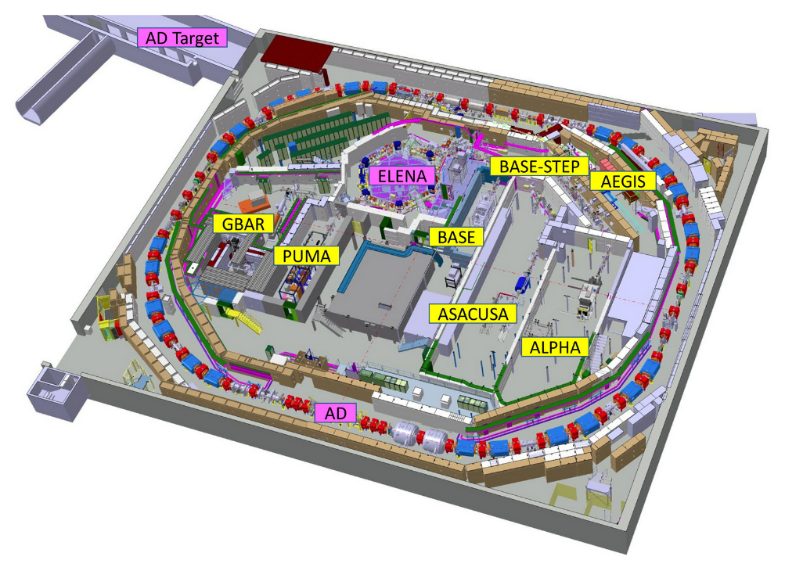
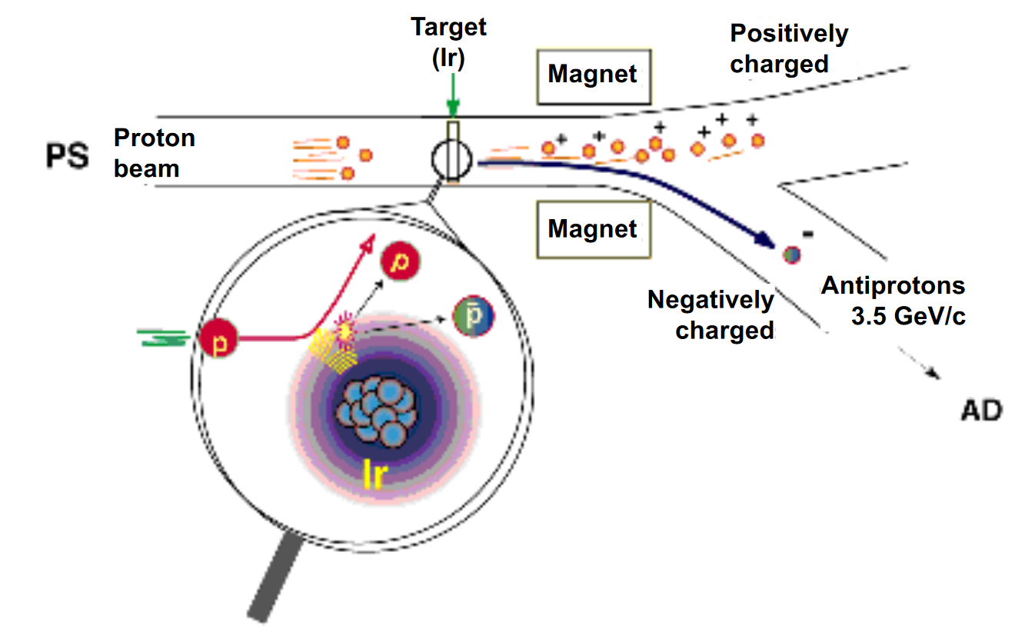
WHAT WE DO?
The Antiproton Decelerator (AD) is a unique machine that produces low-energy antiprotons for studies of antimatter
ELENA (Extra Low ENergy Antiproton) is coupled to AD to reduce energy of antiprotons that can be trapped into expriments.

Slide 5
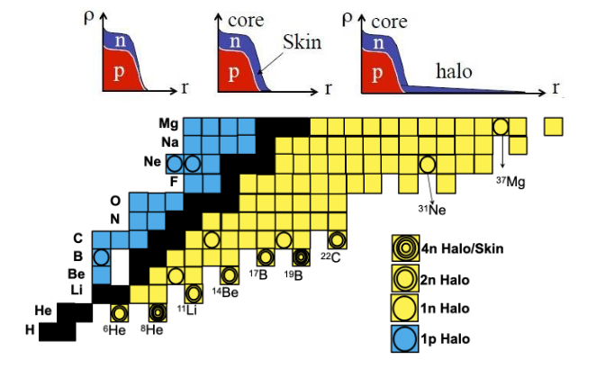
PUMA MOTIVATION
Provide a new observable for nuclear density tail
Characterize and evidence halos and skins
Quantify correlations in low density
PUMA : antiProton Unstable Matter Annihilation
Notes:
The goal of PUMA is to probe the surface properties of stable and rare isotopes by using low energy antiprotons.
Low energy antiprotons offer a very unique sensitivity to the neutron and proton densities at the annihilation site ei The tail of the nuclear density.
Today, no facility provides a collider of low energy radioactive ions and low energy antiprotons.
PUMA aims to transport antiprotons from ELENA to ISOLDE .

Slide 6
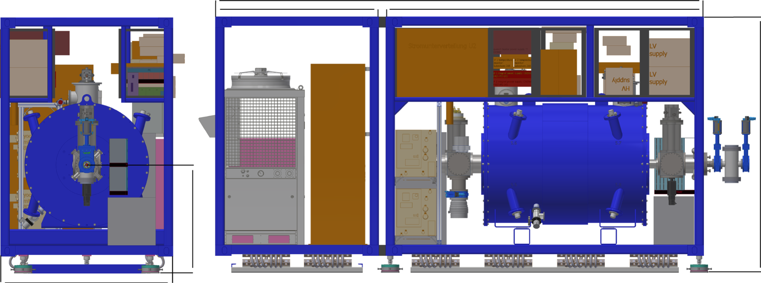
PUMA Trap
Transport antiprotons from ELENA to ISOLDE
Store 10⁹ (First phase at 10⁷) antiprotons at ELENA
Vacuum requirement
Beam
10⁻¹¹ mbar
10⁻¹⁷ mbar

Slide 7
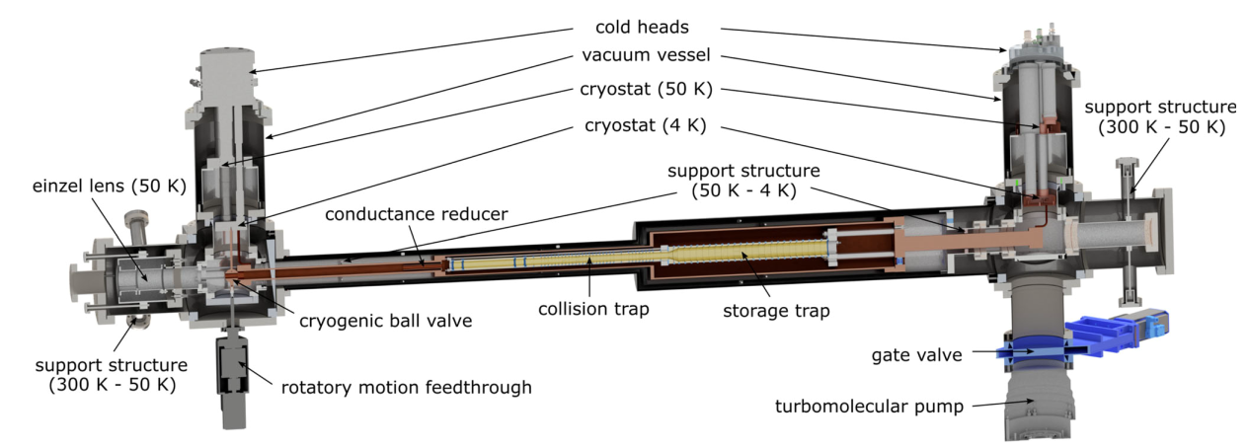
PUMA Trap
Beam

Slide 8
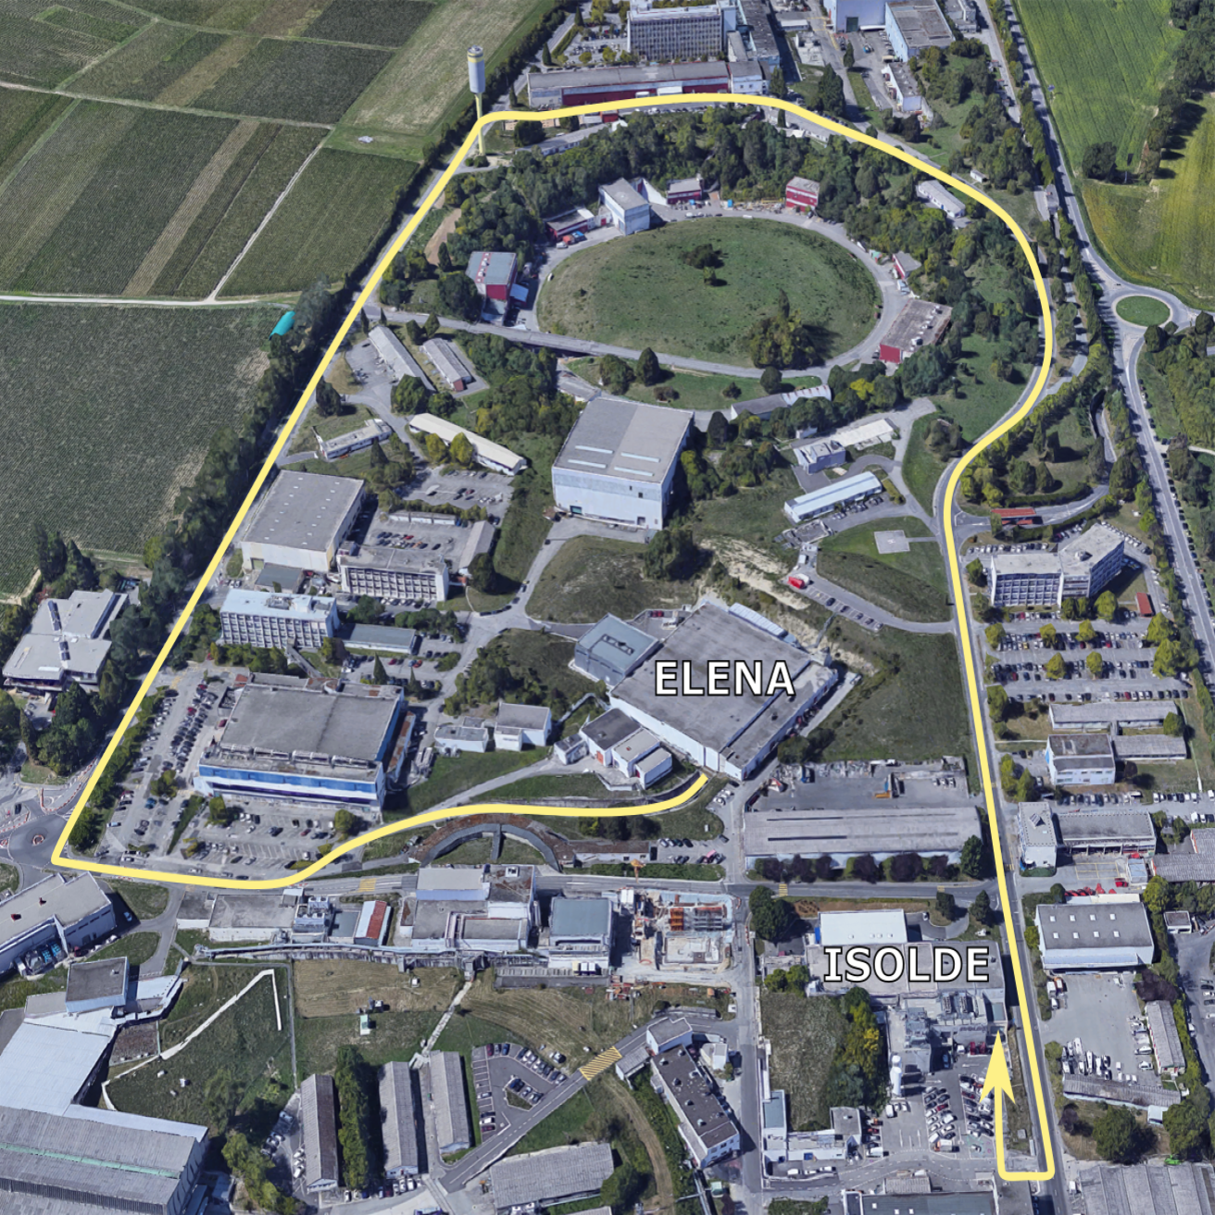
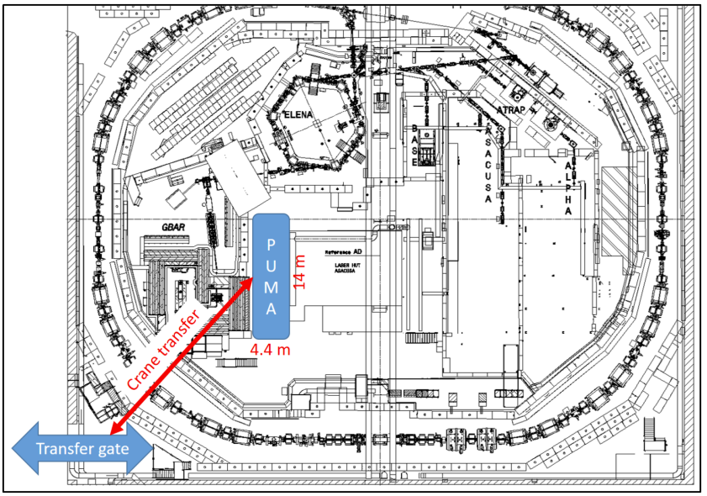
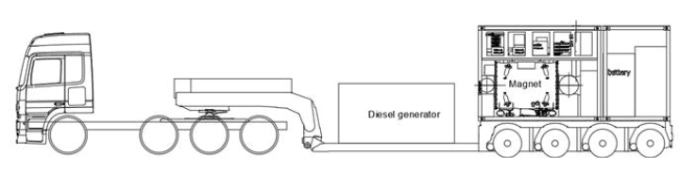
TRANSPORT
Trap transfert AD Hall
Truck AD to ISOLDE
First time on 2023

Slide 9
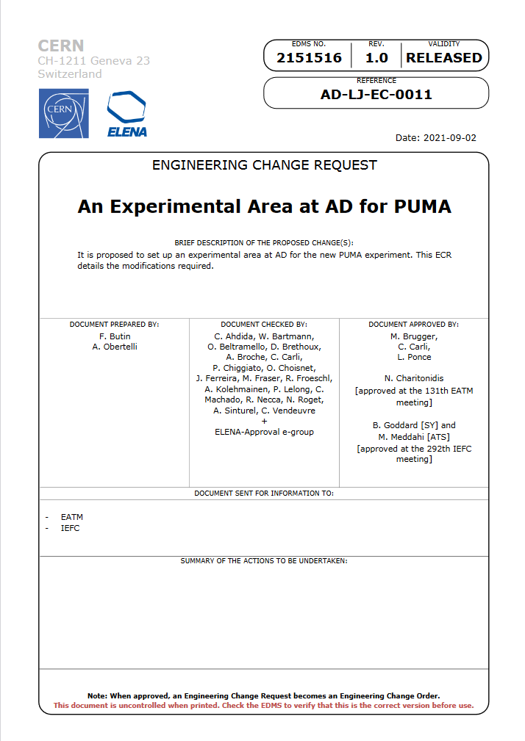
BEAM LINE @ ELENA

Slide 10
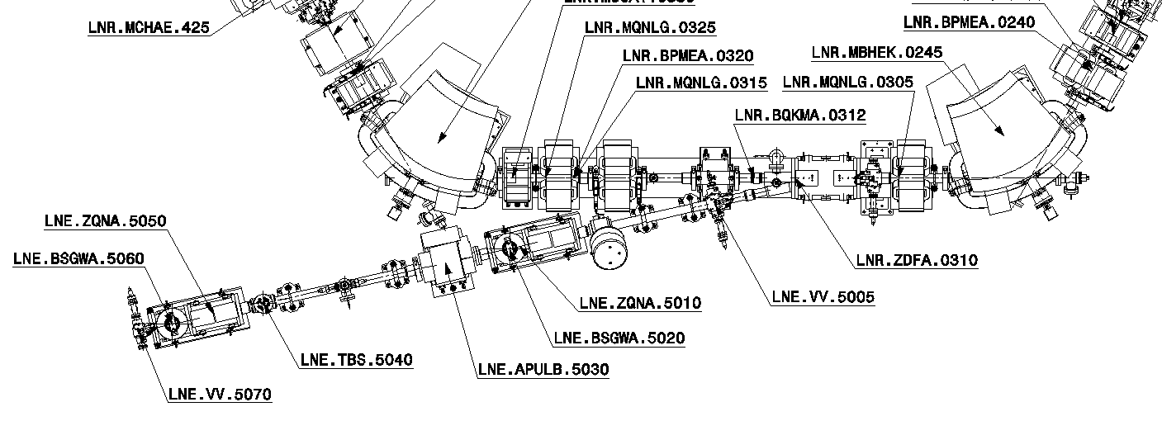
BEAM LINE @ ELENA
From LNE 50 to LNE 50+51

Slide 11
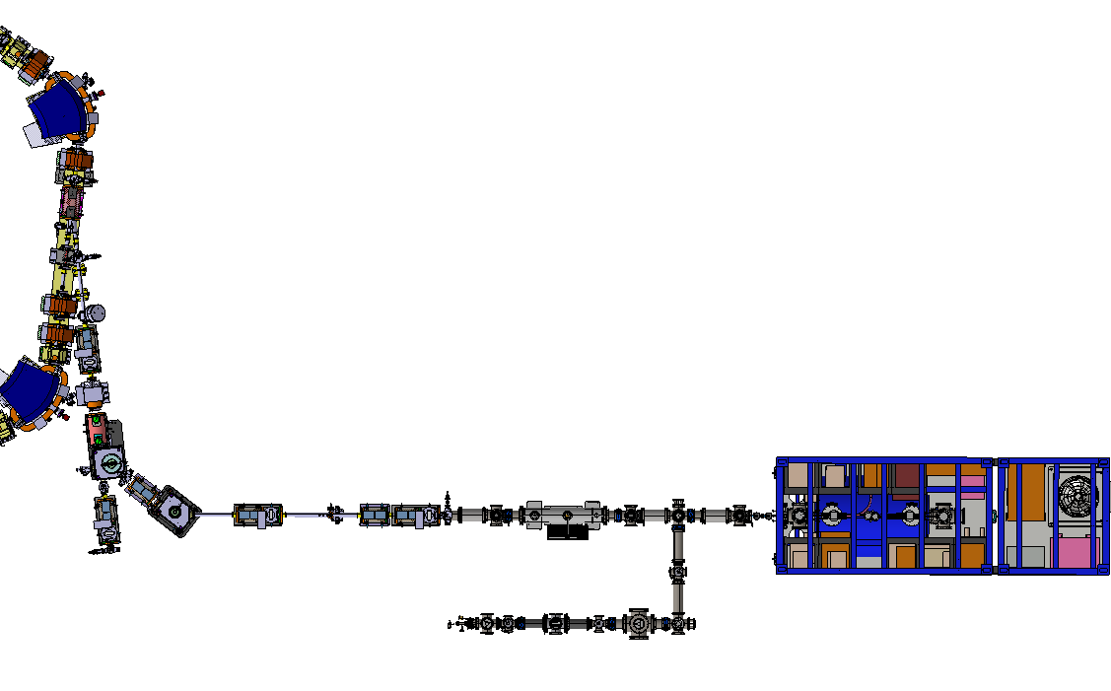
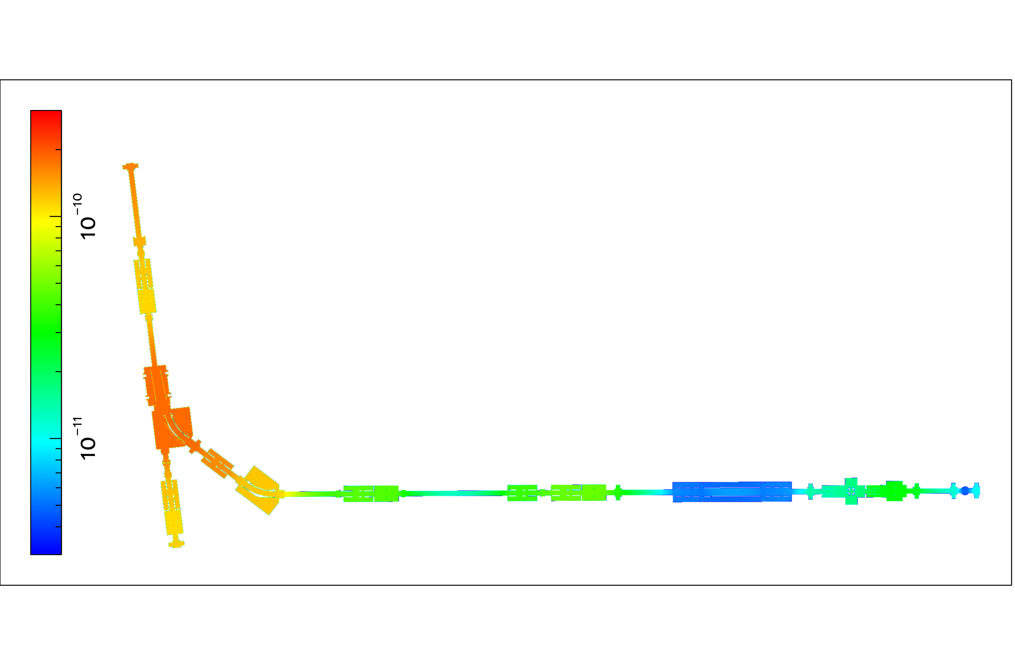
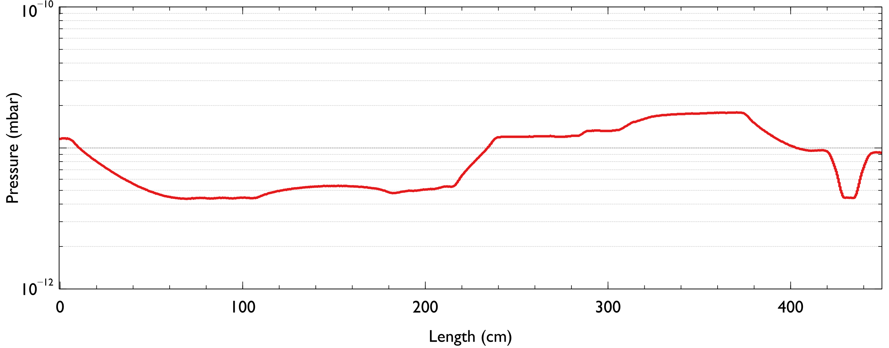
BEAM LINE @ ELENA

Slide 12
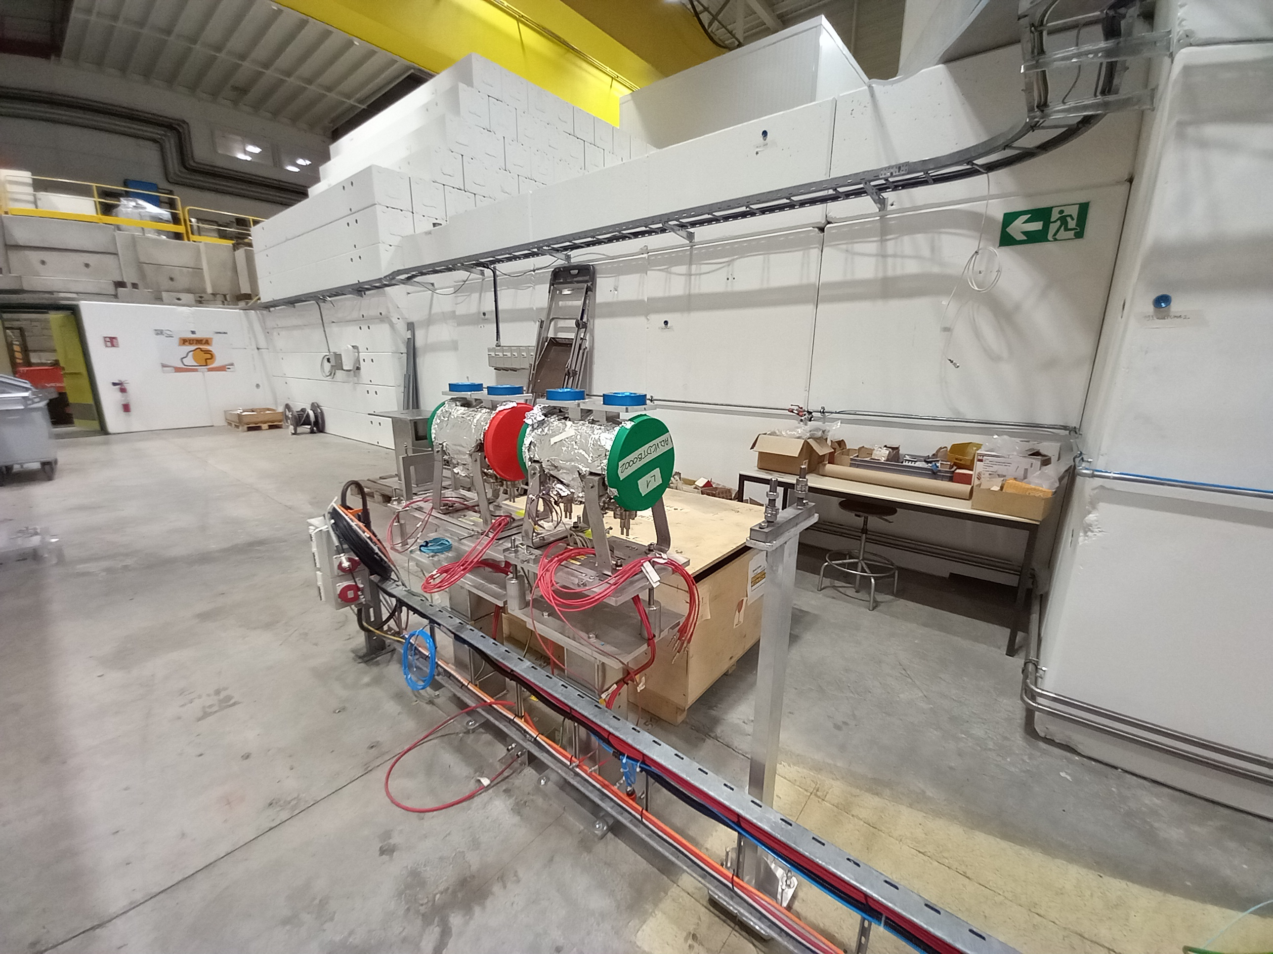
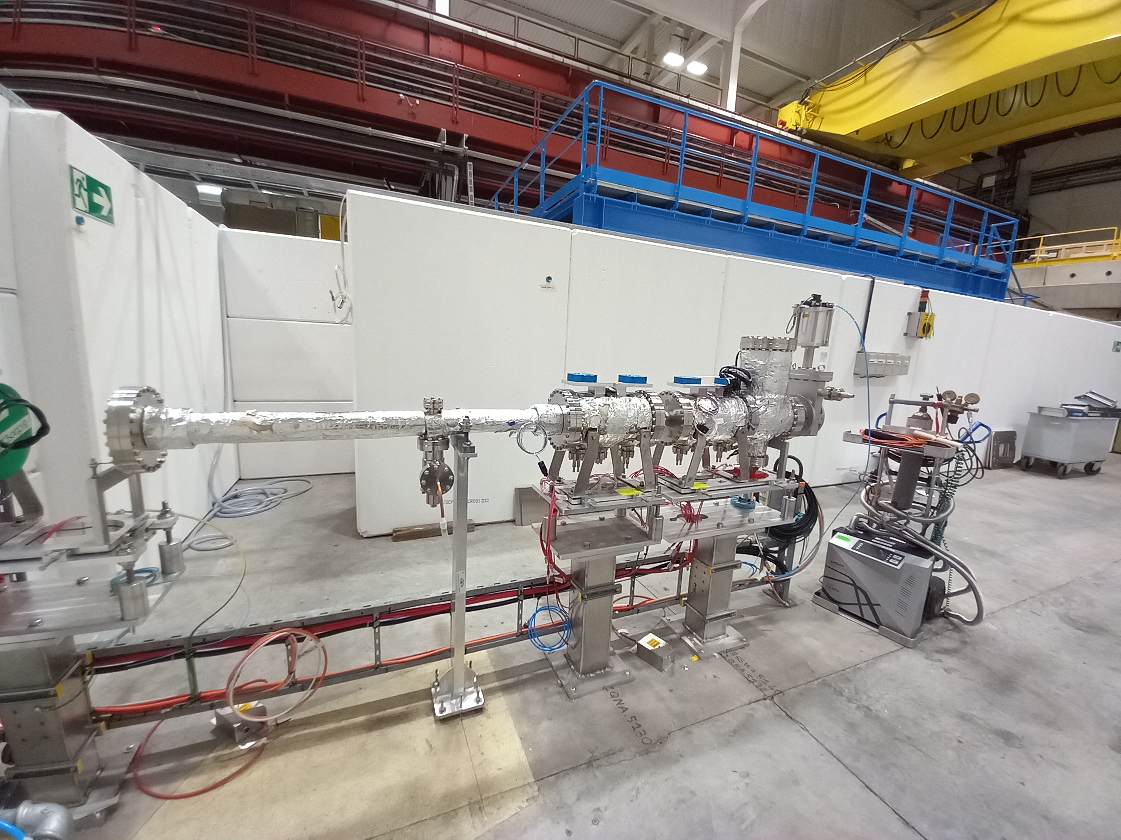
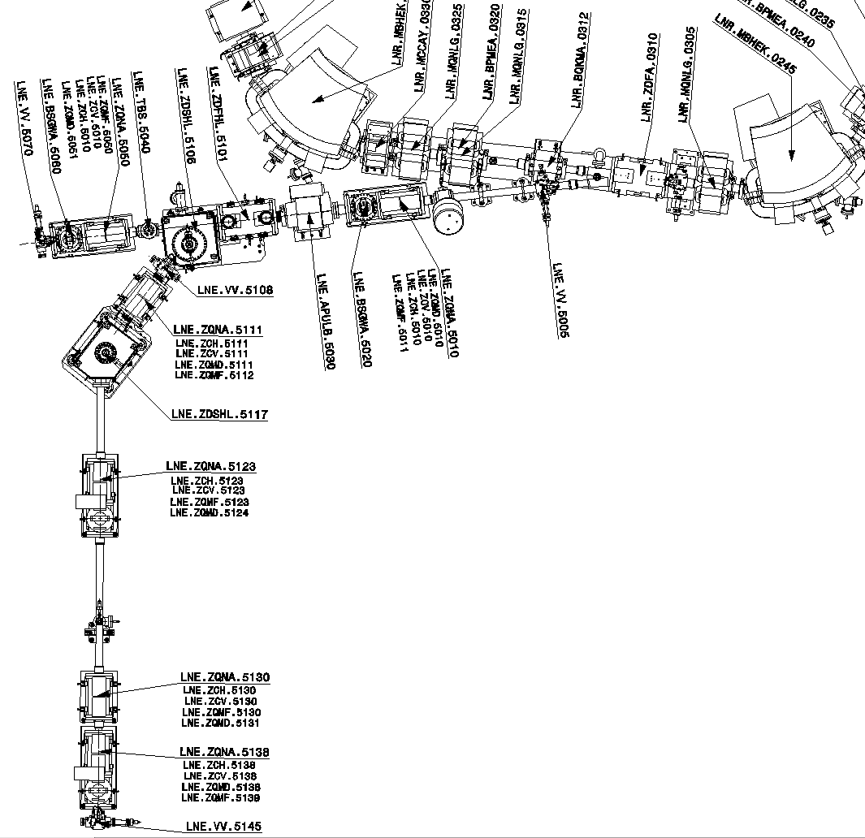
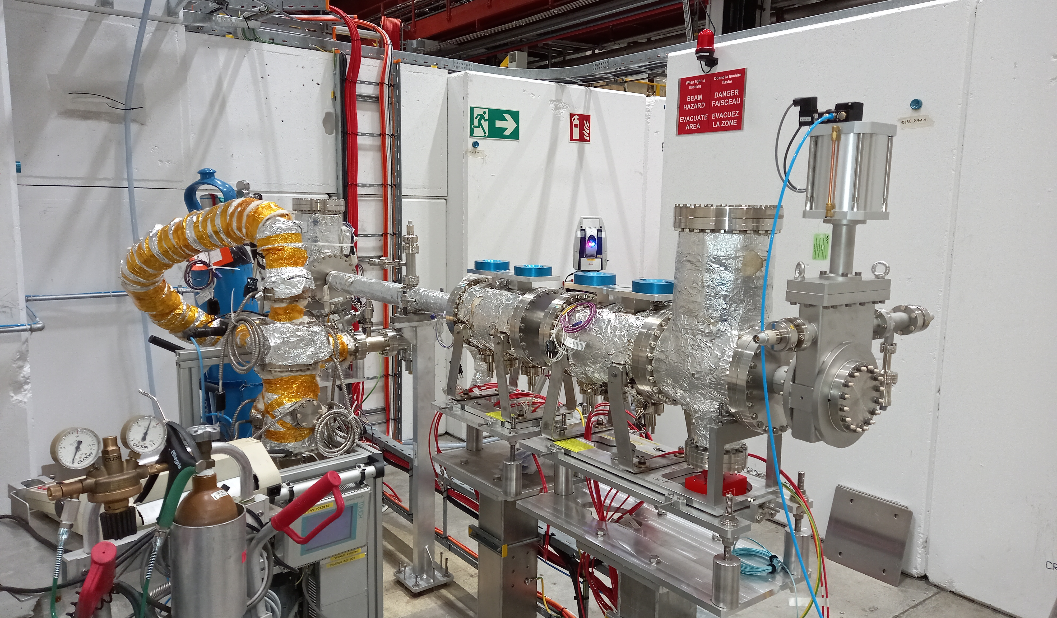
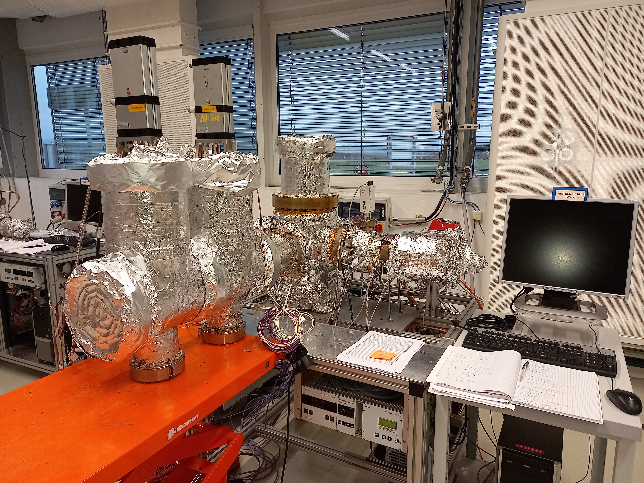
BEAM LINE @ ELENA
1 Fast deflector
2 Deflectors
4 ZQNA
2 SEM grids
2 NEG Coated vacuum chambers
2 NEG cartridges
2 Sector valves
Controls logic with interlocks

Slide 13
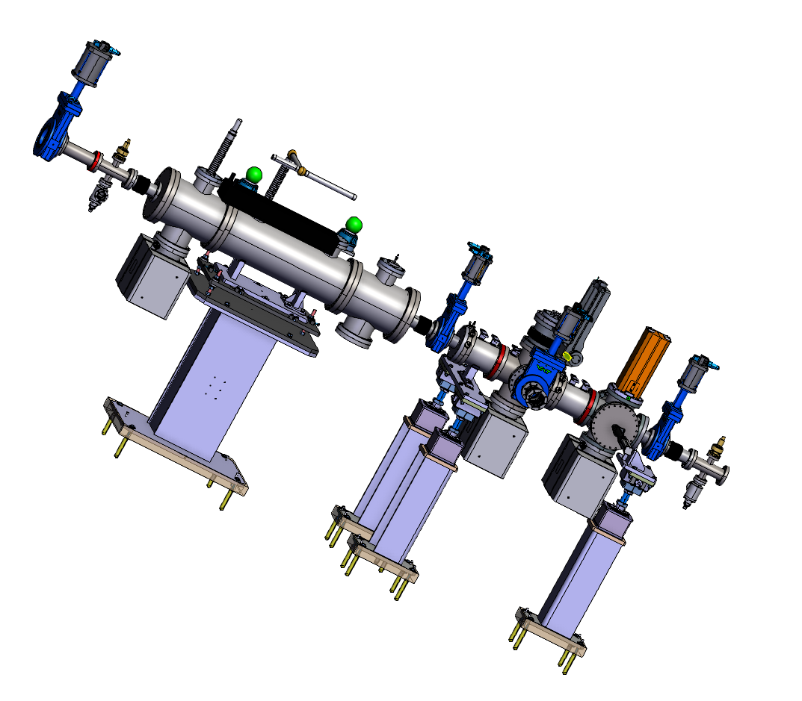
BEAM LINE @ ELENA
Support Experiment
  Help with design/simulation
  Cleaning facility, Vacuum firing
  NEG Coating of PDT vacuum chambers
  Procurement of the valves, NEG cartridge, controls
  Acceptance test of subassembly before installation
  Controls Installation on site with Iker (ICM)

Slide 14
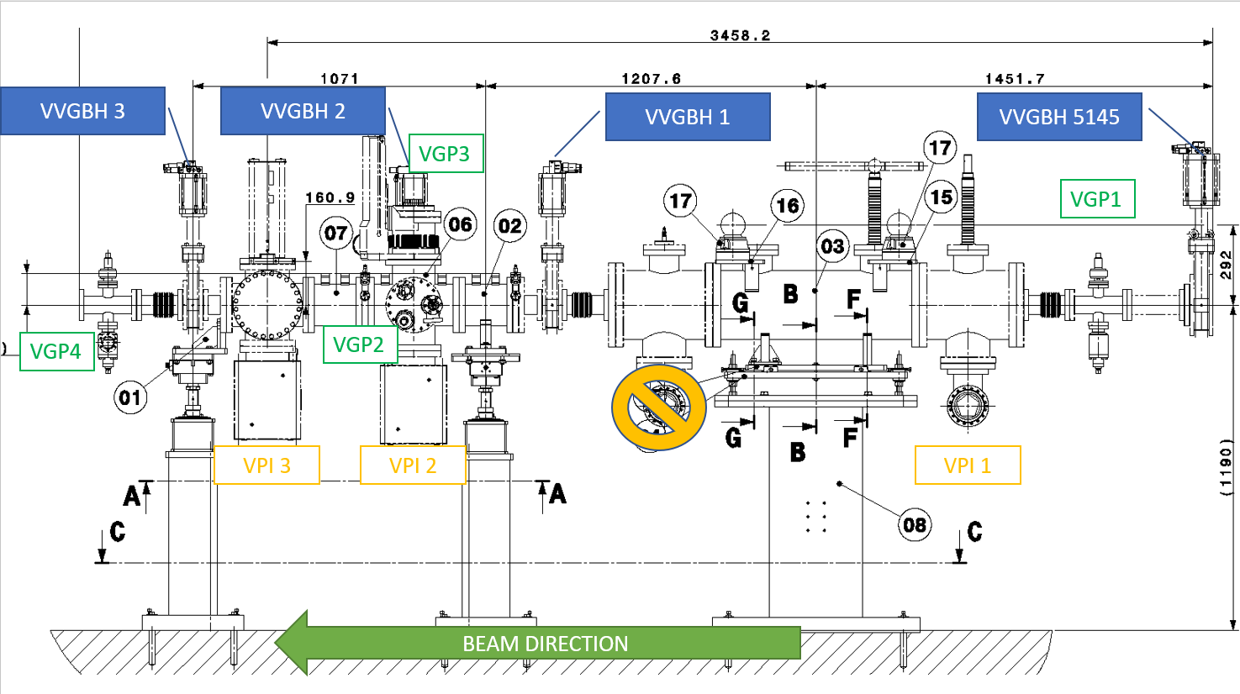
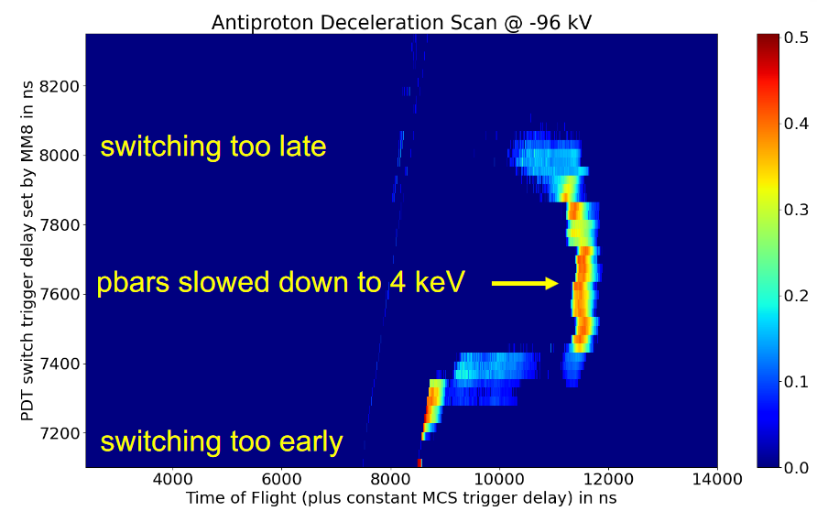
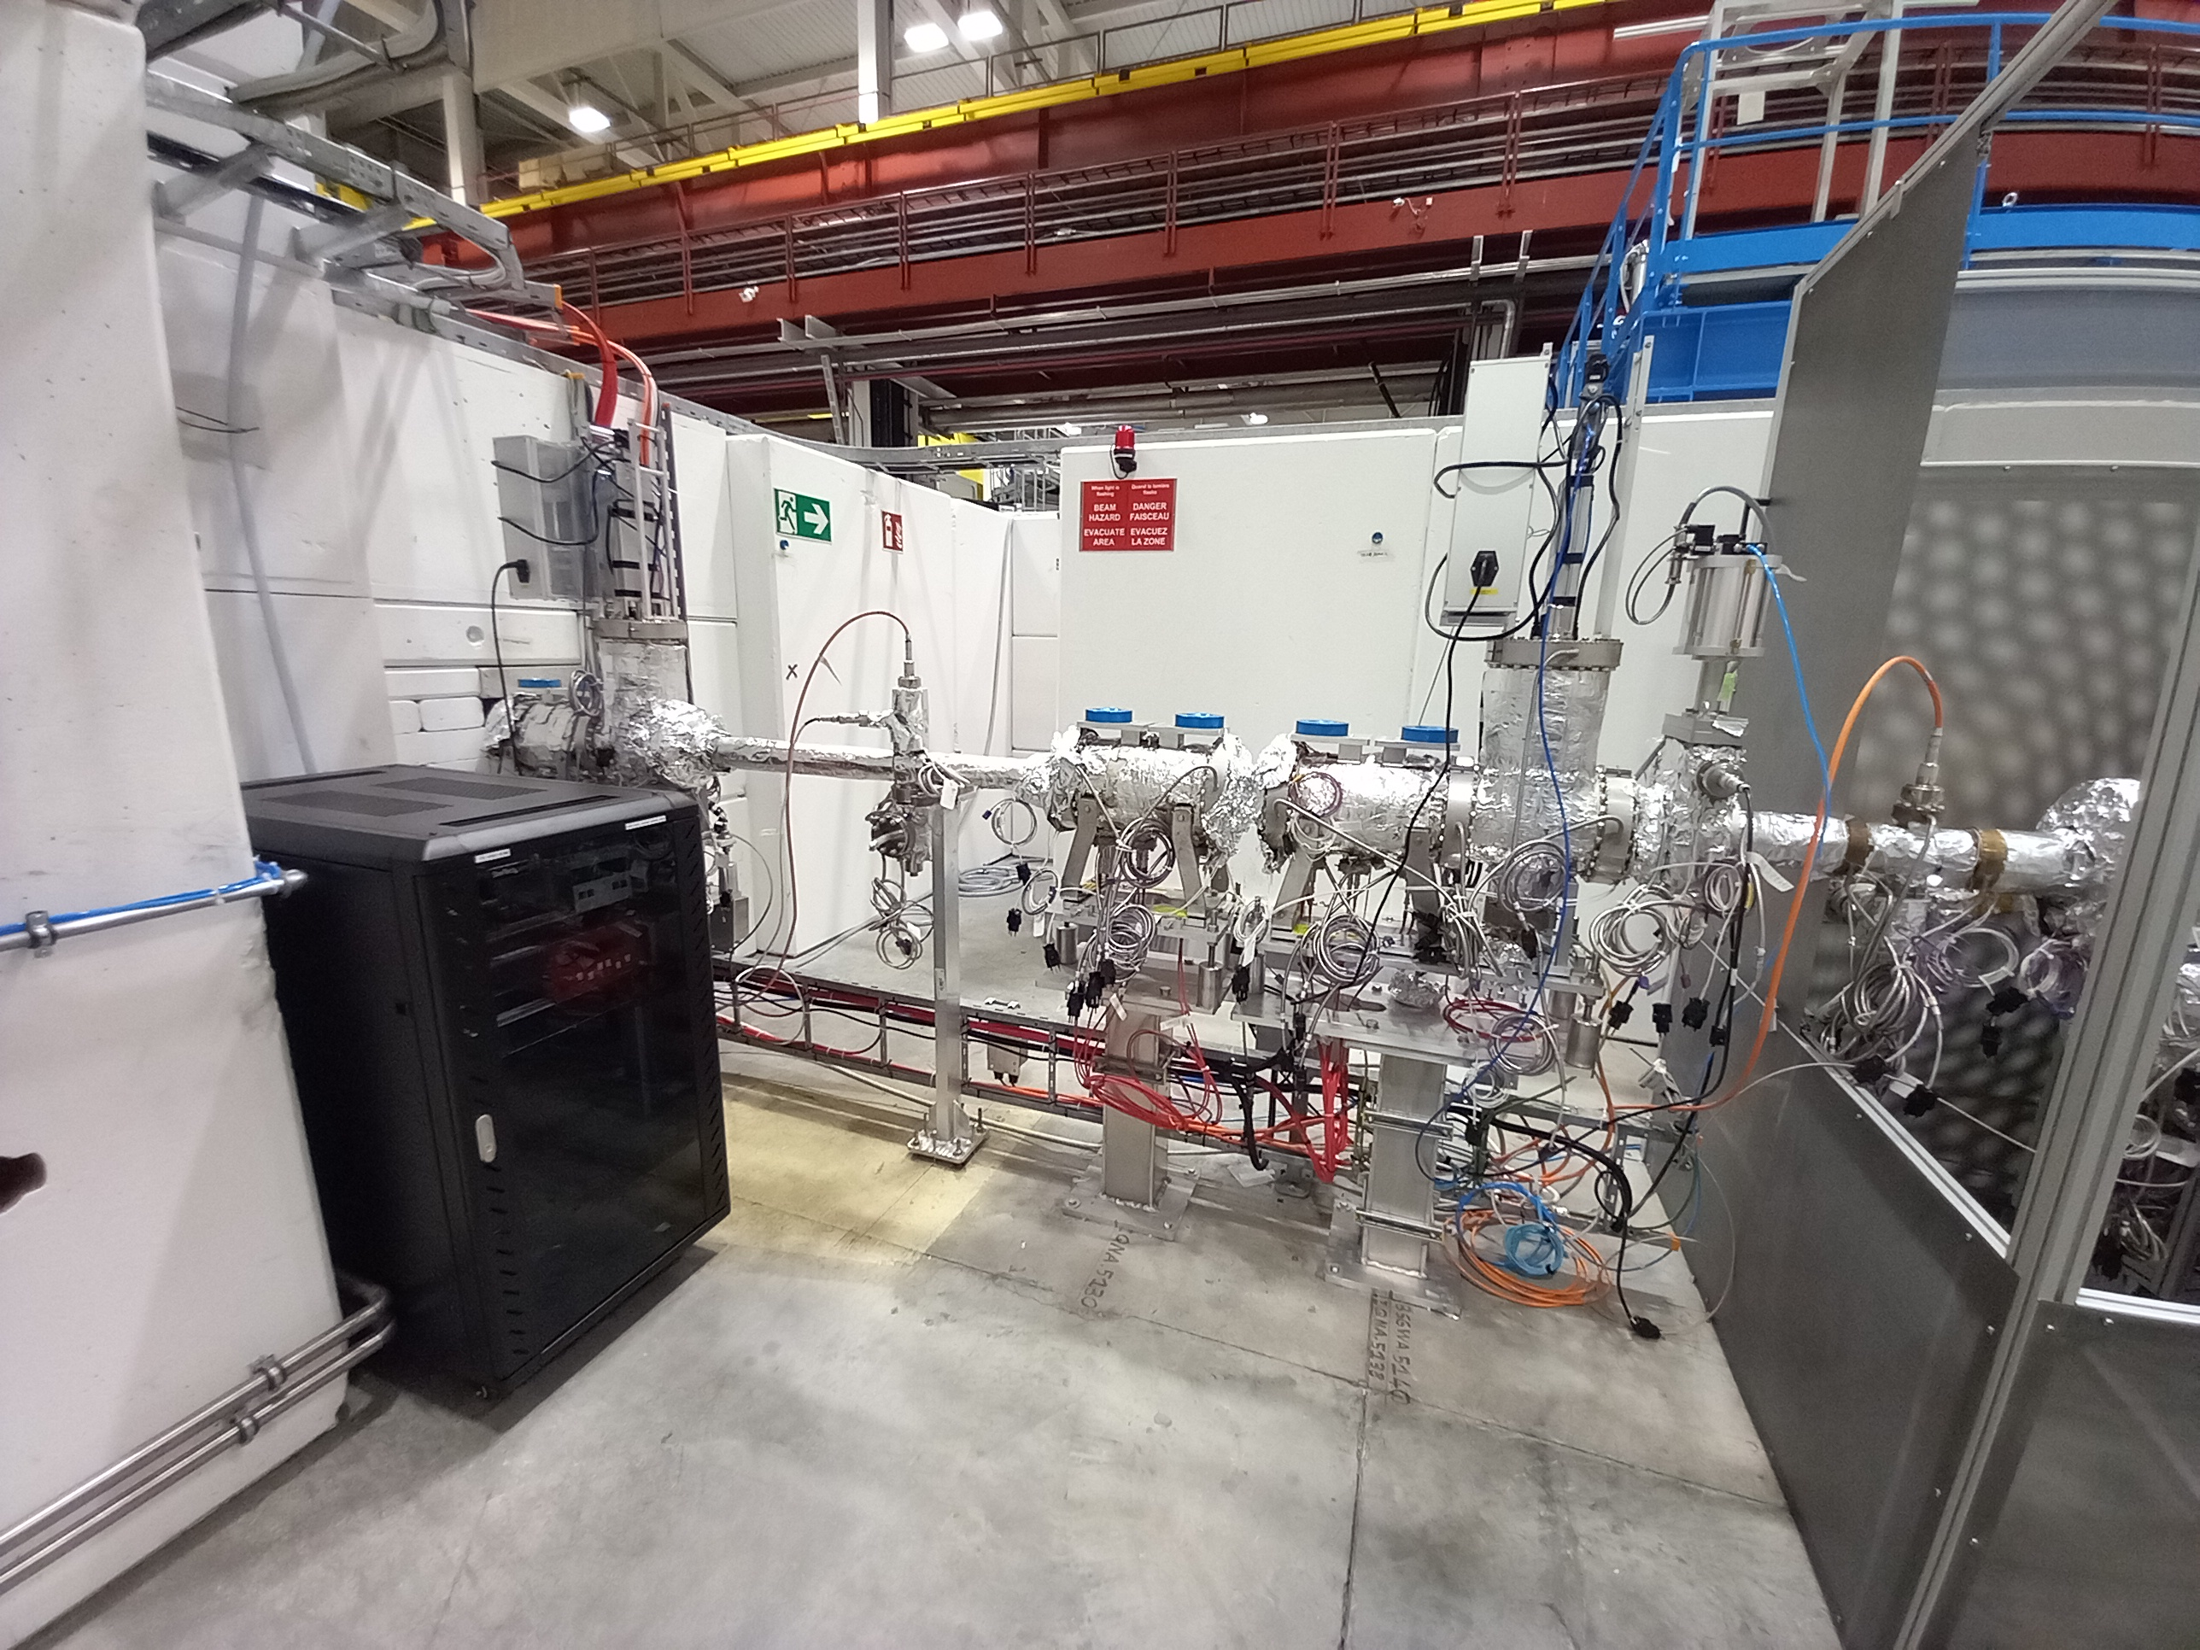
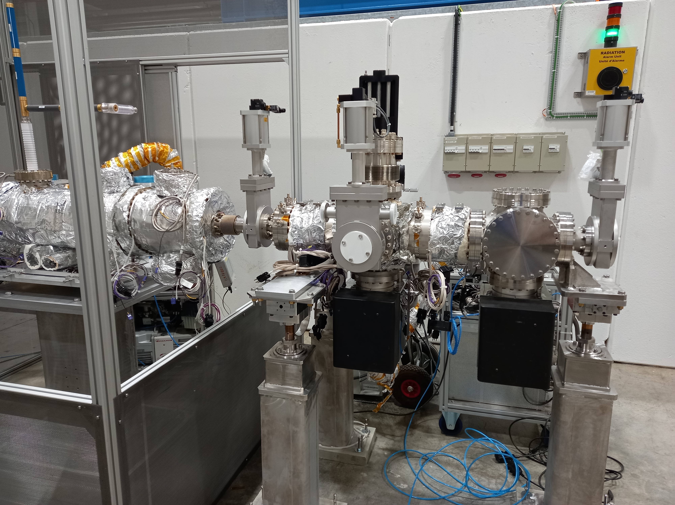
BEAM LINE @ ELENA
1.810⁻¹¹ mbar

Slide 15
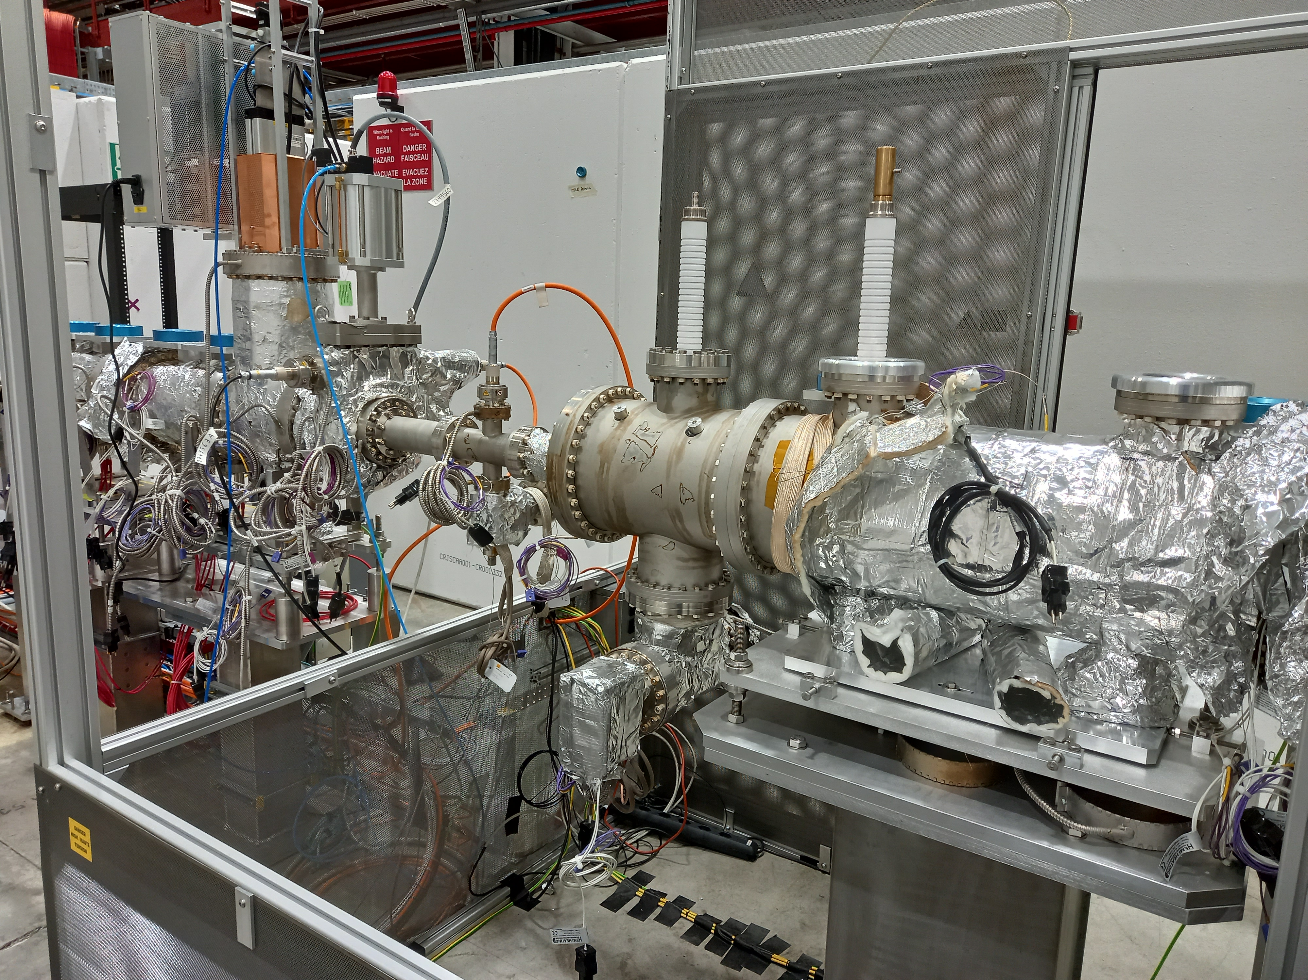
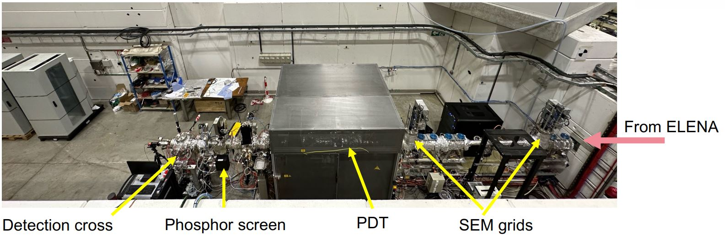
INTERVENTION @ ELENA
YETS 2022-23 : Exchange Einzel lens which was a HV limitation @ 85kV

Slide 16
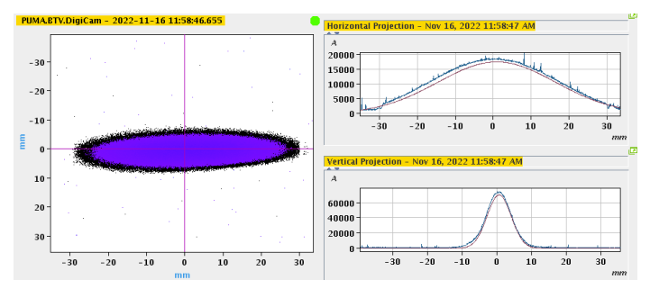
SCHEDULE @ ELENA
Summer 2023 :
  Optimisation of PDT HV-to-ground distances
  Measurement and optimisation of transmission with Pbars

Slide 17
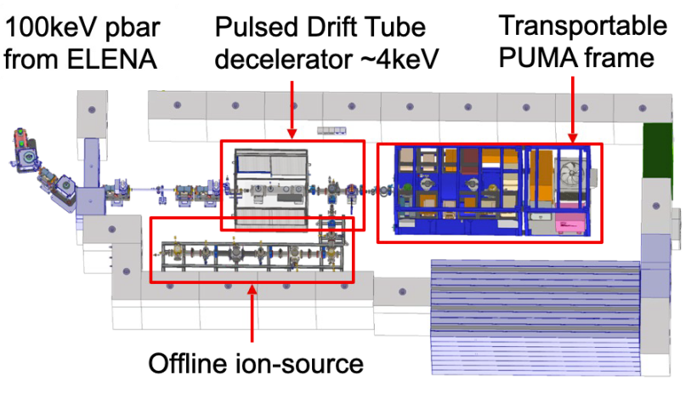
SCHEDULE @ ELENA
Milestones in 2023
Offline ion source connection
Trap assembly with installation

Slide 18
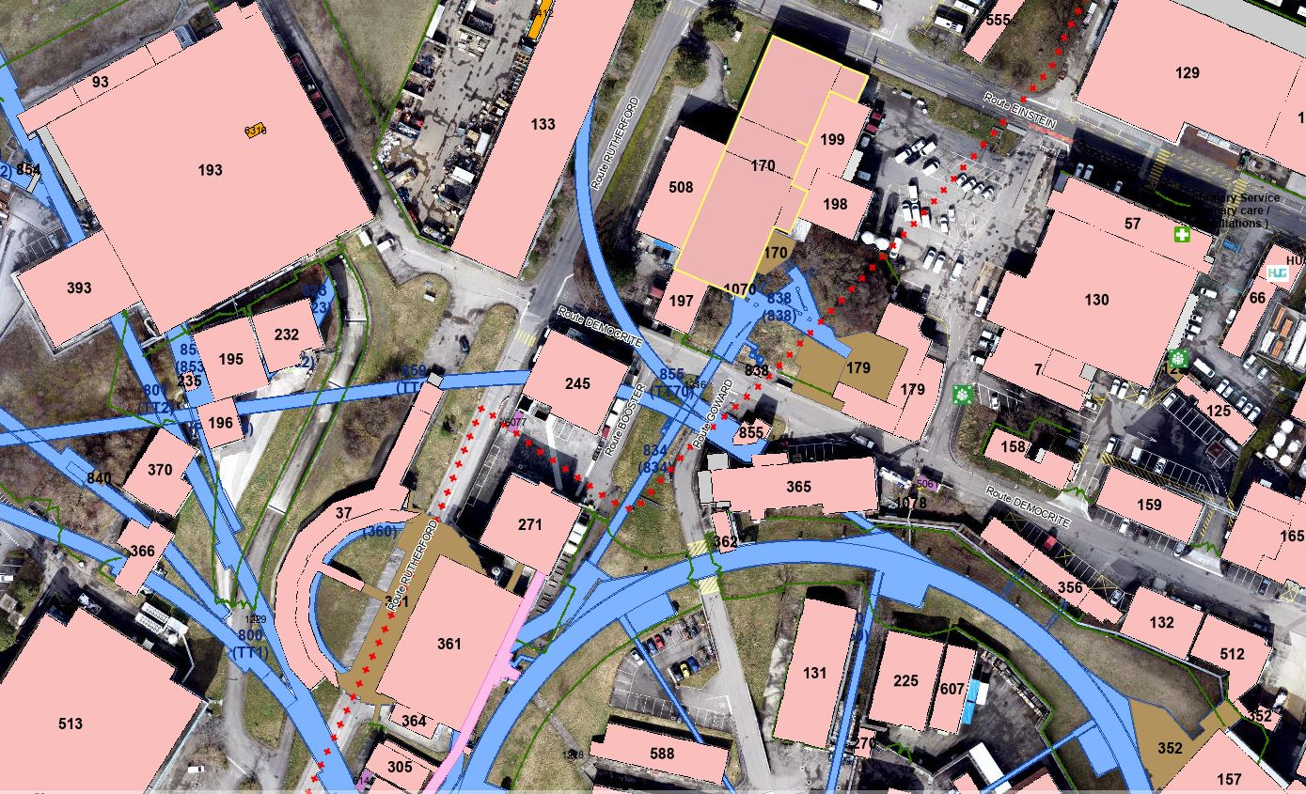
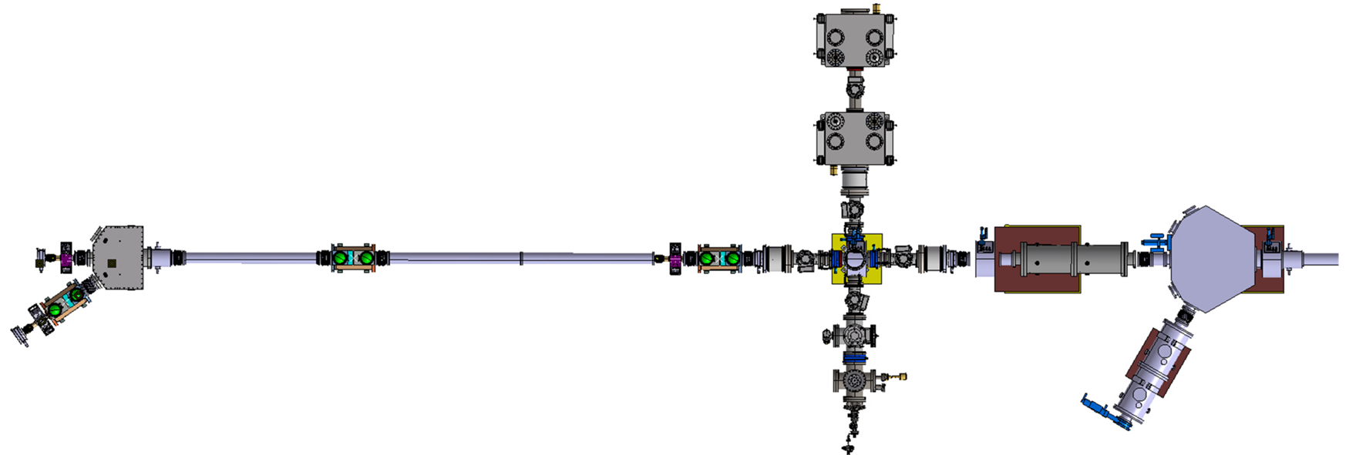
BEAM LINE @ ISOLDE

Slide 19
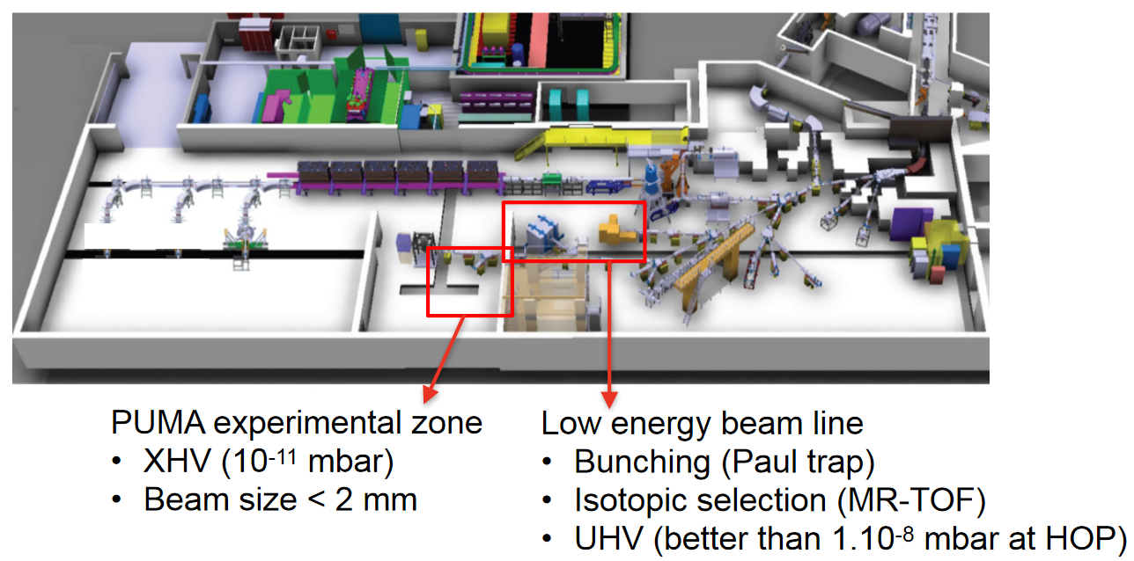
BEAM LINE @ ISOLDE
CERN responsibility of the low energy beam line
Vacuum and optics simulation
Design completion
Procurement of the beam line elements
Measurement of He propagation at LA2
Start beam line installation 2024

Slide 20

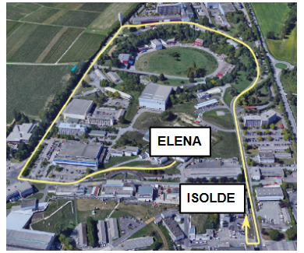
Thank you to all the people involved inside or outside the group

Slide 21
References
SPSC 2021
SPSC 2023
PUMA, antiProton unstable matter annihilation
PUMA Experiments at CERN
PUMA: physics with antiproton at ISOLDE

