Slide 1
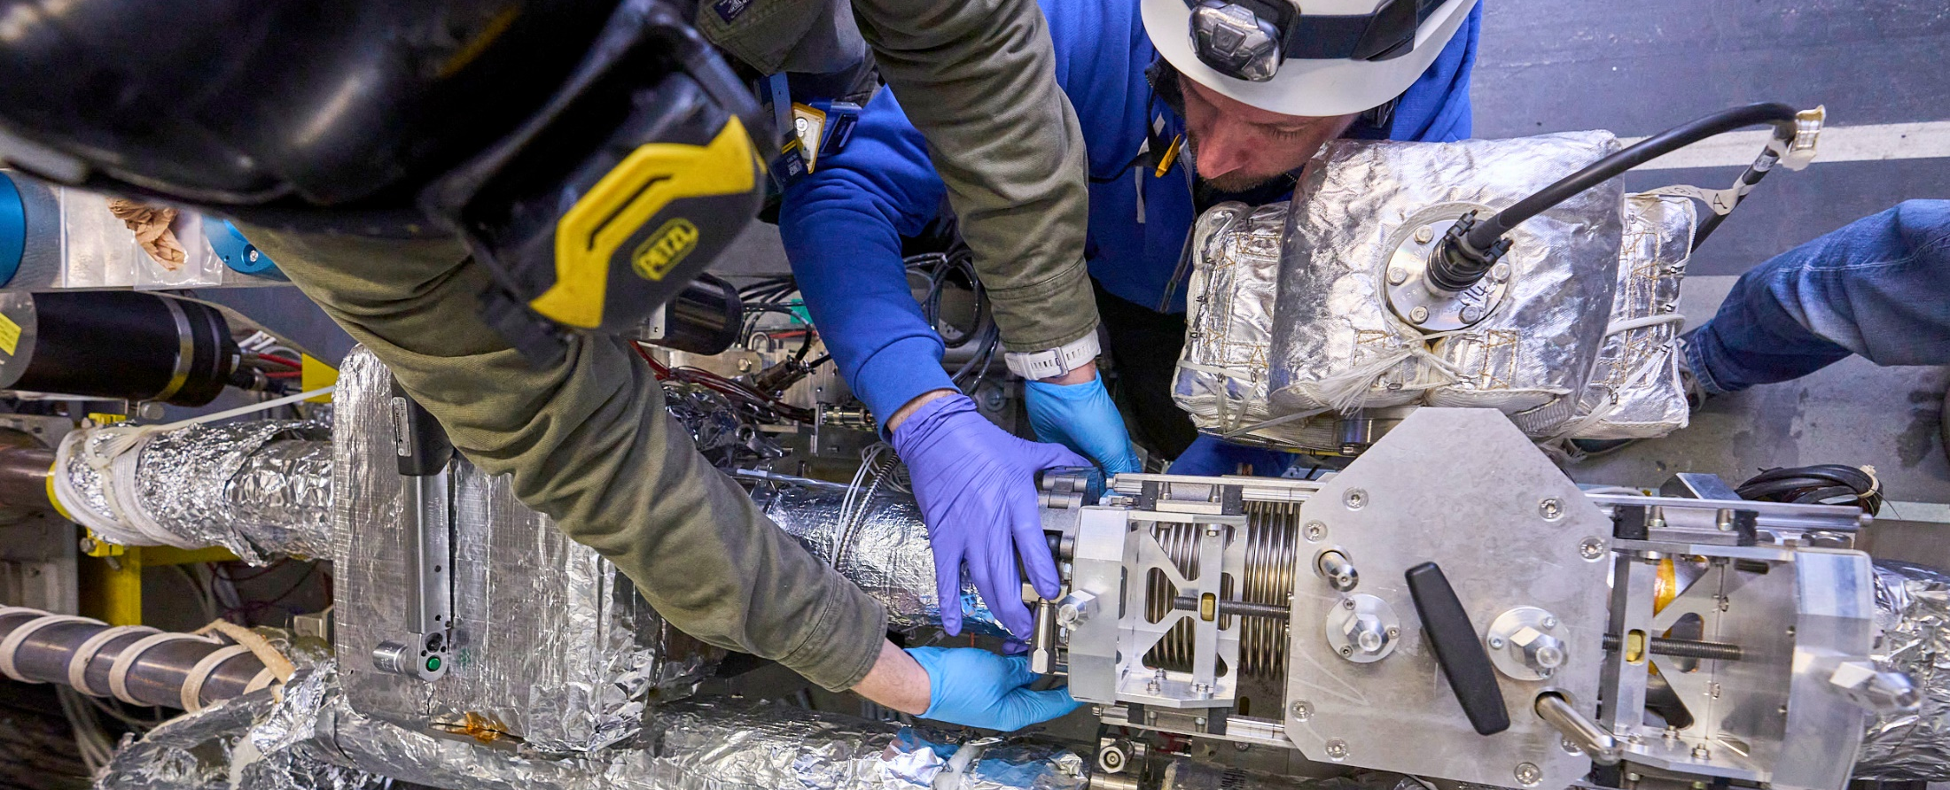


YETS 2022-2023
LHC Beam vacuum activities
Cesar Vazquez Pelaez
on behalf of TE/VSC/BVO
04.07.2023

Slide 2
Outline
LHC vacuum system
YETS Framework
3. Activity overview
HL-LHC
General activities
4. Summary
4th July 2023

Slide 3
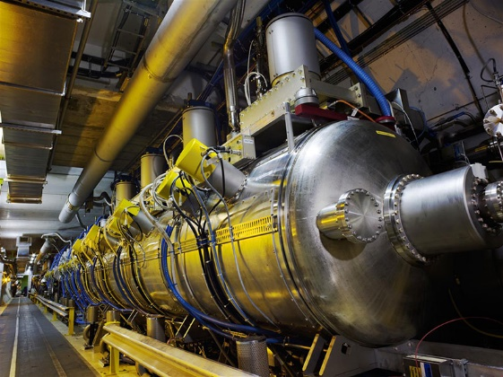
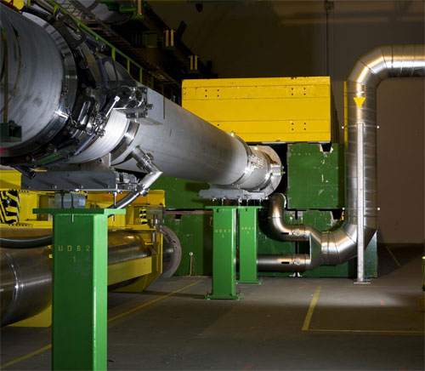
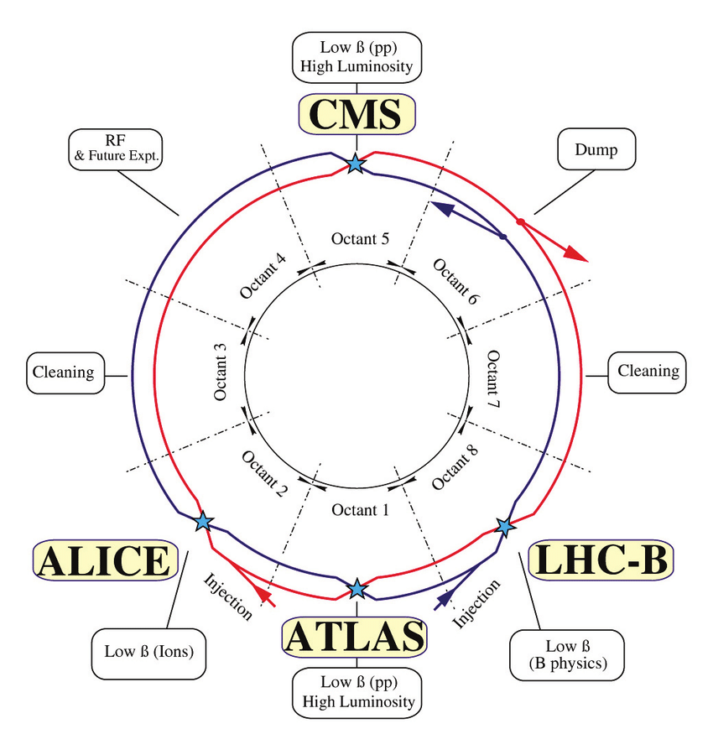
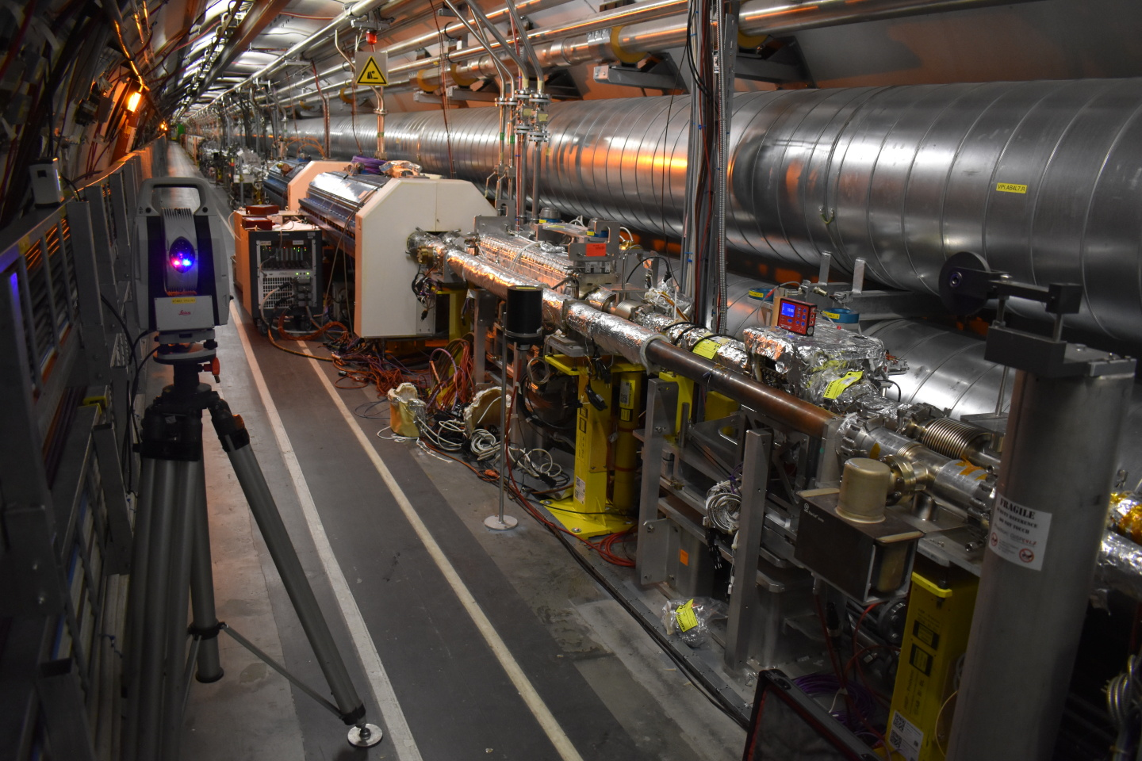
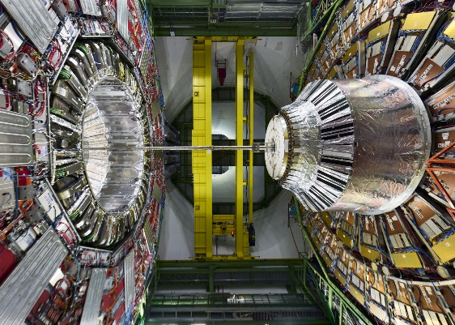
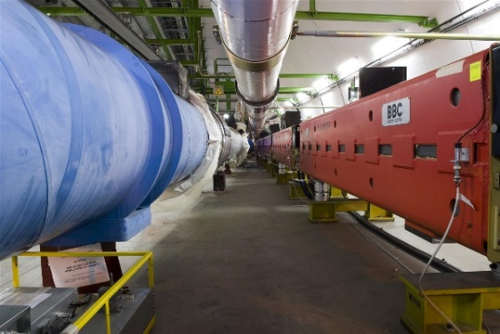
LHC vacuum system
RF accelerating cavities (P4)
2 DUMP lines (P6)
Cleaning insertions (P3, P7)
4 main experiments
Transfers lines (TI2, TI8)
4th July 2023

Slide 4
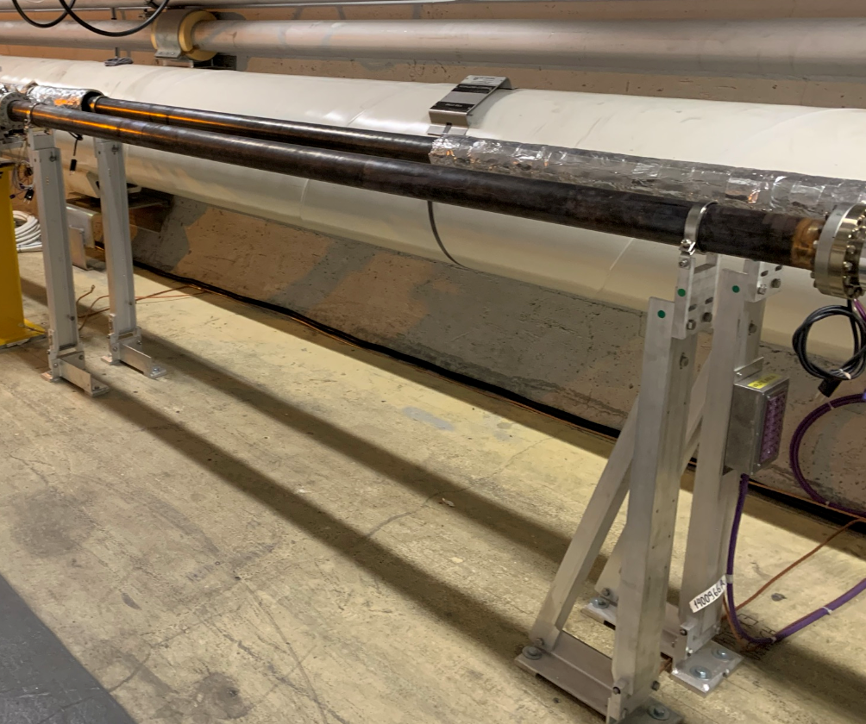
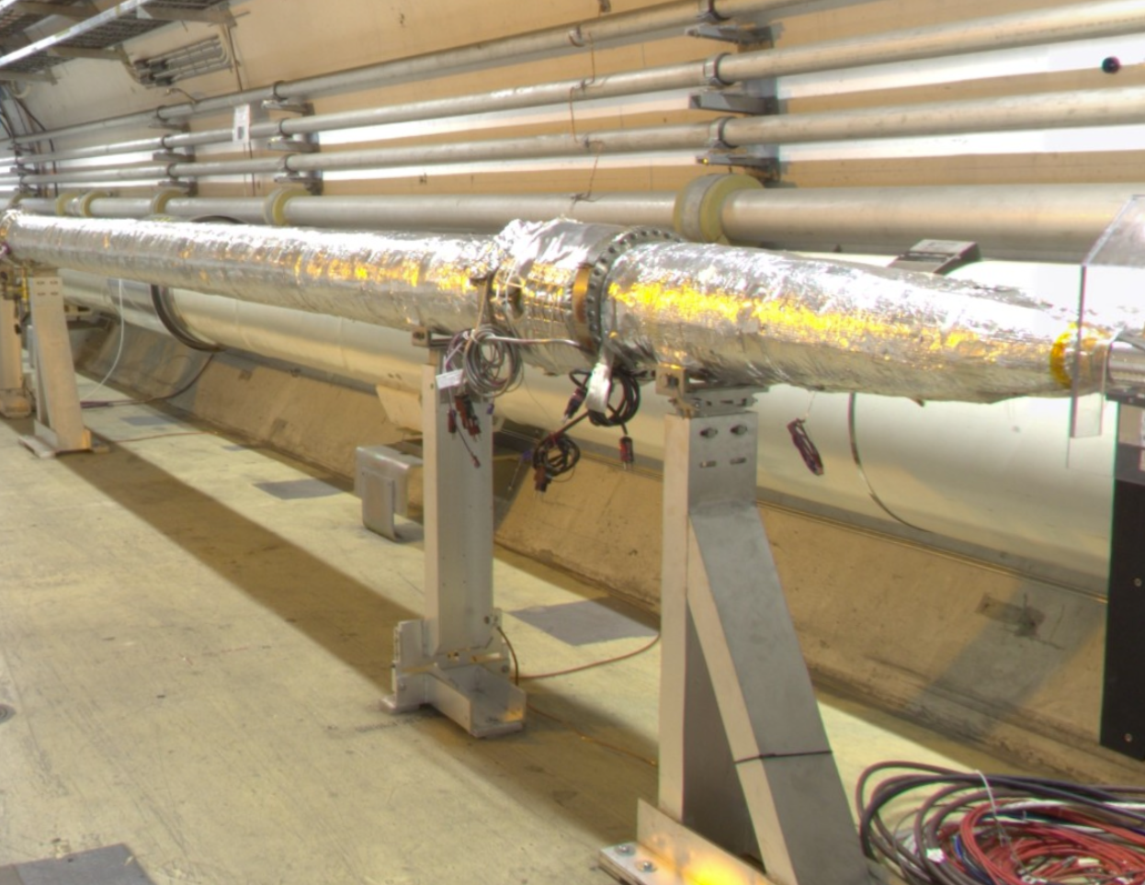
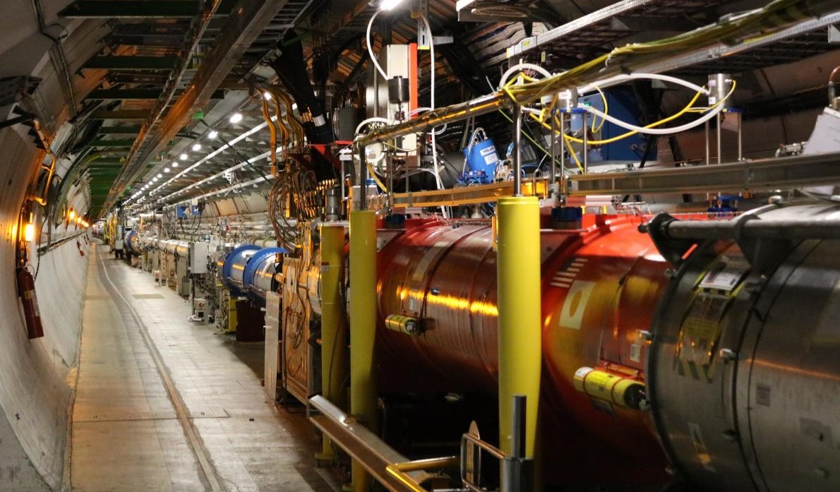
LHC vacuum system
8 Long Straight Sections (~528 m. each)
Room temperature areas:
5.8 km of baked system
  85% are NEG coated chambers
Up to 186 vacuum sectors
  Twin (2 separate beampipes)
  Combined (common beampipe)
Twin sectors
Combined sectors
(both sides of Experiments)
Cryogenic areas:
Stand-Alone Magnets (cold bore @4K)
Inner Triplets (cold bore @1.9K)
~1.4 km of cryogenic vacuum pipes
Up to 82 vacuum sectors
4th July 2023

Slide 5
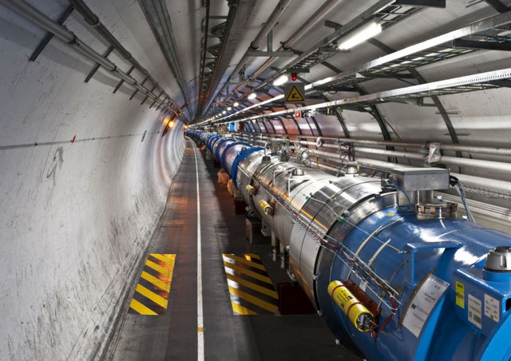
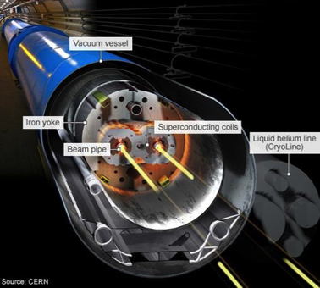
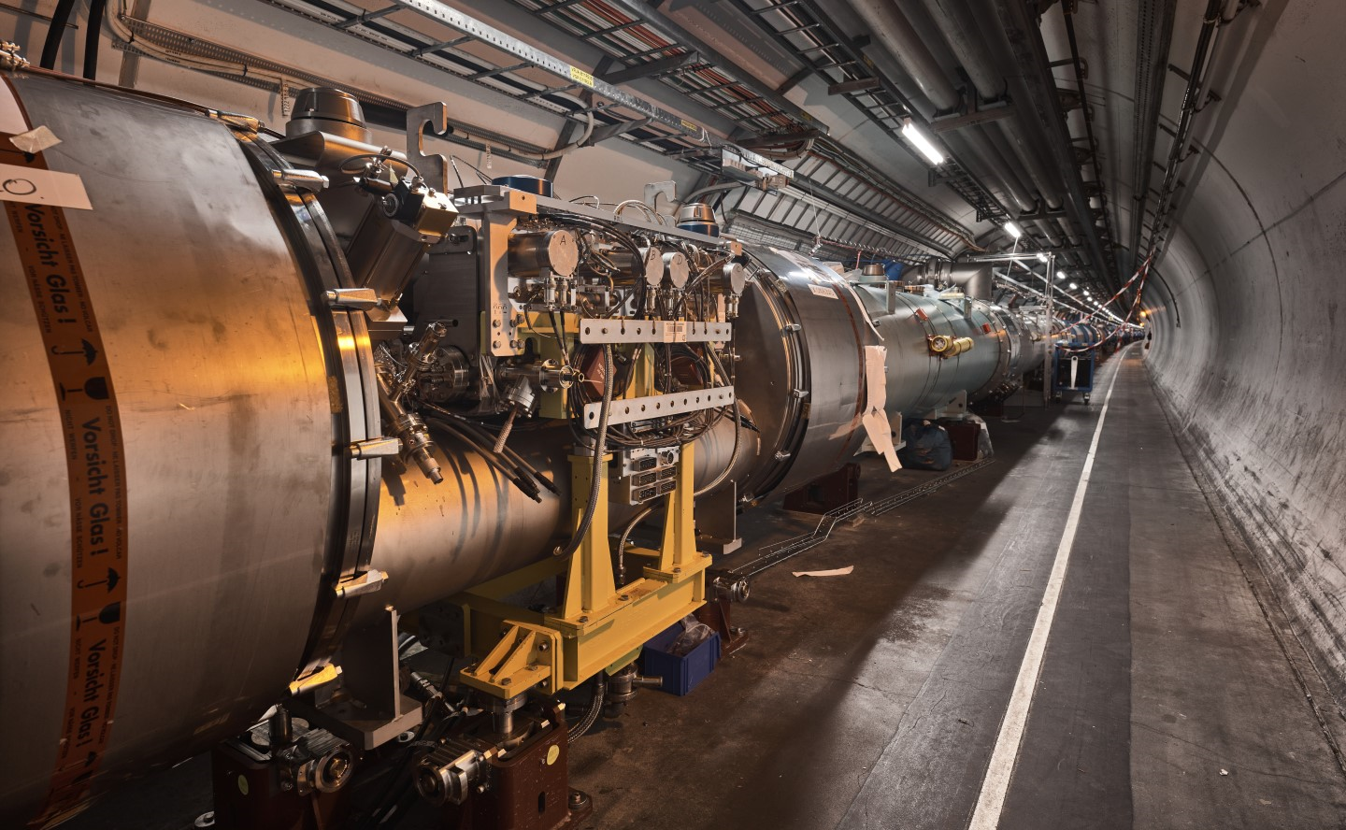
LHC vacuum system
8 ARCs (~ 2.8 km each)
Cryogenic areas:
Superconducting “bending” magnets
Cold bore @1.9K, beam screen @5-20K
~48 km of cryogenic vacuum pipes
Up to 18 vacuum sectors
Room temperature areas:
TCLD collimators
2 vacuum sectors
4th July 2023

Slide 6
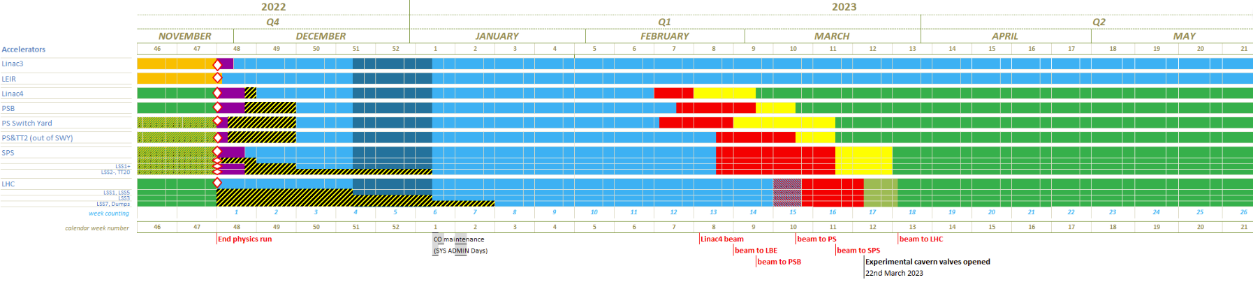
YETS Framework
YETS (Year End Technical Stop) 2022-2023
Works from 28th November to 10th March (P7 from 8th January)
Beam back on 27th March
27th March 2023
28th November 2022
10th March 2023
Maintenance & Operation
Cryogenics
Cooling and ventilation
Vacuum
Electrical systems
Survey
Optics
…
HL-LHC upgrade
WP13
WP5
WP14
WP17
Consolidation & other
Optical fibre
Telecom cable campaign
…
4th July 2023

Slide 7
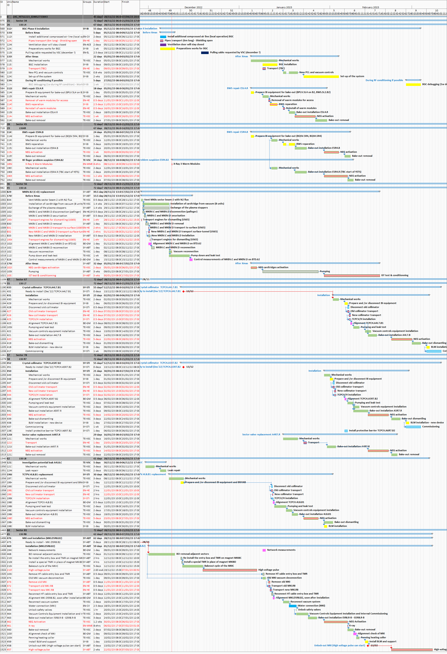
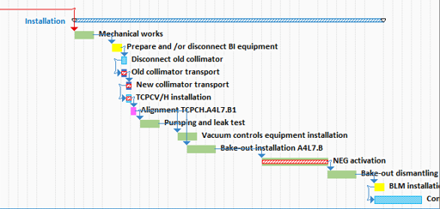

YETS Framework: Planning
Electrical tests = power cuts
VSC
Access constraints
Activities in parallel
Co-activity
4th July 2023

Slide 8
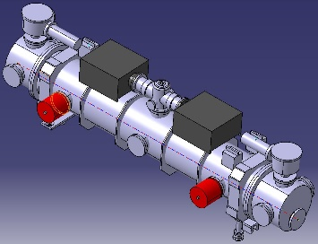
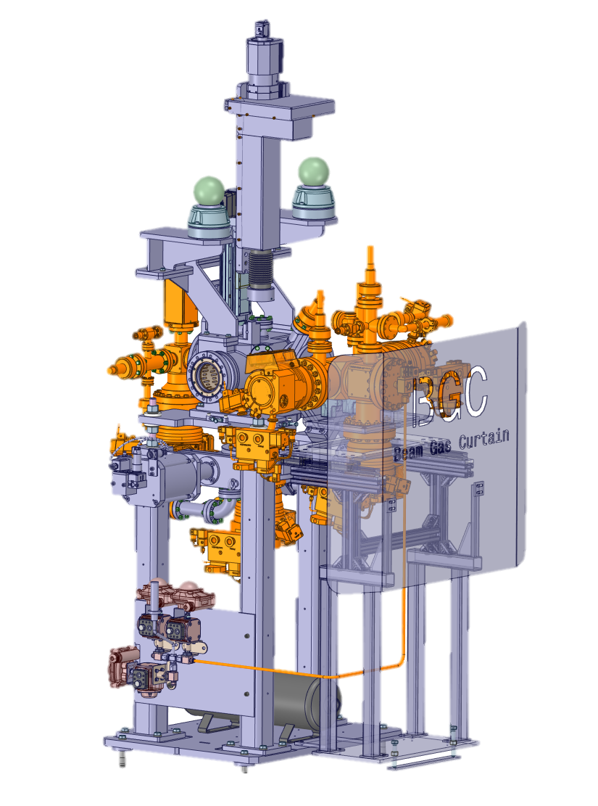
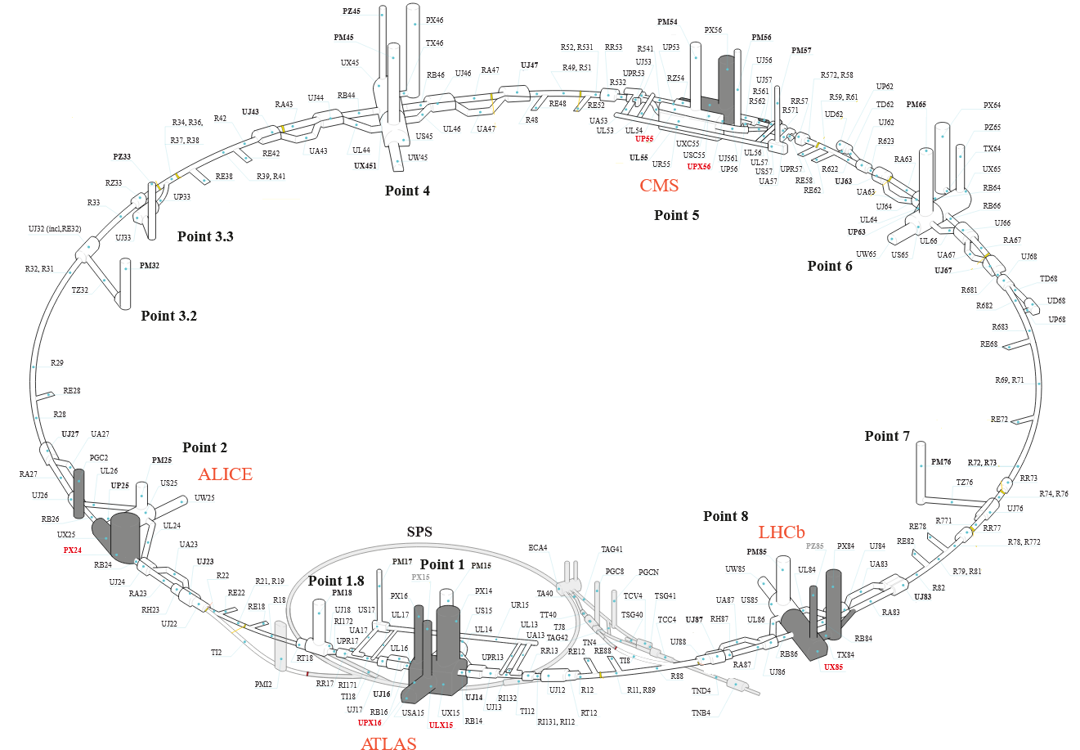
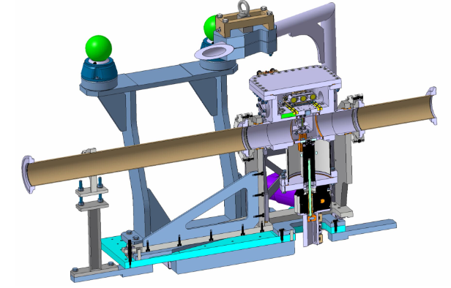
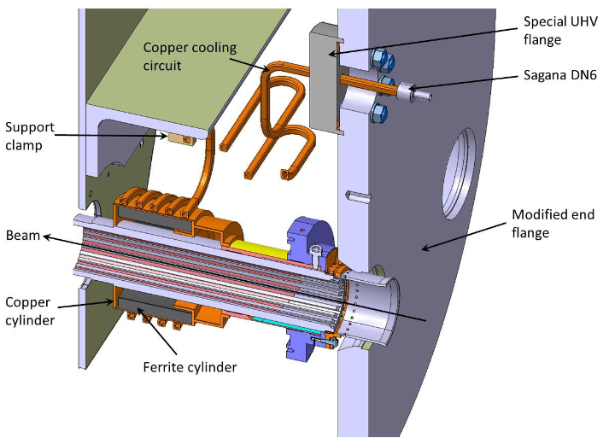
YETS 22-23 activities: Overview
LSS4
BGC phase II (WP13)
2 BWS maintenance
E5R4.R RF-finger problem suspicion
LSS6 - DUMP BTD62
Replacement MKBV.B2
MKBs Pumping upgrade
LSS7
2 TCPC crystal collimators (WP5)
HL-LHC activities
General activities
LSS8
MKI cool prototype (WP14)
A4L8.C Replacement TCTPV.4L8.B1
VSC-led activity
4th July 2023

Slide 9

HL-LHC activities
4th July 2023

Slide 10

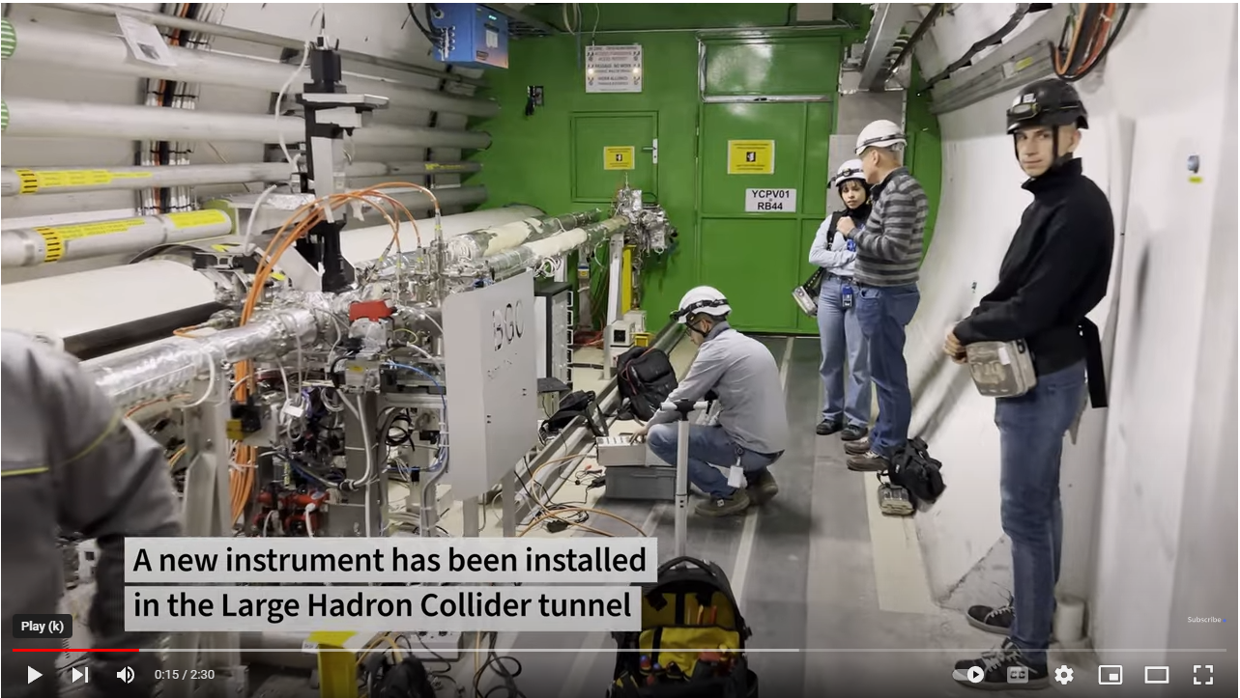
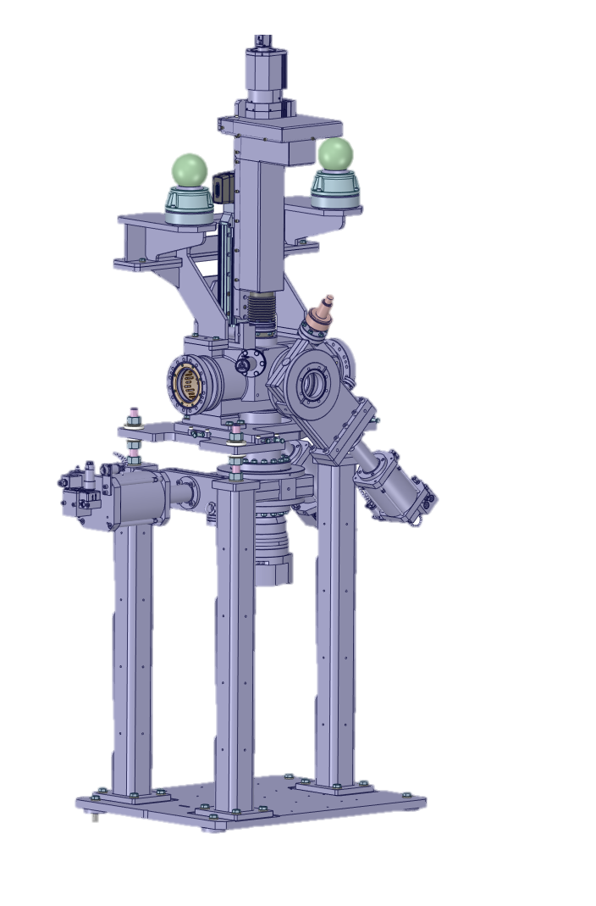
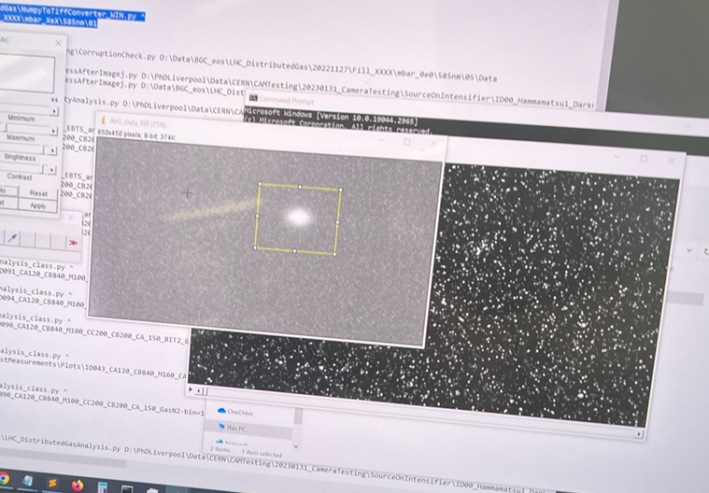
LSS4 | BGC Phase II
BGC (Beam Gas Curtain) phase II installation completed and instrument fully operational for 2023 run
WP13
LHC-BGC-EC-0005
See Cristina’s seminar
from March 21st
LS2
(phase I)
YETS 22-23
(phase II)
Removal of BGI table and installation of new gas injection system
New gauges
New PLC controls + SCADA int.
Independent compressed air supply (new line)
Beam Gas Curtain: a new instrument for LHC Run 3 - YouTube
5 turbomolecular pumping groups + 1 dry pump for injection line
Integration of injection and dump chambers
First injections done during stable beams
4th July 2023

Slide 11
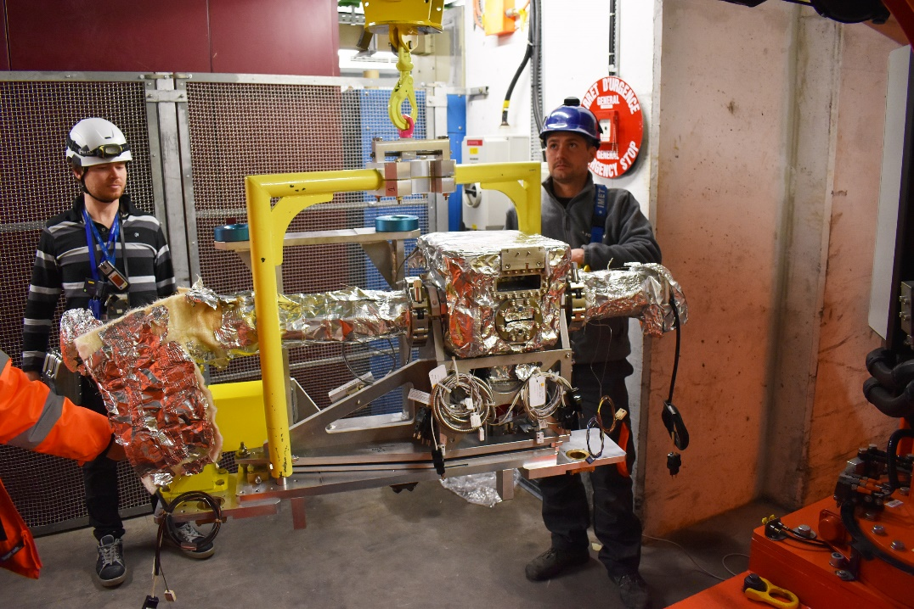
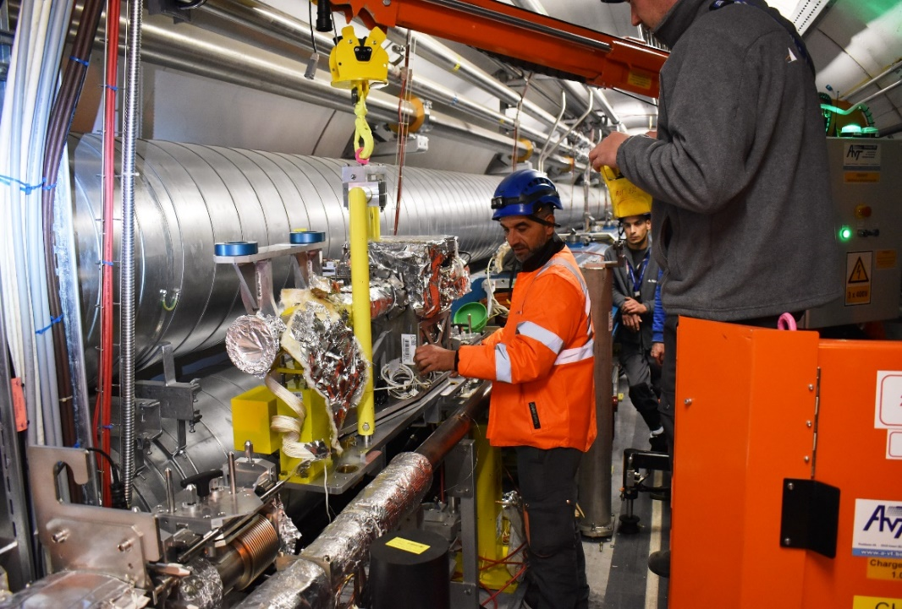
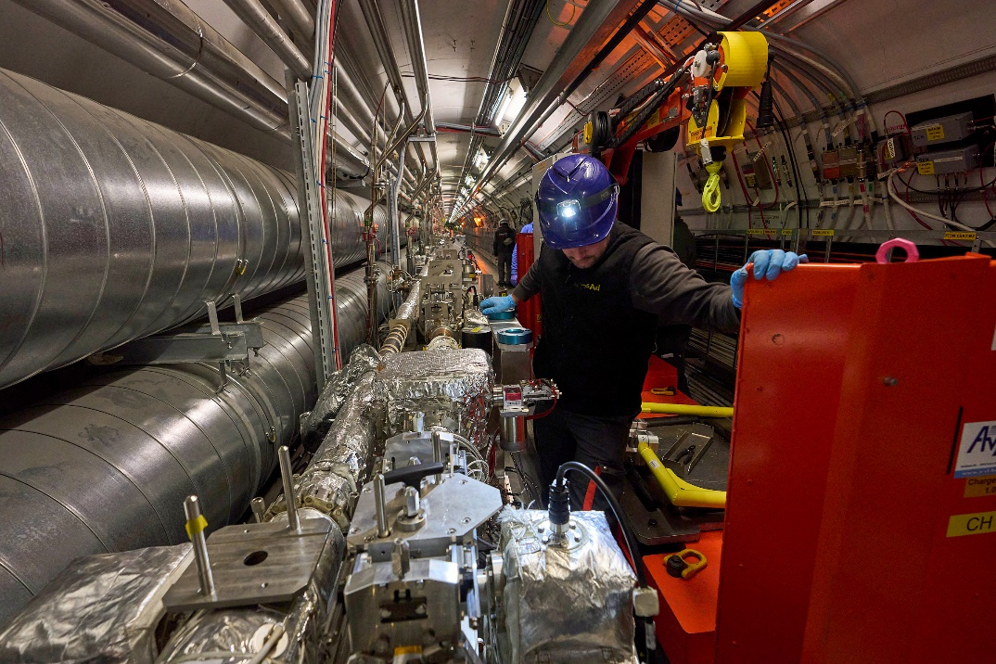
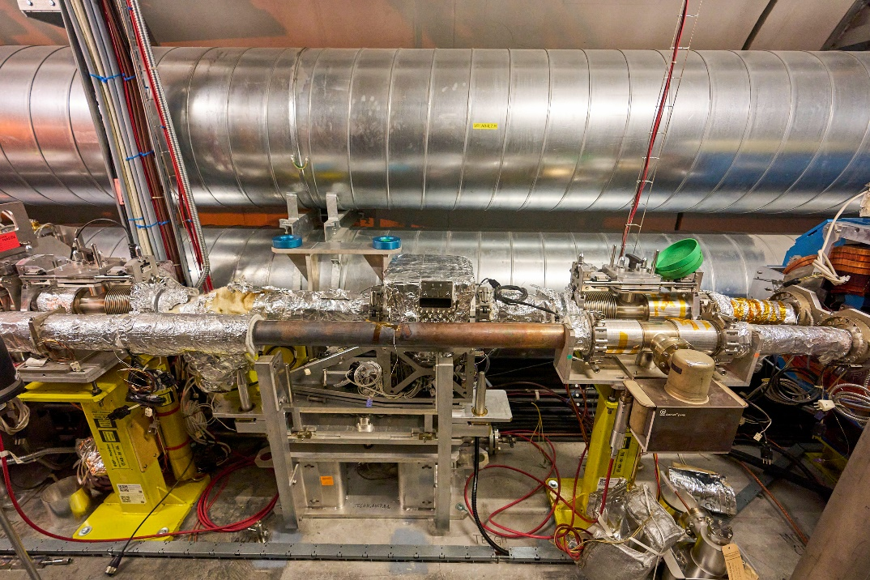

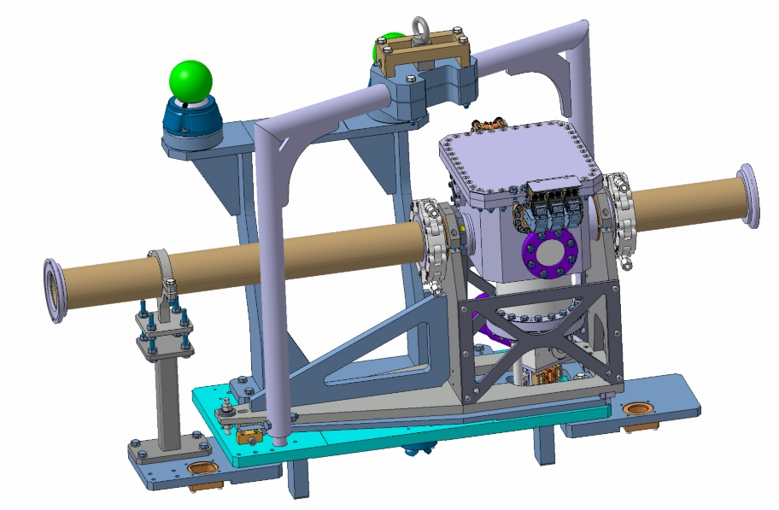
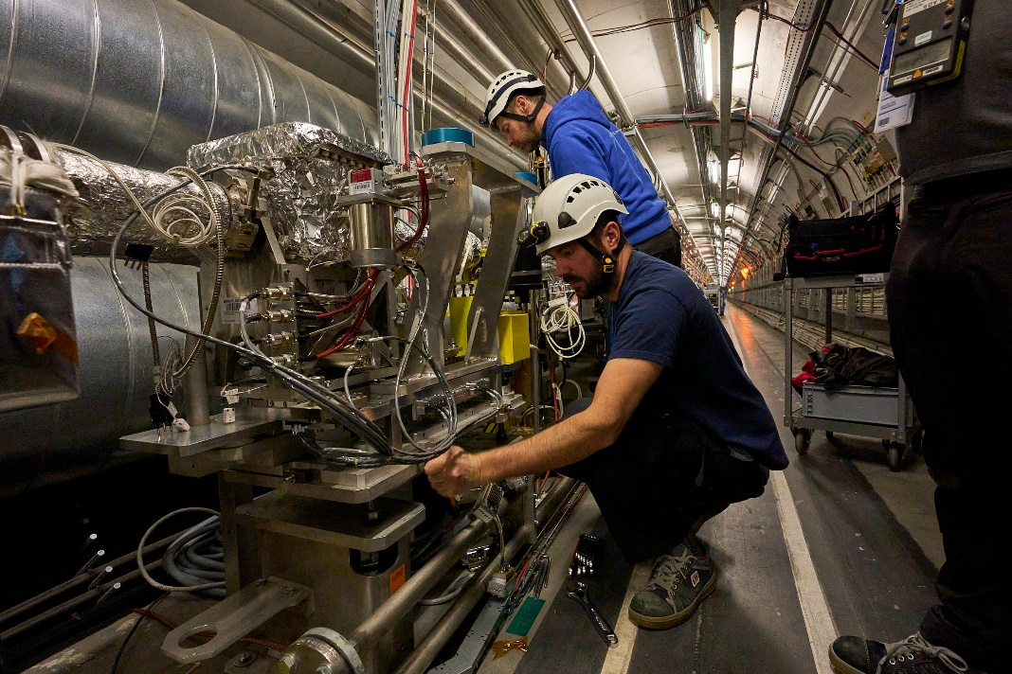
LSS7 | TCPC Crystal collimators
Upgrade of the crystal collimation test stand in IR7
YETS 21-22: Replacement of 2 TCPCV in sectors B5L7.B and B5R7.R
YETS 22-23: Replacement of 2 TCPCH in sectors A4L7.B and A5R7.R
Opening of vacuum sector and releasing of collimators from their slot
Connection of new collimator
Sector reconditioning: Pump + bake + NEG activation
WP5
LHC-TC-EC-0015
4th July 2023

Slide 12
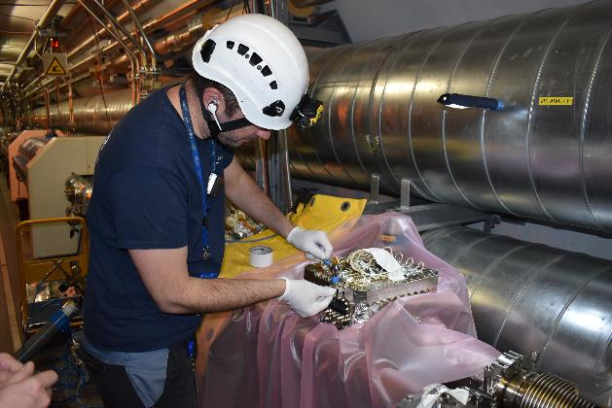
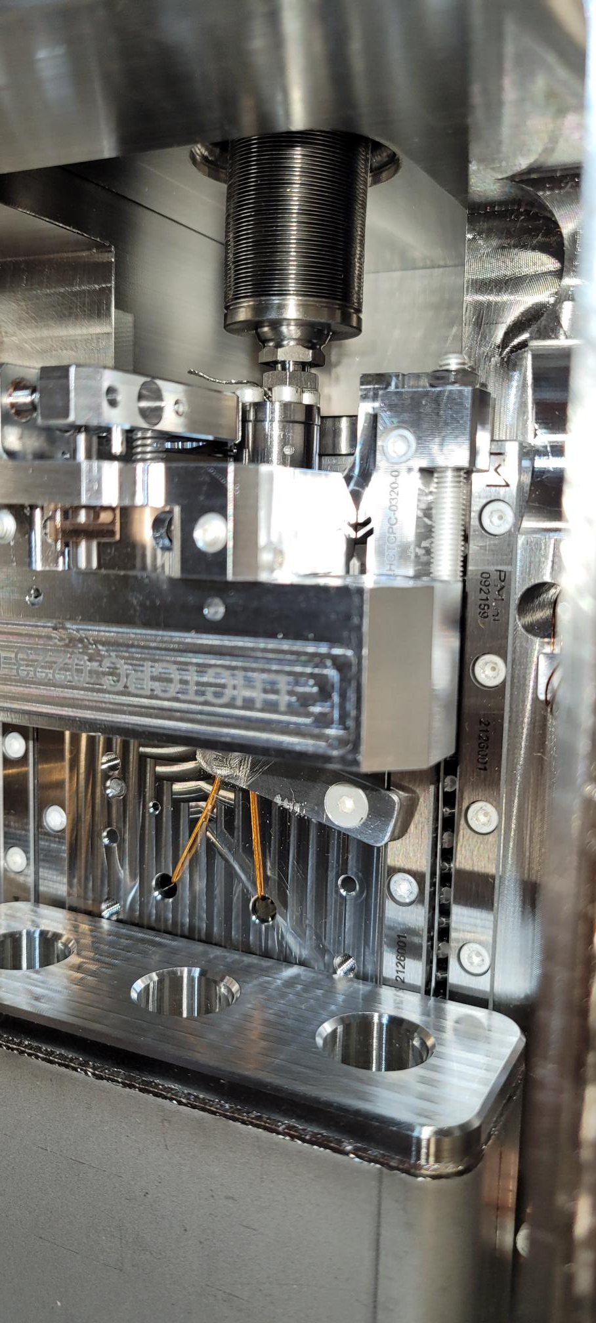
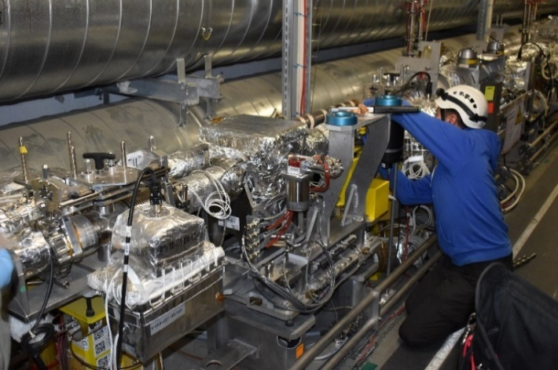
LSS7 | TCPC Crystal collimators
Last minute removal of TCPCH.A4L7.B1
In March, during OP commissioning tests, the crystal remains blocked halfway in (no beam circulation possible)
Prompt action to vent the sector for an inspection (SY/STI)
Mechanical failure (roller cage jammed). Repair in situ not possible
Crystal collimator removed and slot closed with a vacuum chamber
Reconditioning of the sector: Pump, re-bake + NEG activation
Total intervention time: 6 days (very challenging)
Inspection of TCPC by SY/STI
Reinstalled two weeks ago during TS1 – 5 days
Sector opening (TE/VSC)
4th July 2023

Slide 13
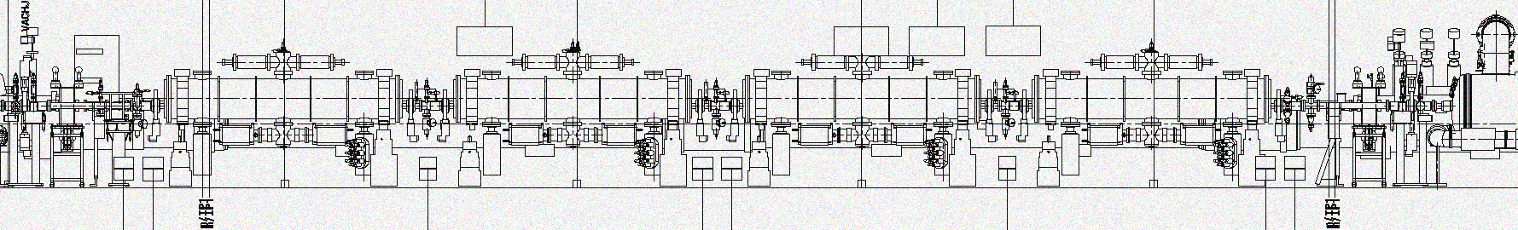
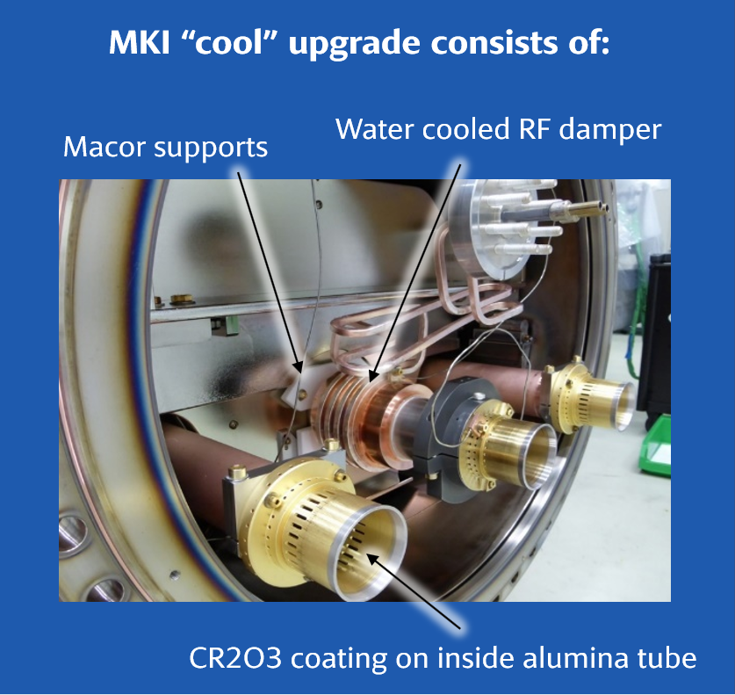
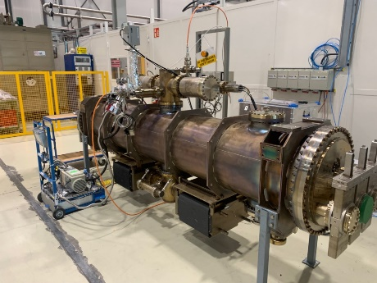
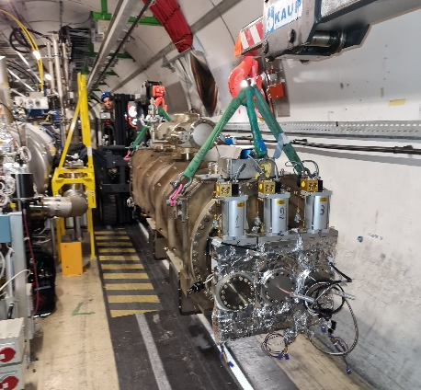

LSS8 | MKI cool
WP14
LHC-MKI-EC-0004
First MKI cool prototype installed during YETS 22-23 (1 out of 8)
MKI8D
Activities in surface
Acceptance test of the MKI cool subcomponents
Acceptance test of the MKI cool tank assembly + bake-out
Acceptance test of the MKI cool in Bldg.867
Activities in tunnel
Adjacent sectors (G5R8 & I5R8)
  Removal/reinstallation of 4 vacuum assembly modules
  Reconditioning: Pump + bakeout
MKI cool transport
4th July 2023

Slide 14
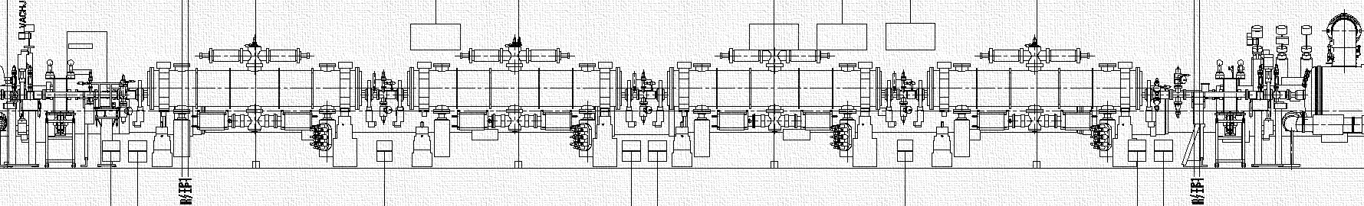

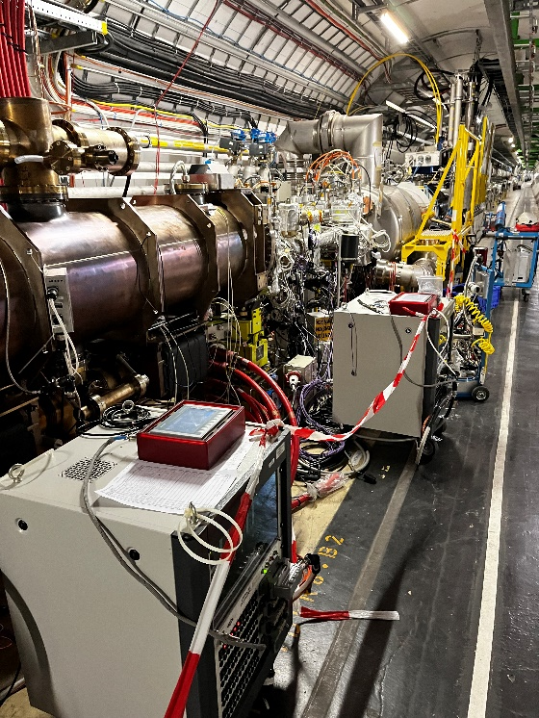
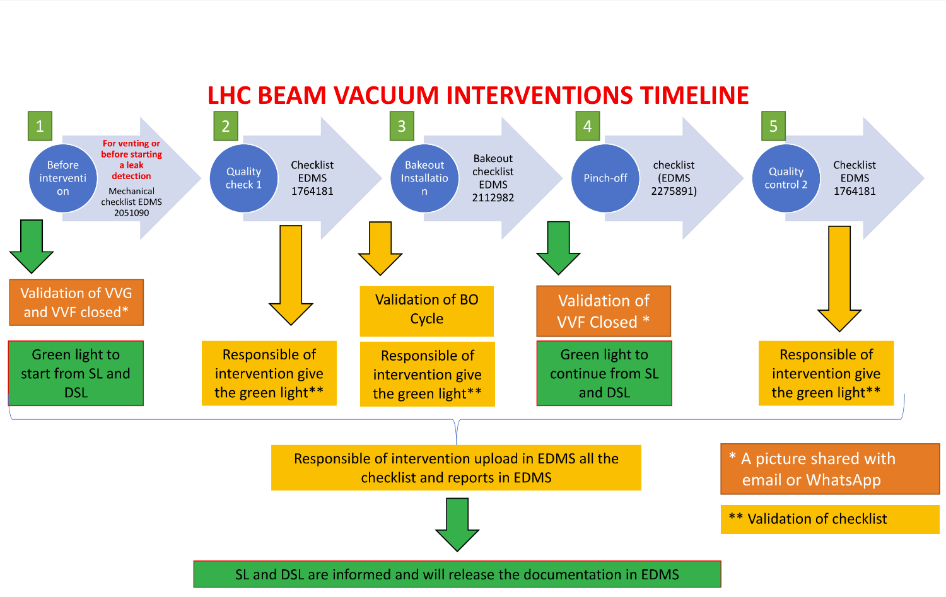

LSS8 | MKI cool
Accidental dry nitrogen inrush inside all the MKI tanks
MKI8A
MKI8B
MKI8C
MKI8D
~5x10⁻⁶ mbar
~2x10⁻² mbar
~4x10⁻¹ mbar
~4x10⁻¹ mbar
Pump-down restarted with fast recovery of vacuum
Bake-out cycle of MKI8C
Reconditioning completed and nominal pressures recovered (<1x10⁻¹¹ mbar). No need of additional bake-out in rest of MKIs sectors
HV test of all MKI performed by SY-ABT. No issues identified
Additional safety measures implemented
Validation check before interventions
Already implemented during YETS 22-23 in other all sectors
Bake-out of MKI8C
4th July 2023

Slide 15
General activities
4th July 2023

Slide 16
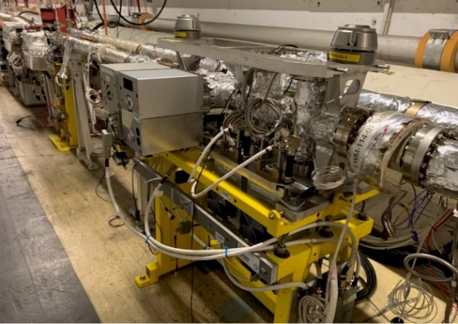
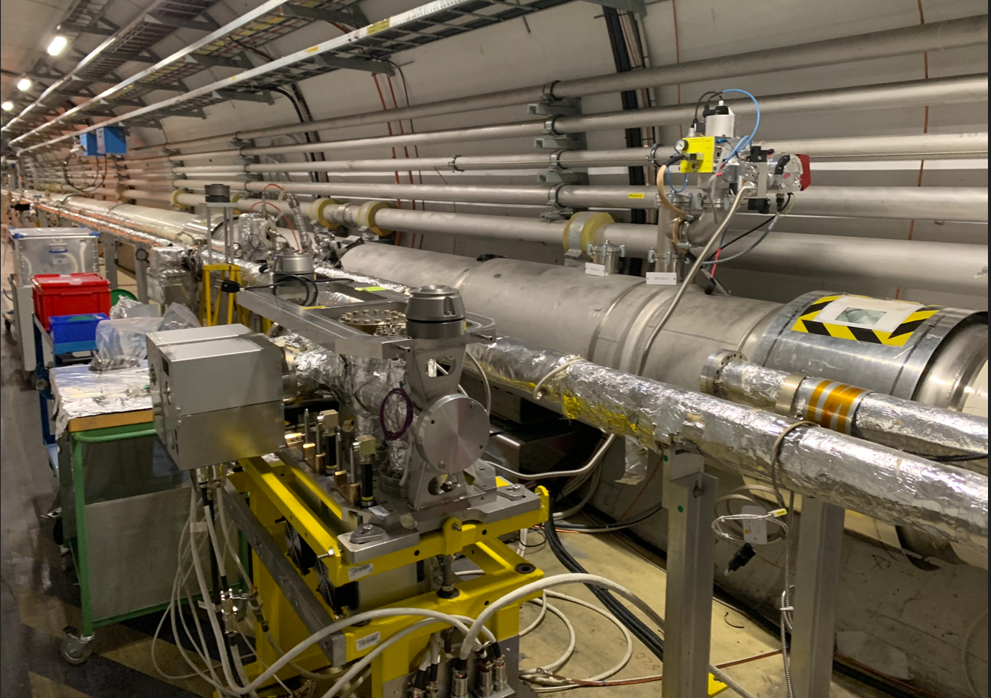
LSS4 | BWS maintenance
Maintenance of 2 BWS (Beam Wire Scanner) in sectors E5L4.R and E5R4.B
E5L4.R (outer beam line): additional mechanical intervention requiring opening and disconnection of the tank from the beamline
Intervention by SY-BI : C-wire inspection (exchange) + functional tests
Vacuum reconditioning: Pump + bake + NEG activation
E5R4.B (inner beam pipe)
E5L4.R (outer beam pipe)
4th July 2023

Slide 17
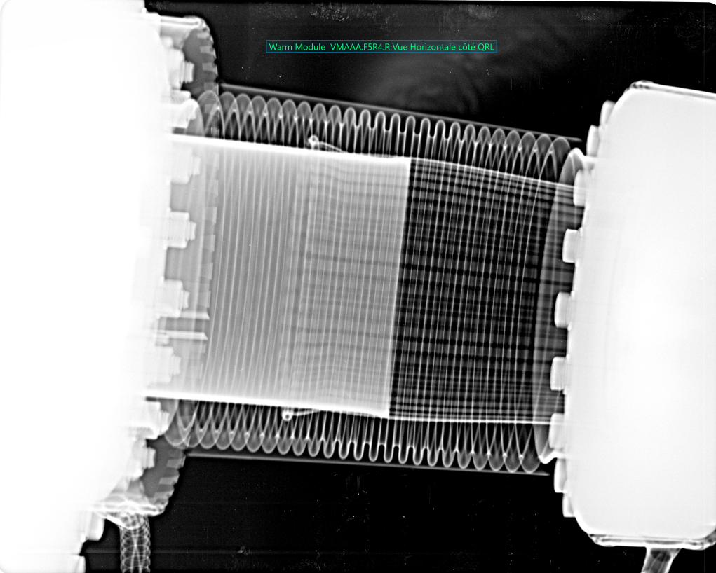
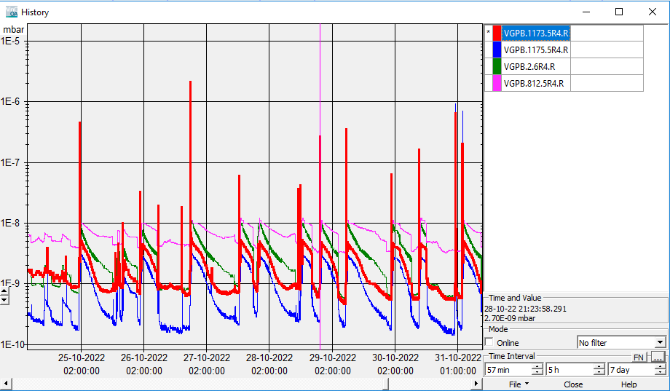
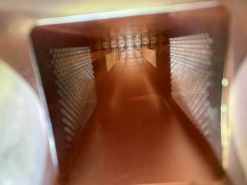
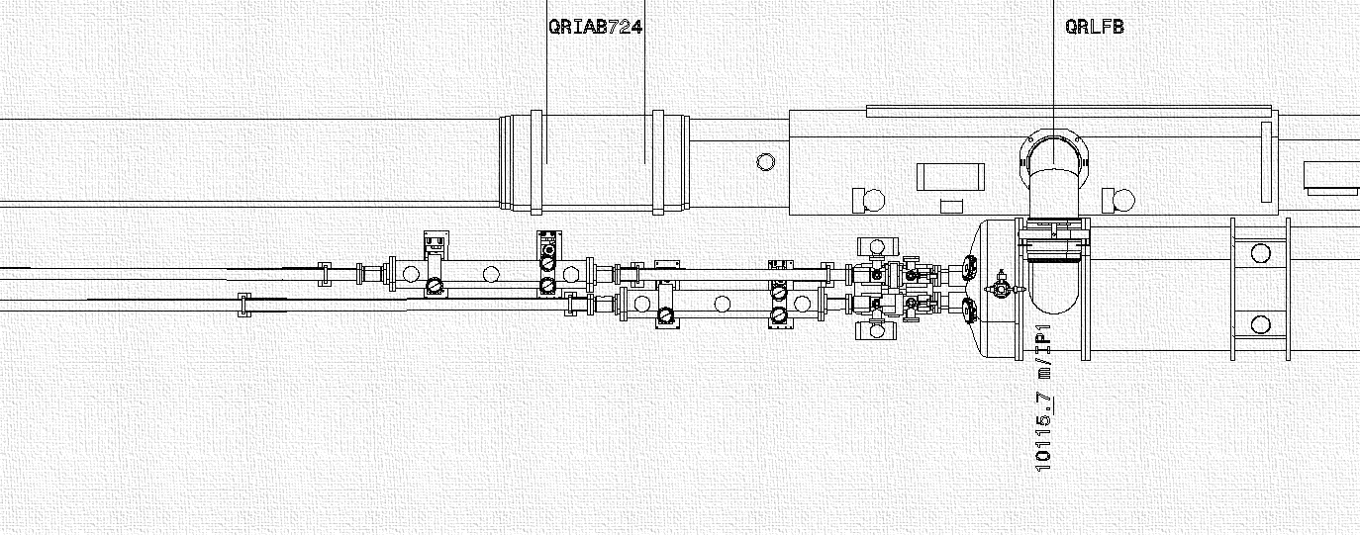
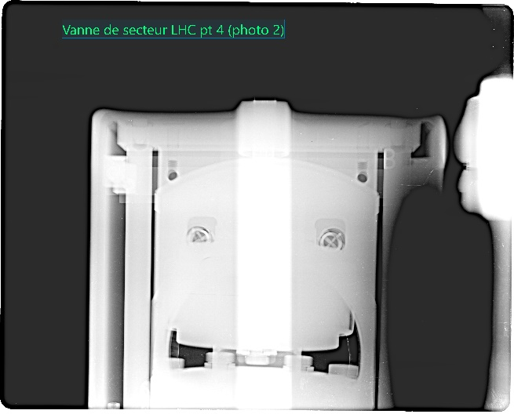
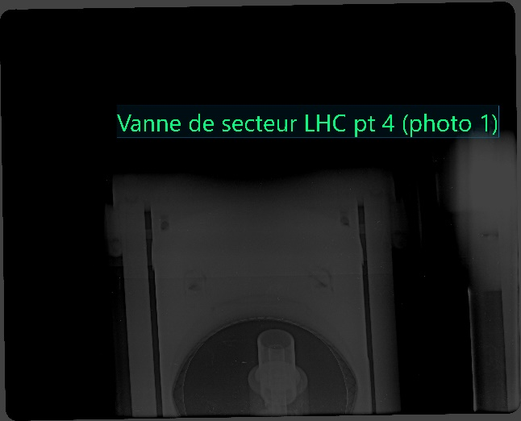







LSS4 | E5R4.R RF-finger problem suspicion
Pressure spikes up to 10⁻⁶ mbar detected during beam operation in two adjacent penning gauges
Objective during YETS: Discard any aperture restriction (ULO, RF-finger damaged, etc.)
X-ray (EN-MME) on 4 warm modules ✓
Opening of the sector for visual inspection of BQS (Schottky Monitor) and adjacent vacuum chambers ✓
Additional X-ray (EN-MME) on sector valve ✓
Warm modules
E5R4.R
D4Q5-R4
F5R4.B
BQS
Sector valve
Penning gauges
4th July 2023

Slide 18
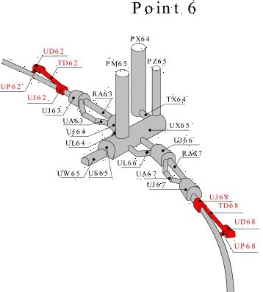
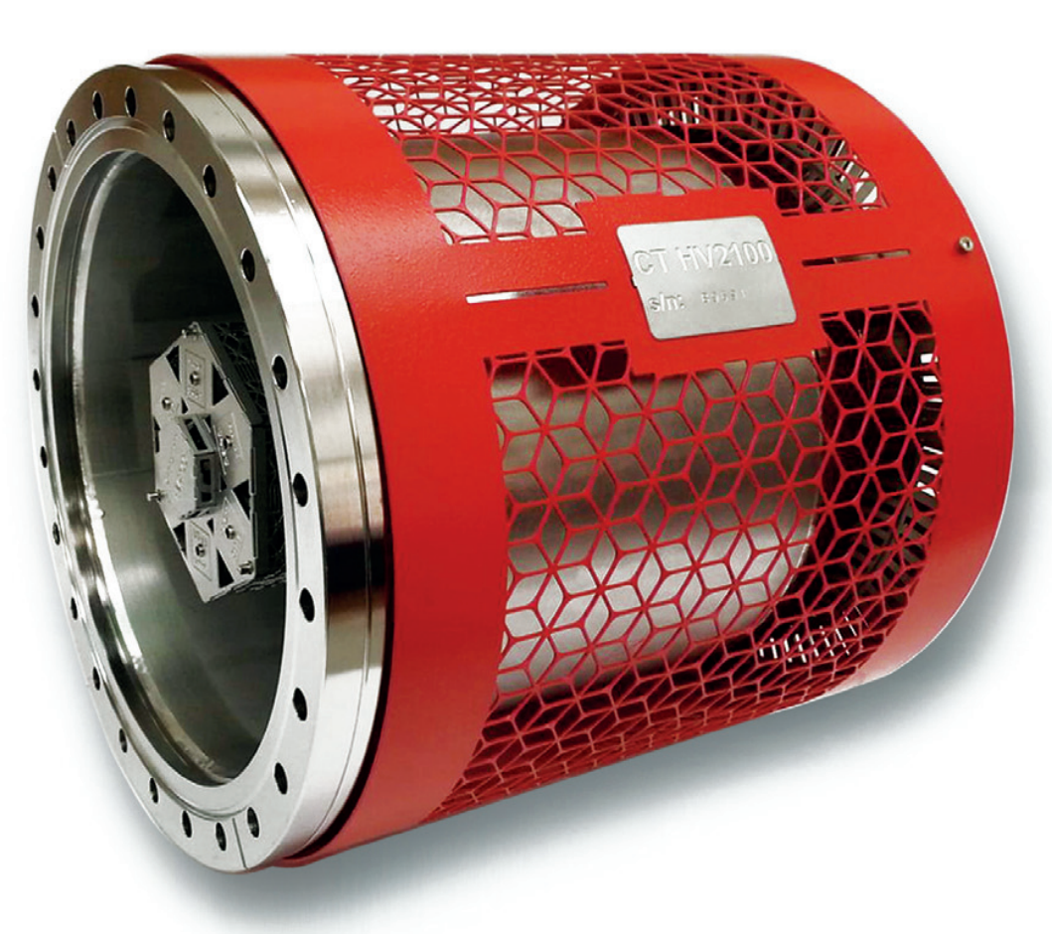



LSS6 DUMP | MKB exchange
Replacement of the MKBV (C+D) in BTD62 due to an electrical flashover during operation
New tank upgraded with 2 modifications:
New interconnection end cap plasma screens with aC coating (SY-ABT)
Additional pumping: 2 NEG cartridges per tank (TE-VSC)
Also implemented in all other 5 tanks in BTD62
BTD68 upgrade planned for EYETS 23-24
CapaciTorr HV 2100 (ZAO alloy)
Plasma screen coated
4th July 2023

Slide 19




LSS8 | A4L8.C replacement TCTPV
Pressure increase detected in sector A4L8.C over a period of months
Complex and long vacuum sector (>50 m, recombination area, chambers ID 212 mm)
Leak confirmed at the beginning of YETS
~2x10⁻⁹ mbar
~5x10⁻¹¹ mbar
Leak rate of ~10⁻⁶ mbar.l/s detected on an edge welded bellow of a collimator (TCTPV) motor
27 June 2023

Slide 20









LSS8 | A4L8.C replacement TCTPV
Replacement of TCTPV.4L8.B1 by spare one
On surface, series of validation done by different groups (including vacuum acceptance test)
New collimator installed
Base pressures recovered after bakeout
Vacuum acceptance test of spare TCTPV in bldg.867
4th July 2023

Slide 21



Consolidation and non-conformities
12x old ion pumps (VPI) exchanged by new pumps (VPIAN) with HV Fischer feedthrough
2x non-conform Penning gauges (VPGB) exchanged
4th July 2023

Slide 22



Bake-out
Some numbers:
LHC Vacuum sectors baked: 9
Length of beamlines baked: 182 meters
But not only…
Injectors Vacuum sectors baked: 3
Length of beamlines baked: 45 meters
Bake-out racks used: 27
Example of instruments equipped:
MKI
Crystal collimators (TCPC)
Beam Wire Scanners (BWS)
BRANB
TCLIA, TCTPV and TCTPH
AWAKE expansion volume
Crystal collimator
AWAKE expansion volume
4th July 2023

Slide 23
Summary
All activities planned have been performed in time with no impact for the restart of the machine.
More activities with respect to baseline including last minute interventions (crystal collimator removal) but well-executed.
Challenging management of the bakeout activities due to implication of the involved team in parallel activities in the Injectors complex.
4th July 2023

Slide 24

    Thanks to all TE/VSC participants, FSU and AL4030 colleagues!
TE/VSC/BVO
D.Digonzelli
C.Moreillon
Industrial support
P.Caseiro
P.Ouvrier
FSU
G.Bregliozzi
J.Finelle
G.Cattenoz
K.Owens
N.Zelko
E.Page
J.Hansen
O.Santos
I.Wevers
K.Henneli
TE/VSC/ICM
L.Zygaropoulos
J.De la Gama
I.Lobato
…and more
J.Sestak
4th July 2023

Slide 25

Thank you for your attention
Any questions?

Slide 26
Spares
4th July 2023

Slide 27
LHC vacuum system
LHC in numbers: Vacuum
Component | Quantity
Vacuum sectors (cryogenic / RT) | 88 / 186
Vacuum sectors valves (all LHC) | 241
Roughing valves (LSS) | 348
Ion pumps (special / 30 / 60 / 350 / 400 l/s) | 12 / 625 / 177 / 36 / 35
NEG cartridges (D400 / D2000) | 257 / 0
Bayard-Alpert gauge (LSS) | 201
Penning gauges (LSS) | 571
Pirani gauges (LSS) | 331
Item in LSS | Length (m) | % wrt total
SAMs & ITs @ cryogenic T | ˜ 1365 | 19
LSS @ RT baked | ˜ 1000 | 14
LSS @ RT with NEG chambers | ˜ 4800 | 67
Total length under vacuum | ˜ 7200 | 100
˜ 85% of the baked vacuum system is NEG coated
4th July 2023

Slide 28
The way we work
Work in the tunnel
Vacuum reconditioning
- Pump-down
- NEG activation
Quality control 1
Quality control 2
Preparation
- ECR / ARR
- Layout modification
- Integration
- IMPACT
- VIC
- Logistics
- WOs
…
Mechanical intervention
No layout modifications required during this YETS
Vacuum controls
(ICM)
ECR: Engineering change request
ARR: Asset replacement request
VIC: “Visite d’Inspection Commune”
4th July 2023

Slide 29


LSS4 | BGC Phase II
YETS 22-23
LS2
4th July 2023

Slide 30

LSS4 | BWS maintenance
Sectorization during LS2
After LS2
Before LS2
New sector valve
Sector valve
BWS
6.6 m
BWS
36.5 m
4th July 2023

Slide 31





LSS4 | E5R4.R RF-finger problem suspicion
X-ray on sector valve
VVGSH.1174.5R4.R
Feasibility study on random valve (on surface )
4th July 2023

Slide 32


LSS4 | E5R4.R RF-finger problem suspicion
X-ray on sector valve
VVGSH.1174.5R4.R
4th July 2023

