Slide 1
ESD measurements from unbaked to baked samples
Paulina Gabriela Czapkowicz
Supervisor: Ivo Wevers
TE-VSC-BVO 26.09.2023

Slide 2
Outline
Electron Cloud in the LHC
ESD Testbench – old design
ESD Testbench upgrade
Measurement procedure
ESD Results:
- Stainless steel
- Copper
- NEG coatings
- Carbon coatings

Slide 3
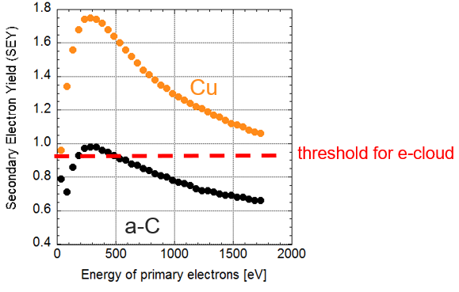
Electron cloud in the LHC
Primary electrons
Residual gas ionization
Photoelectric effect
Acceleration by proton
beam potential
Thermal load
Sec. e⁻
p⁺
p⁺
p⁺
p⁺
Prim. e⁻
hν
Electron Stimulated Desorption
Emission of
secondary electrons
Secondary Electron Yield
Collisions with vacuum chamber walls
Based on data taken from V. Petit, Beam scrubbing and heat loads in the LHC arcs [1]

Slide 4
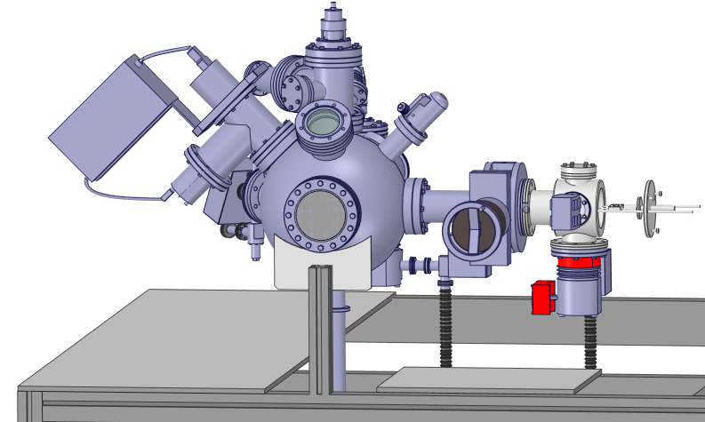
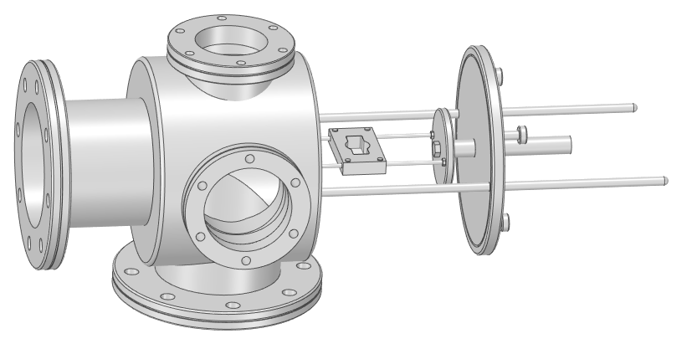
ESD Testbench – old design
Old design of the ESD testbench, located in building 113
Old design of the load-lock

Slide 5
ESD Testbench – old design
Dome
Old design of the ESD testbench, located in building 113
Old design of the load-lock

Slide 6
ESD Testbench – old design
Dome
Load-lock
Old design of the ESD testbench, located in building 113
Old design of the load-lock

Slide 7
ESD Testbench – old design
Dome
Not possible to bake samples due to:
Polymer seal in load-lock
Lack of heater
No direct temperature measurement of sample
Load-lock
Old design of the ESD testbench, located in building 113
Old design of the load-lock

Slide 8
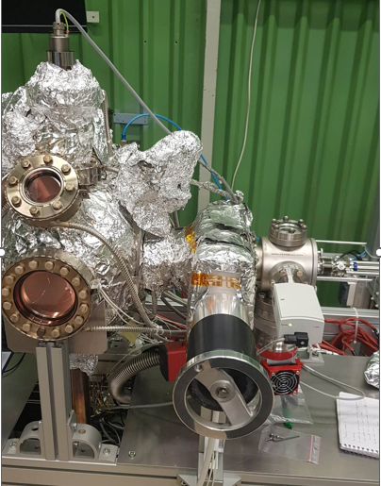
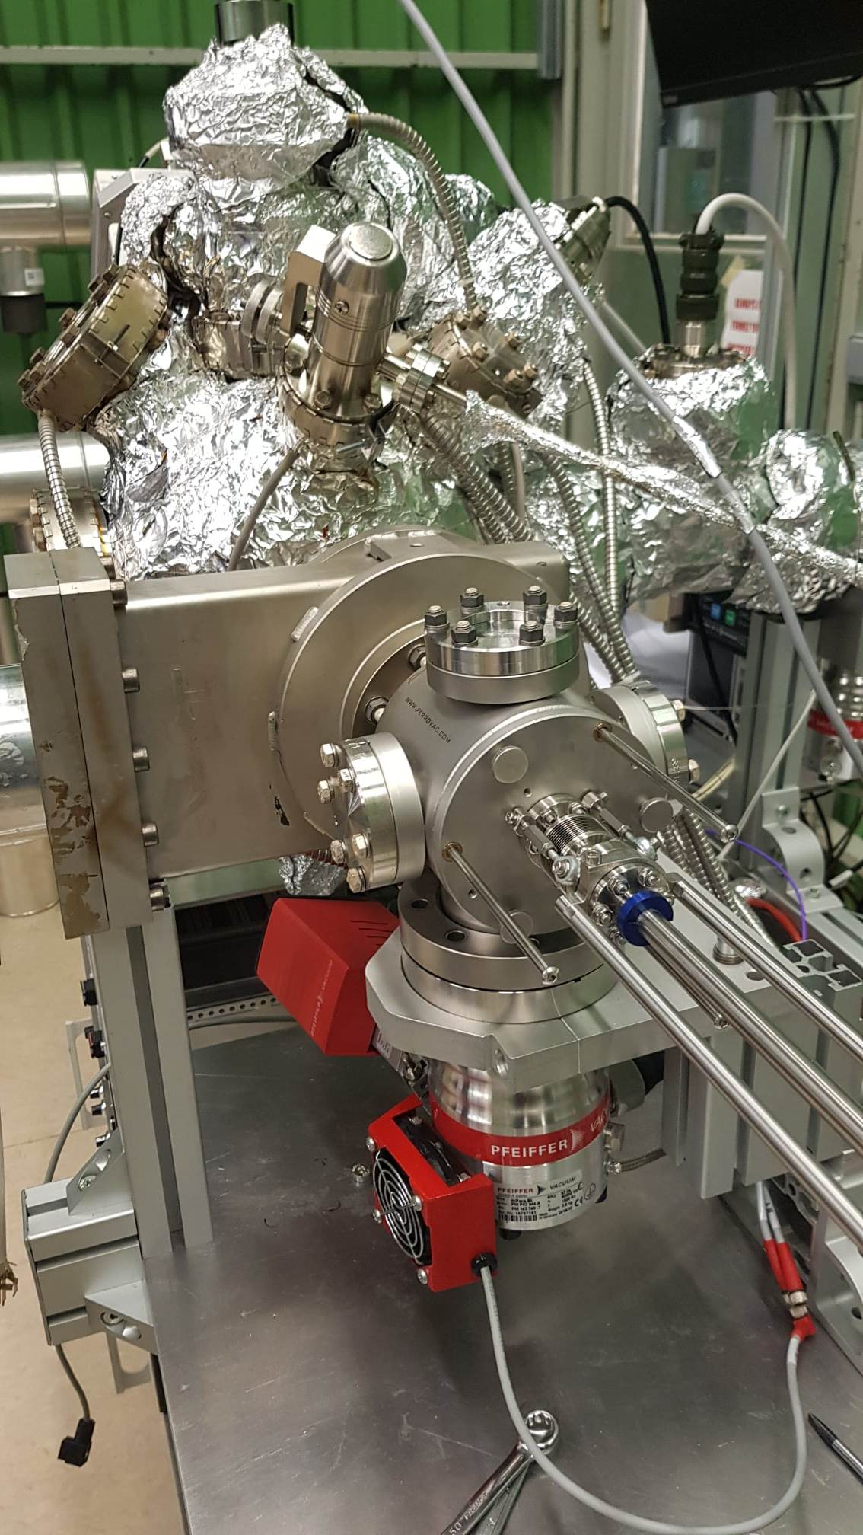
ESD Testbench – old design
Old design of the ESD testbench, located in building 113

Slide 9
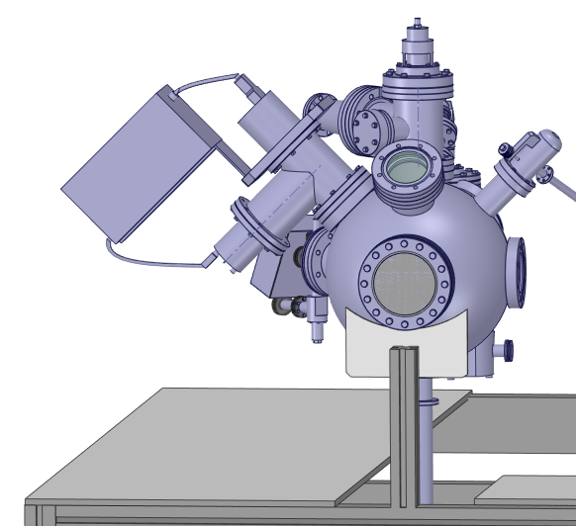
ESD Testbench – dome
2
3
1
4
Residual Gas Analyser (RGA)
NEG cartridge
Electron gun
Conductance
Vertical manipulator
5
Components of the testbench dome

Slide 10
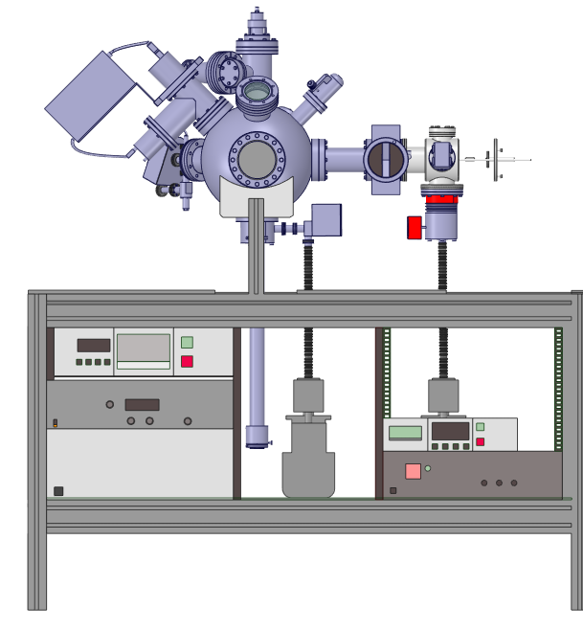
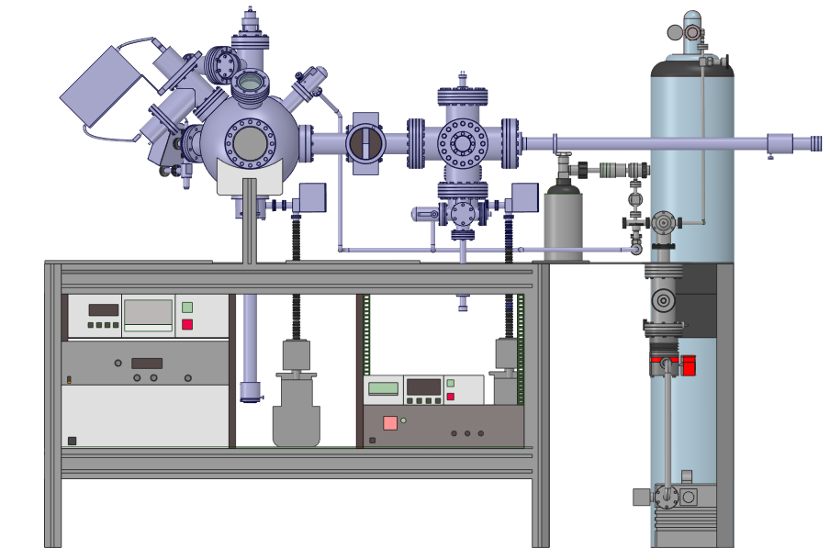
ESD Testbench – overview
Old design of the ESD testbench
New design of the ESD testbench

Slide 11
ESD Testbench – overview
Old design of the ESD testbench
New design of the ESD testbench

Slide 12
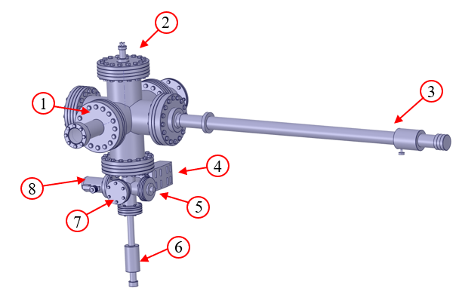
ESD Testbench – new design of load-lock
1 - viewport
2 – heater tectra HC3500
3 - horizontal manipulator
4 - PBR260
5 - thermocouple feedthrough
6 - thermocouple manipulator
7 - blank flange
8 - variable leak valve
New design of the load lock

Slide 13
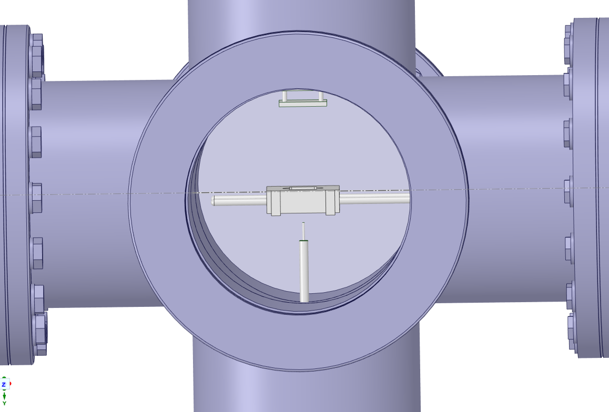
Load-lock temperature measurement
Temperature measurement in load-lock

Slide 14
Load-lock temperature measurement
1
1 – heater (tectra HC3500)
Temperature measurement in load-lock

Slide 15
Load-lock temperature measurement
1
1 – heater (tectra HC3500)
2 – sample holder
2
Temperature measurement in load-lock

Slide 16
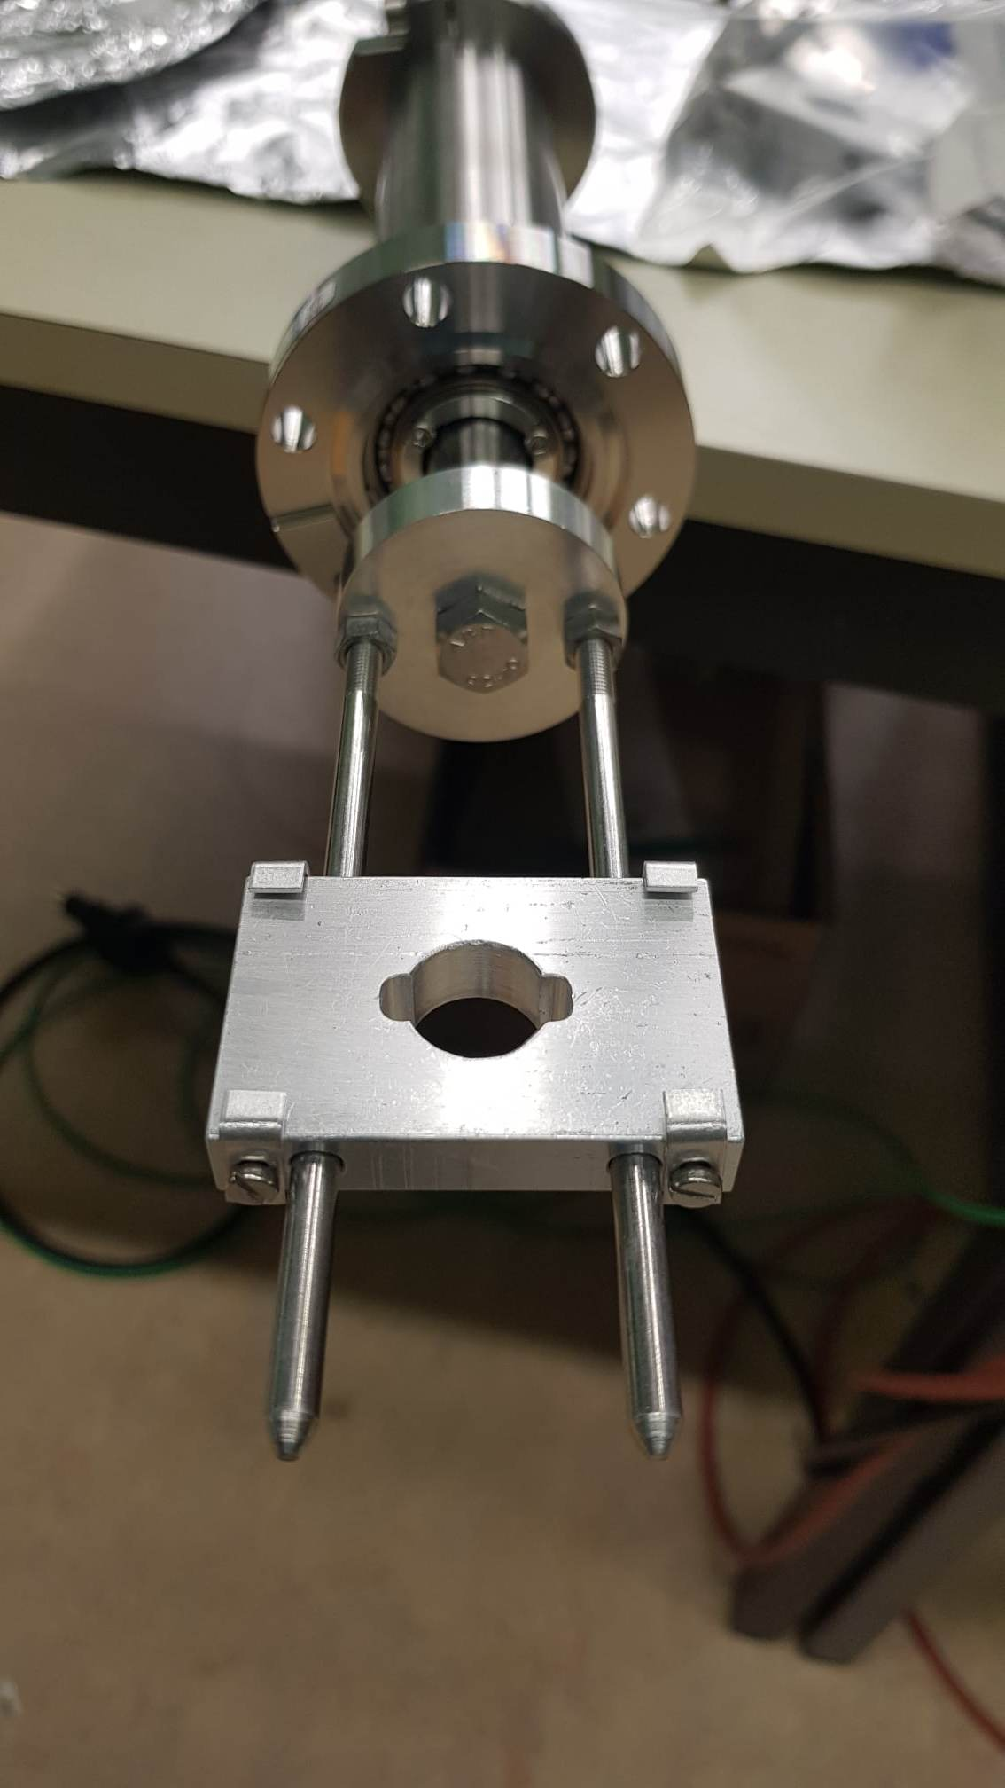
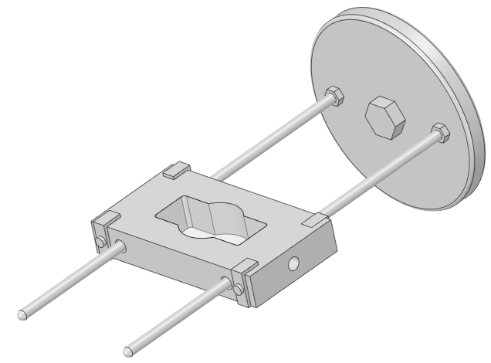
Load-lock temperature measurement
1
1 – heater (tectra HC3500)
2 – sample holder
2
Temperature measurement in load-lock
Model of the new sample holder
Picture of the sample holder

Slide 17
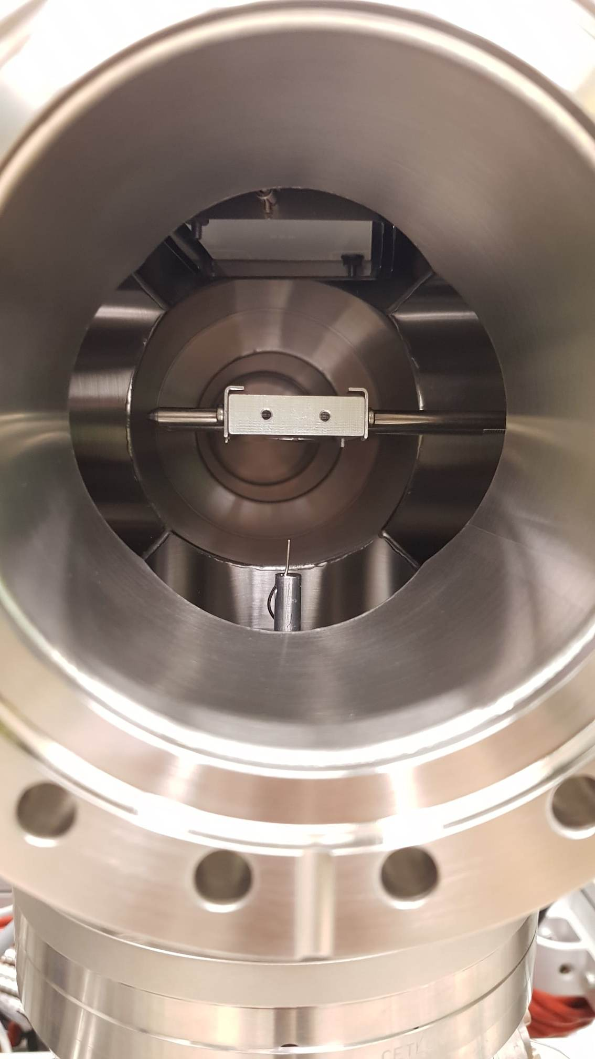
Load-lock temperature measurement
1
1 – heater (tectra HC3500)
2 – sample holder
3 – thermocouple type E
2
3
Temperature measurement in load-lock
Model of the new sample holder

Slide 18
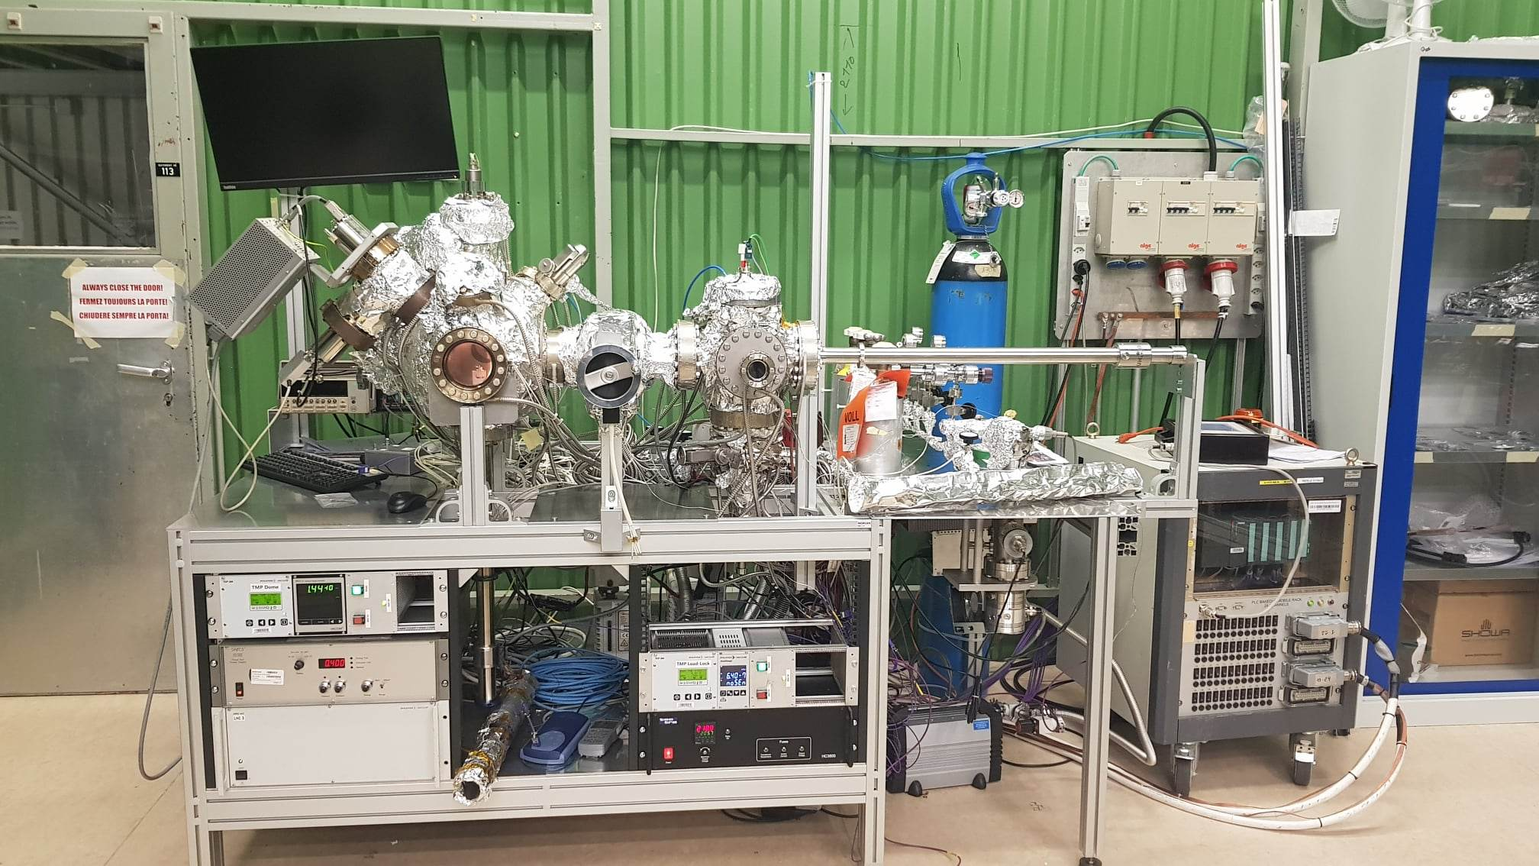
Testbench after upgrade
ESD testbench located in building 113

Slide 19
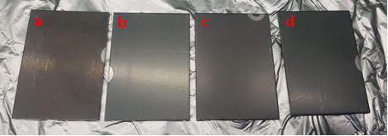
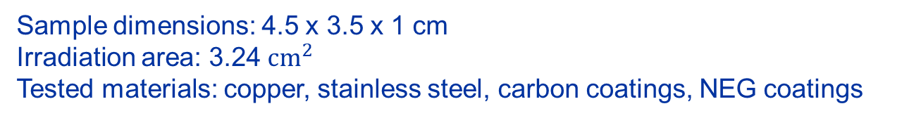
Sample characteristics
Sample dimensions: 4.5 x 3.5 x 1 cm
Irradiation area: 3.24 ${cm}^{2}$
Tested materials: copper, stainless steel, carbon coatings, NEG coatings
Stainless steel carbon coated samples:
Stainless steel + 100 nm aC (substrate not vacuum fired),
Stainless steel + 100 nm aC,
Stainless steel + 400 nm aC,
Stainless steel + 100 nm aC + 200 nm Ti underlayer.
Coating thickness difference: ± 15%

Slide 20
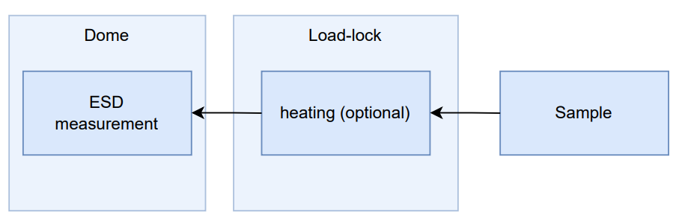
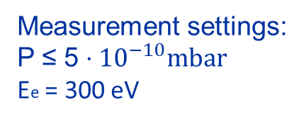
Measurement procedure of ESD
Venting load lock with N2
Sample insertion to load lock
Pumpdown
Sample heating (optional)
Transfer to dome
Sample positioning in dome
Measurement
Measurement settings:
P ≤ 5 · ${10}^{−10}mbar$
Ee = 300 eV

Slide 21
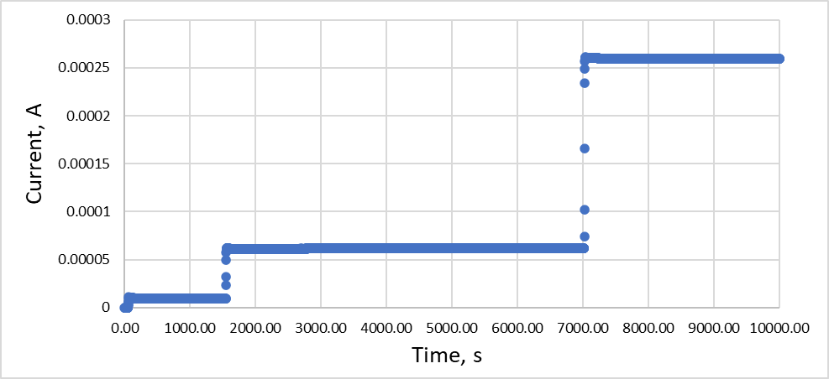
Raw data of OFE copper baked at 150°C for 24h
Current collected on sample

Slide 22
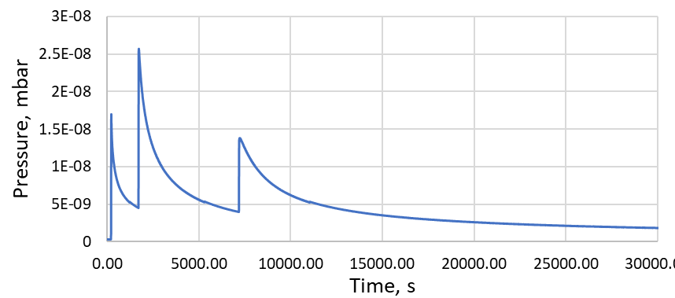
Raw data of OFE copper baked at 150°C for 24h
Current collected on sample
Pressure measured by Bayard-Alpert gauge in dome

Slide 23
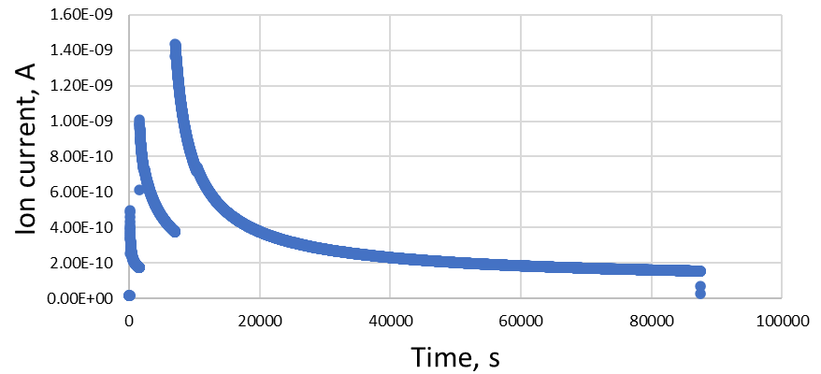
Raw data of OFE copper baked at 150°C for 24h
Current collected on sample
Data collected by RGA (for H2)
Pressure measured by Bayard-Alpert gauge in dome

Slide 24

Raw data of OFE copper baked at 150°C for 24h
Current collected on sample
Data collected by RGA (for H2)
$$ESD= \frac{N_{molecules}}{N_{electrons}}= \frac{Q \left[Pa∙\frac{m^{3}}{s}\right]∙q_{e}\left[C\right]}{k_{B}∙t\left[K\right]∙I\left[A\right]}$$
Pressure measured by Bayard-Alpert gauge in dome

Slide 25
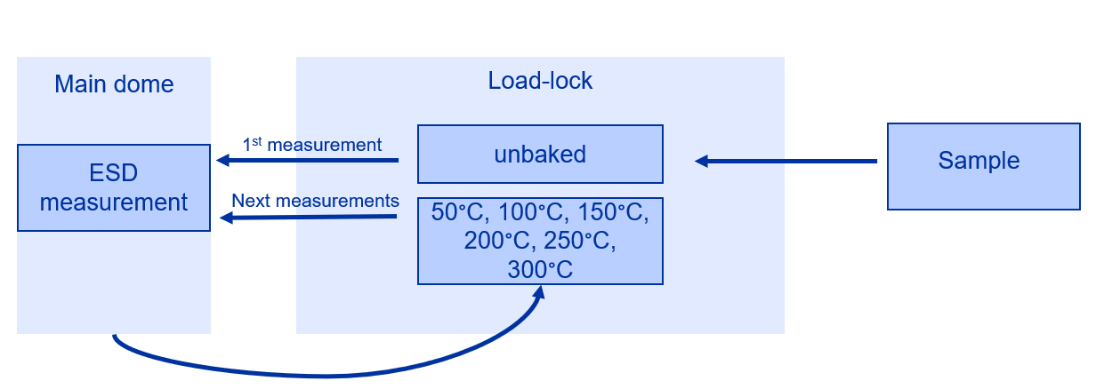
ESD measurement in function of temperature
Measurements parameters:
Electron bombardment: 60s
Ee = 300 eV
Emission current: 24 μA
Heating time: 2h
Procedure:
Inserting sample
Unbaked sample measurement
Transfer to load lock for baking
Measurement of baked sample
Repetition of the steps 3 and 4 for all temperatures

Slide 26
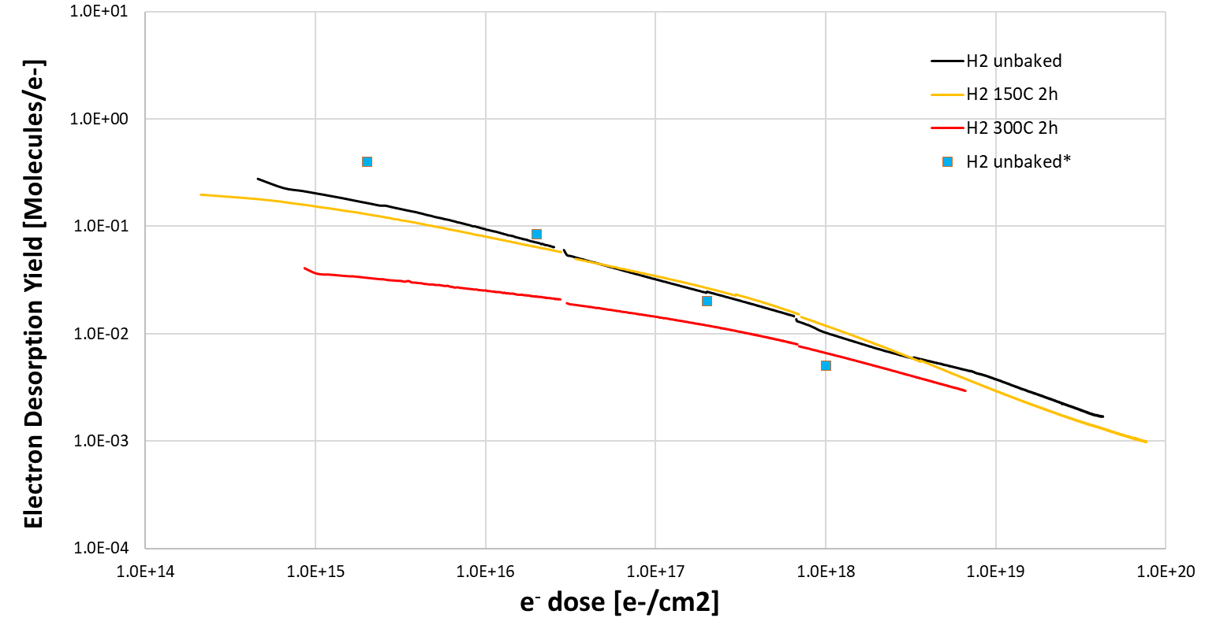
Unbaked vs baked OFE copper
Ee = 300eV
Emission settings:
24μA (25 min)
160 μA (1.5h)
650μA (24h)
Baking time: 2h
Heating temp.: 150°C, 300°C
24μA
160μA
650μA
*research data from O. B. Malyshev, Beam induced desorption, CAS on Vacuum for Particle Accelerators 2017 [2].

Slide 27
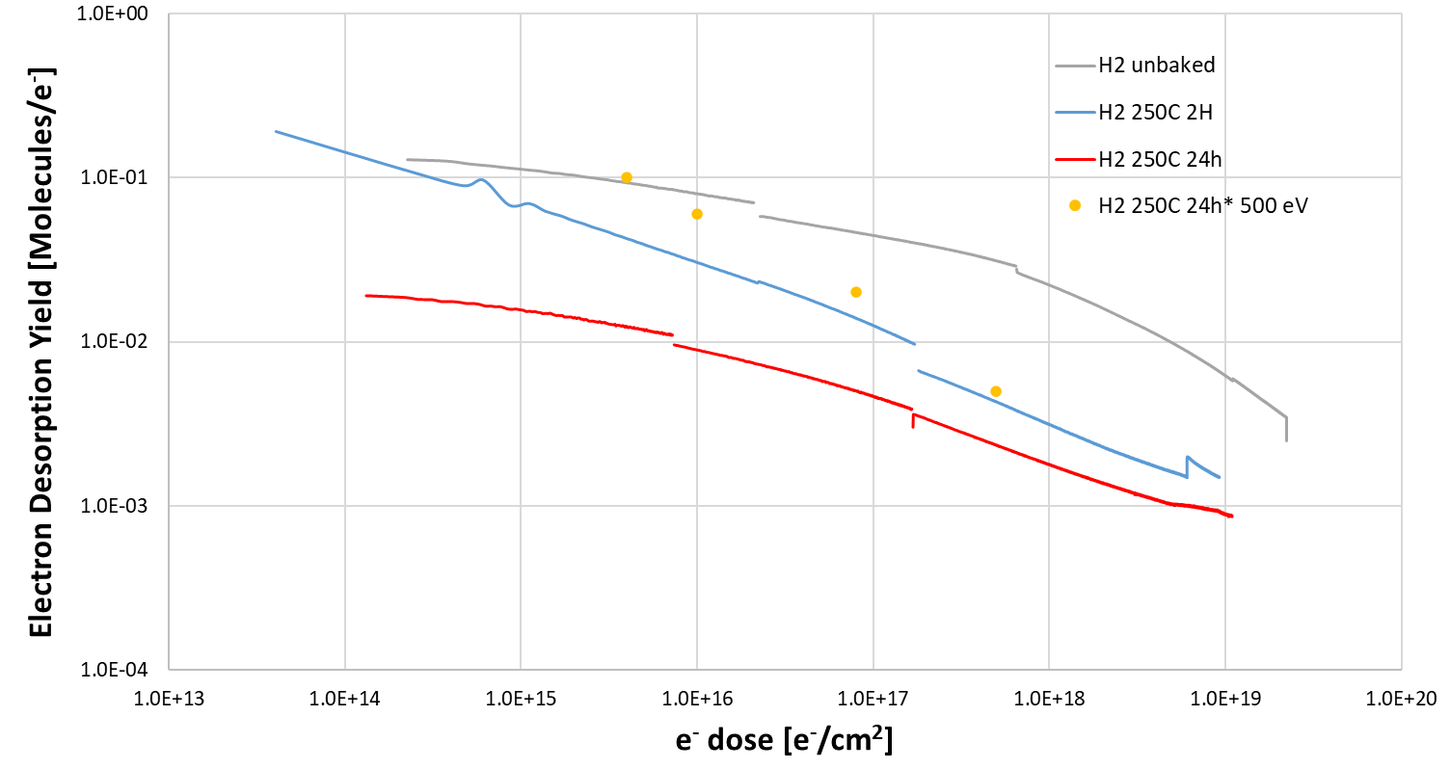
Influence of temperature on ESD of stainless steel 316LN
Ee = 300eV
Emission settings:
24μA (25 min)
160 μA (1.5h)
650μA (24h)
Baking time: 2h and 24h
Baking temperatures: 250°C
*Data taken from O. B. Malyshev; A. P. Smith; R. Valizadeh; A. Hannah, Electron stimulated desorption from bare and nonevaporable getter coated stainless steels, J. Vac. Sci. Technol. A 28, 1215–1225 (2010) [2]
[2].

Slide 28
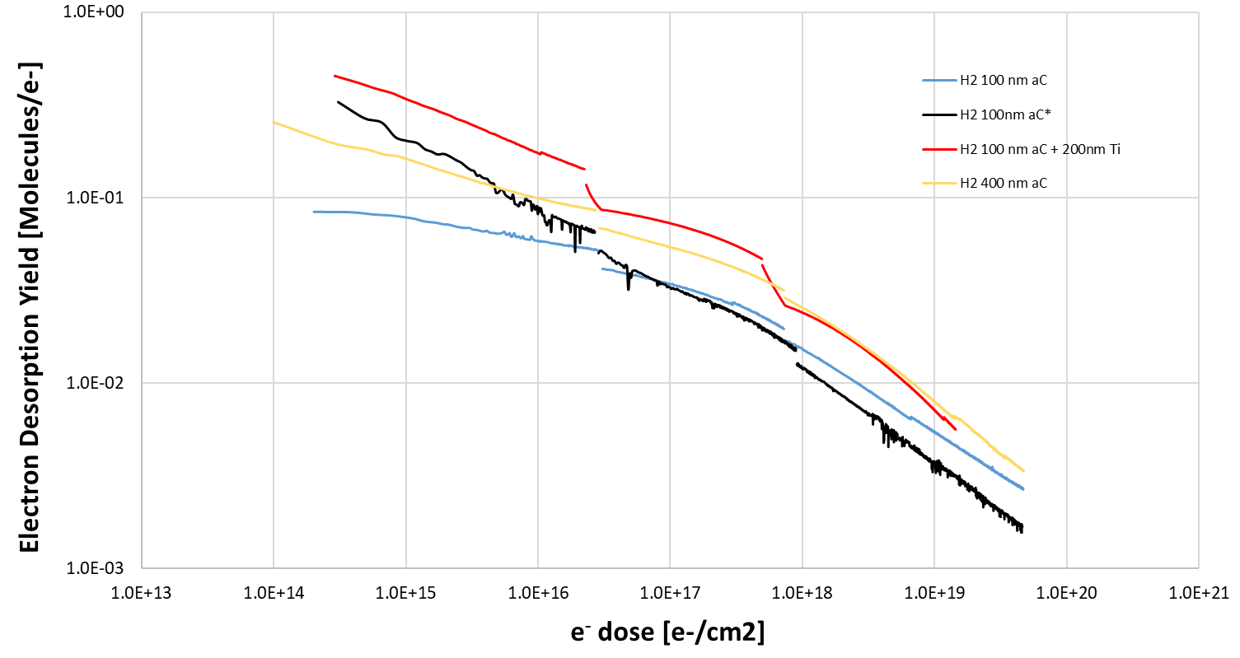
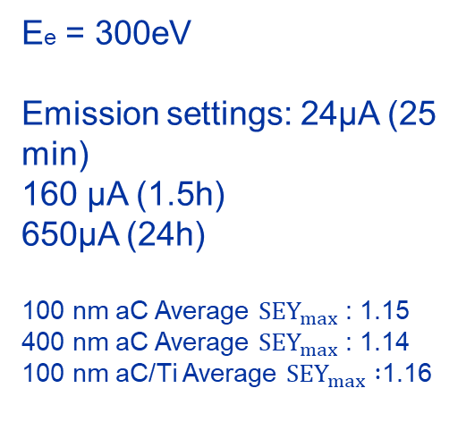
Influence of coating type on ESD of aC
Ee = 300eV
Emission settings: 24μA (25 min)
160 μA (1.5h)
650μA (24h)
100 nm aC Average ${SEY}_{max}$: 1.15
400 nm aC Average ${SEY}_{max}$: 1.14
100 nm aC/Ti Average ${SEY}_{max} :$1.16
*substrate not vacuum fired, rest of the substrates were vacuum fired.

Slide 29
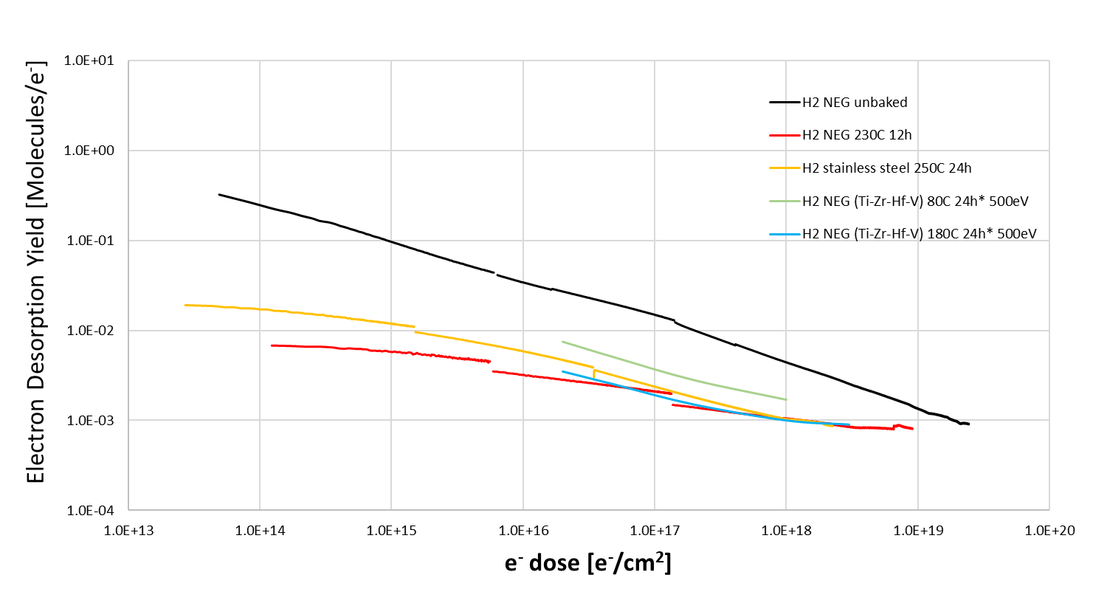
Influence of temperature on NEG samples
Ee = 300eV
Emission settings: 24μA (25 min)
160 μA (1.5h)
650μA (24h)
*Data taken from O. B. Malyshev; A. P. Smith; R. Valizadeh; A. Hannah, Electron stimulated desorption from bare and nonevaporable getter coated stainless steels, J. Vac. Sci. Technol. A 28, 1215–1225 (2010) [2]

Slide 30
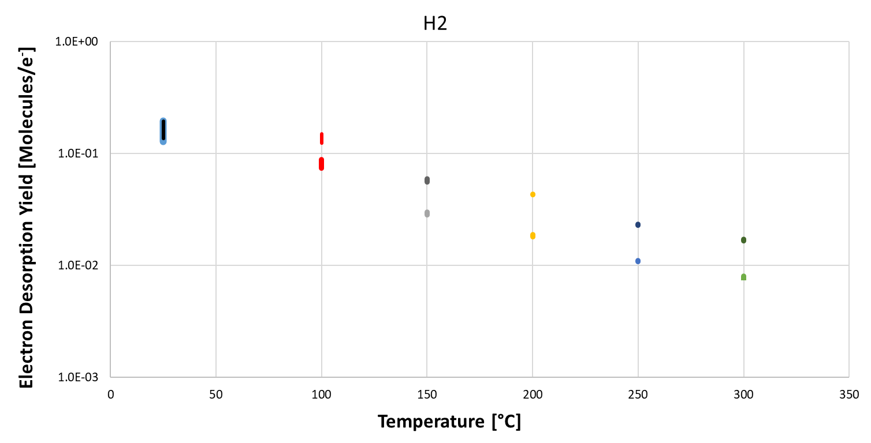
Influence of temperature on NEG sample
Ee = 300eV
Emission settings: 24μA (60s)
Electron Desorption Yield of stainless steel coated with NEG in function of temperature

Slide 31
Conclusion
Upgrade:
New load-lock design
Repeatable measurements
Programmable heater
Direct temperature measurement during sample baking

Slide 32
Thank you for your attention!

Slide 33
Bibliography
[1] V. Petit, Beam scrubbing and heat loads in the LHC arcs
[2] O. B. Malyshev, Beam induced desorption, CAS on Vacuum for Particle Accelerators 2017
[2] O. B. Malyshev; A. P. Smith; R. Valizadeh; A. Hannah, Electron stimulated desorption from bare and nonevaporable getter coated stainless steels, J. Vac. Sci. Technol. A 28, 1215–1225 (2010)

Slide 34
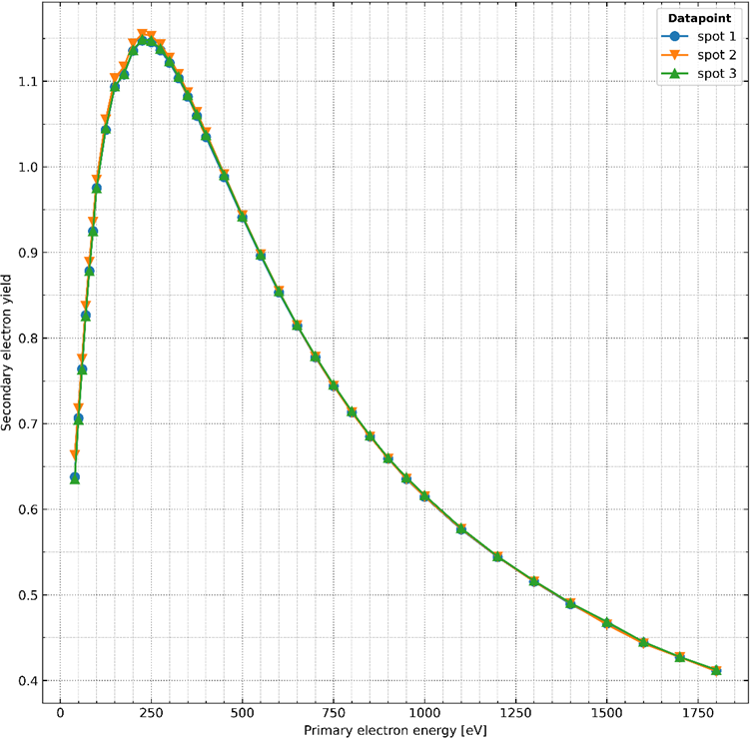
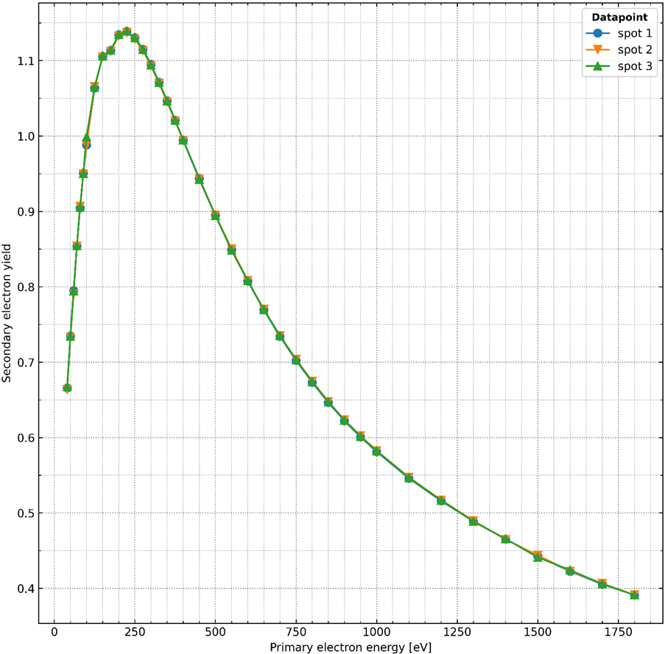
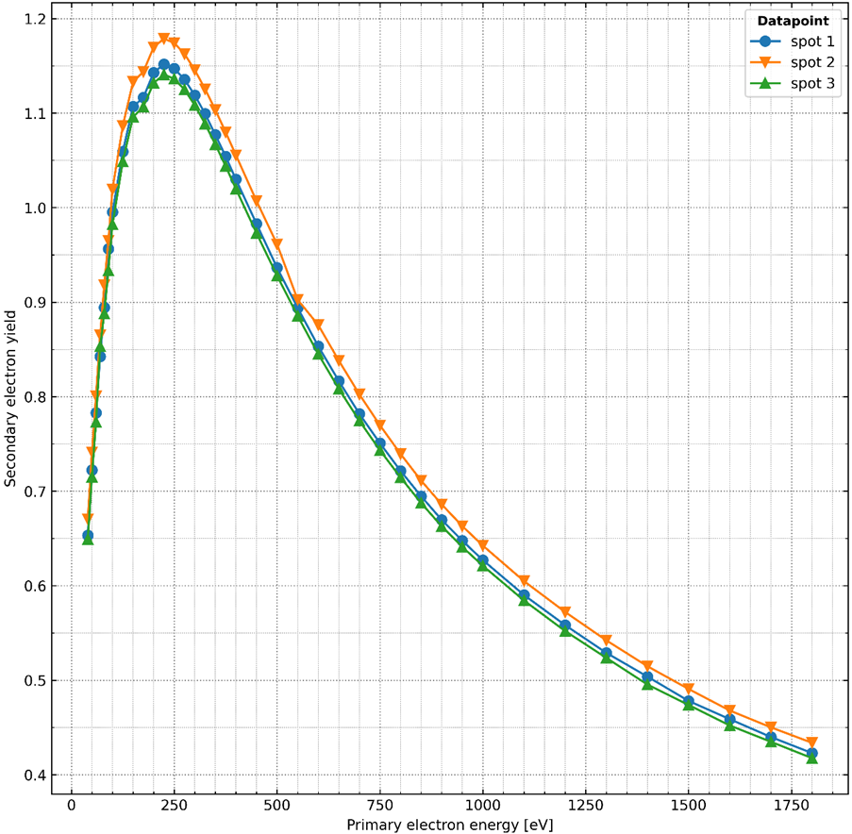



SEY of carbon coatings
100 nm aC
400 nm aC
100 nm Ti/aC
Average ${SEY}_{max}:$ 1.15
Average ${SEY}_{max}:$ 1.14
Average ${SEY}_{max}:$ 1.16
Data from TE-VSC

Slide 35
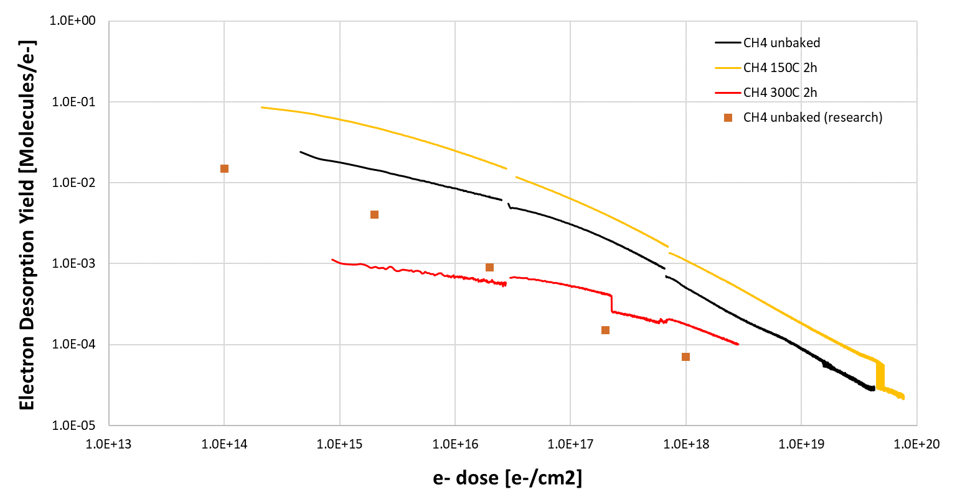
CH4 - OFE copper
Ee = 300eV
Emission settings: 24μA (25 min)
160 μA (1.5h)
650μA (24h)

Slide 36
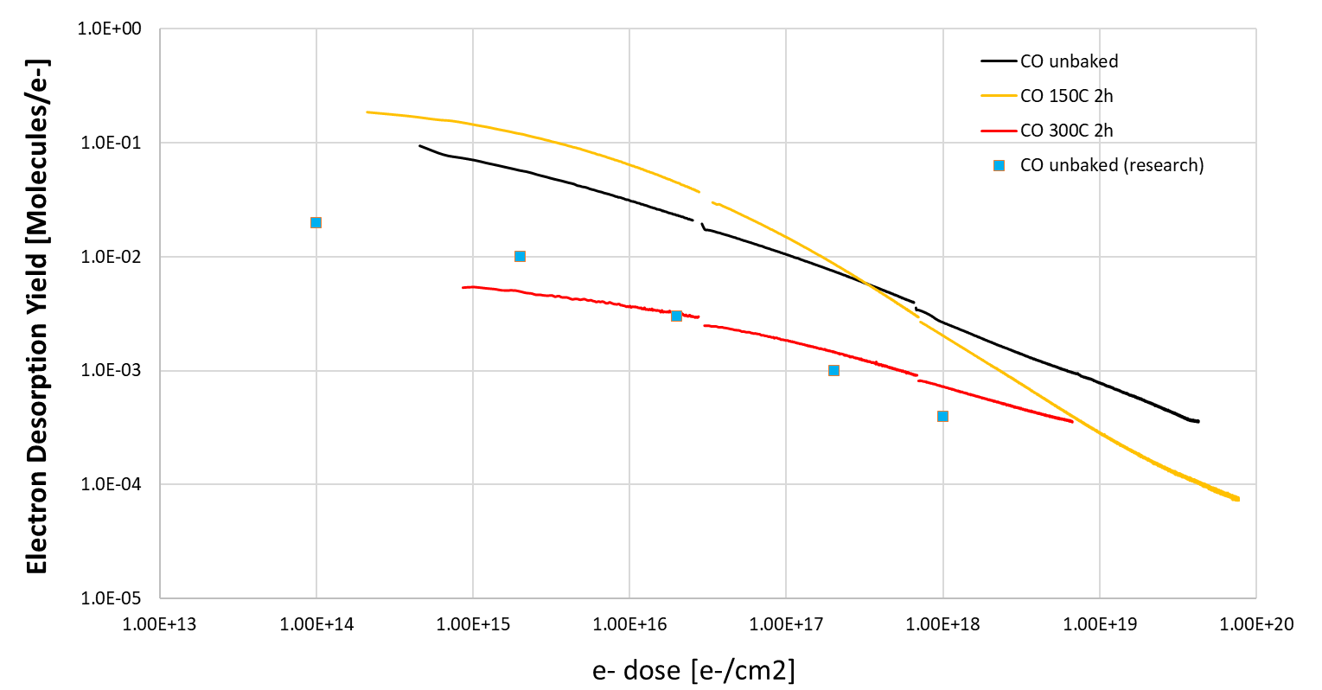
CO - OFE copper
Ee = 300eV
Emission settings: 24μA (25 min)
160 μA (1.5h)
650μA (24h)

Slide 37
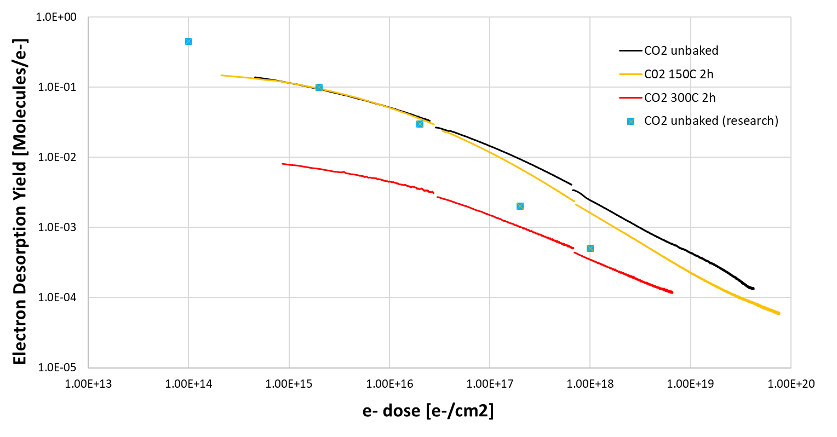
CO2 - OFE copper
Ee = 300eV
Emission settings: 24μA (25 min)
160 μA (1.5h)
650μA (24h)

Slide 38
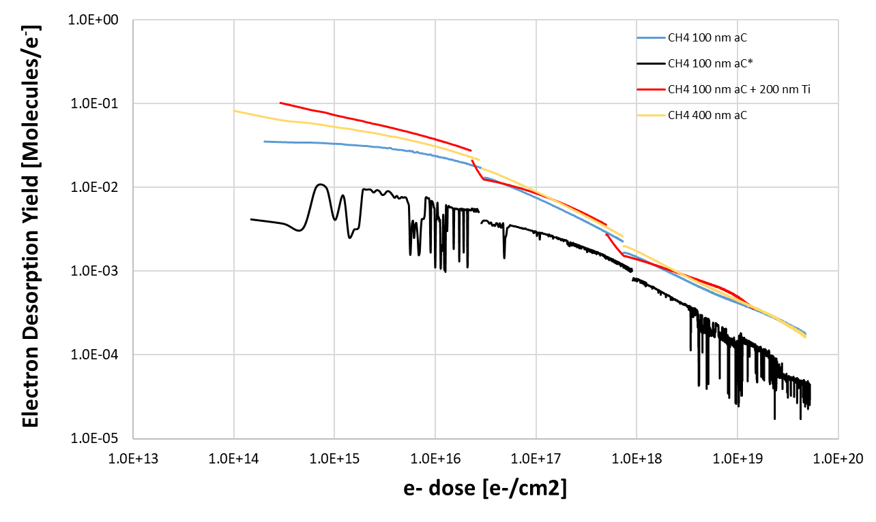
CH4 – aC coatings
Ee = 300eV
Emission settings: 24μA (25 min)
160 μA (1.5h)
650μA (24h)

Slide 39
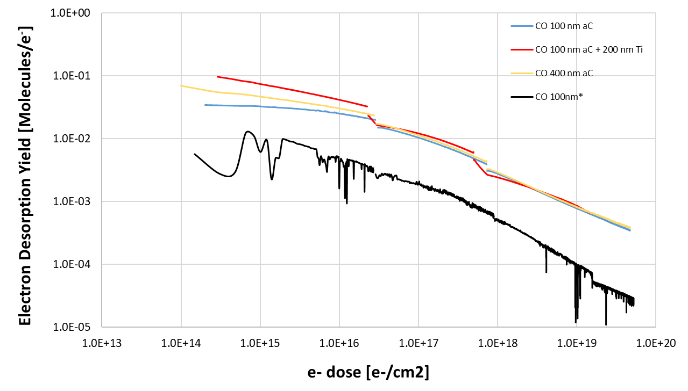
CO – aC coatings
Ee = 300eV
Emission settings: 24μA (25 min)
160 μA (1.5h)
650μA (24h)

Slide 40
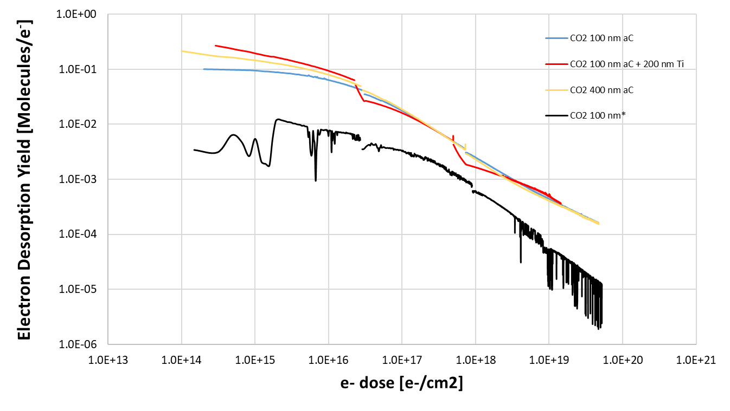
CO2 – aC coatings
Ee = 300eV
Emission settings: 24μA (25 min)
160 μA (1.5h)
650μA (24h)

Slide 41
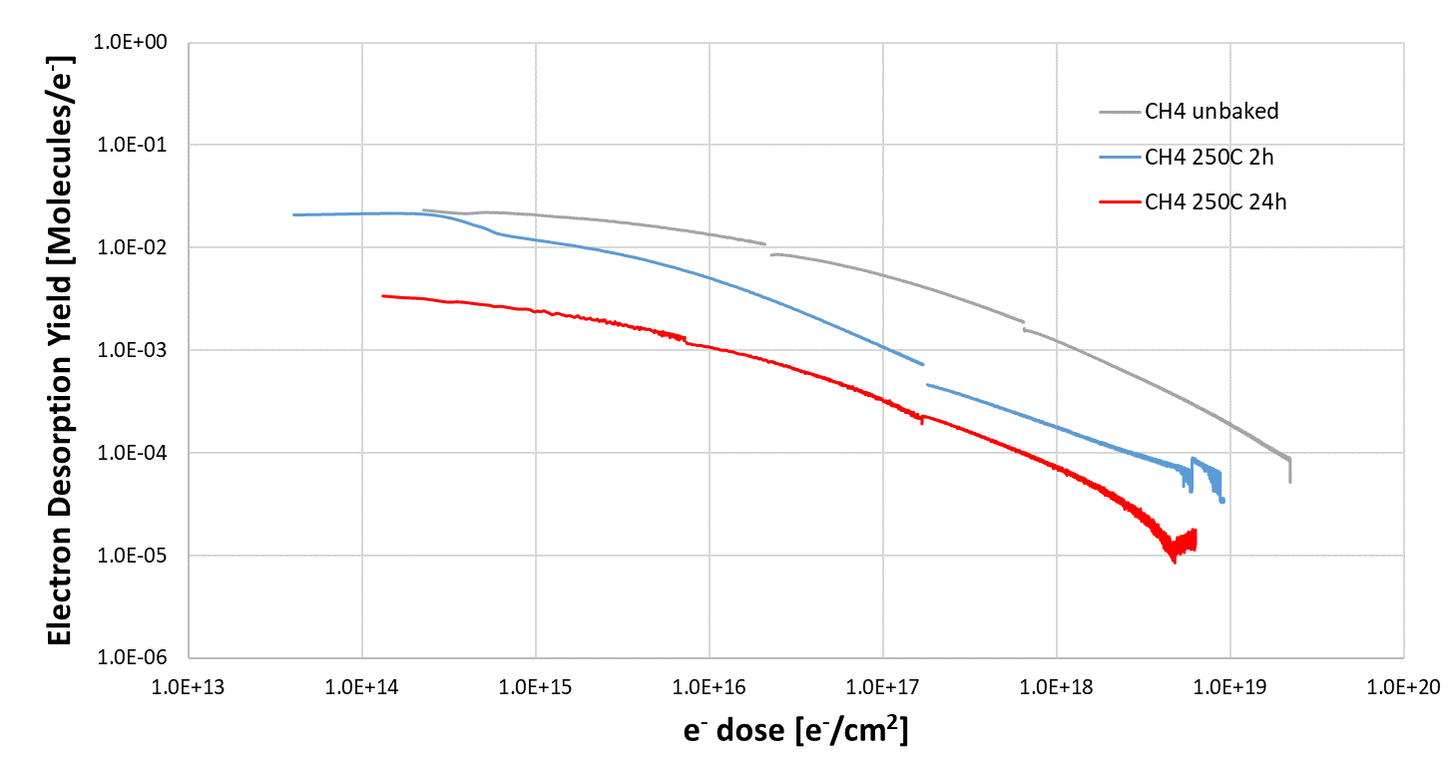
CH4 - Stainless steel
Ee = 300eV
Emission settings: 24μA (25 min)
160 μA (1.5h)
650μA (24h)

Slide 42
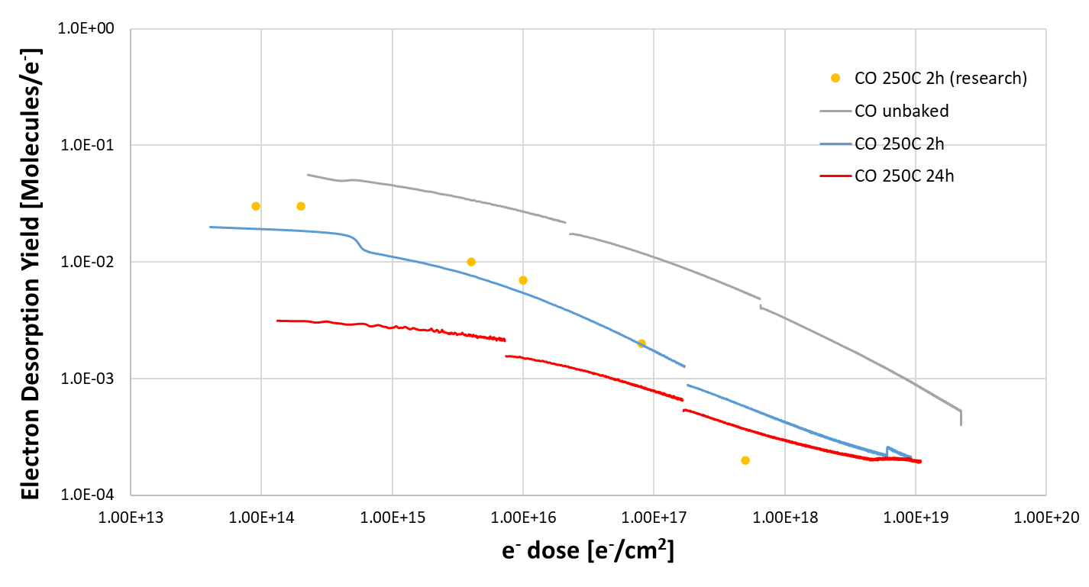
CO - Stainless steel
Ee = 300eV
Emission settings: 24μA (25 min)
160 μA (1.5h)
650μA (24h)

Slide 43
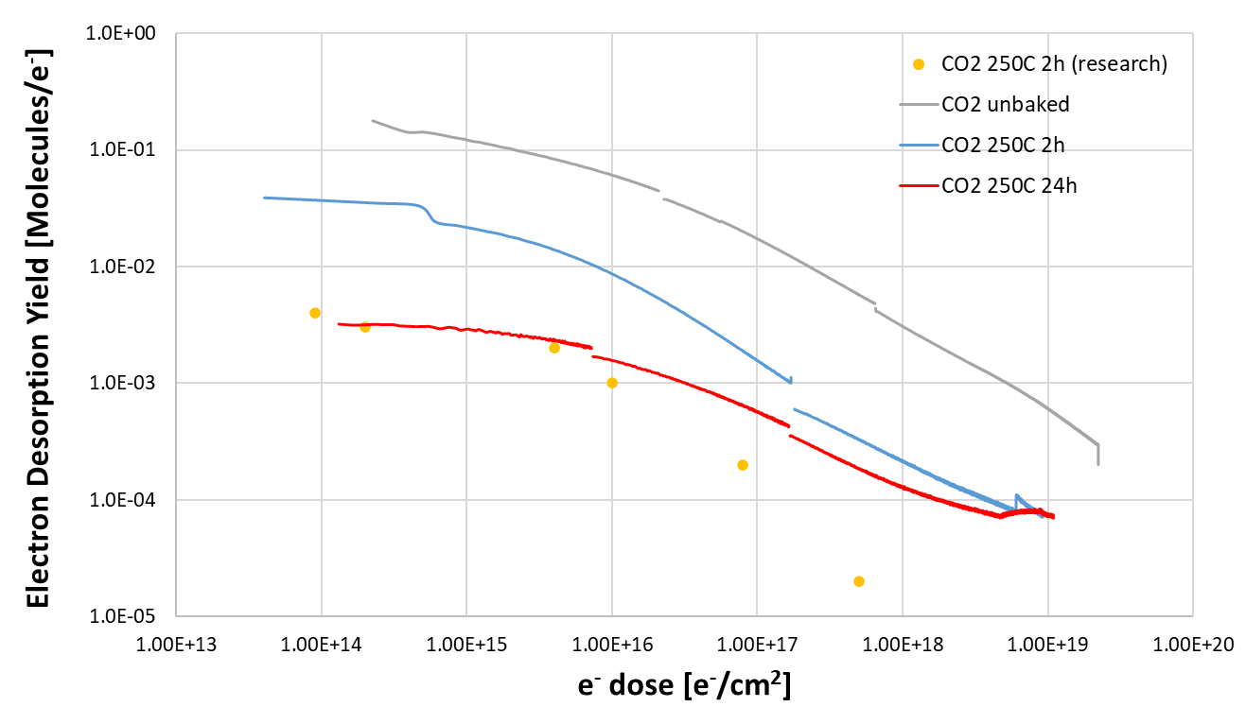
CO2 - Stainless steel
Ee = 300eV
Emission settings: 24μA (25 min)
160 μA (1.5h)
650μA (24h)

Slide 44
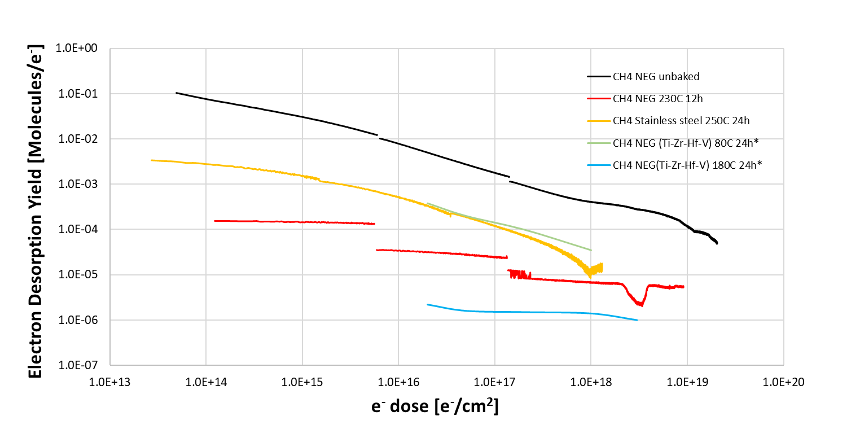
CH4 - NEG
Ee = 300eV
Emission settings: 24μA (25 min)
160 μA (1.5h)
650μA (24h)

Slide 45
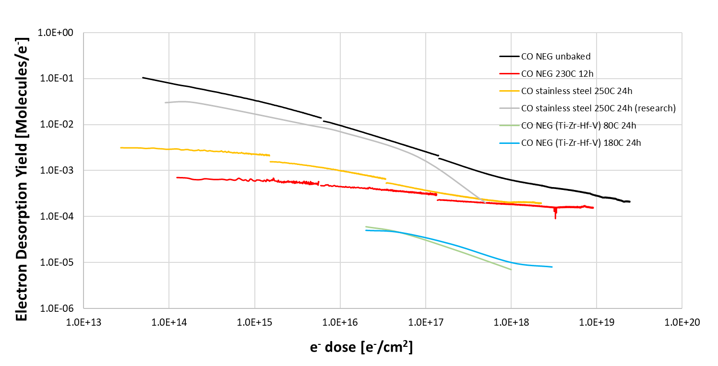
CO - NEG
Ee = 300eV
Emission settings: 24μA (25 min)
160 μA (1.5h)
650μA (24h)

Slide 46
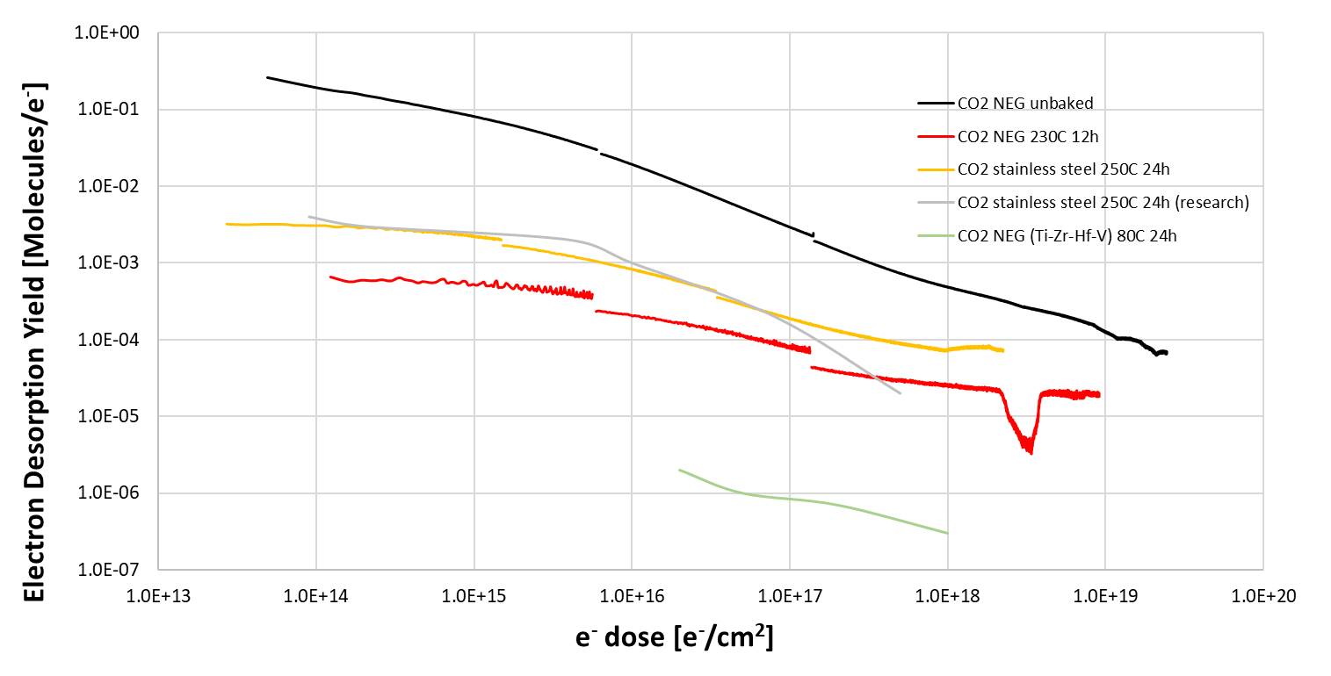
CO2 - NEG
Ee = 300eV
Emission settings: 24μA (25 min)
160 μA (1.5h)
650μA (24h)

Slide 47
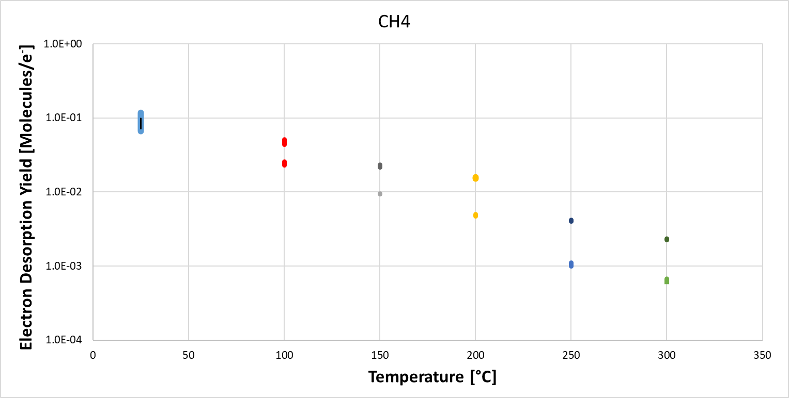
CH4 - NEG
Ee = 300eV
Emission settings: 24μA (60s)

Slide 48
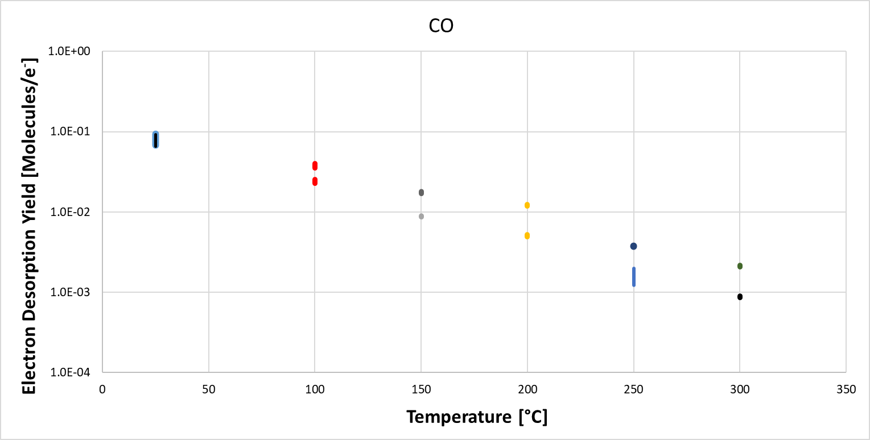
CO - NEG
Ee = 300eV
Emission settings: 24μA (60s)

Slide 49
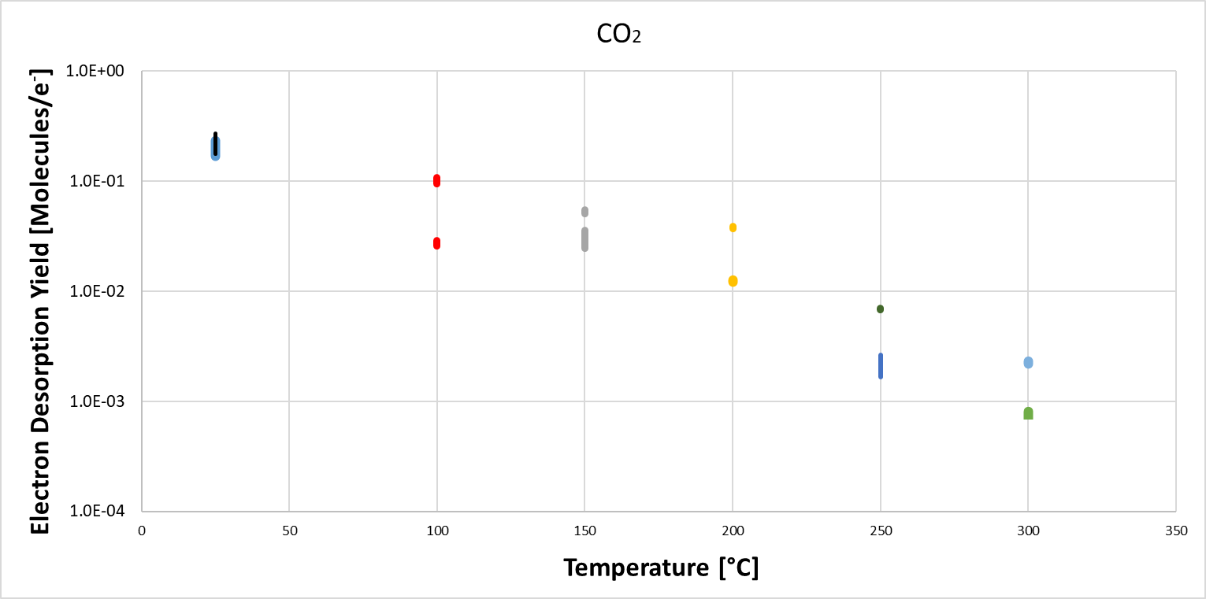
CO2 - NEG
Ee = 300eV
Emission settings: 24μA (60s)

