Slide 1


Accelerator and Research reactor Infrastructures for
Education and Learning
ARIEL
ARIEL Status report for the
Third ARIEL General Assembly
Arnd Junghans,
Helmholtz-Zentrum Dresden-Rossendorf
16. March 2023, NPL Teddington
This project has received funding from the Euratom research and
training programme 2014-2018 under grant agreement No 847594
(ARIEL).
www.ariel-h2020.eu
Notes:
1

Slide 2
General Assembly (GA)
The General Assembly is the ultimate decision-making body of ARIEL. It is composed of the members of the Management Board, together with one representative per partner. The GA meets two times during the project (kick-off meeting and at the second progress meeting). On request of the majority of the members the MB must organise as soon as possible an intermediate GA meeting. The meetings of the GA are chaired by a chairman not belonging to the MB and elected during the kick-off meeting. The scientific Coordinator acts as co-chair of the General Assemblies. On minor issues that do not request the physical presence of the members, the GA may also ‘meet’ by an exchange of e-mails, coordinated by the Chairman.
Tasks
discuss political and strategic orientation related to ARIEL
approve and endorse changes proposed by the MB regarding the Consortium Agreement or structure of the project
admit new beneficiaries
arbitration in case of conflicts

Slide 3
Agenda
Thursday, March 16:
ARIEL Status (A. Junghans)
ARIEL school on Nuclear data measurements
at the Budapest Neutron Center (T. Belgya)
Amendment to the Project: Reorganisation of Schools in WP5 ...
Preparation of the final ARIEL meeting at JCLab Orsay.
Discussion on future collaboration
Euratom Work Programme 2023-2025
A.O.B.

Slide 4
GA members
R. Beyer, HZDR
A. Plompen, JRC
V. Vlachoudis, CERN
E. Gonzalez, CIEMAT
M. Kerveno, CNRS
X. Ledoux, GANIL
C. Varignon, CEA
S. Fiore, ENEA
E. Pirovano, PTB
M. Majerle, UJF
T. Belgya, MTA-EK
H. Penttilä, JYU
T. Sava, IFIN-HH
M. Bunce, NPL
G. Zerovnik, JSI
C. Guerrero, USE
J. Wagemans, SCK*CEN
A. Prokofiev, UU
K. Eberhardt, JGU
S. Siem, UO
G. Pavel, ENEN
J. Praena, UG
M. Kostal, CVR
S. Brandenburg, UMCG
R. Babut, IRSN
Please register on the indico page
to verify the quorum (2/3). 17/25
https://indico.cern.ch/event/1265685/

Slide 5
Management Board
Project Coordinator: Arnd Junghans, HZDR
Scientific Coordinator: Arjan Plompen, JRC
Transnational Access Coordinator: Elisa Pirovano, PTB
Communication Manager: Carlos Guerrero, USE
Training Coordinator: Heikki Penttilä, JYU
Carola Franzen, Roland Beyer, Katja Gröger, HZDR
Management Team

Slide 6
Project Advisory Committee
Daniel Cano-Ott, CIEMAT
Roberto Capote, IAEA
Robert Jacqmin, CEA
Maëlle Kerveno, CNRS
Gert van den Eynde, SCK CEN

Slide 7
Facility status February 2023
AGOR | Jones | 2021-10-25 |  | Cyclotron ready during most of 2022
AIFIRA | Aiche
ALTO | Wilson | 2021-10-01 |  | Fully operational
AMANDE | Babut | 2022-09-16 |  | Technical problem at AMANDE in September. Solved by now?
BNC | Belgya | 2022-03-04 |  | Working on performing experimental backlogs due to the half year long stopped reactor in the 1st half of 2021 caused by pandemic and break down of the cold moderator. Both of them were solved by Autumn 2021. From 7/03 all restrictions due to the pandemic are withdrawn.
CEA-DAM | Marmouget
CVR | Kostal | 2022-03-02 |  | LR-0 and LVR-15 are both in operation
FNG | Fiore | 2021-03-02 |  | FNG fully operational without restrictions
GENESIS | Billeaud | 2022-03-07 |  | Fully operational
HISPANoS | Fernández | 2022-03-03 |  | Fully operational, open for external users.
IFIN-HH | Sava | 2021-02-02 |  | 9 MV Tandem operational
ILL | Köster | 2022-11-11 |  | Reactor cycle in 2023 ends on 12/10/2023
JGU Mainz | Geppert
JRC | Plompen | 2021-10-25 |  | Fully operational, external users allowed on site
JYFL | Penttilä | 2021-02-24 |  | Fully operational.
n_TOF | Vlachoudis | 2022-09-30 |  | Operation of the accelerator complex will be reduced by 20% in 2023.
nELBE | Beyer | 2022-11-09 |  | Normal operation.
NESSA | Pomp | 2022-09-16 |  | Neutron generator not delivered.
NFS | Ledoux | 2022-03-02 |  | Operational
NPL | Bunce | 2021-02-02 |  | Operational, standard Covid precautions for external users
PIAF | Pirovano | 2022-04-25 |  | Downtime of CV28 cyclotron from 2022-05 until 2022-12.
SCK-CEN | Wagemans | 2022-03-02 |  | BR1 is operational. Shutdown of several months expected end 2023.
U. Oslo | Siem
UJF | Majerle | 2021-10-27 |  | Neutron generators operating, access possible with standard Covid precautions, TR24 cyclotron presently not available (downtime 6 months)
Most facilities are operational.
CERN will reduced accelerator operation by 20 % in 2023
GELINA reduced operation by 30 % in 2023
ILL reactor cycle stops 23.10.2023

Slide 8
Transnational Acess to Neutron beam facilities
Status: 25 Experiments have been endorsed with 2739 beam time hours
Number of experiments endorsed in each PAC: (number of proposals)
PAC1: 5 (8) , PAC2: 3 (4), PAC3: 3 (4), PAC4: 4 (5), PAC5: 2 (6), PAC6: 8 (9)
Completed (March 2023) are:
10 experiments with 1386 beam time hours delivered.
ARIEL goal: 3000 hours in 30 typical experiments
support of 4 users per experiment for 7 days

Slide 9
PAC | Title | Spokesperson | Institute | Facility | Contact | Approved hours | Delivered hours | Status
TAA_1_1 | Measurement of the (n,2n) reaction cross section for the 136Ce and 156Dy isotopes | Nikolaos Patronis | U of Ioannina | PTB | Ralf Nolte | 0 |  | rejected
TAA_1_2 | Response matrix of stilbene and new detection materials | Michal Kostal | CVR Rez | PTB | Ralf Nolte | 64 | 60 | completed
TAA_1_3 | SCALP(CF4) @ nELBE | Francois René Le Colley(Gregory Lehaut) | LPC Caen | nELBE | Roland Beyer | 168 | 360 | completed
TAA_1_4 | Characterization of the neutron response function of a C7LYC scintillator crystal for fusion plasma applications | Massimo Nocente | U of Milano-Biococca | HISPANOS | Carlos Guerrero | 60 | 60 | completed
TAA_1_5 | Activation of a Sb-Be monoenergetic neutron source via thermal neutron irradiation | Guiseppe Lorusso (Alberto Boso) | NPL | CVR | Michal Kostal | 1 |  | New PI.
TAA_1_6 | Response function and calibration of a compact fast neutron spectrometer using a stilbene crystal | Alix Sardet | CEA | PTB | Ralf Nolte | 90 | 116 | Completed
TAA_1_7 | Shape coexistence studies in 98Zr via beta decay of 98Y | Vasil Karayonchev | U Köln | ILL | Ulli Köster | 0 |  | rejected
TAA_1_8 | Test of the U n(6(12) x U p(6/4) supersymmetry in ¹⁹³Os | Jean-Marc Régis | U Köln | ILL | Caterina Michelagnoli | 0 |  | rejected
TAA_2_1 | Measurement of the 7Li(p,n)7Be Neutron-Energy spectrum at Proton Energies of 2.5-3.5 MeV | Moshe Friedman | Hebrew Univ. | HISPANOS | Begoña Fernandes | 0 |  | rejected
TAA_2_2 | Proton inelastic scattering cross sections on 40Ca | Greg Henning | IPHC Strasbourg | IFIN-HH | Tiberiu Sava | 168 | 168 | Completed
TAA_2_3 | Isomeric yield ratios and fission fragment angular momentum in alpha-induced fission of 232Th | Stephan Pomp | Uppsala Univ. | JYU | Heikki Penttilä | 104 |  | March 2023
TAA_2_4 | Photoactivation of accelerator beamline and beamdump materials | Markus Nyman | JRC Geel | ELBE | Arnd Junghans | 100 |  | HZDR SAC not accepted

Slide 10
PAC | Title | Spokesperson | Institute | Facility | Contact | Approved hours | Delivered hours | Status
TAA_3_1 | Microscopic investigation of neutron interactions in semiconductor materials in a broad energy range by means of Timepix3 hybrid pixel detectors | Benedikt Bergmann | IEAP CTU | n_TOF | E. Chiaveri | 0 |  | not resubmitted
TAA_3_2 | LIONS light ion production studies with Medley at NFS facility | Alexander Prokofiev | Uppsala Univ. | NFS | Xavier Ledoux | 136 | 136 | Completed
TAA_3_3 | Calibration of new fiber-mounted scintillation neutron detectors in a well characterized neutron flux for measuring the scalar flux and its gradient | Imre Pazsit | Chalmers Inst. Tech. | BR1 SCK CEN | Jan Wagemans | 24 | 24 | Completed
TAA_3_4 | Investigation of the plasma delay time effect in PIPS detectors for the development of the VERDI fission spectrometer | Ali Al-Adili | Uppsala Univ. | ILL | Ulli Koester | 0 | 196 | Completed
TAA_4_1 | Measurement of the fission cross-section of ²⁴³Am at EAR-1 of the CERN n TOF facility | Nikolas Patronis | Univ. of Ioannina | n_TOF | A. Mengoni | 100 |  | delayed 2023
TAA_4_2 | Measurement of the fission cross section of ²⁴³Am at EAR-2 of the CERN nTOF facility | Rosa Vlastou-Zanni | NTUA | n_TOF | A. Mengoni | 100 |  | delayed 2023
TAA_4_3 | Neutron induced cross section measurements on Ge isotopes at the AMANDE facility | Maria Diakaki | NTUA | AMANDE | R. Babut | 25 |  | February 2023, awaiting reports
TAA_4_4 | HPGe detector test at nTOF: Feasibility study for neutron inelastic scattering measurements | Michael Kokkoris | NTUA | n_TOF | A. Mengoni | 0 |  | rejected
TAA_4_5 | 238U nuclear structure study with v-Ball 2 for nuclear energy application | Sorin Pascu (Matthias Rudigier) | U of Surrey (TU Darmstadt) | ALTO | J. Wilson | 125 | 168 | 27.06.- 17.07.2022 + Oct 2022 completed

Slide 11
PAC | Title | Spokesperson | Institute | Facility | Contact | Approved hours | Delivered hours | Status
TAA_5_1 | Neutron transmission experiments on stainless steel nuclear data at GELINA | Thomas Ligonnet | LRS EPFL | GELINA | A. Plompen | 0 | 0 | resubmission received
TAA_5_2 | Measurement of the delayed neutron yield and group constants in the fast neutron induced fission of 238U | Pierre Leconte | CEA | PTB | E. Pirovano | 98 | 0 | completed
TAA_5_3 | Characterisation of the response of neutron detectors from the experimental campaign investigating laser-driven neutron sources | Christian Rödel | TU Darmstadt | HISPANOS | B. Fernandez | 0 | 0 | rejected
TAA_5_4 | Validation of Boag’s model of columnar recombination with fission fragments | Kevin Irazoqui | CEA | SCK-CEN | J. Wagemans | 70 | 0 | approved planned March 2023
TAA_5_5 | Feasibility of the (n,2n) reaction measurement at the CNA/HISPANOS facility, and study of 225Ac production via the 226Ra(n,2n)225Ra(beta-)225Ac reaction | Sotiris Ioannidis | NPL | HISPANOS | B. Fernandez | 0 | 0 | withdrawn with resubmission announced
TAA_5_6 | Determination of light output and response matrixes for new liquid scintillators perspective for large volume scintillator detectors | Zdenek Matej | CVR | PTB | E. Pirovano | 0 | 0 | rejected

Slide 12
PAC | Title | Spokesperson | Institute | Facility | Contact | Approved hours | Status
TAA_6_1 | Correlation of Neutron Effects in electronics to Laser-based SEU/SEL | Caterina Soldano | Aalto University | HISPANOS | Carlos Guerrero | 50 | April/May 2023
TAA_6_2 | Neutron and photon yields for the 51V(p,n)51Cr reaction near threshold | Javier Praena | Univ. Granada | JRC MONNET | Miguel Macias Martinez | 240 | October 2023
TAA_6_4 | GRAPE: Neutron transmission experiments at GELINA for stainless steel nuclear data | Thomas Ligonnet | LRS EPFL Lausanne | JRC GELINA | Arjan Plompen | 78 | 2024 (?)
TAA_6_5 | Characterization of the new annular n_TOF double-sides silicon strip detector at ILL LOHENGRIN spectrometer | Nikolas Patronis | Univ. Ioannina | ILL | Ulli Köster | 96 | June/September 2023
TAA_6_6 | Proton inelastic scattering cross section on 56Fe | Greg Henning | IPHC Strasbourg | IFIN-HH | Tiberiu Sava | 168 | Feb-Oct 2023
TAA_6_7 | Radiative capture study of silver g-decay spectra using gg-coincidences | David Knežević | Institute of Physics Belgrade | MTA EK Budapest | László Szentmiklósi | 288 | 05.06.2023
TAA_6_8 | Development of a 90 keV maxwellian neutron spectrum and measurement of the 30 and 90 keV 50Cr MACS for criticality safety | Adrià Casanovas | CERN | HISPANOS | Carlos Guerrero | 50 | 06.03.2023-10.03.2023
TAA_6_9 | Completion of 235U(nth,f) mass yield measurement in the framework of fission product yield evaluations | Maria Diakaki | NTUA | ILL | Ulli Köster | 336 | April 2023

Slide 13
Education and Training
Education and training activities (March 2023):
26 scientific visits have been approved with 227 weeks
19 involving early stage researchers or technical staff
PAC1: 6, PAC2: 8, PAC3: 1, PAC4: 1, PAC5: 9, PAC 6: 3
(2 proposals were canceled)
13 visits completed with 129 weeks
ARIEL goal: 30 scientific visits of 8 weeks typical length

Slide 14
PAC | Title | Visitor | Facility | Contact | Requested weeks | Approved weeks | Status
SV_1_1 | OPEN-CL framework for Digitizer FPGA signal processing. | Miguel Astrain Etxezarreta | HZDR | Andreas Wagner | 25 | 25 | Completed
SV_1_2 | VERDI “2E-2v” state-of-the-art time-of-flight (TOF) spectrometer | Ana Maria Gomez Londoño | JRC-Geel | Stephan Oberstedt | 12 | 12 | Completed
SV_1_3 | VERDI “2E-2v” state-of-the-art time-of-flight (TOF) spectrometer | Diego Tarrio | JRC-Geel | Stephan Oberstedt | 4 | 4 | request for SV_5_2
SV_1_4 | VERDI “2E-2v” state-of-the-art time-of-flight (TOF) spectrometer | Ali Al-Adili | JRC-Geel | Stephan Oberstedt | 4 | 4 | Completed
SV_1_5 | Target making methods and technologies | Jukka Jaatinen | JGU Mainz | Klaus Eberhardt | 2 | 2 | postponed 2023
SV_1_6 | Activation measurements for laser particle acceleration | Juan Peñas | HZDR | Arnd Junghans | 4 | 4 | Summer 2023
SV_2_1 | Exploring fine structures in the prompt fission neutron (PFN) angular distribution with respect to the fission axis for the reaction 235U(nth,f) | Nicolae Carjan | JRC Geel | Stephan Oberstedt | 12 | 6 | Completed
SV_2_2 | Data analysis for time-of- flight transmission and capture measurements at GELINA and n_TOF | Andrea Oprea | JRC-Geel | Peter Schillebeeckx | 12 | 8 | Completed
SV_2_3 | Sensitivity analyses of PIEs and decay heat measurements of spent nuclear fuels to nuclear cross- sections and fission yields | Ahmed Shama | JRC-Geel | Peter Schillebeeckx | 12 | 0 | canceled
SV_2_4 | Two-step gamma cascade method for obtaining nuclear data | David Knezevic | MTA, Budapest | László Szentmiklósi | 3 | 3 | Completed
SV_2_5 | MC Simulations of a recoil proton telescope | Quentin Ducasse | PTB, Braunschweig | Elisa Pirovano | 3 | 3 | Completed
SV_2_6 | Gd transmission and preparation of Mo cross section measurement | Riccardo Mucciola | JRC Geel | Peter Schillebeeckx | 12 | 9 | Completed
SV_2_7 | Heuristic prediction of nuclear observables/properties | Eckart Grosse | IPN Orsay | Jon Wilson | 4 | 4
SV_2_8 | Assessment of the feasibility for measuring neutron induced reactions at a laser-driven neutron beam | María Ángeles Millán Callado | HZDR | Arnd Junghans | 12 | 11 | Completed

Slide 15
PAC | Title | Visitor | Facility | Contact | Requested weeks | Approved weeks | Status
SV_3_1 | Neutron capture on 50Cr and 53Cr for criticality safety at n_TOF | Pablo Perez Maroto | n_TOF(CERN) | Alberto Mengoni | 12 | 12 | Completed
SV_4_1 | Measurement of the α-ratio and (n,g) cross section of 239Pu at n_TOF | Adrian Sánchez Caballero | n_TOF(CERN) | Alberto Mengoni | 12 | 12 | Completed
SV_5_1 | Time-of-Flight transmission measurements and data analysis on natural iron at the GELINA facility | Georgios Gkatis | JRC-Geel | Peter Schillebeeckx | 12 | 12 | completed
SV_5_2 | Employing VERDI to investigate nuclear fission | Ana Maria Gomez Londoño | JRC-Geel | Stephan Oberstedt | 12 | 12 | Spring 2023
SV_5_3 | Characterisation of spectroscopic ²⁴⁸Cm targets and measurement of prompt gamma-ray spectra from ²⁴⁸Cm(sf) | Andreas Oberstedt | JRC-Geel | Stephan Oberstedt | 10 | 8 | March 6 – May 14, 2023
SV_5_4 | Exploring fine structures in the prompt fission neutron (PFN) angular distribution with respect to the fission axis for the reaction 235 U(n th ,f) (continuation) | Nicolae Carjan | JRC-Geel | Stephan Oberstedt | 12 | 8 | Spring 2023
SV_5_5 | Optimization and intercomparison of the chopper+buncher systems at CNA-HISPANOS and JRC-Geel-MONNET | David Pascual | JRC-Geel | Stephan Oberstedt | 2 | 2 | spring 2023
SV_5_6 | Preparation of the 243Am(n,f) cross section measurements with Micromegas detectors at the CERN n_TOF facility | Nikolaos Kyritsis | nTOF(CERN) | Alberto Mengoni | 12 | 12 | completed
SV_5_7 | Direct measurement of the n_TOF NEAR time of flight neutron fluence with diamond detectors | Kalliope Kaperoni | nTOF(CERN) | Alberto Mengoni | 12 | 12 | First part completed, second in spring 2023
SV_5_8 | 235U(n,f) cross section relative to the 10B(n,α) reaction with Micromegas detectors at the CERN n_TOF facility | Veatriki Michalopoulou | nTOF(CERN) | Alberto Mengoni | 6 | 6 | started October 2022 /separate split visits requested
SV_5_9 | Employing VERDI to investigate nuclear fission | Ali Al-Adili | JRC-Geel | Stephan Oberstedt | 4 | 4 | spring 2023

Slide 16
PAC | Title | Visitor | Facility | Contact | Requested weeks | Approved weeks | Status
SV_6_1 | Neutron and photon yields for the 51V(p,n)51Cr reaction near threshold | Antònia Verdera Garau | JRC-Geel | Miguel Macias Martinez | 12 | 12 | plan May-July 2023
SV_6_2 | Neutron capture measurements at n_TOF/NEAR | Zinovia Eleme | CERN | Alberto Mengoni | 12 | 12 | March-May 2023
SV_6_3 | Development of the new annular double-sided silicon detector at CERN n_TOF facility | Styliani Goula | CERN | Alberto Mengoni | 12 | 12 | September-November 2023

Slide 17
Share of proposals
Facility | Proposals accepted | Proposals not accepted |  | Education and Training activities
AGOR (Groningen)
AIFIRA (Bordeaux)
ALTO (Orsay) | 1 |  |  | (1)
AMANDE (Cadarache) | 1
BNC (Budapest) | 1 |  |  | 1
CEA-DAM (Arpajon)
CVR (Rez) | 1
FNG (Frascati)
GENESIS (Grenoble)
HISPANoS (Seville) | 3 | 3
IFIN-HH (Bucarest) | 2
ILL (Grenoble) | 3 | 2
JGU (Mainz) |  |  |  | 1
JRC (Geel) | 2 | 1 |  | 13
JYFL (Jyväskylä) | 1
n_TOF (Geneva) | 2 | 2 |  | 7
nELBE (Dresden) | 1 | 1 |  | 3
NESSA (Uppsala)
NFS (Caen) | 1
NPL (Teddington)
PIAF (Braunschweig) | 3 | 2 |  | 1
SCK-CEN (Mol) | 2
U. Oslo
UJF (Rez)
Status: March 2023

Slide 18
Performance indicators (status March 2023)
The 10 completed experiments involved 62 users from 11 countries, including 29 early stage researchers and 36 first time users at the respective facilities.
Early stage researchers from Czech Rep.(1), Finland (1), France (10), Germany (5), Greece(1), Italy(4), Norway (4), Poland (3), Romania (2), Spain (4), Sweden (6) and the United Kingdom (1) conducted experiments or took part in education and training activities.
Notes:
Numbers are based on 10 *completed* experiments and 11 *completed* education and training visits.
The typical supported number of users per experiment is 4.
(There are more users, as some experiments involved users that where not supported by ARIEL,
but took part in the project)

Slide 19
ARIEL project performance indicators
ARIEL has been extended by 6 months: project duration: 54 months
March 2023 (month 43): endorsed beam time hours: 2739
10 completed experiments of 25 endorsed experiments
1386 beam time hours delivered
participants of experiments: 62, early stage researchers: 29+10
Average user satisfaction score: 1,2
number of deliverables: 17

Slide 20
ARIEL milestones
OK
OK
OK
OK
Ongoing
Amendment !

Slide 21
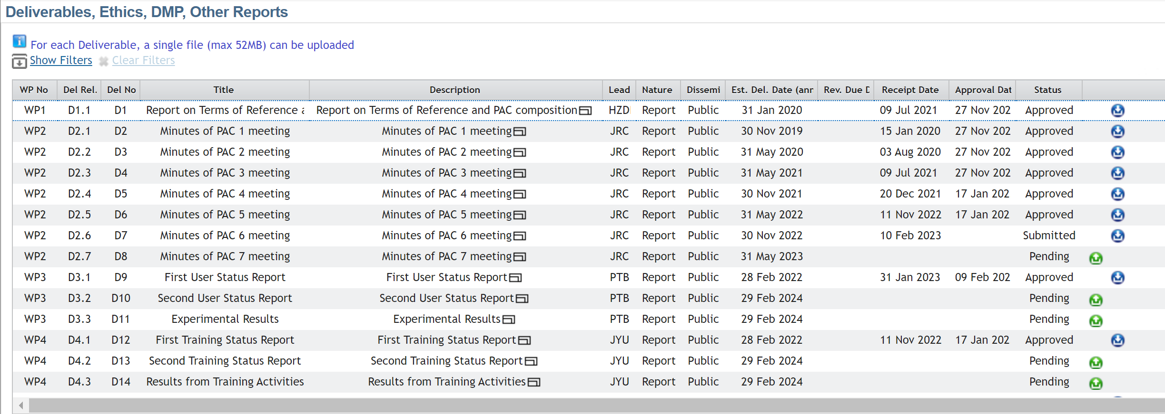
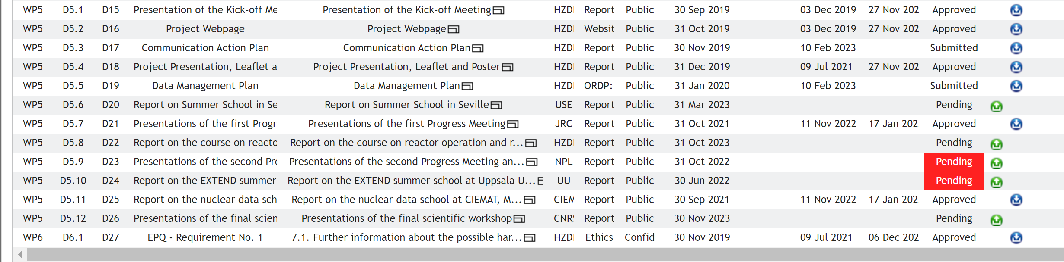
ARIEL deliverables

Slide 22
ARIEL support for PhD theses
Project | Name | University | Project | Name | University
TAA_1_2 | Tomas Czakoj | Rez | TAA_5_4 | Kevin Irazoqui | Cadarache
TAA_1_3 | Aurélien Chevalier | Caen | TAA_6_2,SV_6_1 | Antònia Verdera | Granada
TAA_1_4 | Oscar Putignano | Milano | TAA_6_4 | Thomas Ligonnet | Lausanne
TAA_1_5 | Matt Birch | Teddington | TAA_6_5, SV_6_3 | Styliani Goula | Ioannina
TAA_1_6 | Augusto Di Chicco | Cadarache | TAA_6_7, SV_2_4 | David Knežević | Belgrade
TAA_2_2 | Francois Claeys | Strasbourg | SV_1_1 | Miguel Astrain Etxezarreta | Madrid
TAA_2_3 | Zhihao Gao | Uppsala | SV_1_3 | Adrian Bembibre | Santiago de Compostela
TAA_3_3 | Moad Al-dbissi | Chalmers | SV_2_6 | Riccardo Mucciola | Perugia
TAA_3_4,SV_1_2, SV_5_2 | Ana Maria Gomez | Uppsala | SV_2_8 | María Ángeles Millán Callado | Sevilla
TAA_4_1, TAA_4_2, TAA_6_8 | Maria-Elisso Stamati | Ioannina | SV_3_1 | Pablo Perez Maroto | Sevilla
TAA_4_3 | Sotirios Chasapoglou | Athens | SV_4_1 | Adrian Sánchez Caballero | Madrid
TAA_4_5 | Martin von Tresckov | Darmstadt | SV_5_6 | Νikolaos Kyritsis | Athens
TAA_5_2 | DorIan Belverge | Cadarache | SV_5_7 | Kalliope Kaperoni | Athens
Theses work supported for 26 PhD students.

Slide 23
Scientific meetings
Joint ARIEL / SANDA meeting 07.03.-11.03.2022.
Virtual meeting
https://agenda.ciemat.es/event/3827/
15.-16.03.2023
Second ARIEL progress meeting and scientific workshop
NPL, Teddington
https://indico.cern.ch/event/1242540/
January 2024 (TBC)
Final meeting IPN Orsay

Slide 24
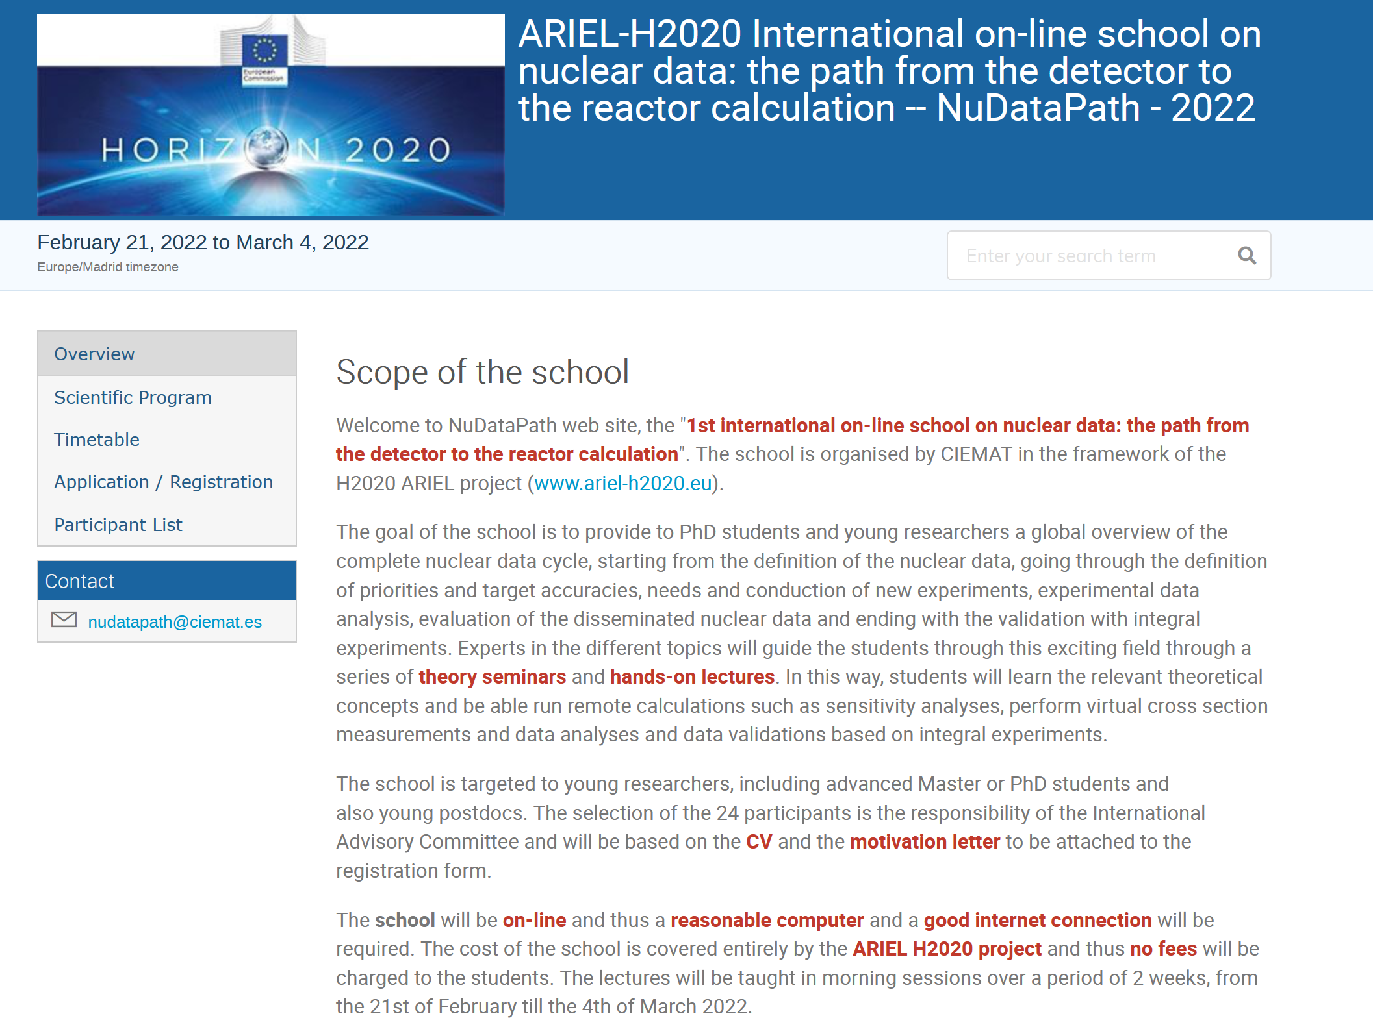
Summer schools
Dedicated new online courses in small supervised groups. 24 participating students
https://agenda.ciemat.es/event/3201/

Slide 25
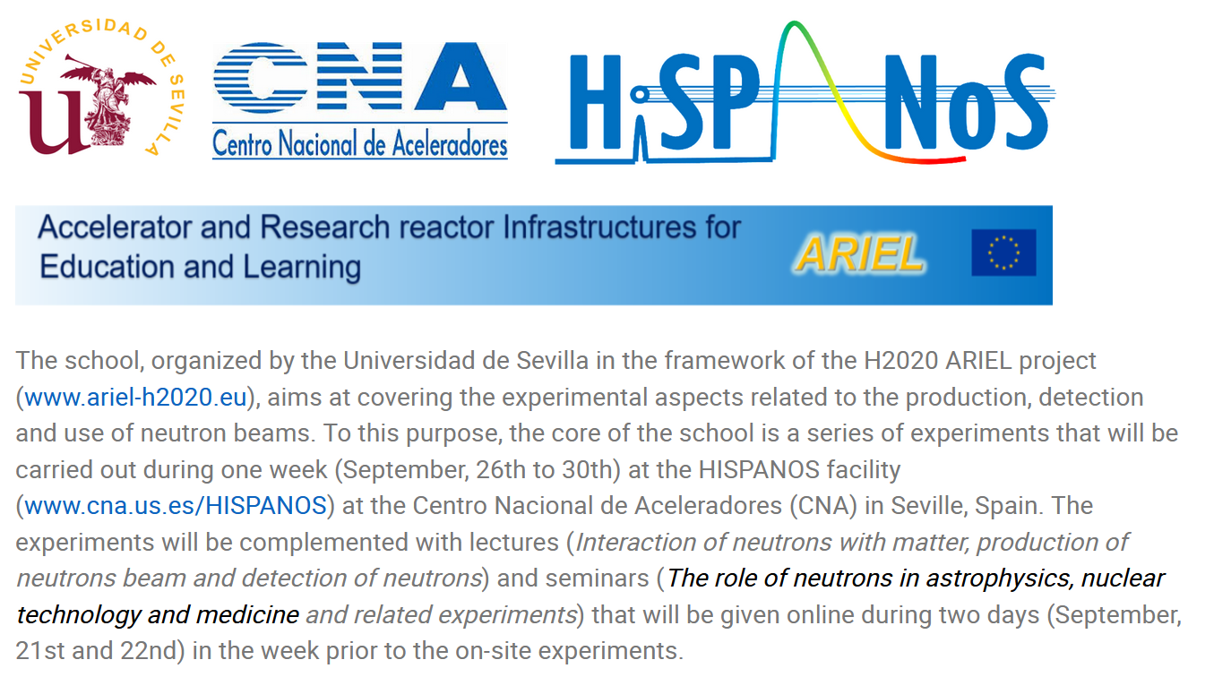
Summer schools
The “[H2020-ARIEL] "HISPANOS Hands-On school on the production, detection and use of neutron beams“ took place from September 21 – September 30, 2022 with 24 students.
The school website describes the scientific program https://indico.cern.ch/event/865322/
Notes:
Summer schools will have up to 80 participants to attract new students to the field.
Organisation will be done by the hosting institutes with advise and help from the PAC and ENEN
25

Slide 26
Summer schools
Lab course in Reactor Operation and Nuclear Chemistry, University of Mainz (10 participants)
November 2023
EXTEND’2023 summer school at Uppsala University
NESSA neutron generator cannot be delivered.
Change of ARIEL description of work:
Budapest Neutron Centre will organize an ARIEL school
➔ Presentation by Tamás Belgya
Notes:
Summer schools will have up to 80 participants to attract new students to the field.
Organisation will be done by the hosting institutes with advise and help from the PAC and ENEN
26

Slide 27
Publications with ARIEL support
Sebastian Urlass, Arnd Junghans, Federica Mingrone, Paul Peronnard, Daniel Stach, Laurent Tassan-Got, David Weinberger, The n_TOF Collaboration,
Nuclear Inst. and Methods in Physics Research, A 1002 (2021) 165297
Gómez-Camacho, J., García López, J., Guerrero, C. et al. Research facilities and highlights at the Centro Nacional de Aceleradores (CNA).
Eur. Phys. J. Plus 136, 273 (2021).
X. Ledoux, J. C. Foy, J. E. Ducret, A. M. Frelin, D. Ramos, J. Mrazek, E. Simeckova, R. Behal, L. Caceres, V. Glagolev, B. Jacquot, A. Lemasson, J. Pancin, J. Piot, C. Stodel, M. Vandebrouck, First beams at neutrons for science, Eur. Phys. J. A (2021) 57:257
Aleš Jančář, Jiří Čulen, Filip Mravec, Michal Košťál, Daniel Dlhopolček, Elisa Pirovano, Ralf Nolte, František Cvachovec, Václav Přenosil, Zdeněk Matěj, Tests of Various Scintillator Detectors in Selected Mono-Energetic Neutron Beams, ANIMMA 2021, EPJ Web of Conferences 253, 07007 (2021)
Jaroslav Jánský , Jiřı́ Janda , Zdeněk Matěj , Filip Mravec , Michal Košťál ,
František Cvachovec, Measurement and simulation of the new liquid organic scintillator response to fast neutrons, ANIMMA2021,
EPJ Web of Conferences 253, 11006 (2021)
Carola Franzen, Arnd R. Junghans, Enrique M. Gonzalez, and Arjan J. M. Plompen, ARIEL & SANDA nuclear data activities,
EPJ Nuclear Sci. Technol. 8, 19 (2022)
E. Grosse, A.R. Junghans, Broken axial symmetry as essential feature for a consistent modelling of various observables in heavy nuclei,
Phys. Lett. B 833 (2022) 137328
Augusto Di Chicco, Alix Sardet, Michaël Petit, Robert Jacqmin, Vincent Gressier,
Brian Stout, Gamma-response characterization of a solution-grown stilbene based detector assembly in the 59 keV–4.44 MeV energy range; an alternative low-resolution gamma spectrometer, Nuclear Instruments and Methods in Physics Research A 1034 (2022) 166740
R. Mucciola, C. Paradela, G. Alaerts, S. Kopecky, C. Massimi, A. Moens,
P. Schillebeeckx, R. Wynants, Evaluation of resonance parameters for neutron interactions with
Molybdenum, Nuclear Instruments and Methods in Physics Research B 531 (2022) 100–108

Slide 28
Summary and ARIEL FINAL CALL 24.03.2023
The COVID pandemic has led to some delays e.g. in planned schools
and experimental schedules. About 50% of the experiments and education and
training activities are scheduled for this year and need to be completed
(surprising remains: home office, zoom meetings)
ARIEL final closing date for experiments and scientific visits:
March 24, 2023
Remaining budget:
Experiment user support : 94000 EUR
Facility support: 166200 EUR
Education and training: 30000 EUR
Please announce the ARIEL call and promote proposals for your facilities
Schools in Budapest and Mainz: promote applications of your students
FINAL ARIEL meeting organized by JCLAB Orsay: January 17-19, 2024
www.ariel-h2020.eu

Slide 29
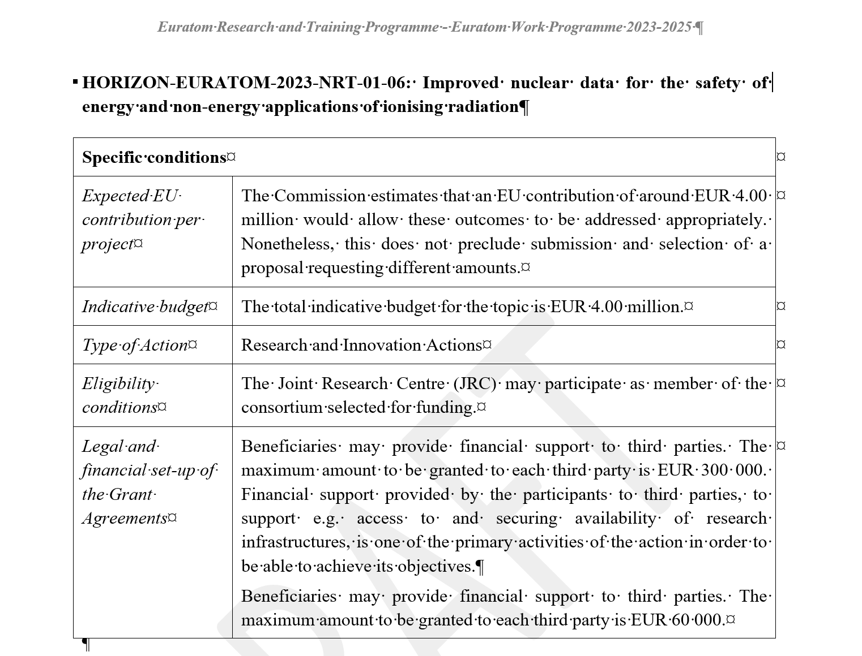

Slide 30
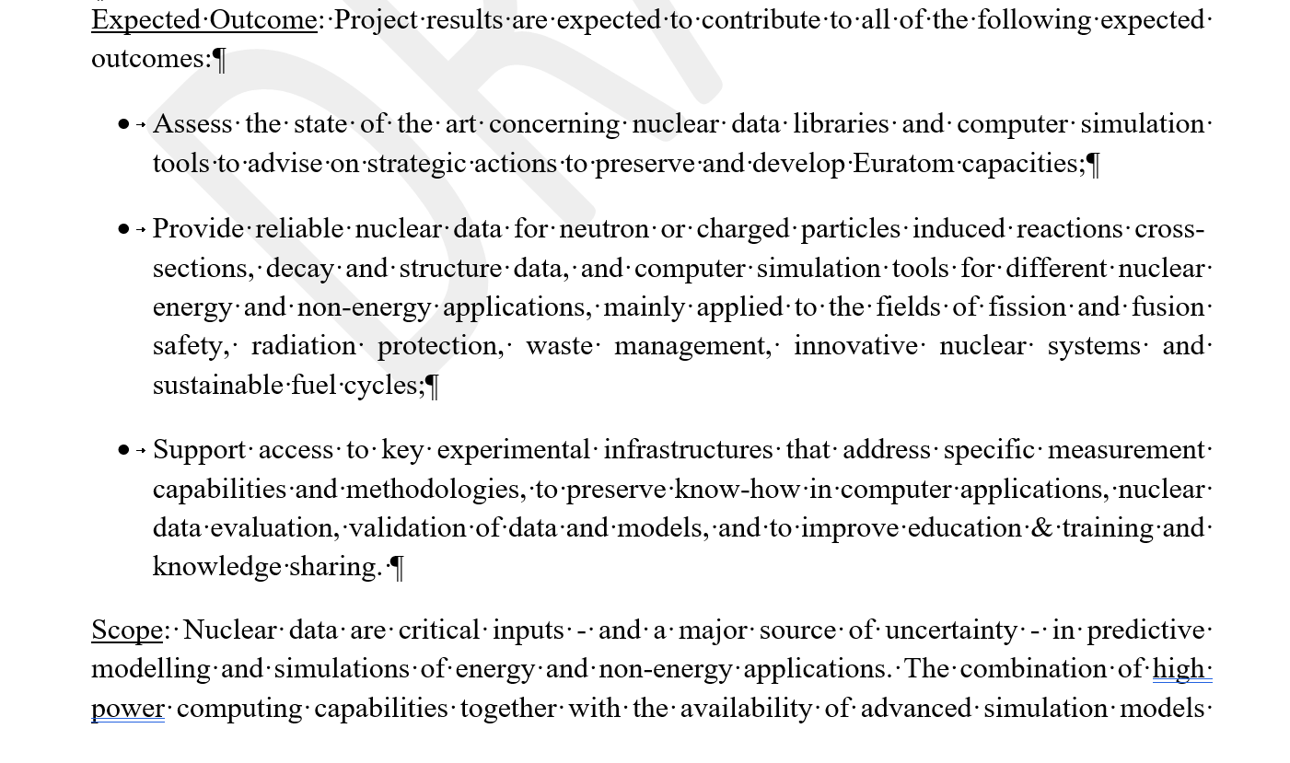
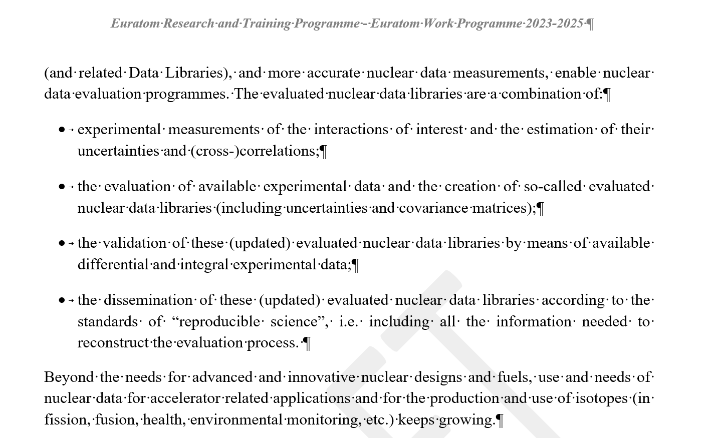
Transnational access support
addressed in the call:
Important role of ENEN+
And OFFERR projects
https://snetp.eu/eufn/
https://plus.enen.eu/

Slide 31
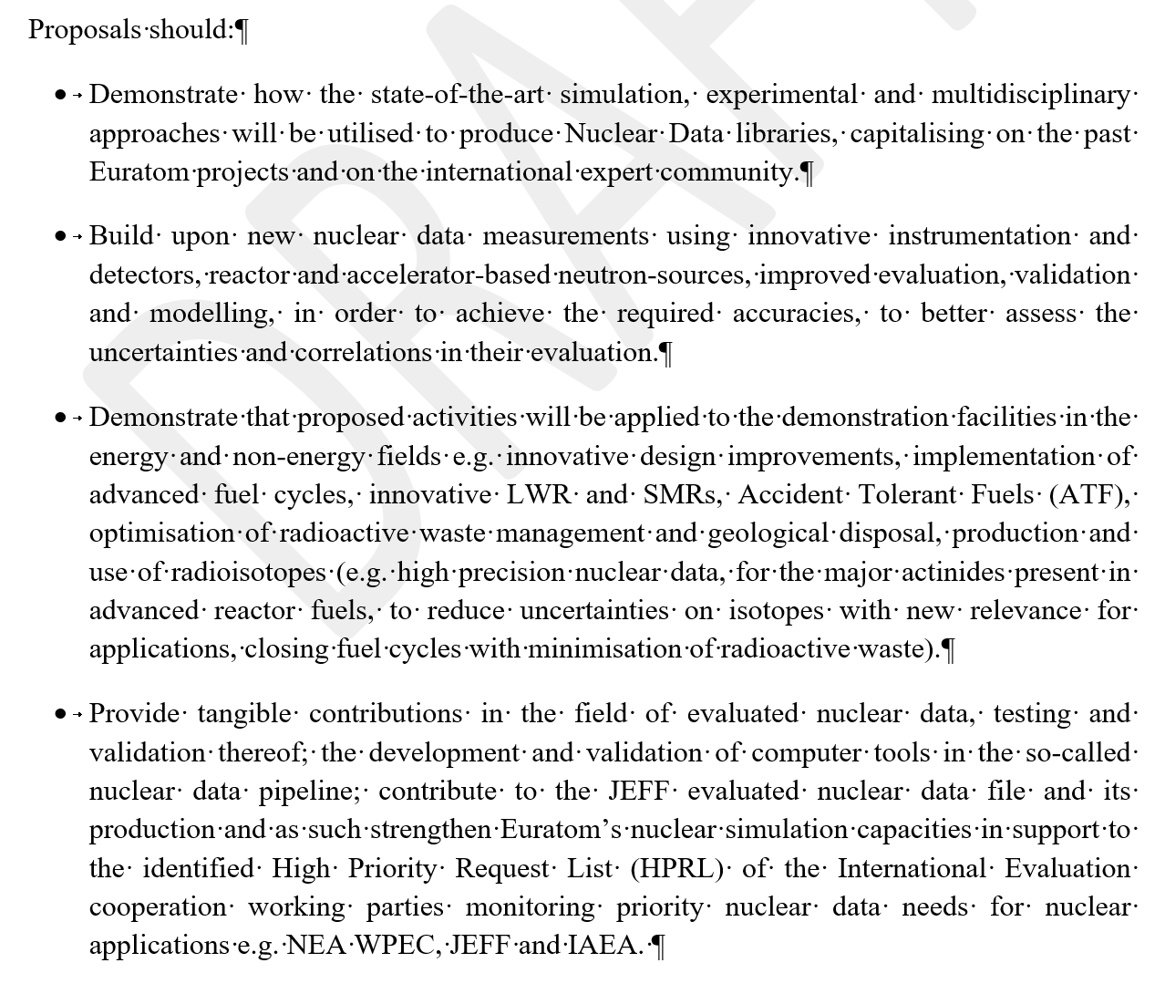

Slide 32
End of presentation

