Slide 1
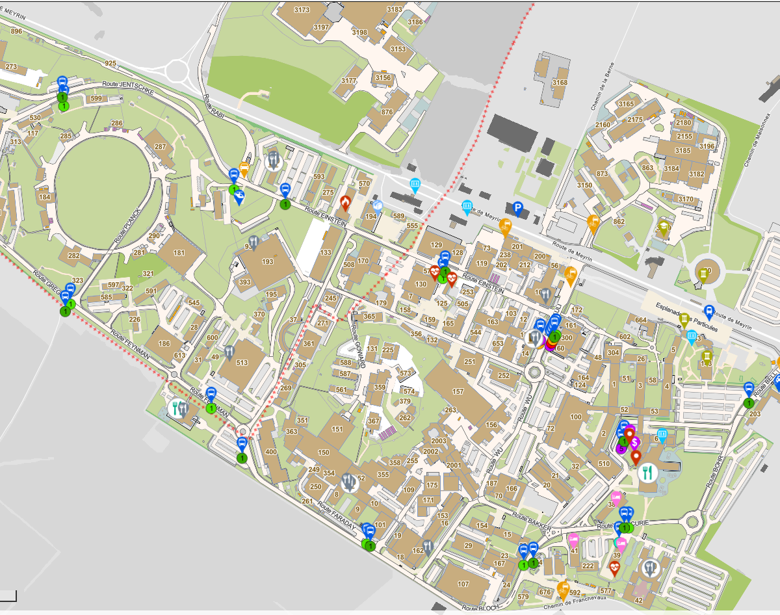
Thin films vacuum coating
M.Taborelli on behalf of the TE-VSC-SCC section

Slide 2
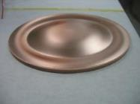
Physical Vapour Deposition by planar magnetron sputtering
DC Magnetron sputter deposition:
-evacuate at p in 1e-8 mbar range and inject Ar (Kr) in 10-3 mbar range
-target at negative potential
-noble gas ionization by electrons
-magnetic field confines electrons and helps to sustain plasma
HIPIMS (High Power Impulse Magnetron Sputtering):
Same configuration, but pulsed high voltage (current) leading to ionized target species
P_{Ar} ~ 10⁻³ mbar
substrate
Process gas
Ar+
+
e
e
Cathode (target)
e
+
+
e
+
+
e
magnets
-500V
Notes:
Appropriate situation with the CERN logotype
Mixture of different logotypes
All of them are circulating
All CERN clubs were also very creatives

Slide 3
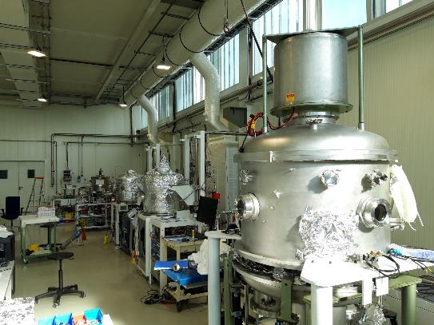
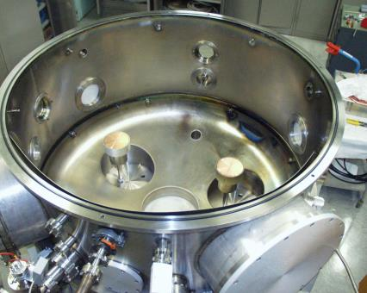
«Small substrates»
up to 1 m length, on substrates of copper, aluminium, StSt, MoGr, graphite, alumina, some polymers, coatings of 1-5 μm thickness typically
coatings to improve static/dynamic vacuum (NEG, a-C), for RF applications or reduction of impedance and charging (Cu, Mo, TiO_{x}), for superconducting RF (Nb, Nb₃Sn R&D) and more (Au, B₄C, n-tof N and Cl rich target layers…), Al, Re…..
Thickness test on partially masked witness glass sample and profilometry on step or XRF
SMA18
SPS tunnel
Ø 1500 mm
targets
SMA18

Slide 4
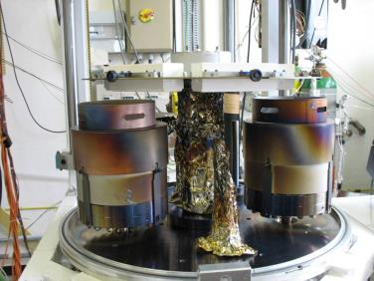
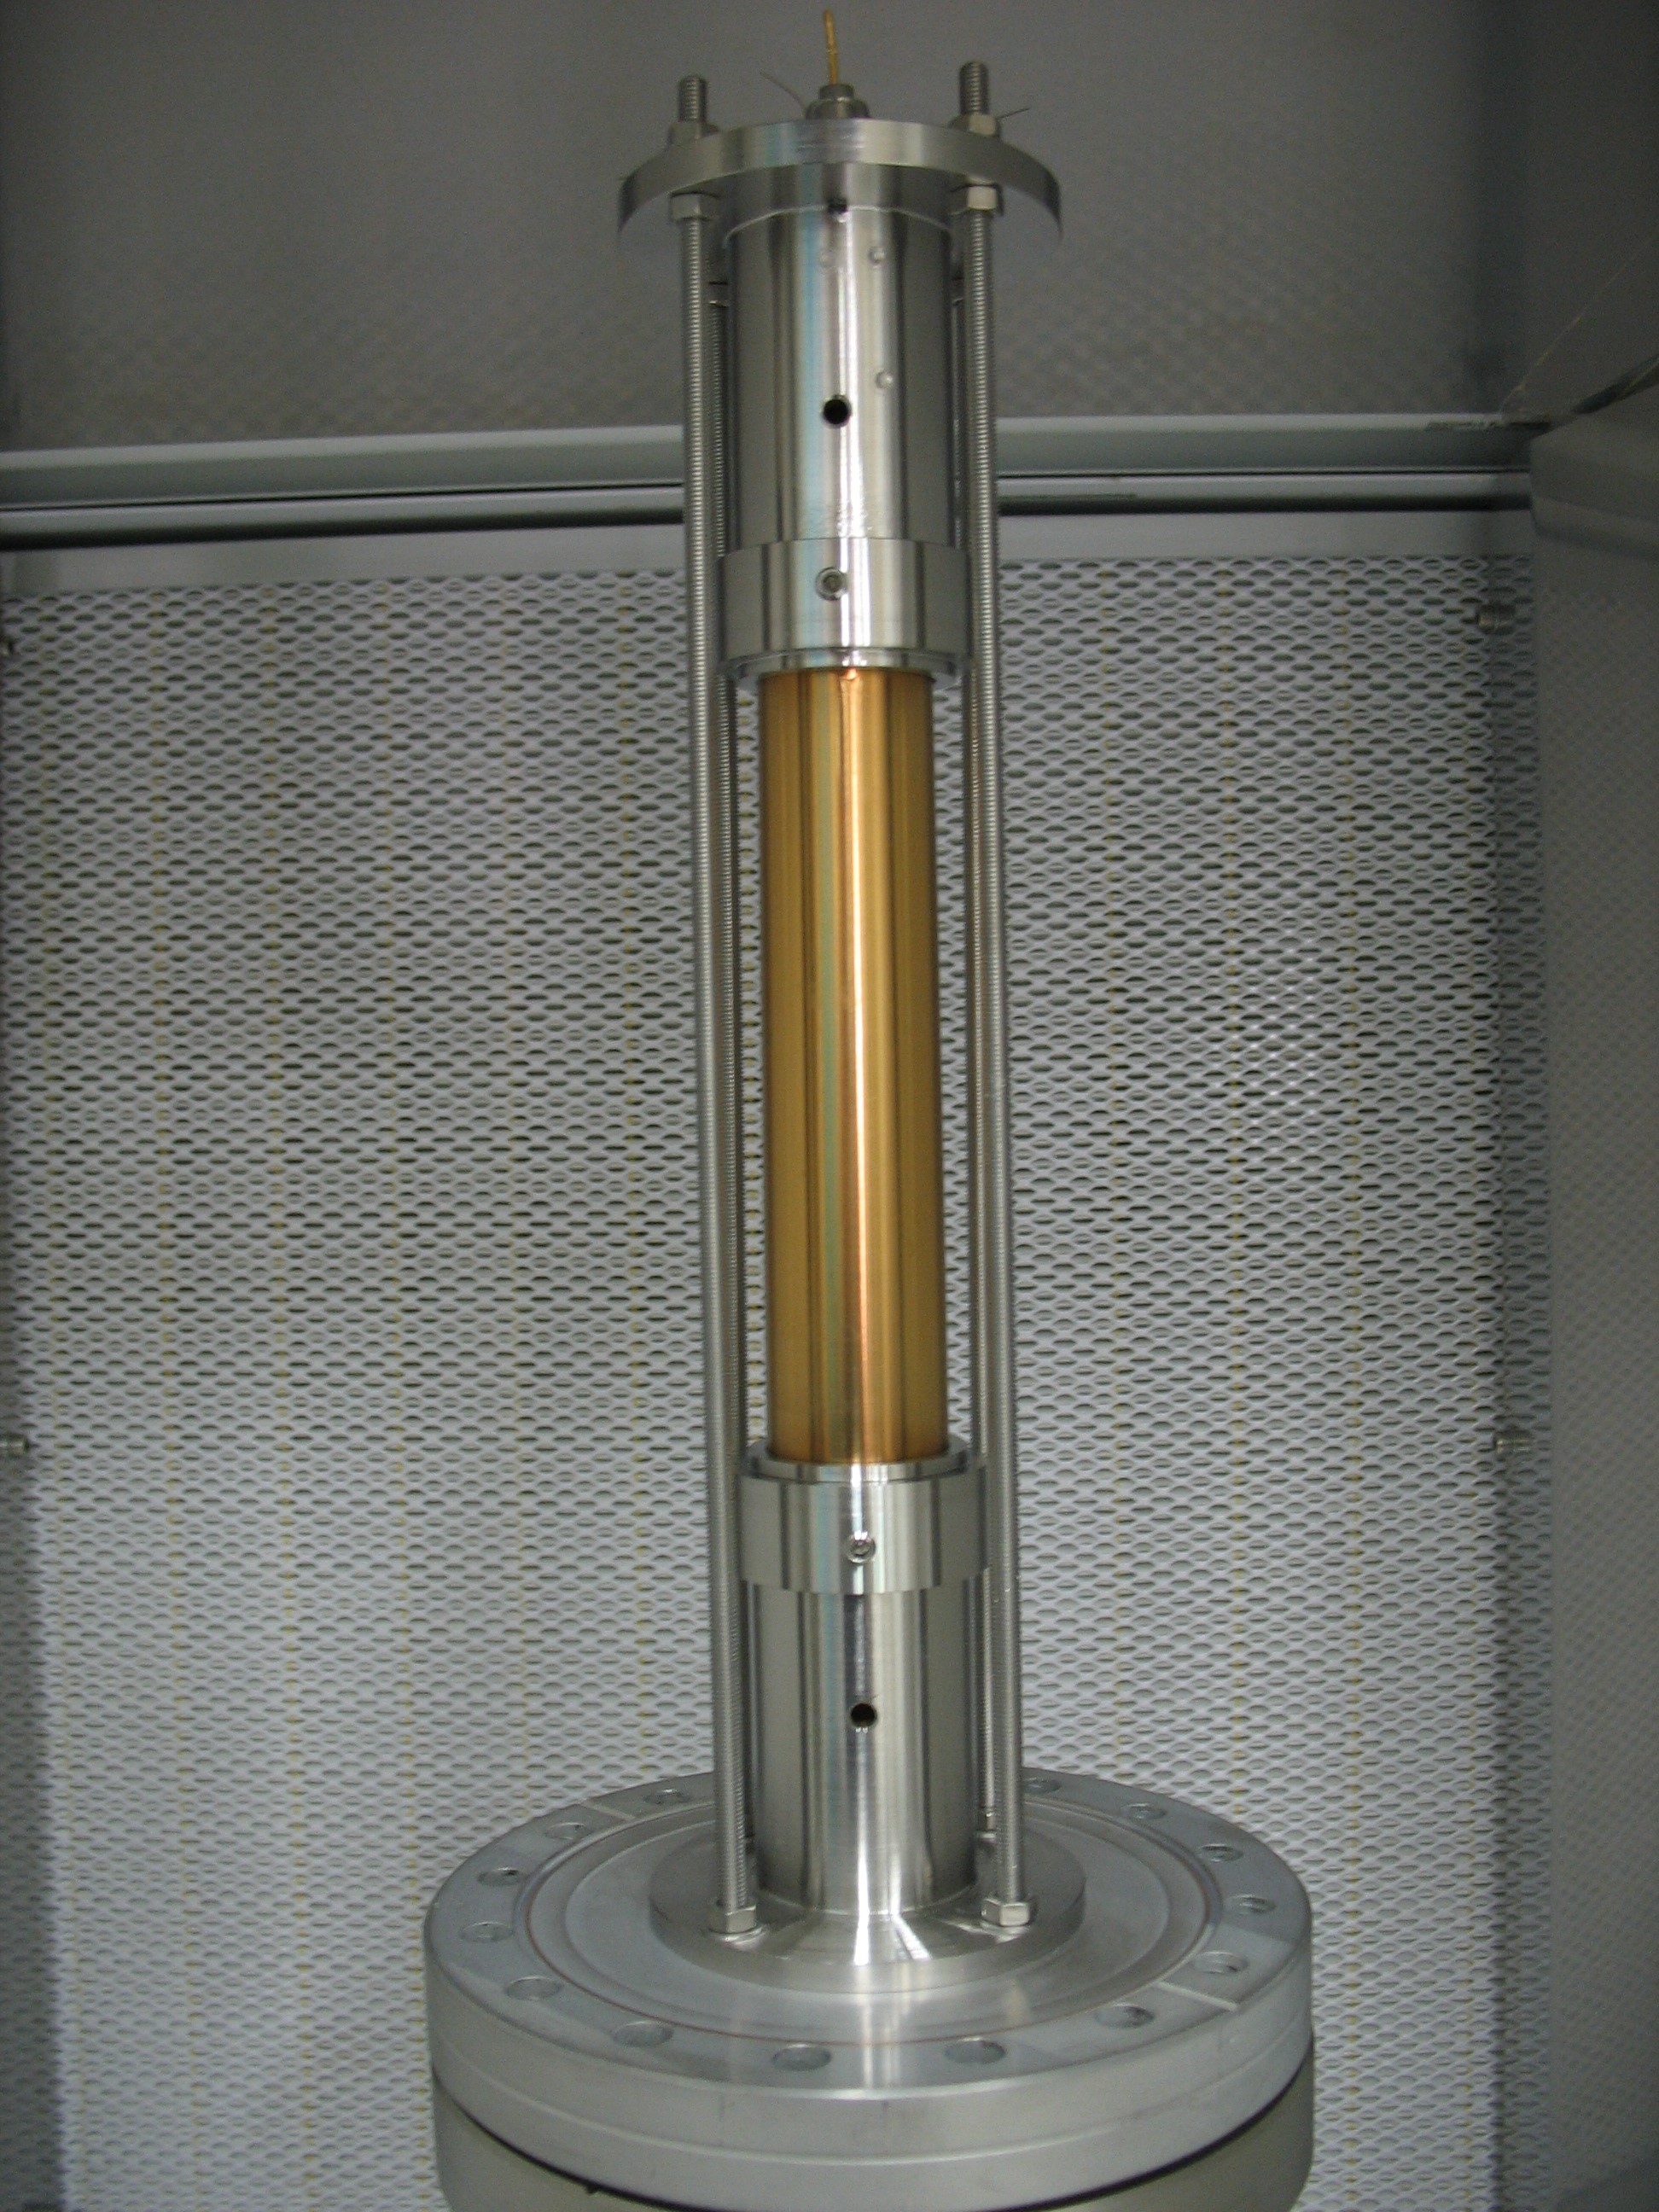
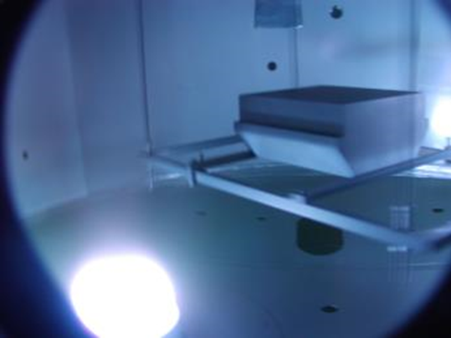
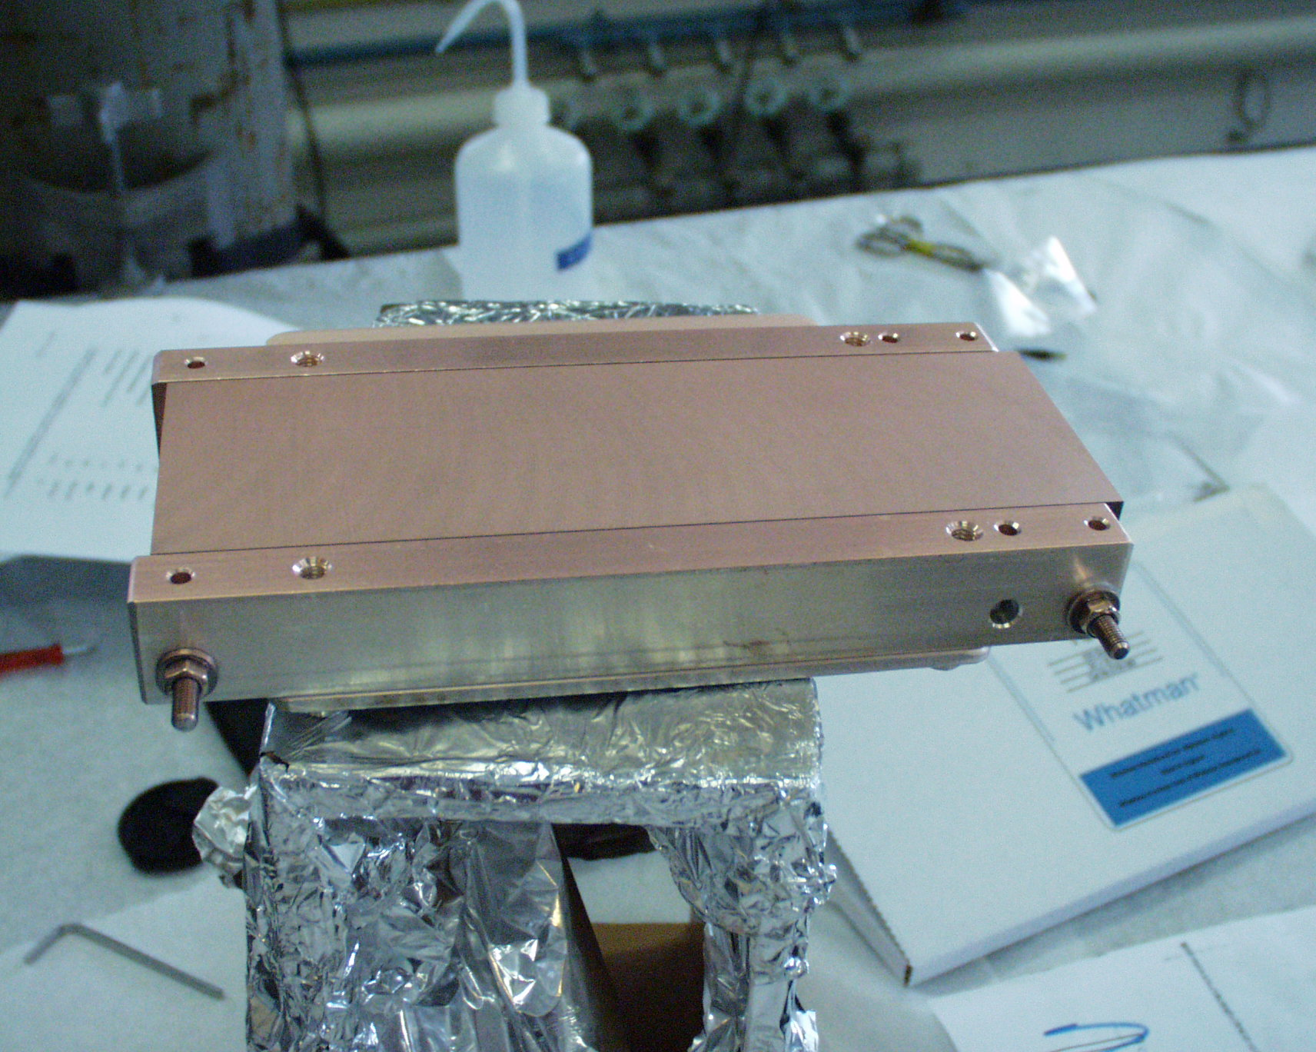
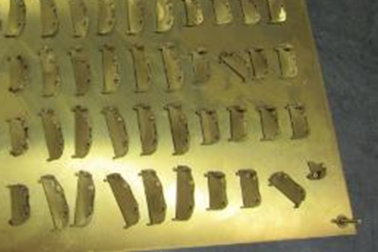
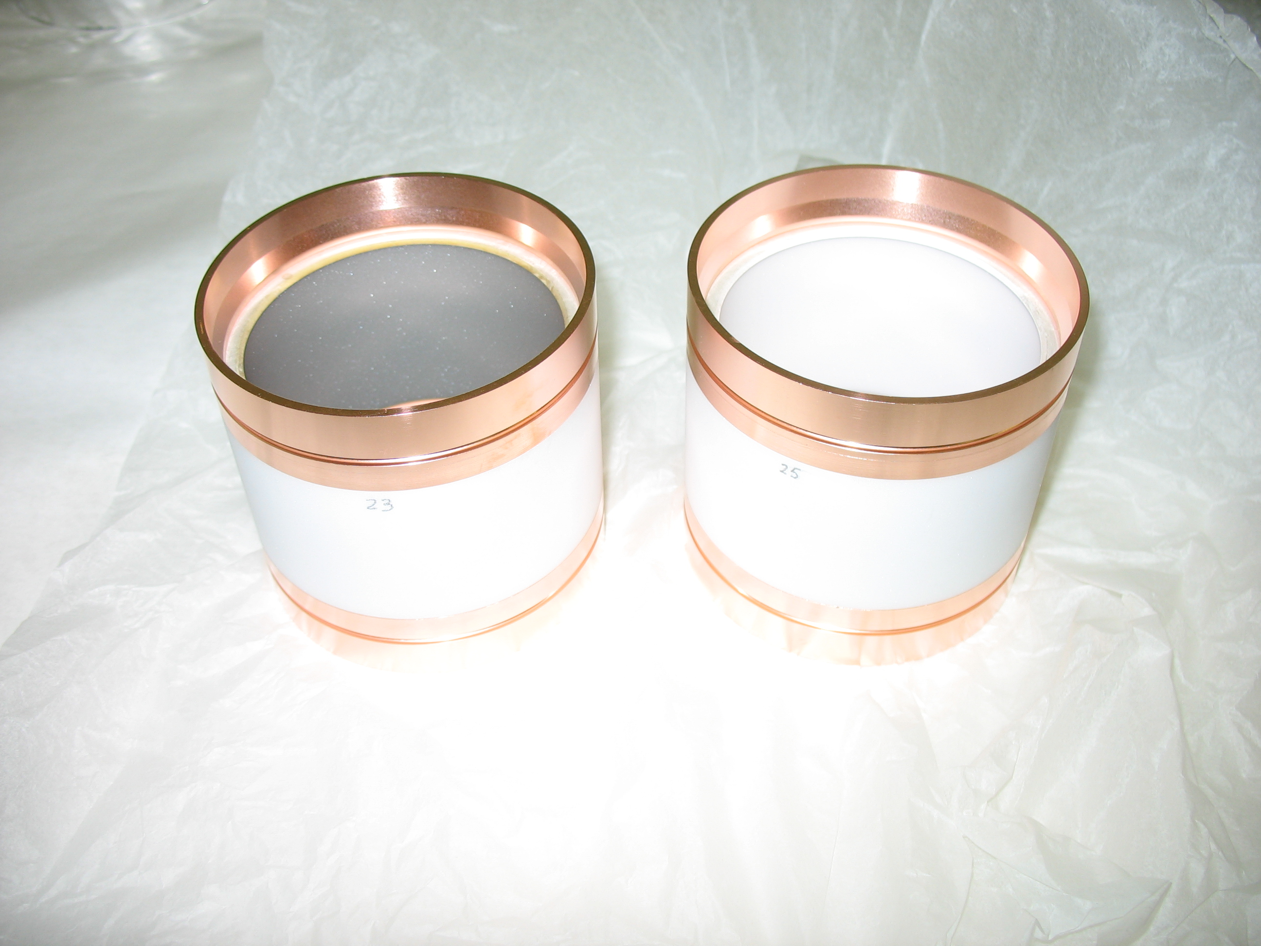

Slide 5
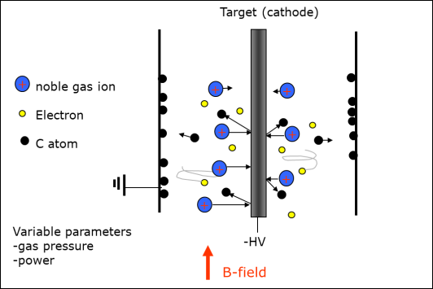
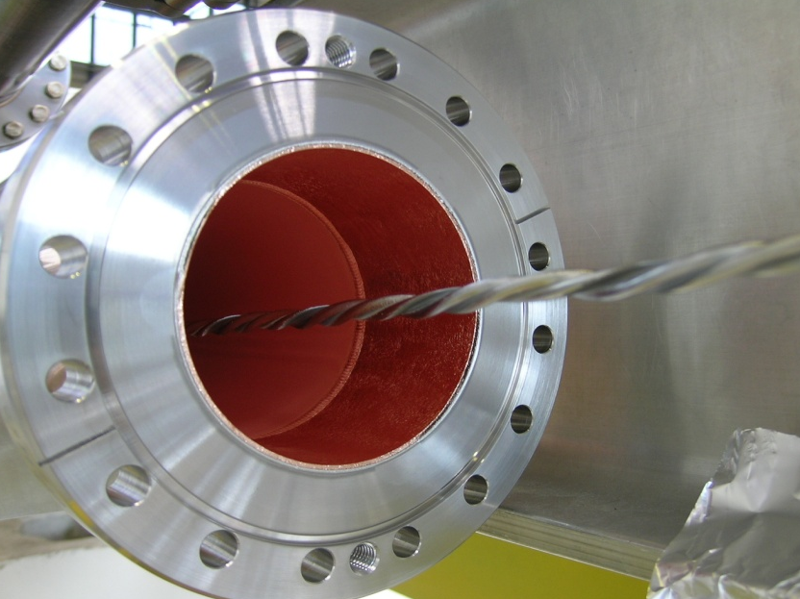
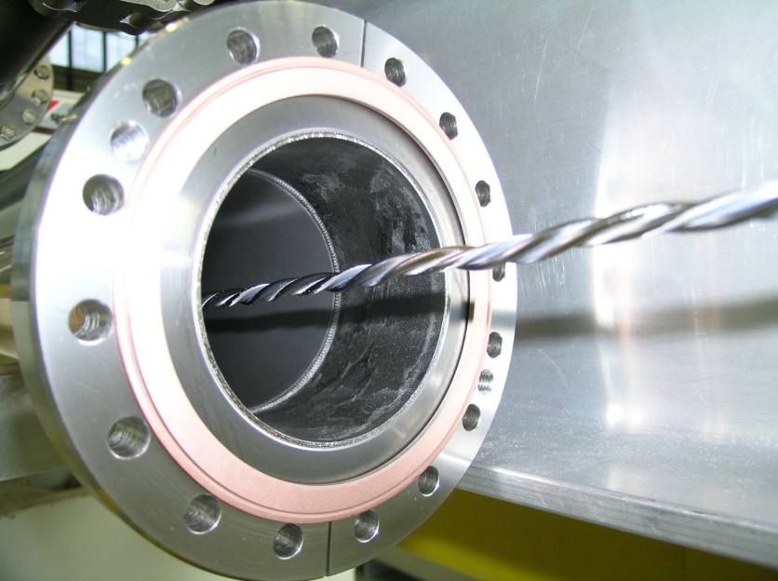
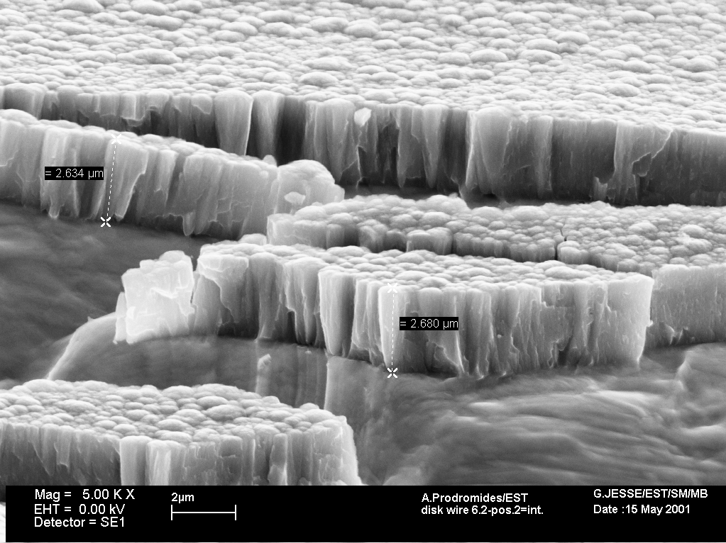
Coating method for long vacuum pipes
Up to 7 m length
Typically for TiZrV (Non Evaporable Getter for pumping) and a-C (low secondary electron yield)
Target made of intertwisted wires or rod, vertical to avoid sagitta
Before coating
coil
after coating
Vacuum chamber
B-field
typically < 300G
Coating after pumping and bake out (below 10⁻⁸ mbar base pressure)
0.5-3 μm thickness for NEG and < 0.5 μm for a-C
Notes:
Appropriate situation with the CERN logotype
Mixture of different logotypes
All of them are circulating
All CERN clubs were also very creatives

Slide 6
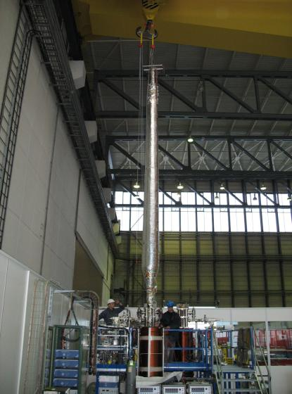
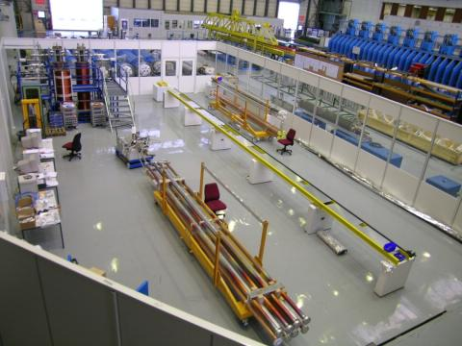
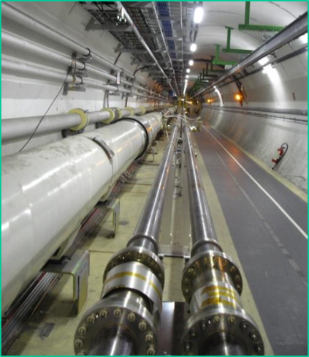
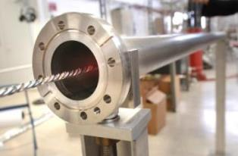
Coating plant bdg 181
CAPE09 Cambridge M.Taborelli CERN

Slide 7
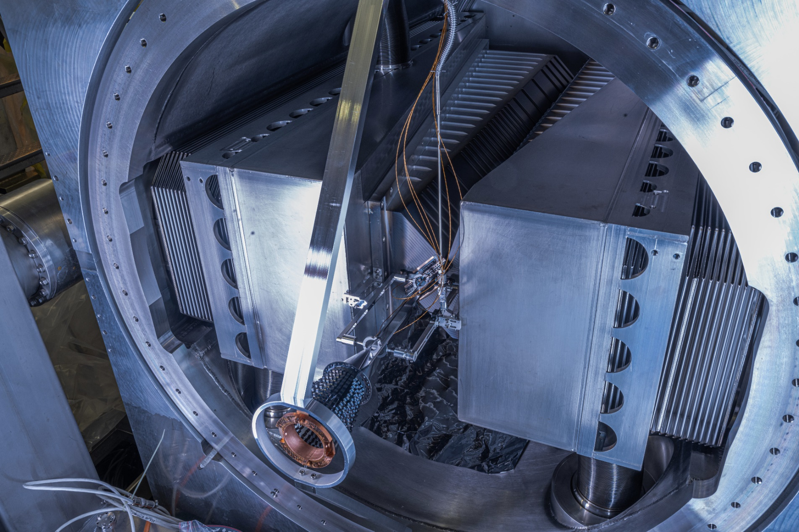
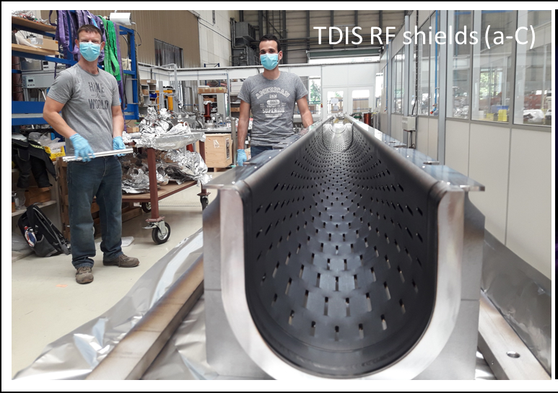
Unusual geometries
VELO RF boxes
(NEG)
SMOG II cell
(a-C)

Slide 8
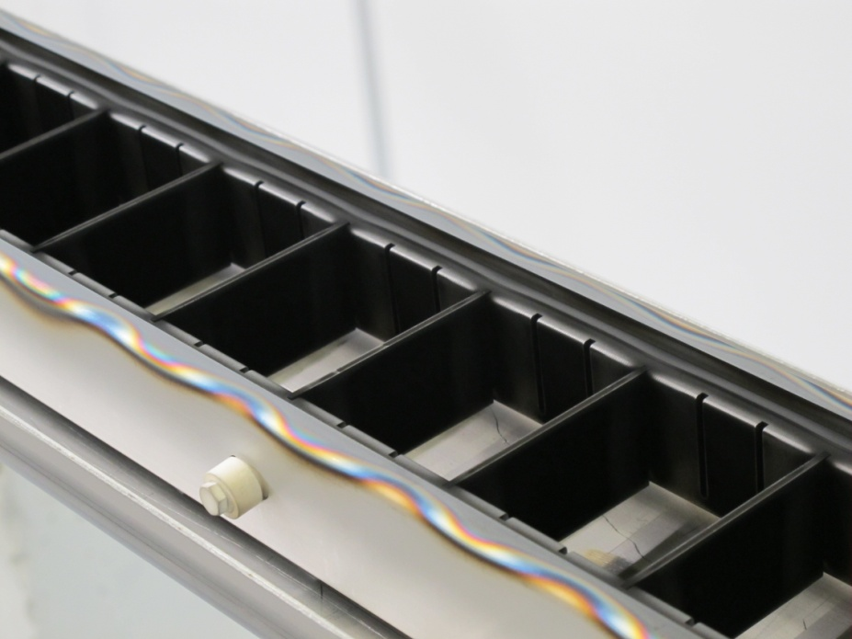
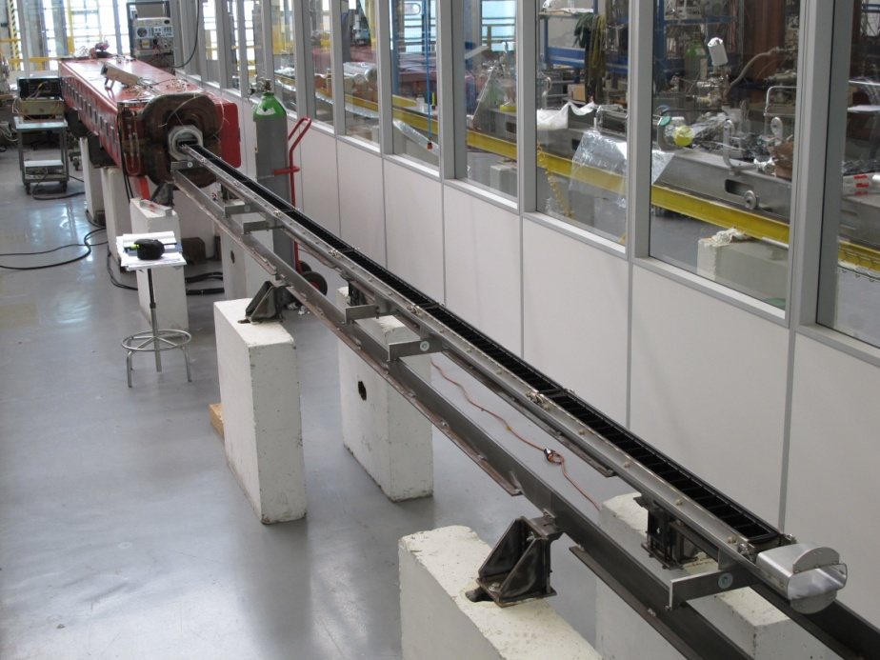
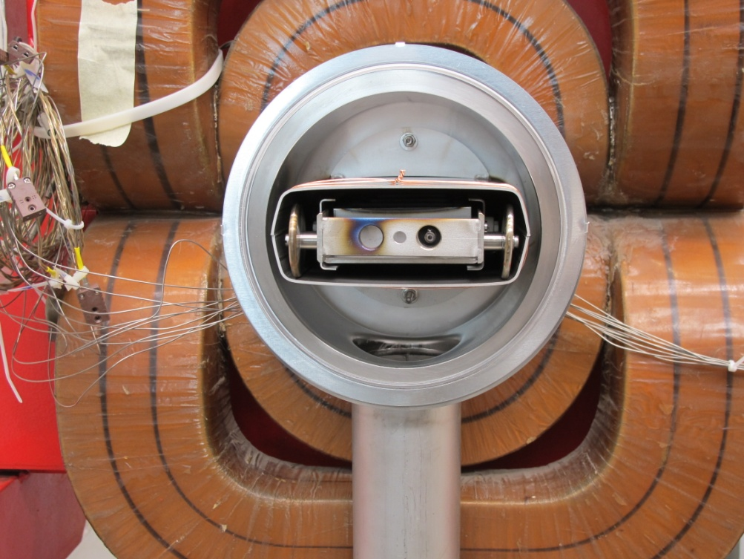
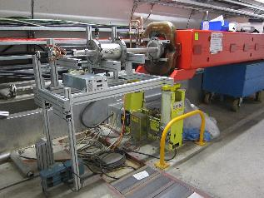
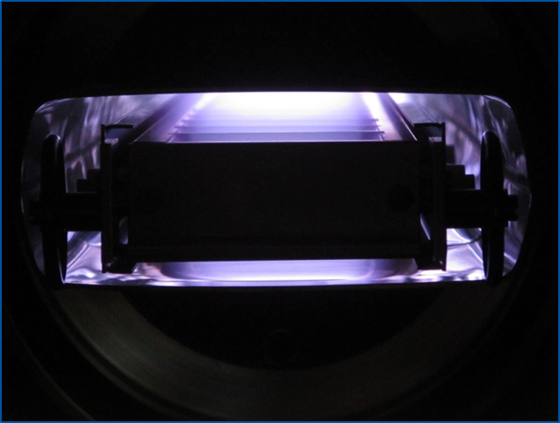
Design, production and operation of custom made coating systems: in SPS
-“train” (modular in several coaches and moved along the pipe) with hollow cathode
-coated in LS2 95 QF quadrupoles of SPS and several dipoles “in situ”
Graphite targets
(cells)
6.5 meter
MBB dipole
132 mm

Slide 9
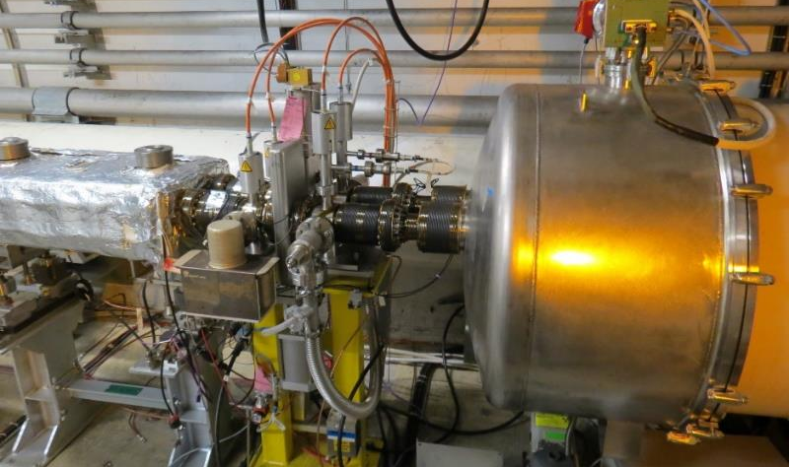
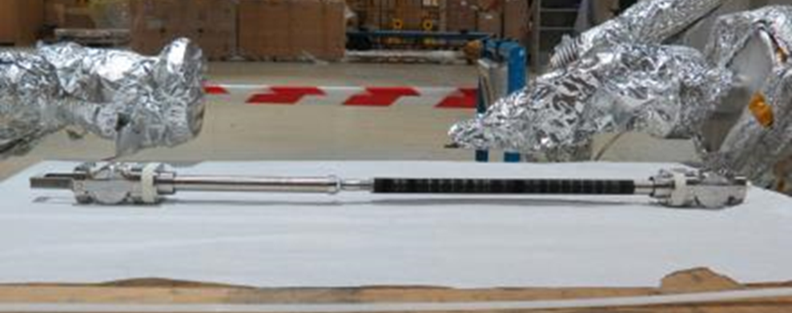
Design, production, operation of coating systems: Standalone magnet in LHC in situ
-coated the beamscreen of Q5L8 during LS2, to suppress e-cloud related heat load
Graphite target
Titanium target
pump hydrogen
enhance adhesion
direction
100
mm
Courtesy of B.Bradu

Slide 10
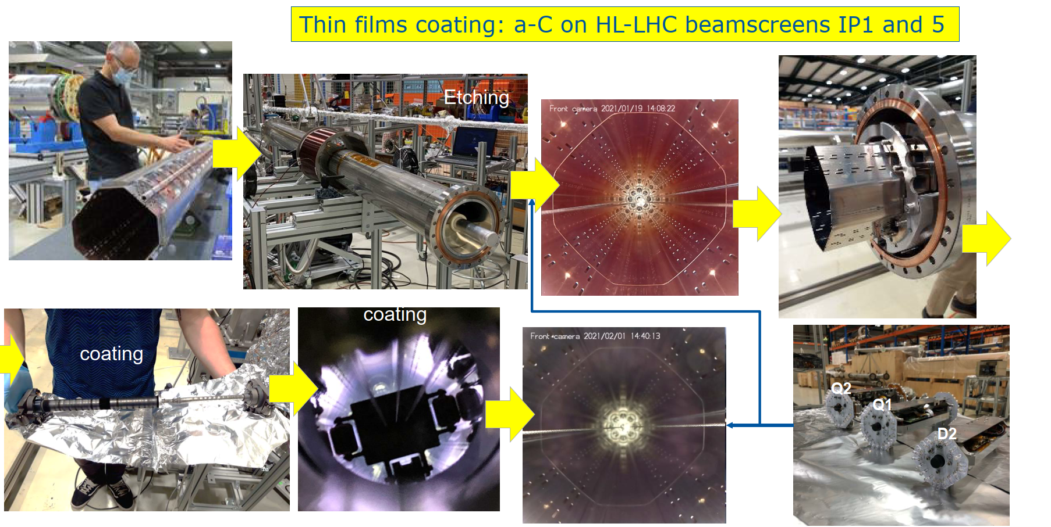

Slide 11
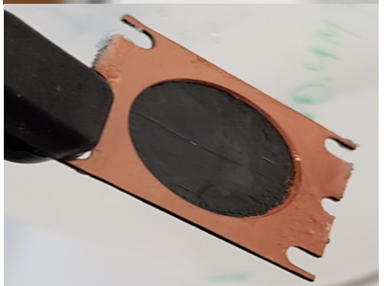
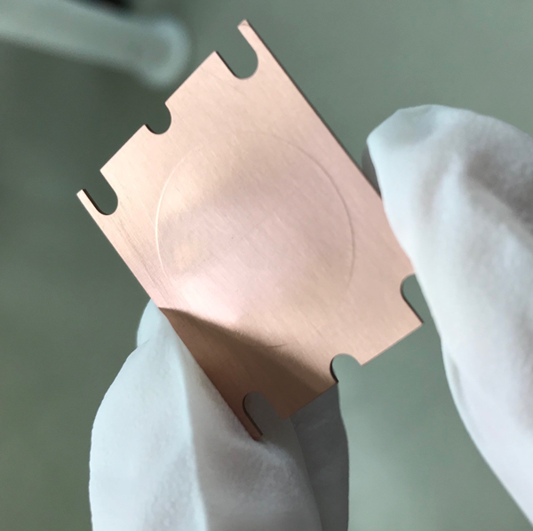
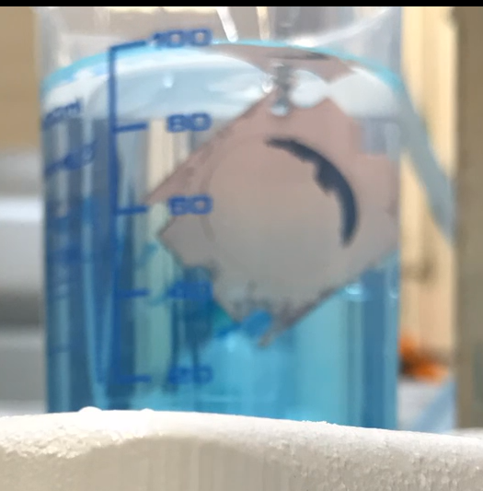
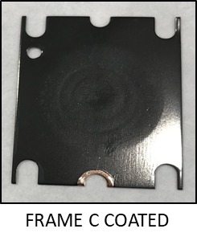
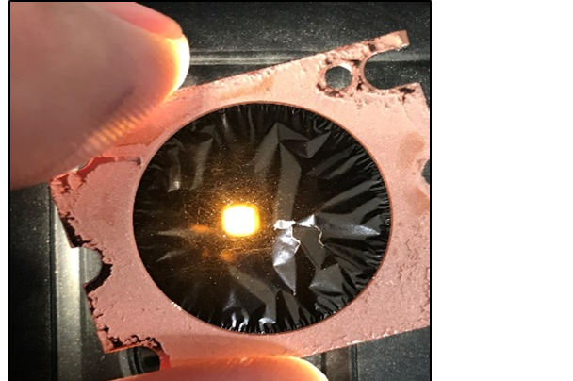
Combine coating and etching: carbon windows as ion stripping foils
  400 nm thick carbon foil (about 100ug/cm2)
  Development in progress as stripper foil for Linac 3
20 mm
Chemical etching of Cu (ammonium persulfate)

Slide 12
Thank you!
Questions?
Reference: Pedro Costa Pinto, Wilhelmus Vollenberg

Slide 13
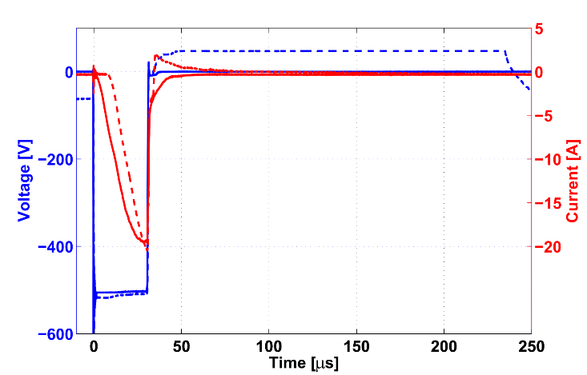
HiPIMS configurations
  Duty cycle : 1 kHz
  Main pulse (MP) : 30 μs
  Delay (D) : 4 μs
  PP duration (PP) : 20 – 250 μs
MP
D
PP
+50 V
+50V PP
no PP
~20 A
-550 V

Slide 14
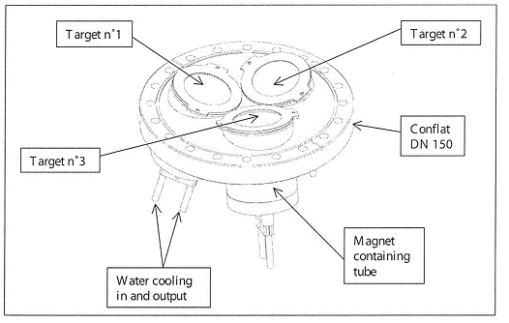
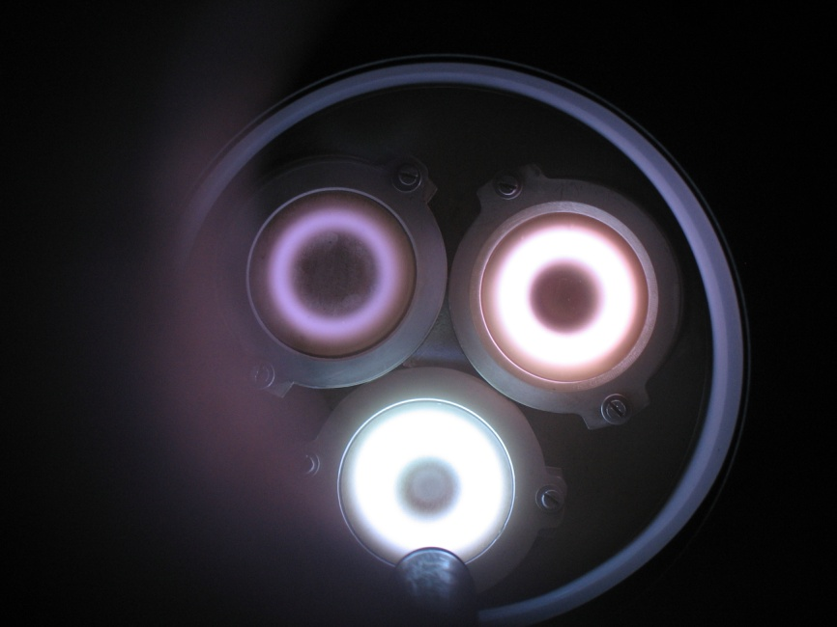
Multicathode system
It is possible to set up a multitarget system to produce coatings of alloys
3* Ø 50 mm targets
For R&D purpose:
Small samples !!
19 November, 2013

