Slide 1
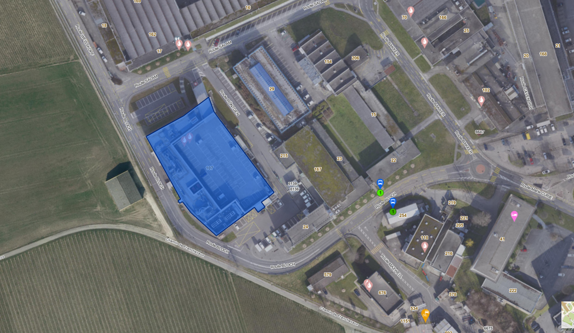
Surface treatments at CERN
M.Taborelli on behalf of the TE-VSC-SCC section
Service and R&D activity
Located at Bdg 107
Bdg 118
107
TE-VSC
TE-VSC

Slide 2
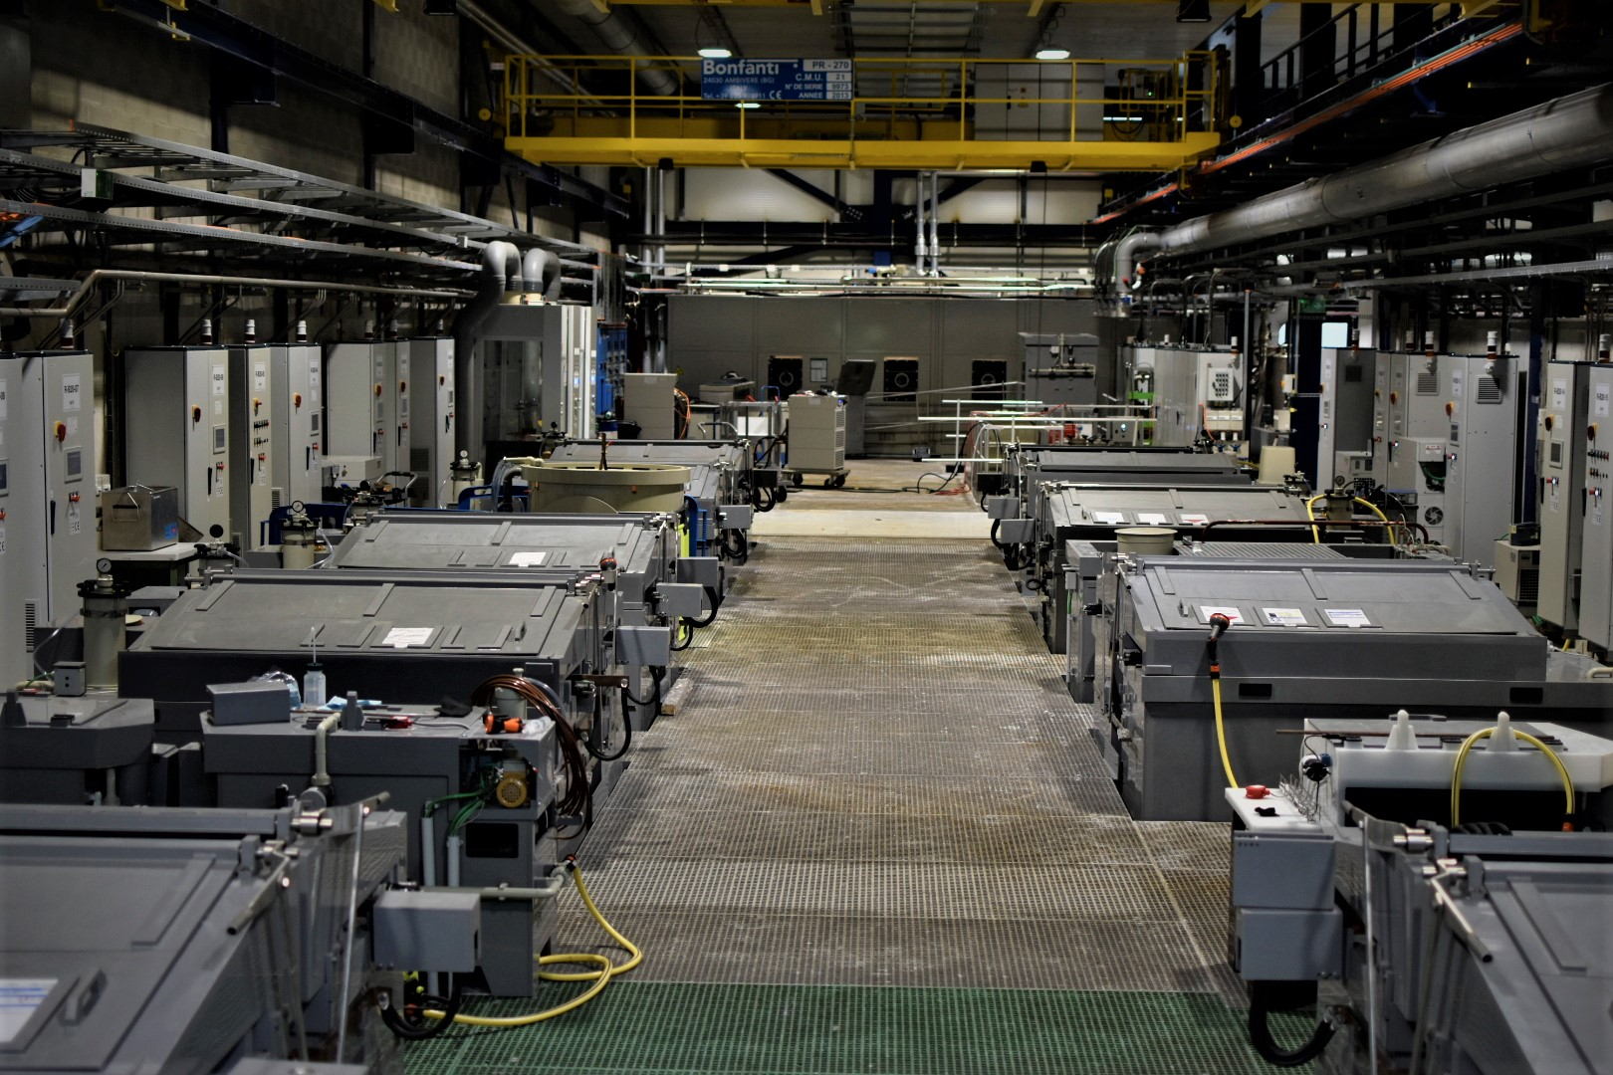
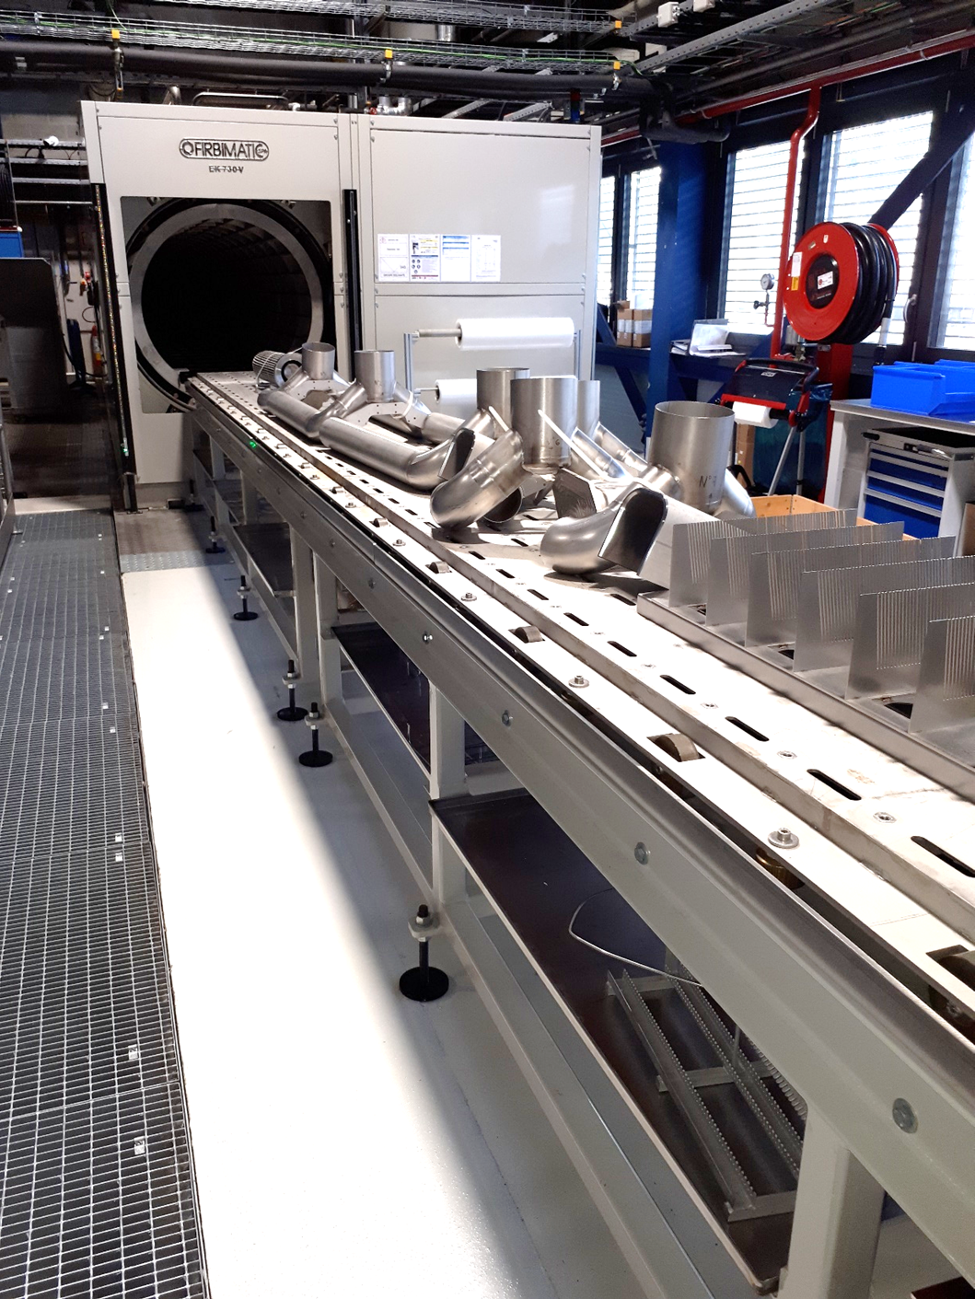
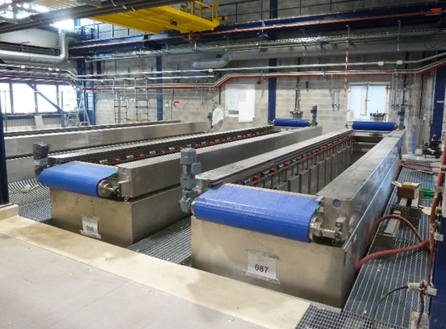
Wet surface treatments: cleaning, etching
-cleaning service of all Ultra High Vacuum components in detergents (chambers up to 7 m length) and solvents (Dualene 1601S modified alcohol)
-as preparation for other processes: PVD coating, welding, brazing
-chemical etching (acids, bases) and passivation, before plating,
PVD coating, welding or for thin film removal
NB: no clean room environment
Alkaline detergent bath
Solvent based cleaning machine

Slide 3
Plating and electropolishing schemes
+
-
Can do electropolishing (dissolution) on this side
G
Can do plating and electroforming on this side
Anodes :
M^{+q}
Cathodes:
M^{+q}
M^{+q}
M_{(s)} M^{+q}_{(aq)} + qē
M^{+q}_{(aq)} + qē M_{(s)}
M^{+q}
M^{+q}
2H₂O 4ē + O_{2(g)} + 4H⁺
M^{+q}
M^{+q}
2H⁺ + 2ē H_{2(g)}
Water electrolysis
NB: the bath, the concentrations, the current density, the voltages, the temperature, the bath agitation are specific for each processes and material

Slide 4
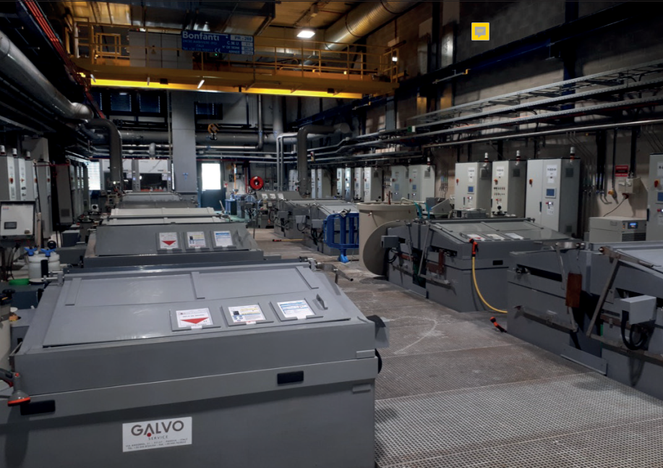

Slide 5
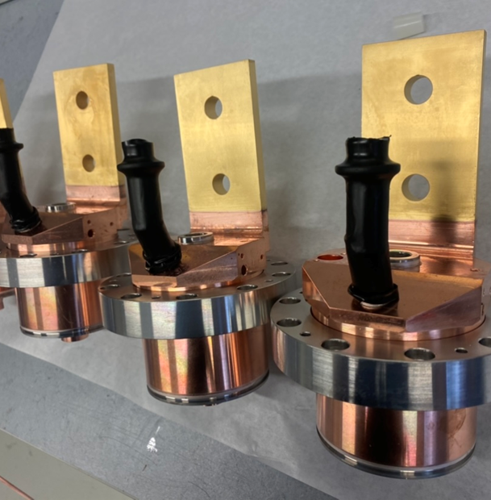
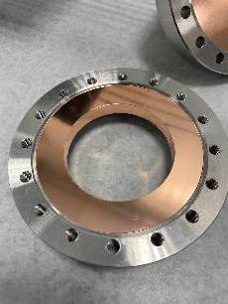
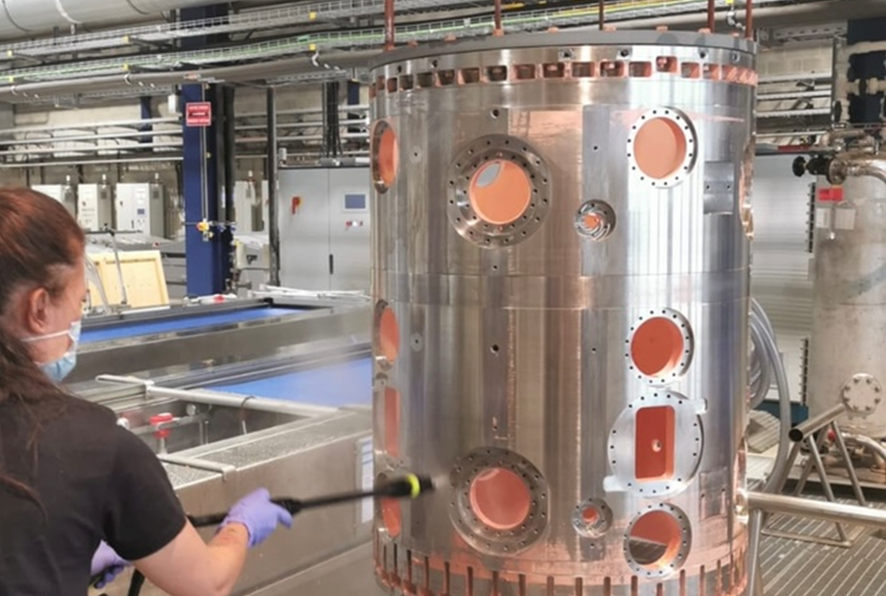
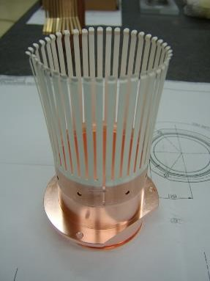
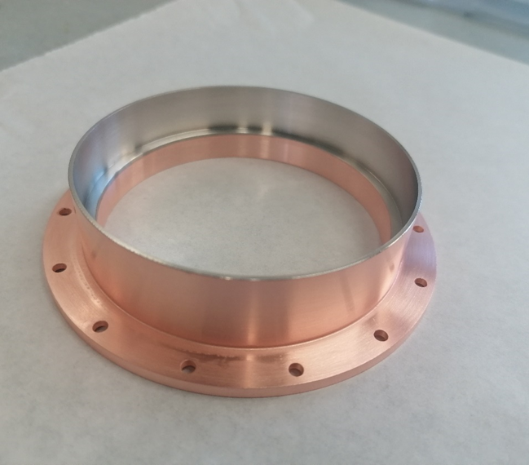
Metal plating
-on substrates like StSt, Cu, Al and their alloys
-by layers of Ni (pre-layer for Cu/StSt plating and StSt vacuum brazing…), Cu, Au, Rh, Ag
-typical thickness of 5-50 μm depending on the material and goals
-copper plating of large objects in dedicated (built on purpose) vessels
Au (RF fingers, current leads, beam-screen edges, pre-layer for Cu plating)
Rh (hard contact to RF fingers …)
Ag (RF fingers, screws, gaskets, pre-layer for brazing, …)

Slide 6
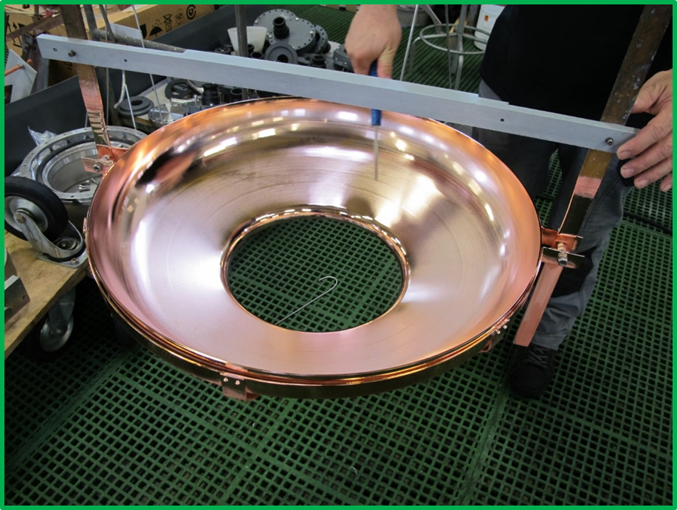
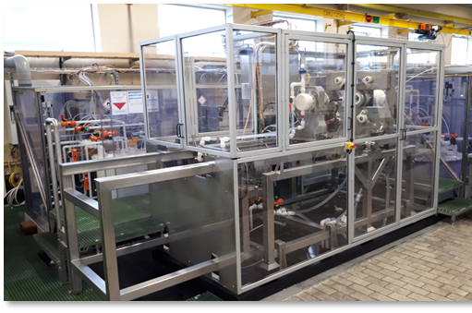
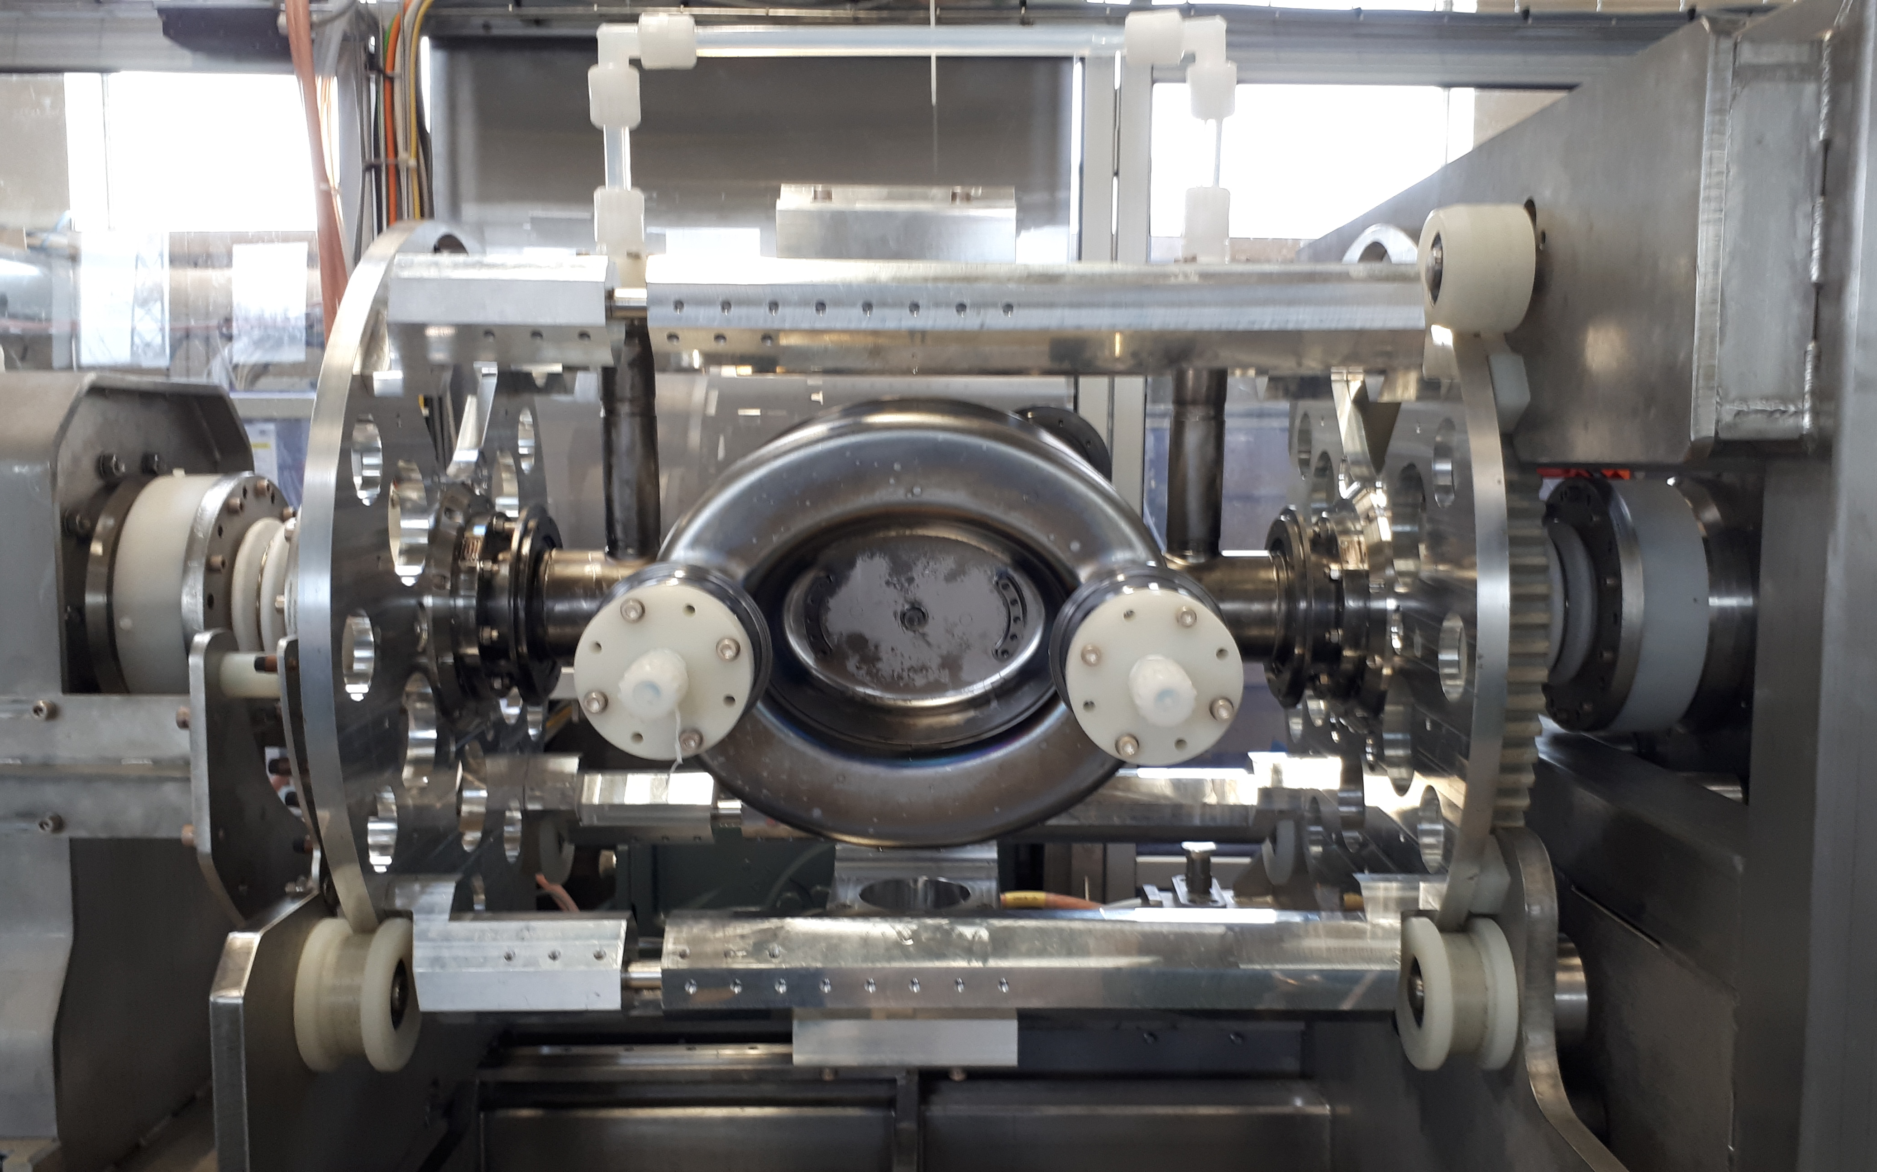
Chemical polishing and electropolishing
chemical and electropolishing of copper (for superconducting RF cavity substrates before Nb coating)
chemical polishing of Nb (CRAB cavities)
electropolishing/polishing machine for cavities
StSt electropolishing
if necessary simulations for R&D can be done by COMSOL
polishing before assembly
HIE full cavity polishing
Nb CRAB, polishing
Cu 1.3GHz, electrop.

Slide 7
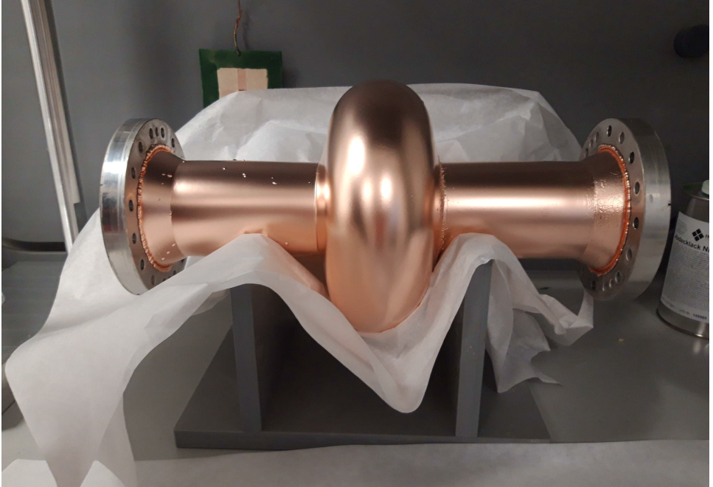
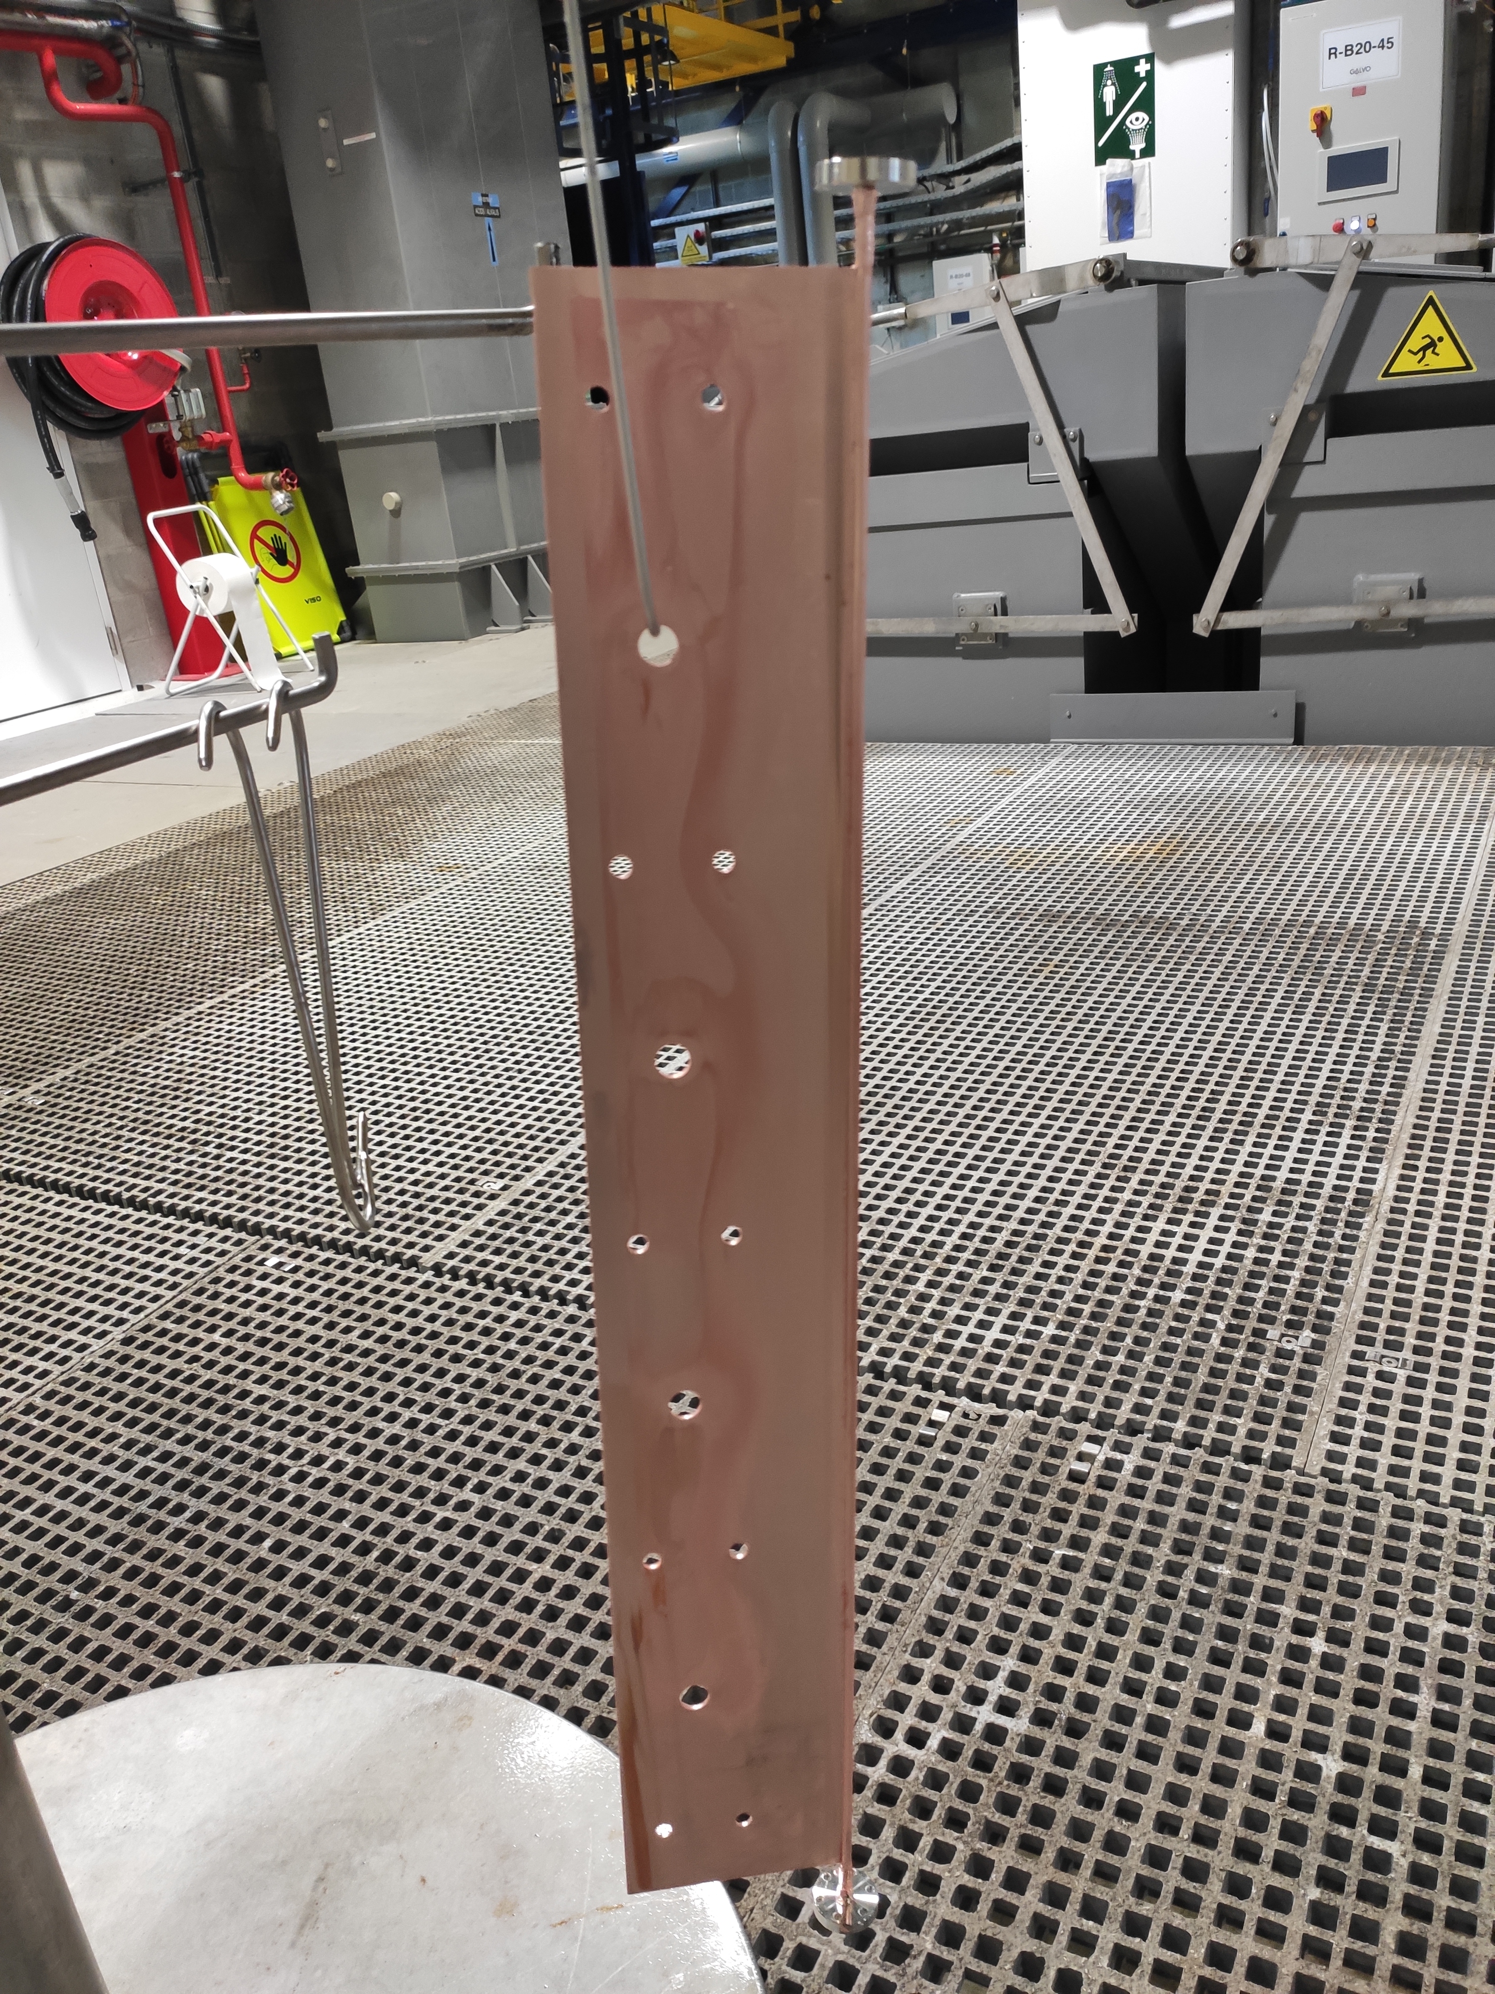
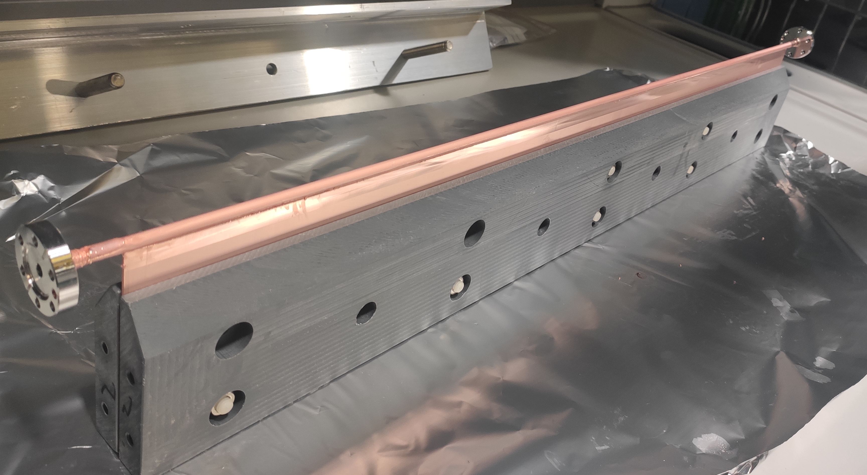
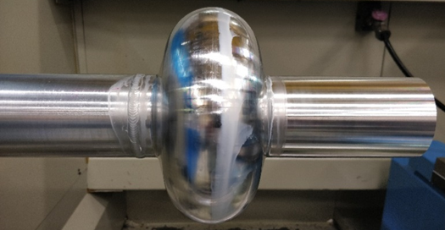
Electroforming: combining machining, plating and etching
Cu electroforming: starting from an internal aluminium mandrel + thin copper coating by magnetron sputtering + electroplating of thick copper + mandrel removal by chemical etching
1.3GHz RF cavity with integrated flanges
Vacuum chamber (ondulator)
6mm diam, 0.2 mm wall thickness, integrated flanges and stiffener
60 cm
80cm

Slide 8
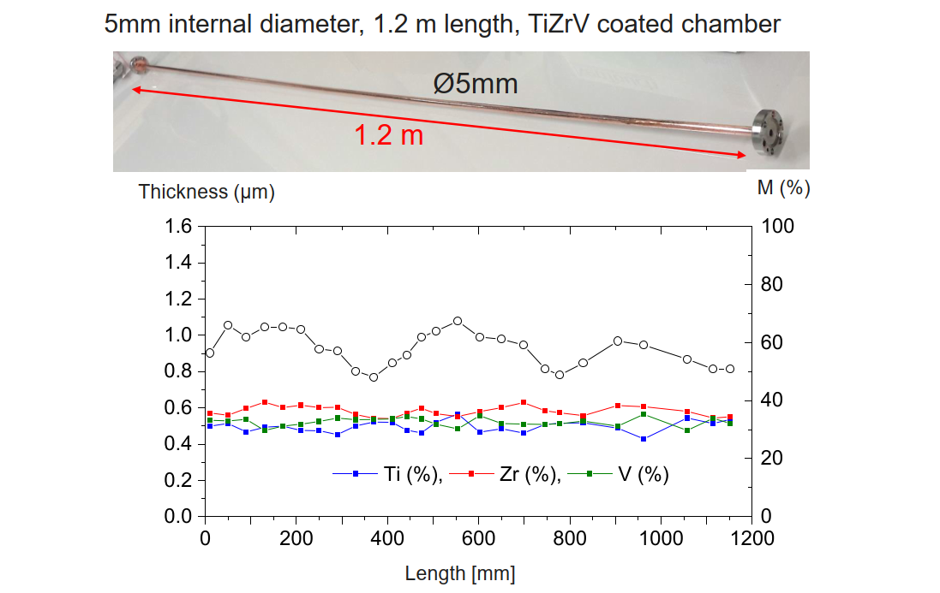
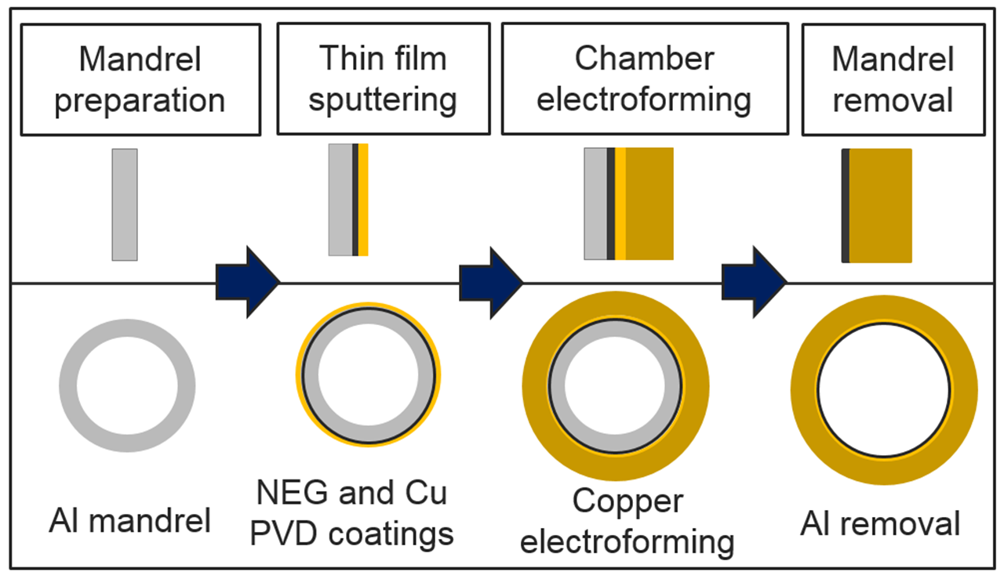
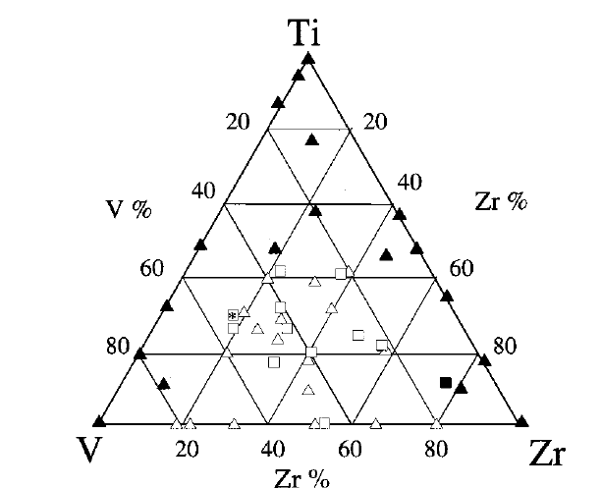
Combination of different technologies: electroforming, etching,PVD
The thickness is uniform
Composition is uniform and correct
Some delay in activation temperature
A. E. Prodromides et al. Vacuum 60 (2001) 35, 41

Slide 9
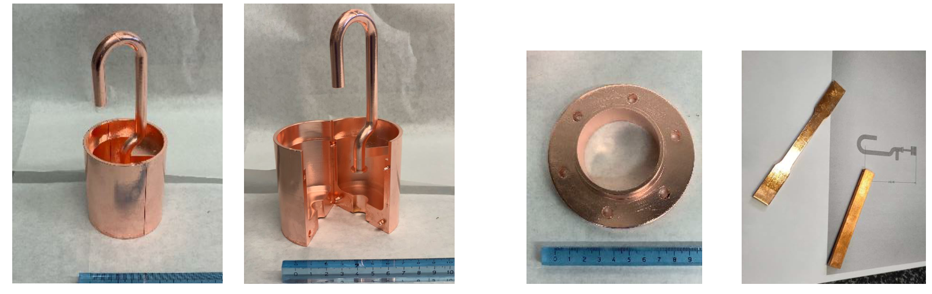
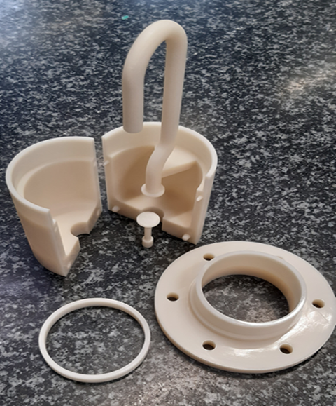
Wet surface treatments: copper plating on 3D printed polymers
-in collaboration with EN-MME, TE-MSC polymer lab, EP-DT
-Mock-ups for low power RF testing and design validation
-3D printing in Accura polymer + 30 um copper plating on a pre-layer of chemical carbon based conductor
-complex configuration of electrodes to get a good thickness distribution

Slide 10
Thank you!
Questions?
Reference persons: Leonel Ferreira, Marc Thiebert
Dedicated sharepoint to submit jobs (after getting access rights) : https://espace.cern.ch/TE-VSC-job-requests/Lists/Surface%20Treatment%202023/AllItems.aspx

Slide 11
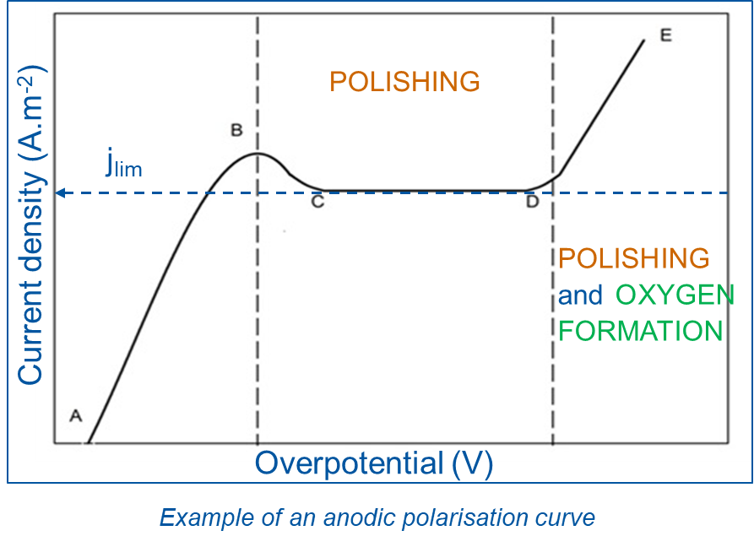
Electropolishing
Electropolishing (EP) is an anodic dissolution process that reduces the roughness of a metal surface.
U
T = t0
convection domain
Electropolishing bath, bulk
A
-
REF
+
V
anode
cathode
R1
R2
Saturated salt/oxide layer
diffusion domain:
- higher density
- higher viscosity
R1 < R2
Anode = cavity surface
resistance

