Slide 1
Picosec Micromegas for the Muon Collider Detector
D. Fiorina – INFN Pavia
On behalf of the Muon Collider Collaboration

Slide 2
Index
Introduction to the Muon Collider
  Requirement for Muon timing in Muon collider
Test Beam results
  Photoelectrons measurement
  Timing measurements
Rate capability (preliminary results)
Eco-friendly gas (preliminary results)

Slide 3
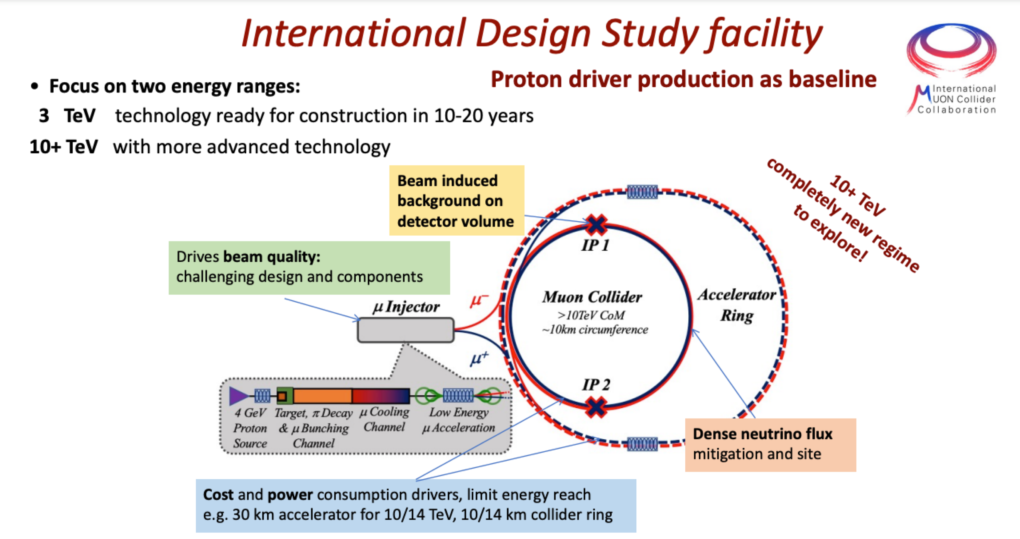
Muon Collider facility
Simulations available for √𝑠=1.5TeV
Production ongoing for √𝑠= 3TeV

Slide 4
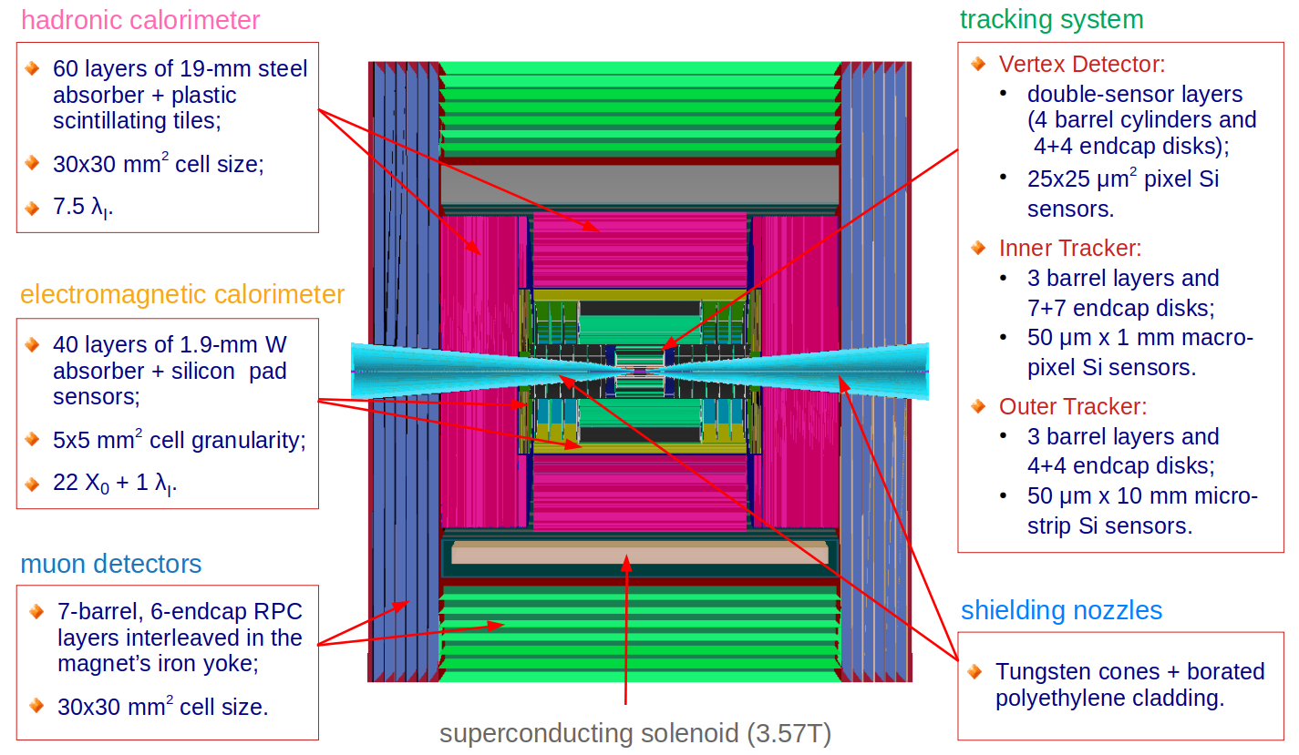
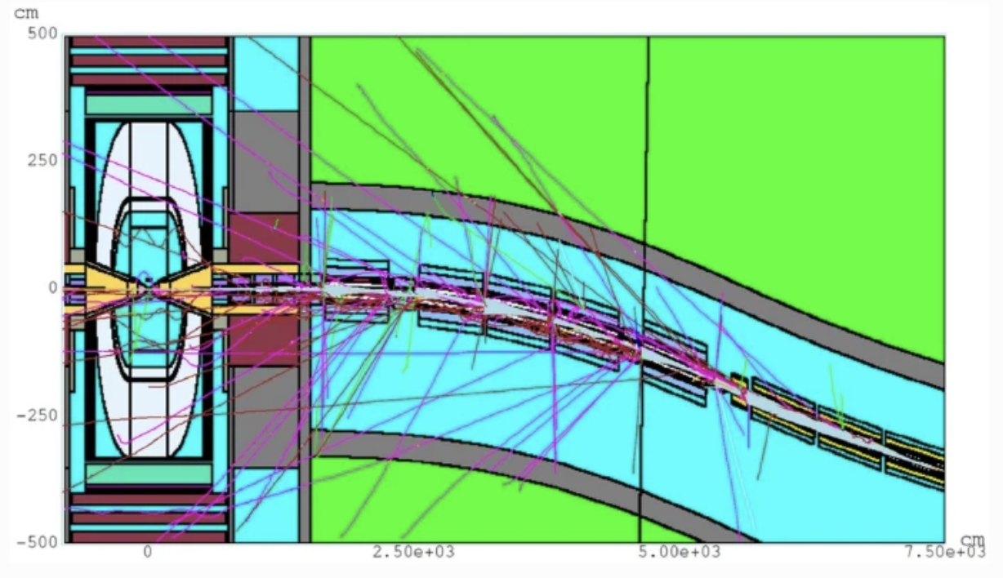
Muon Collider Detector
Design phase of the Muon Collider Detector
For the muon endcaps, a Muon tracking and timing station based on Picosec+MPGD has been proposed
Shielding from Beam Induced background (from decaying muons) limits the coverage in eta (θ>8°, η<2.7 available)

Slide 5
Muon endcap
Out-to-In muon tracking approach currently under study
Resolve muon in the muon system to close the track in the tracker system reducing the combinatory background
Time resolution ~100ps
6.5m
12°
0.9m
Time seed
Picosec
8°
Operation in a heavily ionising particle environment
0.6m
Tracking MPGD
Rate capability (√𝑠=1.5TeV):
  60 kHz/cm² 8°<θ<12°
  2 kHz/cm² θ>12°
Tracker
Endcap – not in scale

Slide 6
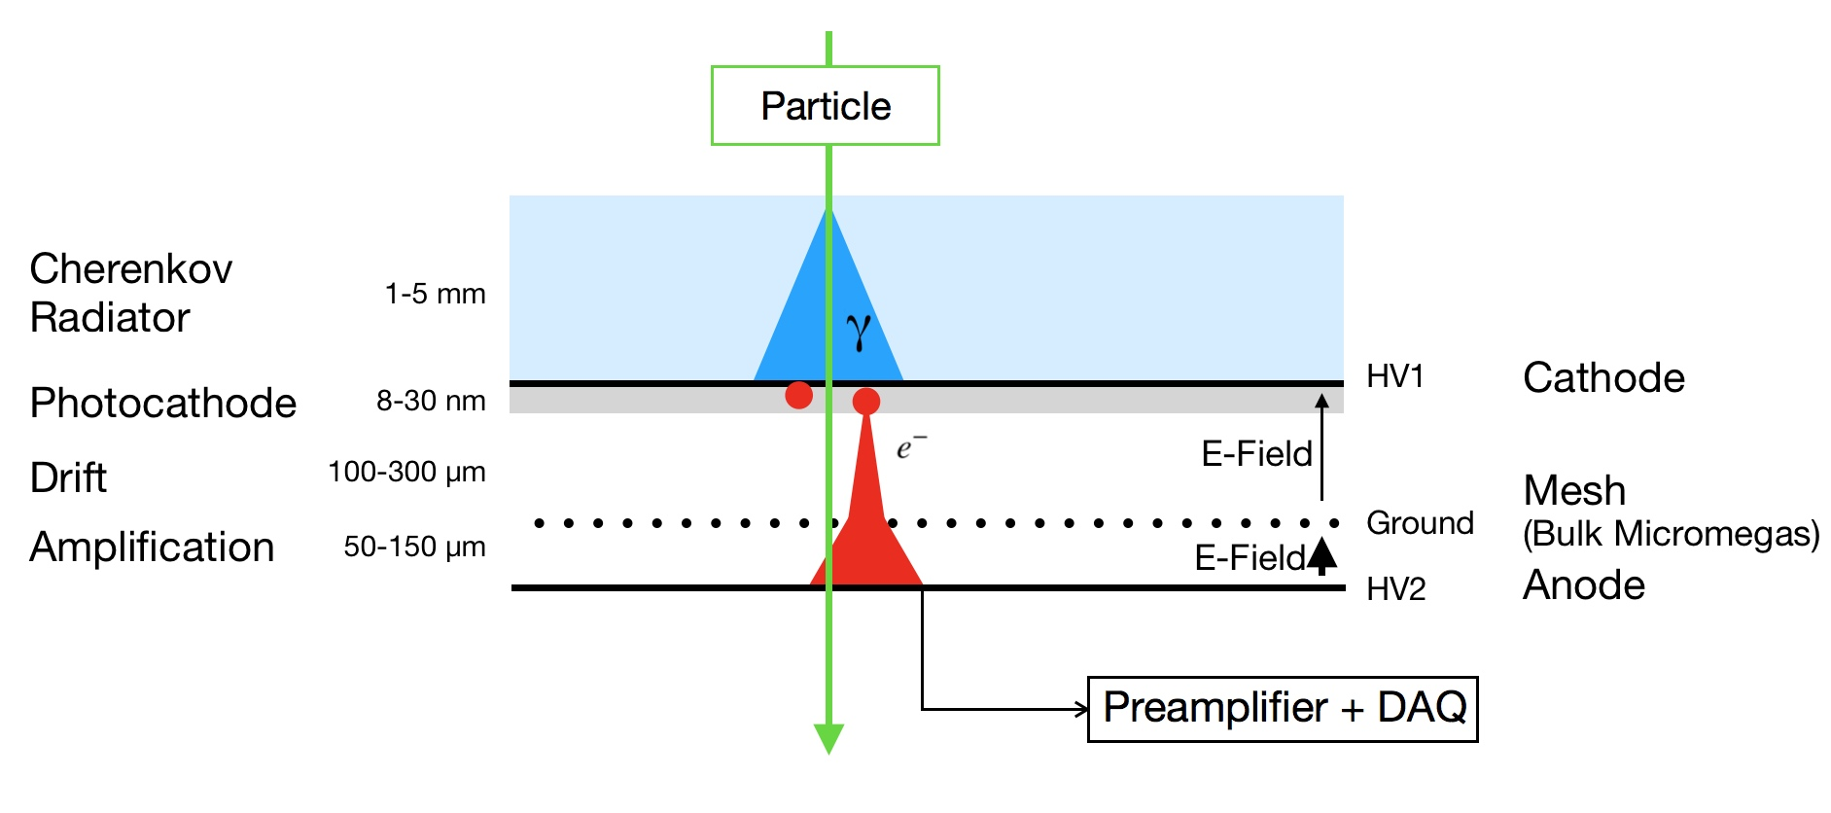
Picosec Micromegas
Gas Mixture:
Ne/C₂H₆/CF₄
80/10/10
Look at Cherenkov, not the ionisation
  Photo-electrons created promptly with the MIP passage
Remove the ‘drift’ gap and start the avalanche as soon as possible
  Avalanche propagate faster
MgF₂ 3mm
CsI 18nm
200µm
18µm wire
Cherenkov radiator
128µm
Cherenkov radiator MgF2:
  Optimal UV transparency, high cost, no technology for large windows, fragile
Photocathode CsI:
  Best UV QE, radiation damage, Hygroscopic
Gas Ne/C2H6/CF4:
  High quenching, high-cost, non-eco-friendly
Photo
cathode
Gas Mixture

Slide 7
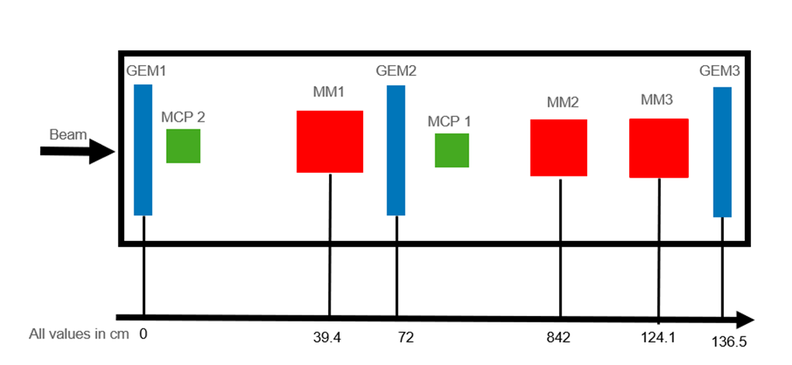
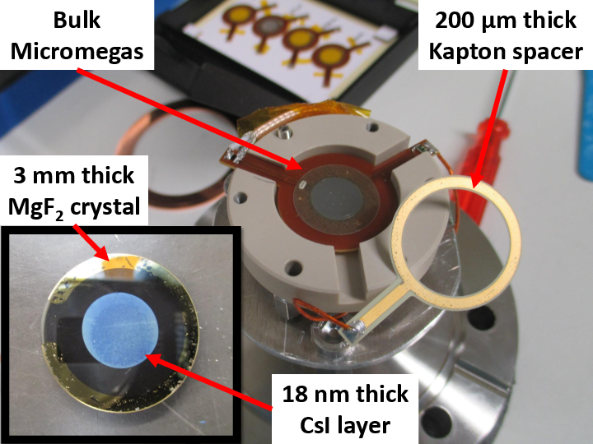
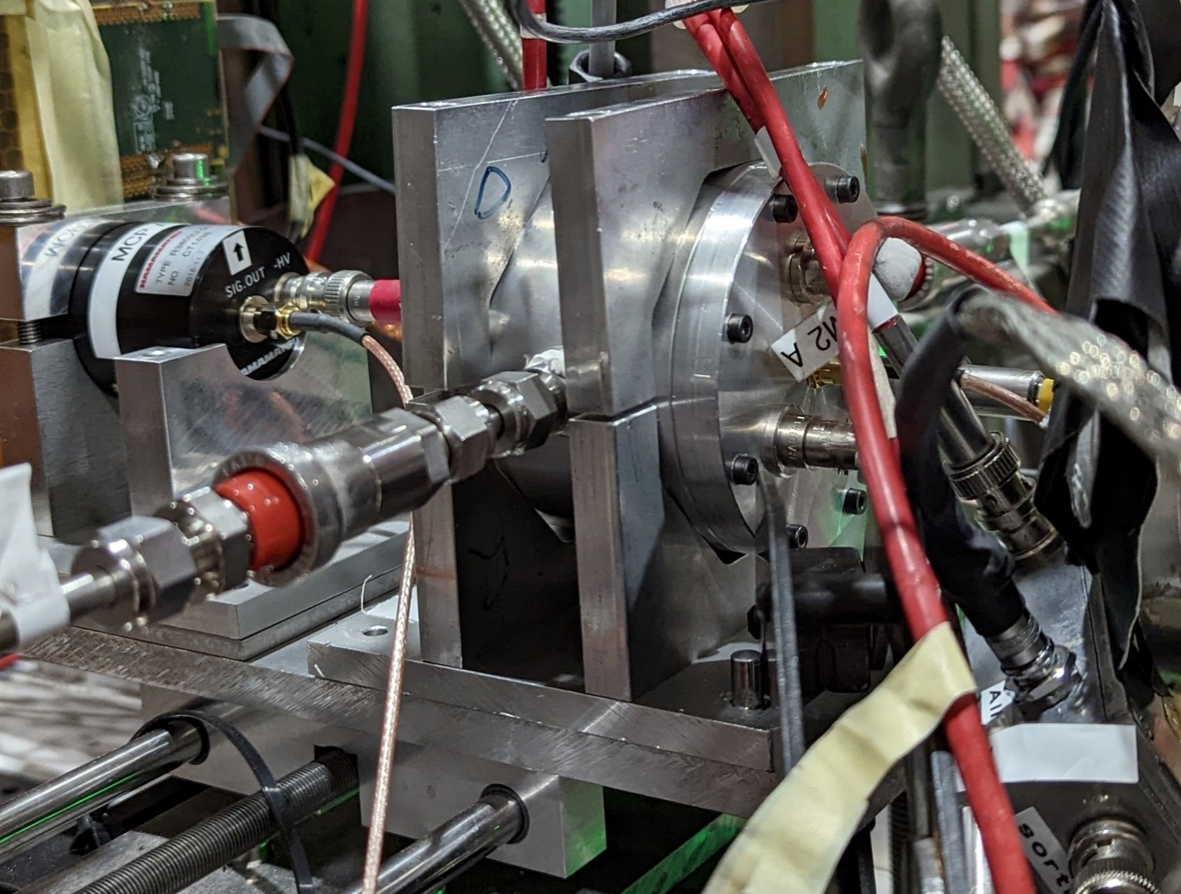
Test Beam Setup
MCP for time reference σ_{t}≈5ps
Test beam, 19Oct-1Nov 2022
Profited of the RD51 GEM-based tracker
Participated to full RD51 R&D campaign
  First beam time with a dedicated detector for muon collider R&D
Single-channel:
Test the detector operation on the beam
Measure different radiator+photocathode combination yield (photoelectrons/MIP) and compare
Measure time resolutions with different radiator+photocathode combination
Comparison between non-resistive MM (amplification 150um) and resistive MM (amplification 128um)

Slide 8
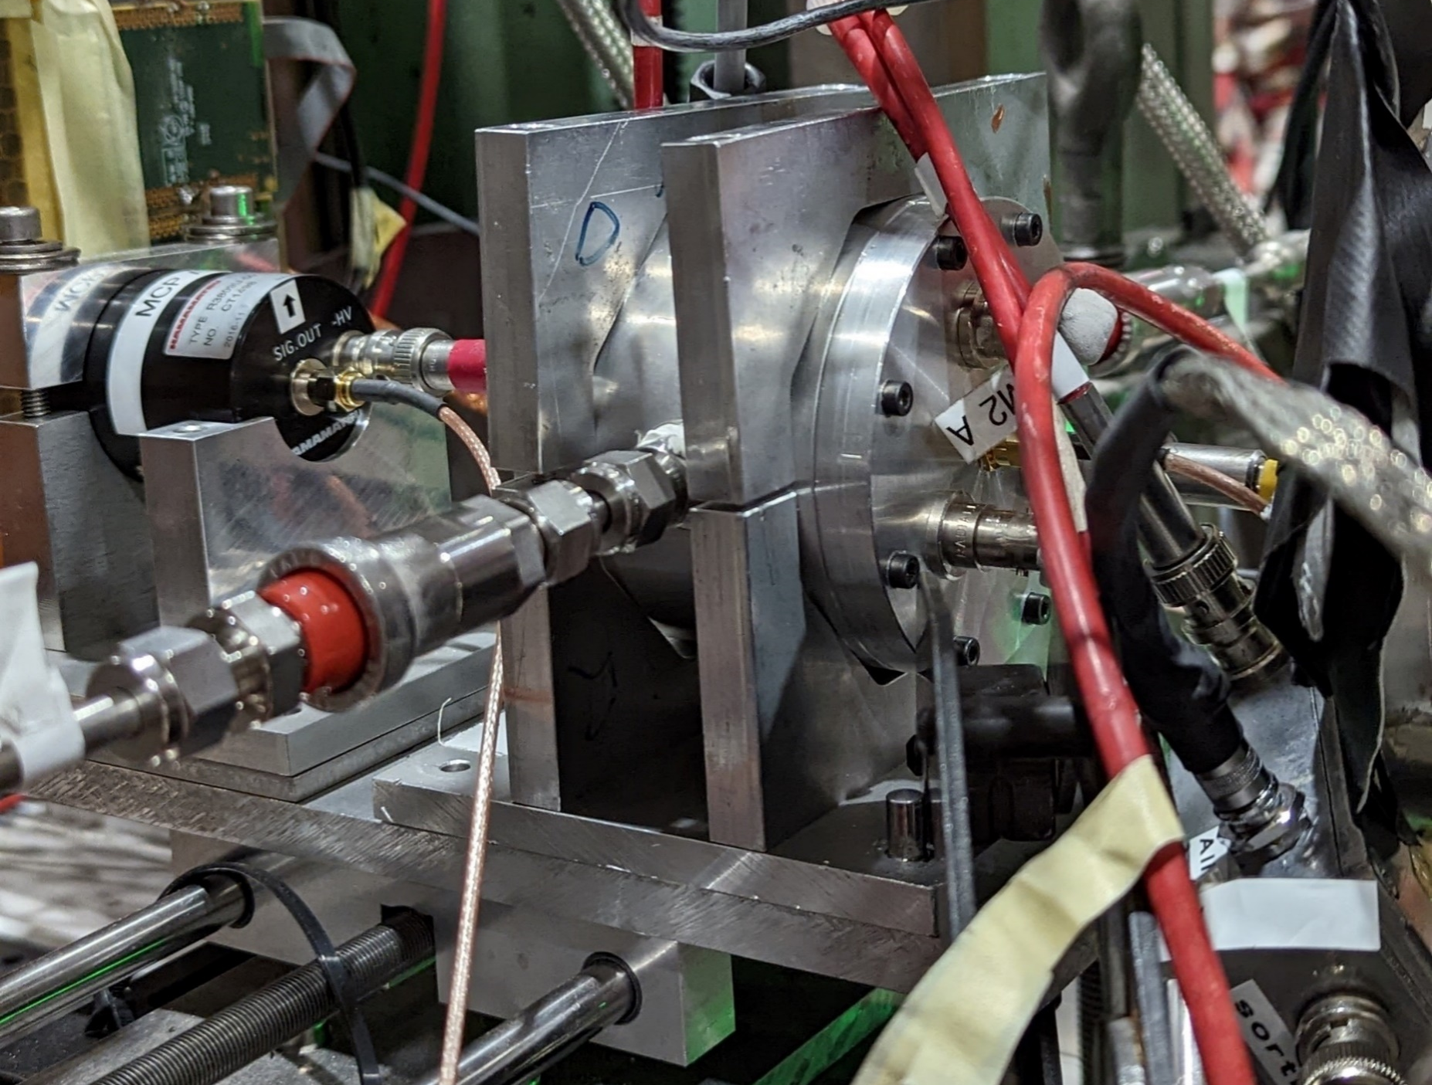
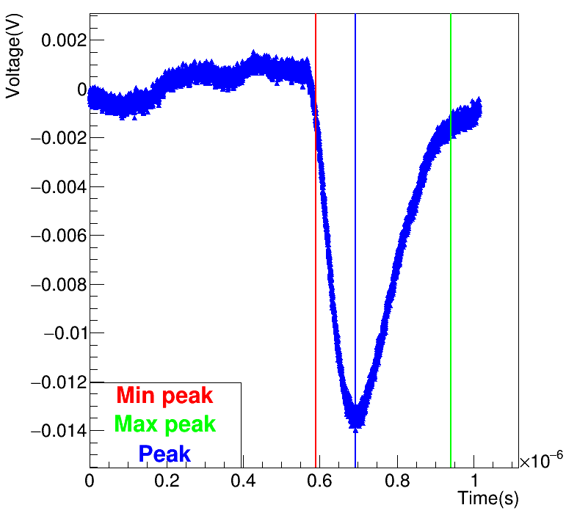
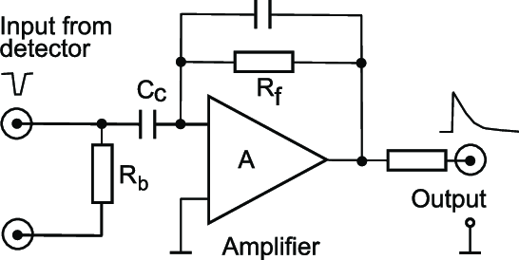
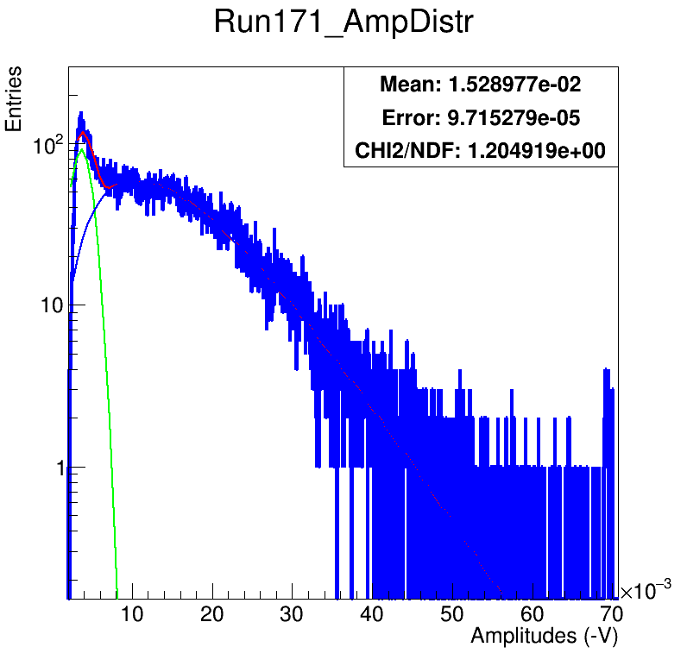
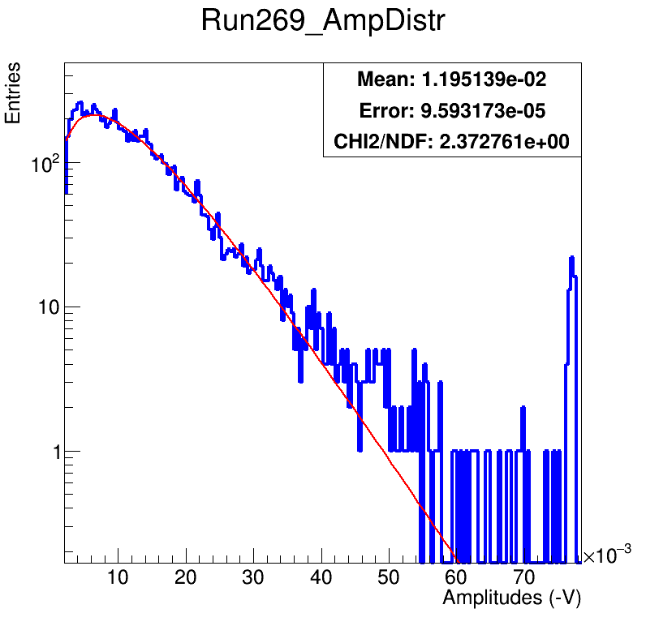
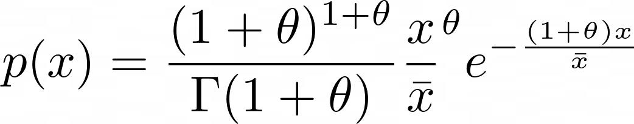
Single-channel setup
- Photoelectrons/MIP measurement-
Charge amplifier
Waveform saved for processing
Charge spectrum with UV LED → single photoelectron spectrum
Charge spectrum with beam → photoelectrons from beam spectrum
  Geometrical cut essential to select only fully contained Cherenkov cones
Integral of the signal
-or-
Just the amplitude
Single PE
Polya function (negative binomial)
Describe well the gain fluctuation when the primary charges are low
Multi PEs

Slide 9
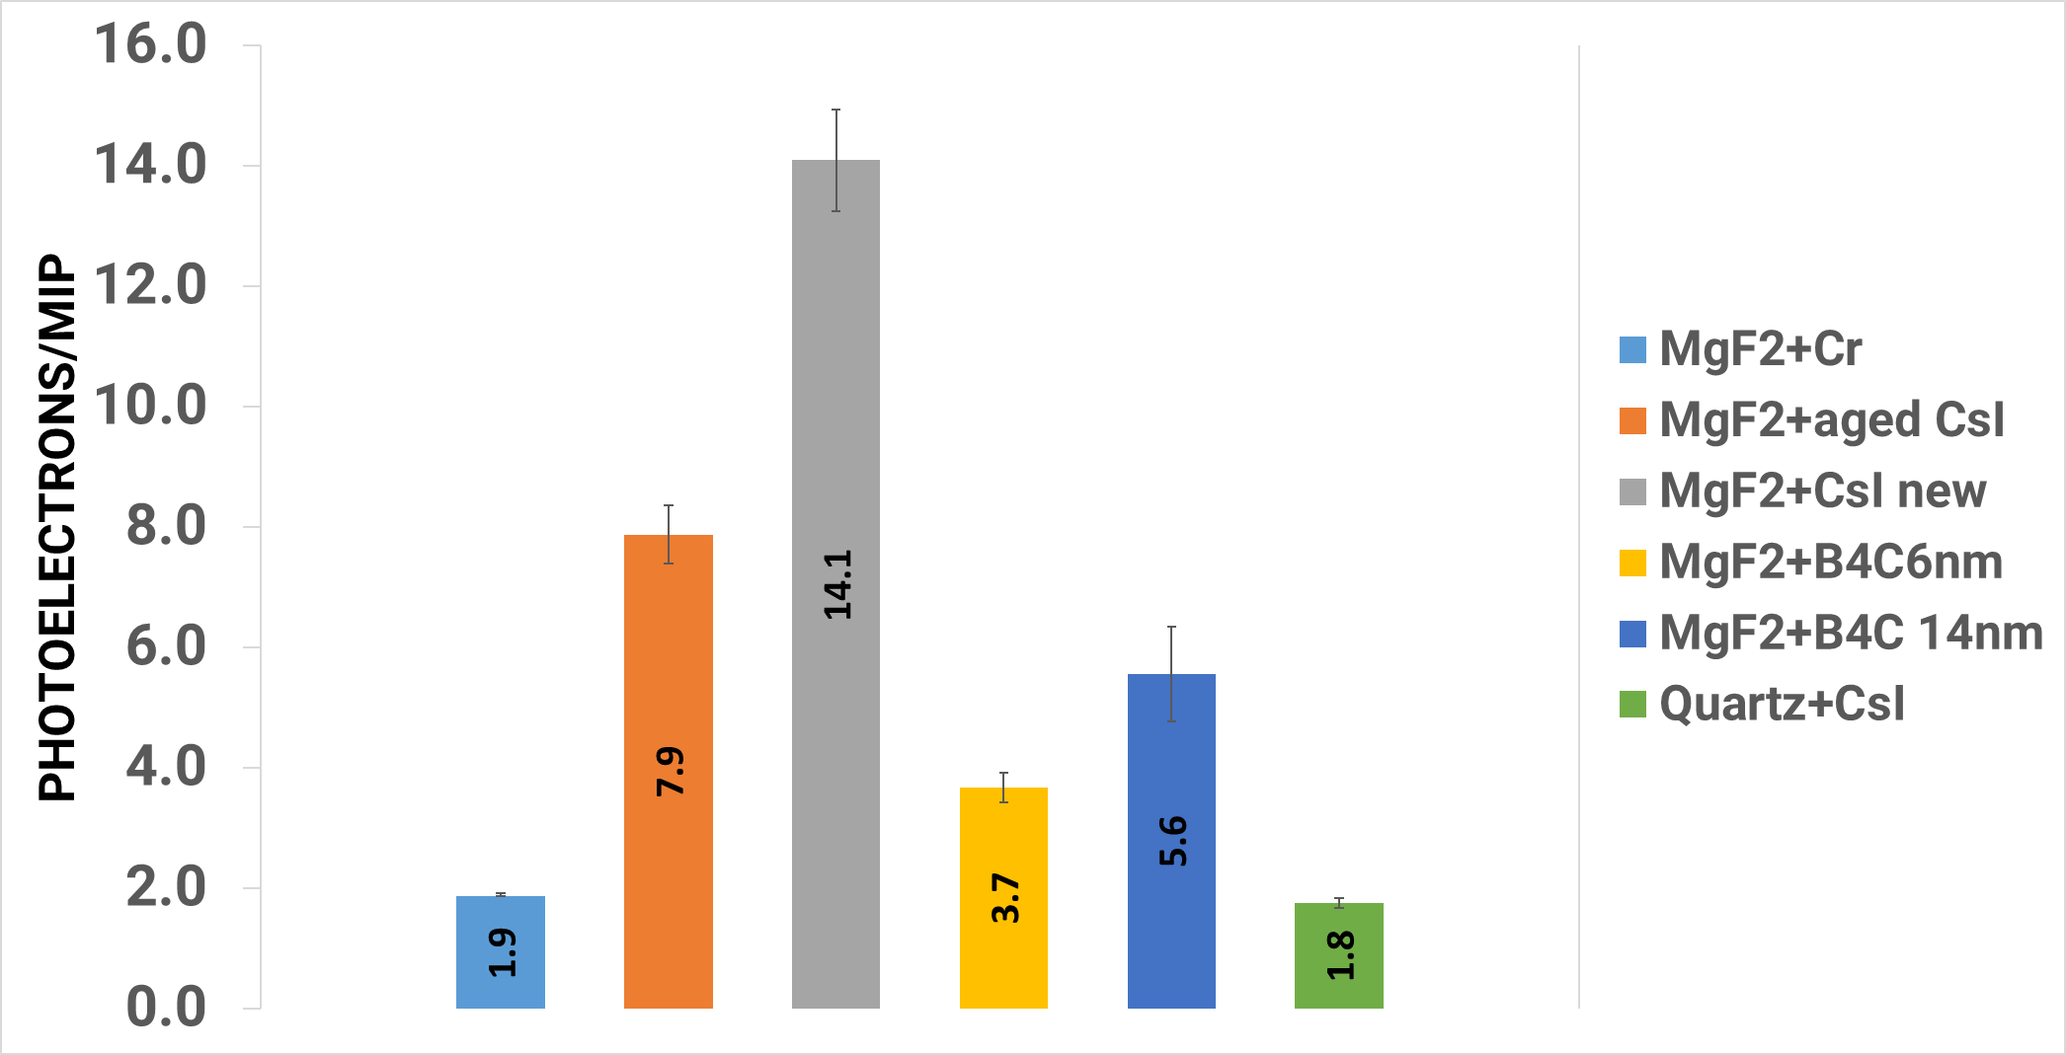
Photoelectrons per Muon
The ratio among the mean amplitudes gives the average number of photoelectrons per incoming muon.
We don’t know precisely the amount of aging of the CsI photocathode in orange, but it was handled in the air multiple times (collected humidity damage). CsI is prone to degradation if exposed to humidity and heavy ion bombardment
Quartz is not a good radiator. Its yield is an order of magnitude lower than MgF2. May create some inefficiencies
B4C is very promising (12nm demonstrated the best performance https://indico.cern.ch/event/1219224/contributions/5130512/attachments/2565710/4423222/Marta Lisowska - PICOSEC Micromegas - MPGD2022.pdf). Moreover is resistive (spark protection) and easy to handle.
MgF2 radiator
Quartz radiator

Slide 10

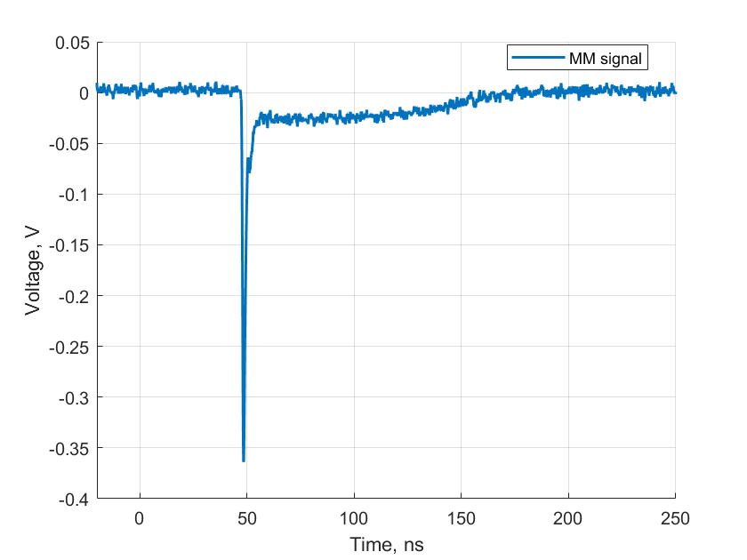
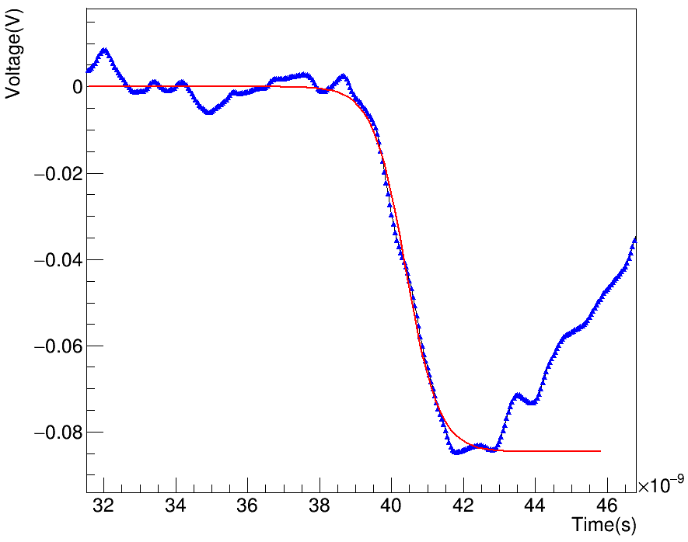
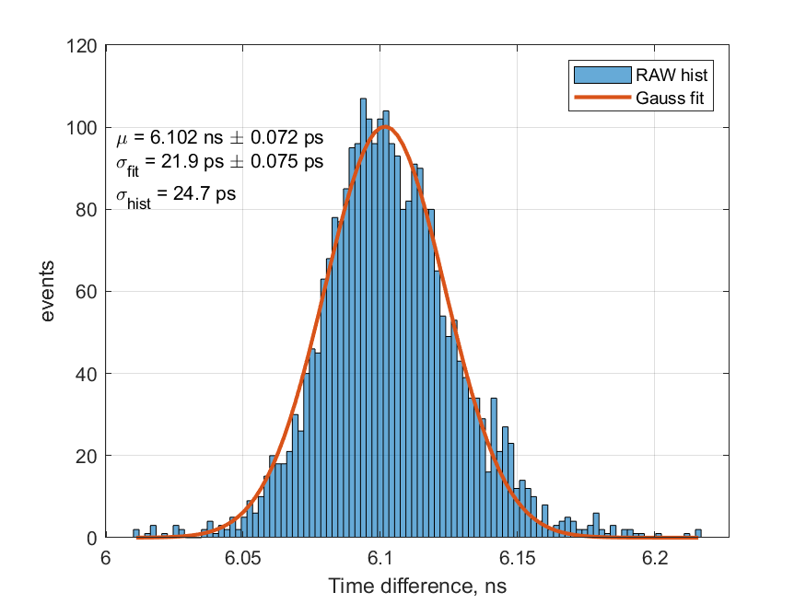
Single-channel setup
-Timing measurement-
Slow ion tail
Current amplifier
To preserve the rising edge!
Fast electron peak
Logistic function fit on Picosec signal
→ CFD on fit → Signal Arrival Time
Logistic function fit on MCP signal
→ CFD on fit → Signal Arrival Time
Δt between the SATs gives the time resolution!
The geometrical cut on the fully contained cones is fundamental also in timing.

Slide 11
Timing Results
←non-resistive MM 150um 1.84 V/um
Resistive MM 128um 2.15kV/um→
The timing performance reflects the number of PEs/MIP
All the combinations may be suitable for Muon Collider application (<100ps)

Slide 12
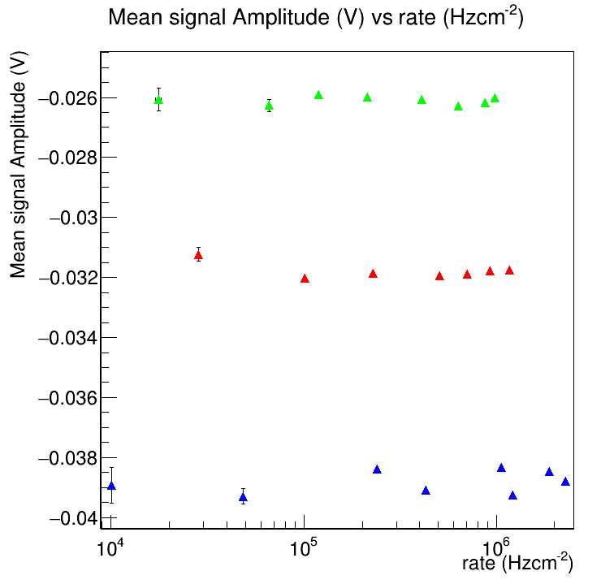
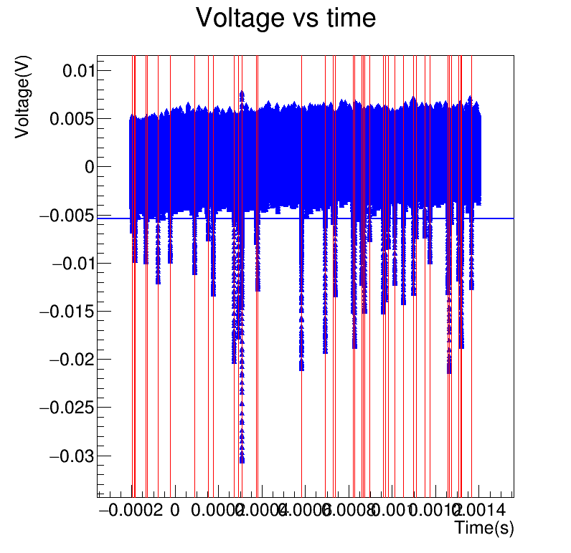
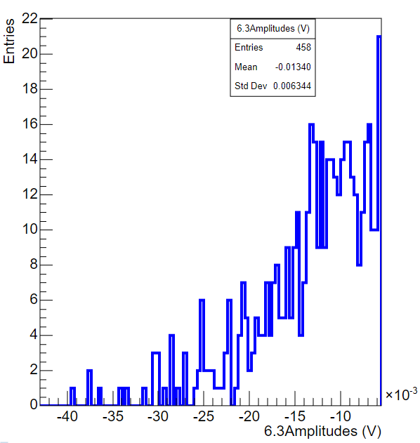
Rate capability to single PEs
-work in progress-
Irradiation with UV LED to generate single-photoelectrons signals
CsI photocathode
Counts signals and measures the average amplitudes
Drift field: 3.13 V/um
Detector performance stays stable up to 2MHz/cm² for single-photoelectron
One can roughly scale a factor of 10 for Muons
We can go higher with the rate, but we have to fight against CsI degradation
Amplification field:
2V/um
1.9V/um
1.8 V/um
←Example of an amplitude spectrum
Example of 1.6ms of acquisition →

Slide 13
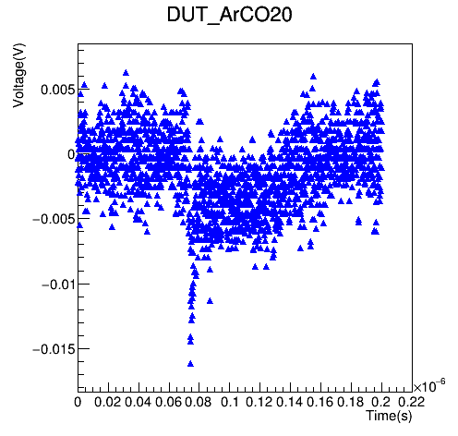
Eco-friendly gases
-work in progress-
LED irradiation → single Photoelectrons signals
Gas: Ar/CO2 93/7
Drift: 150um, Amplification: 150um
Drift: 380V, Amplification 480V (max voltages achievable with such mixture)
Many of the signals do not present the expected electron-peak/ion-tail ratio
Multiple signals on the same rising edge
Probably caused by some feedback process because of the low quenching gas?
Any suggestion on that is very welcomed ☺

Slide 14
Conclusions
Muon Collider requirement
~100ps time resolution
60kHz/cm² rate capability
Spark and radiation hard detector
Scalable technology up to ~m² (baseline option is to tile a large surface with small detectors)
Test Beam results
All configurations satisfied the ~100ps time resolution
Quartz+CsI and MgF2+Chromium may lead to inefficiencies because of the low number of photoelectrons
CsI is the best photocathode but can be easily damaged by ion bombardment and humidity
B4C is a very promising candidate (resistive and easy to handle)
  Not suitable for Muon Collider because of neutrons, but DLC should have a similar performance
Rate capability
Detector response to single photoelectrons stable up to 2MHz/cm²
Operational limit will be tested soon!
Eco-friendly gas
Ar/CO2 (93/7) seems to have a too-small quenching factor for good performance in a single photoelectron case
New gases will be tested in Pavia (Ne, Ar, C2H6, C4H10, R1234ze…)
DRD1 transition:
Pavia group is the ‘watcher’ in the Muon Collider Collaboration for the new DRD1
Expression of interest in RPC, straw tubes and MPGDs (Picosec but not only)

Slide 15
BACKUP

Slide 16
Timeline

Slide 17
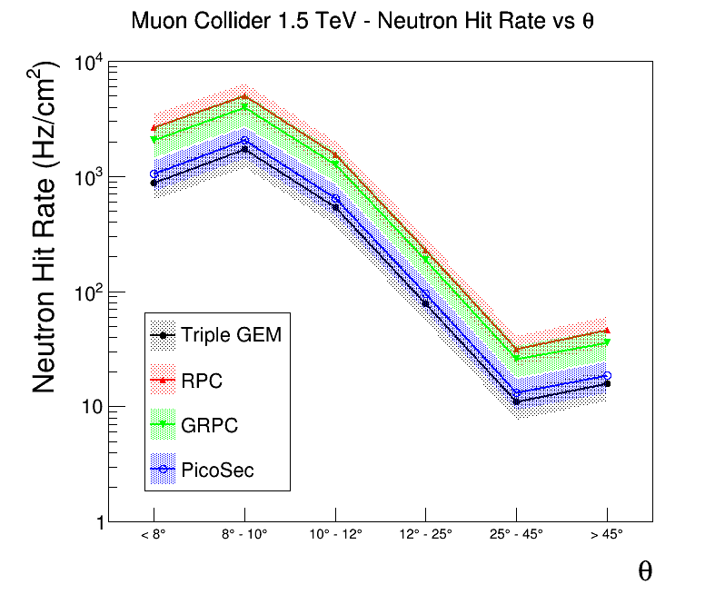
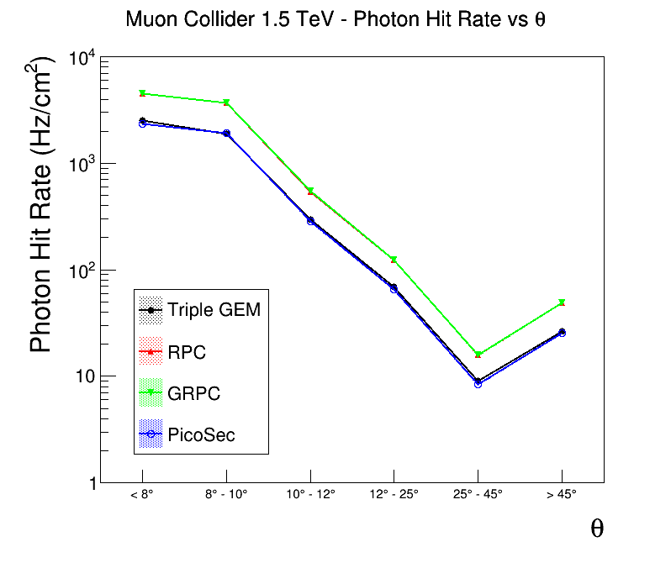
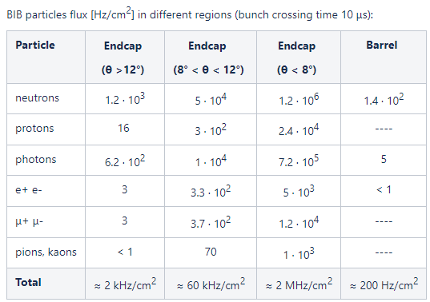
Simulation background
Background interaction with the detector was simulated in Geant4
Convoluted with the response of different gaseous detector technologies (hit when a charged particle is found in the drift gap)
Simulated Picosec: 3mm MgF2 radiator, 18nm CsI photocathode, 200um drift gap
Picosec can potentially operate in high-rate environments and give timing information with higher precision wrt other technologies

Slide 18
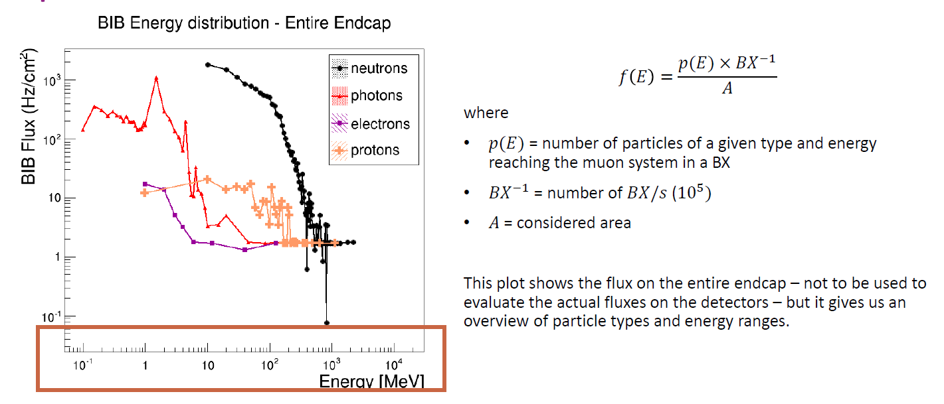
BIB spectrum

Slide 19
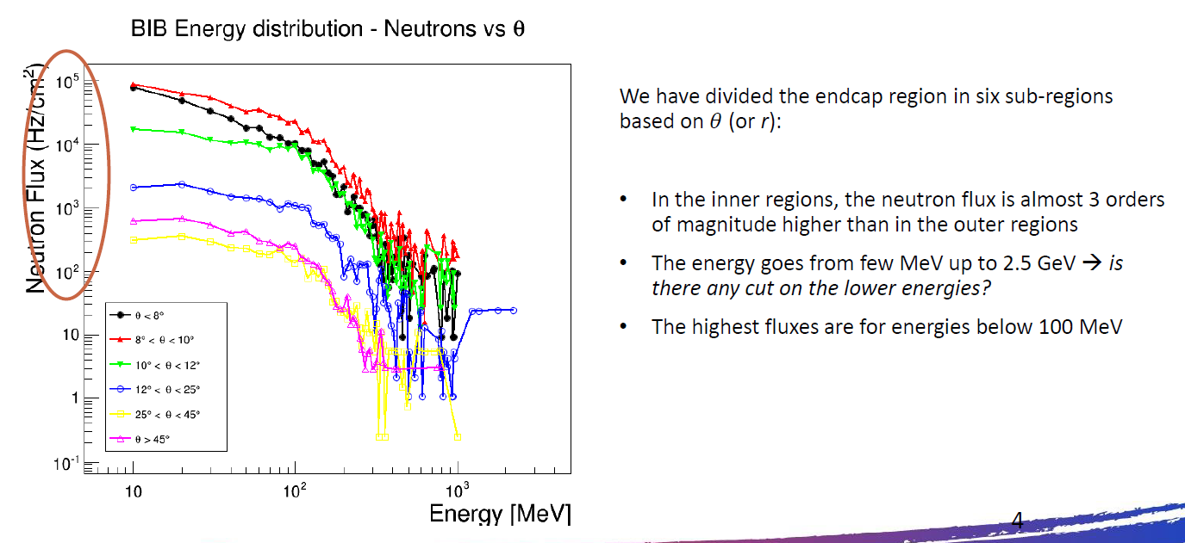
BIB neutrons

Slide 20
Selection of detectors for MIP timing
Detector | Space resolution | Time resolution | Rate capablity | Longevity | Cost (CHF/cm²) | Reference
MRPC ALICE ToF | ≈3cm* | ≈60ps** | 500Hz/cm²** | No issue after 20 years operation** | ≈1 | alice_toftdr.pdf (cern.ch) 1806.03825.pdf (arxiv.org)
LGAD ATLAS HGTD | ≈1mm* | ≈30ps →≈70ps end of life | - | 2.5x10¹⁵n_{eq}/cm² | ≈38 | HGTD TDR (cern.ch)
LGAD CMS MTD endcap | ≈1mm* | ≈30-40ps →50-60ps end of life | ⁻ | 1.5x10¹⁵n_{eq}/cm² | ≈62 | CMS Technical Design Report for the Phase-2 Timing Upgrade (cern.ch)
Picosec 10x10cm² prototype | ≈1cm* | ≈24ps | Tested on ≈50kHz/cm² laser beam and ≈100Hz/cm² muon beam NO LIMIT REACHED | - | ≈70 Cost of one 100cm² prototype
Micromegas ATLAS NSW | <100µm | ≈7ns | >15kHz/cm² required ≈1MHz/cm² max | >230mC/cm² | ≈1 | ATLAS-TDR-020.pdf (cern.ch) pdf (iop.org) 47d84fb8700bff3c5787574218f71972 (inspirehep.net)
*estimated from pad size
**from real operation
Picosec potential:
High rate capability wrt MRPC
Low cost wrt to LGAD

Slide 21
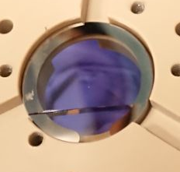
R&D Plan: Cherenkov Radiator
Cherenkov radiator
Broken MgF₂ crystal
Cherenkov radiator – Baseline MgF₂
High UV transparency (>120nm)
Fragile
High cost (12€/cm²)
No technology for large areas (100cm² max)
Quartz (5€/cm², >180um)
Sapphire (6€/cm², hard, large area, >170um)
other F-based crystals have to be studied!
Photo
cathode
Gas Mixture

Slide 22
R&D Plan: Photocathode
Damaged CsI
Cherenkov radiator
Photoelectrons generated per MIP (p.e./MIP) with 3mm MgF₂ radiator
Photocathode – Baseline CsI
High quantum efficiency to UV (≈10p.e./MIP)
Easy to coat by Chemical Vapour Deposition
Hygroscopic (sealed operation, dry gas)
Damage by ion bombardment
Metallic (Al, Cr, Au…) → easy to coat, non-resistive (pro and cons), lower QE (1-2 p.e./MIP)
Carbon-based (DLC, B4C) → dedicated sputtering machine, resistive (pro and cons), lower QE (factor 3-4 p.e./MIP)
Photo
cathode
Gas Mixture

Slide 23
R&D Plan: Gas Mixture
Cherenkov radiator
Gas Mixture– Baseline Ne/C₂H₆/CF₄
High gain and discharge quenching (up to 2-3x10⁵)
High drift velocity (>5 cm/µs)
Very costly (Ukraine was the main producer of Ne, CF4 is heavily taxed for its GWP)
Not eco-friendly (GWP≈740)
C₂H₆ (3k€ bottle, GWP=10.2) can be substituted with other quenchers :
CO₂ (0.7k€ bottle, GWP=1, small quenching)
iC₄H₁₀ (1.5k€ bottle, GWP=3, good quenching)
CF₄ (4k€ bottle, GWP=7390) is difficult to replace:
drop it
R1234ze (1.5k€ bottle, GWP=7, candidate substitute for fluorinated gas in RPC and CMS-CSC)
New mixtures with new gases
ALICE TPC GEM Ne-N₂-CO₂ (relatively high drift velocity, negligible GWP)
Photo
cathode
Gas Mixture

