Slide 1
RD51 ⇆ WG2 ⇆ DRD1

Slide 2
Towards DRD1 Collaboration Structure: WG
Keep RD51 structure in WGs including alignment with the scientific program of the ECFA roadmap, looking more generally to future facilities challenges and specifically to the ECFA Roadmap selected Detector RD Themes (DRDT)
WG1: Technologies
Includes exp. detector physics aspects
MPGD
RPC and MRPC
Wire chambers (incl. Straws, TGC, CSC, ..)
Large Volume Detectors (drift chambers, TPCs)
New amplifying structures
WG3: Gas and material studies – New
Gas Properties (e.g. cross-section, chemical characterization, measurements); light emission in gas
Eco-gases studies
Gas systems, gas recuperation/recirculation systems
Sealed detectors and systems
Resistive electrodes
Solid converters; PCs (novel, aging, protection)
Novel materials (e.g. nanomaterials)
Material properties for detector and infrastructures
Low material budget materials; precise mechanics
Aging, Radiation hardness, Outgassing
WG2: Applications
Full alignment with the ECFA detector R&D roadmap
Muon systems
Inner and central tracking with particle identification capability
Calorimetry
Photon detection
Time of Flight systems
TPCs for rare event searches
Fundamental research applications beyond HEP
Medical and industrial applications
WG4: Detector physics, simulations, and software tools
Detector Physics (modeling and simulations)
Detector Performance Studies (modeling and simulations)
Software development and maintenance
Gas Properties Databases (e.g. cross-sections) - Use and/or Maintenance; Detector design

Slide 3
Towards DRD1 Collaboration Structure: WG
WG5: Electronics for gaseous detectors
Analog/Digital Electronics
Discrete Readout Front End Electronics and ASICs
Charge/Photon readout
FE input protection & spark quenching
Waveforms and Digitizer; Signal Processing
Cluster Counting
Specific needs: Timing, High rate, Low noise, Wide Dynamic Range,… )
Grounding and Shielding; Calibration
SoC based sensor readout
General purpose DAQ, FPGA based readout/trigger and Trigger-less systems
HV Systems and HV distribution schemes
LV Powering, Cooling
Laboratory instrumentation (High resolution floating ammeters, Monitoring and control systems)
WG6: Detector production
CERN EP-DT Micro Pattern Technology (MPT) Workshop
Saclay MPGD workshop
RPC/MRPC workshop
Wire chambers workshop
Novel detector production methods
CERN EP Thin Film & Glass service (photocathodes, coatings, ceramic)
Technology and knowledge transfer (to industry and within the collaboration)
Relationship with Industry
WG7: Common test facilities
Includes development of common detector characterization standards:
General purpose detector development labs
Ageing Study Facility
Gas studies facility
Irradiation facility
Test beam facility
Chemistry and material laboratory
Clean Room
Instrumentation for common detector characterization (e.g. gas, DAQ, HV systems)
WG8: Training and dissemination
Schools and trainings
Topical workshops
Knowledge transfer
( Young ) Researcher Career
Strategies to recognize and sustain the careers of R&D experts

Slide 4
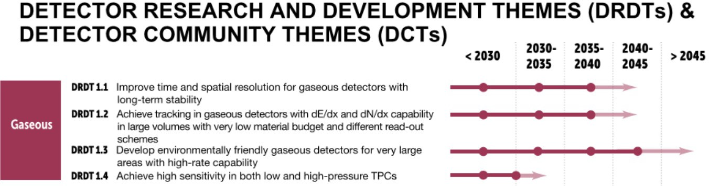
DRD Themes

Slide 5
DRD1 Work Packages
From the draft template
The purpose of a WP in DRD1 is to offer formal and recognized activities to members of DRD1 to facilitate their funding requests
All funding and resources should stay in the end of the groups creating and joining the WP
The format of the WP should be flexible to be adapted by the various team to the funding agency requests
WP proposal:
Scope of WP
  Activities
  Infrastructures, services, tools
Milestones and Deliverables
Cost Estimates and Resources
Groups Participation and Contributions

Slide 6
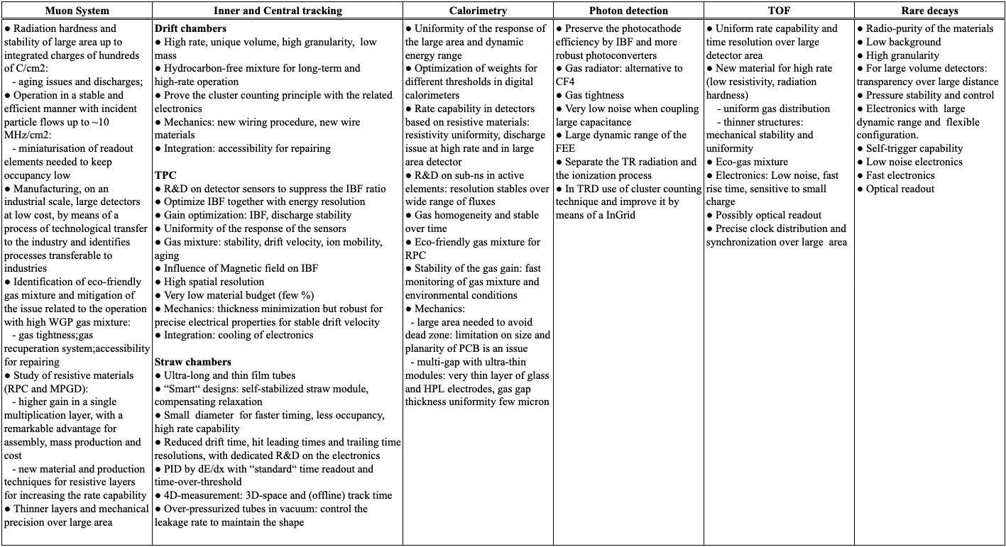


Hard to make a clear cut between RD51 WG1 and WG2

Slide 7
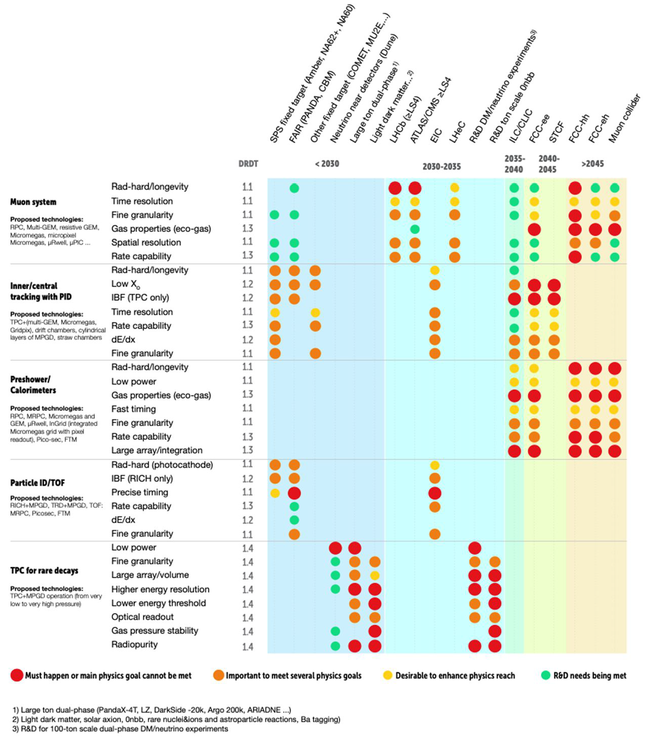
Hard to make a clear cut between RD51 WG1 and WG2

Slide 8
Ongoing and future R&D – way to cluster together?
High-rate trackers
  Discharge suppression
  Resistive materials
  New structures
TPCs
  CEPC: hybrid, IBF minimisation
  ILC: 3GEM / Encapsulated res-anode MMG / GridPix
  Optical readout
  dN/dy
  DLC layers for cryo operation
  Negative ion TPCs
Photons
  Single photon detectors
  New photocathodes, visible light!
  IBF minimization, discharge protection
  TRD with cluster counting?
Timing
  PICOSEC
  Resistive materials (e.g. DLC based RPC)
Hard to make a clear cut between RD51 WG1 and WG2
+ FEE, Simulations, Gas studies, Production sites, Common infrastructure

Slide 9
Ideas welcome…discussion should start now

