Slide 1
Xboxes Update
25/01/2023

Slide 2
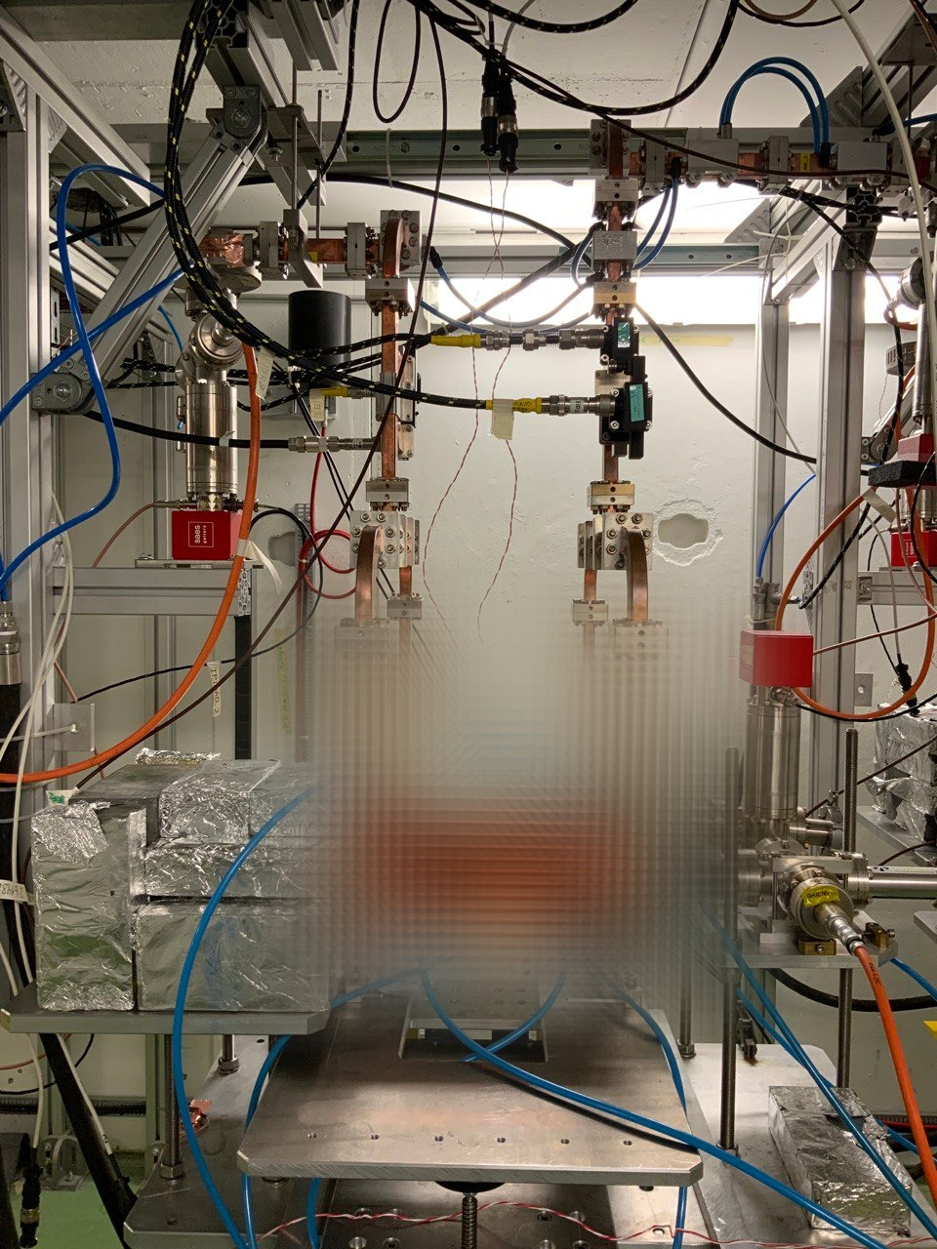
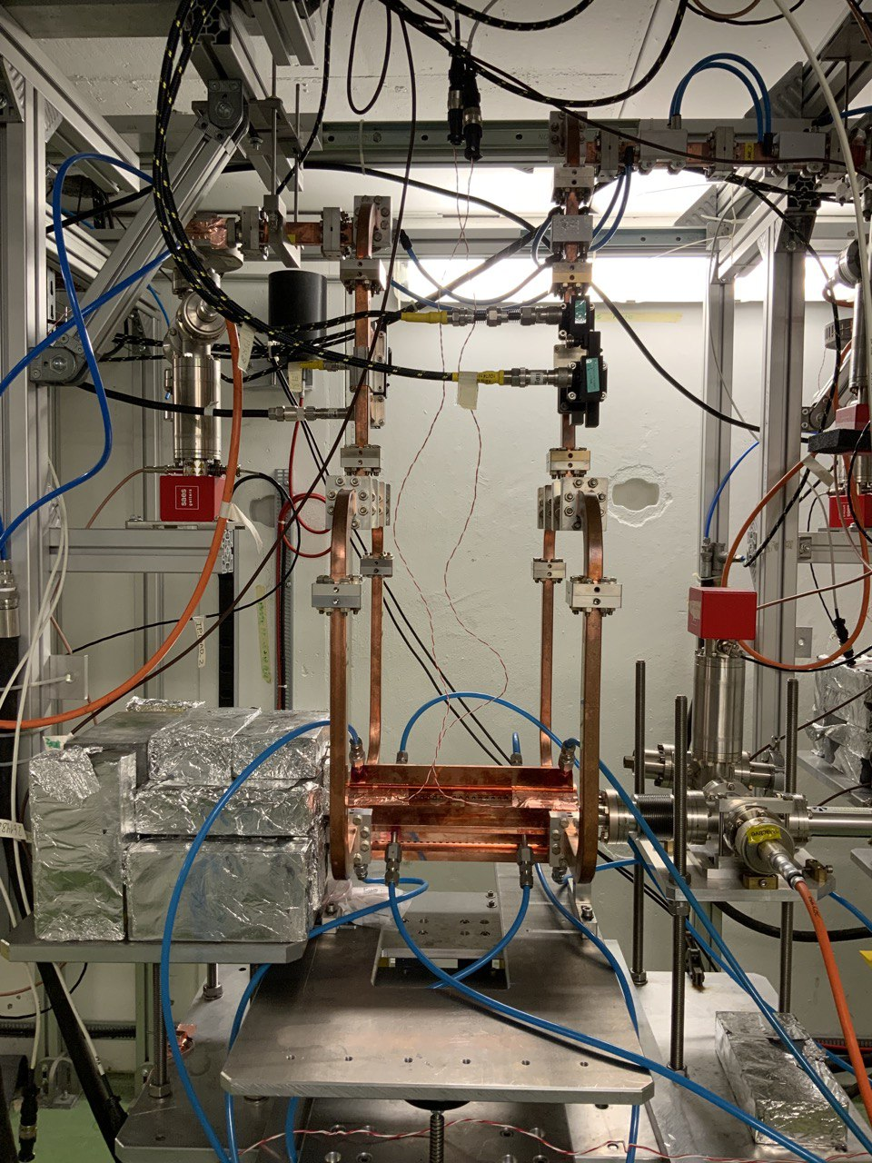
X-Box3 – Line 2

Slide 3
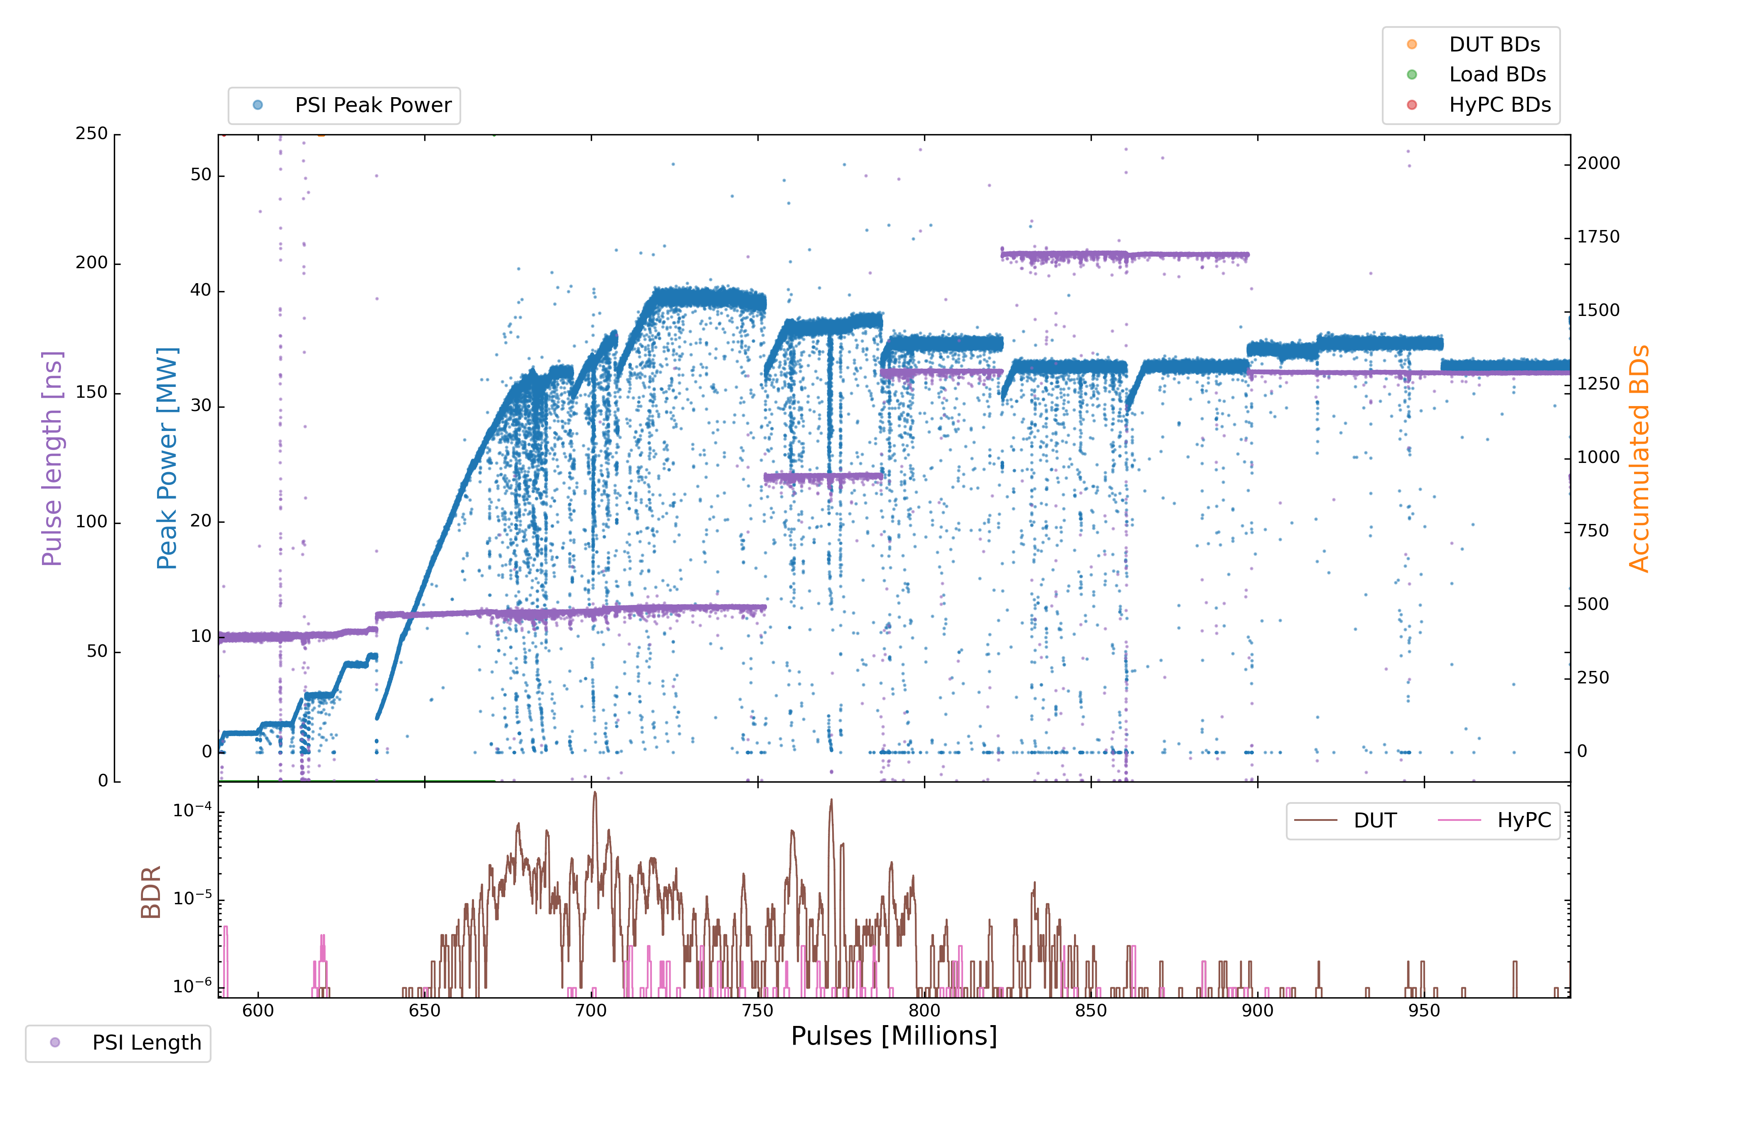
X-Box3 – Line 2
Parameters:
1.9 us klystron pulse
100 ns CP
150 Hz rep rate per line
Current Power: 37,5 MW
17
18
19
20

Slide 4
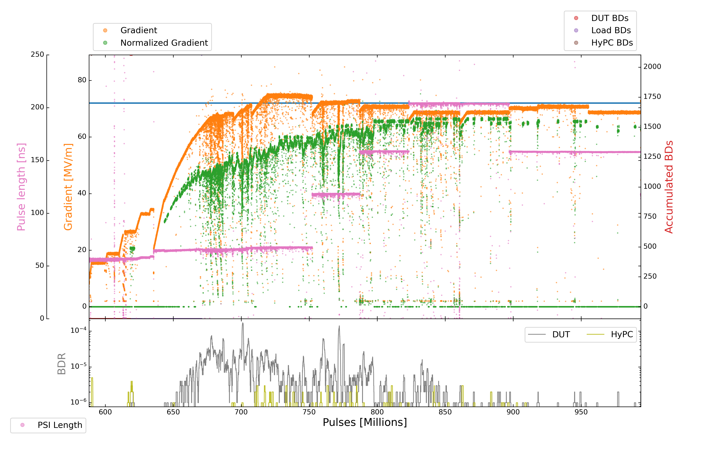
X-Box3 – Line 2
Parameters:
1.9 us klystron pulse
100 ns CP
150 Hz rep rate per line
Current Power: 37,5 MW

Slide 5
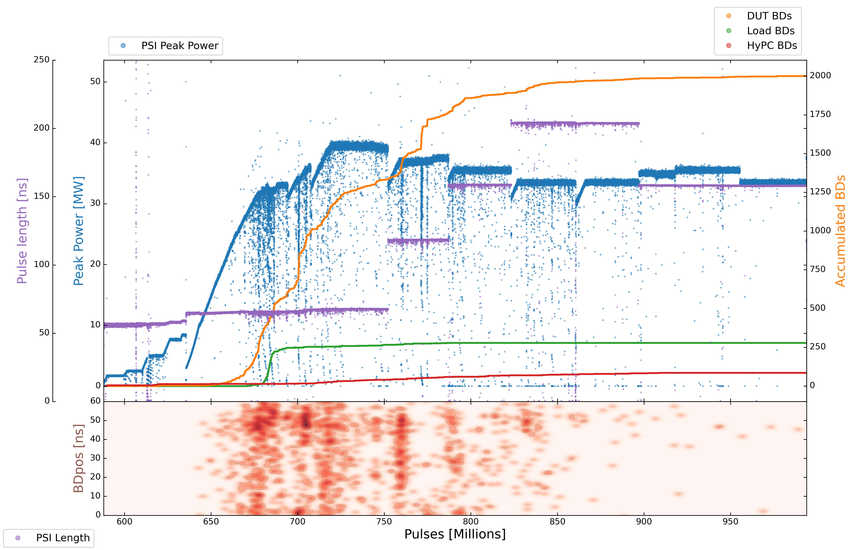
X-Box3 – Line 2
Parameters:
1.9 us klystron pulse
100 ns CP
150 Hz rep rate per line
Current Power: 37,5 MW

Slide 6
X-Box3 – Line 2
Step | Pulse Witdth | Compressed Pulse Width | Power | DUT BDs | DUT BDR | HyPC BDs | HyPC BDR | Millions of Pulses
17 | 1,9 us | 200 ns (210 ns) | 33.5 MW | 16 | 5,0000E-07 | 6 | 1.87500E-07 | 32
18 | 1,9 us | 150 ns (160 ns) | 34.5 MW | 4 | 2.10526E-07 | 2 | 1.05263E-07 | 19
19 | 1,9 us | 150 ns (160 ns) | 35.5 MW | 7 | 2.12121E-07 | 0 | 0 | 33
20 | 1,9 us | 150 ns (160 ns) | 33.5 MW | 4 | 1.08108E-07 | 0 | 0 | 37
21 | 1,9 us | 100 ns (120 ns) | 37.5 MW
22 | 1,9 us | 100 ns (120 ns) | 35.5 MW
23 | 1,9 us | 100 ns (120 ns) | 33.5 MW
24 | 1,9 us | 50 ns (72 ns) | 39.5 MW
25 | 1,9 us | 50 ns (72 ns) | 37.5 MW
26 | 1,9 us | 50 ns (72 ns) | 35.5 MW
27 | 1,9 us | 50 ns (72 ns) | 33.5 MW

Slide 7
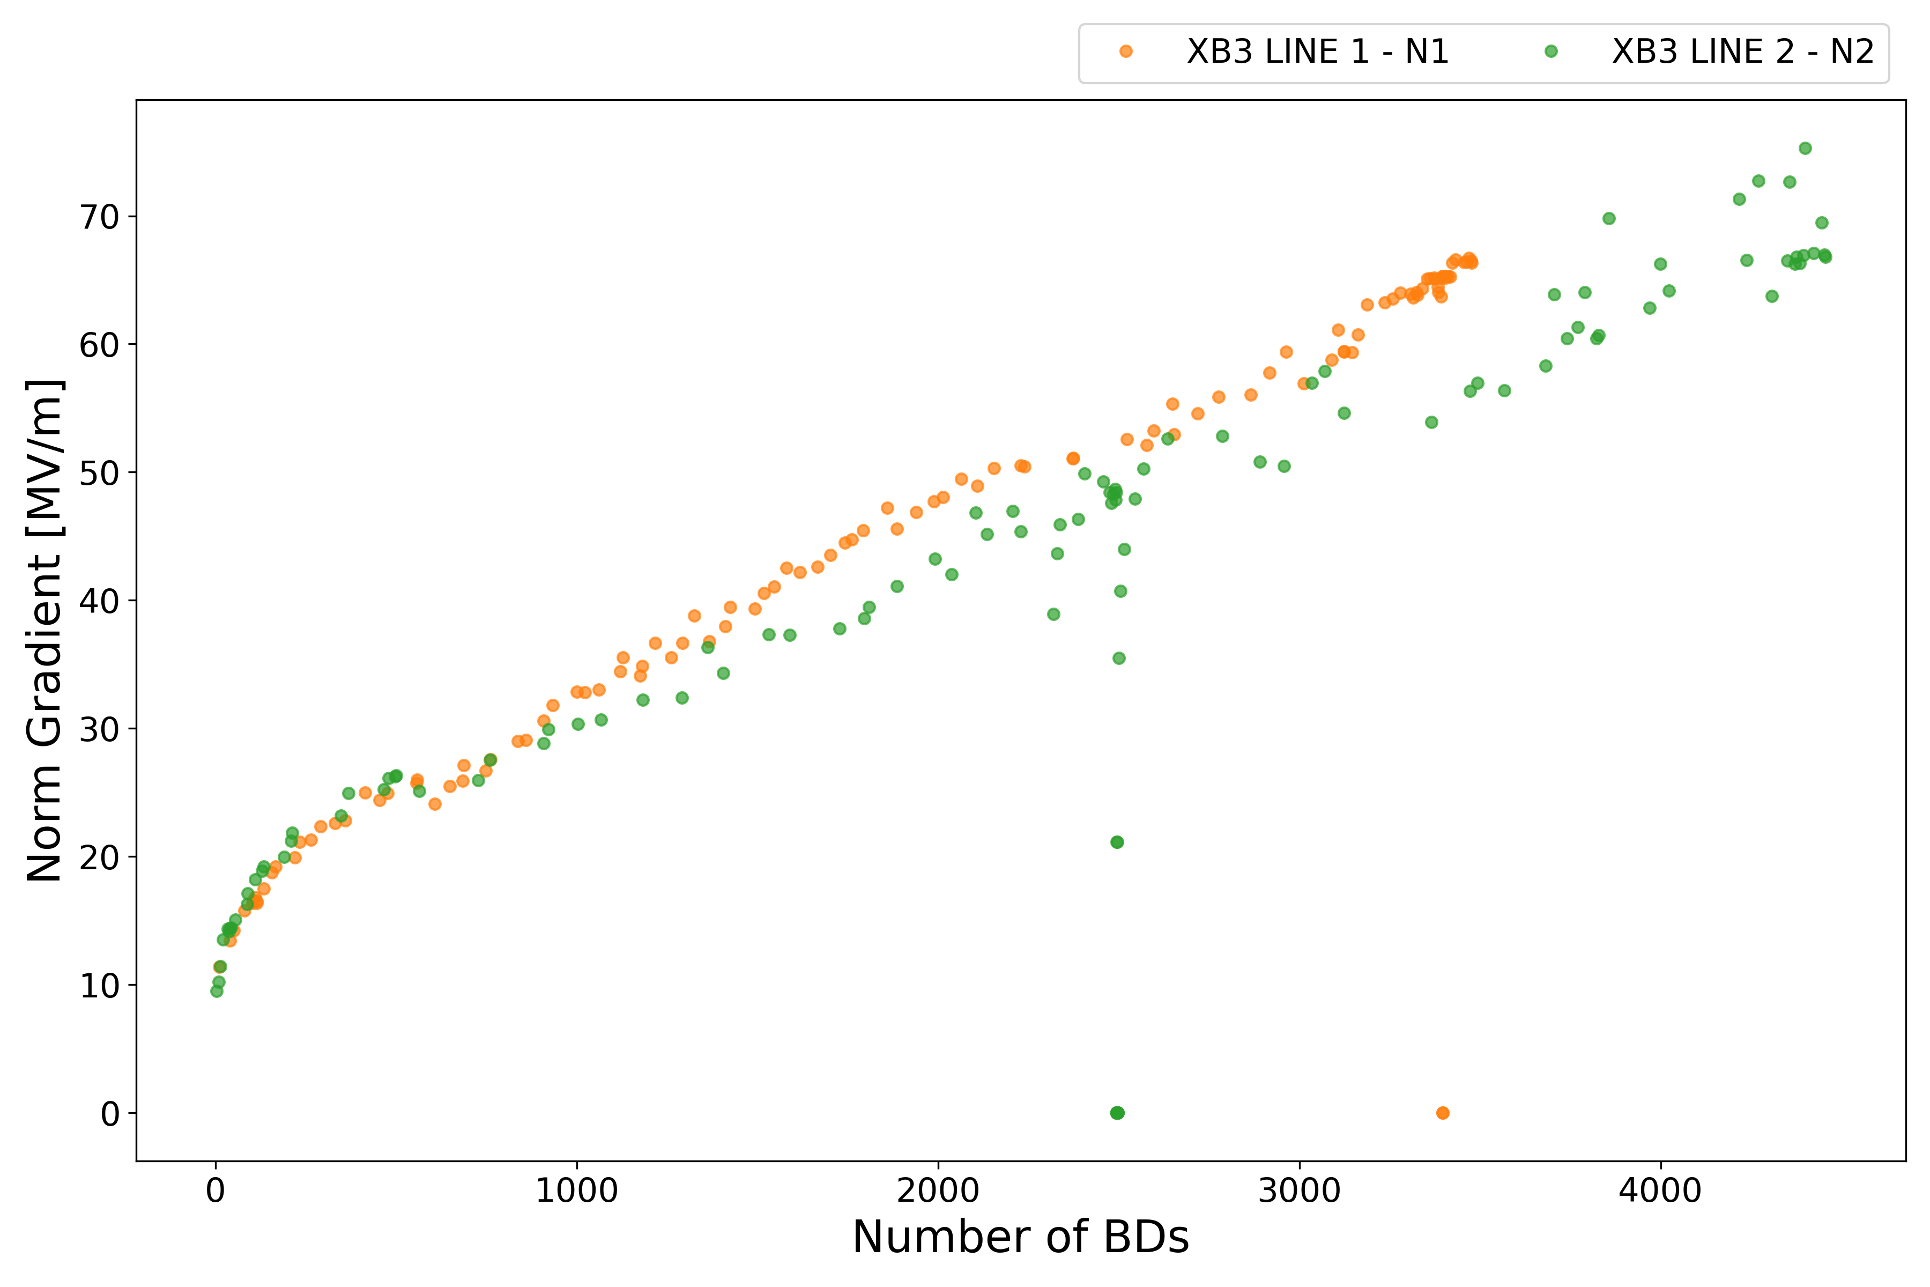
X-Box3 – N1,N2

Slide 8
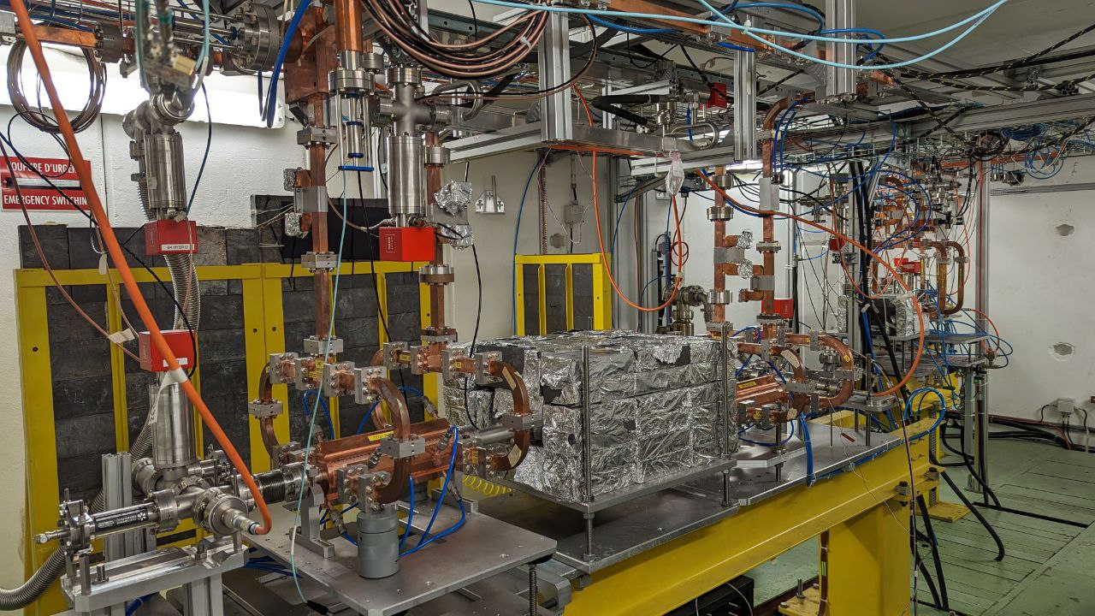
X-Box2

Slide 9
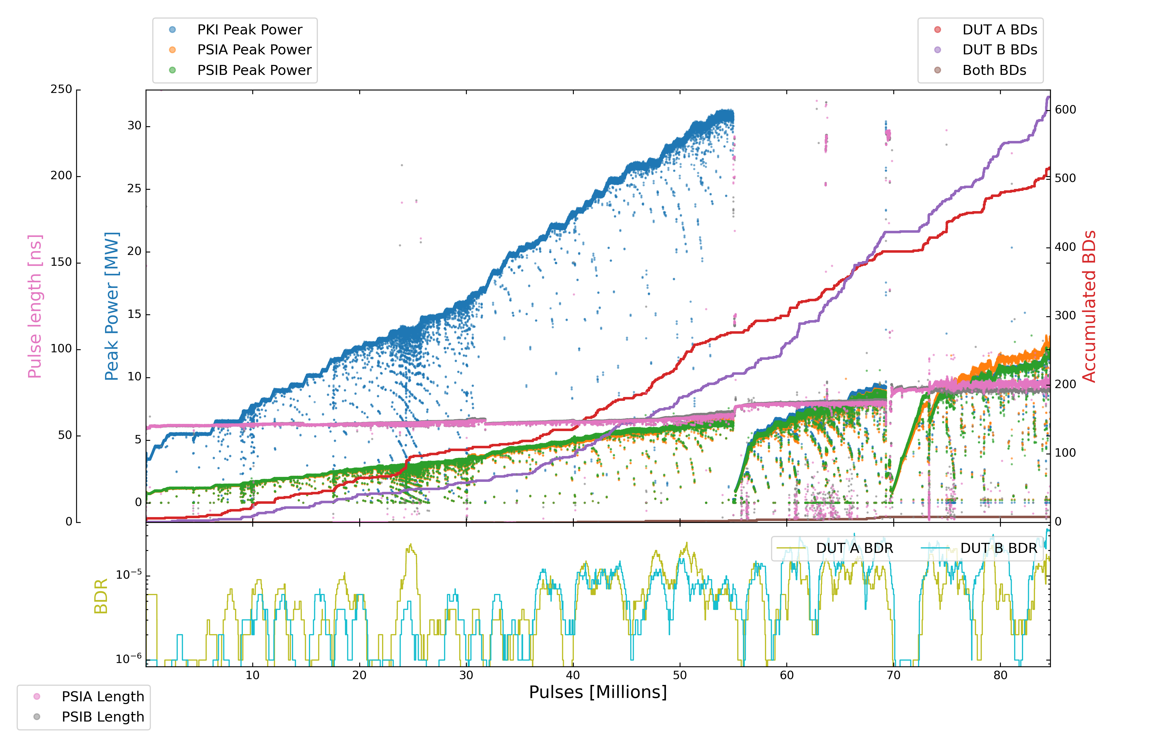
X-Box2
Parameters:
1.6 us klystron pulse
50 ns CP
50 Hz rep rate per line
Current PKI Power: 12 MW

Slide 10
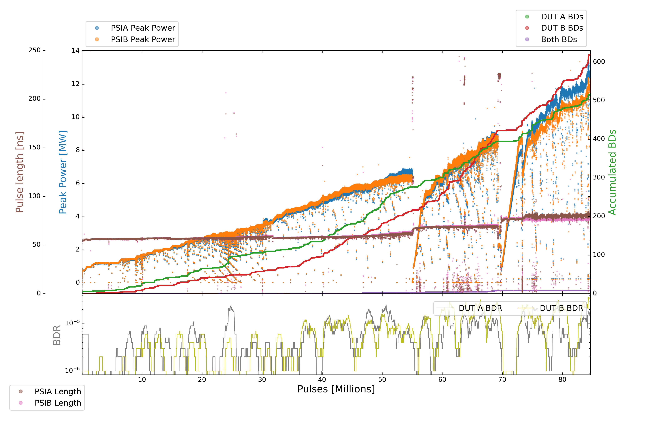
X-Box2
Parameters:
1.6 us klystron pulse
50 ns CP
50 Hz rep rate per line
Current PKI Power: 12 MW

Slide 11
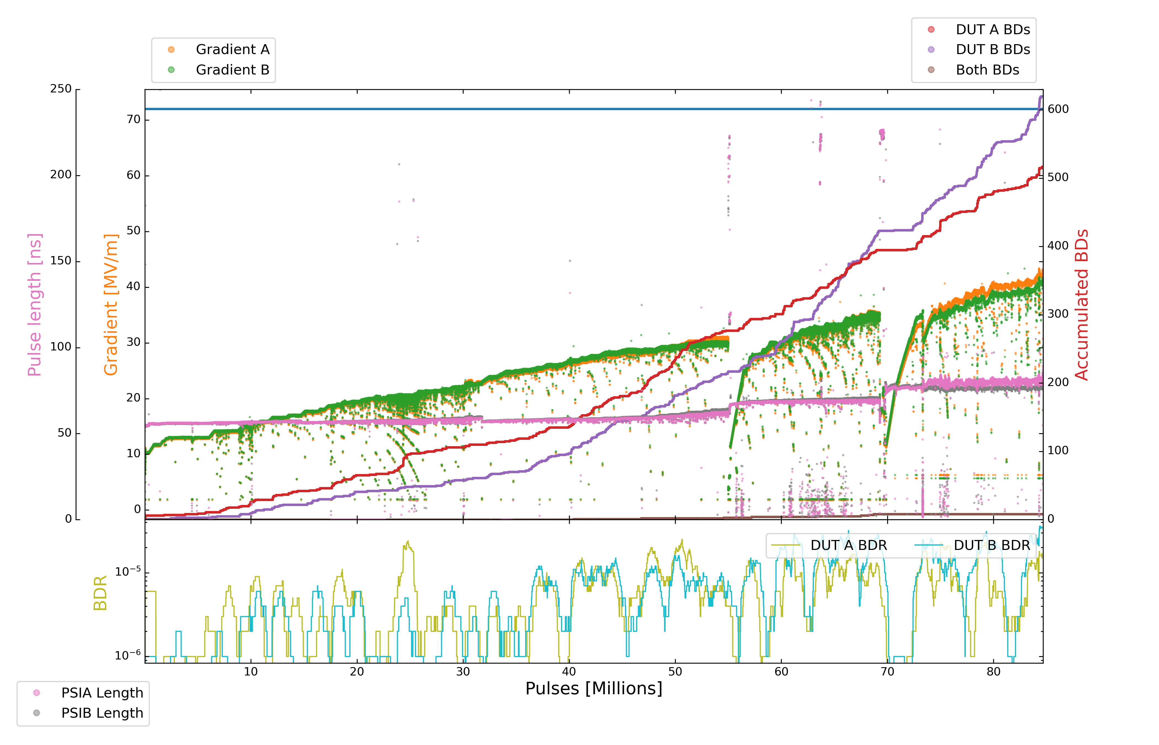
X-Box2
Parameters:
1.6 us klystron pulse
50 ns CP
50 Hz rep rate per line
Current PKI Power: 12 MW

Slide 12
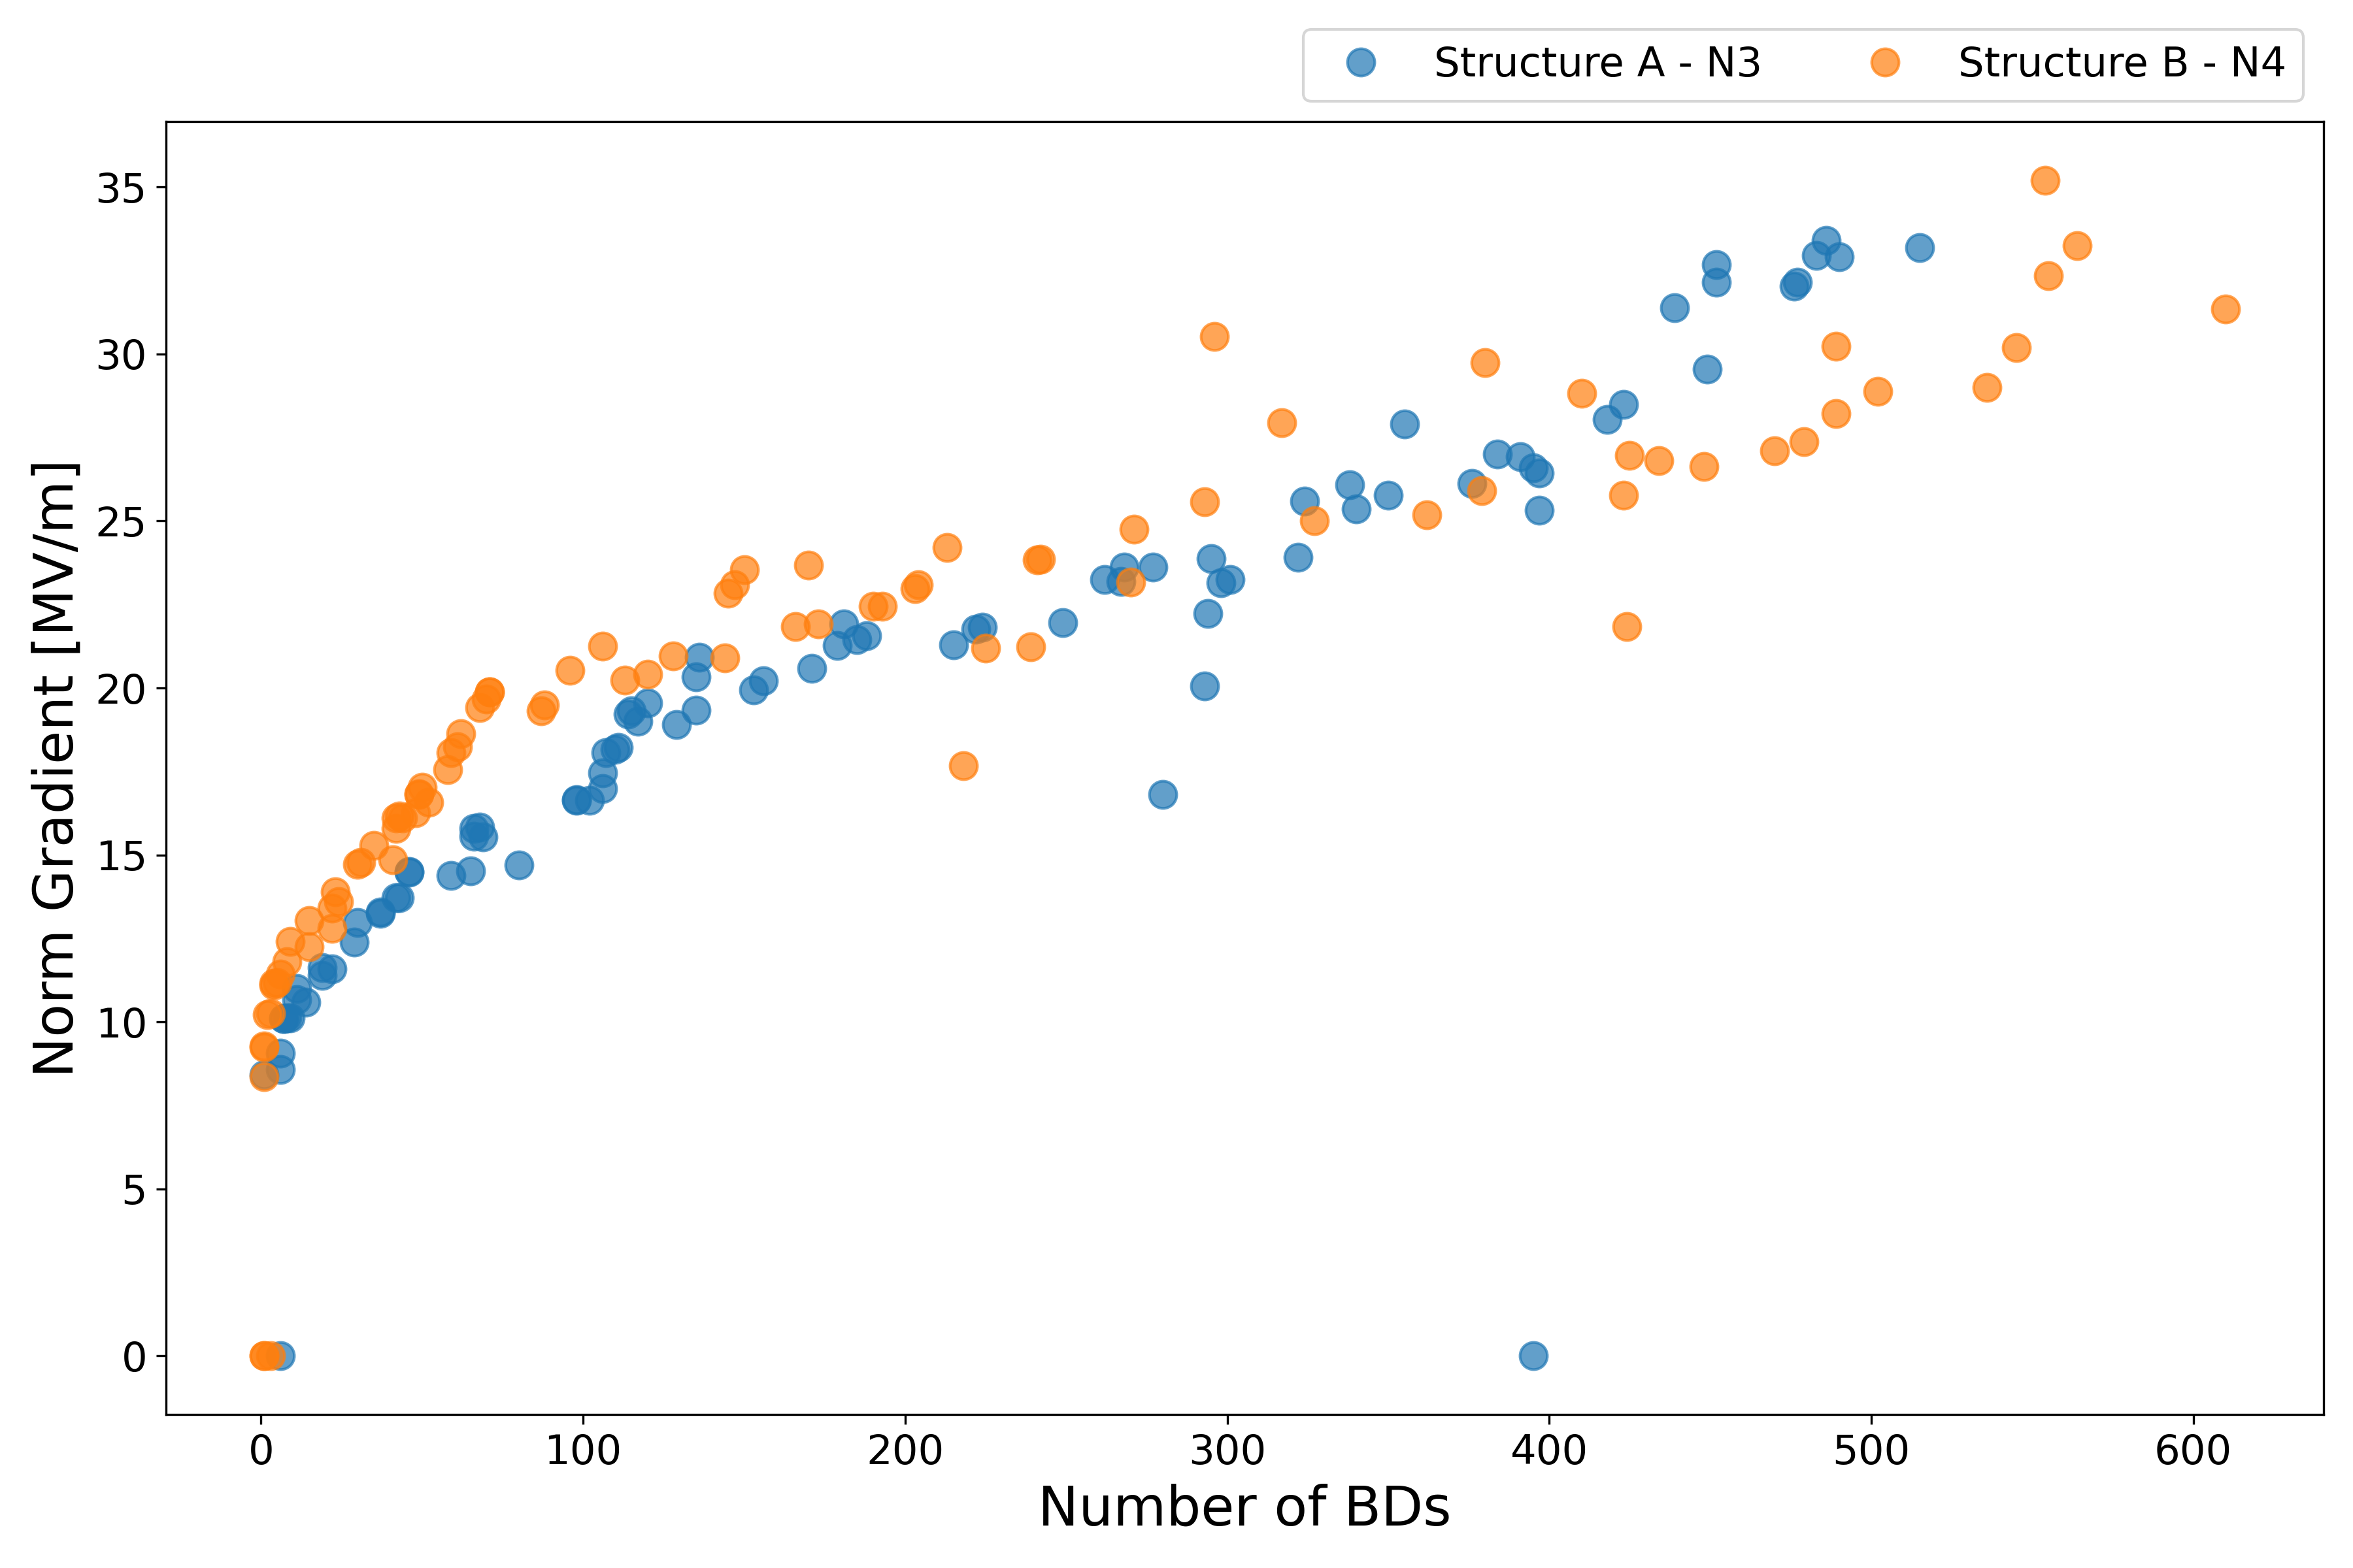
X-Box2

Slide 13
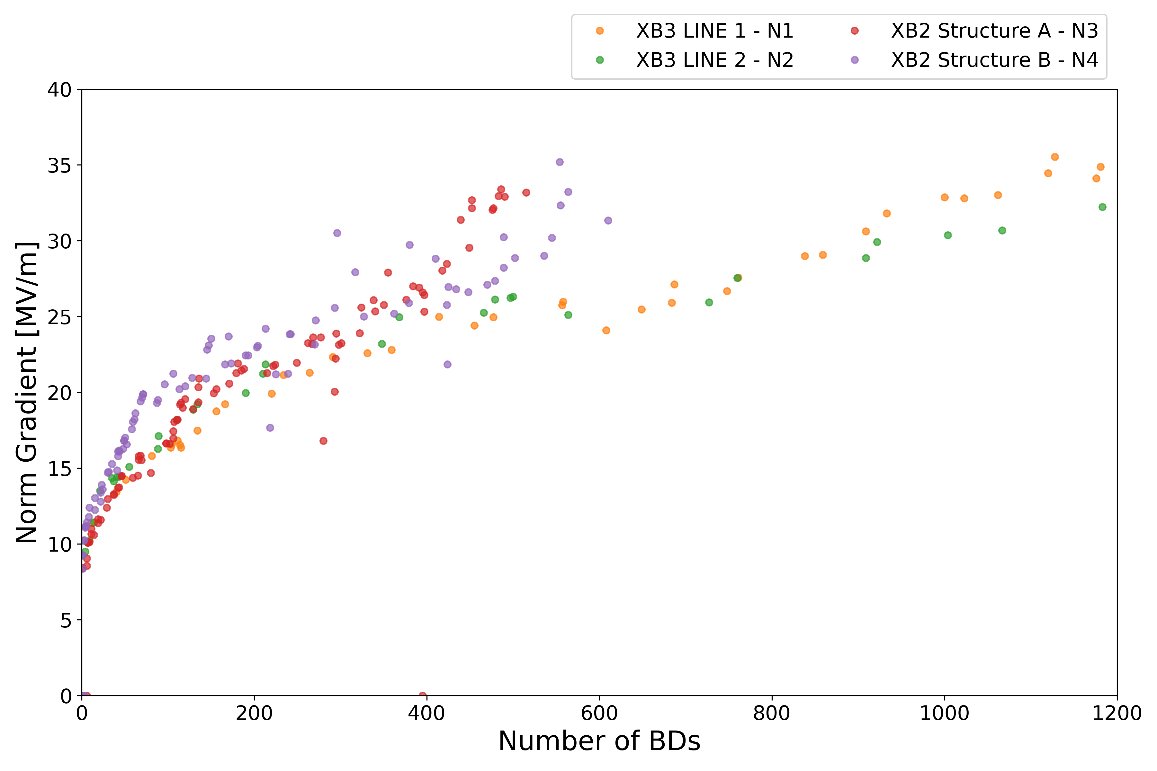
All TD31

Slide 14
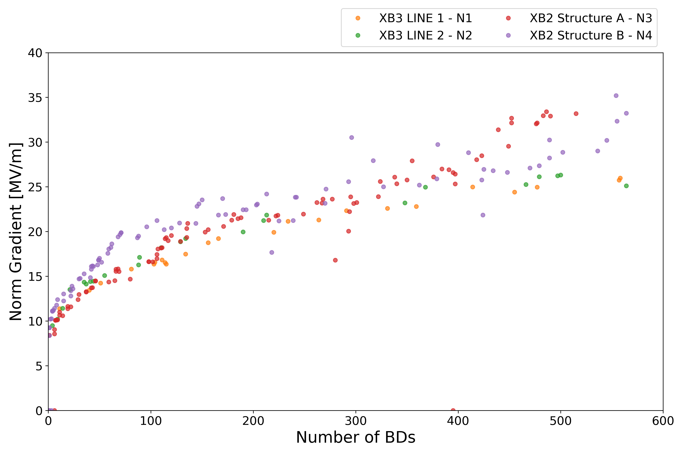
All TD31

Slide 15
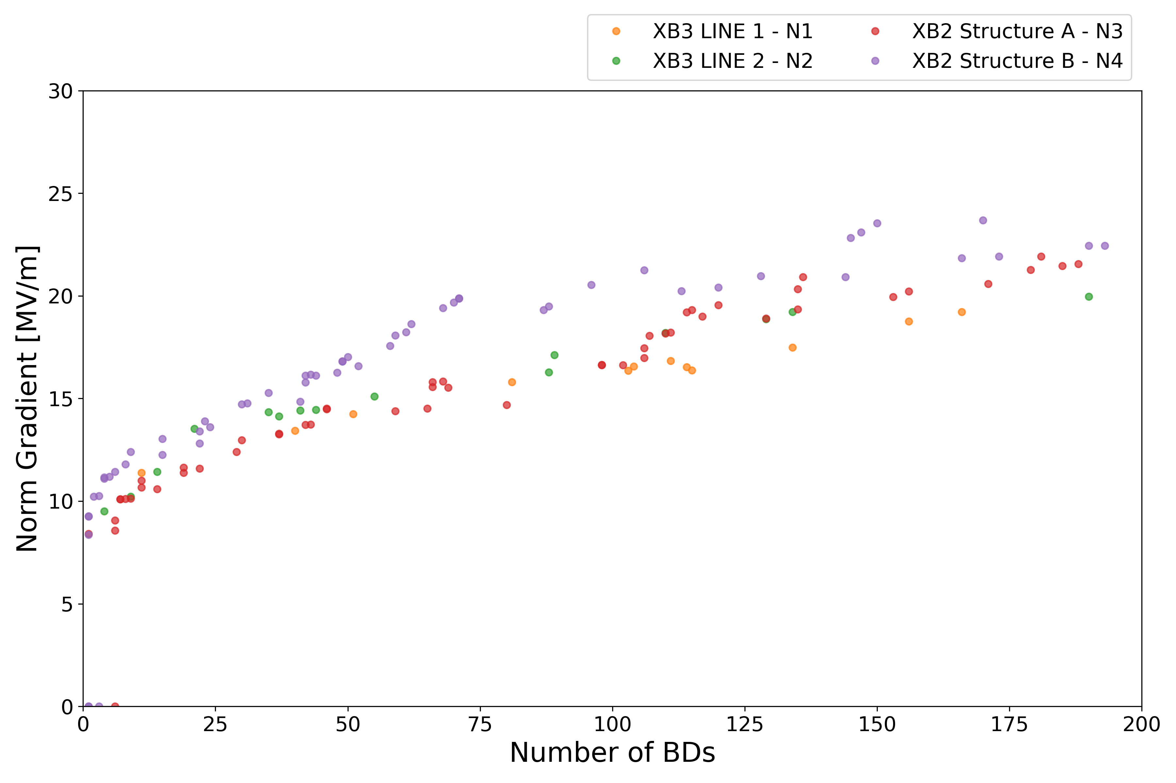
All TD31

Slide 16
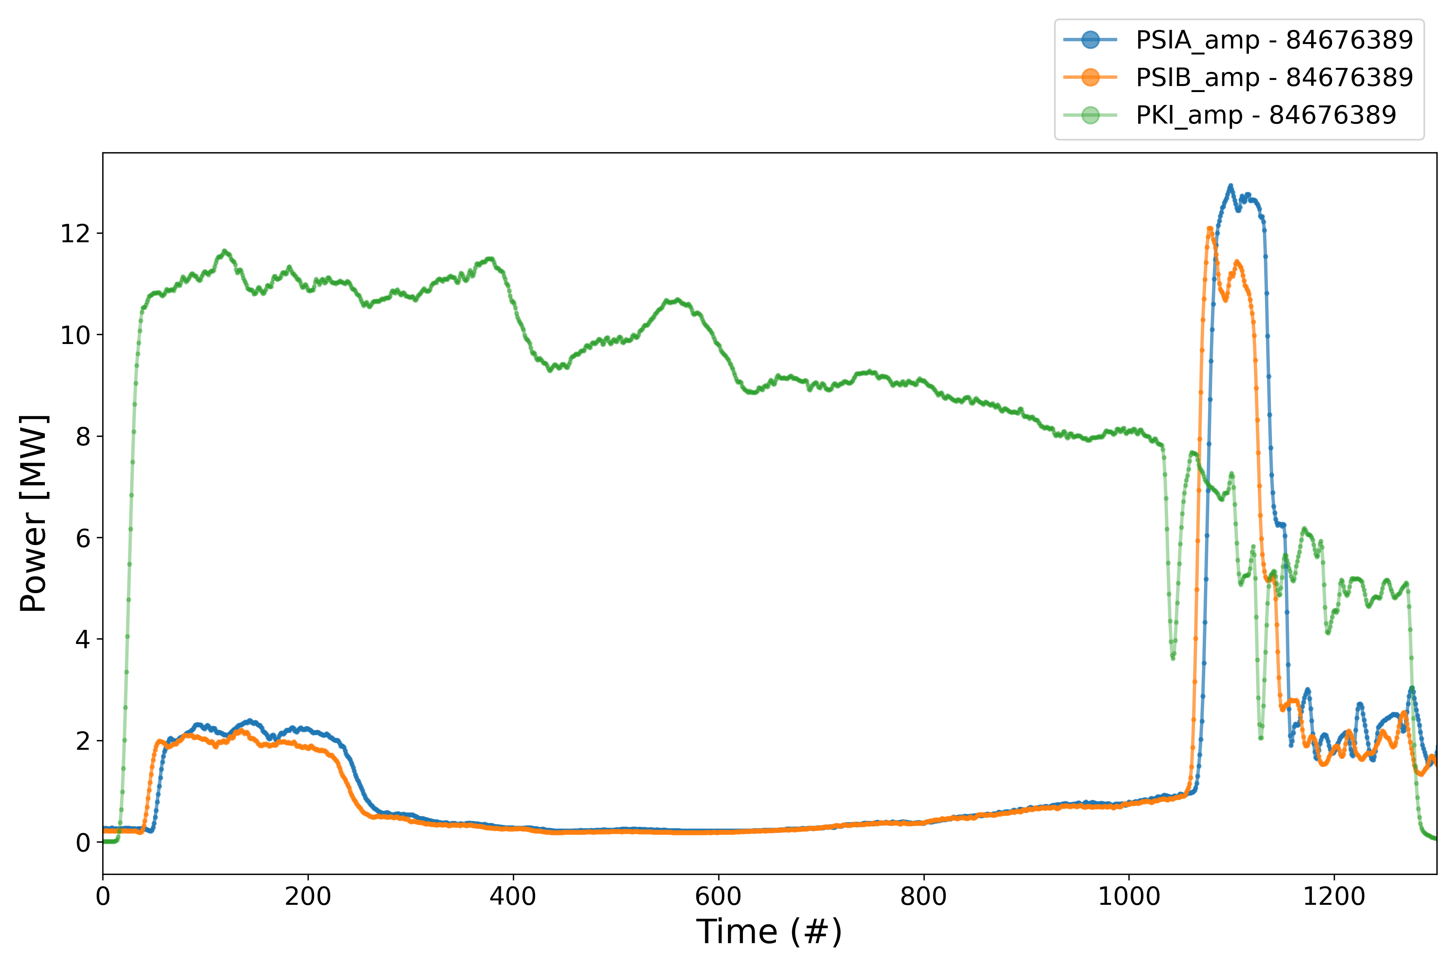
XBox2 Pulses

Slide 17
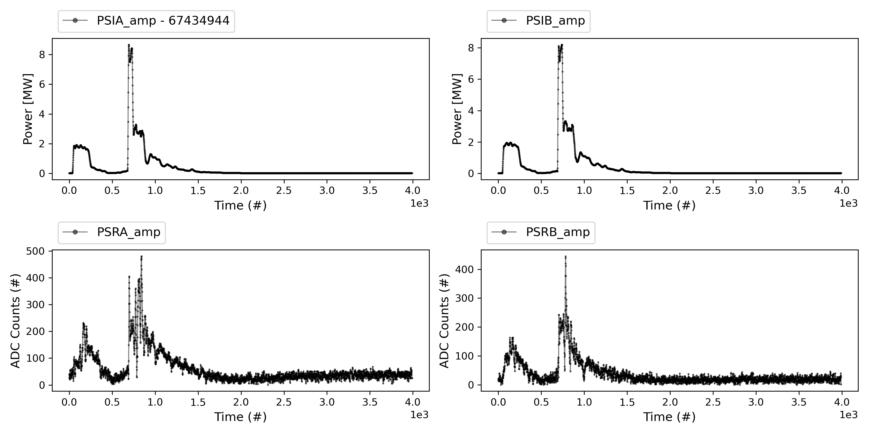
XBox2 Pulses

Slide 18
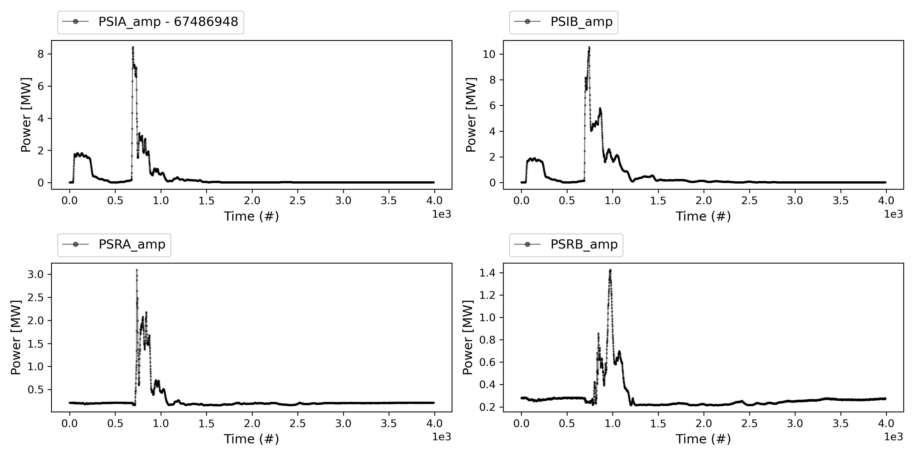
XBox2 Pulses

Slide 19
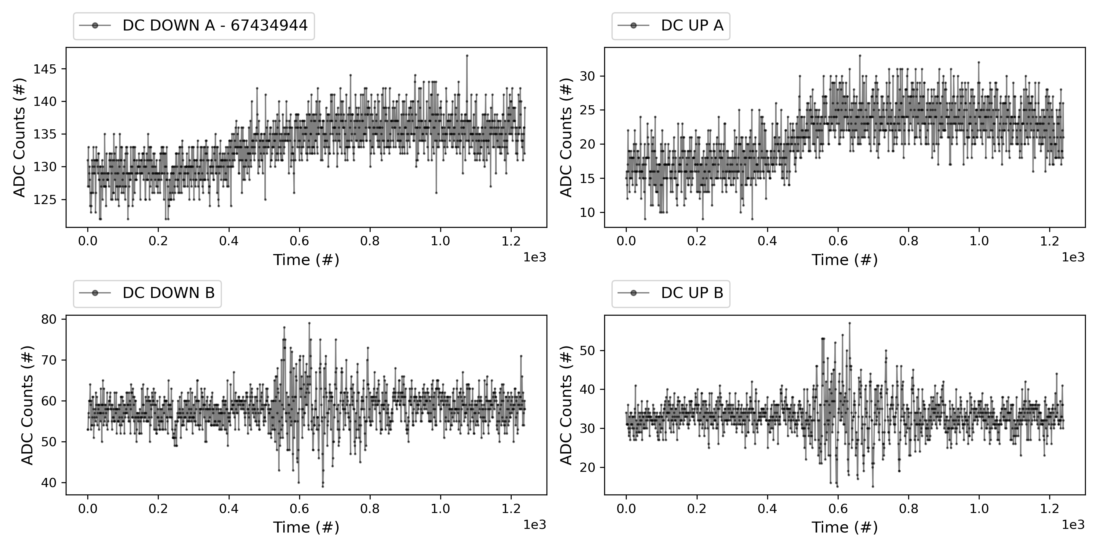
XBox2 Pulses

Slide 20
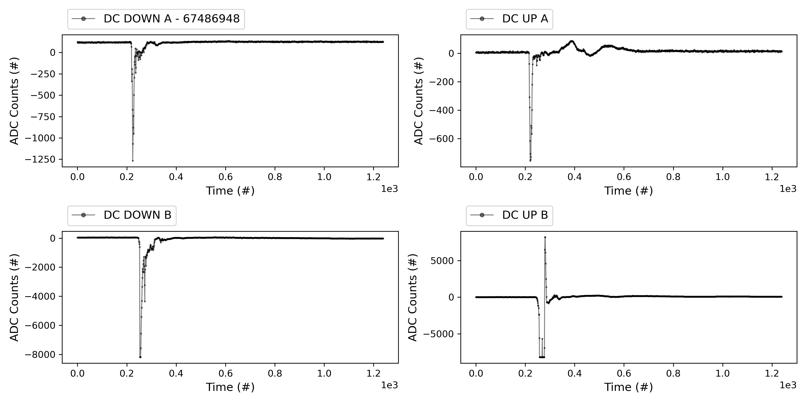
XBox2 Pulses

Slide 21
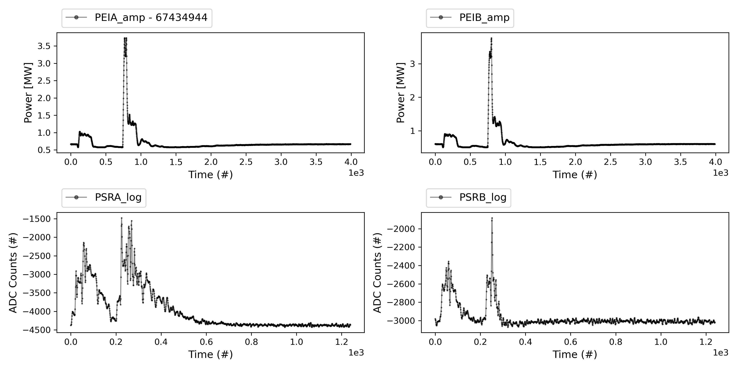
XBox2 Pulses

Slide 22
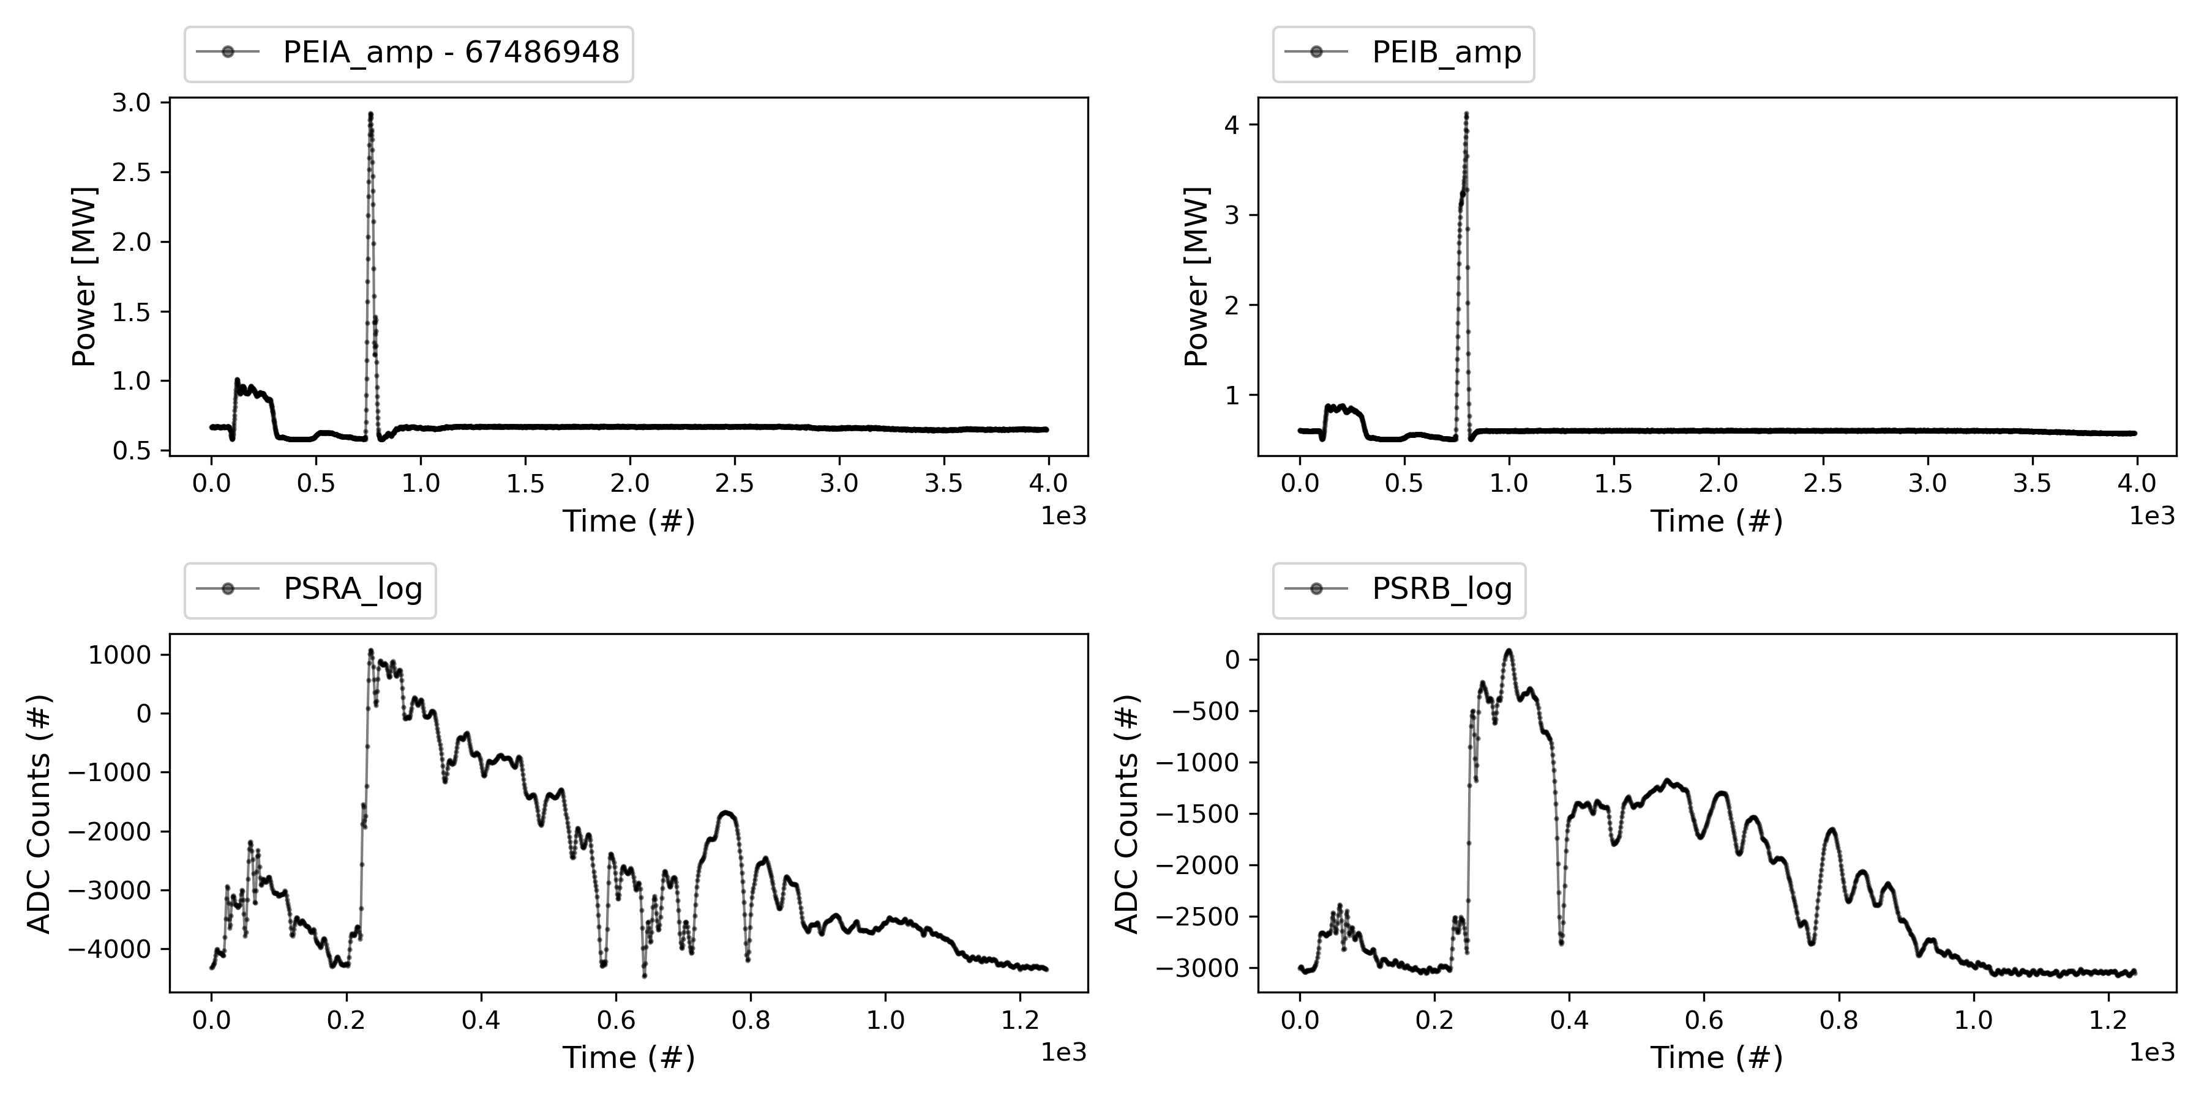
XBox2 Pulses

Slide 23
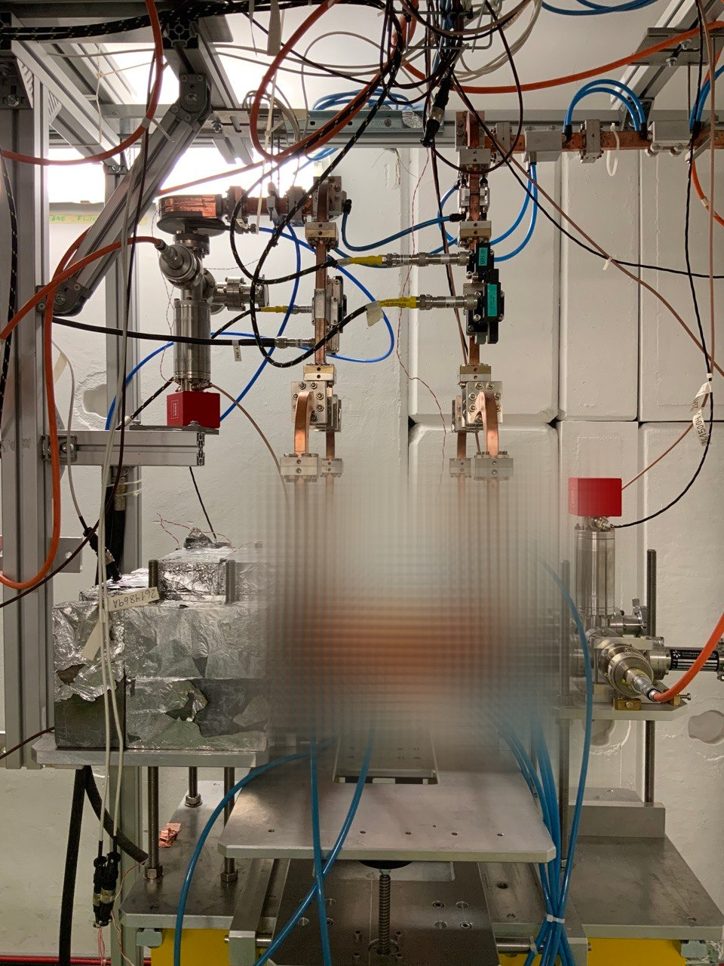

X-Box3 – Line 1

Slide 24
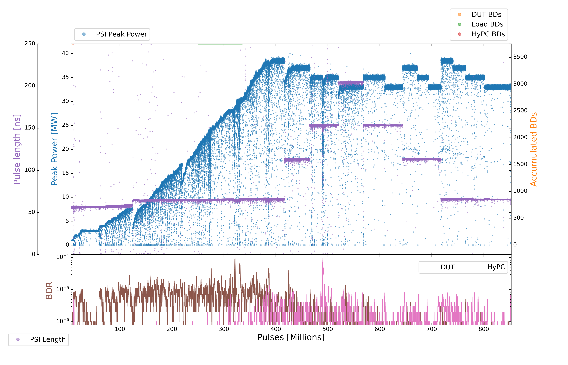
X-Box3 – Line 1
Parameters:
1.9 us klystron pulse
50 ns CP
150 Hz rep rate per line
Current Power: 33 MW (peak)

Slide 25
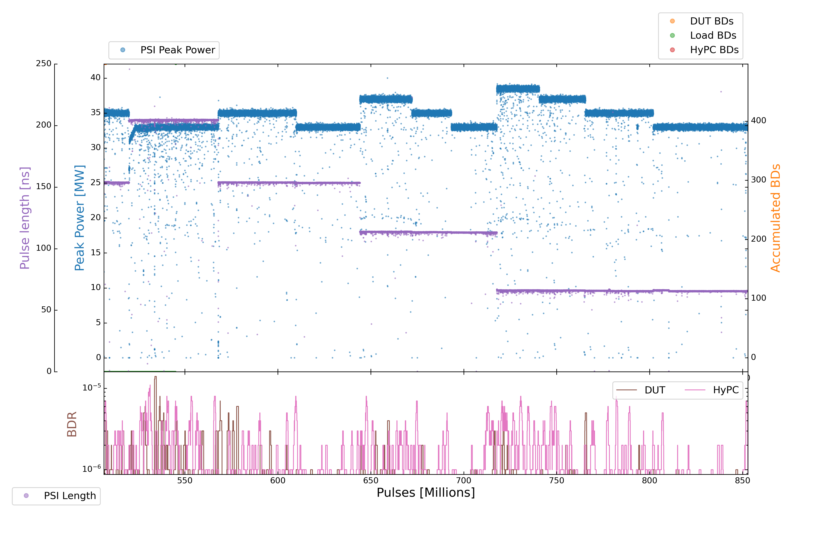
X-Box3 – Line 1
Parameters:
1.9 us klystron pulse
50 ns CP
150 Hz rep rate per line
Current Power: 33 MW (peak)

Slide 26
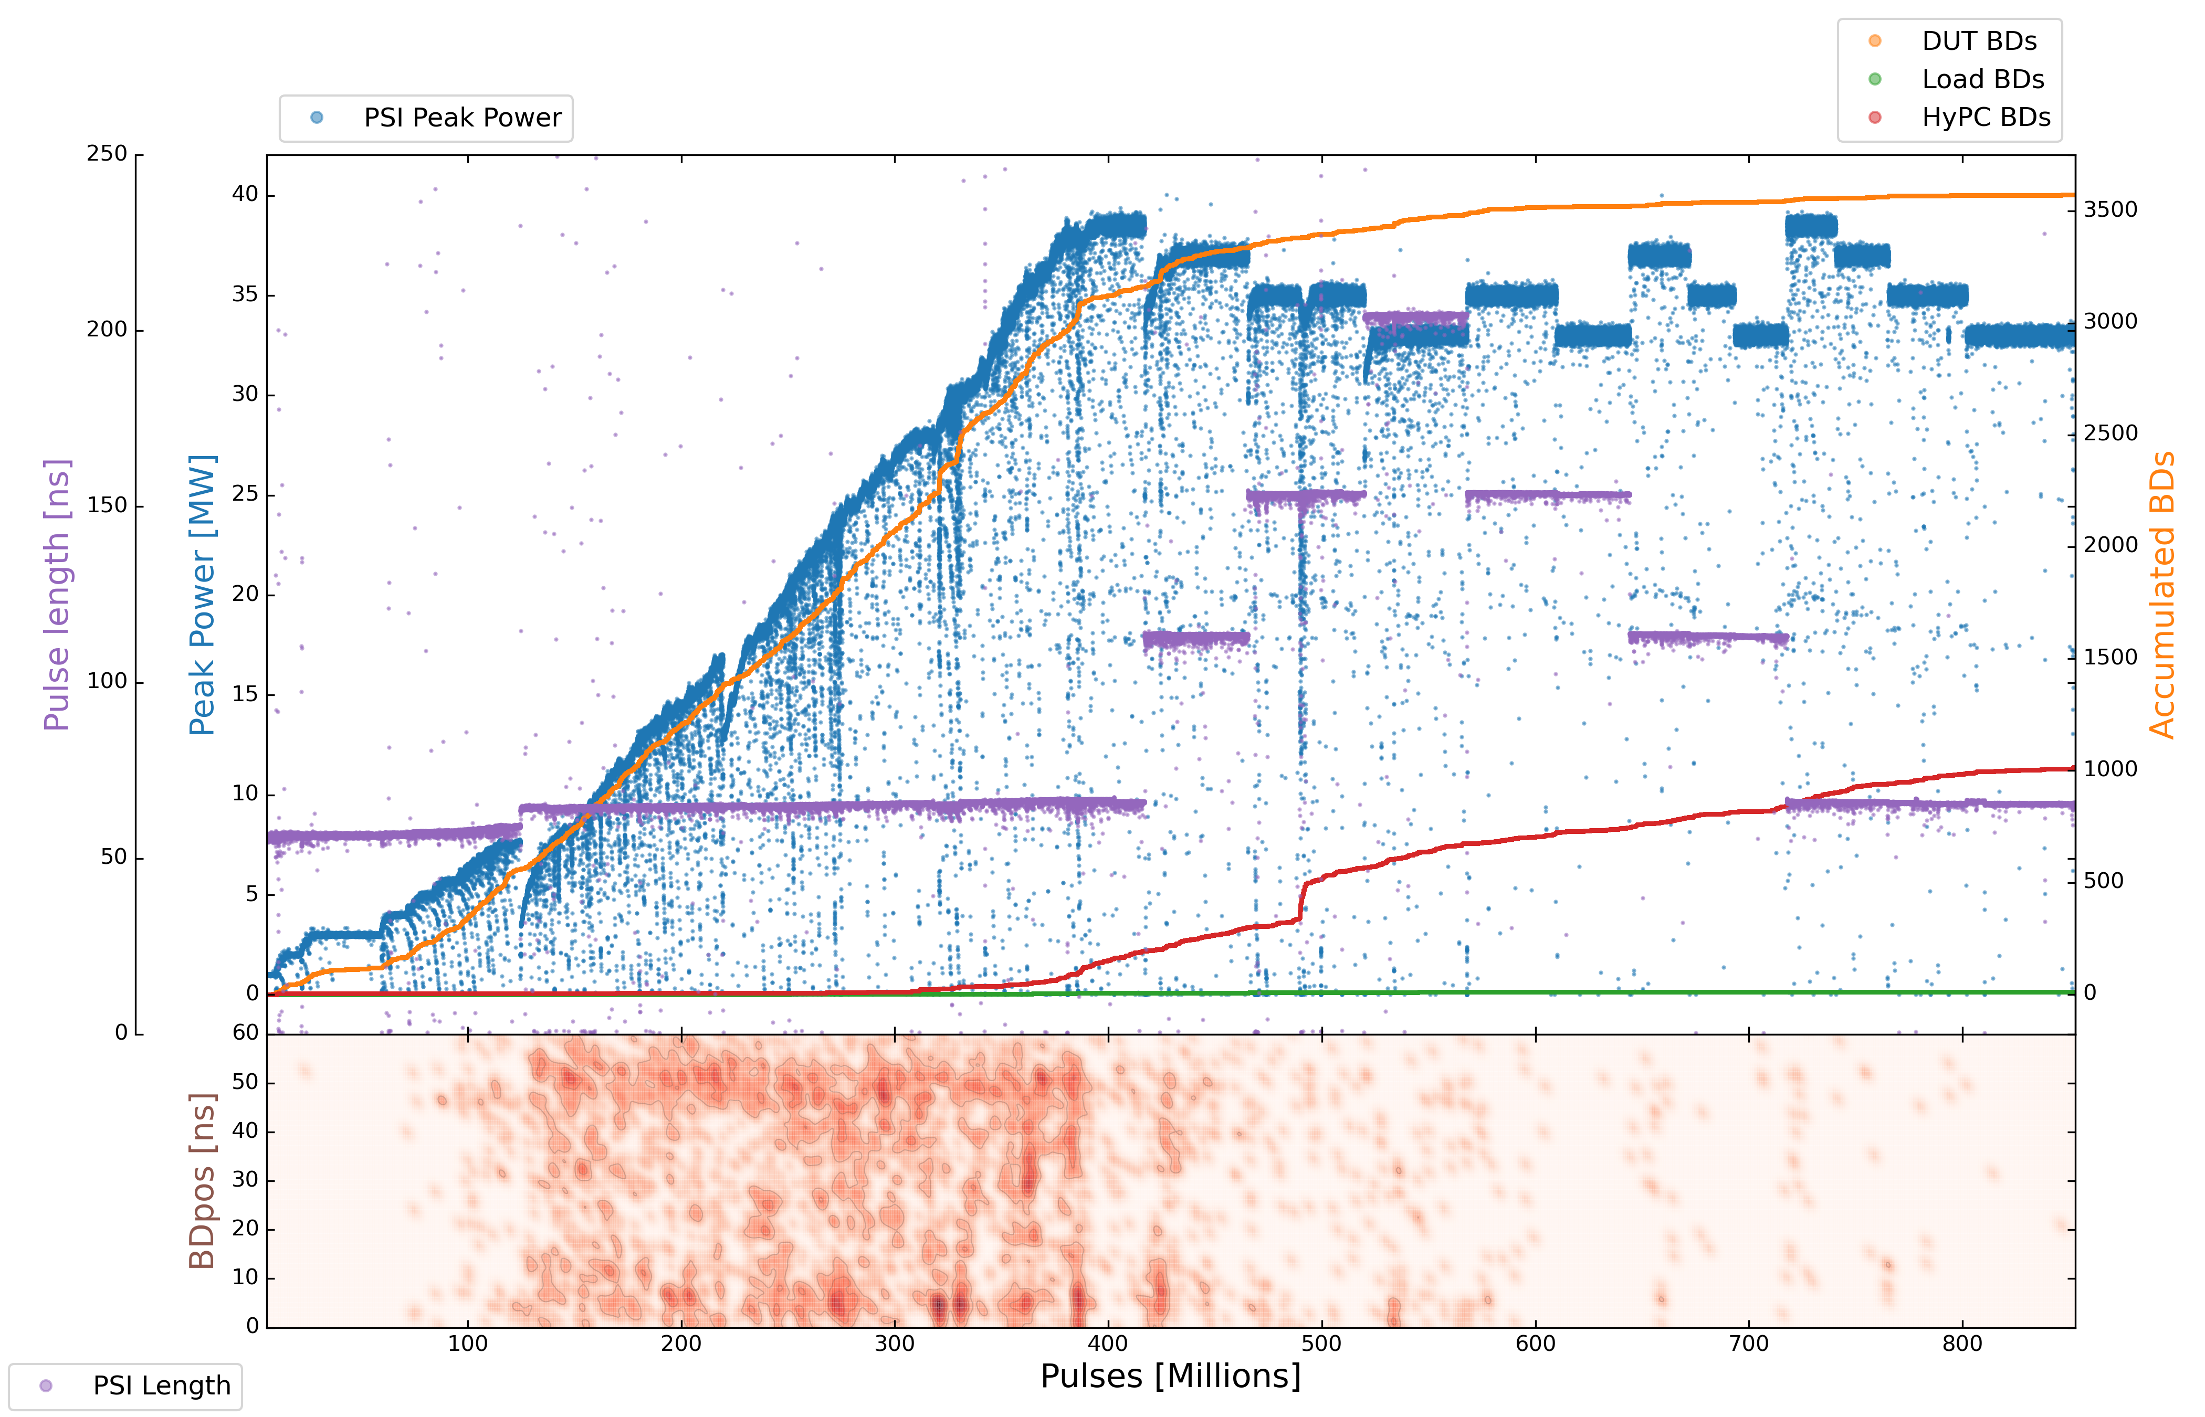
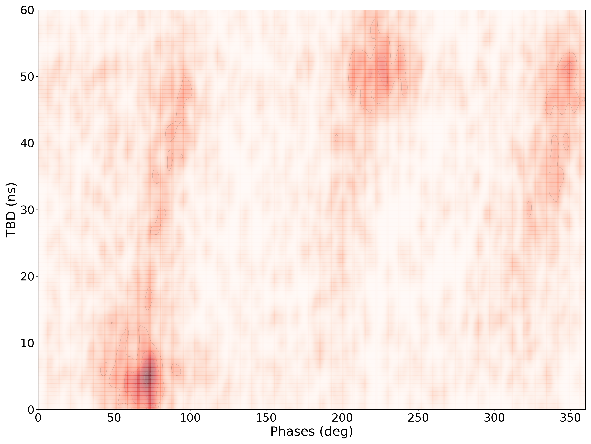
X-Box3 – Line 1
Parameters:
1.9 us klystron pulse
50 ns CP
150 Hz rep rate per line
Current Power: 33 MW (peak)

Slide 27
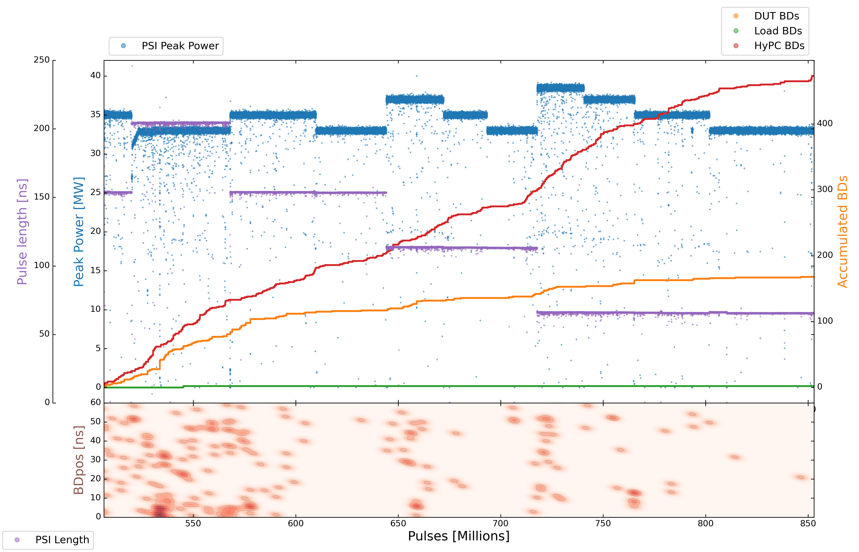
X-Box3 – Line 1
Parameters:
1.9 us klystron pulse
50 ns CP
150 Hz rep rate per line
Current Power: 33 MW (peak)

Slide 28
X-Box3 – Line 1
Step | Pulse Witdth | Compressed Pulse Width | Phase Ramp | Init Power | Max Power | Init | End | Comment
1 | 50 ns (72 ns) | NO | NO | 0,5 MW | 7,7 MW | 27 July 2022 | 6 August 2022
2 | 1,32 us | 50 ns (72 ns) | Manual | 3,5 MW | 28,3 MW | 6 August 2022 | 14 September 2022
3 | 1,62 us | 50 ns (72 ns) | Manual | 27,3 MW | 31,5 MW | 14 September 2022 | 16 September 2022
4 | 1,9 us | 50 ns (72 ns) | Manual | 30,5 MW | 38,5 MW | 16 September 2022 | 22 September 2022
5 | 1,9 us | 100 ns (120 ns) | Manual | 34 MW | 37 MW | 22 September 2022 | 26 September 2022
6 | 1,9 us | 150 ns (160 ns) | Manual | 34 MW | 35 MW | 26 September 2022 | 3 October 2022
7 | 1,9 us | 200 ns (210 ns) | Manual | 31 MW | 33 MW | 3 October 2022 | 5 October 2022
8 |  |  |  |  |  |  |  | Data points run
9 | 1,9 us | 200 ns (210 ns) | Manual | 33 MW | 33 MW | 5 October 2022 | 7 October 2022 | Init Pulse Count: 542 M# End Pulse Count: 567 M#
10 | 1,9 us | 150 ns (160 ns) | Manual | 35 MW | 35 MW | 7 October 2022 | 10 October 2022 | Init Pulse Count: 569 M# End Pulse Count: 600 M#
11 | 1,9 us | 150 ns (160 ns) | Manual | 33 MW | 33 MW | 10 October 2022 | 13 October 2022 | Init Pulse Count: 602 M# End Pulse Count: 643 M#
12 | 1,9 us | 100 ns (120 ns) | Manual | 37 MW | 37 MW | 13 October 2022 | 15 October 2022 | Init Pulse Count: 645 M# End Pulse Count: 671 M#
13 | 1,9 us | 100 ns (120 ns) | Manual | 35 MW | 35 MW | 15 October 2022 | 17 October 2022 | Init Pulse Count: 673 M# End Pulse Count: 693 M#
14 | 1,9 us | 100 ns (120 ns) | Manual | 33 MW | 33 MW | 17 October 2022 | 19 October 2022 | Init Pulse Count: 694M# End Pulse Count: 717 M#
15 | 1,9 us | 50 ns (72 ns) | Manual | 38,5 MW | 38,5 MW | 19 October 2022 | 21 October 2022 | Init Pulse Count: 719 M# End Pulse Count: 740 M#
16 | 1,9 us | 50 ns (72 ns) | Manual | 37 MW | 37 MW | 21 October 2022 | 23 October 2022 | Init Pulse Count: 741 M# End Pulse Count: 764 M#
17 | 1,9 us | 50 ns (72 ns) | Manual | 35 MW | 35 MW | 23 October 2022 | 27 October 2022 | Init Pulse Count: 766 M# End Pulse Count: 801 M#
18 | 1,9 us | 50 ns (72 ns) | Manual | 33 MW | 33 MW | 27 October 2022 |  | Init Pulse Count: 803 M# End Pulse Count:

Slide 29
X-Box3 – Line 1
Parameters:
1.9 us klystron pulse
50 ns CP
150 Hz rep rate per line
Current Power: 33 MW (peak)
12
15
16
10
13
17
9
11
14
18

Slide 30
X-Box3 – Line 1
Step | Pulse Witdth | Compressed Pulse Width | Power | DUT BDs | DUT BDR | HyPC BDs | HyPC BDR | Millions of Pulses
9 | 1,9 us | 200 ns (210 ns) | 33 MW | 23 | 9.20000E-07 | 50 | 2.00000E-06 | 25
10 | 1,9 us | 150 ns (160 ns) | 35 MW | 27 | 8.70968E-07 | 29 | 9.35484E-07 | 31
11 | 1,9 us | 150 ns (160 ns) | 33 MW | 5 | 1.21951E-07 | 40 | 9.75610E-07 | 41
12 | 1,9 us | 100 ns (120 ns) | 37 MW | 13 | 5.00000E-07 | 41 | 1.57692E-06 | 26
13 | 1,9 us | 100 ns (120 ns) | 35 MW | 4 | 2.00000E-07 | 23 | 1.15000E-06 | 20
14 | 1,9 us | 100 ns (120 ns) | 33 MW | 6 | 2.60870E-07 | 24 | 1.04348E-06 | 23
15 | 1,9 us | 50 ns (72 ns) | 38,5 MW | 11 | 5.23810E-07 | 58 | 2.76190E-06 | 21
16 | 1,9 us | 50 ns (72 ns) | 37 MW | 5 | 2.17391E-07 | 37 | 1.60870E-06 | 23
17 | 1,9 us | 50 ns (72 ns) | 35 MW | 2 | 5.71429E-08 | 44 | 1.25714E-06 | 35
18 | 1,9 us | 50 ns (72 ns) | 33 MW | 2 | 4.08163E-08 | 27 | 5.51020E-07 | 50

Slide 31
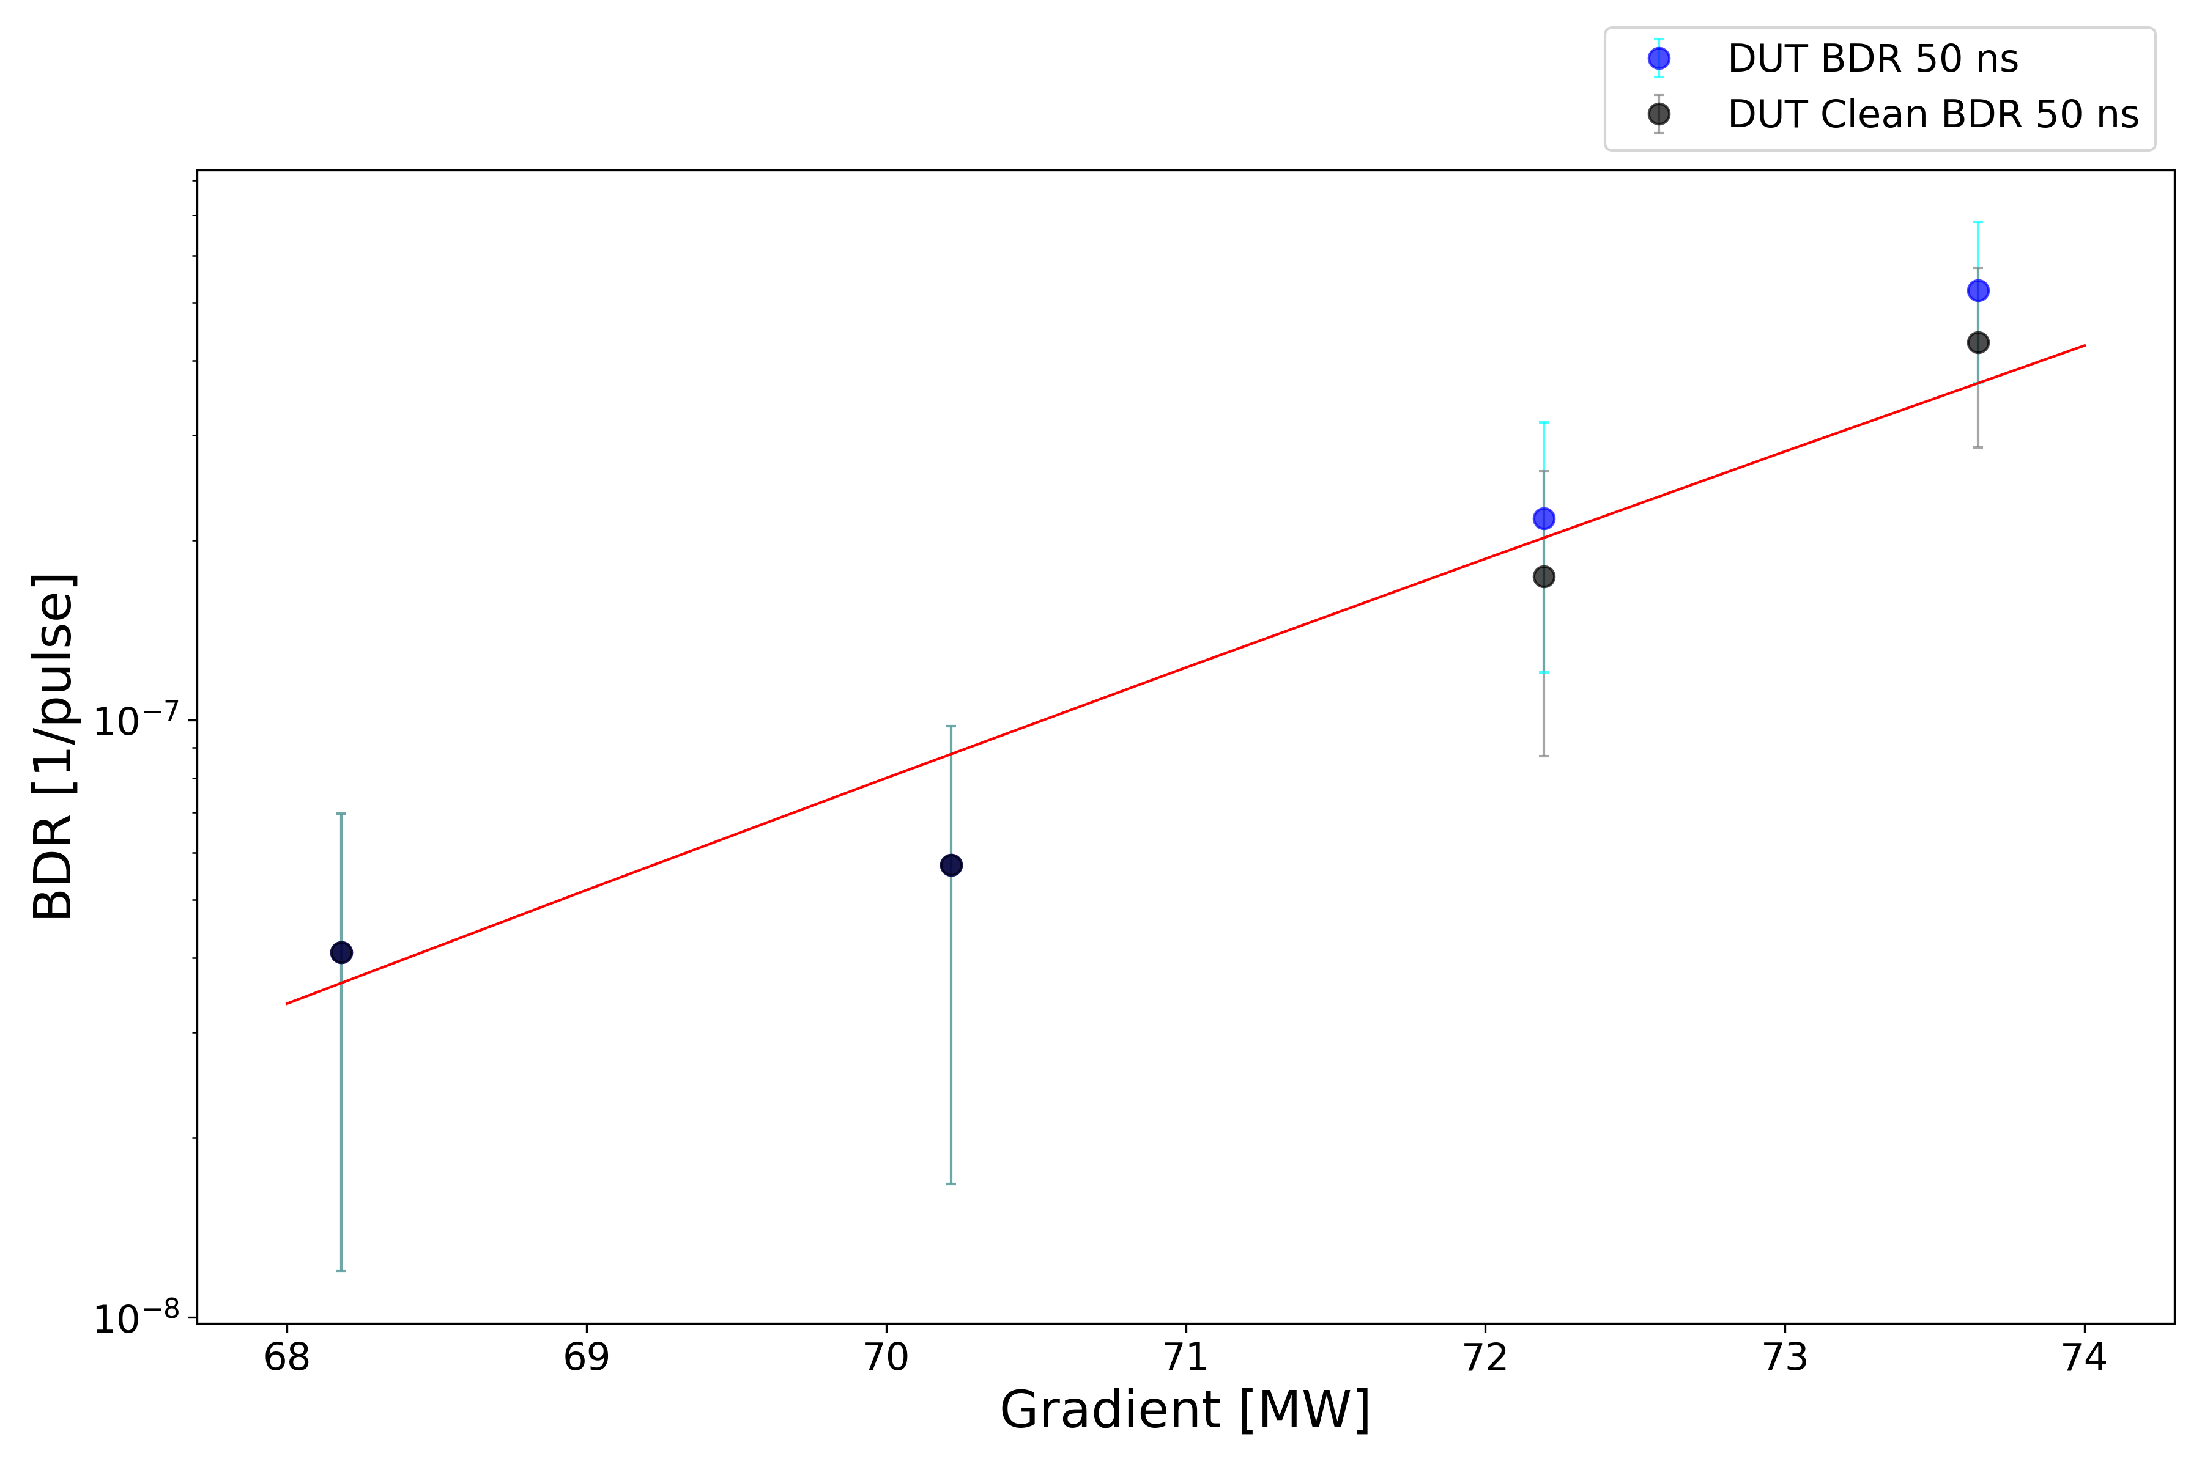
X-Box3 – Line 1

Slide 32
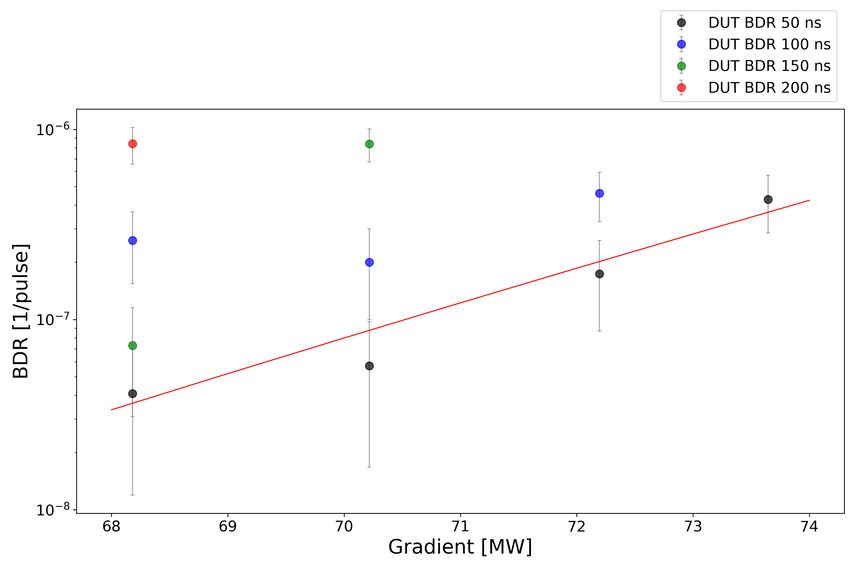
X-Box3 – Line 1

Slide 33
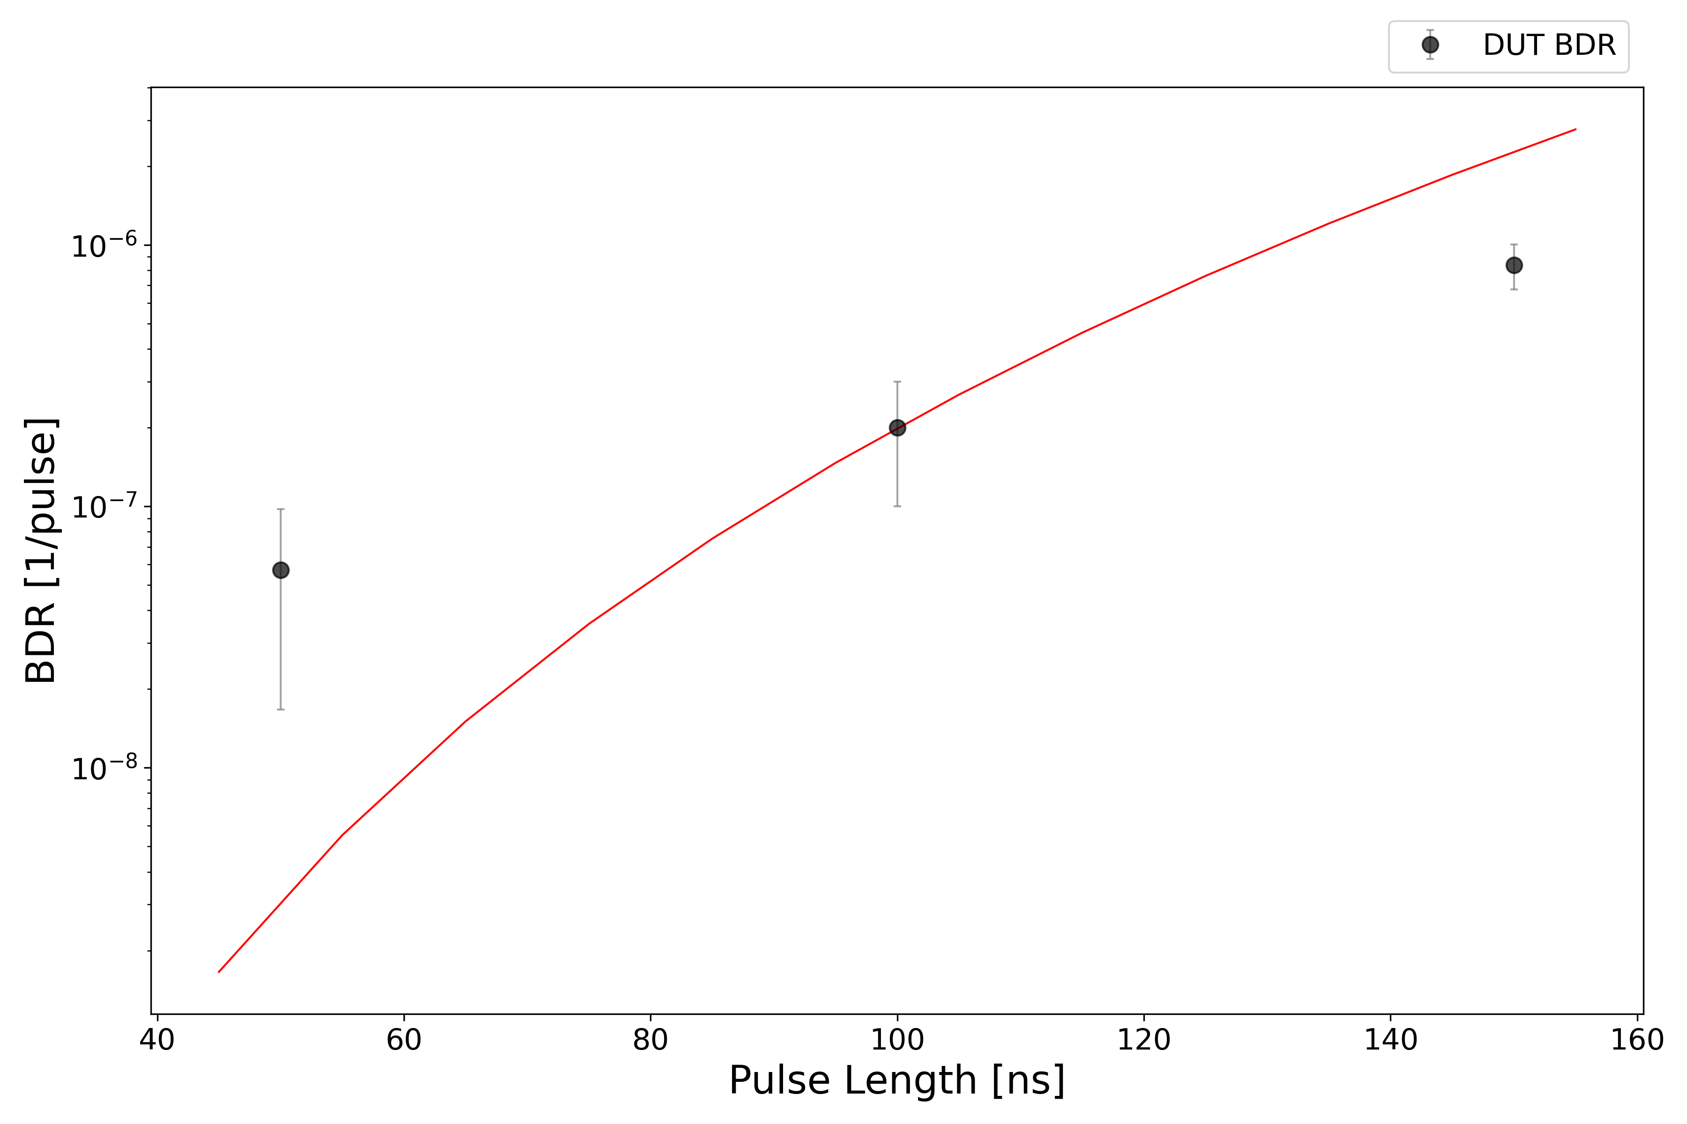
X-Box3 – Line 1

