Slide 1
Xboxes Update
08/02/2023

Slide 2
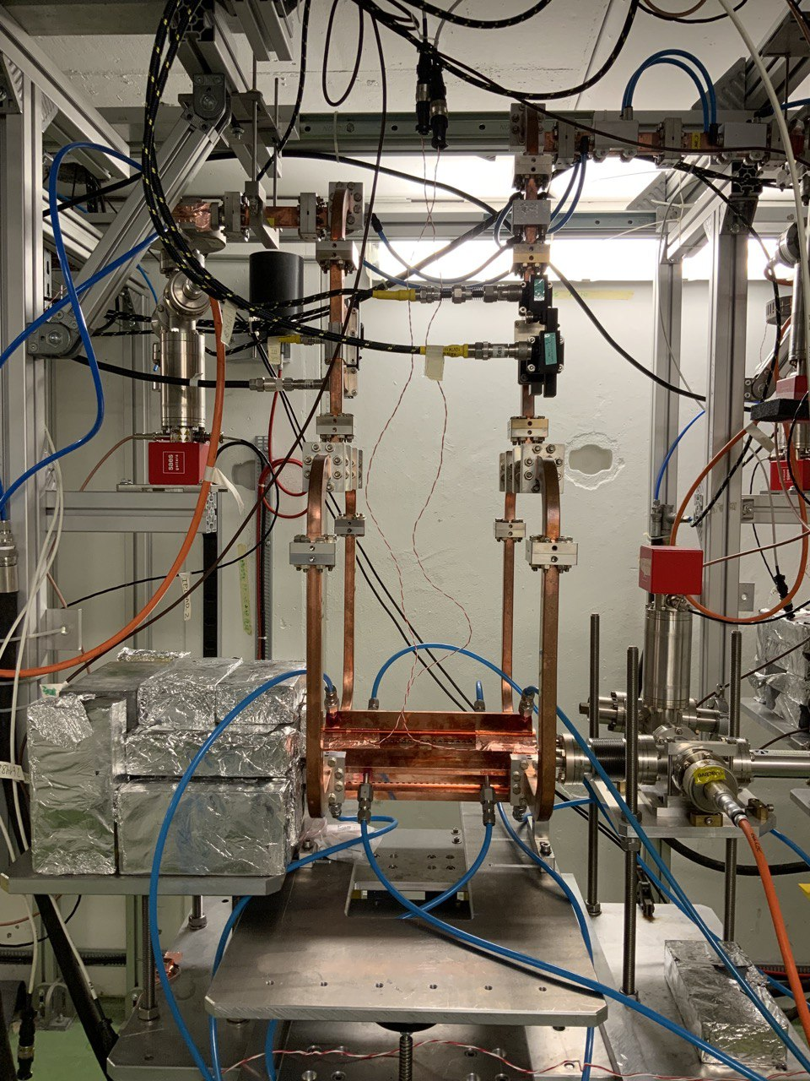
X-Box3 – Line 2

Slide 3
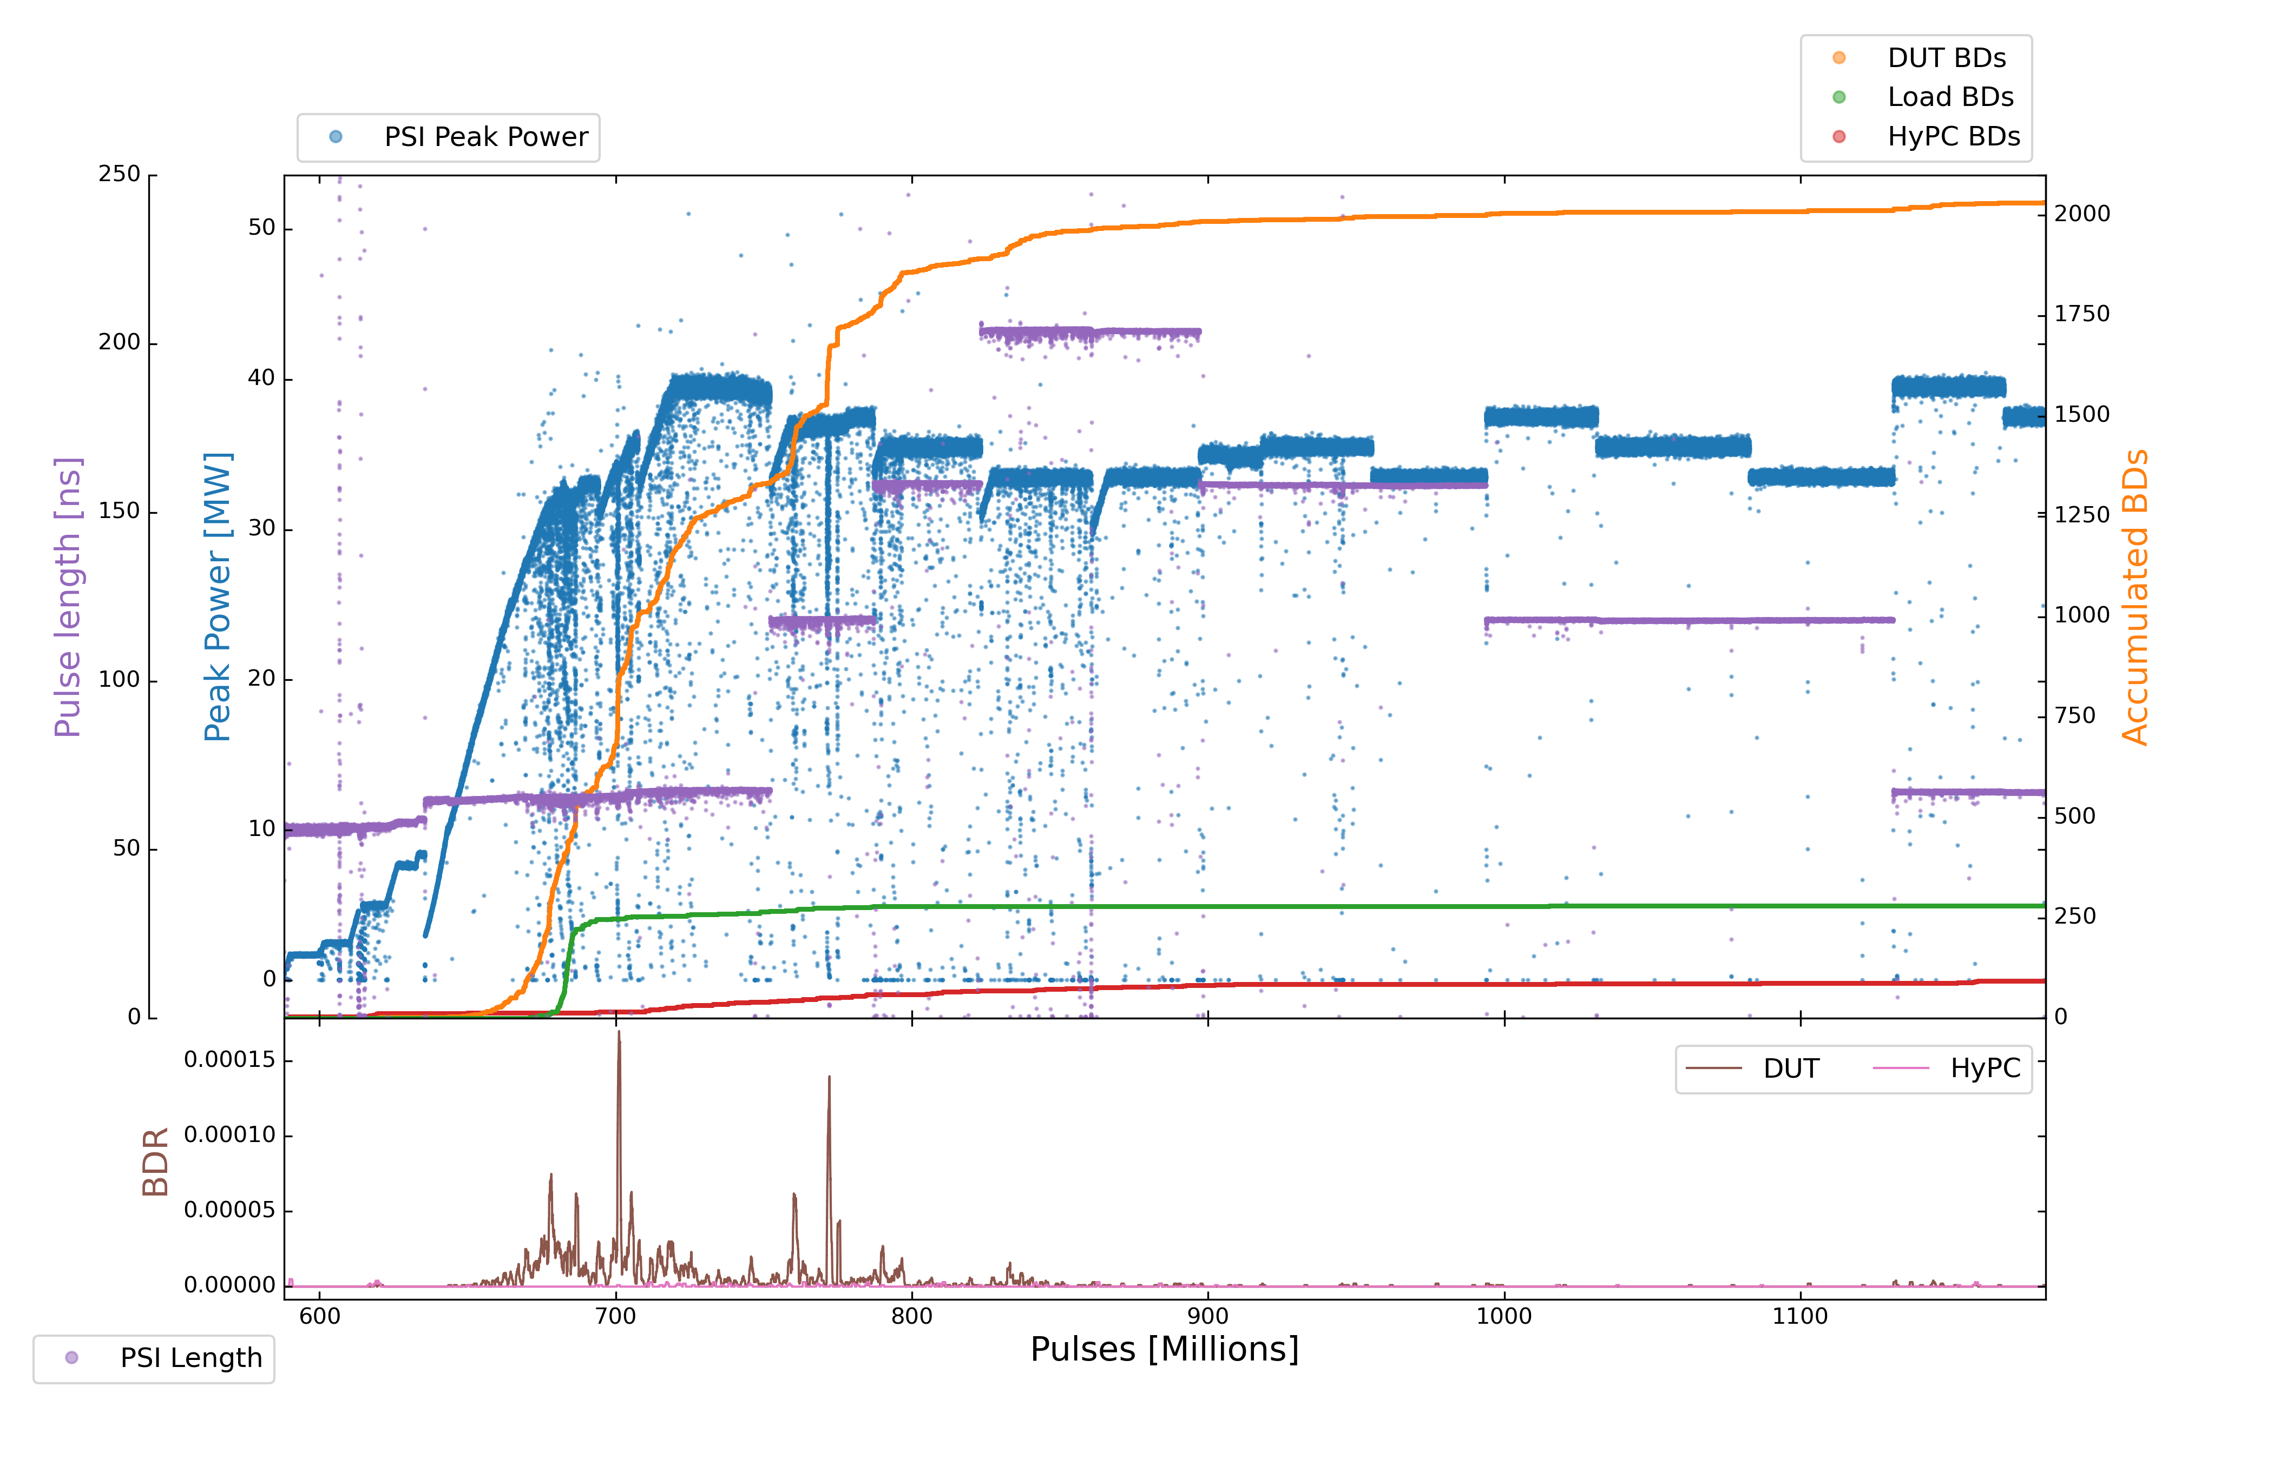
X-Box3 – Line 2
Parameters:
1.9 us klystron pulse
50 ns CP
150 Hz rep rate per line
Current Power: 37,5 MW
24
19
21
22
17
18
20
23

Slide 4
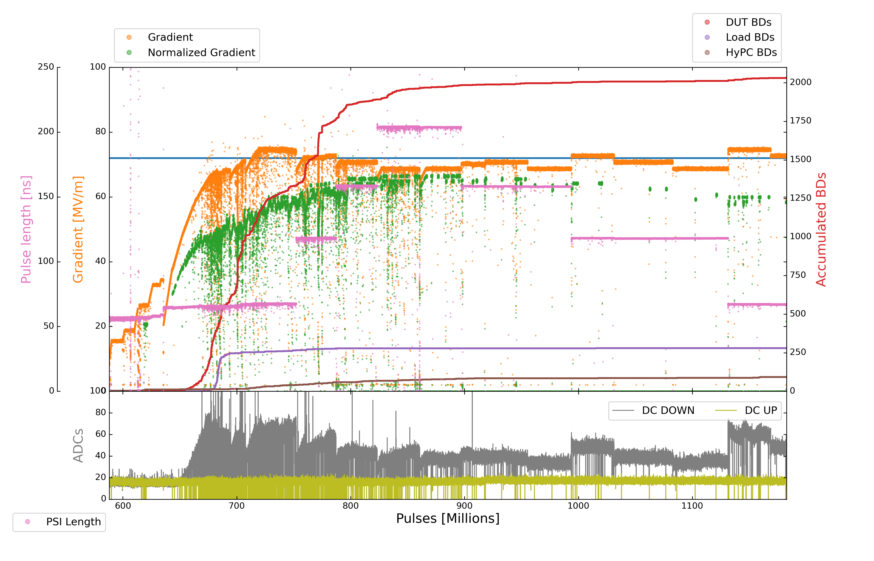
X-Box3 – Line 2
Parameters:
1.9 us klystron pulse
50 ns CP
150 Hz rep rate per line
Current Power: 37,5 MW

Slide 5
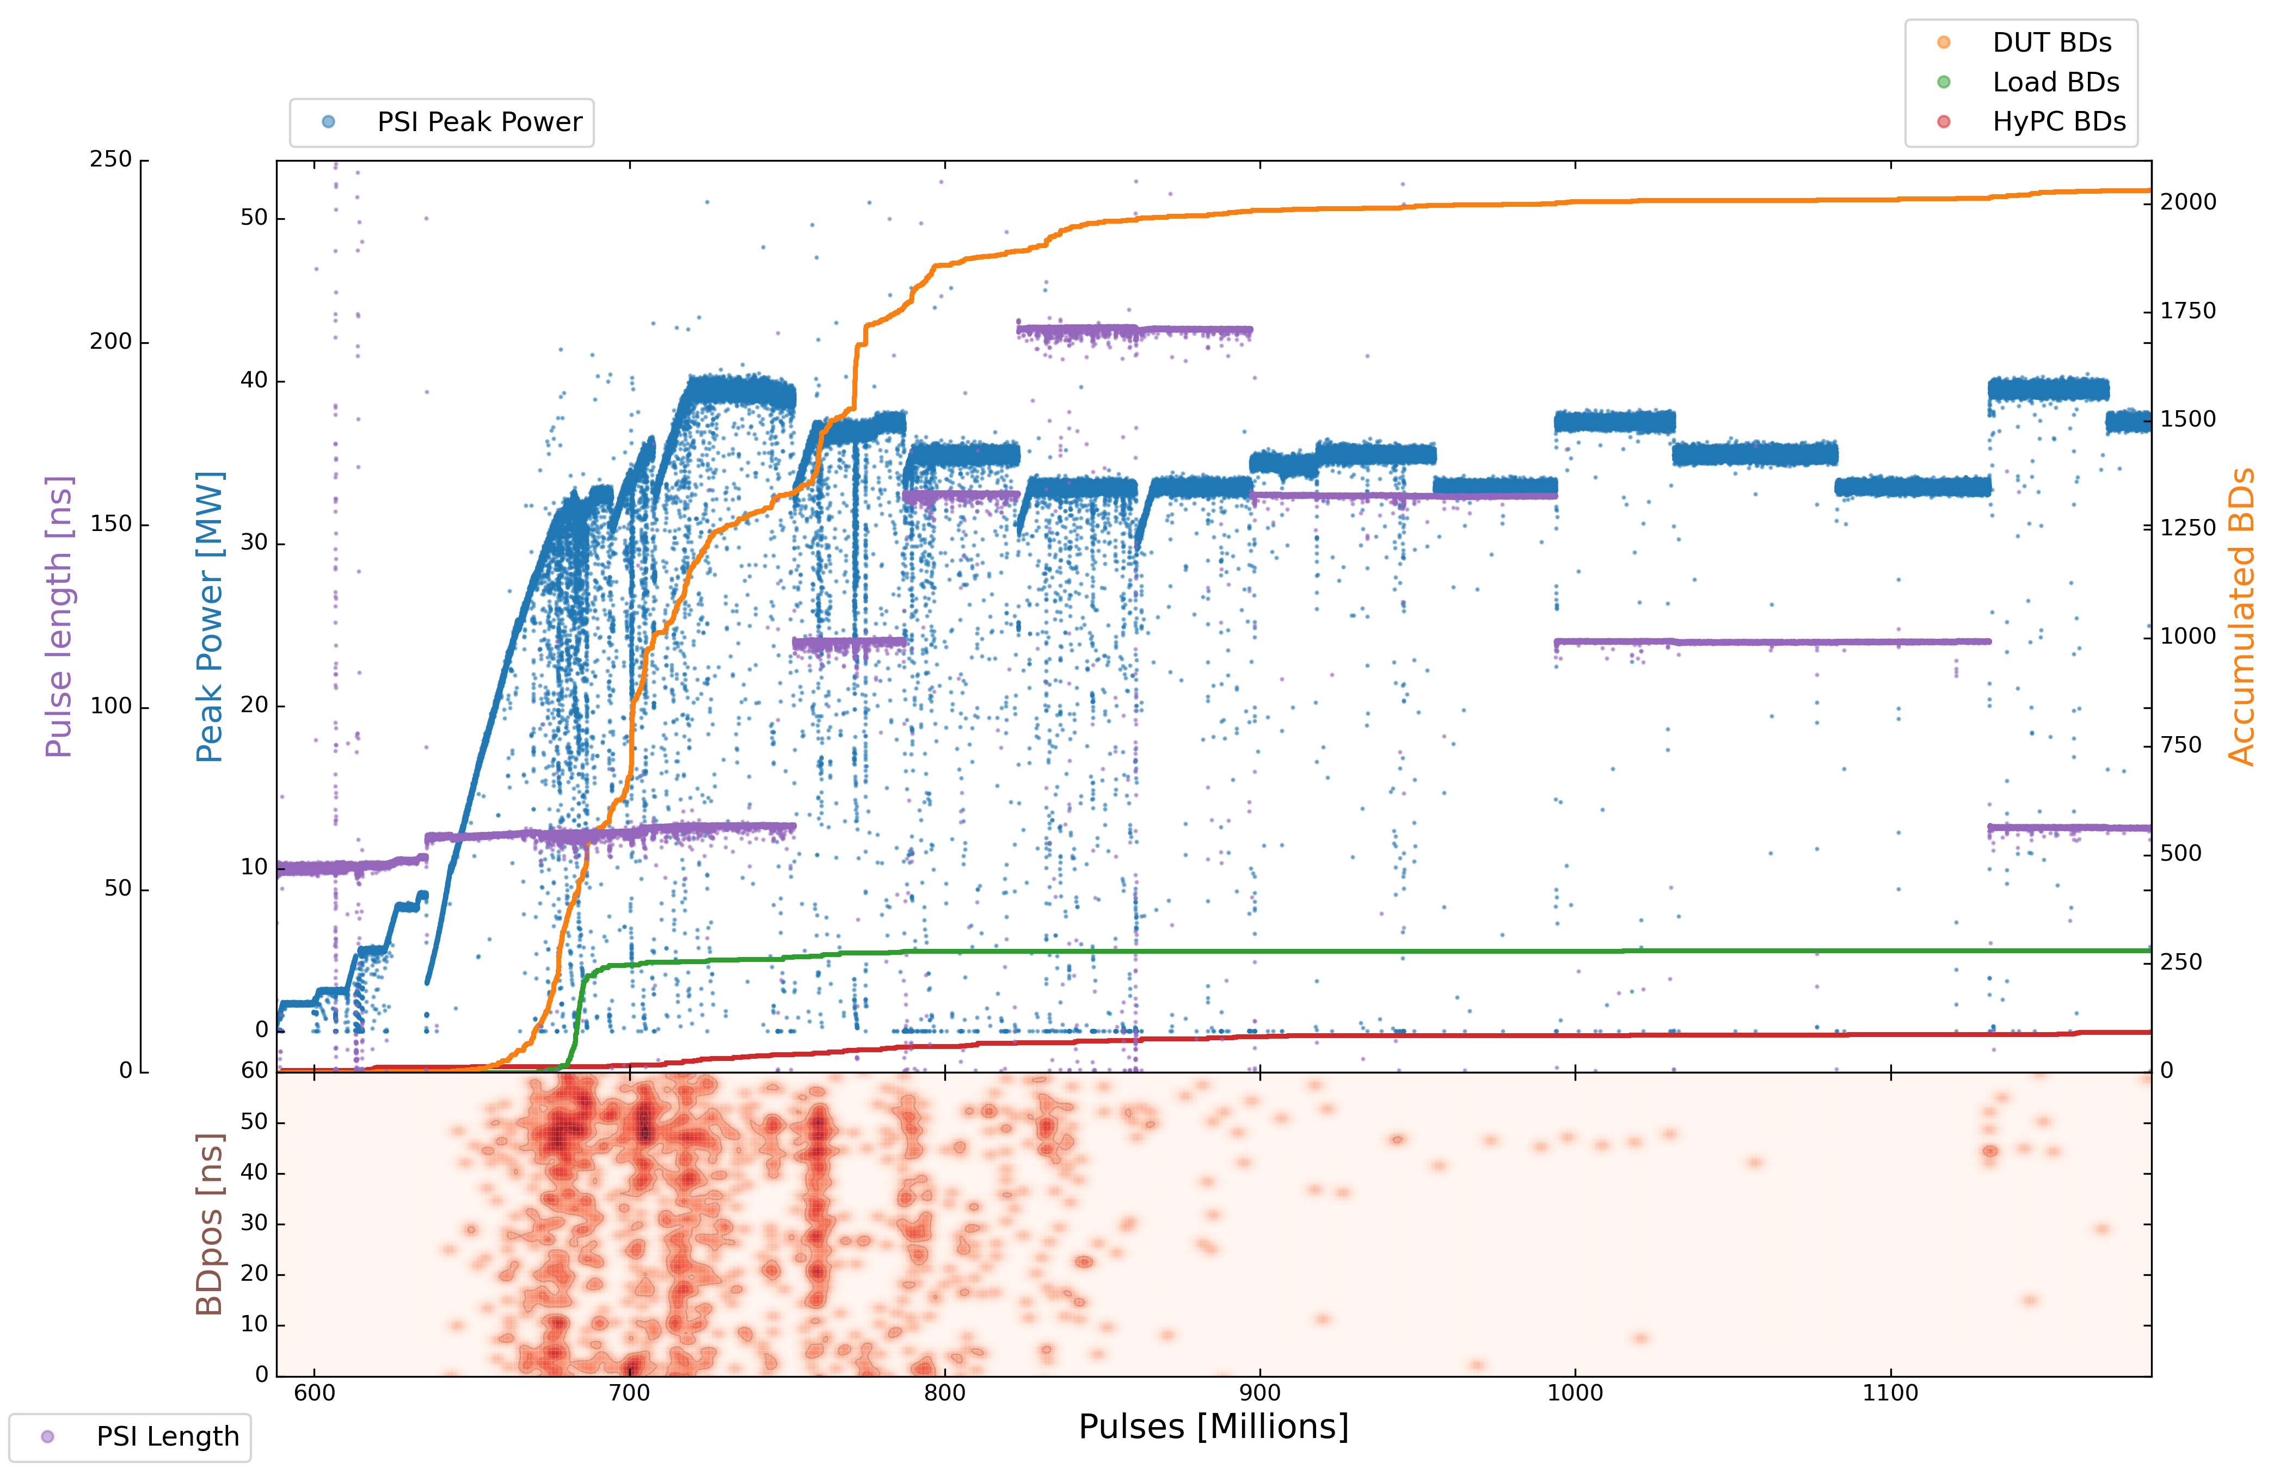
X-Box3 – Line 2
Parameters:
1.9 us klystron pulse
50 ns CP
150 Hz rep rate per line
Current Power: 37,5 MW
24
19
21
22
17
18
20
23

Slide 6
X-Box3 – Line 2
Step | Pulse Witdth | Compressed Pulse Width | Power | DUT BDs | DUT BDR | HyPC BDs | HyPC BDR | Millions of Pulses
17 | 1,9 us | 200 ns (210 ns) | 33.5 MW | 16 | 5,0000E-07 | 6 | 1.87500E-07 | 32
18 | 1,9 us | 150 ns (160 ns) | 34.5 MW | 4 | 2.10526E-07 | 2 | 1.05263E-07 | 19
19 | 1,9 us | 150 ns (160 ns) | 35.5 MW | 7 | 2.12121E-07 | 0 | 0 | 33
20 | 1,9 us | 150 ns (160 ns) | 33.5 MW | 4 | 1.08108E-07 | 0 | 0 | 37
21 | 1,9 us | 100 ns (120 ns) | 37.5 MW | 5 | 1.38889E-07 | 1 | 2.77778E-08 | 36
22 | 1,9 us | 100 ns (120 ns) | 35.5 MW | 2 | 4.00000E-08 | 1 | 2.00000E-08 | 50
23 | 1,9 us | 100 ns (120 ns) | 33.5 MW | 3 | 6.38298E-08 | 1 | 2.12766E-08 | 47
24 | 1,9 us | 50 ns (72 ns) | 39.5 MW | 15 | 4.16667E-07 | 5 | 1.38889E-07 | 34
25 | 1,9 us | 50 ns (72 ns) | 37.5 MW
26 | 1,9 us | 50 ns (72 ns) | 35.5 MW
27 | 1,9 us | 50 ns (72 ns) | 33.5 MW

Slide 7
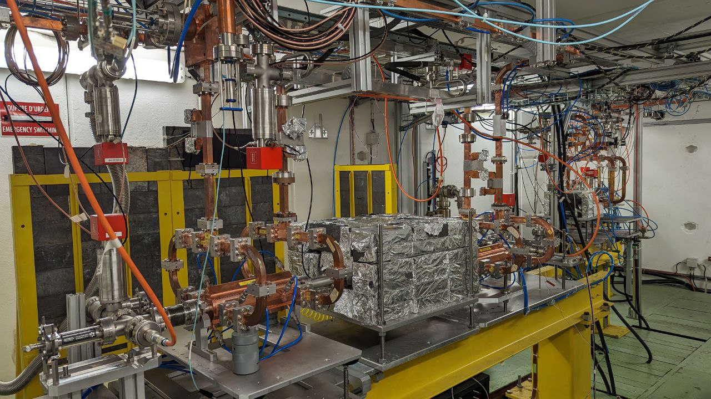
X-Box2

Slide 8
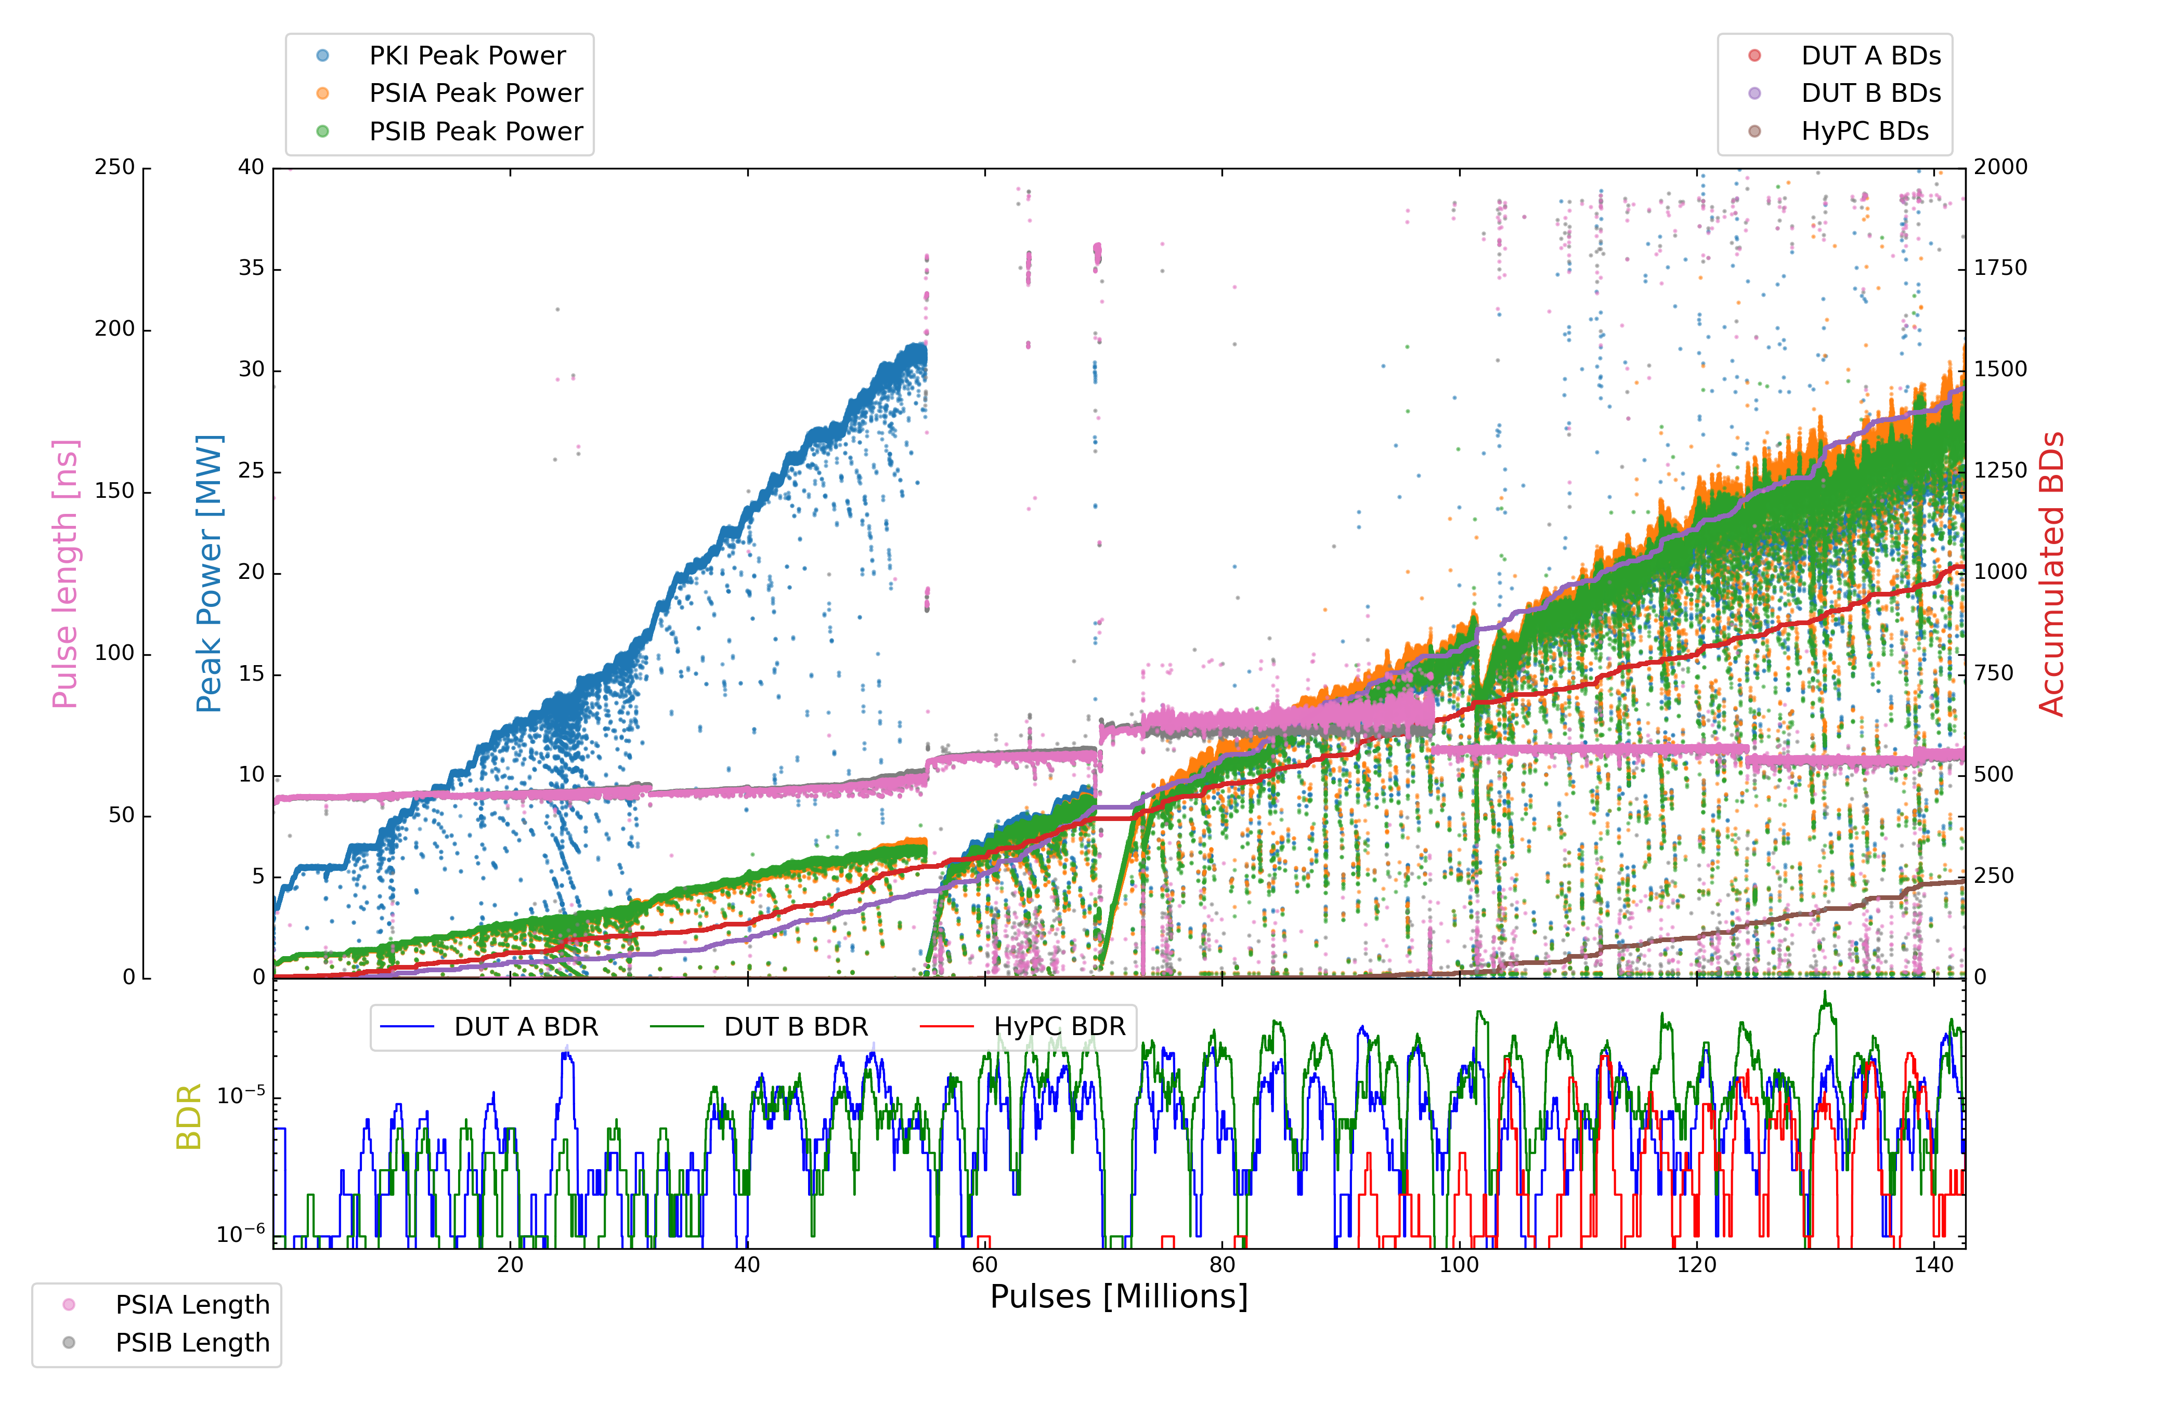
X-Box2
Parameters:
1.6 us klystron pulse
50 ns CP
50 Hz rep rate per line
Current PKI Power: 25 MW

Slide 9
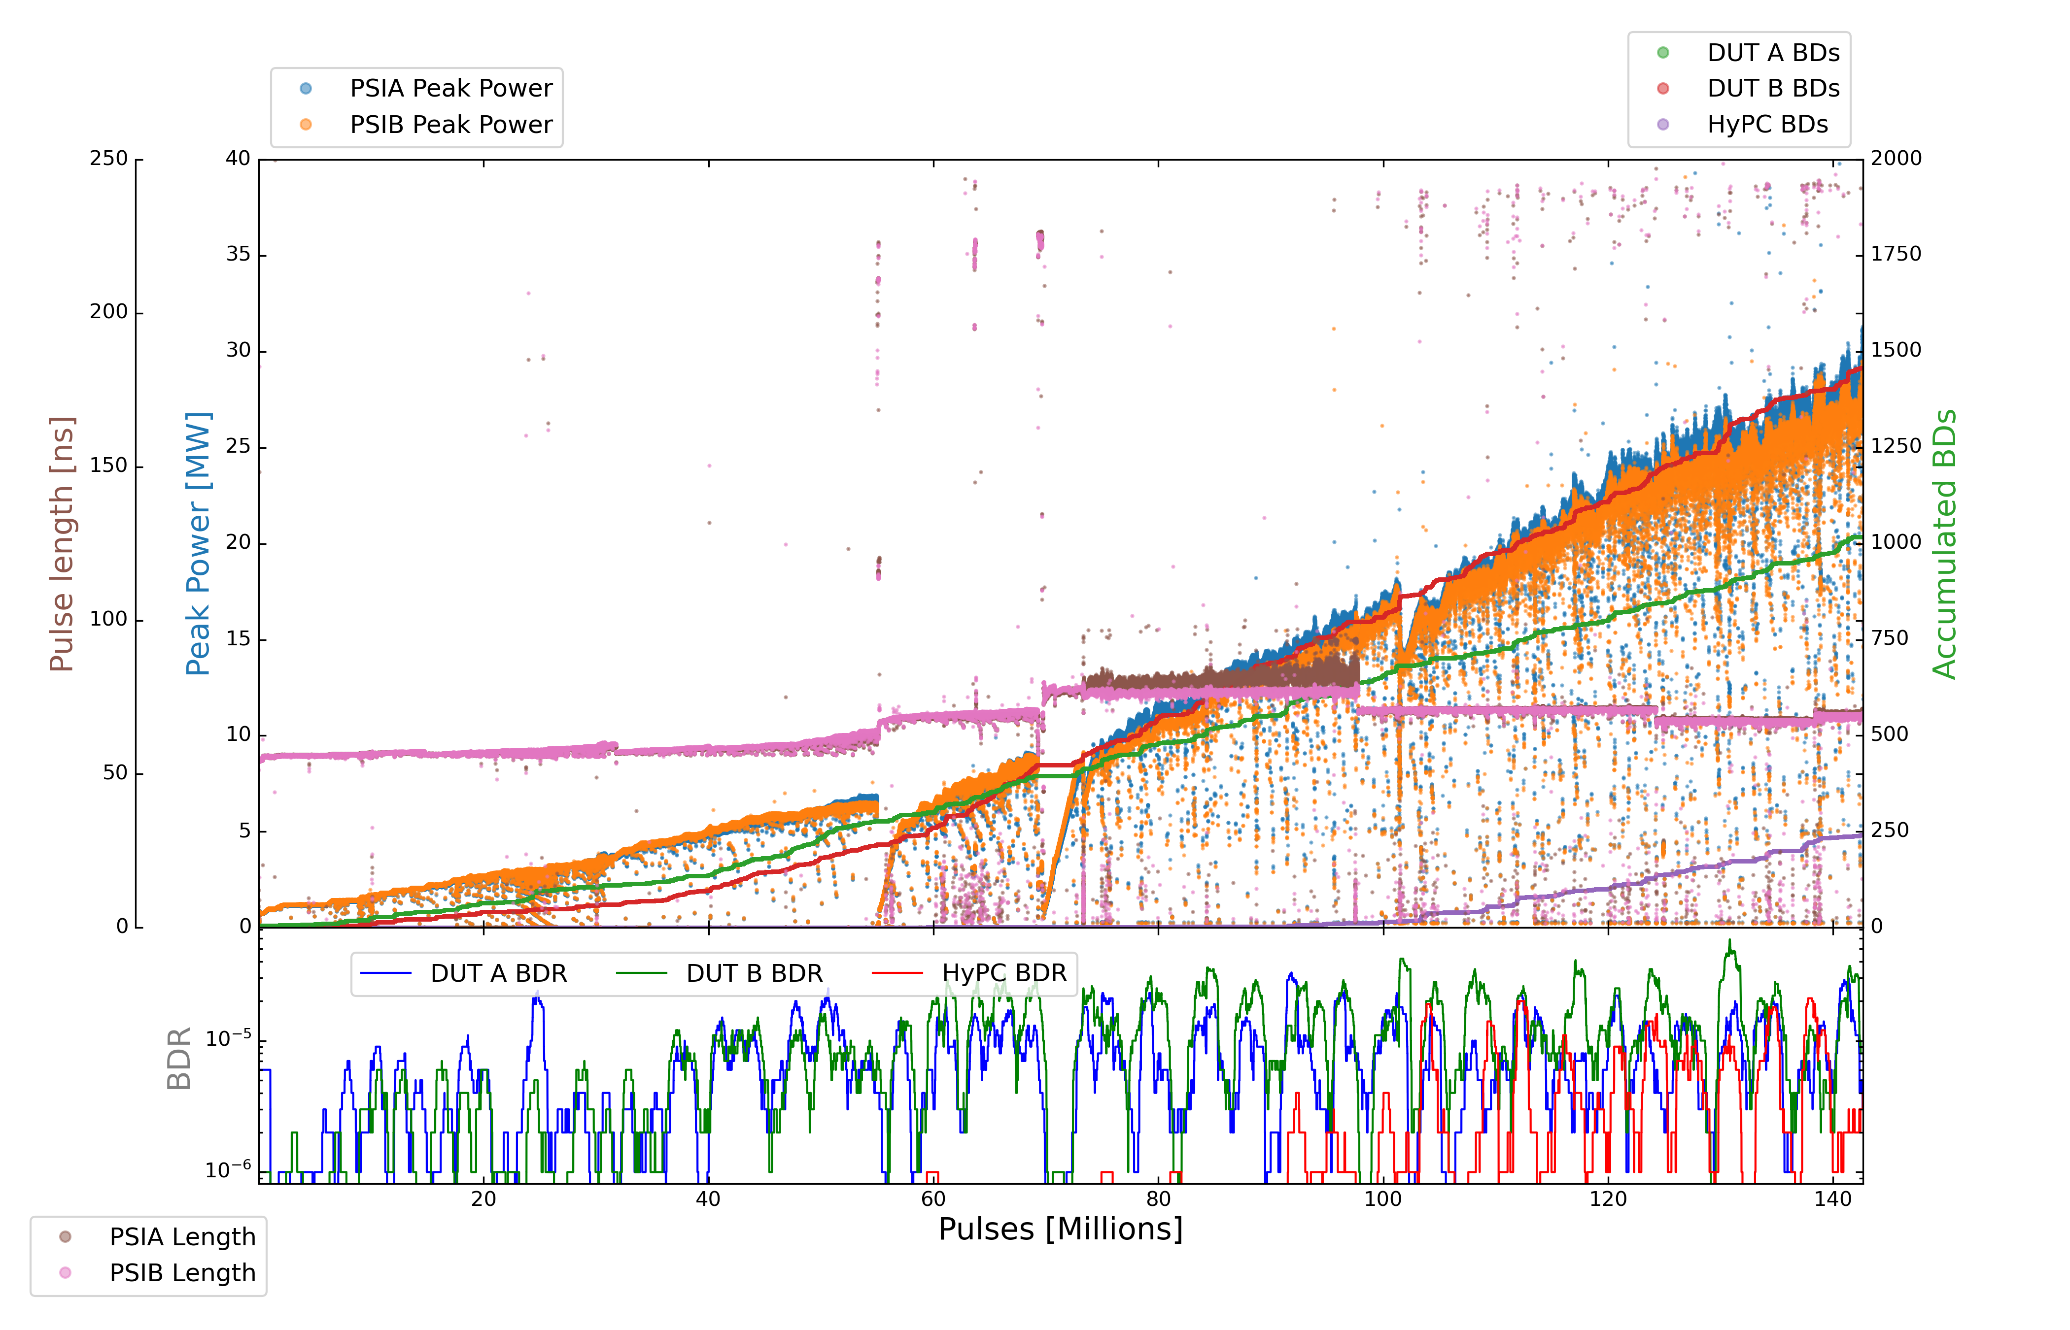
X-Box2
Parameters:
1.6 us klystron pulse
50 ns CP
50 Hz rep rate per line
Current PKI Power: 25 MW

Slide 10
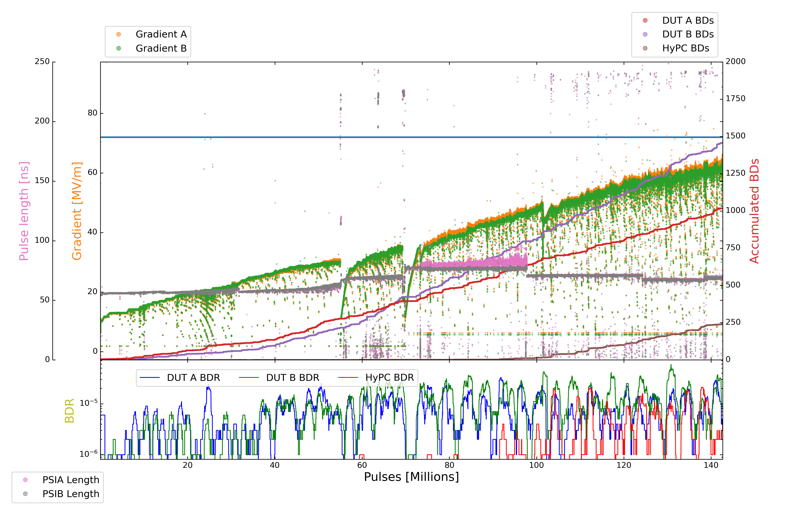
X-Box2
Parameters:
1.6 us klystron pulse
50 ns CP
50 Hz rep rate per line
Current PKI Power: 25 MW

Slide 11
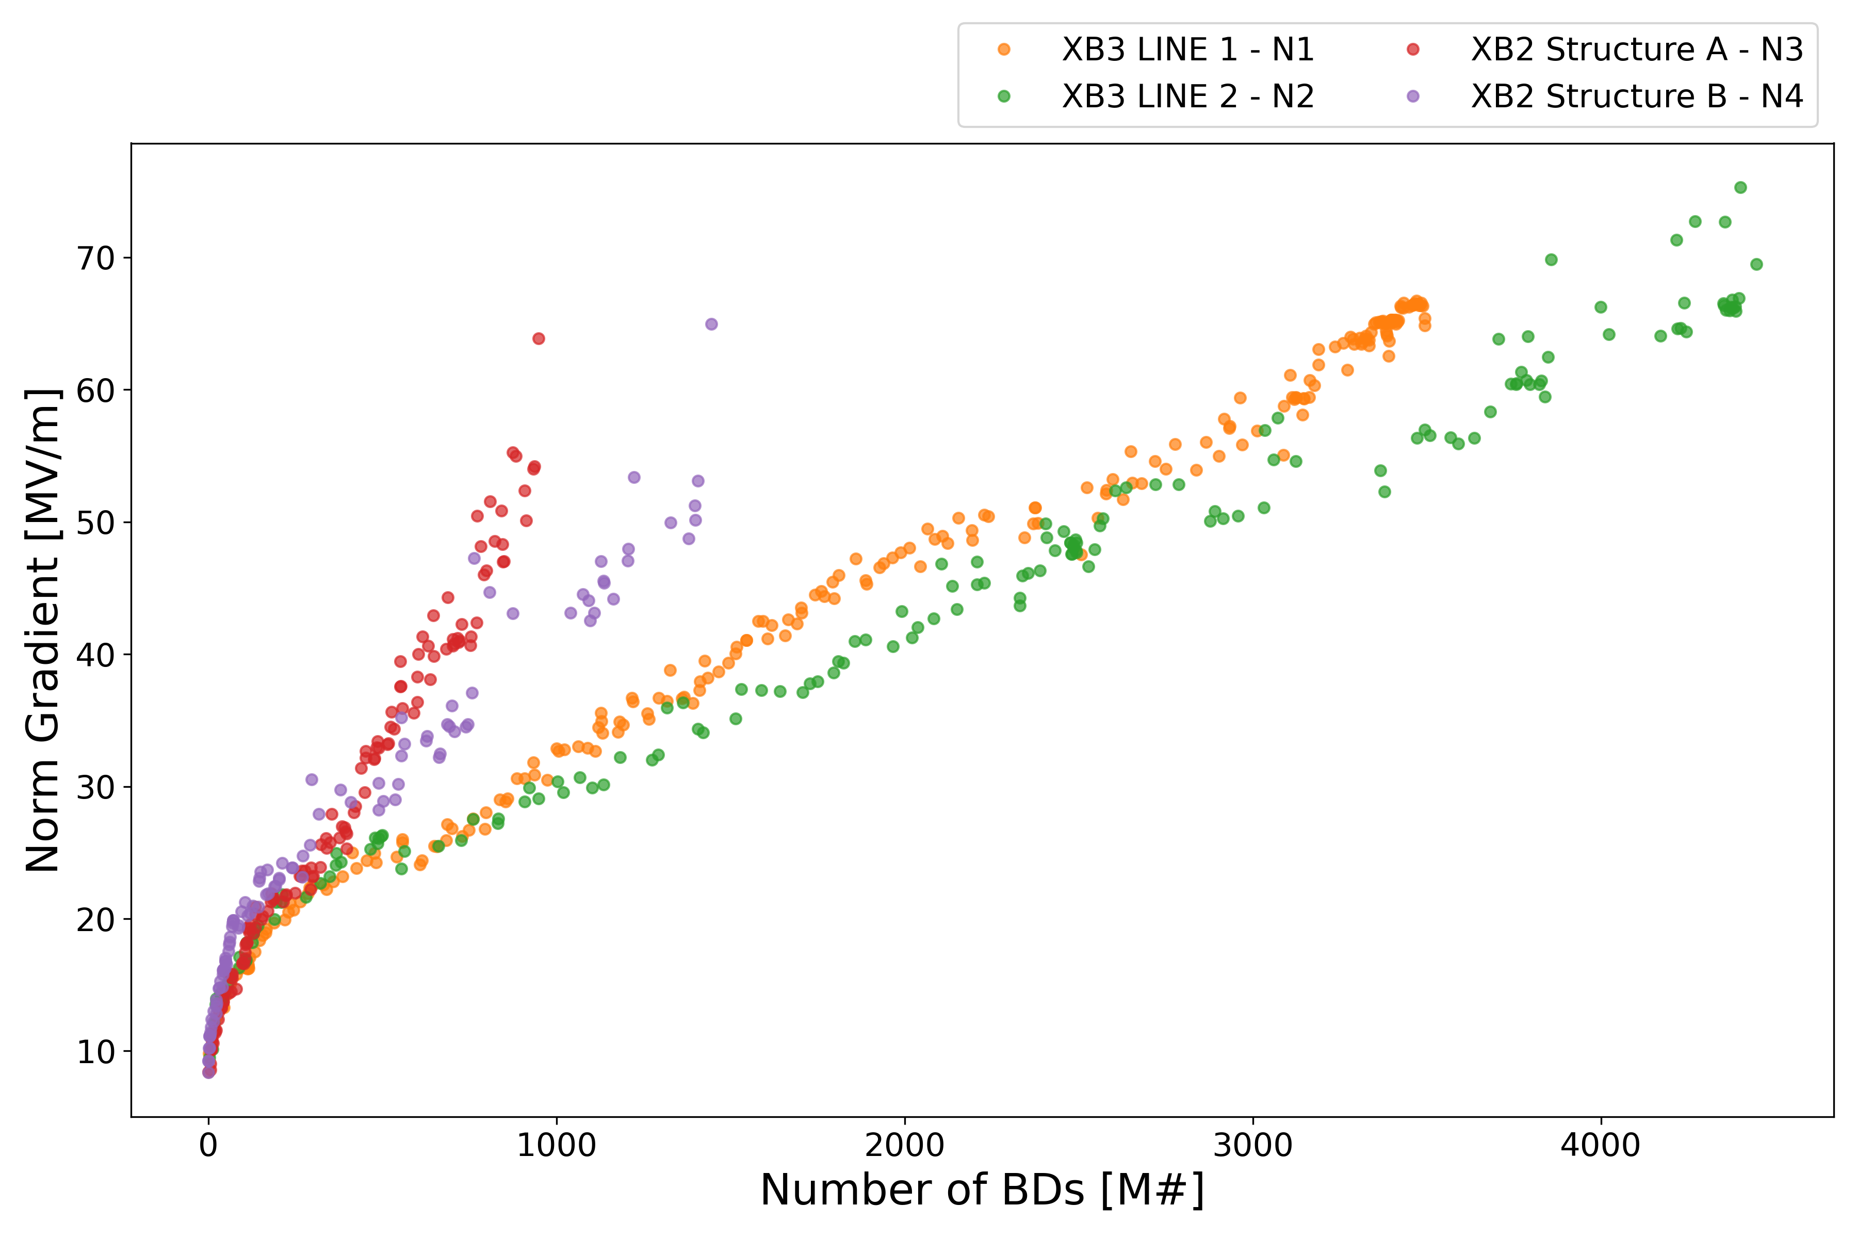
All TD31 BDs

Slide 12
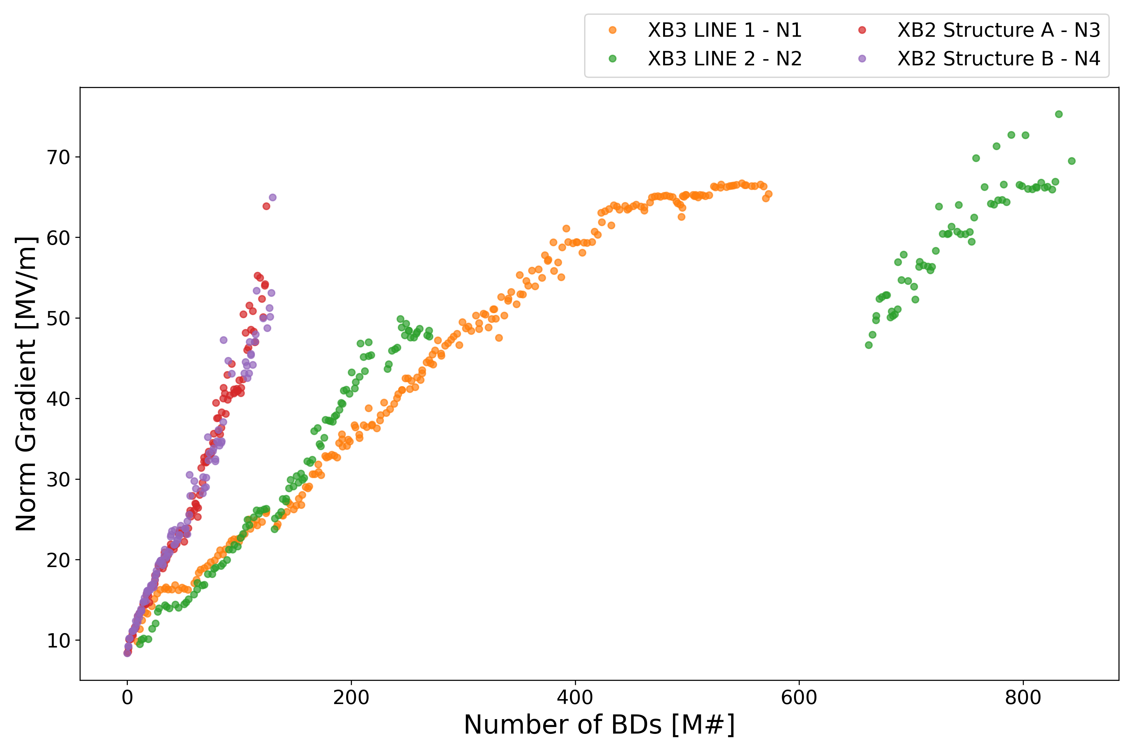
All TD31 Pulse Count

Slide 13
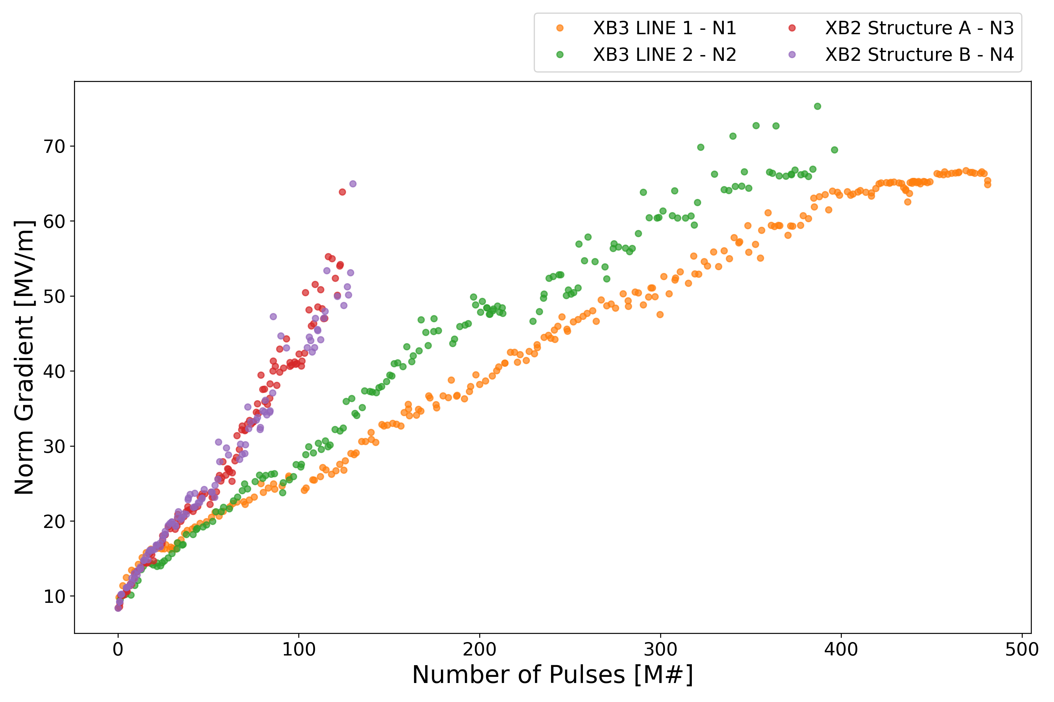
All TD31 RF Pulse Count

Slide 14
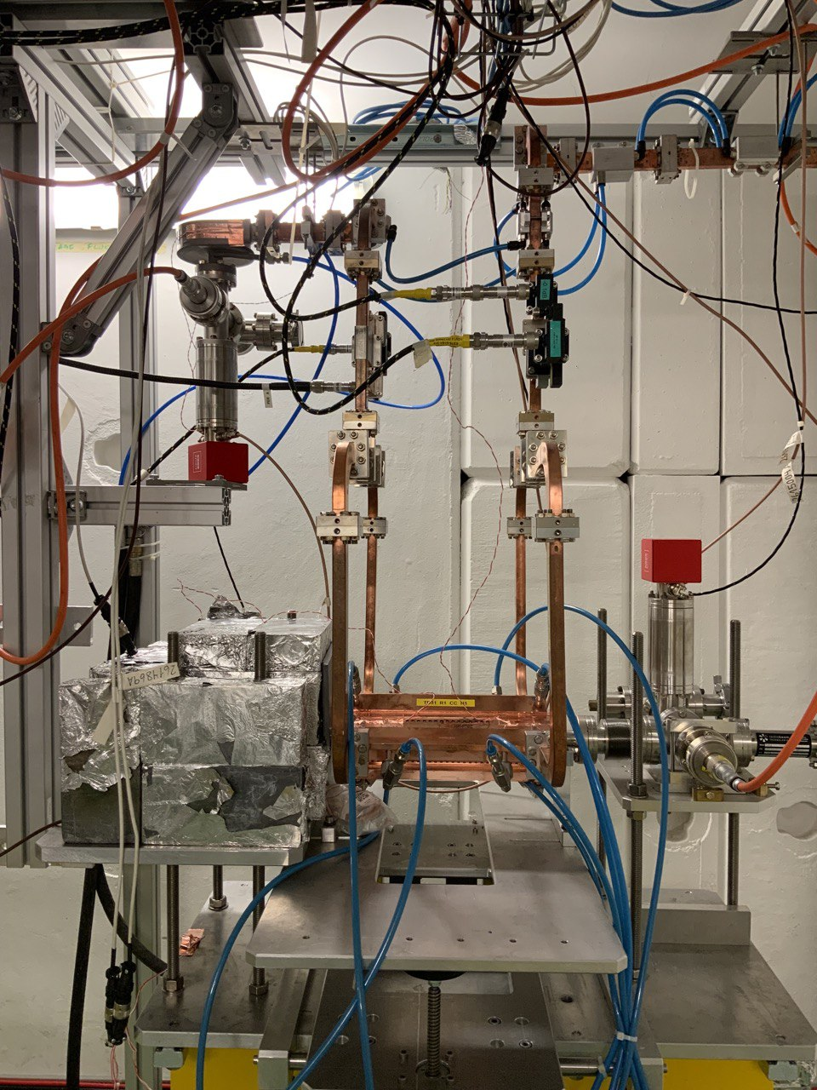
X-Box3 – Line 1

Slide 15
X-Box3 – Line 1
Step | Pulse Witdth | Compressed Pulse Width | Power | DUT BDs | DUT BDR | HyPC BDs | HyPC BDR | Millions of Pulses
9 | 1,9 us | 200 ns (210 ns) | 33 MW | 23 | 9.20000E-07 | 50 | 2.00000E-06 | 25
10 | 1,9 us | 150 ns (160 ns) | 35 MW | 27 | 8.70968E-07 | 29 | 9.35484E-07 | 31
11 | 1,9 us | 150 ns (160 ns) | 33 MW | 5 | 1.21951E-07 | 40 | 9.75610E-07 | 41
12 | 1,9 us | 100 ns (120 ns) | 37 MW | 13 | 5.00000E-07 | 41 | 1.57692E-06 | 26
13 | 1,9 us | 100 ns (120 ns) | 35 MW | 4 | 2.00000E-07 | 23 | 1.15000E-06 | 20
14 | 1,9 us | 100 ns (120 ns) | 33 MW | 6 | 2.60870E-07 | 24 | 1.04348E-06 | 23
15 | 1,9 us | 50 ns (72 ns) | 38,5 MW | 11 | 5.23810E-07 | 58 | 2.76190E-06 | 21
16 | 1,9 us | 50 ns (72 ns) | 37 MW | 5 | 2.17391E-07 | 37 | 1.60870E-06 | 23
17 | 1,9 us | 50 ns (72 ns) | 35 MW | 2 | 5.71429E-08 | 44 | 1.25714E-06 | 35
18 | 1,9 us | 50 ns (72 ns) | 33 MW | 2 | 4.08163E-08 | 27 | 5.51020E-07 | 50

Slide 16
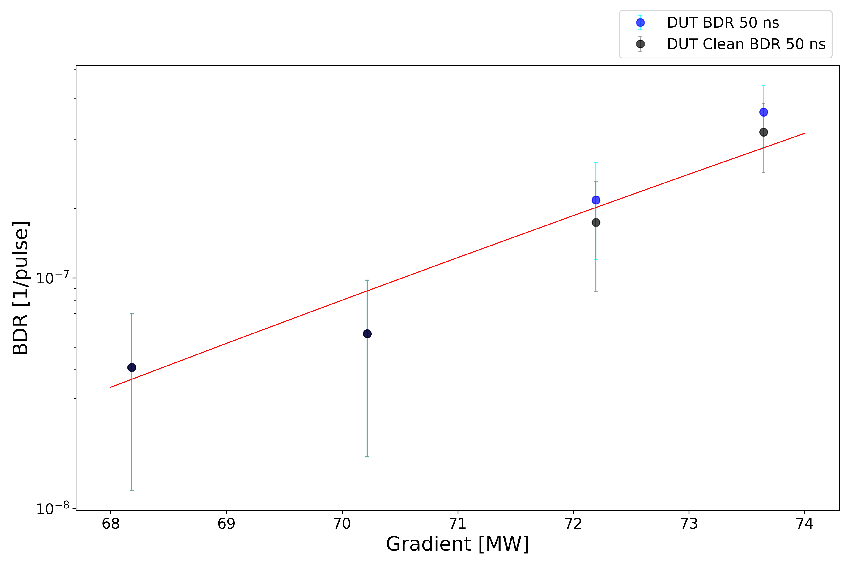
X-Box3 – Line 1

Slide 17
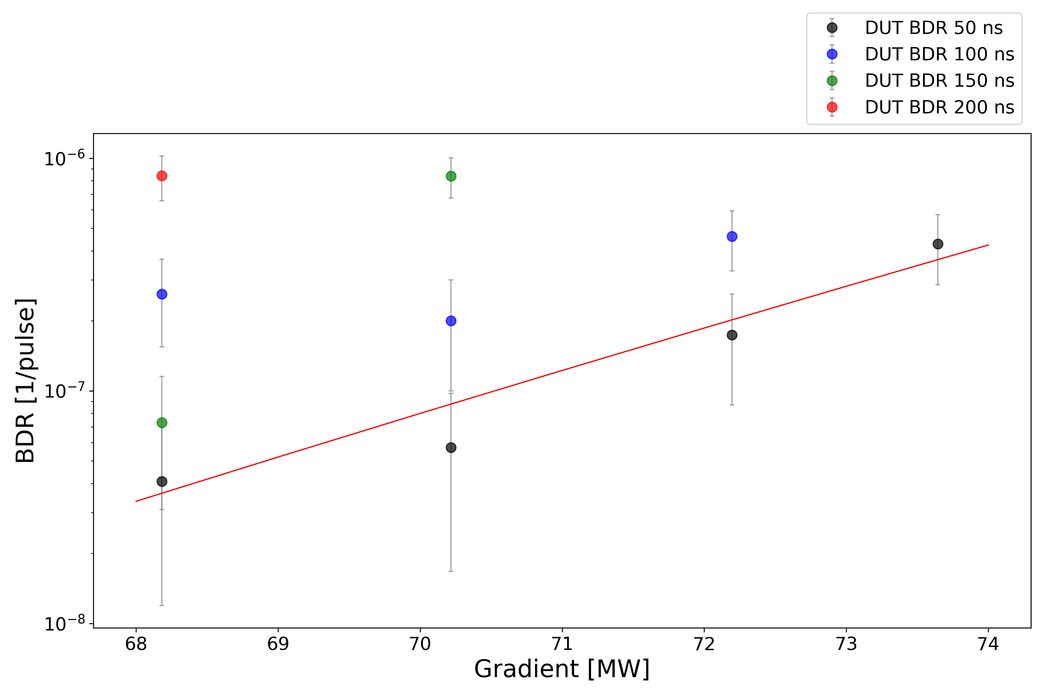
X-Box3 – Line 1

Slide 18
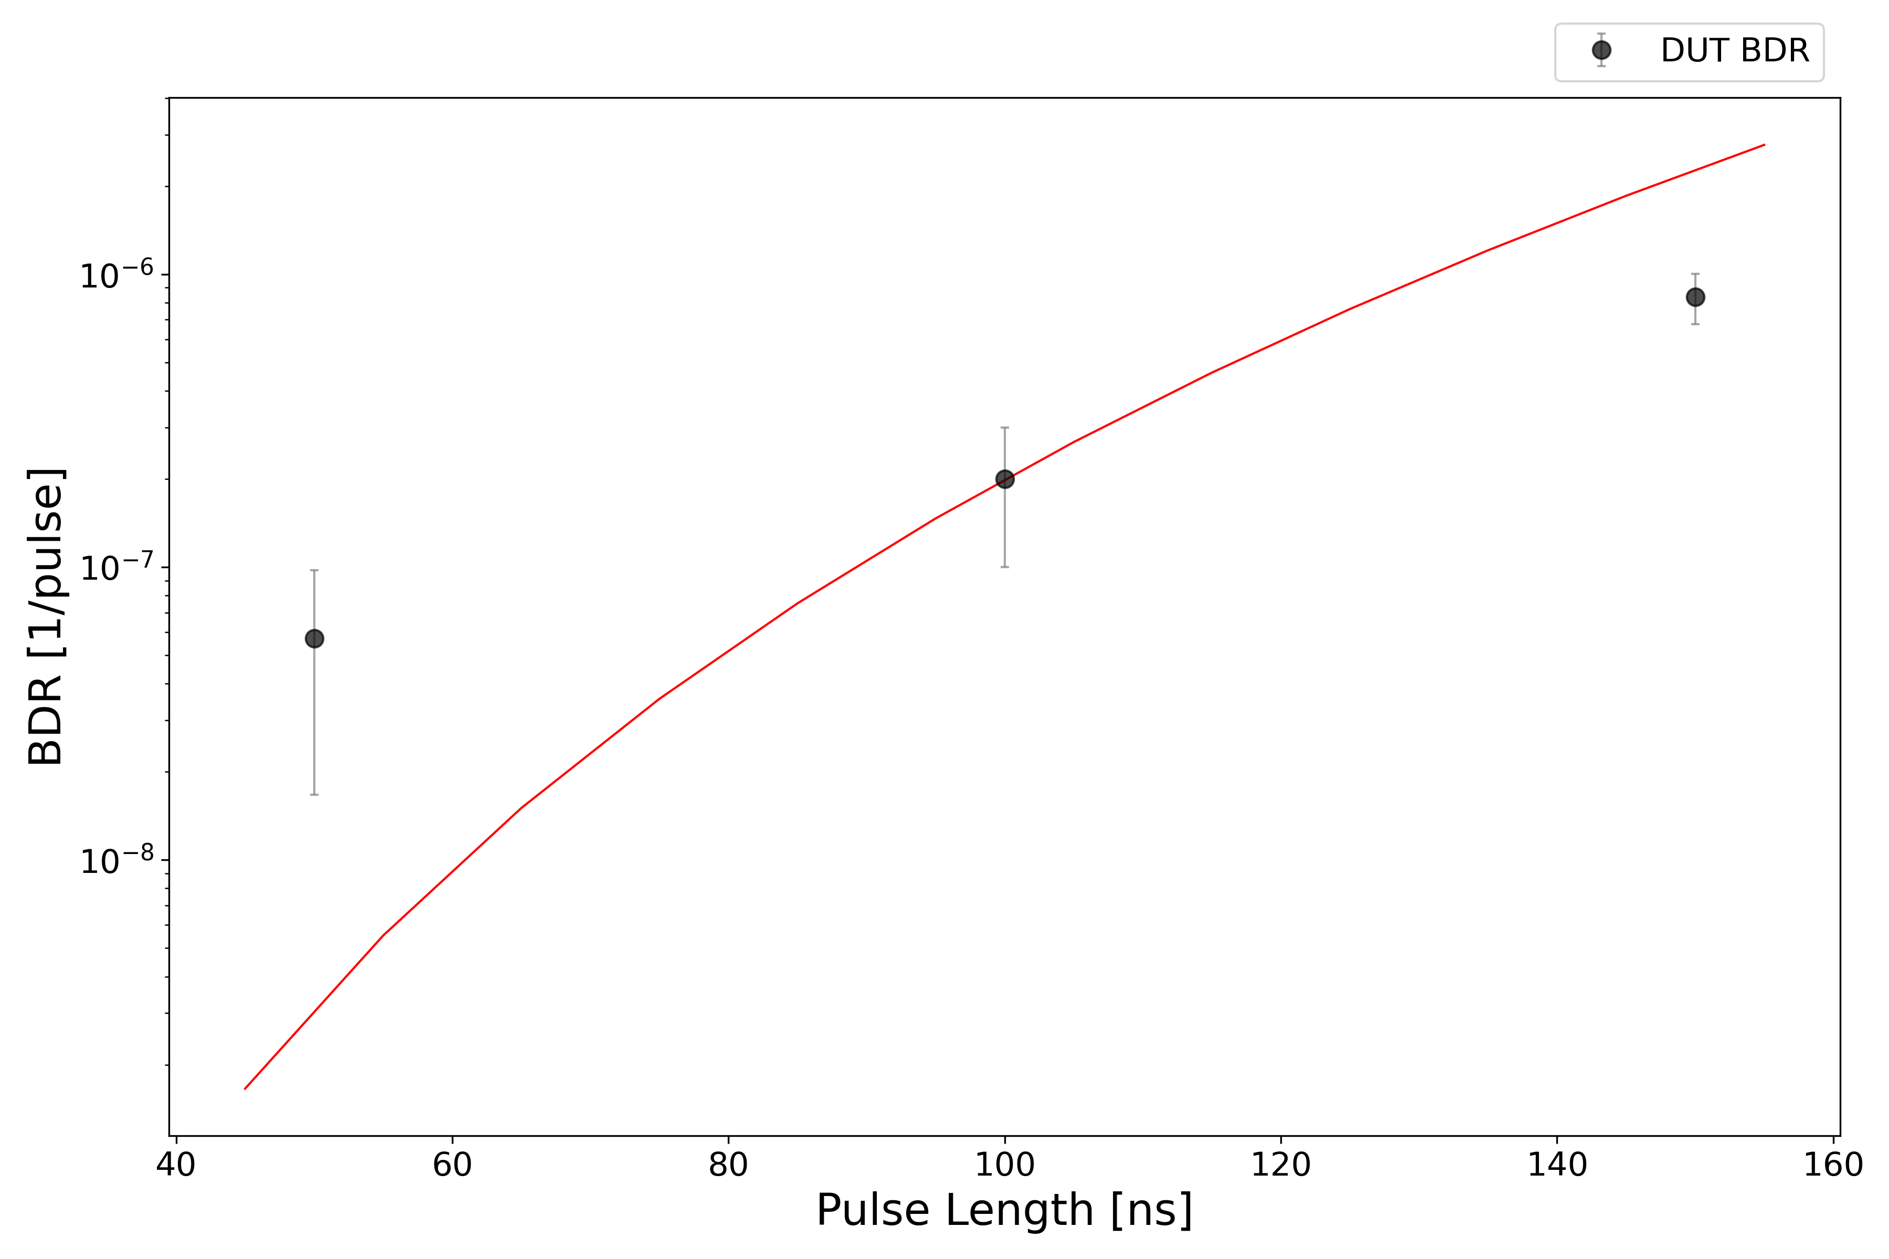
X-Box3 – Line 1

