Slide 1
Xboxes Update
01/03/2023

Slide 2
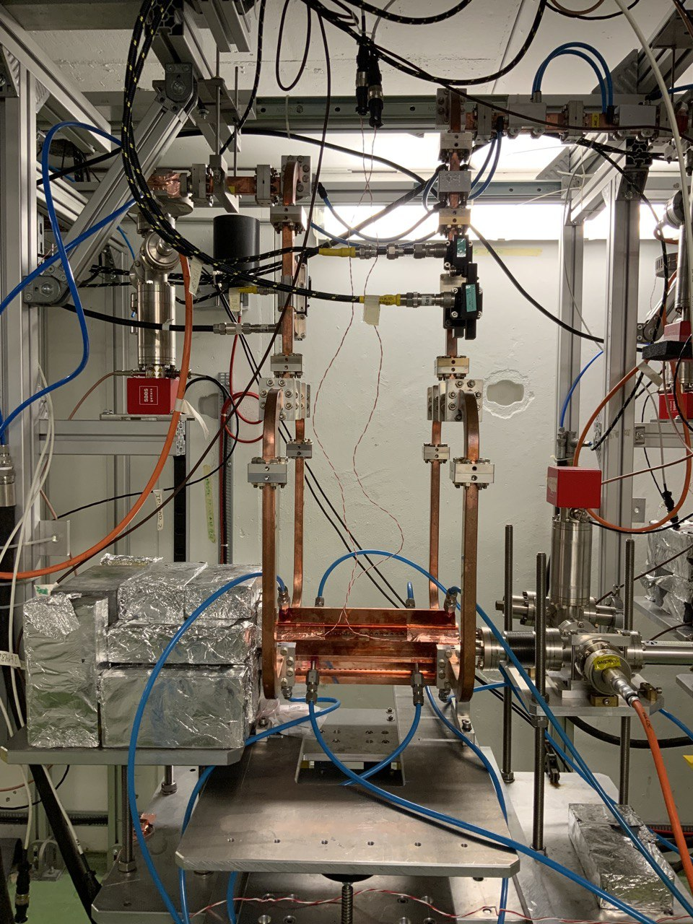
X-Box3 – Line 2

Slide 3
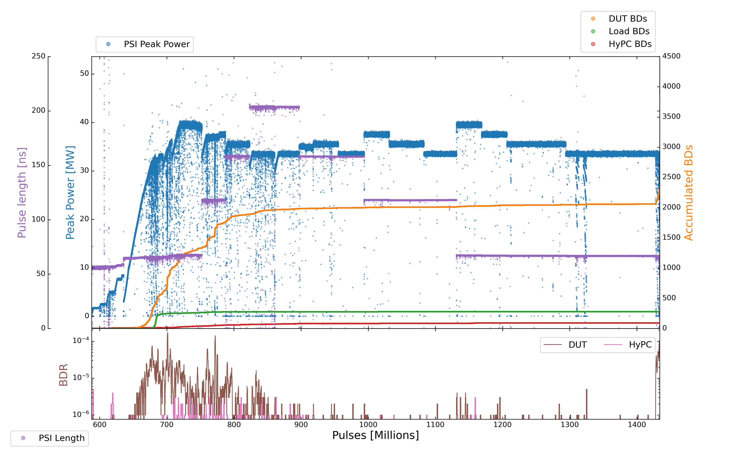
X-Box3 – Line 2
Parameters:
1.9 us klystron pulse
50 ns CP
150 Hz rep rate per line
Current Power: OFF
21
24
25
18
19
20
22
26
27
17
23

Slide 4
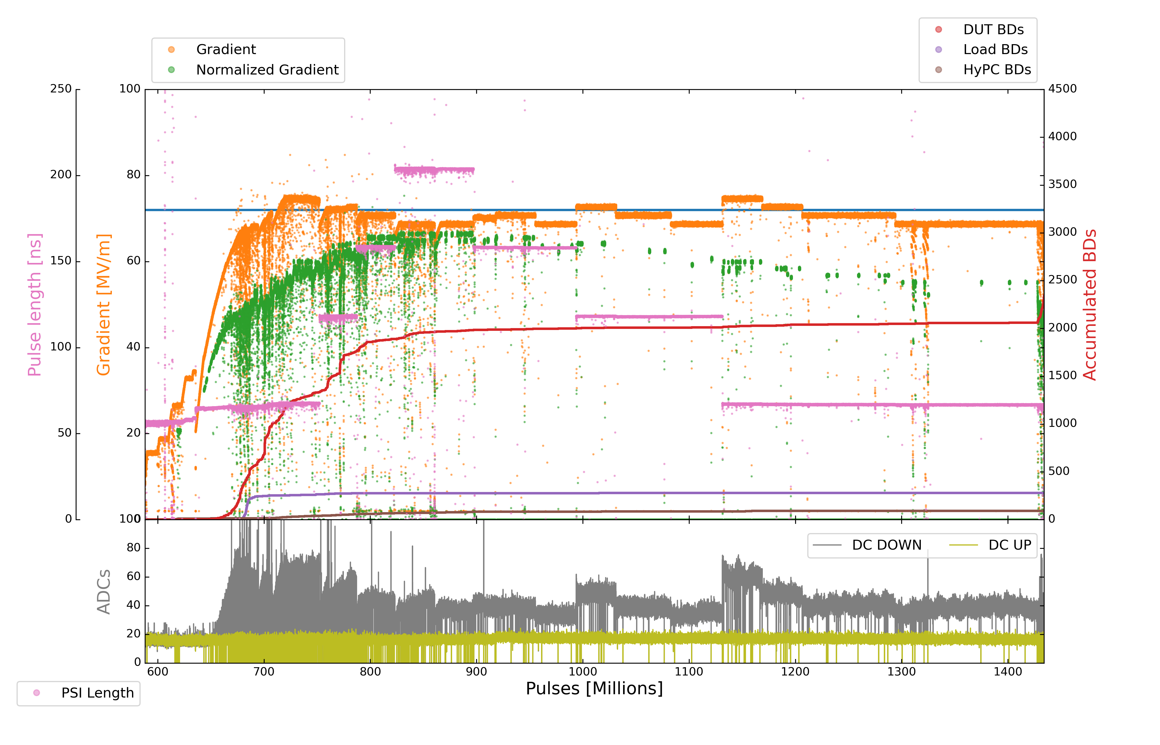
X-Box3 – Line 2
Parameters:
1.9 us klystron pulse
50 ns CP
150 Hz rep rate per line
Current Power: OFF

Slide 5
X-Box3 – Line 2
Step | Pulse Witdth | Compressed Pulse Width | Power | DUT BDs | DUT BDR | HyPC BDs | HyPC BDR | Millions of Pulses
17 | 1,9 us | 200 ns (210 ns) | 33.5 MW | 16 | 5,0000E-07 | 6 | 1.87500E-07 | 32
18 | 1,9 us | 150 ns (160 ns) | 34.5 MW | 4 | 2.10526E-07 | 2 | 1.05263E-07 | 19
19 | 1,9 us | 150 ns (160 ns) | 35.5 MW | 7 | 2.12121E-07 | 0 | 0 | 33
20 | 1,9 us | 150 ns (160 ns) | 33.5 MW | 4 | 1.08108E-07 | 0 | 0 | 37
21 | 1,9 us | 100 ns (120 ns) | 37.5 MW | 5 | 1.38889E-07 | 1 | 2.77778E-08 | 36
22 | 1,9 us | 100 ns (120 ns) | 35.5 MW | 2 | 4.00000E-08 | 1 | 2.00000E-08 | 50
23 | 1,9 us | 100 ns (120 ns) | 33.5 MW | 3 | 6.38298E-08 | 1 | 2.12766E-08 | 47
24 | 1,9 us | 50 ns (72 ns) | 39.5 MW | 15 | 4.16667E-07 | 5 | 1.38889E-07 | 34
25 | 1,9 us | 50 ns (72 ns) | 37.5 MW | 10 | 2.77778E-07 | 0 | 0 | 36
26 | 1,9 us | 50 ns (72 ns) | 35.5 MW | 4 | 6.34921E-08 | 0 | 0 | 70
27 | 1,9 us | 50 ns (72 ns) | 33.5 MW | 3 | 3.15789E-08 | 0 | 0 | 1000

Slide 6
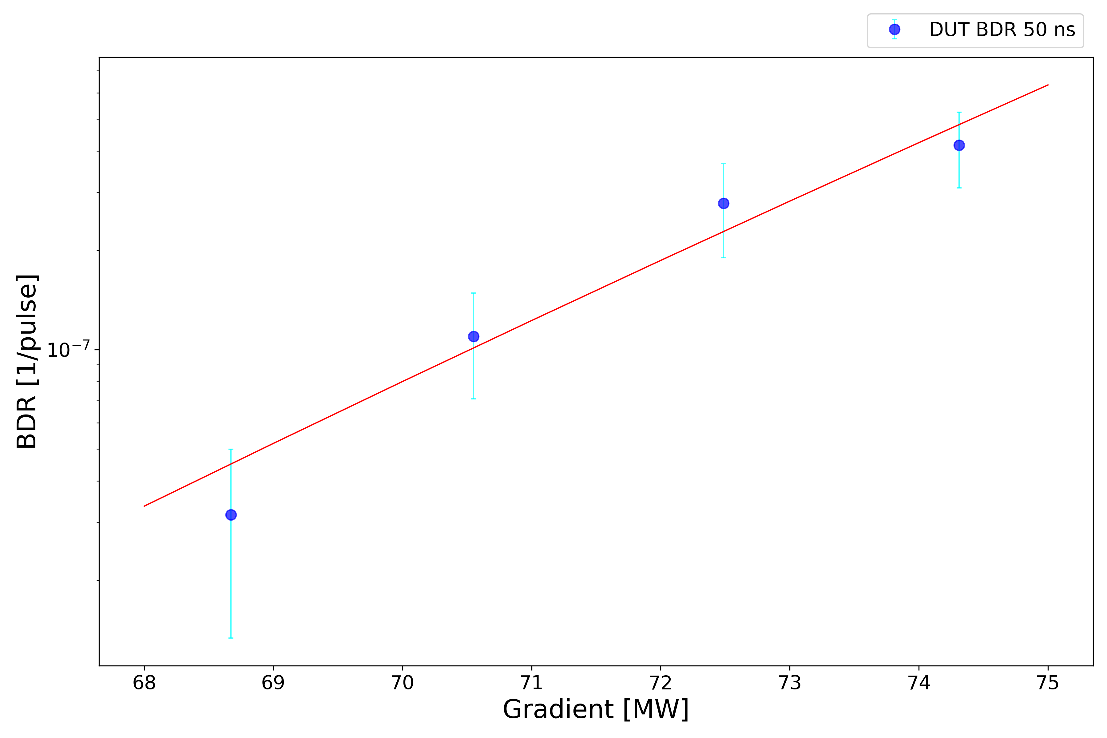
X-Box3 – Line 2

Slide 7
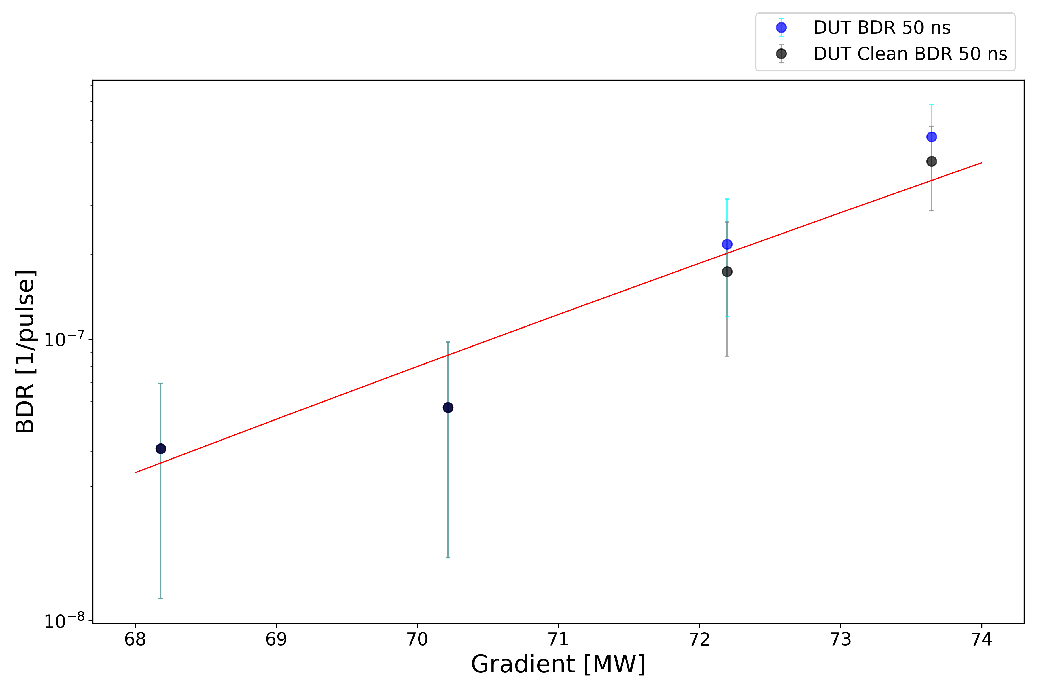
X-Box3 – Line 1

Slide 8
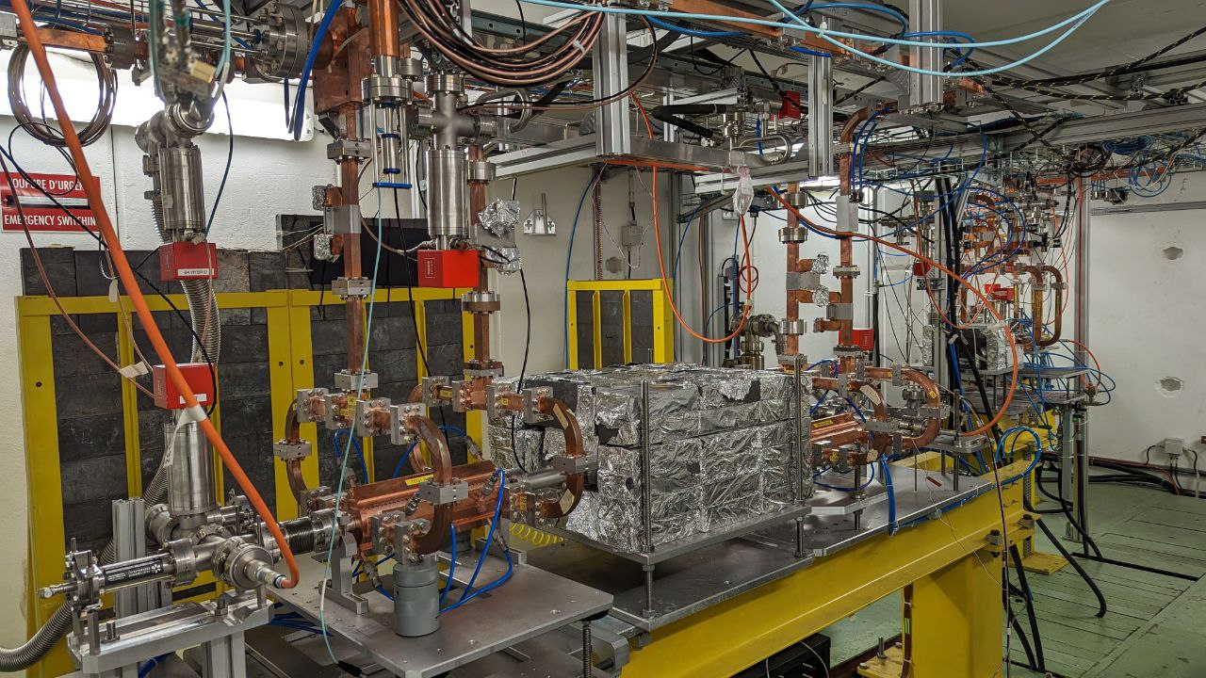
X-Box2

Slide 9
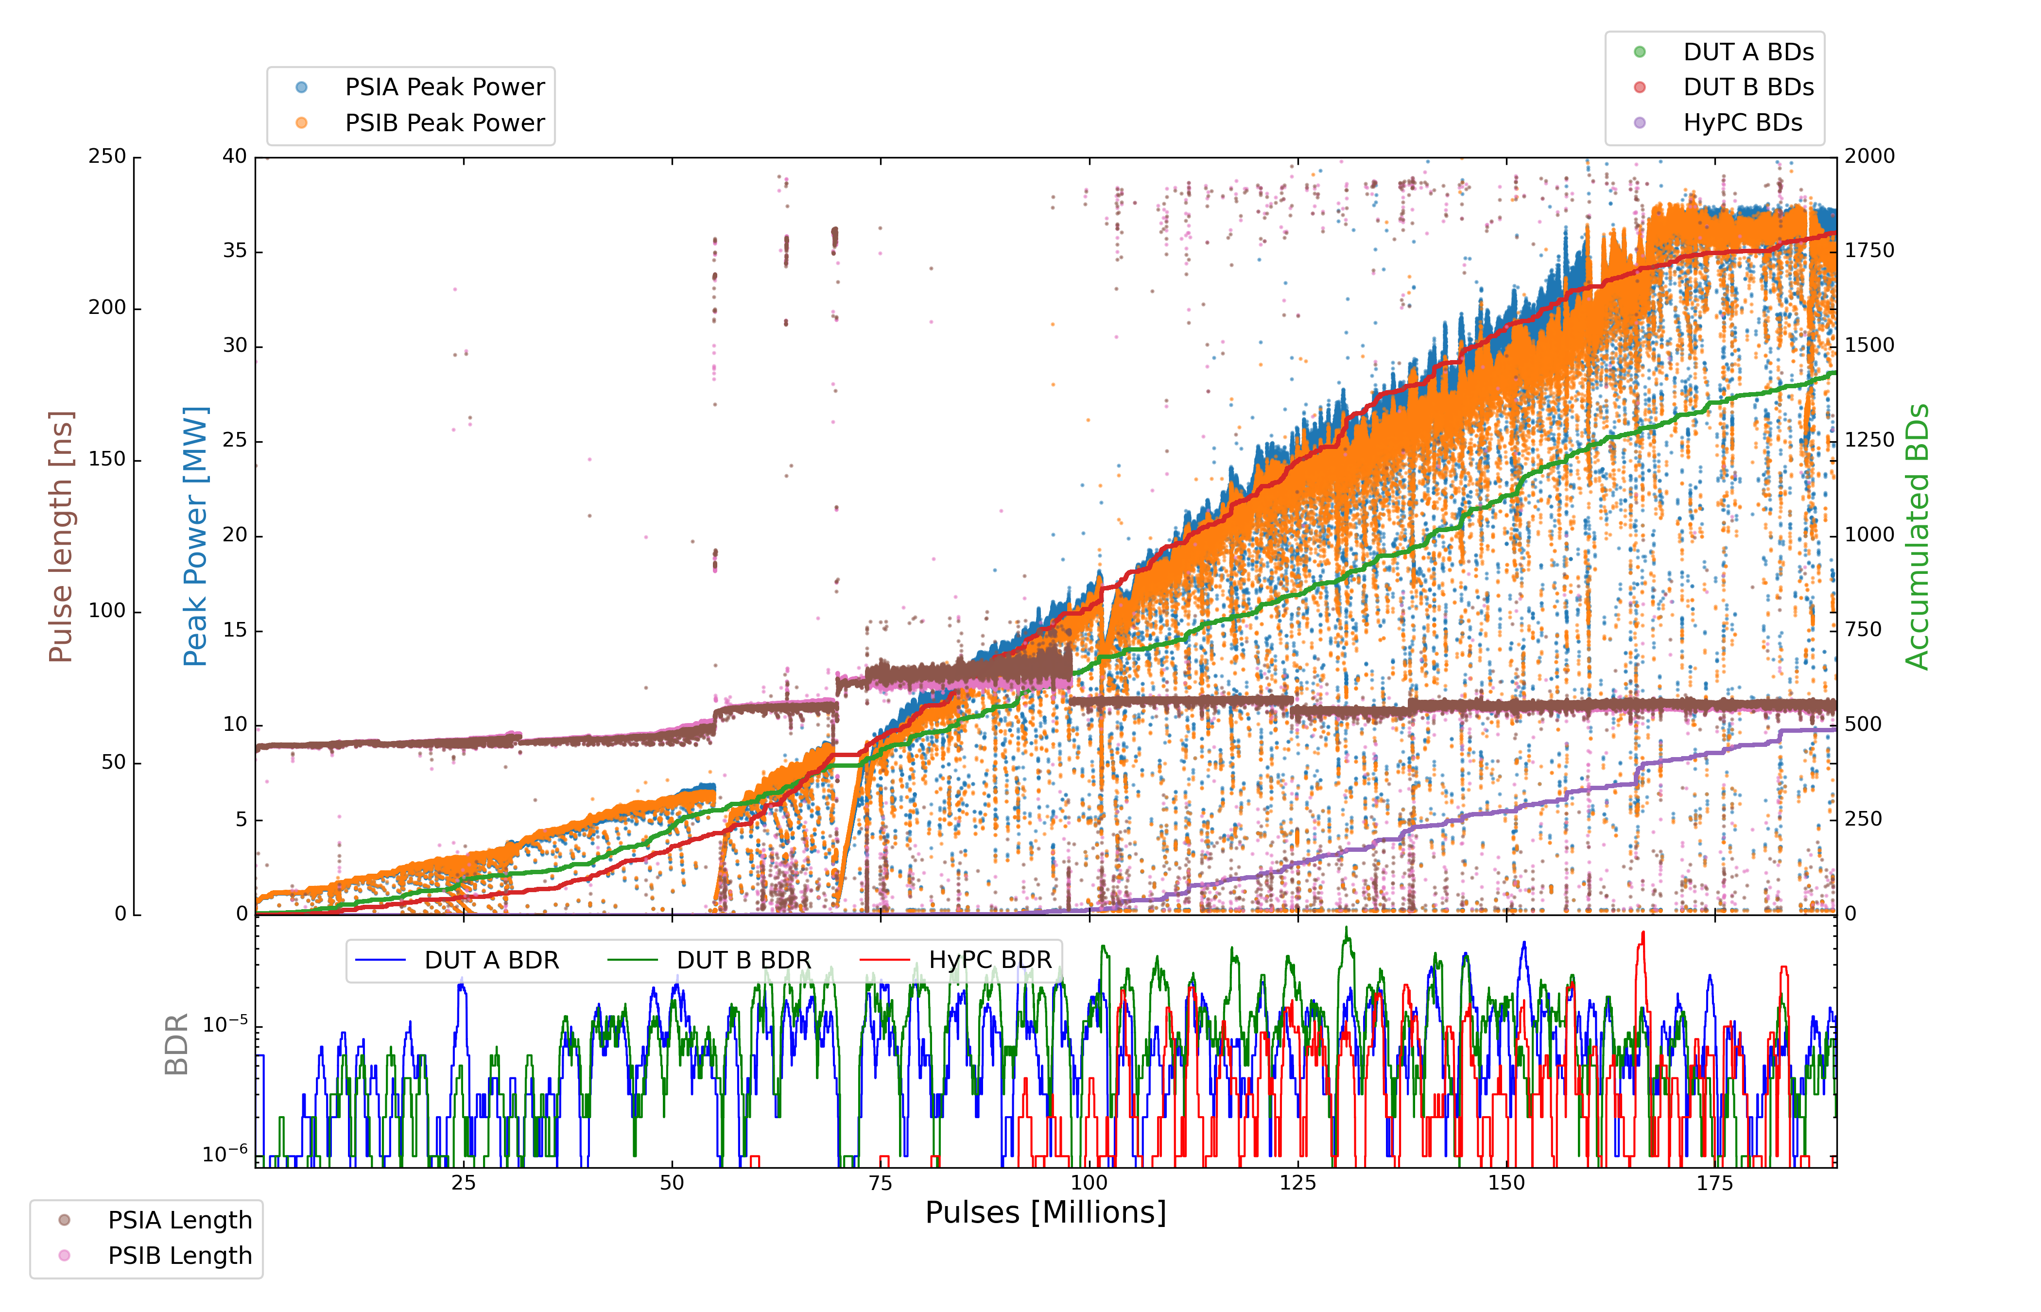
X-Box2
Parameters:
1.6 us klystron pulse
100 ns CP
50 Hz rep rate per line
Current PKI Power: 32.8 MW

Slide 10
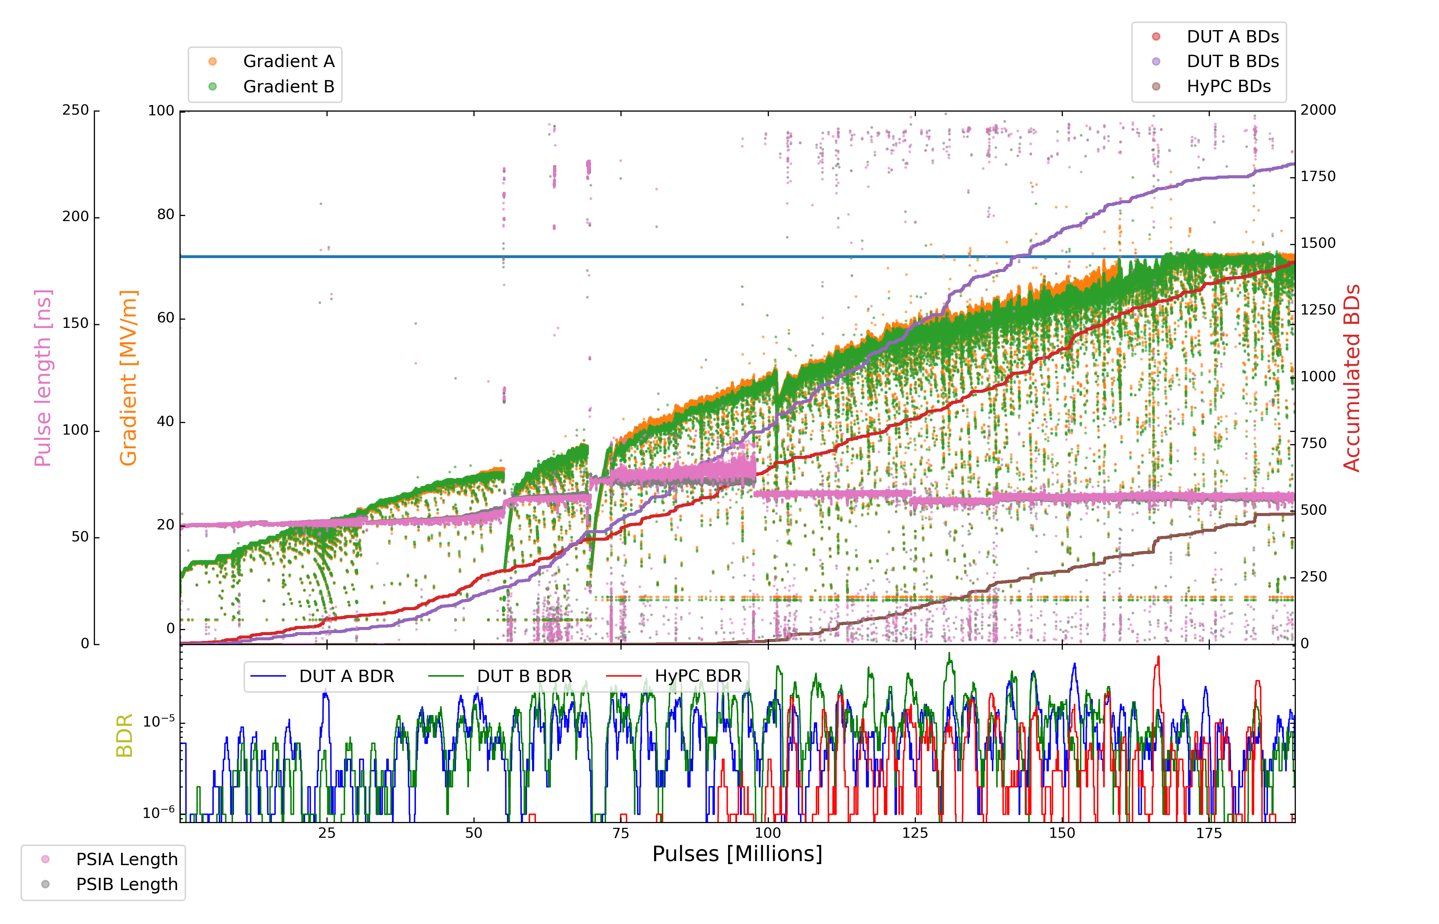
X-Box2
Parameters:
1.6 us klystron pulse
100 ns CP
50 Hz rep rate per line
Current PKI Power: 32.8 MW

Slide 11
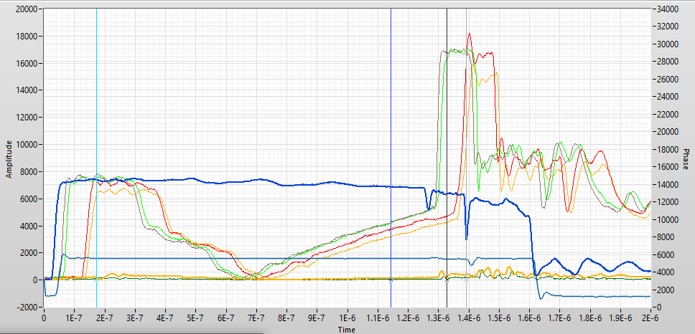
X-Box2

Slide 12
X-Box3 Structure Temperature

Slide 13
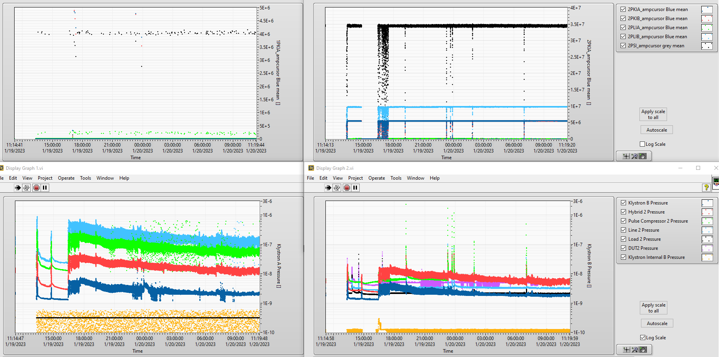
X-Box3 Structure Temperature

Slide 14
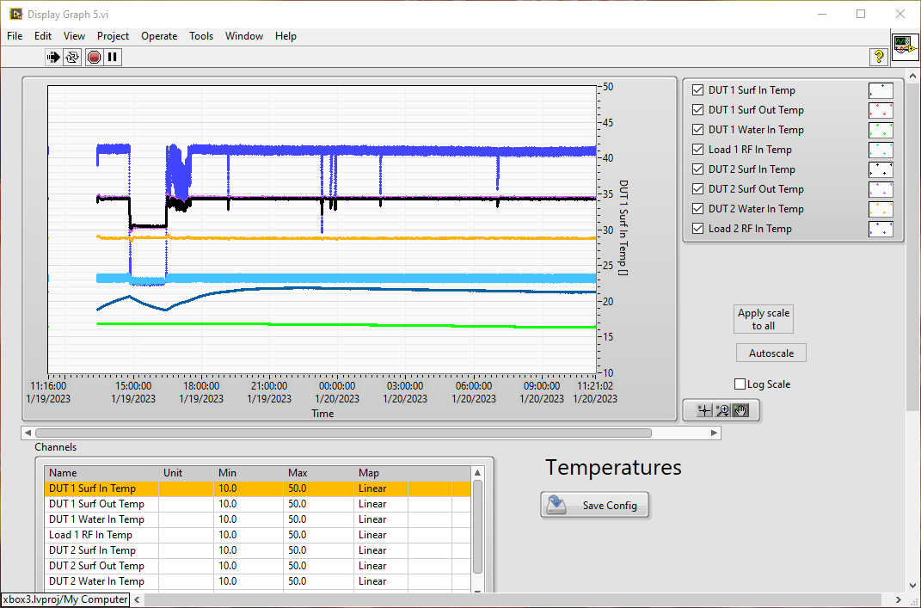
X-Box3 Structure Temperature

