Slide 2
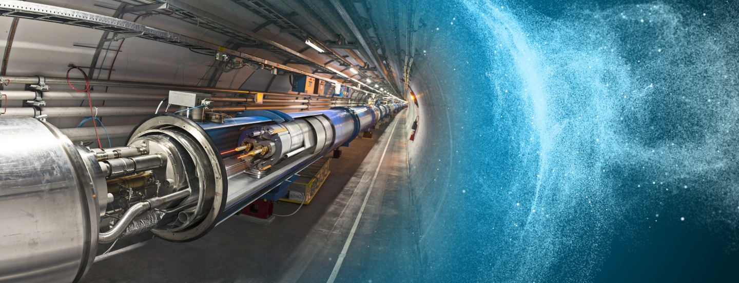
PULPOKS 2023
CERN participants

Slide 3
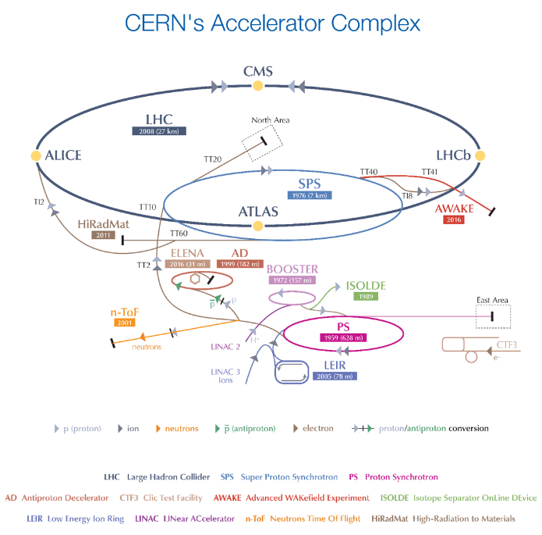
Today’s participants are all from the Accelerator Beam Transfer Group
Scope: Development, construction, operation and maintenance of kicker, septa and associated electronics.
6 Sections in the group:
Beam Transfer Physics (BTP)
Beam Transfer Controls (BTC)
Beam Transfer Electronics (BTE)
Septa (SE)
Pulsed Power Engineering (PPE)
Kicker Design & Construction (KDC)

Slide 4
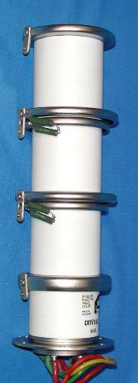
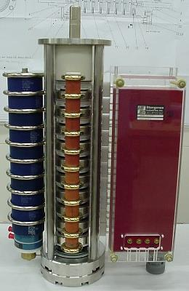
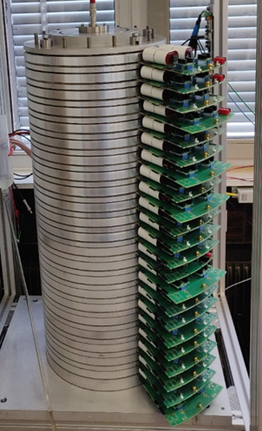
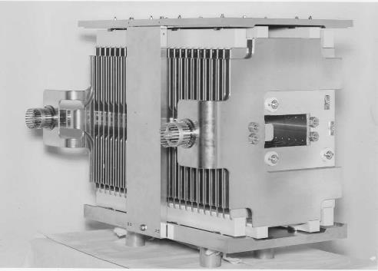
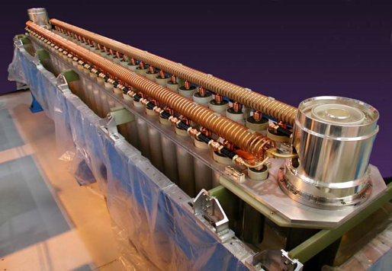
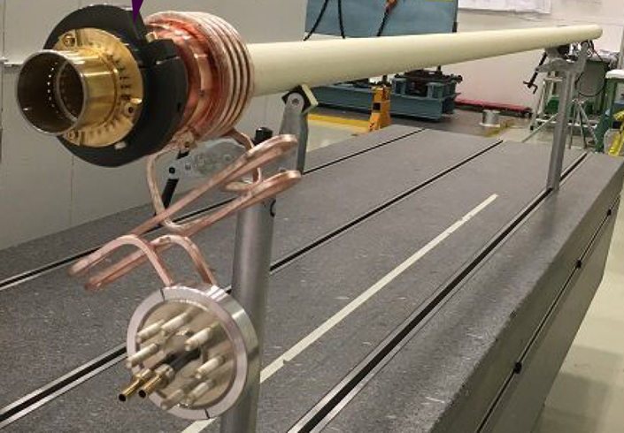
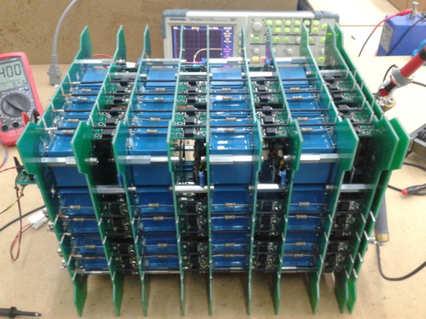
CERN SY-ABT Kicker Activities
Designed, produced and operates over 80 kicker systems in the accelerator complex, beam transfer lines between accelerators and up to targets.
Rise times from 5ns (CLIC) to 2.8 µs (LHC).
Pulse durations up to 90 µs (typically <1% ripple).
Pulsed currents up to 400 kA.
Voltages up to 80 kV.
Competencies in pulsed power technology, high voltage engineering, mechanical design and production, handling of UHV, testing and maintenance.

Slide 5
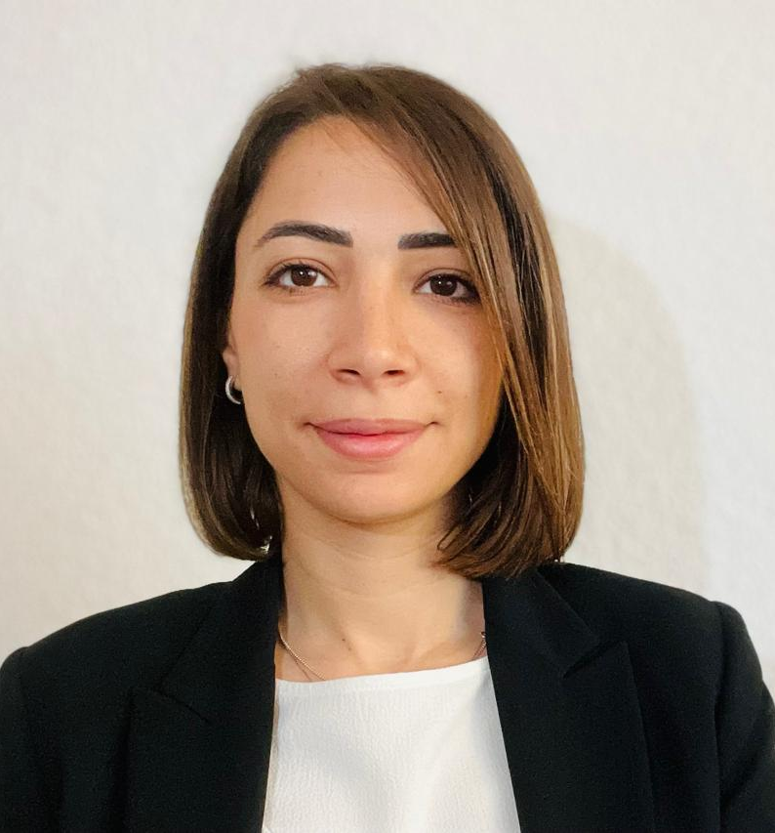
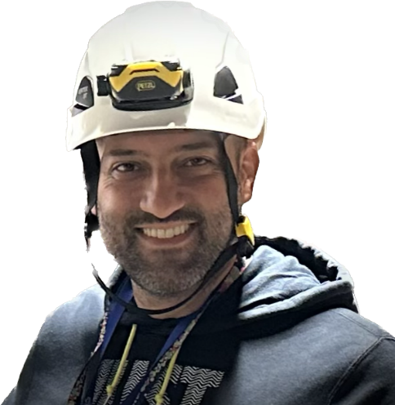
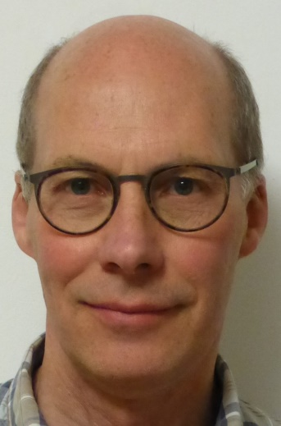
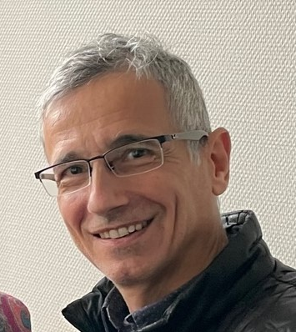
CERN’s contribution to PULPOKS 2023
1 Talk : Optimization of Beam Impedance Mitigation Measures for HV Reliability in an SPS Injection Kicker Magnet
4 posters : - Marx Generator for Kicker Magnets Power Supply Based on SiC MOSFETs (poster)
- Inductive Voltage Adder for driving Kicker Magnets with a Short-circuit Termination (poster)
- High power electrical contacts for Kicker magnets applications (poster)
- Ultra-fast generator for impact ionization triggering (poster)
Giorgia Favia
Electronics engineer, PhD, Joined PPE section at CERN in 2023
Konstantinos Papastergiou
Electronics Engineer
Joined CERN in 2012
Mike Barnes
Electrical engineer, joined CERN in 2006, deputy head of PPE section
Laurent Ducimetière
Electrical engineer, joined CERN in 1992 head of KDC section

