Slide 2
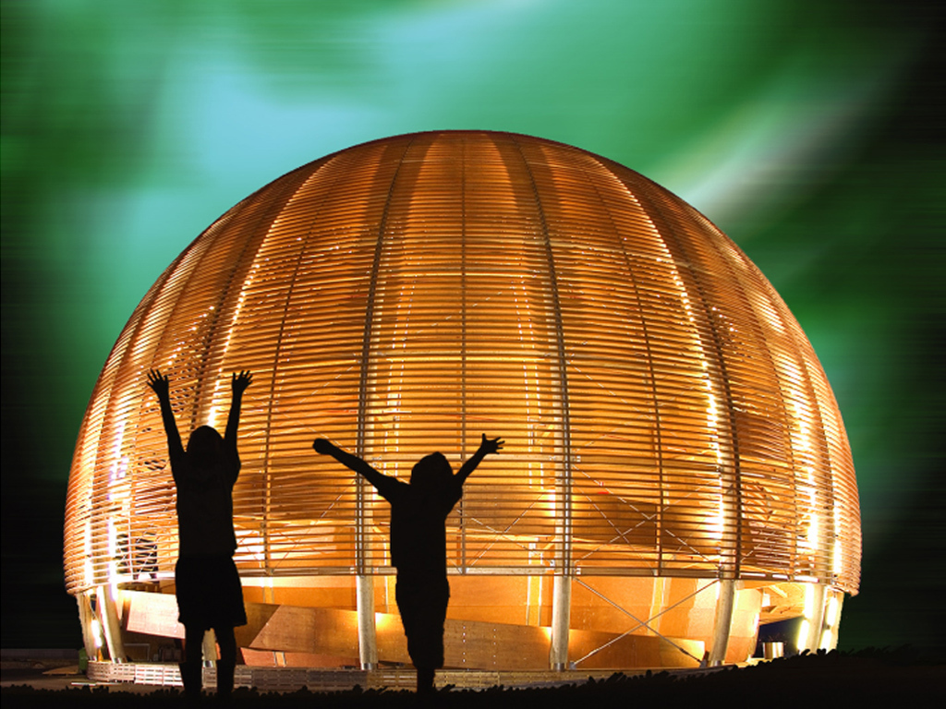
Welcome @ CERN
1 February 2023
© CERN Photo
Notes:
Kyriaki
***************
Good morning and welcome aboard!

Slide 3
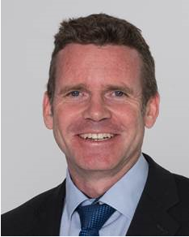
Bienvenue
Welcome
James PURVIS
Chef du département des ressources humaines
Head, Human Resources Department
Link to video on Indico
Notes:
Kyriaki
**************

Slide 4
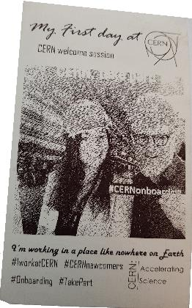
Welcome Bienvenue
Rocio
ALOT
HR Department,
Recruitment and
Sourcing Specialist
Erwin
MOSSELMANS
HR Department,
Learning Specialist

Slide 5

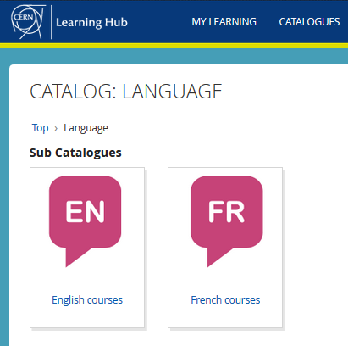
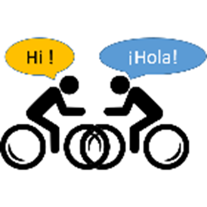
Logistics - language
Classroom courses
cern.ch/learninghub
Tandem
link
Find a partner
to practice speaking
each other’s language
Notes:
Erwin
*************
Au CERN, nous avons 2 langues officielles : l’anglais et le francais.
Qui maitrise bien ces 2 langues ?
Aujourd’hui, nous utiliserons principalement l’anglais, mais n’hesitez pas d’intervenir en francais si vous le souhaitez !
CERN has 2 official languages : English and French. Today, we will use mainly English, as from experience we know that not everyone understands French … yet !.
To learn English or French, there are classroom courses organised on the site, which are also open for spouses. You find the details on the CERN learning hub.
The enrolments open from the 7th November and the classes start in January 2023. 7th speaking platform.
And you can also create the opportunities yourself with the tandem website. The aim of the website is to facilitate finding a partner (not to bike together but) to meet and learn by practicing on a voluntary basis each other’s language, not limited to English and French !

Slide 6

Logistics - slides
Available at any time
direct link : https://indico.cern.ch/category/10150/
Notes:
Erwin
*************
The slides are available on Indico, which is an event management software tool created at CERN.
Later today, you will receive an email with the link to the slides.

Slide 7
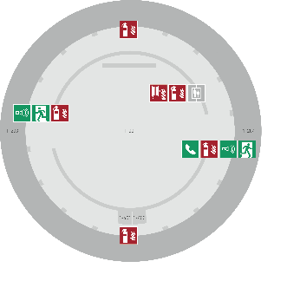
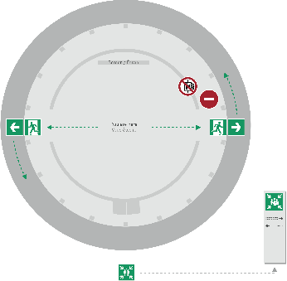
Emergency Procedure d’Urgence
When the alarm sounds
Lorsque le signal d’évacuation retentit
Evacuate immediately
Évacuez immédiatement
Don’t use the lift
N’utilisez pas l’ascenseur
Follow the signs
Suivez le balisage
Go to assembly point
Rendez-vous au point de rassemblement
74444
Escape routes
Voies d’évacuation
Fire hose
Lance d’incendie
Extinguisher
Extincteur
Assembly point
Point de rassemblement
Notes:
Kyriaki
**************
Welcome on board !
When you take a flight, you always get the emergency demonstration
When the alarm goes off (sound), everybody leaves immediately the room, using one of the 2 exits – never the lift.
We come together in front of the green panel “Assembly Point”.
Safety is important at CERN – there is a whole unit in charge of Health, Safety and Environment, which is directly attached to the DG.

Slide 8
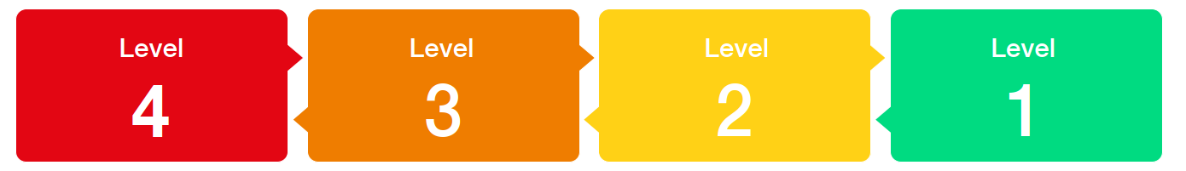
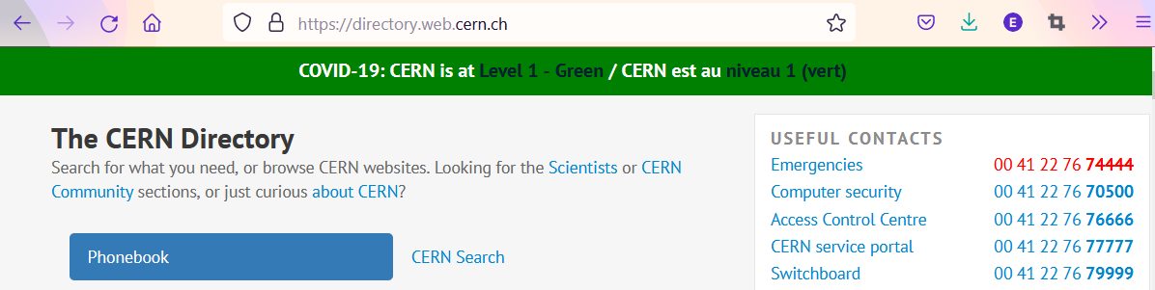

COVID -19
Since
14 March
Mask wearing?
left to the decision of individual ; provided by CERN on request
Notes:
Kyriaki
***********
It is important to stay informed about what is going on at CERN.
There is one central place to find the information about the impact of the Coronavirus for CERN : on the directory page. The information is available in English and in French.

Slide 9
Programme of the morning
08.45 Welcome by James Purvis, Head HR Department
08.55 Quiz – CERN as organization
09.20 Group photo, coffee break and networking
09.55 Quiz – daily life at CERN
10.30 Meet colleagues from your department
Transfer to department
11.00 Welcome in your department
Notes:
Erwin
************

Slide 10


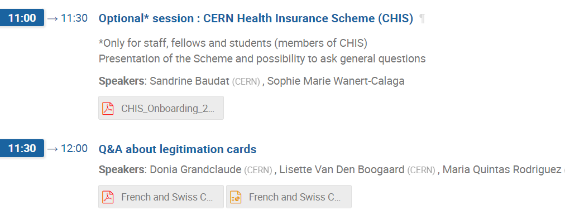
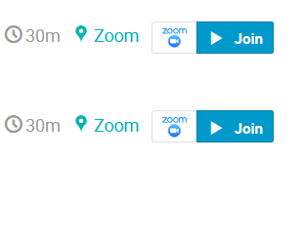
Programme Thursday 2 February
Notes:
Erwin
******************
Programme continues tomorrow with 2 short presentations and the possibility to ask questions about legitimation cards and about the CERN Health Insurance Scheme, for those who are covered by it : staff, fellows and students.

Slide 11

Ready to learn
more about CERN
via a quiz ?
Notes:
Kyriaki
**********

Slide 12
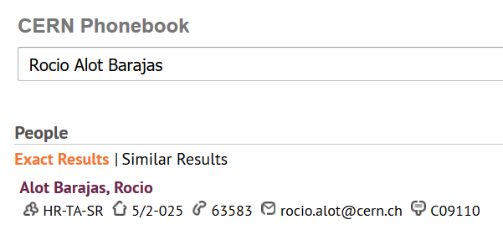
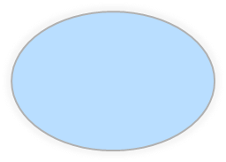

Building 5,
2nd floor
office 025
R = ground floor (rez de chaussee)
S = basement (sous-sol)
Notes:
ROCIO
In the CERN Phonebook, you can find out where people have their office.
For example, me/Rocio has her office in building 5, on the 2nd floor, and the office number is 25, on the side of the corridor with oneven numbers, and which are going up from 1 on one side of the building to the highest number on the other side of the building.

Slide 13
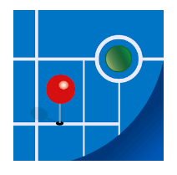
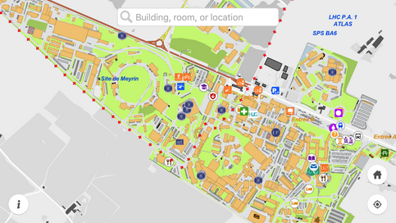
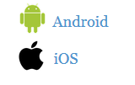
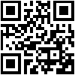
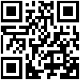
MapCERN
Notes:
Erwin
************************
And there is an application which you can install on your smartphone.
The app is called MapCERN and is available for Android and iOS.
You can do a quick search, it covers all places at CERN and works offline.

Slide 14

CERN as an international organization
Quiz – part 1
Notes:
Kyriaki
************************
Ready to start with the real quiz ?
We first have a few questions about CERN as an international organisation.

Slide 15






CERN MoP
~16 200
Contractors
> 4 500
Employed MPE
~ 3 450
Associated MPA
~ 12 750
Staff
~ 2 670
Fellows
~ 780
Users
~ 11 200
Associates
~ 1000
Students
~ 550
Notes:
Erwin
************
Stats 2021 : https://cds.cern.ch/record/2809746/files/CERN-HR-STAFF-STAT-2021-RESTR.pdf
************************
If you answered 2 670, then you probably only took into account the staff members (click).
But on top of the staff, we also have 780 fellows (click).
The staff members and fellows together are the employed members of the personnel or MPE (click): CERN is their employer.
But besides these more than 3 450 people, there are also many people who have a contract with CERN, although it is not an employment contract :
First of all, we have more than 11 200 users (click) who are working in scientific collaborations
And also more than 1000 associates
And more than 550 students
All together approximately 13 000 people who have a contract of association with CERN.
Both MPE and MPA are considered MoP, and you are a member of that big family of more than 16 200 people.
Kyriaki : How many people on the CERN site on an average day ?
Not all users are present at CERN every day. Note also that there is also personnel from contractors which can be working on the CERN site : there are more than 4 500 such people with an active registration, and some of them come here every day while others come only for the duration of a specific intervention.
Presence on CERN site :
before COVID : average of 7200 people on a normal weekday (of which 1800 contractors)
now (May 2022) : average of 6500 people (including 1500 contractors)
(Source : data presented at ED by Katy Foraz).

Slide 16
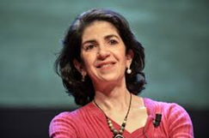
Director General
Health, Safety & Environment
Internal Audit
Legal Service
UNIT
Translation, Minutes & Council support
Accelerators & Technology
Beams
Technology
Finance & Human Resources
International Relations
Research & Computing
Engineering
Finance & Administrative Processes
Industry, Procurement & Knowledge Transfer
Human Resources
Site & Civil Engineering
Experimental Physics
Theory
Information Technology
Systems
Sector
Diplomatic & Stakeholder Relations
Department
Education, Communication, Outreach
Group
Notes:
Kyriaki
*****************************
The Sectors, Departments and Units have acronyms, which are used more often than the full names.
Here they are.
It is not because you are a computing engineer that your department is automatically IT.
Let us look at the organigram of CERN.

Slide 17
DG
HSE
Fabiola Gianotti
Benoit Delille
UNIT
ATS
BE
TE
FHR
IR
RCS
EN
FAP
IPT
HR
SCE
EP
TH
IT
SY
Sector
Mike Lamont
Raphael Bello
Charlotte Warakaulle
Joachim Mnich
Rhodri Jones
Florian Sonneman
Manfred Krammer
Department
J. Miguel Jiménez
Christopher Hartley
Gian Giudice
Katy Foraz
James Purvis
Enrica Porcari
Brennan Goddard
Mar Capeans
Notes:
Kyriaki
****************
The Sectors, Departments and Units have acronyms, which are used more often than the full names.
Here they are.

Slide 18
Sector
Director
Department
Department Head
DAO
DPO
DSO
DTO
…
Group
Group
Group
Group Leader
Section
Section
Section
Section Leader
Notes:
Kyriaki
************
The size of a Department can be from less than 100 people to several hundreds of people.
A Department has usually several groups.
And groups can in turn be composed of several sections.

Slide 19
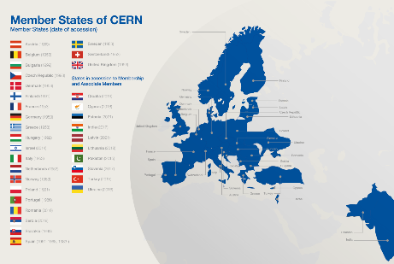
Revenues 2022
Member State contributions 84 %
Associate Member State contributions 2 %
Special contributions 3.7%
(to HL-LHC, specific experiments, from EU)
Other 10 %
(e.g. knowledge transfer, donations, …)
Principle =
proportional to Gross National Income
→ equal effort for every country
Notes:
Kyriaki
************************
Sources :
- https://cds.cern.ch/record/2799098?ln=en (budget 2022)
- https://cds.cern.ch/record/2790156 (map member states)
The CERN member states are indeed providing 84 % of CERN’s budget. (click)
There are today 23 Member states – originally when CERN was founded, there were only 12 countries. (click)
In order to have a fair sharing of the cost, the contributions are calculated as a certain percentage of the National Income.
And were does the remaining 16% comes from ?
Well, CERN also has associated member states, who pay a reduced contribution compared to the members states. This amounts to 2% of the budget.
The remaining 14% of the budget come a variety of sources : special contributions from certain countries or institutes, participation of the European Commission, income from knowledge transfer activities, donations to CERN, …)

Slide 20
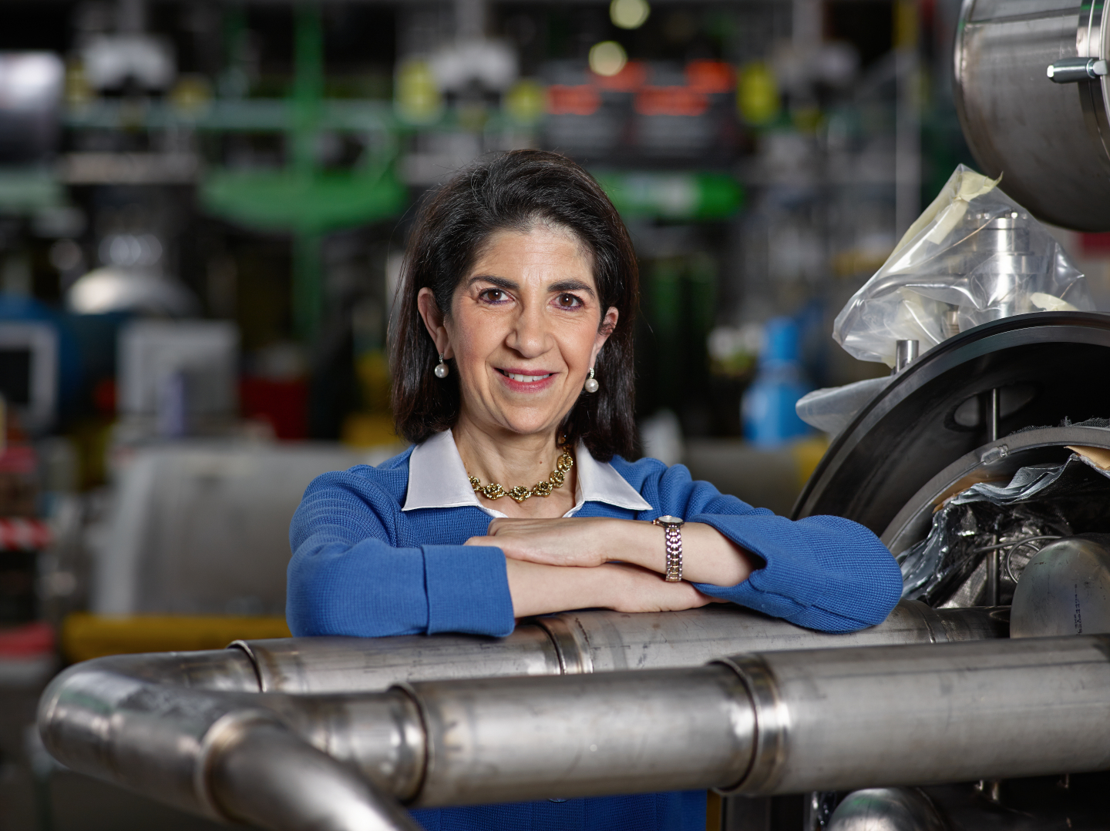
Link to biography
© CERN Photo, 2015
Notes:
Erwin
************************
https://press.cern/biographies/fabiola-gianotti-born-1960-Italian
Fabiola Gianotti is indeed CERN’s 1st female Director General, since 1st January 2016. Like all DG’s, she has a mandate of 5 years. In some exceptional cases in the past, this has been extended, but usually we have a new DG every 5 years.
From 2009 to 2013, she was spokesperson for the ATLAS experiment, and had the task of presenting the results on the search for the Higgs boson in a seminar at CERN on 4 July 2012. This discovery led to the Nobel prize for Higgs and Englert.
Gianotti has been awarded several prizes, but not the Nobel prize.
In 2013, she was included among the “Top 100 most influential women” by Forbes magazine, and today she continues to figure in their top 100 of Power Women.
https://www.forbes.com/profile/fabiola-gianotti/?list=power-women

Slide 21
Working at CERN when Nobel prize
1992 : Georges Charpak
1988 : Carlo Rubbia & Simon van der Meer
1984 : Jack Steinberger (with Lederman and Schwartz)
Working at CERN after Nobel prize
1952 : Felix Bloch
1976 : Sam Ting
Nobel prize thanks to discoveries at CERN
2013 : Peter Higgs & Francois Englert
Notes:
Kyriaki
************************
https://public-archive.web.cern.ch/public-archive/en/About/Nobels-en.html
https://www.nobelprize.org/nobel_prizes/facts/
3 prizes for people who were working at CERN when they received the Nobel prize
1992 : Georges Charpak
1988 : Carlo Rubbia & Simon van der Meer
1984 : Jack Steinberger (with Lederman and Schwartz)
+ 2 Nobel prize winners who worked at CERN
1952 : Felix Bloch, became CERN DG in 1954
1976 : Sam Ting, still works here at CERN on AMS (alpha magnetic spectrometer which is installed on ISS, the International Space Station)
+ 2 Nobel prize winners thanks to discoveries at CERN
2013 : Higgs and Englert

Slide 22
Welcome to HR-PXE colleagues
Opportunity to ask questions during coffee break
Collective induction session by type of contract
  Fellows
  Tech & Admin students in the 2nd week
  Doctoral students
Individually contacted by HRA : Staff
Notes:
Kyriaki
**************

Slide 23


Slide 24
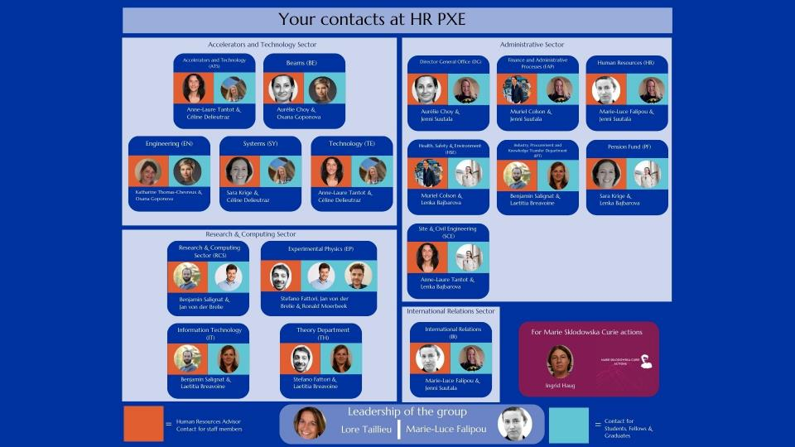

Slide 25
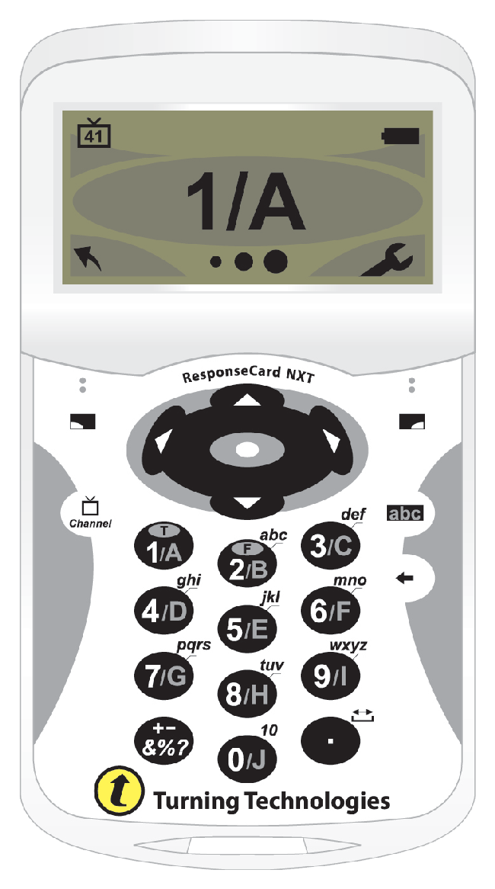
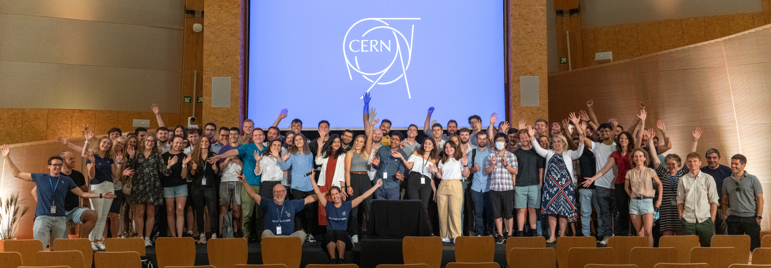
Time for a group photo !
© CERN Photo
Notes:
Kyriaki
***************

Slide 26


Notes:
Kyriaki
Group Photo
Remind about the particle identity – meet with other particles – continue the game.
Back at 9.55

Slide 27
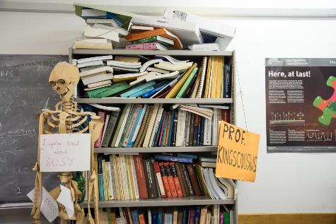
Daily life at CERN
Quiz part 2
Notes:
Erwin
************************
We have some questions for you, which will be helpful for your daily life at CERN.

Slide 28
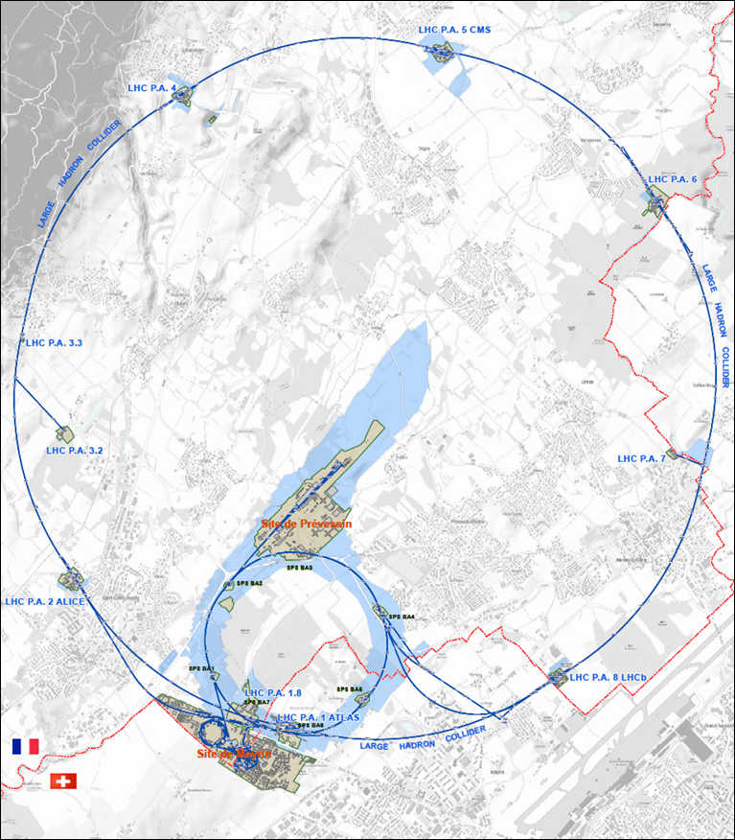




625 ha
515 ha
fenced : 220
110 ha
… 700+ buildings
accounting for
500.000 m²
5 900 parking spots
101 ha
green
spaces
30 km roads
Notes:
Erwin
************************
Source : https://indico.cern.ch/event/669690/contributions/2740056/attachments/1553507/2441980/Mobility_IoT.pptx
CERN is indeed composed of 2 major sites : Meyrin in Switzerland and Prevessin in France. But there are many more smaller CERN sites, especially in France.
CERN has all in all 625 hectares of land, of which 1/3 is fenced. The majority is on the French territory.
There are more than 700 buildings, for a variety of purposes and built in different periods in a variety of styles. Office space as well as parking space are sometimes difficult to find !
There are also 30 km of roads, and normal traffic rules applies. And there is control and sanctions : if you park your car on the footpath, the sidewalk, your car might be towed away.
There also green spaces, especially on the Prevessin site. Some people have the luck to see through their window deers coming out of the wood or a flock of sheep grazing in the prairie next to their office.

Slide 29
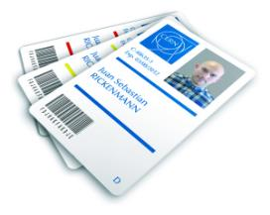
CERN access card
Visitors badge
Validity :
2 working days
CERN access card
Building 55
Working days
from 7:30 to 17:30, non stop
Also
vehicle registration
biometrics registration
https://sce-dep.web.cern.ch/security/access
Notes:
Erwin
****************************
If you hurry to get your CERN access card, you might find yourself queuing.
Avoid
Mondays
1st working day of the month
7:30 to 9

Slide 30
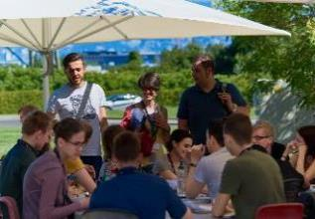
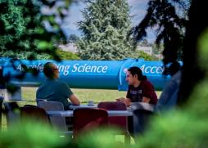
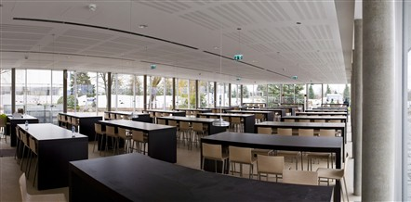
Restaurants
2 in Meyrin (resto 1 & 2)
1 in Prevessin (resto 3)
Cafeteria (snacks)
Building 13, 30, 40, 54, …
© CERN Photo
Notes:
Kyriaki
************************
There are 3 restaurants on the site. There are always several menus, including a vegetarian.
You can find menus and opening hours in the CERN directory.
There are also microwave ovens, when you heat the food you bring along yourself.
There are also some cafeterias, which often have a reduced offer, and shorter opening hours.

Slide 31
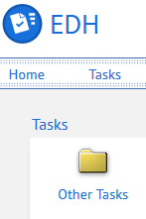
CERN Car
Requires
CERN driving authorization :
Valid driving licence
OK Department Head
Private vehicle
Not requiring registration
  Bike, “trottinette”
Requiring registration
  Registered in member state or EU country
  “Tourist” cars only
  Not allowed :
  Scooter, moto, lorry, bus, …
Notes:
Kyriaki
*************

Slide 32
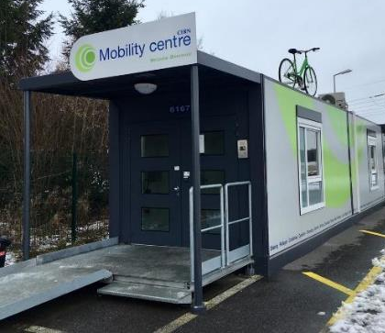
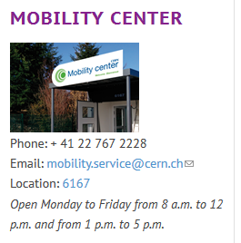
CERN Mobility Centre
Located next to Entrance A
Services offered
Bike rental
Car rental
Car sharing
Bike sharing
Shuttles
….
https://sce-dep.web.cern.ch/campus-life/mobility
Notes:
Kyriaki
************************

Slide 33


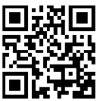
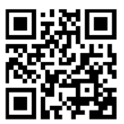
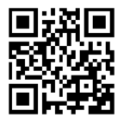
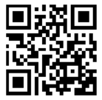
Mobility apps
Car sharing
glide.io
login with CERN SSO
Bike sharing
Urban connect
Suspended until 6 March
Notes:
Kyriaki
****************

Slide 34
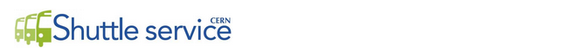
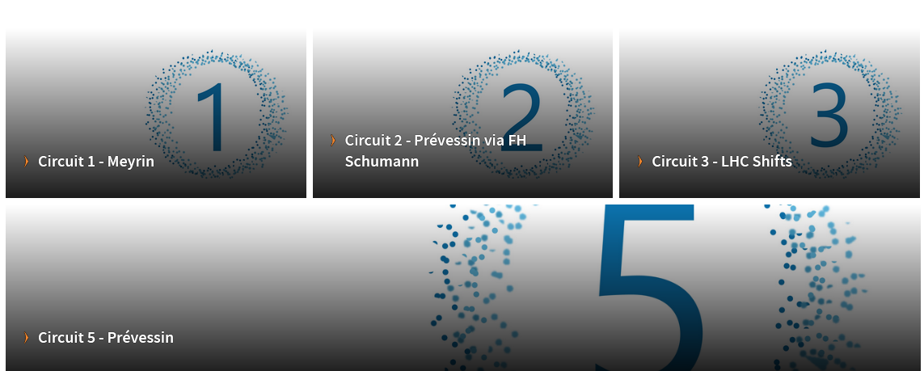
https://sce-dep.web.cern.ch/cern-shuttle-service
Notes:
Kyriaki
********************
Line 4 is temporarily suspended

Slide 35
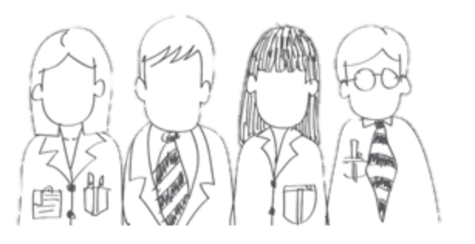

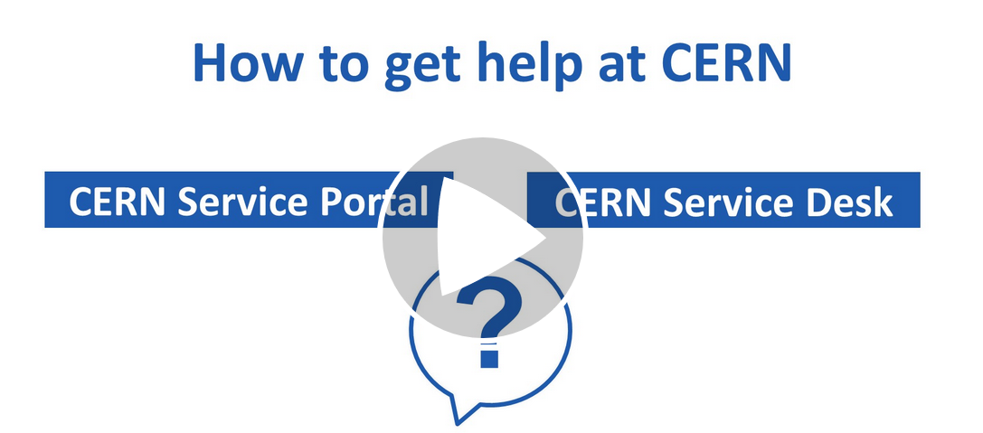




CERN Service Desk
Phone: +41 22 76 77777
Email: service-desk@cern.ch
Monday to Friday
from 7.30 to 18:30
( Geneva time )
CERN Service Portal
Services
Service overview in a glance
Online forms
Report an incident, submit a request
Knowledge articles
Find your answer!
Feedback
Your feedback matters!
https://cern.ch/service-portal
Notes:
Erwin
***************
The CERN service desk will help you with any request, and especially if you do not know which service to contact. They will make sure that your question gets to the right person, and that you get a reply.
Your request will generate a ticket for an efficient follow-up, and you will be informed by mail.
You can contact them by phone or by sending an e-mail.
The CERN service portal, accessible from the directory or from the link below, allows you to search for a service, find out what they offer and make an online request. There are also Knowledge Base articles where you find answers to the most frequent questions.

Slide 36
Accident on site – different cases
In all cases
Inform supervisor
In case of
Injury
Environmental hazard
Disruption traffic
3rd party involved
CERN Fire & Rescue 74444
(+ 41 22 767 44 44)
+
Internal accident report (EDH)
+
European Union Car Accident form
Notes:
Erwin
************************
The correct answer in all cases is to call your supervisor (D) and in some cases (C), the CERN Fire and rescue service, through the number 74444.
Why always your supervisor ?
Internal accident report :
- needs to be signed by your supervisor, so for that reason he must be informed immediately.
- also used to report near-misses -> can be used to avoid further accidents
In certain cases, the CERN Fire and rescue need to be called.
We recommend to add the full number in your mobile phone
+41 22 767 44 44, so you can also call them if you are not connected to the CERN telephone network.
https://admin-eguide.web.cern.ch/node/352
2.2.1 Accident on the CERN site
In the event of injury, disruption to the flow of traffic or involvement of a third party:
The CERN Fire Brigade will go to the scene of the accident, take the appropriate measures required by the circumstances and draw up a call-out report.
The local Gendarmerie/Police will intervene only if so requested by CERN (Relations with the Host States Service or CERN Fire Brigade).
The driver(s) of the vehicle(s) (or, if not possible, the Fire Brigade) must complete a European car accident form (a blue form known as the "Constat européen d'accident automobile"), which must be signed by the parties involved. A copy of page 1 of the form must be sent to the Legal Service and to the CERN's Insurance Manager. If the injured party is a member of the personnel or a family member who is a member of the CERN Health Insurance Scheme, the procedure set out in paragraph 3 must also be followed.
In all other cases, and if the vehicle suffers material damage:
The member of the personnel must draw up a report to which he must attach, where possible, a statement by a witness (the European car accident form may be used). This report (or a copy of the European car accident form) must be sent to the CERN's Insurance Manager together with a statement by the Head of Department or his designated representative, certifying that the journey was made on official duty, or a copy of the official travel form if applicable.

Slide 37
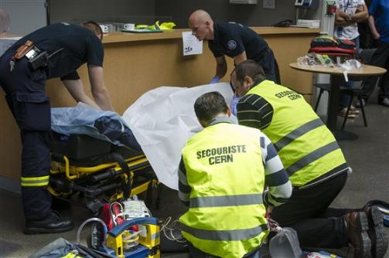
CERN Fire and Rescue Service
assisted by local First Aiders
Find out who
are closest to
your office / usual work places
© CERN Photo
Notes:
Kyriaki
************************
CERN’s Fire and Rescue Service is a team of more than 50 qualified fire-fighters and paramedics. They are available 24h/day, all year long.
They are assisted by more than 150 First Aiders, who are trained volunteers.

Slide 38
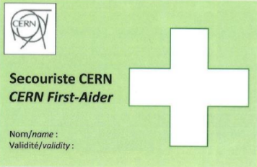
First Aider door sticker
Your safety contacts : http://safety.cern.ch/FirstAid.html
Notes:
Kyriaki
************************
You can find the first aiders in your building in this link.
And you also spot the green stickers on the doors, indicating that there is a qualified CERN first-aider in that office
Training available for all All personnel working at CERN : First Aid - Life-Saving Actions (Covid-19)
https://lms.cern.ch/ekp/servlet/FORMAT1?CID=EKP000043535&LANGUAGE_TAG=en

Slide 39

or click on this slide

Slide 40


Defends all personnel
on a collective and on an individual basis
Become member : Website
Network of people who work(ed) at CERN
Become member : Website
Notes:
Erwin
************************
The Staff association defends your rights, they organize regularly public meetings to inform you. The also have a website, and you can become a member by paying a fee.
CERN Alumni is an initiative launched in 2017.
It brings together people who have worked at CERN and those who work today at CERN. As such, you can be a member as from today. Membership is free.

Slide 41
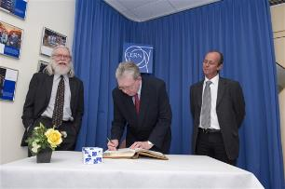
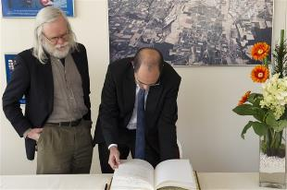
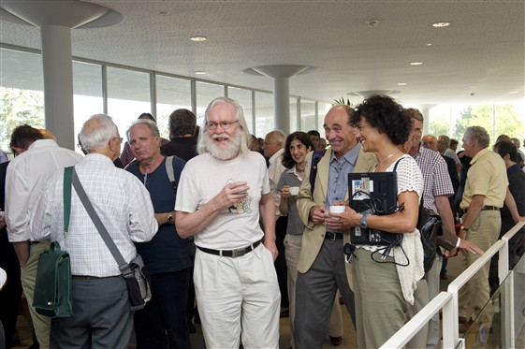
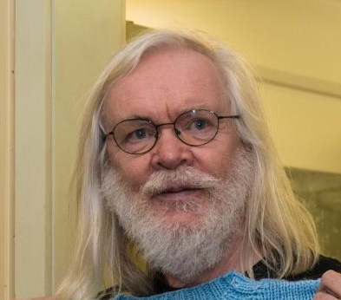
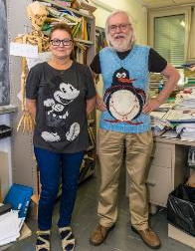
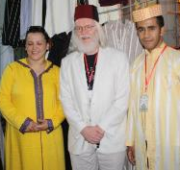
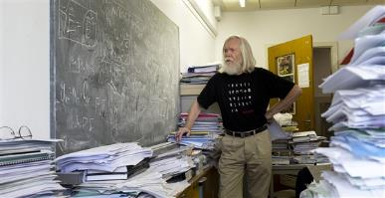
© CERN Photo
Notes:
Kyriaki
************************
This is John Ellis, a British theoretical physicist.
Employed by CERN, he has been department head of the Theory department, and an advocate for geographical enlargement of CERN.
You can see him
At an official ceremony to sign an agreement, dressed business formal, in a suit and tie
In his office, amongst his papers, casual with pants and a black T-shirt
At another official ceremony, smart casual or business casual, with a shirt and jacket, but no tie
At a Physics School in Morocco, in local traditional clothes, including the fez
Again in his office, with a Finnish teacher who knitted him a pullover with his famous penguin diagram
In 2011, at the coffee break of the colloquium in honor for his 65th birthday
Conclusion:
CERN is very casual
CERN is very tolerant
Recommendations :
Dress according to the situation
Nothing offending other people – T-shirts with text/images

Slide 42

Code of Conduct
cern.ch/codeofconduct
Notes:
Erwin
*****************
CERN's values are commitment, professionalism, creativity, diversity and integrity. Taken together they provide the basis for respect: respect for others, respect for the Organization and respect for its mission, and underpin the CERN Code of Conduct.

Slide 43



CERN tools
Phone (audio only) : CERNphone
  Mobile client (iOS and Android)
  Desktop client (Windows, macOS, Linux)
Videocalls and videoconferencing cern.zoom – FAQ
Messaging – individual and public/private ”channels”
integration with Zoom
dedicated channel New @ CERN
Notes:
Kyriaki
****************
A call is usually more efficient than an email,
So we encourage you to reach out to colleagues, programme cordinators or supervisor, and we give you different options to do so:
If you go for a voice call, we are using CERNPhone
You can access the CERN phone book to find any employee working at cern, and dial her or his number.
For video conference, we use now Zoom on a CERN specific instance cern.zoom (with SSO)
For messaging, you can use Mattermost. You can invite someone for a instant Zoom call from

Slide 44


Newcomers website
https://hr.web.cern.ch/joining-cern
Notes:
Erwin
************************
On the HR website, you will find the Welcome to CERN pages.
You have already looked at the pages “Before I arrive”, but there is more information for you to discover now under “My first week” and later on under “life@CERN”

Slide 45



Many questions, answers are …
  Your departmental secretariat
  Your supervisor, your colleagues
  Specific question for personal situation?
  → Make appointment with the expert services
  Pension Fund, Health Insurance, Installation Service, Housing Service, Social Service, …
  HR Website > Welcome > my first week
Notes:
Erwin
************************
CERN is a big and complex organisation, with more than 60 years of history. Enough to have certain traditions, a certain way to do things, a certain culture.
You will certainly have many questions …
But where to find the answers ?
The departmental secretariat is an important info point about your rights and obligations, and it is close to you. You will meet them later today.
Your supervisor and colleagues will also be able to answer certain of your questions.
On the HR website, there is also the Welcome site with a dedicated section “My first week”
If you have specific questions related to you personal situation, there are expert services at your disposal. You’ll find their contact details on the Welcome pages.
We encourage you to make an appointment with them, why not do it later today ?
The quiz will also be an opportunity for you learn about the how and why of certain things.

Slide 46

Public meetings
Click for past and future events (agenda, slides, recordings)
Directorate every 3 months
Highlights of Council Week and other recent news.
HR ad hoc
Focus on one topic (eg. flexibility)
Staff Association every month
Latest information on priorities and current issues
Notes:
Kyriaki
**************

Slide 47


Recap from quiz - recommended
Download CERN map on your smartphone
Enter full number Fire and rescue service in your phone
Find out who are closest first-aiders
+ 41 22 76 74444
Notes:
Kyriaki
************************

Slide 48
Onboarding continues with …
Welcome session in your department
Meet the experts (online – Zoom)
  CERN Health Insurance (CHIS) Thursday 2 February, 11.00 – 11.30
  Legitimation cards Thursday 2 February, 11.30 – 12.00
More short sessions with experts (online – Zoom)
  Computer security* Monday 13 February, 13.30 - 14.00
  Pension Fund* Tuesday 14 February, 13.30 - 14.00
Connecting the dots* Friday 17 February, 13.30 - 17.30
Collective induction session or Individual contact by HRA
Visit* of CERN installations – register via Indico
Spouse* welcome session
Part of
Welcome session
see Indico
* You will be invited
* You need to register
Notes:
Erwin
****************************
Induction sessions by type of contract :
Staff members will be contacted individually by their HRA (Human Resources Coordinator) .
Connecting the dots: you will have the opportunity to learn more about physics and accelerators, meet representatives from several CERN Services and CERN Clubs and network with other newcomers. You will receive an invitation and you will have to choose in which session you will enroll.
Visit of CERN installations open for newcomers and their families

Slide 49
Before joining your Department
Notes:
Kyriaki
************************
For the next step, it is important that you know to which department you belong.
It is not because you are a computing engineer that your department is automatically IT.
Let us look at the organigram of CERN.

Slide 50
End of session

Slide 51
Meet your new colleagues !
Go to the flag of your Department/Unit.
Introduce yourself to your colleagues
Meet with your DAO
  In Pas Perdu (outside Council Chamber)
  on Zoom
  in their office (use CERN Map for directions)
Notes:
Kyriaki
************************
Organise yourself as a group so everyone gets there in time
Don’t be afraid to ask for help
Don’t be afraid to offer help

Slide 52

Notes:
Kyriaki
************************

Slide 53
Meeting points
Dept​ | Place​ | Time​ | Remarks​
ATS​ | Globe​ | 10:30​ | Together with TE​
BE​ | Zoom​ | 14:00​ | DAO meets at flag at 10.30​
DG​ | 60/2-016​ | 11:00​ | Help each other to get there ! With CERN Map​
EN​ | Globe​ | 10:30​ | DAO meets at flag​
EP​ | Globe​​ | 10:30​ | DAO meets at flag​
FAP​ | Globe​ | 10:30​ | DAO meets at flag​
HR​ | Globe​​ | 10:30​ | DAO meets at flag​
HSE​ | Globe​​ | 10:30​ | DAO meets at flag​
IPT​ | 5/3-026​ | 11.00​ | Help each other to get there ! With CERN Map​
IR​ | 60/3-007​ | 11:00​ | Help each other to get there ! With CERN Map​
IT​ | 31/S-023​ | 11:00​ | Help each other to get there ! With CERN Map​
PF​ | Globe​​ | 10:30​ | DAO meets at flag​
RCS​ | Globe​ | 10:30​ | Together with EP​
SCE​ | Globe​ | 10:30​ | DAO meets at flag​
SY​ | Zoom​ | 14:00​ | DAO meets at flag at 10.30​
TE​ | Globe​ | 10:30​ | DAO/GAO meets at flag​
TH​ | Globe​ | 10:30​ | DAO meets at flag​
Notes:
Kyriaki
*****************************

Slide 54

Notes:
All the best !

