Slide 1



Slide 2
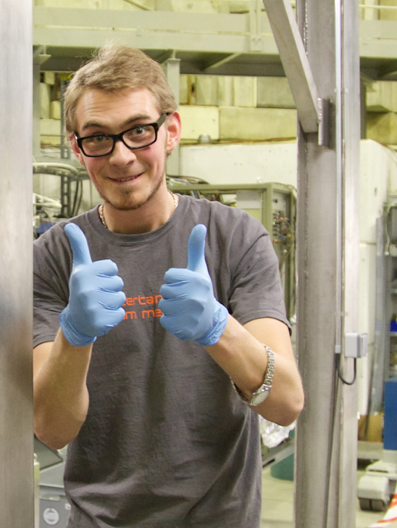

Slide 3
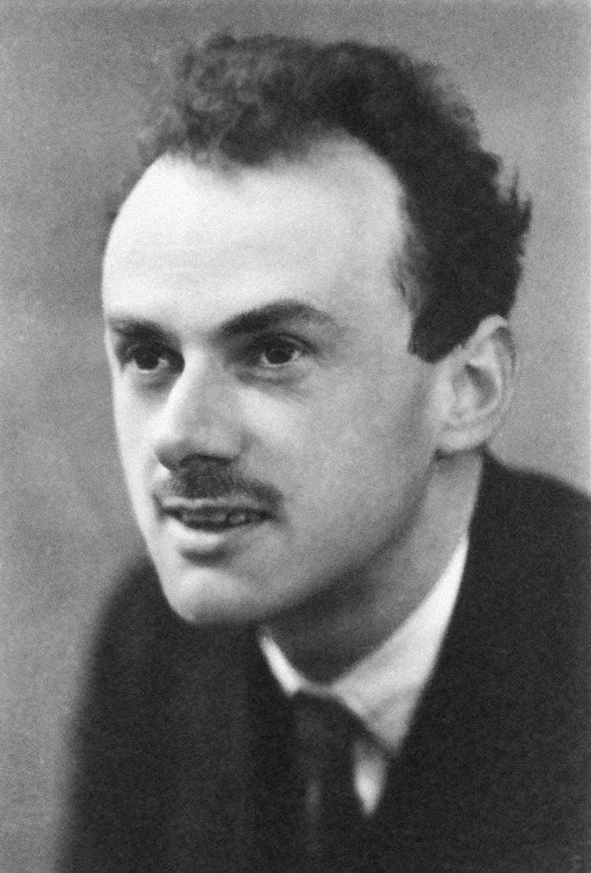

Slide 4
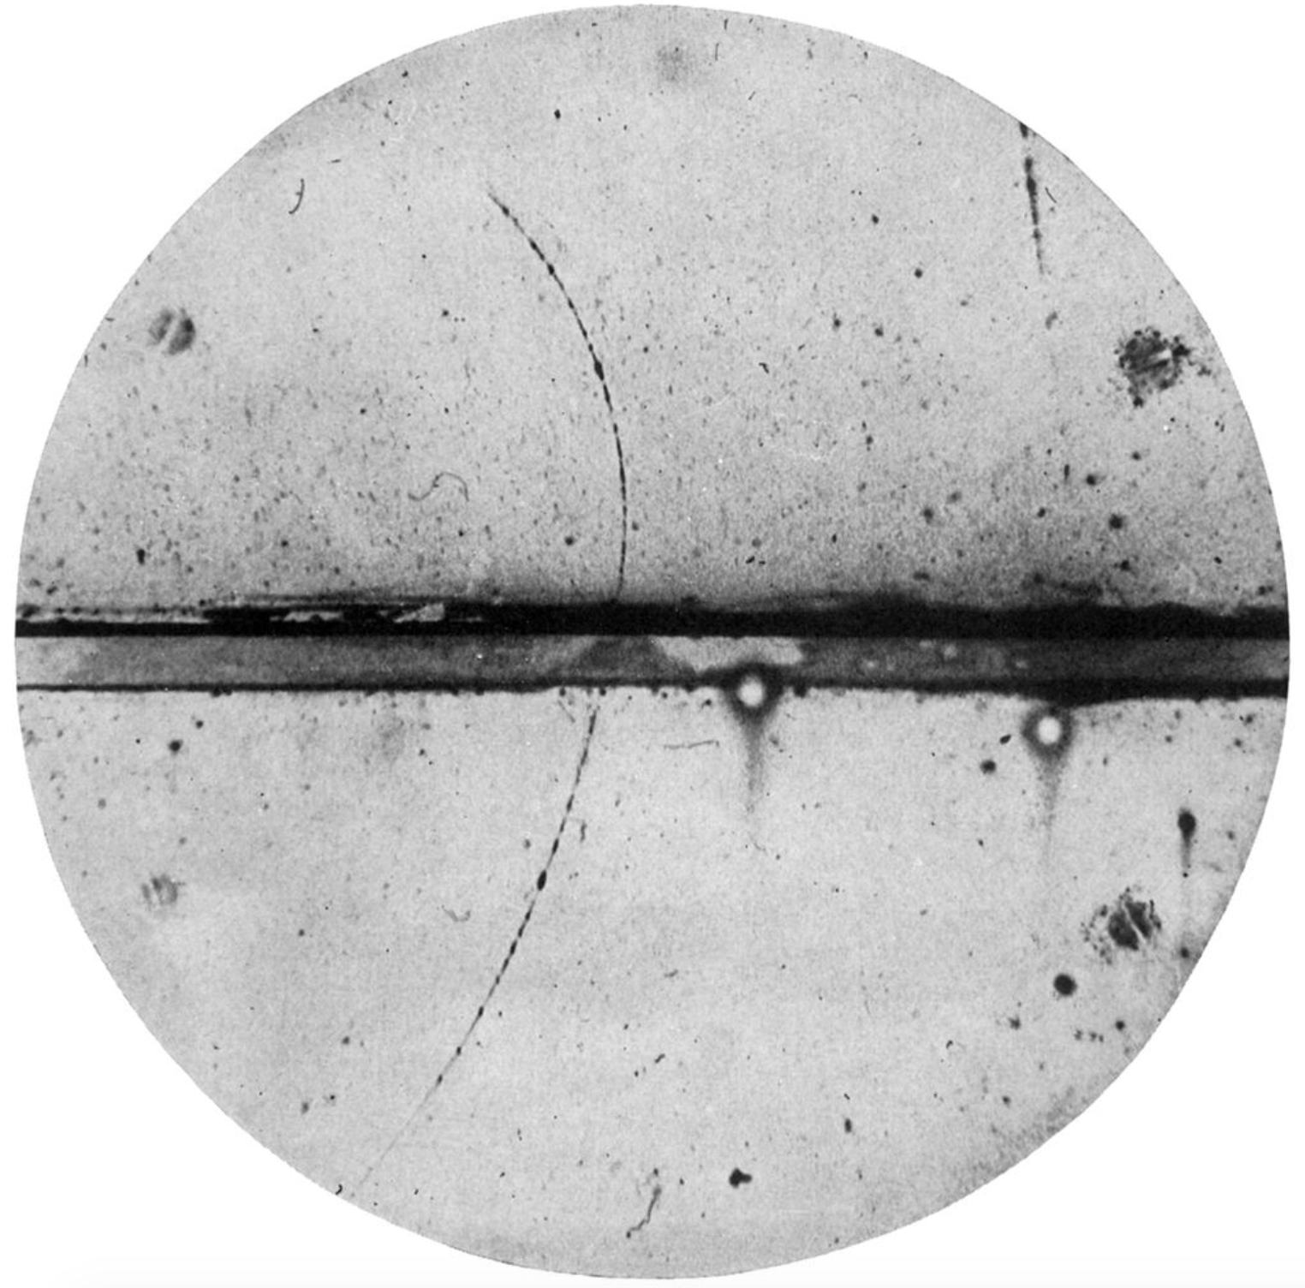

Slide 5
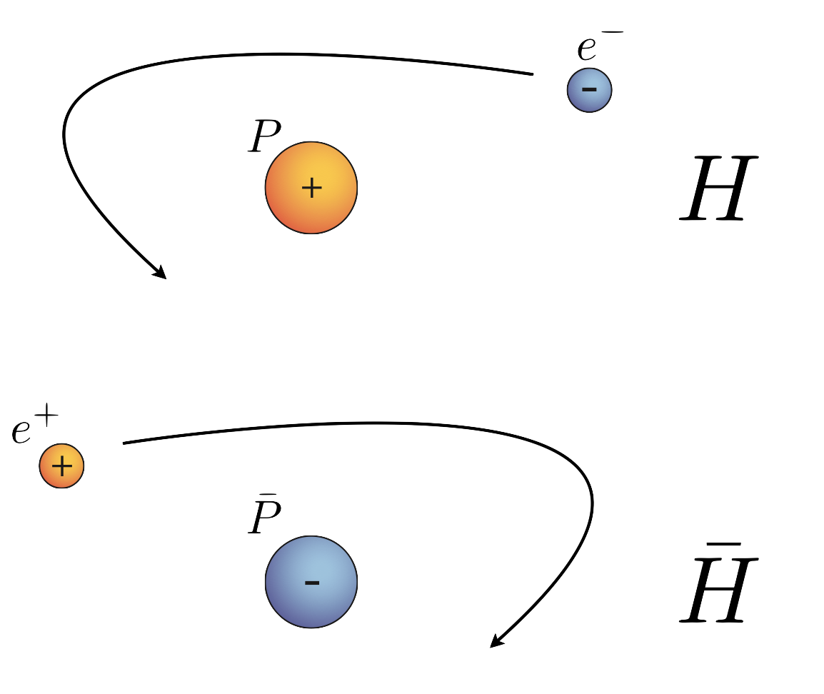

Slide 6
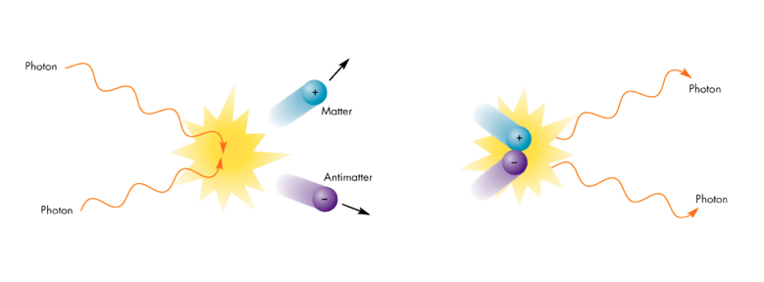

Slide 7
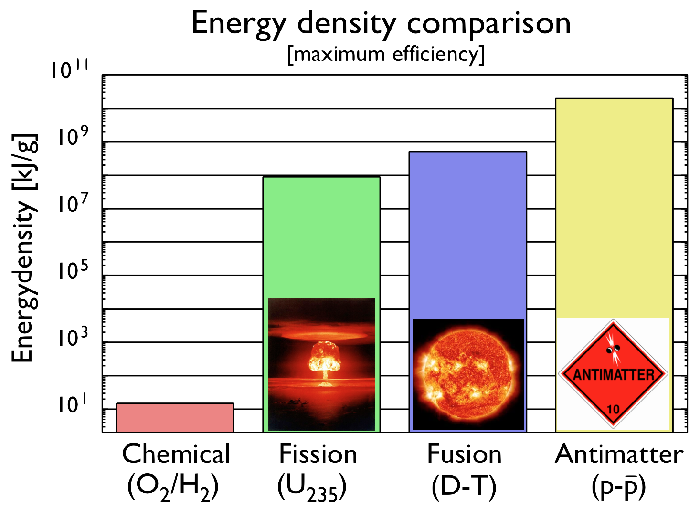

Slide 8
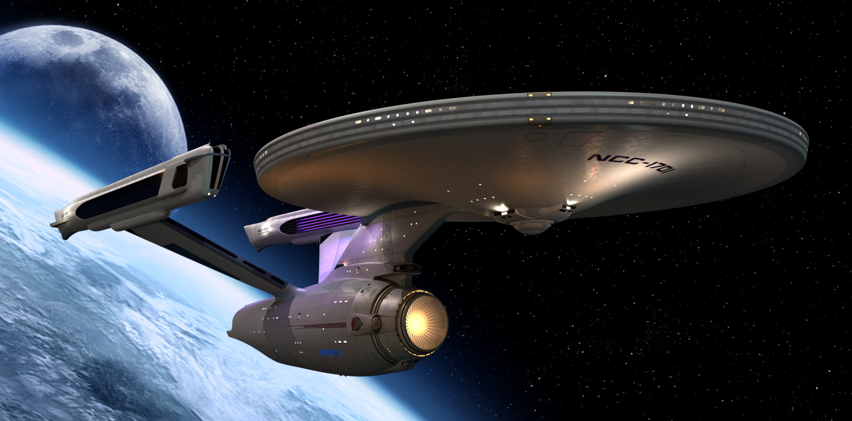

Slide 12
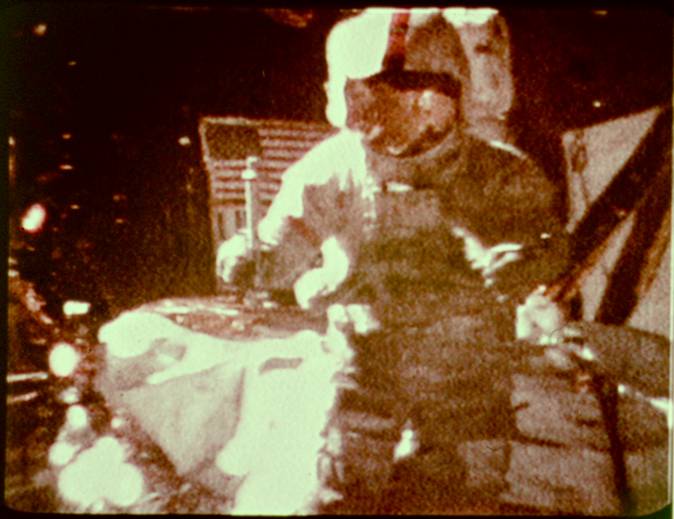

Slide 13
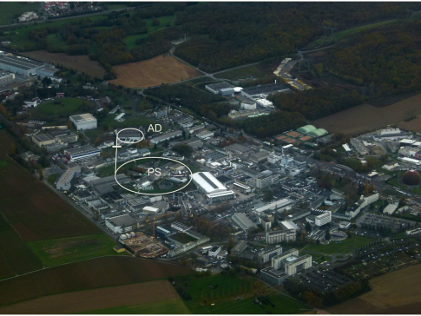

Slide 14


Slide 15
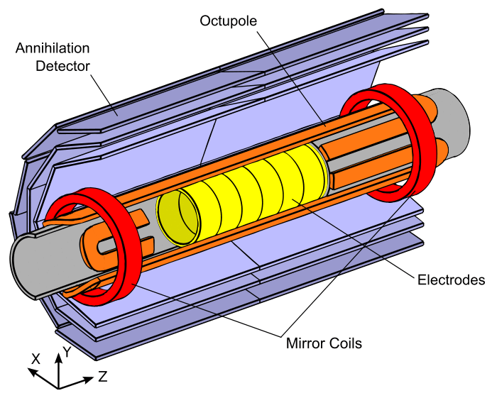

Slide 16
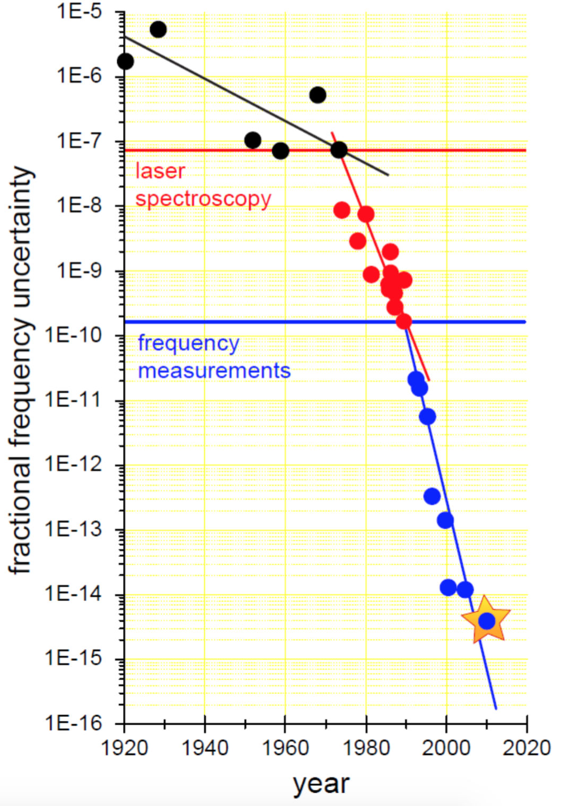

Slide 17
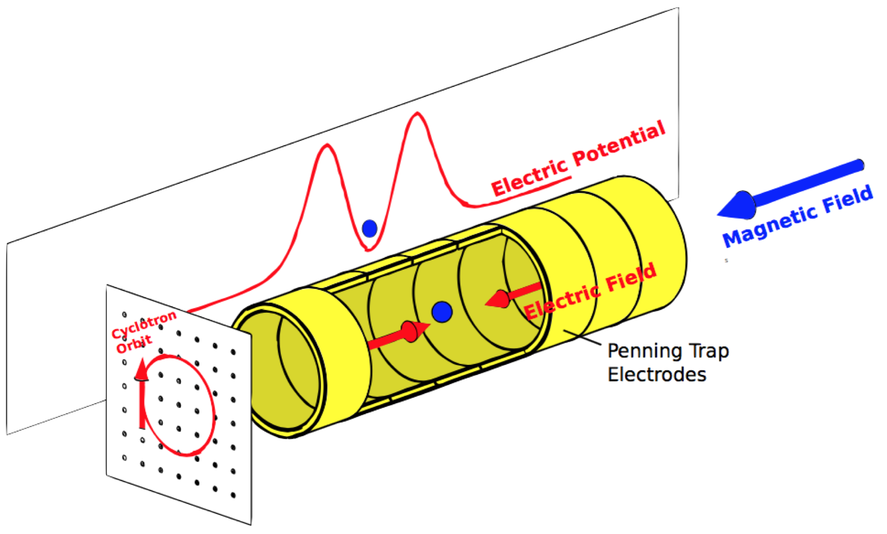

Slide 18
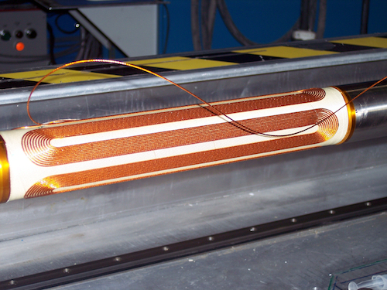
1
Quadrupole
Sextupole
Octupole
0.9
0.8
0.7
0.6
max
0.5
/ B
B
0.4
0.3
0.2
0.1
0
0 0.1 0.2 0.3 0.4 0.5 0.6 0.7 0.8 0.9 1
r / r
Magnet

Slide 20
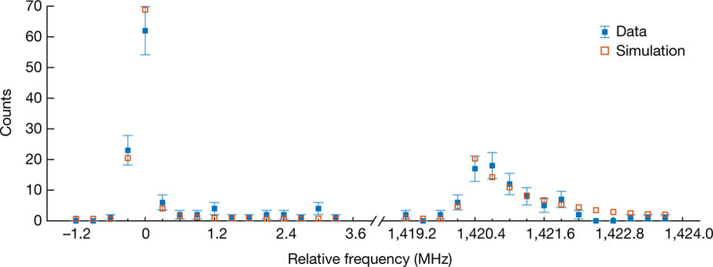

Slide 21
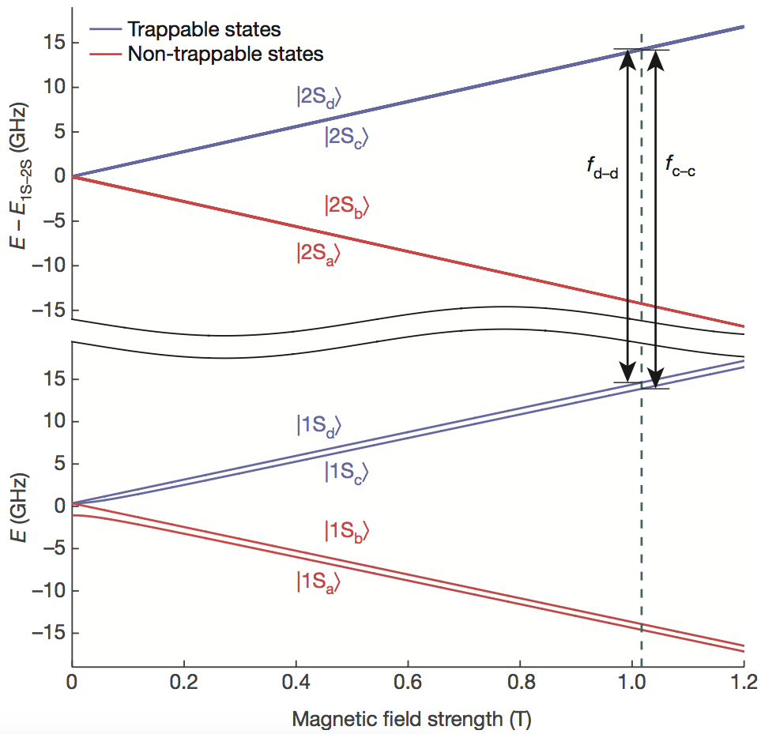
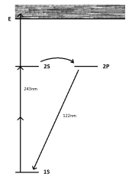

Slide 22
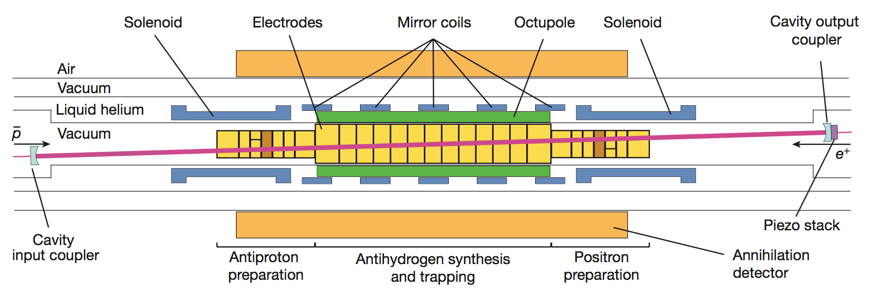

Slide 24
1
0.9
0.8
1
0.7
0.8
0.6
Survived
Ionised
Spin-flipped
0.6
Relative fraction of atoms
Relative fraction of atoms
0.5
0.4
0.4
0.2
0.3
0
0 100 200 300
Time (s)
0.2
0.1
0
-200 -100 0 100 200 300 400
Detuning at 243nm (kHz)

Slide 25
prospective
recent
past
deuteronq/m
muong
10⁻²¹ 10⁻¹⁸ 10⁻¹⁵ 10⁻¹² 10⁻⁹ 10⁻⁶ 10⁻³ 10⁰
relative precision

Slide 26
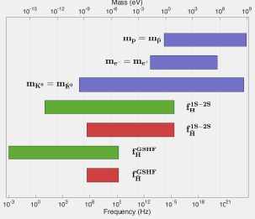

Slide 27
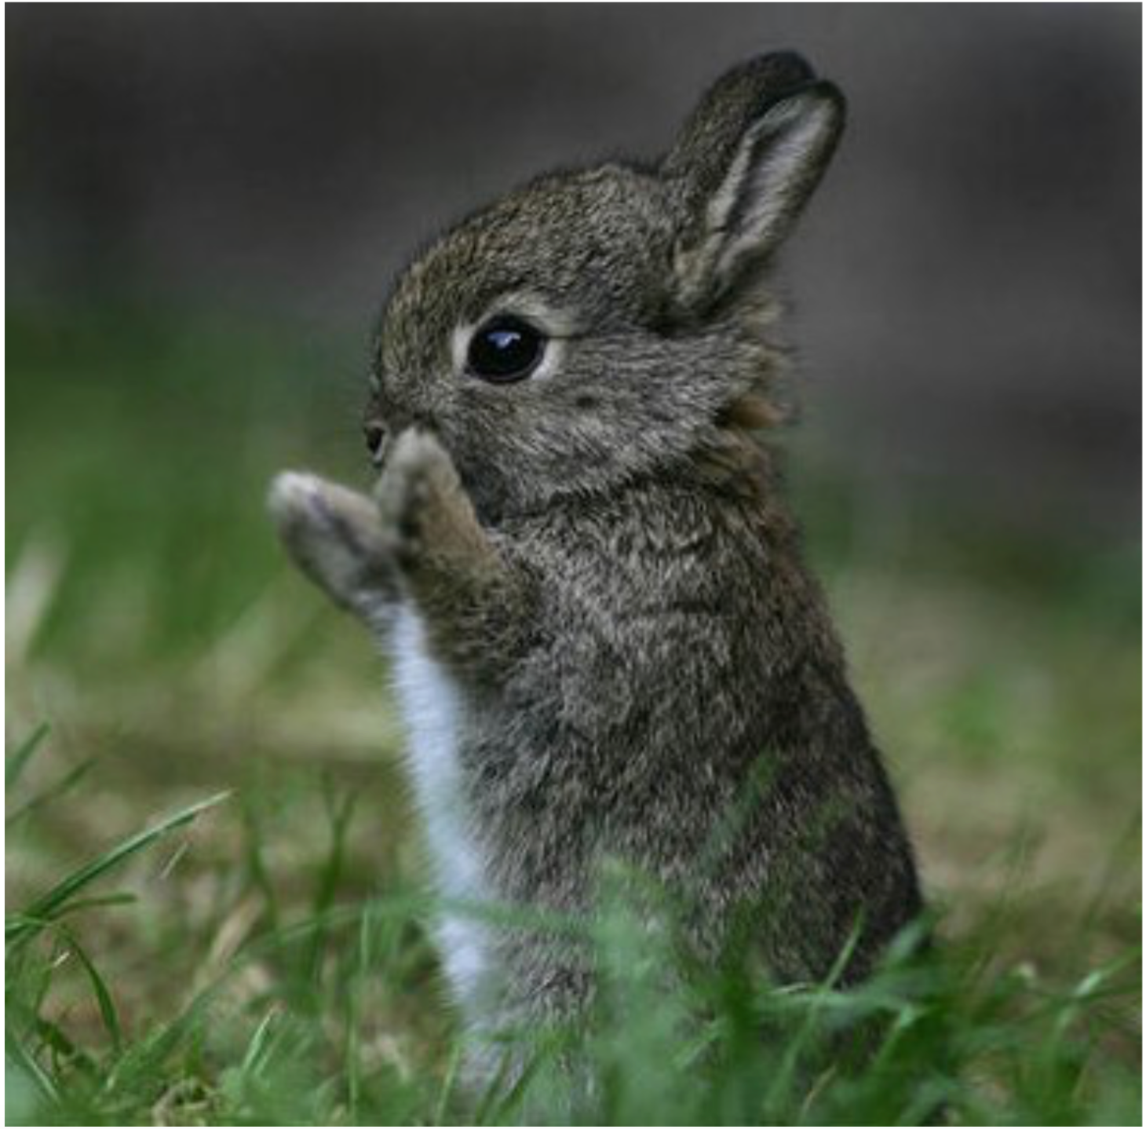

Slide 28
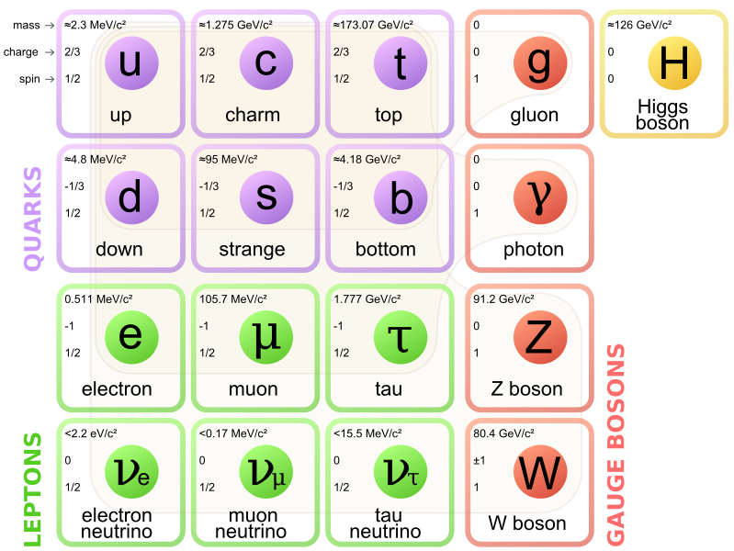

Slide 29
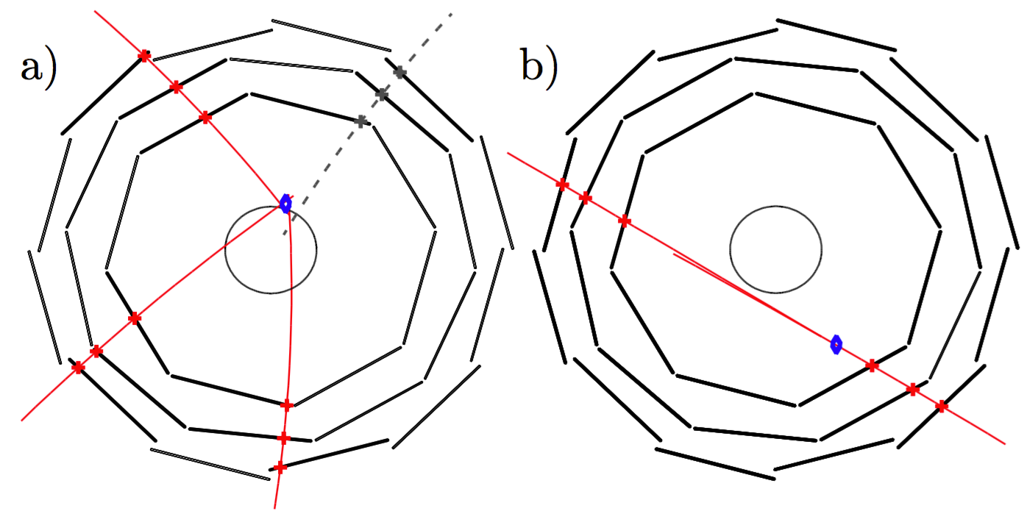

Slide 30
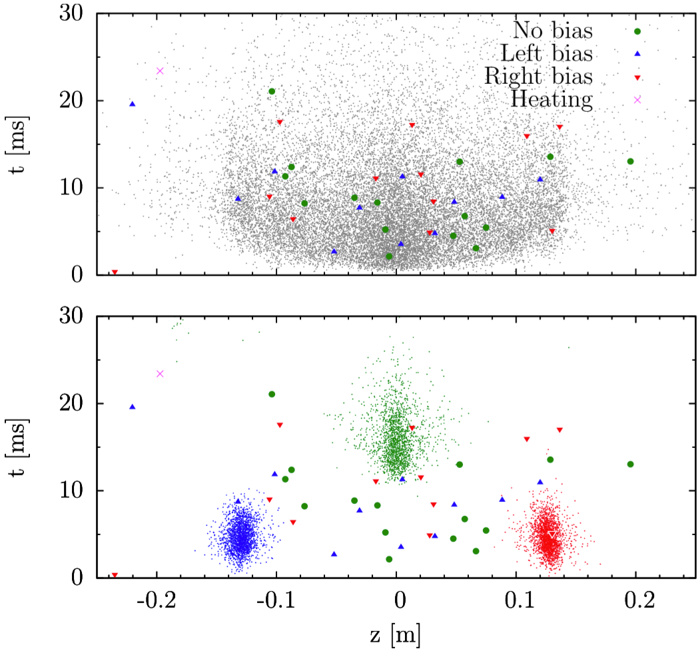

Slide 31
