Slide 1

Electronics Pool
TestPoint : a Python BASED automation test bench for instrumentation
V. Gatto, M. Joos
2023 - BE seminar : TestPoint

Slide 2
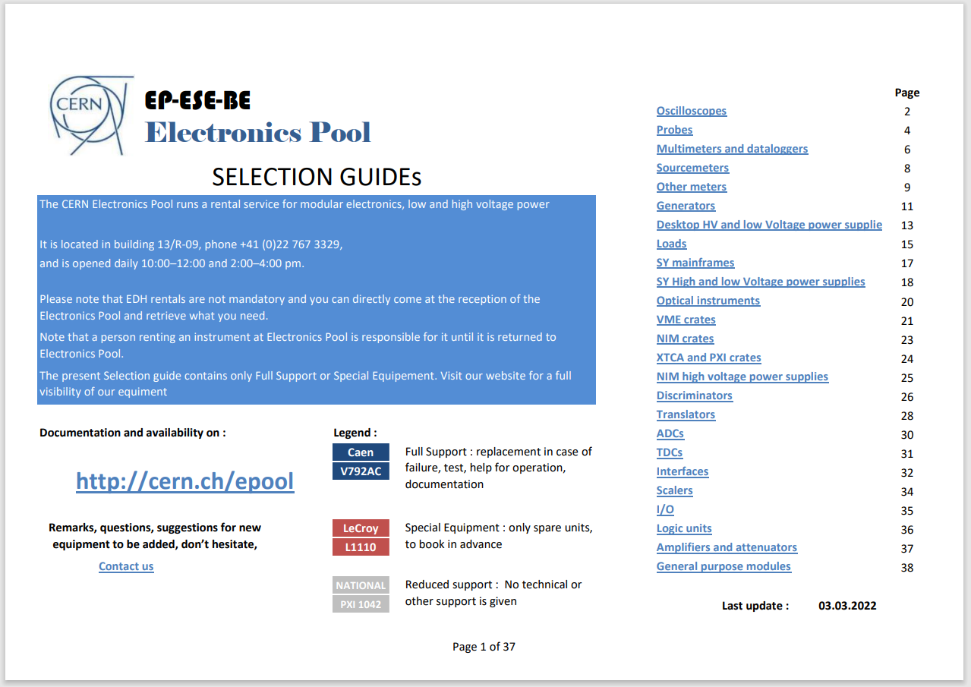
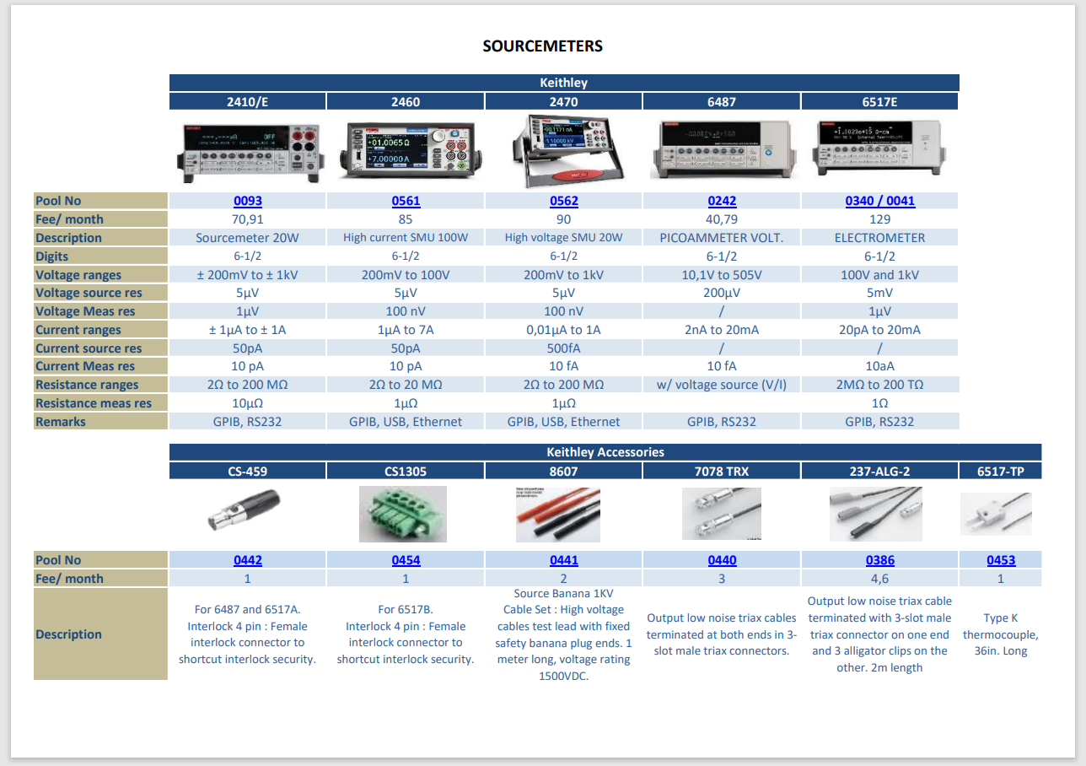
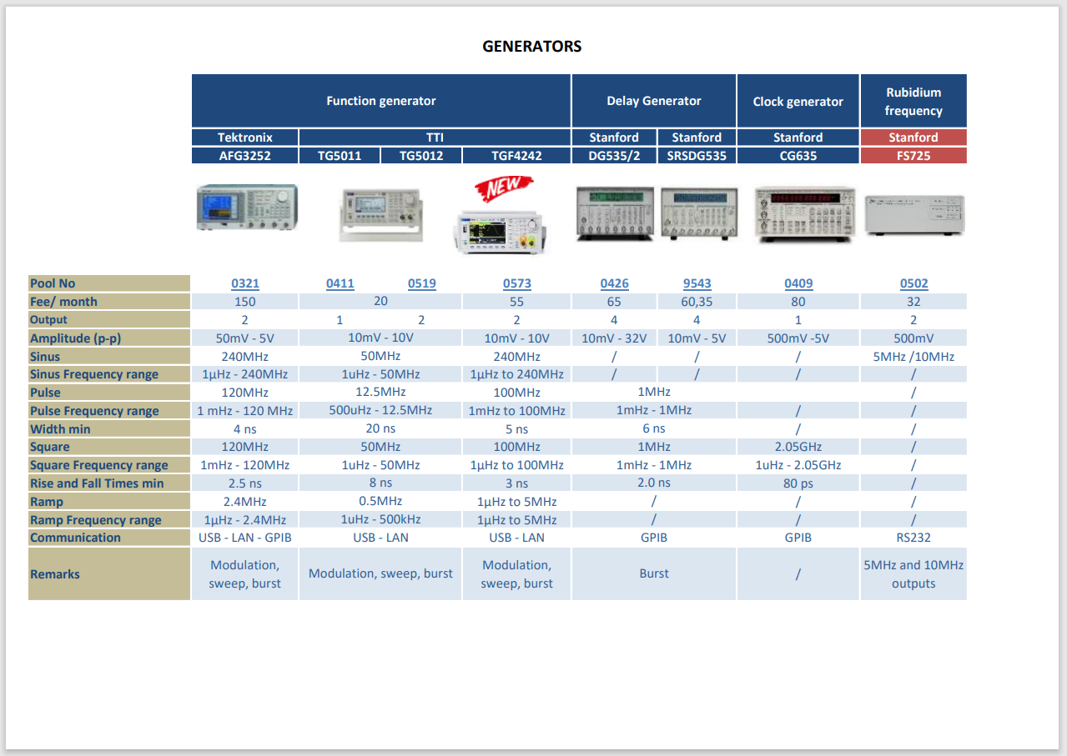
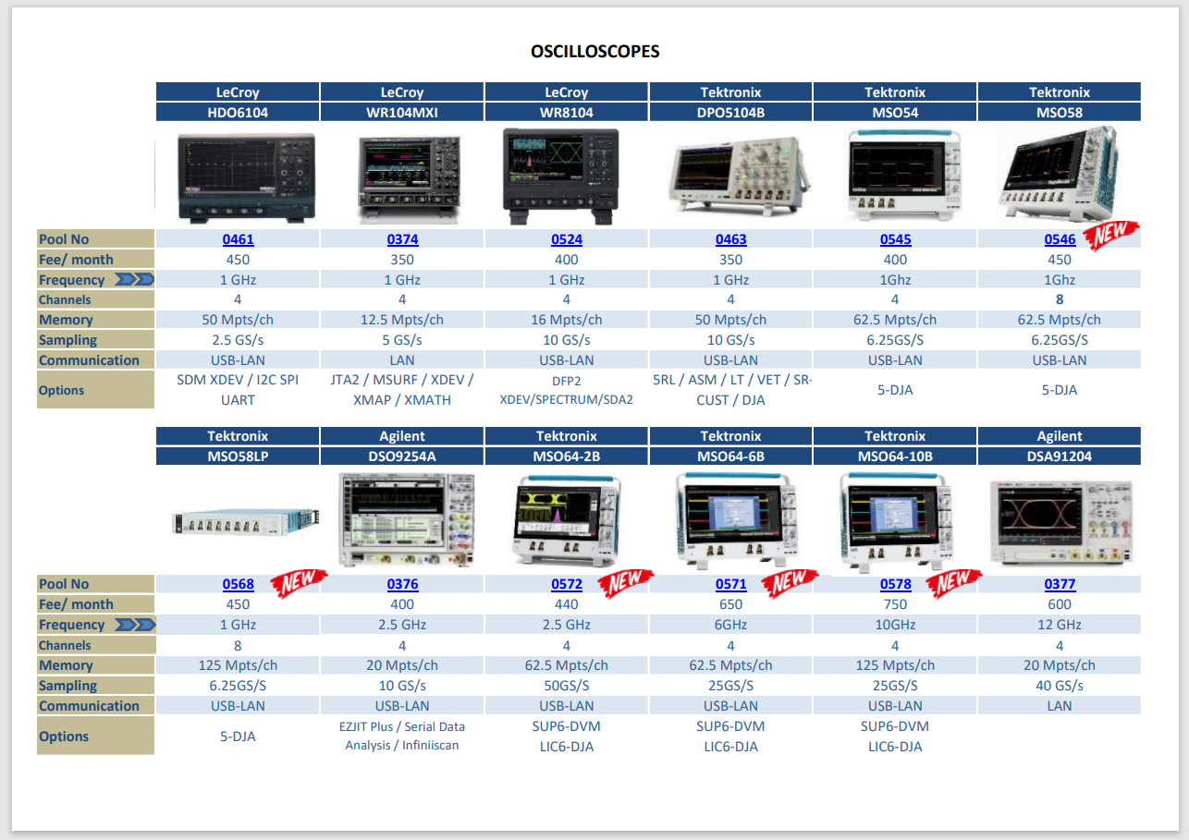
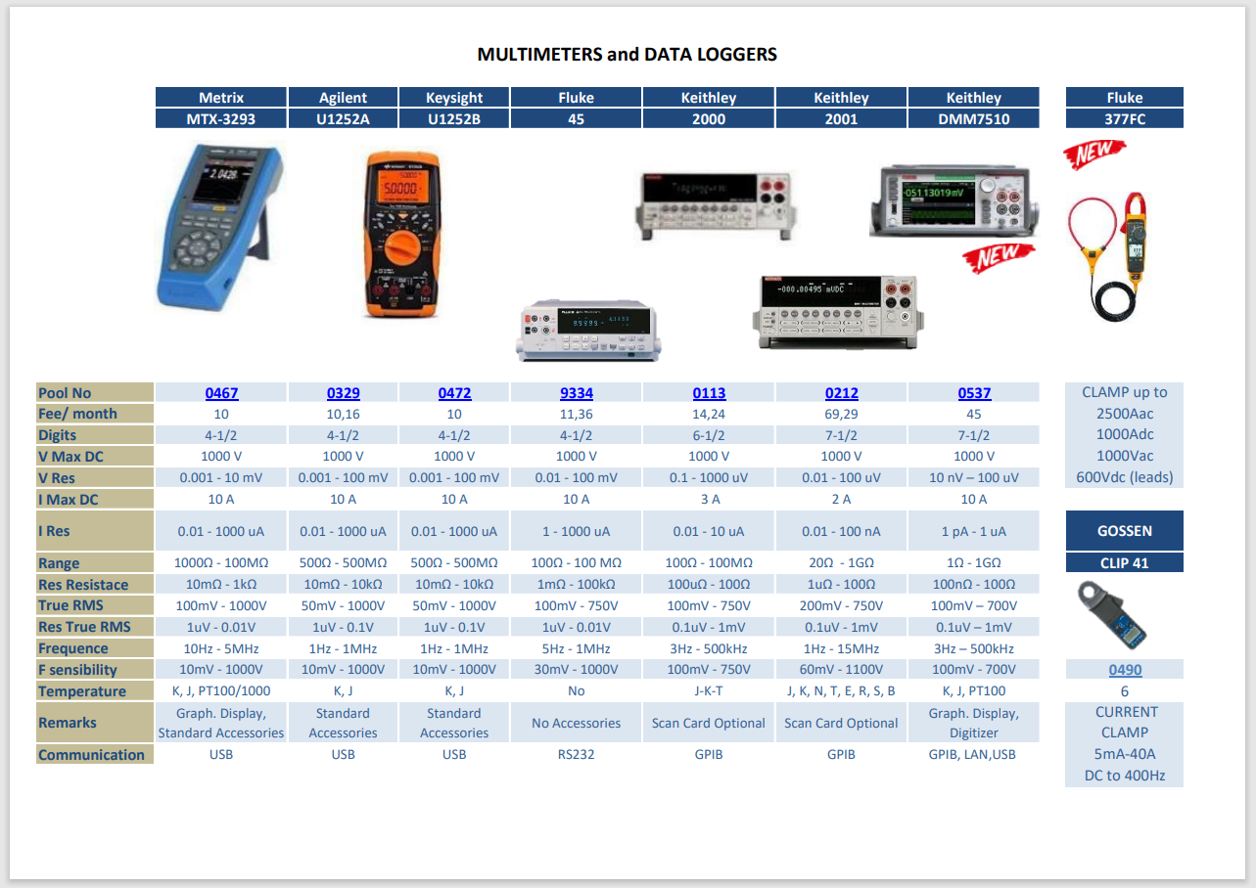
What’s going on at the Electronics Pool ?

Slide 3
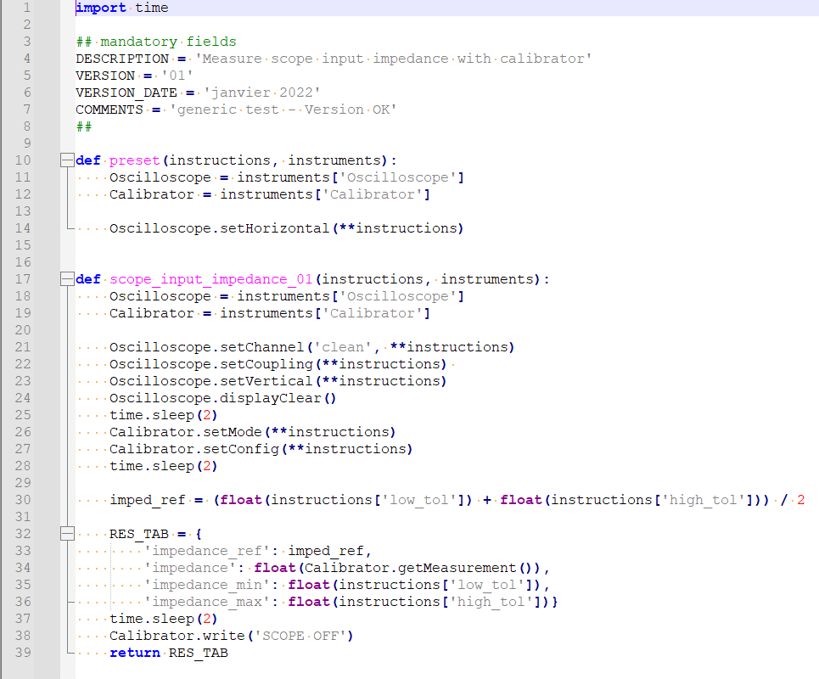


Basics of a test : A recipe

Slide 4
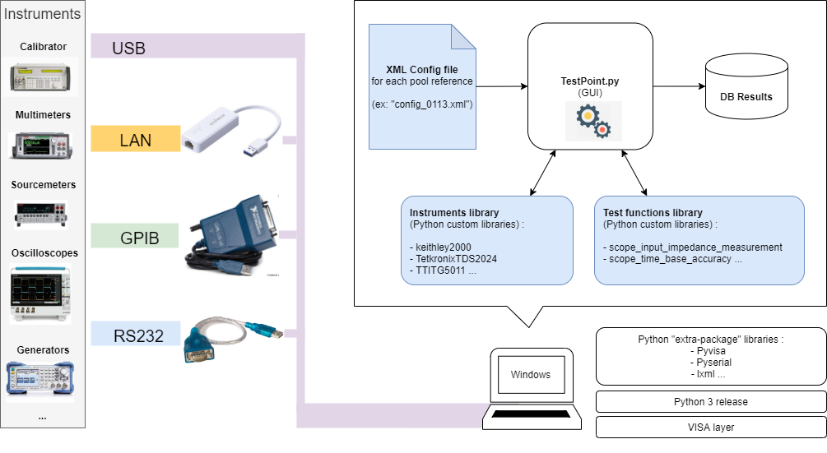
Structure overview

Slide 5
Structure of the application
25 January 2023 - BE Seminar : Python Vincent Gatto, Markus Joos

Slide 6
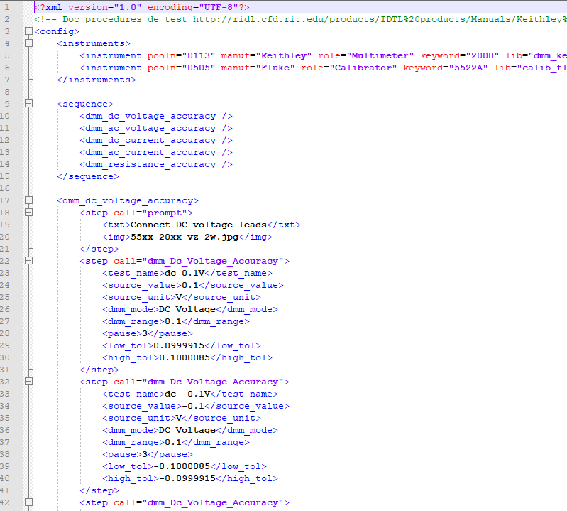
The XML config files
Define :
The instruments to be connected and their respective “role”
The test sequences
The parameters for each test

Slide 7
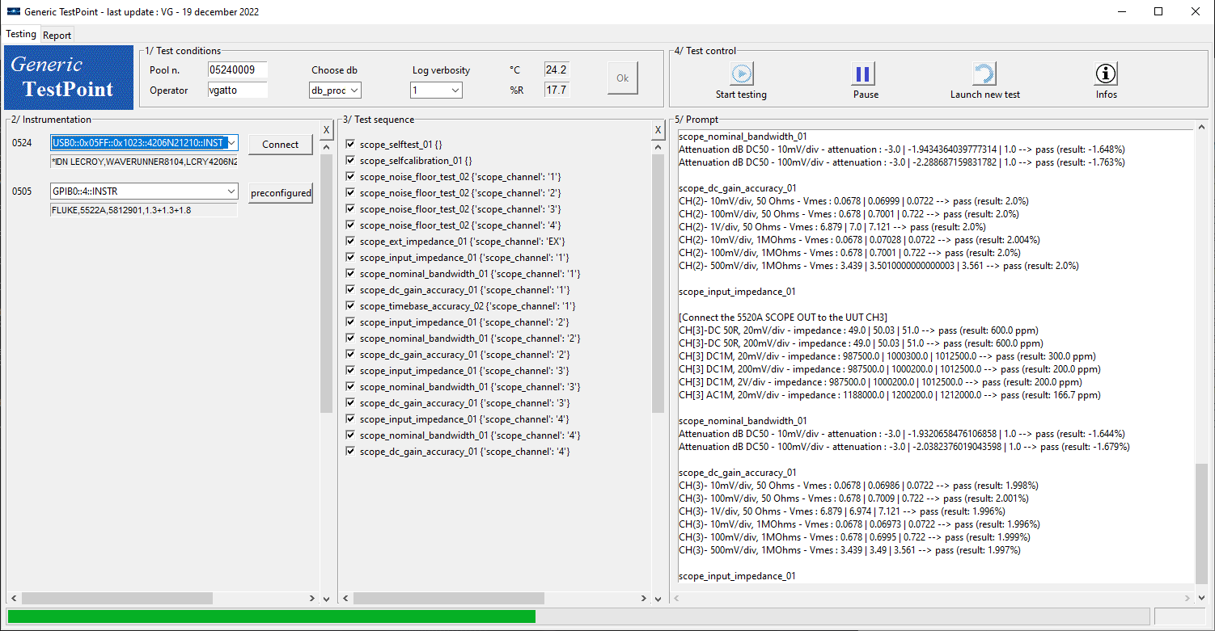
The user interface and main program

Slide 8
Instrument libraries
There are several categories of instruments: Counters, Generators, Loads, Multimeters, Oscilloscopes, Power supplies, Source-meters
For each category there is a base class the defines the mandatory methods
The libraries for the individual instruments:
  Inherit common methods from the base class
  Implement the mandatory methods (to the extent possible)
  Take configuration parameters (mostly) directly from the XML file
Note:
We try limit the libraries to basic methods such that they can also be given to users of the respective El.Pool devices

Slide 9
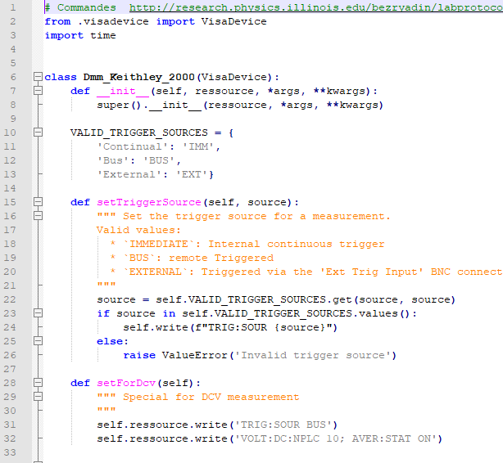
Instrument library example

Slide 10
Code management
There are three packages in GIT:
https://gitlab.cern.ch/epoolnpower
Package | Maintainer | Content
TestPoint | Vincent Gatto | TestPoint application XML files Test procedures PC configuration files
Epool_Instruments | Markus Joos | Instrument base classes Instrument libraries
Tools | Markus Joos | Methods for logging (for code debugging)
We are using Sphinx to document the code

Slide 11
Outlook
TestPoint application
  …
Instruments
  Base classes
    Adding methods as required for the tests
    Adding implementations for specific instruments
  Low level communication:
    So far, we have focused on SCPI
    RS232 support added for a special load (BK8502)
    OPC communication explored but not yet in use
Test procedures
  Some prototyping done for (more) complex tests (for electronic loads)
  Other colleagues to be trained on the development of procedures
  Sill a lot of work to be done

Slide 12
Outlook - 2
Construction of a new PSU test bench
  There is an existing test bench
    For VMEbus, Wiener and CAEN PSUs
    ~15 years old
    Based on Java S/W
    Test results are kept in a complicated format and retrieved via a special Web application
    Strategy: Keep this test bench alive as long as possible
  The experiments will need large quantities of new types of PSUs
  Sylvain in charge of the design / assembly of the H/W of the new test bench
  Markus to develop the instrument libraries (mainly for the electronic loads)
  Markus (and Sylvain) to develop the test procedures

Slide 13
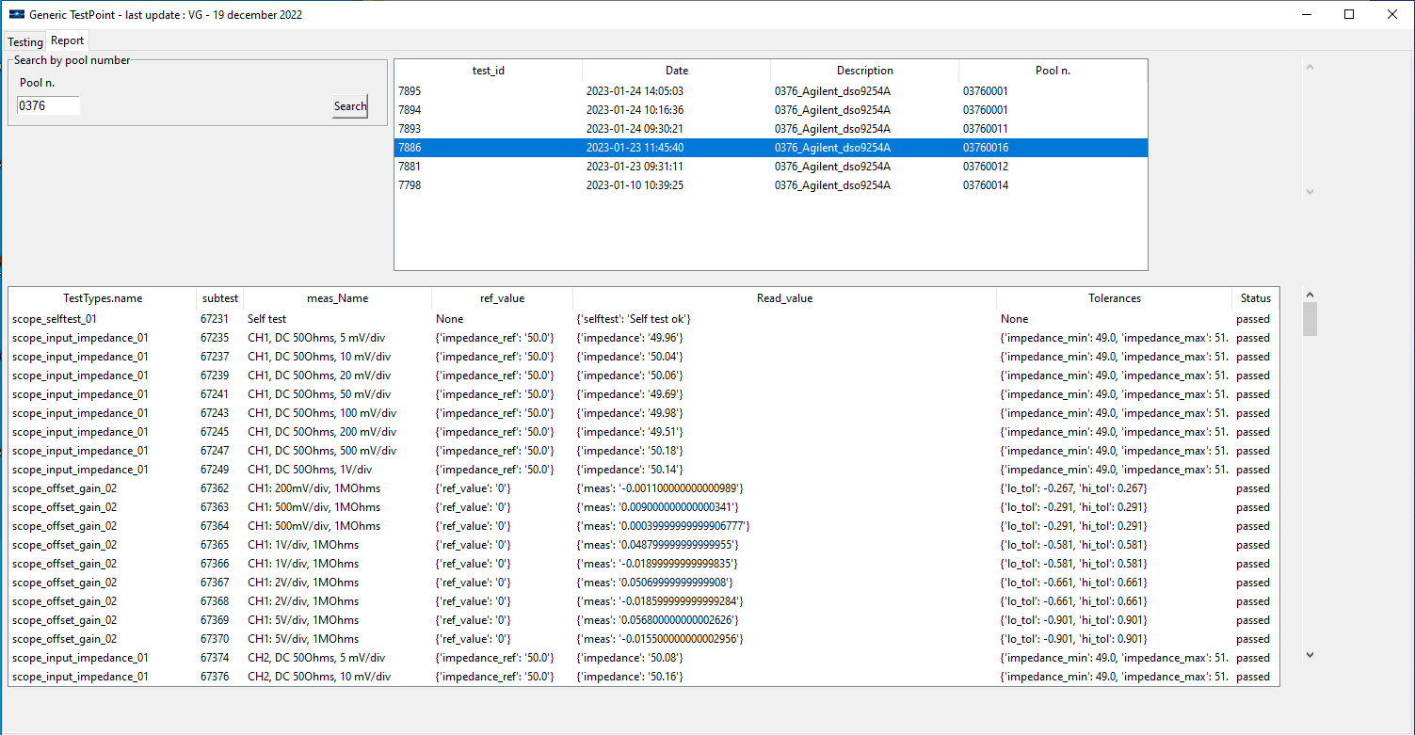
Results display and database

Slide 14
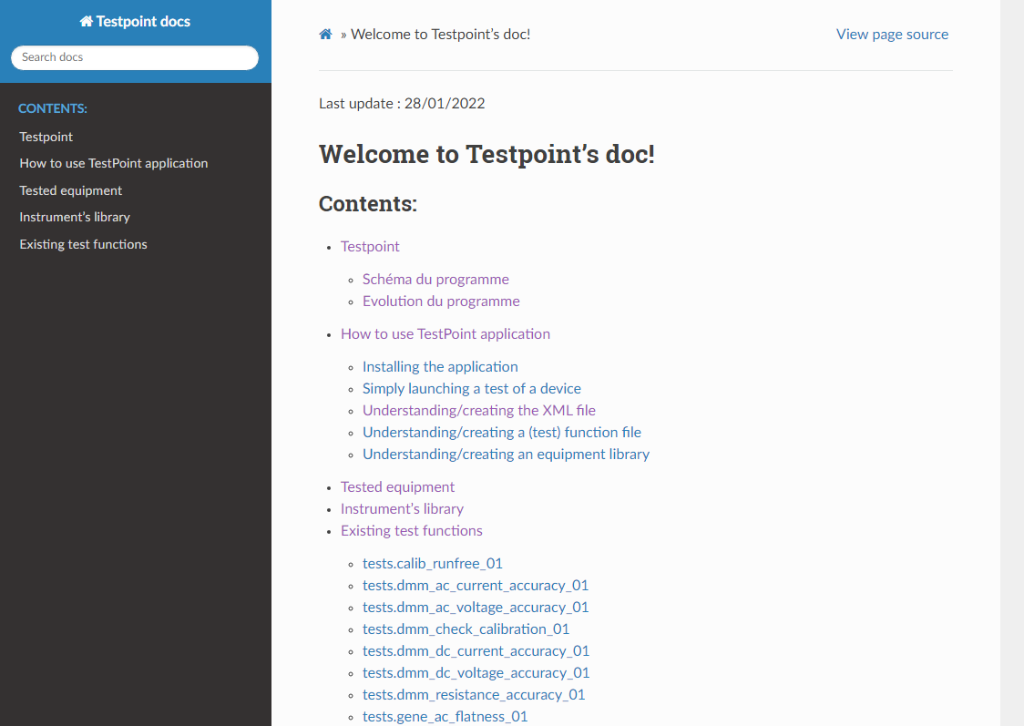
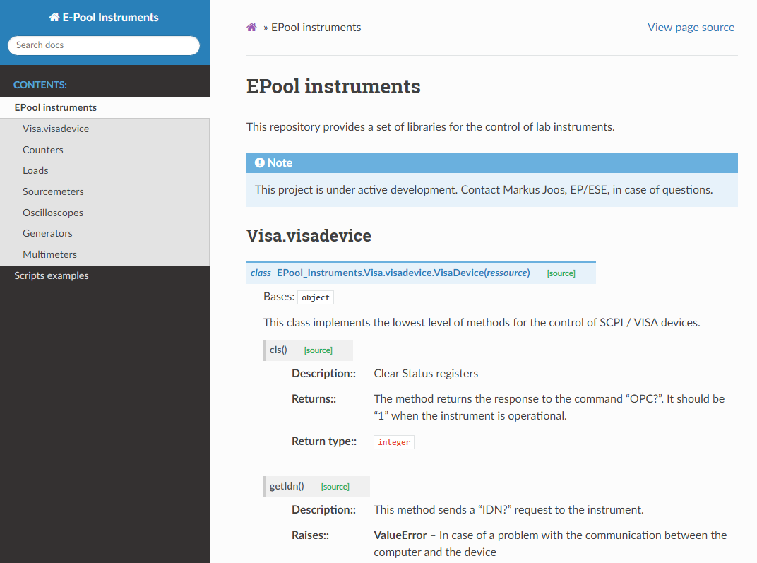
Documentation
https://epoolnpower-testpoint.docs.cern.ch/index.html
https://epool-instruments.docs.cern.ch/Instruments.html

Slide 15
To conclude
Open source, free
More than a testbench, it is a « system of tests » that make it easy to adapt any script / instrument
Expandable to all communicating devices (SCPI instruments and non-SCPI)
Allows to share test scripts and tested basic instruments library

Slide 16
To conclude - 2
Thank you for your attention!
(Merci de votre attention !)
(Vielen Dank für Ihre Aufmerksamkeit!)
https://gitlab.cern.ch/epoolnpower/testpoint
https://gitlab.cern.ch/epoolnpower/epool_instruments

